Slide 1
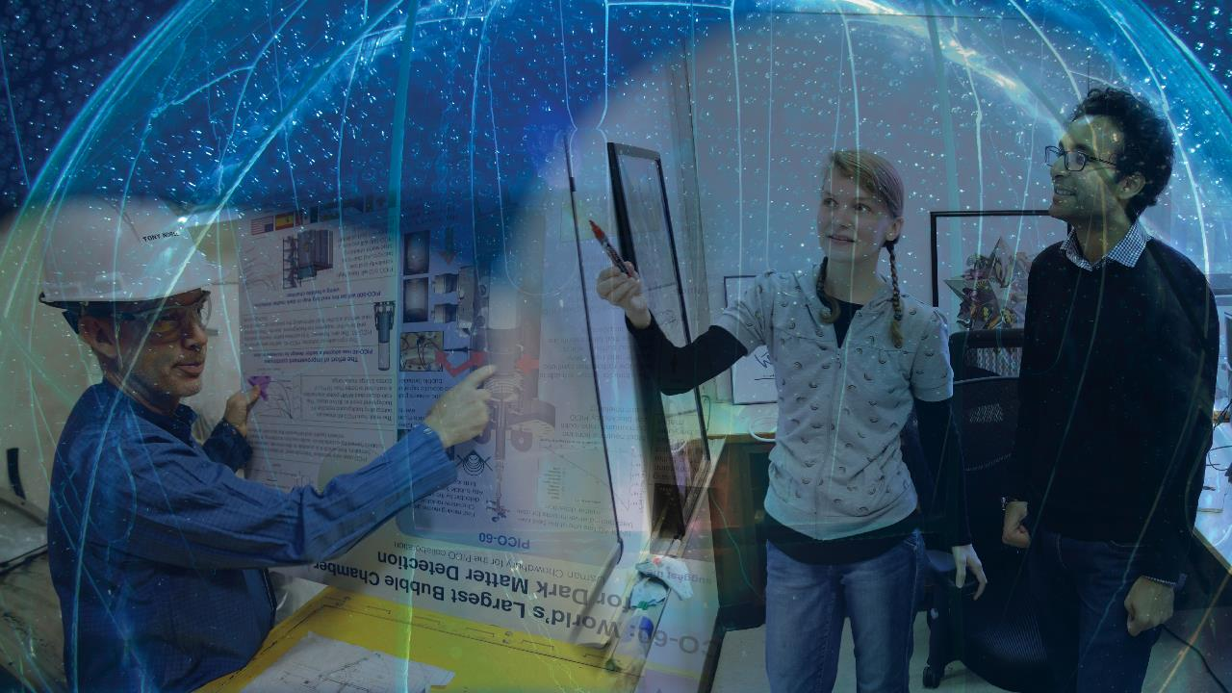
Canada’s Astroparticle Physics Network
Notes:
Welcome, and thank you for coming to the McDonald Institute Annual Community Meeting.

Slide 2
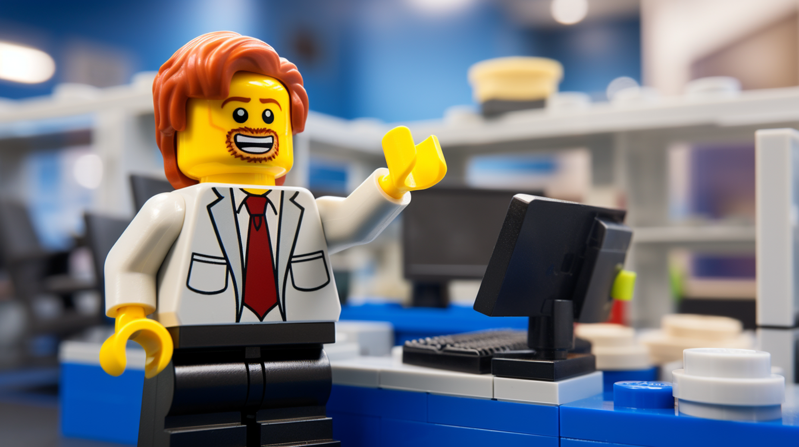
Notes:
I’m Zac, the communications officer at the McDonald Institute.

Slide 3
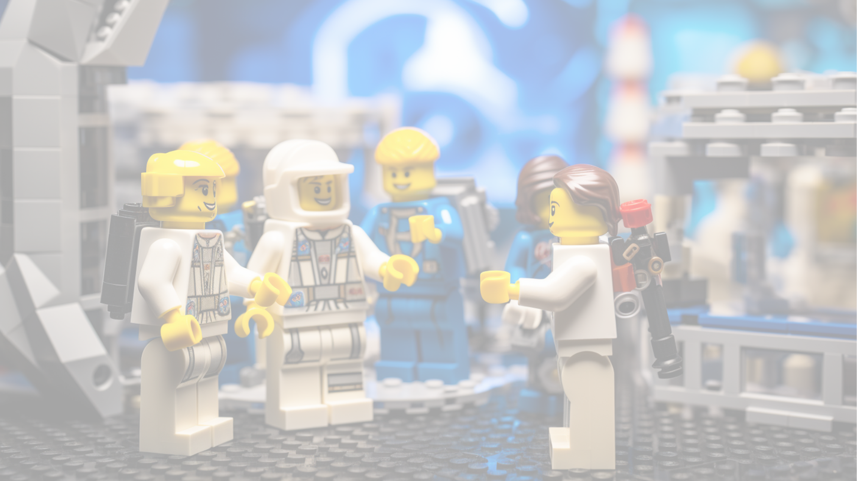
MI-HQPAC
McDonald Institute Highly Qualified Personnel Advisory Committee
Meets monthly to develop ideas and initiatives
Hosts monthly virtual community open discussions to talk about areas of improvement for the HQP Community
Has a budget to make things happen
Advises the McDonald Institute on improvements for the HQP Community
Is a great way to connect and practice community leadership!
The Committee welcomes you to their next open discussion!
mcdonaldinstitute.ca/hqpac

Slide 4
This time last year…

Slide 5
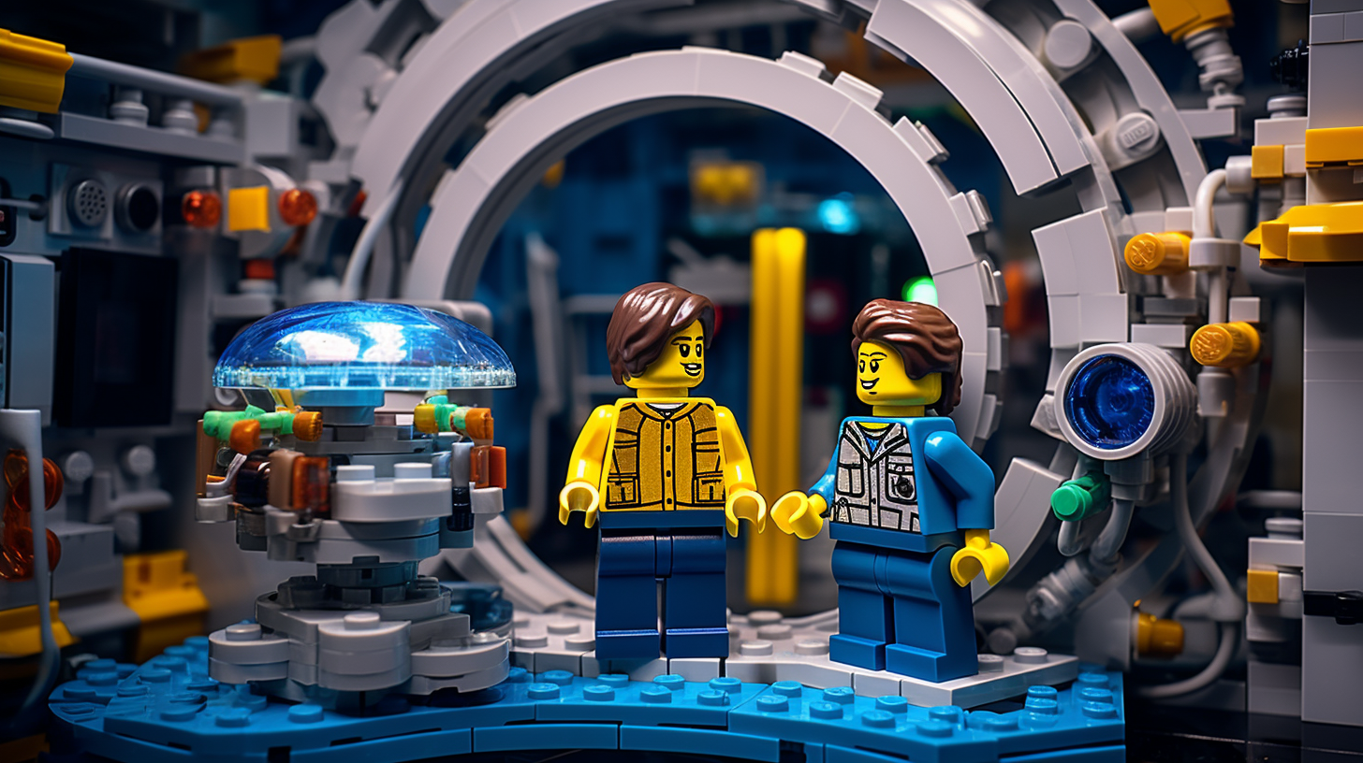
I’m working on a
really tricky problem
at the moment…
Notes:
If you were here for the HQP day at last year’s Annual Meeting, you may remember this idea from my workshop :
Communicating your challenges for better networking. The idea: Talk about the things you are stuck on, want to improve on, or need help with – This gives more opportunity for the person you’re talking with to offer ideas, suggestions, or other connections, creating a more meaningful, stronger connection.

Slide 6
Networking…
…With a card game!
Notes:
So, yes, my title is communications officer, but my portfolio is communications and marketing.
What this all boils down to is building the narrative.

Slide 7
We want a message to be shared throughout the research community and the public that the Canadian astroparticle physics community is dedicated to long-term scientific excellence inclusive of cohesive scientific direction, a nurturing ecosystem for new and emerging talent, and equitable and inclusive recruitment strategies;
We are doing science differently.

Slide 8
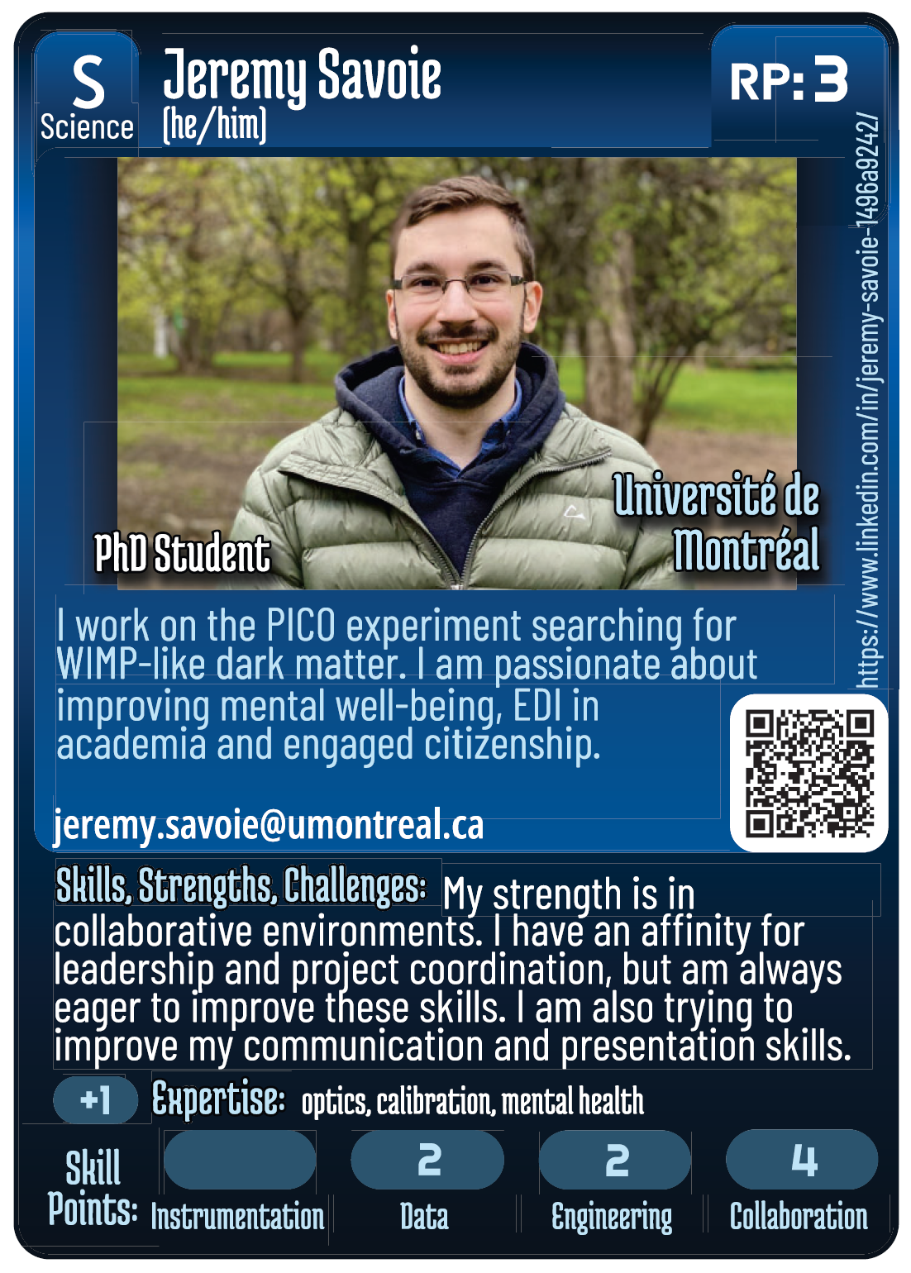
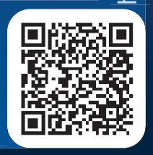
Notes:
Well, first of all, All of the cards have been created by actual members of the community. Technically, I create the cards, all you have to do is fill out a google form.
On these cards are a few key pieces of information. There is a short section called “Skills, Strengths, Challenges” which is precisely an opportunity to communicate your challenges, what you’re stuck on, or what you want to improve!
I bet you’re already thinking of something you might say to Jeremy, or someone who you might connect him with for help improving his presentation skills! This is the magic of communicating challenges.
We also have a short bio, some expertise keywords, his position, current institution, and even ways to get in touch, like an email address, linked in URL, and even a QR code to make connecting super easy.

Slide 9
Notes:
There’s a few details on this card which are not really super relevant for networking, although interesting to know that Jeremy considers himself to be a great collaborator!
These details are for the other side of this project, and the other use for the cards – THE GAME!

Slide 10
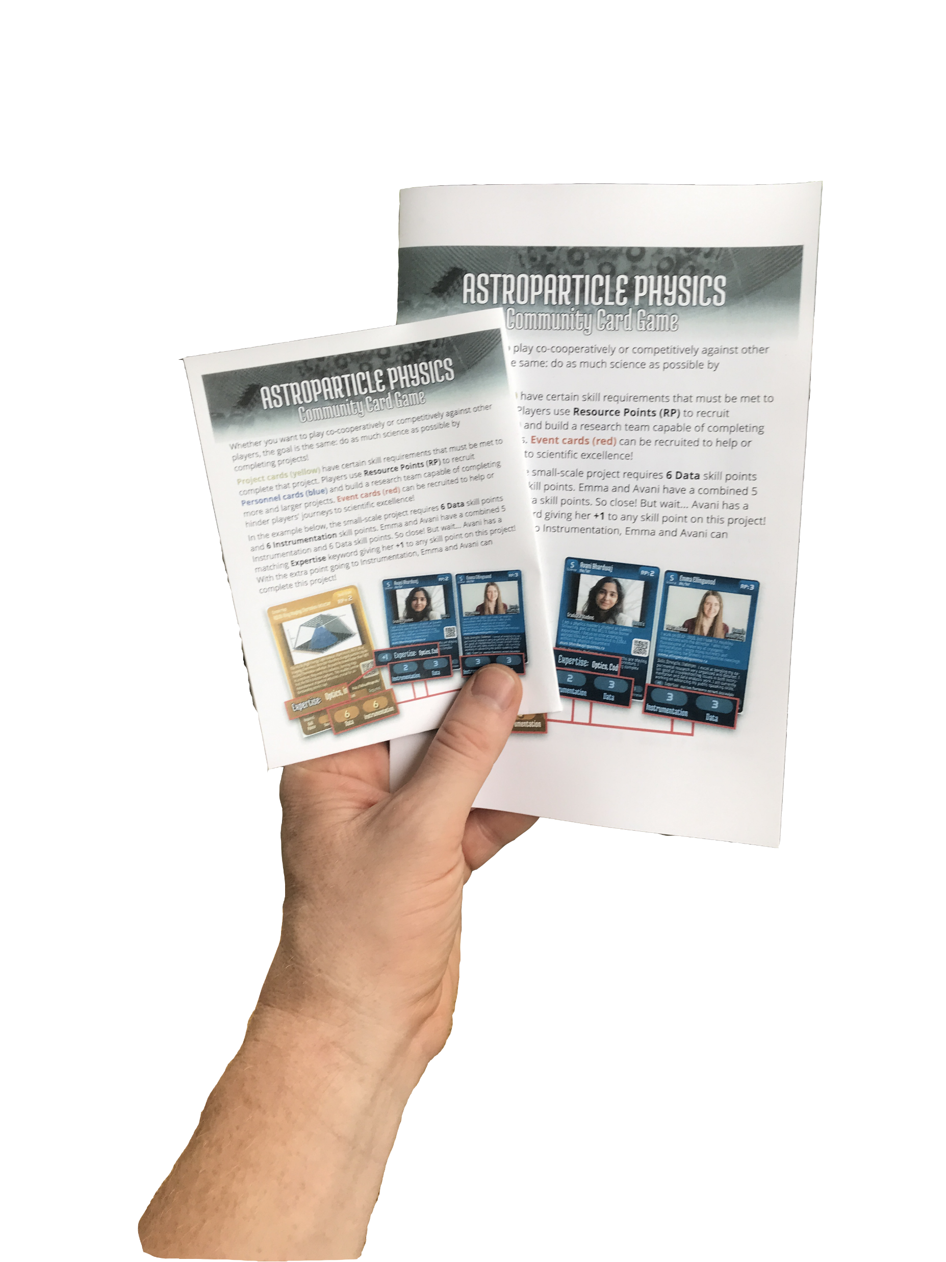
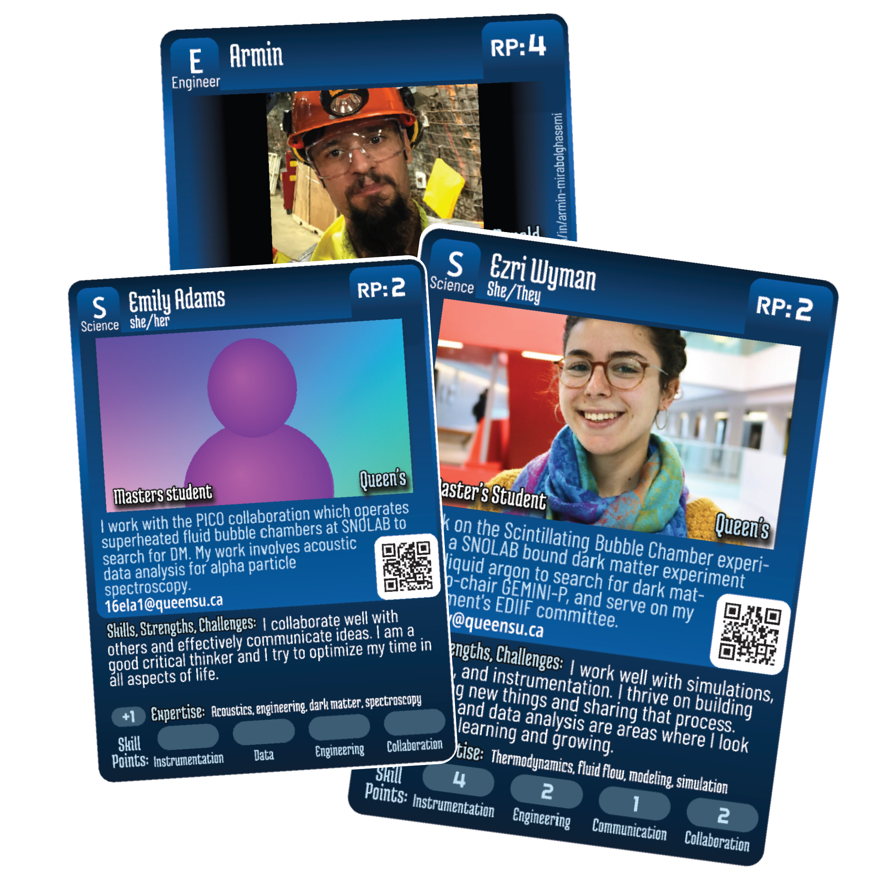
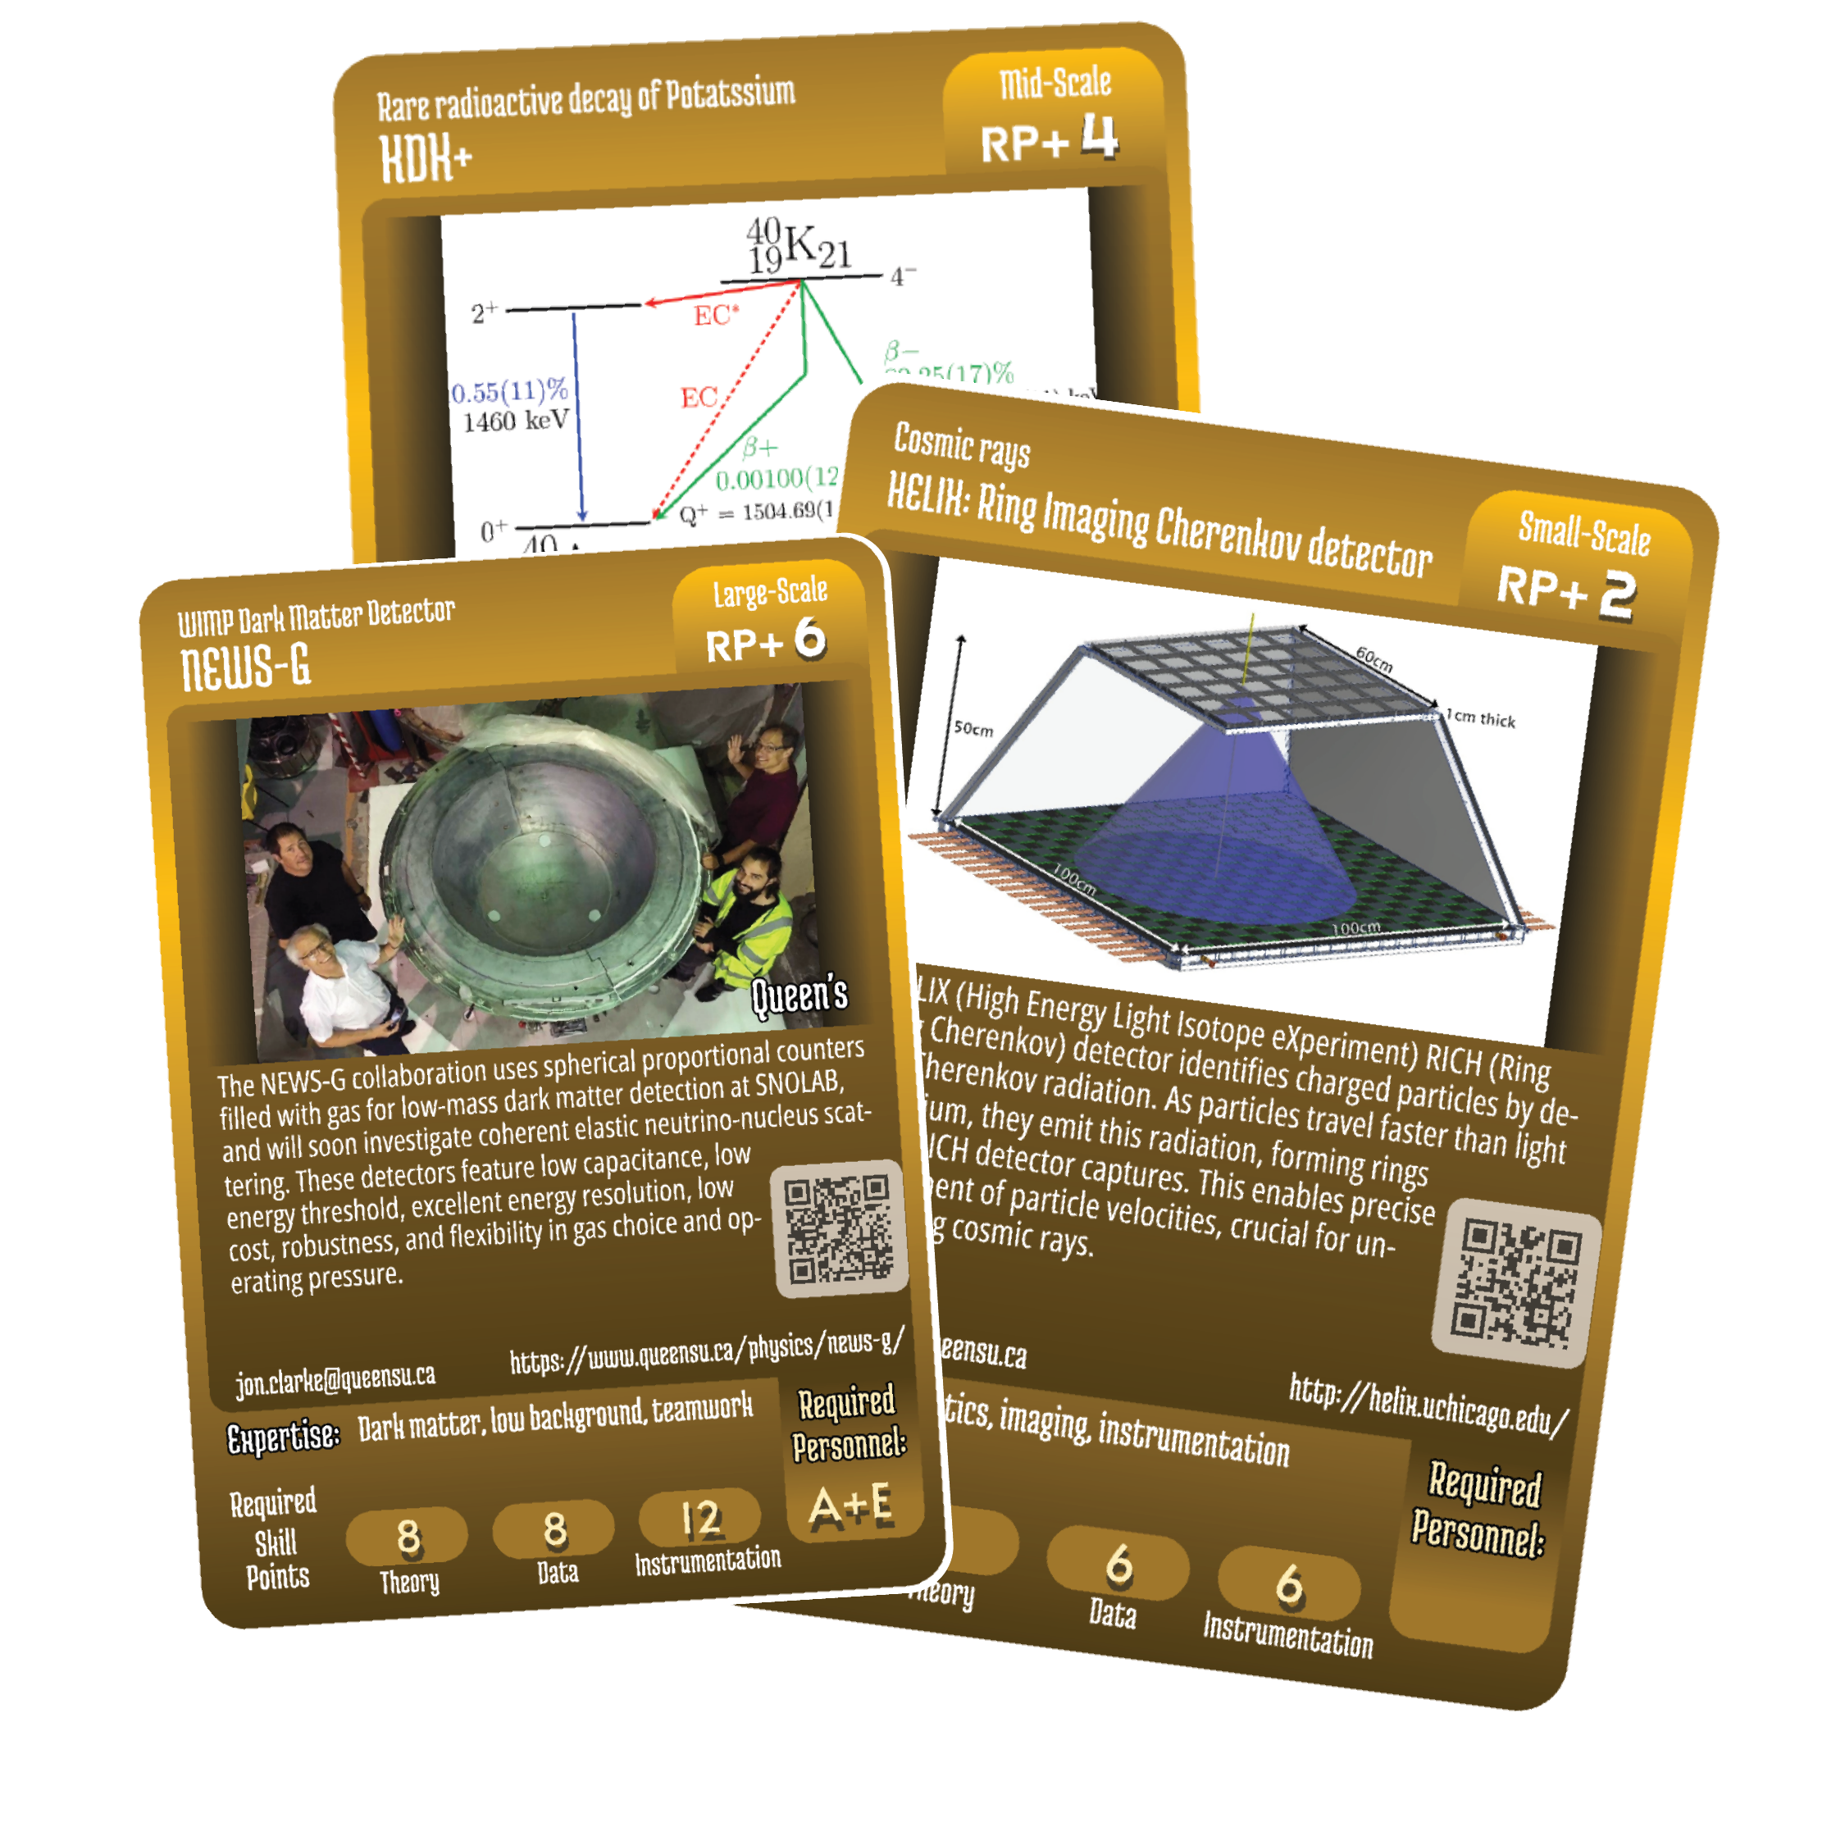
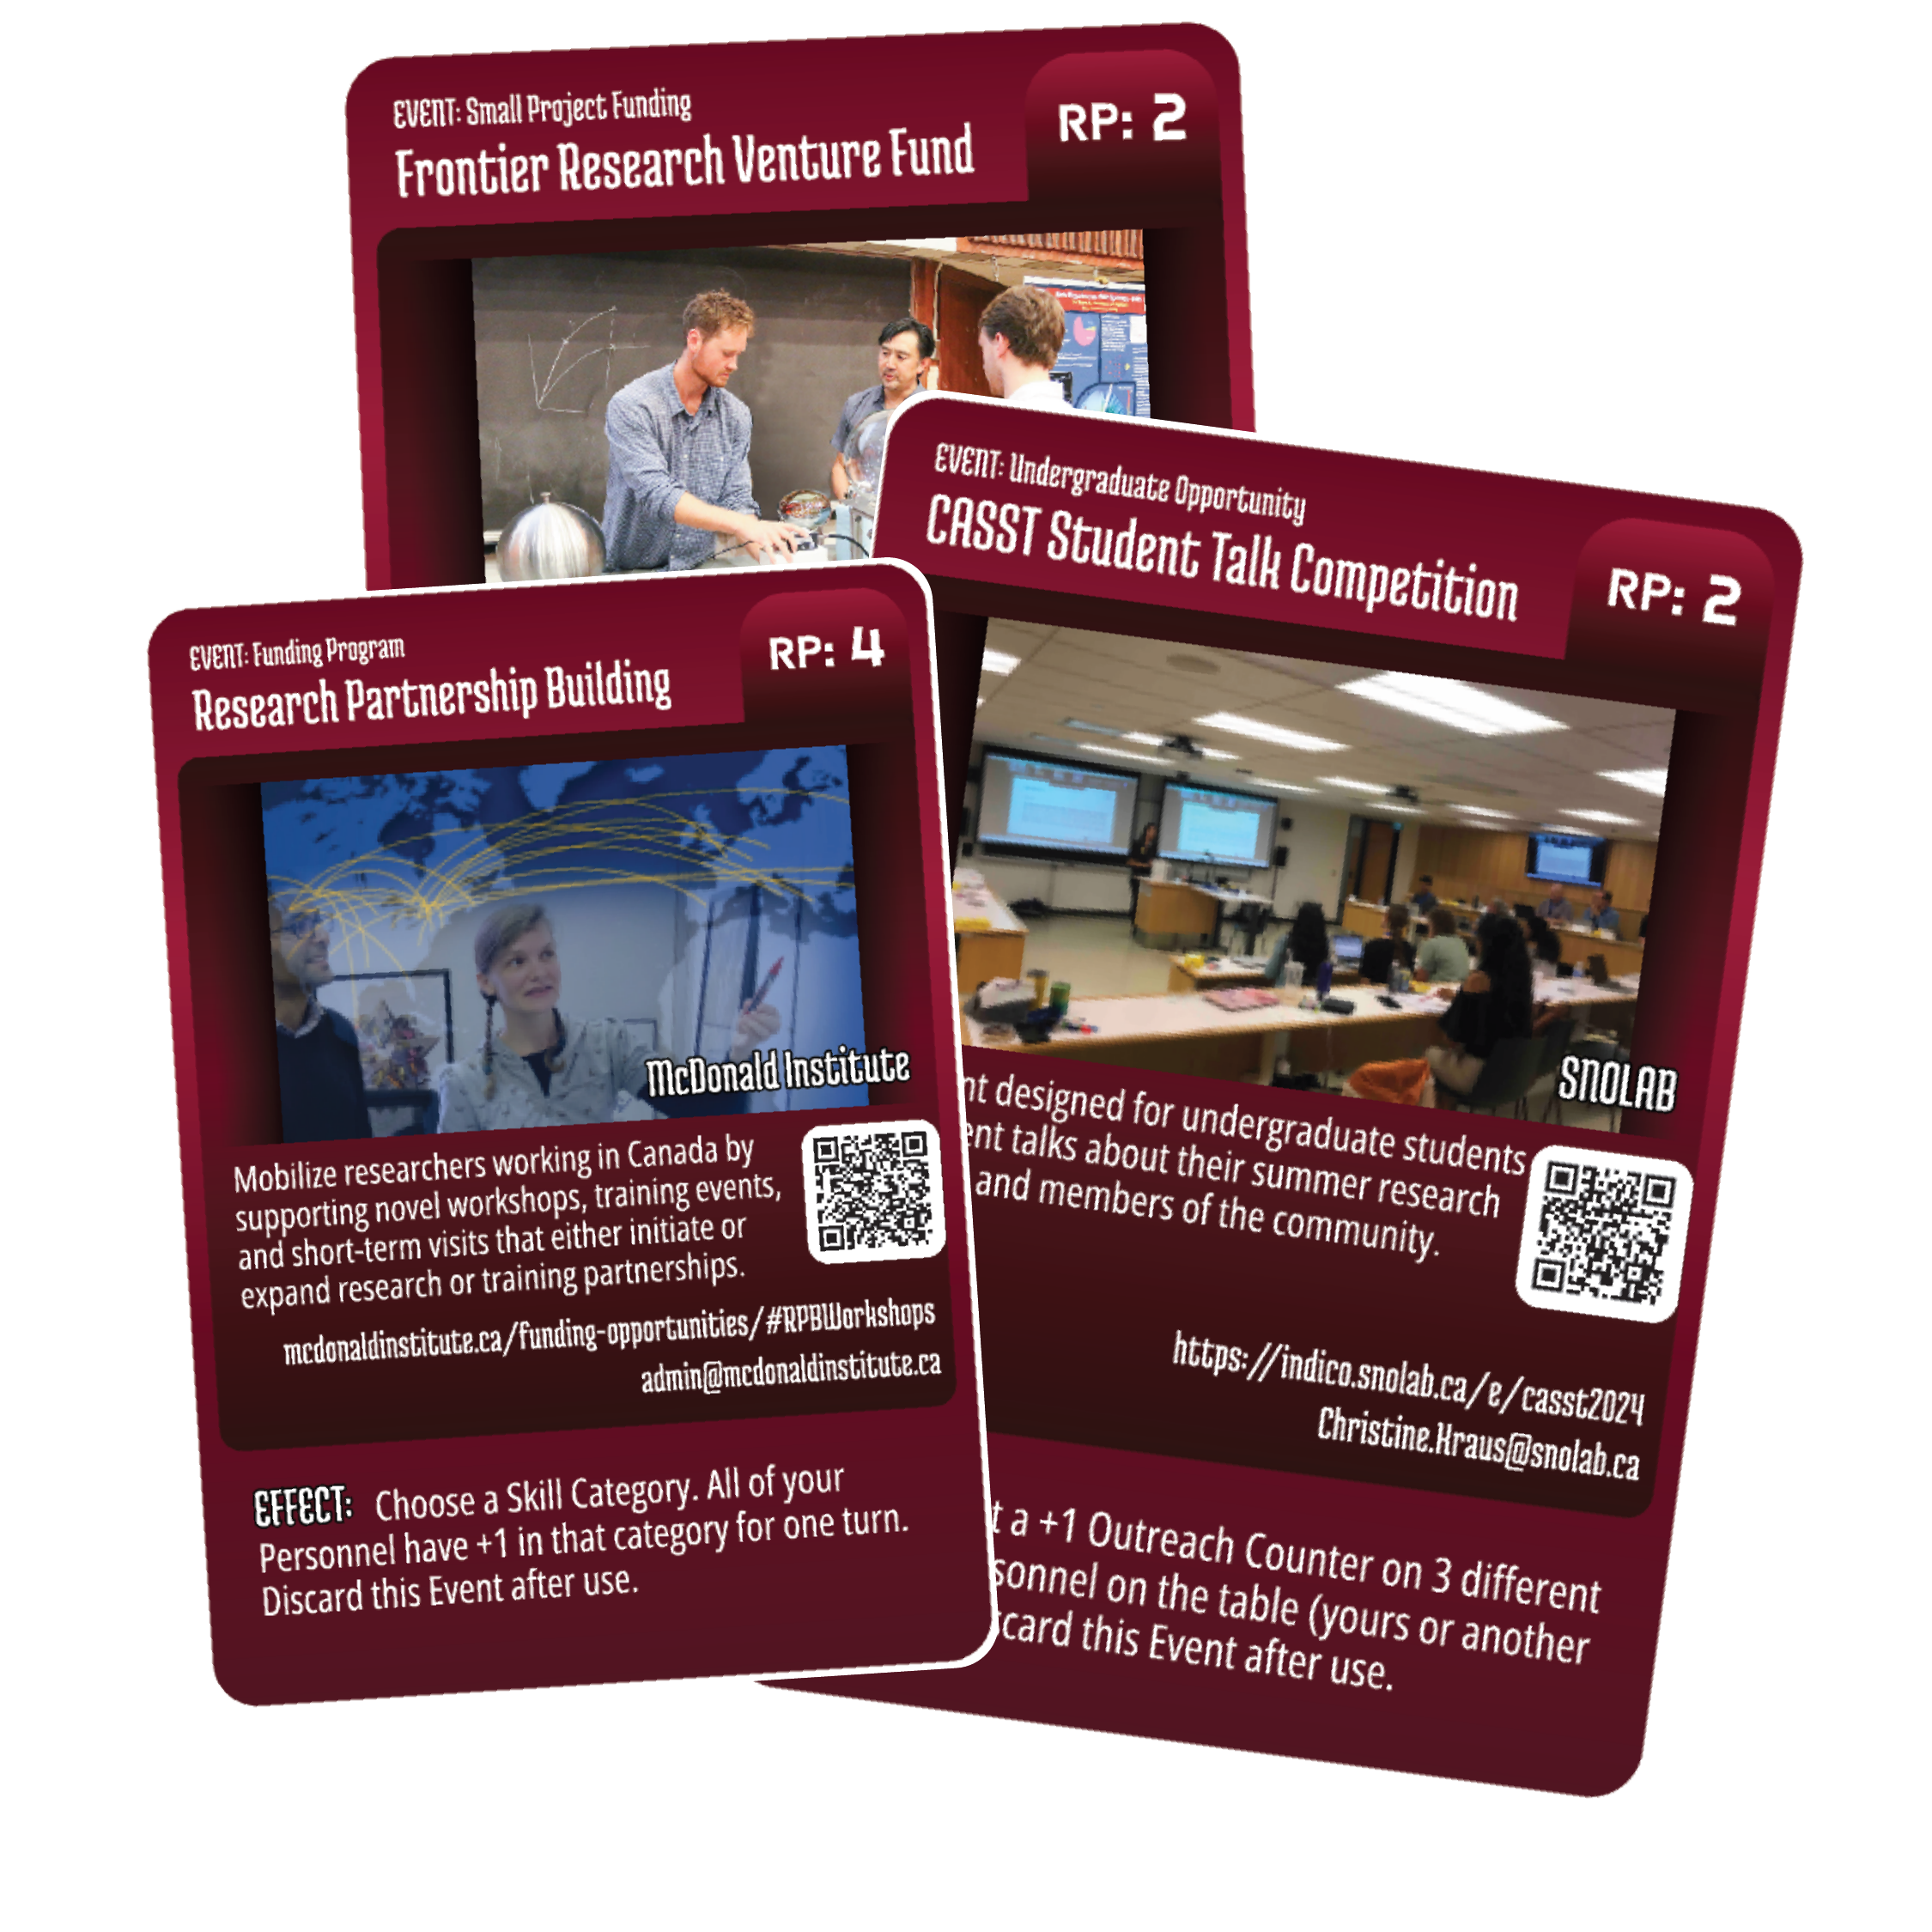

Slide 11
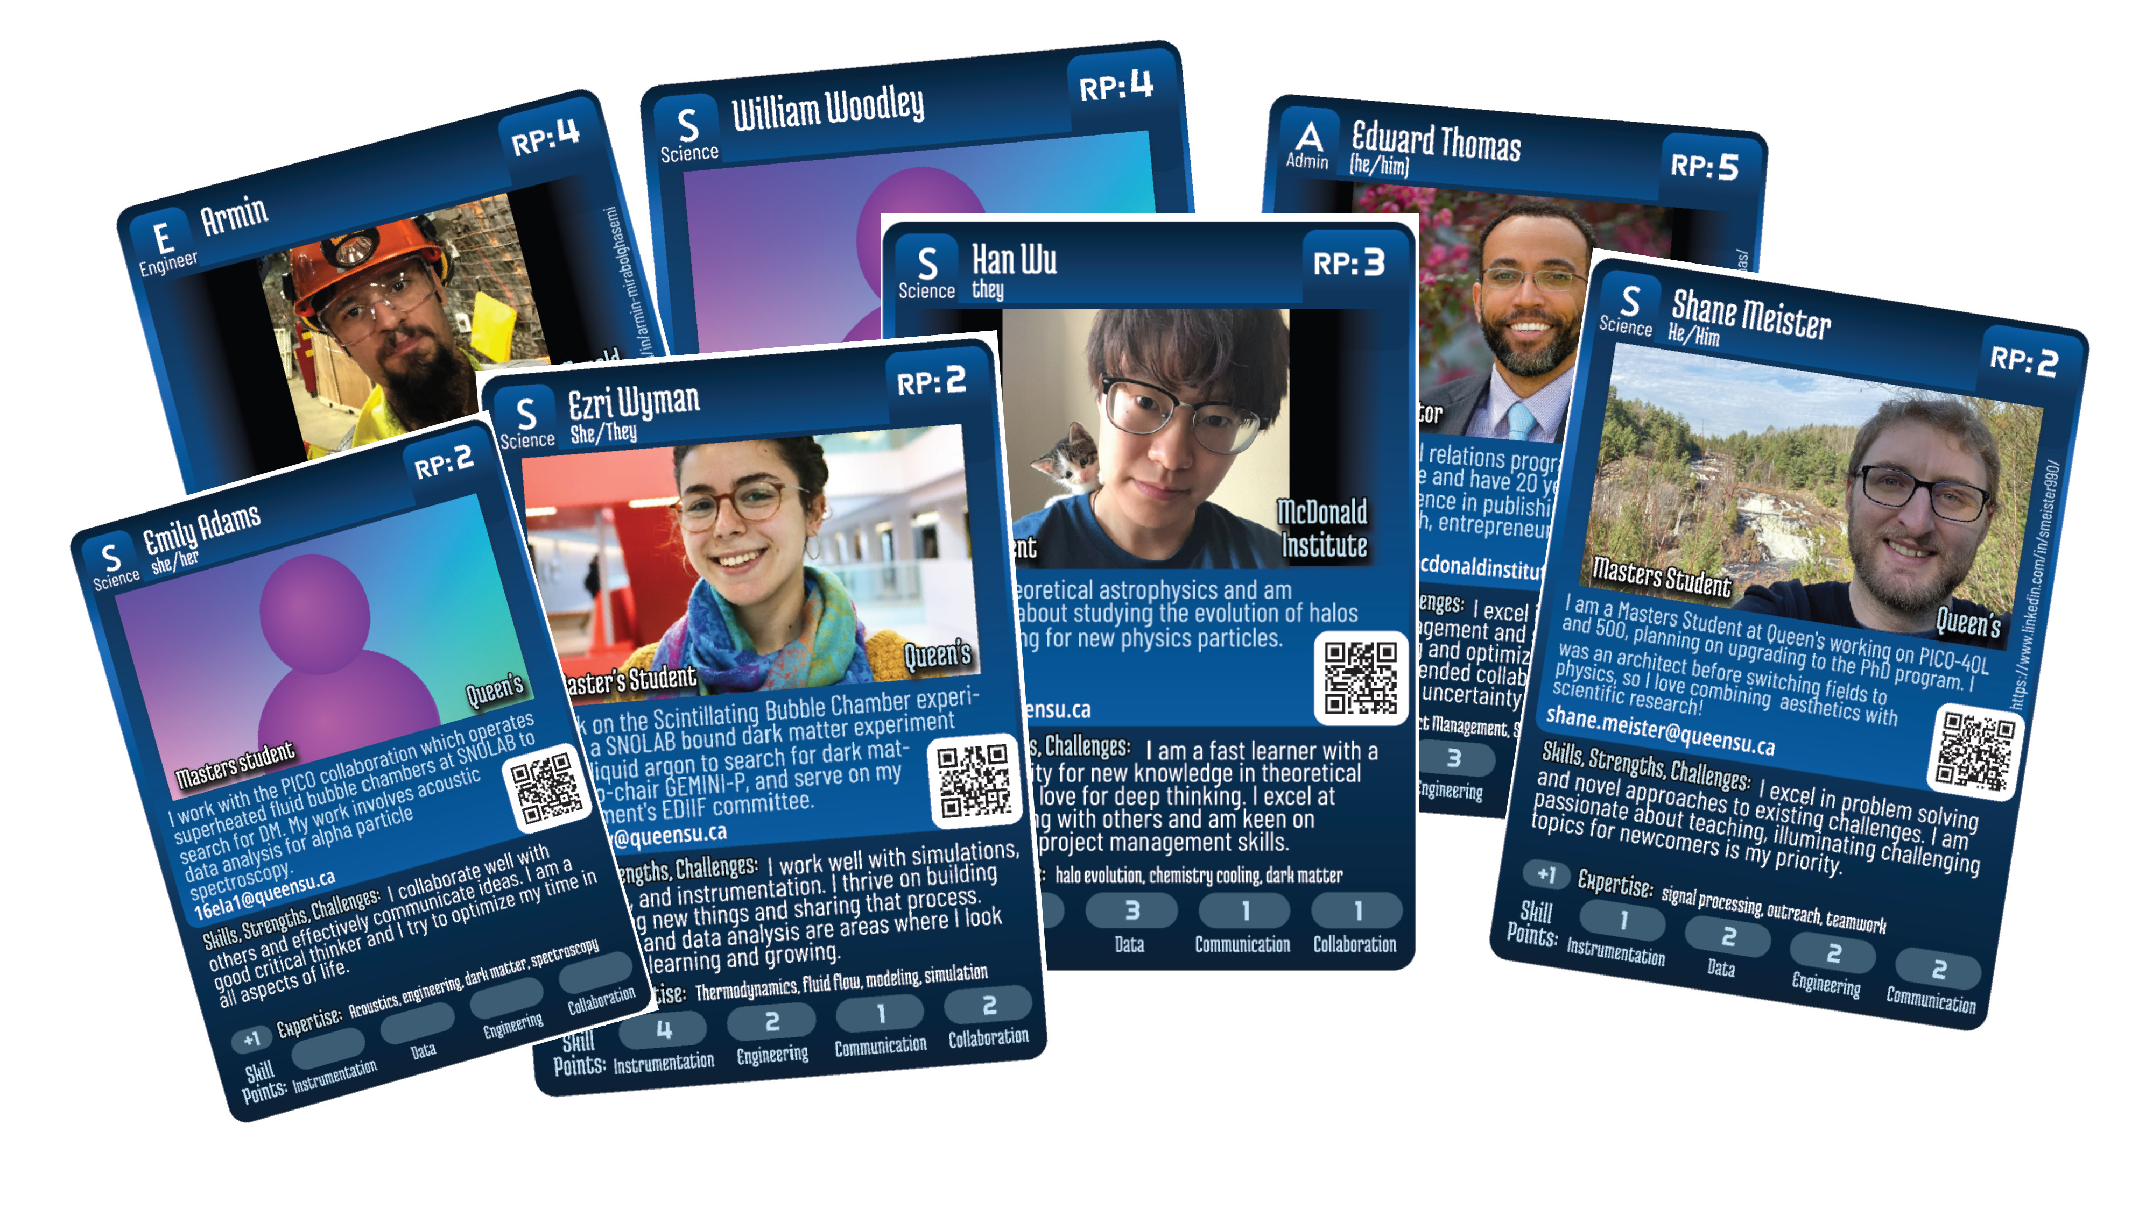
Notes:
But today, we’re just focusing on the Personnel Cards.

Slide 12
Agenda: (10:00 – 11:00 am)
Personal Networking – connect & trade 3 copies of your card
Connection Networking – connect & trade 2 copies of someone else’s card.
Reconnect - Find the people you traded with in step 1 and give them a card of the connection you made for them.
Review - share about the secondary connections you made and why.
Notes:
Slide style 1: You can cycle through these slide designs, or choose one to use throughout the presentation.

Slide 13
1. Personal Networking
Find a set of 15 of your cards on the table. Keep 3 copies!
Walk around for 8 minutes and talk to people and trade 3 copies of your card to three or four different people.
Review your new cards for 3 minutes. Pay close attention to the “Skills, Strengths, Challenges” section.
Just like in real life, not everyone has a card, business card, etc. If you talk to someone without cards, use your traditional networking skills to connect with them. Give them 3 copies of your card.
Notes:
Finish this slide by 10:10
Set the first timer for 8 minutes
Set another timer for 3 minutes.

Slide 14
2. Connection Networking
Walk around for 8 minutes talking to people about the new cards you have and try to make a connection:
Connections can be based on any criteria: Complementary strengths or challenges, similar expertise at different institutions, or even similar research at different career levels.
Notes:
Finish this slide by 10:25 - set a timer for 8 minutes.

Slide 15
3. Reconnect
Find the people you traded with in step 1 and tell them about the connection you made for them. Give them a card of that new connection. (8 minutes)
Notes:
Finish this slide by 10:35, set a timer for 8 minutes.

Slide 16
4. Review
At tables, or in small groups, share about the connections you made and why.
Did anyone else make the same or similar connections?
Consider sharing one or two connections you or someone at your table made with everyone. Talk about why you think those connections were good matches.
Notes:
Finish this slide by 10:45
Set a timer for 5 minutes and leave 5 minutes to allow for groups to share about their connections.

Slide 17
Thank You!
Draw 3 winners for a copy of the game!
Please share any feedback on the project, and today’s activities: communications@mcdonaldinstitute.ca
Visit mcdonaldinstitute.ca/card-game for more!

