Slide 1

Creative
Science Communication
Zachary Kenny (he/him) Mark Richardson (he/him)
Communications Officer Manager for Education & Public Outreach
The McDonald Institute and Queen’s University is situated on traditional Anishinaabe & Haudenosaunee Territory.
Notes:
Mark

Slide 2
Science Communication
Why does it matter?
Find relevance to the public
Get you and your work known
Move science forward
Network
Fun!
What does it all mean if we aren’t telling anyone about it!?
Notes:
Mark
Interactive
I have set up these intro slides to mirror the approach of science communication that we are encouraging.

Slide 3
Science Communication
But what is it?
Is it telling a colleague the method you used?
Is it training a student to work on a detector?
Is it explaining your results and why they matter?
Is it building public science literacy?
Is it making a plot?
It’s all these things and more.
Notes:
Mark
Interactive
Highlight at the end the idea of making a graphical representation of your data or results.
Communication is a sharing an understanding. Of an experience.

Slide 4
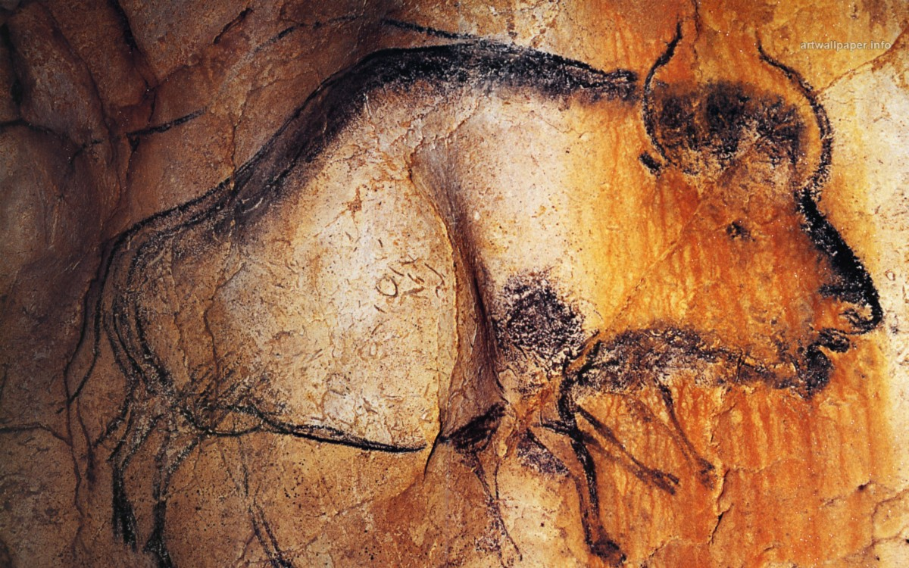
^{Chauvet}
^{Cave}
^{France}
^{~36,000 years old}
Notes:
Zac
People have been
Chauvet Cave, watch “Cave of Forgotten dreams” 2010 Directed by Werner Herzog

Slide 5


^{90%}
of information transmitted to your brain is visual
^{visuals are processed}
^{60,000x}
faster than text
^{75%}
of people respond better to visual information than any other kind
Notes:
Zac
evolved to spot patterns and make visual comparisons. To visualize effectively, however, it helps to understand a little about how our brains process visual information.
1: auditory, written (gets translated in the brain as auditory) , kinesthetic, or sesnsory.
2: 60,000x faster: Important because communication is about time. It’s always been about time. How do I tell you that there’s a lion behind you? How do I tell you about my master’s thesis before your eyes glaze over?
3: Let’s play the odds here and just go visual

Slide 6




1. Get to the essence of an idea.
2. Gives everyone a
common language.
3. Make complex concepts understandable → Help people think
4. Encourage engagement and participation.
Notes:
Zac
1 get the most essential, important part of an idea
2. If we speak different languages, I can’t tell you that I want pizza for dinner or that there’s a lion behind you
3. Simplify
4. connect, communicate – COMMUNE – to come together, to share.

Slide 7
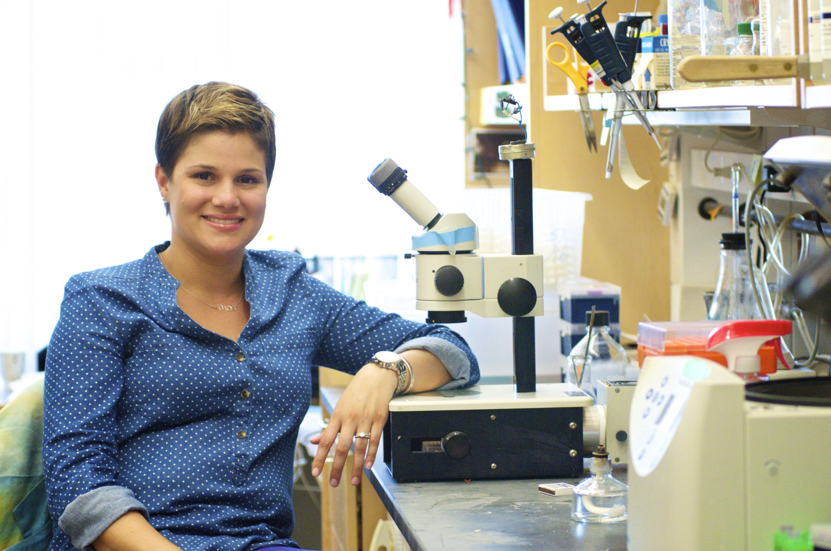
“Science is increasingly interdisciplinary and the ability to communicate more effectively across disciplines fosters collaboration and innovation.
“Being able to communicate the relevance and impact of their ideas and discoveries can enhance scientists’ ability to secure funding or find a job.
…
“When scientists communicate more effectively, science thrives.”
-Mónica I. Feliú-Mójer
Notes:
Mark
As you listen to the talks this week, notice the breadth of expertise, sub-fields, interdisciplinarities, etc. Your ability to communicate with people you work with, apply for funding for,
https://blogs.scientificamerican.com/guest-blog/effective-communication-better-science/

Slide 8
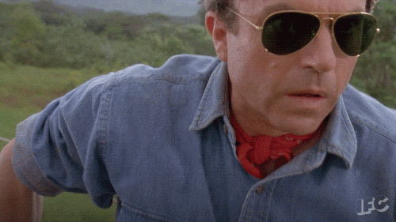
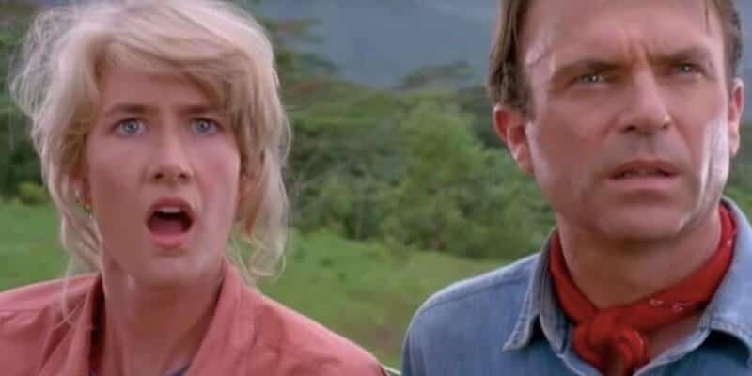
Tell a story!
It gets your audience invested.
It makes them care.
It is more memorable.
It aids comprehension.
Notes:
Mark
Communicating: Intent is to be understood! To share in an understanding.
It’s a communal goal, by both communicator and listener.
Building relationships: the audience CARES about what is being said. They want you to succeed. But how do we make them care?
We care because we invest in the relationships.

Slide 9
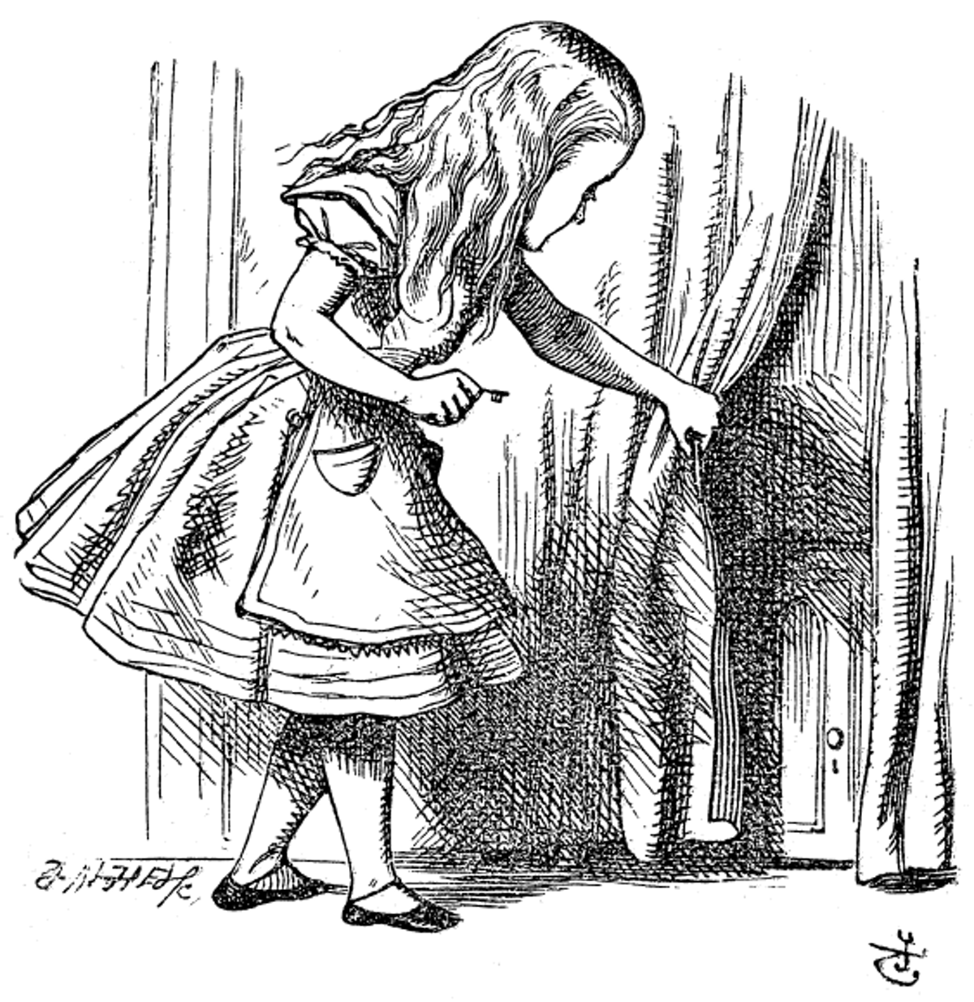
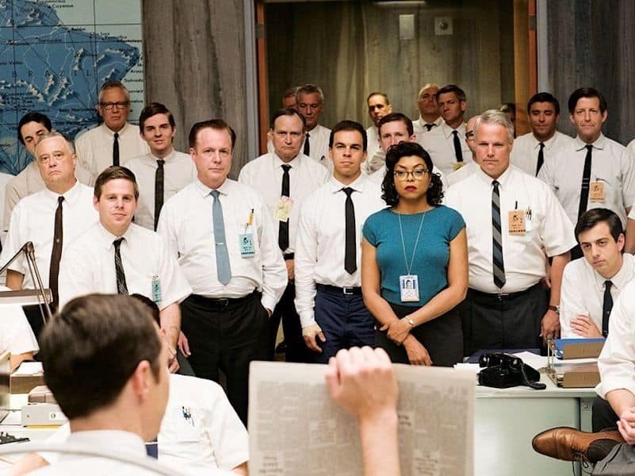
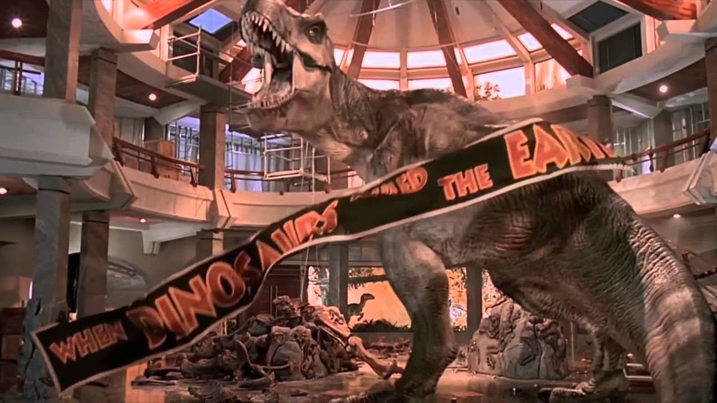
The three-act story
Act I: Problem (Inciting Incident):
  Set the stage: What is the problem and why must it be solved, and who’s going to do it.
Act II: Solution(s?) (Failures and Success):
  Resources collected, plans made, setbacks dealt with, crises points.
Act III: Value/Impact:
  Remind your audience why they should care?
https://ichef.bbci.co.uk/images/ic/640x360/p01gmg5y.jpg
https://theconversation.com/after-150-years-we-still-havent-solved-the-puzzle-of-alice-in-wonderland-44049
https://i.ytimg.com/vi/CsM9py39F0U/maxresdefault.jpg
Notes:
Zac
Stories work. Stories hook us in. Stories capture our imaginations and our emotions.
Stories allow us to connect to a character, care about them, and empathise with their struggle.
Think about it like you’re telling your best friend about it for the first time! You know them, you know their eyes will glaze over if you mention muons again!
You need to grab their attention!
Something DRASTIC happened which had an IMPACT on our research team. But I, Yes, I! acted quickly and developed a SOLUTION!
Story mode is how you get them!
Now your friend can get behind this, because they care about you, and are empathizing with the emotions you are having.
Telling stories is how we deepen our shared understanding with each other.
Single hero characters

Slide 10
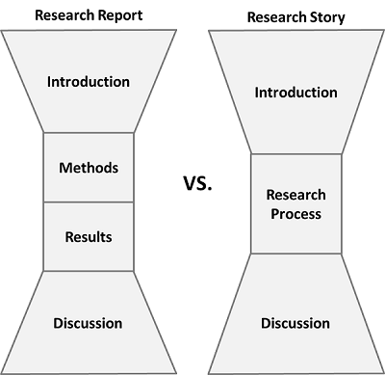
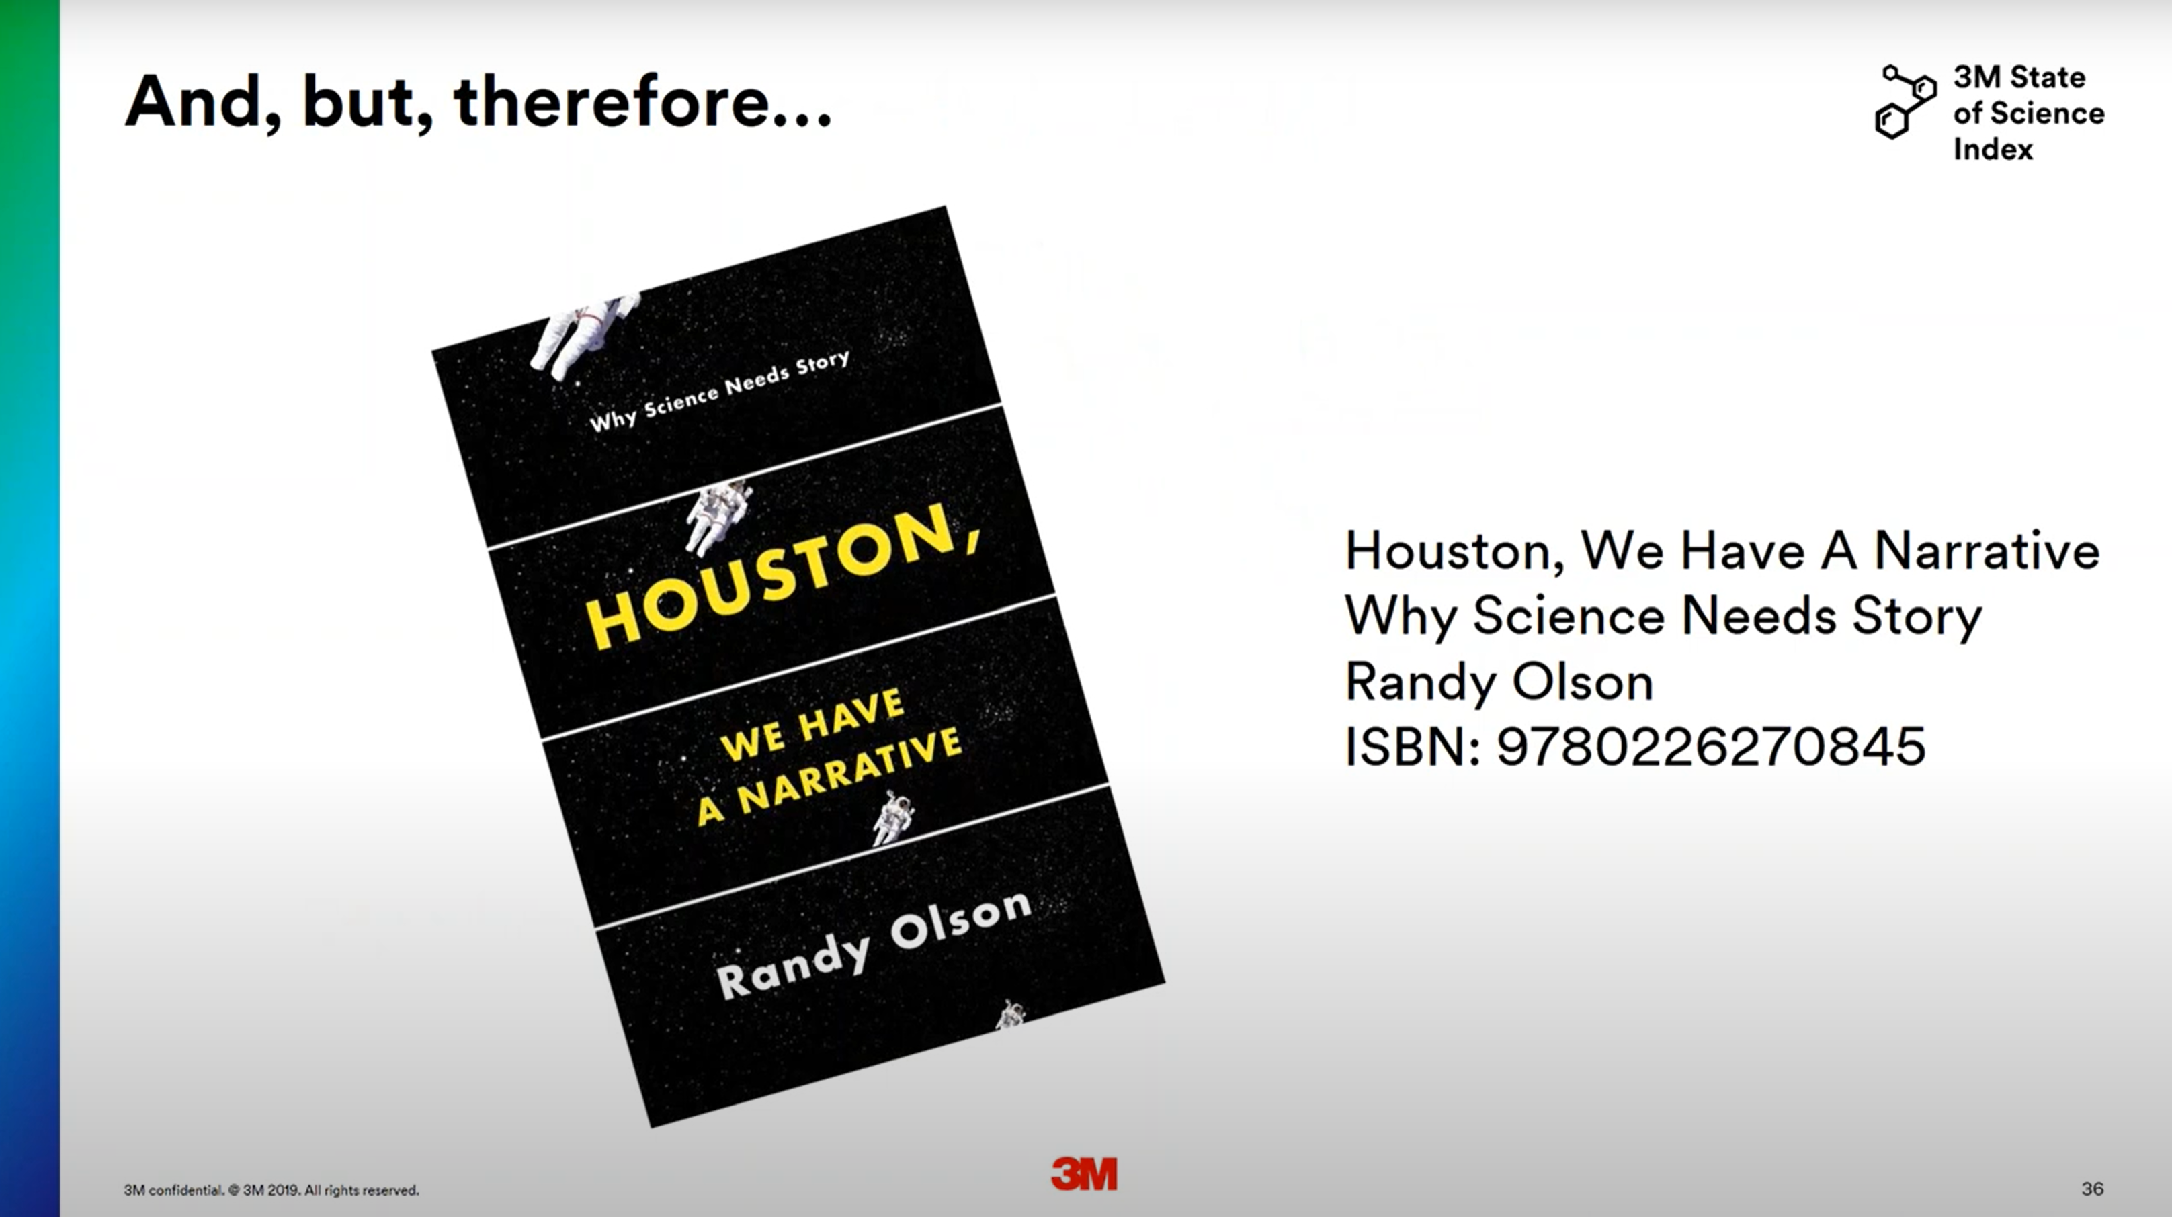
Telling your story
and
but
therefore
Implications
Storytelling for scientists – a masterclass in why and how to make science relatable
https://www.youtube.com/watch?v=6aVgf3T6p_8
Notes:
Zac
Before you begin, remember that you are here because you have seen something or done something that others want to hear about. You are here to give that to them.
– Simon Sinek (U.K.-based motivational speaker)
Never tell a story without making a point,
and never make a point without telling a story.
– Isaac Serwanga (consultant and motivational speaker)
Where are you in your story?
What part have you played?
Telling your story will hook your audience.

Slide 11

Write down:
Three things you know a lot about … It could be a sport you play, video game, book, natural phenomenon, etc.
Three things you learned about this summer.
2
Notes:
Mark
Break after here.

Slide 12

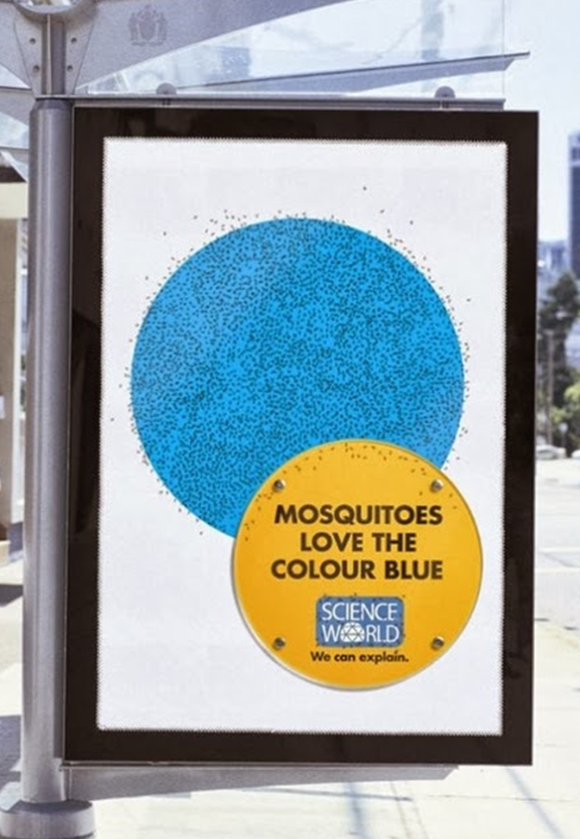

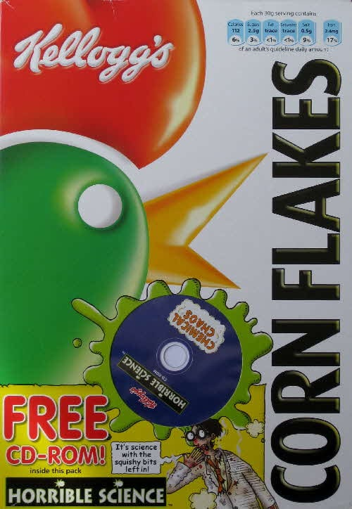
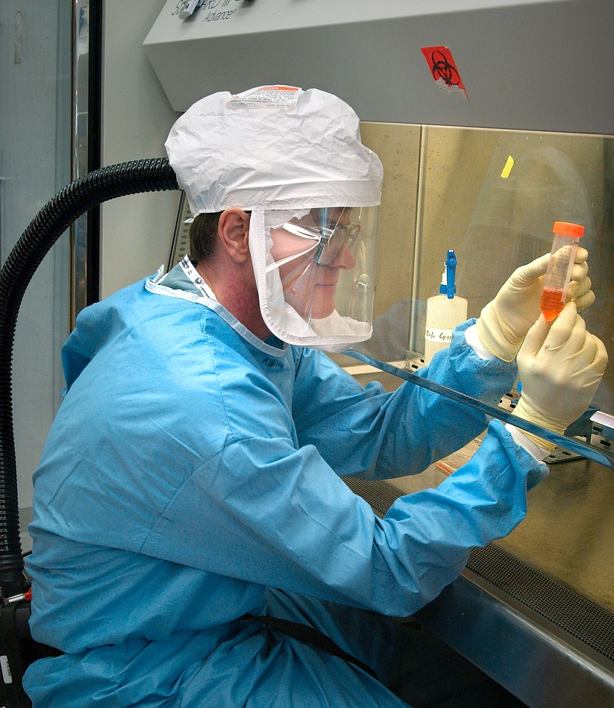

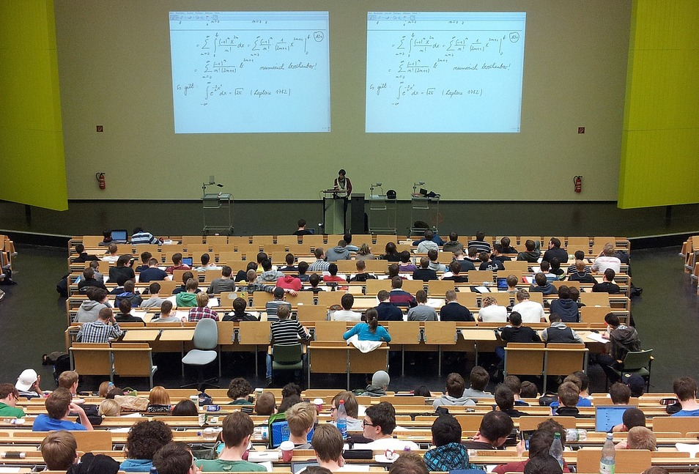
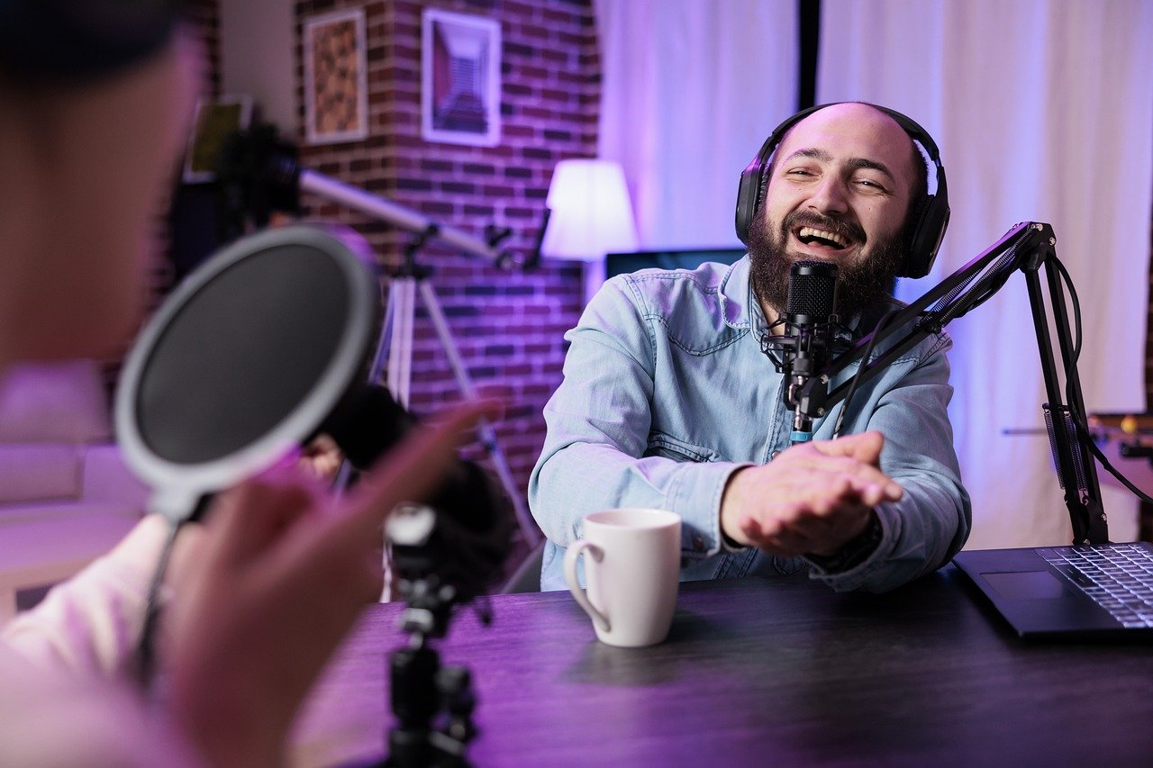

Knowing your audience
Notes:
Mark
Who are the audiences that you could imagine telling the three things you just wrote down
Kids
Classroom / Lecture hall
People reading the newspaper … or online posts/blogs/news
Consumers, who read your material on products
Podcast listeners
Bus riders
Voters
Scientists

Slide 13
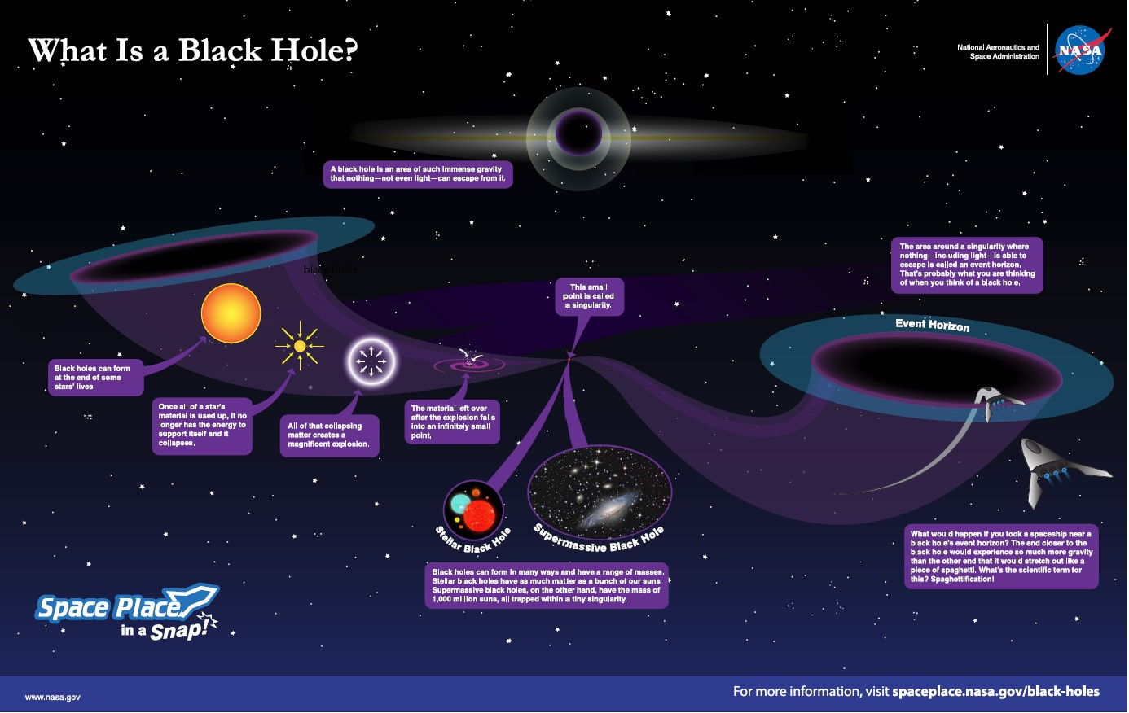
Notes:
Zac
https://spaceplace.nasa.gov/black-holes/en/

Slide 14
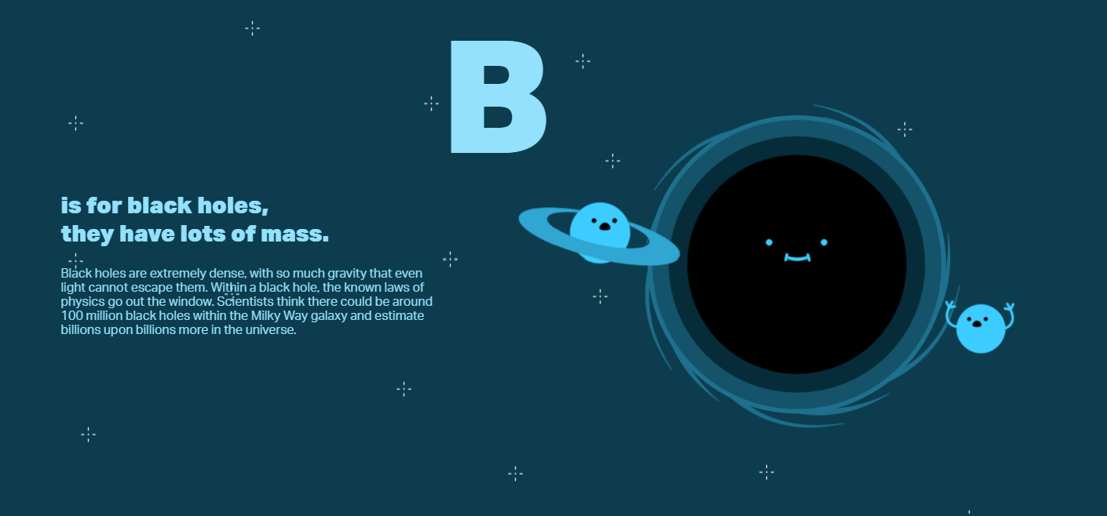
Notes:
https://www.symmetrymagazine.org/particle-physics-abcs/
Depending on who you’re making the poster for, you may want more or much less information. ABC books are usually made for young children, so this illustration is super simple, but the concept is still strong: the planets or other space objects are close to the black hole, and they look worried, like they might fall in.

Slide 15
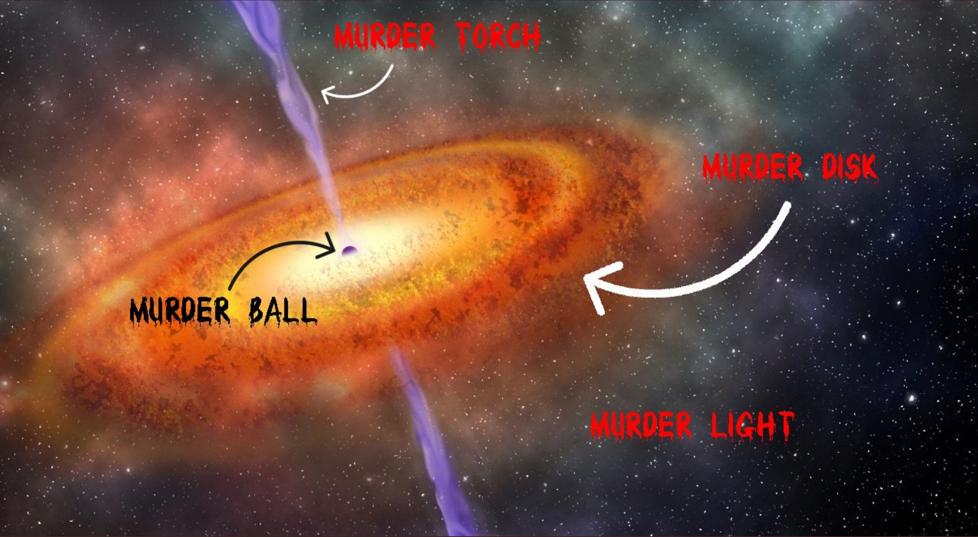
Notes:
Mark
UnScience a space thing
Sometimes humour can be a great way to get people interested in a topic. I bet you kind of want to know that this crazy murder ball in space is all about??

Slide 16
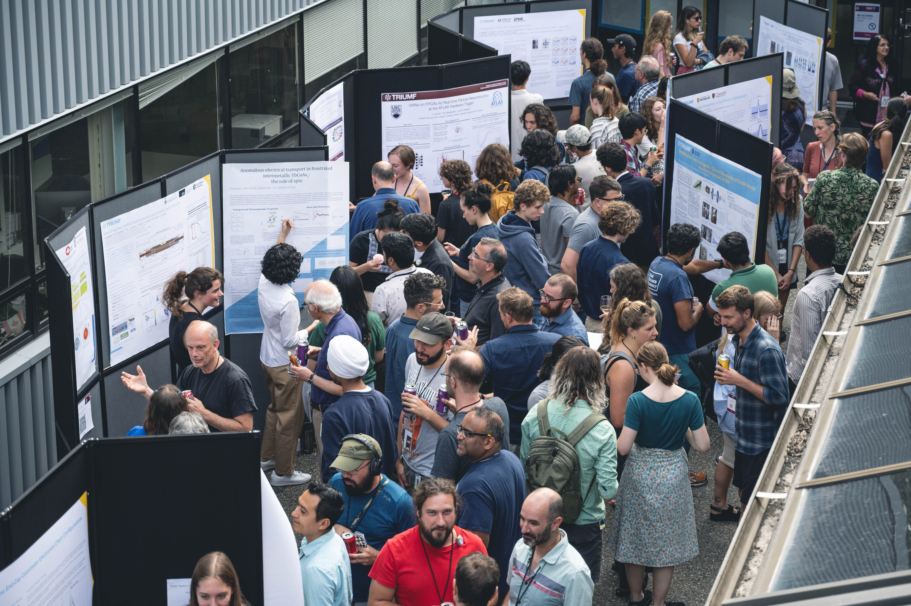
Notes:
Zac
Learning how to make science posters is a great skill, every year, thousands of students meet and compete to communicate their research.
https://twitter.com/TRIUMFLab/status/1687015823754645504/photo/1

Slide 17
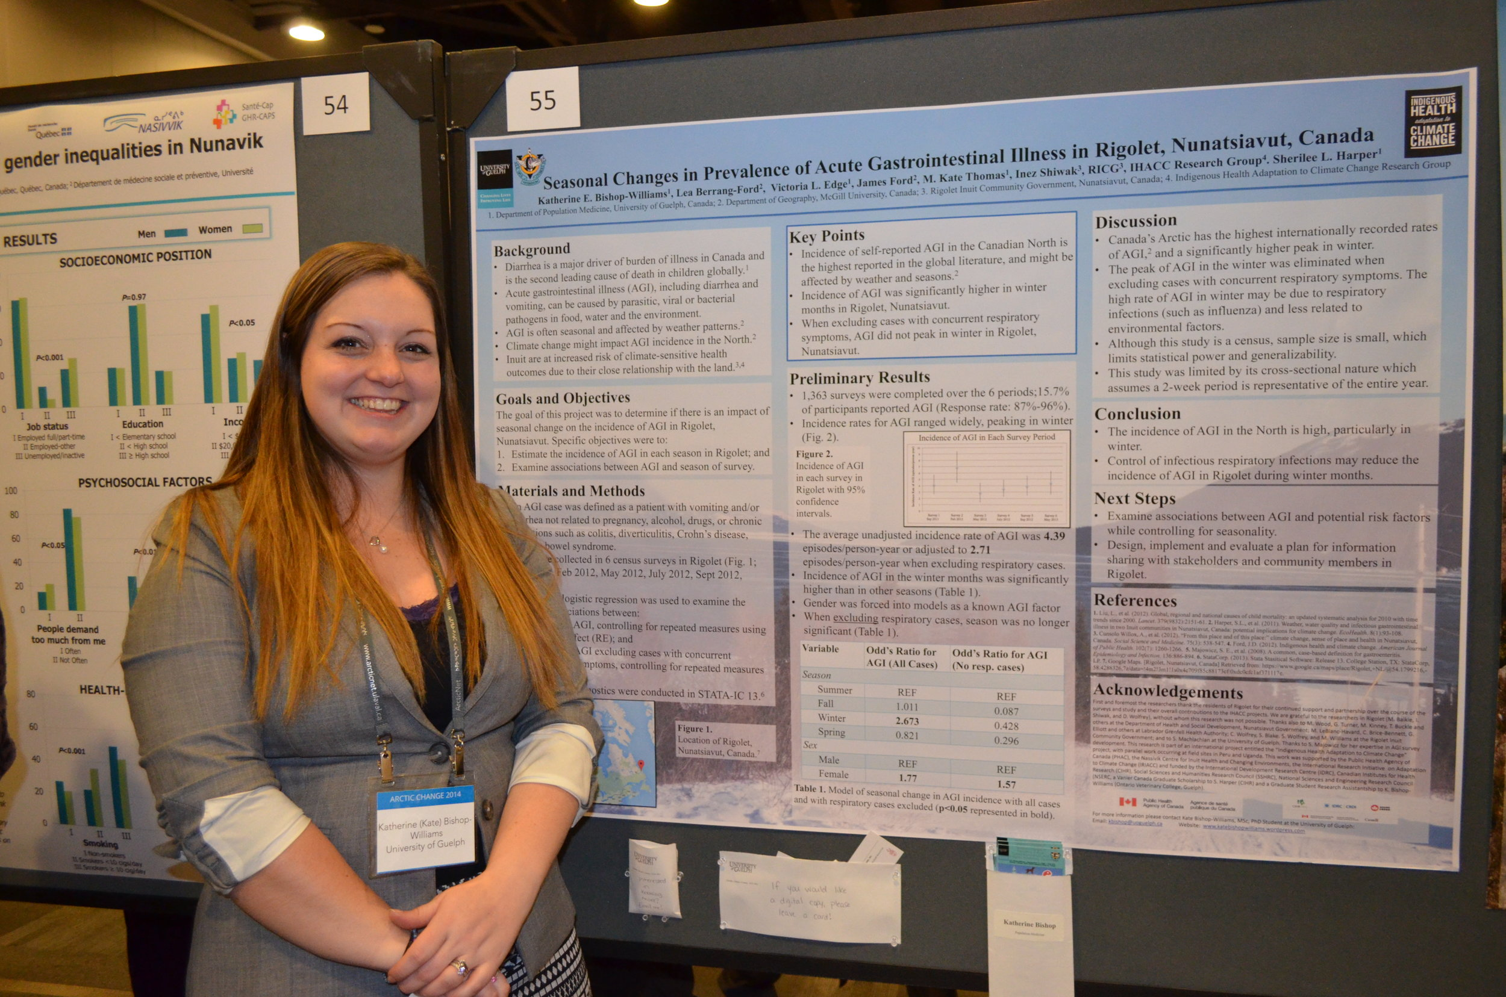
Notes:
Zac
https://www.climatechangeandglobalhealth.com/award-winning-research-conference-posters-1

Slide 18
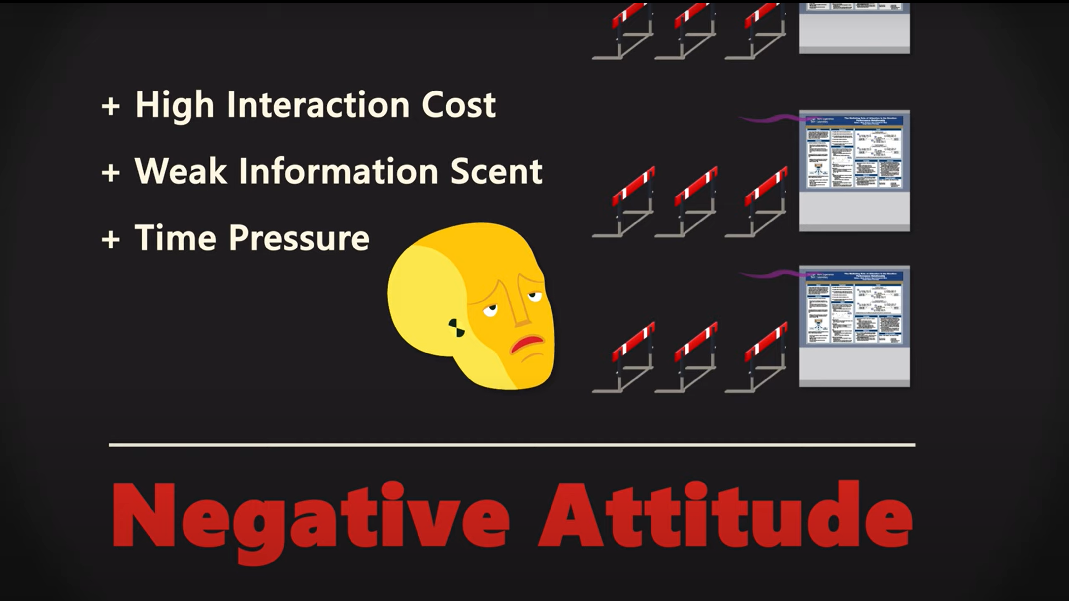
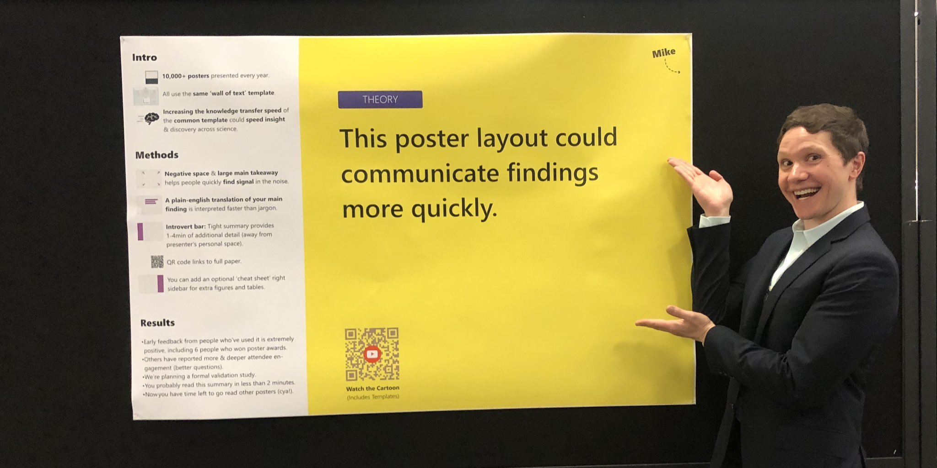
Mike Morrison
Notes:
Zac
Check out Mike Morrison’s videos on YouTube about science posters.

Slide 19
Notes:
Mark
Academic research posters tend to have a lot more information.
In Vanessa Graber’s poster, which won first place at the 2019 Lindau Nobel Laureate Meeting, we can see that there is a missing piece from the image of the star. This simple visual gives us good insight into what she’s talking about.
Note the choice of a ‘hero figure’

Slide 20
NEED TO KNOW
Nice to know
Notes:
Zac

Slide 21
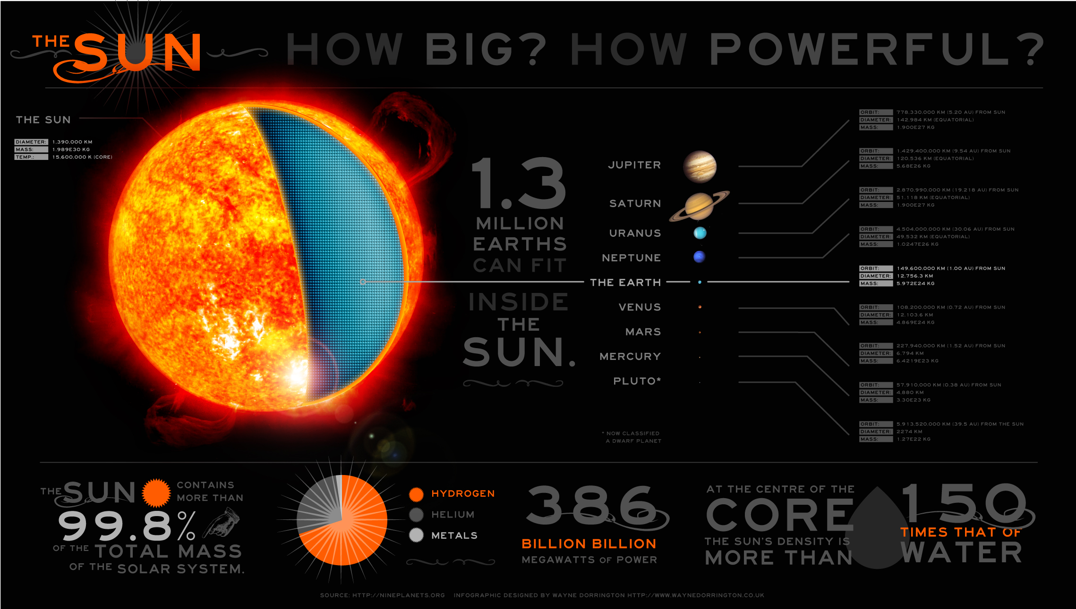
Notes:
Mark
When you look at this poster, the first thing you see is the bright orange sun. The word SUN confirms that it is the sun. the next clearest piece of information is a number, 99.8% - which draws your eye because it has the highest contrast. That number piques your interest and you read the text around it. If you read everything on this poster, I recond the 99.8% thing is the most interesting, most surprising, and easiest to remember piece of information. It’s also probably the last thing you look at when you look away.

Slide 22

You're the expert!
Take the 3 things you know a lot about.
For each: write down one thing you would say to explain each of your things.
Do you think someone else would understand it? Are they excited about your things?
Choose one of the three things you learned this summer, and write down three things you would say to explain it to someone else.
Write one more thing that you think will get them excited about your topic.
Notes:
Mark
Communication is about making a connection, sharing something. Share your excitement and the person you’re talking to can be excited about it too.

Slide 23
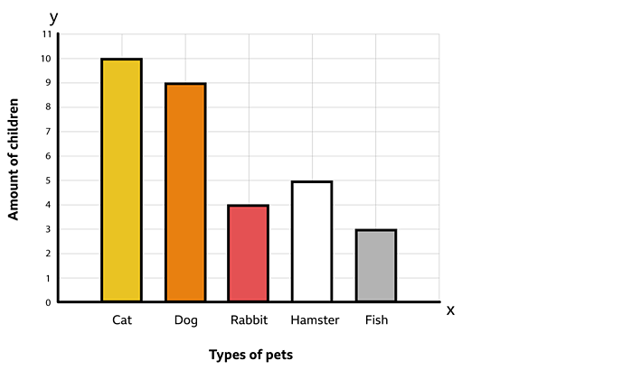
Visualizing Data:
Relate it to something
Notes:
Mark
This is a whole workshop on it’s own but we’re just going to look at a couple ways data (information) can be represented visually.
https://www.bbc.co.uk/bitesize/topics/zqgrd2p/articles/z9kbp4j

Slide 24
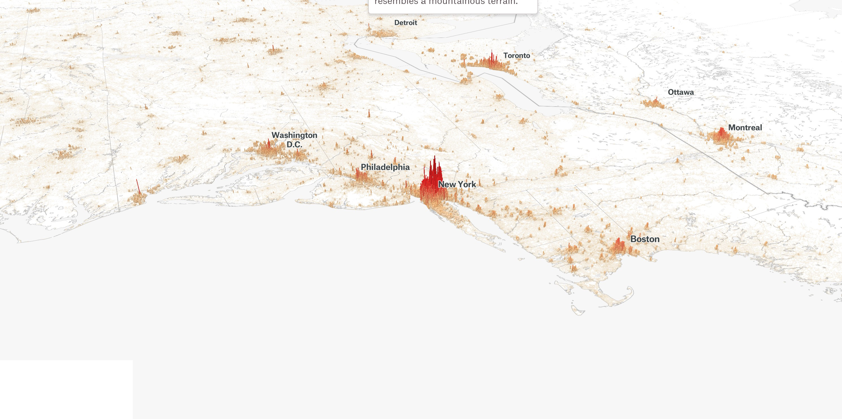
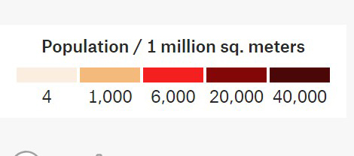
Notes:
Zac
You can do some really cool things. With data in interesting ways.
https://pudding.cool/2018/12/3d-cities-story/

Slide 25
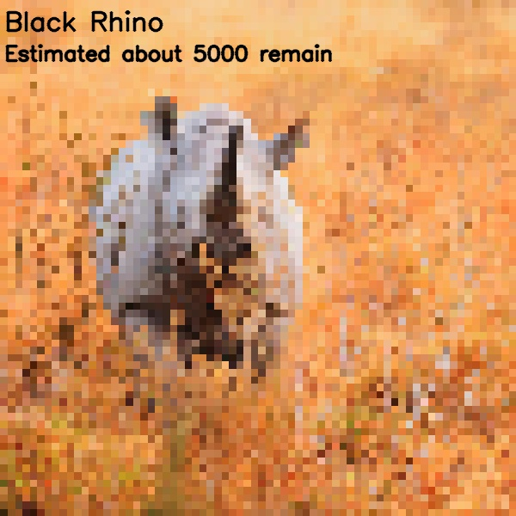
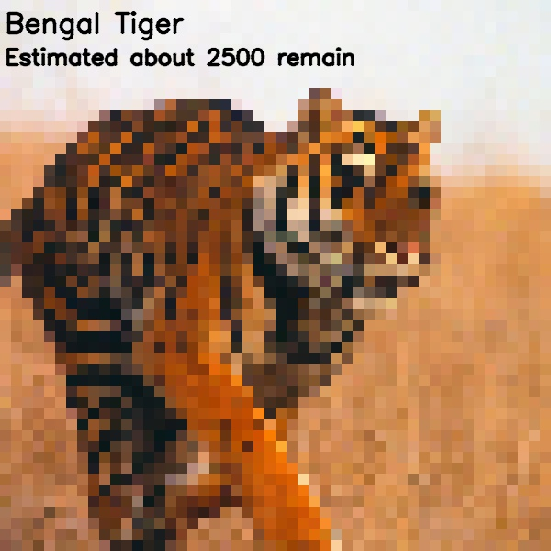
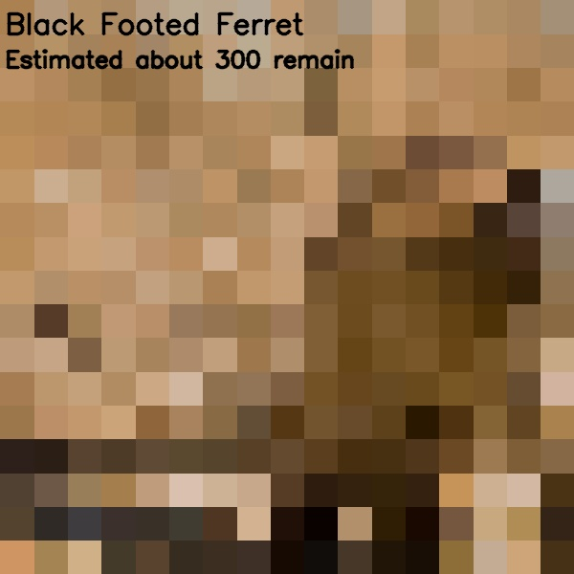
Notes:
Zac
Data Art: visualizing actual data in an artistic and meaningful way. Will get into that, but first…
https://flowingdata.com/2019/09/30/pixelation-to-represent-endangered-species-counts/
Look around at the interesting and dynamic ways people are creating powerful messages with data:
https://flowingdata.com/

Slide 26
Creative examples of science communication

Slide 27
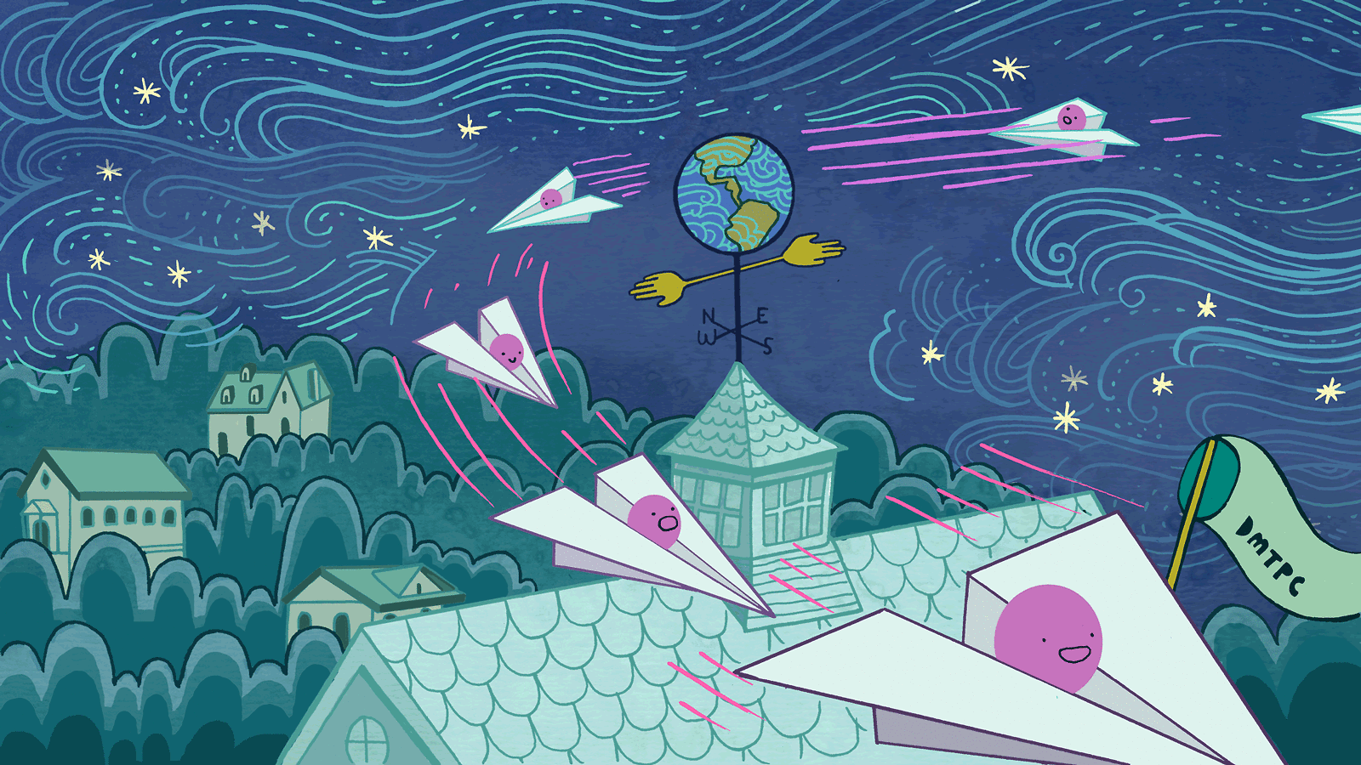
Notes:
Zac
Picture yourself in a car, your hand surfing the breeze through the open window. Hold your palm perpendicular to the wind and you can feel its force. Now picture the car slowing, rolling up to a stop sign, and feel the force of the wind lessen until it—and the car—stop.
This wind isn’t due to the weather. It arises because of your motion relative to air molecules. Simple enough to understand and known to kids, dogs and road-trippers the world over.
This wind has an analogue in the rarefied world of particle astrophysics called the “dark matter wind,” and scientists are hoping it will someday become a valuable tool in their investigations into that elusive stuff that apparently makes up about 85 percent of the mass in the universe.
In the analogy above, the air molecules are dark matter particles called WIMPs, or weakly interacting massive particles. Our sun is the car, racing around the Milky Way at about 220 kilometers per second, with the Earth riding shotgun. Together, we move through a halo of dark matter that encompasses our galaxy. But our planet is a rowdy passenger; it moves from one side of the sun to the other in its orbit.
https://www.symmetrymagazine.org/article/wimps-in-the-dark-matter-wind

Slide 28

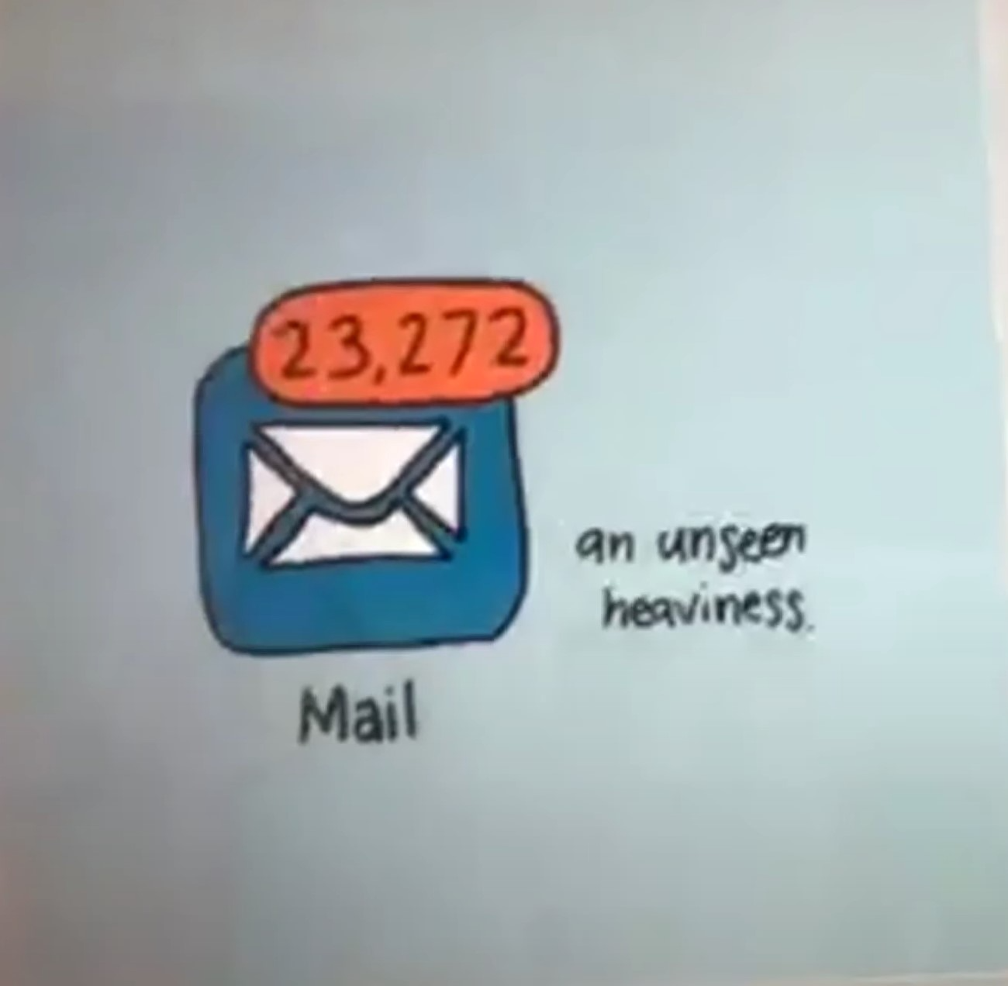
Art of Dark Matter event
Fauxbear
Chrissy Poitras
Notes:
Mark
“Surely they must all be mad” by Fauxbear
https://mcdonaldinstitute.ca/drifting-together/

Slide 29
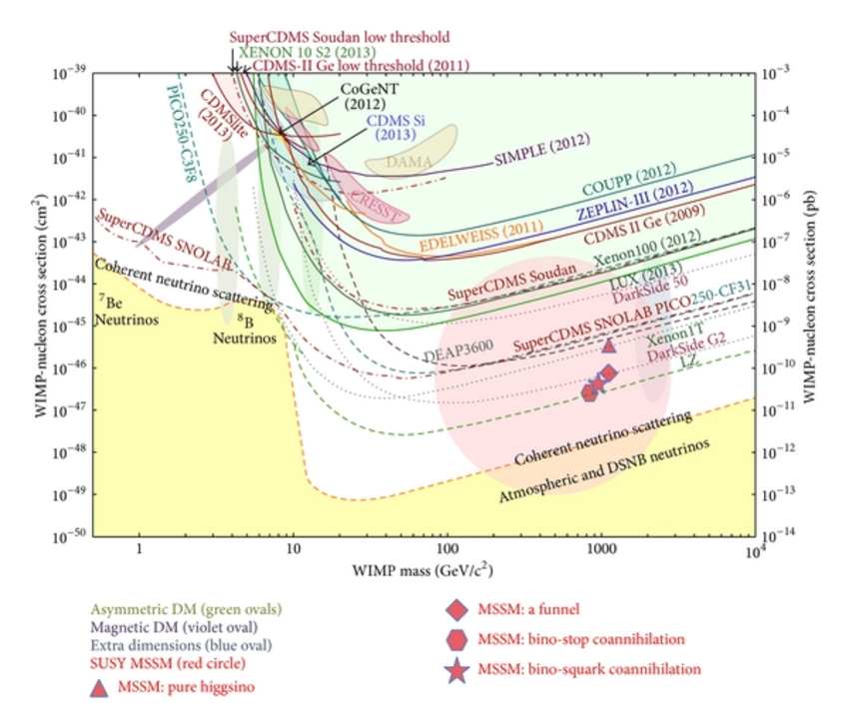
Notes:
Zac:
The DarkSide Multiton Detector for the Direct Dark Matter Search - Scientific Figure on ResearchGate. Available from: https://www.researchgate.net/figure/Current-status-of-direct-dark-matter-searches-results-and-sensitivity-of-future_fig3_281890444 [accessed 4 Apr, 2019]

Slide 30
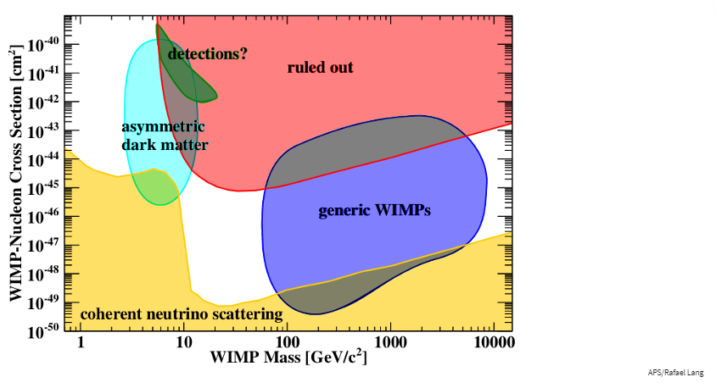
Notes:
Zac
A much simplified version. You can now clearly see a portion of the parameter space that has been ruled out, and two different possible types of dark matter that haven’t been ruled out.

Slide 31
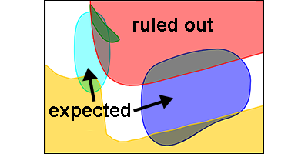
Notes:
Zac
The basic concept though is that there are two areas of the parameter space where dark matter is expected to be found. Or, in other words, there are still two possible theories of dark matter that haven’t been ruled out.

Slide 32
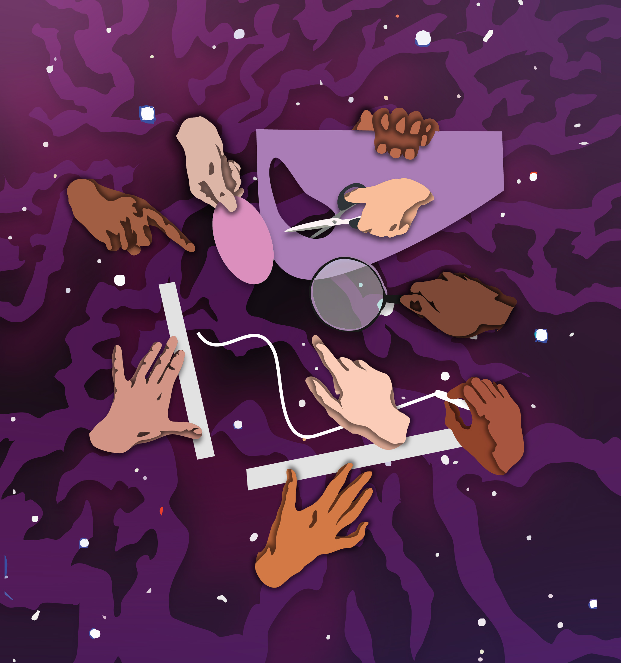
Notes:
Zac
Expected publish date: May 2019 on the new Queen’s Research website.
Communicating the data with the public. Using the actual data… sort of.

Slide 33
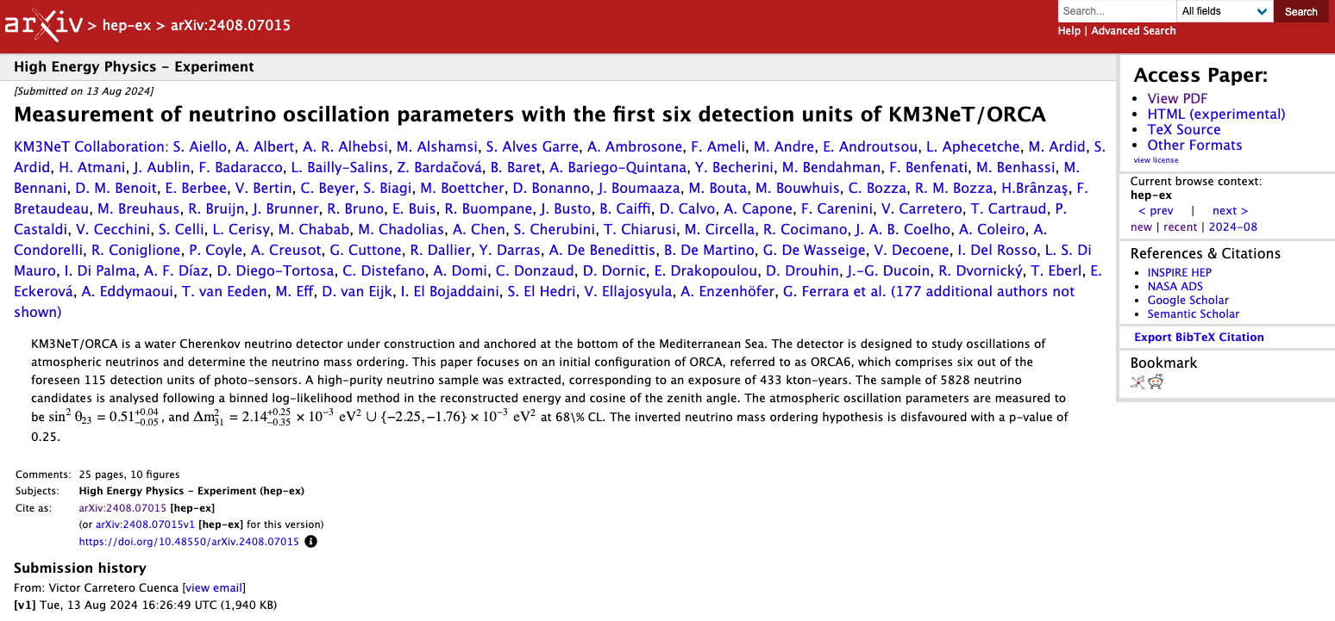
Creative Science Communication
Notes:
Mark: Research article
Communication can come in a variety of formats … think back to the diversity of audiences.
Highlight: papers, posters, talks, podcasts, blogs, social media posts, art, books, zines, etc.

Slide 34
Creative Science Communication
Notes:
Mark: Research poster
Communication can come in a variety of formats … think back to the diversity of audiences.
Highlight: papers, posters, talks, podcasts, blogs, social media posts, art, books, zines, etc.

Slide 35
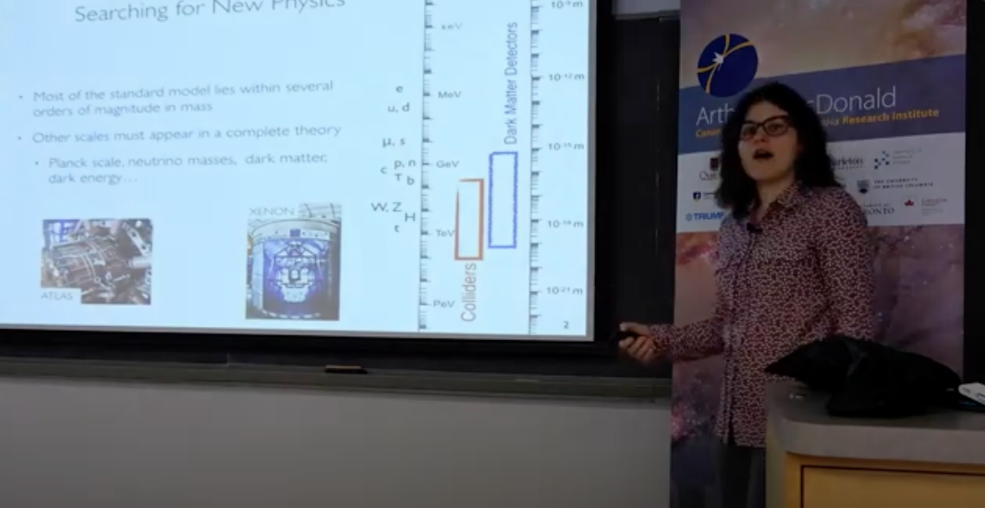
Creative Science Communication
Notes:
Zac: Science seminar
Communication can come in a variety of formats … think back to the diversity of audiences.
Highlight: papers, posters, talks, podcasts, blogs, social media posts, art, books, zines, etc.

Slide 36
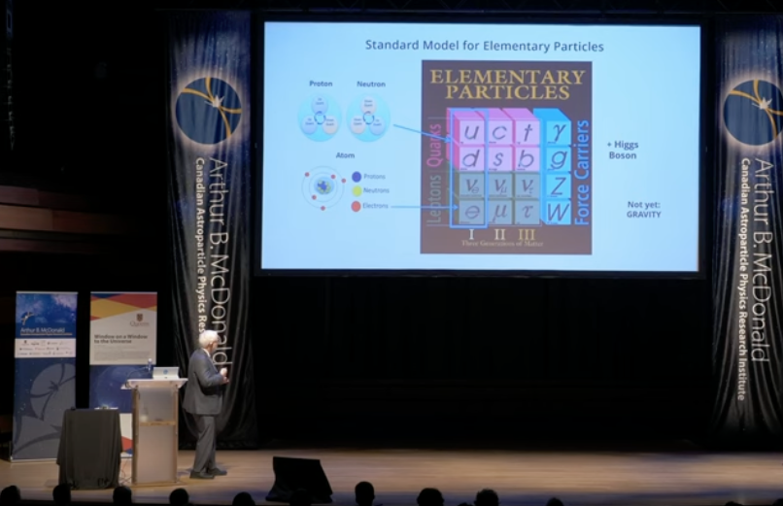
Creative Science Communication
Notes:
Zac: Public science talk
Communication can come in a variety of formats … think back to the diversity of audiences.
Highlight: papers, posters, talks, podcasts, blogs, social media posts, art, books, zines, etc.

Slide 37
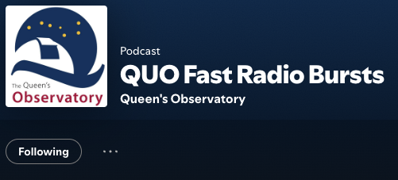
Creative Science Communication
Notes:
Mark: Science podcast
Communication can come in a variety of formats … think back to the diversity of audiences.
Highlight: papers, posters, talks, podcasts, blogs, social media posts, art, books, zines, etc.

Slide 38
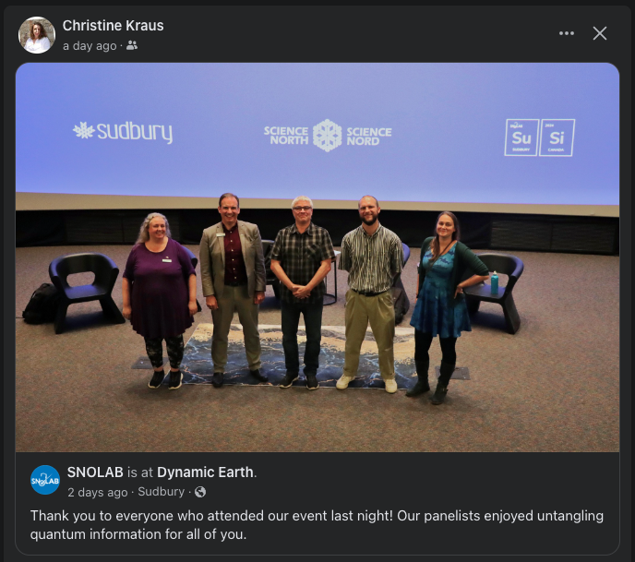
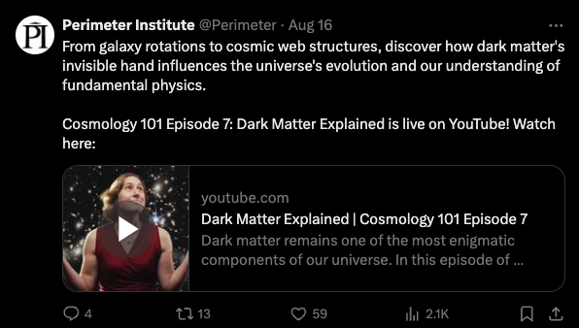
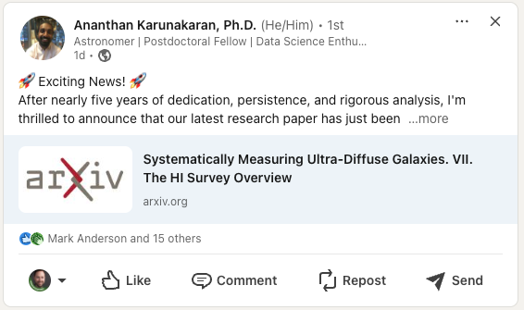
Creative Science Communication
Notes:
Mark: Social media posts
Communication can come in a variety of formats … think back to the diversity of audiences.
Highlight: papers, posters, talks, podcasts, blogs, social media posts, art, books, zines, etc.

Slide 39

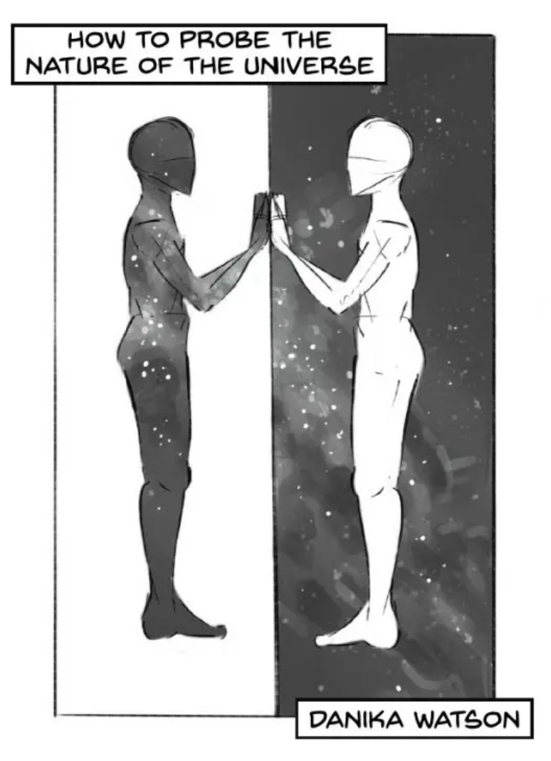
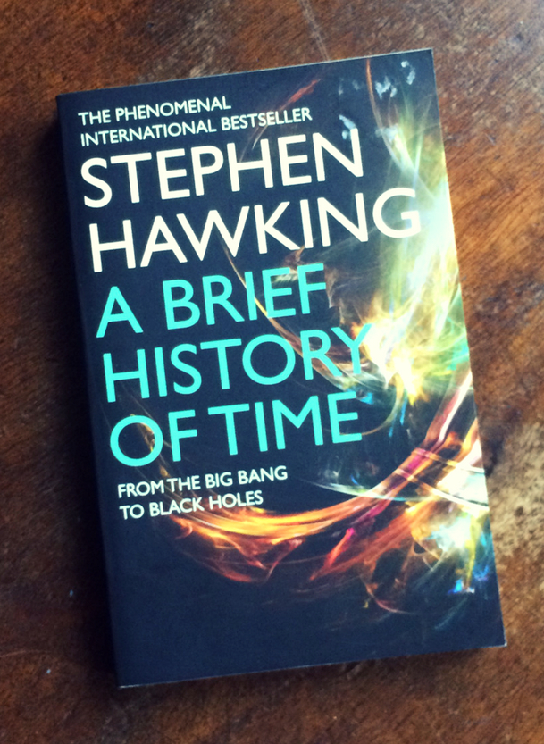
Creative Science Communication
Notes:
Zac: Science books / zines
Communication can come in a variety of formats … think back to the diversity of audiences.
Highlight: papers, posters, talks, podcasts, blogs, social media posts, art, books, zines, etc.

Slide 40
Creative Science Communication
Notes:
Zac: Art
Communication can come in a variety of formats … think back to the diversity of audiences.
Highlight: papers, posters, talks, podcasts, blogs, social media posts, art, books, zines, etc.

Slide 41
Your creative Science Communication project
In pairs, or individually: (You have 30 + 15 minutes for this throughout these two days)
Consider your work from this summer that you are talking about at CASST,
Consider an audience of high school students (grades 10-12).
Write down three super exciting or surprising facts from your topic.
Think of ways to visualize and/or communicate those facts. What is your medium?
Choose one to focus on – This will be your focus.
Fill in the blanks for your focused fact:
_______________ and ___________, but __________________, therefore __________________
Use the 3-act (Introduction – Failures & Success – Value & Impact) to flesh out the narrative more. Each act can itself follow and, but, therefore too.
Do a sketch of a communication including your facts and ask someone to tell you what they think.
Create a final version of your communication.
Notes:
Other options:
Look at your lists of things you're interested in or learned about this summer
OR
Look at what you experience here during CASST.

Slide 43
Introduction to Data Visualization, Fall 2016
http://paldhous.github.io/ucb/2016/dataviz/index.html
http://paldhous.github.io/ucb/2016/dataviz/resources.html
Data Visualization and D3.js
https://classroom.udacity.com/courses/ud507
Data Science: An Introduction.
Chapter 5:Thinking Like a Visual Artist
https://en.wikibooks.org/wiki/Data_Science:_An_Introduction/Thinking_Like_a_Visual_Artist
Learning Data Visualization
https://www.lynda.com/Data-Science-tutorials/Learning-Data-Visualization-2019-Revision/5005071-2.html?org=queensu.ca

Slide 44
What makes a data visualization memorable?
https://phys.org/news/2013-10-visualization.html
Mathematics: forget simplicity, the abstract is beautiful - and important
https://theconversation.com/mathematics-forget-simplicity-the-abstract-is-beautiful-and-important-91757
https://medium.com/communicating-science-with-social-media
https://www.aldacenter.org/aklc/build-skills/webinars-past
https://rework.withgoogle.com/blog/using-improv-to-scientists-tell-stories/

Slide 45
- Principles of design in technical presentations - what is an effective slide, how to design a "story" for your presentation
- Setup for future presentations in the series (expert in data visualization/plotting, expert in data representations, etc)
Workshops in vector graphics editing , production

Slide 46
“Perfection is Achieved Not When There Is Nothing More to Add, But When There Is Nothing Left to Take Away” Antoine de Saint-Exupery.

