Slide 1
DEAP3600 hardware upgrades
And light yield automation
CASST 2024 – CHEYANNE MONK
Notes:
introduction

Slide 2
DETECTING DARK MATTER
Image from: https://physics.aps.org/articles/v8/74
Image from: https://scientifica.ch/en/ausstellungen/bringing-light-into-the-dark-universe/
Notes:
never been able to directly detect dark matter, but that doesn’t stop us from trying
doesn’t interact with the electromagnetic force, the strong nuclear force, or the weak nuclear force
only way we have been able to know it’s there is by its interaction with gravity, and its gravitational effects on the matter around it
because we have been able to observe its gravitational effects, we have been able to determine that dark matter makes up just over 25% of the universe, greatly outweighing ordinary matter which makes up around 5%.

Slide 3
wimps
Nonbaryonic subatomic particle
Electromagnetically neutral
From extended standard model
Heavy & slow
Notes:
class of nonbaryonic subatomic particle called WIMPs (Weakly Interacting Massive Particles)
electromagnetically neutral and are only predicted by extending the standard model
thought to be heavy and slow moving, allowing them to clump together in dense formations that galaxies and galaxies clusters can form in without breaking apart.

Slide 4
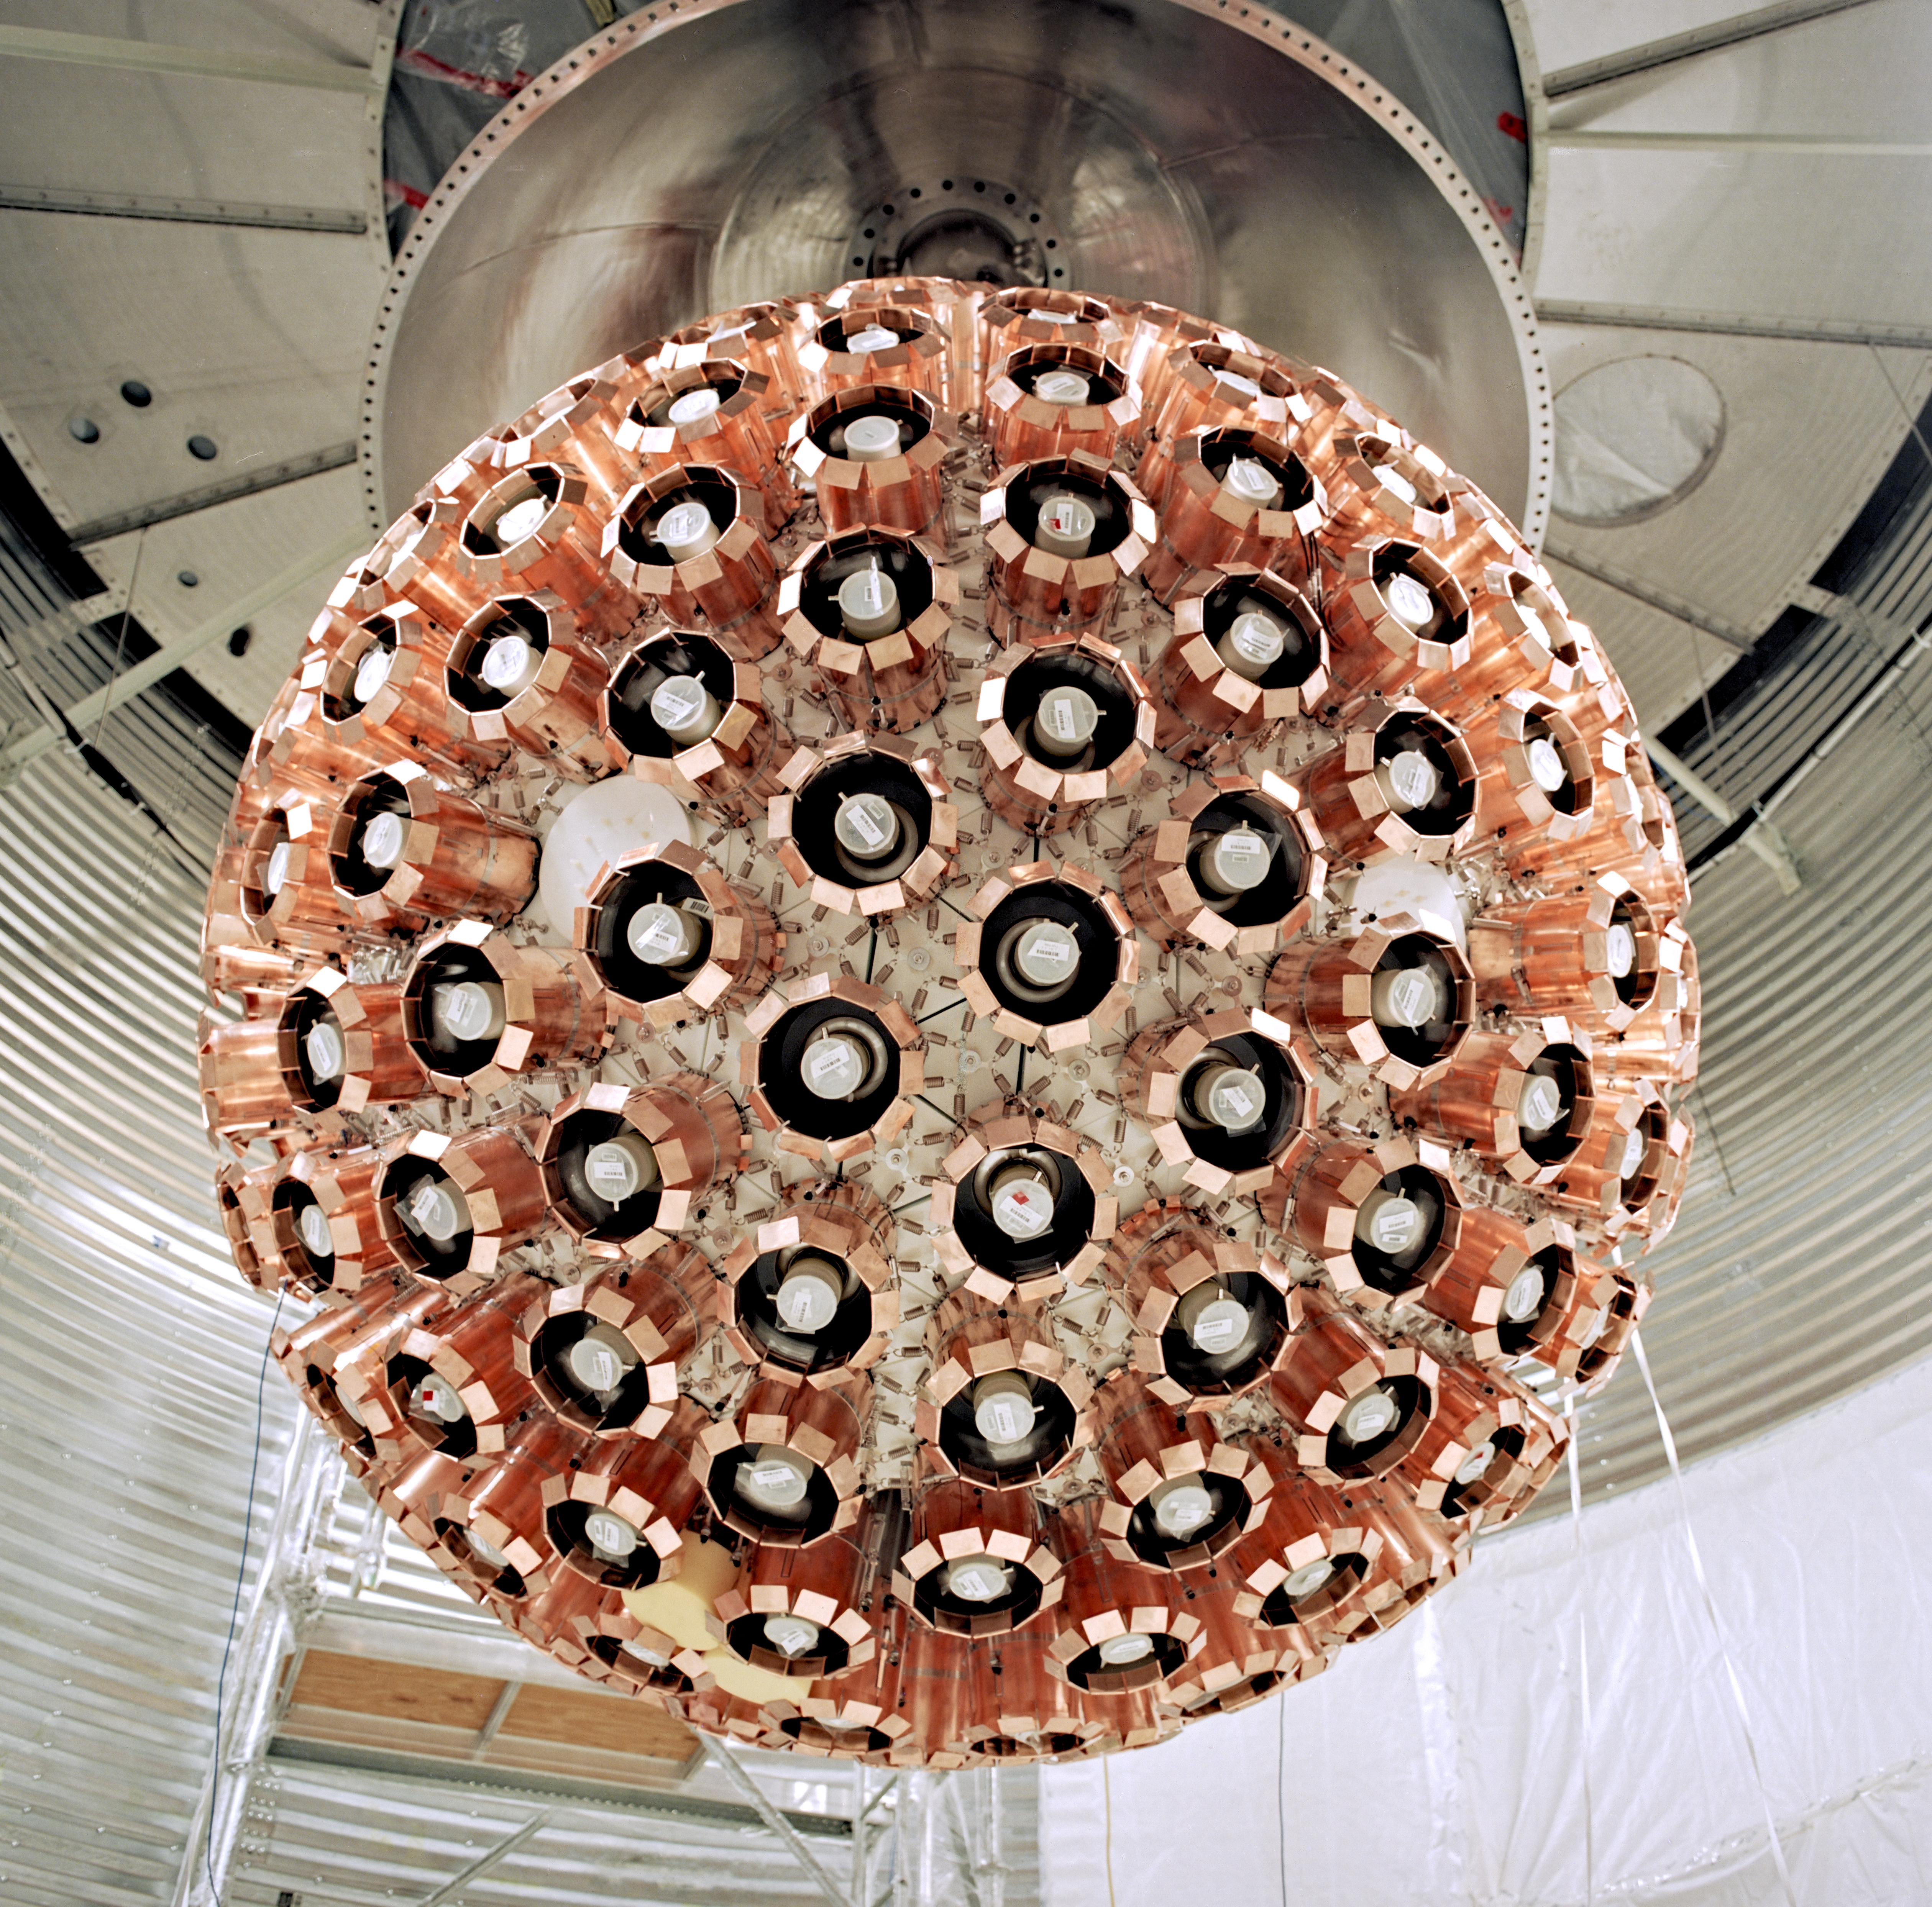
DEAP3600
liquid Argon:
Scintillation photons from nuclear recoils are emitted in order of nanoseconds
From betas and gammas, microseconds
Can reduce beta and gamma events in ROI by factor of around 10 billion
Image from https://deap3600.ca/
Image from https://deap3600.ca/
Notes:
DEAP-3600 designed as a single-phase detector using a large fiducial mass target of liquid argon
reason for LAr is timing characteristics in interactions
Scintillation photons from nuclear recoils are emitted within the order of nanoseconds, whereas from betas and gammas it is within the order of microseconds​
can reduce our beta and gamma events in our ROI by a factor of about 10 billion.

Slide 5
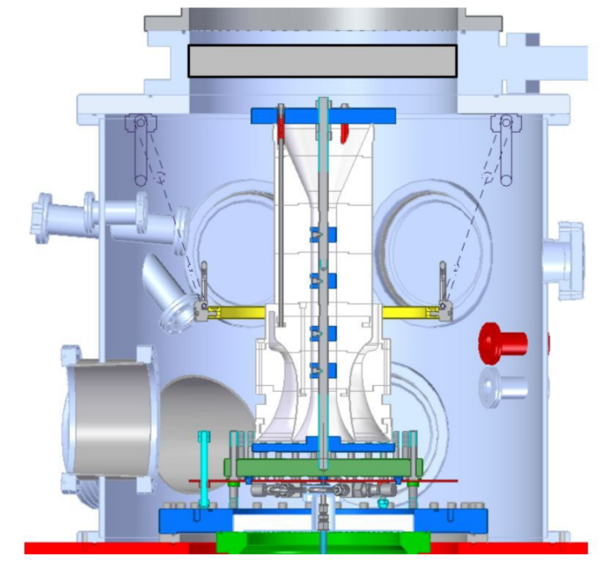
hardware updates
Neck & flow guide installation
Notes:
Biggest project: neck & flow guide installation
in original design, LAr went approx. 2m above spherical volume so cooling coil would be submerged
o-rings between acrylic & steel portions of neck needed to be temperature controlled in order to maintain seal
acrylic neck cooled by LAr, causing three o-rings to become too cold to function, preventing them from forming a proper seal
caused nitrogen to leak into the argon, argon needs to be very pure for scintillation to happen, needed to be boiled off and AV refilled
fixing neck seal would allow us to fill detector to the top as originally intended
also update to flow guide to reduce neck events
when alpha is in the neck and most of the light doesn't reach the PMTs so it mimics lower energy events like neutrons and dark matter
flow guide allows argon to flow smoothly into AV while minimizing line-of-sight to the PMTs
new version has a pyrene wavelength shifter that is different than the TPB wavelength shifter coating the AV, allowing us to identify neck events more easily

Slide 6
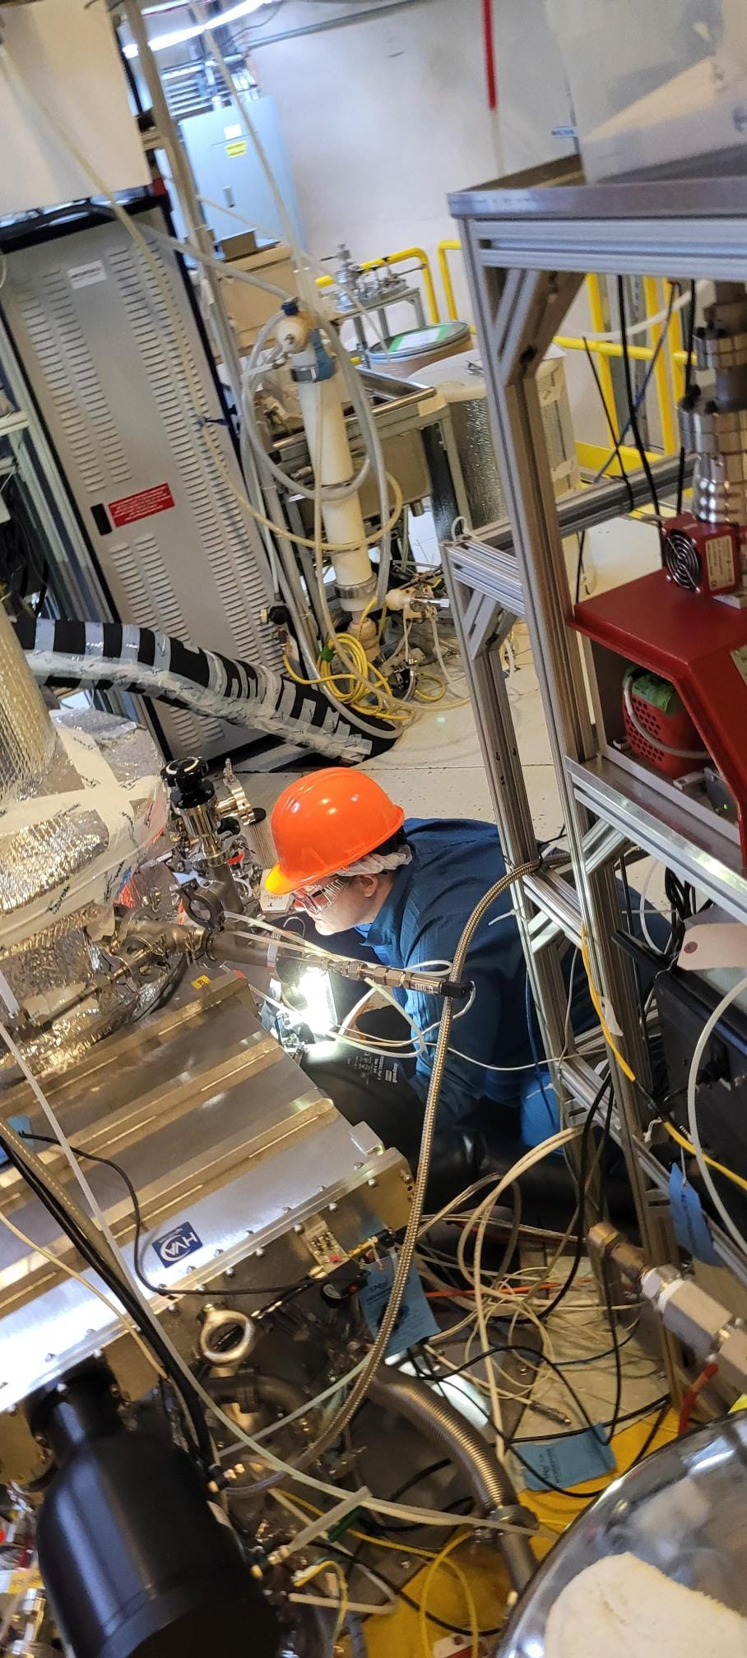
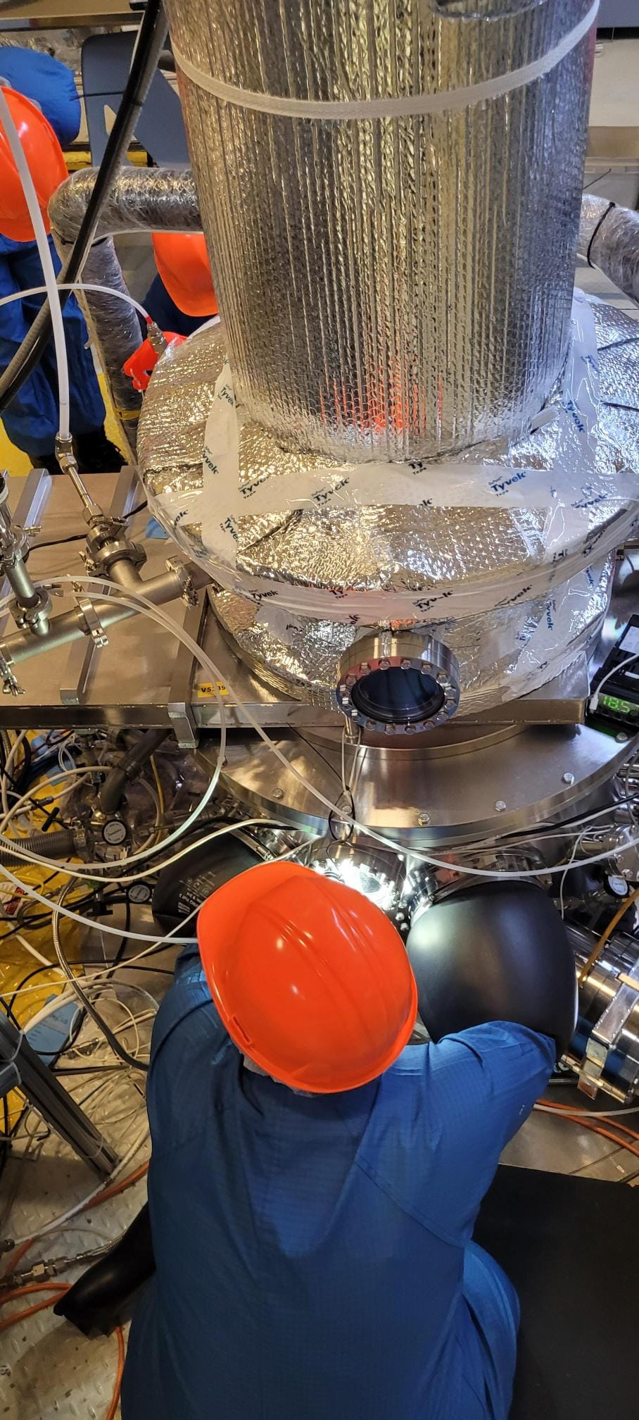
hardware updates
Neck & flow guide installation (cont’d)

Slide 7
Purification Loop before…
Notes:
need to purify the argon to sub-ppb impurities and reduce radon levels as low as possible
state before: passive flow from dewar to RGA because at dewar psi is 21, at RGA outlet is at lab pressure (18psi)

Slide 8
Purification Loop after
Notes:
gas injected into KNF pump – double diaphragm, maintains forward pressure of 30 psig
then goes into a hot metal getter that performs chemical purification
gas is then cooled and passed through a charcoal trap that removes radon and radioactive impurities
currently in storage recirculation mode (dewar to dewar) – bypass condenser, detector and boiler, keeps everything in a stable state

Slide 9
light yield automation
light yield: number of photoelectrons measured by the PMT’s *
calibrate with Tl208 and K40*
calibrate energy response function for energy deposited in argon*
previously fits were run individually
Image from paper “Search for dark matter with a 231-day exposure of liquid argon using DEAP-3600 at SNOLAB”, R. Ajaj et al. (DEAP Collaboration), Figure 5
https://doi.org/10.1103/PhysRevD.100.022004
*Ajaj, R., Amaudruz, P.-A., et al, (2019). Search for dark matter with a 231-day exposure of liquid argon using DEAP-3600 at SNOLAB. Physical Review D, Volume 100(022004). DOI: 10.1103/PhysRevD.100.022004 ​
​
Notes:
light yield: number of photoelectrons measured by the PMT’s
different kinds of events can produce more or less light, but we calibrate the detector with known sources like Tl208 and K40 that produce peaks of known energy
we specifically calibrate the energy response function for energy deposited in argon
image shows the ER function (red) showing number of detected PE for an event depositing energy E in LAr (yellow band represents the uncertainties of the function)
previously fits were run individually using code made by previous student (Stephanie Langrock, edited by Rena Liu)

Slide 10
light yield automation
Traditional English Code Trifle
LaTeX document, PDF
Error checking
Plots & fits
Create reduced ntuple file, ROOT files and JSON file
Read analytical root files
GetAr39Spec.C, GetFitRoot.C, FitSpectra.C
LightYieldAuto.py
LightYieldBash.py
Notes:
LightYieldBash.py, LightYieldAuto.py
entered run numbers are processed through Stephanie’s Light Yield Energy Response code
read analytical root files to fit runs based on pre-existing fit parameters,
create reduced ntuple file, ROOT files and JSON file for each run
plots & fits
Error Checks
LaTeX, PDF

Slide 11
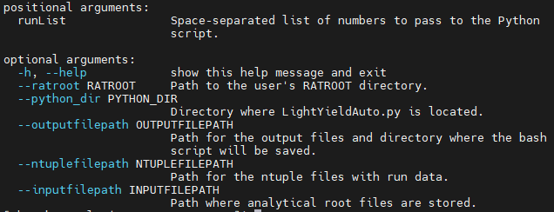
cherry on top…
Multiprocessing/multithreading
Faster job time
Enter one command with arguments, fully automated process
Notes:
Python’s Multicprocessing
SLURM’s multithreading
fully automated
Error checking parameters:
light yield values are within 10 percent of each other (for both QPE and NSC)
light yield values are greater than 5, less than 10
light yield values for QPE are greater than light yield values for NSC

Slide 12
thank you!

Slide 13
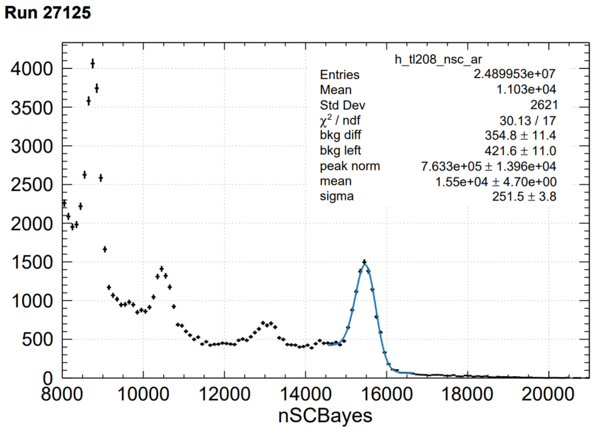
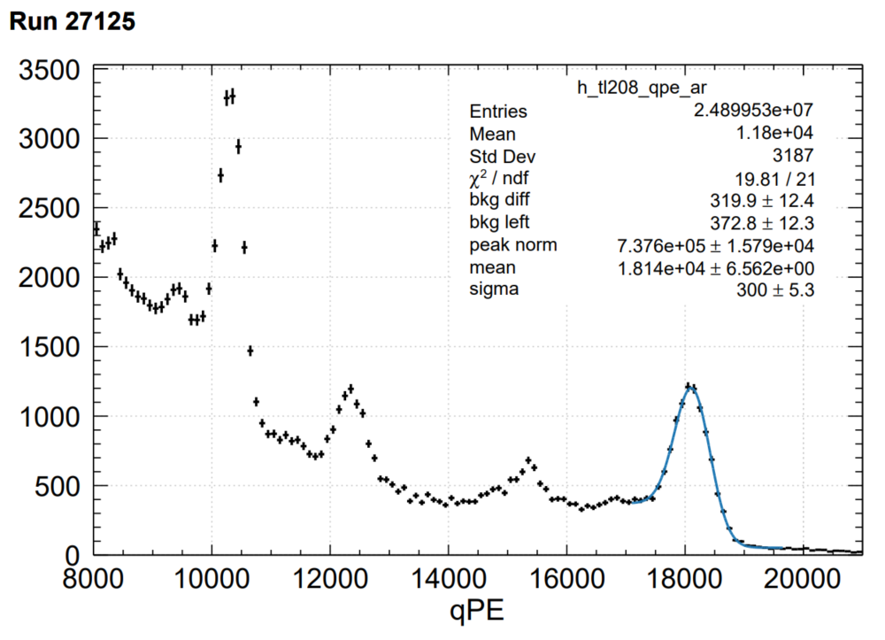
Additional slides

Slide 14
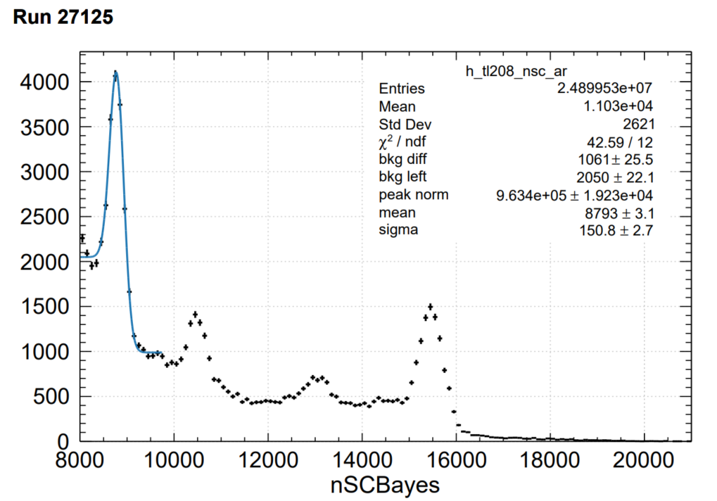
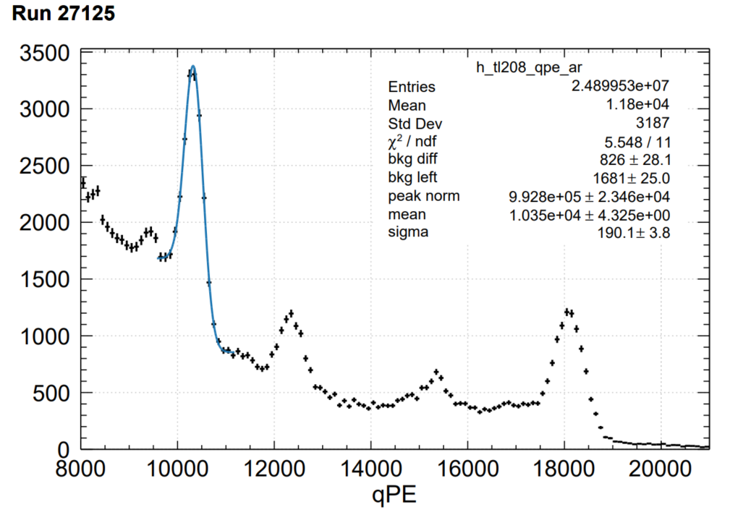
Additional slides

Slide 15
Additional slides

Slide 16
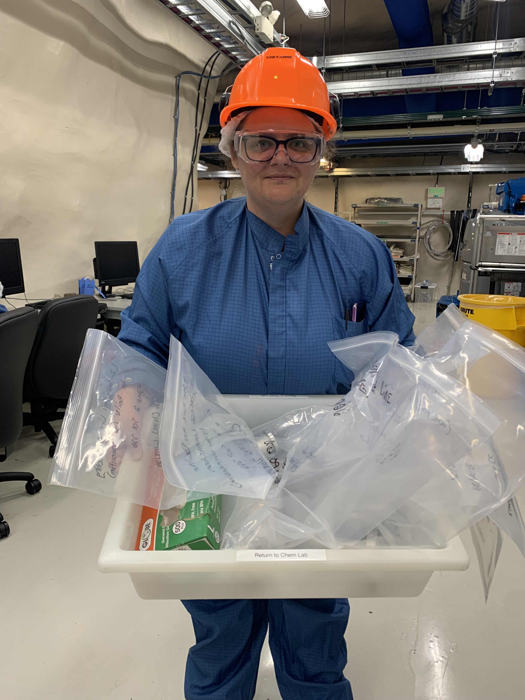
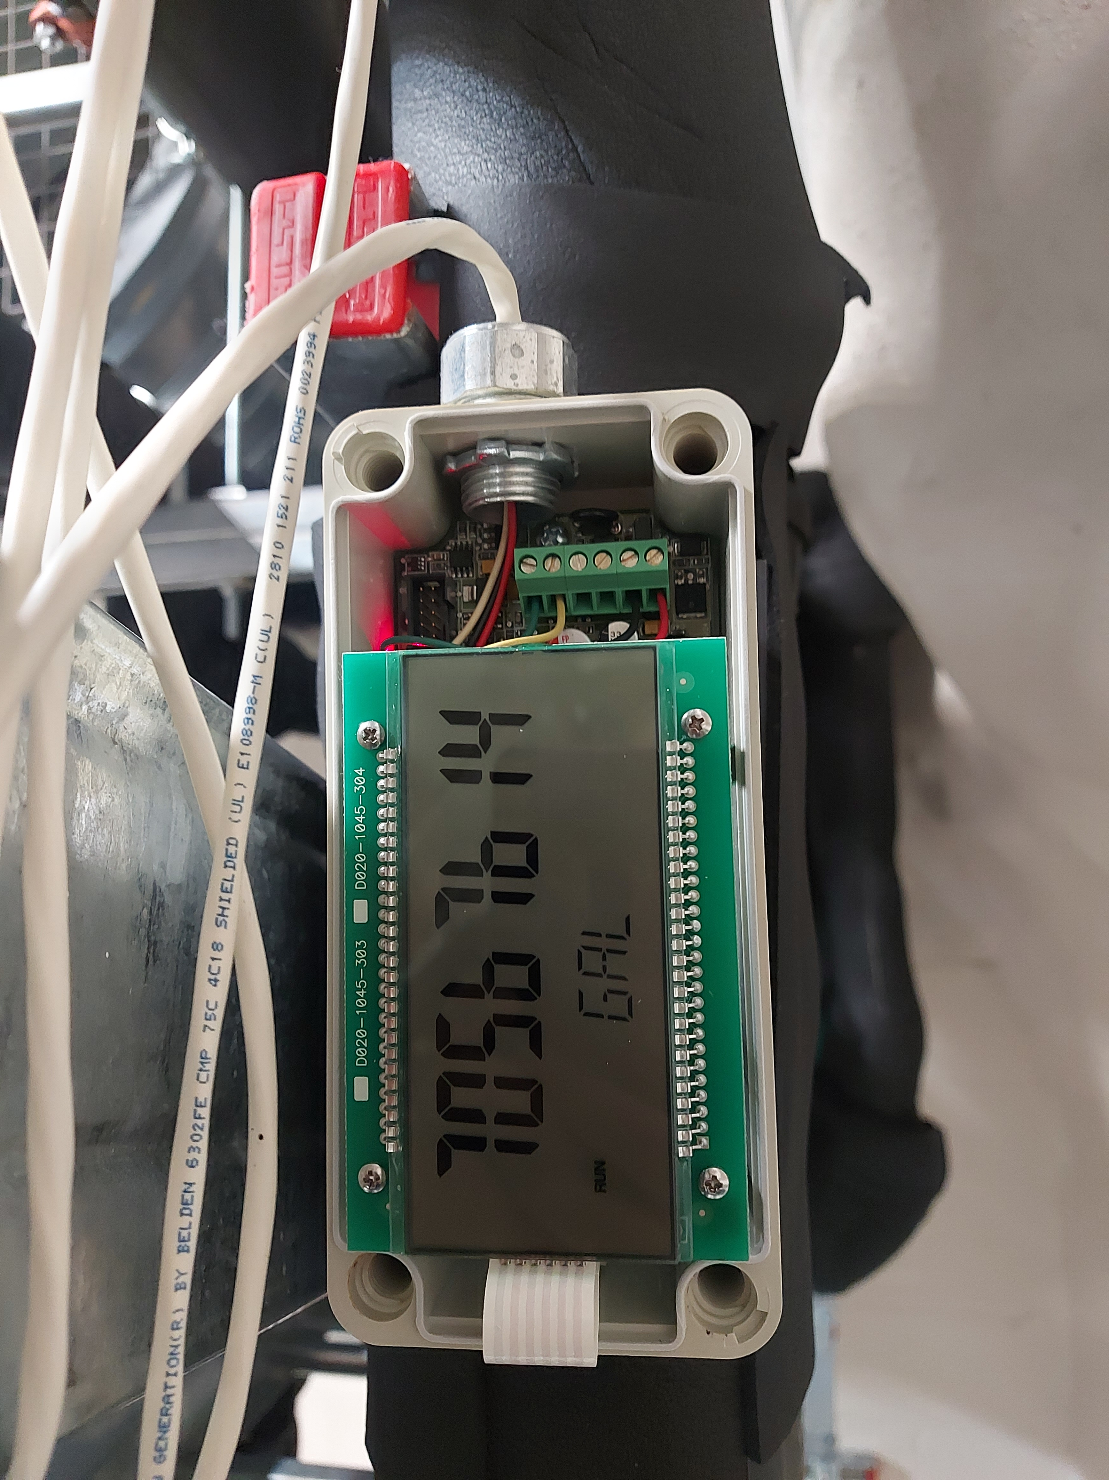
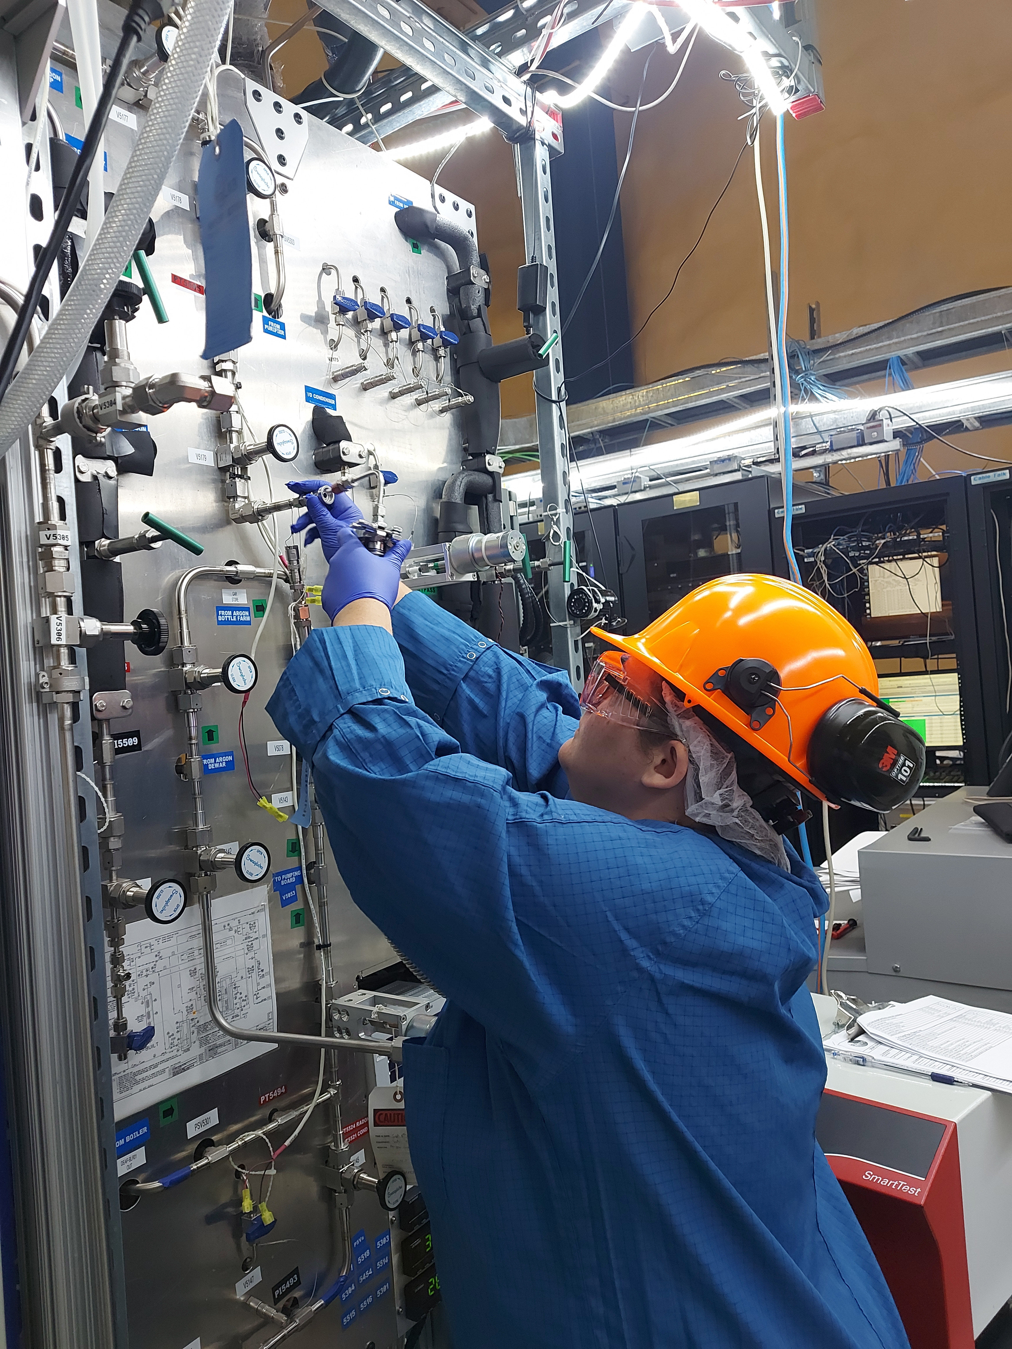
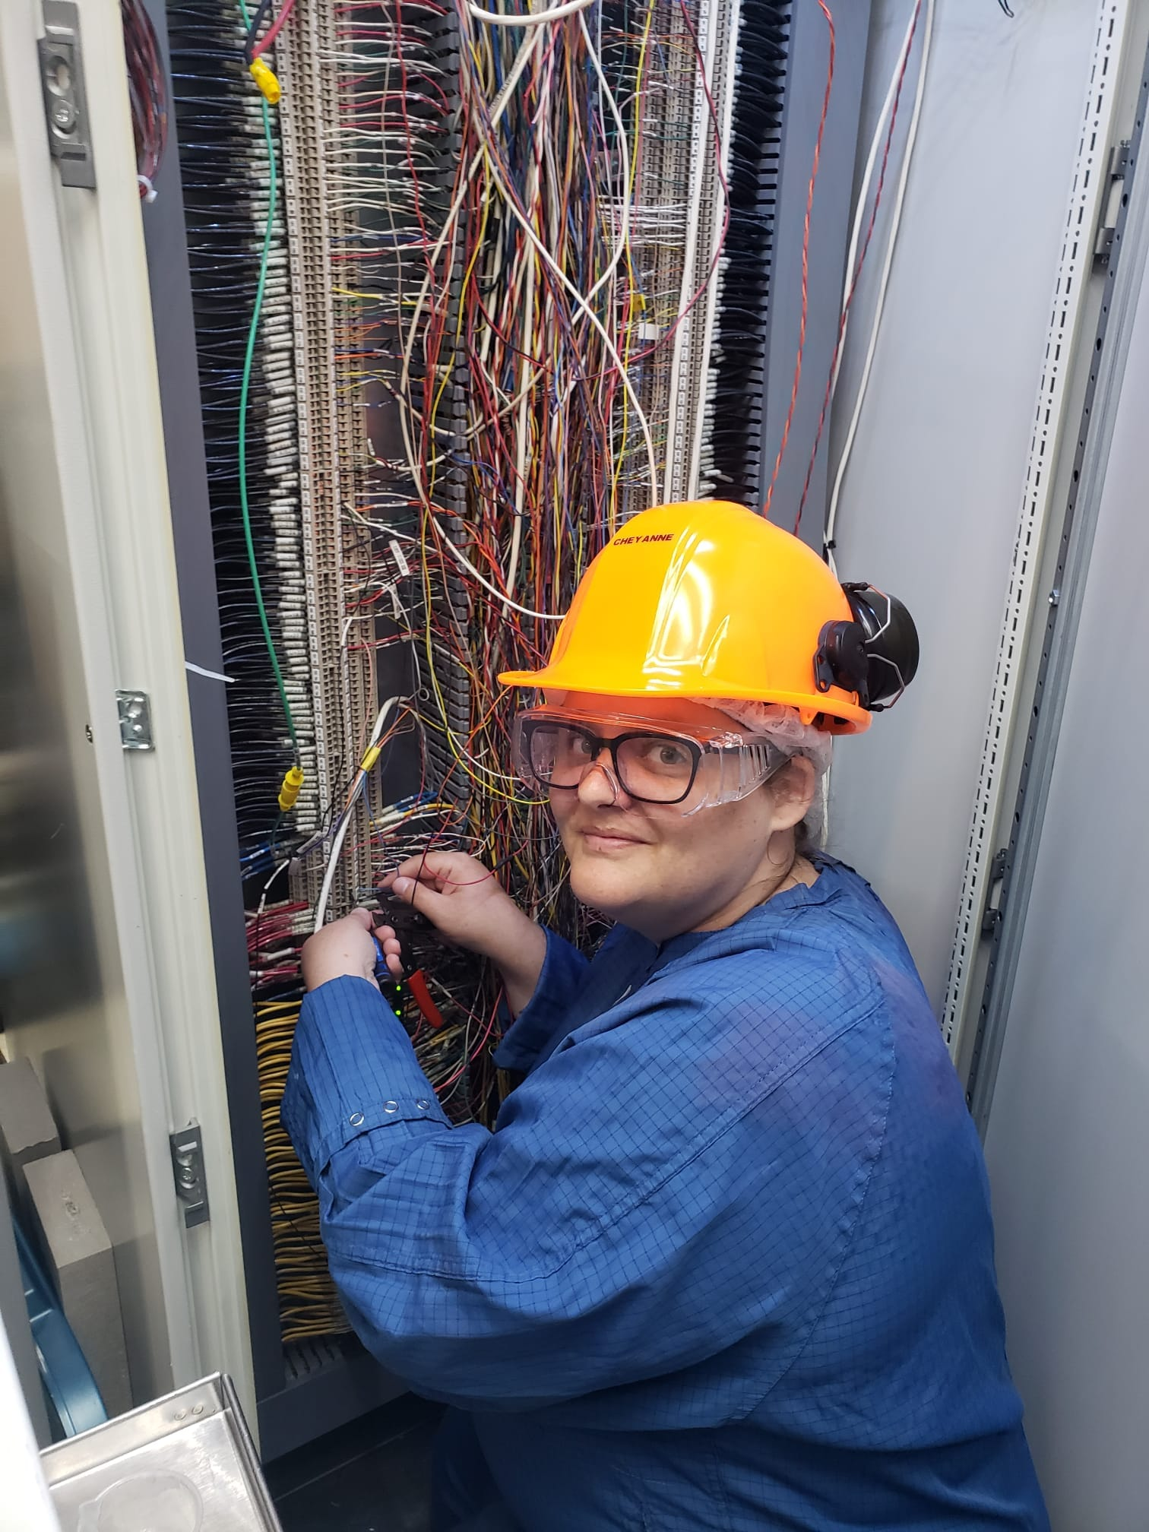
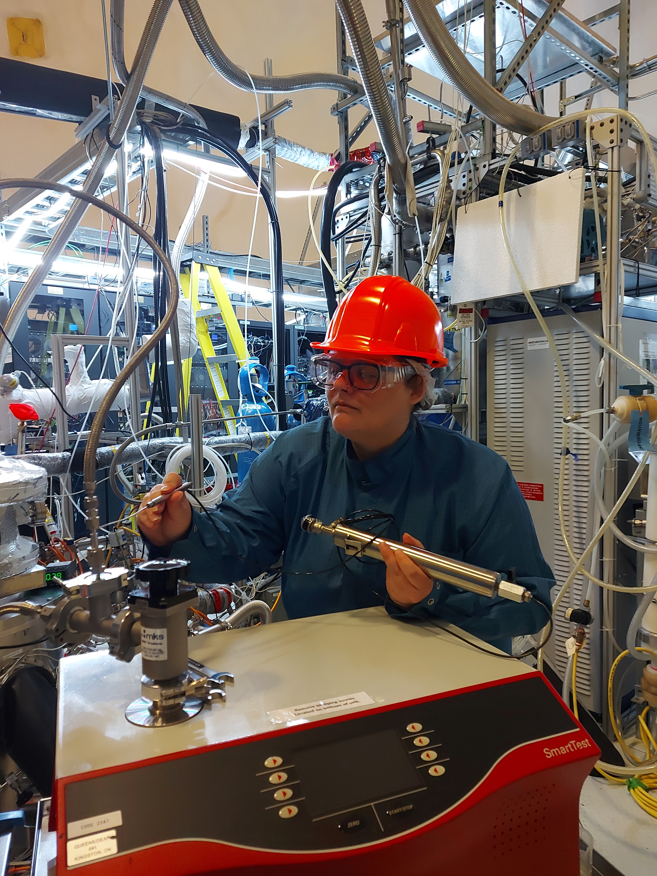
additional slides
Pump/purge, washing parts, leak checking, flow meter, PIT wiring

