Slide 1
SNO+ and Radon
2024/08/19
Keegan Paleshi
Student, Laurentian University
Notes:
Hi everyone, Today im going to be talking to you about SNO+’s efforts to improve our methods for quantifying radon in and around our detector

Slide 2
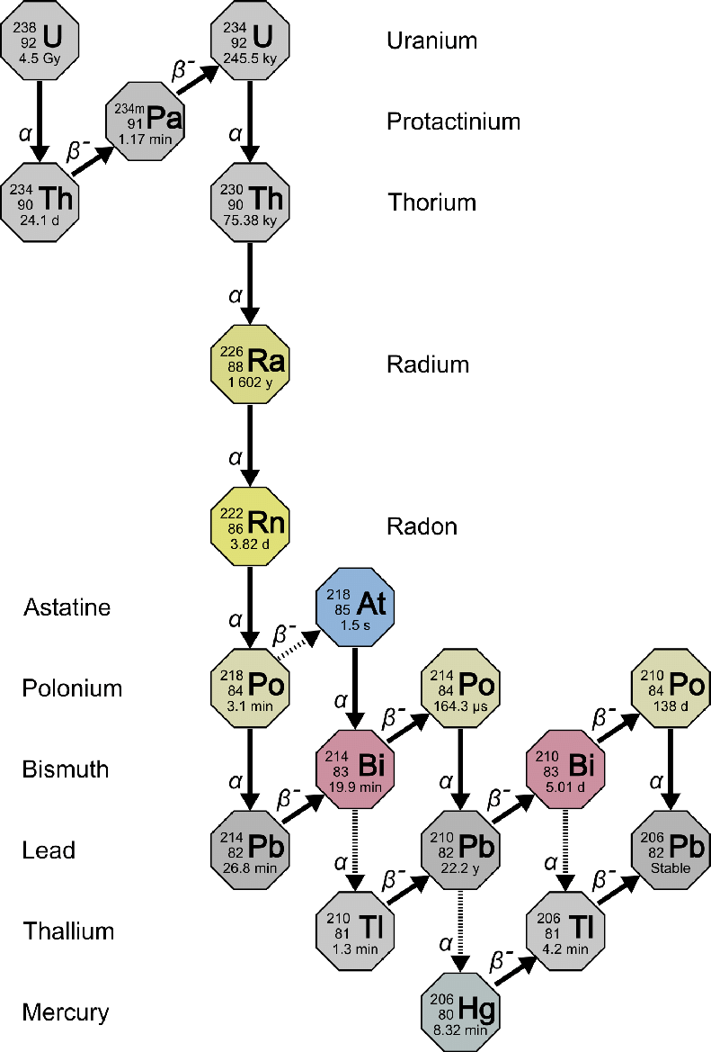
Disentangling the U-238 Decay Chain
Dirt, rock, and dust
Radon vs Parents
Pb-210 long lived
https://www.epa.gov/sites/default/files/styles/medium/public/2015-05/u-238_decay.png?itok=558OwVAJ
Notes:
Radon comes from Uranium, Uranium is everywhere, radon emanates

Slide 3
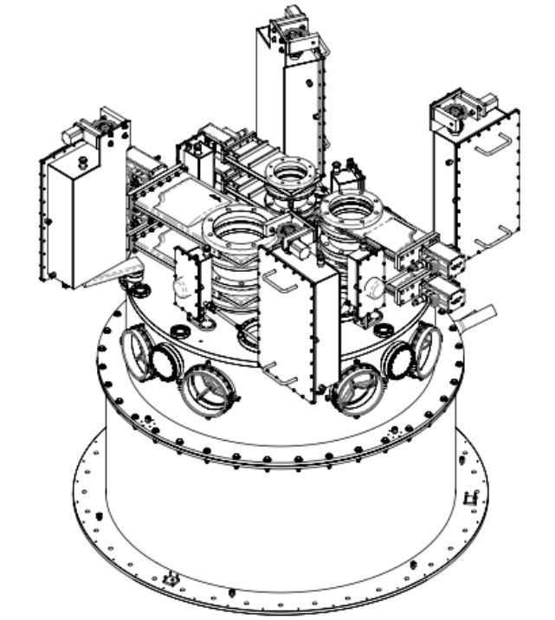
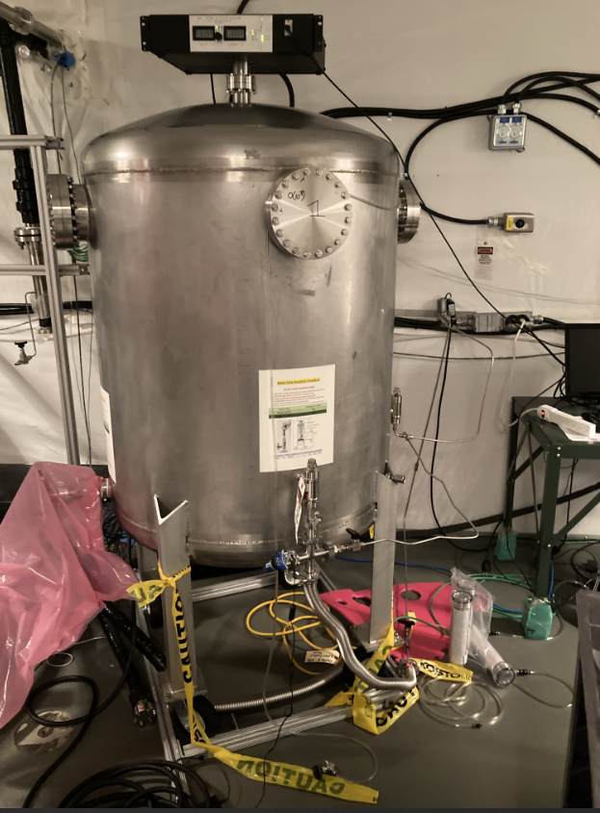
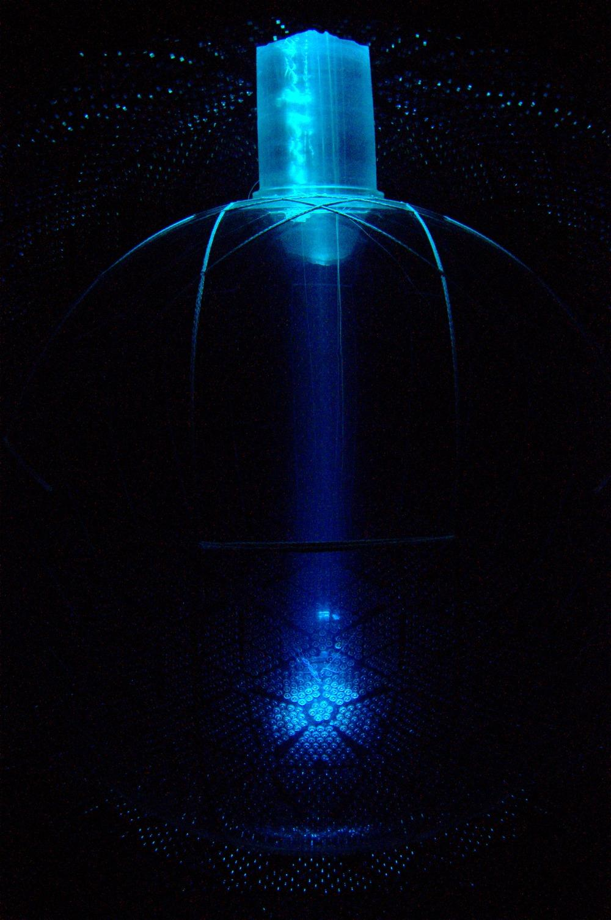
SNO+ Radon Mitigation
N2 Cover Gas system
Universal Interface (UI)
Ultra pure water (UPW) shielding
Electrostatic Radon Monitor
Notes:
Mention cover gas system is ~ 4196L mention how we need UI for samples mine air 64000atoms/L, 10^-5 factor reduction

Slide 4
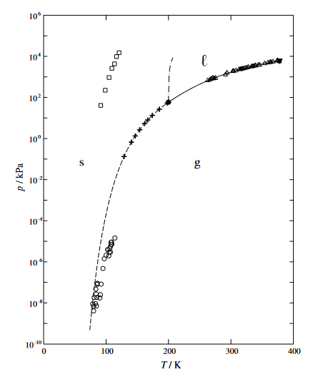
Cryogenically Trapping Radon Gas
Radon Phase Diagram
Noble Gas
Can be frozen by LN2 - 77K
Control sublimation and deposition
A.G.M. Ferreira, L.Q. Lobo, (2007) On the vapour pressure of radon
Notes:
Van der Waals Radii ~220pm

Slide 5
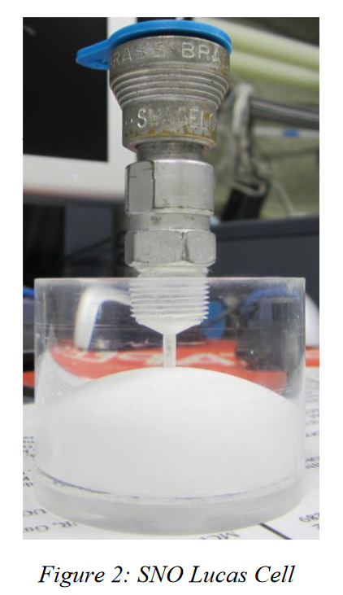
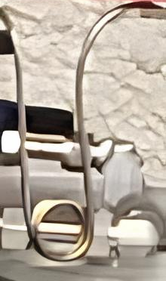
What is a Radon Assay
Radon
Radioactivity
Clogging
Vapour
Off-gassing
Leaks
Notes:
1.5hours
10 hours for full

Slide 6
Lucas Cells
Quantifying an analyte - Rn222 atoms
ZnS (Ag) scintillator
Counting flashes
Notes:
Van der Waals Radii ~220pm

Slide 7
Counting Alphas
Single alpha signal - Photomultiplier Tube
Three alphas per Rn
Read out by Photomultiplier Tube
Credit Adil Hussain
Notes:
Van der Waals Radii ~220pm

Slide 8
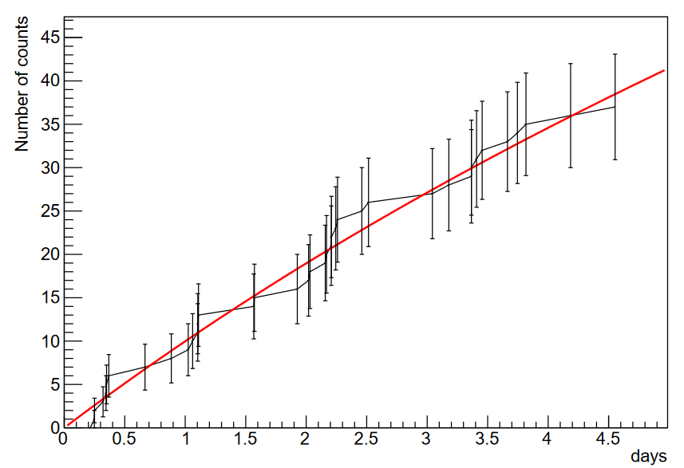
Background Results
System Background
Radon Counts vs Time
Multiple fixes
Leak checked hot + cold
38 +/- 6 counts
Notes:
Mention cover gas system is ~ 4196L
6.9 cpd background

Slide 9
Improving Assays with Titan Trapping
Cools down to -90C
Freezes H2O, CO2, and Scintillator Vapour
Leak checked

Slide 10
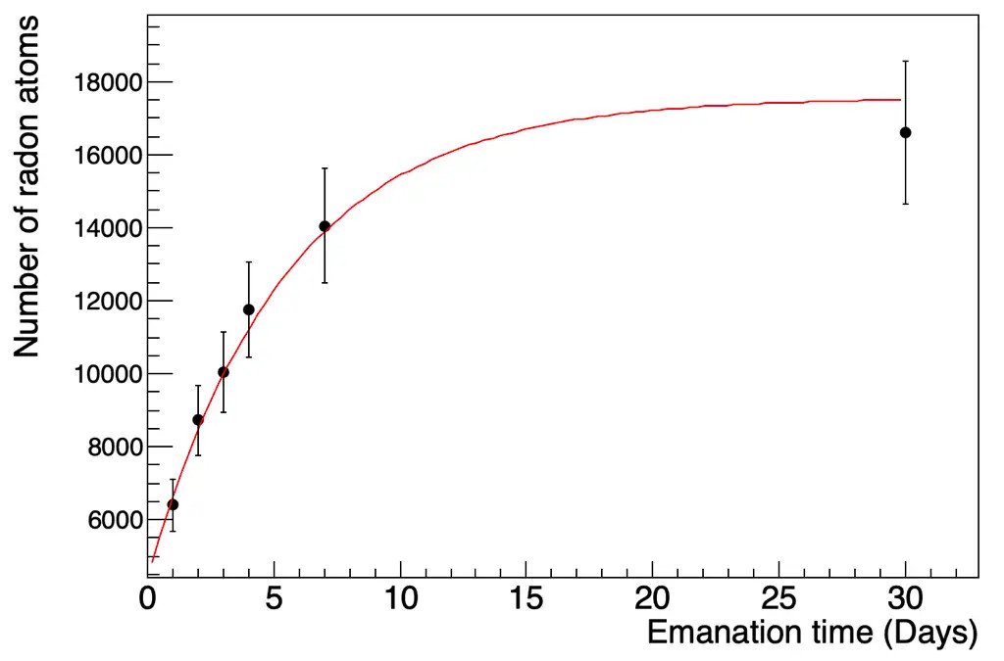
Gas Assay Calibration
Calibration Can Radon Emanation Curve
Available emanation source
Background of carrier gas understood
Emanation curve characterized
Credit to Yusuf Ahmed and Nasim Fatemighomi
Notes:
show radon board - highlight this is a different method quickly dont explain in detail - Note that the
10x-100x is good enough

Slide 11
Gas Assay Calibration Campaign
Background needed after modifications
Flow through calibration possible
Compare cold vs warm calibration
Notes:
show radon board - highlight this is a different method quickly dont explain in detail - Note that the
10x-100x is good enough

Slide 12
Next Steps
Lots of Data from Electrostatic Radon Monitor available
Radon Monitor Calibration Campaign Planned
Characterization of consistent high activity source ongoing
Notes:
Germanium detector double-check

Slide 13
Special Thanks!
Christine Kraus
Nasim Fatemighomi
Adil Hussain
Yusuf Ahmed
Juliette Deloye
Justin Suys
Nelson Zhou
Danica Levesque
Mark Ward
Aleksandra Bialek

Slide 14
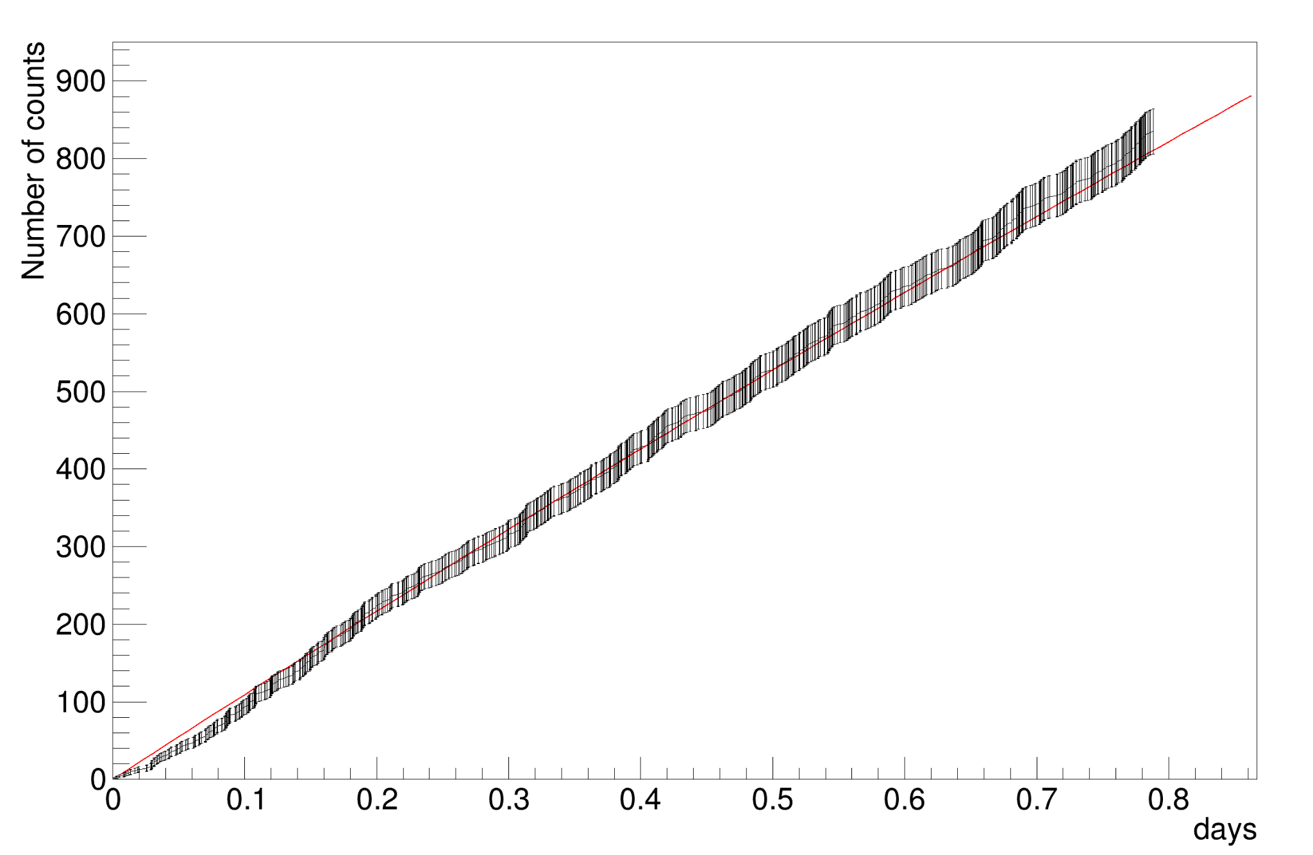
Preliminary Calibration Results
15 Minute Calibration Assay with Titan Trap Cold
1st run, 3 day emanation
1625 +/- 40 cpd
59% efficiency

