Slide 1
Observation of neutrino flux from supernovae with SuperCDMS by CE$ν$NS.
Rodrigo Pacheco
CASST
20/08/24

Slide 2
Overview
Supernova neutrinos
Modeling
Cryogenic detectors
CE$ν$NS
Results
Summary

Slide 3
Supernova neutrinos

Slide 4
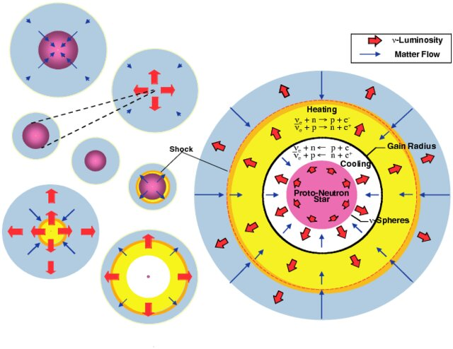
Supernova neutrinos
A Supernova is the explosion of a star more massive than $8M_{⊙}$*[13]
Most of the energy released by SN comes in the form of neutrinos of all flavors
Neutrinos from SN 1987 A ($18M_{⊙}$ progenitor) have been observed.
NLCF 2006
*$M_{⊙}=1.9×{10}^{30}kg$

Slide 5
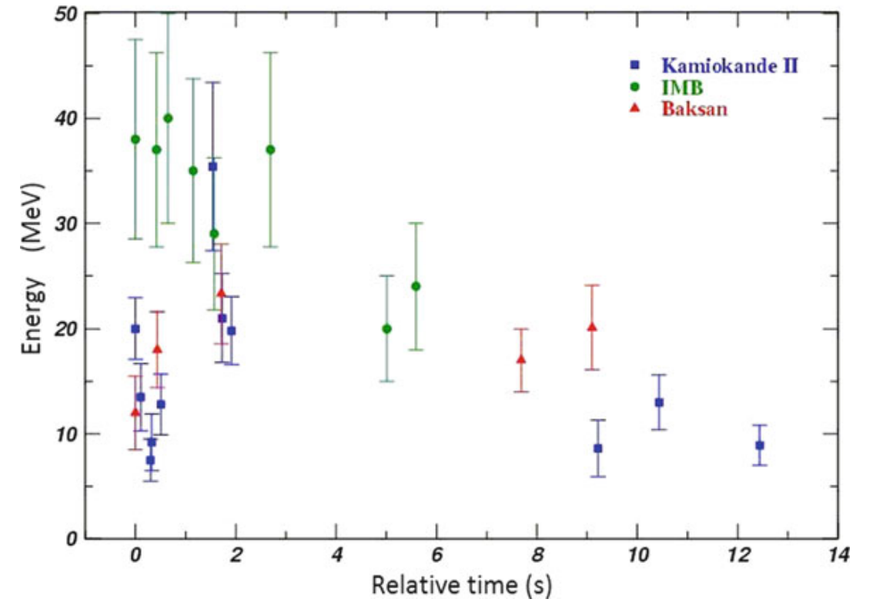
Supernova neutrinos
Supurio et. Al. 2018

Slide 6
Modeling

Slide 7
Modeling
“Very crudely, a SN core is a black-body source of neutrinos of all flavors” [10]
Neutrino opacity processes give place to the pinching of the curve.
Quasi-termal emission model for neutron star SN: ${8M}_{⊙}<M_{p}^{∗}<{20M}_{⊙}$
Simulation for Black Hole SN $M_{p}>{20M}_{⊙}$
*$M_{p}$: progenitor mass

Slide 8
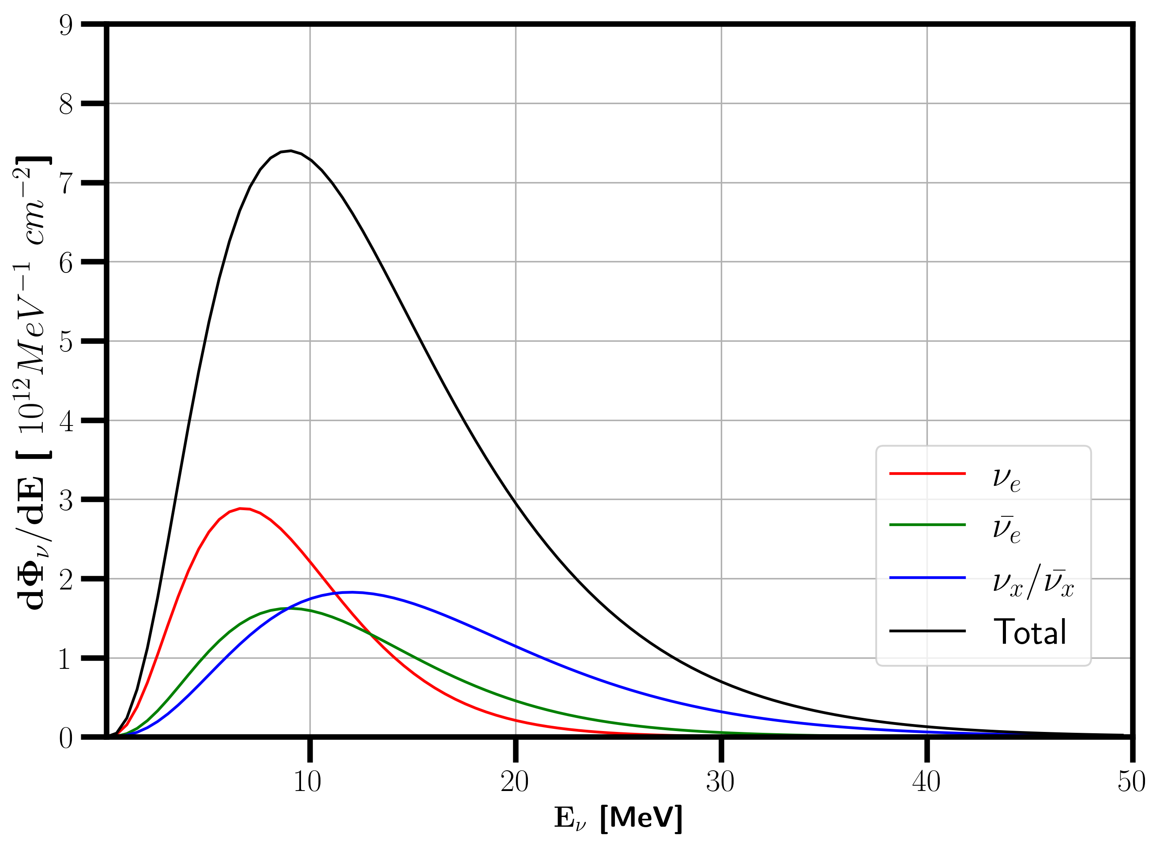
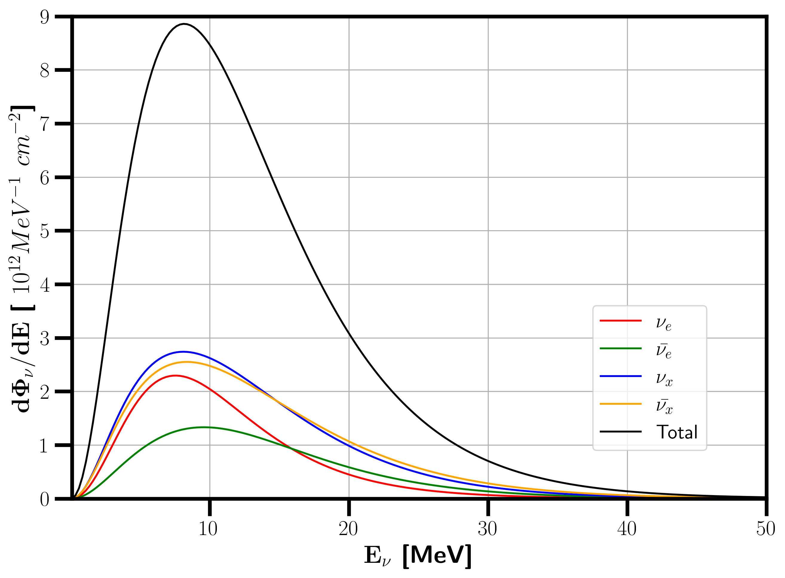
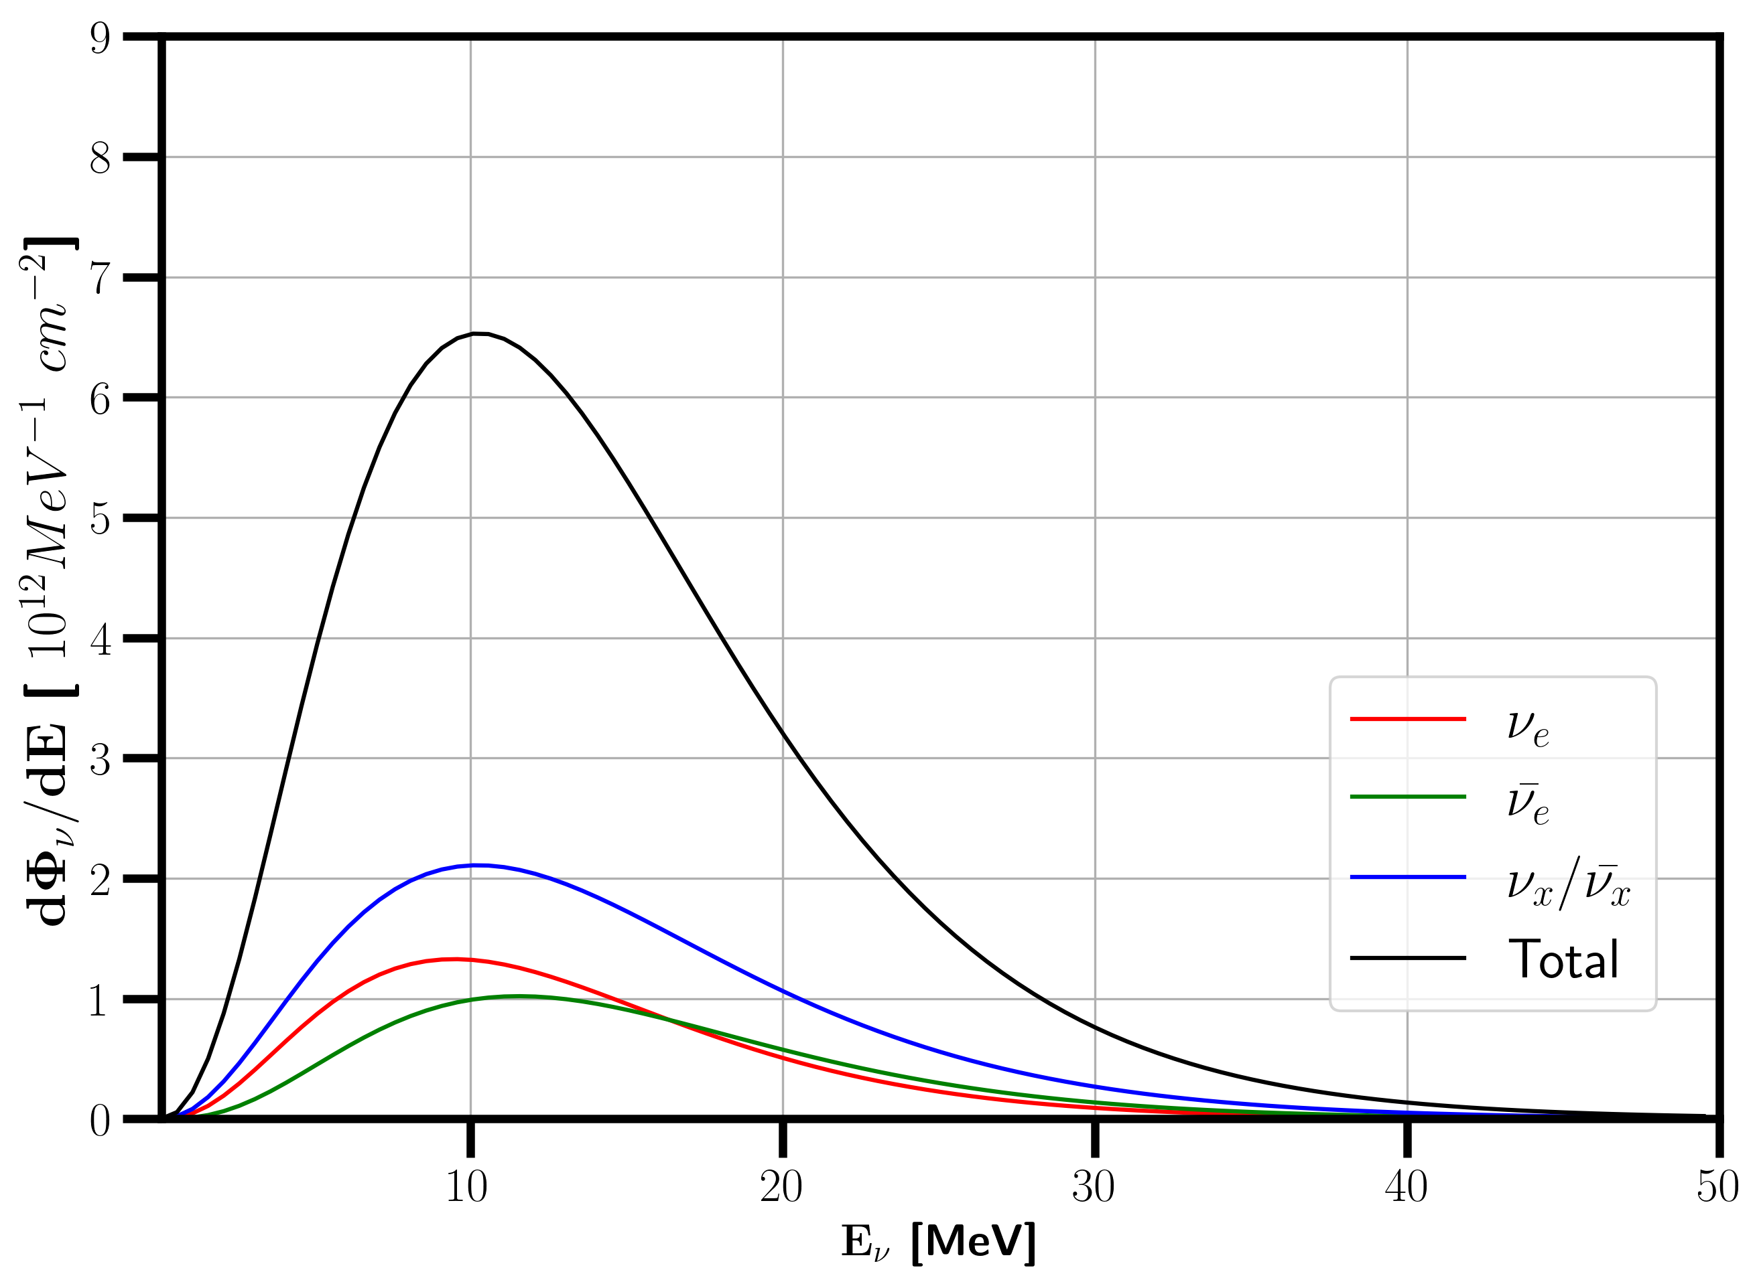
SN 1987A fit
($18 M_{⊙}$)
$28 M_{⊙}$
simulation
$$15 M_{⊙}$$
simulation
SN neutrino differential spectrum (1 kpc*)
$$\frac{{dΦ}_{i}}{dE}∝\frac{E_{S}}{4πd^{2}}\frac{E^{α}}{{\left\langle E_{i}\right\rangle }^{α+2}}e^{−\frac{\left(1+α\right)E}{\left\langle E_{i}\right\rangle }}$$
*1 kpc = 3261.56 ly

Slide 9
Cryogenic detectors

Slide 10
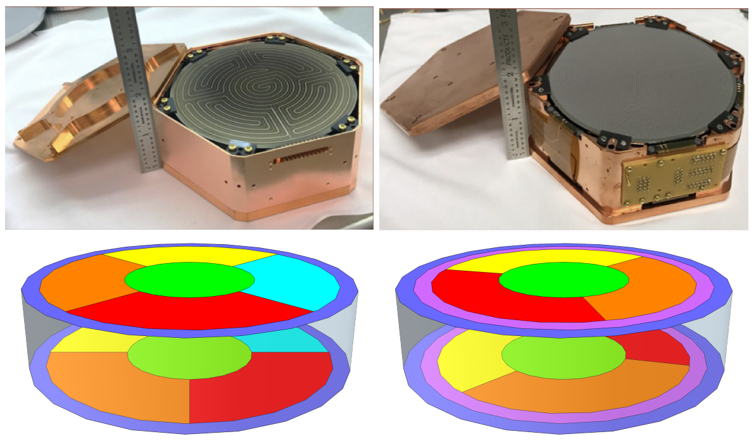
Cryogenic detectors
SuperCDMS: Dark Matter search at SNOLAB
iZIP
HV
Dilution refrigerator as cryogenic system ($\sim 10$ mK)
Silicon or Germanium detectors
Superconducting aluminum collectors
Transition Edge Sensors (TES)
Albakry et. Al. 2023

Slide 11
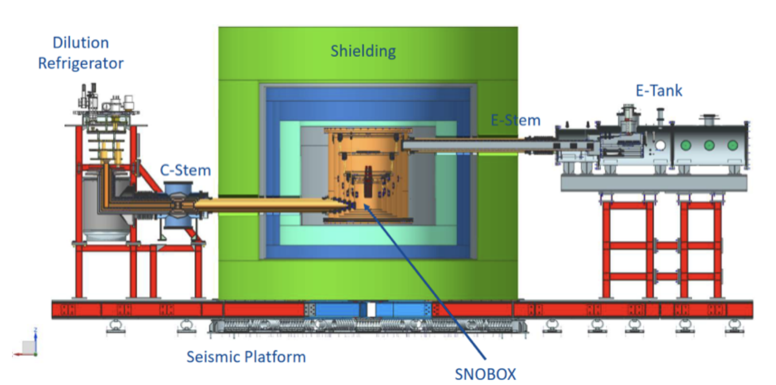
Cryogenic detectors
Albakry et. Al. 2023

Slide 12
Cryogenic detectors
SuperCDMS: Dark Matter search at SNOLAB
TES used to detect the phonons produced in the substrate
Phonon resolution for Si (Ge) of 13(34) eV
Uses a trigger system for data adquisition
Total latency for the triggers ~ 26 ms

Slide 13
Cryogenic detectors
SuperCDMS
 | HV |  | iZIP
 | Si | Ge | Si | Ge
Phonon resolution (eV) | 13 | 34 | 19 | 33
Module mass (kg) | 0.61 | 1.39 | 0.61 | 1.39
Number of detectors | 4 | 8 | 2 | 10
Resolution: $\sim 5σ$ of the noise signal

Slide 14
Coherent Elastic Neutrino-Nucleus Scattering (CE$ν$NS)

Slide 15
CE$ν$NS
Neutrinos have weak interactions with nuclei
CE$ν$NS is a neutral current process.
Interactions of neutrinos with nuclei produce recoil.
$$\frac{dR}{dE_{r}}=\int_{E_{ν}^{m}}{\frac{dσ}{dE_{r}}\frac{dΦ}{dE_{ν}}dE_{ν}}$$

Slide 16
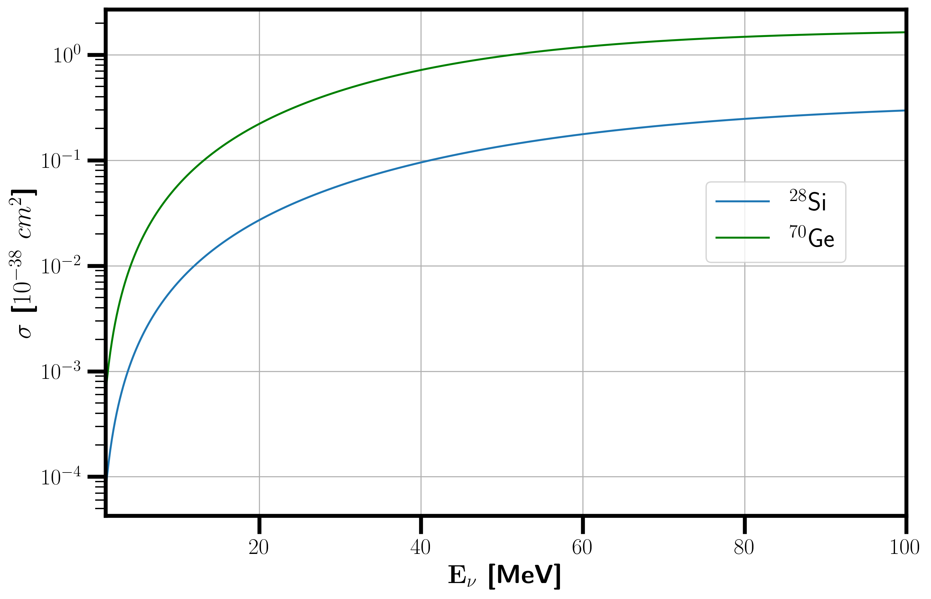
Energy dependent cross-section
$$\frac{dσ}{dE_{r}}∝\frac{G_{F}^{2}m_{t}}{8π}\left(2−\frac{E_{r}m_{t}}{E_{ν}^{2}}\right)$$

Slide 17
Recoil Spectrum
$$\frac{dΦ}{dE_{ν}}$$
$$R=\int_{E_{ν}^{m}}{dE_{ν}}$$
$$×$$
$$σ$$

Slide 18
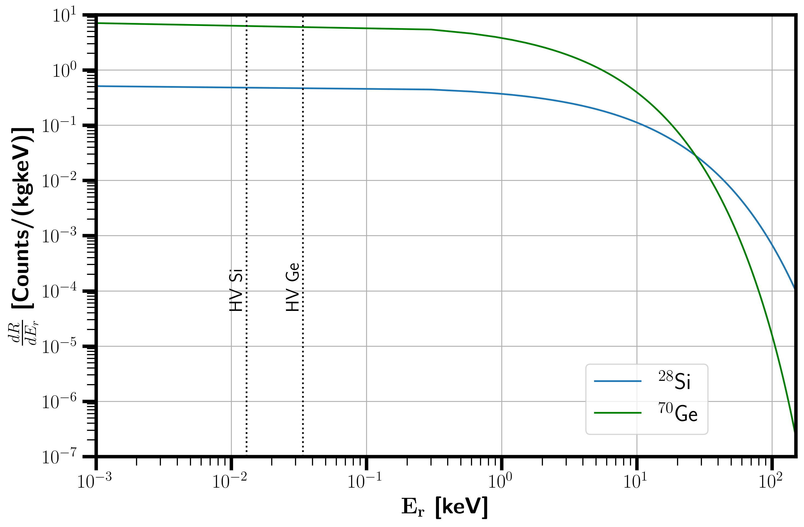
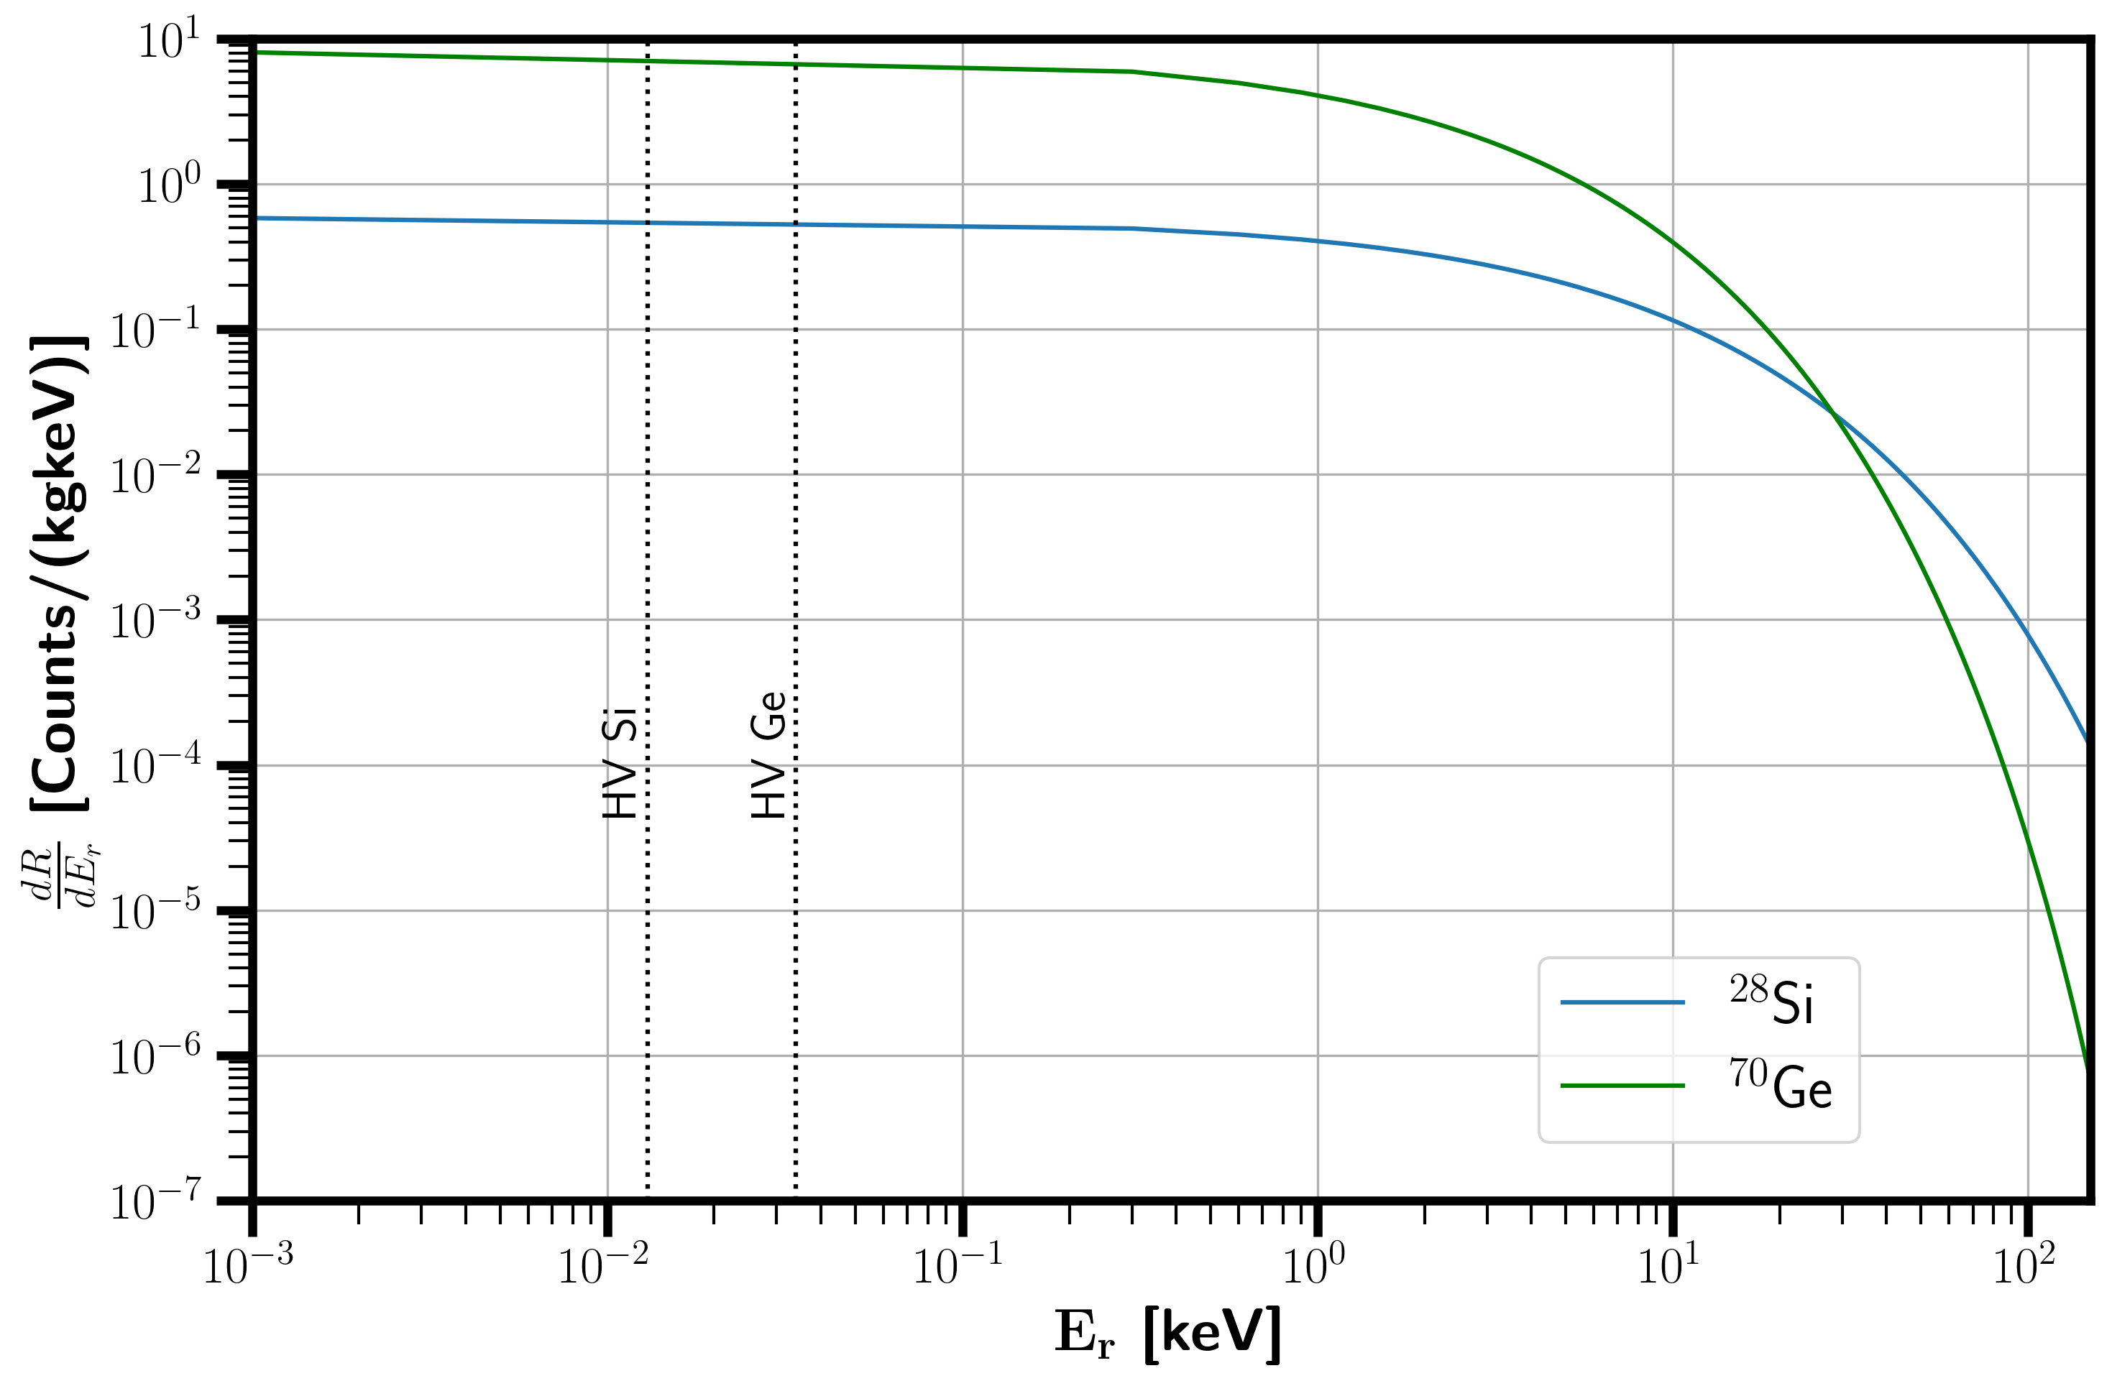
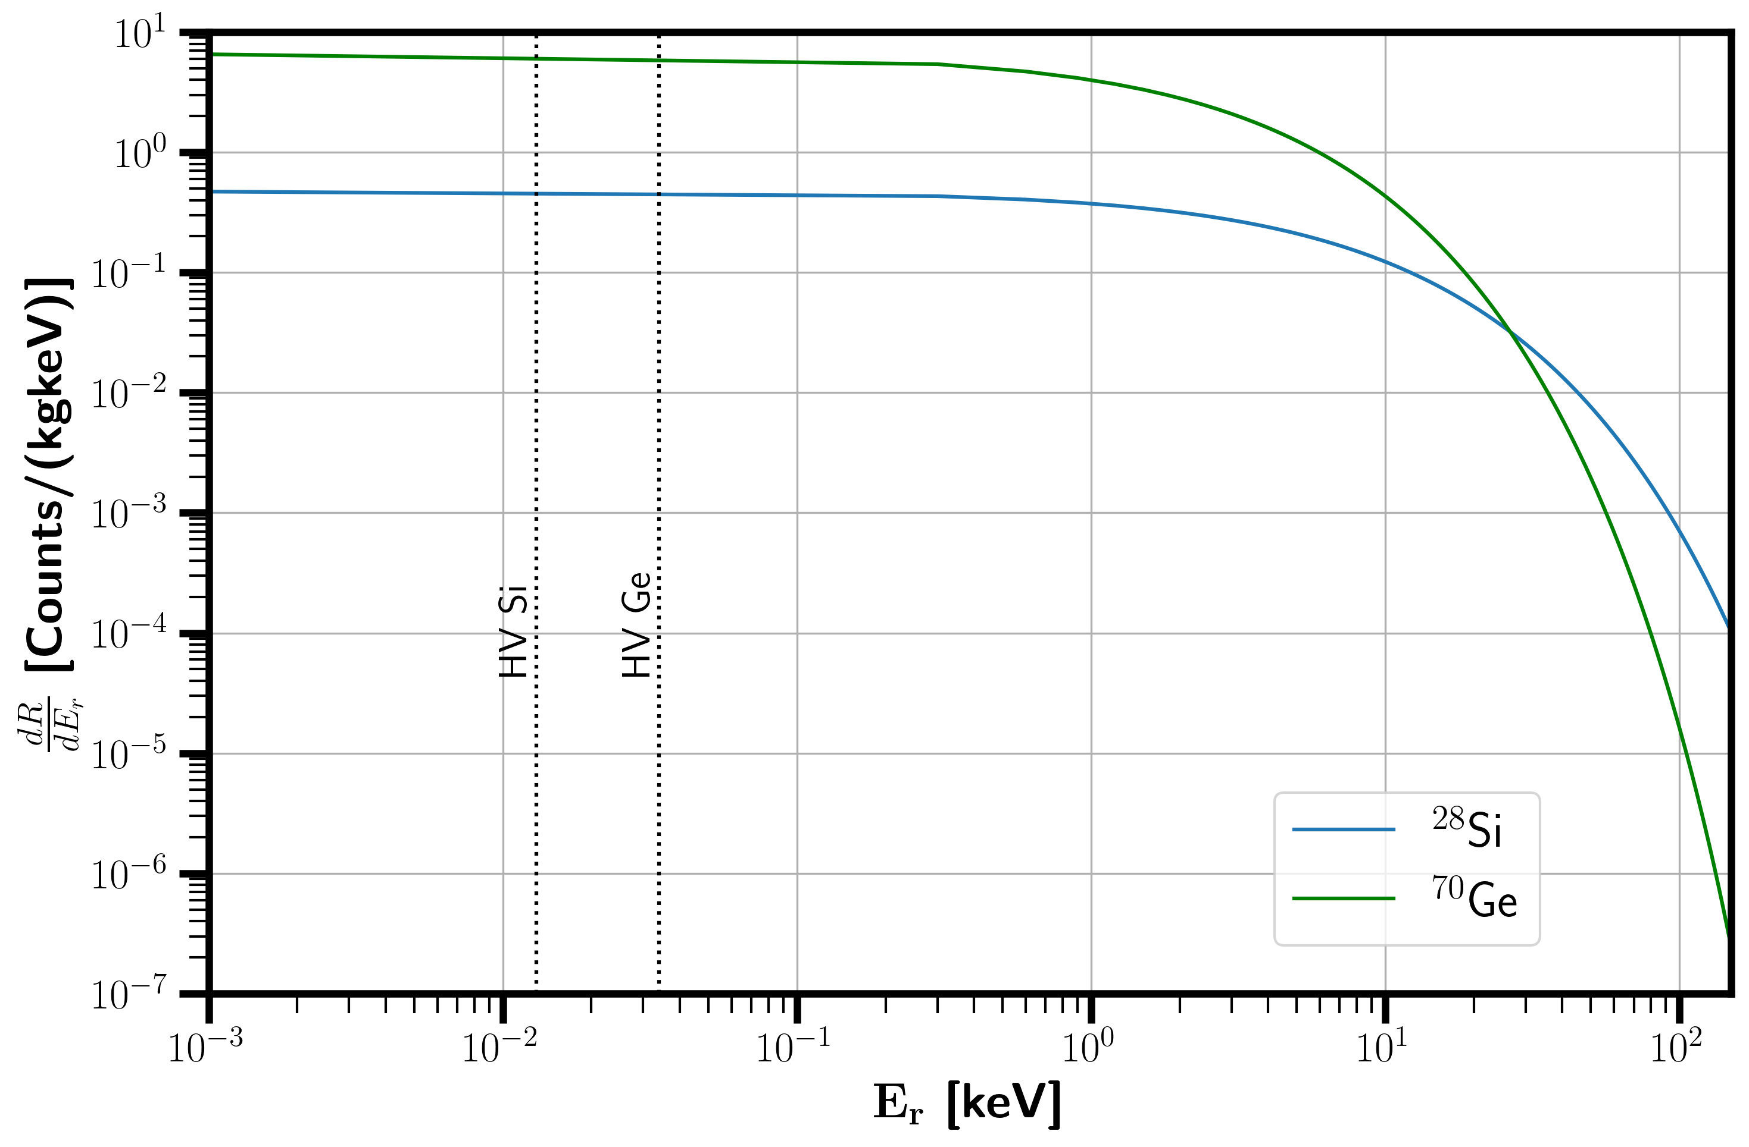
Recoil spectrum
SN 1987 A
$28 M_{⊙}$
$15 M_{⊙}$

Slide 19
Results

Slide 20
Results
Number of events
Different energy thresholds and masses for IZIP and HV detectors and also by substrate (Si and Ge)
Event pileup probability due to trigger latency $\sim 1−e^{−N}$
Discovery potential ($3σ$) set assuming zero background events

Slide 21
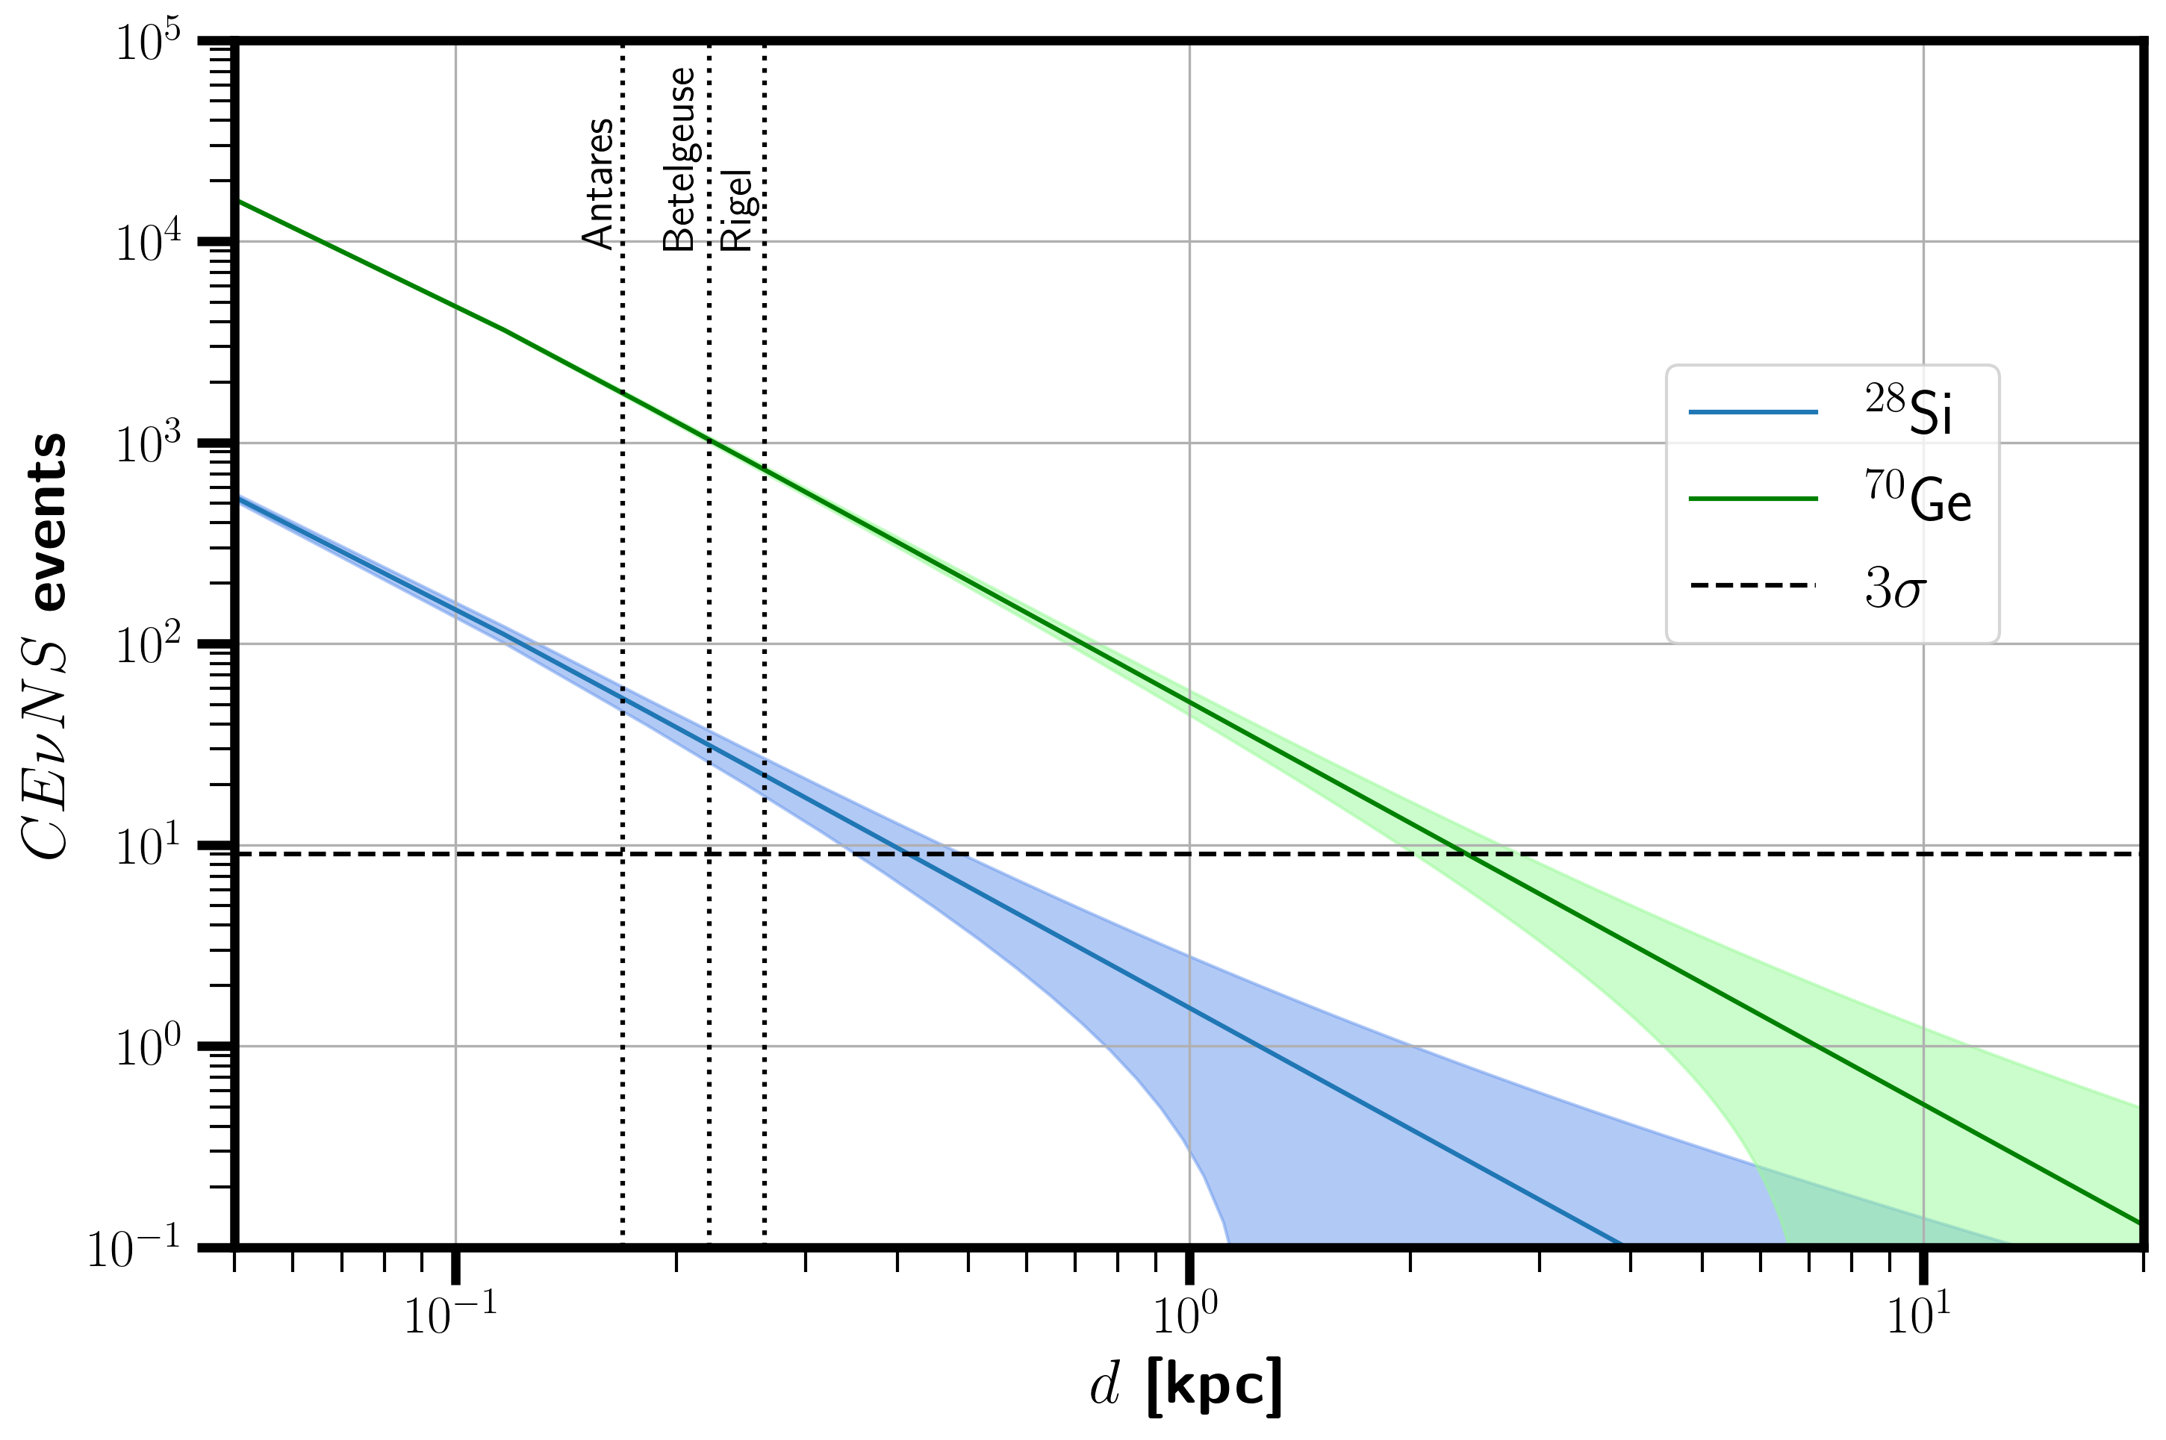
SN 1987 A

Slide 22
28 $M_{⊙}$

Slide 23
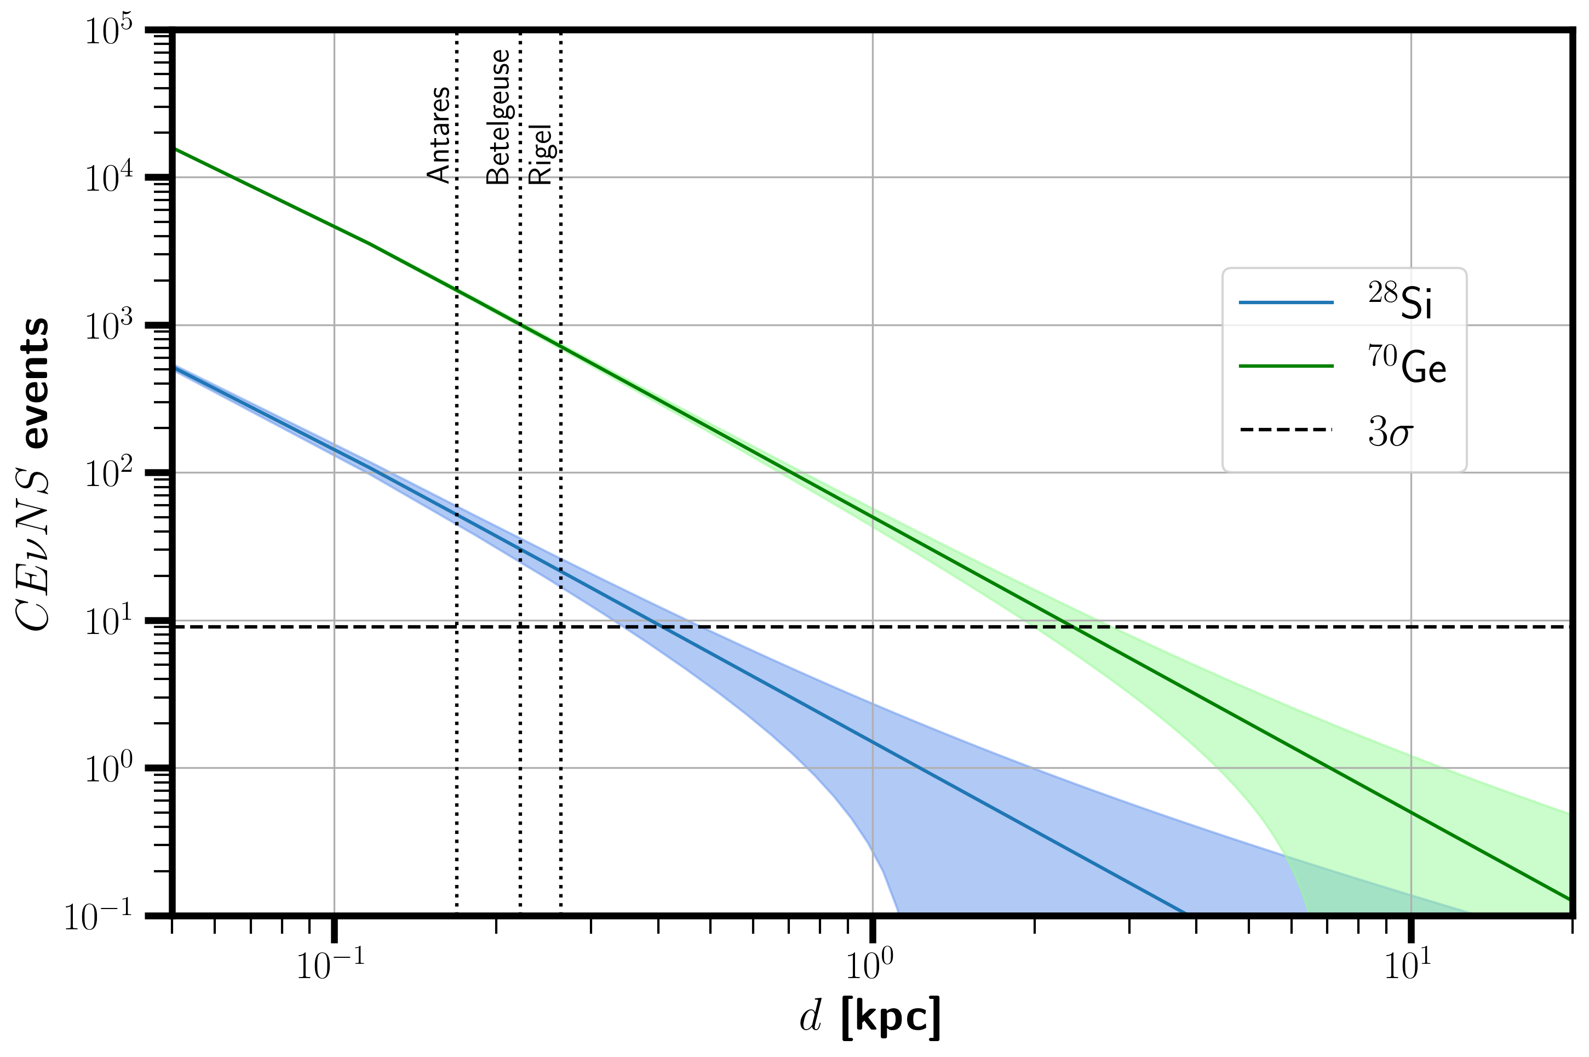
15 $M_{⊙}$

Slide 24
Results
 | Substrate | Distance (kpc)
SN 1987 A | Si | $${0.40}_{−0.06}^{+0.07}$$
 | Ge | $${2.37}_{−0.36}^{+0.43}$$
28 $M_{⊙}$ | Si | $${0.41}_{−0.06}^{+0.07}$$
 | Ge | $${2.45}_{−0.37}^{+0.44}$$
15 $M_{⊙}$ | Si | $${0.40}_{−0.06}^{+0.07}$$
 | Ge | $${2.41}_{−0.37}^{+0.43}$$

Slide 25
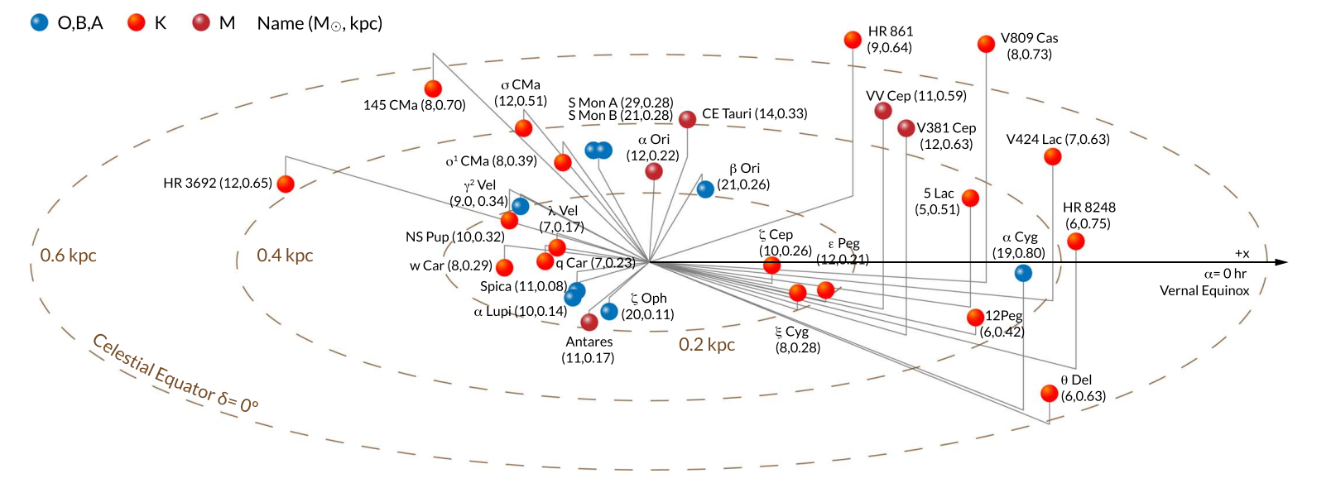
Pre-SN candidates closer than 1 kpc
Mukhopadhyay et. al. 2020

Slide 26
Summary

Slide 27
Summary
Supernovae is when stars more massive than $8M_{⊙}$ explode forming a neutron star or a black hole
Neutrinos are one of the most important messengers about SN and can be detected by CE$ν$NS
SuperCDMS could be capable of detecting the occurrence of SN
up to 2.45 kpc with the proposed thresholds and models
A great number of SN events closer than 1 kpc could be observed by SuperCDMS
Even if event pileup probability is considered, only lower distances are affected
The greatly reduced threshold of the SuperCDMS detectors and its high target mass contribute to the detection sensitivity.

Slide 28
Thank you!

Slide 29
References
[1] Abdullah M., Dent J. B., Dutta B., Kane G. L., Liao S., Strigari L. E., 2018, Phys. Rev. D, 98, 015005 [2] Abdullah M., et al., 2022, Coherent elastic neutrino-nucleus scattering: Terrestrial and astrophysical applications (arXiv:2203.07361), https://arxiv.org/abs/2203.07361 [3] Agnese R., et al., 2017, Physical Review D, 95 [4] Angeli I., Marinova K., 2013, Atomic Data and Nuclear Data Tables, 99, 69 [5] Biassoni M., Martinez C., 2012, Astroparticle Physics, 36, 151–155 [6] Burrows A., Vartanyan D., 2021, Nature, 589, 29–39 [7] Collaboration S., et al., 2023, A Strategy for Low-Mass Dark Matter Searches with Cryogenic Detectors in the SuperCDMS SNOLAB Facility (arXiv:2203.08463), https://arxiv.org/abs/2203.08463

Slide 30
References
[8] Freedman D. Z., 1974, Phys. Rev. D, 9, 1389 [9] Halim O., Casentini C., Drago M., Fafone V., Scholberg K., Vigorito C. F., Pagliaroli G., 2021, Journal of Cosmology and Astroparticle Physics, 2021, 021 [10] Keil M. T., Raffelt G. G., Janka H., 2003, The Astrophysical Journal, 590, 971–991 [11] K ̈onig K., et al., 2023, Nuclear charge radii of silicon isotopes (arXiv:2309.02037), https://arxiv.org/abs/2309.02037 [12] Mukhopadhyay M., Lunardini C., Timmes F. X., Zuber K., 2020, The Astrophysical Journal, 899, 153 [13] Pagliaroli G., Ternes C. A., 2024, Observing neutrinos from failed Supernovae at LNGS (arXiv:2403.06678), https://arxiv.org/abs/2403.06678
[14] Ruso L. A., et al., 2022, Theoretical tools for neutrino scattering: interplay between lattice QCD, EFTs, nuclear physics, phenomenology, and neutrino event generators (arXiv:2203.09030), https://arxiv.org/abs/2203.09030

Slide 31
References
[15] Spurio M., 2018, Probes of multimessenger astrophysics: Charged cosmic rays, neutrinos, Y-rays and gravitational waves. Springer [16] Tamborra I., M ̈uller B., H ̈udepohl L., Janka H.-T., Raffelt G., 2012, Physical Review D, 86 [17] Tamborra I., Hanke F., M ̈uller B., Janka H.-T., Raffelt G., 2013, Physical Review Letters, 111 [18] Wang S., et al., 2024, Physics Letters B, 856, 138867 [19] Wilson J., et al., 2022, Journal of Instrumentation, 17, P07010

