Slide 1
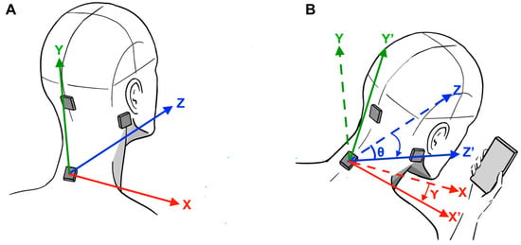
SNO+ Neck Analysis
Yuan (Nelson) Zhou DATTEE

Slide 2
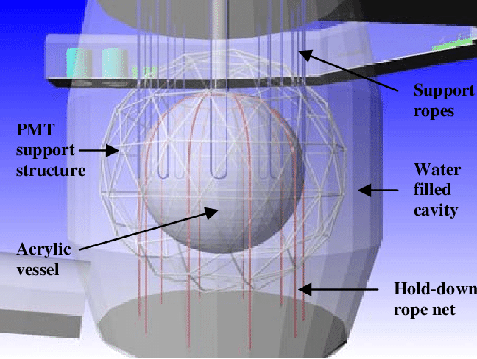
SNO+ Detector
Solar Neutrino Detections
Aprox. 10,000 Photo Multiplier Tubes (PMTs)
Acrylic Vessel (6m radius)
PMT Support Structure, PSUP (8.5m radius)
Neck (14.72m)
4 Neck PMTs
Linear Alkyl Benzene (LAB)

Slide 4
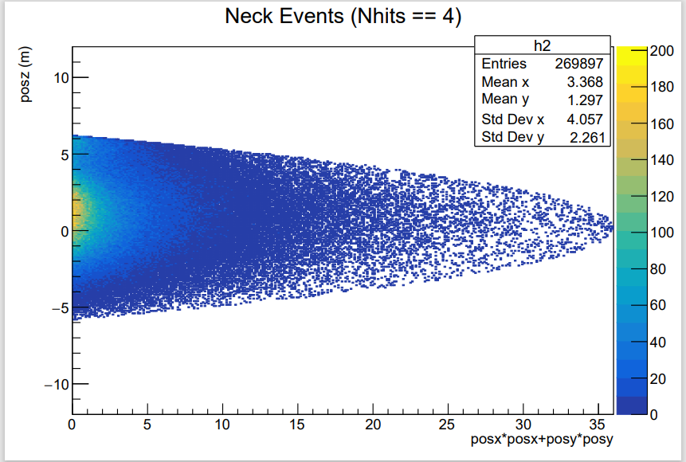
Motivation
Reconstruction of Po-210 and C14 events should be uniform, 60-1800nhits
Extra concentration at center for Neck hits > 0 (Existing Neck Cut Filtering Plot)
Mis-reconstruction of events in the middle of detector in simulation
Accounting for unaccounted neck events and pile up events

Slide 5
List of Potential Sources of Problem
False positive (Events WITHIN AV vessel firing Neck PMT)
Backgrounds inside the Neck (Polonium-210)
Neck PMT noise coincident with scintillator background events

Slide 6
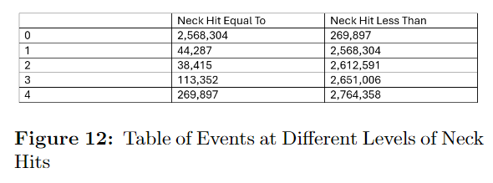
Magnitude of Neck Events
465,951 events (in one run) out of total events are registered as neck events (necknhit > 0)
129.4Hz of neck events

Slide 8
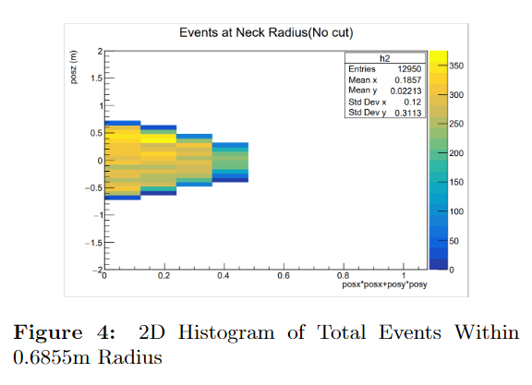
Geometric Method
Probability of seeing a center event being registered as a neck event
Neck Radius Region (0.6855m radius)
Total entries: 12950
Entries with neck hits: 9465
73.1% entries have neck hits

Slide 9
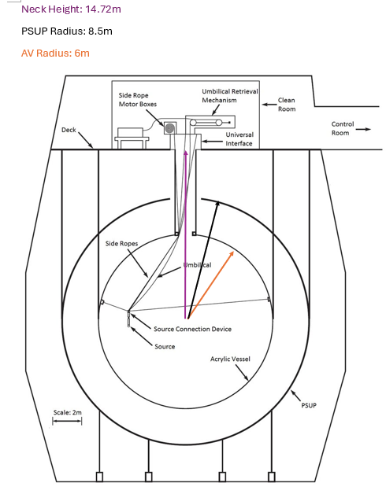
Geometric Method
Two step probabilities:
Area of Neck opening over area of PSUP
Area of 4 Neck PMTs over are of Neck opening (Assume reflection without loss)
Shows probability of 0.026%
Apply to detector trigger rate(40Hz) for center events -> 0.0104Hz
Can be applied as an uncertainty to neck events

Slide 11
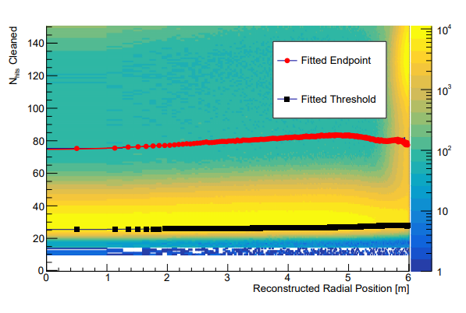
Neck Acrylic Polonium-210
70 to 200 nhits region 5.6 to 6 meters
194,647 Events in that region
Graph from Ryan Bayes (Document 8399-v1)

Slide 12
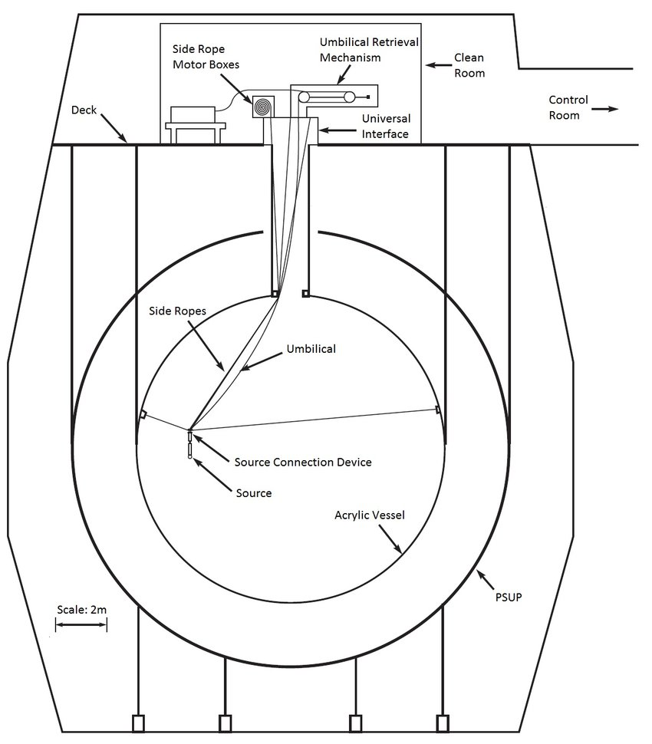
Normalizing
Surface Area and Run Time (1 hour)
0.1195 bq/m^2
Previous: 2.1 bq/m^2, Nhits from 60 -150, 5.5m to 6m
(From Acrylic vessel Po210 scintillator events analysis, ShengZhao Yu, 2021)

Slide 13
Neck Acrylic Rate
Applied 0.1195 bq/m^2 to the surface area of the side wall of the neck
Returned rate of 4.1176 bq

Slide 15
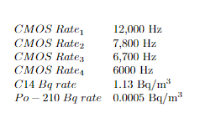
Neck PMTs’ Coincident Pile Ups
One or more Neck PMTs Firing on its own, at the same time with C14 or Polonium-210 event
Detector collects data in a period of 300ns window following by a dead time
Generated random time stamps within a second, see how many times one or more Neck PMT event occurs in the same window with an event

Slide 16
Coincident Result
Probability of 1.005e-4 %
Apply to overall detector trigger rate of 2000Hz: 2.01e-3Hz

Slide 18
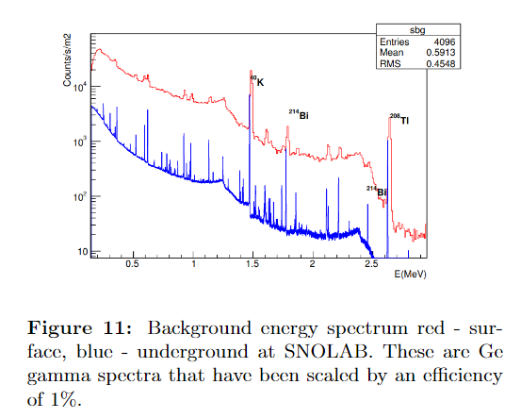
Next Step
Unshielded area of 42in of scintillator above PSUP
Events due to gamma exposure
Surface areas exposed is 7.547m2, in a cylindrical shape
UG Potassium-40 alone has a count density of 10e4 Counts/s∗m2 when applied to the area, 75,470Hz of events are generated.

Slide 19
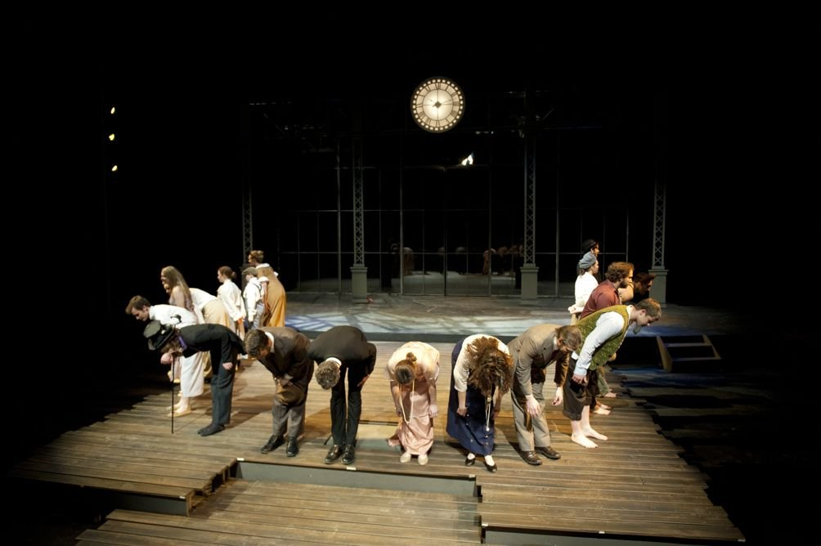
BIG THANK YOU…
Alex Wright and Christine Kraus
Ryan Bayes

