Slide 1
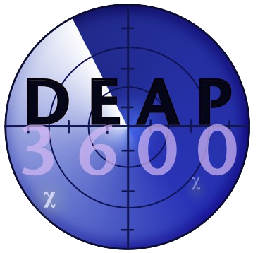
ALL hands on DEAP
Trang Bui
Supervisor: Pierre Gorel, Chris Jillings
Notes:
Good morning everyone, my name is Trang, and I am a summer student with DEAP.
I am here today to present my quick summation of what’ve done over the summer.

Slide 2
outline
Dark matter and DEAP-3600
Trang on surface
Trang underground

Slide 3
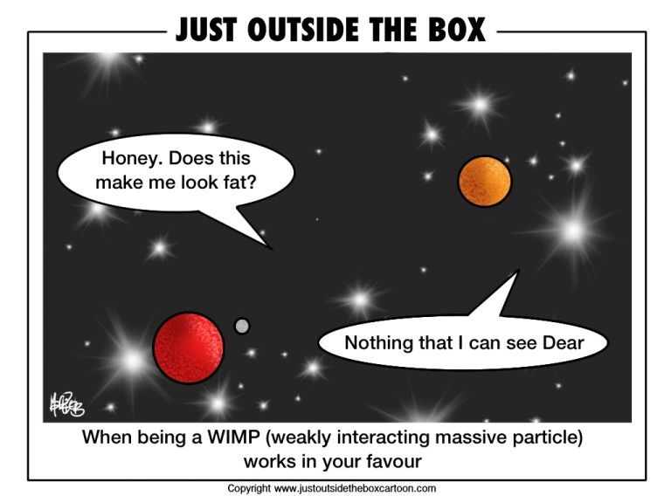
DARK MAtter
Notes:
Galaxies is spinning faster than calculated speed from their mass. The same applies to galaxies in clusters. We believe an invisible substance, known as "dark matter," provides the extra mass and gravity needed to keep galaxies intact.
WIMPs are one of the most popular candidates for dark matter for variety of reasons.

Slide 4
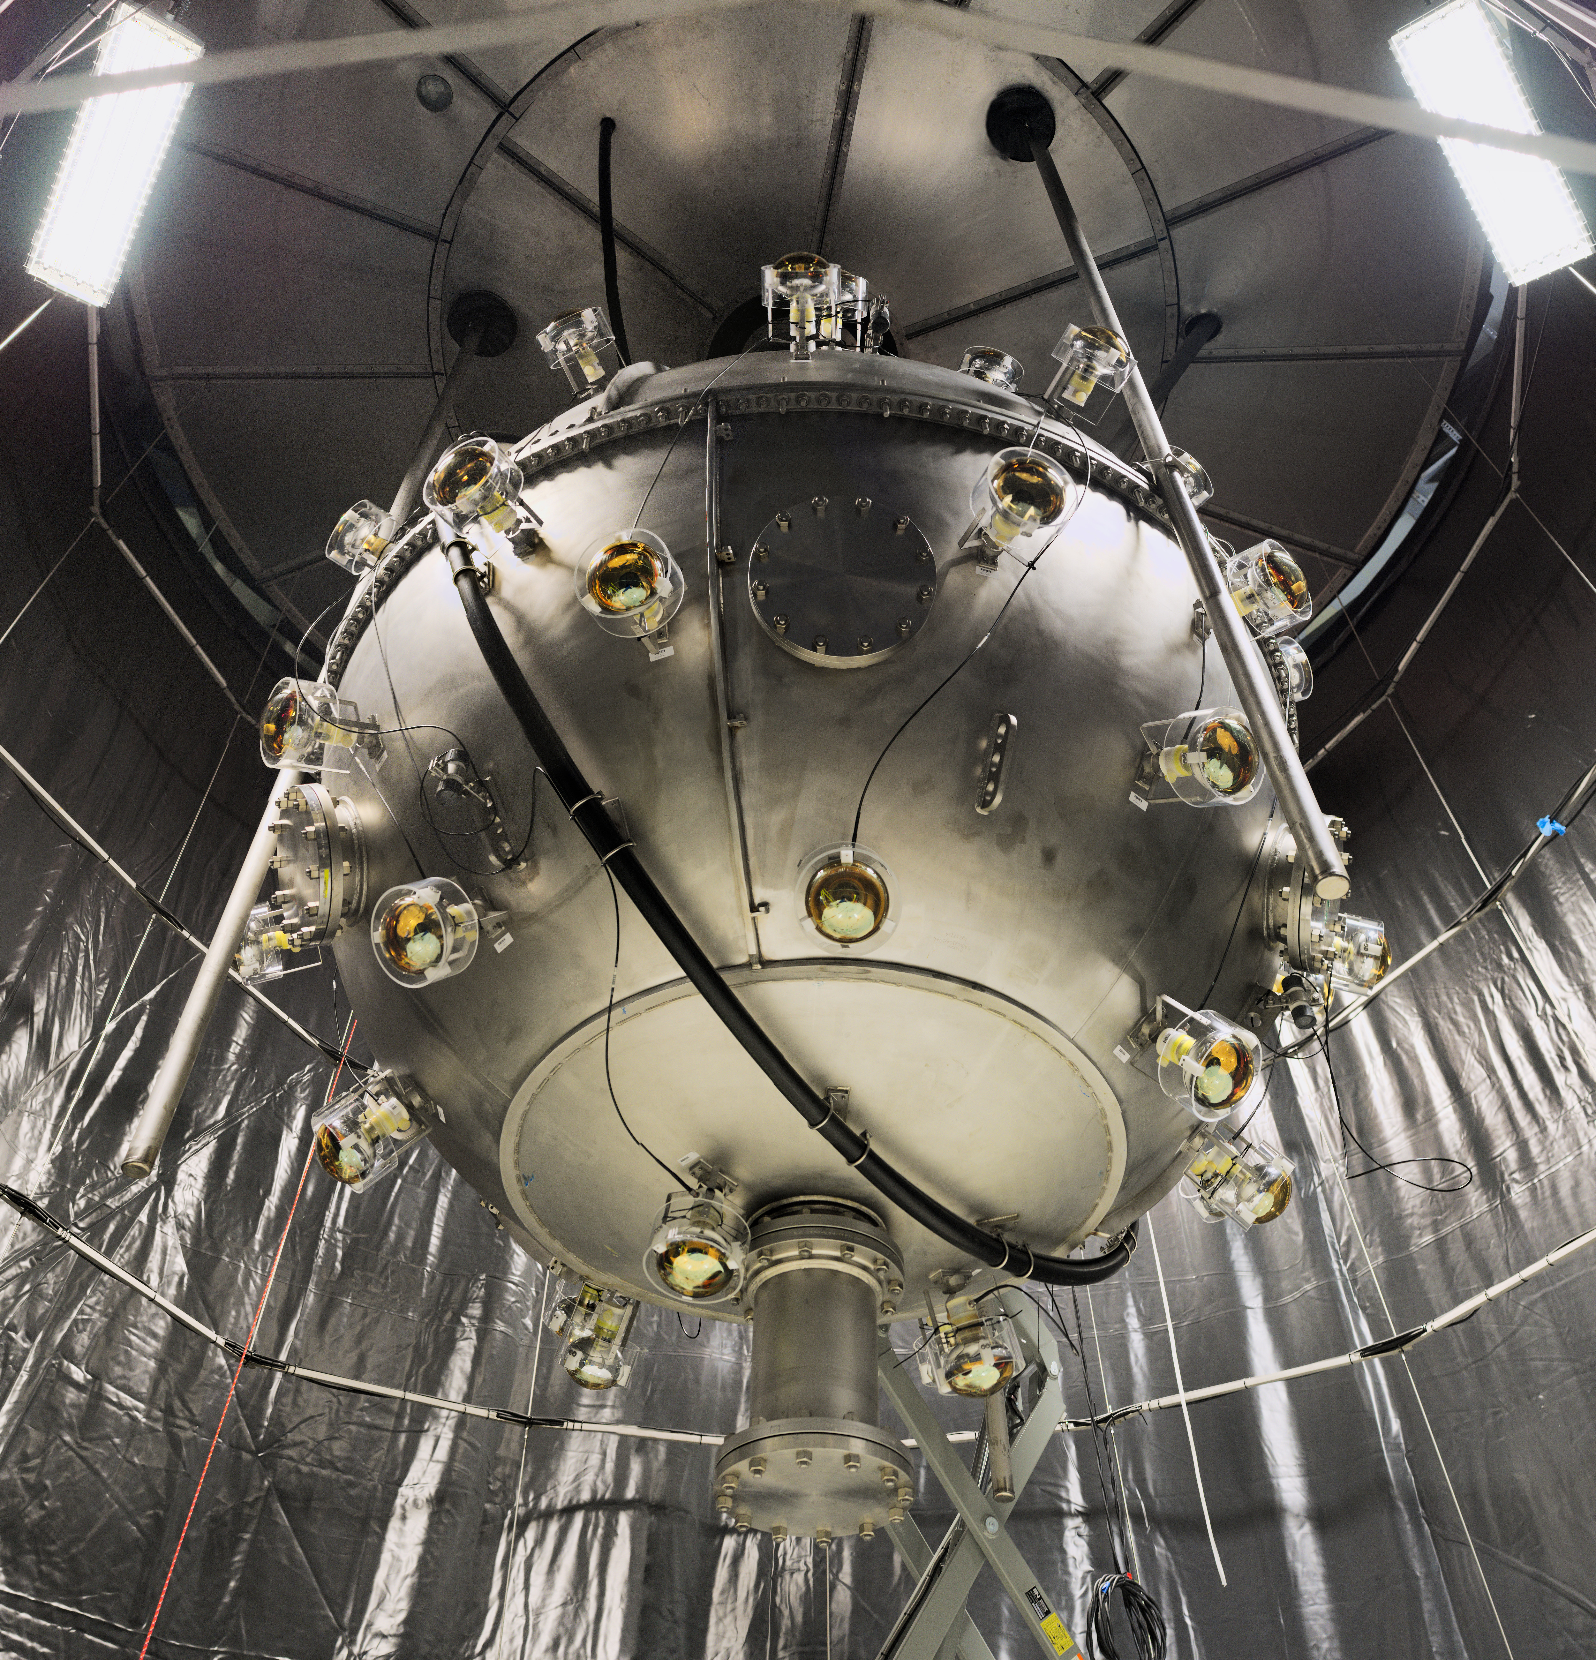
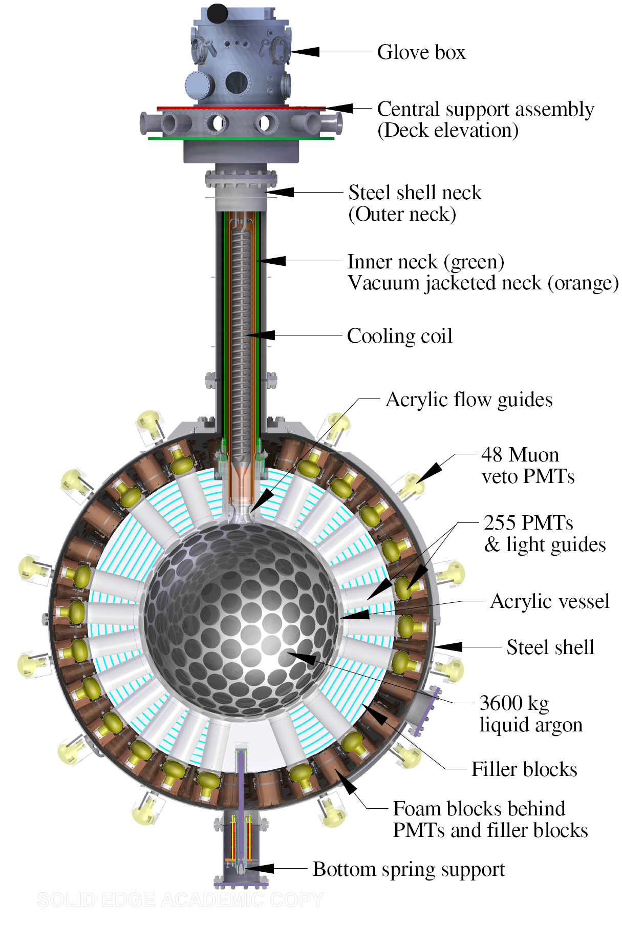
Deap-3600 Dark matter experiment using argon pulshape discrimination
3300kg
LAr
Notes:
In the race of searching for WIMP, DEAP-3600 is the leading candidate. DEAP has extremely high sensitivity. This sensitivity comes deep underground and the design.
On the right is the full diagram of DEAP. The detector consists of 3.3 tons of ultra-pure LAr contained in an AV. The inside is coated with tetraphenyl butadiene (TPB, C₂₈H₂₂) wavelength shifter to shift the ultraviolet (UV) light generated by Argon scintillation to the visible range. The signal will be detected by 255 photomultiplier tubes (PMTs) through the acrylic. The detector is in a spherical stainless steel shell which is immersed in a UPW tank.
The acrylic material was chosen to reduce the amount of Cherenkov light originating from the acrylic.
large detector exposure and the extraordinary rejection power achievable in liquid argon against electron recoil backgrounds.
The top 30 cm of the AV is filled with gaseous argon (GAr). It is held at close to -180 degrees Celcius.
Light guide is 45-cm long. PMT approximately 30cm long, wild guess from ratio in the pic. Steel shell radius is about 1.6m. Total height is around 6.5m.

Slide 5
outline
Trang underground

Slide 6
Residual gas analyzer (RGA)
Notes:
In the spotlight of what I have done UG, I would talk about RGA.
In DEAP system, we control our gas quality strictly to eliminate all contamination, and RGA is the tool to analyze gas quality.
A residual gas analyzer (RGA) is a mass spectrometer. The working principle is a small fraction of the gas molecules are ionized (positive ions), and the resulting ions are separated, detected and measured according to their molecular masses.
A typical modern residual gas analyzer ionizes some of the gas in the vacuum chamber with electrons from a filament. The ions are then directed into a quadrupole mass filter that uses electric fields to pass only the ions of a particular mass. Finally, the flowing charge of ions are detected as a current. By varying the electric fields in the mass filter and recording the resultant current to the detector, a mass spectrum is obtained.

Slide 7
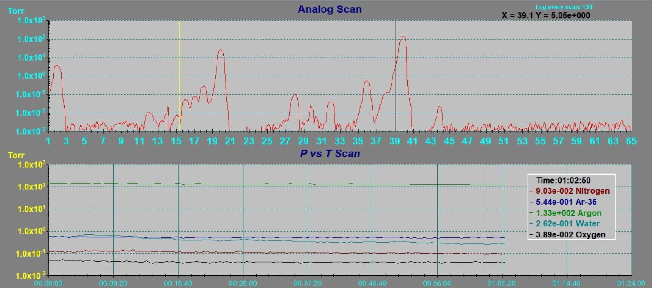
Residual gas analyzer (RGA)
Notes:
This is a sample result from our RGA. As we can tell, there are few dominate peaks at Hydrogen 2, Water 18, Argon 36, Argon 40.
We can confirm that the gas sample contains mainly Argon but also small fractions of hydrogen, water and carbon dioxide.

Slide 8
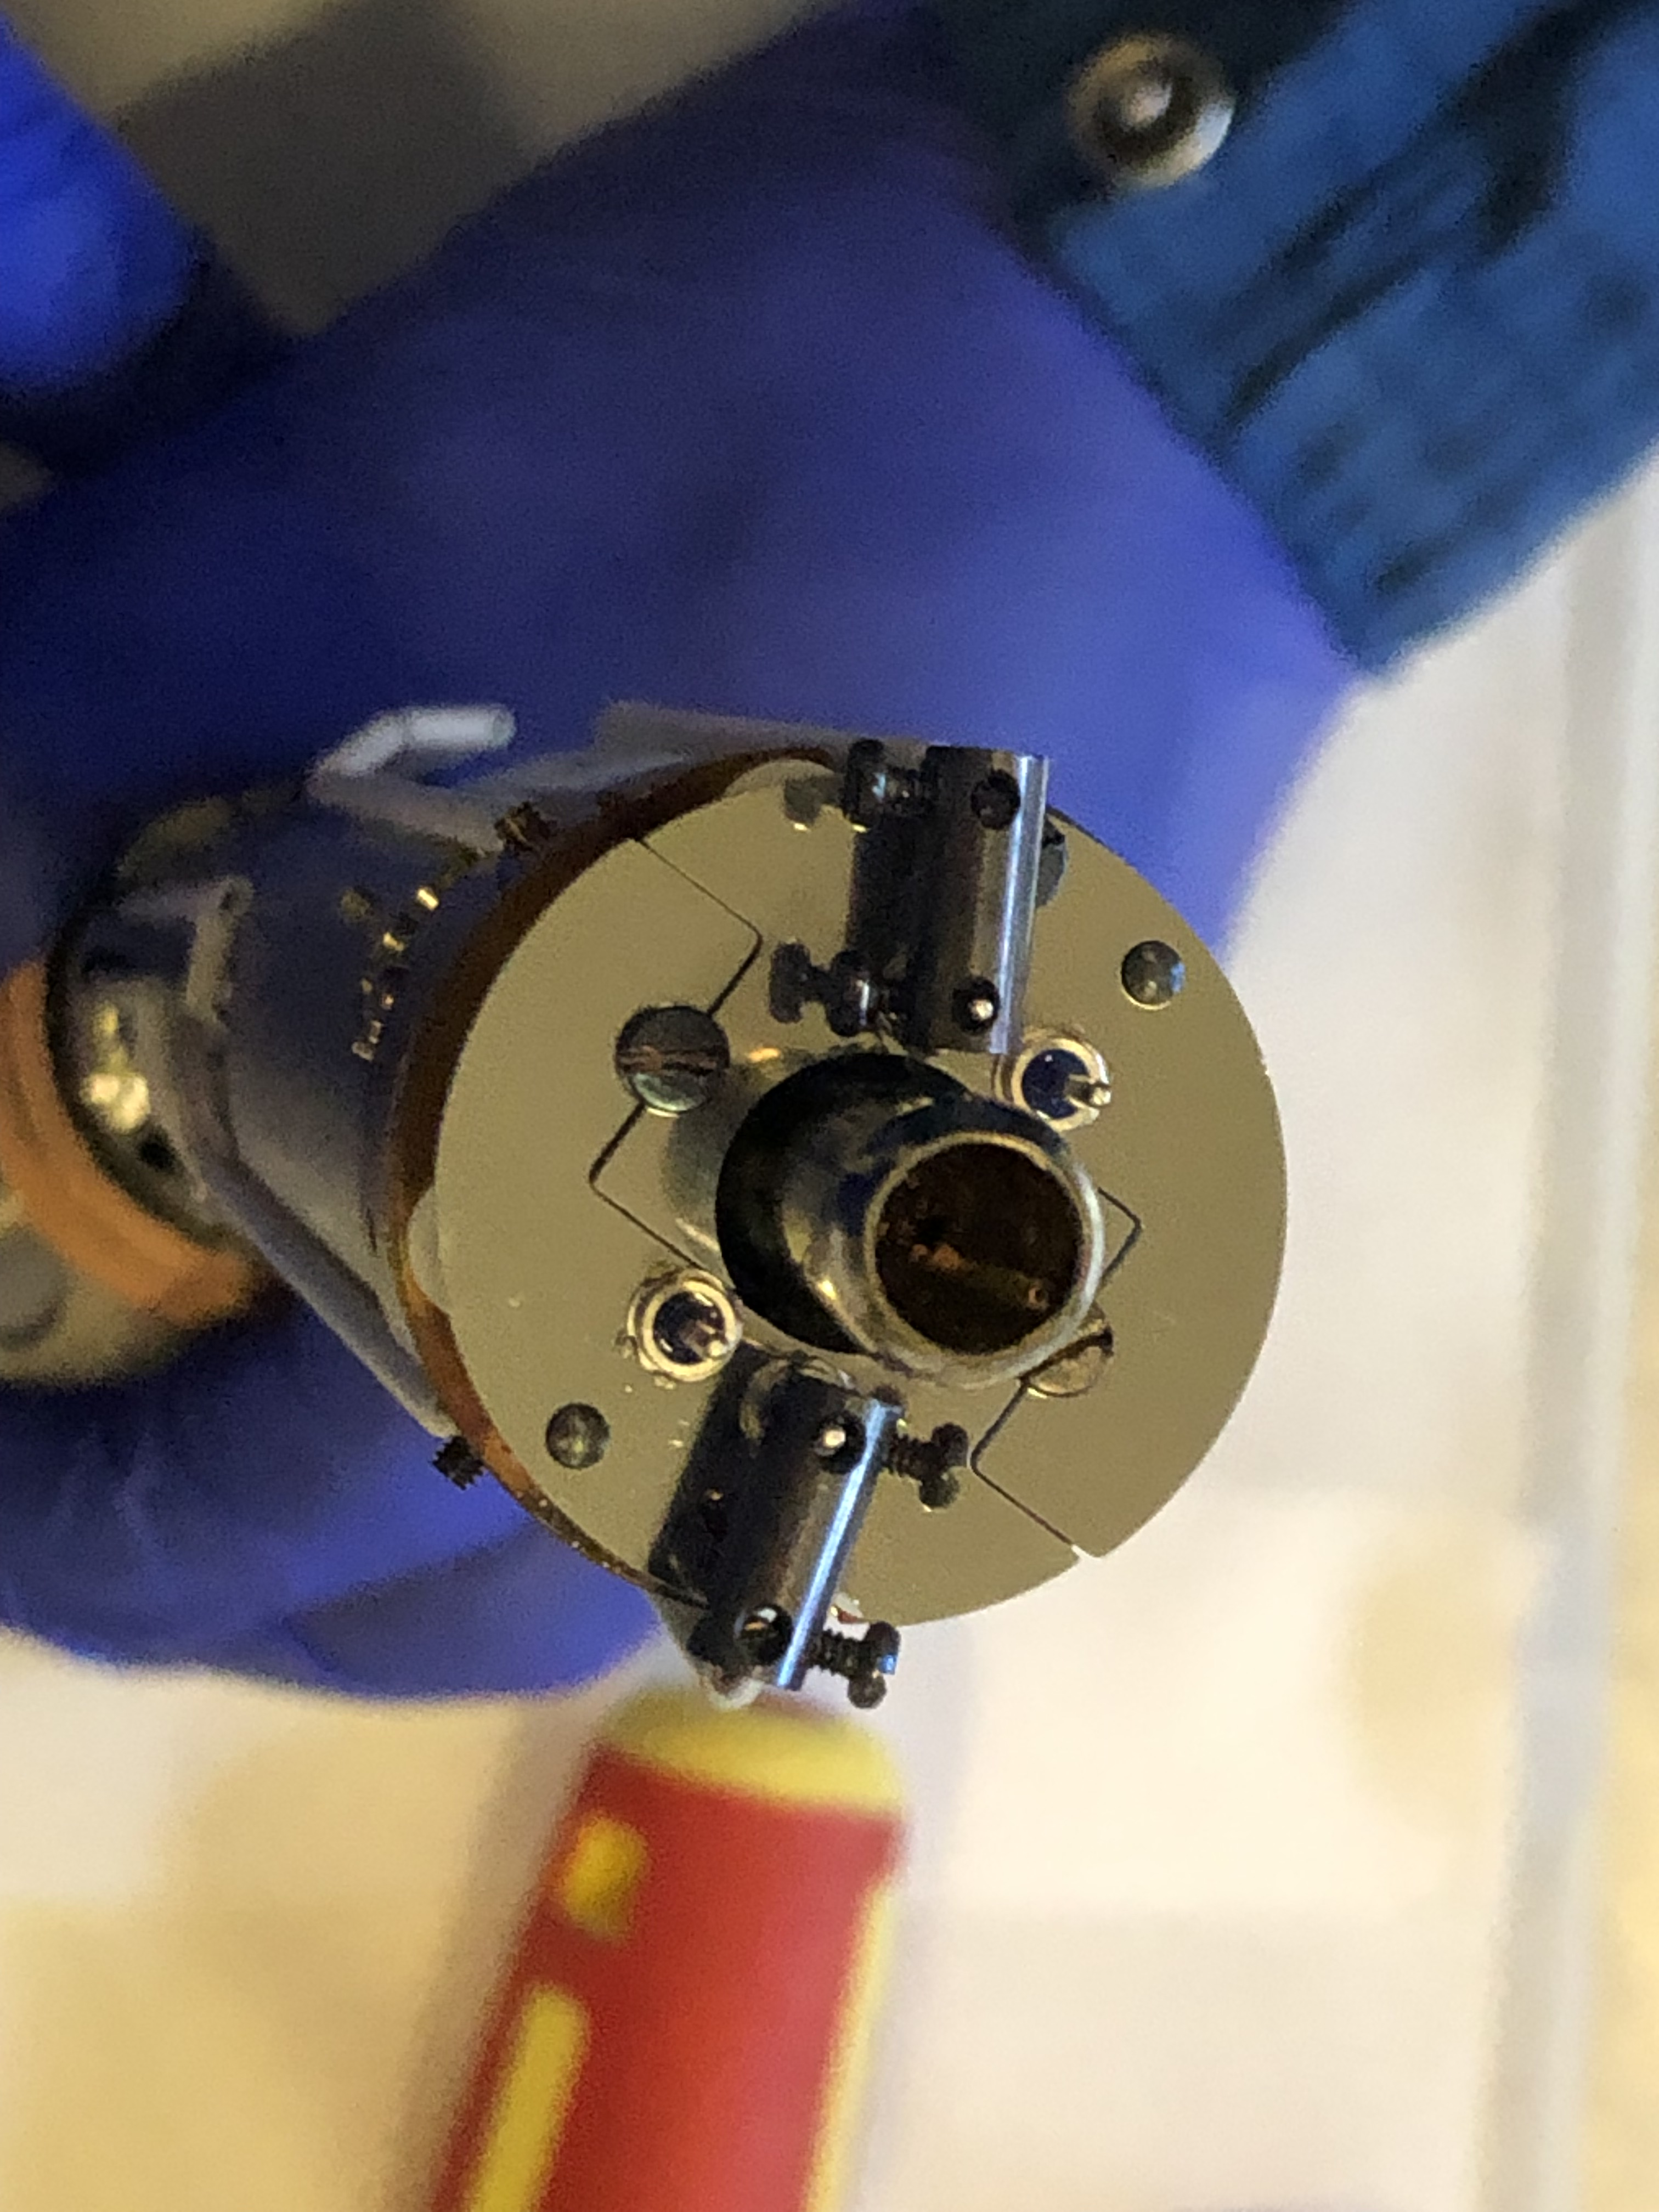
Residual gas analyzer (RGA)
filaments
Notes:
During my time UG, both of our RGAs went broken, and I participated in fixing them. So the first problems was we can not start the filaments.
About the filaments, RGA ionizes some of the gas in the vacuum chamber with electrons from filaments. If the filaments are out of order, there will be no ions, meaning no results. When the filaments get old, they will lose ability to ionize gas.

Slide 9
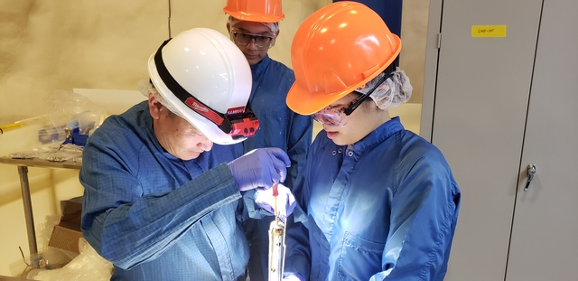
Residual gas analyzer (RGA)
Notes:
This pic was Sambuu and I replacing new filaments. We look like doctor and nurse LOL ☺
After we replaced the filaments, we thought that our RGA would be back in service, but oh no, another error happened that RGA can not pump down the gas sample to the operating pressure.

Slide 10
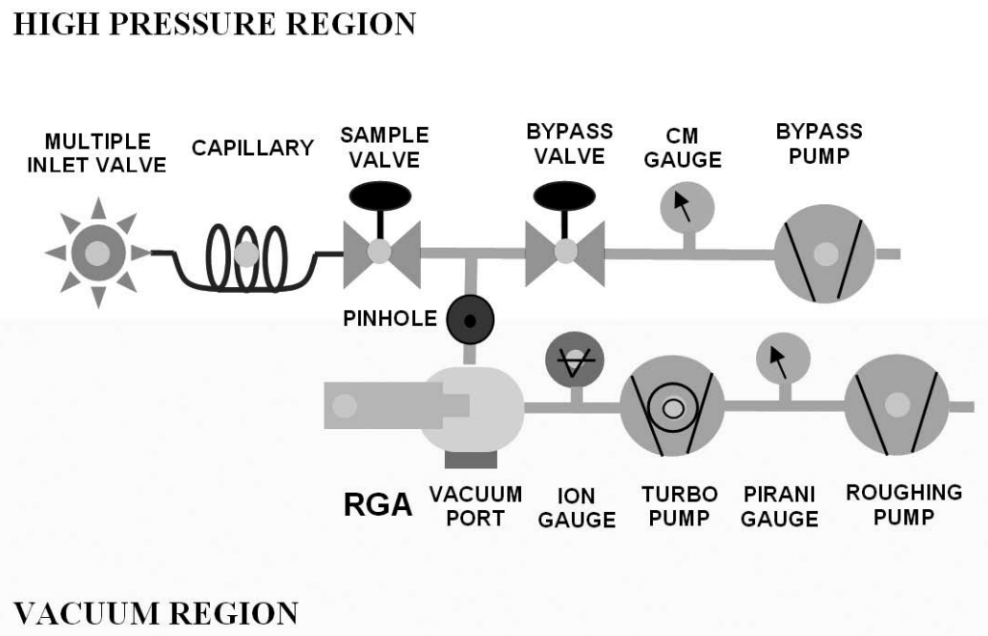
Residual gas analyzer (RGA)
Backing pump
Notes:
The RGA requires low pressures to operate (10-6 Torr). This involves two stages using different pumps. In our RGA, the bypass pump and roughing pump is combined, called backing pump. The backing pump evacuate a bypass line and allows back streaming through the Turbo Pump.
In UGA systems, an atmospheric pressure gas sample is drawn through a capillary (6 ft of 175 mm ID) which drops the pressure by 3 decades. A small amount of gas sample is drawn by the TP through a pinhole (40 mm) which reduces the pressure to about 10-6 Torr, while most of the inlet gas (about 99.9%) flows directly to the bypass DP.

Slide 11
Residual gas analyzer (RGA)
Working! YAY!
Notes:
So we need to fix turbo pump or the backing pump. We decided to replace the backing pump with scroll pump first.
After all our efforts, the RGAs are working now.

Slide 12
outline
Trang on surface

Slide 13
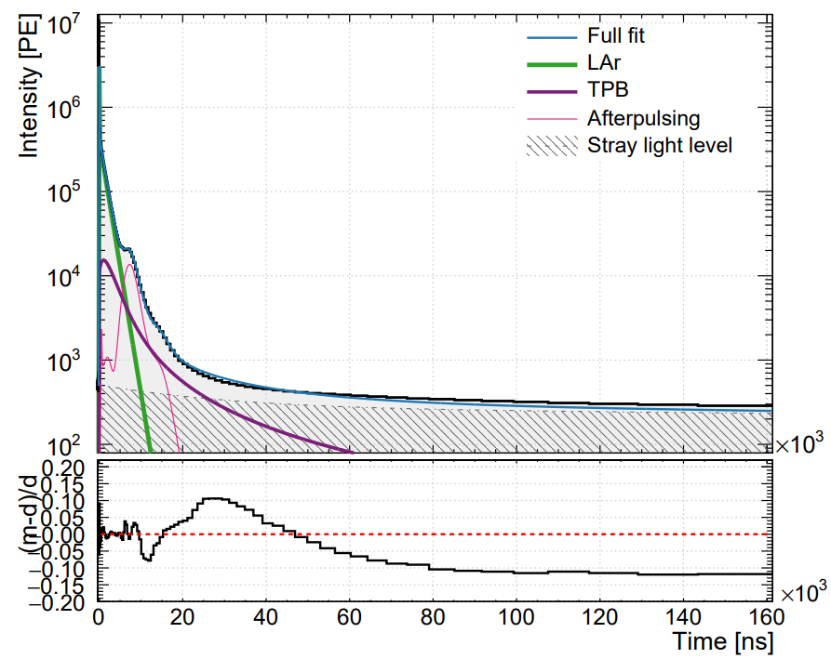
target
Study previous pulseshape model if it is still applicable to recent runs.
→ 3rd fill analysis.
since 2017
Notes:
First and foremost, DEAP is a scintillation detector, we are looking at the way the light is emitted from LAr.
My task is to work with a model for light emission and determine if it is still applicable to recent data.
The current fit was built in 2017. It is a model of the detector response to events, folding the scintillation, TPB wavelength shifting and PMT effects.
There are some modifications need to be made to the code because it was never re-validated since 2017, built in outdated version of our analysis package and not automatic.
It is used as a base for our PSD model

Slide 14
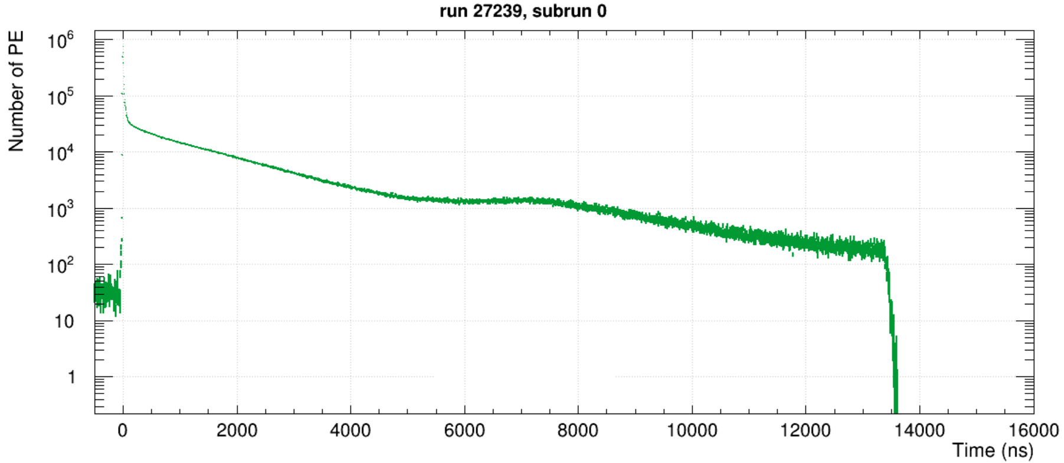
Pulseshape
LAr singlet:
fast emission light from LAr
LAr triplet:
slow emission light from LAr
Afterpulse:
PMT effect, giving late pulses
Prompt range
[-28ns, 60ns]
Late range
[60ns, 16000ns]
Notes:
Our data is analyzed in pulseshape. The plot above displays a pulseshape of a run in 16000us long. We can observe several phenomena here.
First and foremost, in the prompt region, the event peak at 0 ns, dominated by the LAr singlet decay. The LAr triplet decay dominated region around 300ns to approximately 5000ns. The slight peak around 7000ns is due to PMT afterpulsing.
Besides, there are instrumental effects, mostly in the late region, including dark noise, afterpulsing due to LAr scintillation light, afterpulsing of afterpulsing, double and late pulsing, scattering of light inside the detector, as well as the response of TPB.
Stray light (background levels of photons in the detector)

Slide 15
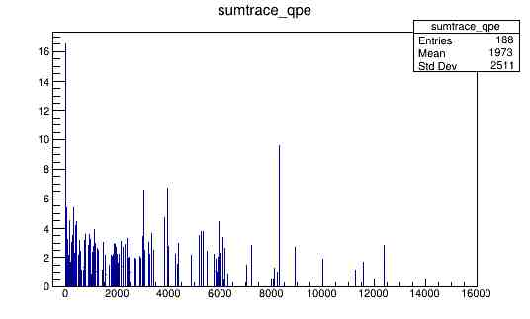
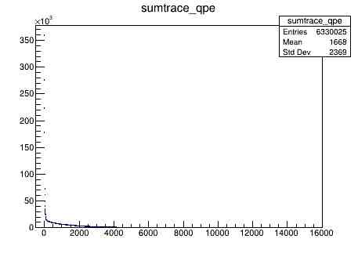
Bit mask logic
if (!cal->GetCuts()->GetCutWord() & 0x31f8 && !ds->IsMC()) {return Processor::OK; }
if ((cal->GetCuts()->GetCutWord() & 0x31f8) && !(ds->IsMC())) {return Processor::OK; }
Run 019503, subrun 0000, before and after
Notes:
The previous code has a confusion in logic bit mask, explaining why I had a very low number of events at first, pointing to the left.
The cut 0x31f8 will eliminate bad events not good for physics analysis.
We do not want to use these events, the previous code keeps these bad events.
After fixing the logic by removing the exclamation point, those bad events are now eliminated. I was able to generate reasonable pulseshape with a reasonable number of events.
Sumtrace_qpe = Number of PE in all PMTs along 16000ns
0x31f8 = Removes any instances of bits 3, 4, 5, 6, 7, 8, 12 and 13

Slide 16
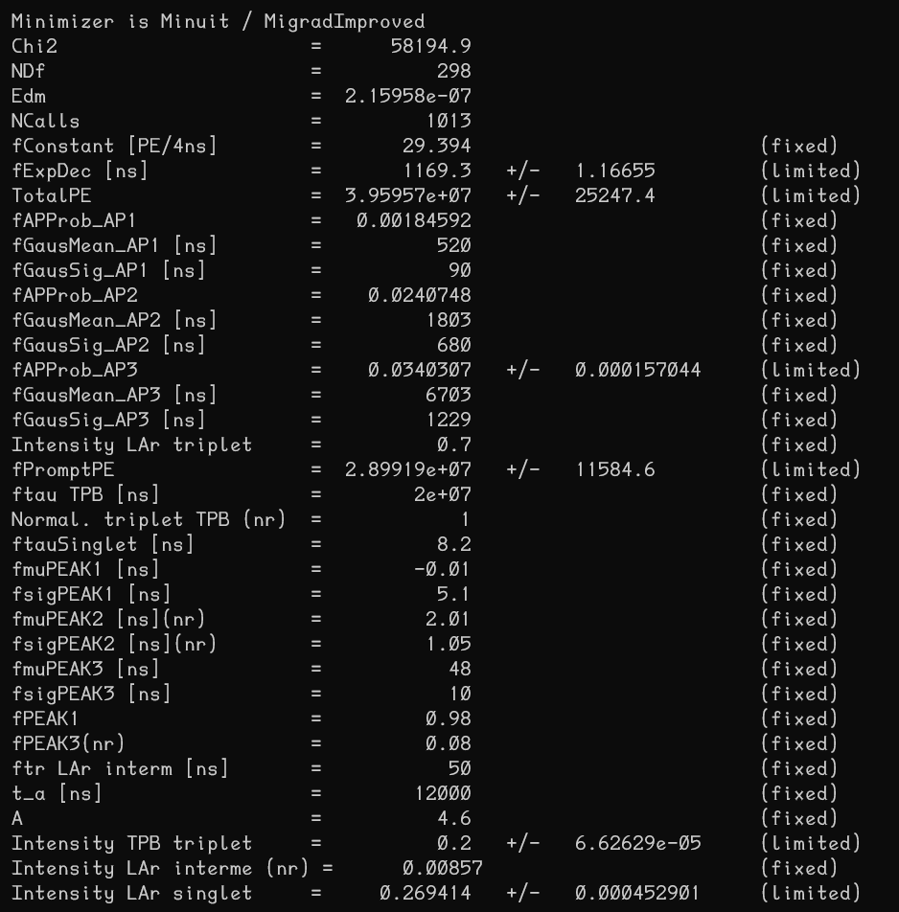
Fitting parameters
31 parameters!
Notes:
There are many effects under a single pulseshape, therefore, the fit requires many different parameters. Totally, 31 parameters are used.
As my initial inspection, the triplet LAr lifetime is around 1200ns, which is a bit lower than expected of 1500ns. The afterpulse position is around 6700ns which is reasonable.
Because AP1 had a low intensity, only AP2 and AP3 were considered in the convolution. Cross afterpulsing is the convolution of the second afterpulsing with the third afterpulsing, it describes how the second afterpulse signal causes a new afterpulsing signal according to the distribution of AP3 which has the highest probability.

Slide 17
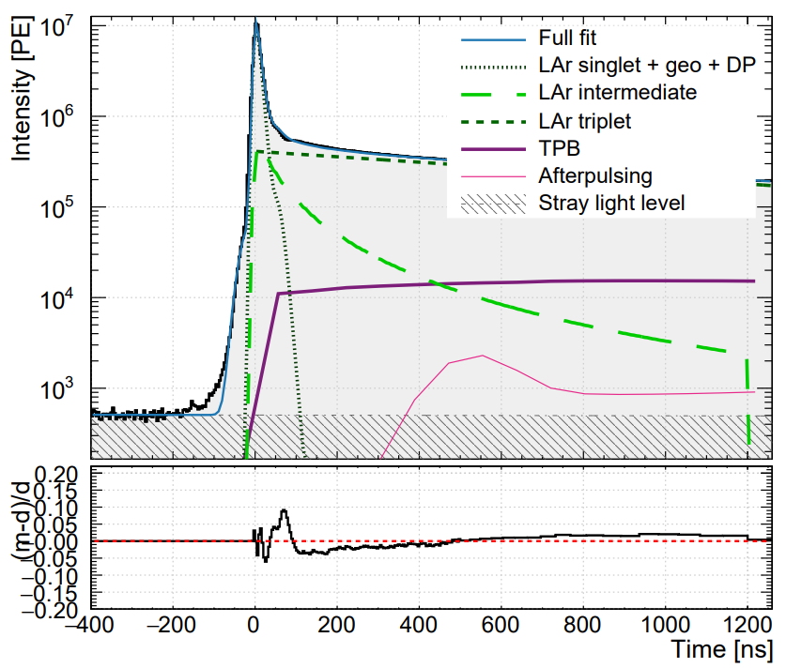
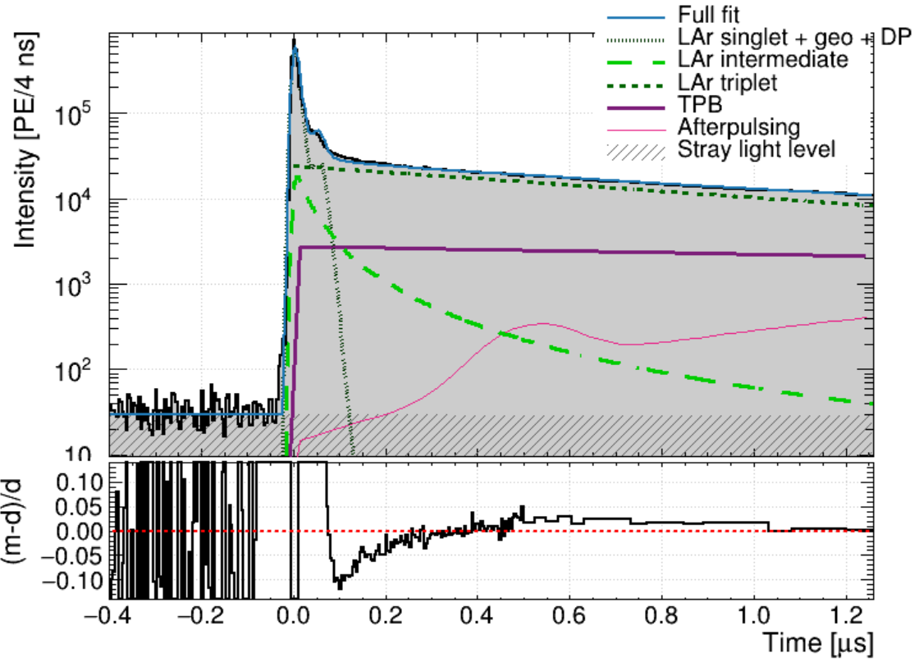
Full fit
expectation
reality
Notes:
Well now the full fit… I have not get the perfect fit yet, but there are positive feature.
First of all, my stray light level is correct. The LAr triplet lifetime looks correct. The fit matches well the afterpulse.
The pre-pulse region is not well predicted with my fit. We are investigating the reasons why.
Overall, the fit is working well. However, some improvements can be done on the pre-pulse region.
Lemme explain a bit about the legend here
Let’s talk about Geo. Due to geometrical effects in the detector, the singlet component used in the fit is not a trivial exponential decay but rather a combination of convoluted exponential and gaussians.
DP = double pulsing

Slide 18
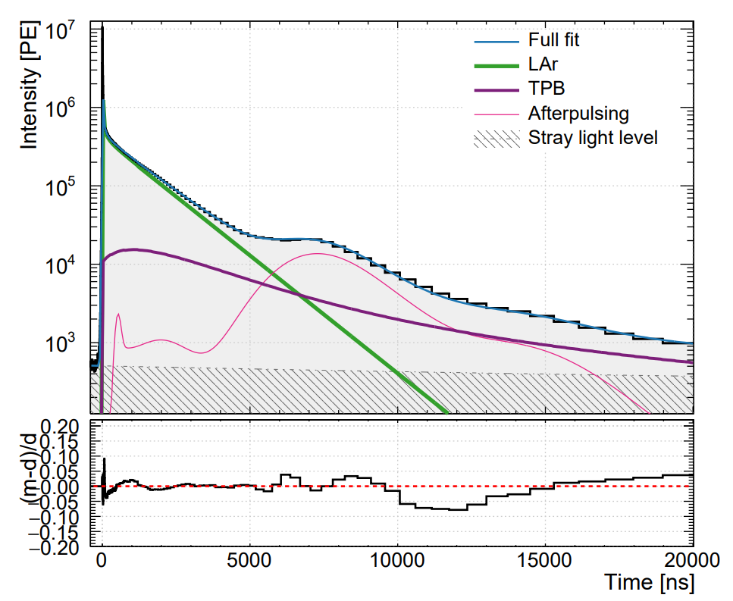
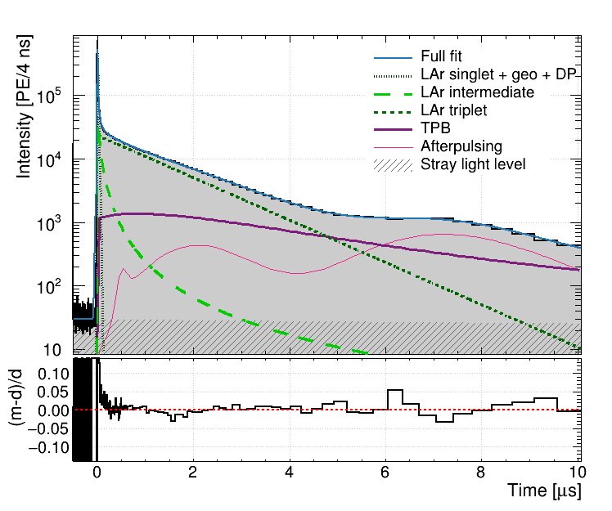
Full fit
expectation
reality

Slide 19
Summary

Slide 20
References
[1] Adhikari, P., Ajaj, R., Araujo, G. R., Batygov, M., Beltran, B., Bina, C. E., Boulay, M. G., Broerman, B., Bueno, J. F., Butcher, A., Cai, B., Cárdenas-Montes, M., Cavuoti, S., Chen, Y., Cleveland, B. T., Corning, J. M., Daugherty, S. J., Di Stefano, P., Dering, K., … Zuñiga-Reyes, A. (2020). The liquid-argon scintillation pulseshape in DEAP-3600. The European Physical Journal C, 80(4). https://doi.org/10.1140/epjc/s10052-020-7789-x
[2] Ajaj, R., Amaudruz, P.A., Araujo, G., Baldwin, M., Batygov, M., Beltran, B., Bina, C., Bonatt, J., Boulay, M., Broerman, B., Bueno, J., Burghardt, P., Butcher, A., Cai, B., Cavuoti, S., Chen, M., Chen, Y., Cleveland, B., Cranshaw, D., Dering, K., DiGioseffo, J., Doria, L., Duncan, F., Dunford, M., Erlandson, A., Fatemighomi, N., Fiorillo, G., Florian, S., Flower, A., Ford, R., Gagnon, R., Gallacher, D., Garcés, E., Garg, S., Giampa, P., Goeldi, D., Golovko, V., Gorel, P., Graham, K., Grant, D., Hallin, A., Hamstra, M., Harvey, P., Hearns, C., Joy, A., Jillings, C., Kamaev, O., Kaur, G., Kemp, A., Kochanek, I., Kuźniak, M., Langrock, S., La Zia, F., Lehnert, B., Li, X., Lidgard, J., Lindner, T., Litvinov, O., Lock, J., Longo, G., Majewski, P., McDonald, A., McElroy, T., McGinn, T., McLaughlin, J., Mehdiyev, R., Mielnichuk, C., Monroe, J., Nadeau, P., Nantais, C., Ng, C., Noble, A., O’Dwyer, E., Ouellet, C., Pasuthip, P., Peeters, S., Piro, M.C., Pollmann, T., Rand, E., Rethmeier, C., Retière, F., Seeburn, N., Singhrao, K., Skensved, P., Smith, B., Smith, N., Sonley, T., Soukup, J., Stainforth, R., Stone, C., Strickland, V., Sur, B., Tang, J., Vázquez-Jáuregui, E., Veloce, L., Viel, S., Walding, J., Waqar, M., Ward, M., Westerdale, S., Willis, J., & Zuñiga-Reyes, A. (2019). Search for dark matter with a 231-day exposure of liquid argon using DEAP-3600 at SNOLAB. Physical Review D, 100(2).
[3] TPD3PulseshapePaper < Main < TWiki (snolab.ca)
[4] BSc thesis: Mohamed Younes Sassi (2018). Average Pulseshape of Liquid Argon in a Dark Matter Search Experiment.

Slide 21
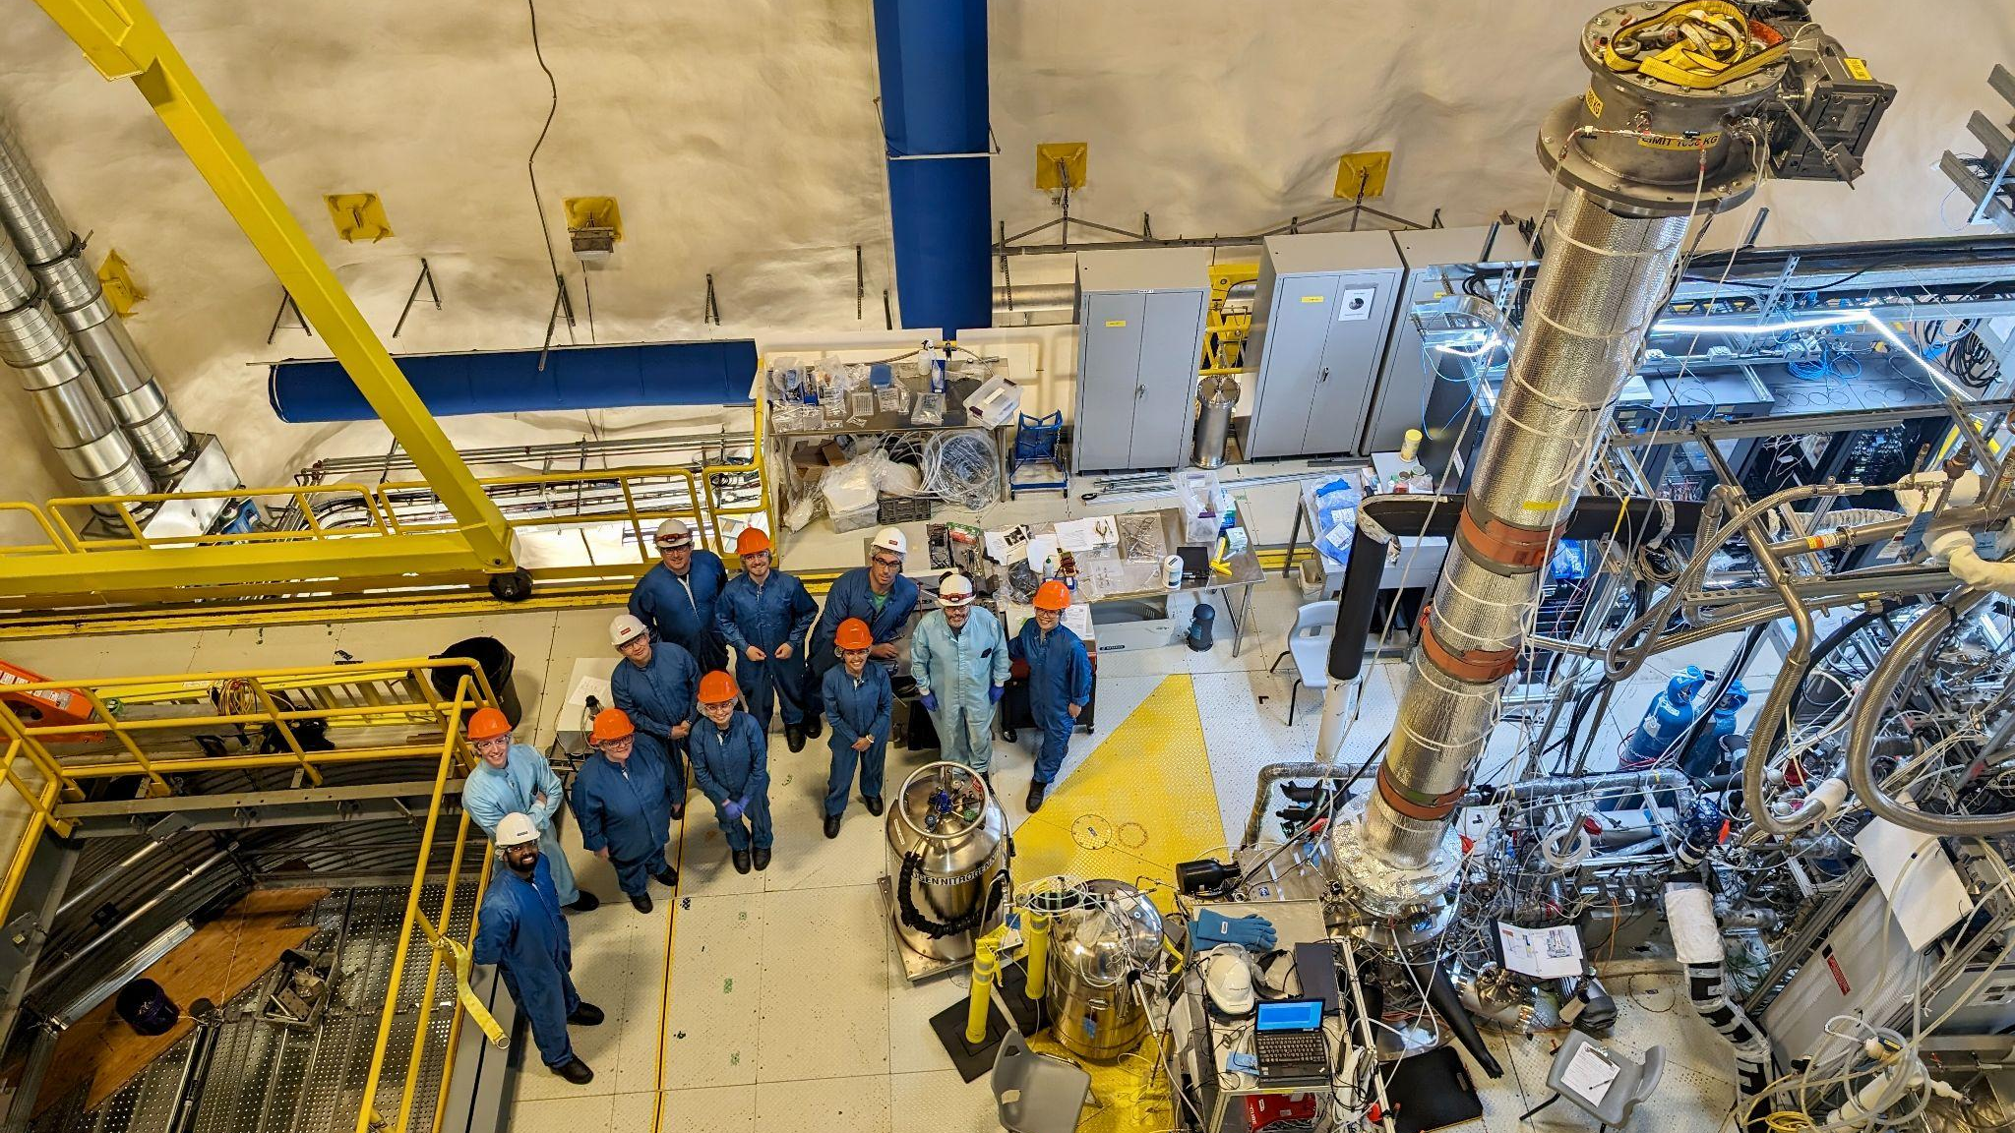
My special appreciation for the grand supports from
my supervisors Pierre Gorel, Chris Jillings, Sean Daugherty,
my senior colleague Badamsambuu Jigmeddorj, and my dear DEAP friends!

Slide 22
Backup slides

Slide 23
Pulseshape discrimination
Liquid scintillators emit scintillation light with different pulseshapes depending on the ionization power of the incident particle. Different ionization powers result in different excitation mechanisms of the scintillating atoms.
Therefore cause the scintillator to have different decay times and intensities.
By using the proprieties of these decay types we can distinguish between the excitation mechanisms and have an idea about the incident particle, this technique is called Pulse Shape Discrimination (PSD).

Slide 24
Side definitions
Cross sections: probability that a reaction will occur
Pulseshape: In physics, particularly in the context of particle detectors and scintillation measurements, pulse shape refers to the characteristic pattern of light or electrical signal generated over time in response to a particle interaction. When a particle interacts with the scintillator material, it emits light pulses. The shape of these pulses (i.e., how the light intensity varies over time) provides valuable information about the nature of the interaction. Different types of particles or different energy deposits will produce pulses with distinct shapes.
Notes:
Cross sections: probability that a reaction will occur
In physics, particularly in the context of particle detectors and scintillation measurements, pulse shape refers to the characteristic pattern of light or electrical signal generated over time in response to a particle interaction. When a particle interacts with the scintillator material, it emits light pulses. The shape of these pulses (i.e., how the light intensity varies over time) provides valuable information about the nature of the interaction. Different types of particles or different energy deposits will produce pulses with distinct shapes.

Slide 25
Side questions
Leak detector vs rga: Leak detectors, in general, are fine-tuned to detect the presence of helium. Residual Gas Analyzers (RGAs) look beyond the presence of helium. They evaluate all the gases present within a space.
Why water hurt RGA? Gases like nitrogen, oxygen, and argon are not strongly bound to the surfaces. This means they easily enter the gas phase and are easily pumped away. Water vapor, by contrast, clings to every surface, many molecular layers thick. As the pressure is reduced, water vapor molecules enter the gas phase but when they hit another surface they are again strongly bound. This makes it very difficult to pump away and it eventually becomes the dominant residual gas.
Why LAR? Because of high scintillation light yield, high discrimination power between wimp and background. This power is from short singlet and long triplet decay time. Singlet is from NR from WIMP, triplet is from ER from background. LAr has high singlet decay because there is enough ionizing power, triplet excimer will interact with hot electron, creating singlet.
Why WIMP? According to a model that when Universe was very hot, dark matter and its anti-matter annihilate, creating new particles. These particles also decayed into dark matter and its anti-matter. But temperature decreased, leading to new particles decay rate dropped while annihilation was still going on. At one point, the density of dark matter is constant. If dark matter exists, its cross section must be smaller than cross section of weak interaction. WIMP fits in this cross section range.
Notes:
Leak detector vs rga: Leak detectors, in general, are fine-tuned to detect the presence of helium. Residual Gas Analyzers (RGAs) look beyond the presence of helium. They evaluate all the gases present within a space.
Why water hurt RGA? Gases like nitrogen, oxygen, and argon are not strongly bound to the surfaces. This means they easily enter the gas phase and are easily pumped away. Water vapor, by contrast, clings to every surface, many molecular layers thick. As the pressure is reduced, water vapor molecules enter the gas phase but when they hit another surface they are again strongly bound. This makes it very difficult to pump away and it eventually becomes the dominant residual gas.
Why LAR? Because of high scintillation light yield, high discrimination power between wimp and background. This power Is from short singlet and long triplet decay time. Singlet is from nr from wimp, triplet is from er from background.

