Slide 1
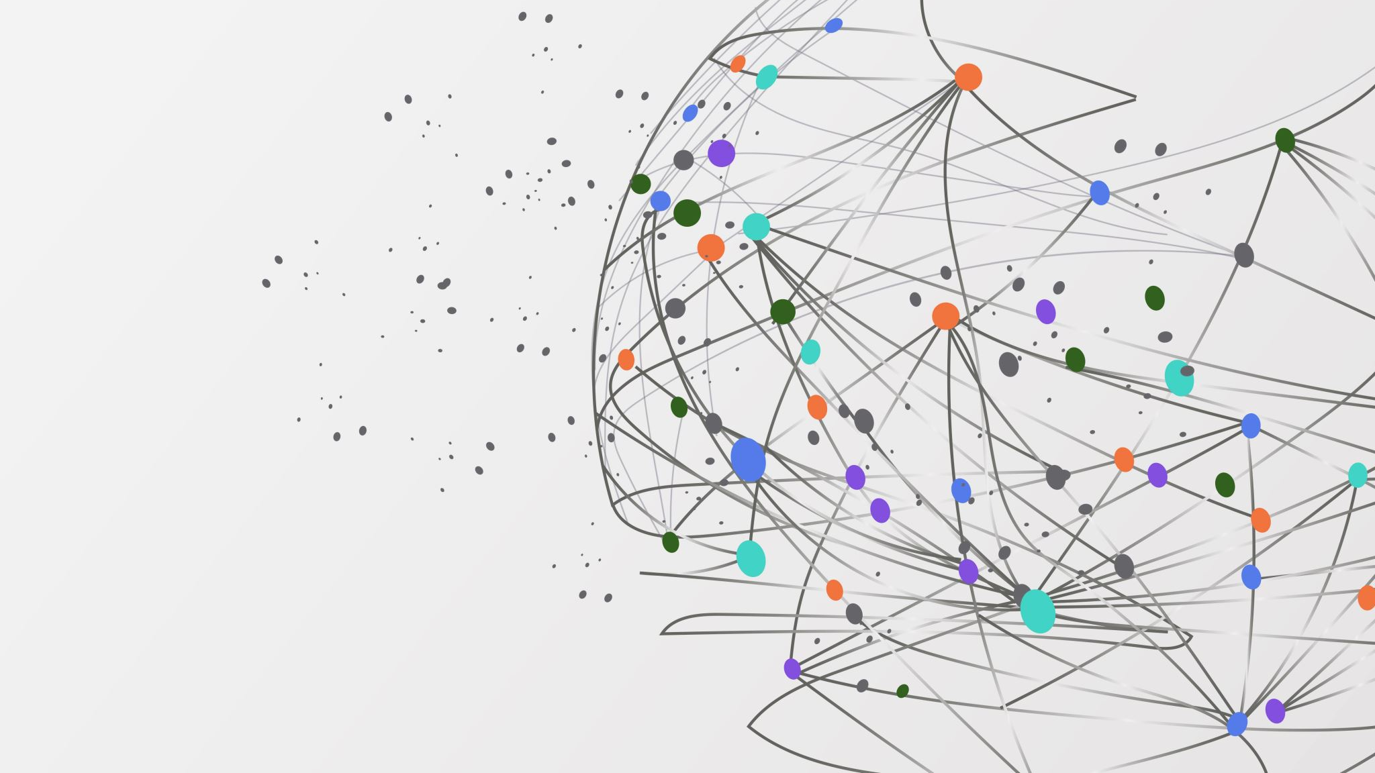
Beyond The Classroom:
Investigating Gendered Imposterism in Undergraduate Physics

Slide 2
Table of contents
Background
What is the Imposter Phenomenon?
Contextualized approach
IFI scale
Imposterism Feelings Index: A quantitative measurement
Results
Discussion & Conclusion

Slide 3
Introduction
Imposter Phenomenon:
A cyclical, distressing feeling in which an individual considers themselves less worthy of their achievements, and may attribute their successes to luck, deceit, or fraudulence, instead of their own competence, despite verifiable evidence of their skills [1]
Contextualized approach:
Recognizing that feelings of being a fraud are influenced by external social, institutional, and interpersonal factors, not just individual traits [2]

Slide 4
IFI Scale: Imposterism Feelings index
Marginalized groups are particularly impacted by social factors, and taking this into account allows for a more comprehensive investigation of this phenomenon
IFI score: a contextualized approach to quantifying Imposterism
IFI = Imposter Feelings Index
IFI scores come from the results of survey

Slide 5
IFI score calculation
How to calculate IFI score:
3-item scale, answers range from “definitely not” to “definitely yes”
“Definitely not” = 5 , “Probably not” = 4 , “Not sure” = 3 , “Probably yes” = 2 , “Definitely yes” = 1
Score > 3 is considered “high Imposterism” , score < 3 is considered “low Imposterism”
ITEMS IN THE SCALE:
Question 9: “Do you agree with this statement? ‘I feel smart in physics’”
Question 10: “Do you agree with this statement? ‘I belong in physics’”
Question 12: “Do you agree with this statement? ‘I feel smart in physics compared to peers in my program’”

Slide 6
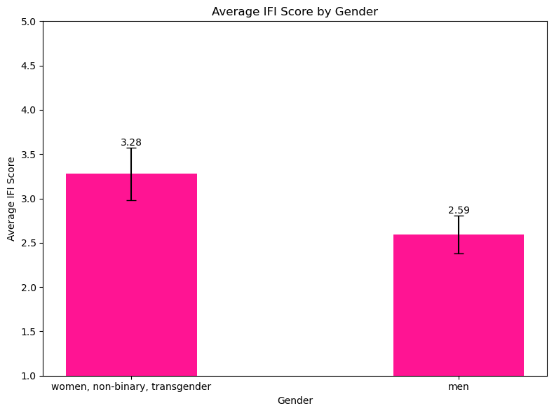
results
Women, non-binary, and trans students have higher IFI scores than men and these differences appear in the second year of study

Slide 7
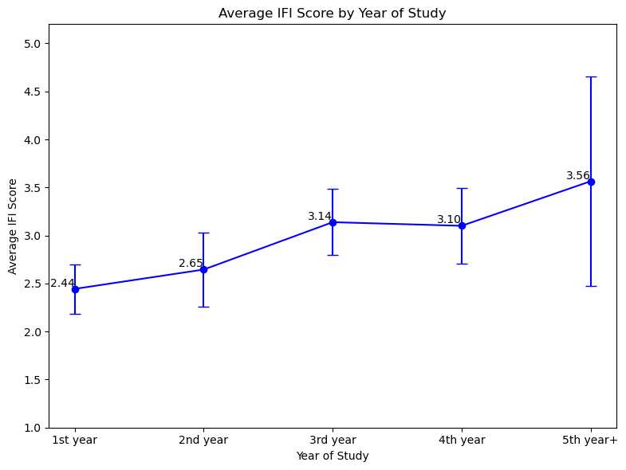
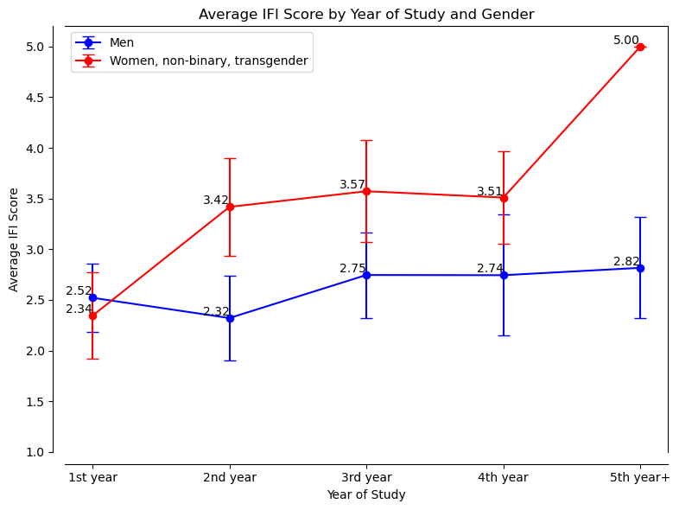
results
Women, non-binary, and trans students have higher IFI scores than men and these differences appear in the second year of study

Slide 8
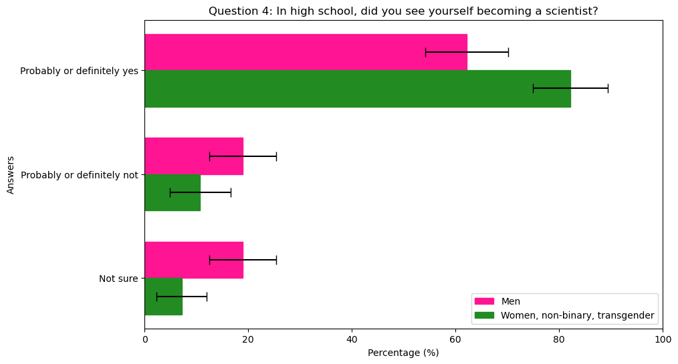
Results II
94% of survey responders said that they chose to study physics because they love the subject and/or they were good at it in high school!
Low IFI scores are not correlated with individual action, and wider experiences have a greater impact on IFI scores

Slide 9
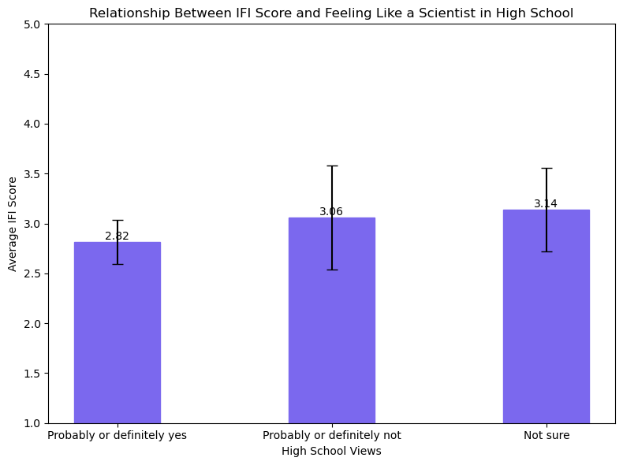
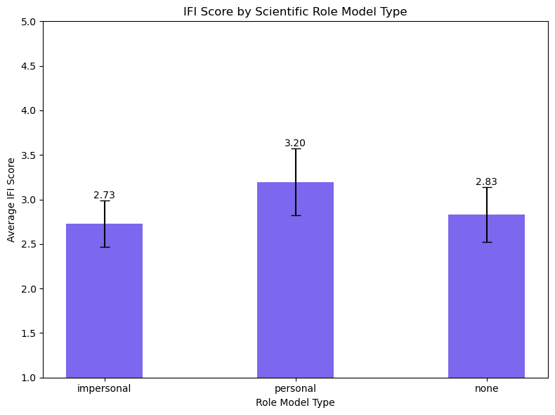
Results II
Low IFI scores are not correlated with individual action, and wider experiences have a greater impact on IFI scores

Slide 10
Results II
Low IFI scores are not correlated with individual action, and wider experiences have a greater impact on IFI scores
Notion of “peer group” vs “departmental community”

Slide 11
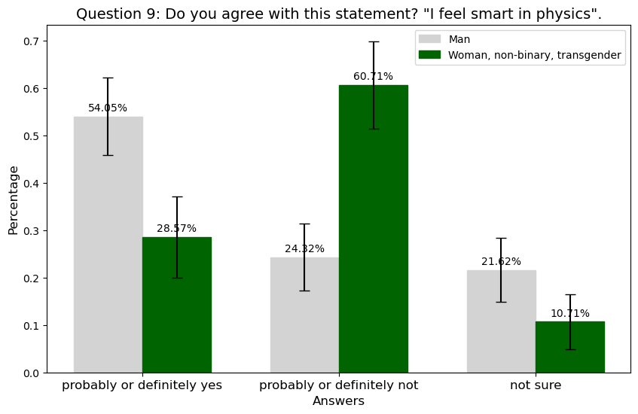
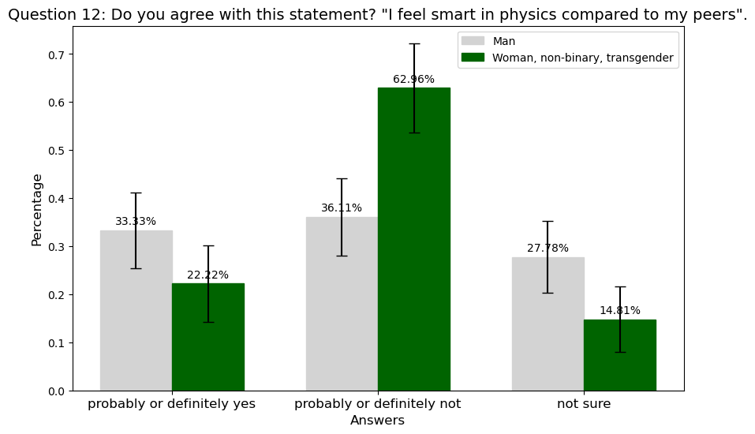
Results III

Slide 12
Discussion & conclusion
Physics as a discipline, has a unique culture and history
Historically (and presently) there is a baseline of masculinity and hierarchy that is present in the way the system works
Imposterism is not just an individual experience, but a reflection of educational and social norms that exist within departmental practices
Emphasis on equitable teaching strategies and EDII-based curriculum

Slide 13
references
[1] Clance, Pauline R., and Suzanne A. Imes. “The Imposter Phenomenon in High Achieving Women: Dynamics and Therapeutic Intervention.” Psychotherapy (Chicago, Ill.), vol. 15, no. 3, 1978, pp. 241–47, https://doi.org/10.1037/h0086006.
[2] Feenstra, S., Begeny, C. T., Ryan, M. K., Rink, F., Stoker, J. I., & Jordan, J. (2020). Contextualizing the impostor “syndrome.” Frontiers in Psychology, 11, 575024. https://doi.org/10.3389/fpsyg.2020.575024

