Slide 1
SNO+ External Am-Be Deployment Analysis
CASST 2024
August 19th, 2024
Cody O'Neill

Slide 2
Overview
What is SNO+
What is the purpose of deploying a neutron source?
The AmBe deployments
The Data
Results
Next steps

Slide 3
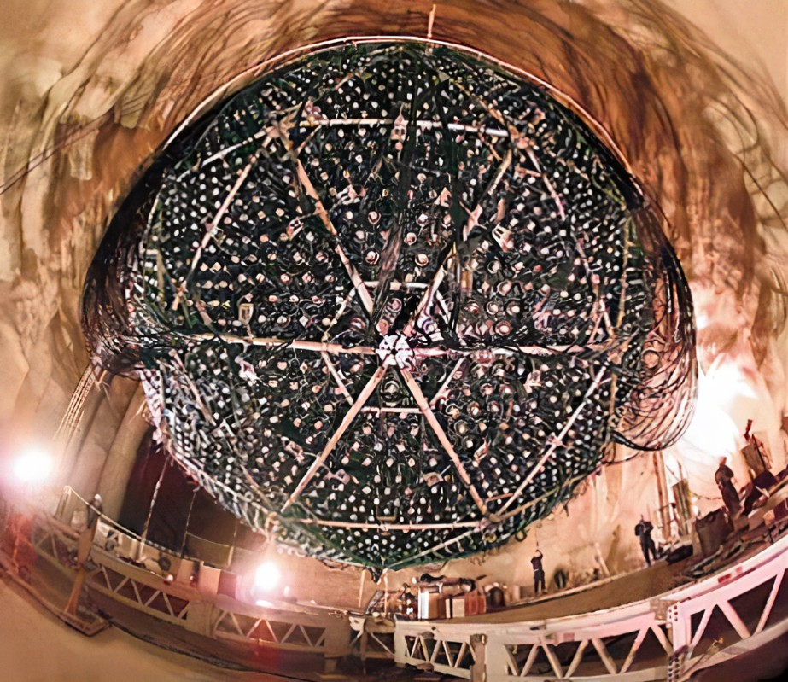
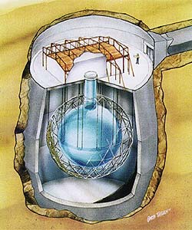
SNO+
Goals
2Km Underground
7000 Tonnes of UPW shielding
12m diameter Acrylic Vessel
780 Tonnes Liquid Scintillator Fill
9500 Photomultiplier Tubes
​Multipurpose Neutrino Detector:
Reactor Anti-Neutrinos
Geoneutrinos
Solar Neutrinos
Supernova Neutrinos
0vbb

Slide 4
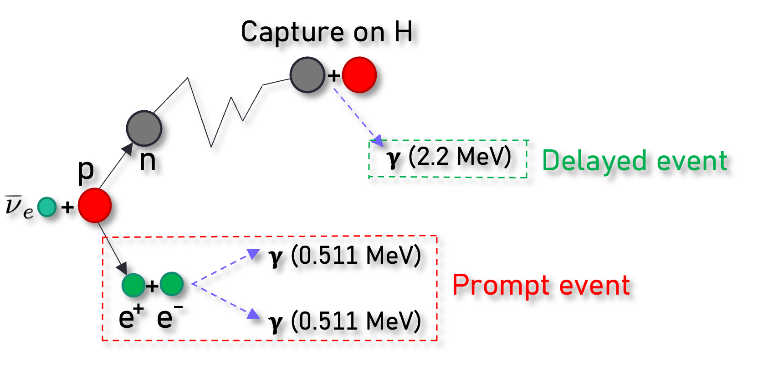
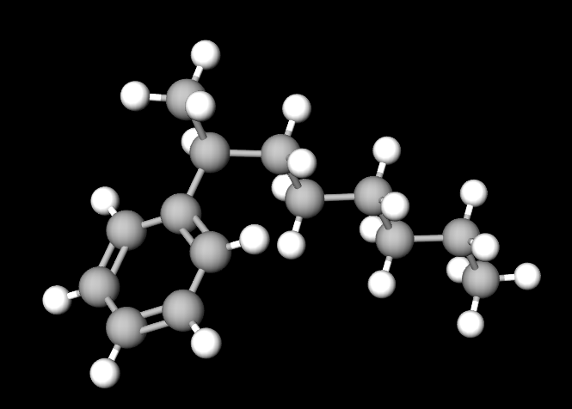
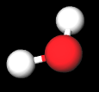
IBD and Neutrons
Weak interaction between proton and electron antineutrino
Results in a positron and neutron
Linear Alkyl Benzene (LAB)
Credit: James Page, Sussex
Water and LAB both hydrogen rich
Neutron bounces around before being captured on hydrogen
Excited hydrogen produces 2.2MeV gamma ray

Slide 5
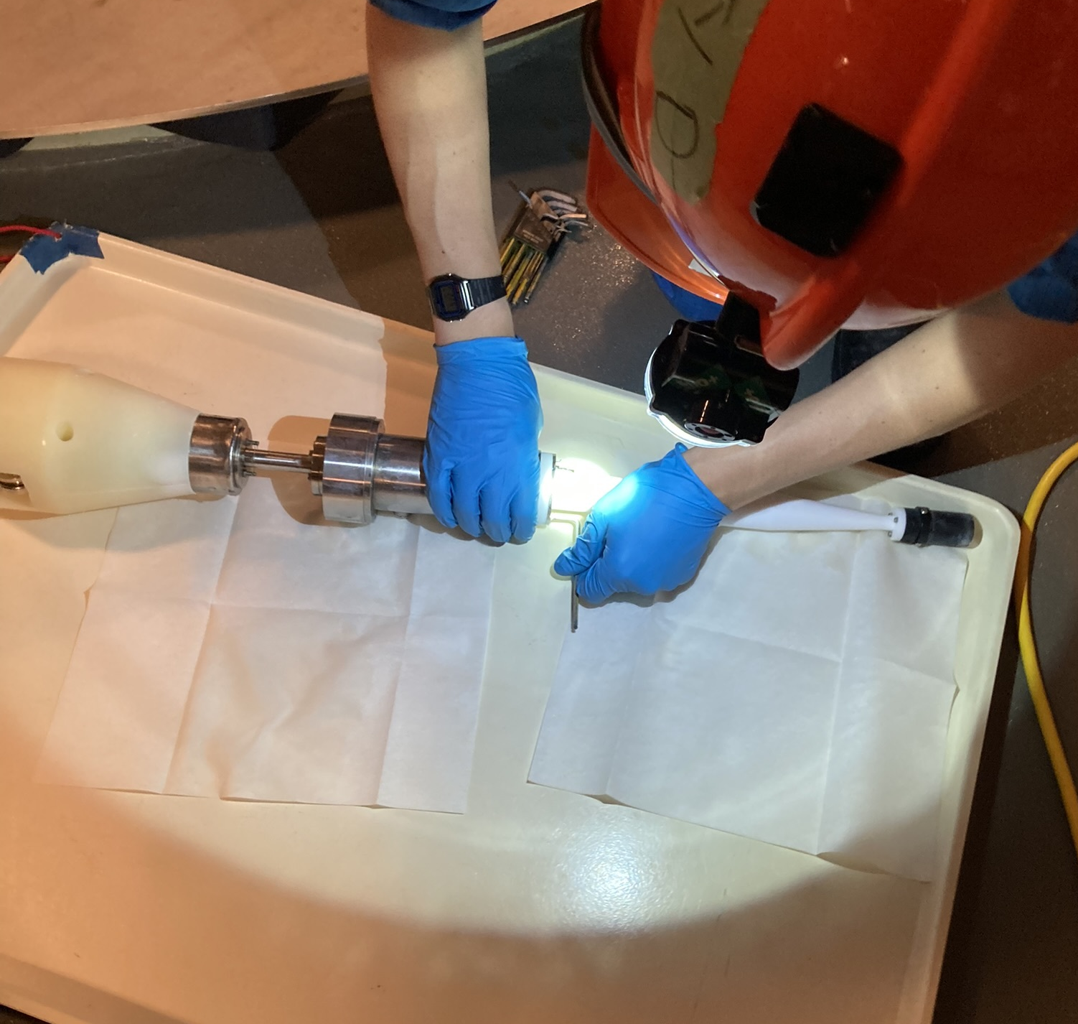
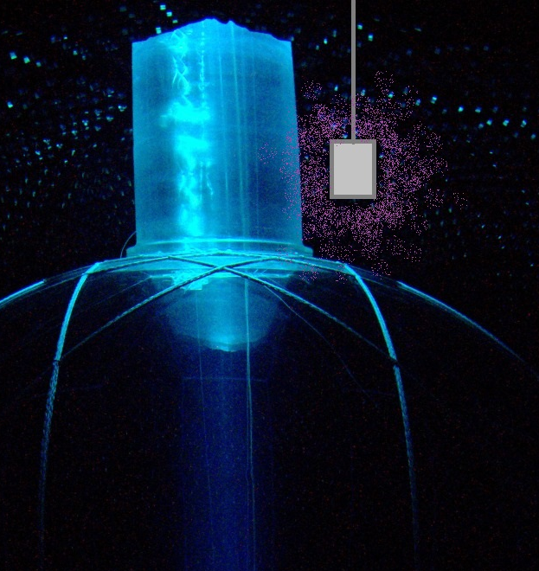
AmBe Source
Produces 4.4MeV gammas and Free Neutrons
Produced neutrons can be used to calibrate energy response to 2.2MeV gammas
Source deployed in external cavity water from Dec 8-10, 2023​
Data collected at three heights
Date
Dec 8-9
Dec 9-10
Dec 10
Vertical Distance
594.03 cm
600.01 cm
650.06 cm
Distance to AV
17.31 cm
23.06 cm
71.40 cm
(Artist's Rendition)

Slide 6
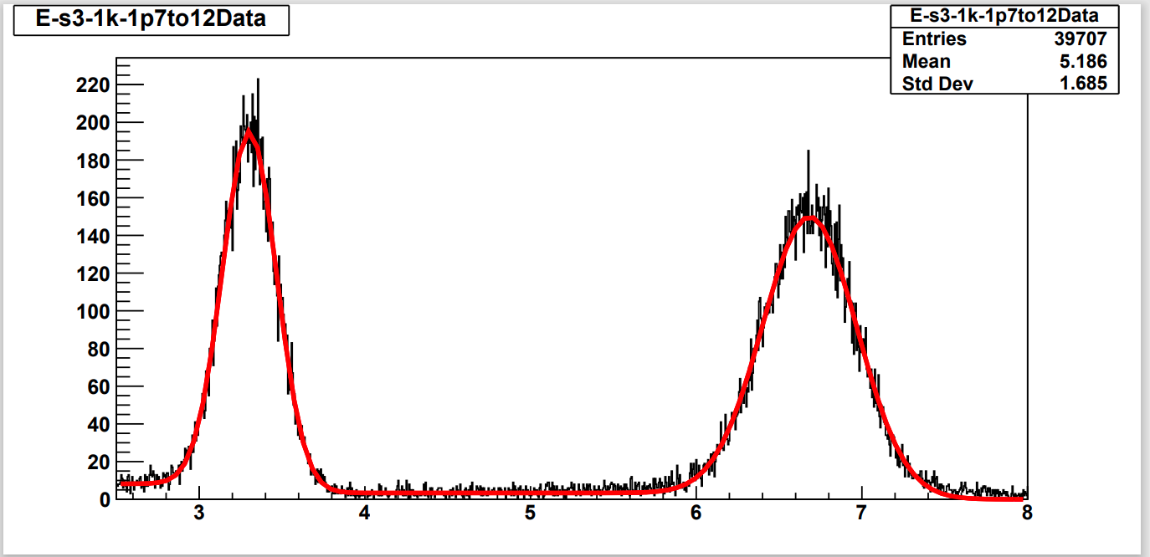
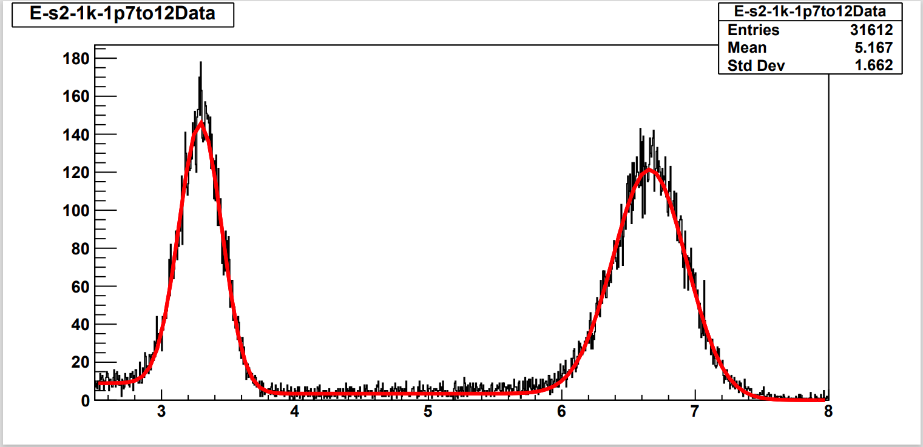
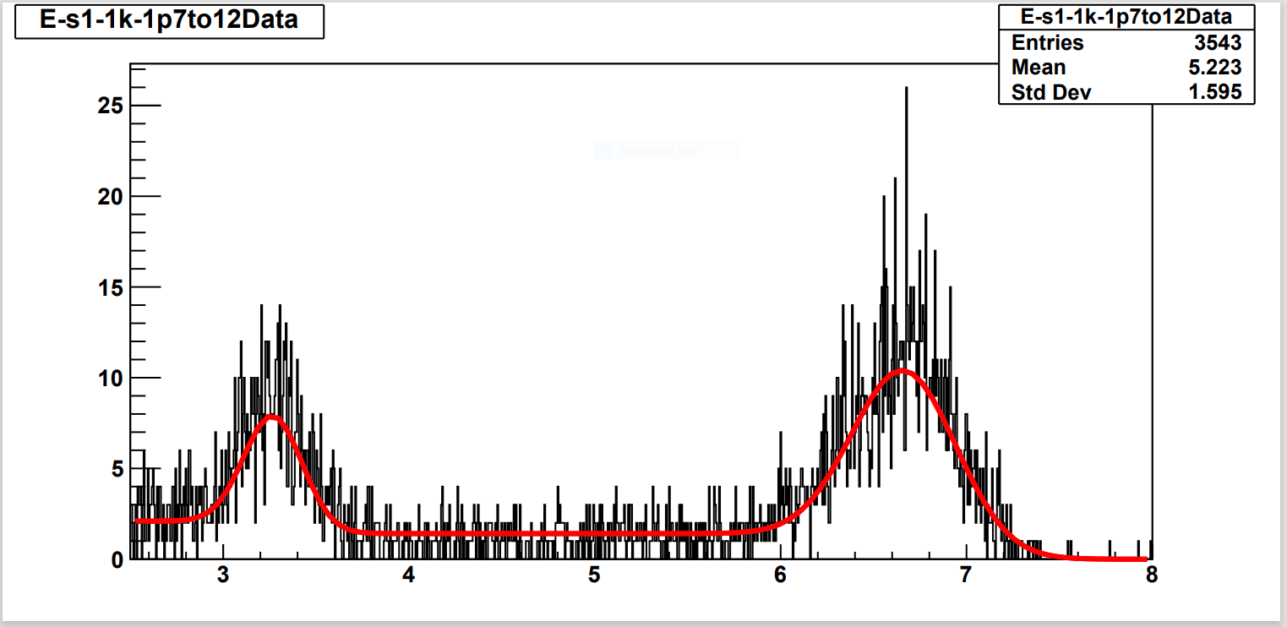
Deployments
Energy histograms for the December AmBe Deployments
Label
S3
S2
S1
Distance to AV
17.31 cm
23.06 cm
71.40 cm
2.2 Mean
3.30 MeV
3.29 MeV
3.23 MeV
4.4 Mean
6.68 MeV
6.65 MeV
6.62 MeV
Data Cuts
350 < NHits < 1800 FitValid 5000 < Radius < 5400
Energy (MeV)
Energy (MeV)
Energy (MeV)

Slide 7
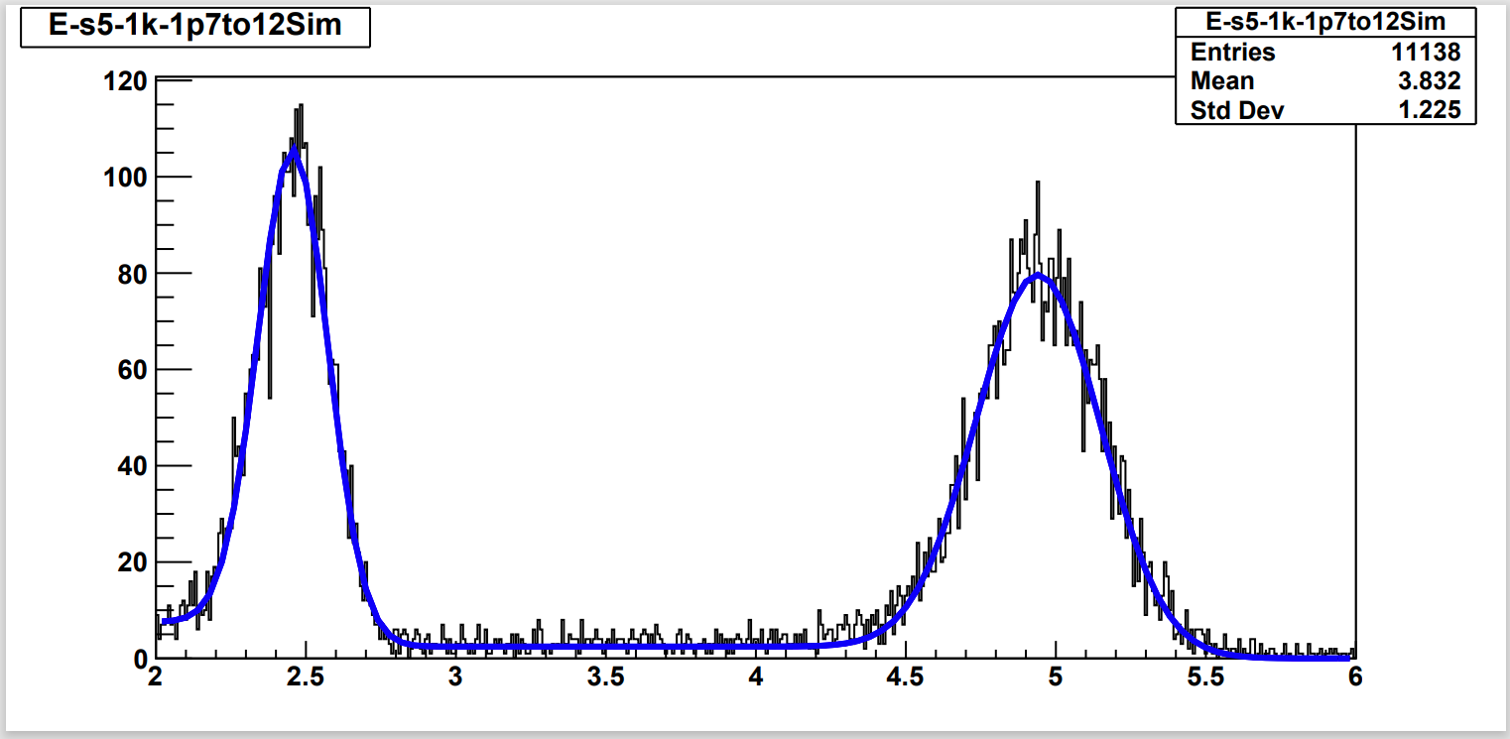
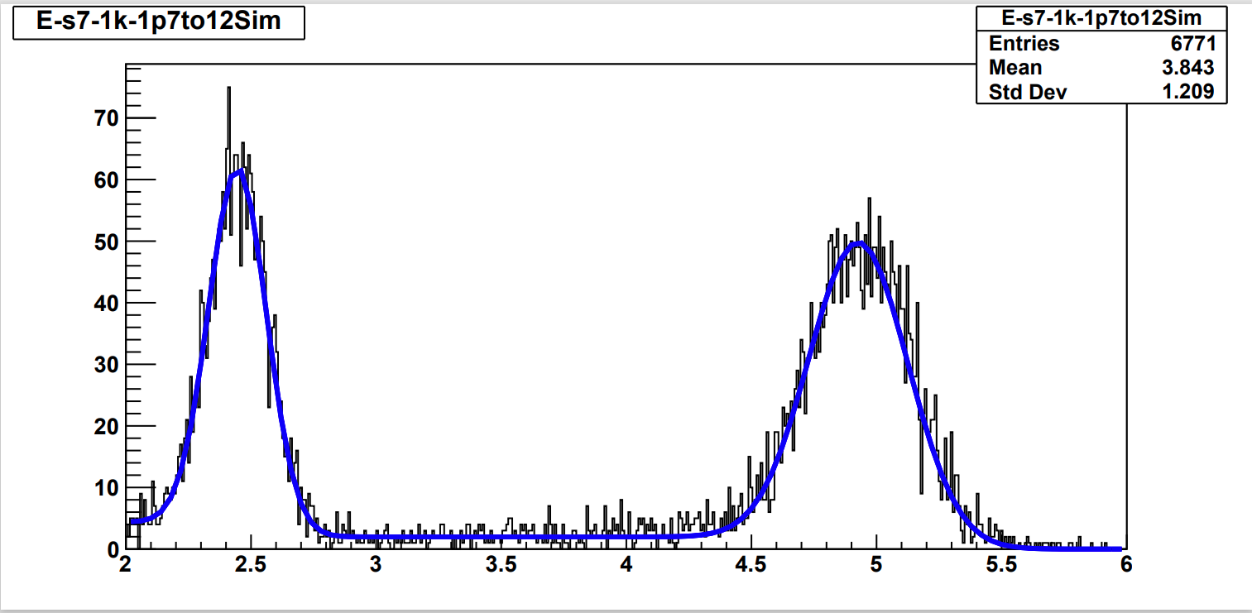
Comparison to Simulations
Distance to AV
17.31 cm
23.06 cm
34.62 cm
47.17 cm
71.40 cm
Initial Simulations conducted at various heights, same data cuts:
Energy Reconstruction varies between data and simulation
Time differences between data and simulation

Slide 8
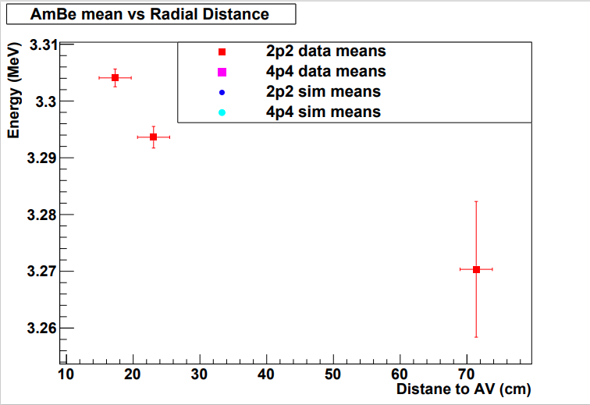
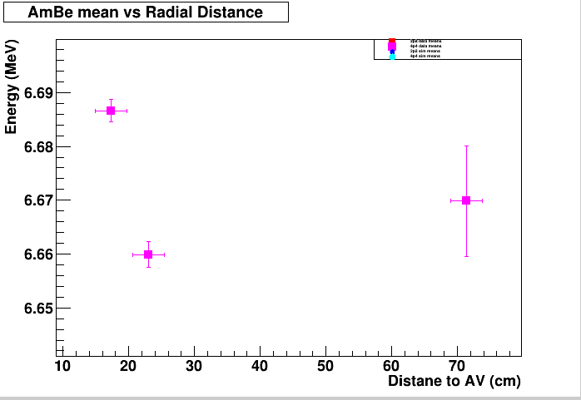
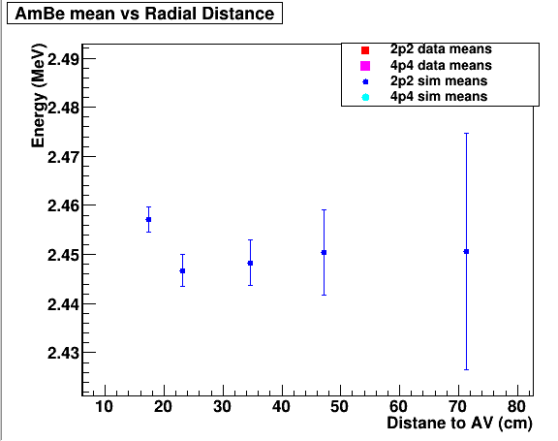
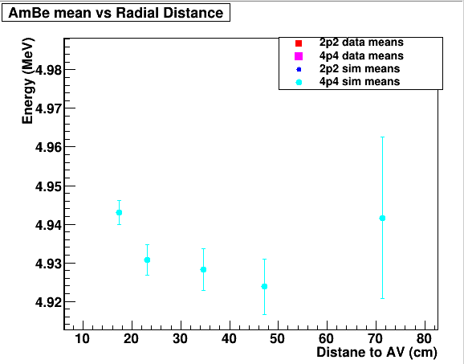
Energy Reconstruction
2.2 MeV
4.4 MeV
Data
Simulation

Slide 9
Time Delays
Ryan Bayes: March 2024
Data and simulation agree at distances <10cm
Comparison shows simulation does not match data at distances > 20cm
Goal to investigate neutron propagation
Credit: Ryan Bayes, Queens

Slide 10
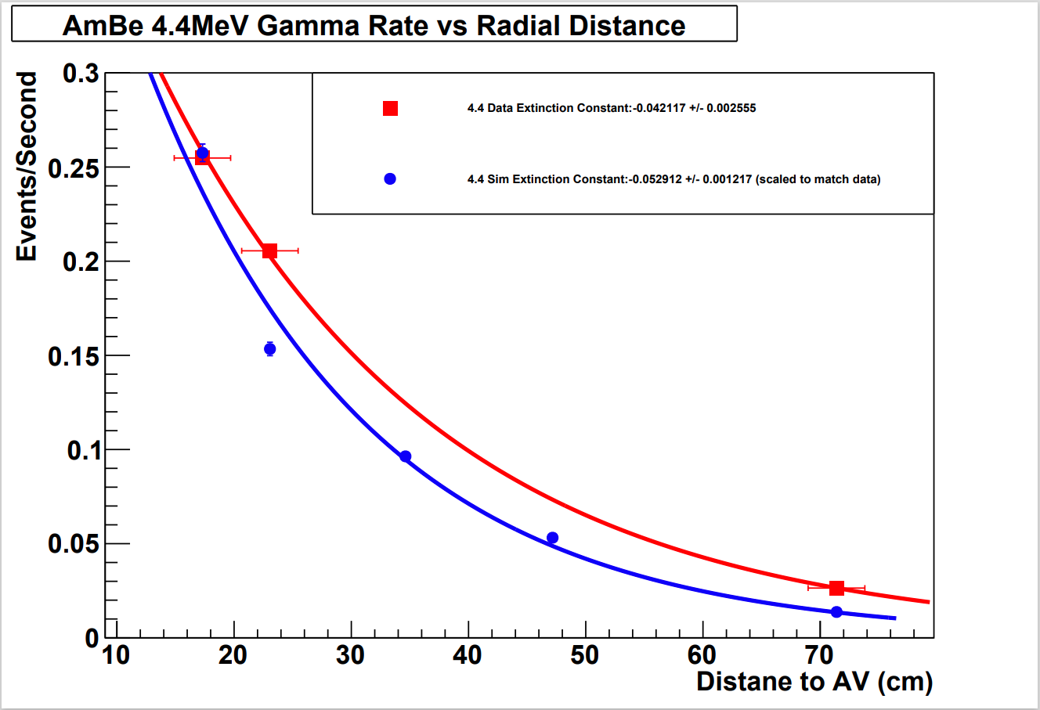
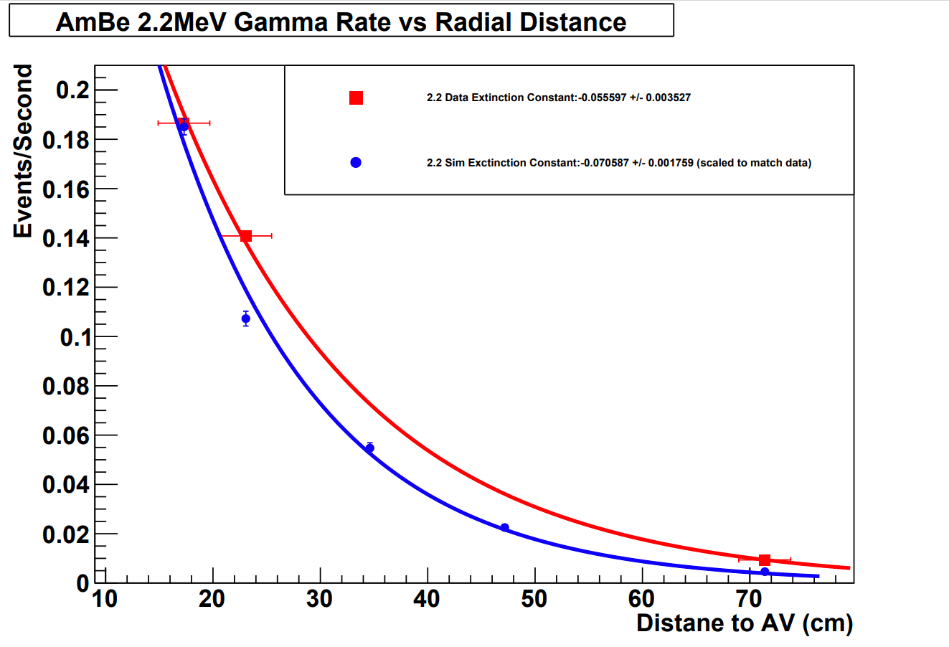
Gammas vs Radial Distance
𝛾_{data} = - 0.042 ± 2.555e⁻³
𝛾_{Sim} = - 0.053 ± 1.217 e⁻³
𝛾_{data} = - 0.056 ± 3.527e⁻³
𝛾_{Sim} = - 0.071± 1.759 e⁻³
Δ𝛾 = 0.011 ± 2.83 e⁻³
Δ𝛾 = 0.014 ± 3.94 e⁻³

Slide 11
Results
Overall, I was able to:
Quantify differences in energy reconstruction
Describe trends in energy reconstruction with distance
Quantify the number of *C¹² and nº events and compare them to simulation
Compare the behaviours of *C¹² and nº events

Slide 12
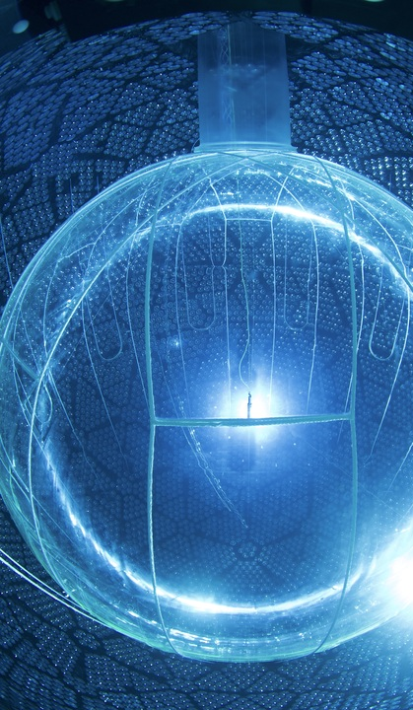
Moving Forward
Continue to investigate different simulation options
Conduct the planned internal deployments
Develop Explicit Simulations to test the relationship of rate to distance
Finish incorporating geometric effects to make statements about efficiency

Slide 13
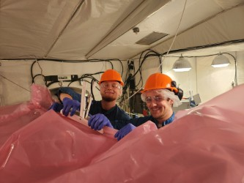
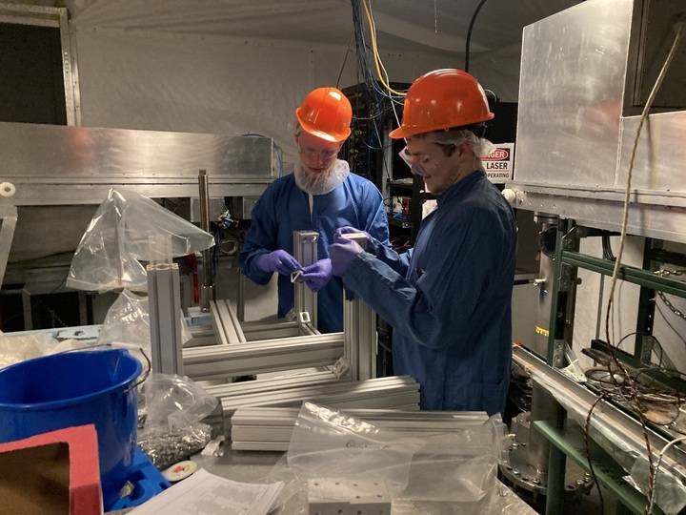
Bonus Slide: Underground
URM Lifting Table Pre-assembly
UI cover bag assembly for PMP
O-Ring replacements on UI motor boxes
UI cover gas bag piping preparations

