Slide 1
GEANT4 Lucas Cell Simulation
By Justin Suys
Supervisors : Lina Anselmo, Nasim Fatemighomi

Slide 2
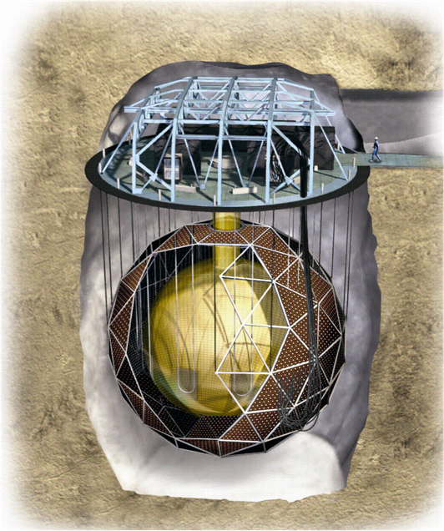
Motivation
²²²Rn and its progeny are a problematic source of background for SNO+ and for the other experiments at SNOLAB
As part of SNOLAB’s ²²²Rn testing program, we measure the concentrations of ²²²Rn for these experiments through Radon Assays.
Image provided by SNO
2

Slide 3
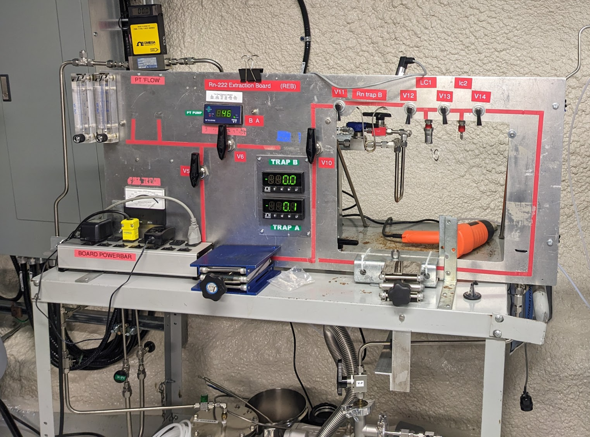
Motivation
3
Underground Radon Board

Slide 4
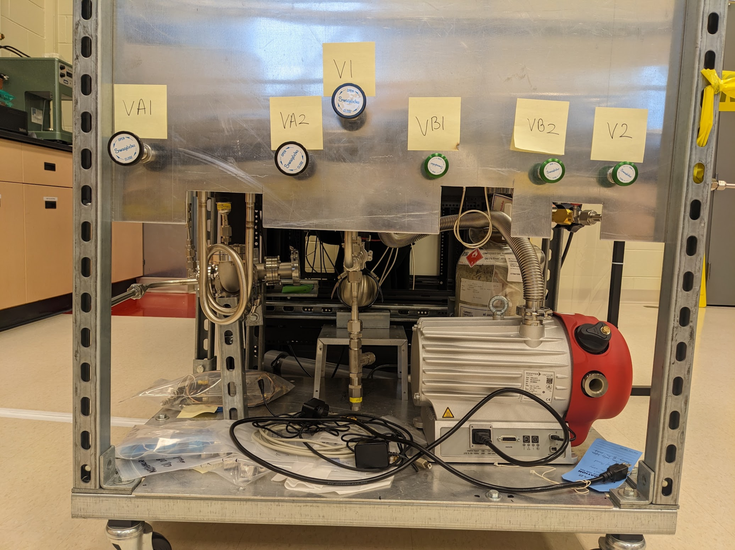
Motivation
4
DEAP Radon Board

Slide 5
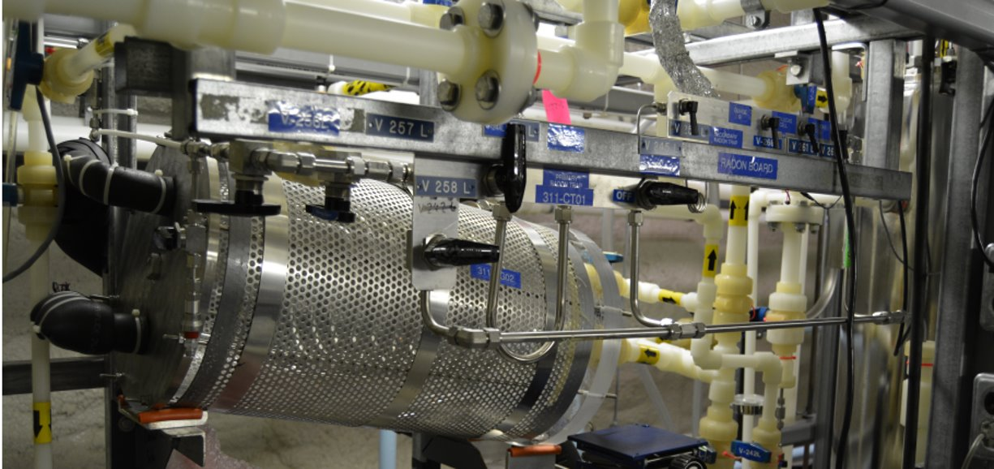
Motivation
Water Assay System
5

Slide 6
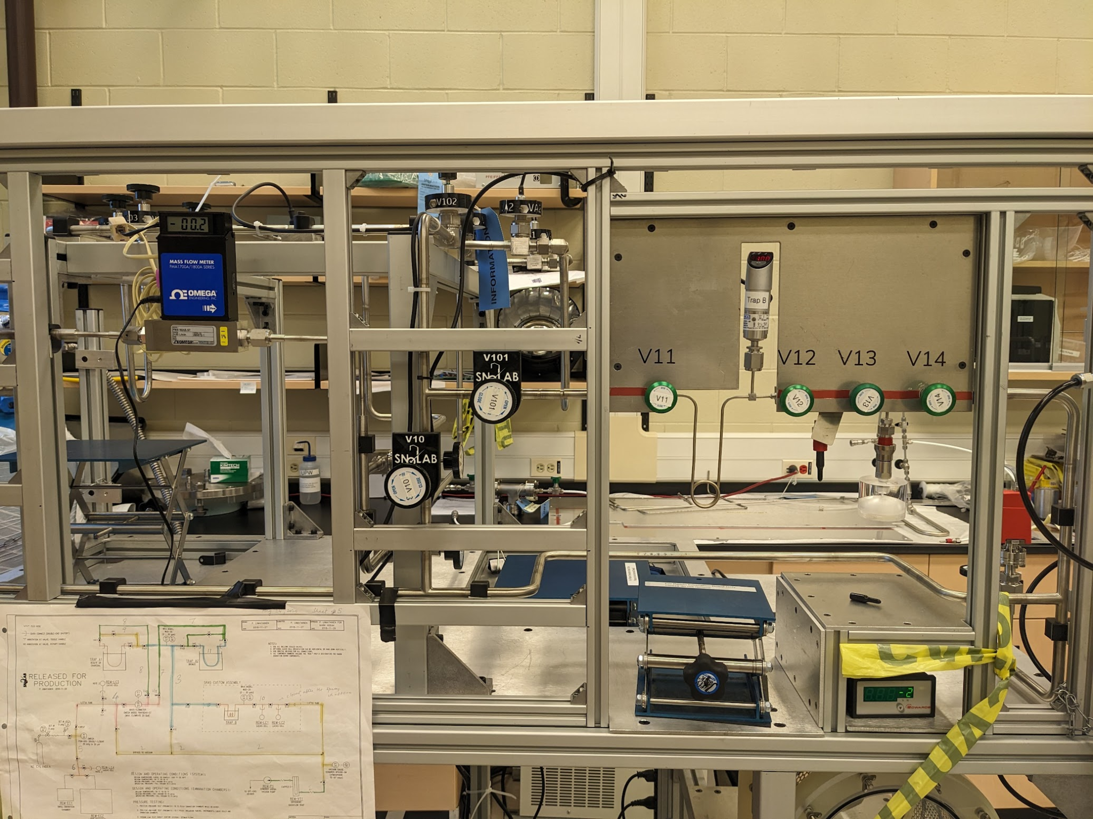
Motivation
6
Surface Radon Board

Slide 7
What is a Lucas Cell?
Scintillation counter sensitive to alpha particles made at SNOLAB
Individual ²²²Rn alpha decays can be counted with 2-inch photomultiplier tubes (PMTs) with known quantum efficiencies
Used to quantify the amount of ²²²Rn for the four systems presented
7

Slide 8
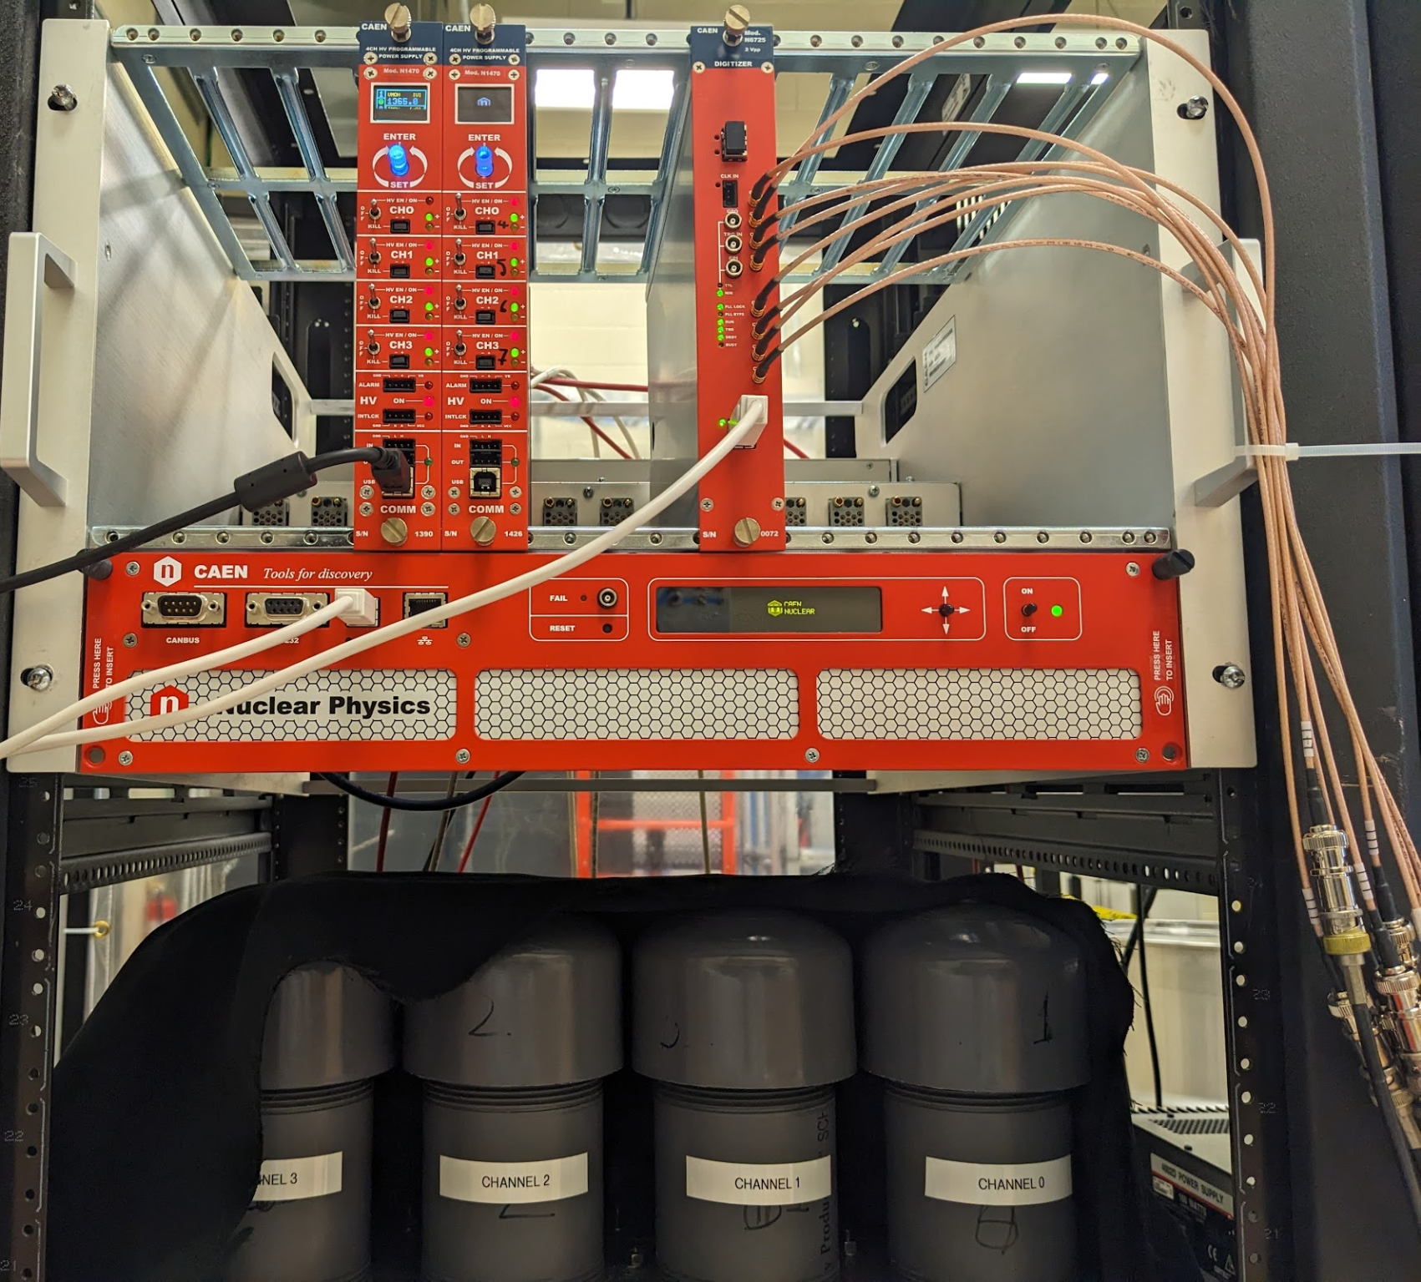
Data Acquisition System (DAQ)
6
Power supply unit (Above), PMT channels (Below)

Slide 9
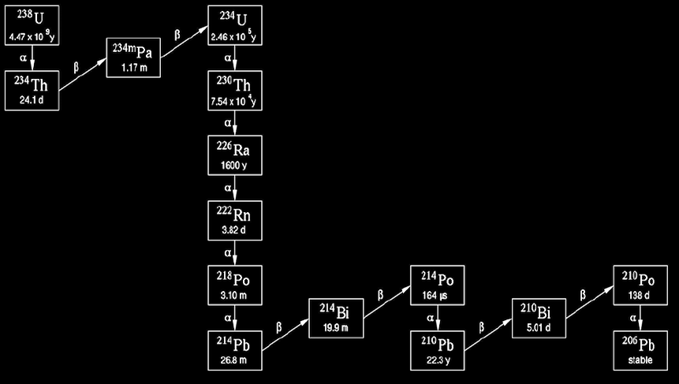
Measured Alpha Decays
1. ²²²Rn decay -> Measurement
2. ²¹⁸Po decay -> Measurement Verification
3. ²¹⁴Po decay -> Measurement Verification
4. ²¹⁰Po decay -> Background
1
2
3
4
Image provided by IAEA
8
Notes:
To model the time before the next decay, for each isotope, 4 concurrent Poissonian random variables were sampled based on their mean activity. The half lives of the intermediate beta emitters are included in the calculations to ensure realistic decay times. (Remove this)

Slide 10
Why simulate Lucas Cells?
𝜂_{T} =
Radon in Lucas Cell
Lucas Cell Efficiency(𝜂_{LC})
PMT Quantum Efficiency(𝜂_{QE})
Threshold/DAQ Efficiency(𝜂_{DAQ})
Number of detected Radon Decays
Total Number of Radon Decays
(Photons per alpha decay)
(Photoelectrons per photon)
(Detections per photoelectron)
Detected Radon
9

Slide 11
Why simulate Lucas Cells?
𝜂_{T} = 𝜂_{LC}𝜂_{QE}𝜂_{DAQ}
𝜂_{T} = 74±7%
Source : ²²²Rn emanation into vacuum(1993) [3]
𝜂_{T} = 62±3%
Source : Measurement of ²²²Rn dissolved in water at the Sudbury Neutrino Observatory(2004) [1]
The focus of my presentation is understanding this counting efficiency
10

Slide 12
Why simulate Lucas Cells?
To give us a better understanding of the underlying processes at play during radon assays at SNOLAB
11

Slide 13
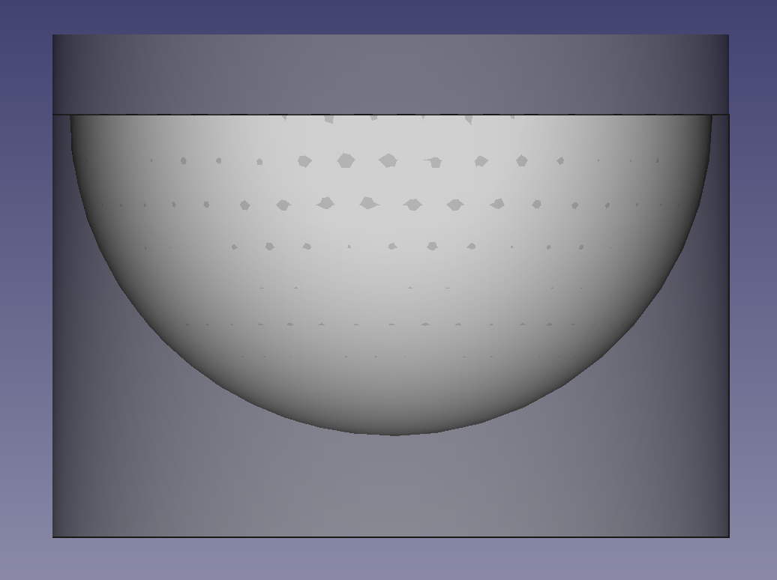
Lucas Cell Geometry
Radon Sample (Inside hemisphere)
Acrylic
(PMMA)
ZnS(Ag) scintillator
FreeCAD GDML Workbench - Keith Sloan
12
Notes:
Made the model using FreeCad’s GDML workbench add-on
The shape is composed of cylinders and spheres. With cuts we can make a more complicated geometry.
Acrylic or PMMA makes up the body and photomultiplier tube window of the Lucas Cell. The spherical silver doped zinc sulfide makes up the scintillator volume. The radon sample is contained within the cavity.

Slide 14
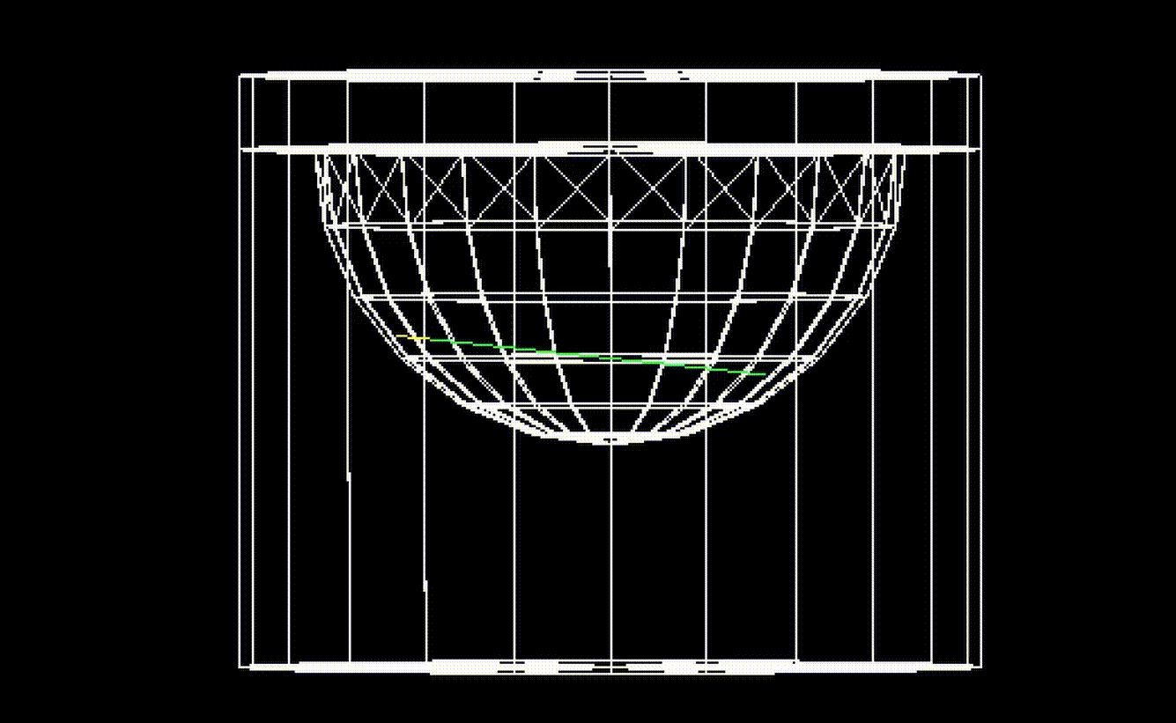
Lucas Cell Geometry
13
Notes:
Made the model using FreeCad’s GDML workbench add-on
The shape is composed of cylinders and spheres. With cuts we can make a more complicated geometry.
Acrylic or PMMA makes up the body and photomultiplier tube window of the Lucas Cell. The spherical silver doped zinc sulfide makes up the scintillator volume. The radon sample is contained within the cavity.

Slide 15
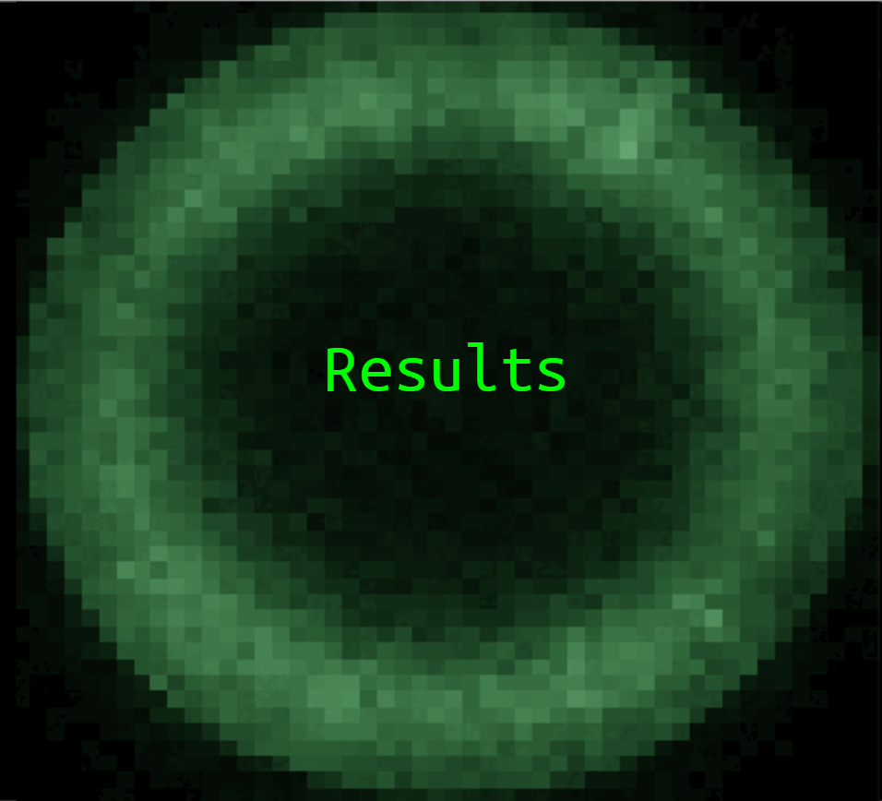
14

Slide 16
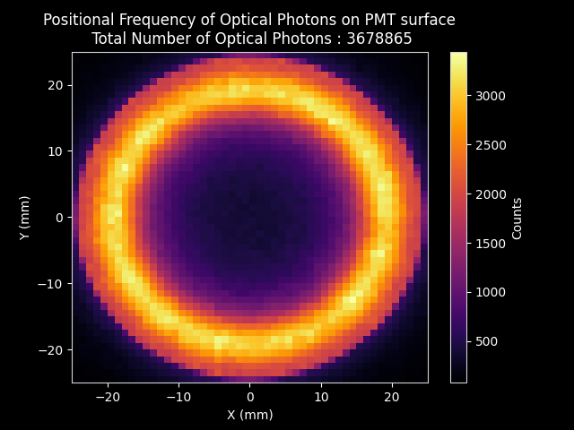
15
Notes:
Introduce the graph
Present axes
Show the graph
Talk about total internal reflection between volumes
Highlight asymmetry between quadrants

Slide 17
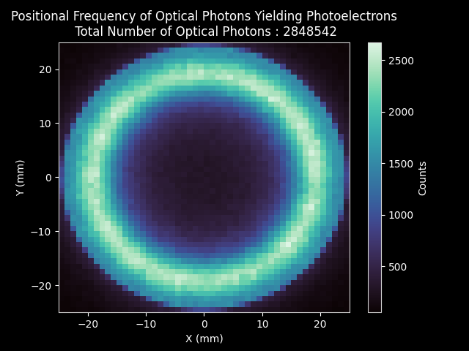
16
Notes:
Introduce the graph
Present axes
Show the graph
Talk about the number of photons in comparison after quantum efficiency.
Give the efficiency ()

Slide 18
Photon Distribution Testing
Expectation: ~90% less counts
Expectation: No counts
Expectation: ~90% less counts
Result: No reduction
Result: No counts
Result: No reduction
Tape : Partial Coverage
Tape : Full Coverage
Cloth : Partial Coverage
17
Notes:
Introduce the graph
Present axes
Show the graph
Talk about the number of photons in comparison after quantum efficiency.
Give the efficiency ()

Slide 19
Total Internal Reflection
Vacuum
n = 1
Thin ZnS(Ag) Layer
𝛼 Particle
ZnS(Ag)
n = 2.356
PMMA
n = 1.5
Isotropic Scintillation
18
Notes:
Introduce title
Introduce axes/units (charge = photoelectrons), number of radon decays
Talk about low charge spike, and scintillation spike
Compare peak width with previous slide 250 vs 650 000

Slide 20
Total Internal Reflection
Vacuum
n = 1
Thin ZnS(Ag) Layer
𝛼 Particle
ZnS(Ag)
n = 2.356
PMMA
n = 1.5
Isotropic Scintillation
19
Notes:
Introduce title
Introduce axes/units (charge = photoelectrons), number of radon decays
Talk about low charge spike, and scintillation spike
Compare peak width with previous slide 250 vs 650 000

Slide 21
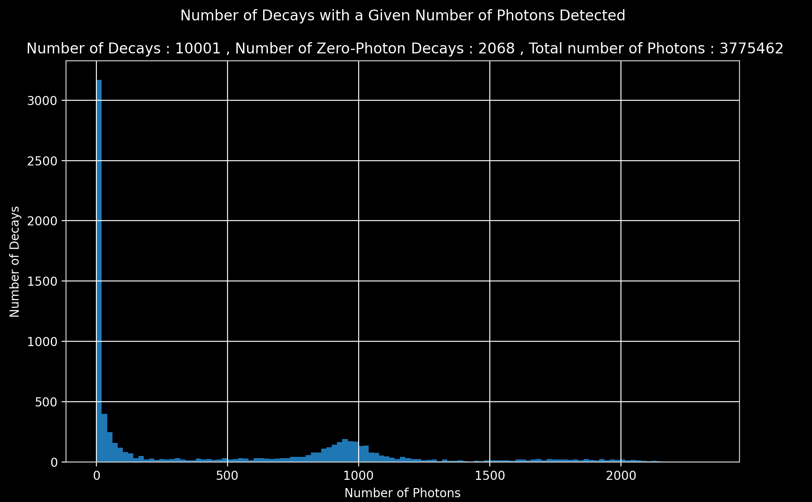
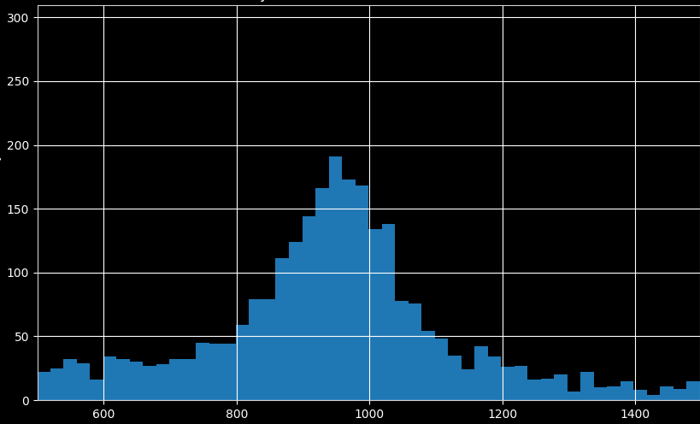
20
Notes:
Introduce title
Introduce axes/units
Talk about low photon count spike, and scintillation spike

Slide 22
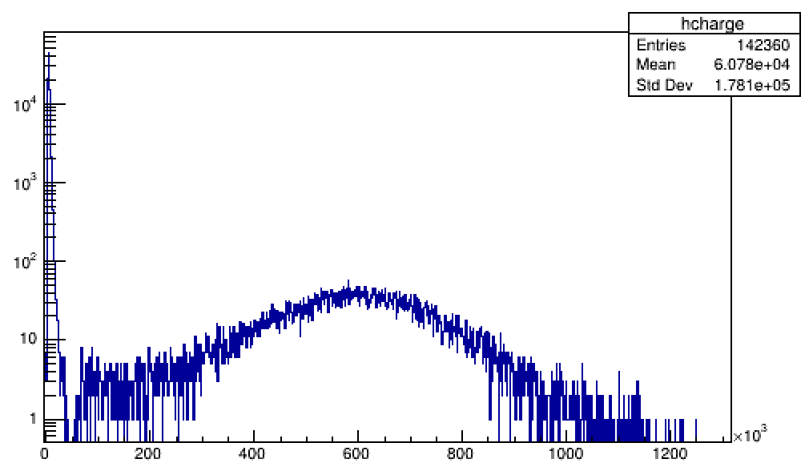
Integrated PMT Charge Distribution
Number of Decays
Energy (A.U.)
21
Notes:
Introduce title
Introduce axes/units (charge = photoelectrons), number of radon decays
Talk about low charge spike, and scintillation spike
Compare peak width with previous slide 250 vs 650 000

Slide 23
GEANT4 Simulation Milestones
Stochastic Decay Timing Model implemented for the relevant isotopes
GDML functionality for different Lucas Cell dimensions
2848542
Value for 𝜂_{QE,Rn222} =
= 0.7743 photoelectrons/photon
3678865
GUI to facilitate graphing and knowledge transfer
22

Slide 24
Future Work
Implementing the ZnS(Ag) surface roughness***
Transfer simulation to computer cluster
Measuring the spatial distribution of ²²²Rn daughters
Enhancing GUI and uploading code to Github
23

Slide 25
Thank you!
Nasim Fatemighomi Keegan Paleshi
Mark Ward Ryan Bayes
Lina Anselmo
24

Slide 26
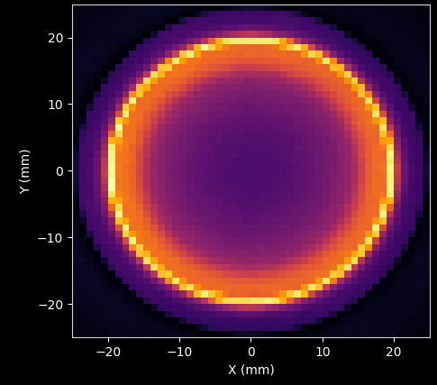
Smooth Scintillator Surface
Rough Scintillator Surface
Not Realistic
More Realistic
26

Slide 27
Backup - QE calculation
Positional Frequency of Optical Photons Yielding Photoelectrons
Total Number of Optical Photons : 2848542
Positional Frequency of Optical Photons on PMT surface
Total Number of Optical Photons : 3678865
2848542 photoelectrons
𝜂_{QE,Rn222} =
= 0.7743 photoelectrons/photon
3678865 photons
25

Slide 28
References
[1] Blevis, I., Boger, J., Bonvin, E., Cleveland, B. T., Dai, X., Dalnoki-Veress, F., Doucas, G., Farine, J., Fergani, H., Grant, D., Hahn, R. L., Hamer, A. S., Hargrove, C. K., Heron, H., Jagam, P., Jelley, N. A., Jillings, C., Knox, A. B., Lee, H. W., … Zhu, X. (2004). Measurement of 222 Rn dissolved in water at the Sudbury Neutrino Observatory. Nuclear Instruments and Methods in Physics Research Section A: Accelerators, Spectrometers, Detectors and Associated Equipment, 517(1–3), 139–153. https://doi.org/10.1016/j.nima.2003.10.103
[2] IAEA. (2010). Analytical Methodology for the Determination of Radium Isotopes in Environmental Samples. https://www-pub.iaea.org/MTCD/publications/PDF/IAEA-AQ-19_web.pdf
[3] Liu, M., Lee, H. W., & McDonald, A. B. (1993). 222rn emanation into vacuum. Nuclear Instruments and Methods in Physics Research Section A: Accelerators, Spectrometers, Detectors and Associated Equipment, 329(1–2), 291–298. https://doi.org/10.1016/0168-9002(93)90948-h
20

