Slide 1

Developing Machine Learning Techniques for Particle Flow in the ATLAS Experiment
Joshua Himmens with Dr. Maximilian Swiatlowski

Slide 2
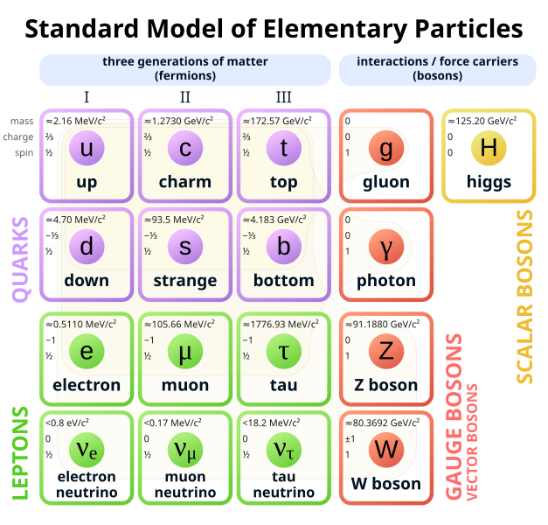
Why do we collide?
Unique processes: We can test the standard model at the highest possible energies
Heavy particles: We can see particles that can’t be produced in any other lab
Push the boundaries of the standard model by testing it at the highest (humanly) possible energies

Slide 3
How do we collide?
We collide pairs of bunches of 10¹¹ protons
At 99.999999% the speed of light
With energies as high as 13.6 TeV
Every 25 nano seconds

Slide 4
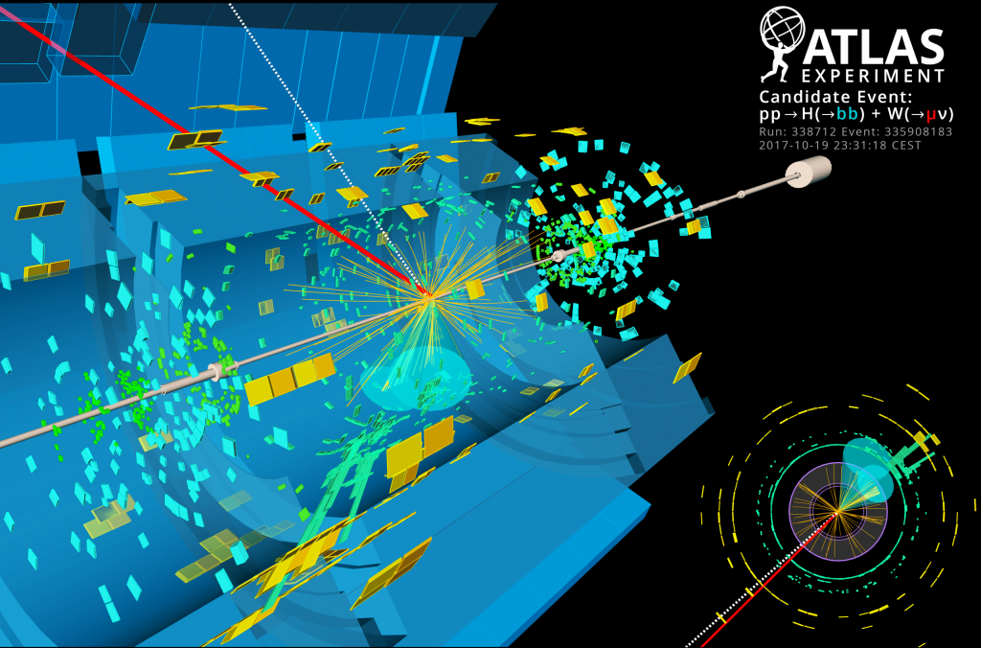
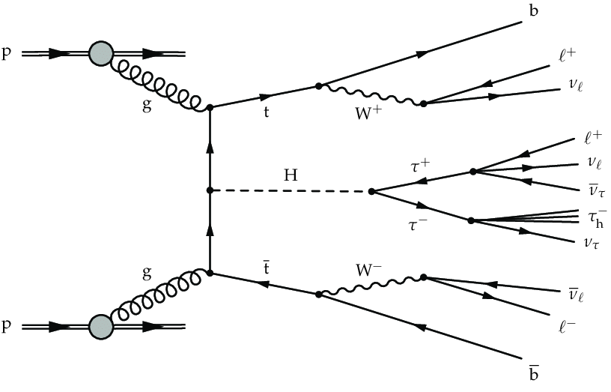
What happens when we collide?
Image: http://news.fnal.gov/2018/08/lhc-scientists-detect-most-favored-higgs-decay/
Image (R): https://www.researchgate.net/figure/An-example-of-a-Feynman-diagram-for-ttH-production-with-subsequent-decay-of-the-Higgs_fig1_323796380

Slide 5
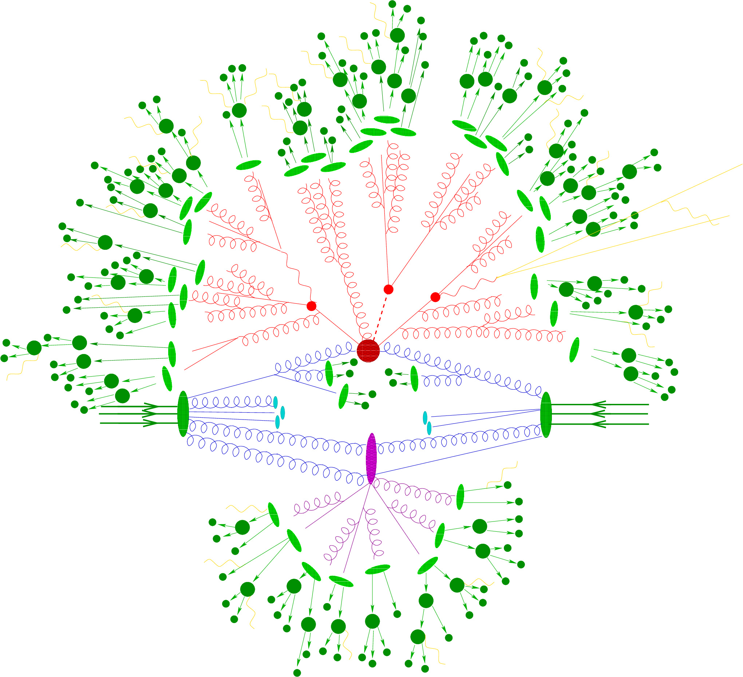
Particle Flow
While the results are interesting, we care about the fundamental physics, which requires understanding the decay process
Particle Flow is the practice of piecing together the signals from multiple detectors so that we have the information to reconstruct the event
Visible to the detector
The Higgs and two top quarks
Background
Image: https://w3.lnf.infn.it/research/theoretical-physics/enp/?lang=en

Slide 6
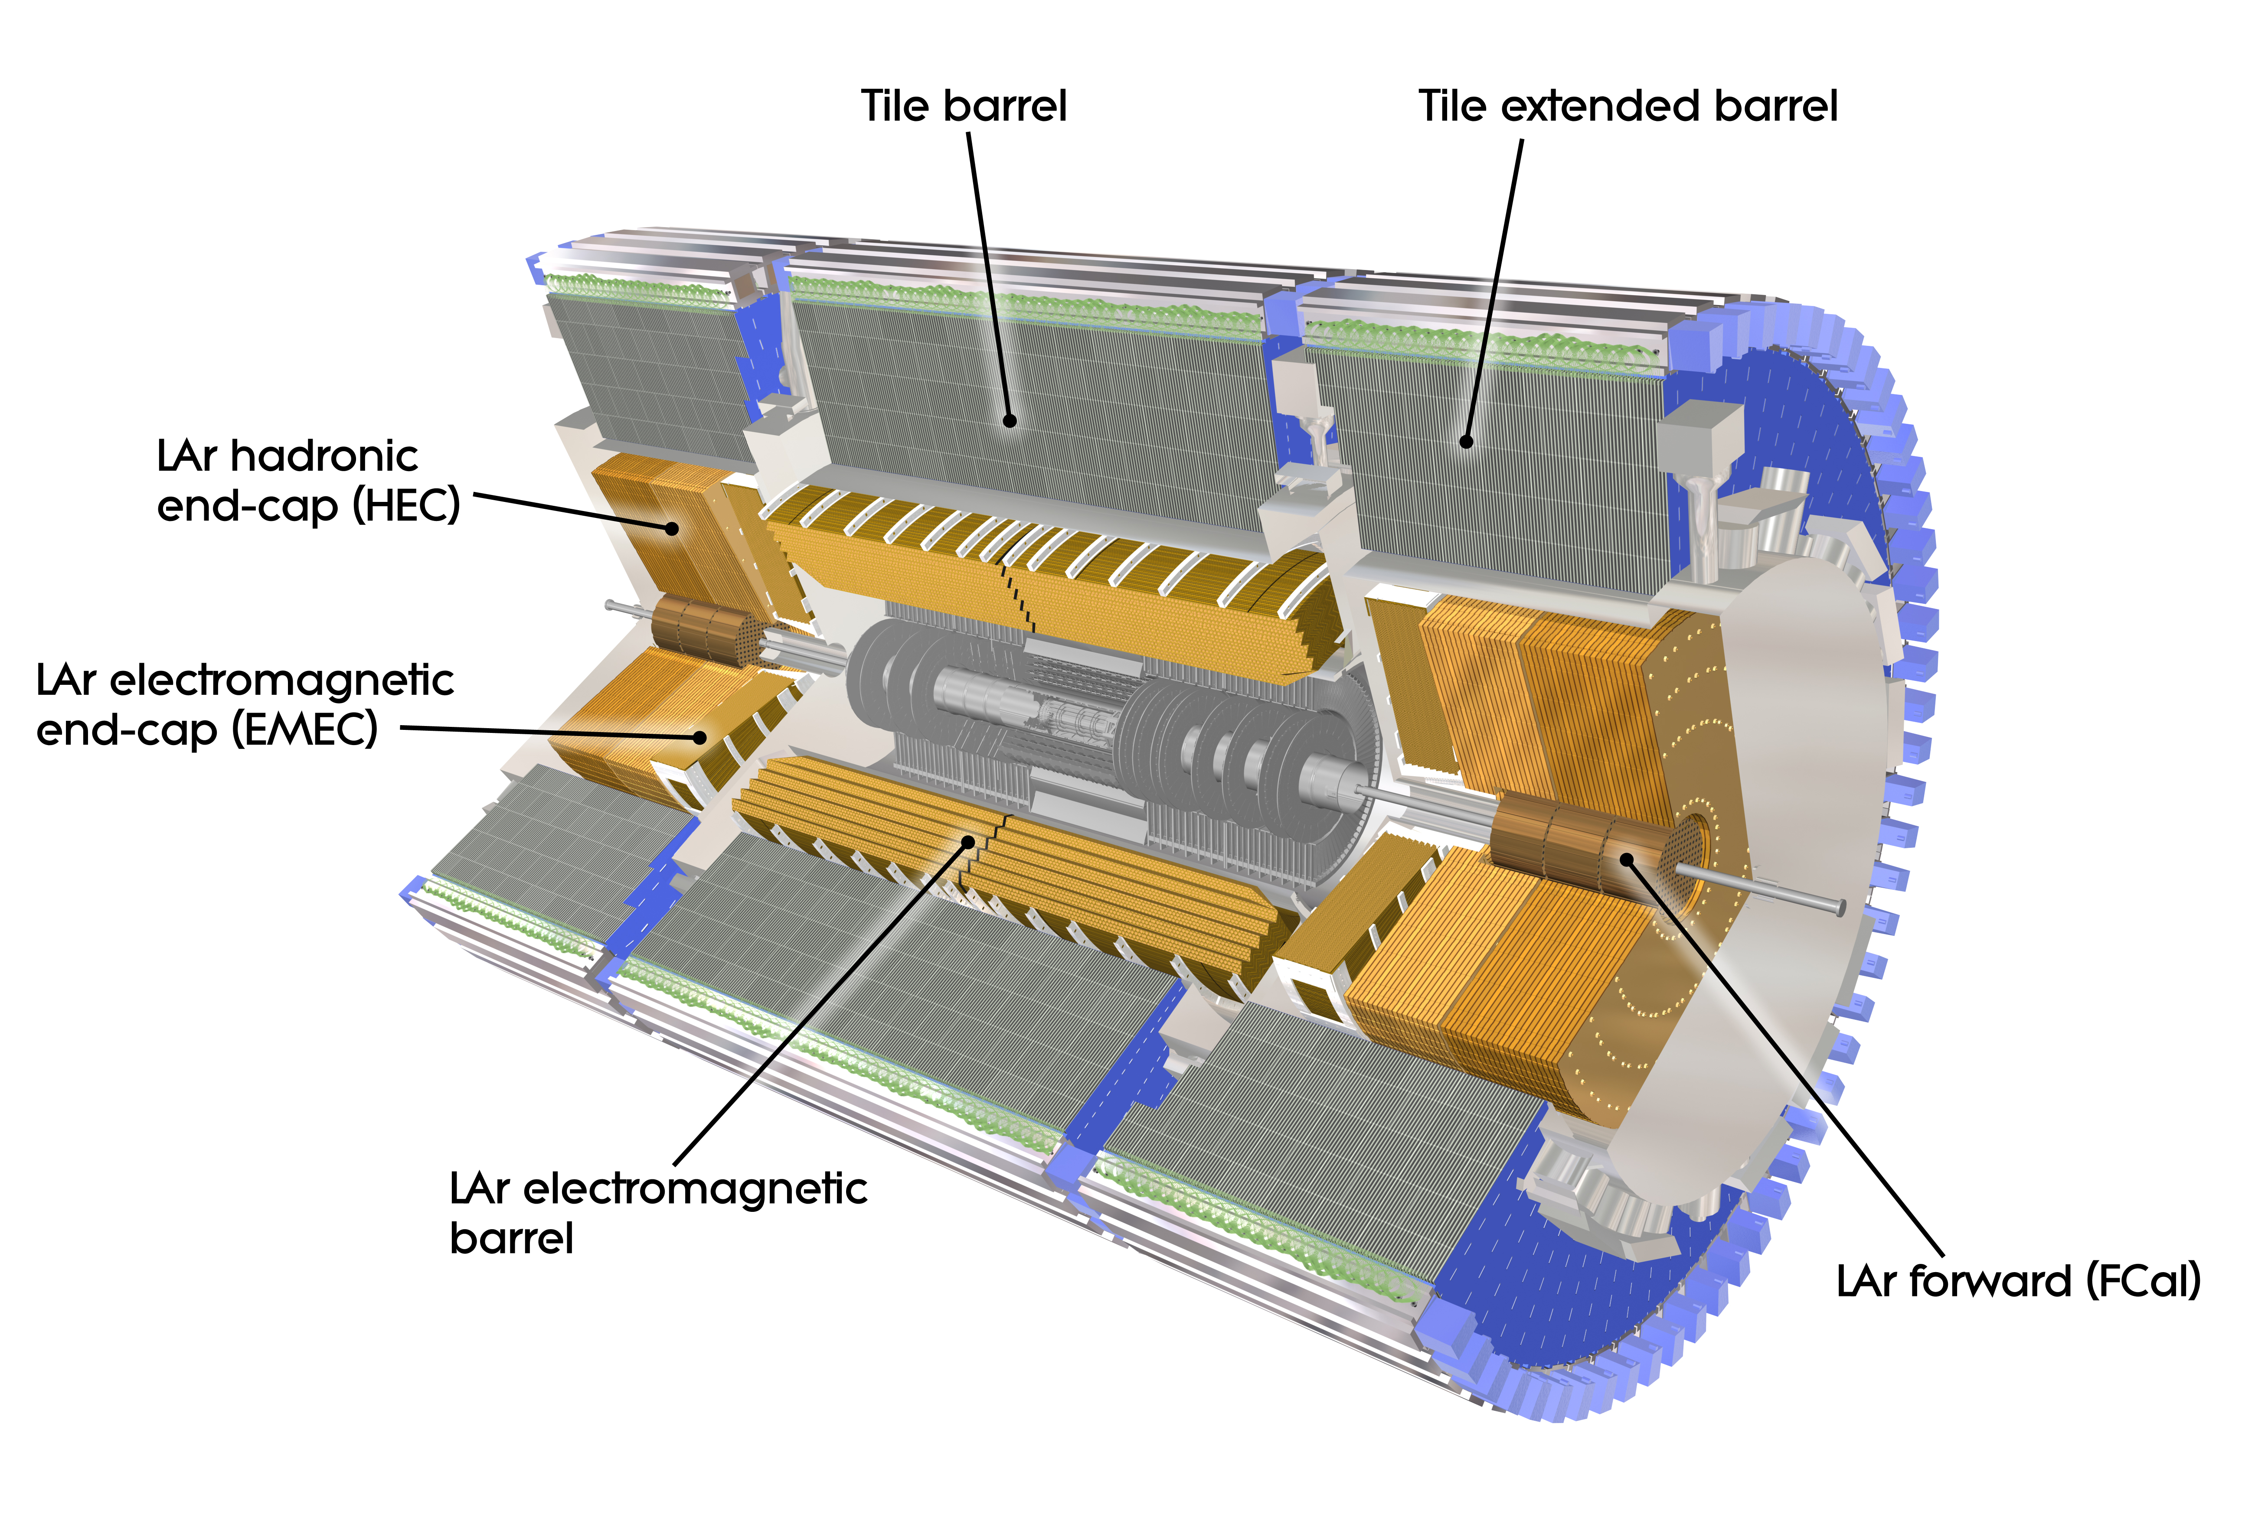
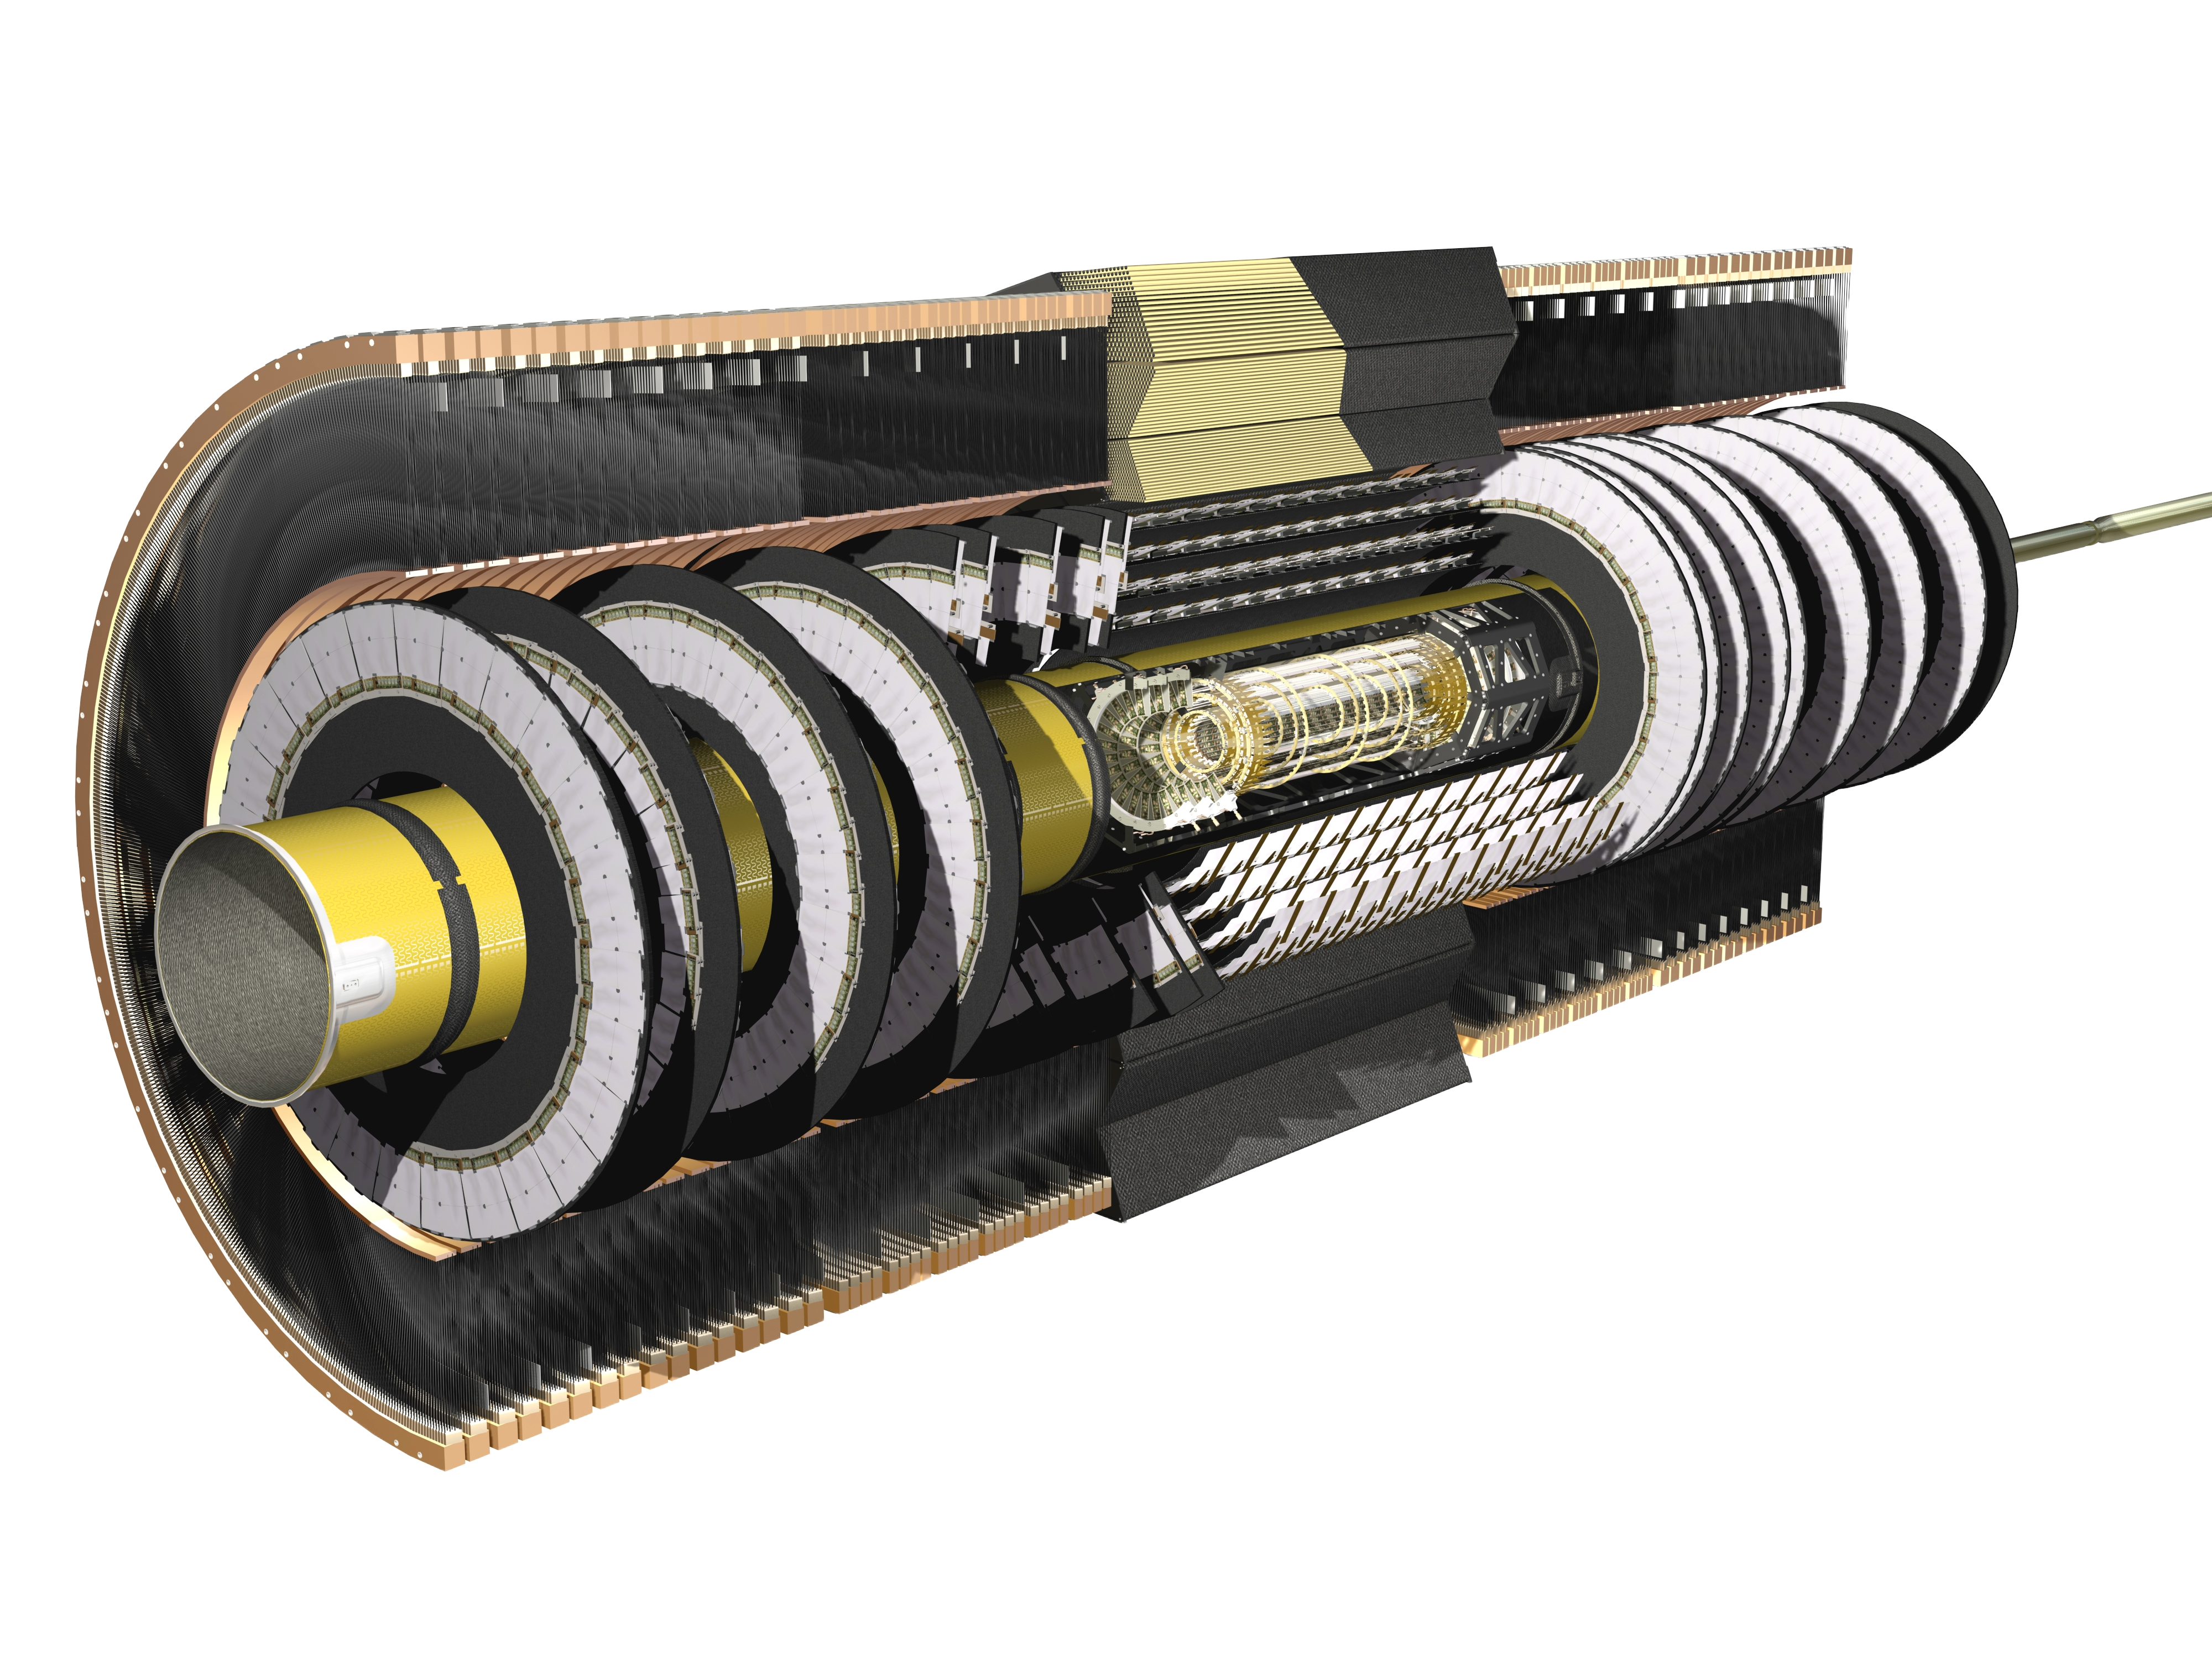
What is ATLAS?
ATLAS detects the results of these collisions with 2 types of detectors
  Trackers – which tell us where particles are traveling
  Calorimeters - which tell us how much energy particles have

Slide 7
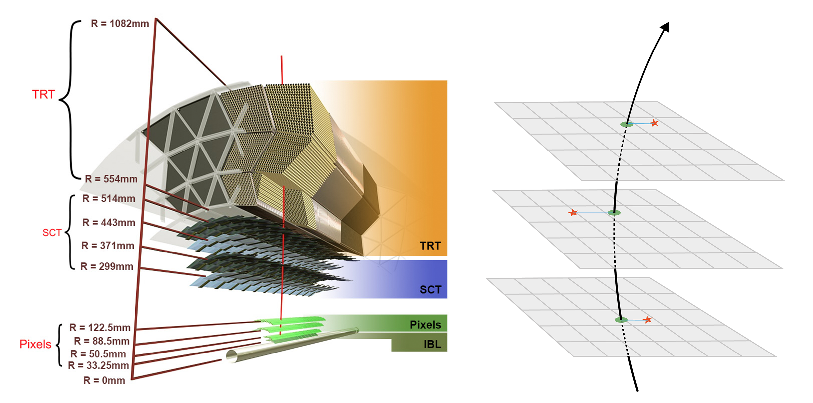
Following a particle – The inner detector
As the particle interacts with the detector we get signals from the layers
Curve fitting the track is able to tell us the momentum
Higher accuracy at lower momentums

Slide 8
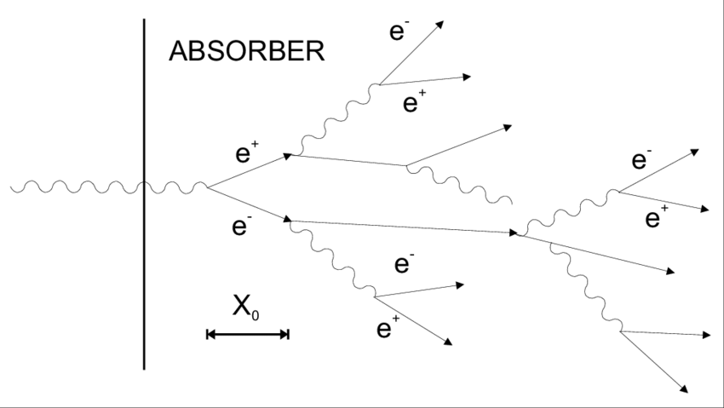
Following a particle – The calorimeter
As particles hit the detector they deposit energy
We stop stop the particles by causing them to shower
Tells us the energy of particles
Image: https://www.researchgate.net/figure/Schematic-development-of-an-electromagnetic-shower_fig9_254468999

Slide 9
The two (heterogenous) detectors
Tracker (tracks)
Calorimeter (cells)
Pros:
High accuracy at low energy
Gives us the momentum of particles
Format:
Helices of extrapolated path of the particle
Pros:
High accuracy at high energy
Gives us the energy of particles
Format:
Points in 3D space

Slide 10

How do we predict the the truth from the visible information?
This is where we can use machine learning!

Slide 11
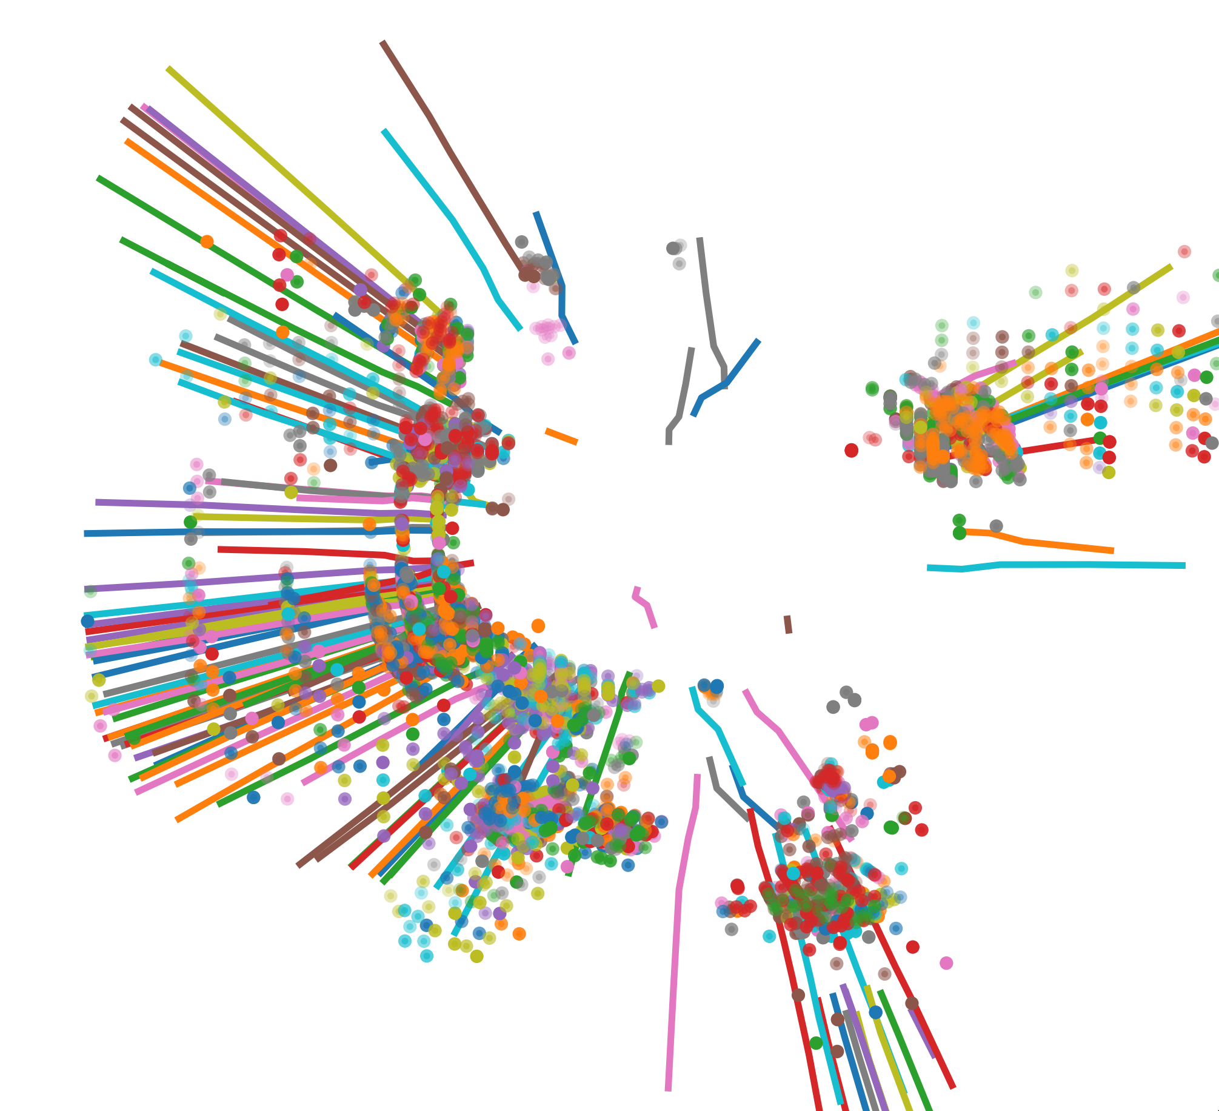
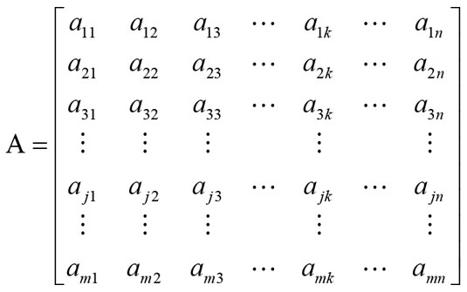
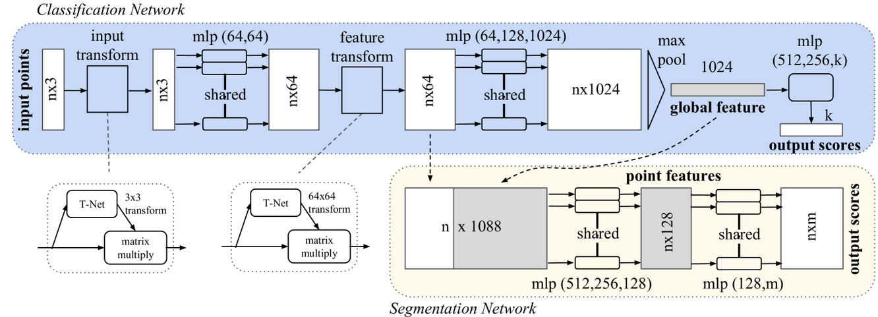
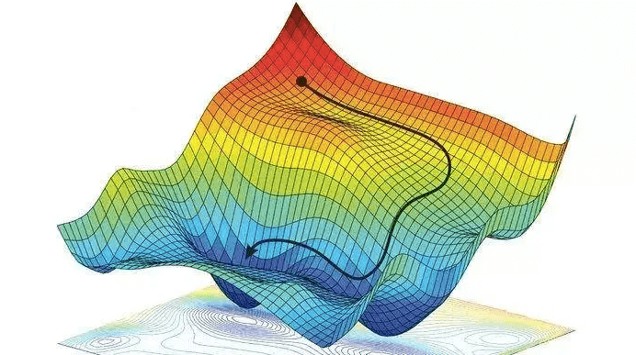
Deep Learning A Crash Course
Data needs a standard format (constant size matrix matrix)
We define a set of matrix operations to the input data
Each operation contains a set parameters (in our case over 6 million!)
Gradient Descent: We define a loss function that the model attempts to minimize

Slide 12
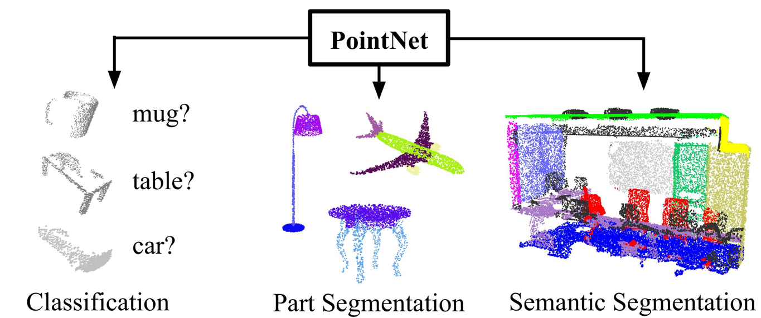
PointNet – our model
PointNet allows us to represent data as spare points
Been successful at similar classification problems

Slide 13
Defining success – What do we care about the most?
Defining a loss metric is complicated
Two key metrics we have used so far:
Accuracy: How many cells did we correctly predict
Statical Strength (F1): How certain is our model in its predictions
There are many metrics that we hope to get ‘for free’:
Energy accuracy
Minimized false positives and false negatives
Predictive value

Slide 14
Datasets
We use 2 datasets to train our models, both are Geant4 simulations
Simplified Set:
Well defined 2 particle system
Realistic Set:
Complicated collisions with many tracks and many cells

Slide 15
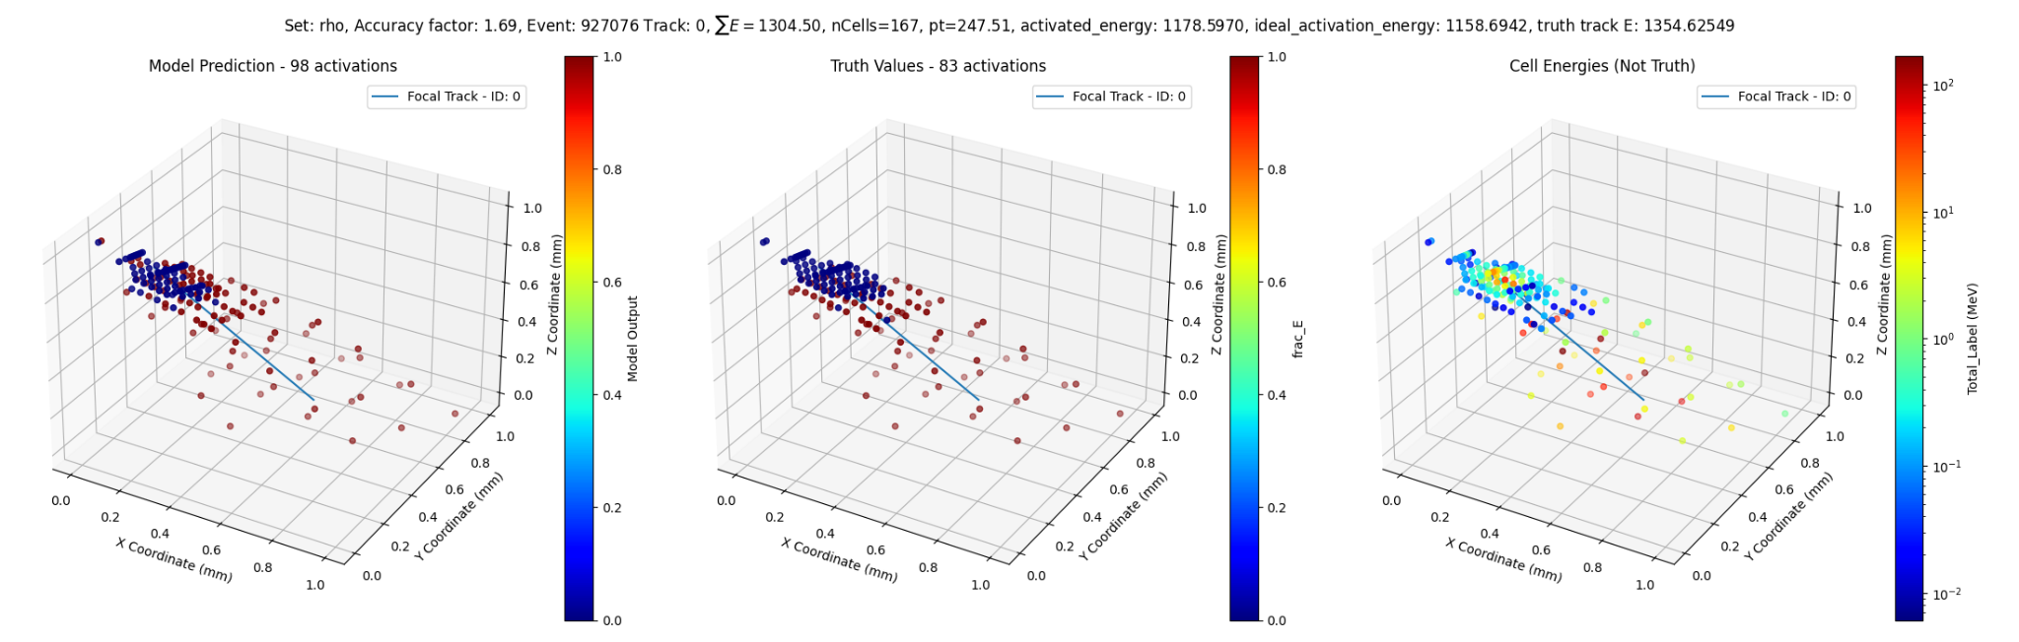
Energy Primarily Neutral Particles
Results so far – It works! (on simplified data)
Energy Primarily from Track
Truth Data – 83 Activations
Model Predictions – 98 Activations
Truth Activation Energy = 1159 GeV
Model Activated Energy = 1179 GeV
83 to 98

Slide 16
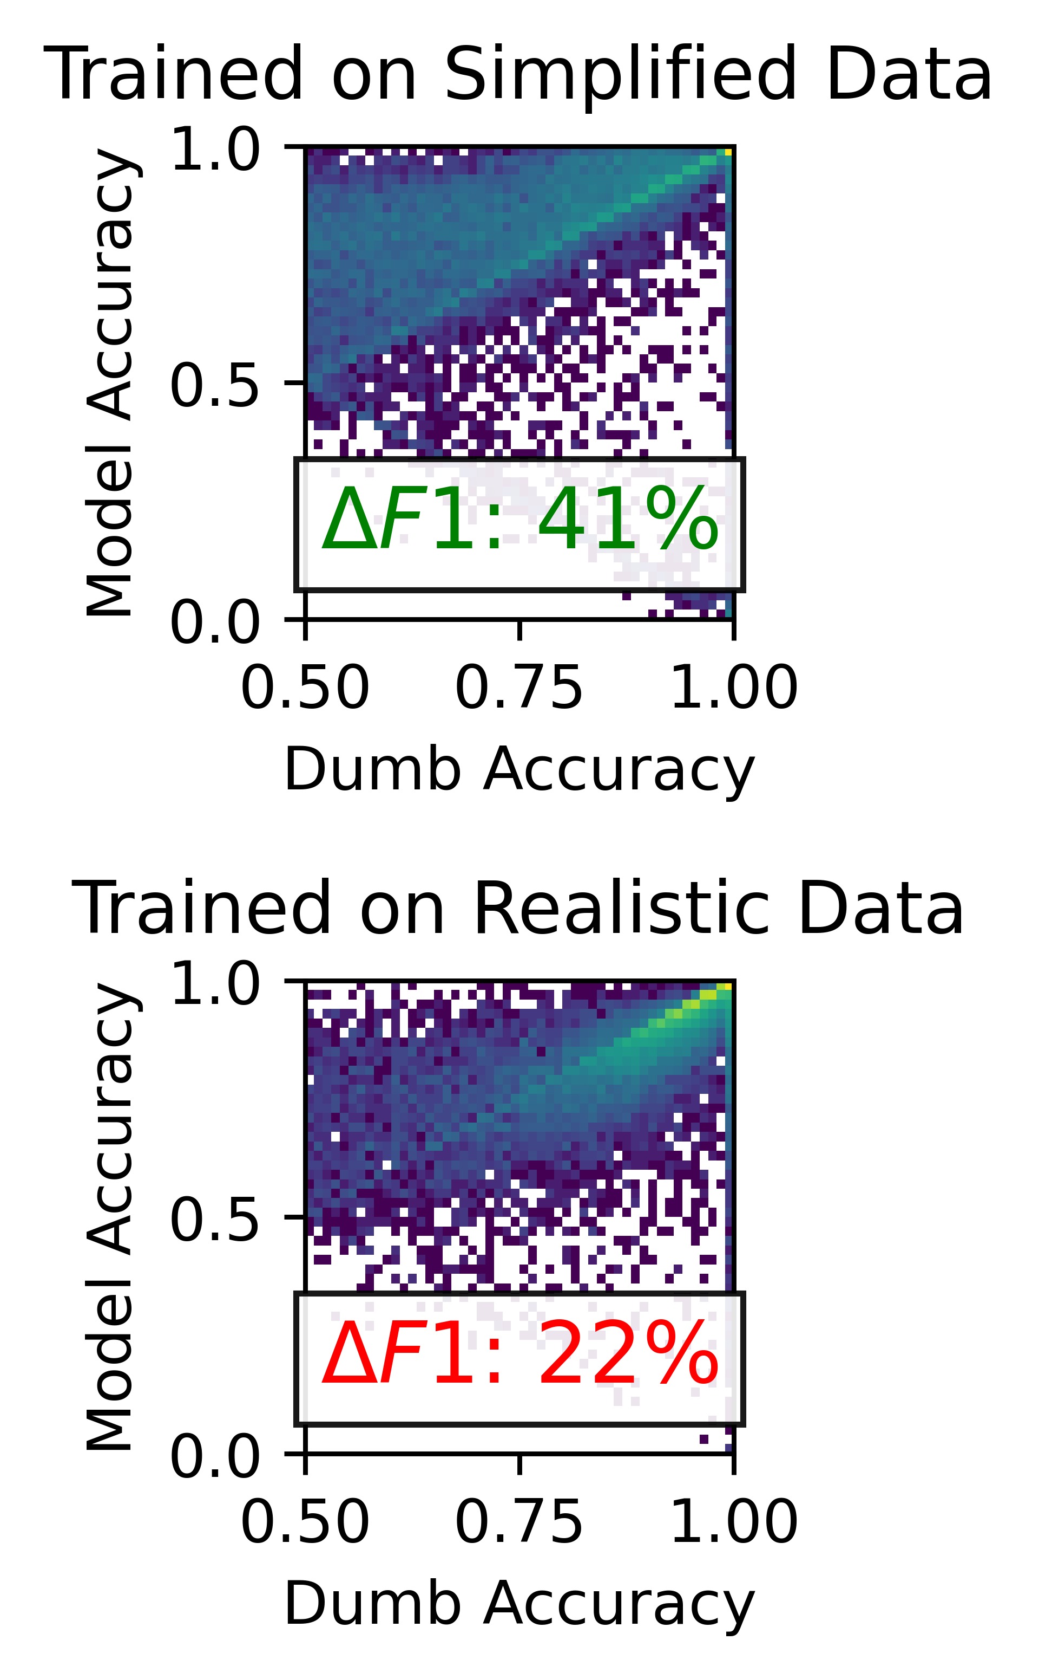

Results so far – It works! (on simple data)
We have run the model on two data sets.
The model works with simplified data, but struggles with more realistic data
Dataset | Model | Accuracy | Statistical Certainty (F1)
Simplified Data | PointNet | 0.83 | 0.78
 | Random Estimator | 0.63 | 0.37
Realistic Data | PointNet | 0.94 | 0.28
 | Random Estimator | 0.94 | 0.06

Slide 17
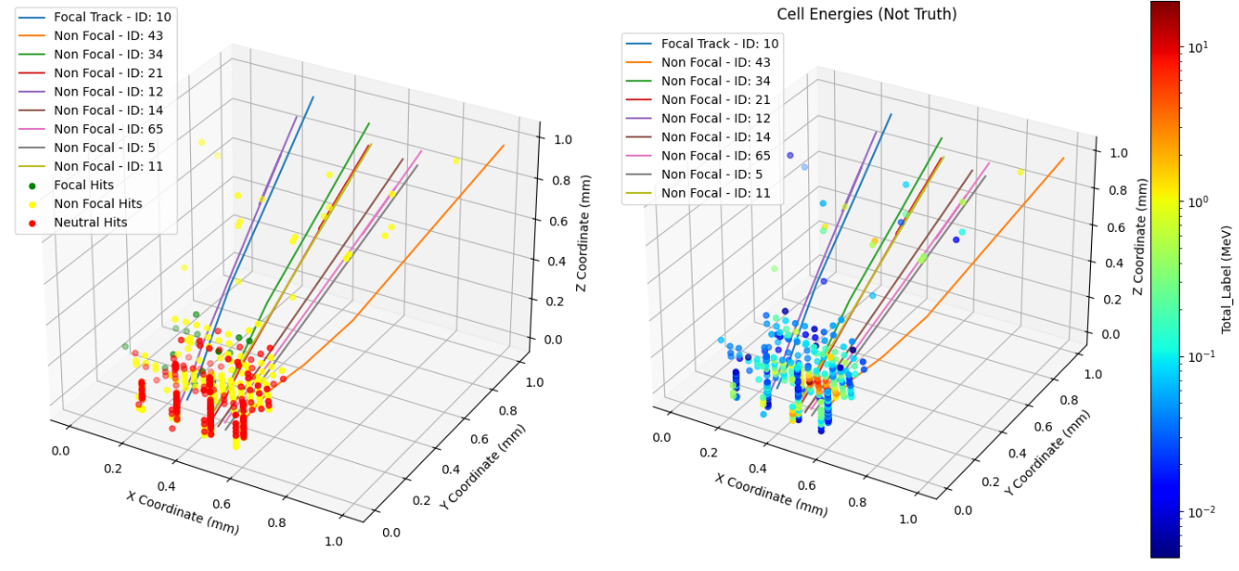
How are we planning on translating this success? - Information
Give the model more information with multiple labels

Slide 18
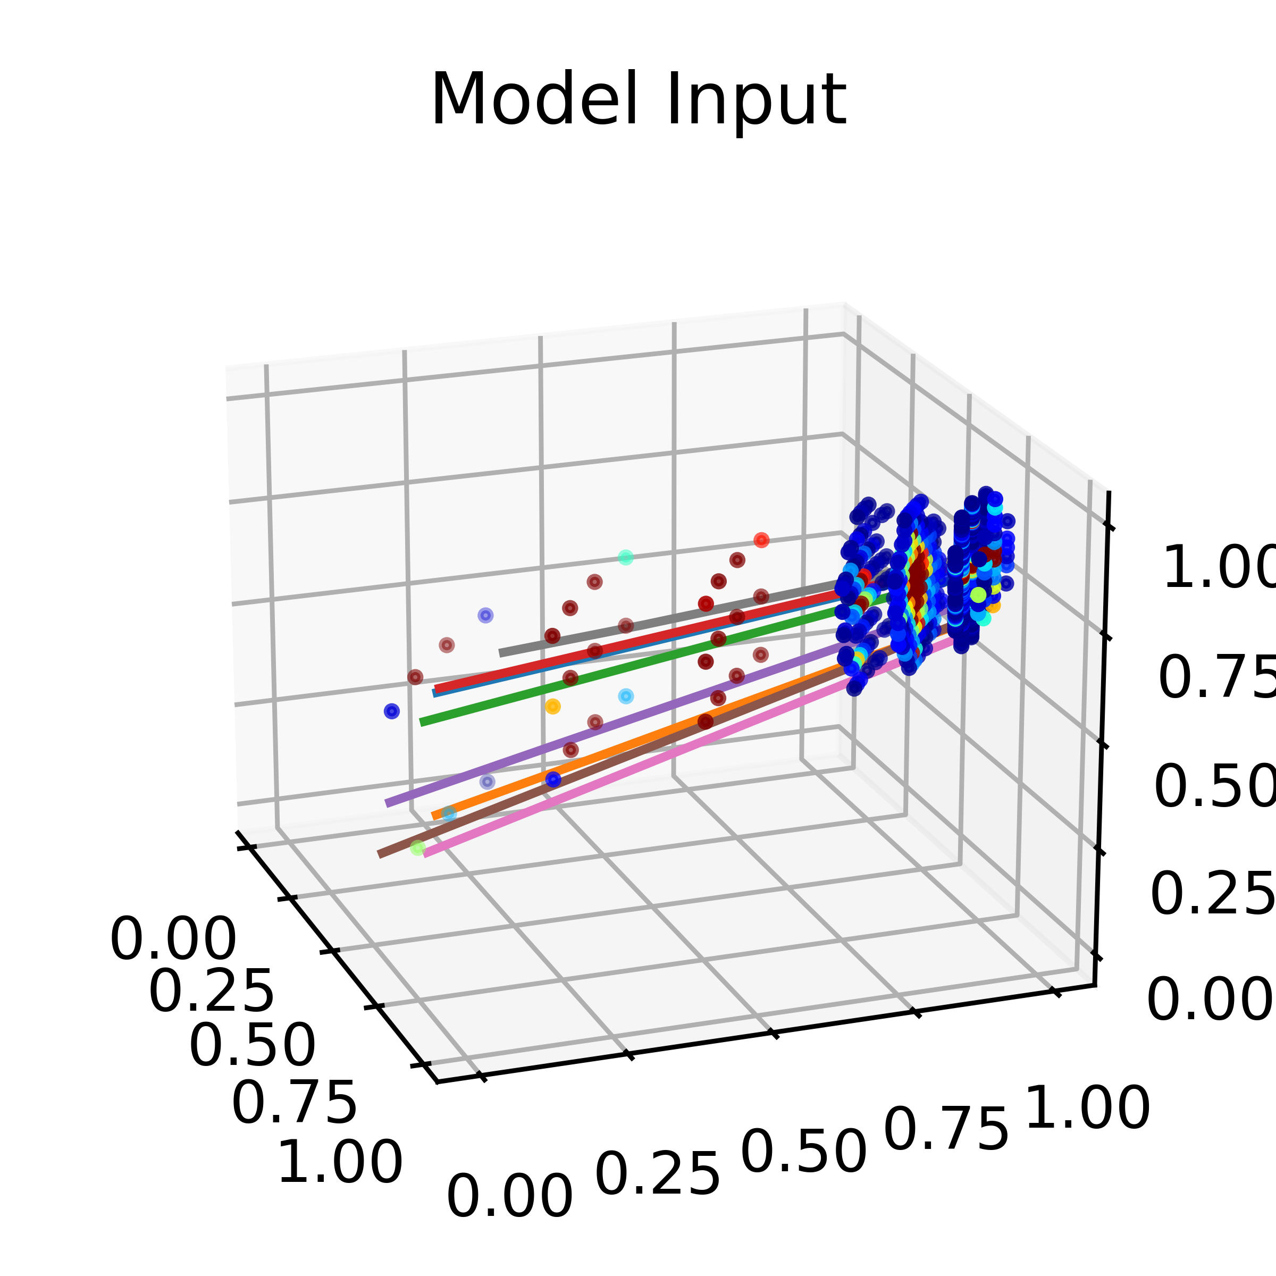
In Summary
ATLAS hopes to unearth new physics at the high energy frontier
ATLAS uses multiple different detector systems
Combining detector signals is a non-trivial problem
Machine learning approaches to particle flow are promising

Slide 19
Thank you!
How do you determine which cells to include in your data?
What would an ideal model look like?
Are there types of events where the model doesn’t work?
What does the current segmentation strategy look like?
How do you turn events into point clouds?
How do you use two metrics simultaneously to train a model?

Slide 20
Backup

Slide 21
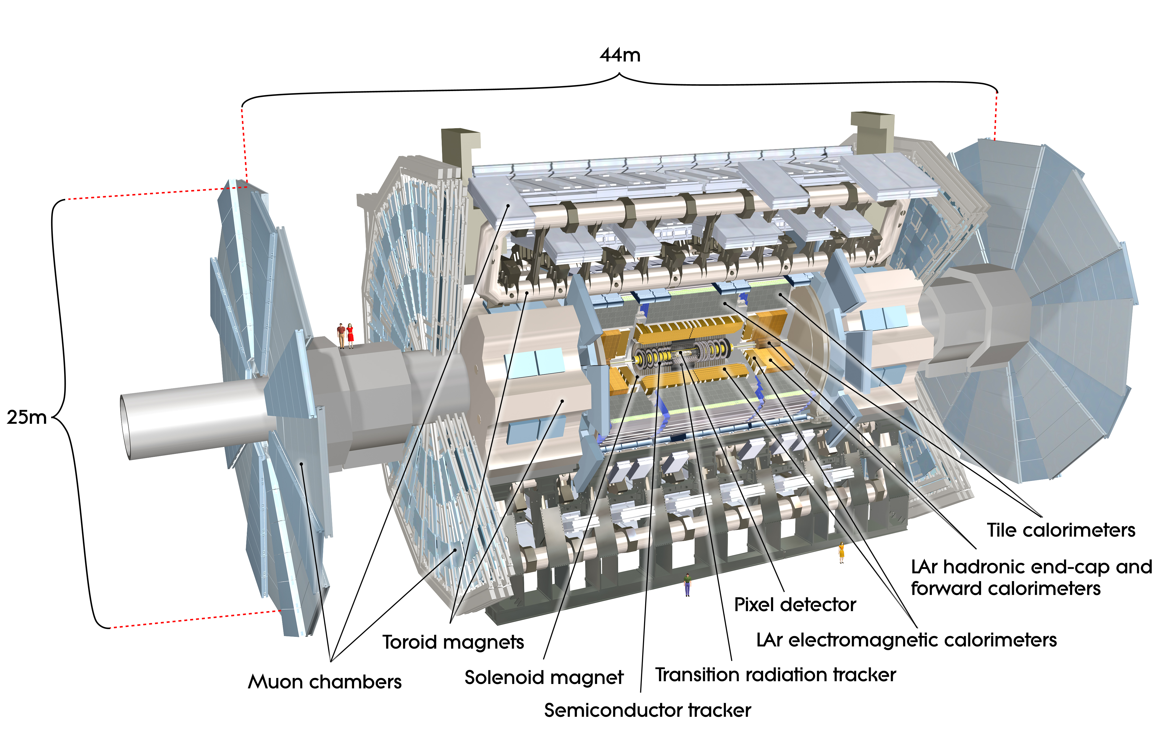
The ATLAS detector

Slide 22
The ATLAS Inner Detector

Slide 23
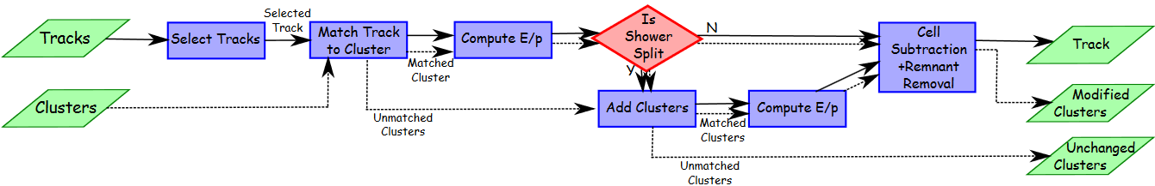
ATLAS p-flow algorithm [ATL-PERF-2015-09]
For track in descending pT:
associate closest topo-cluster based on angular distance ΔR’
compute expected energy deposit based on the topo-cluster position and track momentum
if expected and measured energies differ significantly, associate more topo-clusters
subtract the expected energy by calo cells
if remaining energy lies within expected fluctuations, remove the remnants

Slide 24
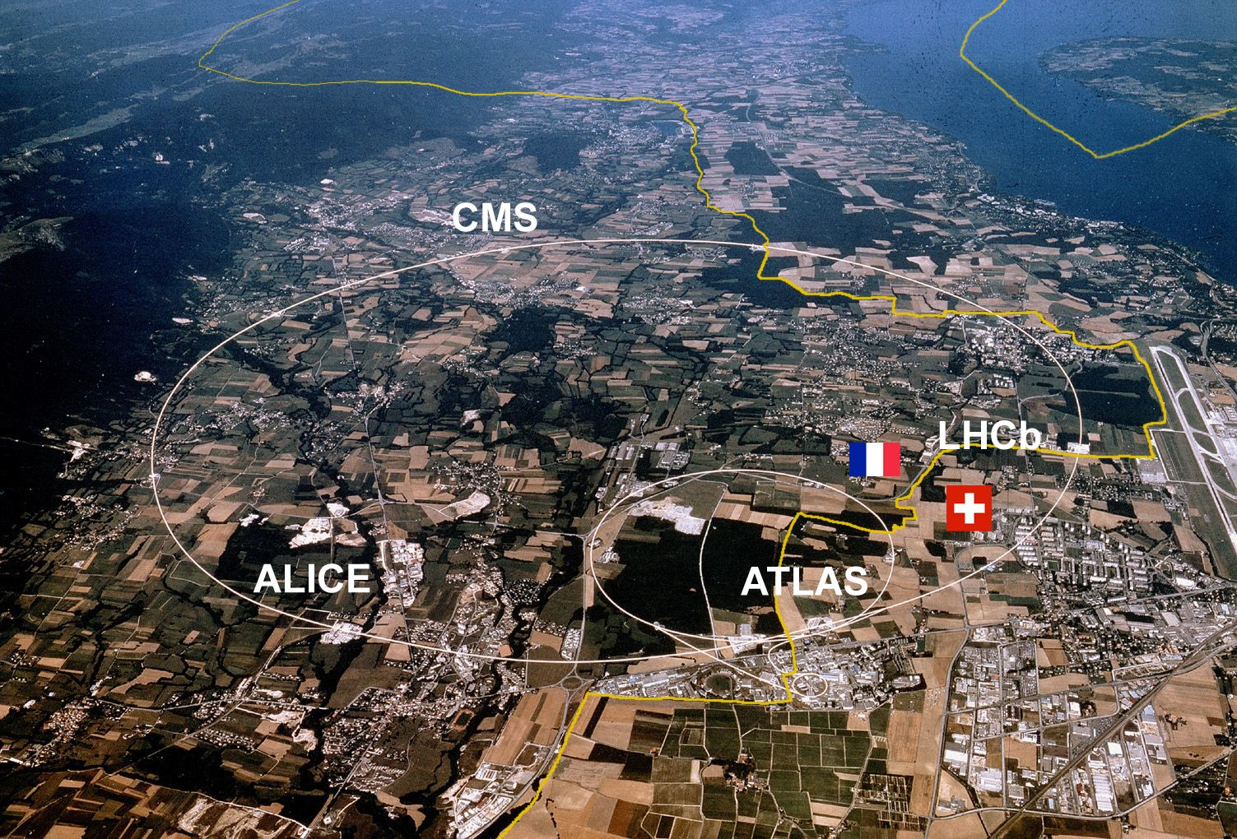
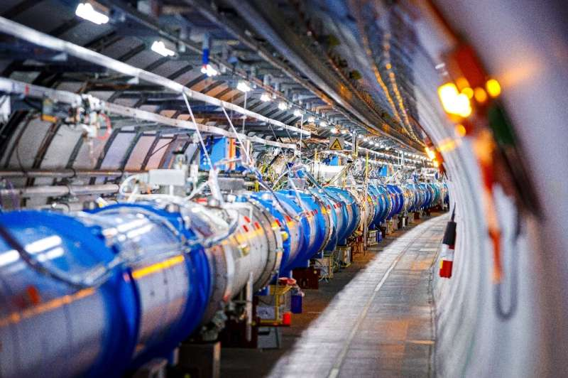
A crash course on ATLAS
ATLAS is a detector located at the Large Hadron Collider
Image: https://spectrum.ieee.org/computing/software/analyzing-the-lhc-magnet-quenches
https://phys.org/news/2020-04-cern-physics-lab-basic-covid-.html

Slide 25
Particle Flow: Telling the story of what happened in each event
Collide ->
Physics Happens
Signals are generated
We get data
We analyse the event

Slide 26
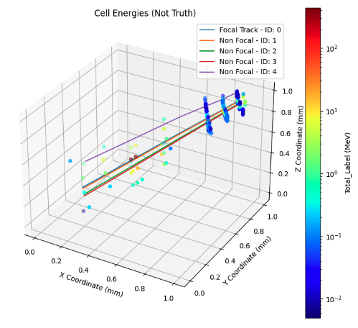
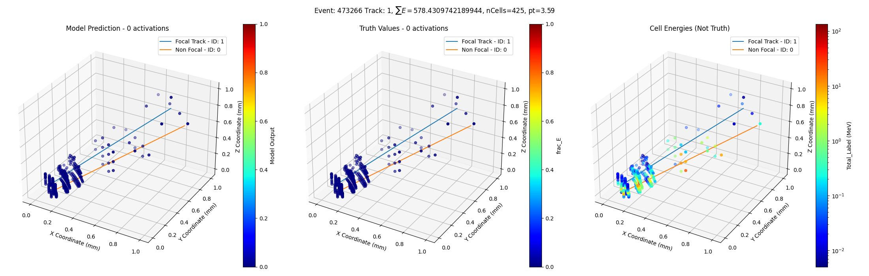
Putting the Layers Together – The visible information

Slide 27
The core problem: How do we relate tracks to cells?
Tracks
Cells
Helices of extrapolated path of the particle
Contain momentum of particles
Points in 3D space
Contain energy deposits of particles
IMAGE OF JUST TRACKS
IMAGE OF JUST CELLS

Slide 28
Putting the Layers Together – The truth information

Slide 29
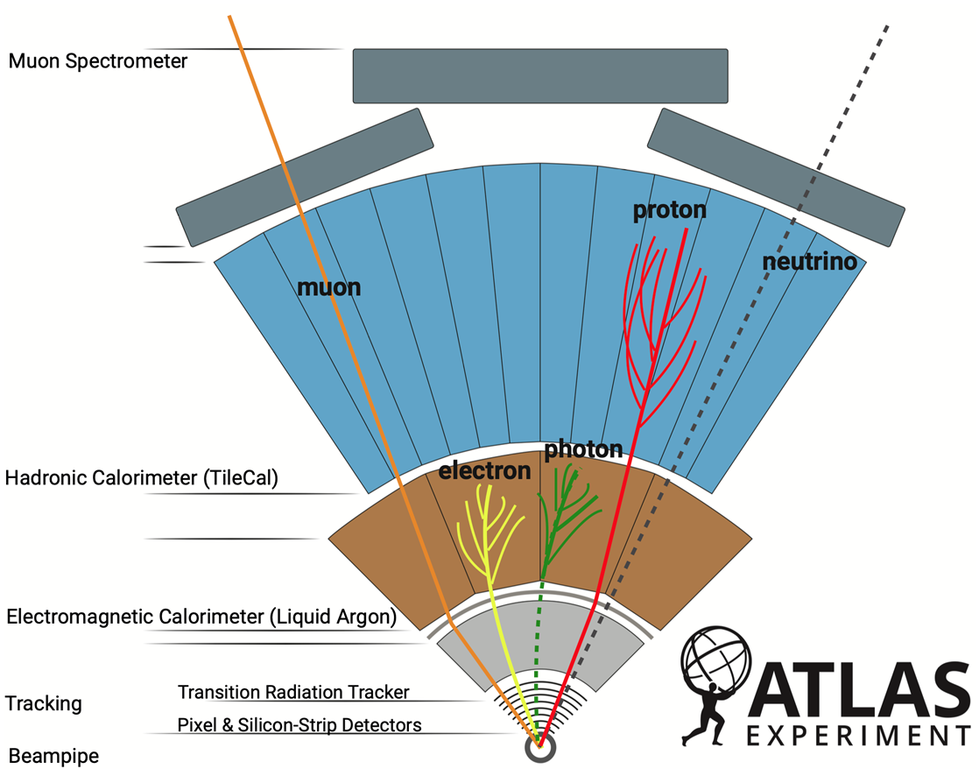
The problem is non-trivial
Inner Tracker relies on charge
  Neutral particles are missed
Different particles have different signatures
Dense environments can have overlapping tracks
This is where we can use machine learning!
Image: https://cds.cern.ch/record/2770815/files/

Slide 30
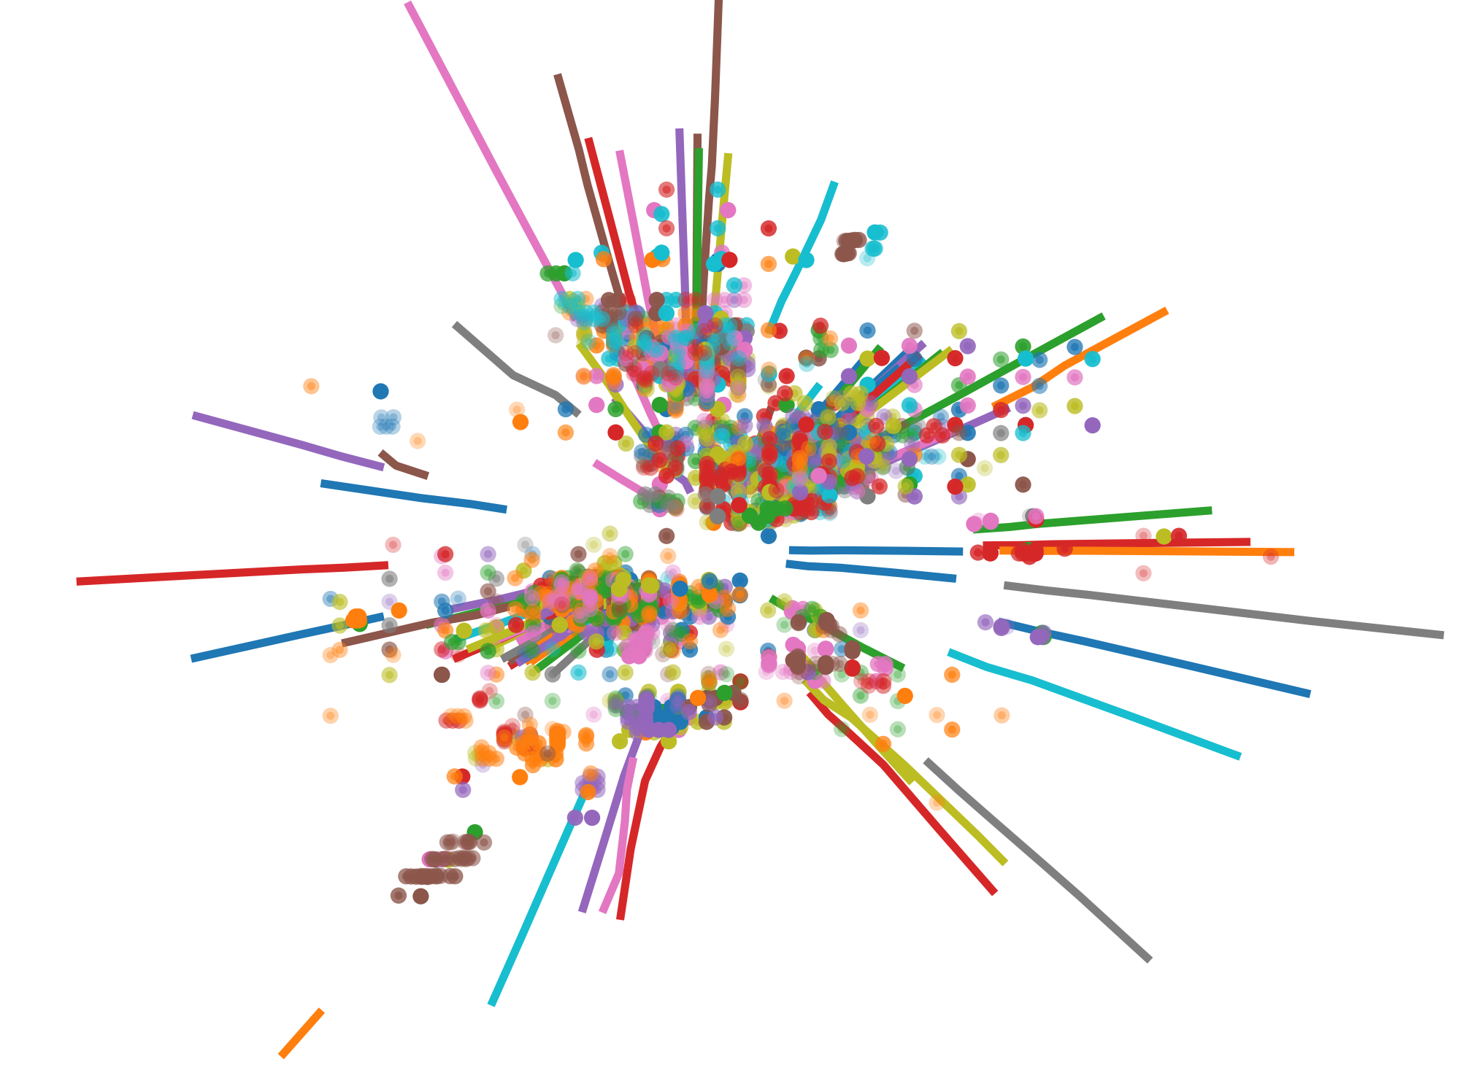
Data Representation
Data is represented as a single combined point cloud
Data encoded into each point
Point type (e.g. cell hit, track, padding)
ΔR
Track Identifier (for tracks)
Normalized coordinates
Track ꭓ²/dof (for tracks)
Cell E (for cells)
Track pt (for tracks)
Cell Sigma (for cells)

Slide 31
Representing the data
PointNet allows us to represent data as a point cloud
Data is encoded into 11 dimensions

Slide 32
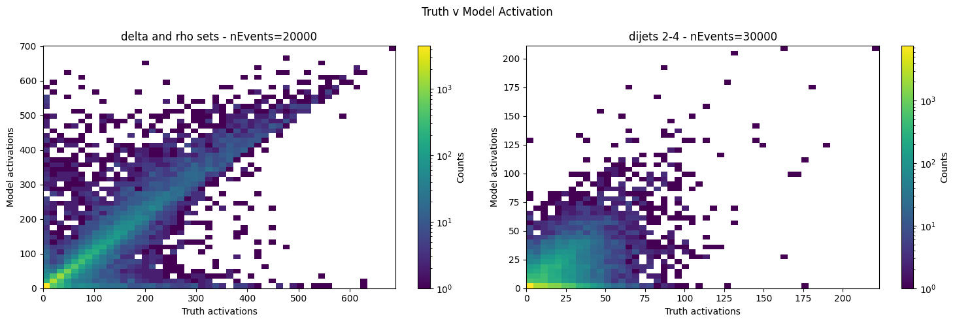
Modal collapse – our high complexity challenge
Modal Collapse is a phenomenon where the model chooses a trivial solution and applies it where it shouldn't
Large event-negative regime
Healthy Model

Slide 33
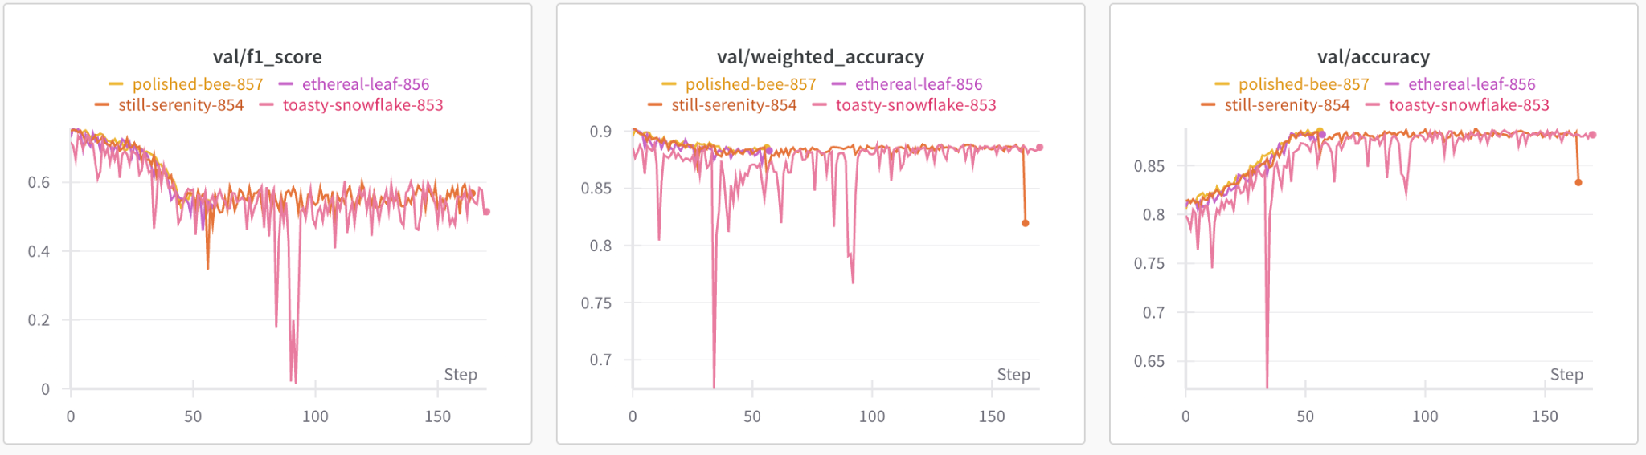
How are we planning on translating this success? – Transer Learning
Should I even include this?
I think it could get a little techincal
End of data injection phase

Slide 34
Image References
Evidence for associated production of a Higgs boson with a top quark pair in final states with electrons, muons, and hadronically decaying $\tau$ leptons at $\sqrt{s} =$ 13 TeV - Scientific Figure on ResearchGate. Available from: https://www.researchgate.net/figure/An-example-of-a-Feynman-diagram-for-ttH-production-with-subsequent-decay-of-the-Higgs_fig1_323796380 [accessed 18 Aug 2024]

