Slide 1
Argon removal from liquid nitrogen using zeolites
2024/08/20
Franco Cabral

Slide 2
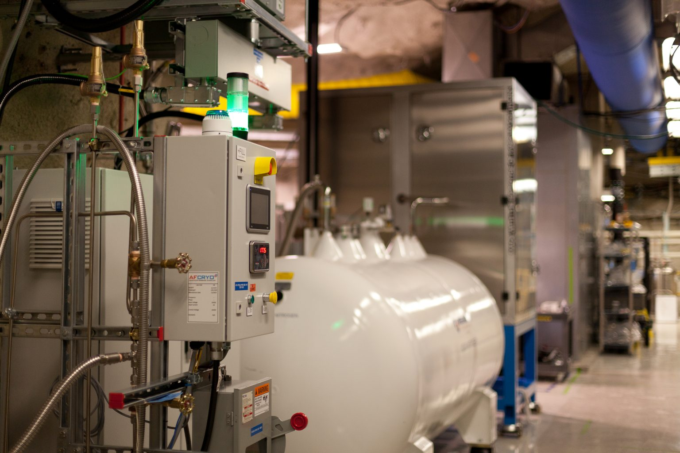
Argon in liquid nitrogen
SNOLAB experiments use liquid nitrogen for cooling, purification, and as a cover gas
Liquid nitrogen underground comes from pressure swing adsorption of air, which has argon
Nitrogen used underground has ~3.6% argon
Argon has slightly radioactive isotopes
Argon (84 K) has higher freezing point than nitrogen (63 K)
Figure 1: Liquid nitrogen underground (SNOLAB)

Slide 3
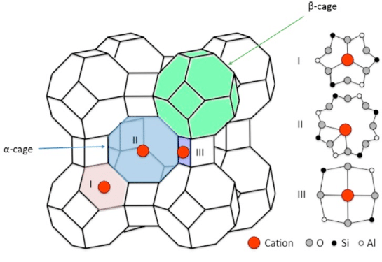
Zeolites
Aluminosilicate or silicate framework
Well defined and uniform pore structure
Use Linde Type A (LTA) framework, cations located inside the α-cages
Silver chosen, large polarizable electron cloud
Argon more polarizable than nitrogen
Stronger van der Waals interactions with silver
Figure 2: LTA zeolite structure (Al-Ezzi, 2017)

Slide 4
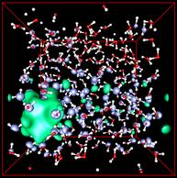
Software
CP2K: complex simulation software for quantum chemistry and solid state physics
Calculations of electronic structure, forces, and energies
Input and output files
Figure 3: CP2K simulation

Slide 5
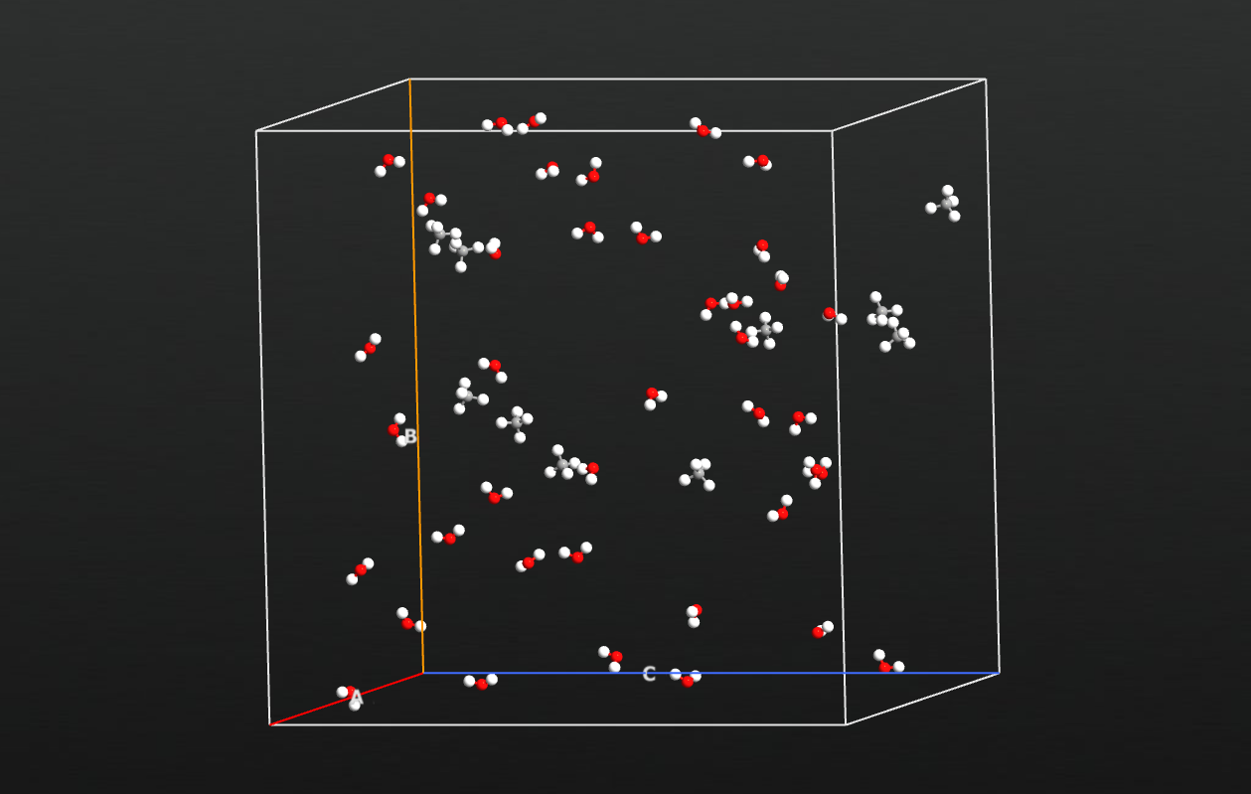
Software
Avogadro: software to create molecular structures
Gives PDB files detailing atomic coordinates and bonds
Packmol: tool to create molecular systems for simulations by packing different molecules into a box
Figure 4: Packmol simulation box (QuantumATK)

Slide 6
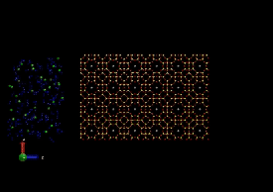
Problems
Simulations previously run where liquid nitrogen, argon start outside zeolite
Argon slowed at the surface but not as much inside the zeolite
Need to do molecular dynamics simulations where liquid nitrogen and argon start inside zeolite
Geometry optimization: look at stable configurations of zeolite and its properties
Figure 5: Previous simulation (John Deligiannis)

Slide 7
File Format Issues
PDB
PDB file previously used as external input file describing atomic coordinates and bonds
Sometimes Avogadro would produce duplicate atoms in PDB files
Shifted to regular COORD file format, directly written in the CP2K input file
Wrote script to directly write coordinates in input file from PDB file
XYZ
INP
Figure 6: File format solution

Slide 8
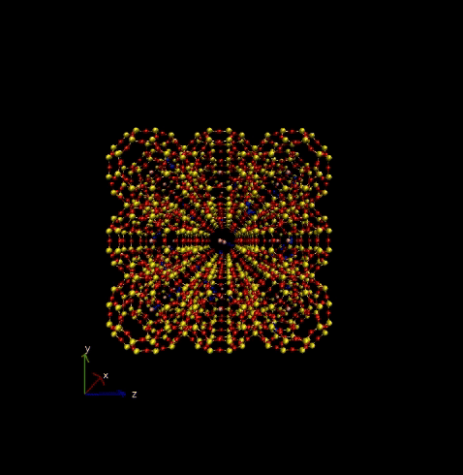
Molecular Dynamics
Simulations of 3x3x3 Å and 4x4x10 Å LTA were run on the order of picoseconds (10⁻¹² s)
External potential used to move argon and nitrogen through the zeolite
Stronger potential for Ar, heavier atom
Simulations: Ar filtering only, N filtering only, mixed filtering, no external potential
Figure 7: Mixed filtering simulation for 3x3x3 Å LTA

Slide 9
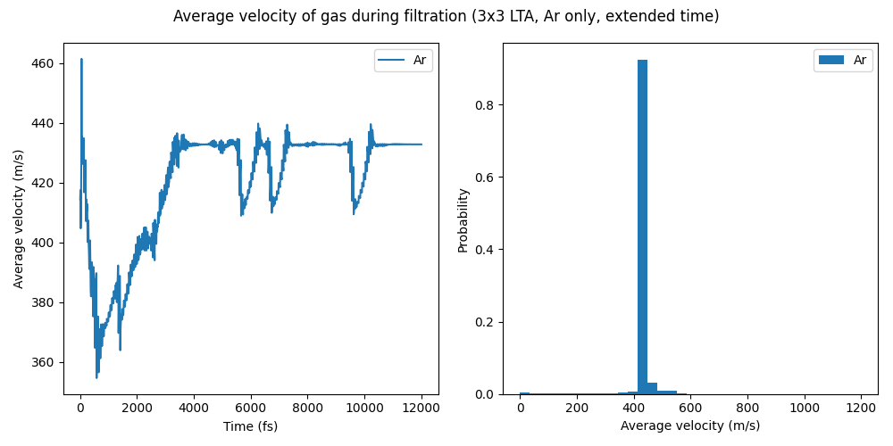
Figure 8: Plots of average gas velocity during argon-only filtration. Velocity vs time plot (left) and velocity probability distribution plot (right).

Slide 10
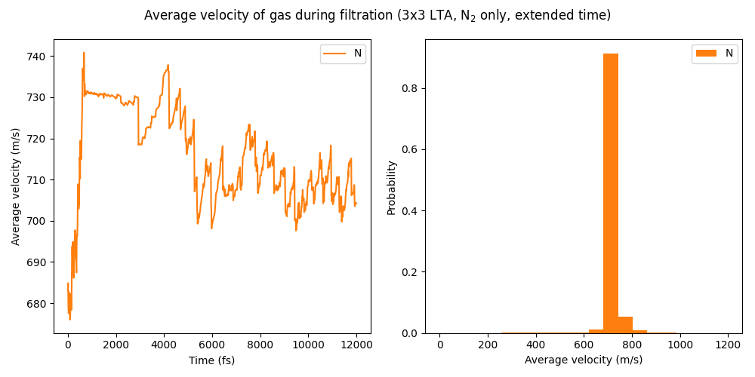
Figure 9: Plots of average gas velocity during nitrogen-only filtration. Velocity vs time plot (left) and velocity probability distribution plot (right).

Slide 11
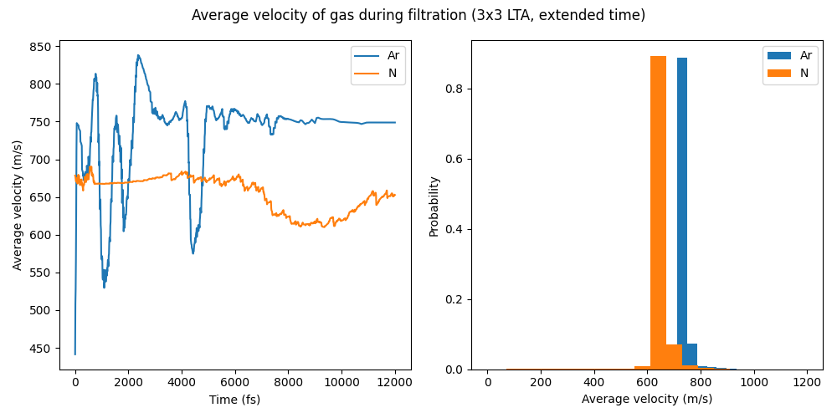
Figure 10: Plots of average gas velocity during mixed argon and nitrogen filtration. Velocity vs time plot (left) and velocity probability distribution plot (right).

Slide 12
Figure 11: Plots of average gas velocity inside zeolite with no external force. Velocity vs time plot (left), argon velocity probability distribution plot (middle), and nitrogen velocity probability distribution plot (right).

Slide 13
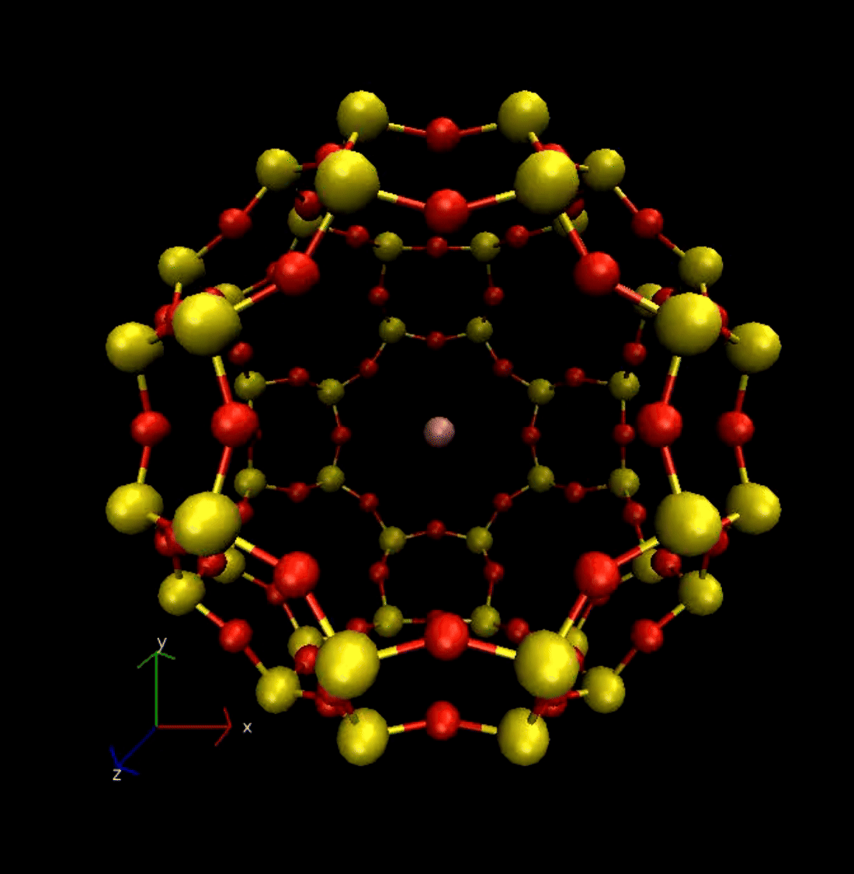
Geometry Optimization
Optimized geometry of LTA unit cell with different cations in the center
Choice of cation affects stability and interaction with other molecules
Ag+ binding energy: 52.88 kJ/mol
Au+ binding energy: 142.11 kJ/mol
Na+ binding energy: 9.10 kJ/mol
Figure 12: Geometry optimization with Ag in the center.

Slide 14
Conclusion and Next Steps
Molecular dynamics: trapping velocity, interactions, and equilibrium
Geometry optimization: binding energies
Running more simulations
Zeolite and distillation setup
Figure 13. Sample zeolite test setup (John Deligiannis)

Slide 15
Thank you!

