Slide 1
Testing Photomultiplier Tubes for nEXO’s Outer Detector
2024 CASST Competition
Lazar Paroski
Queen’s University
August 19 2024
Notes:
:)
Just say title

Slide 2
Outline
Introduction to 0vββ and nEXO
Designing the PMT testing Setup Cooling Loop
Intro to the PMT Testing Setup
Initial Design Ideas
Calculations
Bill of Materials and Concerns
Improved Design
Calculations
Final Bill of Materials
Future Setup
Design
Calculations
Bill of Materials
Data Analysis Script Improvements
Data Management Improvements
FFT and Peak Isolation Stress Test
Conclusion
Notes:
:)
Intro to 0vbb and nEXO
Cooling loop
Data

Slide 3
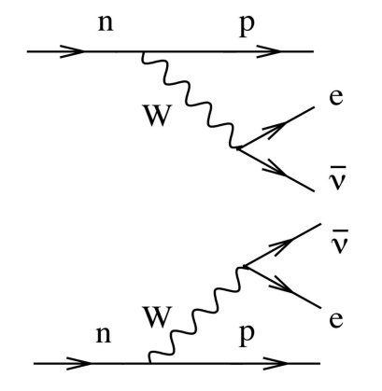
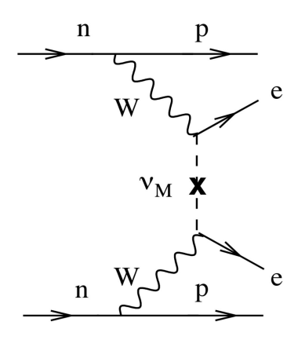
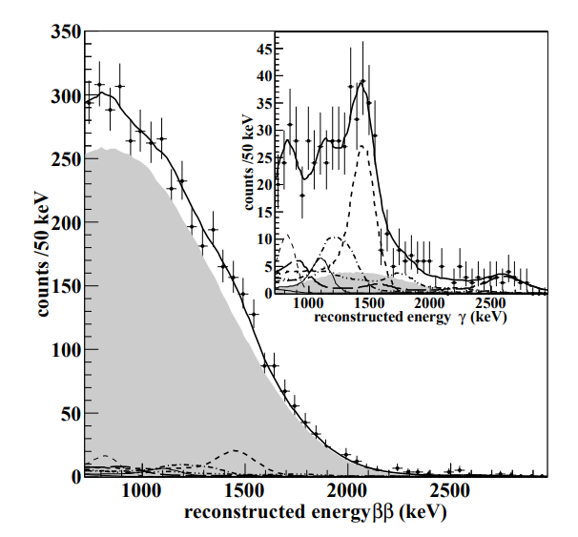
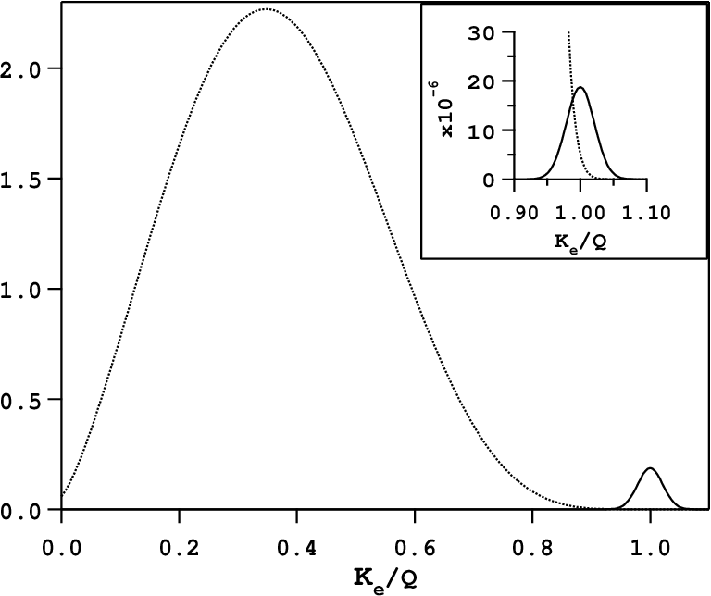
2vββ vs 0vββ
Introduction to 0vββ and nEXO
0vββ signature is peak at nucleus Q value
2vββ spectrum measured in ¹³⁶Xe with EXO-200!
Peak Smeared by energy resolution?
2vββ
Q_{ββ}
Adapted from: https://arxiv.org/pdf/1108.4193
Notes:
:)
antiv majorana (own antiparticle)
Should see at nucleus Q value
Haven’t seen it yet

Slide 4
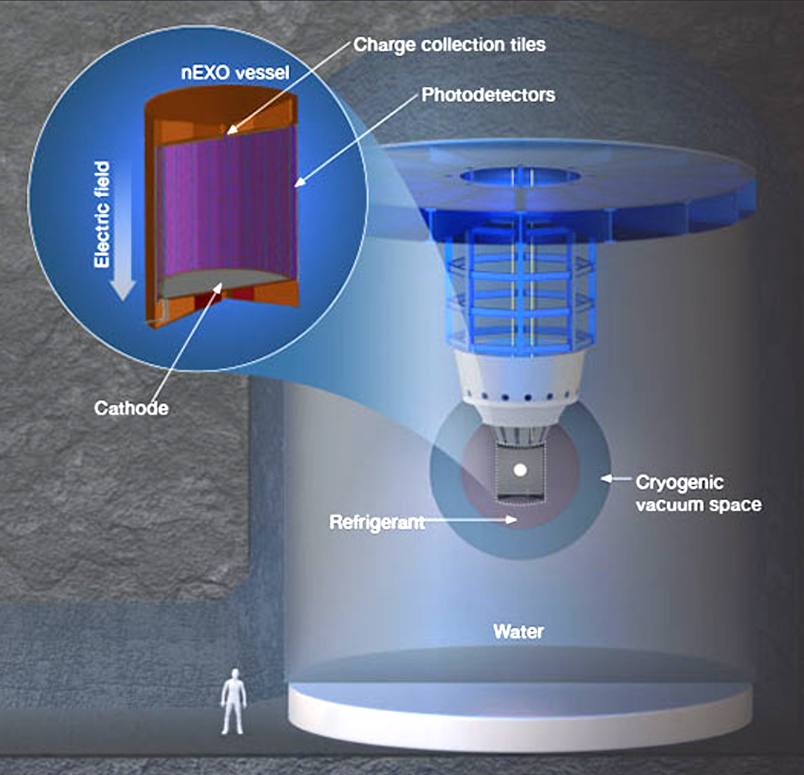
nEXO Experiment
Introduction to 0vββ and nEXO
5-tonne single-phase liquid Xenon Time Projection Chamber (TPC)
Enriched to 90% in isotope ¹³⁶Xe
OD used for passive and active shielding
Target half-life sensitivity of 1.35 · 10²⁸ years
Source: https://nexo.llnl.gov/nexo-overview
Notes:
:)
5t tpc
Enriched in 90% isotope…
Outer detector muon veto
Target half life 10^28

Slide 5
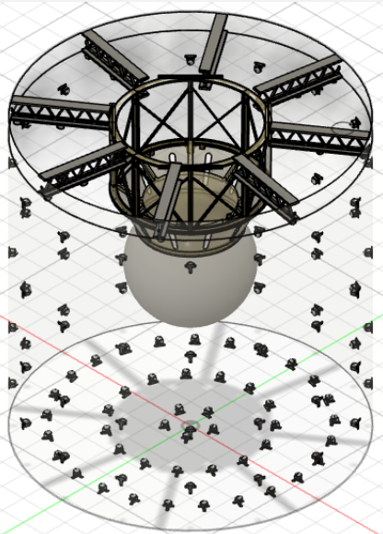
nEXO Outer Detector (OD)
Introduction to 0vββ and nEXO
Passive and active shielding
Q value for 0vββ ¹³⁶Xe → ¹³⁶Ba is 2458 keV [1]
Muons passing through TPC can create neutrons that can create energy signatures around Q value :(
OD is veto for TPC by detecting Cherenkov radiation :)
[1] Search for double-beta decay of 136Xe to excited states of 136Ba with the KamLAND-Zen experiment https://arxiv.org/pdf/1509.03724
Source: https://escholarship.mcgill.ca/concern/theses/j9602648j
Notes:
:)
125 PMTs
Passive and active
Underground and muons can knock neutrons that can create false signals
Detecting muons helps us ignore those signals

Slide 6
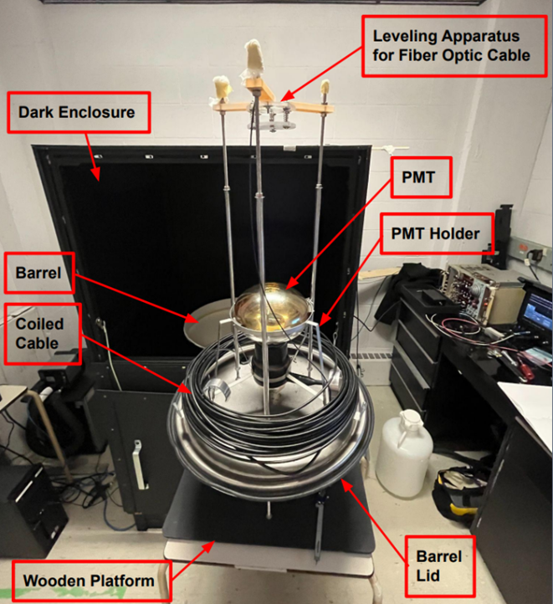
The PMT Testing Setup
Intro to the PMT Testing Setup
Located at Laurentian University
PMT attached to barrel lid
Barrel lid in dark enclosure
This will help learn for future setups
Notes:
:)
Go over setup

Slide 7
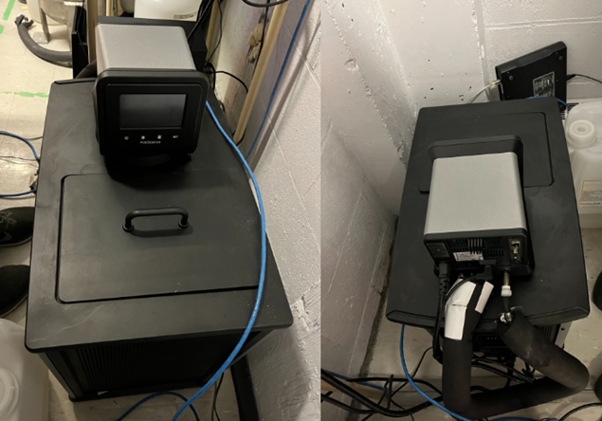
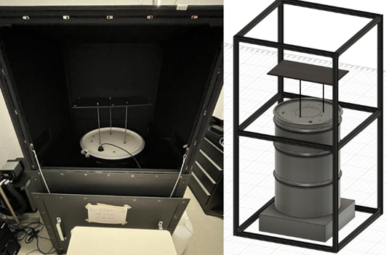
The PMT Testing Setup
Intro to the PMT Testing Setup
Barrel needs a way to change and keep stable temperature
OD will be held at 12°C
PolyScience AP15R-40-A11B refrigerated circulator
Notes:
:)
Barrel closed
Need coller to stabilize temperature

Slide 8
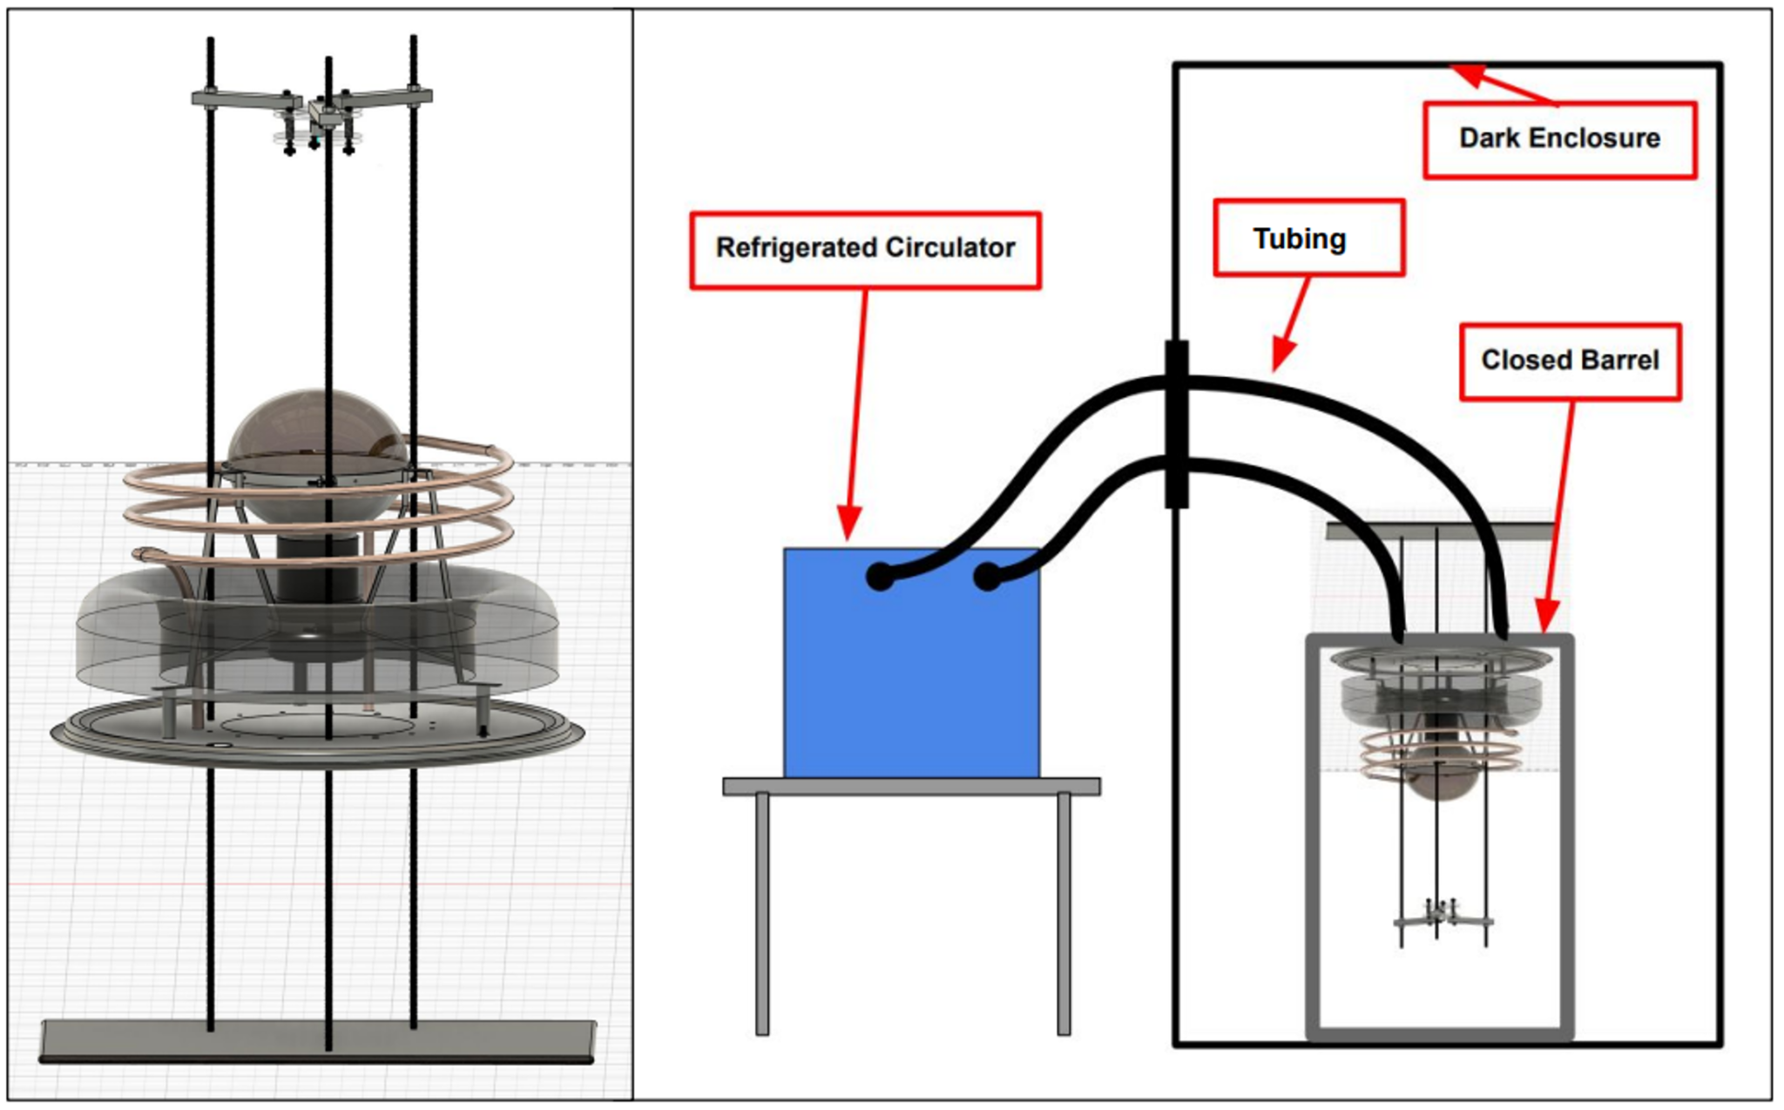
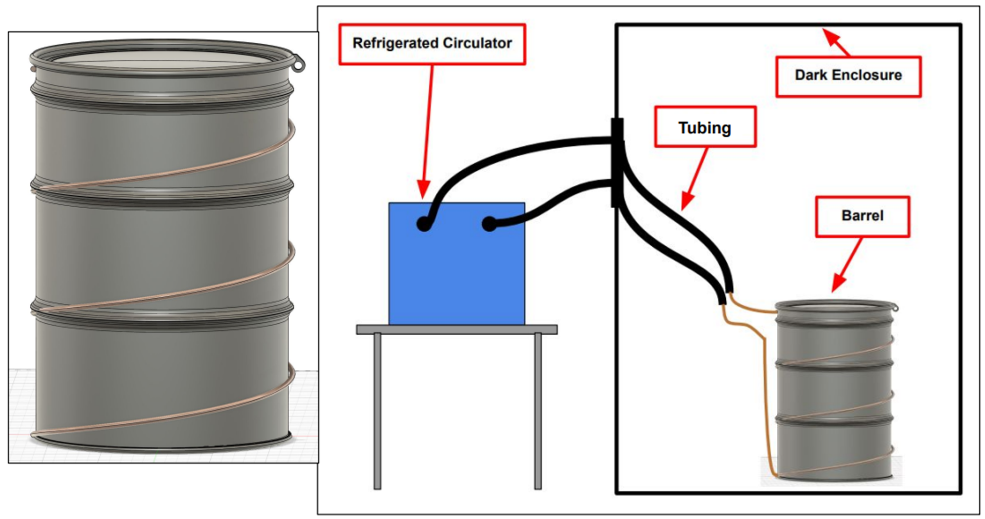
Design Ideas
Initial Design Ideas
Coil Inside Barrel
Coil Outside Barrel
Each setup has some pros/cons
I updated CAD models in Fusion 360
Notes:
:)
2 Ideas
Drawbacks

Slide 9
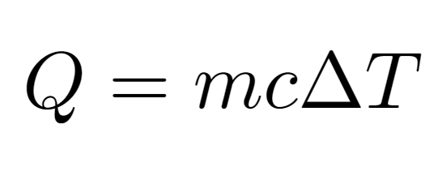
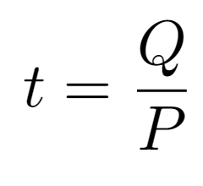
Calculations — Simple
Calculations
Time to cool barrel from 25 °C to 10 °C,
P = 956 W (Cooling Capacity at 17.5 °C )
Time with no heat leaking in barrel :
Time with Insulation with an R-Value of 2:
t = 4.07 Hours
t = 4.14 Hours
Notes:
:)

Slide 10
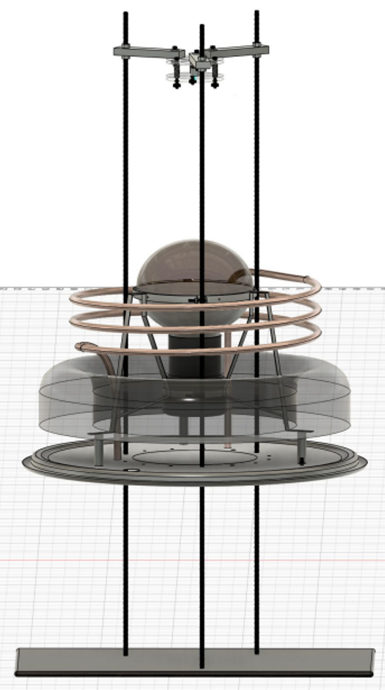
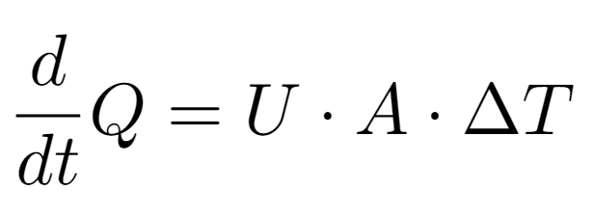
Calculations — Coil in Barrel
Calculations
dQ/dt < 956 W – Area of coil is bottleneck cooling
dQ/dt = 956 W – Coil exchanges heat at the same rate as the cooler:
dQ/dt > 956 W – Making coil longer has no cooling benefits
L = 4m
Will Cool in 4.14 Hours if more than 4m of tubing is used
Notes:
:)

Slide 11
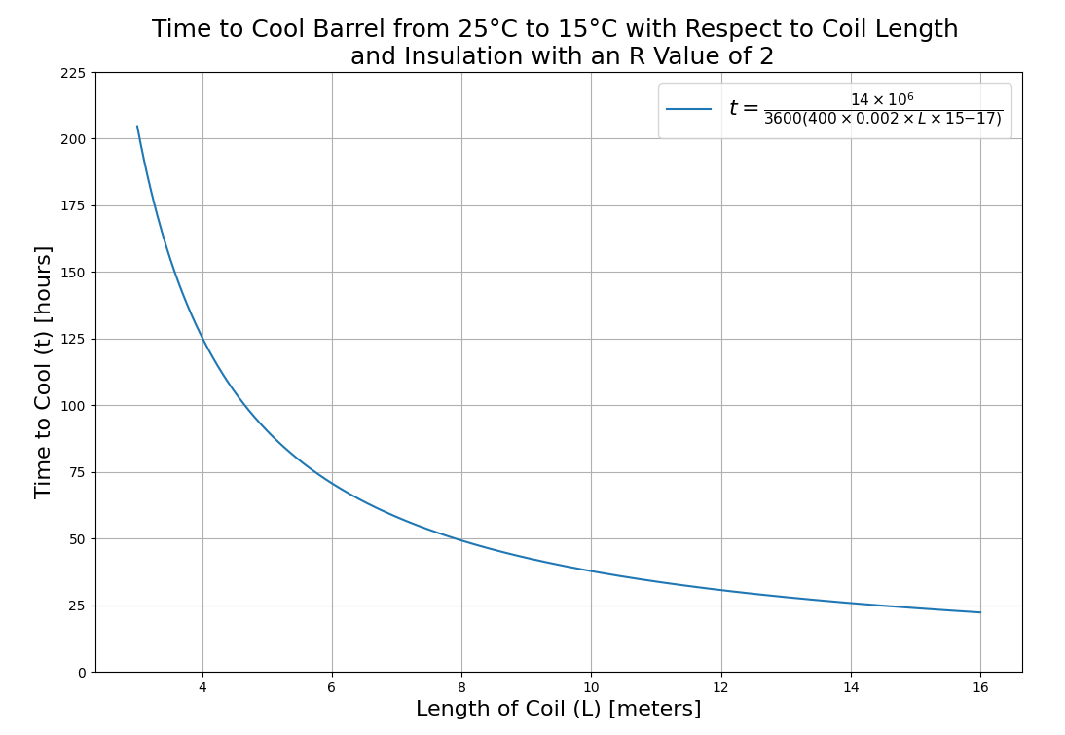
Calculations — Coil Outside of Barrel
Calculations
Too Long to cool
Don't want to use more than 15m of coil
Notes:
:)

Slide 12
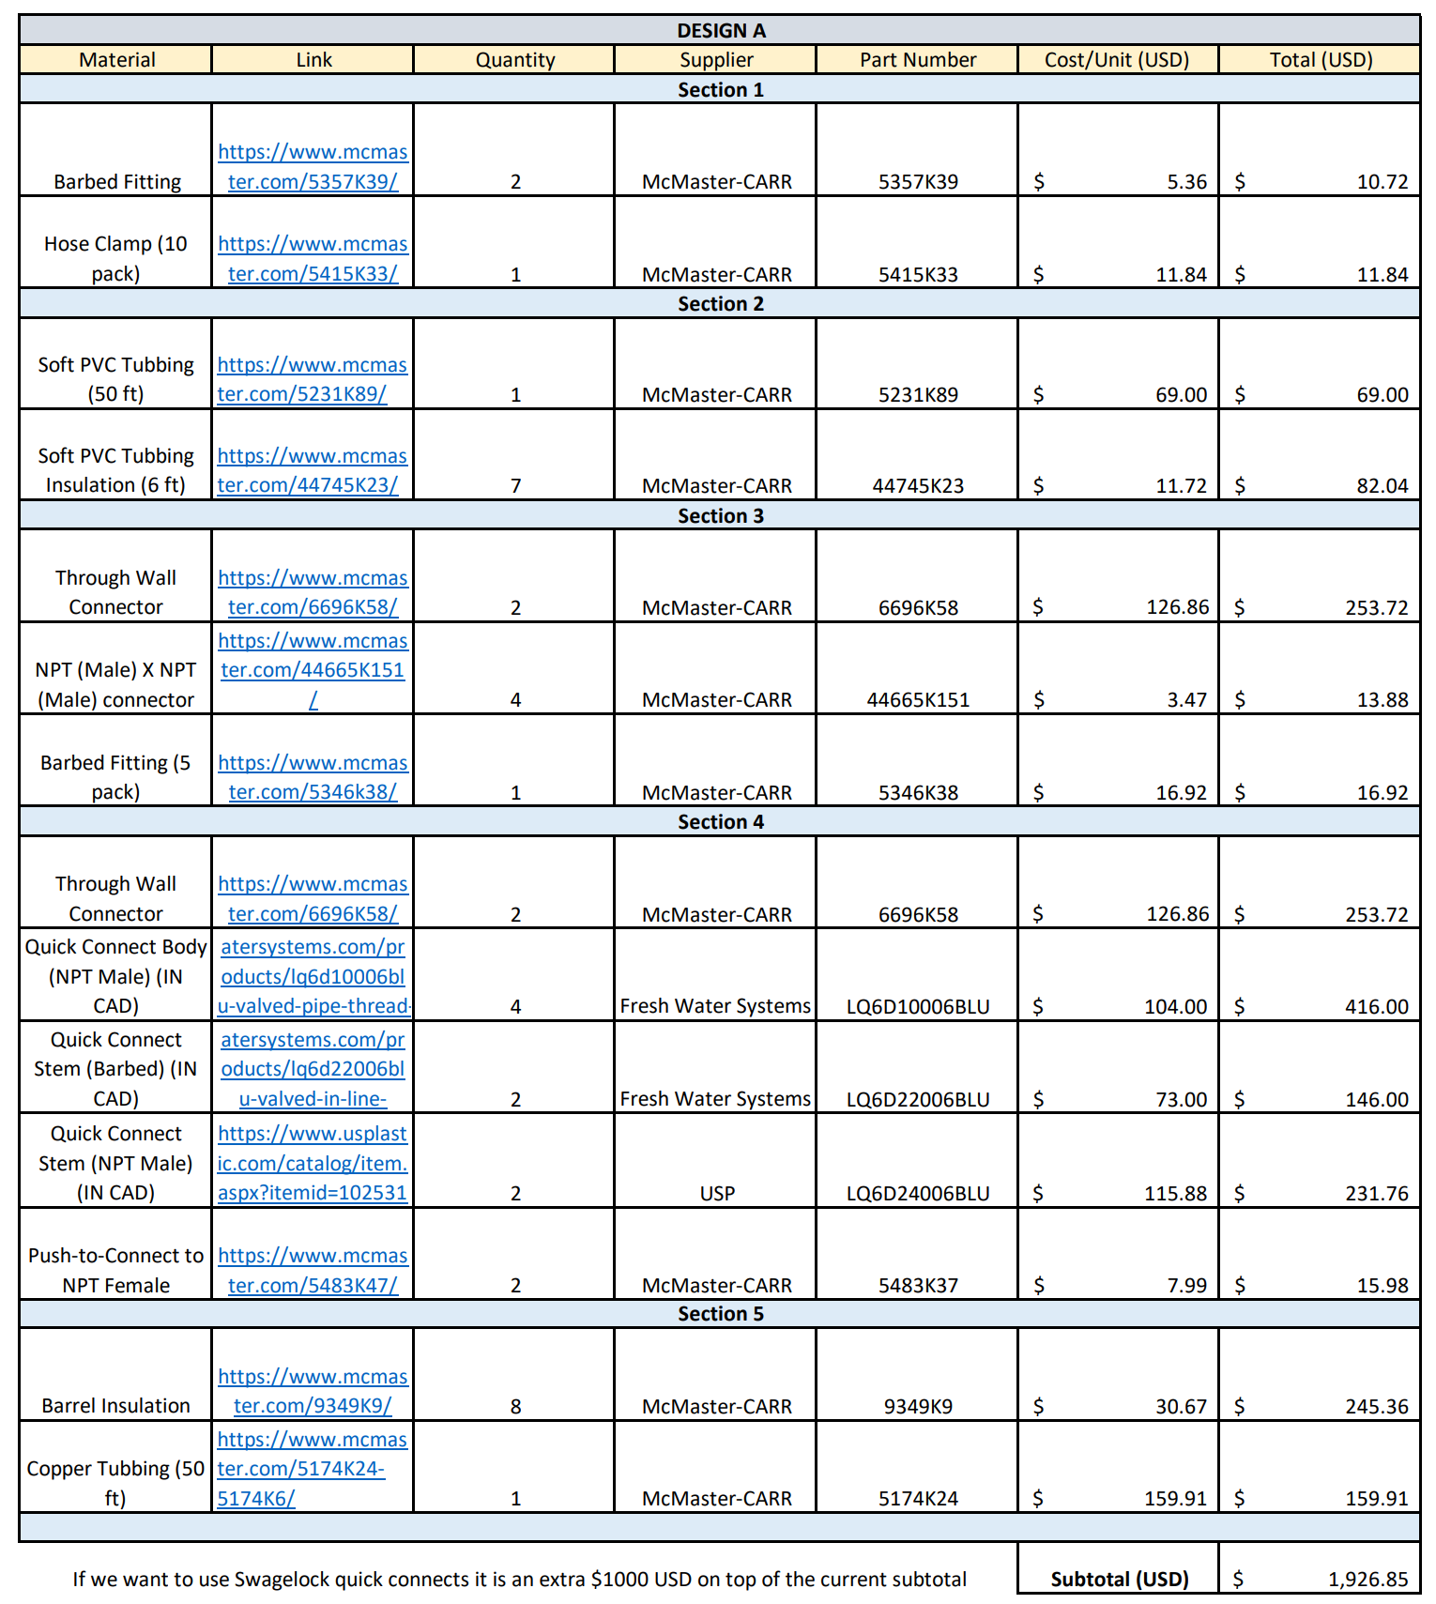
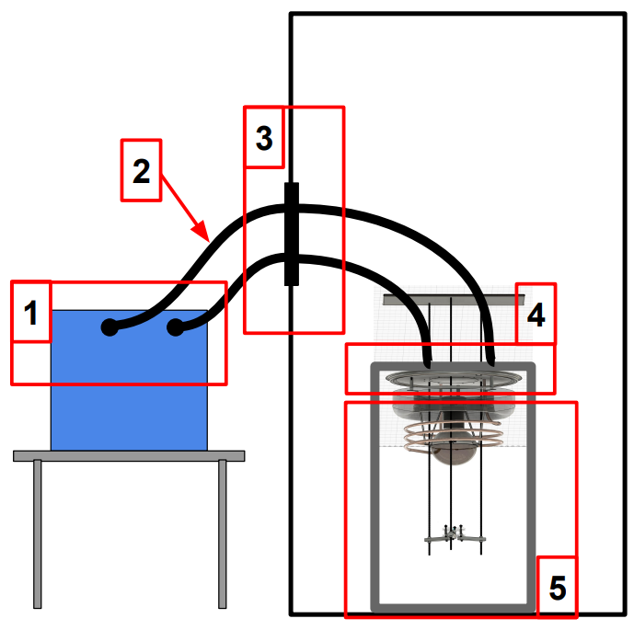
Bill of Materials
Bill of Materials and Concerns
Still concerns with setup
Coil in barrel could interfere with detection
Setup has additional Issues…
Notes:
:)

Slide 13
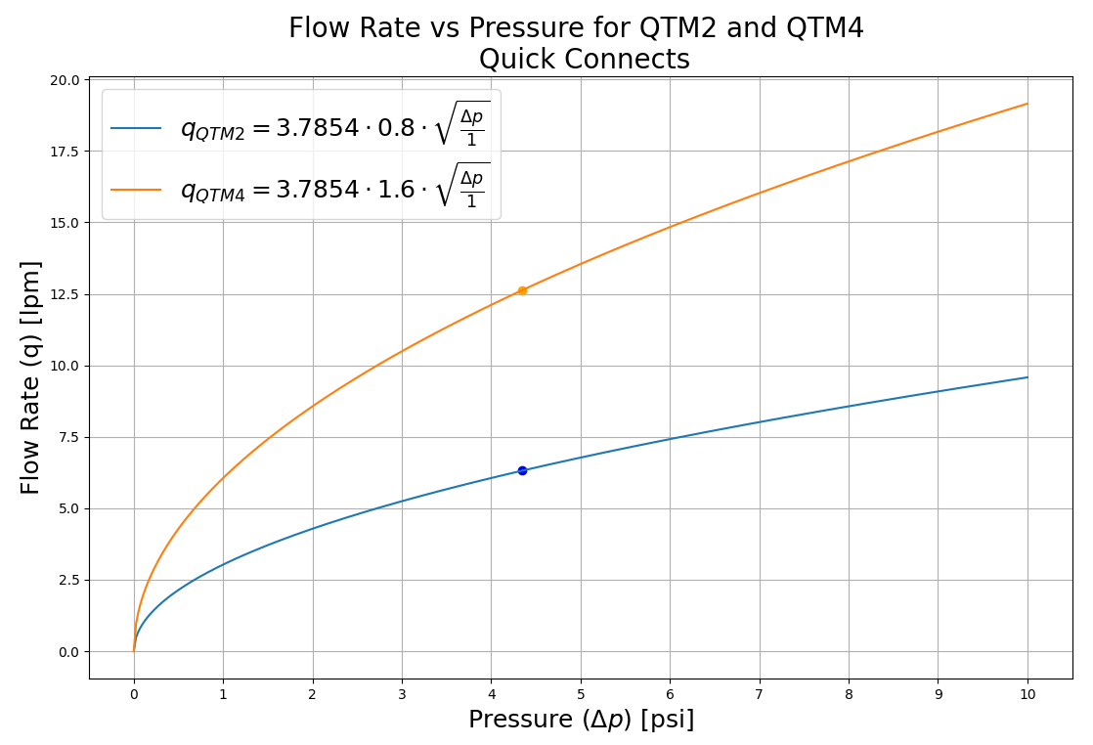
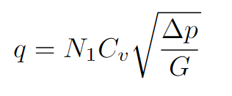
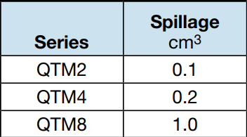
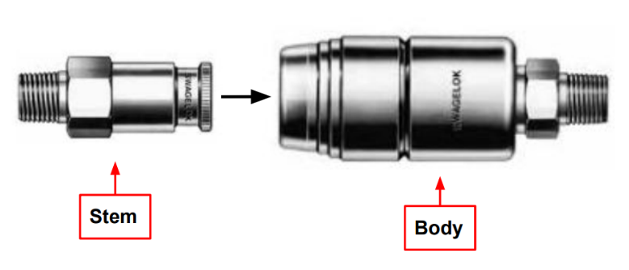
Quick Connect Concerns
Bill of Materials and Concerns
Cooler max Pressure: 4.35 Psi
Cooler max Flow Rate: 20.1 lpm
Notes:
:)

Slide 14
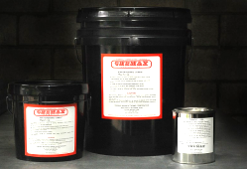
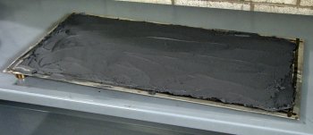
Improved Design
Improved Design
TRACIT-1100 heat transfer compound
Heat transfer coefficient: 114-227 W/m²*K
Relatively inexpensive solution
Avoids quick connect flow and spillage issues
Avoids coil interfering with detection issues
Notes:
:)

Slide 15
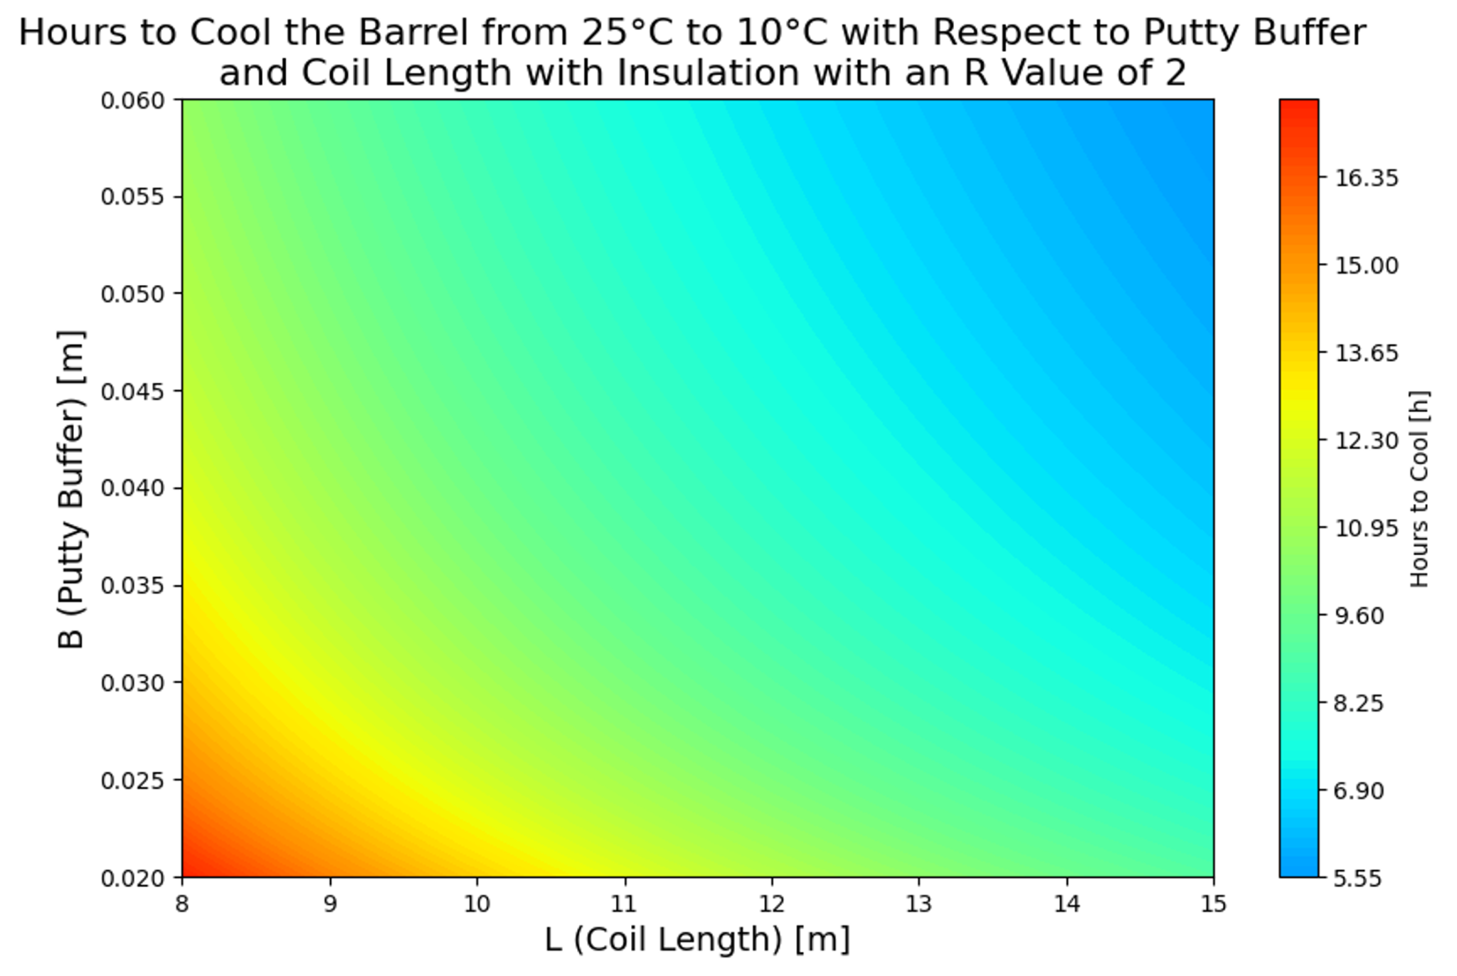
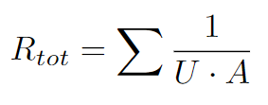
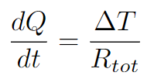
Calculations
Calculations
Used thermal resistance
Putty buffer is amount of putty on either side of tubing
Cooling time reasonable making this option feasible
Notes:
:)

Slide 16
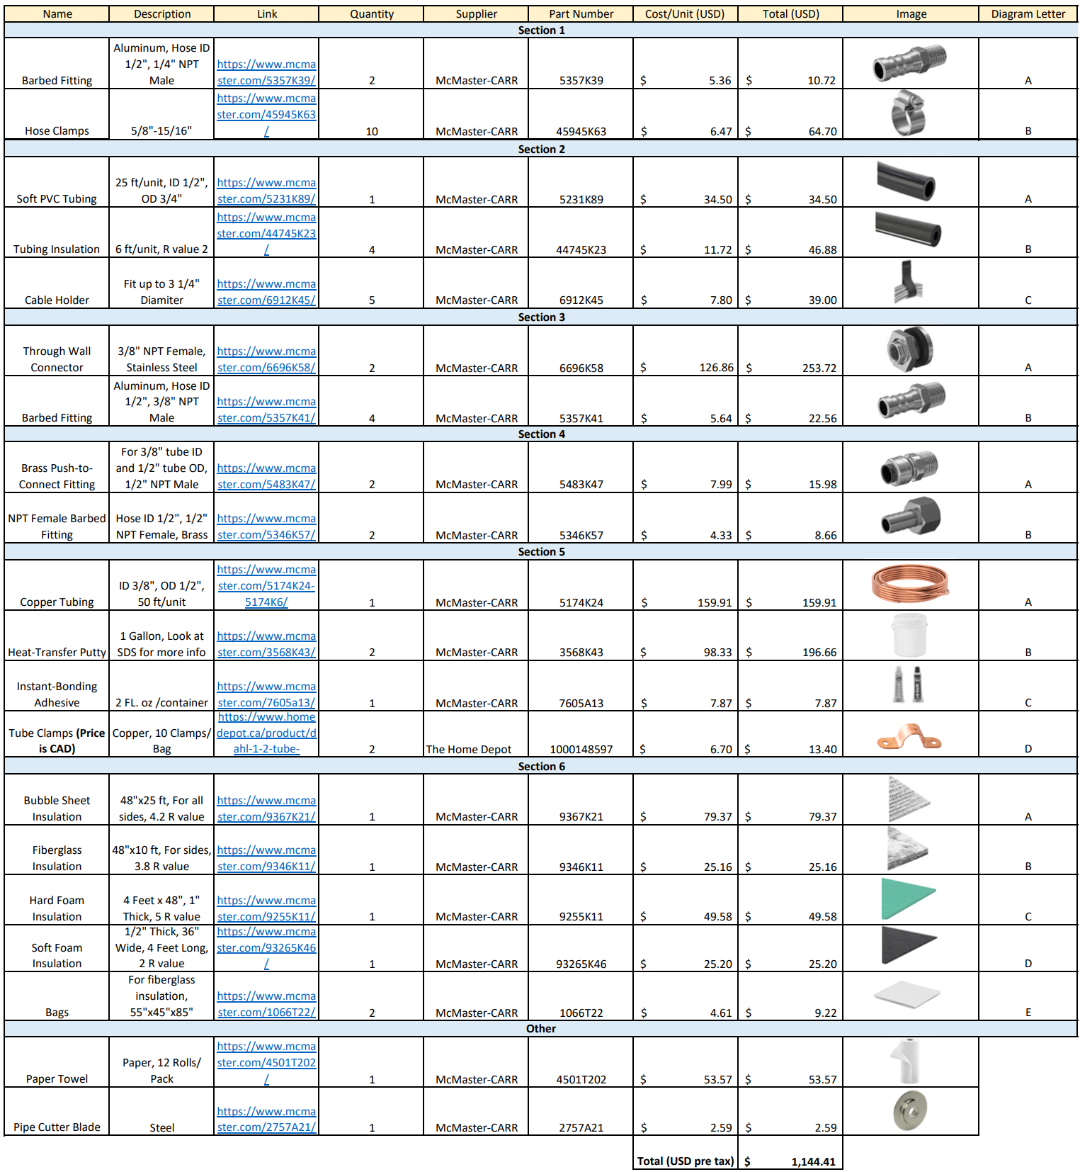
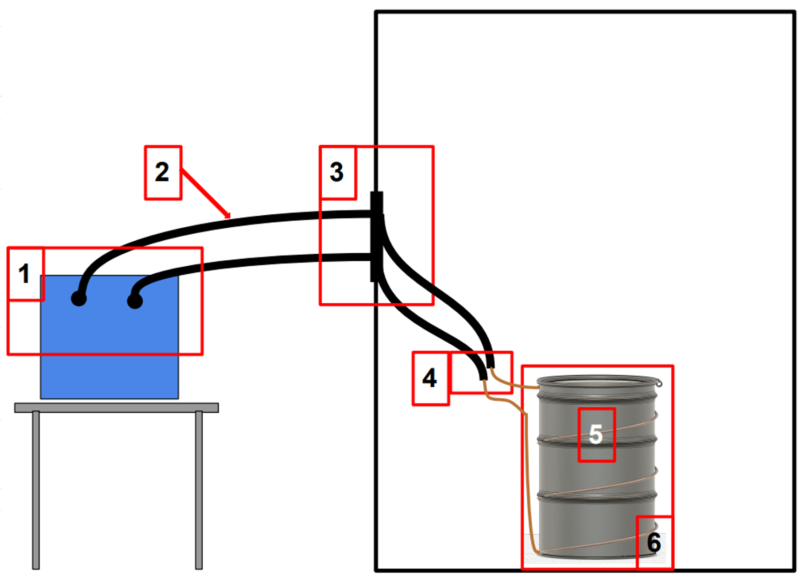
Final Bill of Materials
Final Bill of Materials
Avoids issues with previous set up by putting coil outside of barrel
BOM was ordered
Notes:
:)

Slide 17
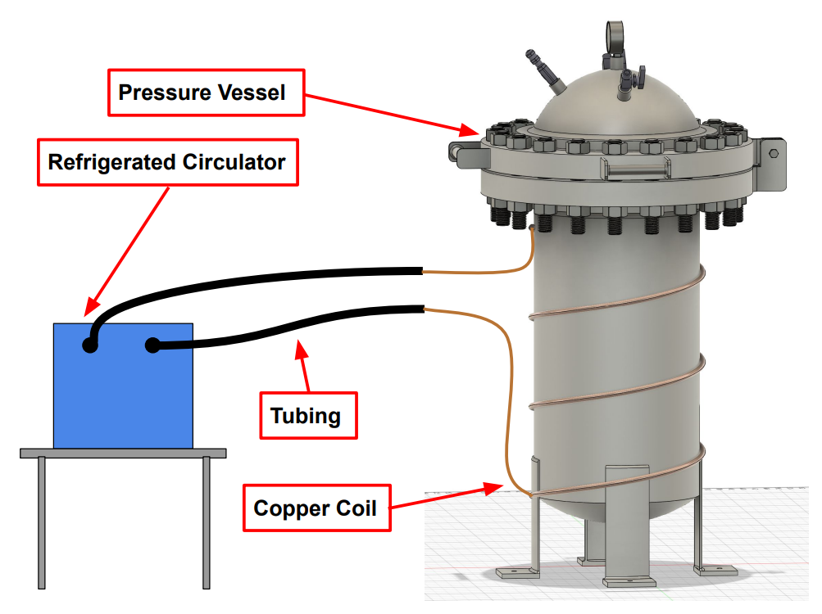
Design
Future Setup
Same as successful barrel design
Heat transfer putty will be used, and coil is outside pressure vessel
I made CAD model for PV from scratch in Fusion 360
Notes:
:)

Slide 18
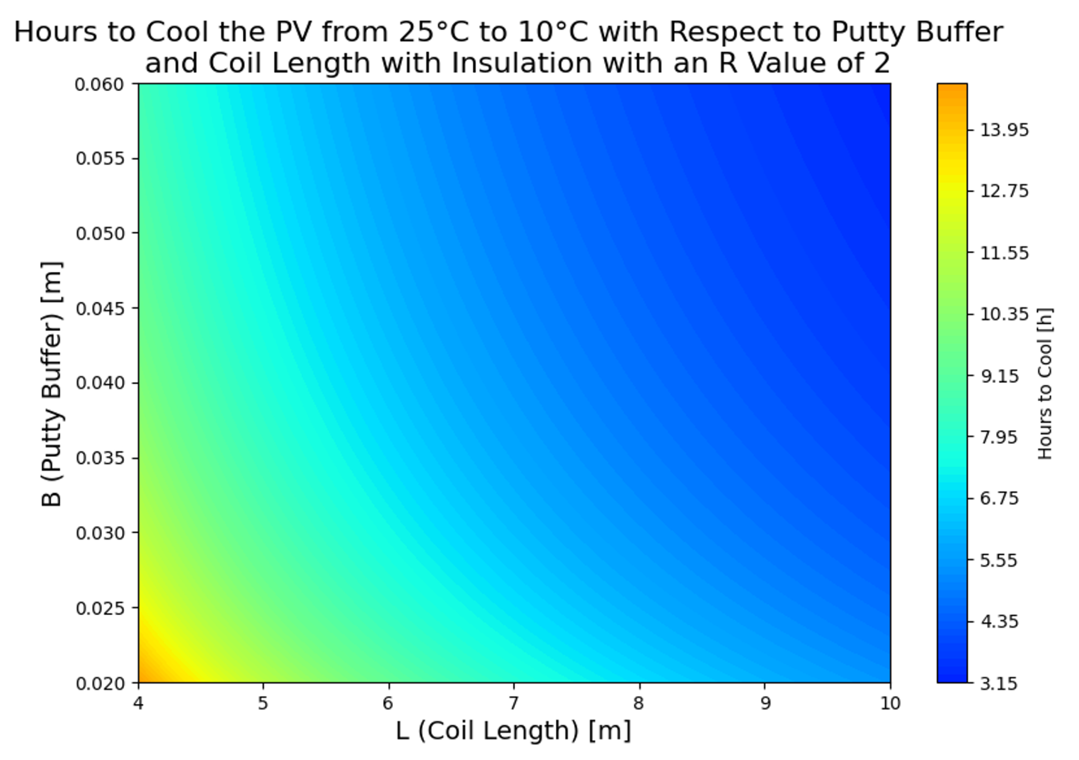
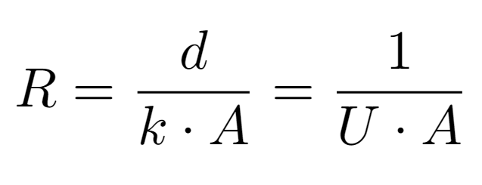
Calculations
Future Setup
Fast cooling time
Can use less coil for PV due to this
This is good for space reasons since PV is smaller than barrel
Notes:
:)

Slide 19
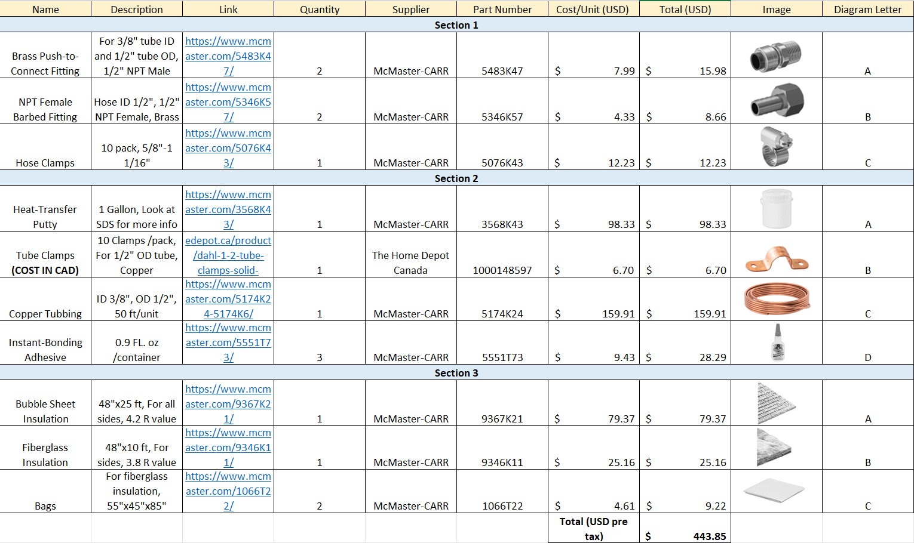
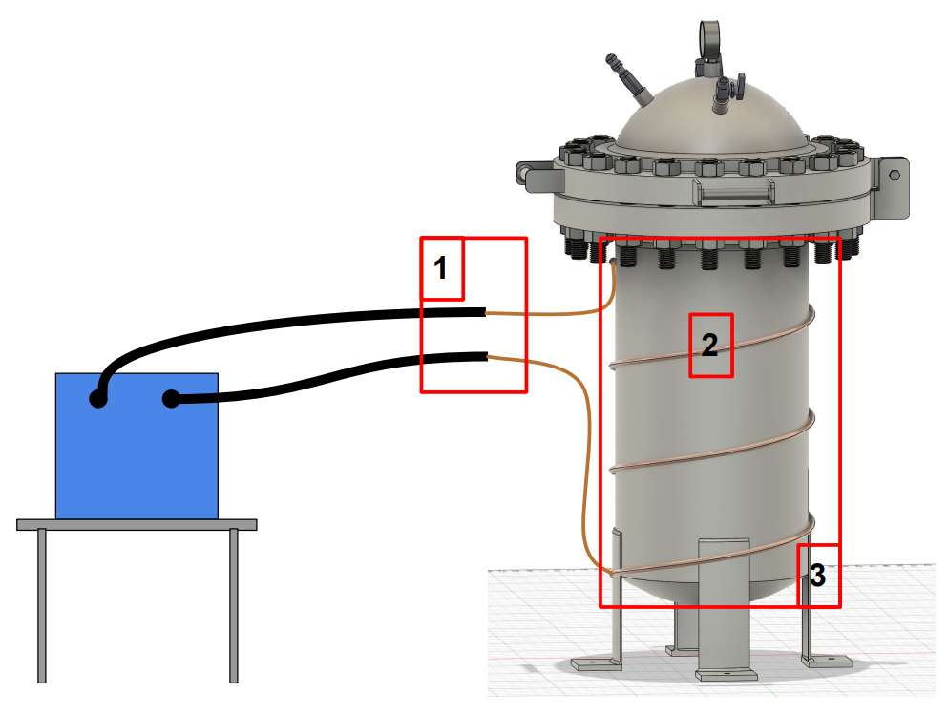
Bill of Materials
Future Setup
Very affordable BOM
Can reuse parts from barrel setup
Notes:
:)
Transition to next part
Mention in passing the data improvements

Slide 20
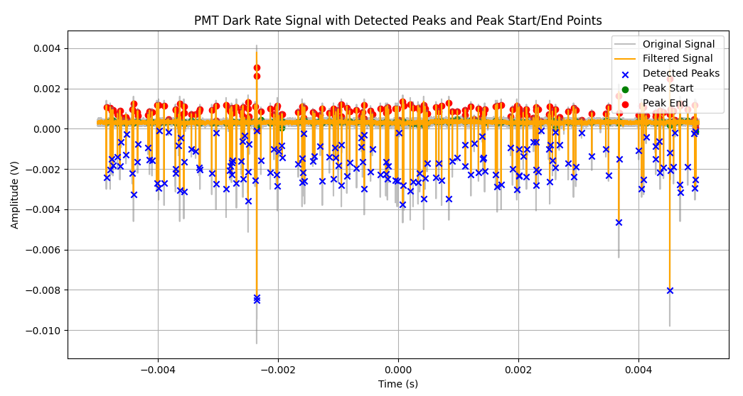
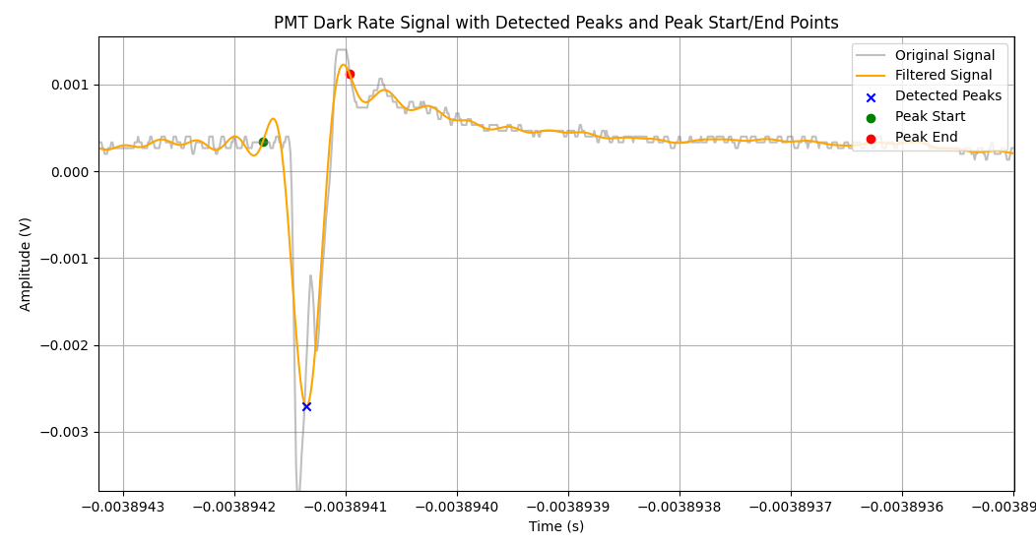
How the Code Works
FFT and Peak Isolation Stress Test
The oscilloscope captures chunks of PMT data
FFT is applied to convert the data to the frequency domain for filtering
Inverse FFT brings it back to time domain
Peak detection marks the start and end of peaks based on set amplitude thresholds
I made a script that lets me analyze what is happening visually
Notes:
:)

Slide 21
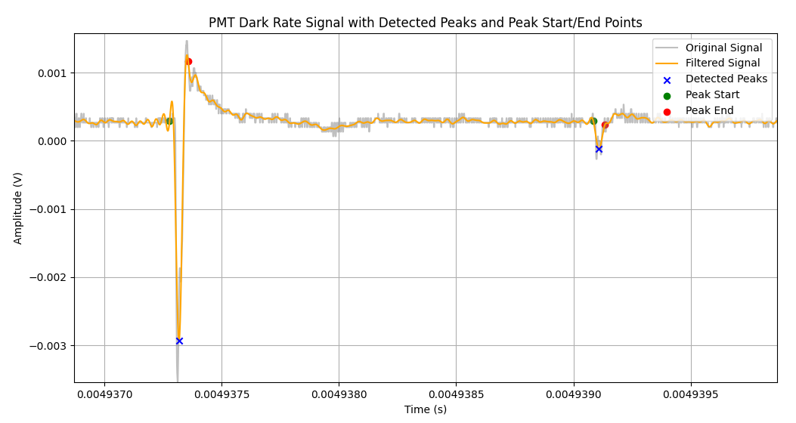
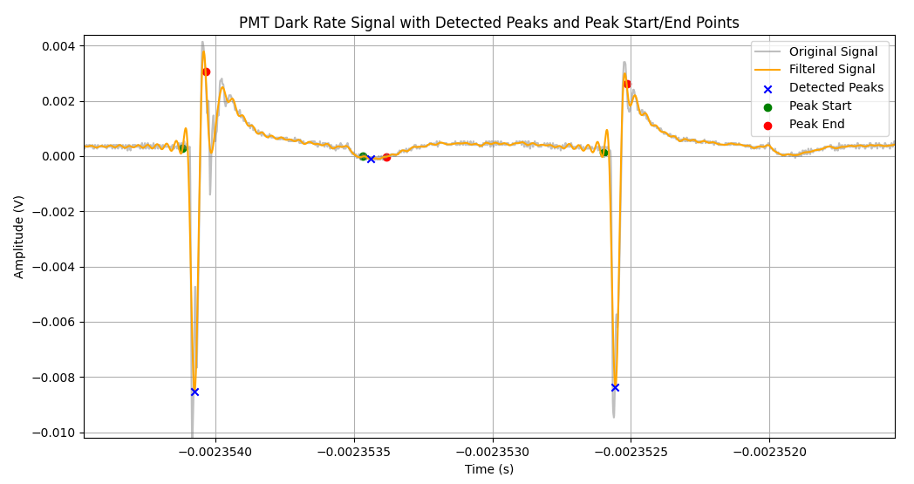
Issue Found through Testing
FFT and Peak Isolation Stress Test
Code is marking peaks that are too small as signals
Easy fix!
Can adjust thresholds for peak detection to >-0.0005 V (peaks are negative)
Can verify if it works with visualization code I made
Notes:
:)

Slide 22
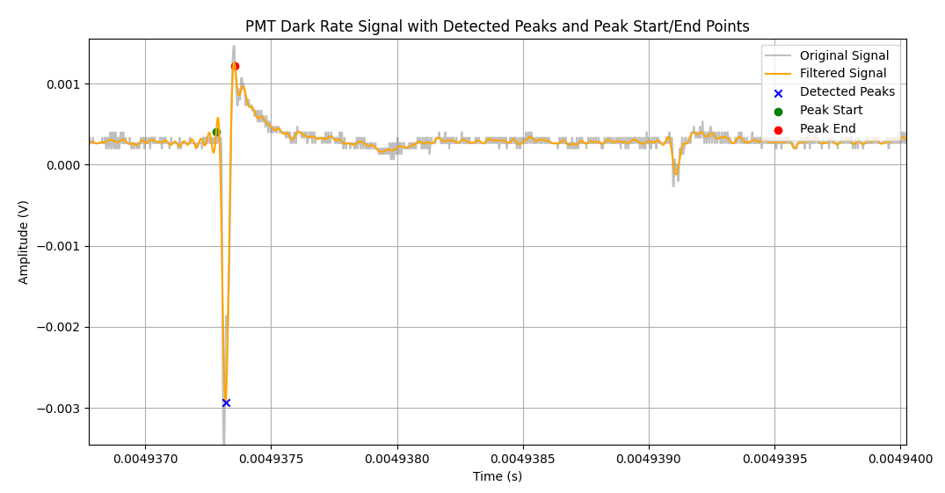
Improvement Results
FFT and Peak Isolation Stress Test
Quick fix, but important issue to discover
Would have had incorrect dark rate
Notes:
:)

Slide 23
Conclusion
Conclusion
Designed multiple potential cooling systems
Made CAD models for the various setups
Did calculations to identify the best approach
Made bills of materials for multiple designs and ordered parts for the final design
Did the above for the future testing setup (Pressure Vessel)
Made improvements to how data is managed for data analysis
Stress tested FFT and peak isolation scripts and made improvements
Notes:
:)

Slide 24
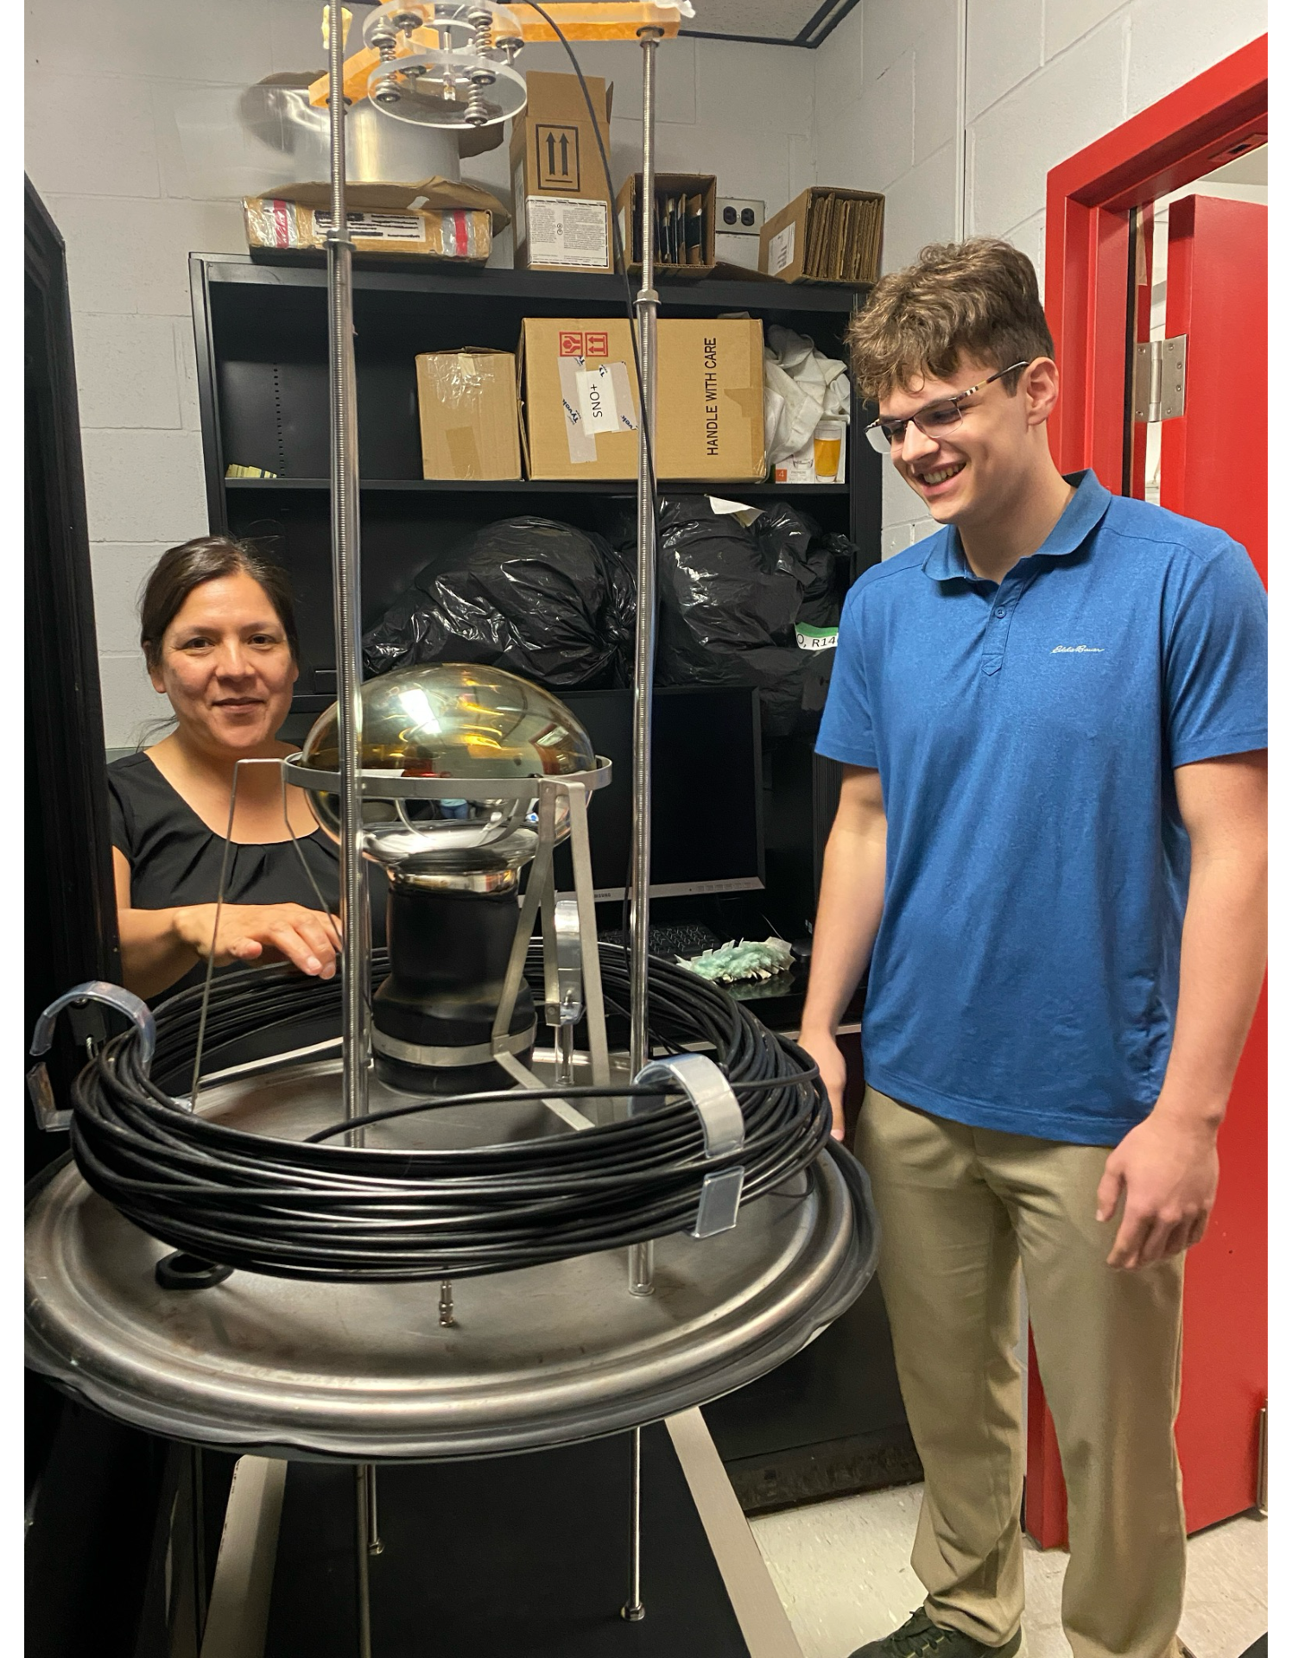
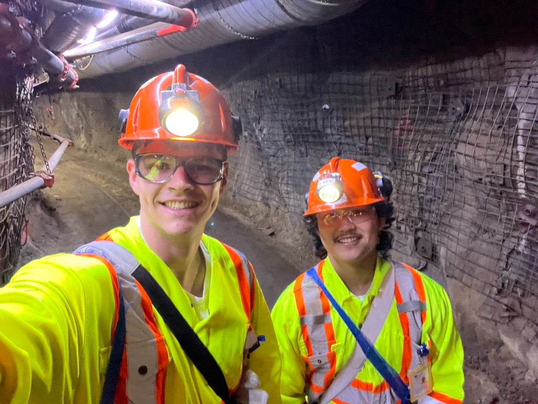
Acknowledgements
Conclusion
Thank you to:
Dr. Erica Caden
Anita Masuskapoe
Dr. Ubi Wichoski
SNOLAB and the nEXO collaboration for making this great summer possible!
Notes:
:)

Slide 25
Backups

Slide 26
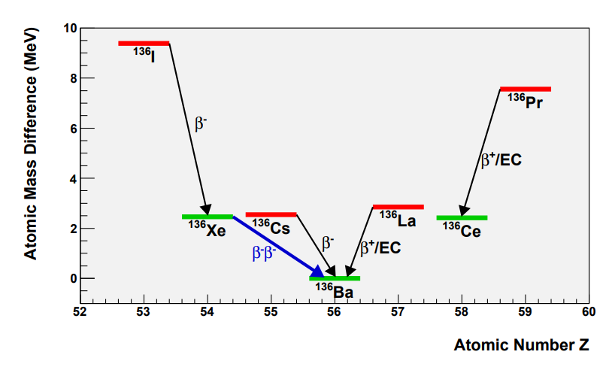
Double Beta Decay – 2vββ
Introduction to 0vββ and nEXO
2vββ decay is rare
Candidate isotopes: even-even nuclei where single β decay is forbidden
Observed in 14 isotopes
Source: https://arxiv.org/pdf/1109.5515
Notes:
:)
n → p e antiv twice
Happens with …
Rare
nEXO uses…

Slide 27
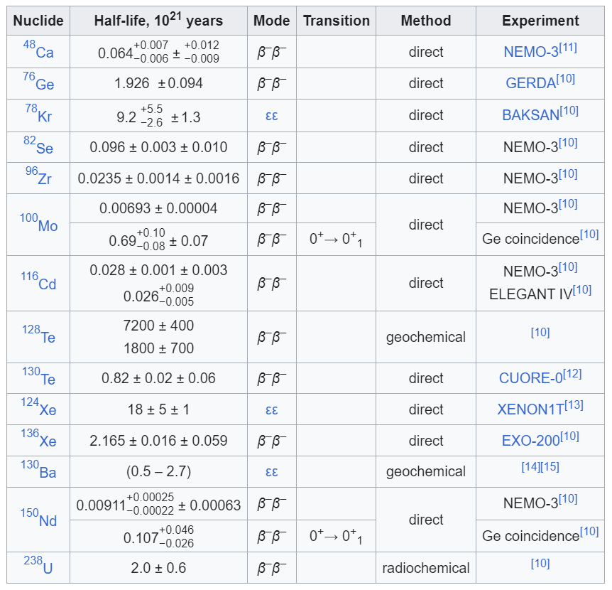
Isotopes that can Undergo 2vββ

Slide 28
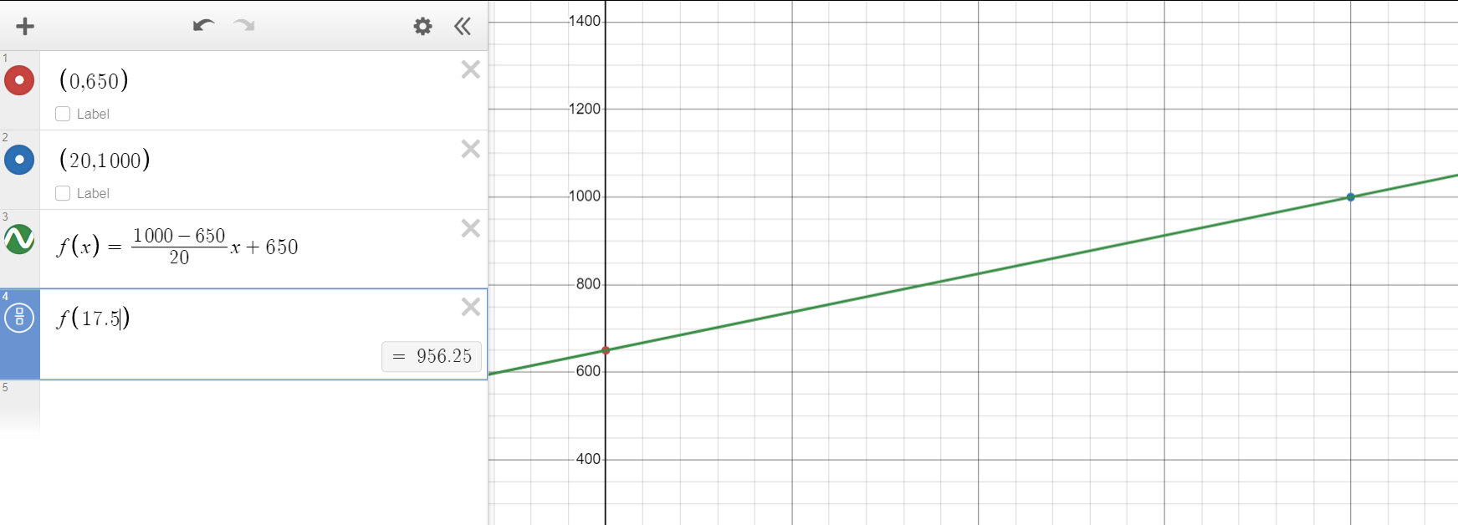
Linear Interpolation for Cooling Capacity
Most Calculations Look at cooling time from 25 °C to 10 °C
Middle is 17.5 °C
Cooling Capacity at 20 °C is 1000 W and at 0 °C is 650 W
Average Cooling Capacity is:
956 W

Slide 29
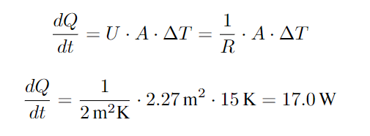
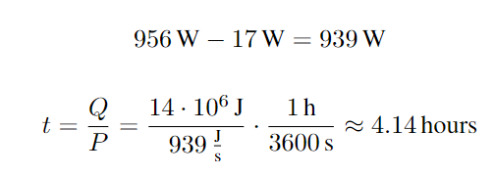
Calculations - Simple
Time to cool from 25 °C to 10 °C
Simple Calculation Perfect Insulation:
Simple Calculation with R-Value 2 Insulation:
Coolers Max Cooling Capacity is 956 W

Slide 30
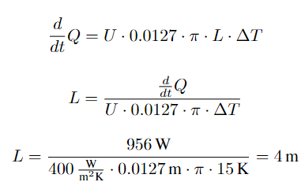
Calculations — Coil in Barrel
Cooling Capacity depends only on A. This gives 3 cases for dQ/dt that only depend on A:
dQ/dt < 956 W – Area of coil is bottleneck cooling
dQ/dt = 956 W – Coil exchanges heat at the same rate as the cooler
dQ/dt > 956 W – Making coil longer has no cooling benefits
Increasing coil length past 4m has no benefits

Slide 31
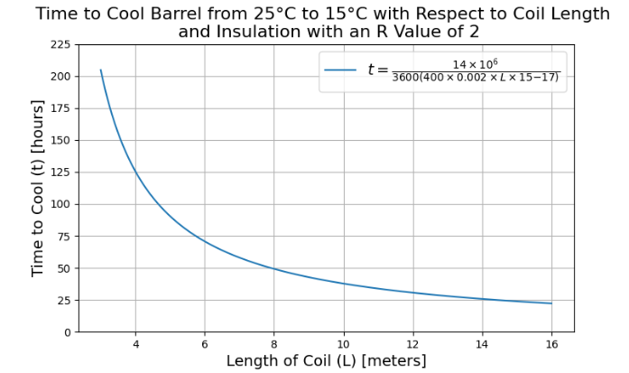
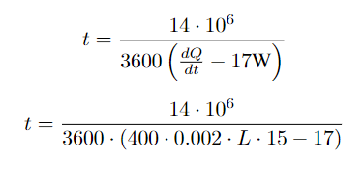
Calculations — Coil Outside of Barrel

Slide 32
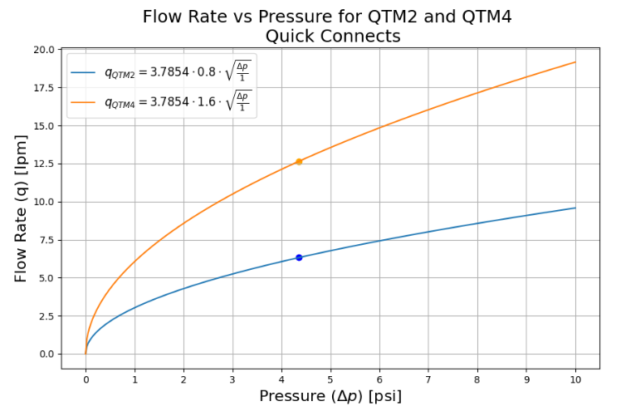
Quick Connect Concerns

Slide 33
Calculations Outside Barrel Final

Slide 34
Calculations PV

Slide 35
Time for Exterior to Heat Barrel by 1 °C wrt R-Value

Slide 36
Data Management Improvements
PMT_Data_Folder
├── Other Folders and files (not relevant)
└── Data
├── 1
│ ├── Other files (not relevant)
│ └── pmt-1560_noise_closed_loff-2023-11-23
│ ├── C2pmt-1560-noise-000000
│ ├── C2pmt-1560-noise-000001
│ ├── C2pmt-1560-noise-000002
│ └── ...
├── 2
│ ├── Other files (not relevant)
│ └── pmt-1560_noise_closed_loff-2023-12-4
│ ├── C2pmt-1560-noise-000000
│ ├── C2pmt-1560-noise-000001
│ ├── C2pmt-1560-noise-000002
│ └── ...
└── ...
Having to hard code file and folder names every time you change something.

Slide 37
Data Management Improvements
PMT_Data_Folder
├── Other Folders and files (not relevant)
└── Data
├── Subfolder
│ ├── Other files (not relevant)
│ └── Sub-Subfolder
│ ├── Data File
│ ├── Data File
│ └── ...
├── Subfolder
│ ├── Other files(not relevant)
│ └── Sub-SubFolder
│ ├── Data File
│ ├── Data File
│ └── ...
└── ...
Only having to put things in the right folder when you change something.

Slide 38
Data File Example

