Slide 1
N, N-dimethyldodecylamine (DDA) Quantification
2024/08/19
Danica Levesque
CASST 2024

Slide 2
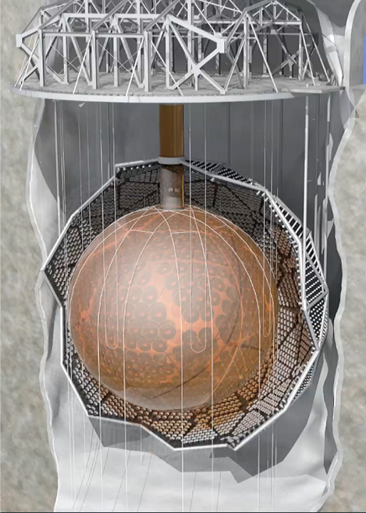
SNO+
Located in Creighton mine, 6800 ft underground
Multipurpose particle astrophysics detector, focuses on the search for neutrinoless double beta-decay
12 m diameter acrylic vessel filled with 780 tons of liquid scintillator, linear alkylbenzene (LAB)
Notes:
Extra slide that talks about scintillator

Slide 3
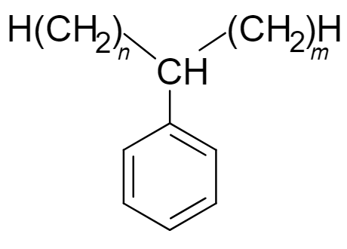
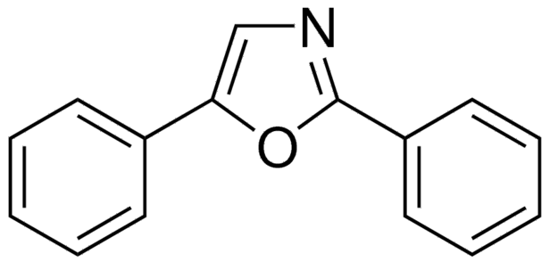
The Scintillator Cocktail
Wavelength Shifters
Conjugation → decreases energy transition, increasing the emitted wavelength
2, 5-Diphenyl Oxazole
Linear Alkylbenzene (LAB)
Scintillator
Aromatics → delocalized electrons are easily excited
1,4-bis[2-(2-methylphenyl)ethenyl]-benzene
Stabilizer
Amine → electron donors help stabilize free radical and prevent oxidative reactions
..
N, N-dimethyldodecylamine (DDA)

Slide 4
DDA Purification
DDA will be distilled three separate times to obtain different levels of purity
The distillation plant will be washed with LAB in between batches

Slide 5
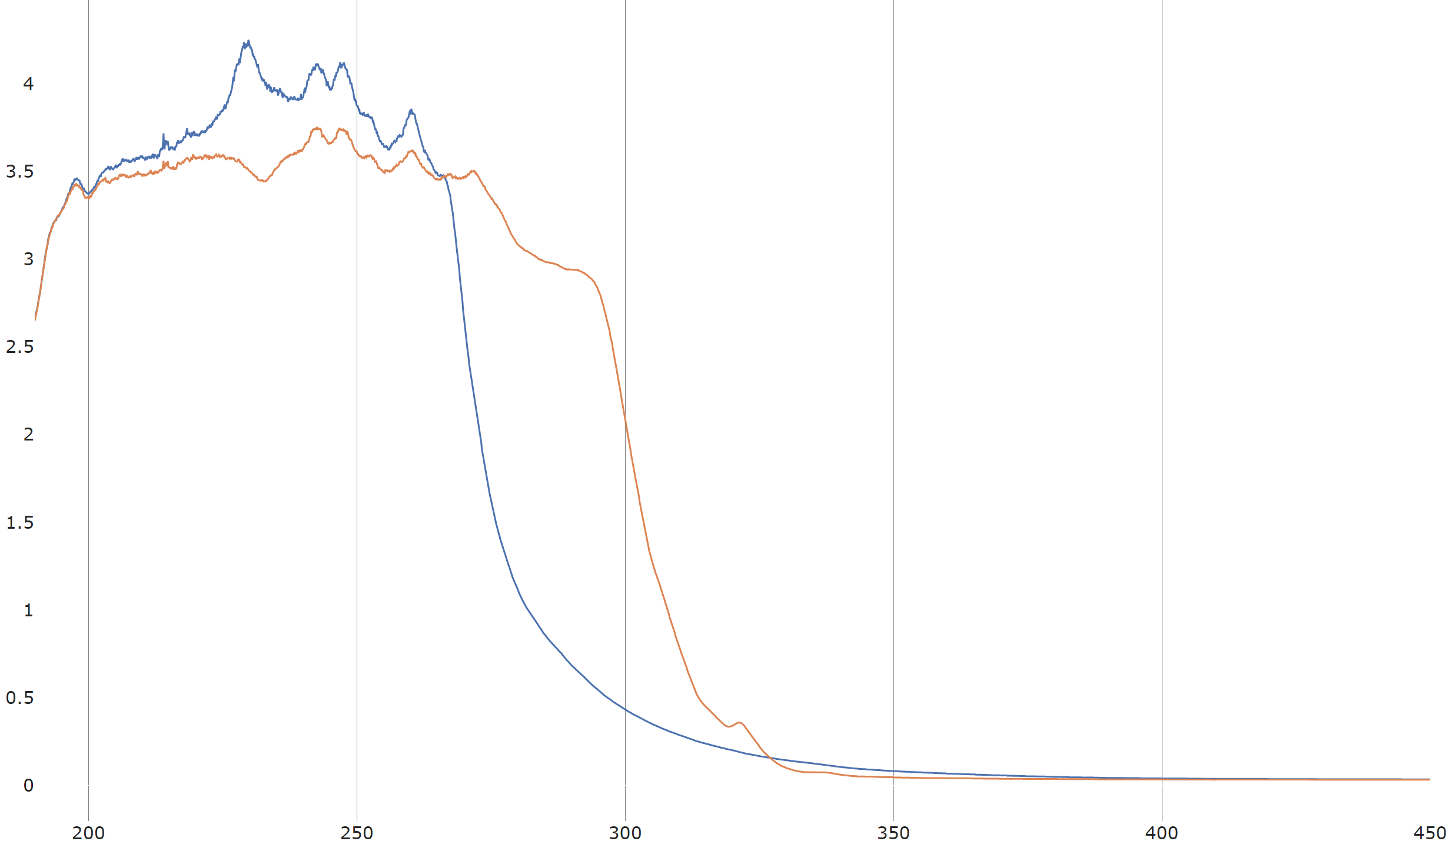
LAB and DDA UV-Vis Spectrum
4
At the isosbestic point, both LAB and DDA have the same absorptivity
Helps discriminate the absorption contributions of LAB/DDA at those wavelengths
Expected to be a linear function
$$A=ε𝓁(\left[DDA\right]+\left[LAB\right])$$
3.5
3
2.5
2
Absorbance (AU)
1.5
1
0.5
0
200
250
300
350
400
450
Wavelength (nm)

Slide 6
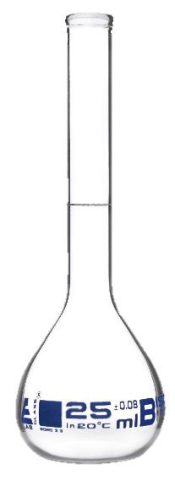
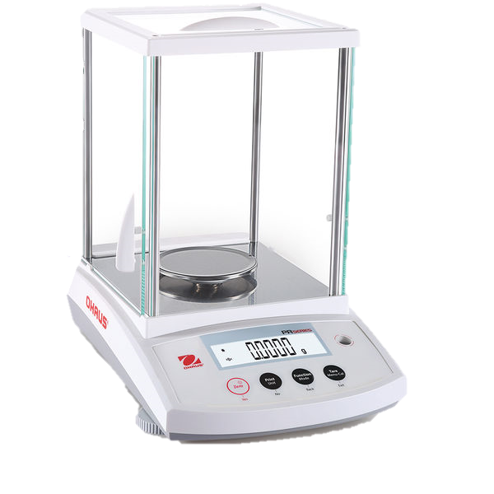
Procedure
DDA
LAB

Slide 7
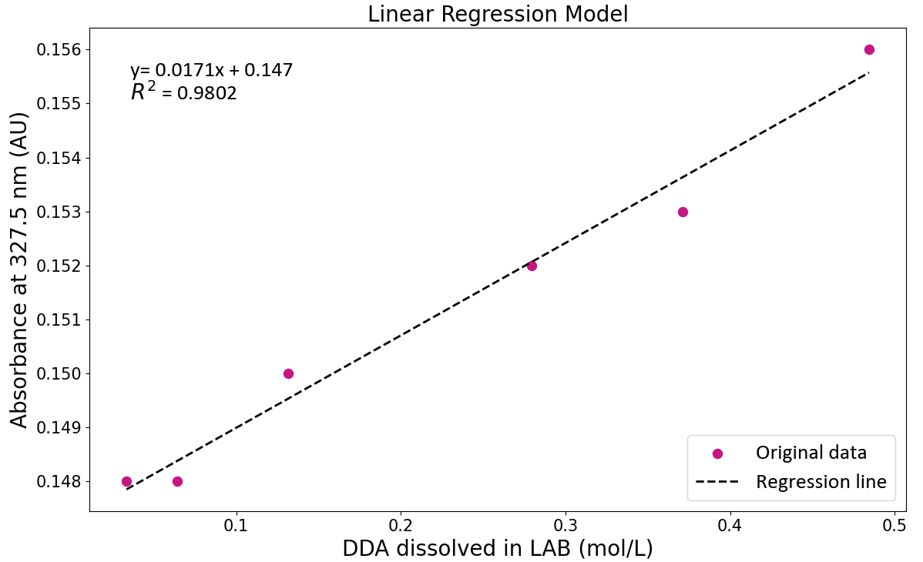
Concentration Curve With UV-Vis

Slide 8
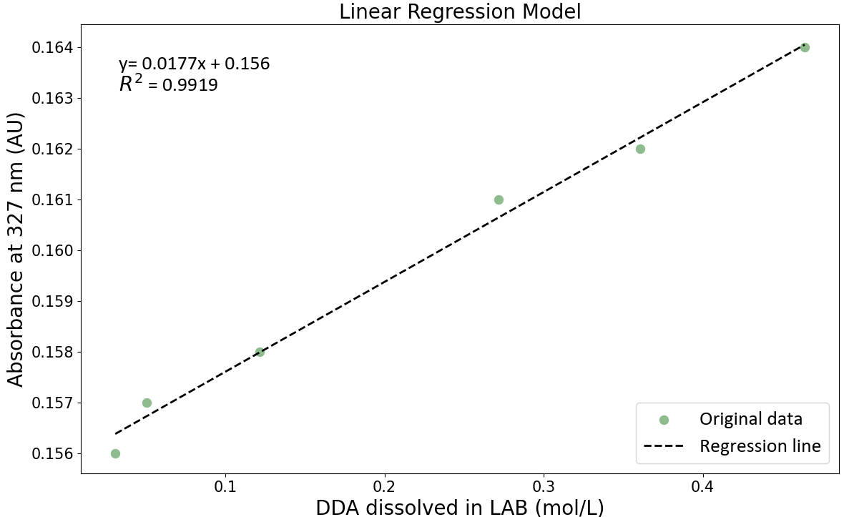
Concentration Curve With UV-Vis – Trial 2

Slide 9
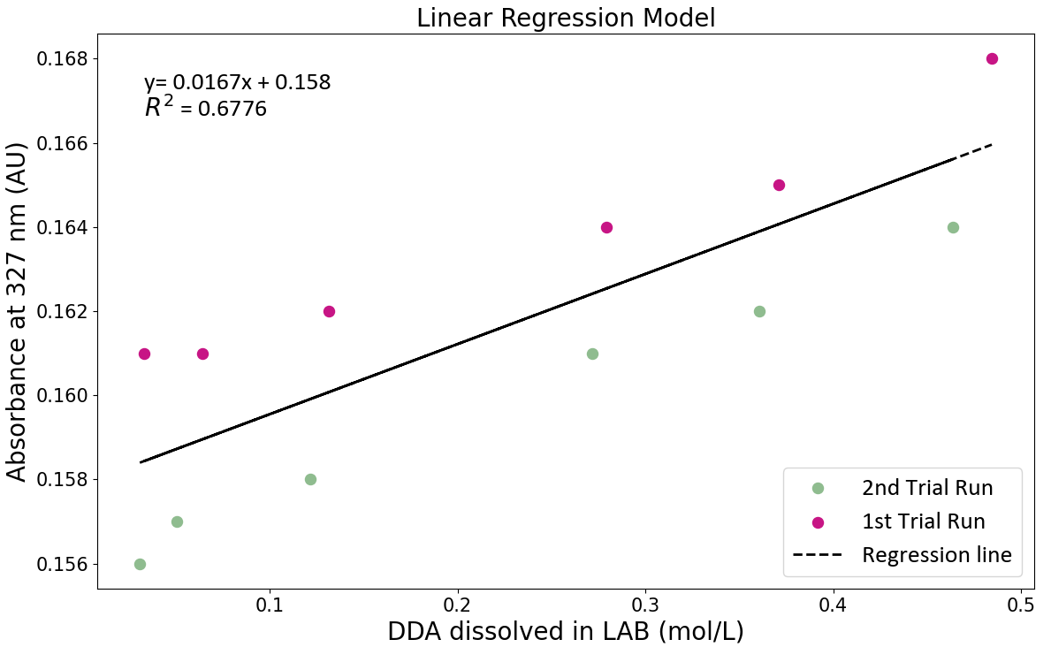
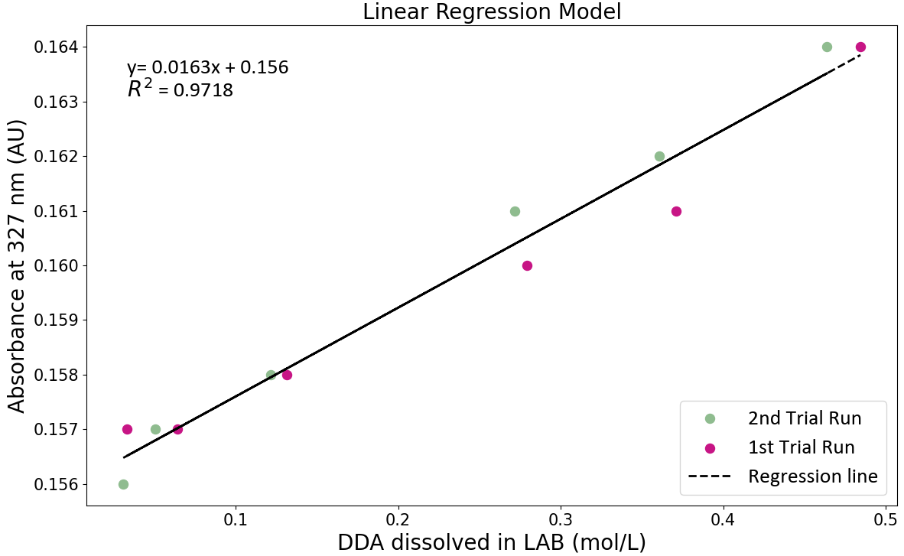
Concentration Curve With UV-Vis – Trial 1 and 2
Shift was due to minor changes in the LAB spectrum at the isosbestic point.
This change can be corrected with previous data of LAB.

Slide 10
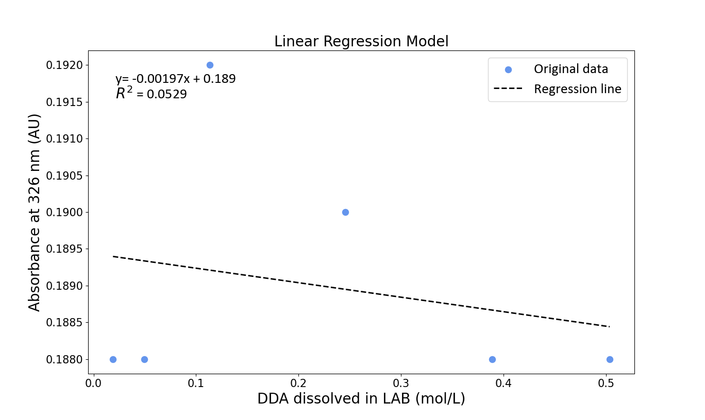
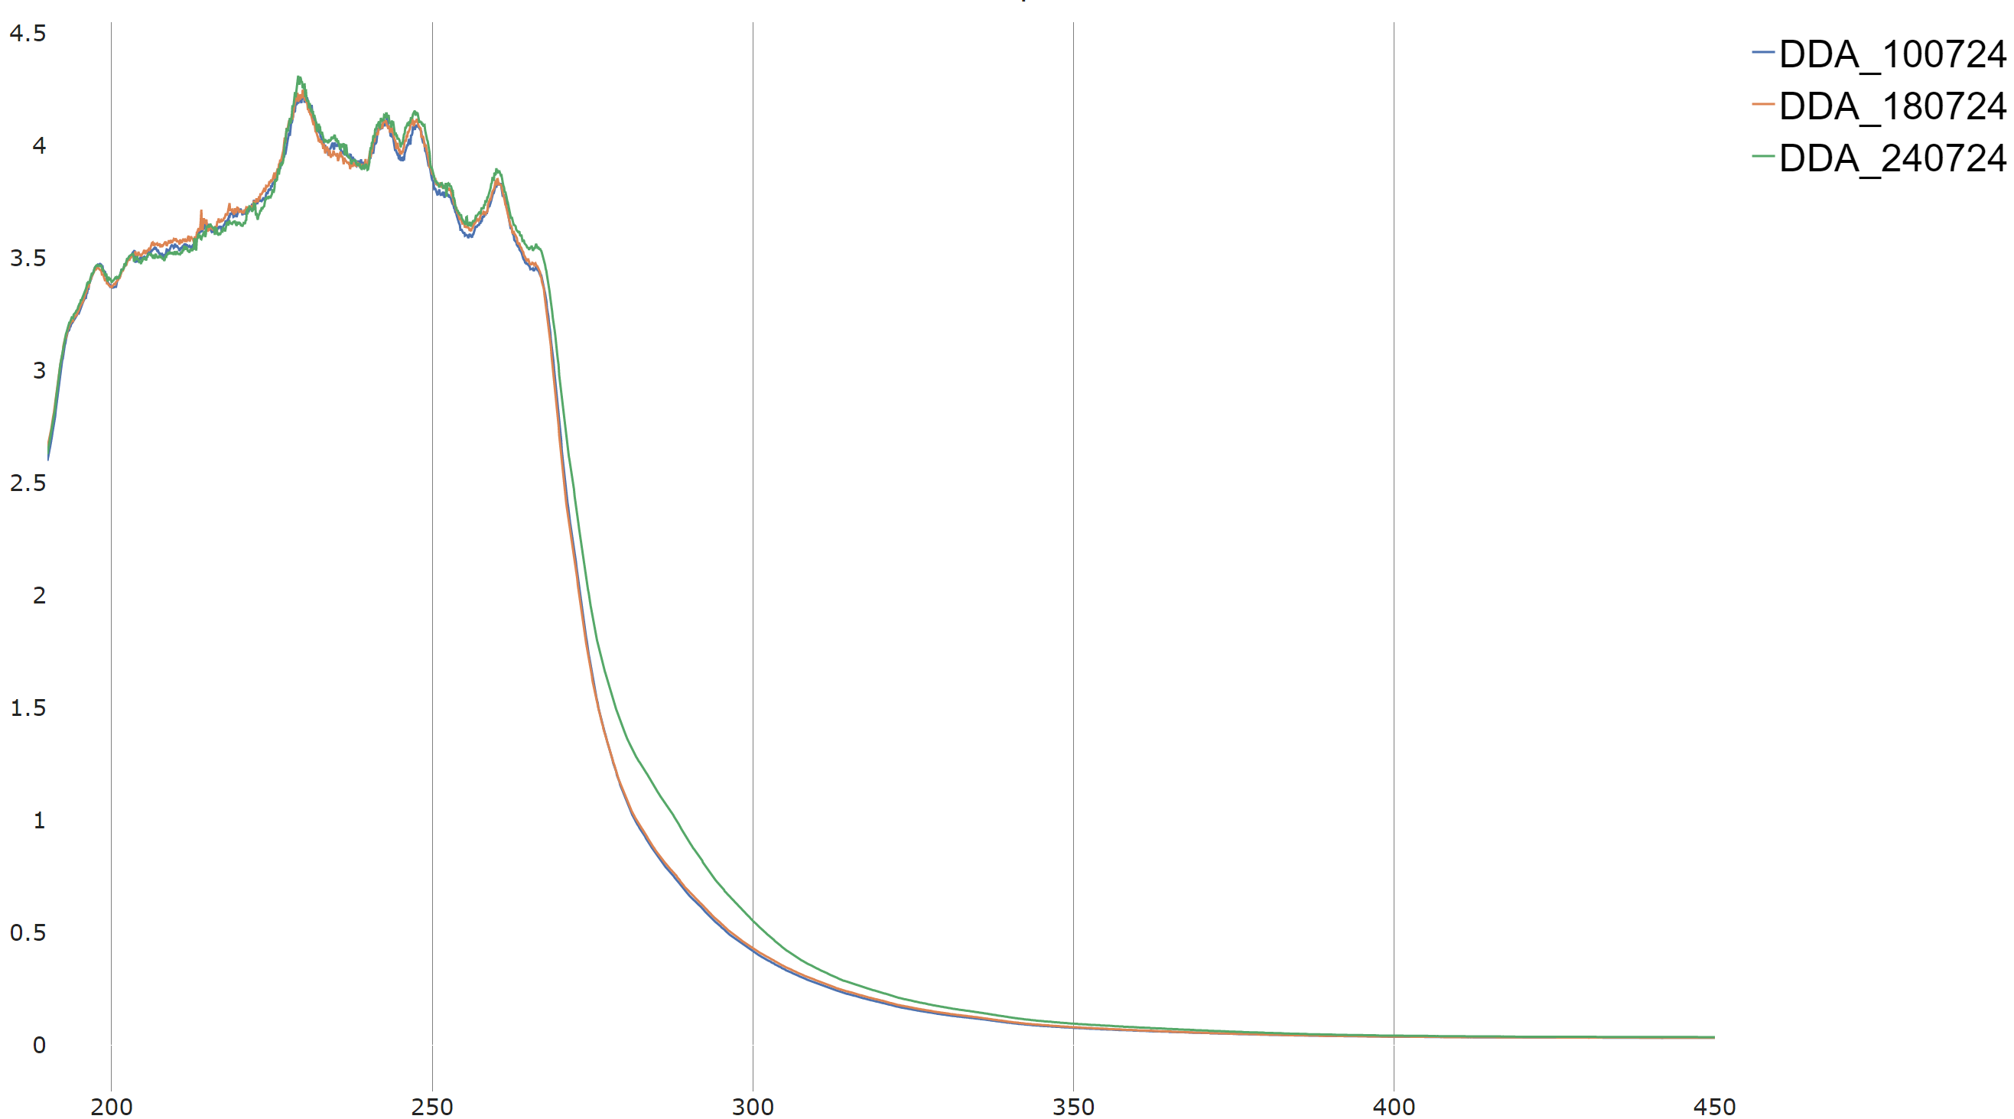
Concentration Curve With UV-Vis –Trial 3
Absorbance (AU)
The lack of the fit is attributable to DDA shifting, maybe due to improper storage (N₂).
Wavelength (nm)

Slide 11
Problems with UV-Vis
Limited by the isosbestic point for the analysis
Light sensitivity and oxygen sensitivity
This would require constant correction and a lot of work to understand this behaviour

Slide 12
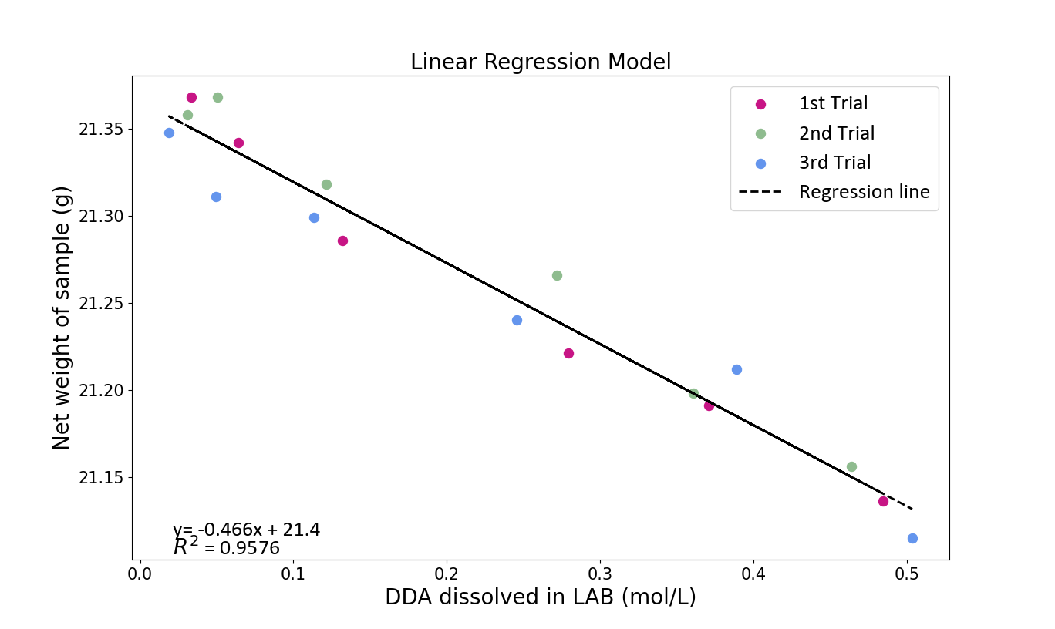
Concentration Curve With Density

Slide 13
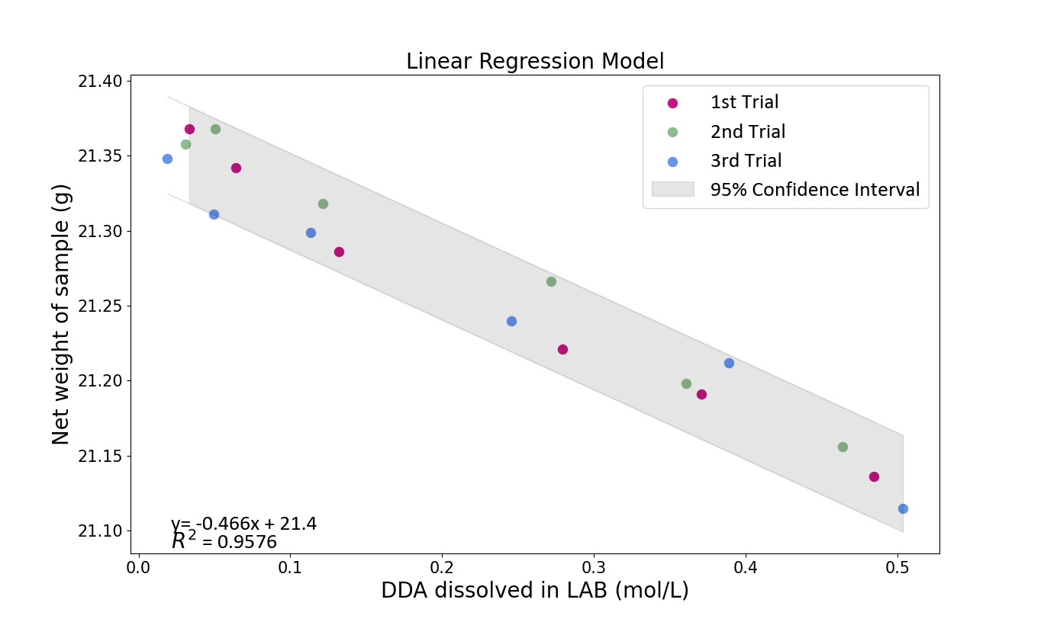
Concentration Curve With Density

Slide 14
Summary
Light and oxygen influences the spectroscopic properties of LAB and DDA
Concentration curve with UV-Vis data is not repeatable
Plotting the weight of the sample versus the concentration of DDA utilizes the differences in density of the two compounds
Need to control temperature and humidity
Results were repeatable!

Slide 15
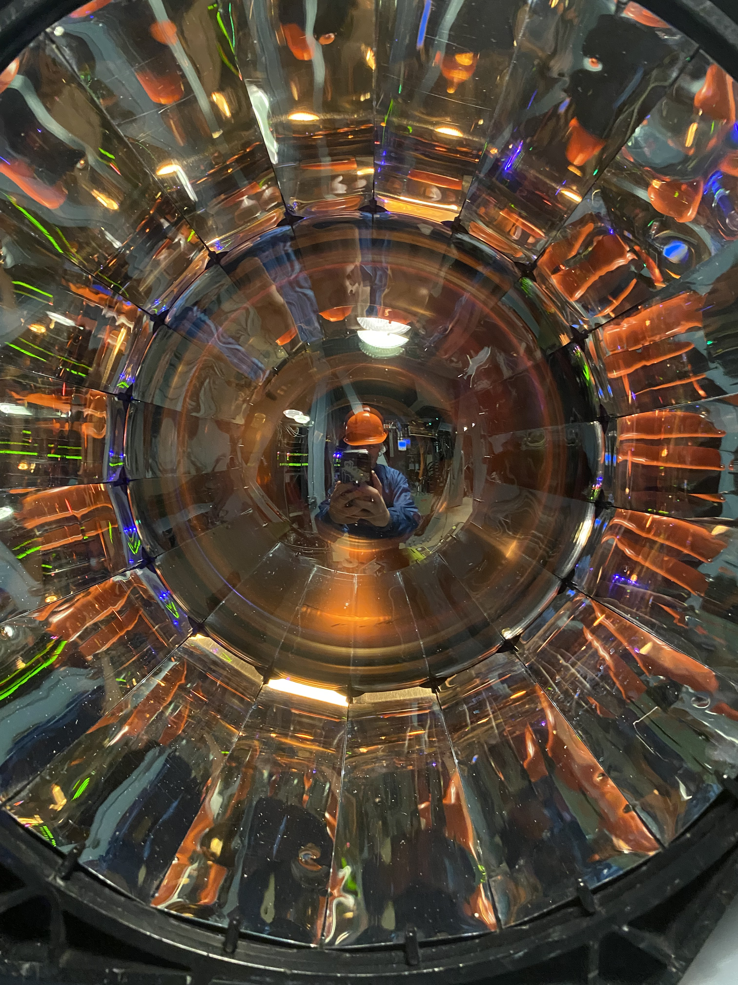
Questions?

