Slide 1
Staying Cool: the Thermoelectic Cooling of SiPMs
Julien Hacot-Slonosky
Supervisor: Thomas Brunner
CASST 2024
Contact: julien.hacot-slonosky@mail.mcgill.ca

Slide 2
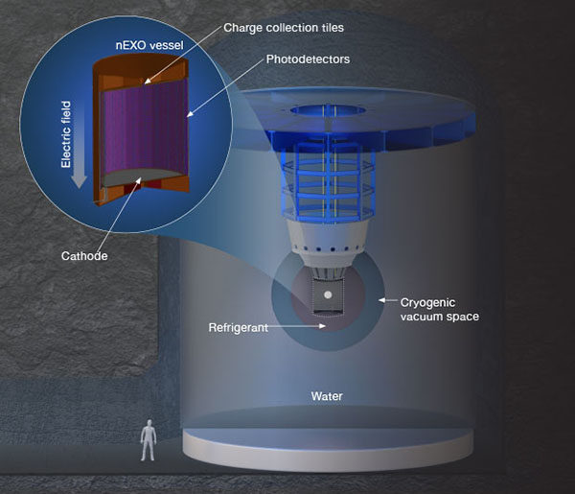
The nEXO Experiment
A proposed search for the hypothetical neutrinoless double beta decay ($0νββ$), proposed to be at SNOLAB
5 tonnes LXe enriched to 90% ¹³⁶ Xe
The time projection chamber houses ~10⁴ silicon photomultipliers (SiPMs) to detect scintillation light from $0νββ$
Projected half-life sensitivity of 1.35x10²⁸ years at 90% C.L.
Characterize how silicon photomultipliers (SiPMs) act at LXe temperatures
https://nexo.llnl.gov/nexo-overview

Slide 3
SiPM Characterization at Low Temperatures
Silicon photomultipliers (SiPMs) in nEXO will work to detect scintillation light from $ββ$ decay events at LXe temperatures (~ -100$℃$).
One part of testing SiPMs is measuring their sensitivity to a single photon at low temperatures, and so we want to suppress the dark count rate.
-40$℃$ is a low enough temperature where the dark counts can be neglected.
Can reach -40$℃$ much more easily with thermoelectric coolers (TECs).

Slide 4
How Do Thermoelectric Coolers Work?
TEC employ the Peltier effect:
When current passes through two dissimilar semiconductors (n-type and p-type), a temperature gradient forms across the junctions, depending on the direction of the current.
TE coolers pass direct current from N-type to P-type semiconductors.
Modules are made of many semiconductors arranged thermally in parallel, but electrically in series.

Slide 5
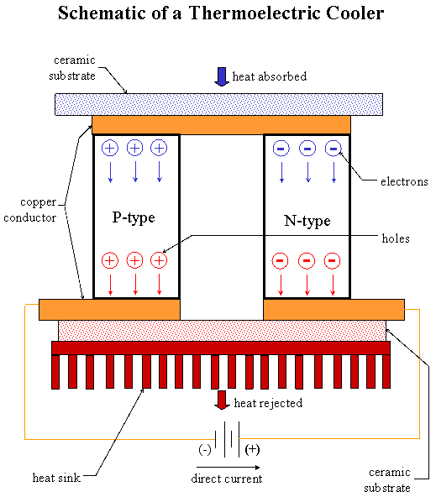
How do TECs Work?
Direction of heat moved
Modules are made of many semiconductors arranged thermally in parallel, but electrically in series.
Direction of current applied
https://tetech.com/faqs/#15

Slide 6
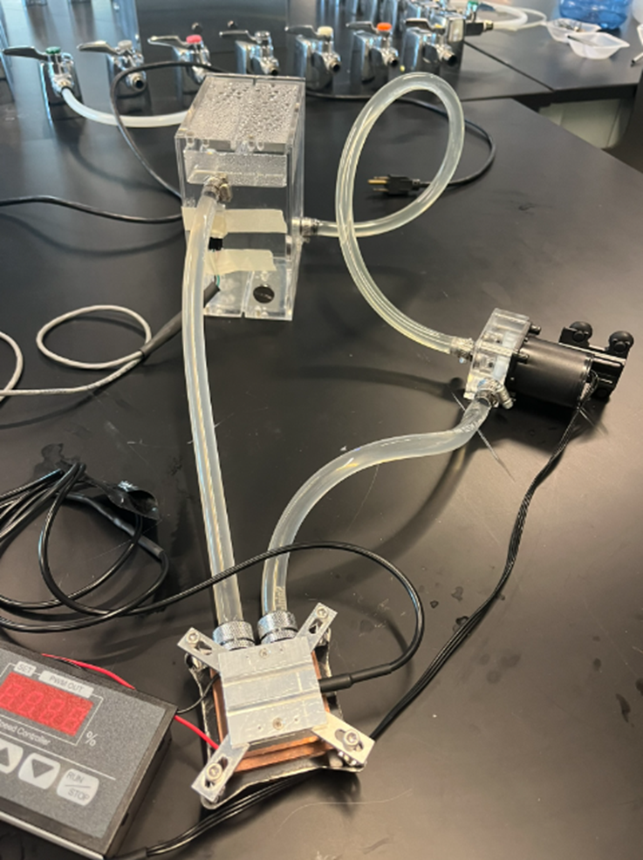
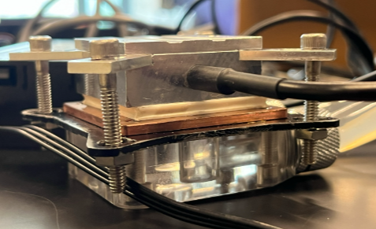
Initial Tests
1 TEC pressed between a pc chip water cooling block and an aluminum thermal load.
Closed loop cooling
water reservoir
Thermistor
Aluminum block
12V water pump
TEC
Stainless steel bolts
cooling module
PC water cooling block

Slide 7
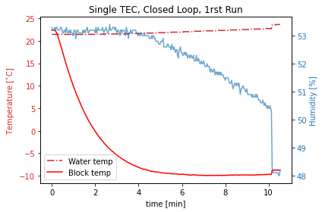
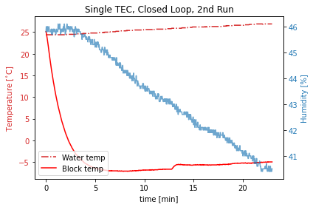
Initial Tests
The original setup works:
As the water temperature increased, so did the temperature of the aluminum block.
Recycled water from closed loop decreases the amount of heat able to be pulled away.
Single unit gave a constant $ΔT \sim 30℃$.

Slide 8
Upgrading the System
Two avenues for improvement:
Better heat sink
More heat moved
Better heat sink:
Closed loop recycles warm water with limited heat dissipation
Open loop from the building chilled water supply allows for cooler water at constant temperature
More heat moved
Using more units allows for greater $ΔT$
Stacking units loses efficiency quickly

Slide 9
The Trouble With Stacking TECs
The thermal load on an individual TEC increases the further down the stack it is until it cannot cool the load any further.
Load
Unit 1
Unit 2
Unit 3
Heat Sink
Notes:
Individual units produce their own heat as they operate
Units below must move the heat leaking from the units above as well as the heat to cool the load
This effect cascades until no more heat is moved from the lower units

Slide 10
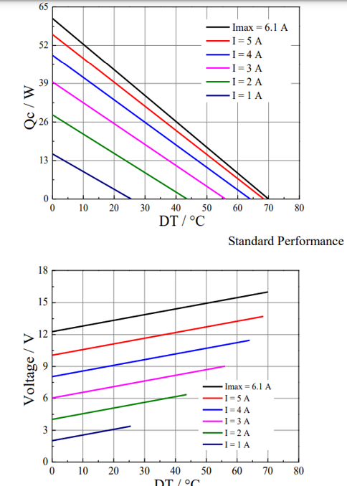
The Trouble With Stacking TECs
$$ΔT=37℃$$
8 V
x 3 A = 24 W used
For first unit 24 W used + 13 W pumped = 37 W total
$$ΔT=3℃$$
6 V
x 3 A = 18 W used
For second unit 18 W used + 13 W pumped = 31 W total
In total, 18 W used + 21 W used = 39W total for a $ΔT=40℃$
Quickly diminishing returns

Slide 11
How to Stack TECs
Unit 1
Unit 2
Vin
3-stack
All thermally in series
First two electrically in series
Bottom in parallel with first two
Bottom receives twice the current to deal with the extra heat load
Unit 3
GND

Slide 12
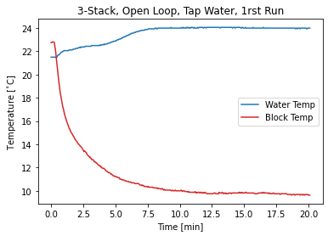
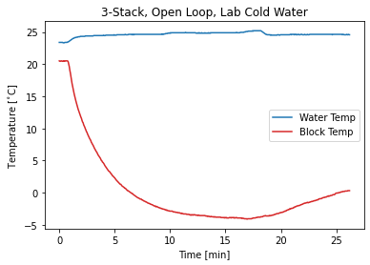
First Trials
Tested a 3-stack with open loop cooling with water from the tap
Clearly something is not working as intended…

Slide 13
Back to Basics
The 3-stack method only works if all the units are the same, these were not…
Replaced the 3-stack with one TEC1-12704k10 unit
Replaced the stainless steel bolts with plastic bolts
Used open loop water cooling
Aluminum block
14.90 V, 3.65 A
Plastic bolts
TEC1-12704k10
GND
Water Cooling Block
Water out
Water in

Slide 14
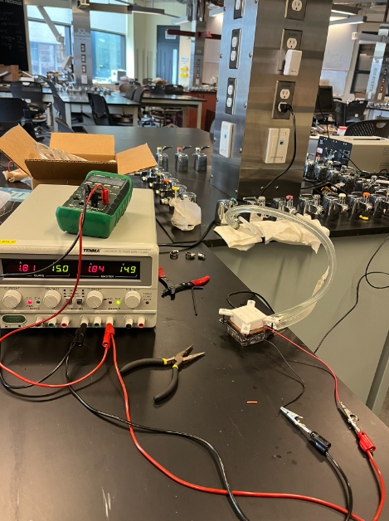
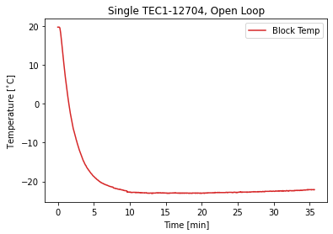
Back to Basics
$−23℃$ !
The open loop cooling is much better than the closed loop cooling
Using a thermally insulating layer between the hot and cold side also improves performance

Slide 15
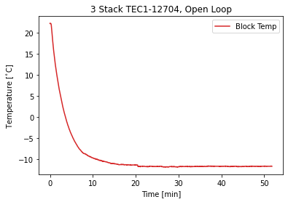
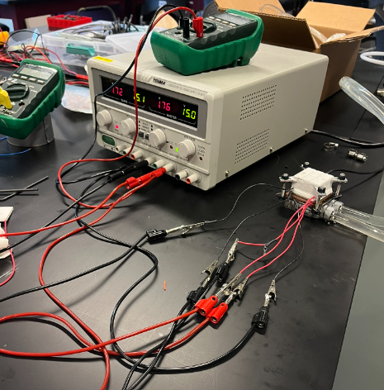
Latest Attempt With 3-Stack
Stacked 3 TEC1-12704k10
Used 3D printed spacers between the bolts
Used open loop cooling
Still only -11$℃$ with the 3-stack

Slide 16
Moving Forwards
Find better ways to thermally isolate the load from the environment, hot side
Prevent the buildup of ice crystals that will envelop the SiPM
Incorporate the open loop cooling with the building chilled water supply

Slide 17
Acknowledgements
Professor Thomas Brunner
And all the McGill Physics department technical staff

Slide 18
Extra Slides

Slide 19
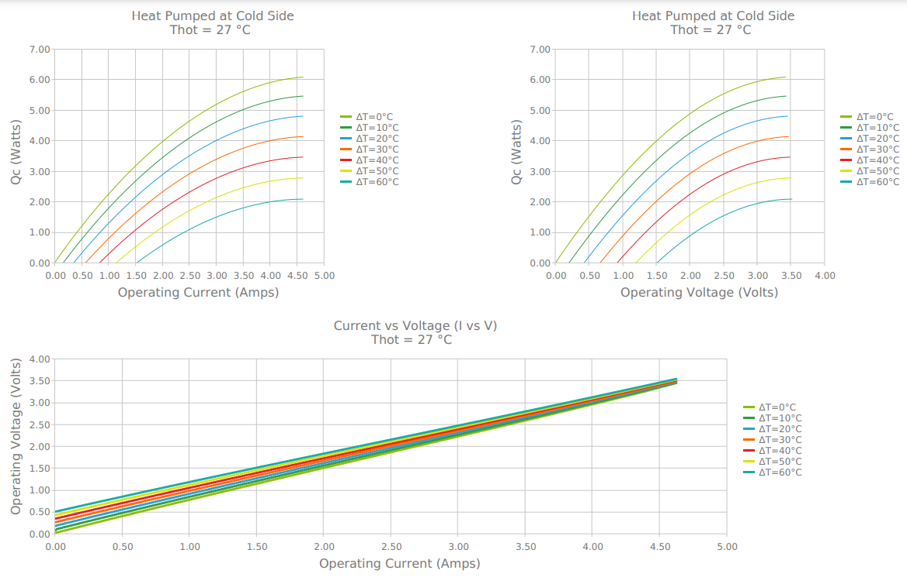
The Trouble With Stacking TECs
Laird Thermal Systems, Multistage series electric cooler https://www.lairdthermal.com/datasheets/datasheet-MS2-049-14-14-15-15-11-W8.pdfr

