Slide 1
Neutrinoless double beta decay and SNO+
Jerry Cao
University of Oxford
CASST Presentation, August 20th, 2024

Slide 2
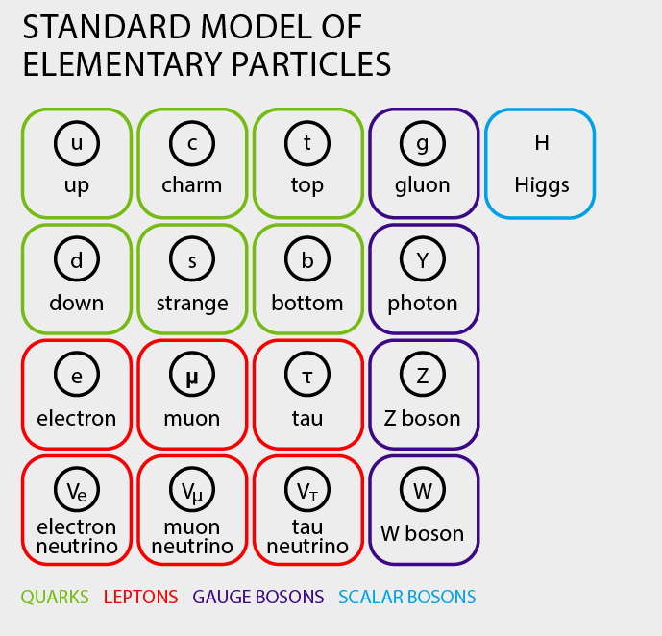
Neutrinos (ν’s)
Fermions with spin ½
Neutral electromagnetic charge
Comes in 3 generations
Each generation relates to a specific charged lepton (electrons, muons, taus)
Only interacts with the weak force in the Standard Model
Credit: BBC Science Focus

Slide 3
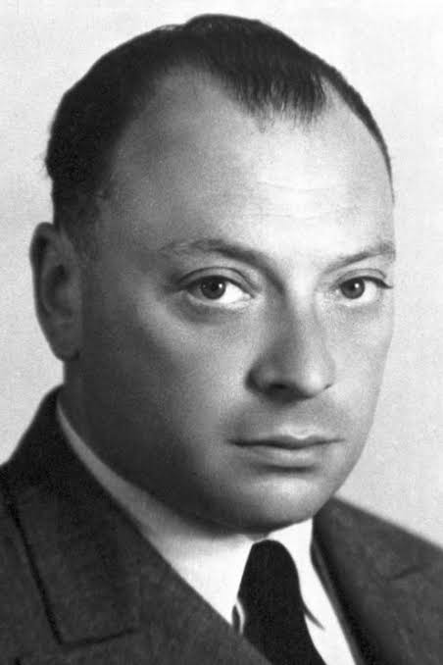
A (very brief) history of neutrinos
β decays appears to violate energy and momentum conservations
Pauli postulates the neutrino to solve this problem. A massless, neutral particle that can never be detected…
I have done a terrible thing, I have postulated a particle that cannot be detected.
Wolfgang Pauli on neutrinos, 1930
Wolfgang Pauli
Credit: The Nobel Prize

Slide 4
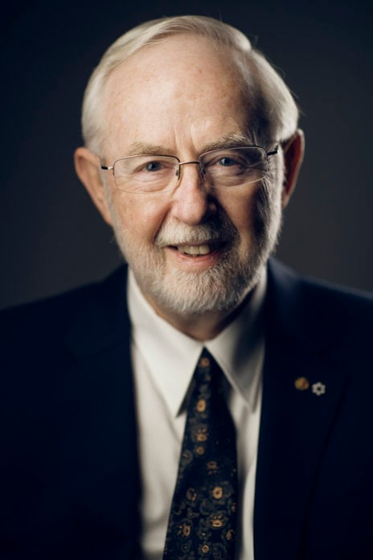
A (very brief) history of neutrinos
Detected in 1956 by the Cowan-Reines experiment
Solar ν measured in the 1960s by the Homestake experiment
Observed only one third of expected!
Neutrino oscillations
2015 Nobel Prize for Art McDonald and Takaaki Kajita for the SNO and Super-Kamiokande experiment
Oscillations require neutrinos to have mass…
Art McDonald
Credit: The Nobel Prize

Slide 5
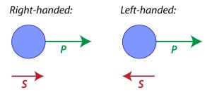
Mass?
Mass!
All other particles get mass by interacting with the Higgs…
But that requires two ‘chirality’ of particles - left-handed and right handed
The weak force is only left-handed
No right-handed neutrinos
Chirality of particles
Credit: ATLAS

Slide 6
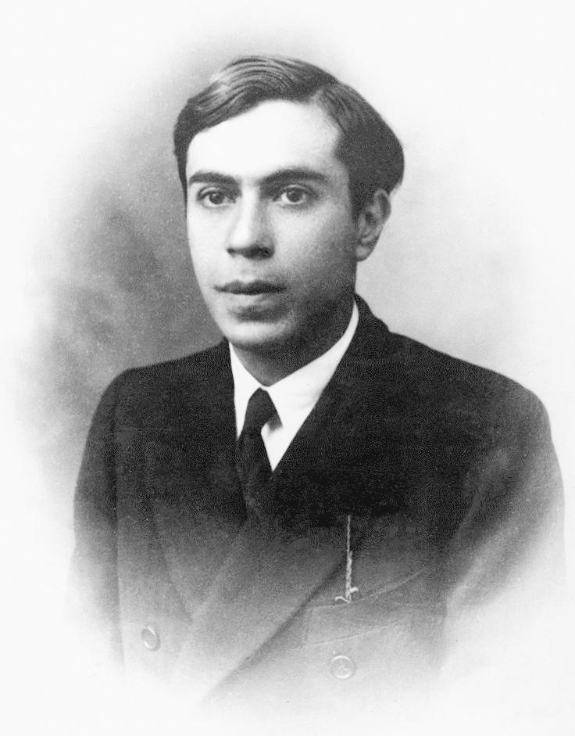
Majorana neutrinos
One idea to solve this mass acquisition problem…
Neutrinos have both a left-handed and right-handed component together
If reversed - still one left-handed and one right-handed component
Neutrinos are their own antiparticles!
Ettore Majorana
Credit: Mondadori Collection

Slide 7
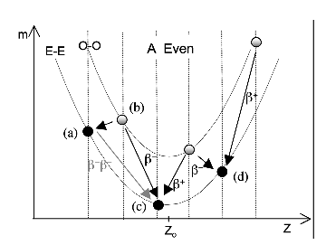
Double beta decay
Two of the neutrons in the nucleus of an atom turn into protons simultaneously
Emits two electrons (β) and two neutrinos (ν)
Occurs when single beta decay is prohibited but two occur at the same time is possible
Half life ~ 10^18-10^21 years - much longer than the age of the universe ~ 10^10 years!
First observed in 1987 by Michael Moe’s group at UC Irvine from Selenium-82
Energy graph of double beta decay (Credit: University of Warwick)

Slide 8
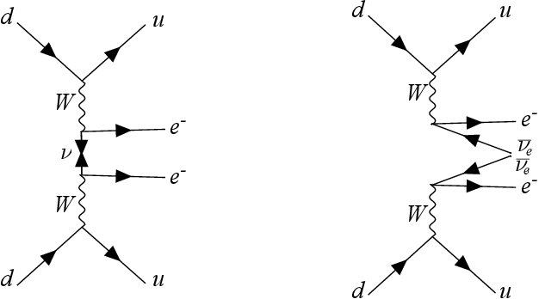
Double beta decay… But no neutrinos
Neutrinoless double beta decay (0νββ)
Hypothesized mode of ββ that emits no neutrinos
Possible if neutrinos are Majorana
Neutrinos internally annihilate each other within the reaction
Half-life greater than 10^22 - 10^26 years!
The ‘smoking gun’ for Majorana neutrinos
Feynman diagrams for 0νββ and 2νββ
Credit: Giuliani et al., arXiv 1910.04688

Slide 9
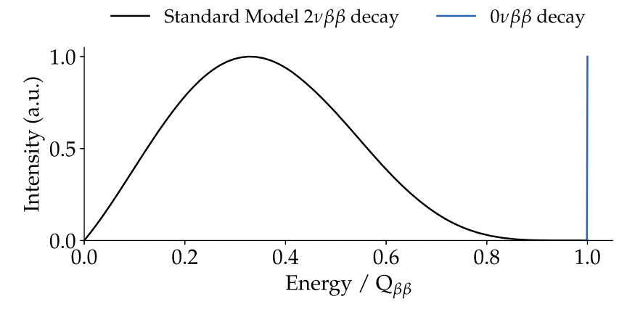
Energy spectrum of 2νββ vs 0νββ.
Credit: Elisabetta Bossio and Matteo Agostini 2024 J. Phys. G: Nucl. Part. Phys. 51 023001
Notes:
Variation in neutrino energy gives a variation in electron energy spectrum

Slide 10
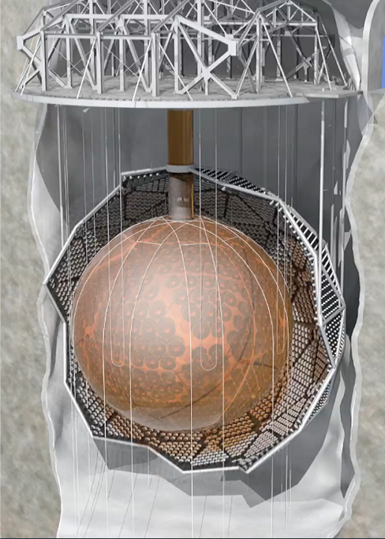
SNO+
Acrylic Vessel filled by the liquid scintillator linear alkylbenzene (LAB)
12m in diameter, almost 10000 PMT sensors
2 km underground in Sudbury, Canada
Loading with tellurium
Attempts to detect neutrinoless double beta decays of tellurium-130
Concept picture of SNO+
(Credit: SNO+)

Slide 11
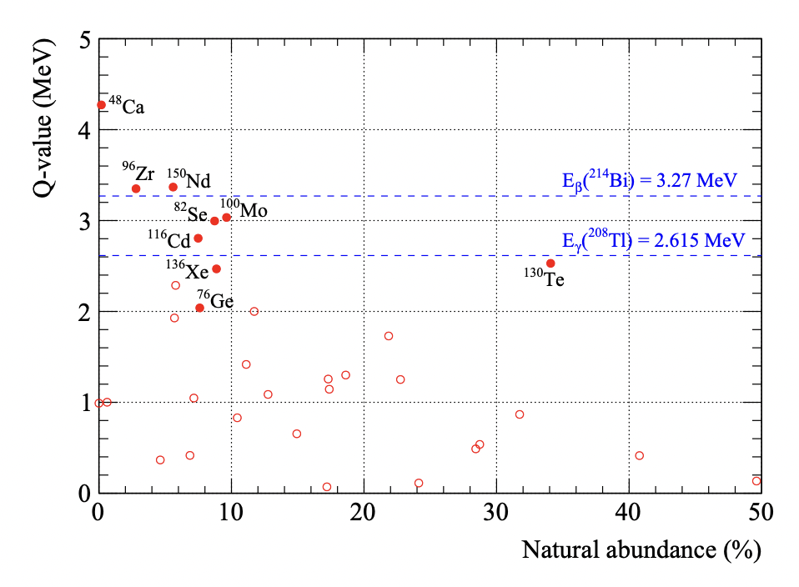
Why tellurium-130?
Massive amount of isotope
With Q-value high enough to overcome backgrounds
Low rate of 2νββ as background
Tellurium-130 comes as a natural choice
Isotopes for double beta decay
Credit: SNO+ white paper

Slide 12
Sensitivity of SNO+
Will be 0.5% loaded of tellurium
~3.9 tonnes of tellurium, ~1.3 tonnes of Te-130
After 3 years of data taking, a half life bound of 2*10^26 years will be reached at 90% confidence level
After 5 years, a half life bound of 5*10^26 years at 90% confidence
Current best limit: CUORE, 2.2*10^25 years

Slide 13
Thank you!
Christine Kraus
Steve Biller
Steve Sekula
SNO+ team (Beymar, Gulliver, Shuai, Ben, Gurpreet, Adil)

Slide 14
Questions?

Slide 15
References
[1] Elisabetta Bossio and Matteo Agostini 2024 J. Phys. G: Nucl. Part. Phys. 51 023001
[2] Giuliani et al, 2020, Double Beta Decay APPEC Committee Report, arXIv 1910.04688
[3] Jeanne Wilson, Neutrinoless Double Beta Decay, TRISEP 2024
[4] José Maneira, Neutrino Science, SuSi 2024
[5] Steven Biller, SNO+ with Tellurium, Physics Procedia, Volume 61, 2015, Pages 205-210, ISSN 1875-3892,
[6] The SNO+ collaboration et al, 2021 JINST 16 P08059

Slide 16
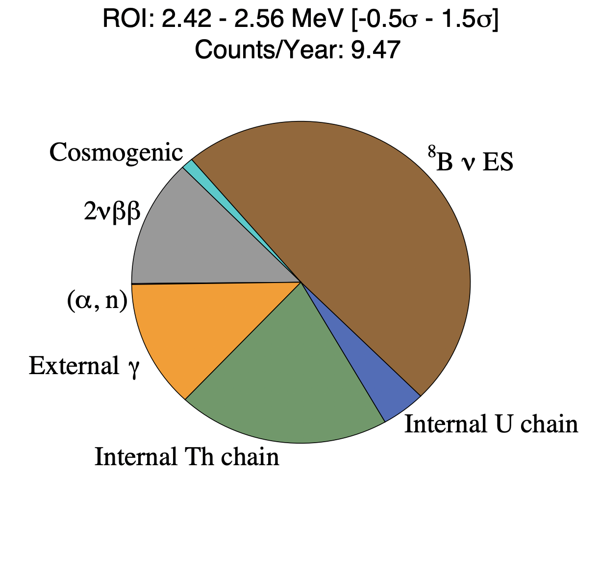
Relevant backgrounds
Tellurium-130 has a Q-value of 2.528 MeV.
Backgrounds to 0νββ:
2νββ
Cosmic μ (2 km of rock)
Cosmogenics (tellurium ‘cooling underground’)
External γ (attenuate by outer volume)
U/Th decay chain (identify by tagging and minimize cleaning)
Simulated backgrounds for SNO+
Credit: Jeanne Wilson, TRISEP 2024

