Slide 1
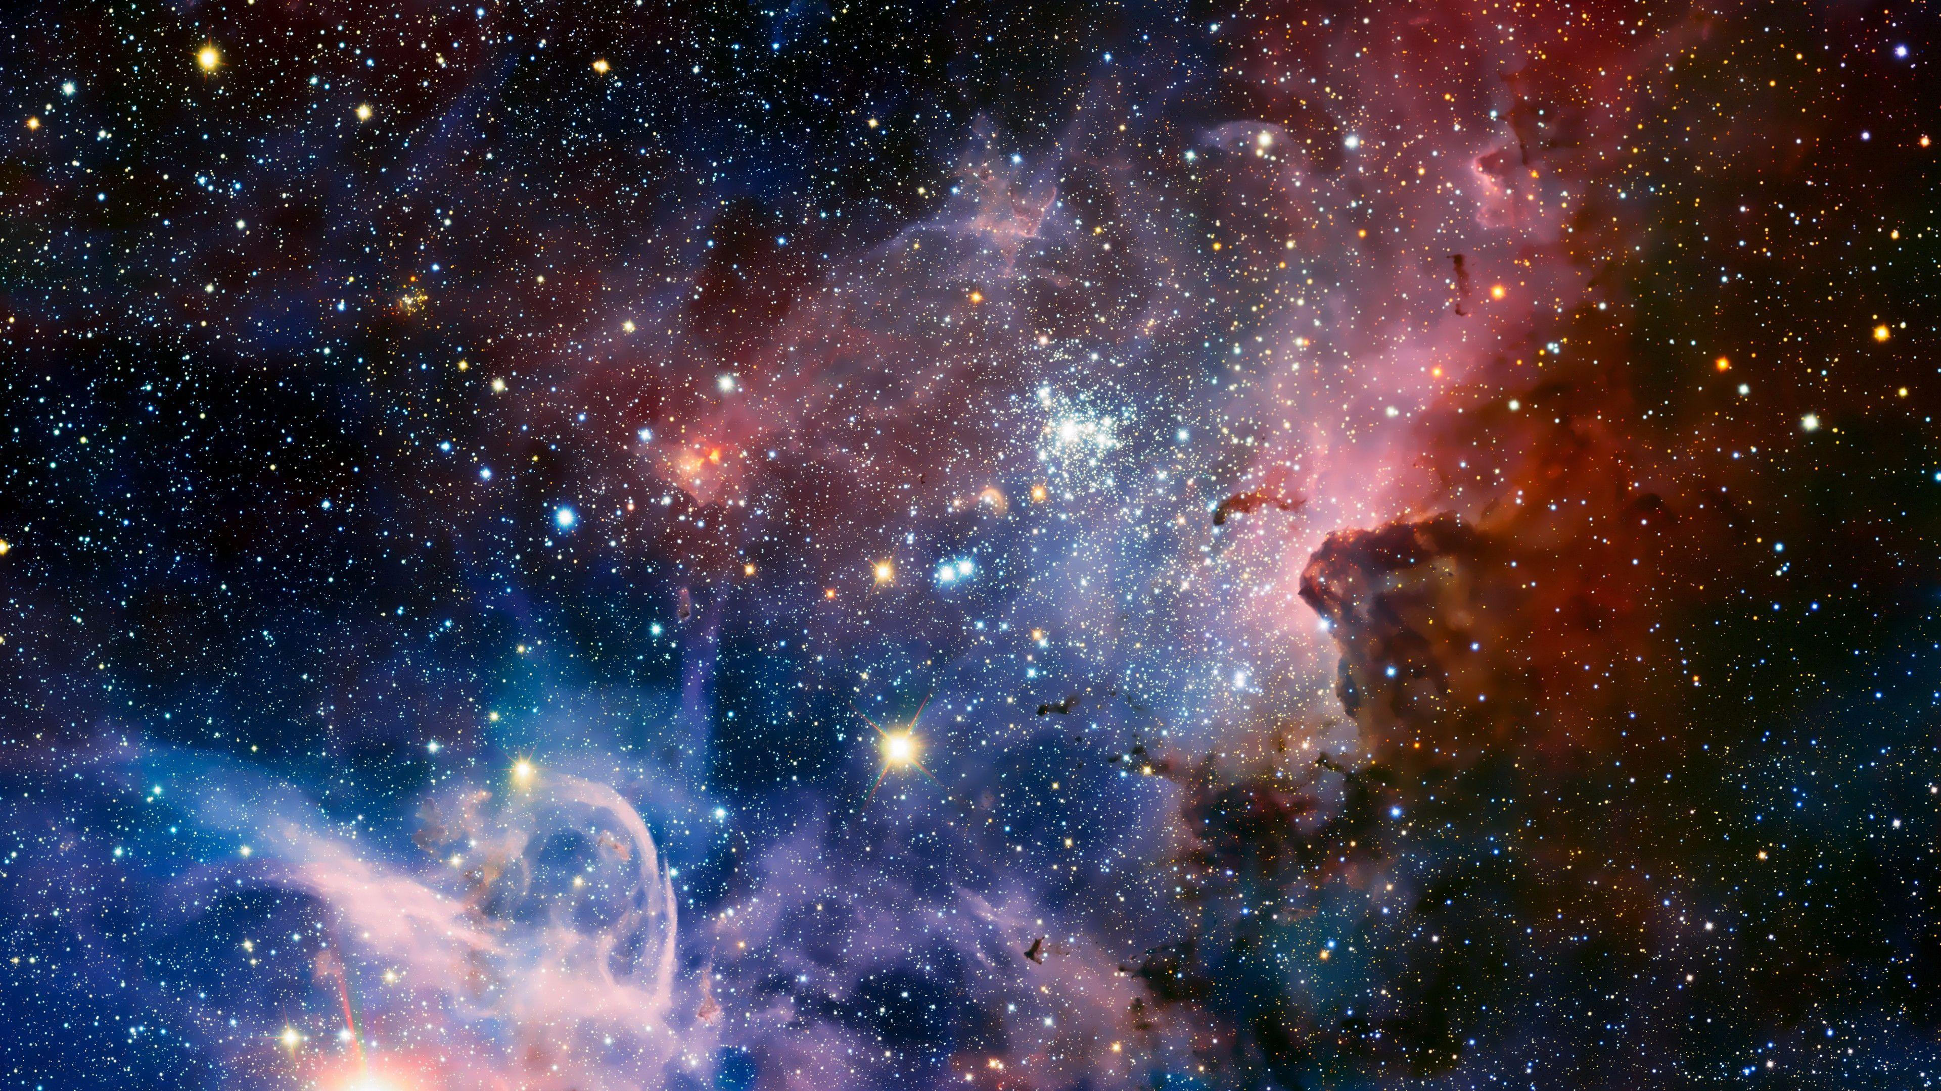
Bringing Astroparticle Physics to the Classroom
By Emma Acres, with Mark Richardson
Notes:
Good morning, everyone! My name is Emma Acres, and I am excited to share my summer projects with you today which are lesson plans designed to bring astroparticle physics to classrooms.

Slide 2
Table of Contents
The Public’s View on Modern Physics
Curriculum ties
Challenges & Solutions
“Understanding the Standard Model”
Teacher & Student Resources
Next Steps
Notes:
In my presentation, I will start with the public’s perspective of modern physics which will lead me into a very quick taste of one of the lesson plans I created called “Understanding the Standard Model.”

Slide 3
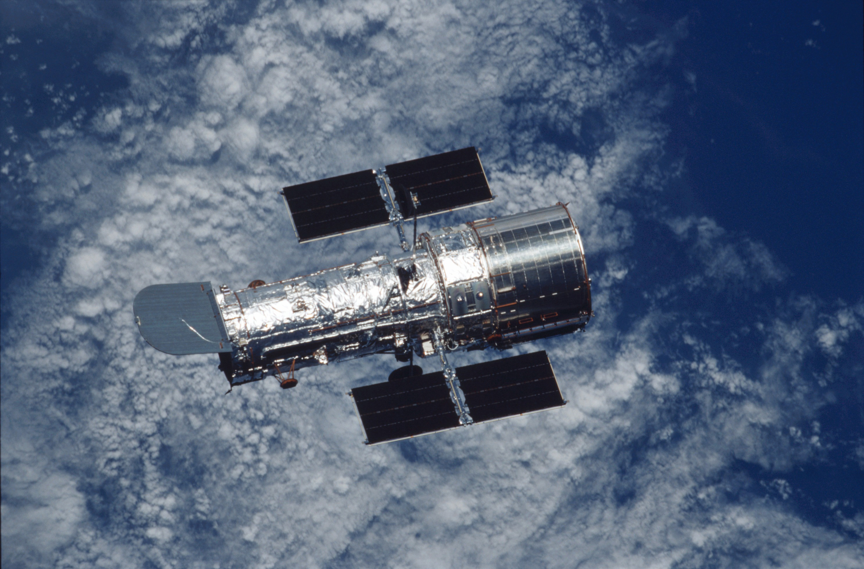
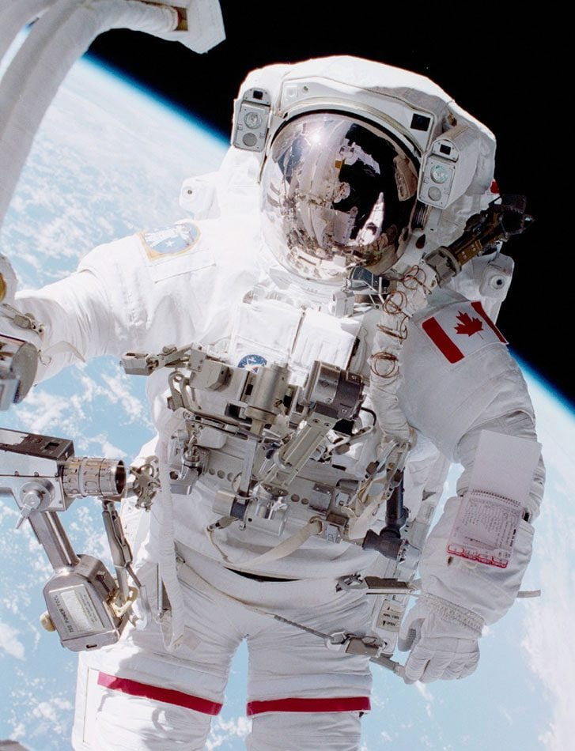
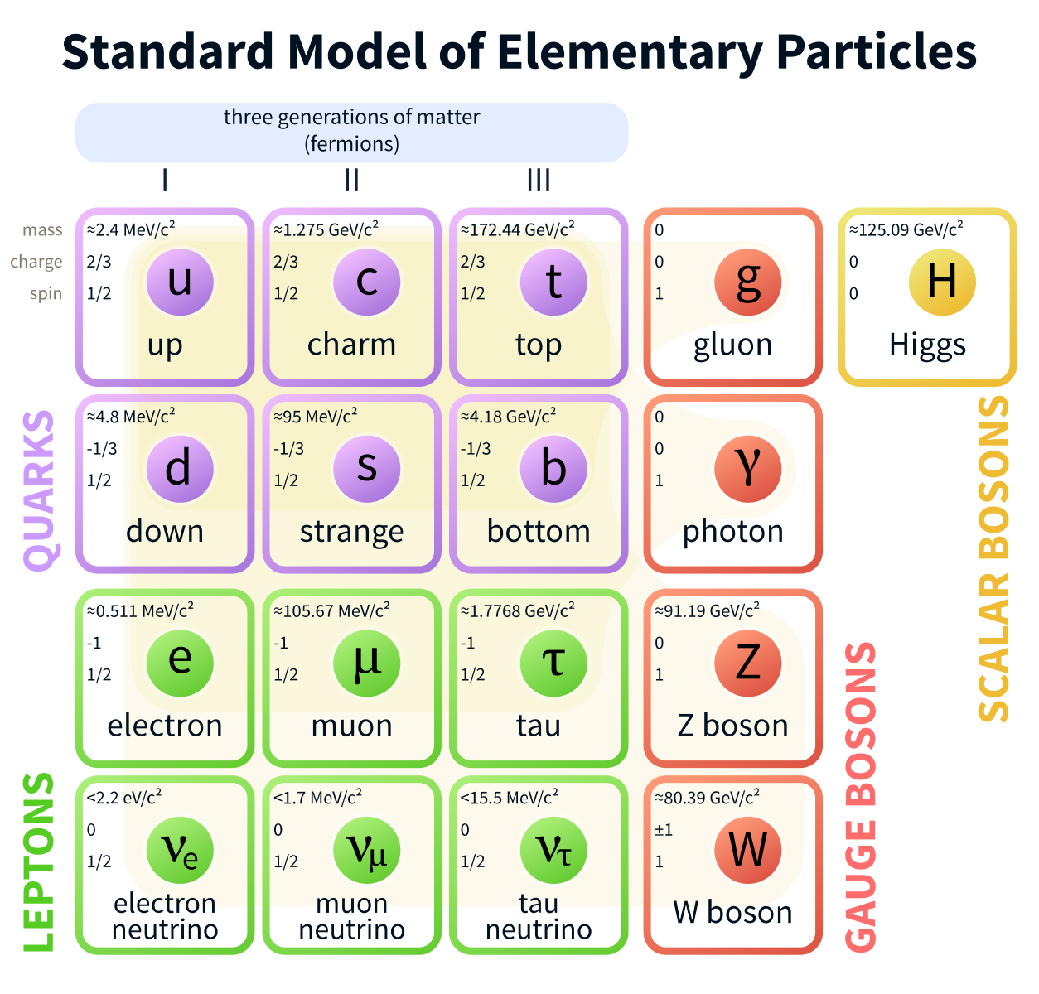
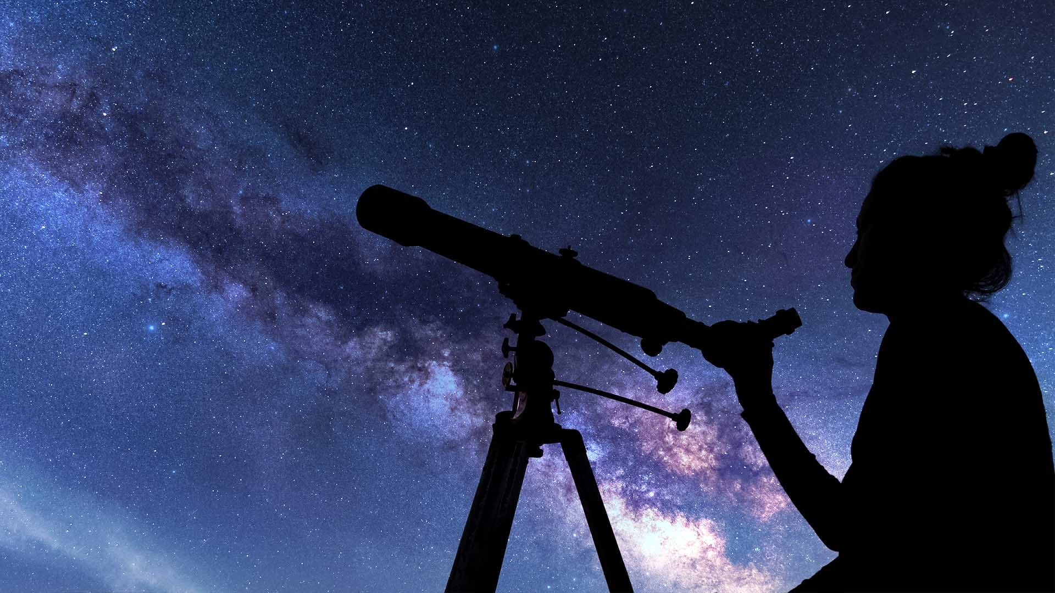
What is the ‘current’ model of the atom?
Notes:
If I were to ask someone with limited physics background what they think the current model of the atom was, they may tell me the 1911 nuclear model, or maybe the 1913 planetary model, or even the 1926 quantum model. They also may tell me that our understanding of the atom is complete with one of these models and that there is nothing more to be learned

Slide 4
What is the current model of the atom?
Notes:
However, if I asked the same question to a physicist, they would instead point to the standard model of elementary particles and say that we are constantly learning more about the atom and the standard model will change and evolve as we learn more. As you can tell, there is a large gap in knowledge of particle physics between the public and the scientific community.

Slide 5
Addressing the gaps
By bringing astroparticle physics into schools, we can inspire the next generation of physicists and spread awareness of current science.
Everyone benefits greatly from more outreach to education.
Bringing knowledge to the public can be facilitated through the existing curriculum as the concepts being taught relate with astroparticle physics.
Notes:
How do we address this gap? A major step toward narrowing the gap is to bring astroparticle physics into schools. In doing this, we can inspire the next generation of physicists, as well as spread awareness about current science to the public. Everyone benefits greatly from more education outreach, including the science community, educators, students and the public. Bringing this knowledge to classrooms can be facilitated through the existing curriculum as the concepts being taught in schools directly relate with astroparticle physics.

Slide 6
Curriculum Ties
C3.5 explain how the laws of conservation of energy and conservation of momentum were used to predict the existence and properties of the neutrino
STEM Skills, Careers & Connections
D2.2 analyse, and solve problems relating to, Newton’s law of universal gravitation and circular motion (e.g., with respect to satellite orbits, black holes, dark matter)
Matter and Energy (Chemistry)
D3.1 identify, and compare the properties of, fundamental forces that are associated with different theories and models of physics (e.g., the theory of general relativity and the standard model of particle physics)
Structures and Mechanisms (Physics)
Earth and Space Science
F3.4 describe the standard model of elementary particles in terms of the characteristics of quarks, hadrons, and field particles
Notes:
As I mentioned, curriculum ties are already in place to bring astroparticle physics into education. On the left of the screen, I have highlighted some expectations from the grade 12 university preparatory course. As you can see, there are many tie-ins to astroparticle physics, including coverage of concepts such as neutrinos, dark matter and the standard model. Beyond grade 12, there are many tie-ins in all grades from 1 to 12 as some of the units covered are STEM Skills, Careers and Connections, Matter and Energy, Structures and Mechanisms, and Earth and Space Science.

Slide 7
Challenges
Information daunting for teachers
Information too complex for students
Less hands-on activities available
Teachers: not as familiar with this content. They may avoid covering astroparticle physics with their students.
Students learn and remember by connecting new ideas to existing understanding.
Astroparticle physics has less obvious opportunities for experiential learning.
Notes:
Bringing astroparticle physics into classrooms comes with some challenges as well that we hoped to solve in the lessons plans made this summer. Firstly, the information my be daunting for teachers. Teachers are less likely to cover content that they are not familiar with. Therefore, teachers with less background in physics or particle physics specifically may avoid teaching students about the field.
Another challenge is that the information may be too complex for students. Students are less likely to learn and remember information that they cannot pull connections from their own experiences. Brand new concepts without background context often cause confusion.
A final thing that makes teaching astroparticle physics challenging is that there are less hands-on activities available. Unlike other fields of science, (chemical reactions, dissections, projectile motion) it is difficult to find opportunities for experiential learning in astroparticle physics.

Slide 8
Solutions
Providing materials for teachers to learn
Connecting previously learned ideas
Creating fun activities
Our resources include multiple opportunities for students to get out of their seats, think, discuss and conduct investigations.
We purposefully connect with existing knowledge of physics and science.
We support the resource with extra context and information.
Notes:
In our resources, here are some of the ways we overcome these challenges. Our resources provide explanations for all concepts and terms in more detail than what is presented to students. Therefore, teachers will be more equipped to explain concepts and answer questions.
We also connected new knowledge to previously learned ideas. By building on previously learned knowledge, students can make their own connections to background knowledge allowing for greater understanding of concepts.
Finally we created more opportunities for hands-on learning. Our resources include multiple opportunities for students to get out of their seats, think, discuss and conduct investigations. This makes the content more engaging and remembered by students.

Slide 9
Understanding the Standard Model
This lesson plan resource is intended for Grade 12 university preparatory physics courses in Ontario. It spans 3-4 75-minute sessions and is designed to be used as an application of curriculum concepts of Energy Conservation, Electricity and Magnetism and Modern Physics. The activity is designed to be a mix of individual and group activities, reading, class discussion, and problem solving, with an optional assignment.
For Teachers:
For Students:
Notes:
Now I want to bring you all to one of the lesson plans I created this summer. It is called understanding the standard model and is intended for grade 12 physics courses in Ontario. It takes about 4 to 4 classes to complete and is a good application of many curriculum concepts such as energy conservation and electricity and magnetism. Those concepts are used for student to build on and understand how fundamental particles were discovered. For teachers, there is a word document that we will take a look at that makes this lesson easily presentable to their class. For the students, they will see the slideshow and activites presented by teacher that we will also take a look at. I will go through the content fairly quickly just to give you a brief overview of some key points of the presentation, not presenting it fully.

Slide 10
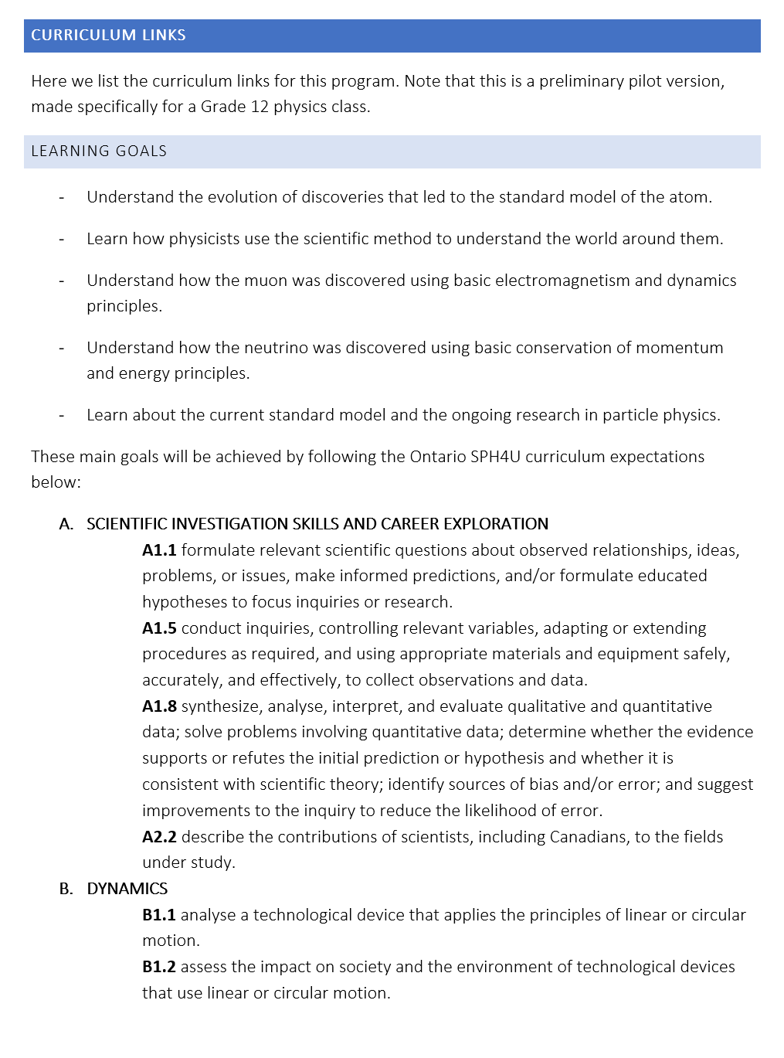
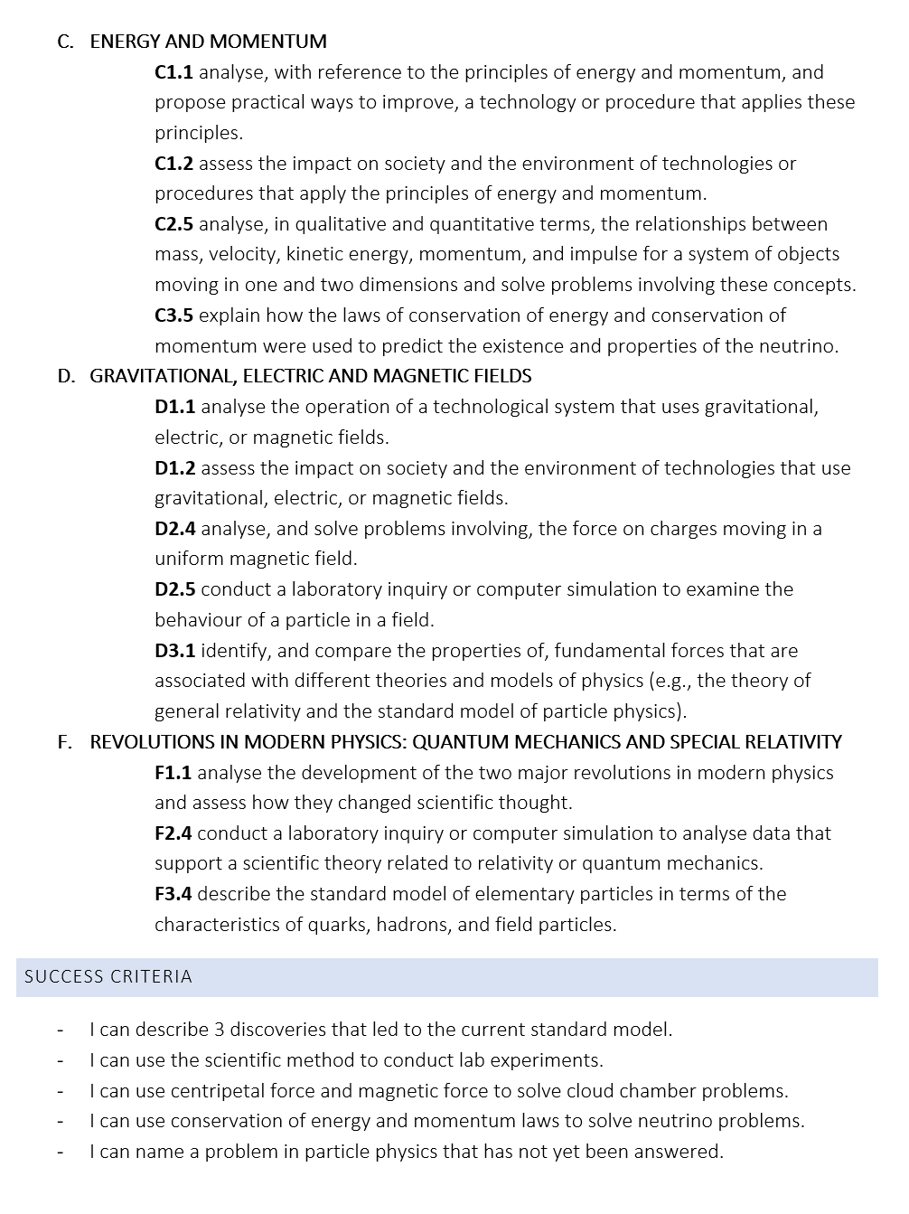
For the teacher (highlight curriculum, info for teacher, background knowledge)
Notes:
In the teacher resource, we have included learning goals for teachers to present to their class. There are also the specific curriculum expectations covered in the lesson and success criteria that teachers can use to assess student’s understanding of the material.

Slide 11
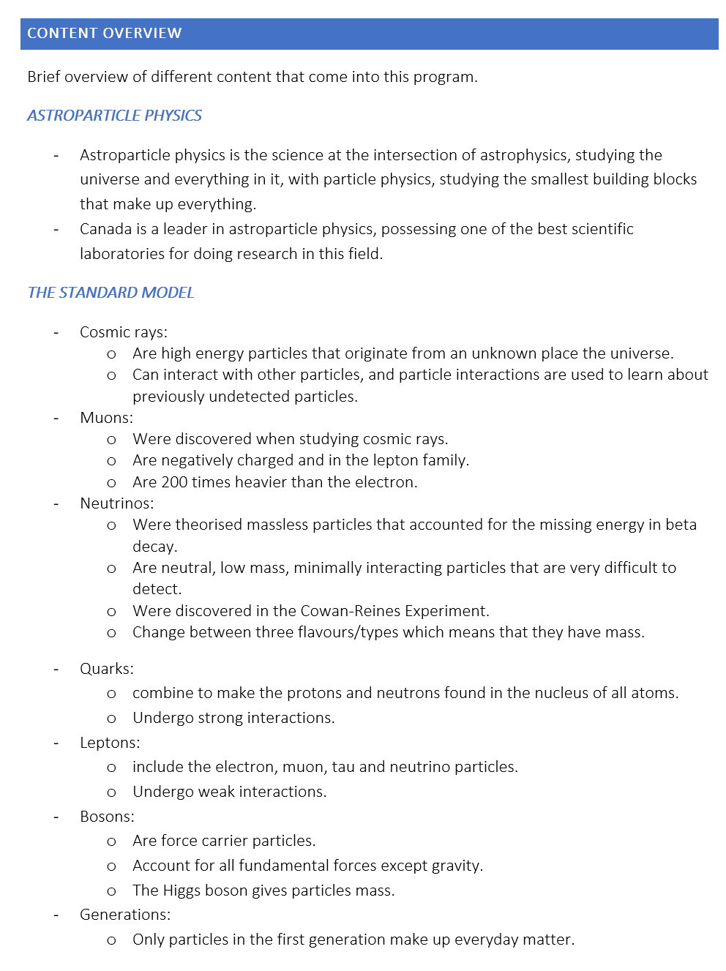
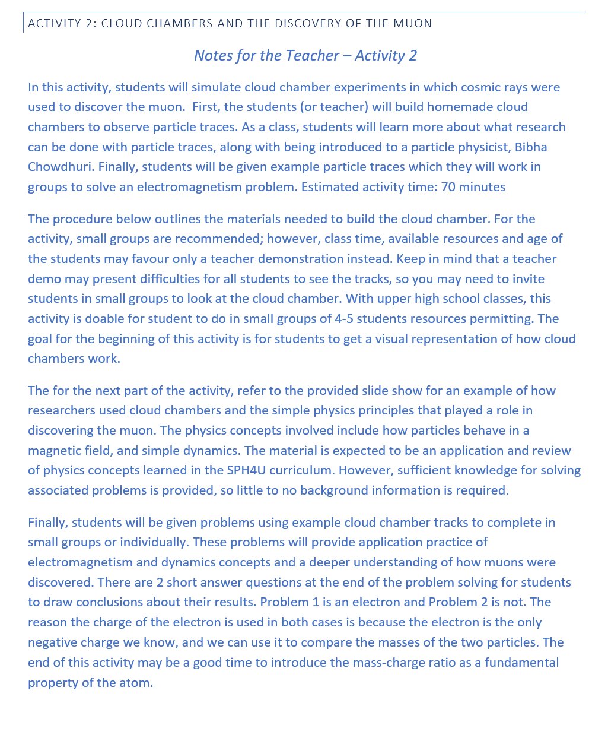
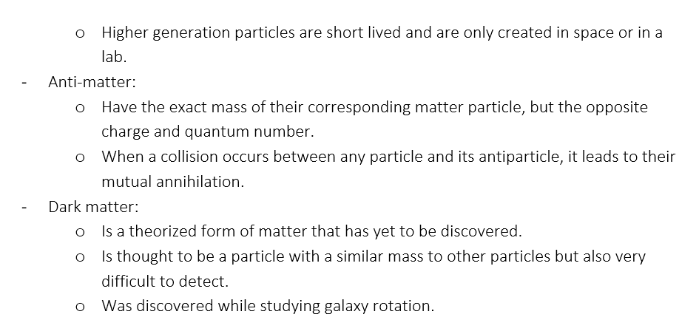
Notes:
We also included a content overview, which is a glossary of the astroparticle physics terms included in the resource. At the beginning of each section of the lesson plan, there is a “Notes for the teacher” section. This outlines what is to come in the section, the estimated time frame, any materials or setup needed in advance, and any accommodations you could make depending on your class. For example, the section offere\ an option to leave the equations up on the screen or take them off if the teacher thinks their class is up for the challenge!

Slide 12
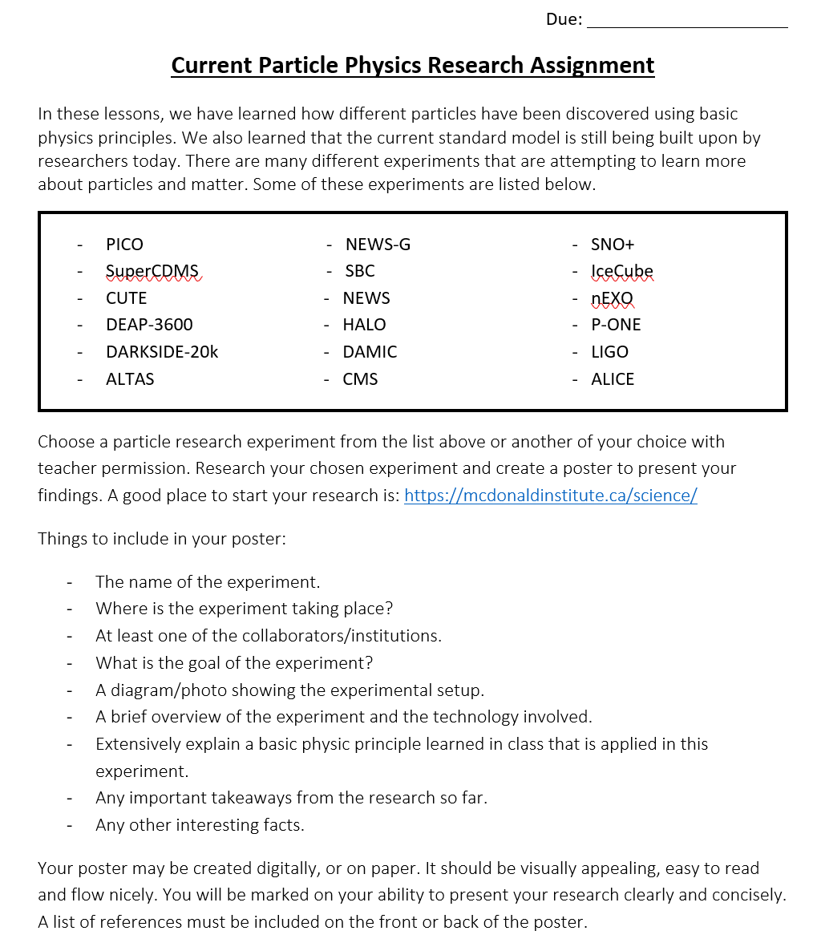
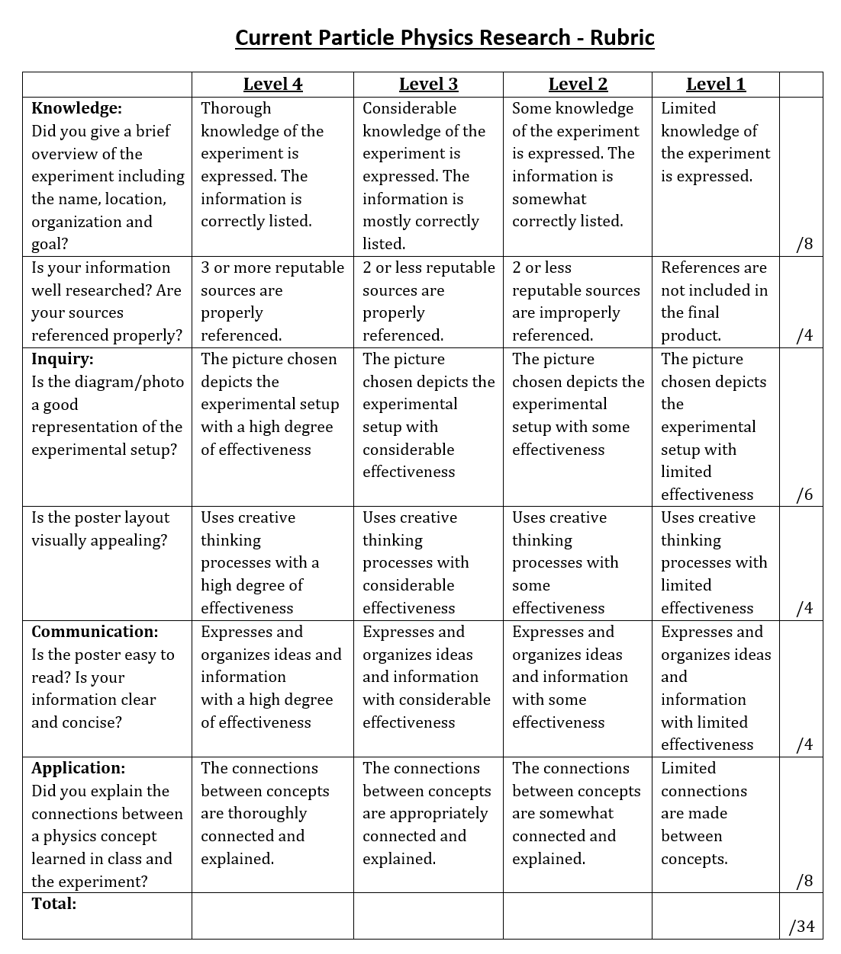
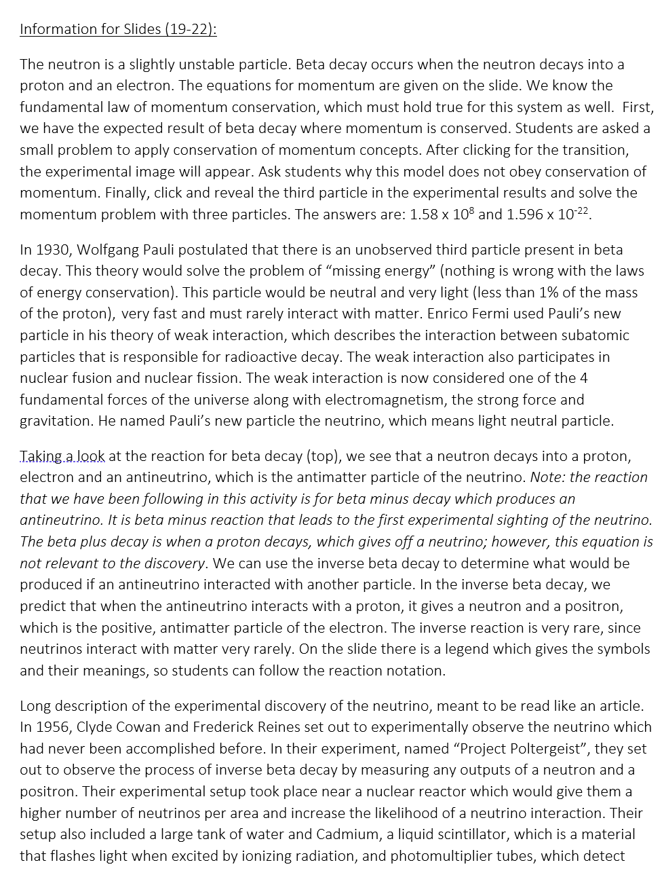
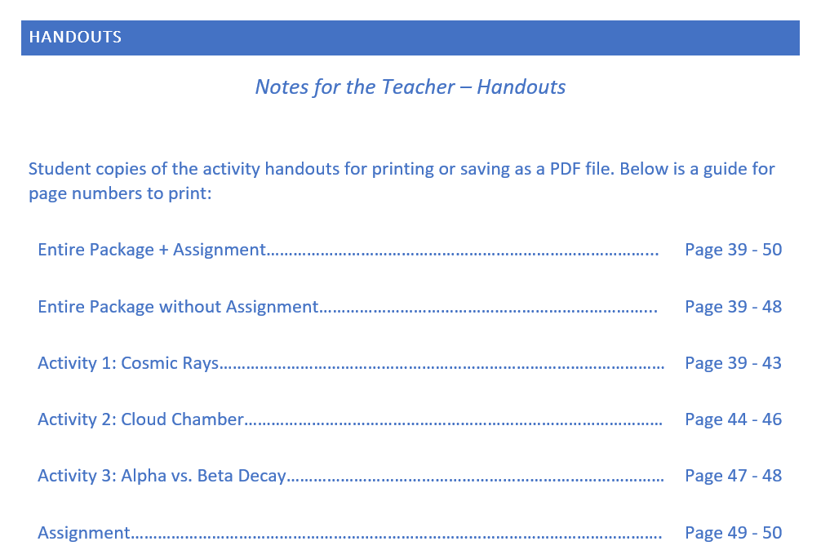
Notes:
A few more features we included in the teacher resource are highlighted here. For each slide in the presentation to the class, there is accompanying information for the slides. Teachers will have a background about what is to be said on those slides along with extra information if students have questions. We have also included handouts for student to use while they complete activities and an assignment for students to complete if the teacher would like. This assignment has the students research a current particle physics experiment and make a poster about it.

Slide 13
Understanding
the
Standard
Model
Notes:
Now we will move over to the presentation and activities shared with the students. Like I mentioned before, students have more understanding of a new concept if it is connected to previous knowledge, that is why the presentation starts with a timeline.

Slide 14
1900
1905

Slide 15
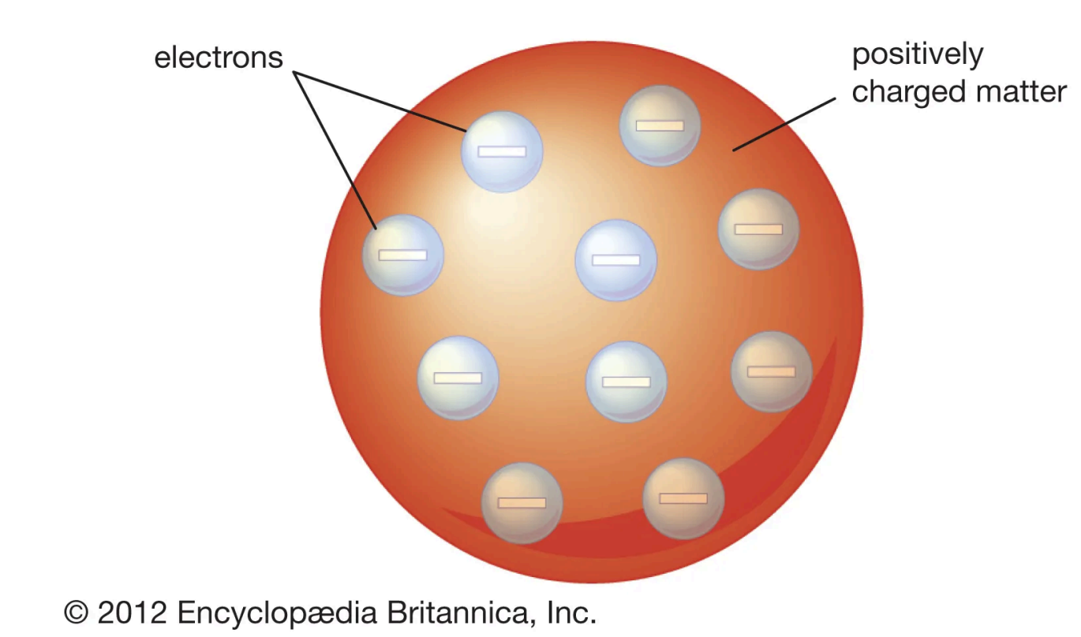
1900
Scientists believed they had most of the fundamental laws of physics figured out. People trusted Newtonian laws of motion and knew that atoms were the building blocks of nature.
J.J. Thompson’s “Plum Pudding” model was the accepted model of the atom. The Plum Pudding model postulated the atom as a positively charged sphere containing negatively charged particles (electrons).
At the end of this year Max Planck suggested that radiation is quantized (it comes in little packages).
"Plum Pudding" model of the atom.
Notes:
Then, students can build off their previous knowledge, whatever model they are most familiar with.

Slide 16
1905
1900
1911

Slide 17
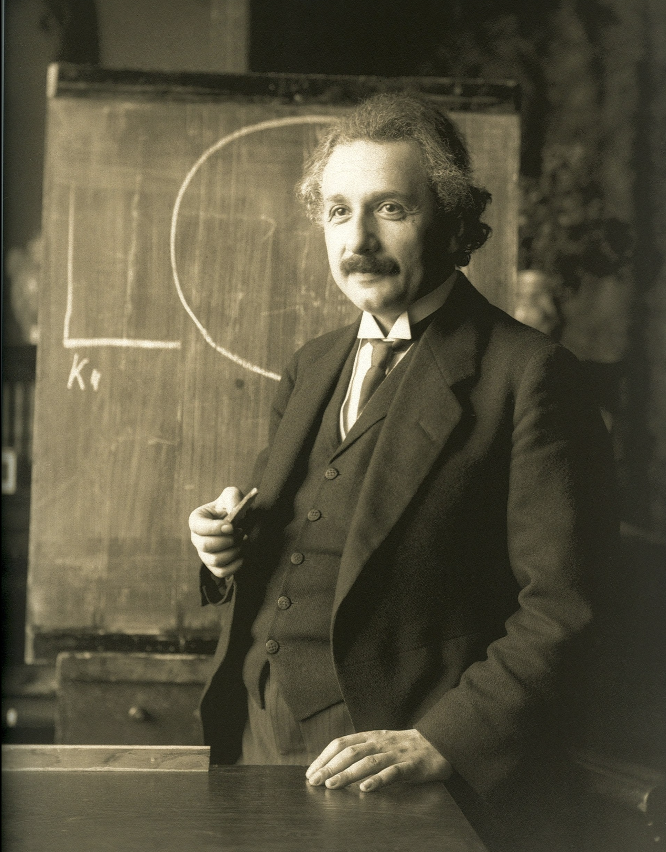
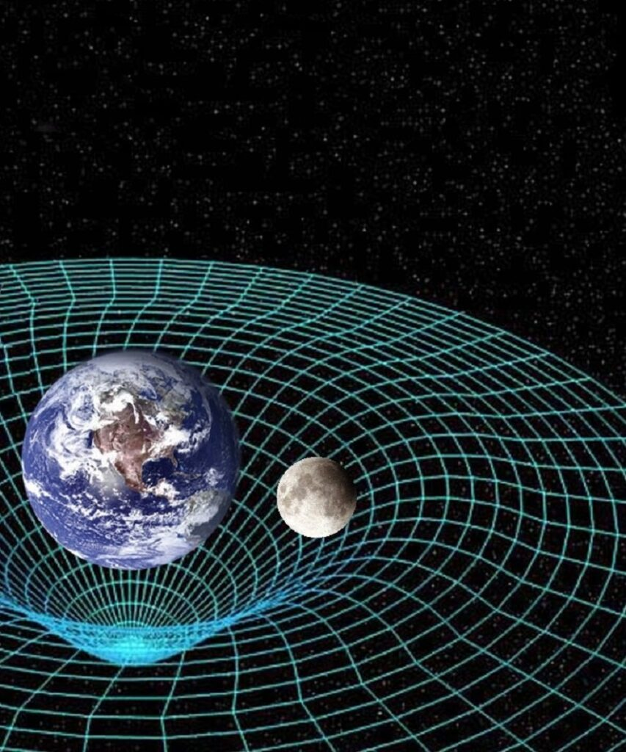
1905
Einstein’s theory of relativity was published and changed our understanding of fundamental physics concepts. Albert Einstein was one of few scientists to take Planck’s ideas seriously and proposed a quantum (or package) of light, called a photon, which behaves like a particle.
Scientists began to realize that their knowledge of physics was far from complete, and that more research needed to be done to determine a better model of the atom.
https://wikipedia.org
Notes:
It also shows the concept of how our understanding of particles is always evolving and we are learning more.

Slide 18
1911-1913
1905

Slide 19
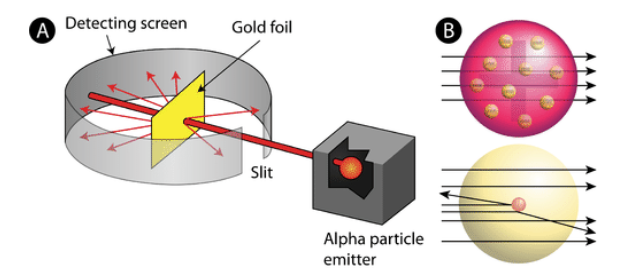
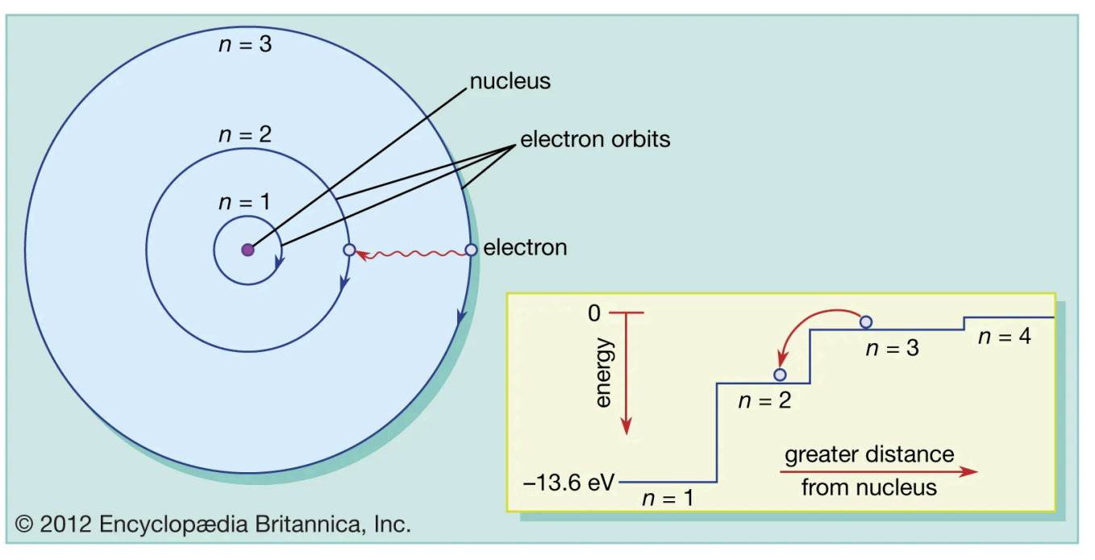
1911-1913
1911: Ernest Rutherford performed the gold foil experiment where large scattering angles of alpha particles were observed. This result suggested that atoms have their positive charges concentrated in a small space at their centre, called the nucleus.
1912: Victor Hess discovers cosmic rays.
1913: Niels Bohr theorizes a model of the atom which includes quantized energy levels.
https://chem.libretexts.org
The gold foil experiment.
The Bohr model of the atom.

Slide 20
Activity 1 – Cosmic Rays
Notes:
After the timeline students have their first activity and a chance to get out of their seats.

Slide 21
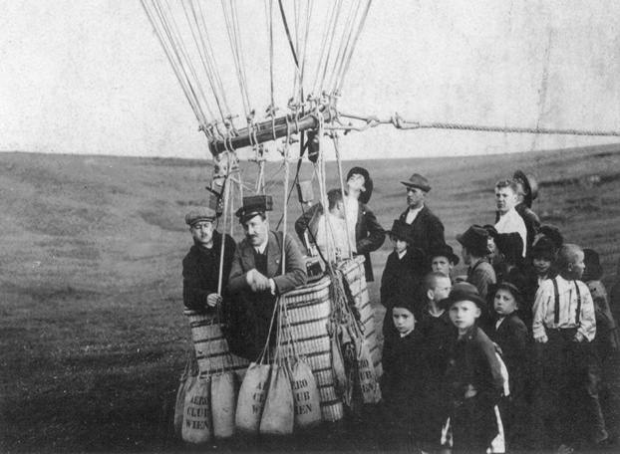
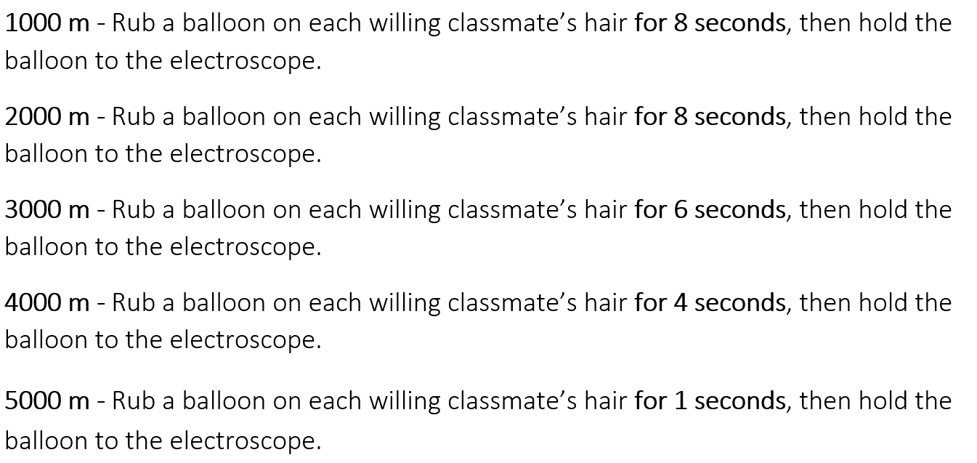
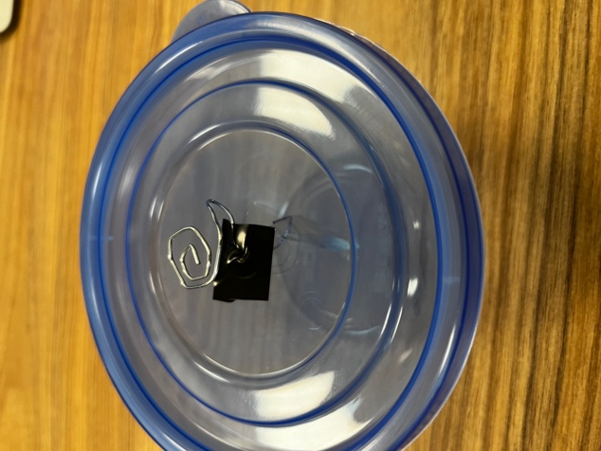
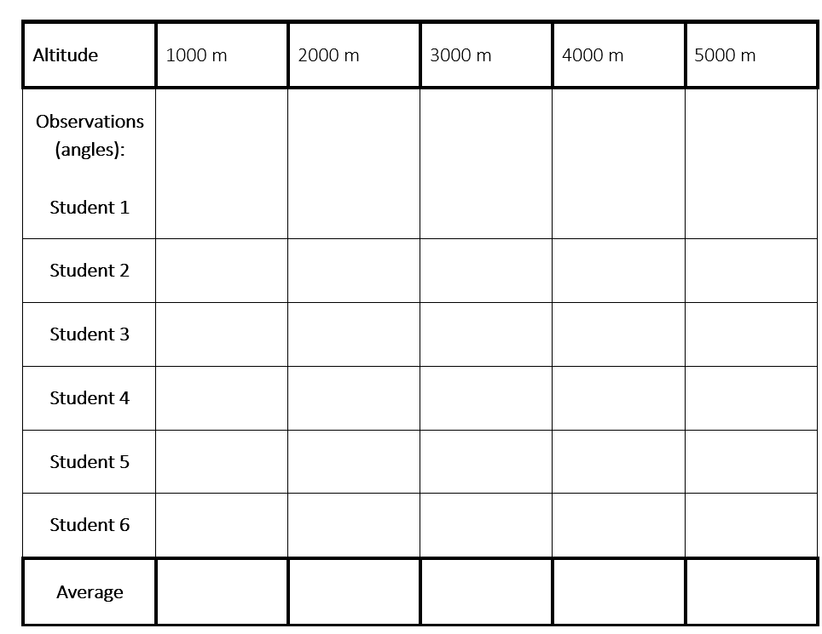
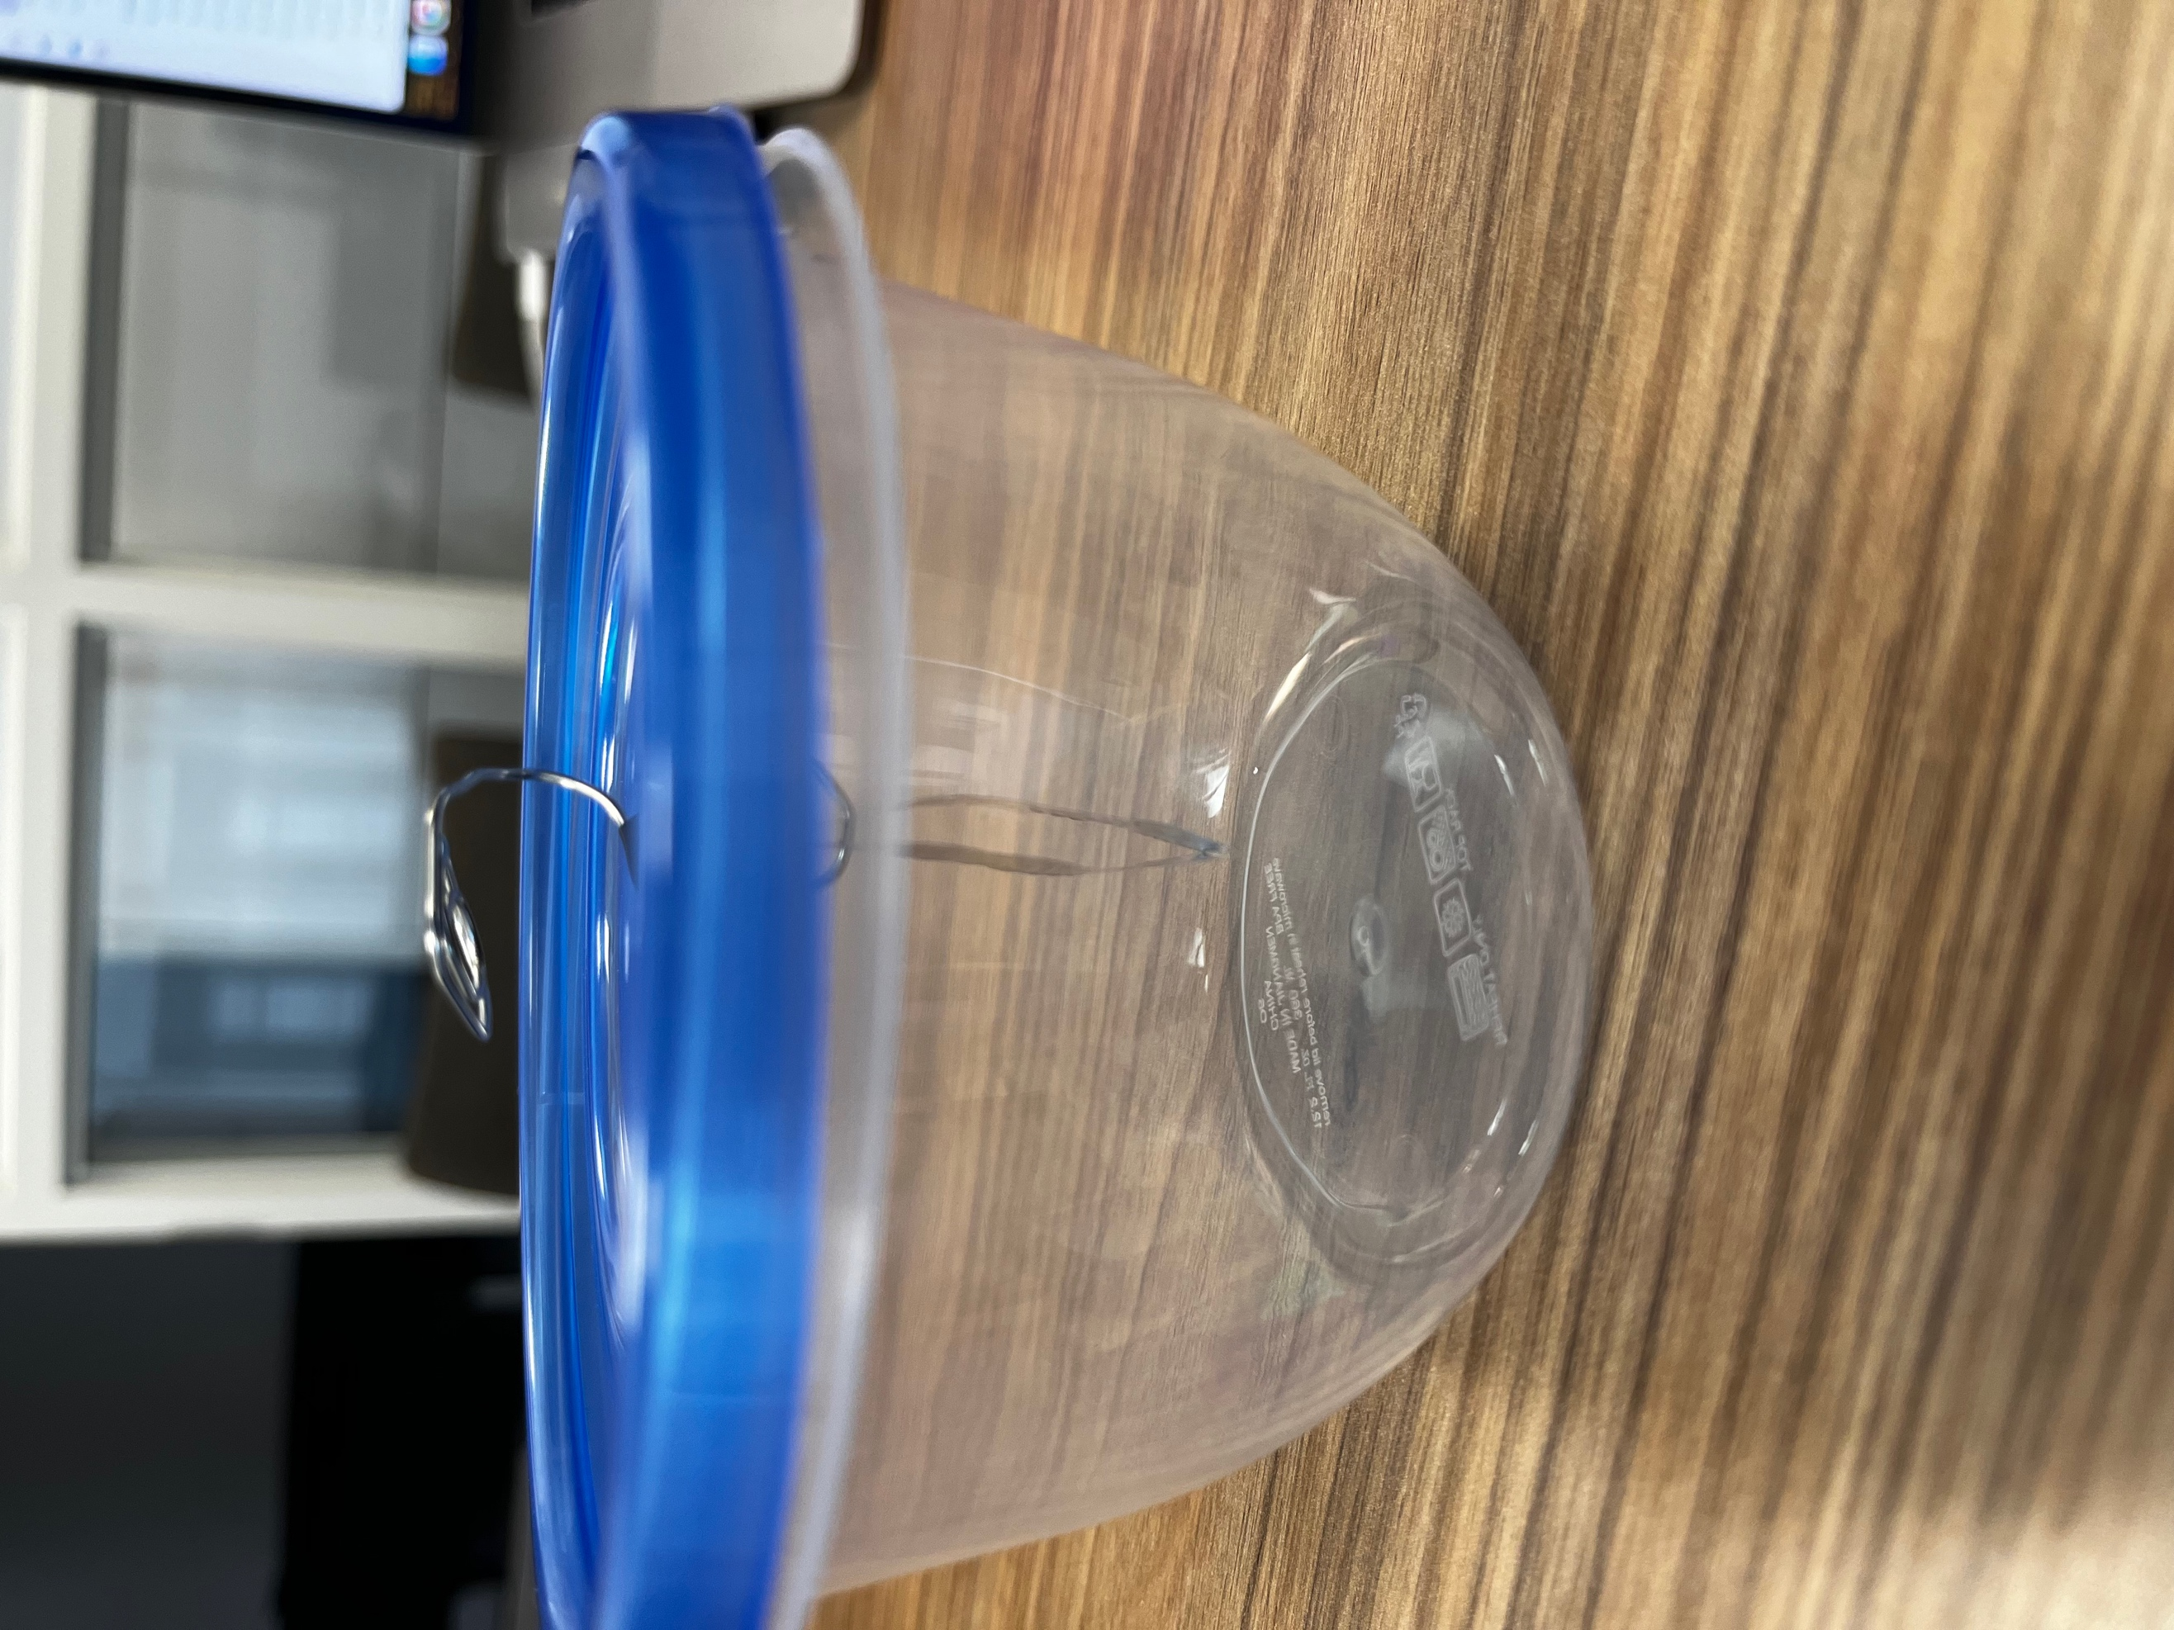
21
Notes:
In this activity, they simulate the discovery of cosmic rays by Victor Hess. Although they can’t physically get in a hot air balloon with an electroscope, they get a chance to build their own electroscopes and simulate the results of different altitudes by rubbing a balloon on their hair. I will now pass around a sample homemade electroscope and balloon for the audience to try while I am speaking. This connects to the concept of electrostatics covered in previous units and helps students form a hypothesis and analyse results.

Slide 22
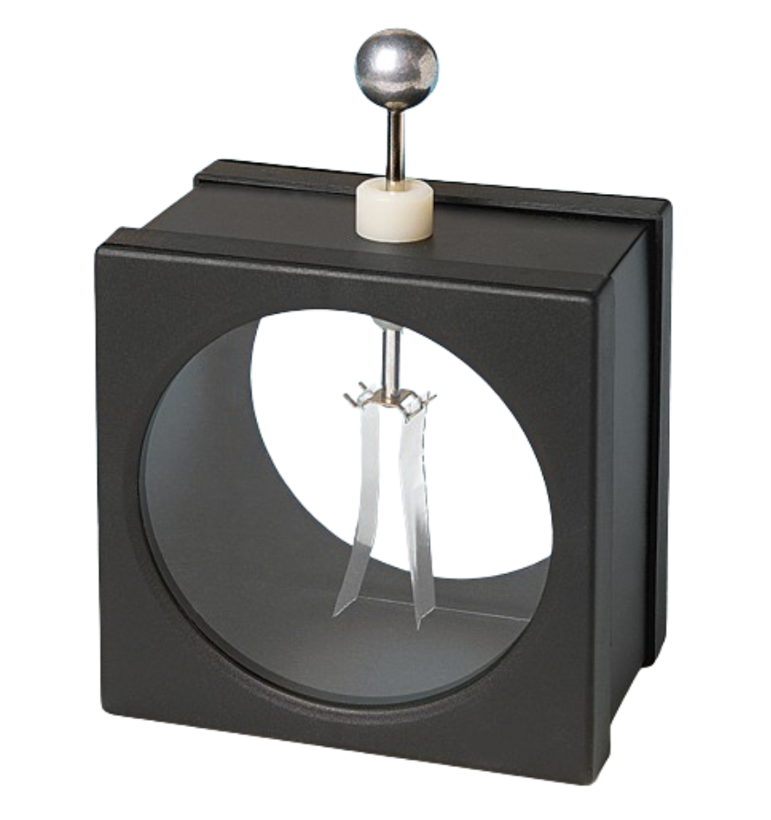
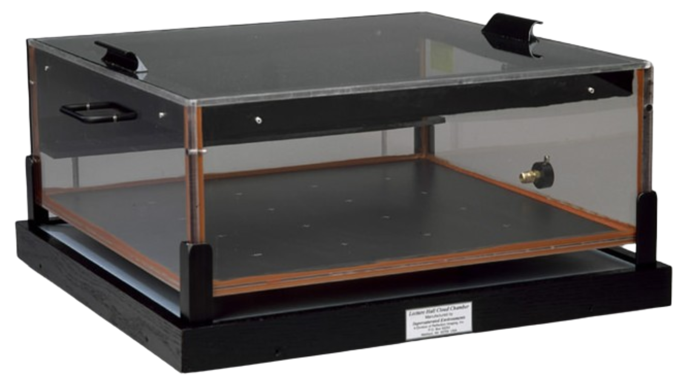
Particle Detectors in the Early 20th Century
Electroscopes
Cloud Chambers
Used for detecting electric charge.
When the charge is applied, it is split equally over the device’s two leaves.
Like charges repel: the charge is revealed when the leaves push against each other.
Does not determine the sign of the charge (+ or -).
Invented in the early 1900s.
Took advantage of ionizing radiation to detect the tracks of charged particles moving through a gas.
The particle tracks trigger the formation of precipitation (rain drops) which reflect light.
The visible tracks show the impacted gas as the particles moved through the chamber.
https://www.flinnsci.ca/metal-electroscope/ap5640/
https://www.cloudchambers.com/
Notes:
On the slides, student can then learn about different types of particle detectors that were used in the early 20th century.

Slide 23
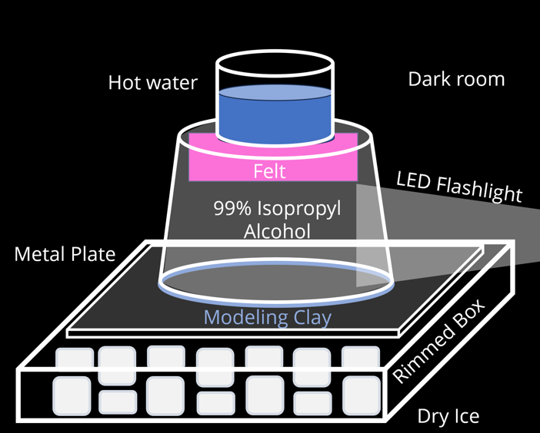
Activity 2 – Cloud Chambers
Notes:
And afterwards get a chance to build their own cloud chamber.

Slide 24
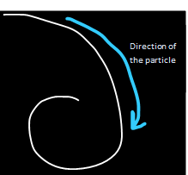
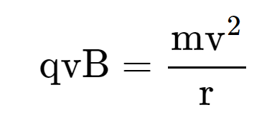
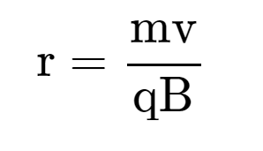
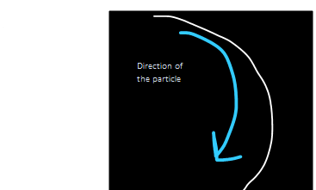
Problem 1
In a cloud chamber, a magnetic field of 1.5 T is applied. The particle travels with a radius of 0.00023 m at a velocity of 6 x 10⁷ m/s. Assuming the particle has the charge of an electron, find the unknown variable.
Problem 2
In a cloud chamber, a magnetic field of 1.5 T is applied. The particle travels with a radius of 0.405 m at a velocity of 2.7 x 10⁸ m/s. Assuming the particle has the charge of an electron, find the unknown variable.
Notes:
This is a nice transition into how the muon was discovered by scientists such as Bihba Chowdhuri and gives students a chance to do some of the same problem solving used to find the muon. This again builds on previously learned knowledge of magnetism and circular motion and lets the students conduct their own investigations to come to the conclusion that a new particle had been discovered.

Slide 25
Activity 3 – Alpha Decay vs Beta Decay
Notes:
Another activity in this package introduces the neutrino with the help of lego bricks.

Slide 26
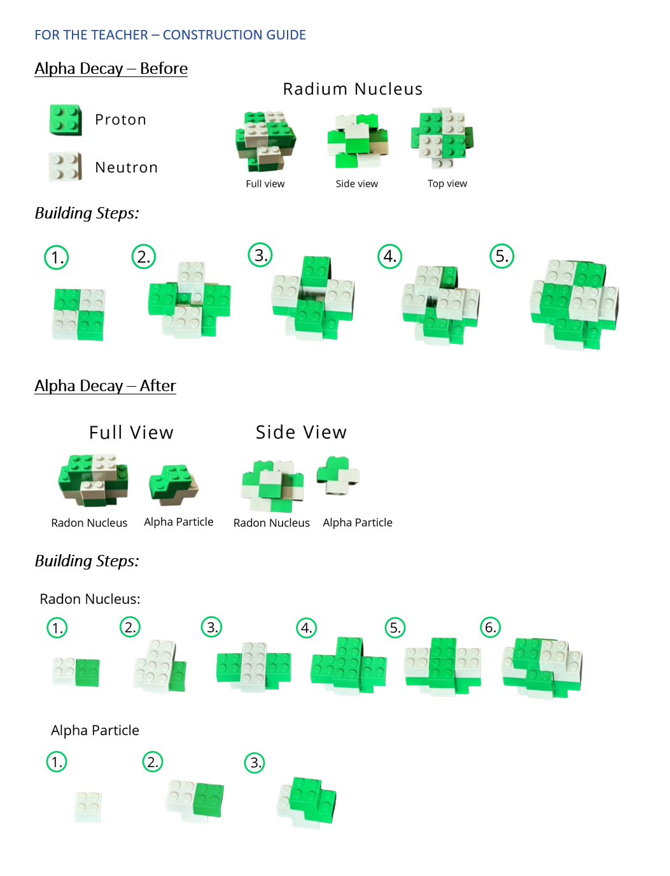
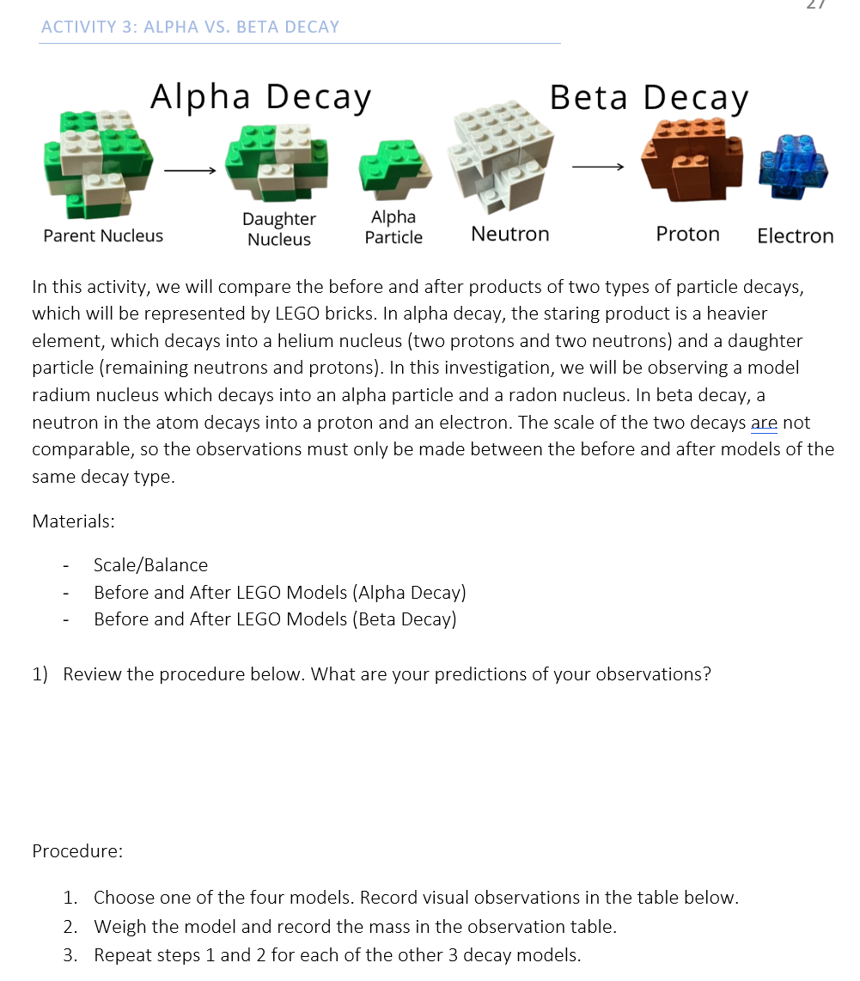
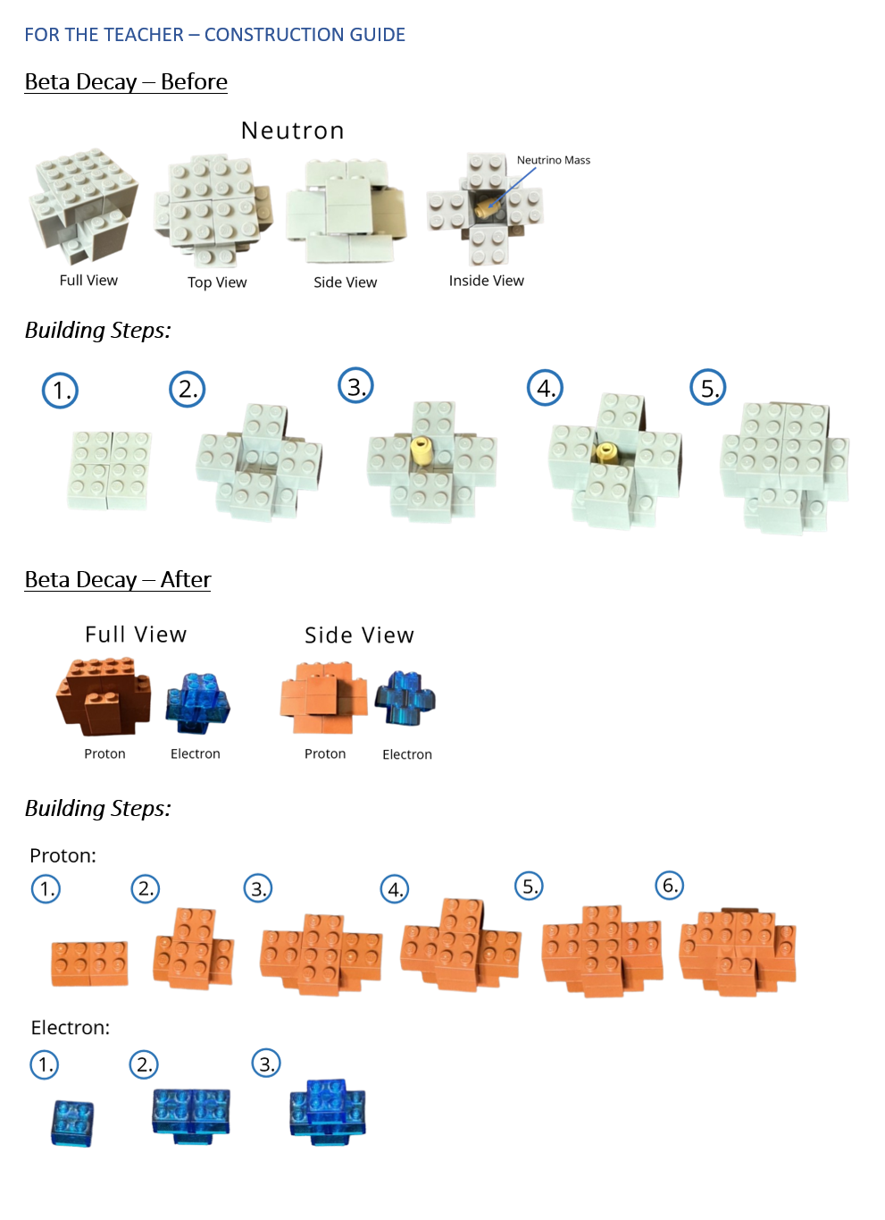
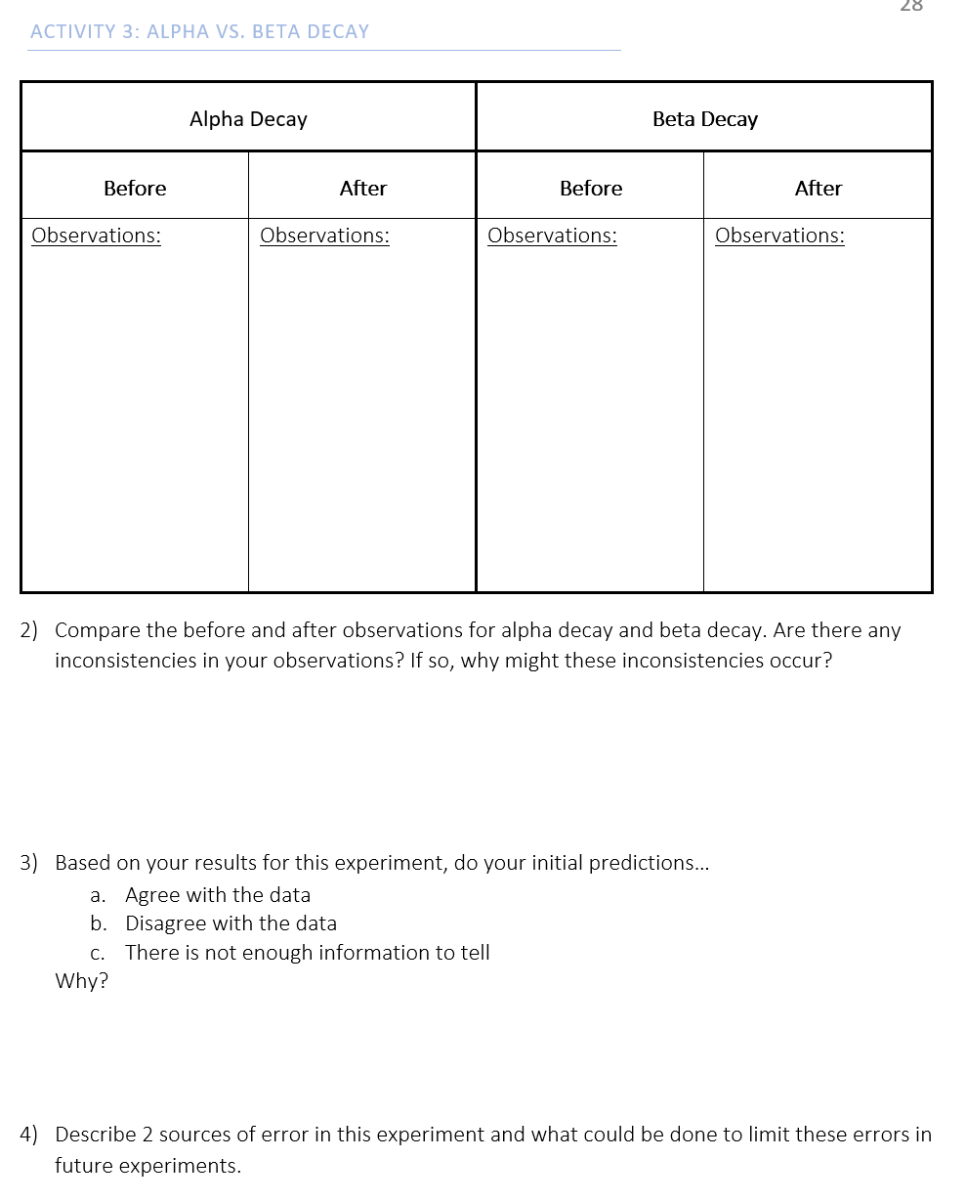
26
Notes:
The setup guide has teachers hide a hidden mass in the before case of beta decay. Because of this, mass is not conserved in the after product. This challenges students to deal with unexpected results in an experiment and question if something may be wrong with the conservation laws. This activity again has ties to the scientific method and previously learned concepts of conservation of momentum.

Slide 27
What have we found so far in this activity?
proton
neutron
electron
muon
neutrinos
photon
Mass: 938.27 MeV/c²
Charge: +1
Spin: $\frac{1}{2}$
Mass: 939.57 MeV/c²
Charge: 0
Spin: $\frac{1}{2}$
Mass: 0.511 MeV/c²
Charge: -1
Spin: $\frac{1}{2}$
Mass: 105.66 MeV/c²
Charge: -1
Spin: $\frac{1}{2}$
Mass: < 2 eV/c²
Charge: 0
Spin: $\frac{1}{2}$
Mass: 0
Charge: 0
Spin: 1
1) Can any of these particles be broken into smaller particles?
2) What forces act on these particles?
3) Are there any patterns to these particles?
Notes:
After completing all the activities in the package, student can see how all of these particles were discovered using fundamental physics laws. So, after asking some more questions, it is not a far leap…

Slide 28
Completing the standard model
3) Are there any patterns to these particles? Let’s fill in the rest of the standard model.
t
g
u
c
H
up
charm
top
gluon
Higgs boson
s
b
ϒ
d
down
strange
bottom
photon
τ
Z
μ
e
electron
muon
Z boson
tau
±W
electron
neutrino
muon
neutrino
tau
neutrino
±W boson
Notes:
… to take them the current standard model of elementary particles.

Slide 29
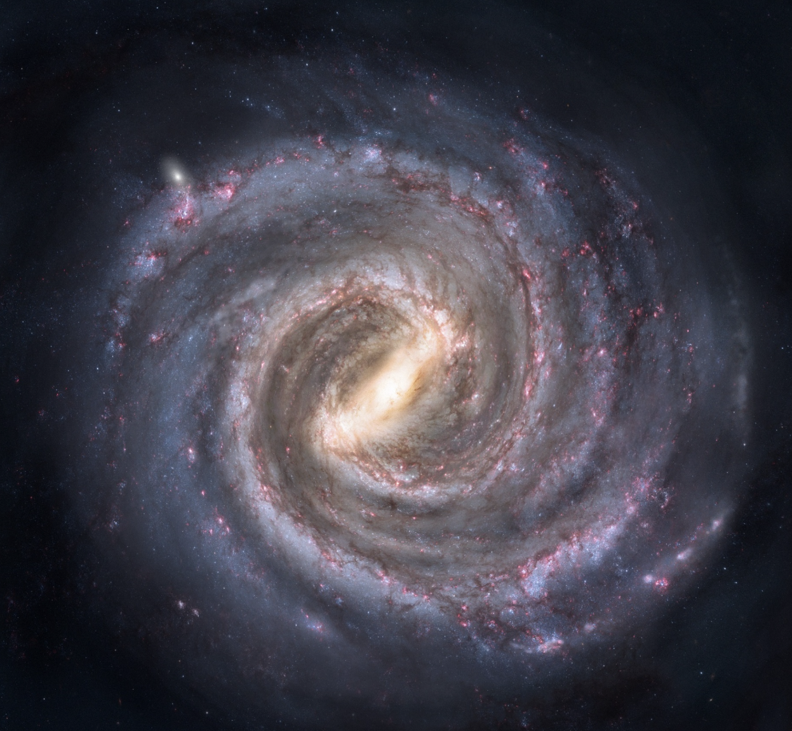
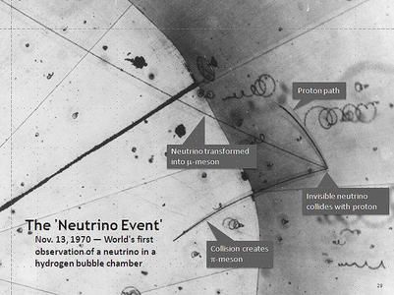
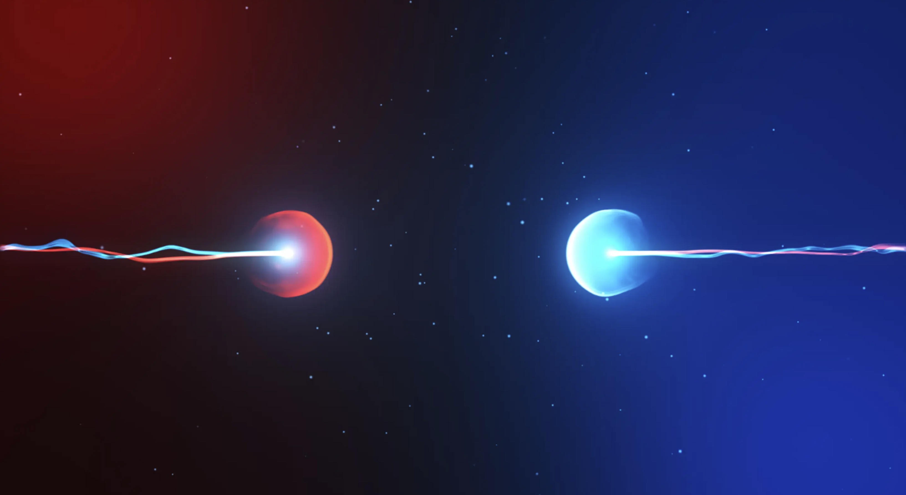
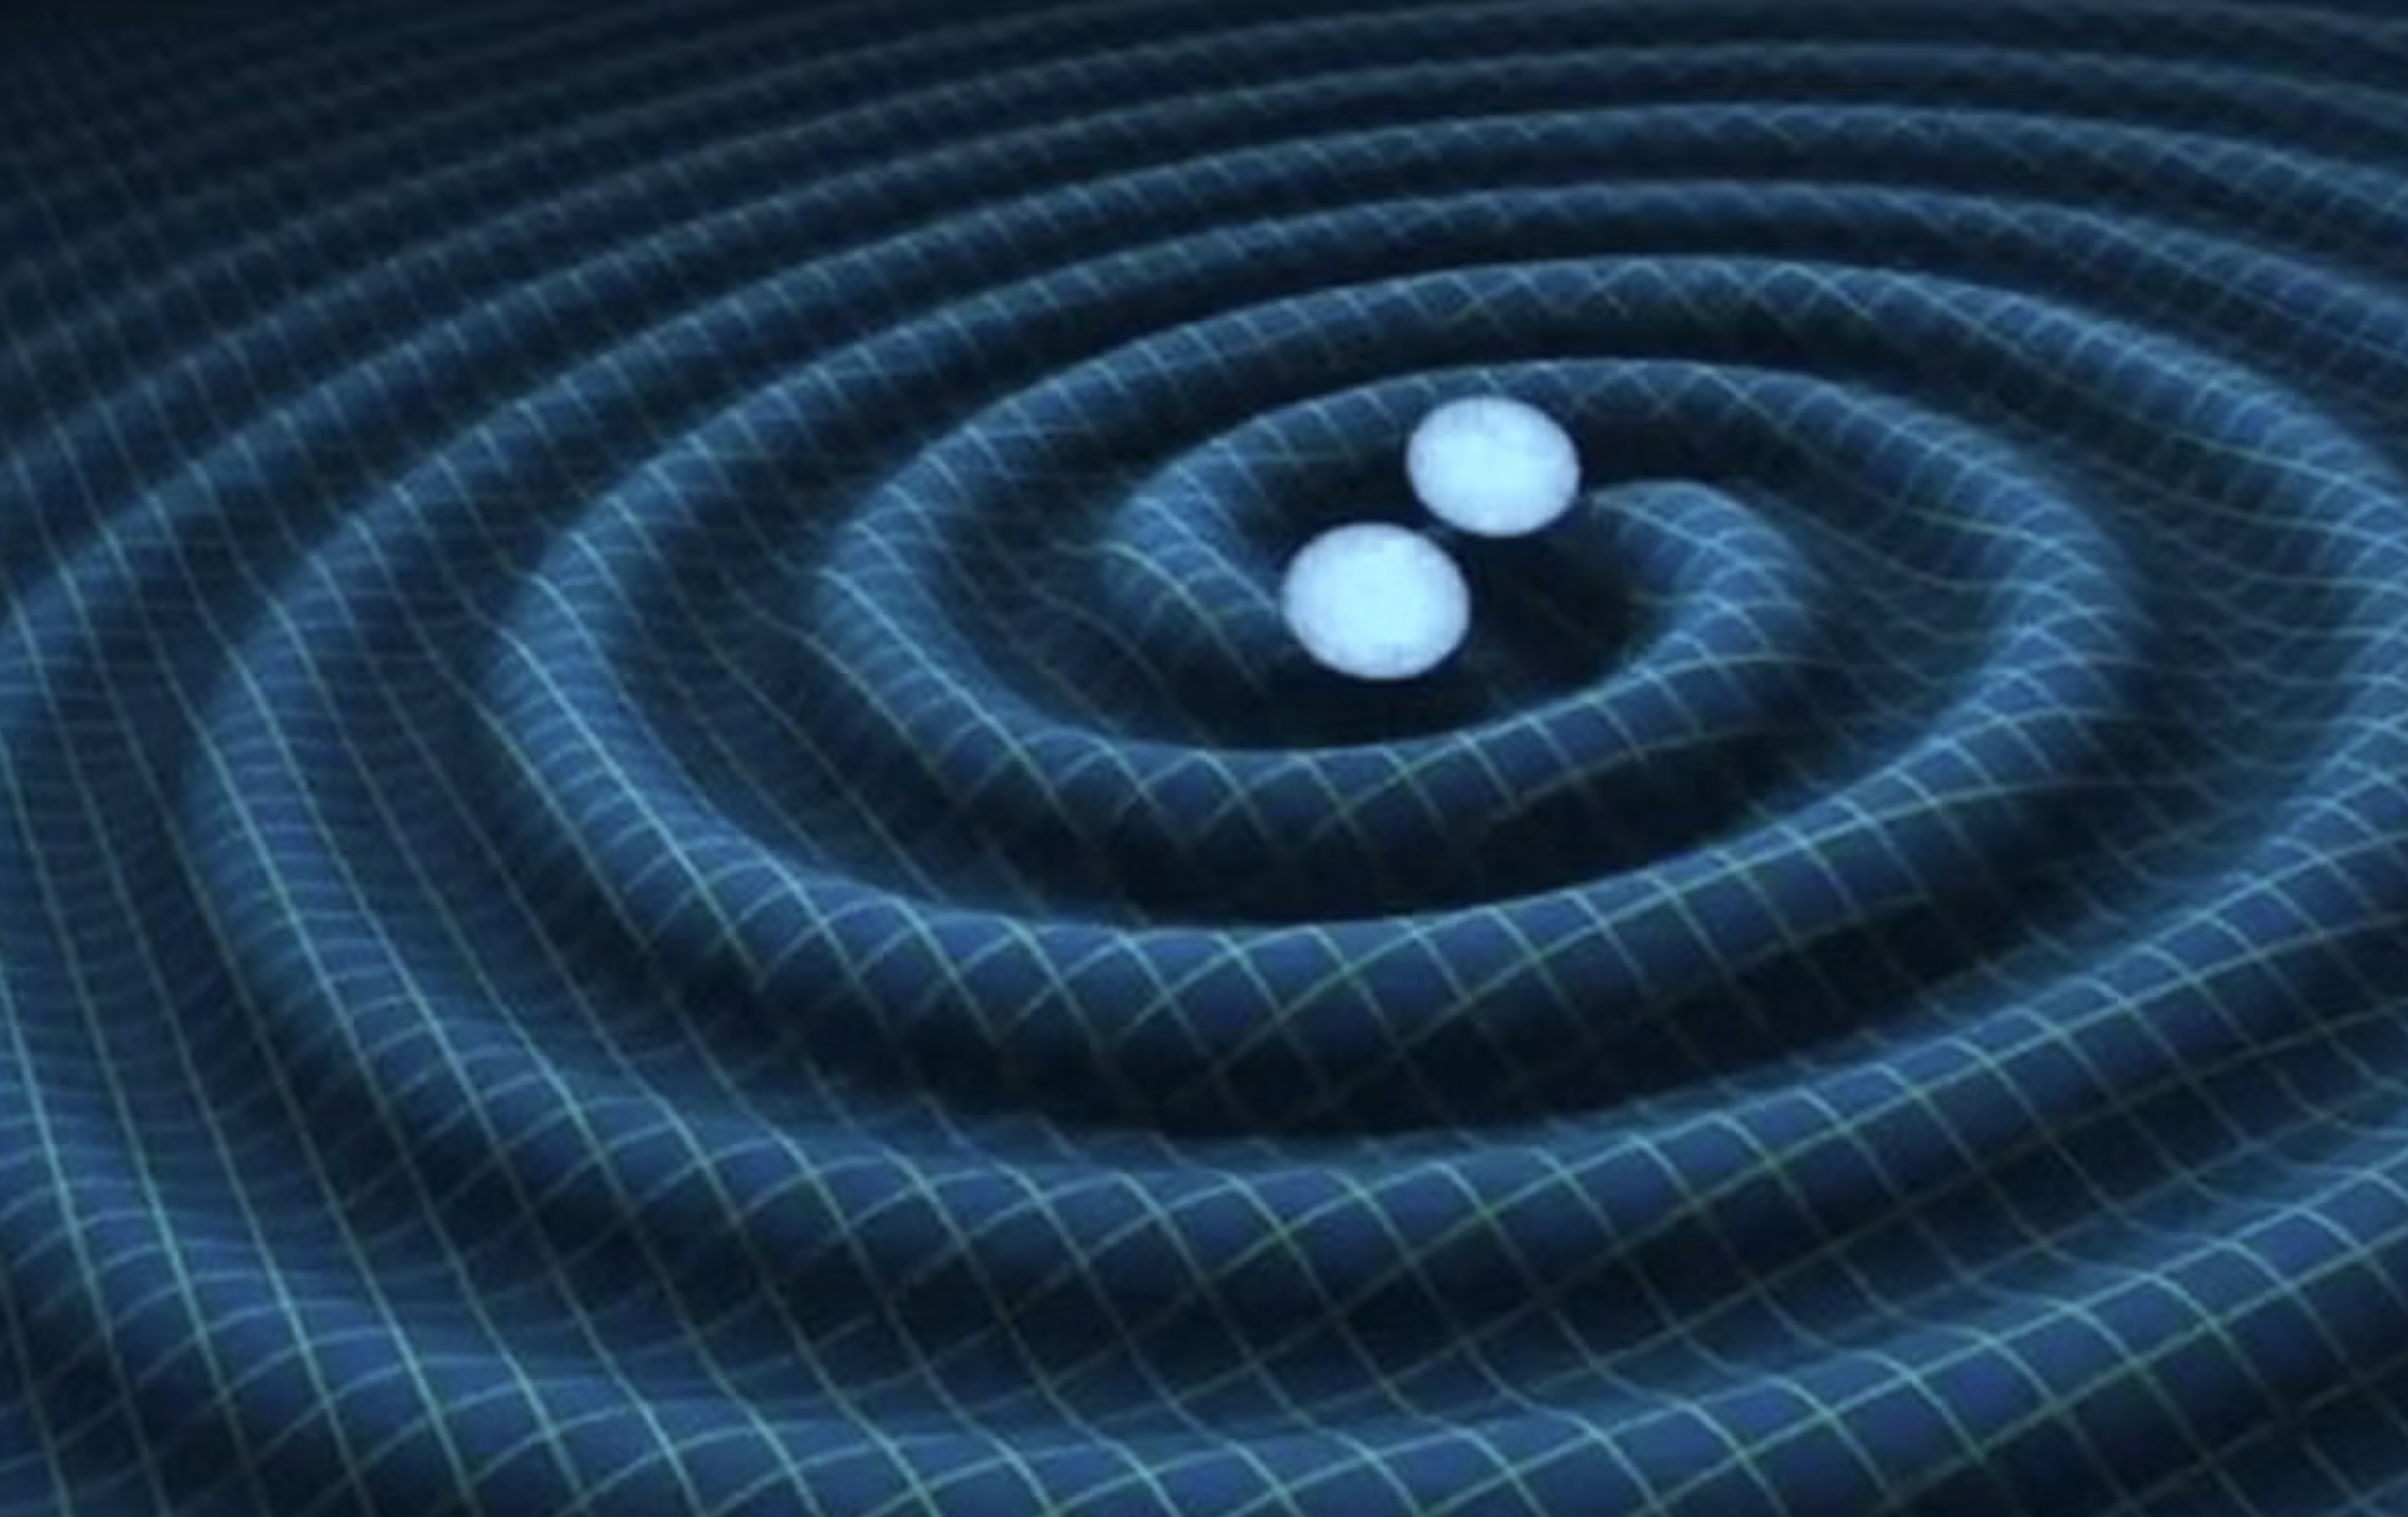
Is the standard model complete?
Is there more to learn about particle physics?
newatlas.com
National Science Foundation, YouTube
Anti-Matter
Gravitation
Scientists suppose that when the universe was created in the Big Bang, matter and antimatter should be created equally. Since antimatter annihilates its counterpart, why is there so much matter in the universe?
Dark Matter
Neutrinos
The only fundamental force not explained by the standard model is the force of gravity. Is there a subatomic particle that might transmit gravity in the same way other force carriers do?
Galaxies were observed to be spinning much faster than theorised based on the gravitational pull of visible matter. This means there may be matter that we have not detected yet – named dark matter.
Theorised to be massless particles, Arthur McDonald and Takaaki Kajita showed that neutrinos do have mass. What implications does this finding have on the standard model and neutrino physics?
Notes:
Finally, the presentation ends by showcasing some questions we are still attempting to answer in particle physics, letting students know that this field is still ongoing with many exciting research projects currently underway.

Slide 30
Grade 12
Next Steps
Easy-to-use lesson plans have been created: it’s time to implement them in the classroom. Teaching conferences, outreach, and media will help us reach many teachers across the province and country.
Grade 6
Grade 7 - 10
Grade 9
Grade 11 - 12
Notes:
Now that easy to use lesson plans have been created, the next step is to have them implemented into the classroom. Along with understanding the standard model, other resources I have worked on this summer include observing space which showcases current technologies used to study space from telescopes to particle detectors. I adapted that resource to meet curriculum expectations of grades 6, 9, and 12. I also worked on Drifting Together which brings together art classes and science classes to think about dark matter. I also adapted that resource to meet the expectations of upper year classes, and younger grades from 7 -10. All of these resources will be presented to reach teachers across the province and country at teaching conferences, and through outreach and media.

Slide 31
Table of contents??
Questions &
Thank you!
Notes:
I would like to thank you for listening to my talk today about bringing astroparticle physics to classrooms. I will now open the floor to any questions.

