Slide 1
The Search for Long-Lived Particles: Construction of MATHUSLA Test Stand
MAssive Timing Hodoscope for detection of Ultra-Stable neutraL pArticles
https://mathusla-experiment.web.cern.ch/
Speaker: Alex Lau
Supervisor: Dr. Miriam Diamond
Notes:
University of Toronto logo

Slide 2
Introduction
(1) Motivation
(2) MATHUSLA Proposal
(3) Test Stand
(4) Next Steps

Slide 3
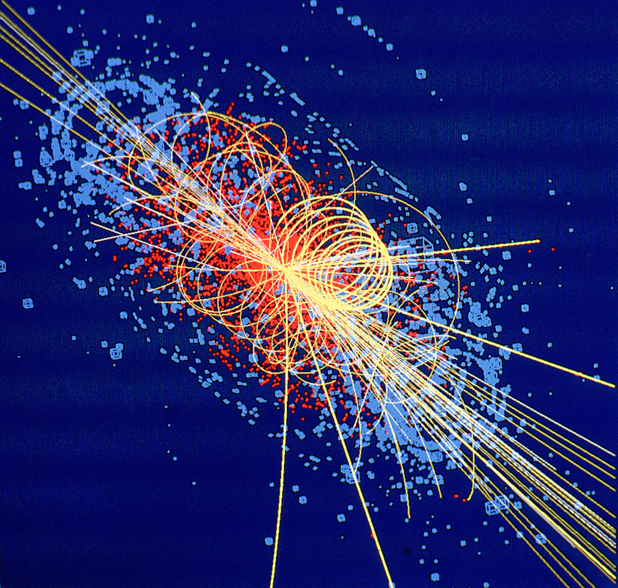
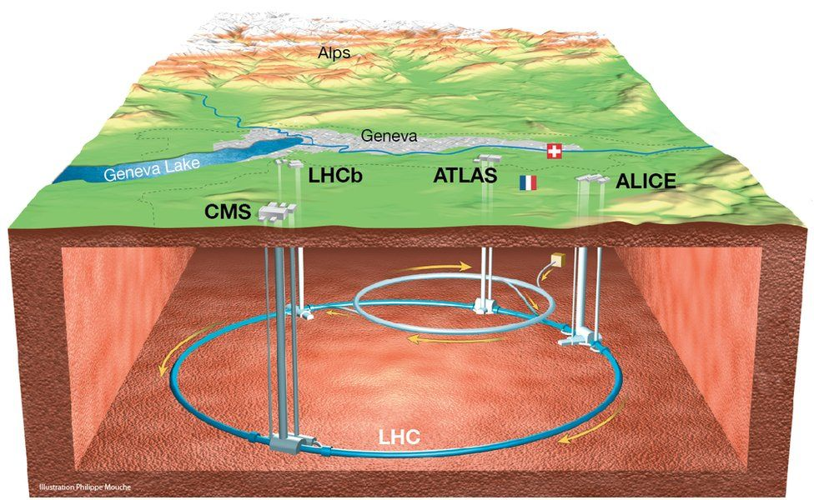
Large Hadron Collider (LHC)
Operated by CERN (European Organization for Nuclear Research)
World’s largest particle collider
Beams of protons
Higgs Boson discovered here!
LHC
Notes:
https://www.bbc.co.uk/news/science-environment-36094282
https://cds.cern.ch/record/39444 (higgs boson decaying to 4 muons)
CERN
World’s largest particle collider, located at CERN, Switzerland.
Beams of protons are accelerated to near the speed of light.
They are collided to produce various products.
Collisions can reach up to 13.0 TeV!
The Higgs Boson was discovered in one such collision in 2012.
Hopefully, some of the particles produced will have properties that indicate that there is new physics at play.

Slide 4
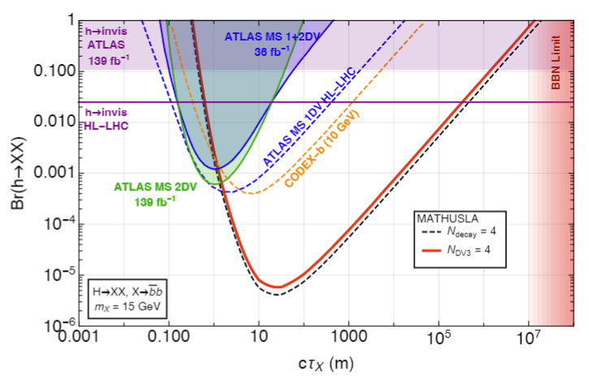
Long-Lived Particles (LLPs)
Open problems: dark matter, hierarchy problem, baryogenesis
Many Beyond the Standard Model (BSM) theories involve LLPs
Weakly coupled → Long-lived
May be produced in the LHC!
MATHUSLA would be orders of magnitude more sensitive than the current ATLAS searches
Updated MATHUSLA Sensitivity Graph
Notes:
Theories have been proposed to solve various open problems in physics!
The weakness of coupling makes them long lived.
Large number of llps might be produced in the LHC.
[Sensitivity of MATHUSLA compared to other detectors graph?]
Hidden Sectors refers to particles and fields that are Beyond the Standard Model (BSM).
They can still interact with Standard Model particles and fields through portals, or very weak couplings.
What this means is that they still must interact with “normal” particles! Otherwise, it just seems like you’re making it all up…

Slide 5
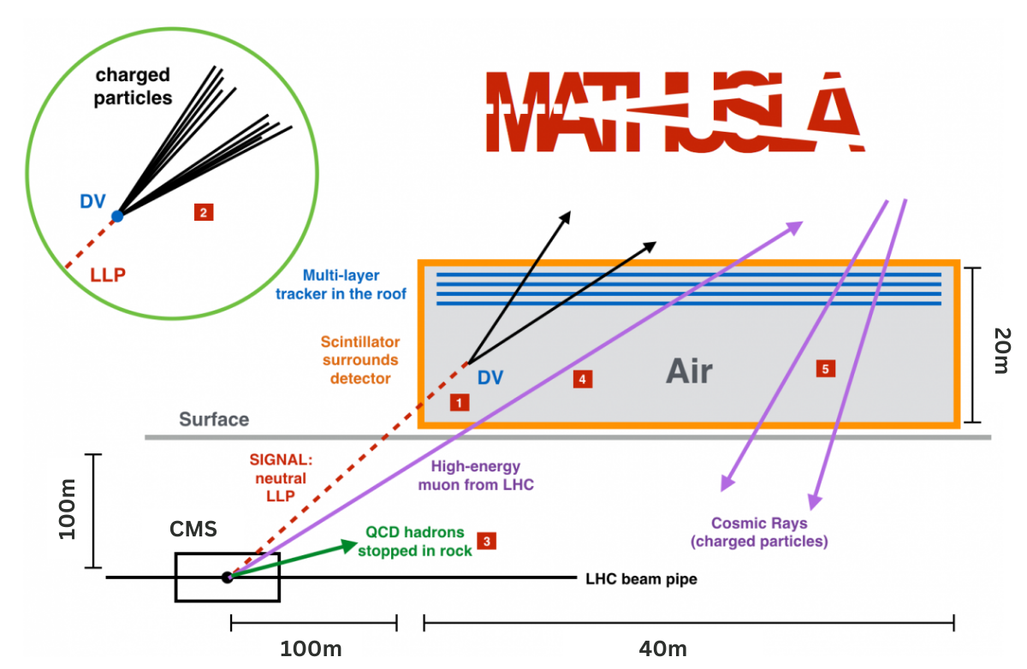
Proposal
Proposed detector
*not to scale.
Notes:
The proposed MATHUSLA experiment would be installed on the surface, above the CMS detector.
Charged particles deposit energy in the plastic scintillator layers, which allows for accurate track reconstruction.
The geometry of the detector is designed for an effective veto of possible backgrounds.
We hope that a neutral LLP will be identified as a displaced vertex (where two track intersect within the detector volume).

Slide 6
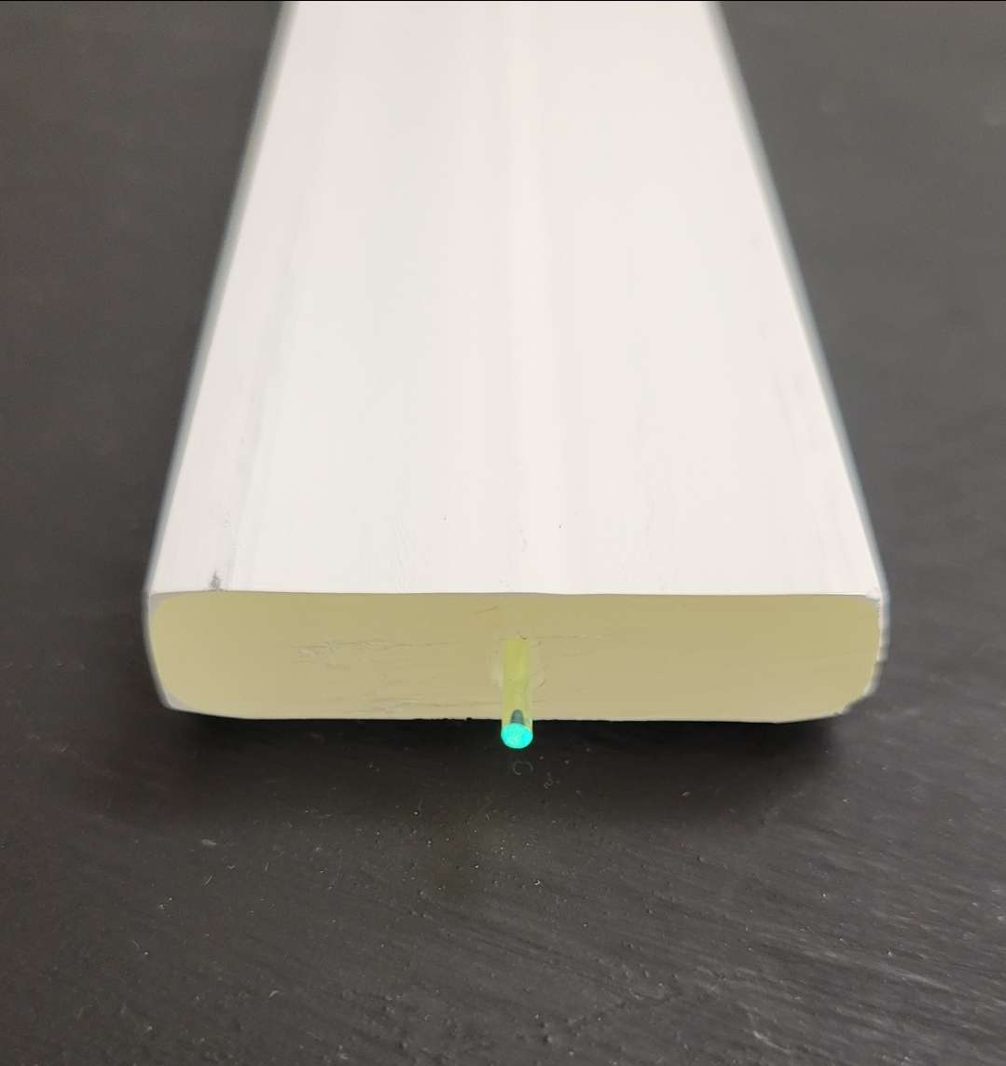
Detection Mechanism
Plastic Scintillator
Ionizing radiation passing through plastic scintillator bars deposit energy
Fluor molecules (PPO and POPOP) emit light
Wavelength-shifting fibre (WSF) collects and shifts light
Silicon photomultipliers (SiPMs) produce signal
WSF
Charged Particle
Photons propagate
WSF
Plastic Scintillator
SiPM
Notes:
2,5-diphenyloxazole (PPO) and 1,4-bis(5-phenyl-2- oxazolyl)benzen (POPOP)
Ionizing radiation passing through plastic scintillator bars deposit energy.
Fluor molecules (PPO and POPOP) in the scintillator emit that energy in the form of light!
A wavelength-shifting fibre (WSF) placed within the bar collects that light, and fluors within that fiber absorb and re-emit light so that the wavelength is detectable by our SiPMs.
Silicon photomultipliers (SiPMs) detect light and produce an electrical signal.

Slide 7
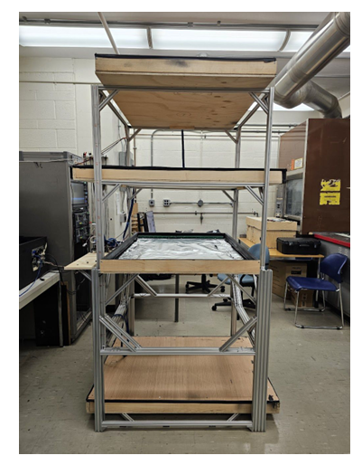
Detection Mechanism
Charged Particle
Timing resolution is crucial!
Distinguish upward and downward going tracks
Identifying location of hits in detector
Alternating layer orientations
Nanosecond precision
UofT Test stand
Layer of Test stand
Notes:
If we know the total length of each fibre, we can calculate the location of the hit in the bars.
This comes from the time difference between the signals from the SiPMs.
Since the number of photons is very low, it’s important that the signal is distinguishable from background noise.
We are looking at nanosecond precision.

Slide 8
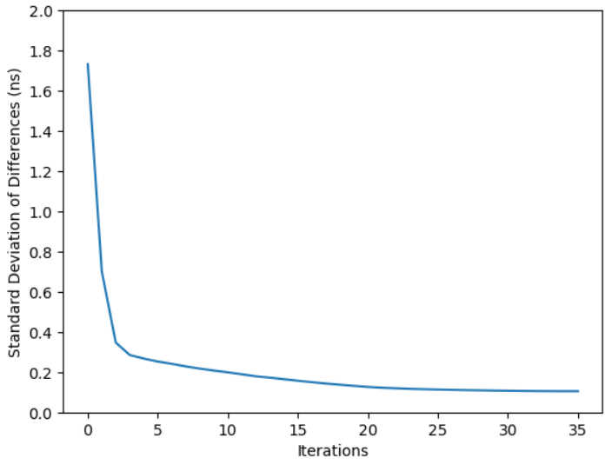
Time Synchronization with Cosmic Rays
Entire detector (~100,000 bars) can be synchronized at once
Fits coordinates of hits to a track reconstruction, then fits the times of the hits to the distances of the hit along track reconstruction
150 seconds of data-taking, synchronization uncertainty down to ±0.10ns
Notes:
For the MATHUSLA 40 geometry, I wrote and tested an algorithm which would synchronize the entire detector system at once (~100,000 bars).
Fits the coordinates of the hits to a track reconstruction, then fits the times of the hits to the distances of the hit along the track reconstruction.
With 150 seconds of data-taking, we expect detectors to be synchronized up to +/- 0.10ns.
Currently working on applying it to our test stand geometry!
260000, 40 million in 150 seconds

Slide 9
Time Resolution
Component | Model & Dimensions
SiPM | Hamamatsu S14160-3050HS 3.0mm x 3.0mm
Wavelength Shifting Fibers | Saint-Gobain BCF-92XL Attenuation length: 530 cm, 1.5mm diameter
Scintillator Bars | Fermilab Extruded polystyrene 1cm x 4cm x 100cm
DAQ Board | PETsys TOFPET2
Factors that affect our time resolution:
SiPM Signal & Trigger Threshold
SiPM Dark Counts
Light Output / Scintillator Quality
DAQ (Data Acquisition System) Board & Cabling

Slide 10
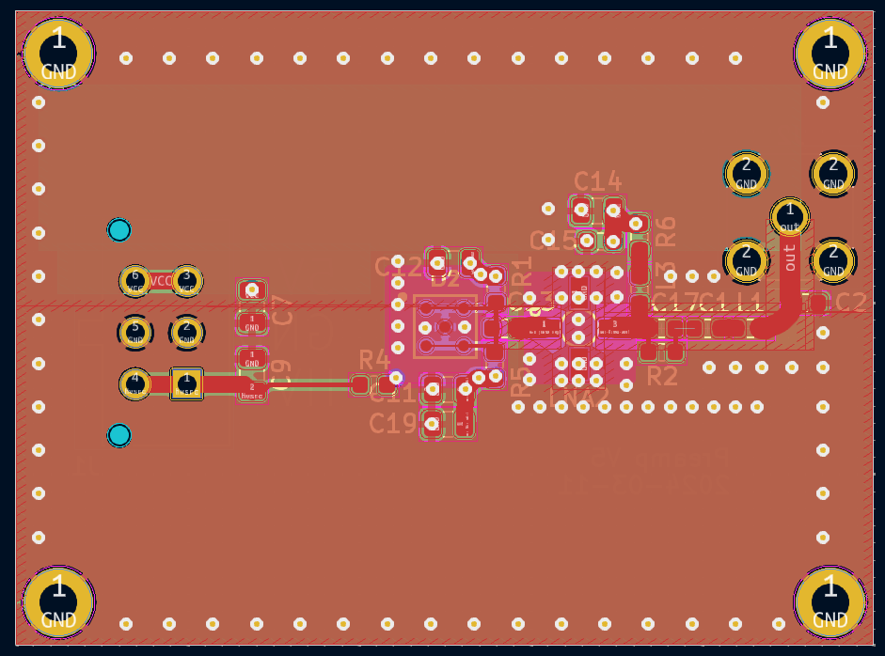
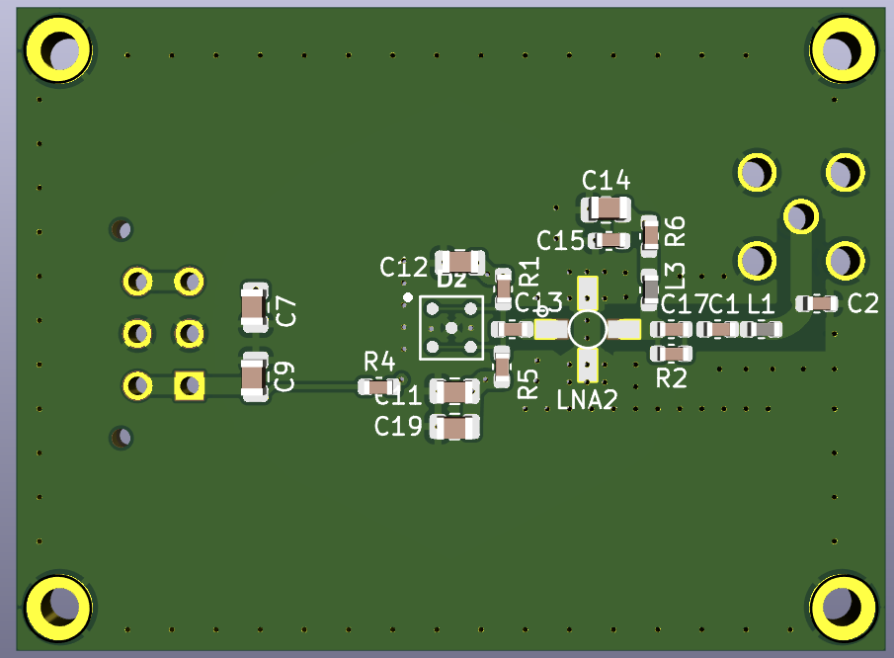
SiPM Signal
Rise time should be as fast as possible
Fall time should not be too long. Otherwise dark counts will pile up!
Minimize noise and distortion:
Shield signal layer
Decoupling capacitors
Make sure components are close together
Minimize trace lengths
Pre-Amplifier V.5

Slide 11
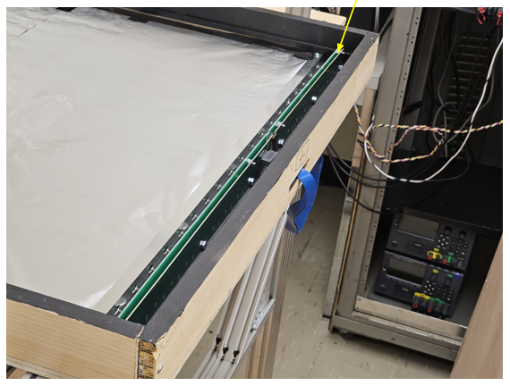
SiPM Signal
Bars (Wrapped)
SiPM + Pre-Amplifier Boards
Rise time should be as fast as possible
Fall time should not be too long. Otherwise dark counts will pile up!
Minimize noise and distortion:
Shield signal layer
Decoupling capacitors
Make sure components are close together
Minimize trace lengths
Layer
Cable

Slide 12
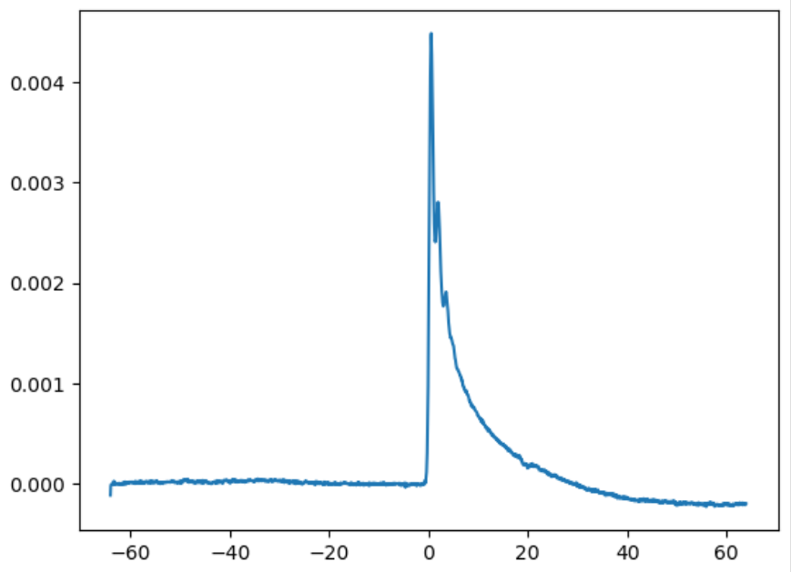
Trigger Threshold
Trigger: 1.5 photoelectrons
Voltage (V)
Time (ns)
Single Photon Pulse
Notes:
Rise time should be as fast as possible.
Fall time should not be too long. otherwise dark counts will pile up!
Minimize noise and distortion:
Shield signal layer with power layers.
Add decoupling capacitors.
Make sure components are close together.
Minimize trace lengths.

Slide 13
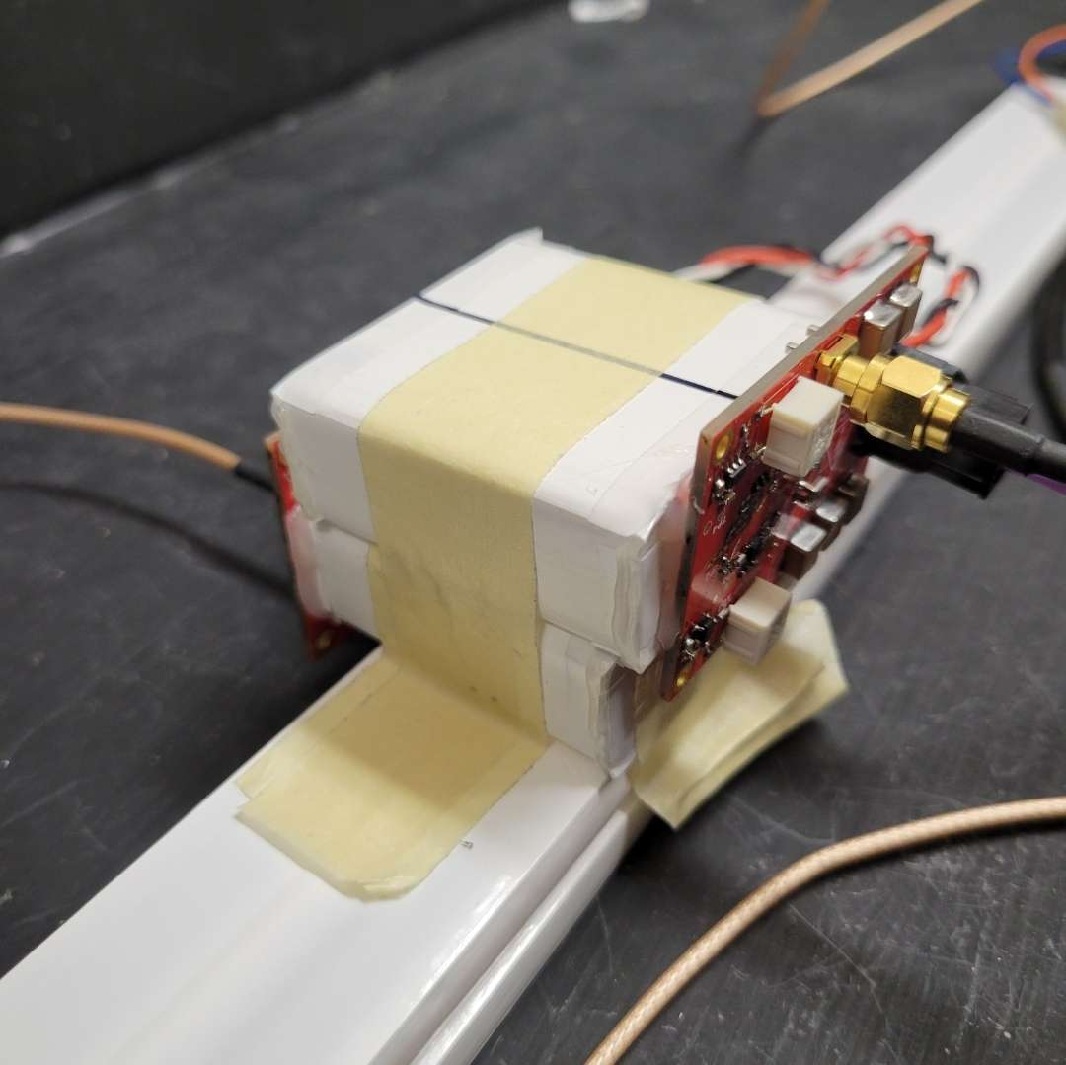
Scintillator Quality
Bar quality differed between batches!
How do we prove this?
Built a cosmic ray trigger to isolate signals from cosmic rays
Issue with the TiO₂ coating process and polystyrene source
Cosmic Ray Trigger
Notes:
Fermilab, dimensions
Bar quality differed between batches!
Built a cosmic ray trigger, which allowed us to isolate signals that came from cosmic rays.
We expected the distribution of intensities to be the same for all bars, but:

Slide 14
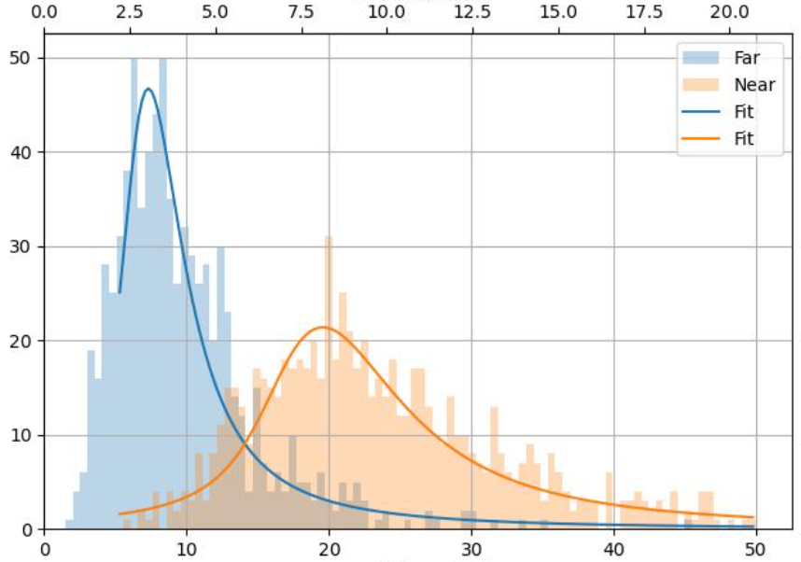
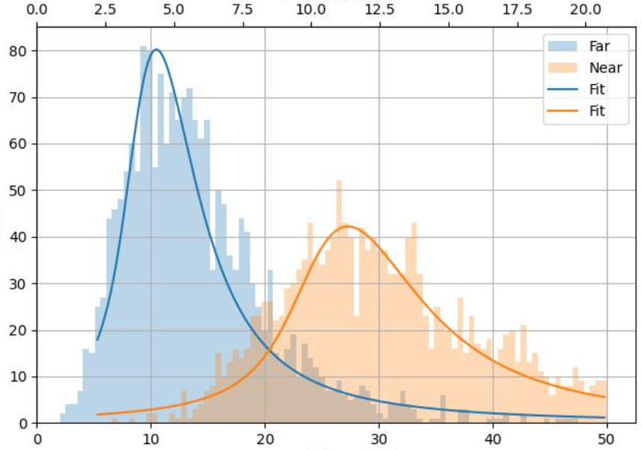
Scintillator Quality
Amplitude [pe]
Bar quality differed between batches!
How do we prove this?
Built a cosmic ray trigger to isolate signals from cosmic rays
Issue with the TiO₂ coating process and polystyrene source
Counts
Total Charge [pe]
New Bar

Slide 15
Scintillator Quality
Amplitude [pe]
Bar quality differed between batches!
How do we prove this?
Built a cosmic ray trigger to isolate signals from cosmic rays
Issue with the TiO₂ coating process and polystyrene source
Counts
Total Charge [pe]
Old Bar

Slide 16
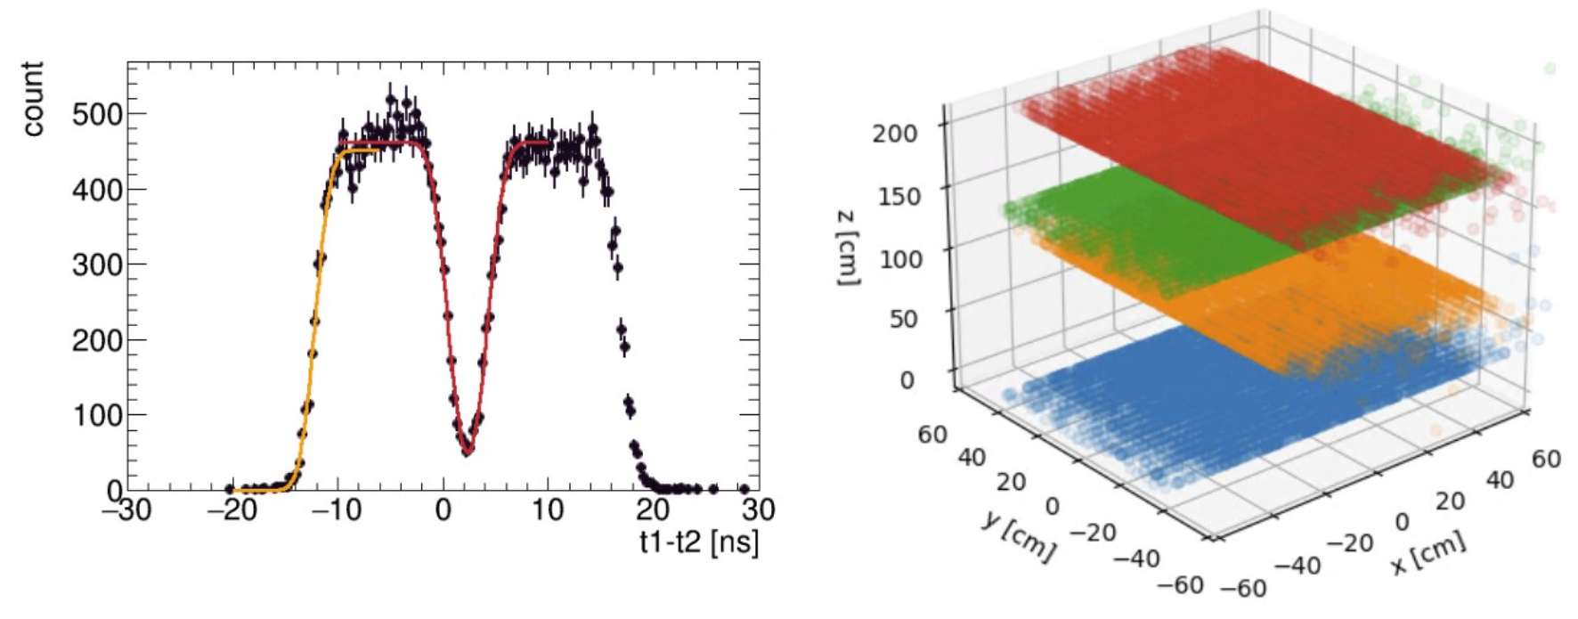
Results
3D visualization of the hits within our detector!
Position uncertainty of 9.5cm.
Credit: Tom Ren

Slide 17
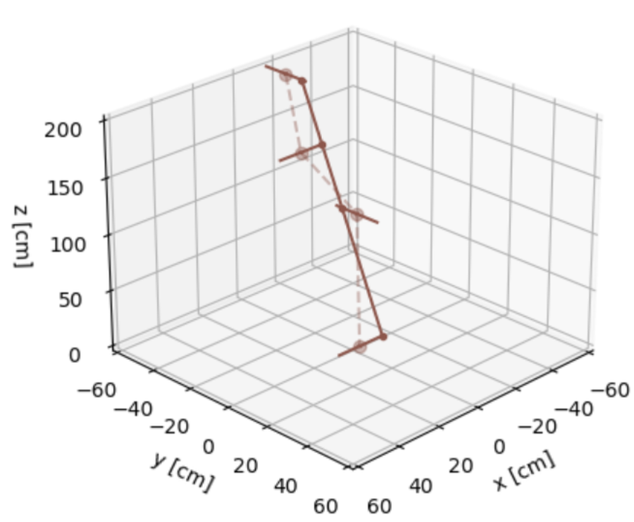
Results
Hits in our detector with uncertainties, plotted with the results of track reconstruction algorithm

Slide 18
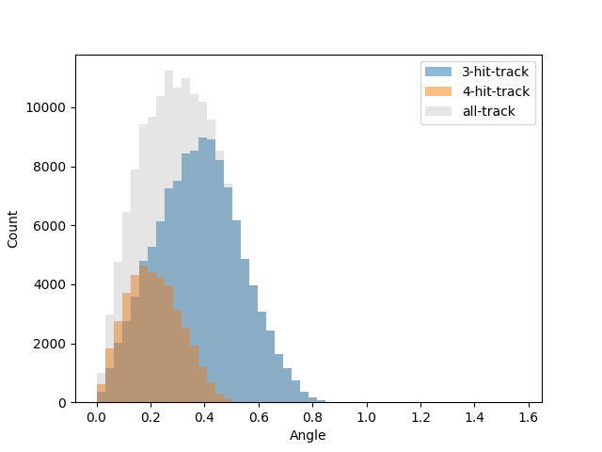
Results
Hits in our detector with uncertainties, plotted with the results of track reconstruction algorithm
Preliminary results suggest 88% efficiency
Simulated Track Angular Distribution

Slide 19
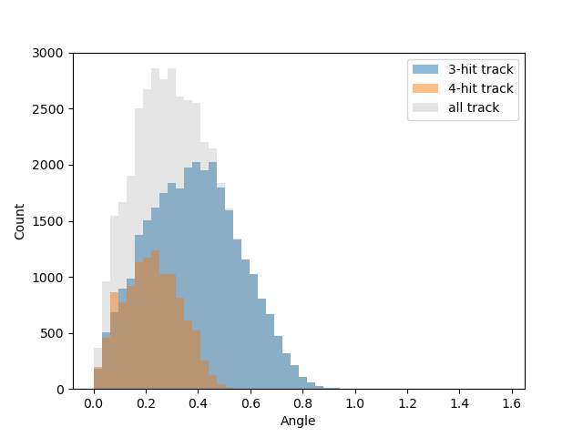
Results
Hits in our detector with uncertainties, plotted with the results of track reconstruction algorithm
Preliminary results suggest 88% efficiency
Test Stand Track Angular Distribution

Slide 20
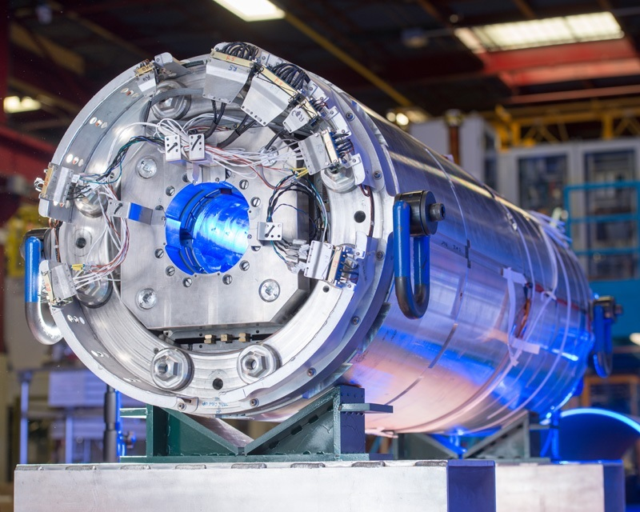
Next Steps?
Preparing technical design report
Seeking funding for 10m x 10m first module at CERN
Aim to run during High Luminosity LHC in a few years
Superconducting Magnet for HL-LHC
Notes:
Working towards technical design report which will incorporate various test stand results and the Canadian team is currently leading a push to fund a 10mx10m first module at cern

Slide 21
Collaboration
Canadian Groups:
PIs: David Curtin (UofT), Miriam Diamond (UofT), Heather Russell (UVic), Steven Robertson (McGill)
Postdocs: Caleb Miller, Tom Ren
Students: Gabriel Owh, Alex Lau, Caleb Gemmell, Andrija Rasovic, Zhihan Yuan, …
Notes:
Credit to tom for his technical expertise and help :)

Slide 22
References & Readings
The lifetime frontier. EP News. (n.d.). https://ep-news.web.cern.ch/content/lifetime-frontier
Fermilab. (n.d.). https://www.fnal.gov/
The MATHUSLA experiment. Home | mathusla.web.cern.ch. (n.d.). https://mathusla-experiment.web.cern.ch/
MATHUSLA LHCC letter of intent: arXiv:1811.00927, 2009.01693
MATHUSLA Physics Case: arXiv:1806.07396
LLP decays in MATHUSLA: arXiv:2308.05860
Analysis of Long Lived Particle Decays with the MATHUSLA Detector: https://arxiv.org/abs/1705.06327
On the Origin of Long-Lived Particles: https://arxiv.org/abs/2007.05538
Recent Progress and Next Steps for the MATHUSLA LLP Detector: https://arxiv.org/abs/2203.08126

Slide 23
Supplementary Slides

Slide 24
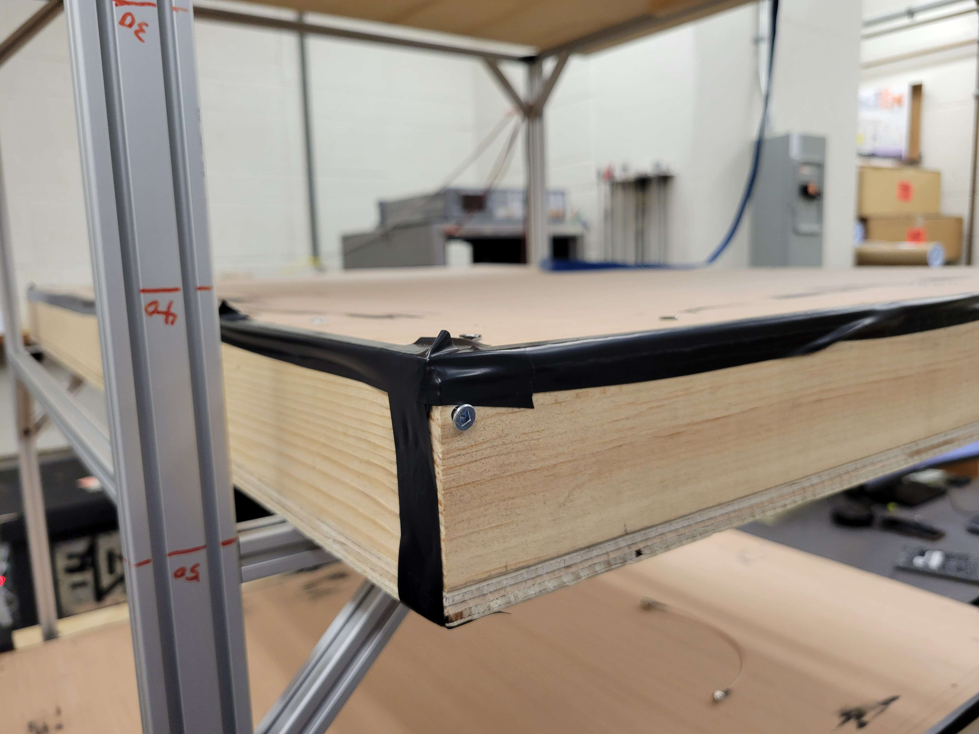
SiPM Dark Count
Thermal noise in SiPMs
Layers should be light-tight
Spray-painted insides black
Lined edges with black foam
Taped edges of the box
Calibrated our data acquisition board trigger to ignore dark counts
Picture of Layers
Notes:
Thermal noise in SiPMs.
Make sure layers were light-tight.
Spray-painted insides black to absorb leaked photons.
Lined edges with black foam to create a seal.
Taped edges of the box.
Calibrated our data acquisition board trigger to ignore dark counts.

Slide 25
Scintillator Quality
Issue with the TiO₂ coating process and polystyrene source
Tried wrapping the bars in different materials
 | Old Bar | New Bar | Mylar, Adhesive Side In | Mylar, Adhesive Side Out | Teflon | Tyvek | Mylar and Teflon | Printer Paper | Aluminum Foil
Near End | 34.6 | 24.7 | 24.4 | 29.3 | 28.9 | 25.2 | 28.8 | 28.2 | 28.2
Far End | 14.2 | 9.7 | 7.5 | 8.7 | 8.9 | 8.2 | 8.6 | 8.2 | 7.7

