Slide 1
Luminescence Testing of Materials in the Scintillating Bubble Chamber Experiment
Alex Hayes
Supervisor: Dr. Ken Clark

Slide 2
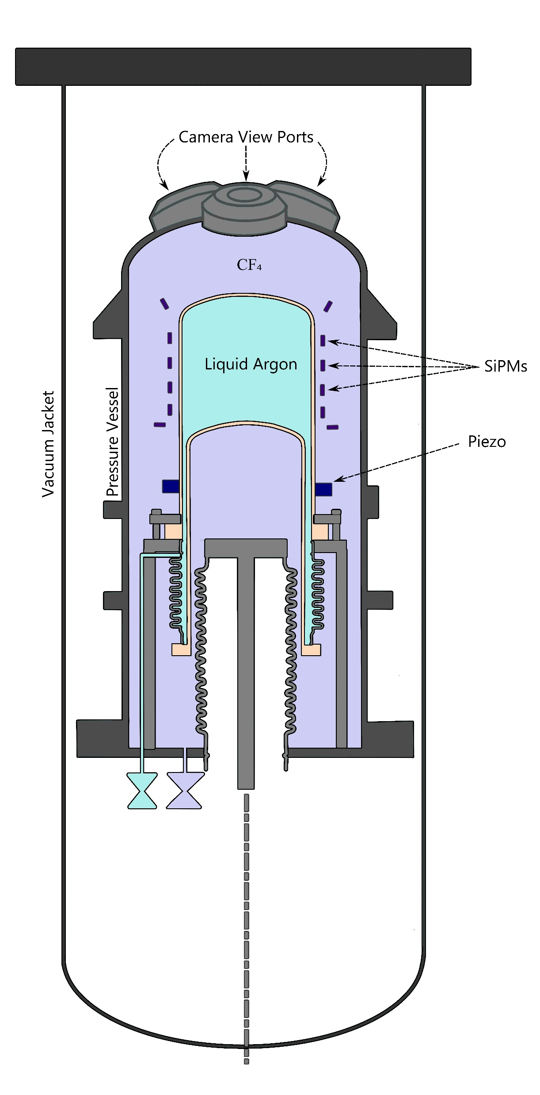
Scintillating Bubble Chamber (SBC)
850 nm LEDs mounted next to camera viewports (not shown)
Notes:
Dark matter direct detection experiment
Dark matter interaction nucleates bubble in superheated liquid argon
Scintillator identifies non-dm interactions, scintillation light captured in SiPMs (Silicon Photomultipliers: photon detector)
850 nm LEDs mounted close to camera view ports to illuminate target volume, flash every 10 ms on a 10% duty cycle
SiPMs also sensitive to LED light: non-scintillation light makes it difficult to determine scintillation pulses

Slide 3
Excerpt from SBC Snowmass 2021 Paper
Arxiv: 2207.12400
Notes:
This is a review paper that went over the SBC design at the time. Essentially it says that if more data corroborates this preliminary study, then SBC would have to operate without visuals until some other trigger indicated a bubble was forming. Not ideal!!
As referenced in this text, we would have to trigger using a pressure system rather than the cameras, which is slower.

Slide 4
Project Outline
Identify 850nm light response of materials used in SBC volume
Determine if SBC can operate the LEDs without sacrificing scintillation detection time

Slide 5
Design Challenges
Little information on 850nm luminescence
Difficulty controlling LED light pulse
SiPM operation challenges
Room-temperature dark count rate
Isolation from external light

Slide 6
Apparatus
LED flasher circuit to control light pulse
Fiber optic cable piping light into dark box with SiPM and sample
Amplifier for SiPM output
Oscilloscope to analyze signal
Notes:
LED Flasher: high intensity flash to discriminate signal features from dark counts

Slide 7
Apparatus
Oscilloscope
Dark Box
LED Circuit Power
SiPM Signal Amplification
LED Flasher Circuit

Slide 8
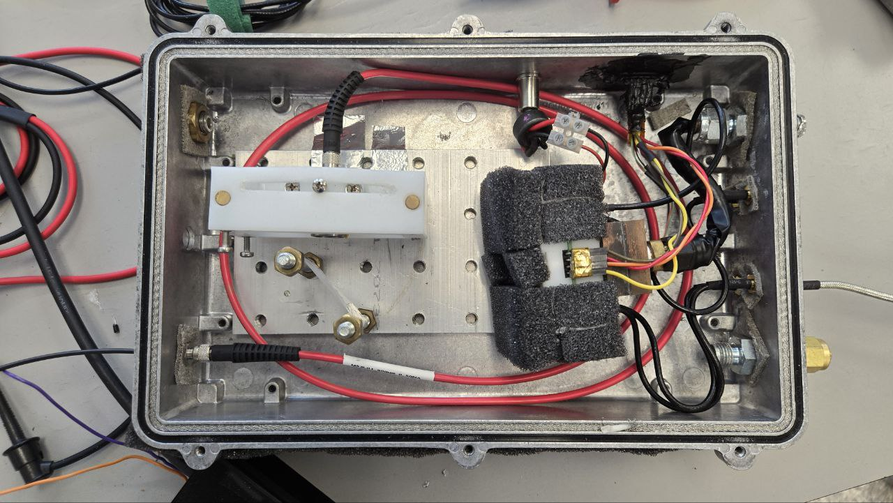
Apparatus
Light Collimator
Sample
Optic Cable
SiPM Holder
Notes:
Describe the flow of light through the apparatus!

Slide 9
Calibration: Reflection Pulse
Metal tape used for pure reflection signal.
Reflection pulse waveform. All plots created using Matplotlib.
Notes:
Averaged over 10,000 waveforms.
Peak at ~52.8 ns.
Takes ~1 us to reduce back to baseline. We will therefore only concern ourselves with delayed luminescence on timescales longer than 1us.
For proposed SBC operation, would be ~10 ms of time to look for scintillation light after LED pulse. Perform testing for this timescale.

Slide 10
Calibration: Luminescence Signal
Selected InP as control material for luminescence signal
Band gap $≈$ 1.46 eV
850 nm photon energy $≈$ 1.46 eV
Measured SiPM response with and without reflection pulse
Successfully exhibited luminescence signal
Notes:
InP band gap = 1.46 eV at room temp
Corroborates results of “Photoluminescence of InP” paper

Slide 11
Analysis Method
Set oscilloscope to average 10,000 waveforms
Take two of these waveforms for each sample
Characterize background noise (mean, standard deviation)
Determine if both waveforms have groups of points below 3 standard deviations from the background at the same time
Notes:
Background = waveform before LED pulse trigger

Slide 12
Results: HDPE
Signal reaching below 3 standard deviations for both trials of HDPE.
SiPM signal for HDPE with the reflection pulse removed.
Notes:
HDPE is used in SBC in a “castle” surrounding the target volume providing thermal isolation
Example of a signal in both waveforms below 3 standard deviations.
Only a signal point.
Further discussion later in presentation.

Slide 13
Results
No signal detected for:
Kapton
FR4
Durable V2Formlabs Photopolymer Resin
Notes:
Kapton: wrapping for cables in SBC
FR4: SiPM circuit board
Resin: (low-background material) mount for SiPM and circuit board to copper structure within HDPE castle
Also tested PTFE (not pictured): no signal
PTFE: seals between the target volume and “bellows” (pressure regulating device)

Slide 14
Discussion
HDPE match: only one point
Signal shapes quite different
Very likely due to noise
All other materials exhibited no luminescence above the noise
Notes:
First signal is skewed opposite to second signal. Would expect similar shape if it was an actual signal and not noise.

Slide 15
Conclusion
No luminescence signal was detected beyond 1 µs after reflection pulse
SBC can operate as planned without sacrificing scintillation detection uptime
Notes:
Great success! SBC capable of scintillation detection for the proposed 90% of the LED flashing cycle.

Slide 16
Thank you
Notes:
Special thanks to Dr. Ken Clark and Dr. Hector Hawley Herrera

Slide 17
InP Reflection Signal

Slide 18
InP Luminescence Signal

Slide 19
HDPE Alternate Image

Slide 20
LED Flasher Circuit

Slide 21
Results: Kapton
SiPM signal for Kapton with the reflection pulse removed.

Slide 22
Results: FR4
SiPM signal for FR4 with the reflection pulse removed.

Slide 23
Results: Durable V2Formlabs Photopolymer Resin
SiPM signal for the photopolymer resin with the reflection pulse removed.

Slide 24
Results: PTFE
SiPM signal for PTFE with the reflection pulse removed.

