Slide 1
SNO+ Transfer Stations
2024/08/20
Gurpreet Kainth
Research Assistant
Supervisor: Szymon Manecki

Slide 2
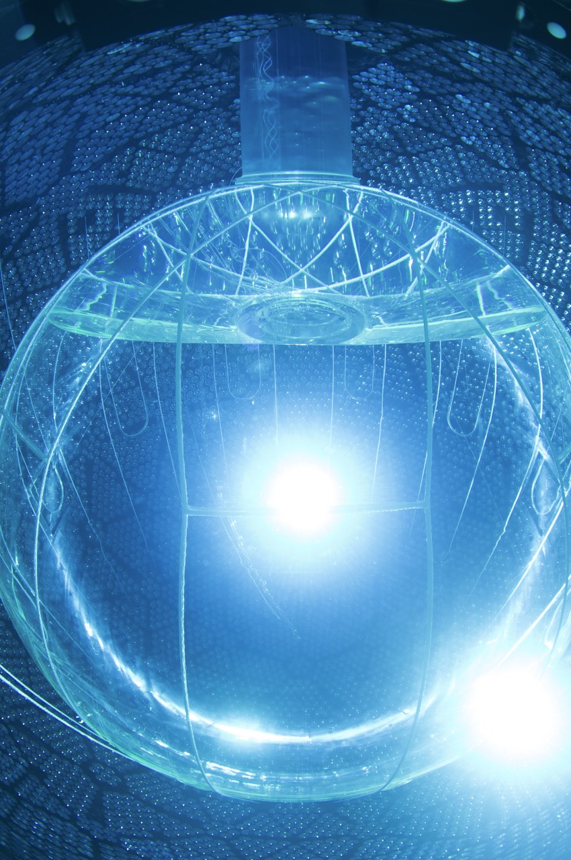
SNO+
Multipurpose detector
Main goal: Neutrino-less double beta decay 0νββ in 130Te
SNO+ Cocktail ingredients: LAB, PPO, Bis-MSB, BHT, TeBD and DDA
Next Phase: Load Te into Acrylic Vessel (AV)
Notes:
The SNO+ is a multipurpose neutrino detector which aims to look for Neutrino-less double beta decay in Te-130
SNO+ uses a cocktail of ingredients to search for neutrinoless double beta decay. Our primary component is LAB, making up 90-95% (780 tonnes) of the liquid scintillator. PPO which makes up (2 tonnes) our wavelength shifter that shifts neutrino interaction light to a detectable wavelength, while Bis-MSB our secondary shifter (1-2 g/L) providing further light shift makes even easier for our detector to detect. BHT, an antioxidant, stabilizes the mixture only added trace amount, and TeBD dissolves tellurium, the key element for our search. DDA improves stability and red0uces fluorescence quenching.
So, the next phase as you now already will be to load Te into the AV.

Slide 3
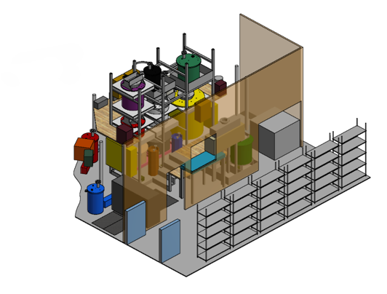
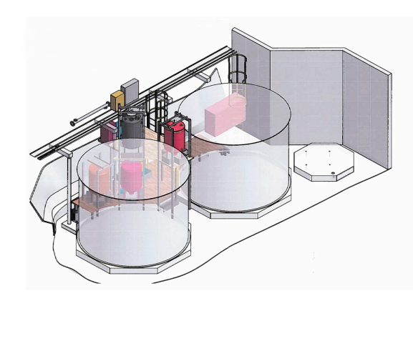
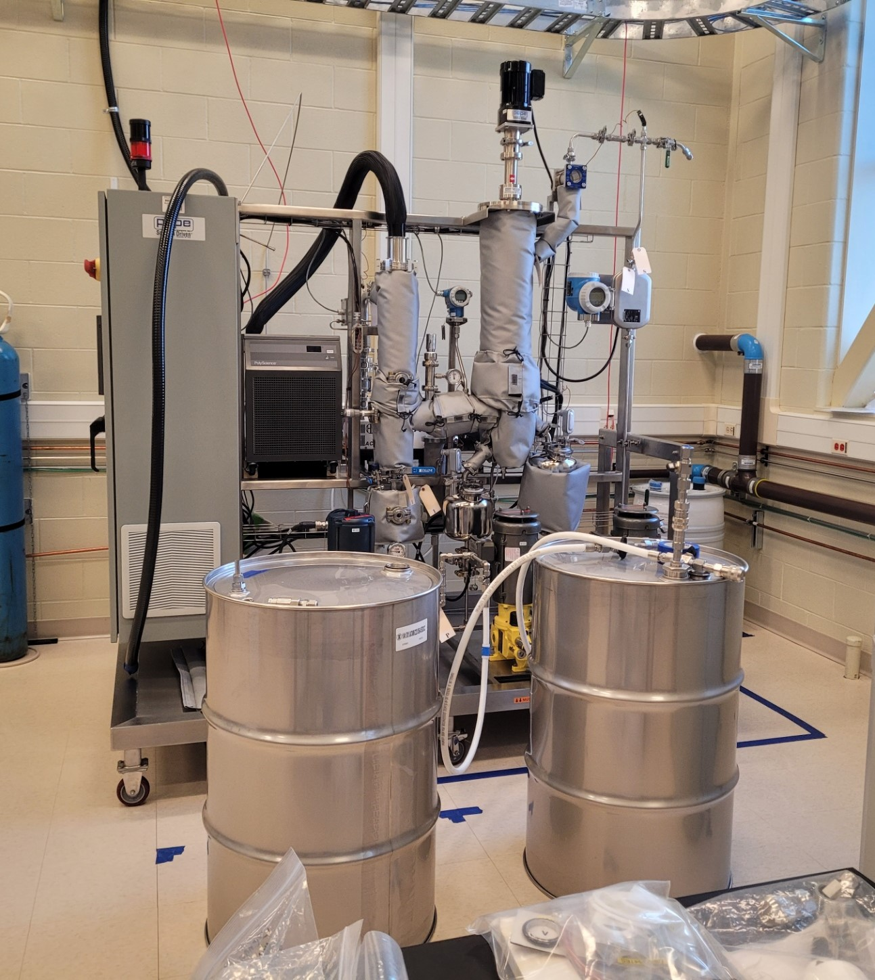
Tellurium systems
TeA
TeDiol
DDA Distillation
Notes:
But the question is How do we do that? Well, to answer that question we will have to look at our tellurium systems of SNO+. First, we have TeA (telluric acid plant) where the purification of tellurium takes place and then we have a TeDiol where once Te is purified will go to mix with our other ingredients Butane Diol and DDA. Then we have our DDA thin file distillation where the DDA distillation will take place which will be on surface. So, how do we get there?

Slide 4
Tellurium systems
TeA
TeDiol
DDA Distillation
DDA & BD Transfer stations
Notes:
Well, I think everyone knows it was right on my first slide. BD and DDA Transfer station. So, the DDA once distilled will make it to our underground lab and transfer station will take it the Diol plant. Similarly, our BD drums will be sent to the TeDiol however after it is distilled in our scintillator plant underground. And eventually into our AV.

Slide 5
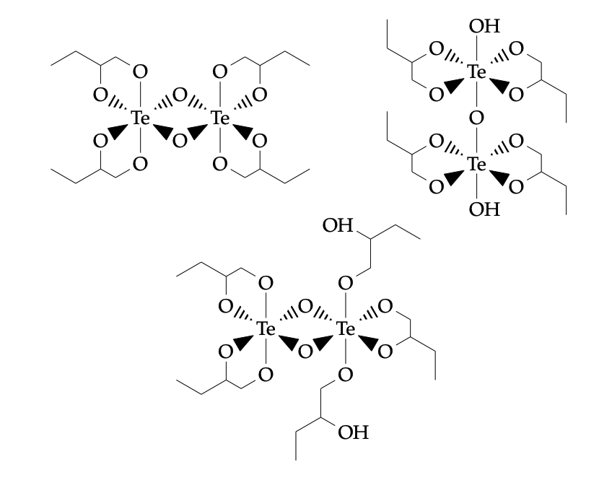
1,2-BD (Butanediol)
To mix Tellurium with organic liquid scintillator (LAB), a new compound TeBD must be synthesized
LAB soluble TeBD complexes are formed in condensation and further oligomerization reactions of Telluric Acid (TeA) with BD
Notes:
Is that it? Someone, here might be wondering why TeDiol plant is there anything more to it than just mixing of two additional chemicals. Why cant we just get the Te directly into the LAB? As, previously mentioned earlier Te doesn’t directly go into our detector. The reason is that tellurium by itself isn’t soluble in LAB. To solve this, we need to create a compound called tellurium butanediol (TeBD), and this process happens in the TeDiol plant.
The reaction between telluric acid (TeA) and butanediol (BD) forms TeBD complexes, but water is produced, and these initial compounds aren’t yet fully soluble in LAB. We solve this by heating the mixture and using nitrogen gas to remove the water, which finalizes the TeBD complex, making it fully soluble.
So, oligomerization here means that Telluric Acid and 1,2-Butanediol react repeatedly to form complex, multi-unit structures (oligomers), but not long enough to create a large polymer. These oligomerized structures are then more soluble in LAB (Linear Alkyl Benzene) for use in the scintillator.
Oligomerization is a chemical process in which smaller molecules (called monomers) combine to form larger, chain-like structures known as oligomers

Slide 6
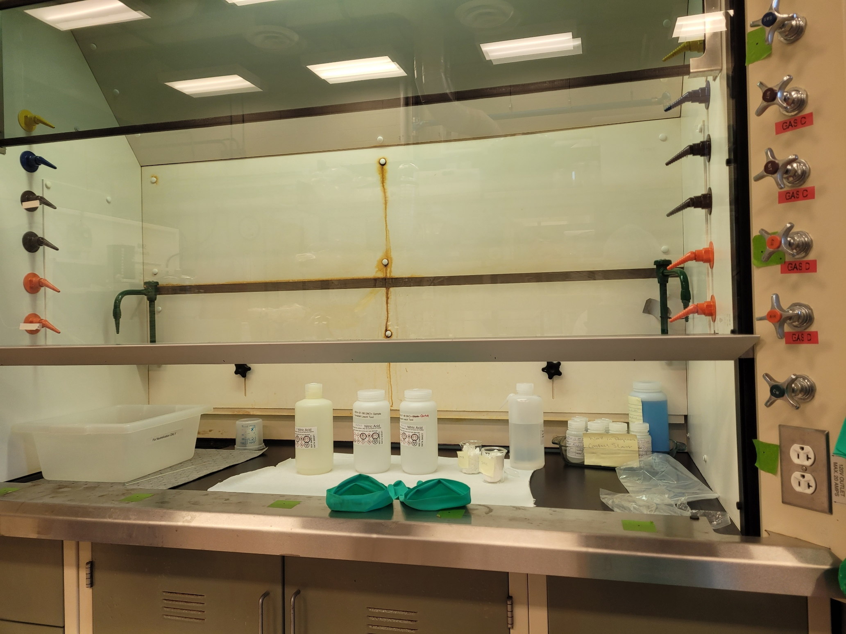
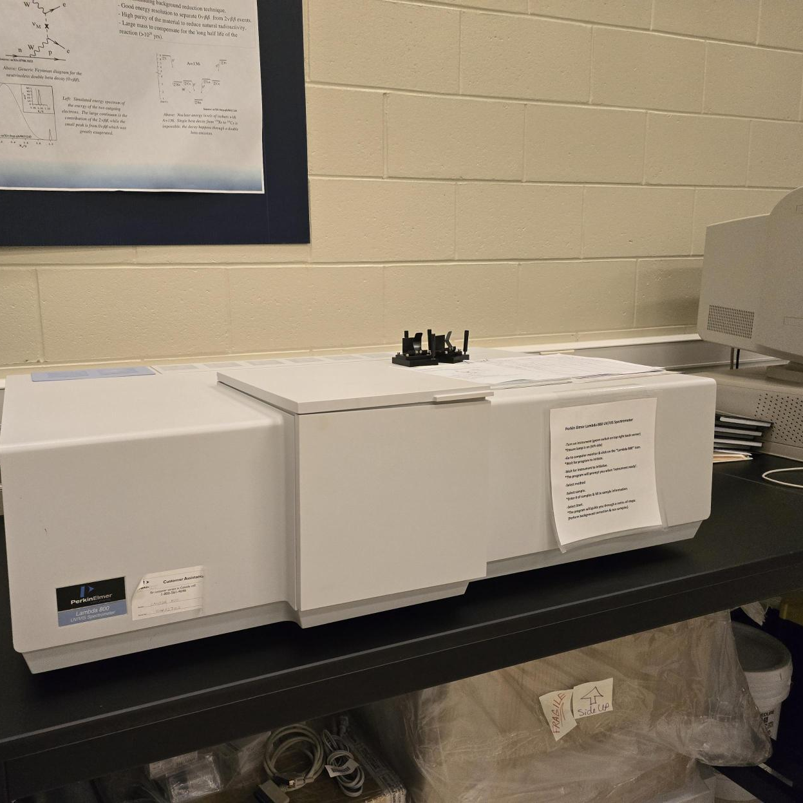
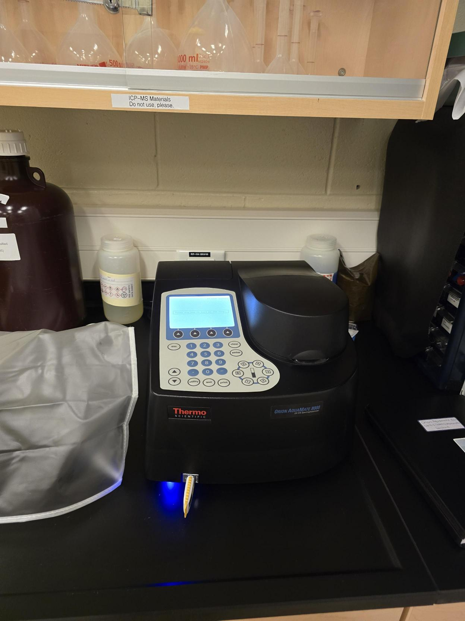
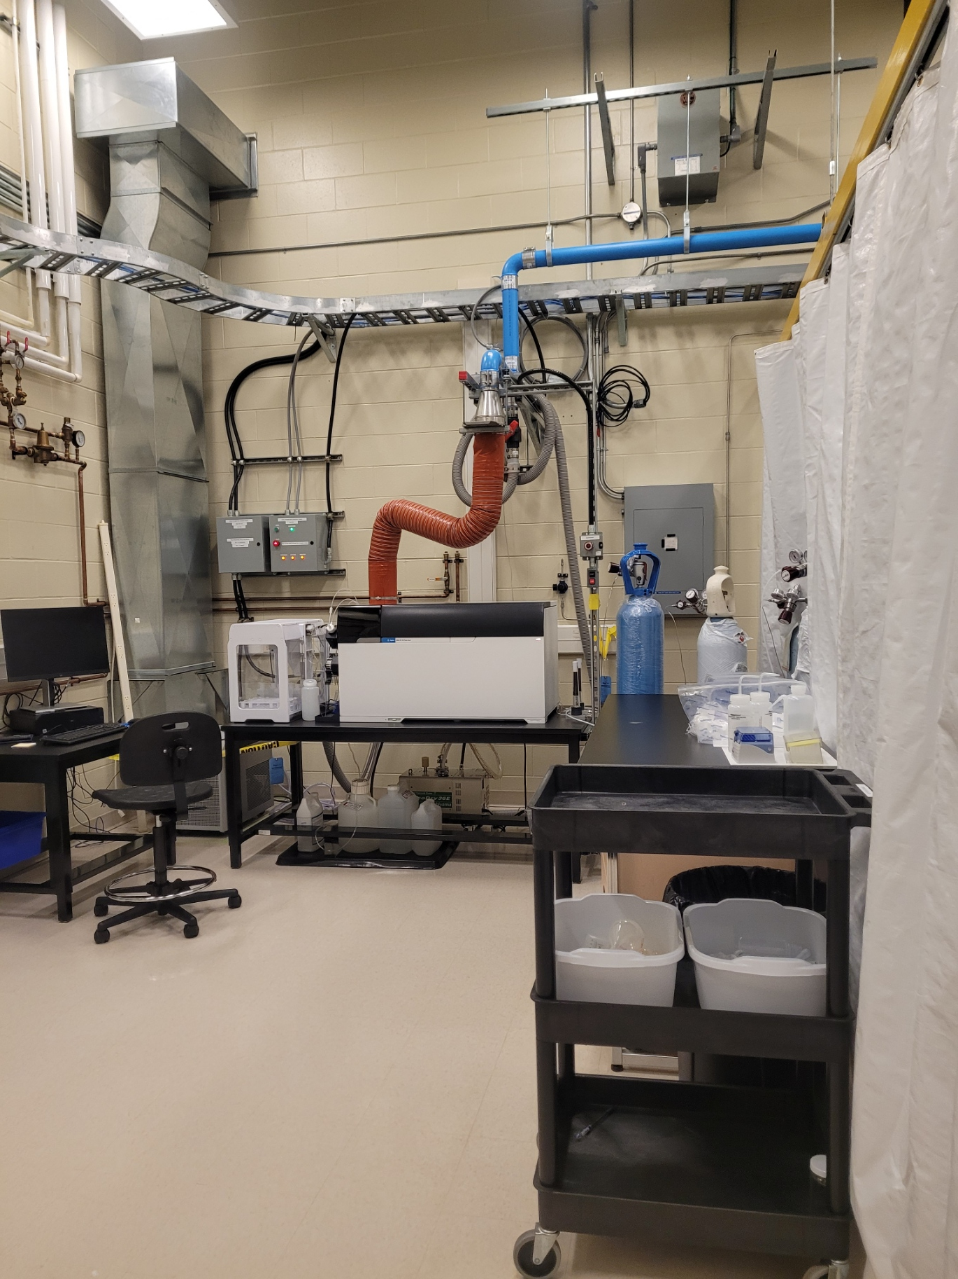
Cleanliness and Quality Assurance (QA)

Slide 7
Importance of Cleaning
Transfer stations will need to adhere to strict cleanliness protocols/standards of SNO+
Crucial step to avoid introducing additional backgrounds to detector
The small parts cleaned in conjunction with UPW and Acid bath set up
The bigger parts lines and drums to have 1% Nitric acid run through and leached for 24 hours

Slide 8
Goals of QA
To determine the cleanliness at different stages of cleaning steps
To assess the quality of the acid and monitor contaminants from leaching
Ensure effectiveness of cleaning process
Develop standard for overall cleanliness and background for Transfer station

Slide 9
QA Development

Slide 10
QA Overview
PDFE ultrasonically cleaned bottles used for QA tests
1% Trace Metal Grade Nitric acid
1 bottle to act as control others as sample used for leaching part
Parts pre-cleaned with Nucleon and UPW prior
Samples analyzed with UV-vis spectroscopy and ICPMs
Observe spectral changes and trace level contamination
Notes:
Inductively coupled plasma mass spectrometry

Slide 11
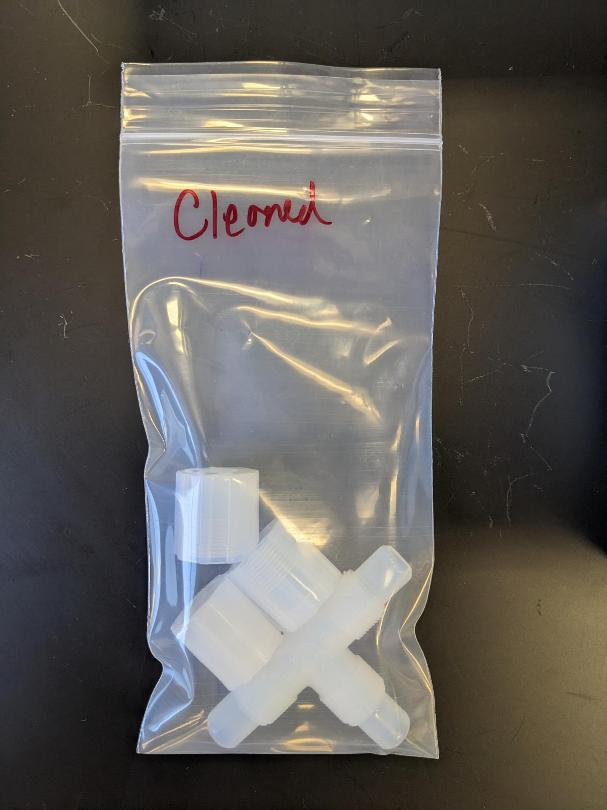
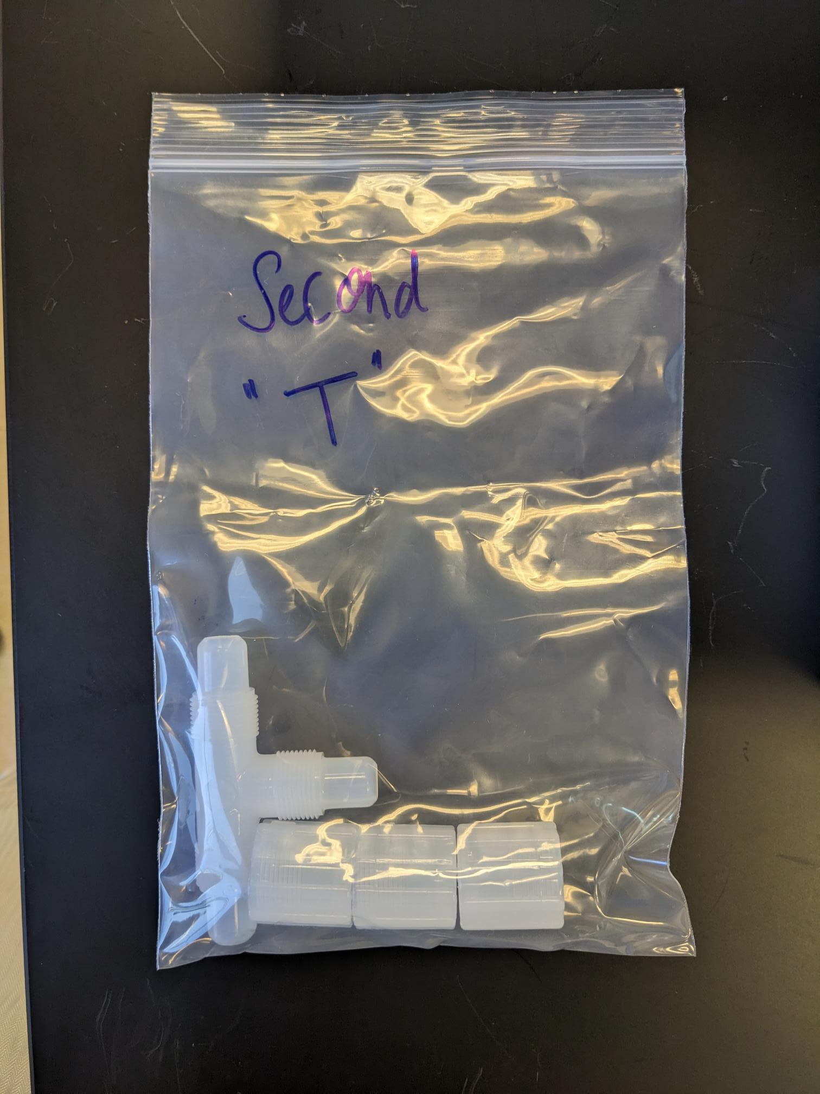
QA Methods Overview
QA Method #1:
Goal: Determine Baseline contamination
Leach part (2 hrs), sample hourly (up to 24 hrs)
QA Method #2:
Goal: Assess effects of re-using contaminated acid
Leach new part in used acid, analyze (up to 24 hrs)

Slide 12
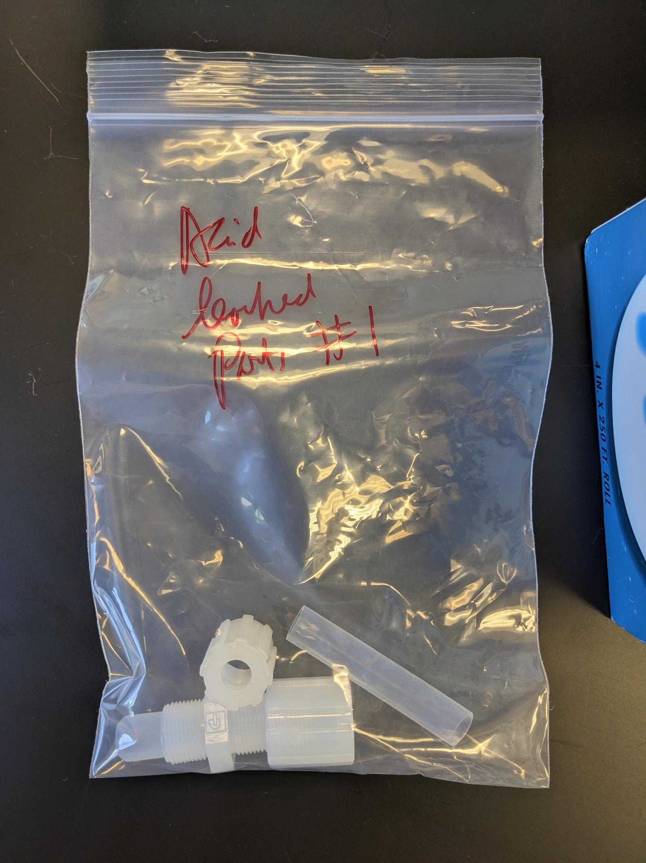
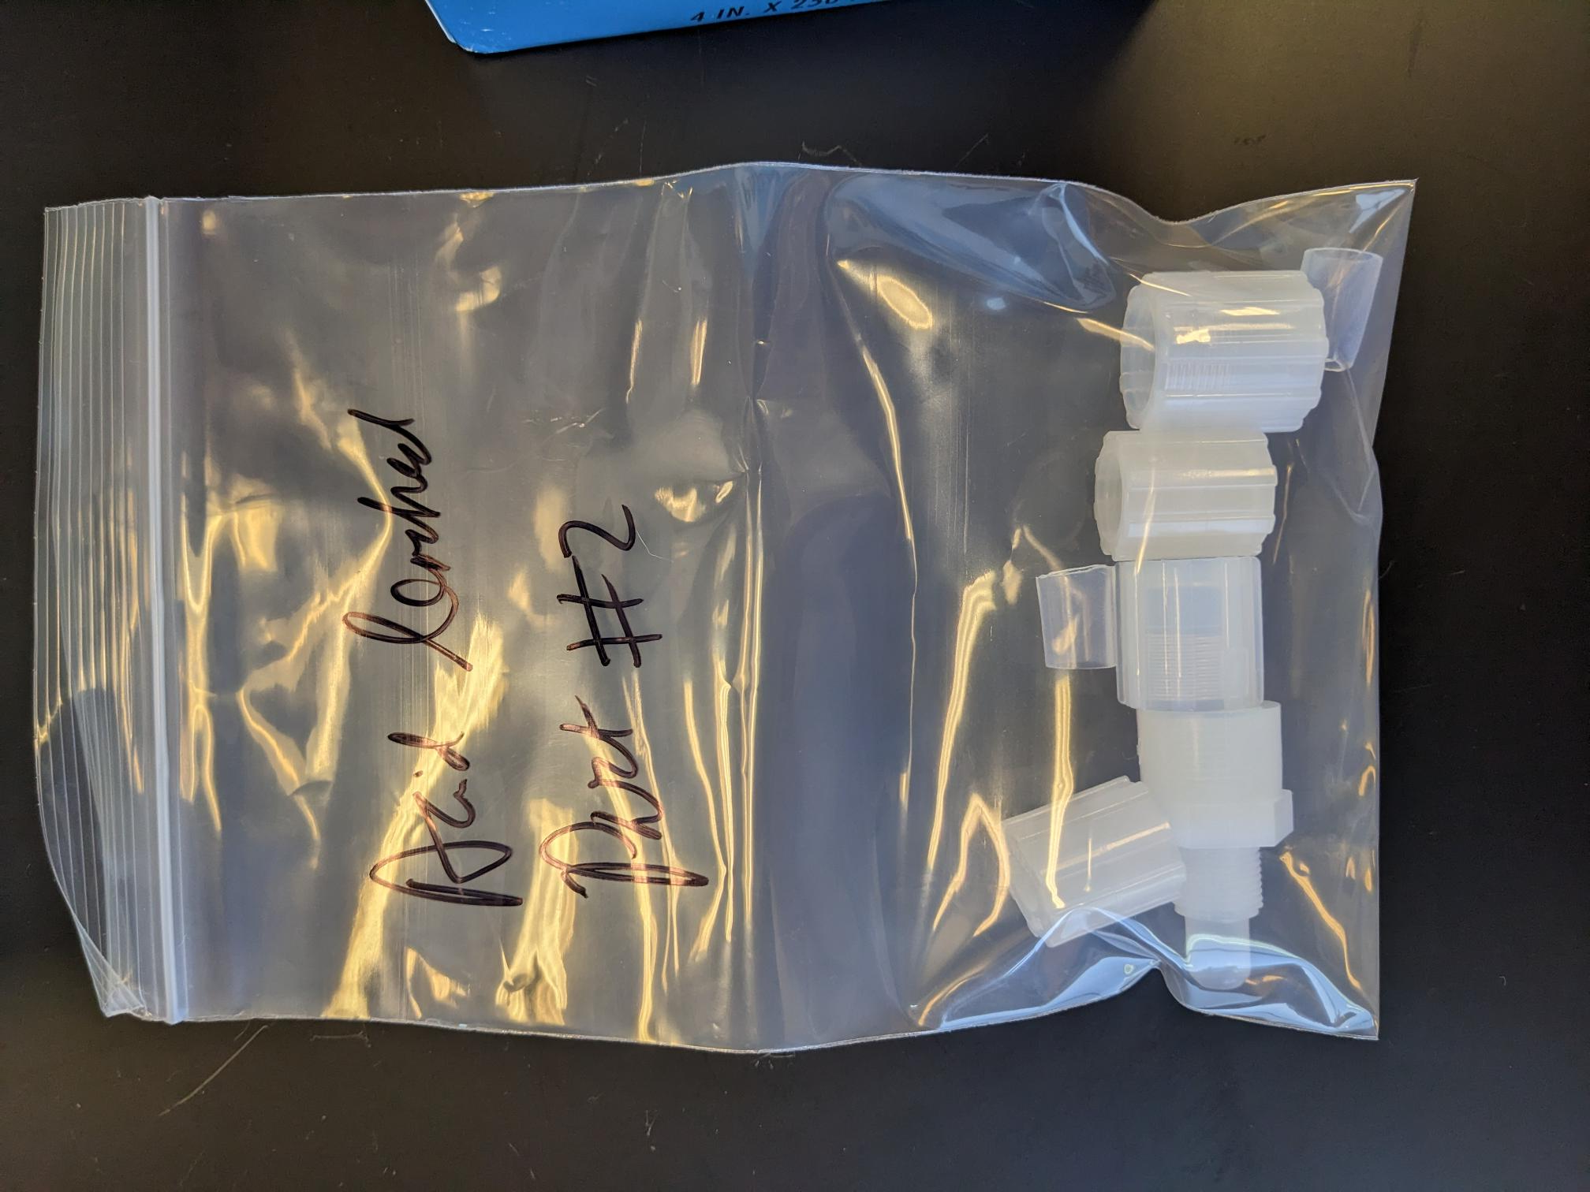
QA Methods Overview
QA Method # 3:
Goal: Test contamination transfer between acid bottles (new acid)
Leach in two acid bottles, analyze at 2-hour intervals
Repeat procedure with other parts

Slide 13
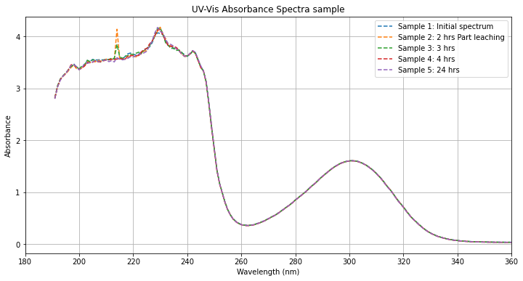
QA #1: Baseline Contamination

Slide 14
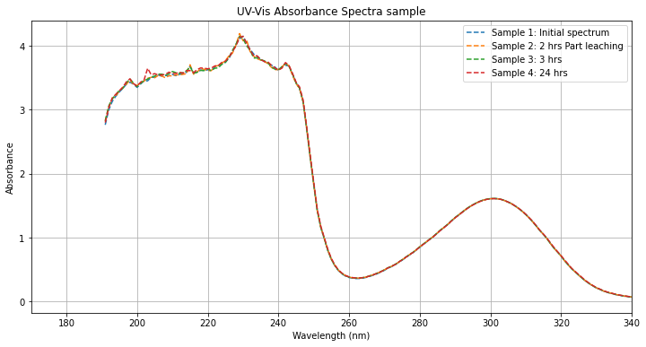
QA #2: Re-use of Contaminated Acid

Slide 15
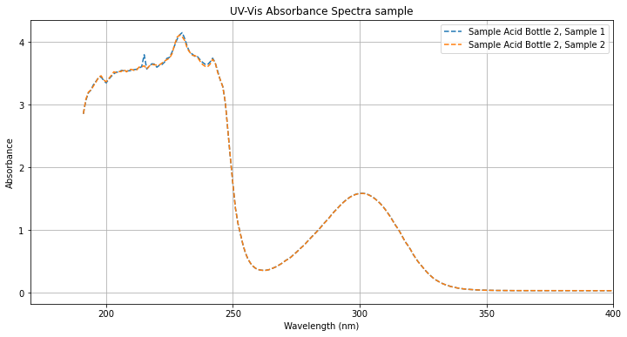
QA #3: Transfer Between Acid Bottles

Slide 16
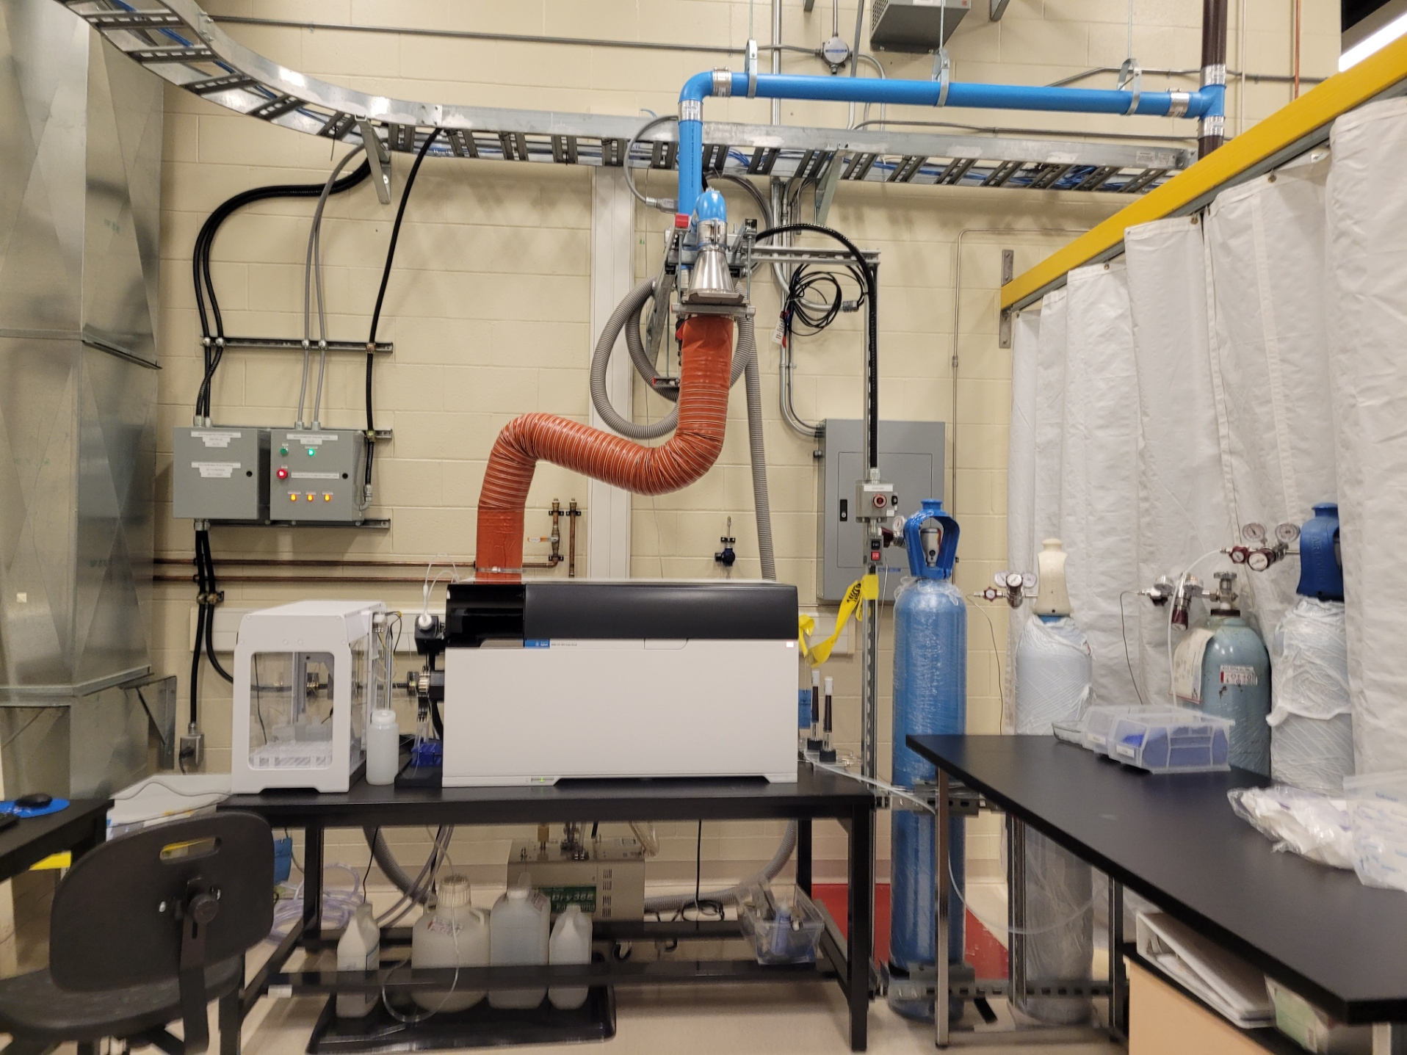
Future QA Prospects
ICP-MS Integration:
Analyze Contaminants and compare with UV-Vis spectra (results pending)
Replicate QA Method 3:
Repeat acid leaching and transfer for small parts
Further Sampling:
Explore new methods or conditions for further testing
Small & Large parts:
Use small parts QA data to develop method for QA for large parts ug

Slide 17
Concluding Remarks
Key Takeaway:
BD allows LAB to mix with Telluric Acid (TeA).
DDA enhances stability and reduces fluorescence quenching.
DDA distilled on surface and BD in the scintillator plant, transfer station allows SNO+ to add these additional chemicals to cocktail in AV
QA methodology in place to ensure proper cleanliness that adhere to SNO+ cleanliness standards

Slide 18
Thank You!
Szymon Manecki and Christine Kraus
SNO+ QA Team: Adil H., Lorna Nolan, Sumanta Pal
Sahima Dema and Sharayah Read
Justin Suys (thx for the pictures)
Chem techs and rest of the Snolab

Slide 19
Backup

Slide 20
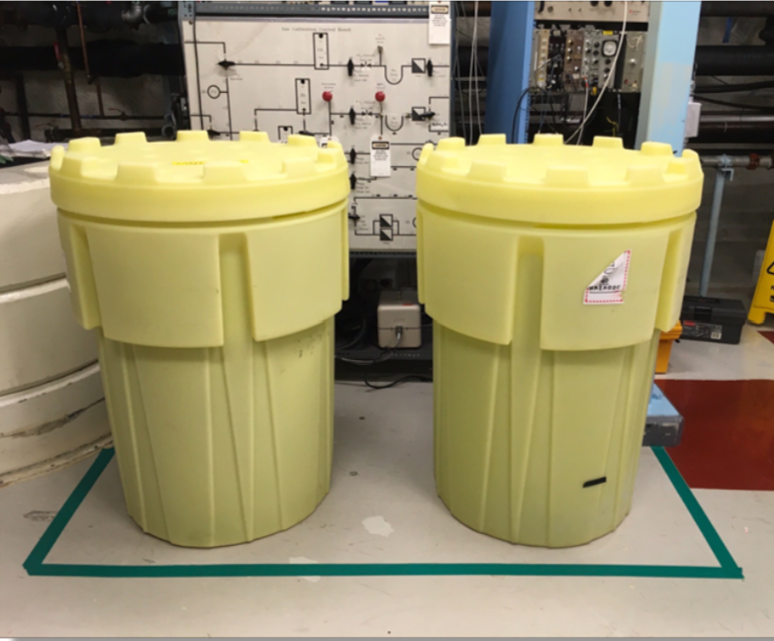
BD Transfer Station Location
The BD transfer station will be located in the junction outside of the utility room, across from the SNO+ control room, to the right of the DT generator.
The DDA transfer station will be located outside of the low background lab
BD Transfer Station Credit: Olivia Conrad

Slide 21
BD & DDA Transfer Station Space Allocation
*Information collected from SNO+ Space Allocation drawing SLDO-SNP-AR-0016

Slide 22
Tellerium-130?
Te-130 is one of 35 isotope considered as a candidate for 0νββ.
High Abundance: Te-130 has a natural abundance of 33%, reducing the need for costly enrichment.
No Absorption in Optical Range: Retains excellent optical properties for scintillator use.
Low Background: Provides better sensitivity for rare event searches.
Long term stability: allows for multiple years of data taking.

