Slide 1
PICO-500 Muon Veto System
Emma Greenall
CASST 2024
Notes:
Hello! My name is Emma and today I will be presenting on my work building and testing the electronics for the PICO-500 muon veto system.

Slide 2
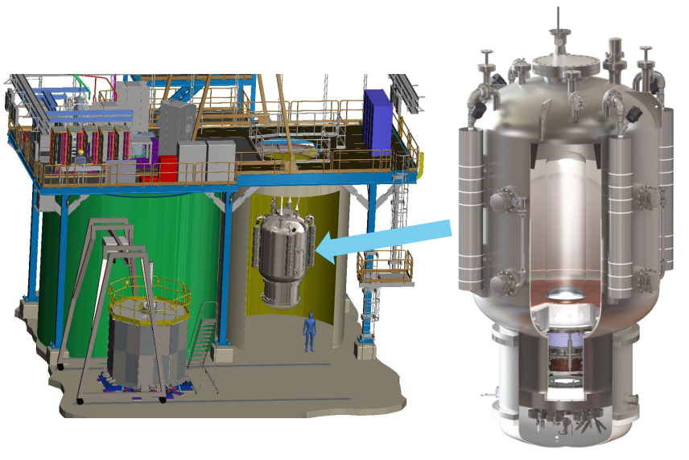
PICO-500
Scaled up version of PICO-40 bubble chamber
Direct detection of WIMPs
Target fluid C₃F₈ kept in super heated state
Bubbles created from nuclear recoils
Cameras, acoustic sensors, pressure sensors
SNOLAB CUBE hall
Notes:
First a bit of background about the experiment.
PICO 500 is a scaled-up version of the PICO 40 direct detection dark matter experiment and uses the same “upright” design. The target fluid is kept in a superheated state. Adding just a bit of energy into the system (like from a nuclear recoil) can nucleate a gas bubble. These bubbles are monitored with cameras, acoustic sensors, and pressure sensors. After a bubble event the chamber recompresses and returns to the superheated liquid state. PICO 500 is currently in development and will be installed in the CUBE hall at SNOLAB once completed.

Slide 3
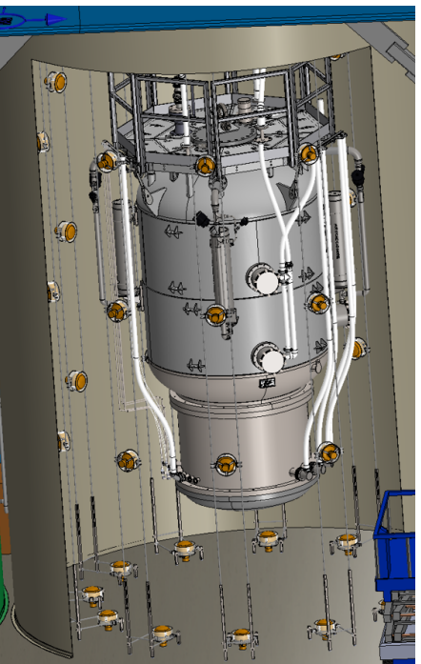
Muon Veto System
Extensive shielding underground
Muon spallation -> neutrons -> nuclear recoils -> bubbles
Cherenkov radiation
48 PMTs in water tank surrounding detector
20s correlation window
Notes:
Despite extensive shielding from muons in SNOLAB, muons can still pose a problem.
Water tank expected to be hit by 5100+- 1300 muons per year (using Mei & Hime flux values) (from hector thesis)
Might not seem like a lot of muons, but this is actually a big problem! Why?
Muon interactions with nuclei can lead to the emission of neutrons. This process is called muon spallation. The resulting neutrons could cause nuclear recoils which are energetic enough to nucleate a bubble in the detector.
We only care about muons that traverse the detector itself and lead to a neutron in the detector volume. These muons emit Cherenkov radiation as they move through the water tank. That light is then picked up by 48 SNO PMTs.
When a bubble event occurs in the detector, the previous 20s of data from the PMTs is checked for a muon signal. If there was a muon, the event is vetoed.

Slide 4
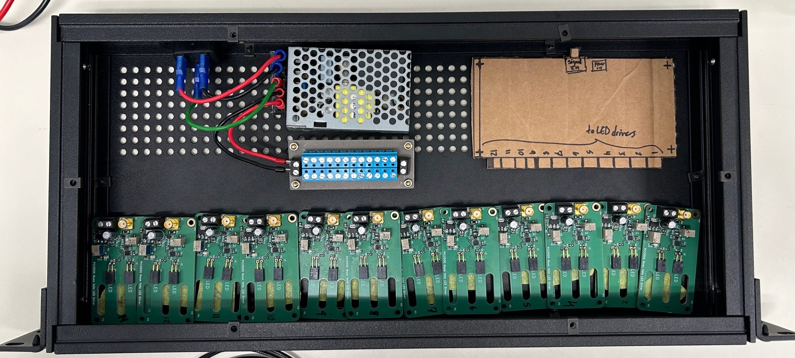
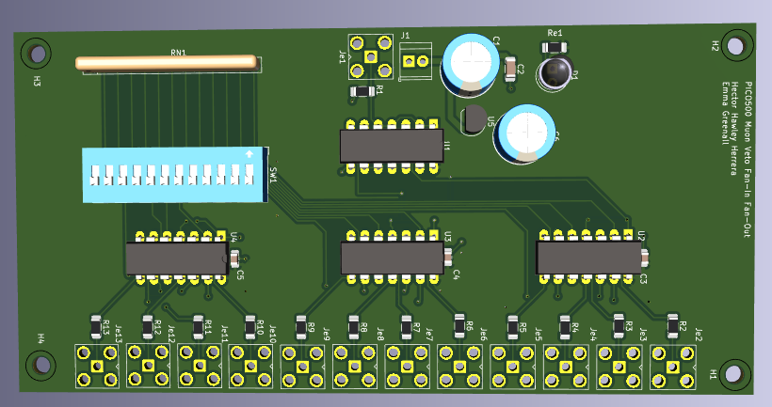
Electronics Unit
Notes:
We constructed a self-contained electronics unit with 12 driver circuits. This is a calibration system for the PMTs used to veto muons. The drivers will make sure all the PMTs are functioning properly throughout the course of the experiment. Ultrashort pulses will be used to minimize veto down time.
Switching power supply to convert from AC to DC
Power distribution board to send 5V to each board
Fan in fan out board to send square waves to all boards
Alternating heights of drivers to ensure all 12 fit in a row
Holes still need to be drilled when exact placement finalized
24 optical fibers (two PMT per fiber)

Slide 5
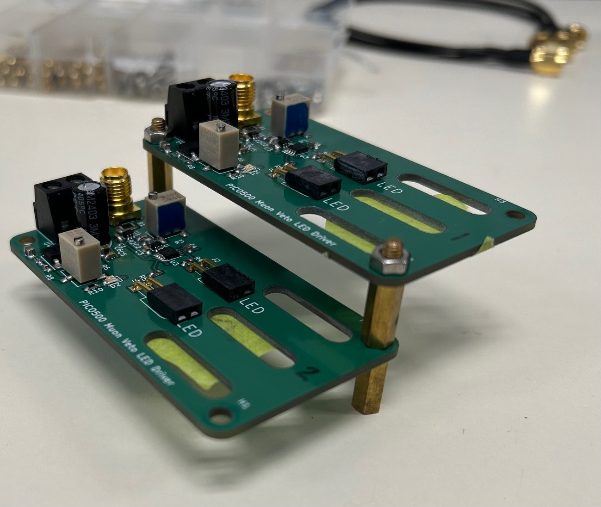
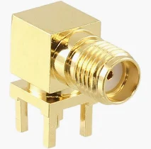
Notes:
We are waiting for this new hardware to come in, but when it does we will stagger the boards like this so they all fit in a row. We are also swapping to a 90 degree connector to stay with in height limits.

Slide 6
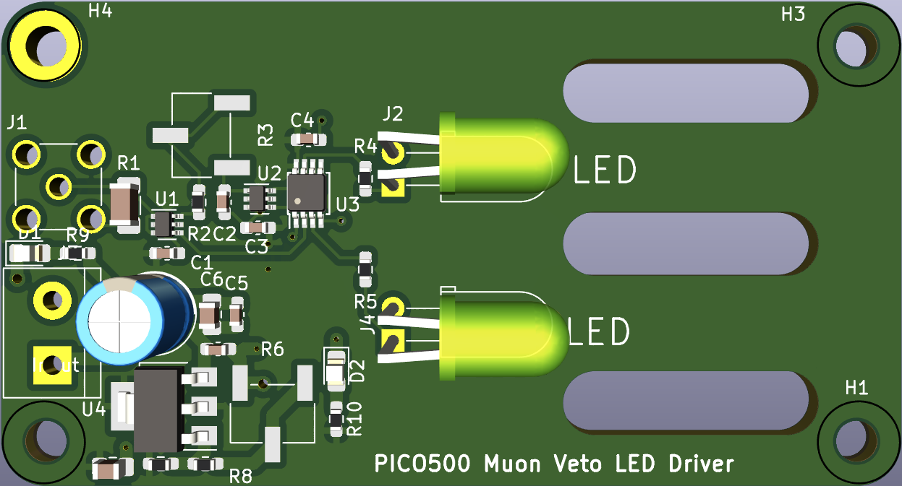
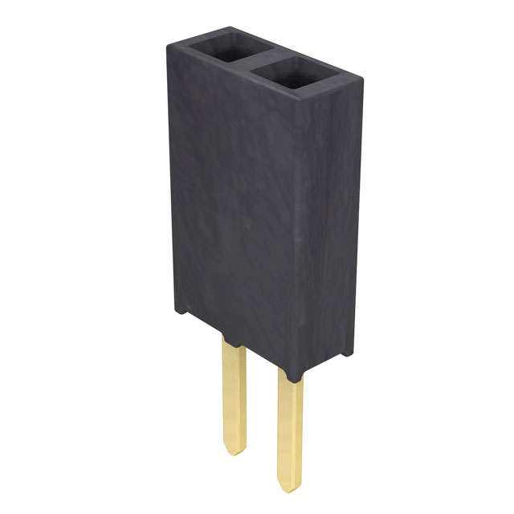
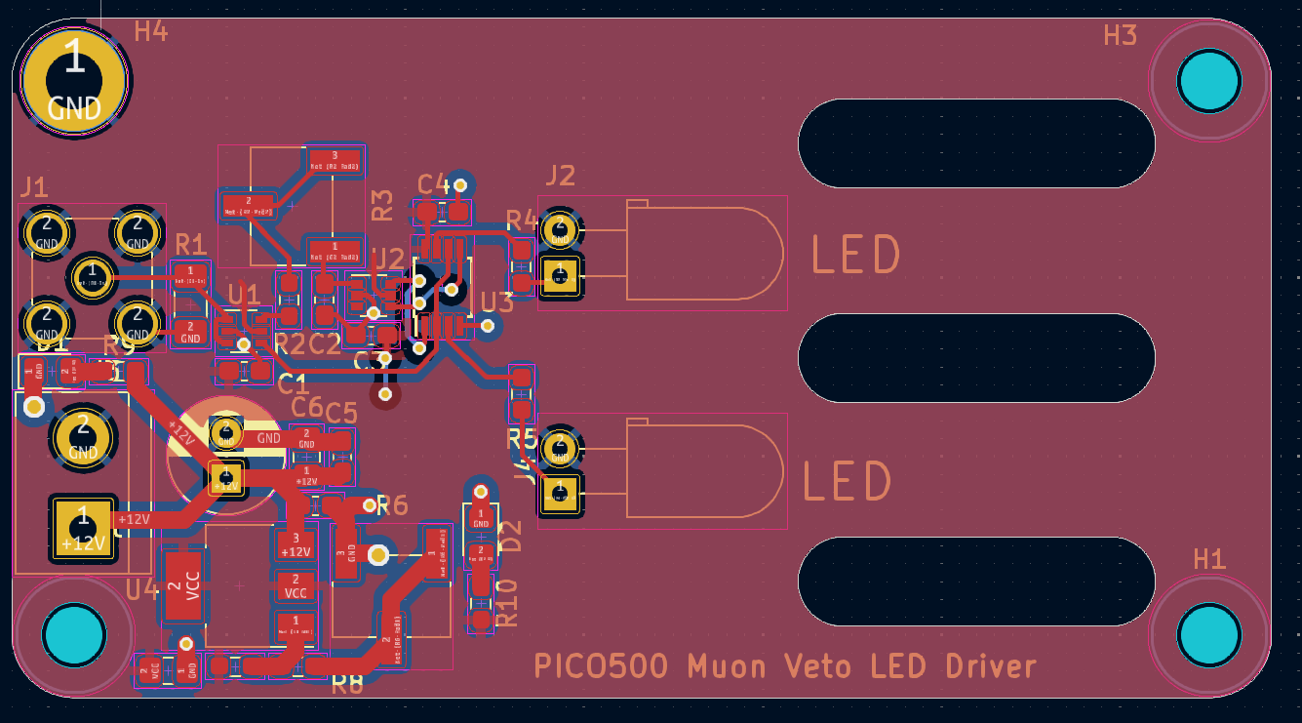
LED Drivers
Notes:
This is the LED driver circuit. It transforms a square wave into an ultra short pulse with tunable width and amplitude.
Some of the large components have been left out of the graphic for better visibility.
A key change I made was to add pin headers instead of soldering the LEDs in so the LEDs can be replaced easily if needed.
We use blue LEDs in the final design since blue light is the least attenuated by water, Cherenkov is blue, PMTs are sensitive to this wavelength
Wavelength of 465nm

Slide 7
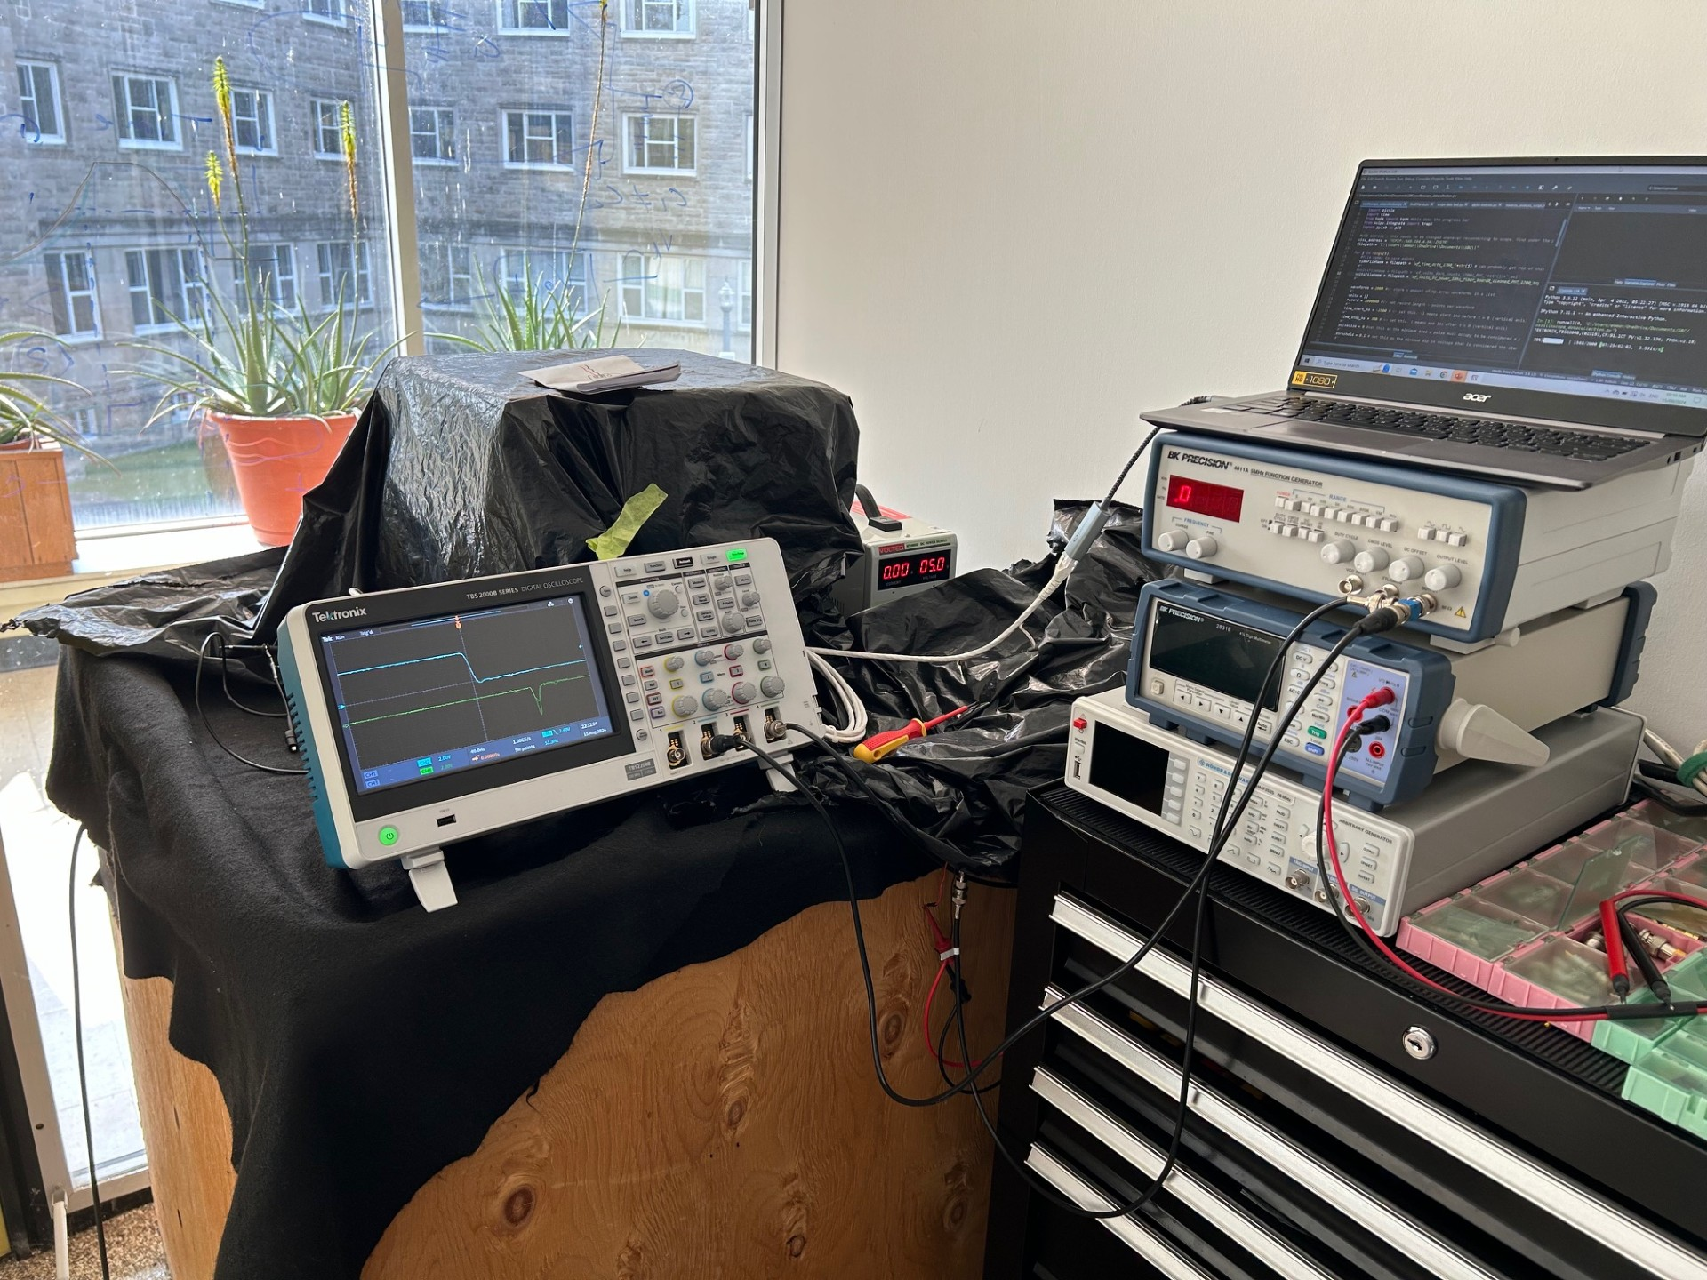
Experimental Setup
Notes:
Here is my testing set up for the LED drivers. The power supply and function generator run into the LED driver which is kept under the black plastic. This is to avoid any light leaking into the fiber. The fiber leads into the dark box with the PMT. The oscilloscope reads the outputs from the PMT and then sends waveforms to the computer.
Function gen, power supply, scope, driver location, covered by felt and black plastic to keep out light from fiber and PMT

Slide 8
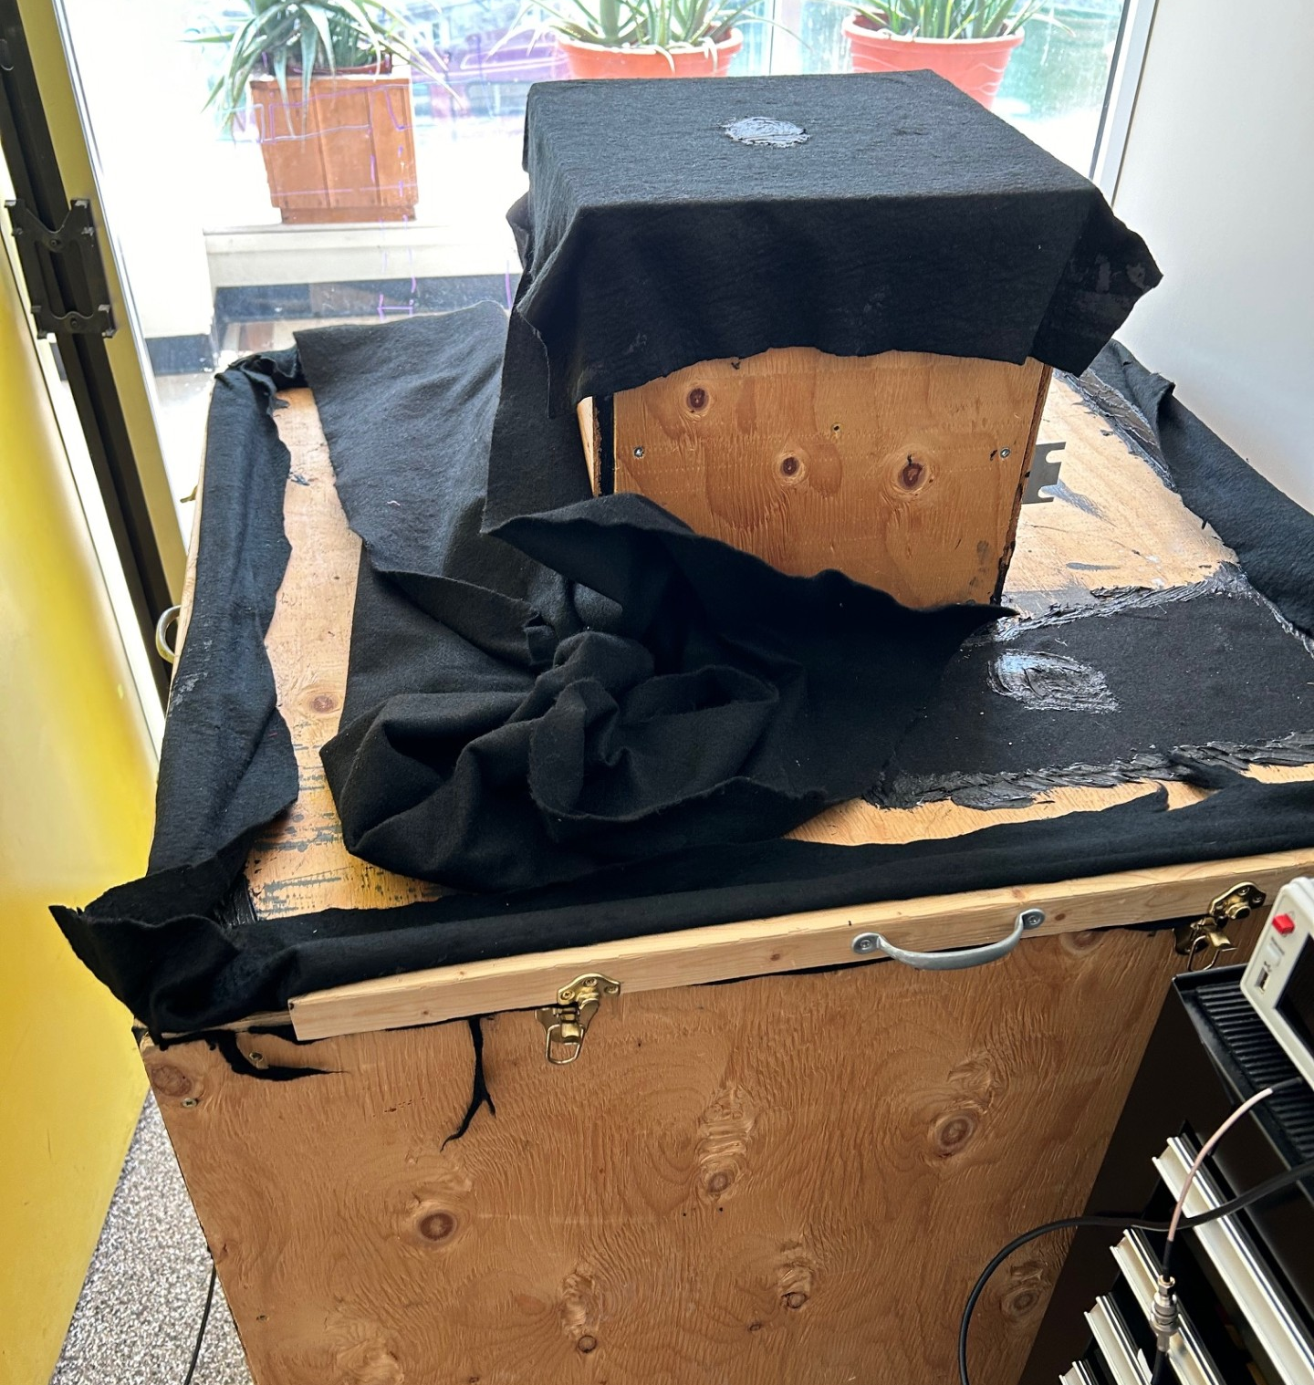
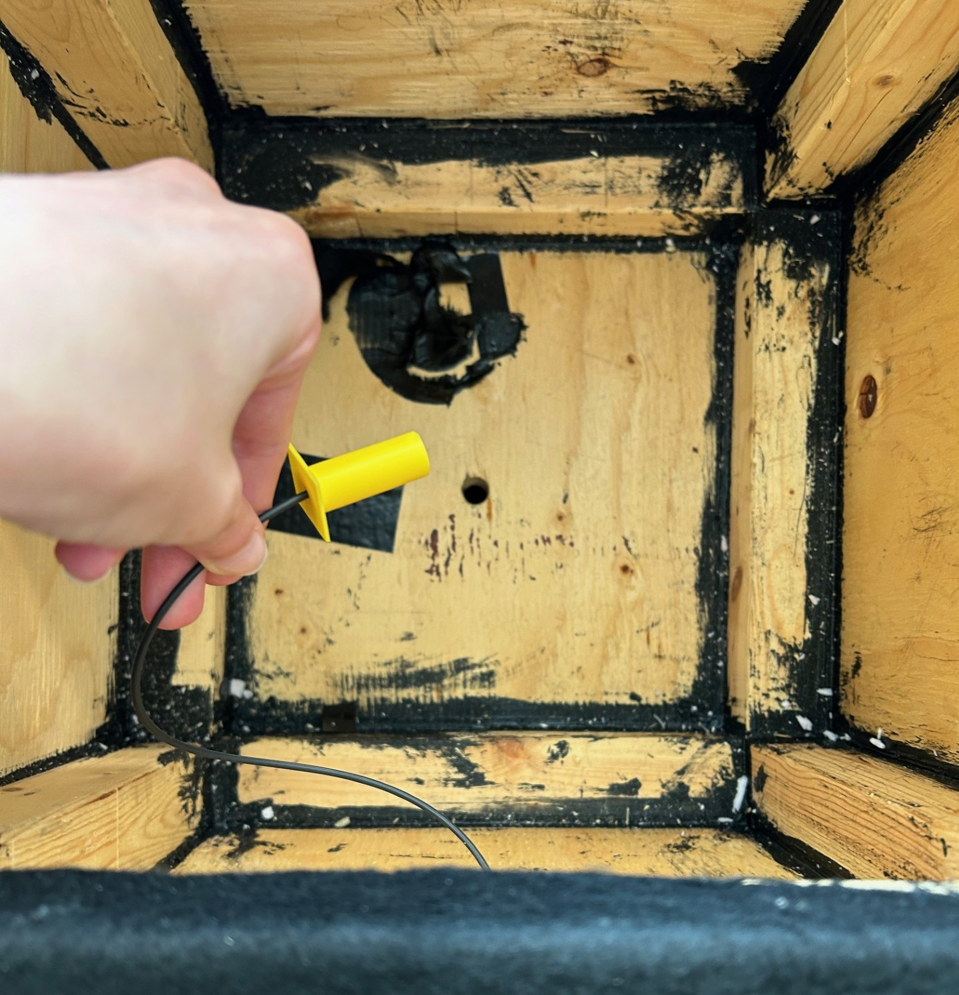
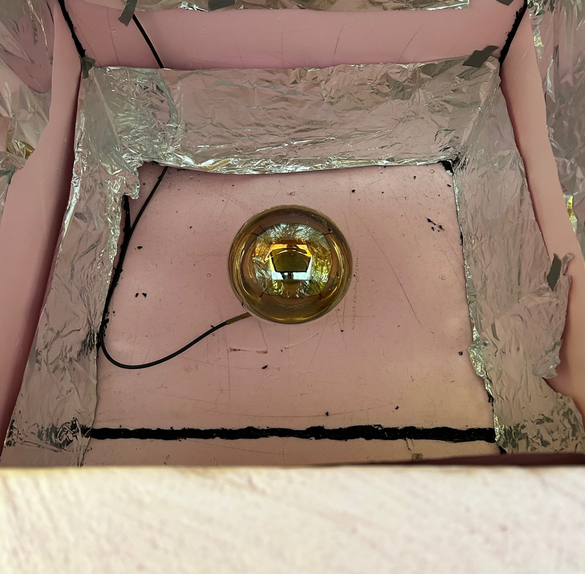
Notes:
Here removed electronics and plastic
Upper box has hole, 3d printed fiber holder, drilled hole for fiber optic to pass through
Dark box with SNO PMT in lower section
LED drilled, attached with optical glue and cured with UV

Slide 9
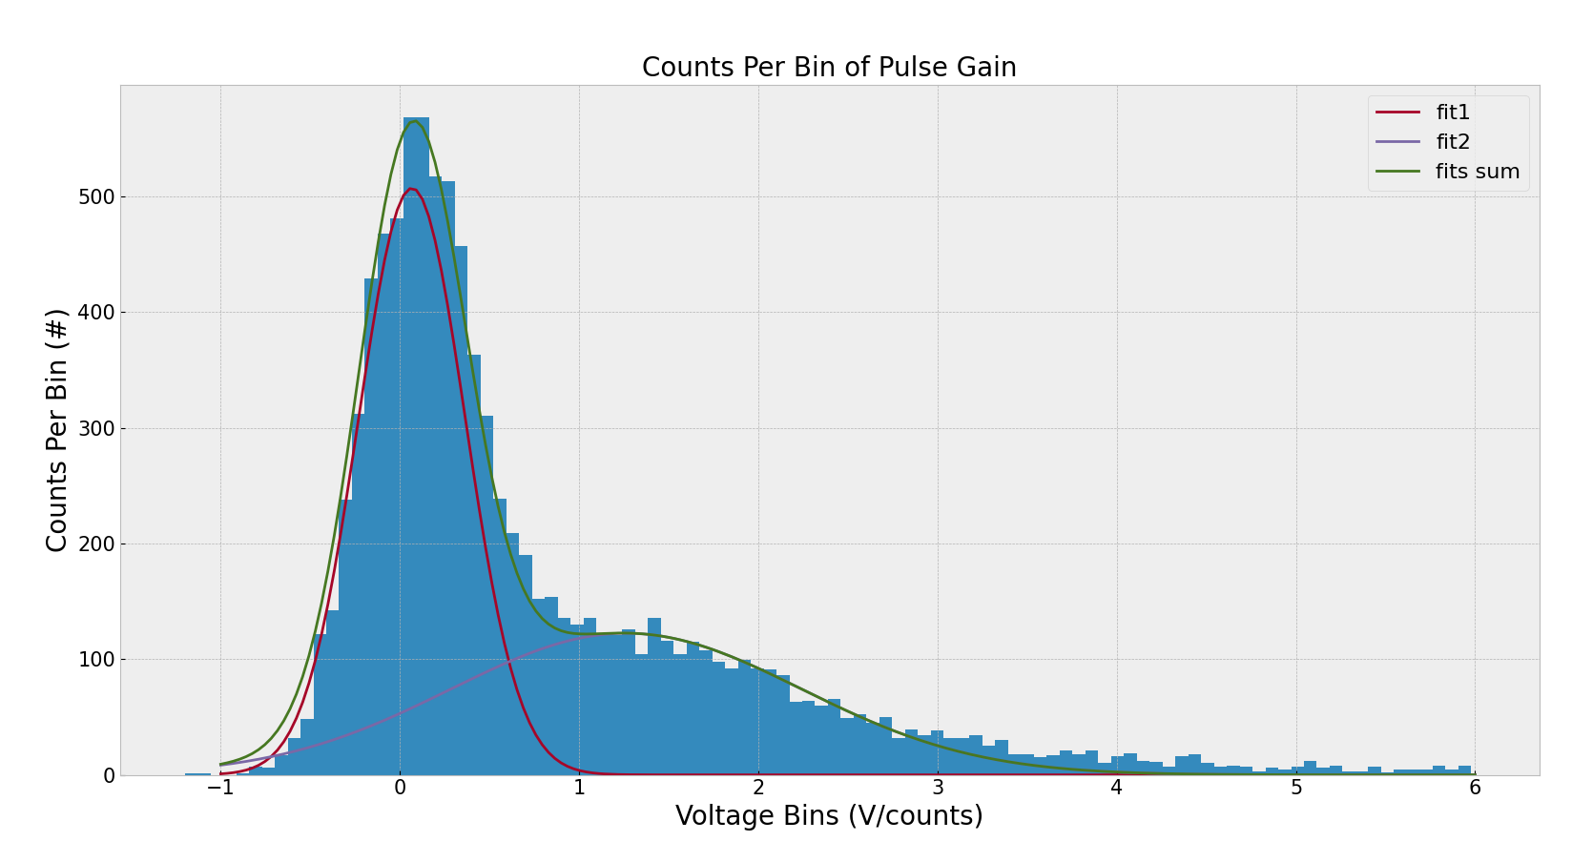
PMT Gain
Notes:
the mean of the second peak is 1.2629873258550333 (used second peak mean to calculate PMT gain)
the PMT gain is 10 725 097.789025467
10.7 million
PMT was ran 1700V – this gain is a bit higher than expected (they found gain to be closer to 9 million) (based on https://www-sciencedirect-com.subzero.lib.uoguelph.ca/science/article/pii/0168900296000678)
Single photon runs (most of the runs have no pulse – peak 1):
1st peak is noise because peak at 0 (those are the no photon waveforms)
2nd peak is single electron photons. (use this peak to calculate gain)
Long waveform – therefore wider peaks

Slide 10
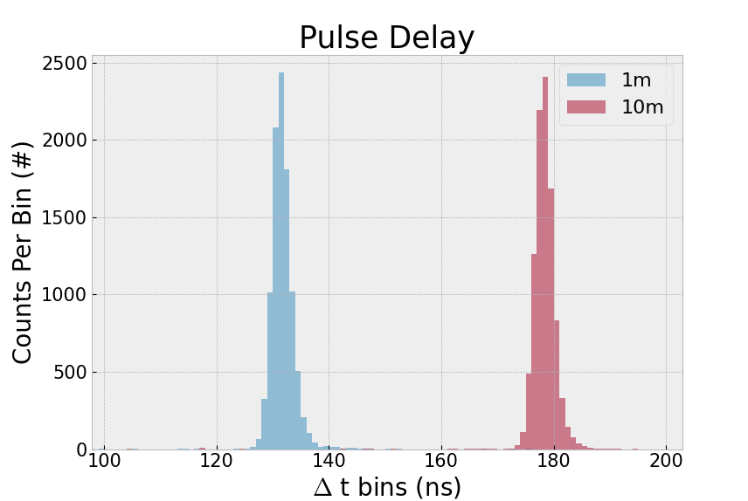
Optical Fiber
Plastic fiber
Consistent shape
46.77ns propagation delay (5.2ns/m)
Data sheet: ~5ns/m propagation delay
Notes:
Plastic fiber
Short fiber length: 1m
Long fiber length ~ 10m
Input power – 5V DC
Input signal – 50Hz, 5V amplitude square wave
Voltages across R6 potentiometer selected with short fiber
2.269V single photon
2.398V multi photon
1h dark time after exchanging fibers
Show the 4 plots and show that the fiber length causes a time shift
manufacturers say 5.0ns/m propagation delay in fiber
9m difference - ~45ns delay between fibers
Measured difference multi photon - 46.77ns
Test done with prototype board not final 12 drivers

Slide 11
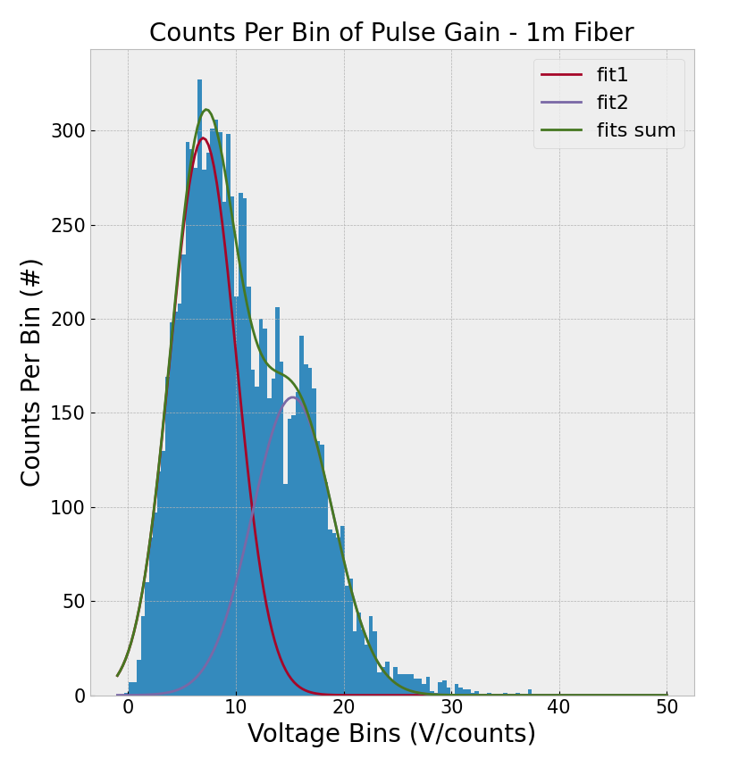
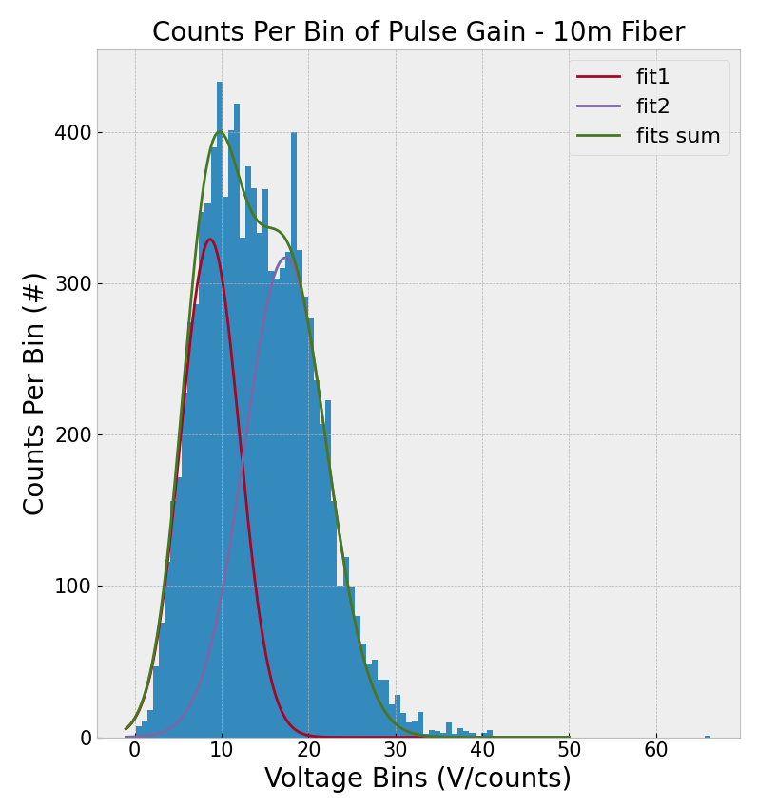
Optical Fiber Attenuation
$Attenuation=\frac{20 log\left(\frac{mean_{s}}{mean_{l}}\right)}{l_{l}−l_{s}}$
Calculated: -0.2142 dB/m
Data Sheet: -0.22 dB/m
Notes:
Calculated using mean of first fitted peak in double gaussian fit. After pulsing not a problem with the LED drivers, just a PMT problem. Confirmed with SiPM test – results are gaussian (unimodal).
Data Sheet Value: typical 0.22 dB/m loss, range of 0.15 – 0.27 dB/m loss
afterpulsing is typically caused by the residual gas ions inside the PMT that drift and strike the photocathode resulting in the emission of many photoelectrons.

Slide 12
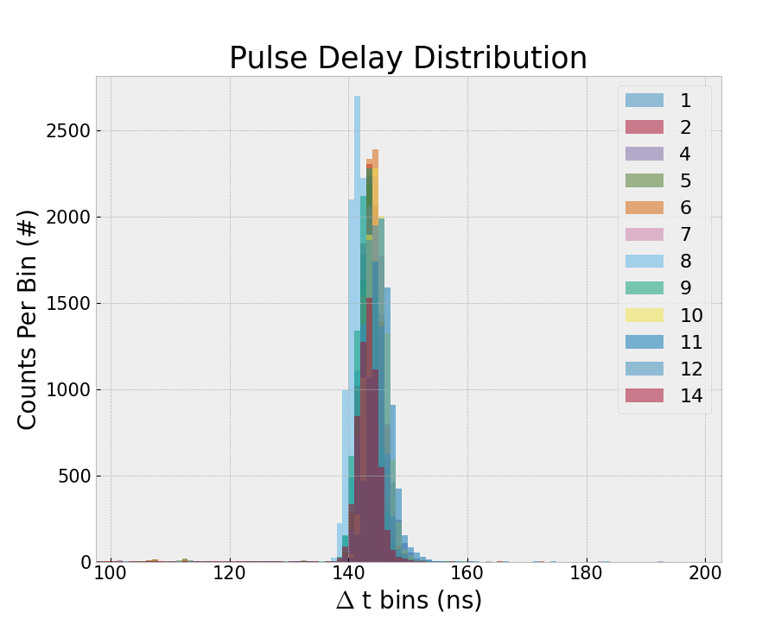
12 Driver Pulse Delay
Notes:
Looks very great!
want to know how much delay there is between the square wave trigger and the PMT outputting a signal. Delay from board, cables, fiber, PMT processing time, travel time to PMT. All with 1m fiber, 5V input, R6 set to ~2.4V. We are very happy with how consistent the boards are, largest difference between boards is under 4ns.
As long as all signal cables are same length for all drivers, pulses will all be in synch
Looking for tail – want to make sure led turns off quickly, afterpulsing?
Looking for tail in single photon regime, actually operating in multiphoton regime to ensure photons reach PMTs after traveling through fiber and water tank
Tail is no longer really a problem with the 12 drivers.

Slide 13
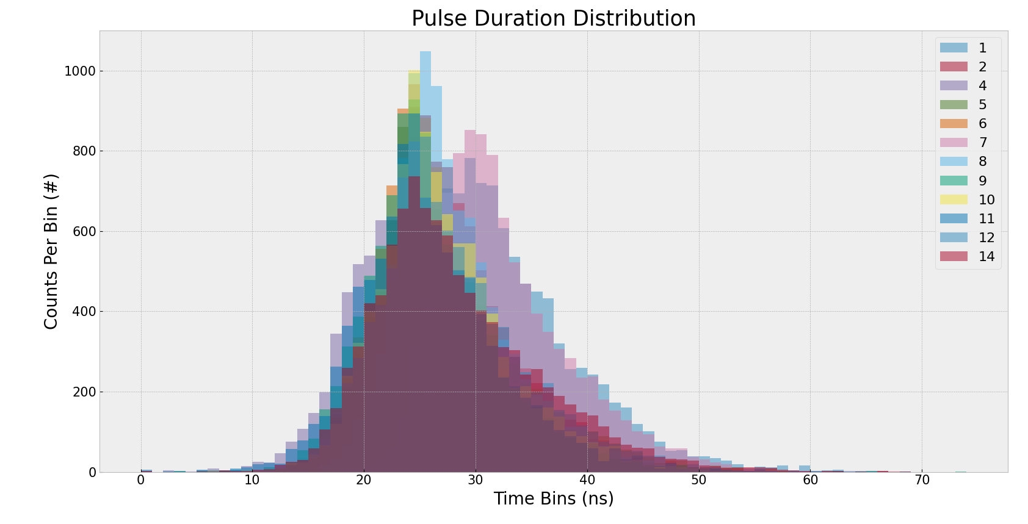
12 Driver Pulse Duration
Notes:
Pulse width is tunable with potentiometer.
Also including rise and fall time (this makes it 2 or 3 times more range than expected)
Square wave pulse width – 50Hz = 0.02s = 2x10^7ns
USP ~20ns width (reduction by factor of 10^6)
Want to ensure that the pulse seen by the PMT is ultra short and uniform in duration
I think this is wide range of values bc it is multi photon and there are after pulsing effects from PMT. (Checked with SiPM and get much more gaussian distribution). Additionally, the rise and fall time of the pulse can be quite long. Usually look at 10% and 90% amplitude for start and end of pulse.
This is likely why the mean values are near 25ns when USP is 15-20ns. Next steps are checking that USP to LED are all exactly same width instead of just ~20ns, and more characterization of the PMTs. In short, more measurements will need to be completed by the next student.
All with 1m fiber, 5V input, R6 set to ~2.4V (slight variation in pulses could be due to slight variations in potentiometer settings)
Wide distribution of pulse durations likely due to afterpulsing. These secondary pulses are not always present and can vary in size. This became more pronounced when looking at multiphoton pulses. To really account for what the true main pulse width is would likely require curve fitting the waveforms. More work required here in the future. The mean is around 25ns which is acceptable given that the pulse sent to the LEDs is about 20ns. Board to board differences could be reduced more by spending more time making sure all R3 potentiometers give same exact pulse width on the oscilliscope. I just turned all to the minimum.

Slide 14
Summary of Results
Drivers can be used to estimate PMT gain
Optical fiber propagation delay agrees with manufacturers value
Optical fiber attenuation agrees with manufacturers value
Pulse delay is consistent across drivers (all within 4ns range)
Pulses last ~25ns (PMT characterization next steps)
Notes:
Confirming characteristics of optical fibers allows us to estimate delay and attenuation for much longer fibers used in PICO. Pulse delay being consistent was most important factor for us. This is great news! Knowing the pulses are in synch with 1m fiber gives us confidence they will stay in synch with longer fibers.
More measurements on pulse duration as seen by PMTs required. It is okay that the pulses look a bit wider, because they are fairly consistent between boards. This can be further improved with more precise tuning of potentiometers.
Future steps: testing whole system together with multiple PMTs
Some of the results initially looked strange but after testing with a SiPM I am happy to report that it is caused by the PMTs, not the LED drivers, and can be attributed to afterpulsing effects. This means we have achieved ultrashort pulses from the drivers with consistent delay and duration between boards.

Slide 15
Extra Slides

Slide 16
Pulse Delay Stats
Board # | Mean (ns) | Standard deviation (ns)
1 | 142.8311015624067 | 1.5715337021286548
2 | 143.17581208358567 | 1.6361500310154458
4 | 143.76227235198152 | 1.7426513831531933
5 | 143.09603377926894 | 1.50701440392896
6 | 143.43548106413812 | 1.550091287353425
7 | 143.70162295611559 | 1.6371868175190663
8 | 141.06185928749343 | 1.4284153326973816
9 | 142.60567764360252 | 1.5645807809979424
10 | 144.1722794991163 | 1.6960427598940175
11 | 144.8956218229711 | 1.7233349505178281
12 | 143.49272950160147 | 1.698154737518298
14 | 142.77264838535527 | 1.593733048330228
Notes:
Estimating mean and sd by fitting each peak with a gaussian
Mean of means: 143.2502617
Mean of sds: 1.612407436
Range of means: (141.0618593 , 144.8956218 ) = 3.8337625
Error = 4.1590374663

Slide 17
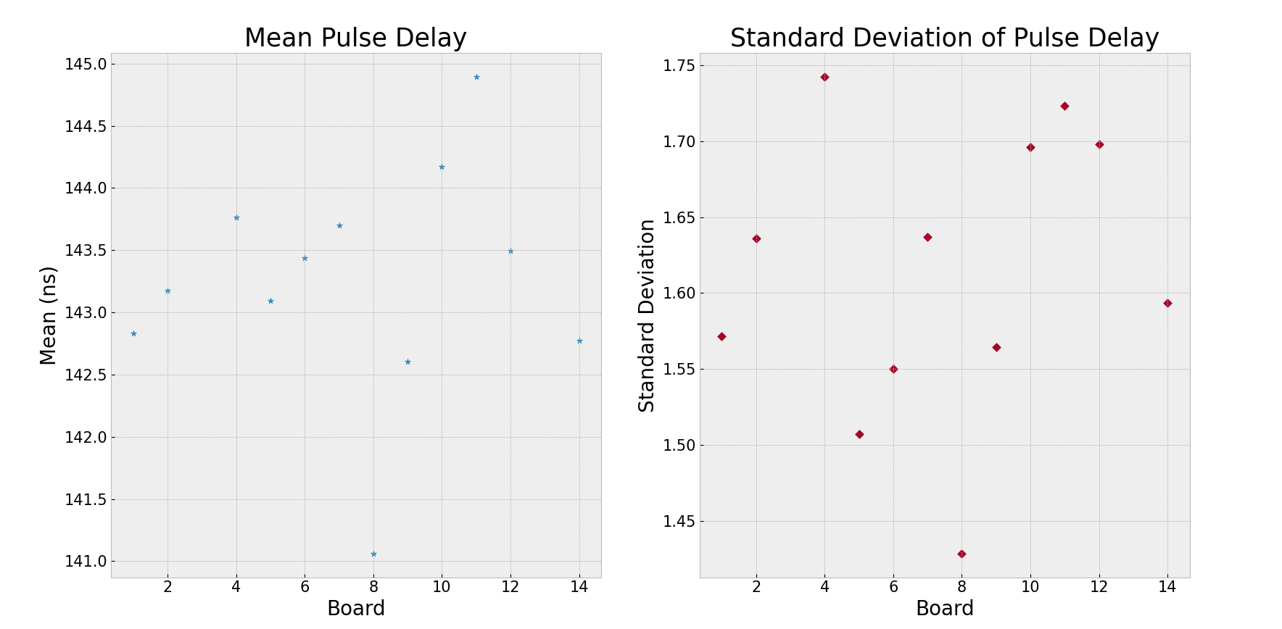

Slide 18
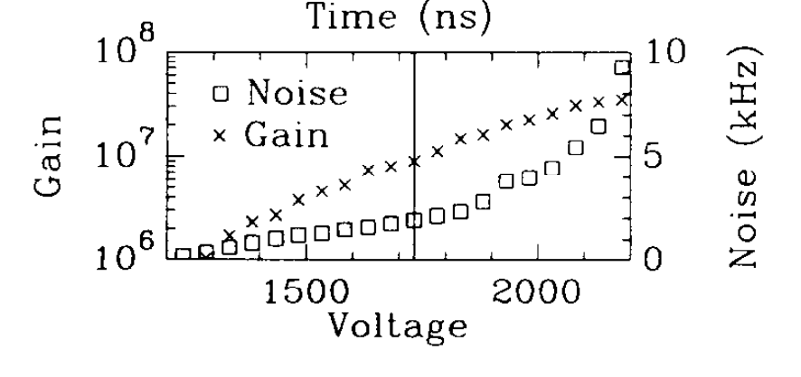
PMT Gain Comparison
Data from The photomultiplier tube testing facility for the Sudbury Neutrino Observatory (1996)
Gain and noise vs operating voltage plot for PMT S
Vertical line shows operating voltage of 1732V
Gain is ~9 million at this voltage
Notes:
PMT S is the same kind of PMT as in my dark box – Hamamatsu R1408

