Slide 1
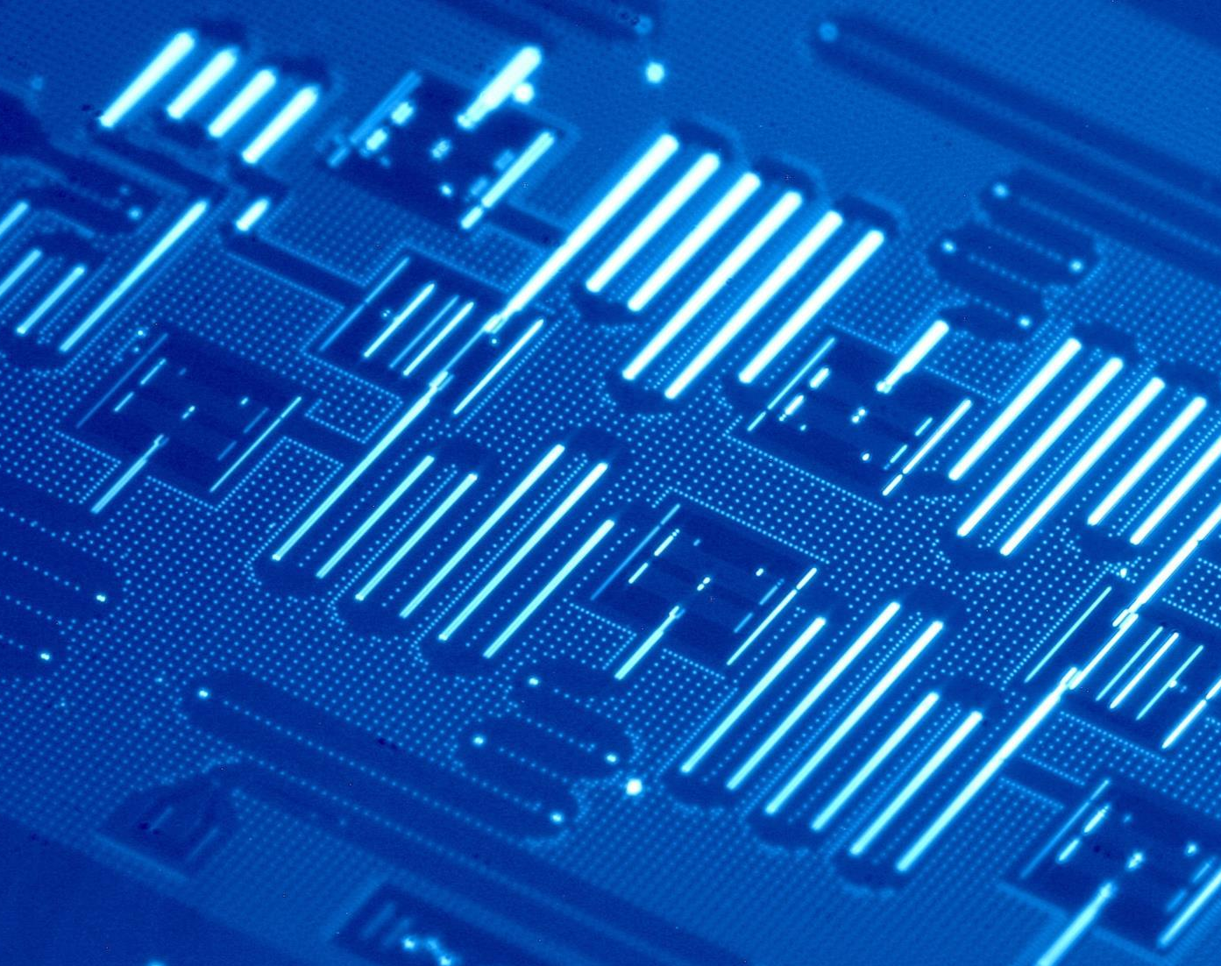
Characterization and Mitigation of Decoherence Sources in Superconducting Qubits
Yusuf Ahmed
Supervisor: Jeter Hall, SNOLAB
Project PI: Christopher Wilson, UW
Per Delsing, Chalmers

Slide 2
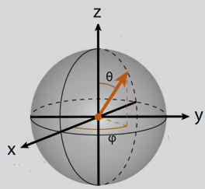
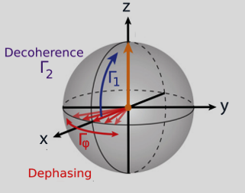
What is Qubit?
Classical Bit
Quantum Bit (Qubit)
$$\left.\left|1\right.\right\rangle$$
Superposition
$$\left.\left|Ψ\right.\right\rangle =\left.α\left|0\right.\right\rangle +\left.β\left|1\right.\right\rangle$$
$\left.\left|0\right.\right\rangle$with probability${ \left|α\right|}^{2}$
$\left.\left|1\right.\right\rangle$with probability${ \left|β\right|}^{2}$
Measurement
$$\left.\left|0\right.\right\rangle$$
$$\left.\left|1\right.\right\rangle$$
Coherence
Decoherence
The ability of a qubit to maintain a well-defined phase relationship between different states in a superposition.
Loss of coherence due to interactions with the environment.
Longer coherence time $→$More complex algorithms.
$$\left.\left|0\right.\right\rangle$$

Slide 3
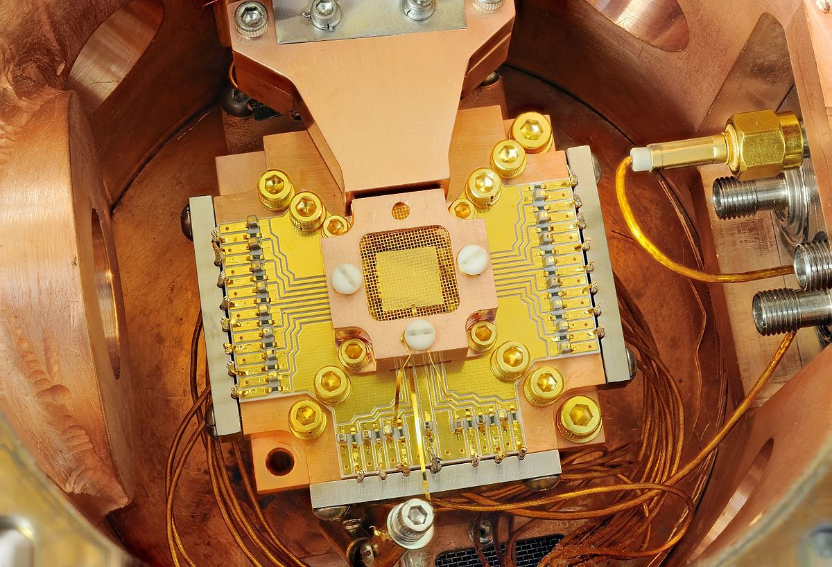
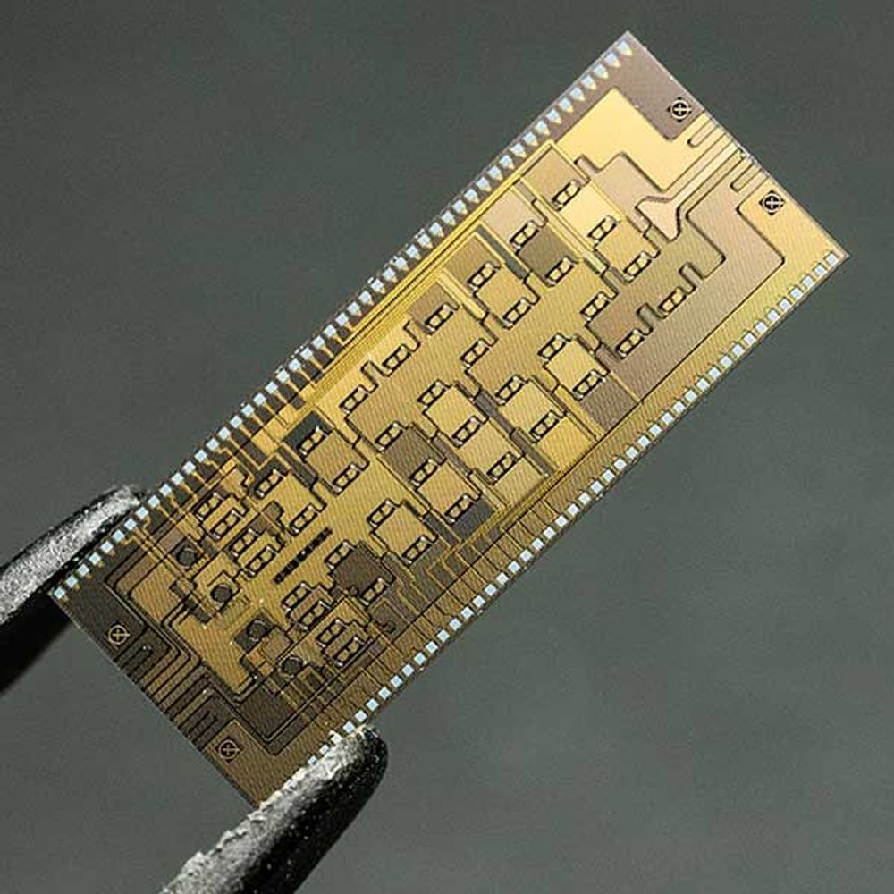
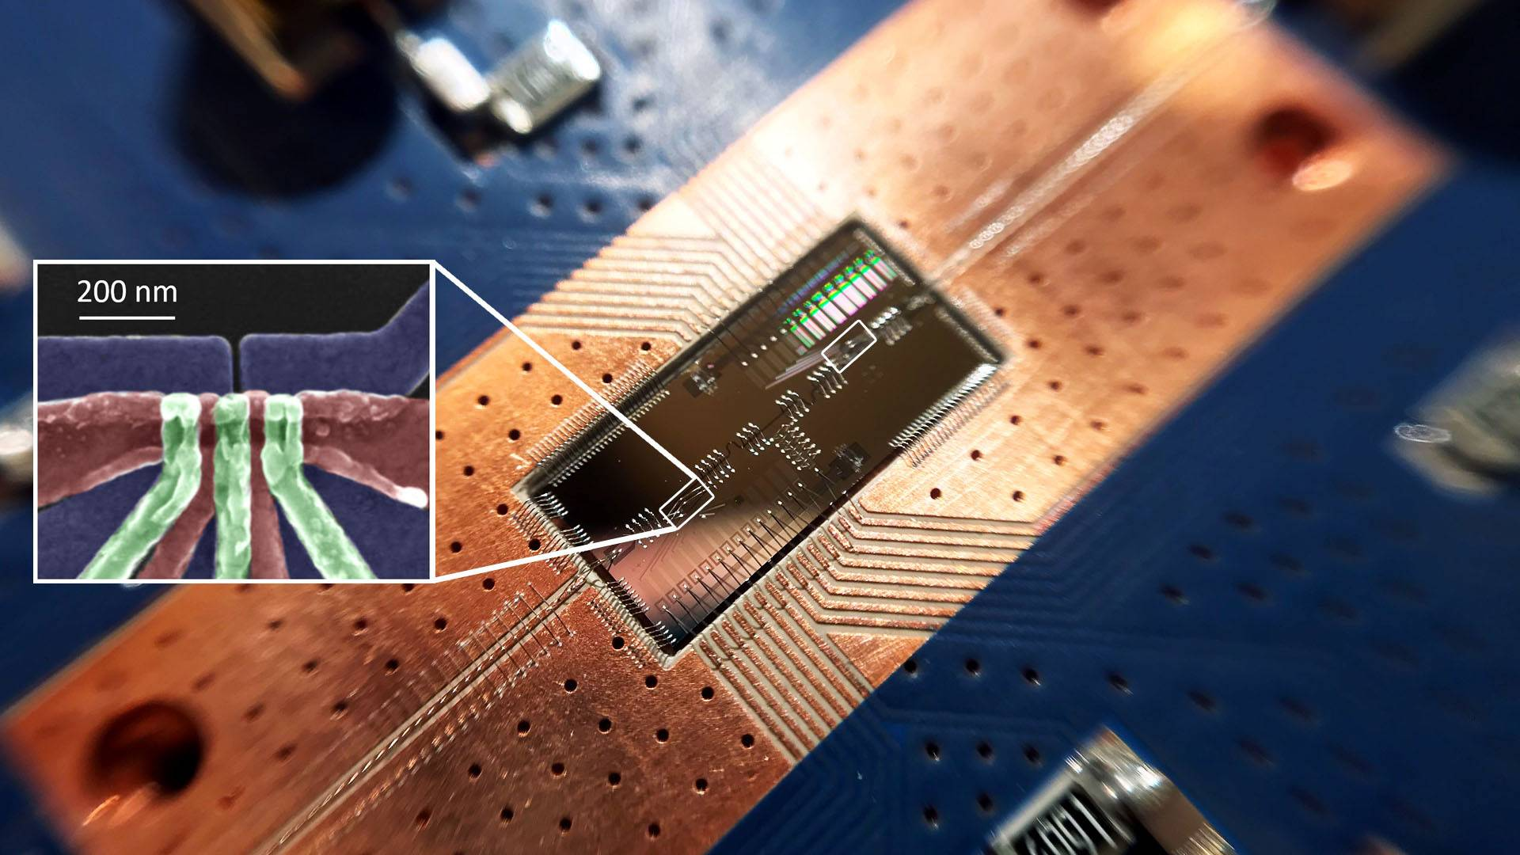
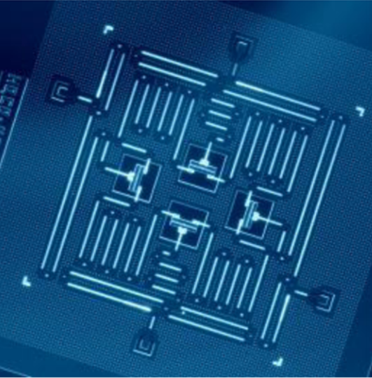
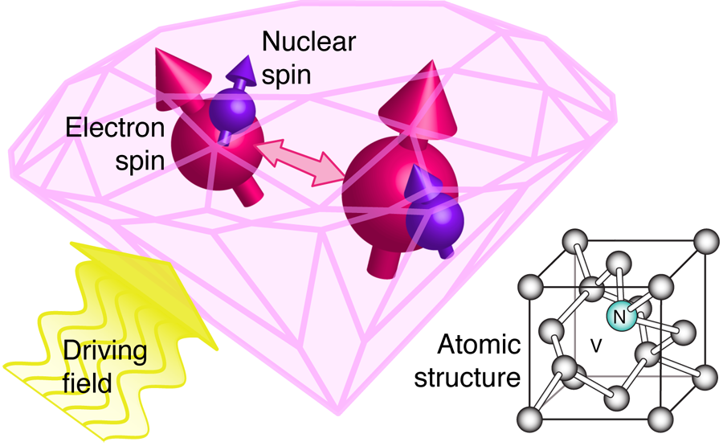
Physical Implementations
Photonic
Trapped-Ion
Quantum Dots
Diamond NV Centre
Neutral Atom
Superconducting

Slide 4
Physical Implementations
Phase
Xmon
Charge
Transmon
Gatemon
Flux
Superconducting

Slide 5
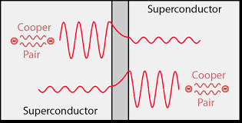
Transmon
An Artificial Atom
Quantum LC Circuit
Josephson Junction
A non-linear inductor
$${\hat{H}}_{LC}=\frac{{\hat{Q}}^{2}}{2C}+\frac{{\hat{φ}}^{2}}{2L}$$
$$\left[\hat{φ},\hat{Q}\right]=iℏ$$
Inductive Energy
$$=$$
Cosine function
$$ω_{1}$$
$$≠$$
$$ω_{2}$$
$$≠$$
$$ω_{3}$$
$$≠$$
$$ω_{4}$$
$$ℏω$$
$$ℏω_{4}$$
Cooper pairs can tunnel through the barrier
$$ℏω$$
$$ℏω_{3}$$
$$ℏω$$
$$ℏω_{2}$$
$$ℏω$$
$$ℏω_{1}$$
Qubit Space!

Slide 6
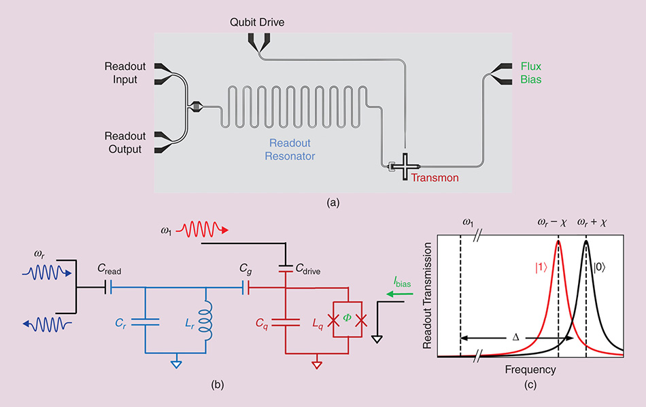
Transmon
Circuit

Slide 7
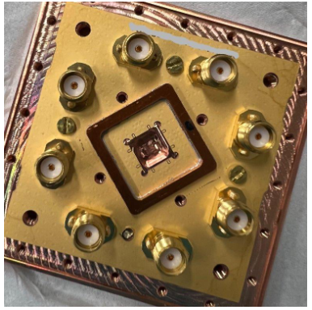
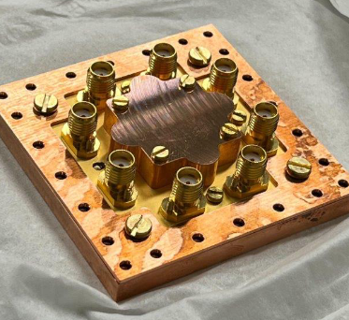
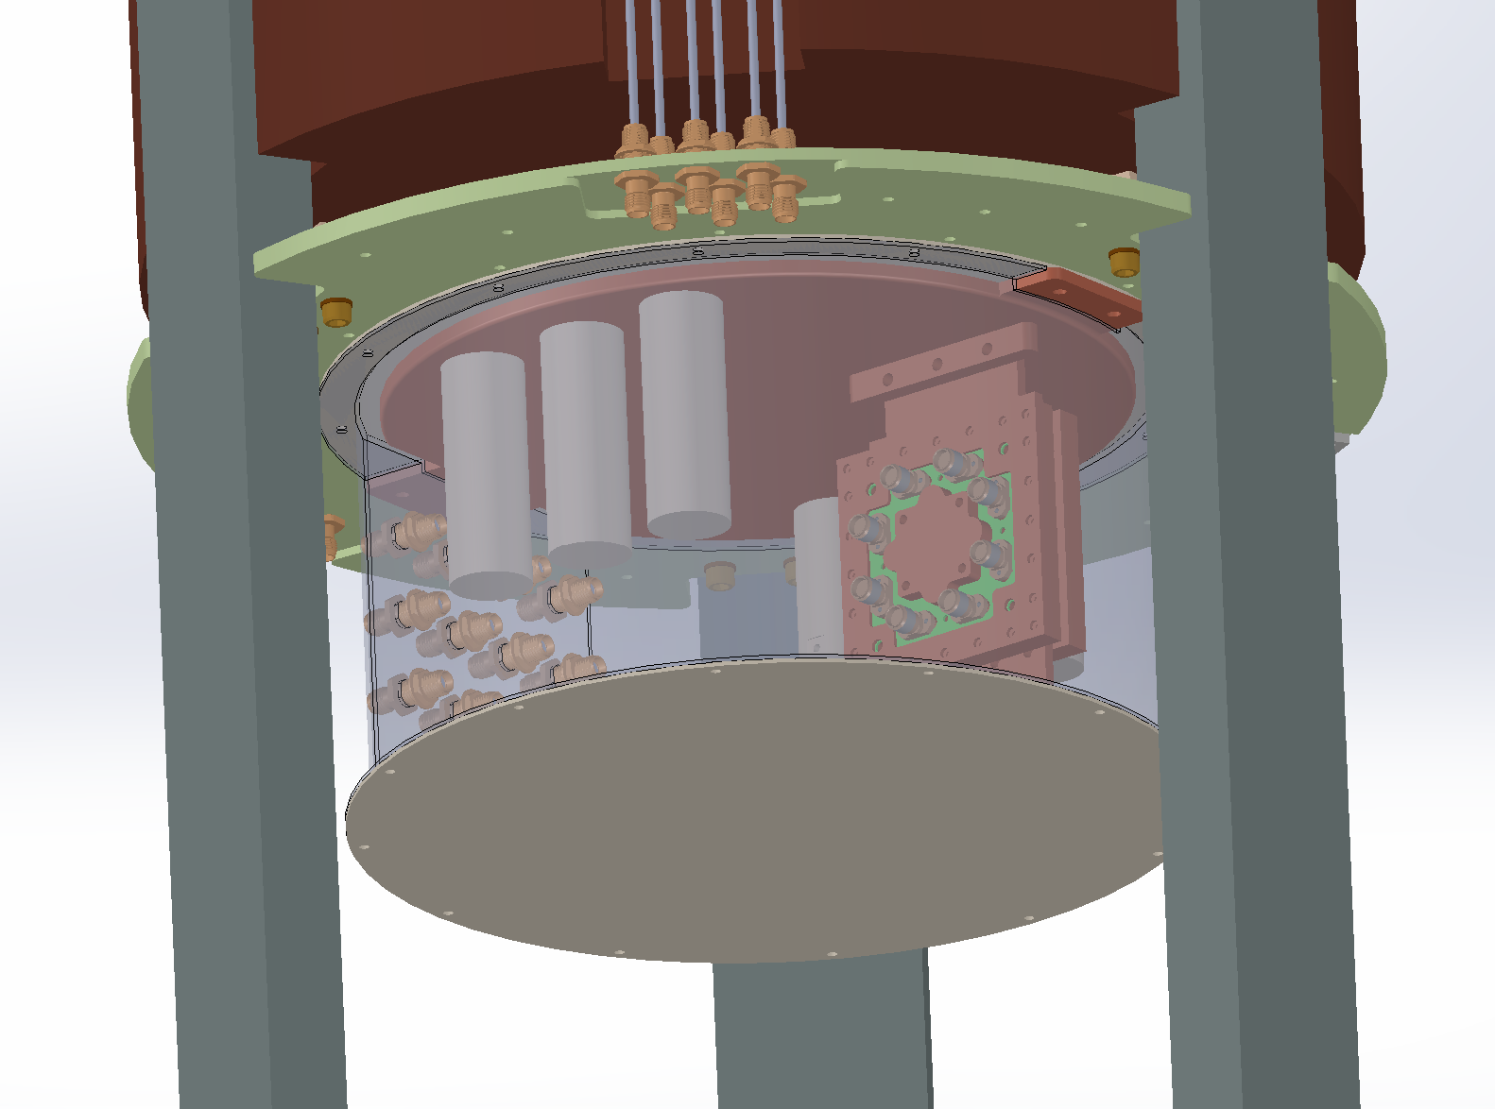
CUTE Facility
Project Goal
~300K
Vibrationally isolated dilution refrigerator.
Offers a low-radiation background environment.
“Characterize and Mitigate Decoherence Sources in Superconducting Qubits”
~50K
~4K
Chip Holder
designed by
Chalmers University collaborators.
Thermal Switch
~1K
Qubit chip goes here.
~100mK
Mixing Chamber Stage
(~10mK)
why
Lead shielding
We are in Noisy Intermediate-Scale Quantum Era (NISQ).
Decoherence sources producing errors are a barrier to fault-tolerant computing.
On envisioning qubits as sensors for particle detection.

Slide 8
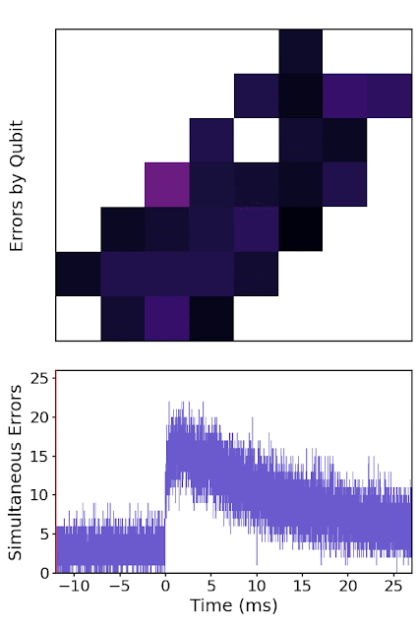
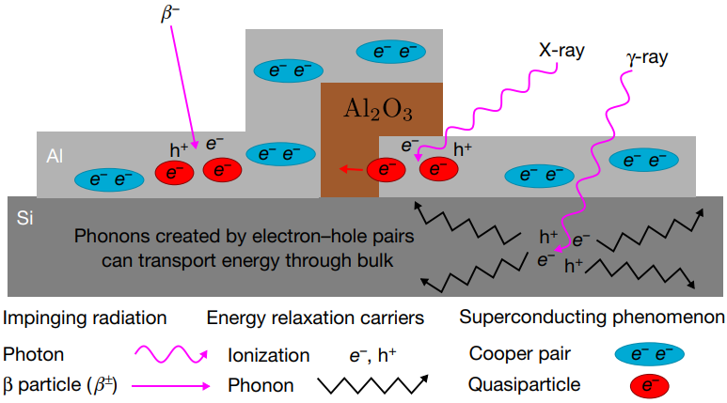
Impact of Ionizing Radiation
Task 1
Task 2
Task 3
Nature Physics 18, 107–111 (2022)
Quasiparticles are sources of decoherence.
Ionizing radiation produces quasiparticles.
Existing error correction schemes assume uncorrelated errors.
Nature. 2020;586(7827):E8
Our Aim
Investigate and quantify the extent of radiation induced correlated errors on qubits placed on the same and different chip (surface and underground).
Devise strategies to mitigate the effect of radiation.

Slide 9
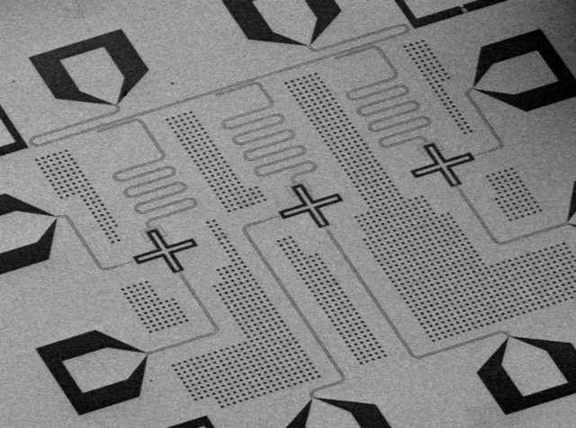
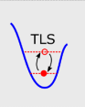
Qubit Fabrication – Material Noise Mitigation
Task 1
Task 2
Task 3
Fabrication involves several steps.
Diffusion-limited oxidation
Ion etching
Vapour deposition
Electron beam lithography
…
Imperfect processes.
→ Create defects.
Josephson
Junction
Two-Level System (TLS) Defects
Our Aim
Generally thought of as atomic-scale material defects that support low-energy excitations
Impurities in qubit materials.
Test alternative superconducting materials
Use advanced fabrication techniques
UHV Deposition System @ UWaterloo
Use advanced characterization tools
X-Ray Crystallography @ UWaterloo
Transmission Electron Microscopy @ UWaterloo
Charged nature
→ Dipole moment
→ Interaction with electromagnetic fields.

Slide 10
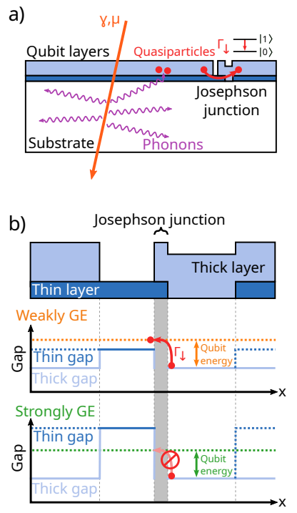
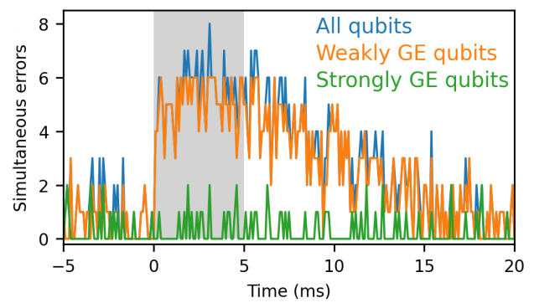
Quasiparticle Mitigation
Task 1
Task 2
Task 3
Gap Engineering (GE)
Phonon Absorbers
Nature Communications | (2022) 13:6425
arXiv:2402.15644v1
Our Aim
Replicate and improve gap engineered qubits with phonon absorbers.
Fabricate a new substrate lattice structure that absorbs phonons of qubit-sensitive frequencies.

Slide 11
Tentative Project Timeline
Project Design and Quotes
CUTE Hardware Changes
September
October/November
January/February 2025
SNOLAB Review Deadline
Data

Slide 12
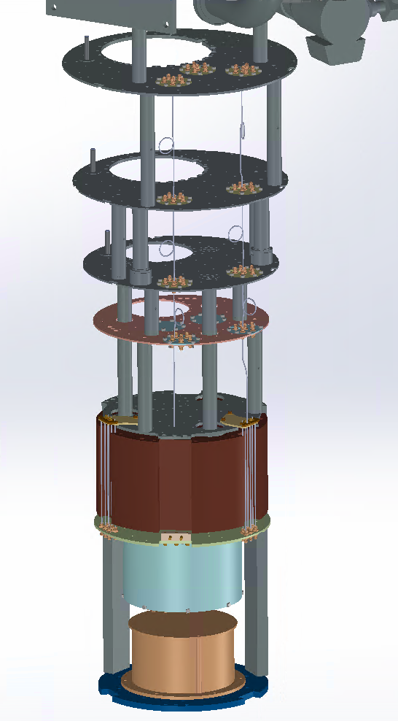
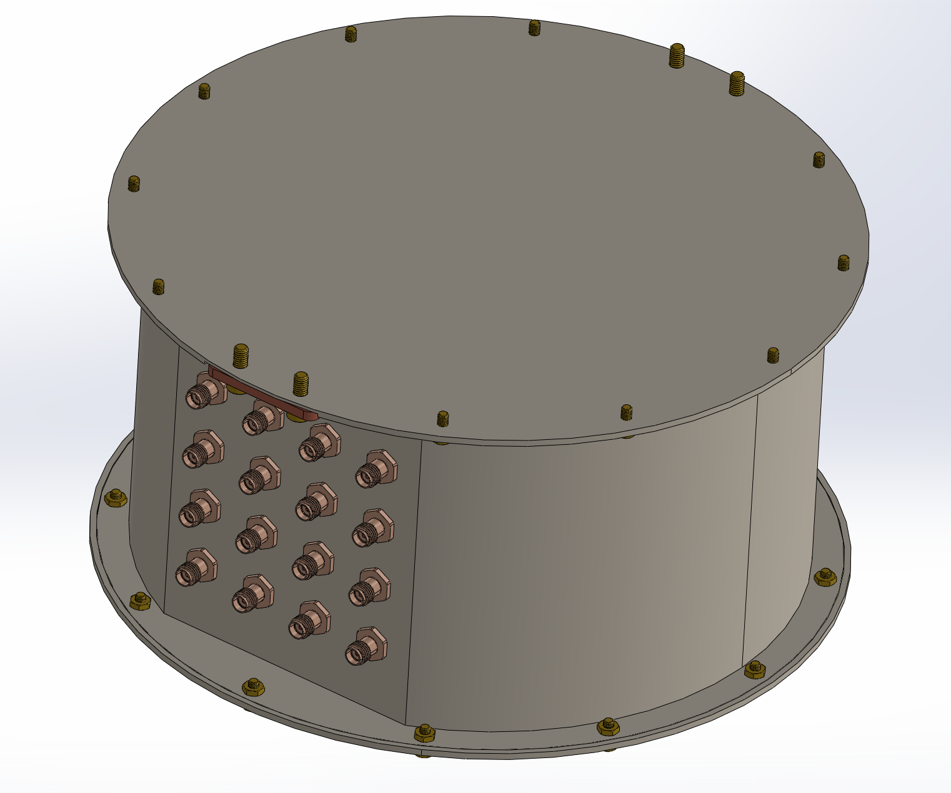
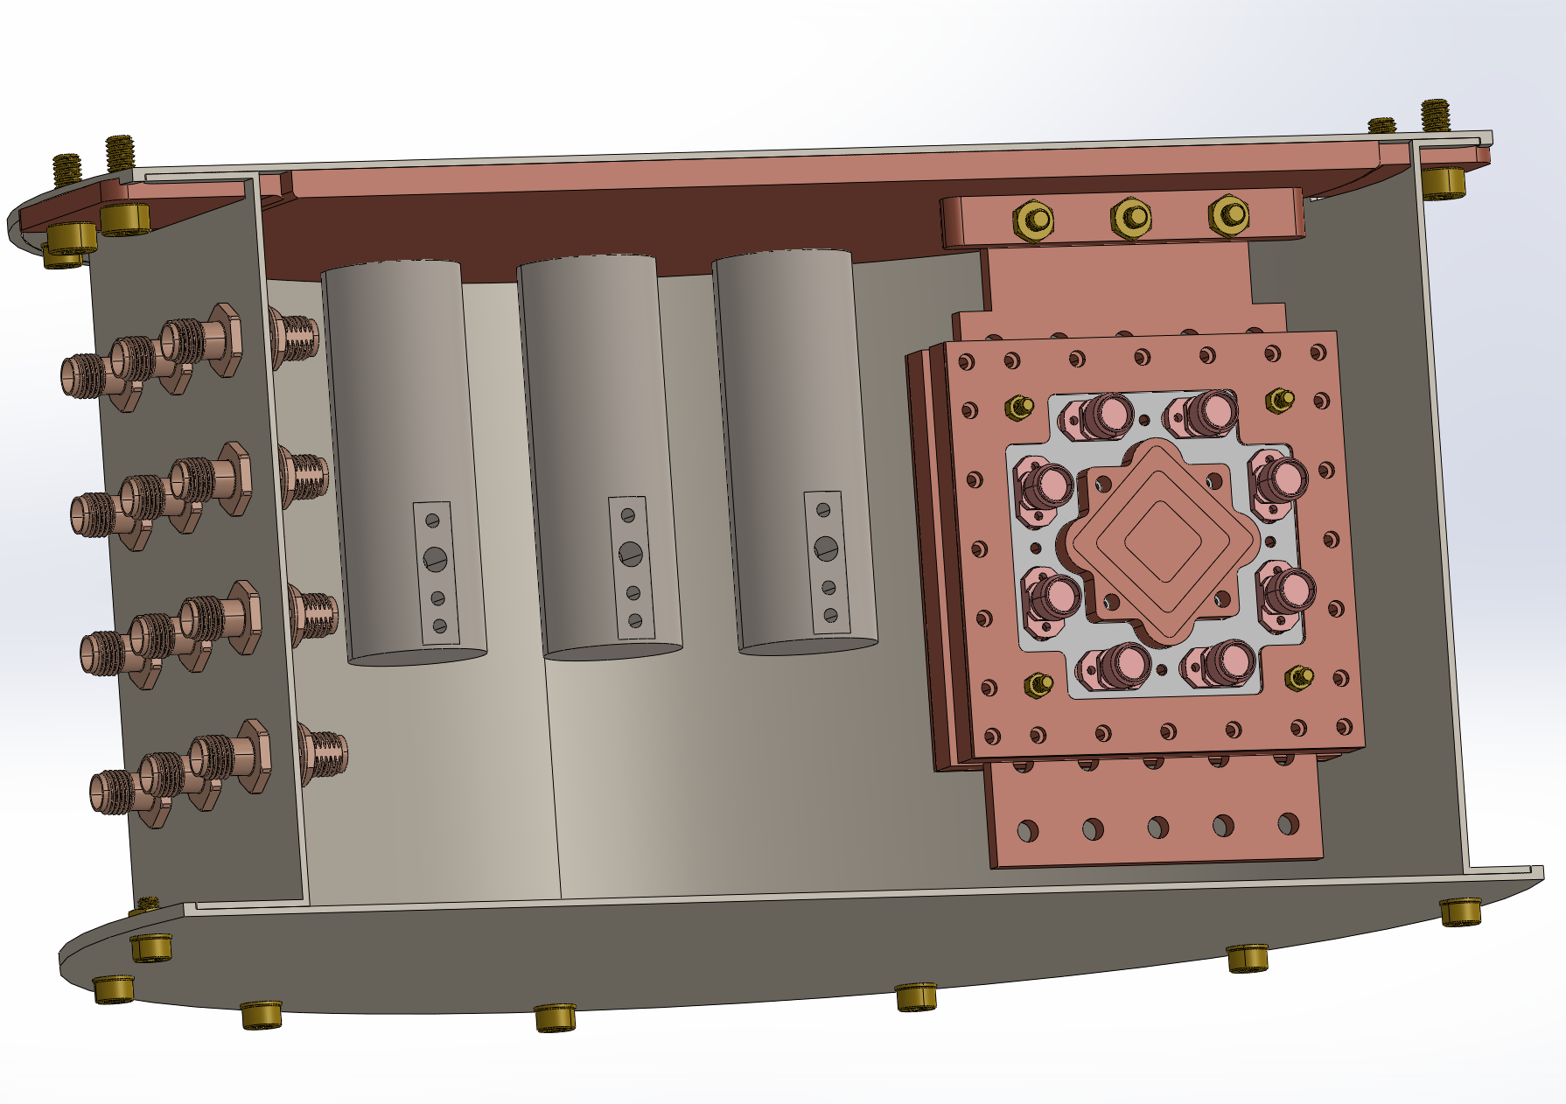
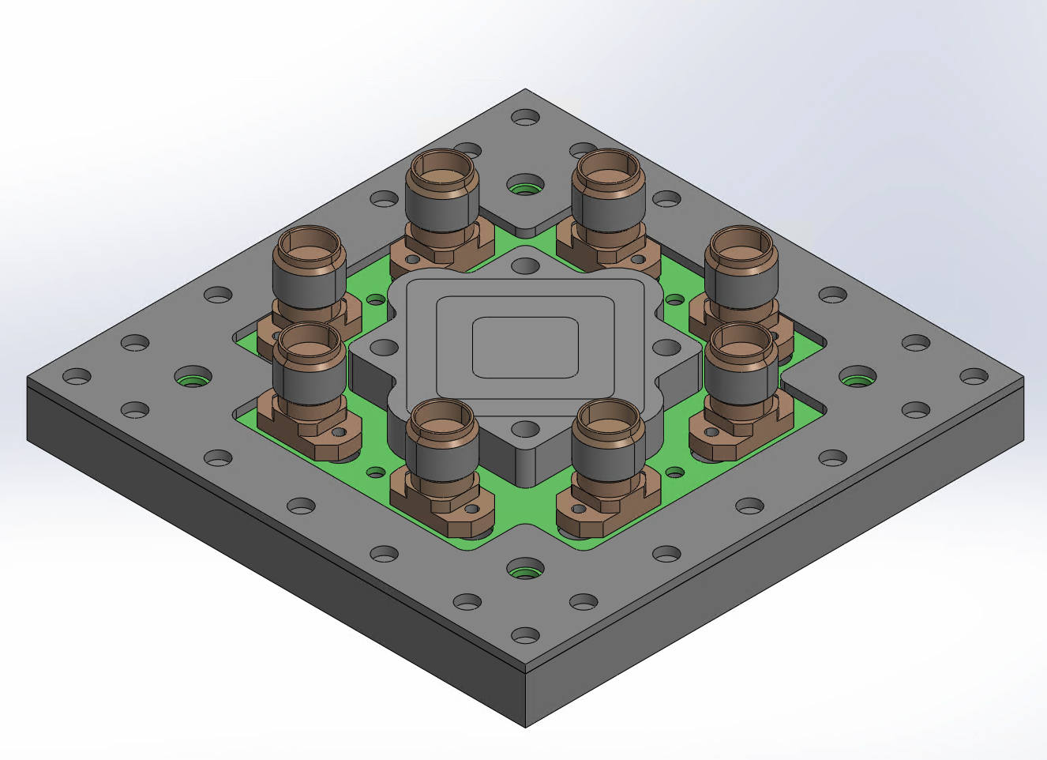
Made by Ariel Zuniga Reyes, UToronto

Slide 13
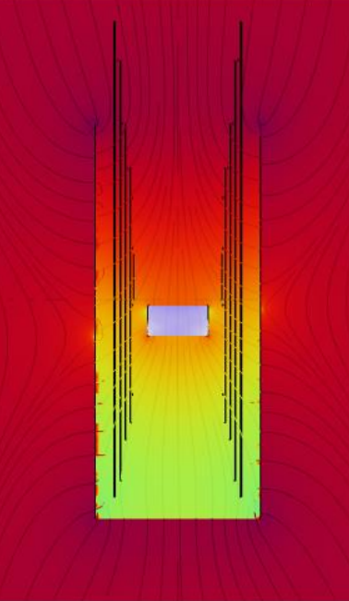
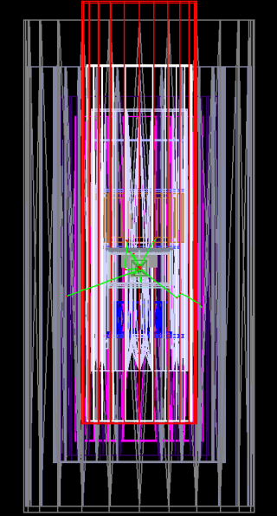
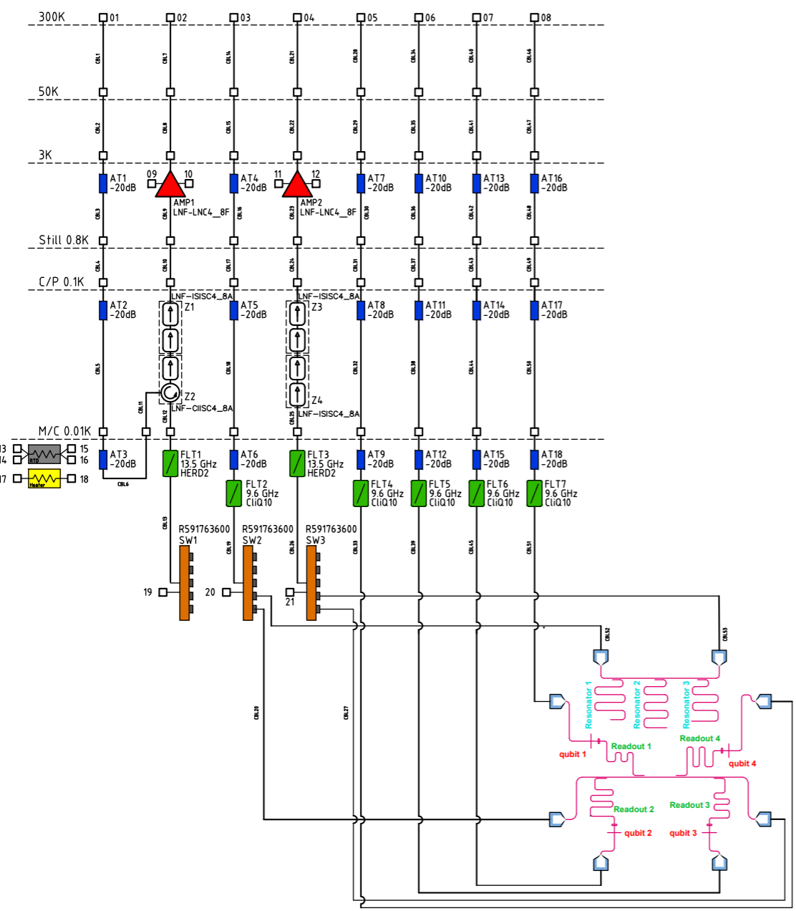
Magnetic Shielding (COMSOL)
Geant4 Simulations
Electronics
TENTATIVE
Tyler Reynolds, UToronto
Stefan and Birgit Zatschler, UToronto
Anita Masuskapoe, SNOLAB

Slide 14
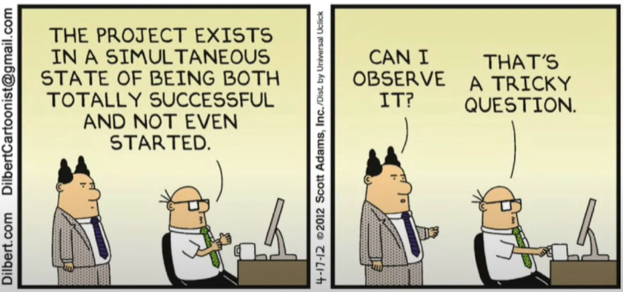
Thank you

Slide 15
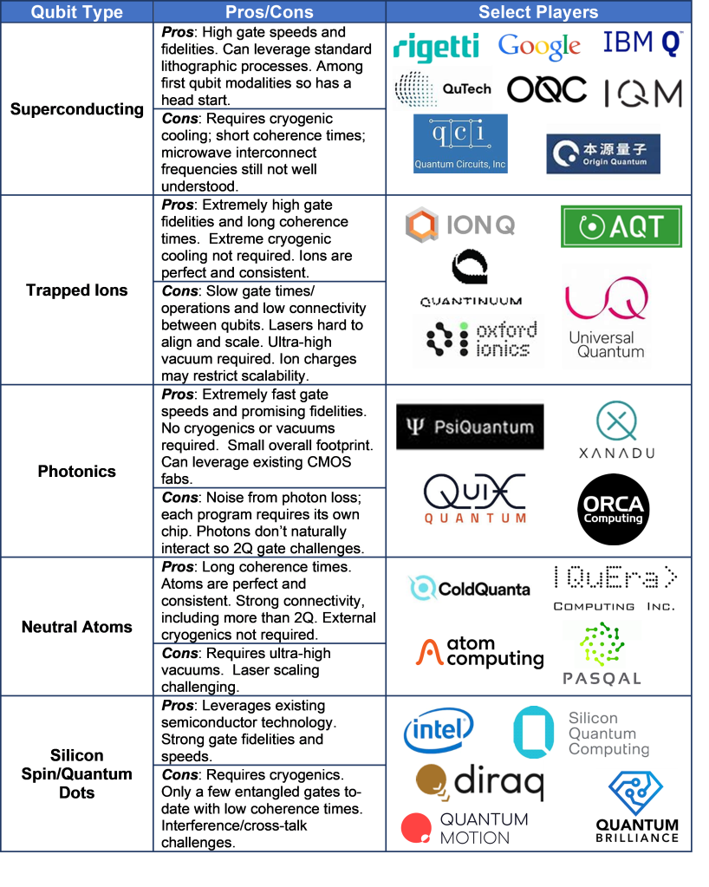

Slide 16
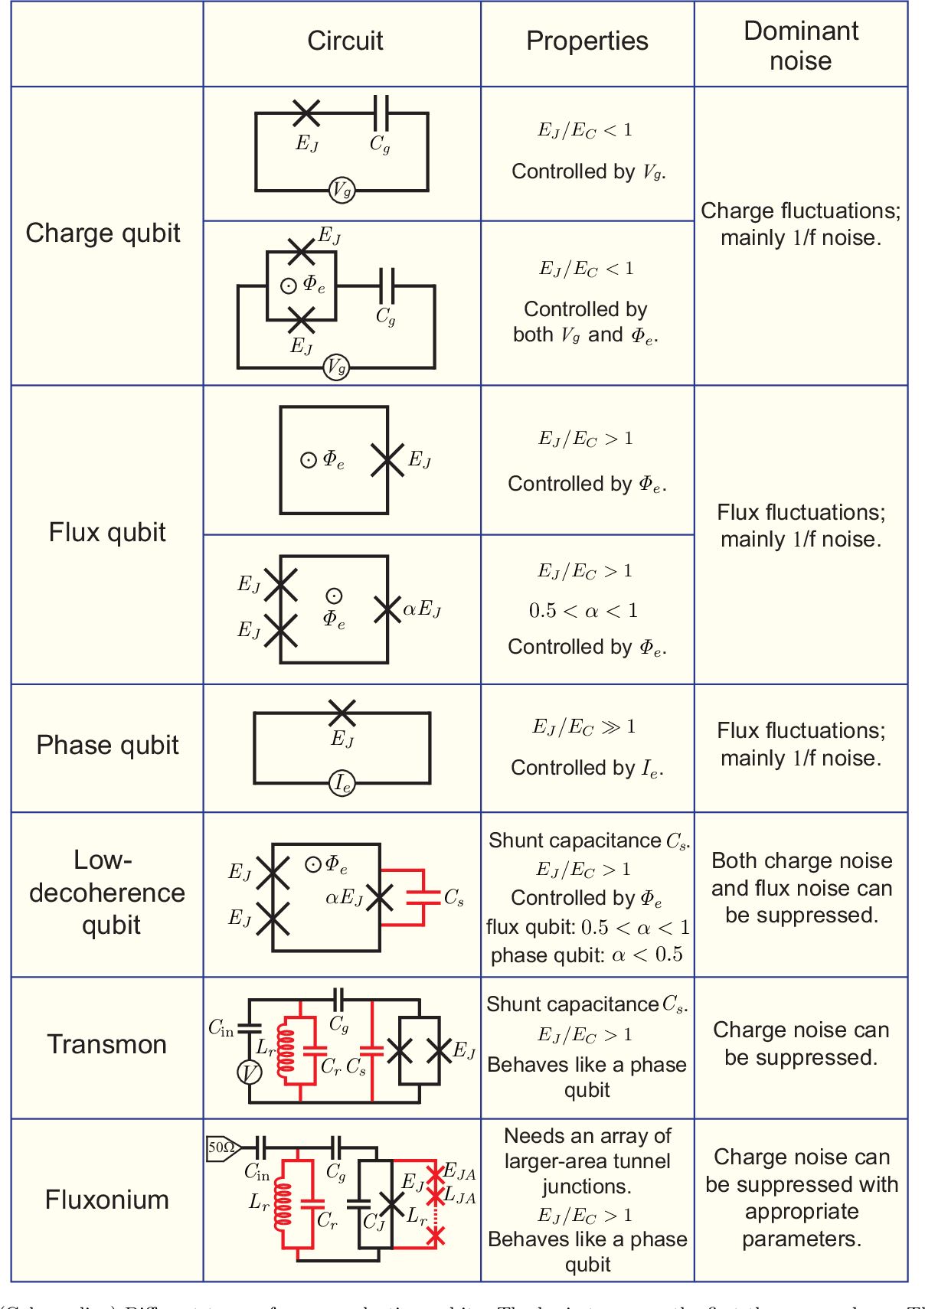
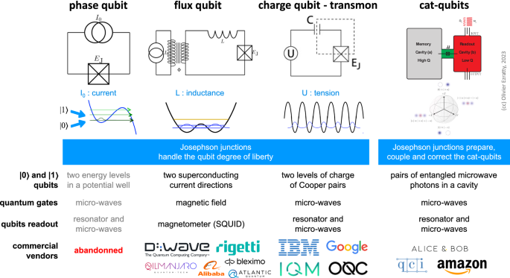

Slide 17
Transmon
Chip

Slide 18
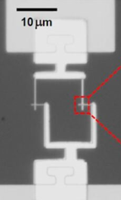
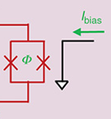
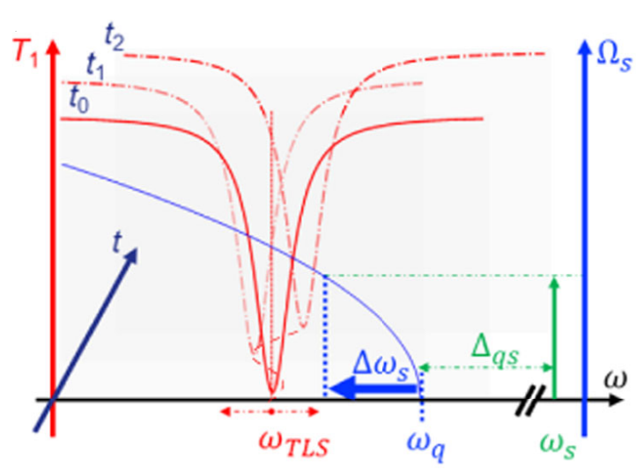
Magnetic and Spin Defects Isolation
Task 1
Task 2
Task 3
Task 4
Stray magnetic field source
A type of Two-Level System (TLS) Defect
Flux Noise
npj Quantum Information (2022) 132
The T₁ dips are indicative of the qubit coming into resonance with a strongly coupled TLS, at the frequency $ω_{TLS}$.
Coherence Time
Our Aim
Electron Spin Resonance (ESR) to probe defects @UWaterloo
Study TLS behaviour on surface and underground
Transmon $T$₁ response to shift in qubit frequency (red traces), at different times, $t$.
Notes:
“

