Slide 1
Are Supermassive Stars in Primordial Halos a Source of Observable Gravitational Waves?
Florent Thibault^{1,2}, Nathan Steinle², Tyrone Woods², Samar Safi-Harb²
1. Concordia University (Montreal), 2. University of Manitoba

Slide 2
Motivation
Pulsar Timing Array (PTA): detects nanoHz gravitational waves (GW)
GW background 2016
LIGO: first detection 2015
Laser Interferometer Space Antenna (LISA): launch ~2035
Model sources of GWs to compare with observations

Slide 3
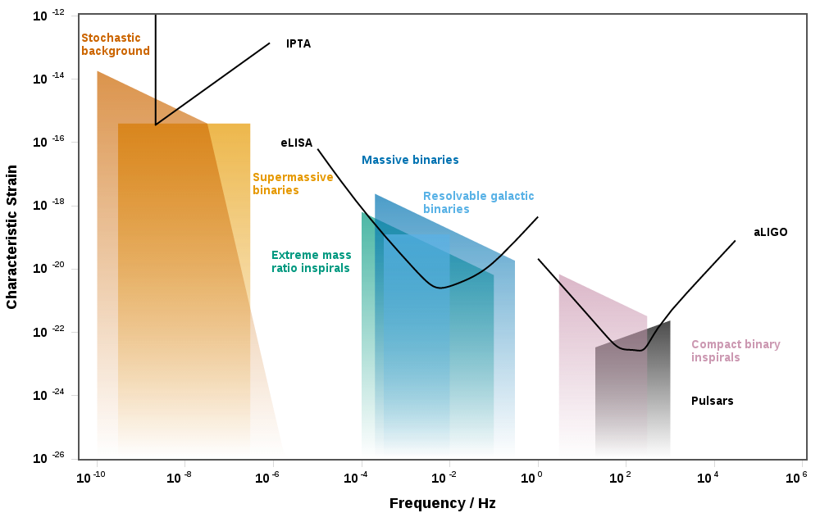
Motivation
Characteristic strain: amplitude of GW wave
Moore et al., 2014
Notes:
Area between the detector’s curve and top of the box for a source: how loud signal would be.

Slide 4
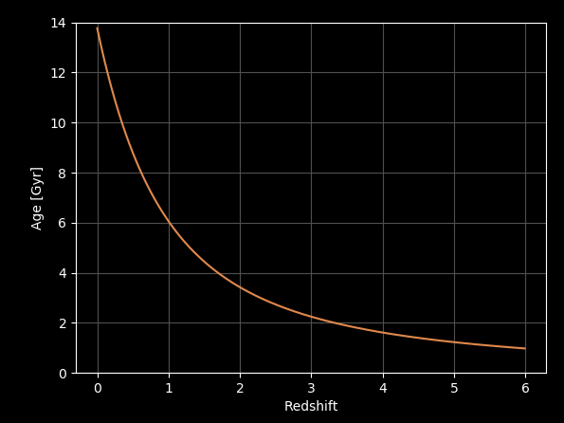
Background
Stellar Black Hole: ${<100 M}_{\text{☉}}$
Intermediate Mass Black Hole (IMBH): ${100−{10}^{5} M}_{\text{☉}}$
SuperMassive Black Hole (SMBH): ${{>10}^{5}M}_{\text{☉}}$
Redshift (z): cosmological redshift caused by expansion of universe
C. Mihos
Greene et al., 2020

Slide 5
How do SMBHs form astrophysically?

Slide 6
Hierarchical (classical) formation channel
Galaxy (central BH) merging
GW emission: dominant at smaller separations
Other astrophysical processes shrink binary
Dynamical friction (gravitational drag)
Stellar scattering throught the binary’s loss cone
Circumbinary disk migration
Low z
Colpi, 2014
Begelman, 1980
Notes:
Traditionally, it's thought that GW emission is not efficient enough shrink the binary for it to merge within t_u Dominant/relevant

Slide 7
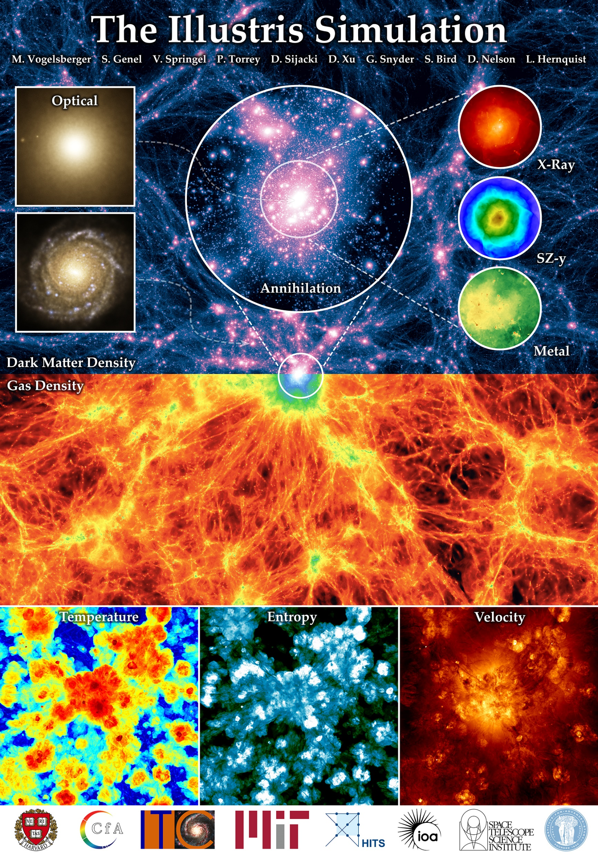
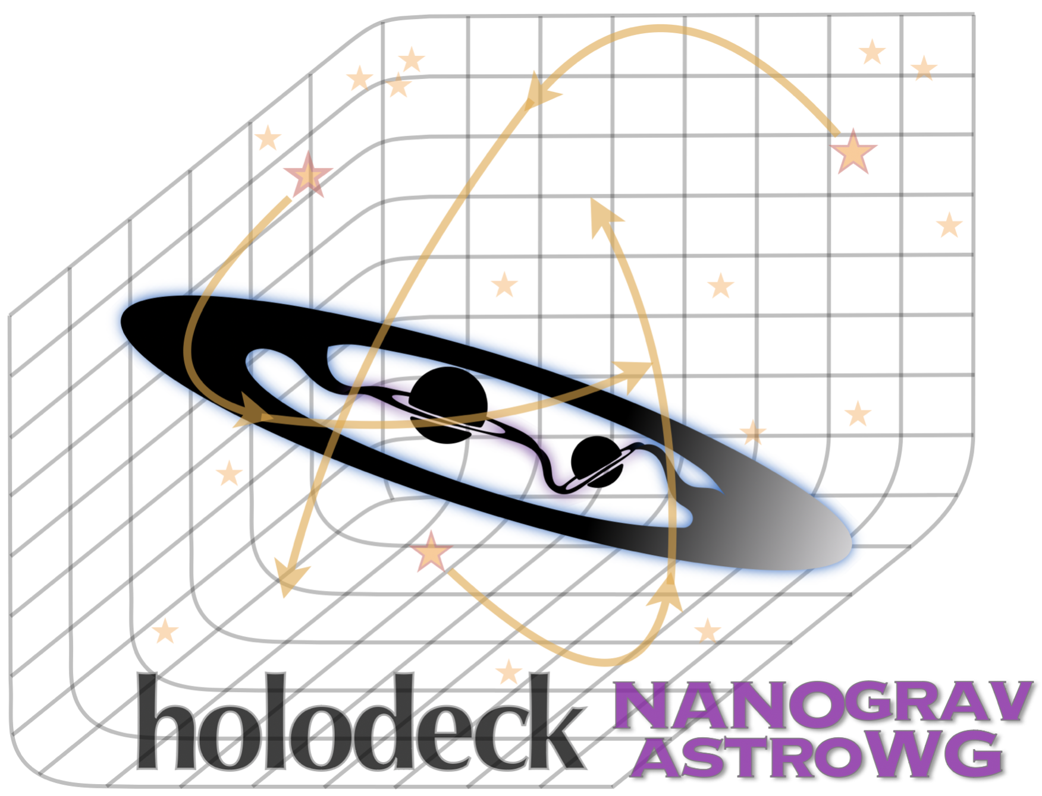
Holodeck
NANOGrav: PTA GW
Public python framework package
Initial binary population from Illustris
Evolution via hierarchical astrophysics
Calculation of GW emission
NANOGrav, 2023
Illustris Collaboration

Slide 8
Background
Population-III (pop-III) stars:
First generation stars (early universe)
Metal poor
Not observed yet
Population (pop) - I/II stars:
« normal » stars, discovered first
Lyman-Werner (LW) radiation:
In ultraviolet (11−13.6 eV)
Agarwal et al., 2012
Incatasciato et al., 2023
Rydberg et al., 2013

Slide 9
New formation channel
Supermassive Pop-III star in primordial halo
LW radiation: photo-dissociation H_{2,} ↓ cooling, ↓fragmentation
Direct collapse -> IMBH
IMBHs in same halo
Rydberg et al., 2013
Agarwal et al., 2012
Notes:
(How much binaries per halo is an « active area of research »
Primordial halo: halo in early universe)

Slide 10
New formation channel
Binary IMBHs
Mass of each black hole (m₁, m₂)
Initial redshift (z)
Initial semi-major axis (a)
Initial eccentricity of binary (e)
Possible SuperMassive BHs formation
Hartwig et al., 2018
Notes:
(After they merge, they can accrette mass and 100% become SMBH, even if they weren’t after the merger)

Slide 11
This project: modification of Holodeck
Population given by user
m₁, m₂ : ${{10}^{4}−{10}^{6} M}_{\text{☉}}$
z : 6-15
a: 0.1-0.2 pc
e: 0-1
Focus on GW emission, BBH evolution
Assume range (based on litterature)
Agarwal, 2012
Patrick, 2023
Notes:
Emission -> shrinking

Slide 12
Merger timescale
$$\text{GW} \text{emission}\text{ −> }\text{extracts} \text{energy} \text{from} \text{binary}\text{ (}\text{↓}\text{a}\text{, }\text{↓}\text{e}\text{)}$$
${\text{↑}t}_{m}$ for ↑a
$t_{m}=14.4\frac{{\left(1+q\right)}^{2}}{4q}{\left(\frac{a}{{10}^{−4}pc}\right)}^{4}{\left(\frac{M_{tot}}{2∗{10}^{7}{ M}_{\text{☉}}}\right)}^{−3}$yr
Steinle, 2024
Peters, 1964
Notes:
(-e because minimization energy of keplerian orbits (read about specific orbital energy)

Slide 13
This project: modification of Holodeck
Final parameters
Mass
Redshift
Holodeck
GW evolution
Separation
formula t_{m}
simulation t_{m}
Eccentricity

Slide 14
m₁, m₂, e, z, a: random uniform distributions
Vertical dotted lines: 5%, 50%, 95% quantiles
Contour lines at 11.8%, 39.3%, 67.5%, 86.4%
t_{m} calculated from intial conditions, formula from litterature
$t_{m}=14.4 \frac{{\left(1+q\right)}^{2}}{4q}{\left(\frac{a}{{10}^{−4}PC}\right)}^{4}{\left(\frac{M_{tot}}{2∗{10}^{7}{ M}_{\text{☉}}}\right)}^{−3}$yr

Slide 15
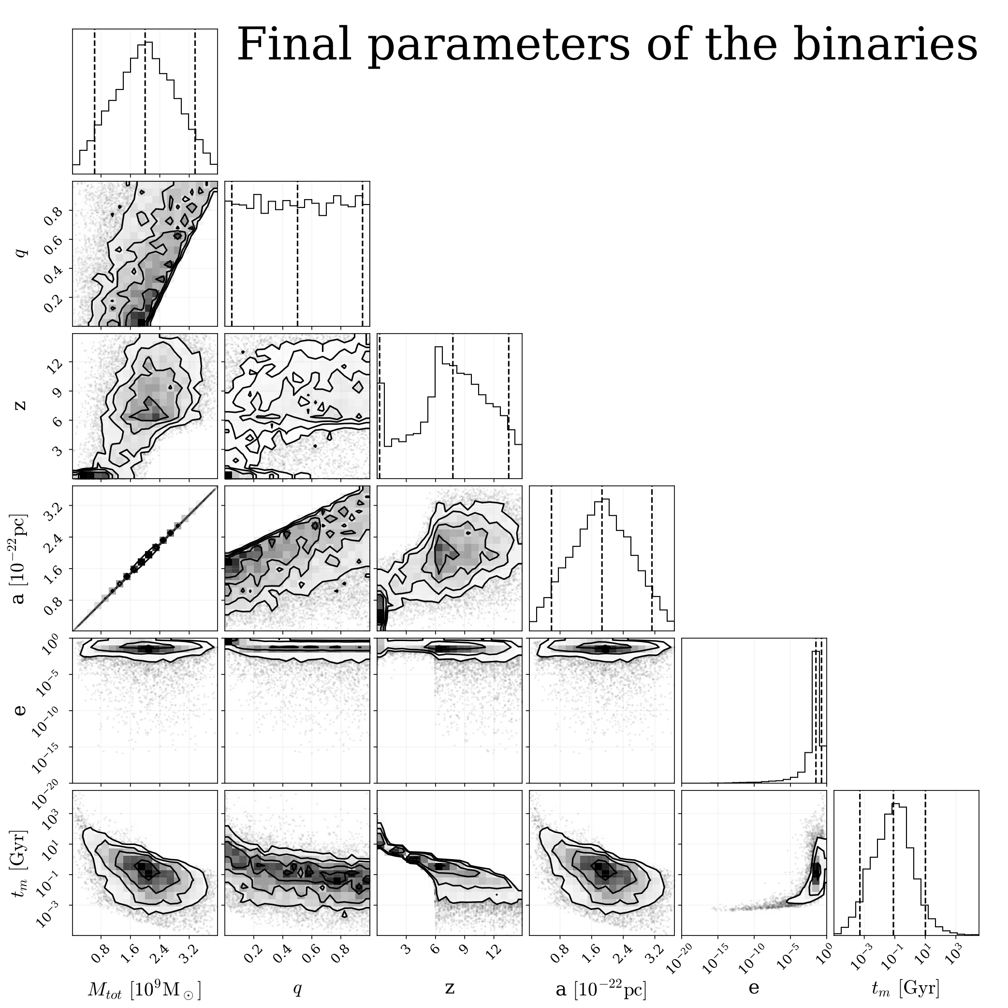
a very small
e->0
t_{m} calculated at each step of simulation and summed

Slide 16
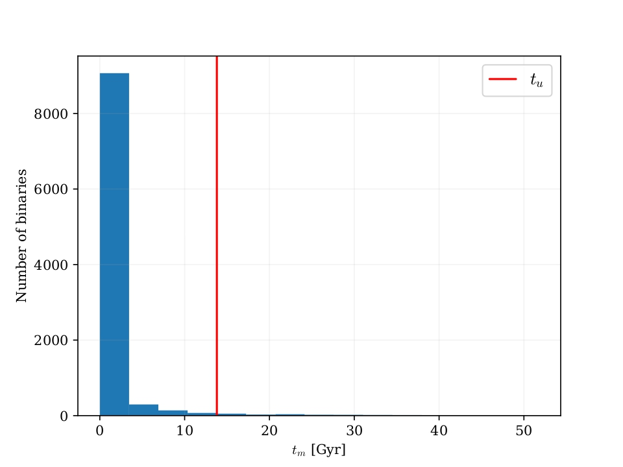
Result: which binaries are observable?
t_{u} = 13.8 GY
« Observable » : $t_{m}≤t_{u}$
Merging time of 1000 binaries by GW only
Most are observable

Slide 17
Notes:
every binary total evolution time

Slide 18
What now?
Other shrinking processes – how they work in new formation channel
Determine PTA & LISA detectability
Data VS simulation results
New formation channel could explain early SMBHs observations (z>6)
Banados et al., 2018
Wu et al., 2015

Slide 19
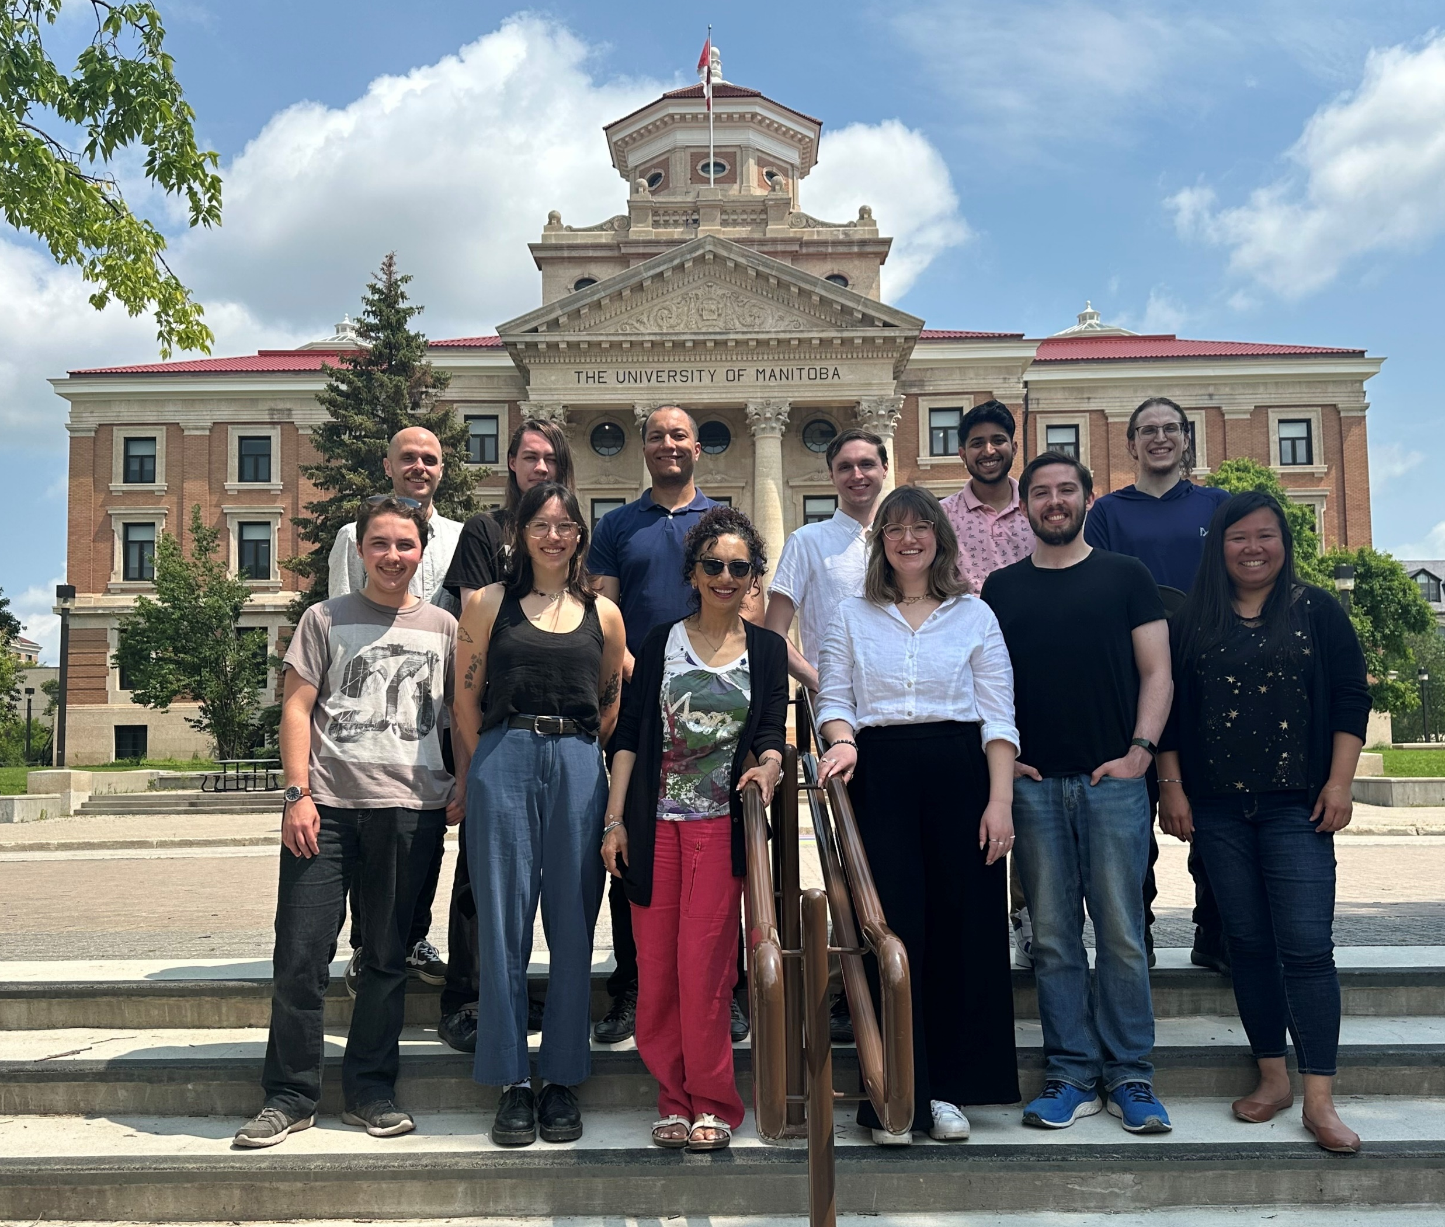
Thanks
Part of Samar’s group

