Slide 1
Flasher Events
Analysis of a Potentially Problematic Background in the DEAP3600 Dark Matter Search
Matt Poser
Supervisor: Dr. Philippe Di Stefano
Queen’s University, DEAP3600 Collaboration

Slide 2
Important Concepts
Scintillation
“See” the light
Photoelectric effect [1]
Electrical signal
Flash of light
Evidence of particle interactions
PhotoMultiplier Tubes (PMTs)
1

Slide 3
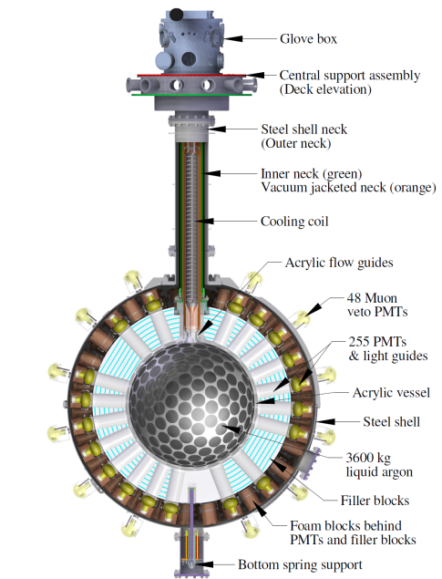
The DEAP Experiment
Looking for dark matter as W.I.M.P.s
2.07 km underground to filter out strongly interacting particles
3600 kg liquid argon
PMTs inside, turn scintillation light into electrical signals
From particle interaction to data:
Interaction
→ Scintillation (light)
→ PMTs ‘see’
→
Electrical Signals
→
Figure 1- The DEAP 3600 dark matter detector. Obtained from DEAP collaboration paper: Design and Construction of the DEAP-3600 Dark Matter Detector [2]
Converted to code!
2

Slide 4
What is a ‘Background’?
Backgrounds are important in particle detection
Easy concept to understand, needle in a haystack analogy [3]
Dark matter WIMP events are our needle
Backgrounds are pieces of hay that look like the needle
Analysis Goal:
Our job is to filter out the events which may look like dark matter WIMP events, ie: as much ‘background’ as possible
3

Slide 5
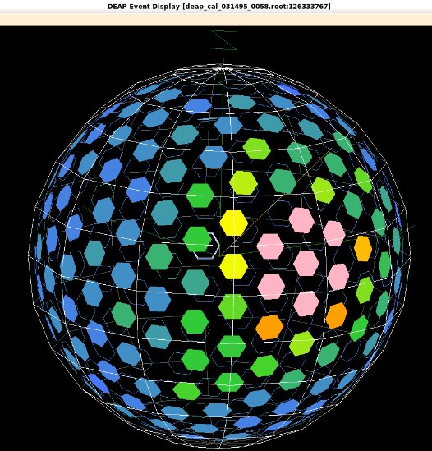
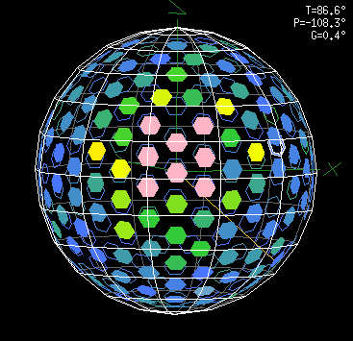
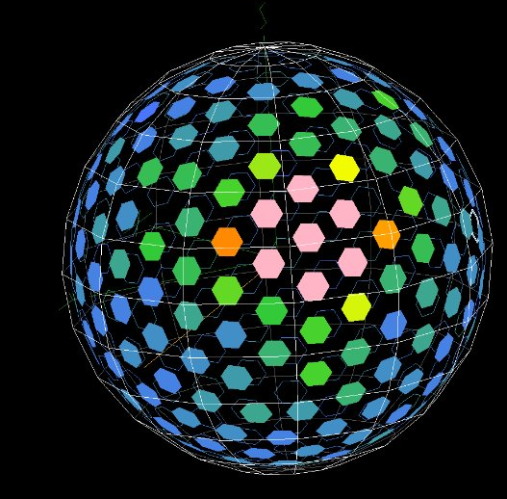
Flasher Events
A special kind of event, not caused by particle interaction
A single PMT emits a BIG signal
Rest of the PMTs light up, smaller signal
Specific order, visual look
What do we know?
They are consistent in their characteristics
And
Can be defined visually
Figure 2- Flasher Events depicted using animation software
4

Slide 6
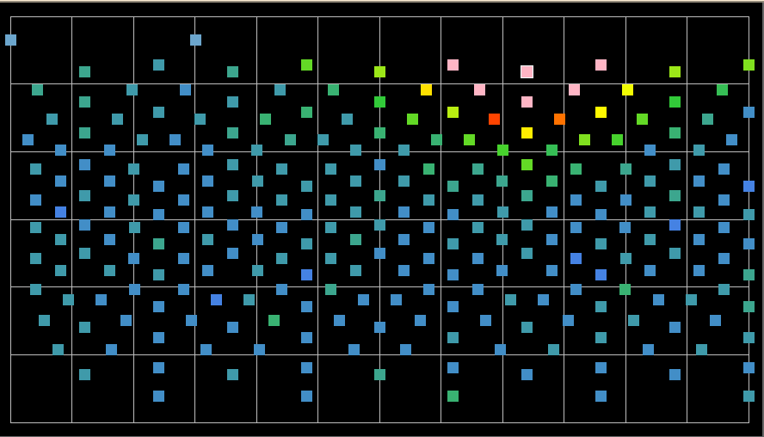
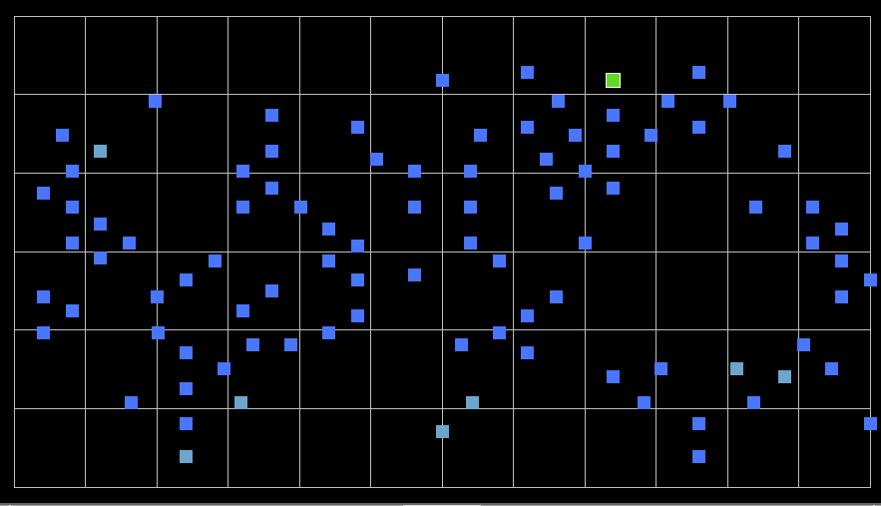
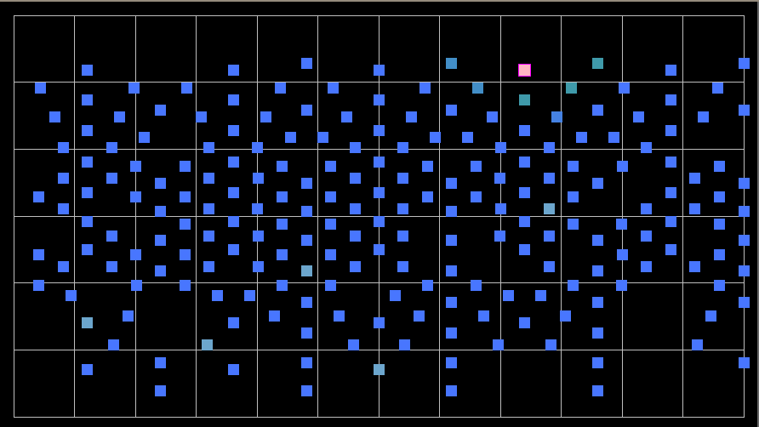
Background Flasher Events
We want to cut out flasher events
Flashers have the chance to continue into subsequent lower energy flasher events
These subsequent low energy events could look similar to WIMP events
If we can pick flashers out of data, we can treat the following events more carefully, filter out our background events
Why do we want to cut them out?
The following events could be a problem, may look like the WIMP events we are looking for!
Flasher event
First event after
Second event after
5

Slide 7
How Were Cuts Made?
Collect many flashers
Identify unique characteristics
Make cuts based on these characteristics
1. Events before and after
2. Event specific variables
6

Slide 8
Looking Before and After
Time difference between sequential events
Translates to event rate
Sampled and plotted Δt for events before & after flashers
Flashers had a clear graphical trend
Tested against random data, was trend significant?
7

Slide 9
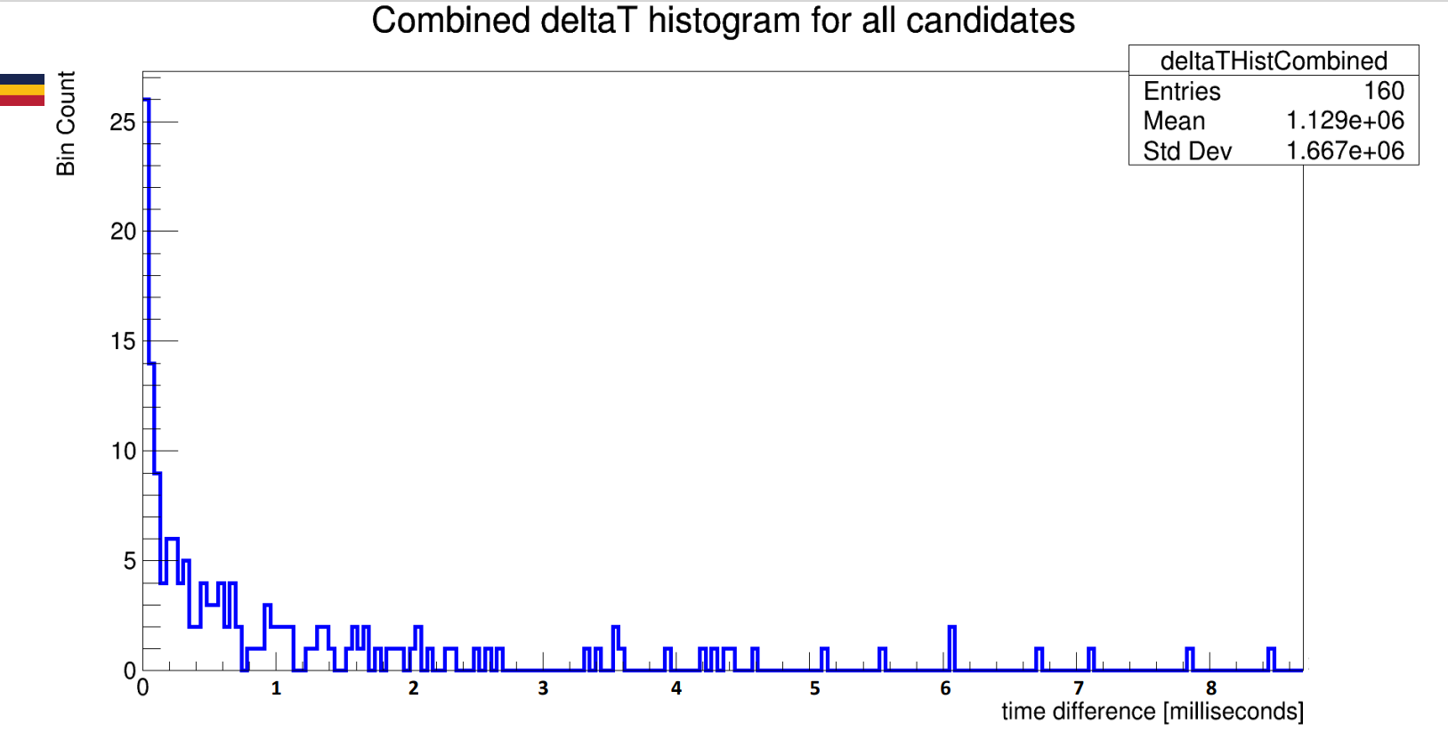
8

Slide 10
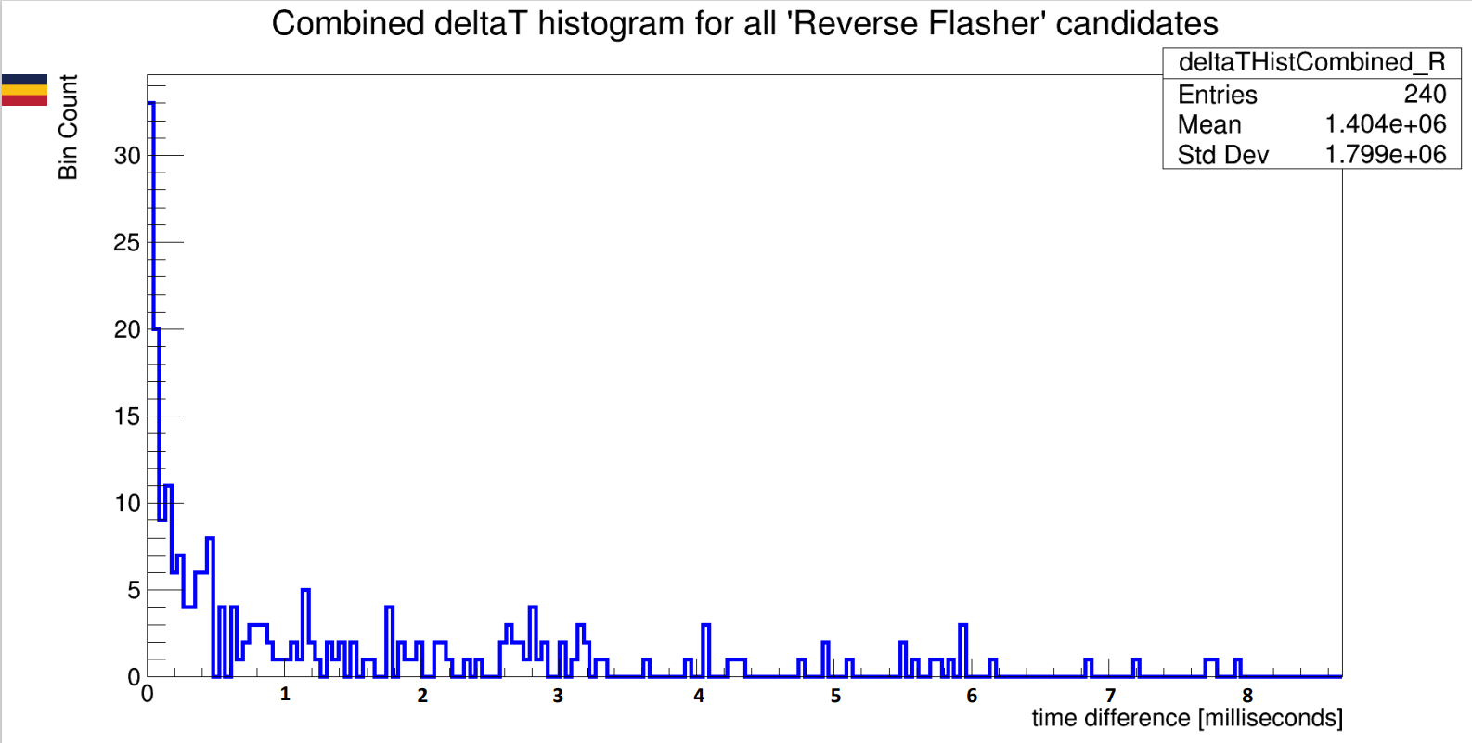
9

Slide 11
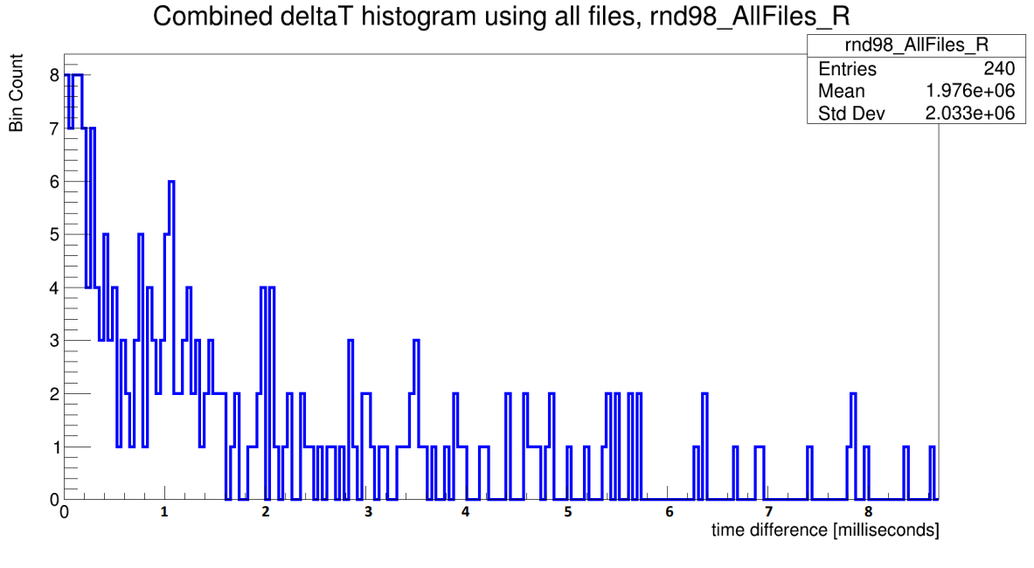
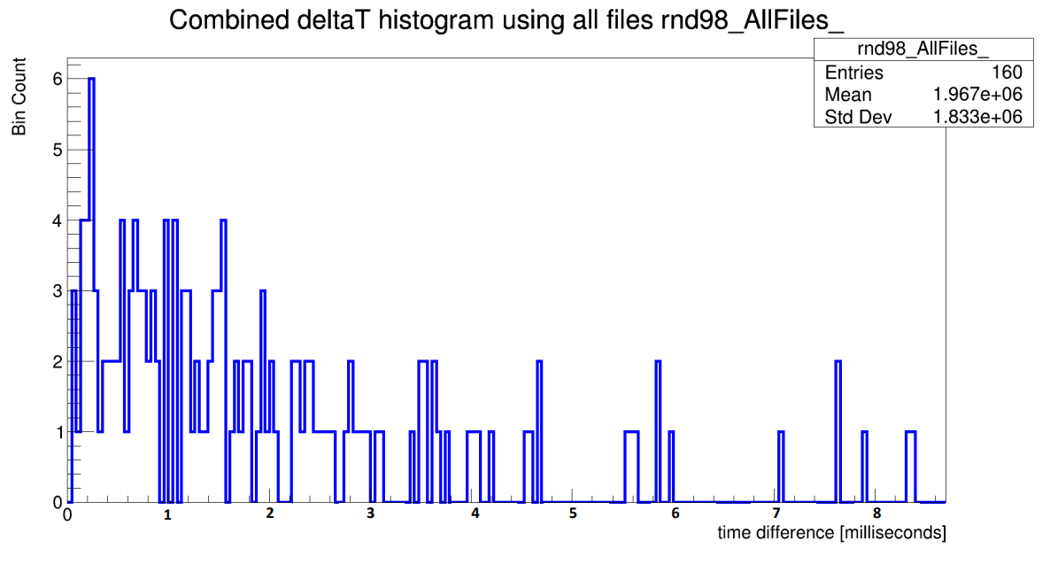
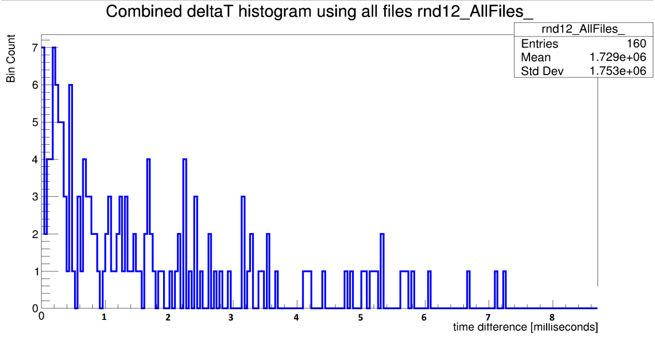
Notice anything different?
The graphical trend seen in flasher events differs from random data in the same file.
The trend may be a unique characteristic to flasher events, could be used as a cut!
10

Slide 12
Event Variables
We wanted to find quantitative traits
How is DEAP data stored for single events? Crowd of people analogy
Columns are events, rows are event attributes (ntp variables)
Gather our flasher events up, look at each row to find commonalities
Making selections becomes simple: cut out events where row contents are different than the flasher events
Person #4
Person #1
Person #3
Event #4
Event #1
Person #2
Event #3
Event #2
. . .
. . .
Shoe Color
Event Energy
Blue
Red
2000
80000
Green
Grey
5600
13000
Shirt Style
Event Location
Long Sleeve
Jersey
T-Shirt
(20, 90, 15)
Sleeveless
(0,0,0)
(30, 40, -5)
(30, 10, -50)
Number of PMTs Turned on
Hair Color
Blonde
Brown
255
Black
Red
235
240
239
Height
Time of Event
5’7”
5’9”
5’4”
5’8”
12:34:59
2:44:09
21:17:38
4:07:01
. . .
. . .
11

Slide 13
Cutting Out Flasher Events
This is exactly what we want to do for flashers
Looking for commonalities when plotting
found preliminary cuts between candidates
Tested cuts on the files containing original flasher events, 79% success rate (53/67 events)
Events must pass all of the following cuts:
Above energy of 2000 qPE (unit of energy measurement),
Ignite at least 210 PMTs,
Have no PMTs ignited by muons,
Have an elapsed event time of 15 microseconds or less,
Have less than 900 qPE of charge from the PMTs in the neck of the detector,
Have the event be tracked to a distance of at least 70cm away from the center of the detector
12

Slide 14
Optimizing, Filtering
Good starting point, but we want 100% !
Cuts need to be tweaked, made stricter. Iterative process
Testing on Vacuum & LAr data
Once good success has been reached with ntp cuts, use a secondary filter
End Goal:
To make a filter that picks out flasher events from data with confidence, and only picks out flashers!
13

Slide 15
References & Readings
[1] Shimazdu North America, “How does a photomultiplier tube work?” Shimadzu North America, Analytical and Measuring Instruments. Accessed: Jul. 31, 2024. [Online]. Available: https://www.ssi.shimadzu.com/service-support/faq/uv-vis/instrument-design/9/index.html
[2] P.-A. Amaudruz et al., “Design and Construction of the DEAP-3600 Dark Matter Detector,” Dec. 2017, p. 70. Accessed: Jul. 30, 2024. [Online]. Available: https://www.snolab.ca/deap/private/TWiki/pub/Main/PaperOverviewEntry0/view.pdf
[3] Dr. Tina Pollmann for the DEAP collaboration, “DEAP Data Wrangling,” presented at the Data analytics workshop, SNOLAB, Apr. 25, 2016. Accessed: Jul. 31, 2024. [Online]. Available: https://www.snolab.ca/deap/private/TWiki/pub/Main/TPMyTalks/DEAPDataWrangling.pdf

