Slide 1
Precision Measurements of (Ultracold) Neutron Properties at TRIUMF
Kyle Drury, McMaster University
On behalf of the TUCAN Collaboration

Slide 2
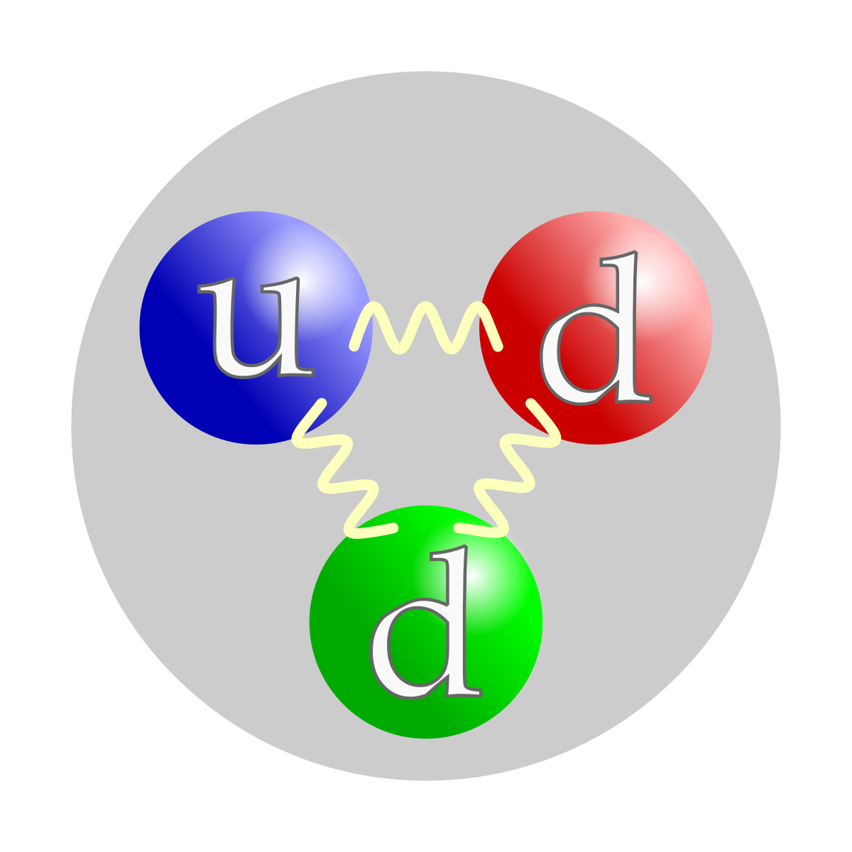
Outline
The TUCAN Collaboration
The Neutron Lifetime, Electric Dipole Moment, and Ultracold Neutrons (Motivation)
The TUCAN Source
My Work on the TUCAN Source

Slide 3
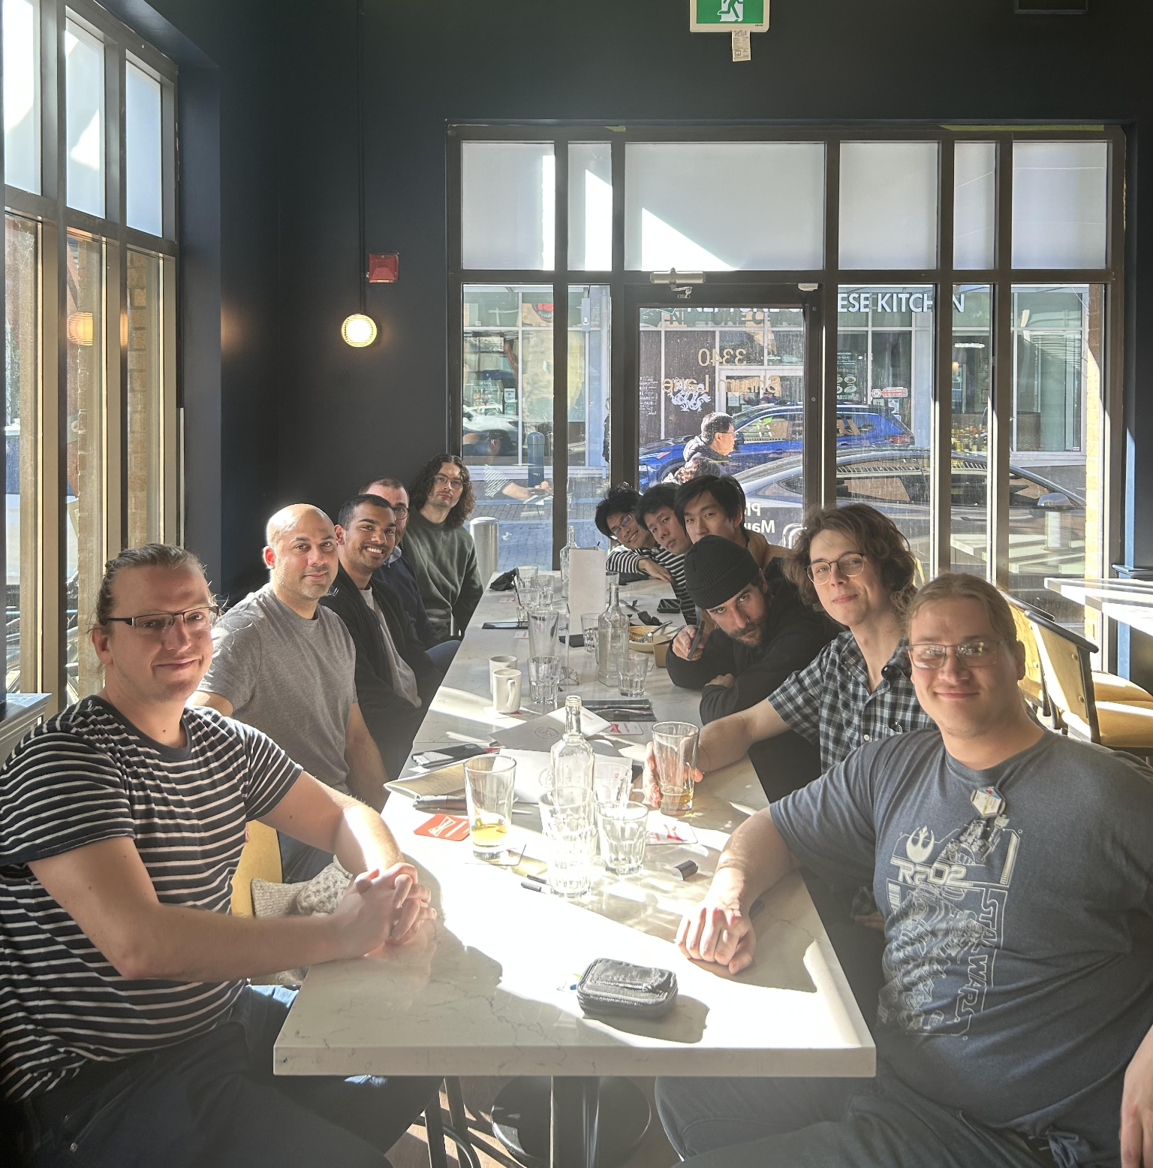
The TUCAN Collaboration
TUCAN → TRIUMF UltraCold Advanced Neutron
Canadian-Japanese endeavour to measure the free neutron lifetime and neutron electric dipole moment (nEDM) with unprecedented accuracy
Designing and building the world’s highest-density source of UCN in the world to do this

Slide 4
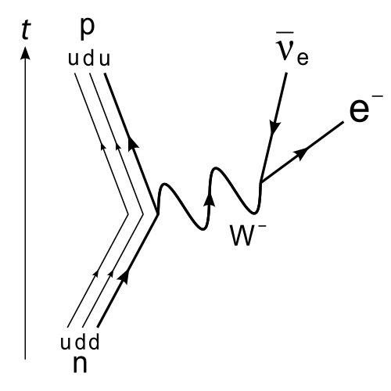
The Free Neutron Lifetime
The neutron lifetime is related to the V_{ud} element of the quark mixing CKM matrix
Current estimations of the V_{u} elements may not add to unity
Verification of unity is necessary to validate the weak interaction
Deviation from unity would indicate beyond-SM physics

Slide 5
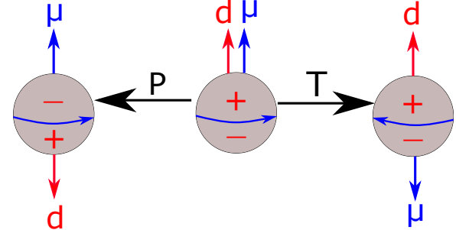
The Neutron Electric Dipole Moment
A finite fundamental electric dipole moment violates T-symmetry, and therefore CP-symmetry due to CPT conservation
CP violation sometimes referred to as “matter-antimatter asymmetry,” and is required to explain the matter-antimatter asymmetry problem
Although the neutron is not a fundamental particle, an nEDM would indicate a more fundamental electric dipole moment
Steve Sidhu, 2021.

Slide 6
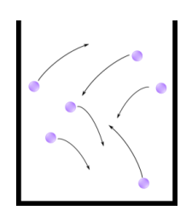
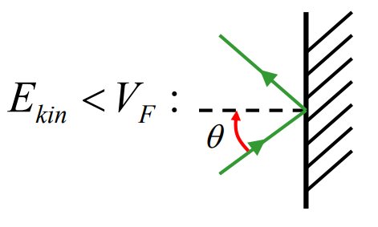
Why UCNs?
Low-energy; can be stored for hundreds of seconds in magnetic traps and gravitational wells ~1m
Large De-Broglie wavelength; can be stored in material bottles of high Fermi potential due to high reflection coefficient
Electrically neutral; easier to isolate an EDM than particles with a net charge

Slide 7
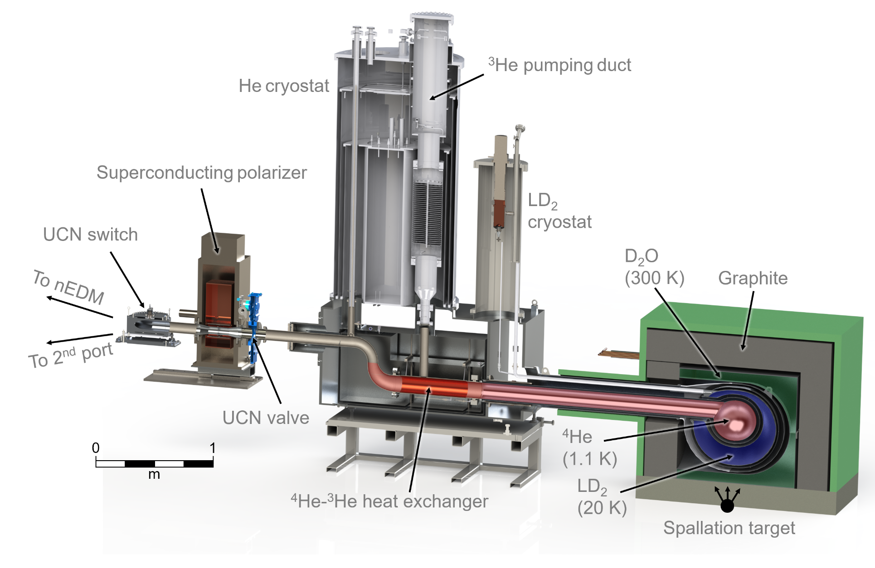
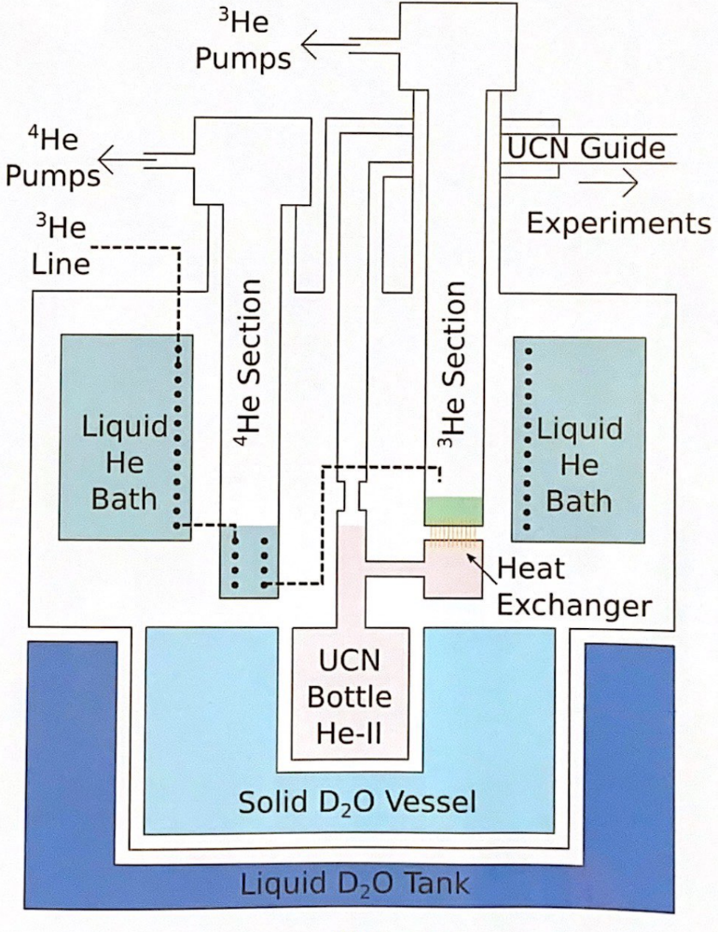
The TUCAN Source

Slide 8
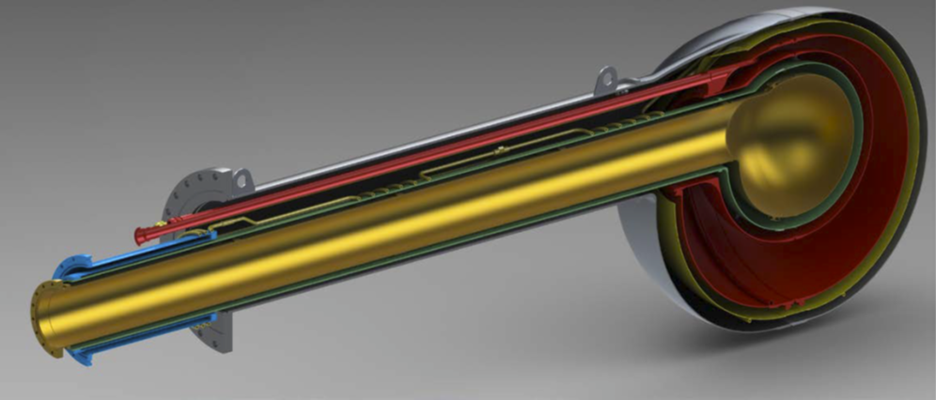
The Liquid Deuterium System
Recovery Line
Deuterium Reservoir
Coldhead
Pressure Transducer
Pressure regulator
Vacuum gauges
Vacuum
O2 Sensor
Cold trap
LD2 Cryostat
Purge Line
Oxygen sensor is used to determine whether concentration of D2 is within flammability limits
Reservoir and D2 line can be vented via the purge line through opening of valves
Flows, pressures and temperatures are closely monitored and regulated with instrumentation
I selected the hardware needed to accomplish this in an explosive environment

Slide 9
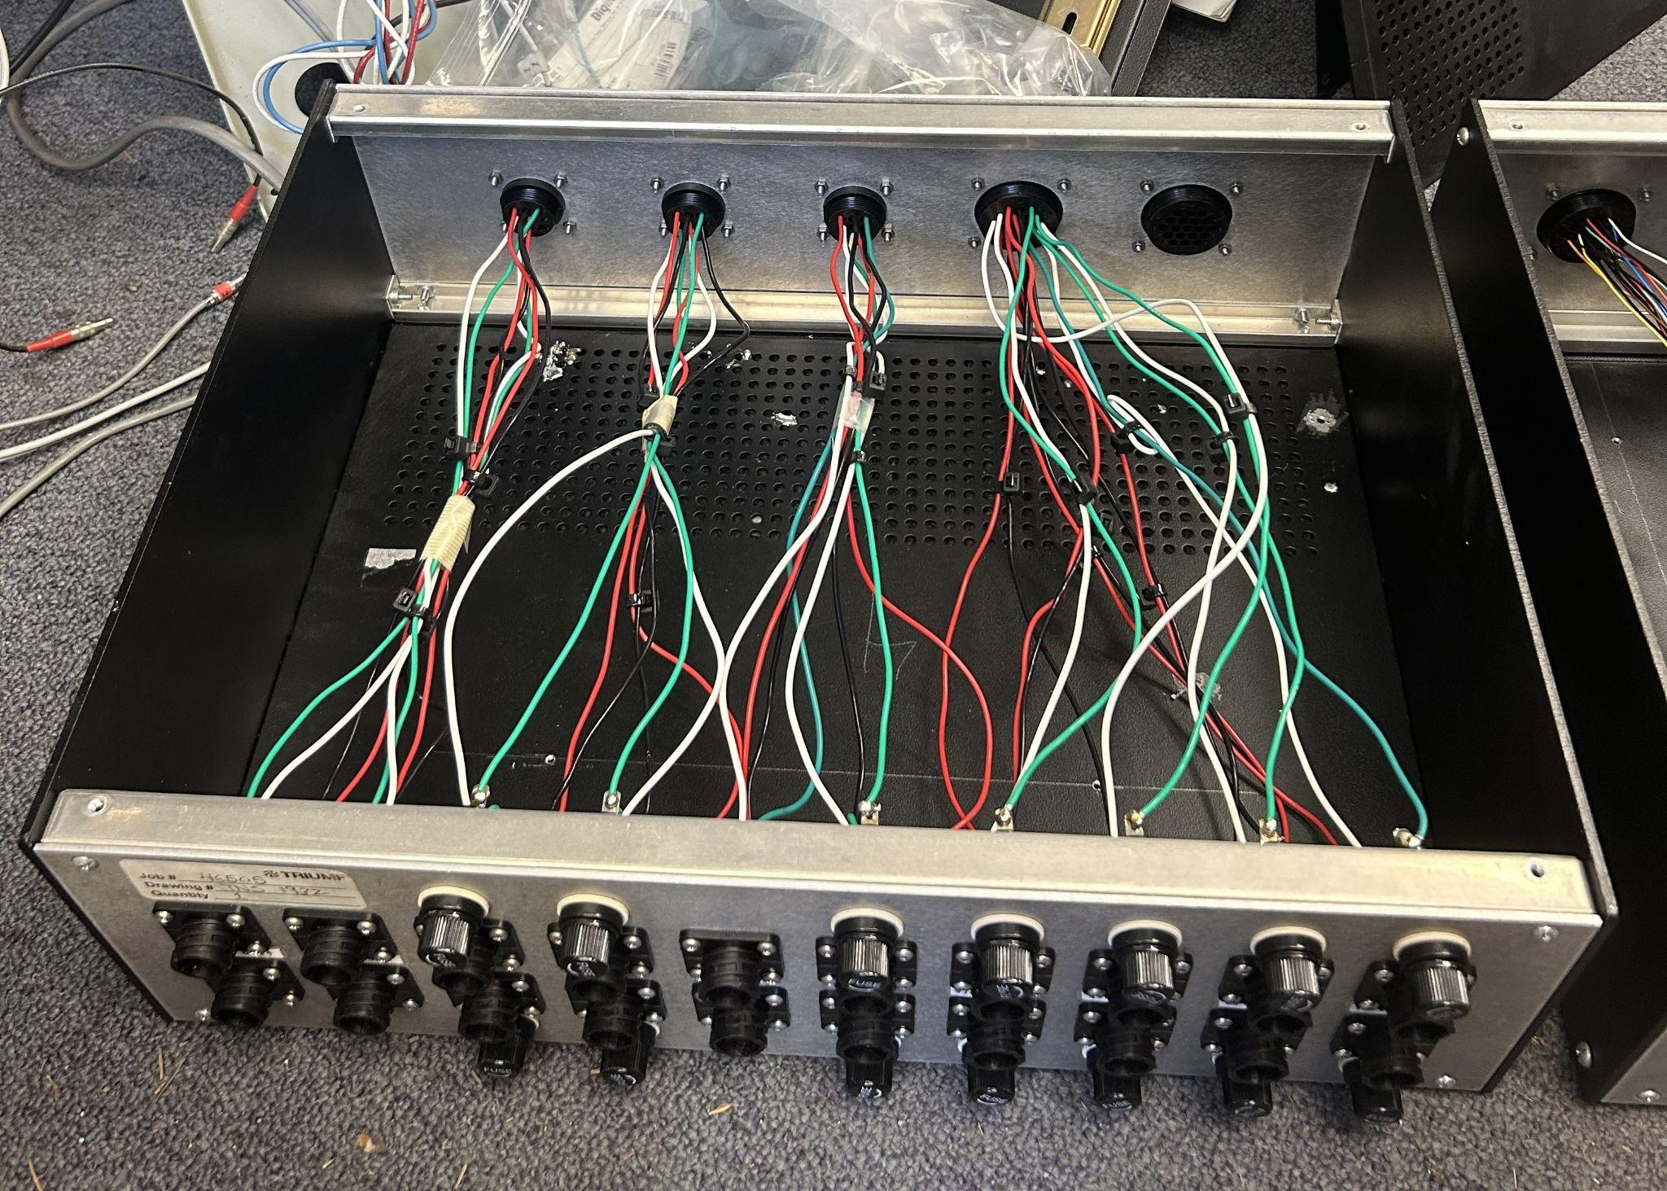
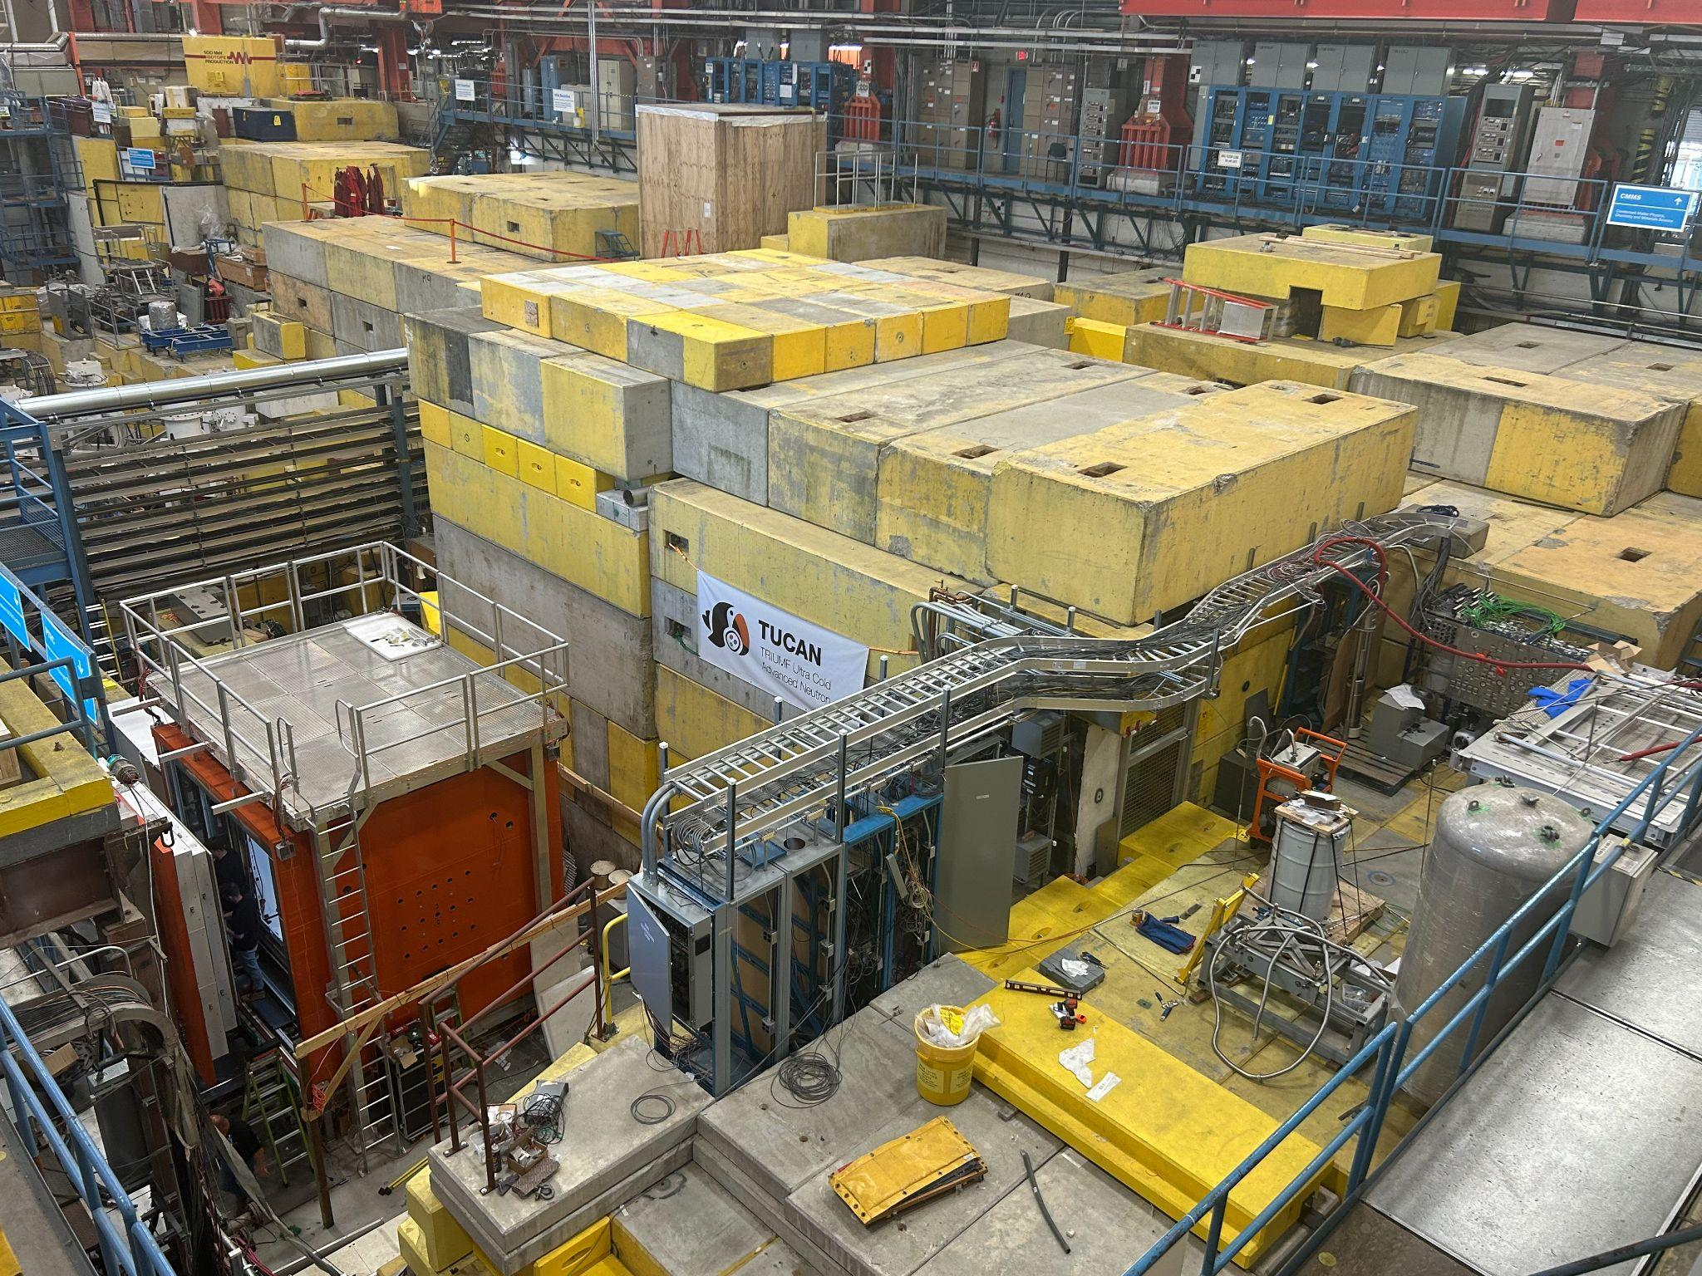
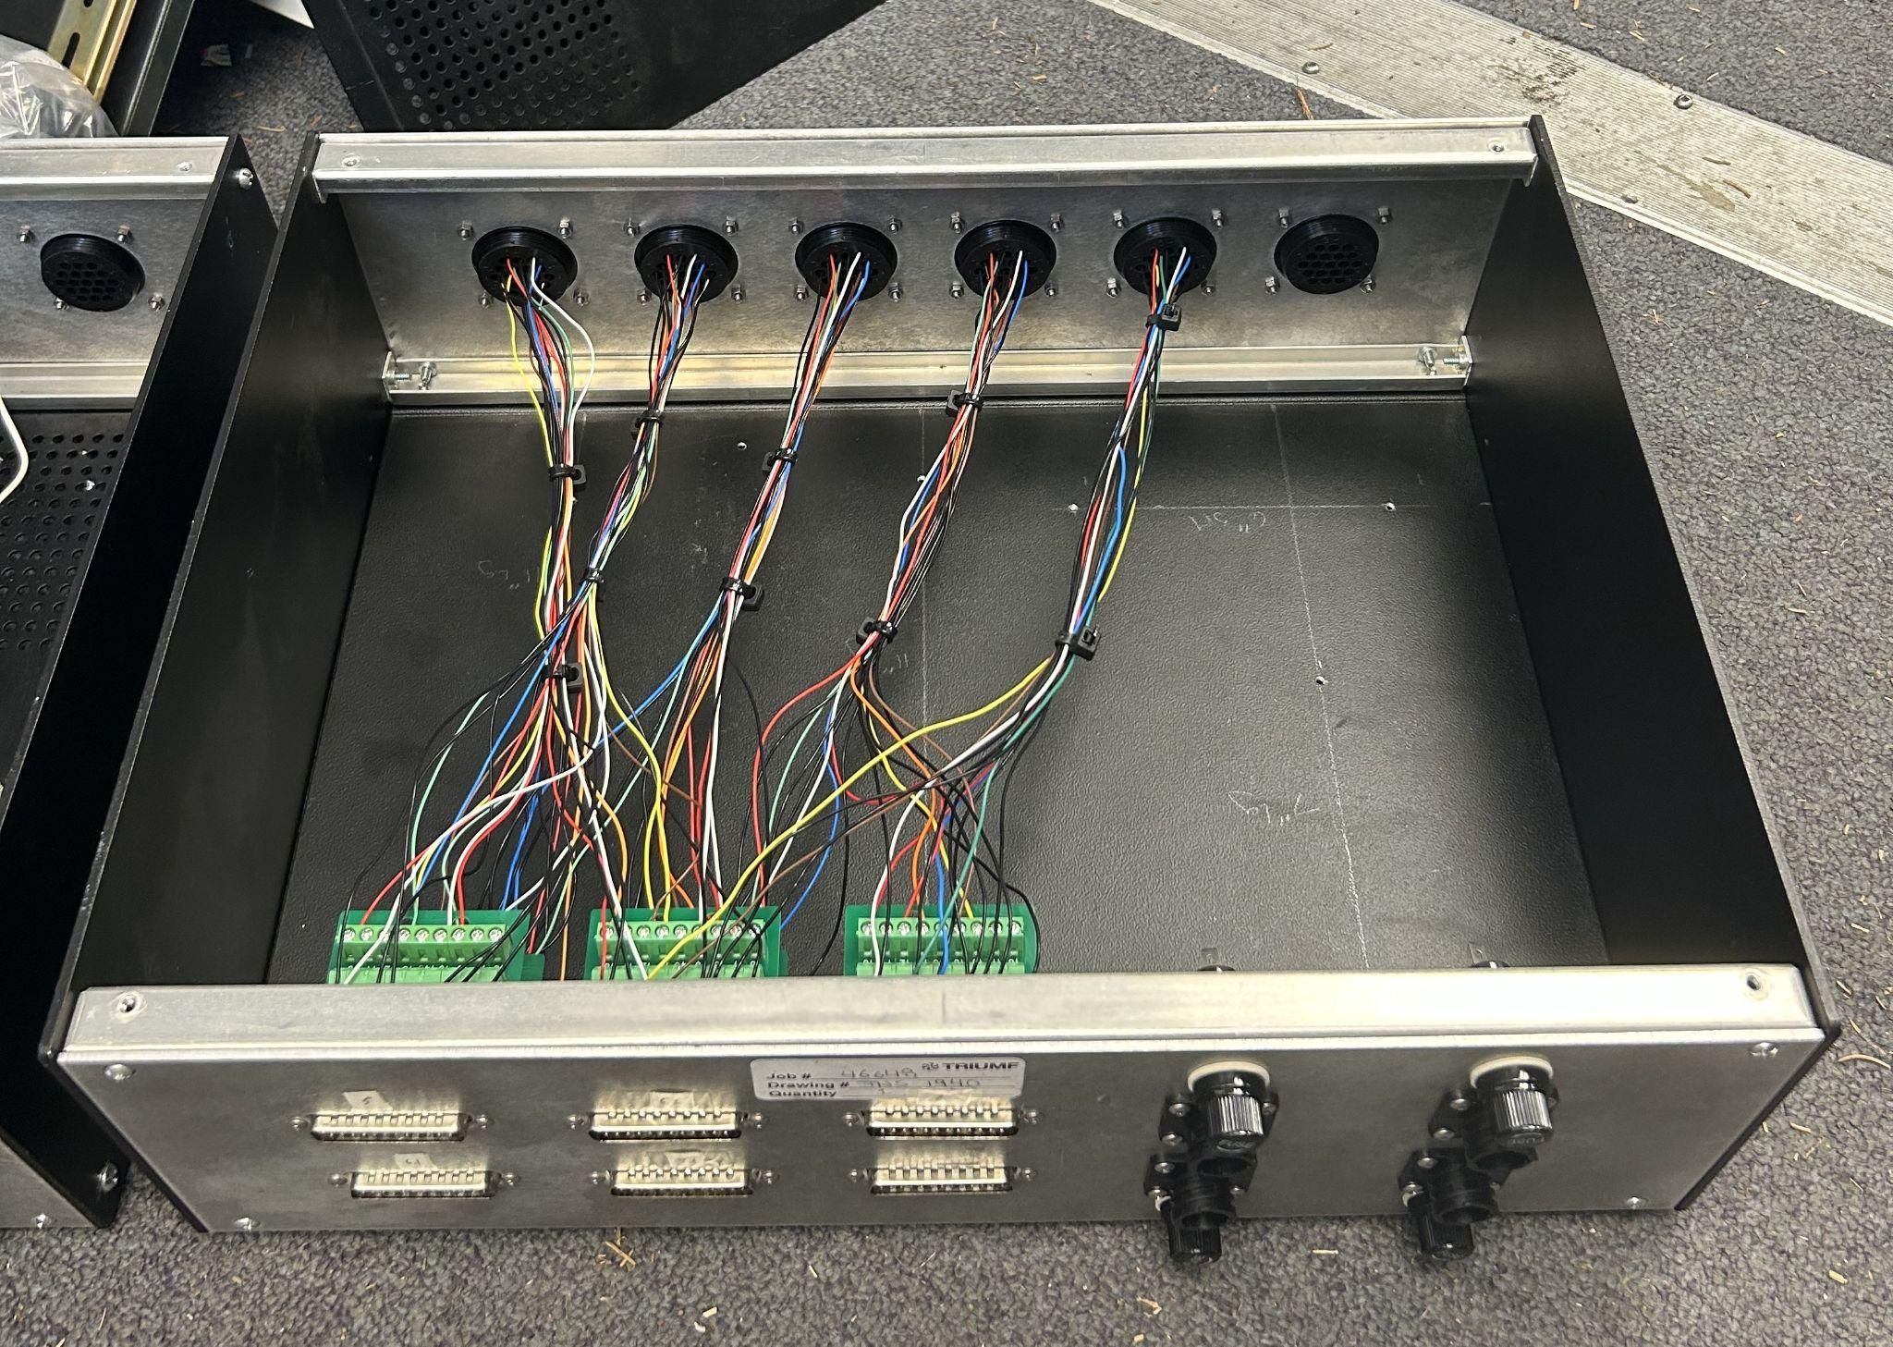
Slow Control
“Slow Control Systems are used for setup and monitoring of hardware that is not time-critical, and can be run at a low priority”
We must be able to interface with various devices and instrumentation remotely
I contributed to the development of the hardware needed to achieve this
Top of boxes; to and from devices
Bottom of boxes; to and from control systems (voltage readouts, PLC, power supplies, etc.)
Cryostat and pumps under these shielding blocks
PLC Racks

Slide 10
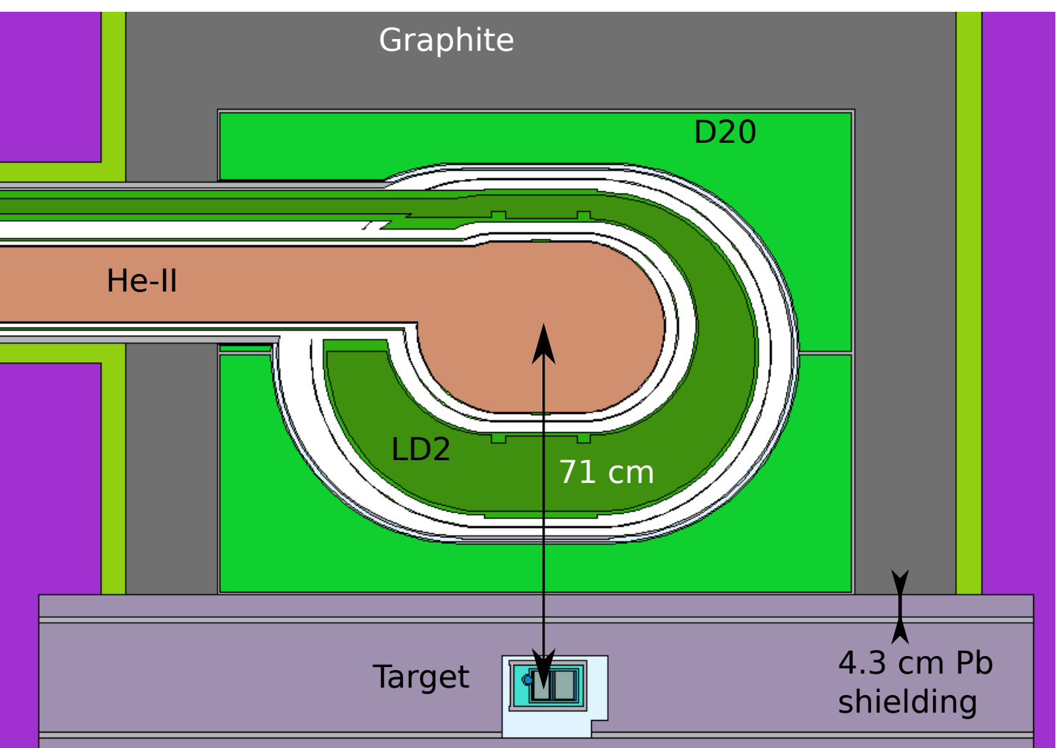
Breakout Boxes
Breakout box 6 is required to interface with various temperature sensors in the liquid deuterium system
Most of them are located around the production bulb, within the deuterium cryostat, and along the delivery and recovery lines going to and from the bulb
Breakout Box 6
Coldhead
Temperature Sensors
LD2 Cryostat
Breakout Box 5
Heaters

Slide 11
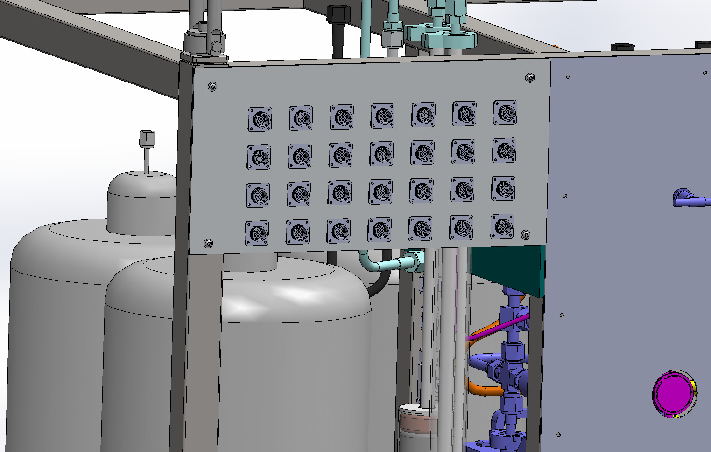
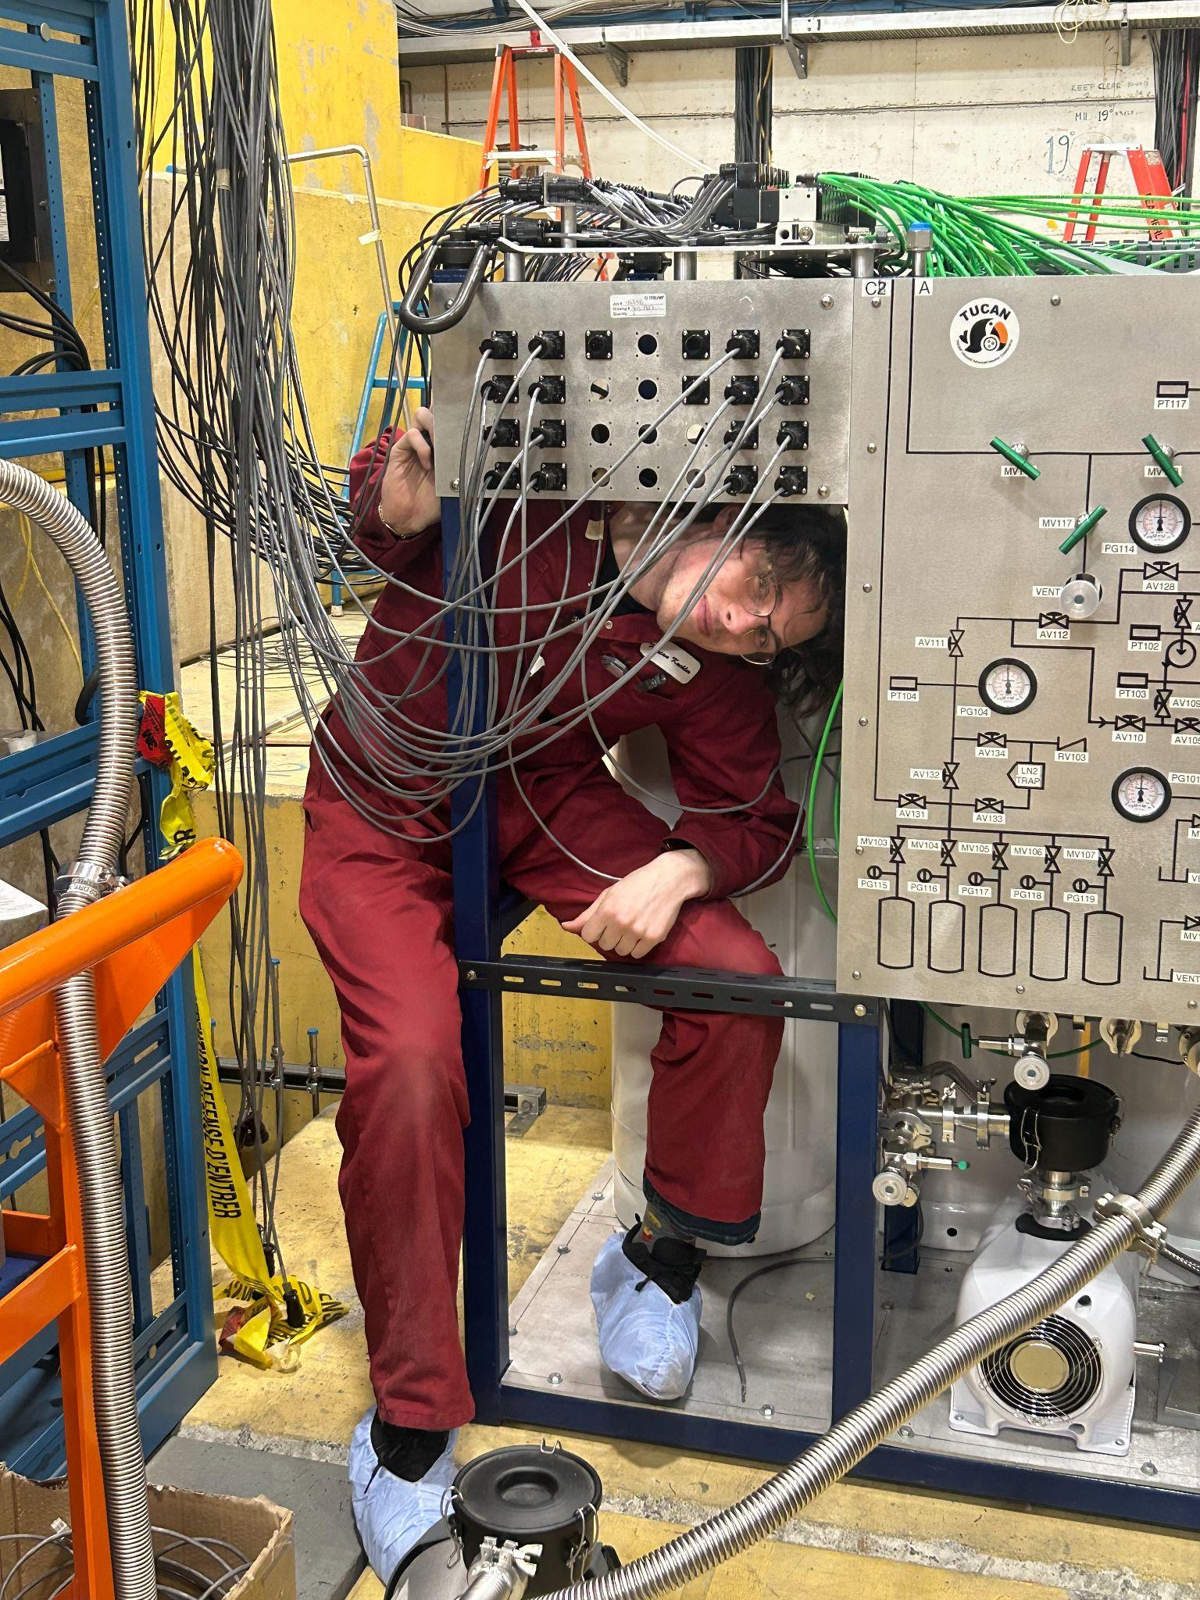
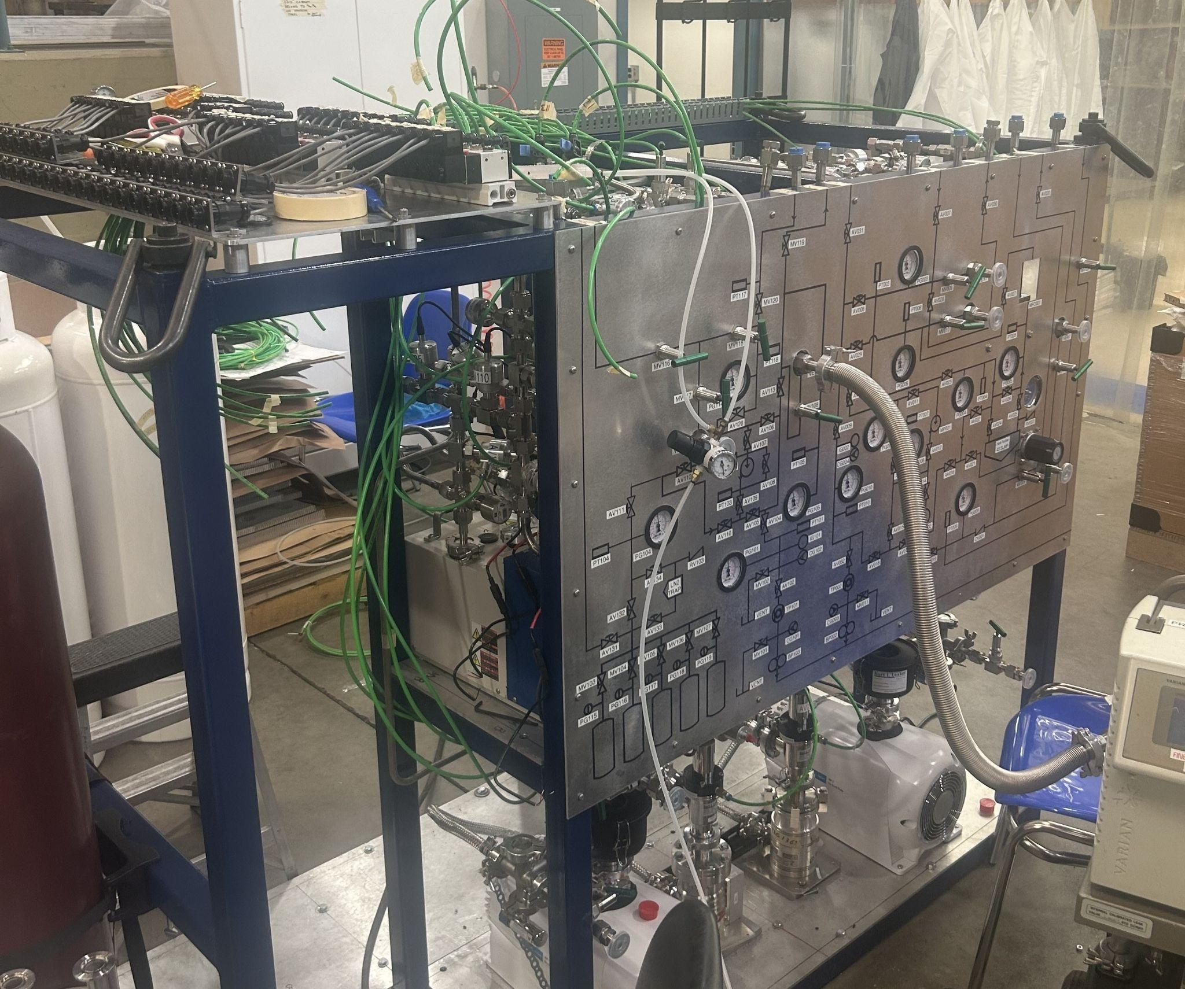
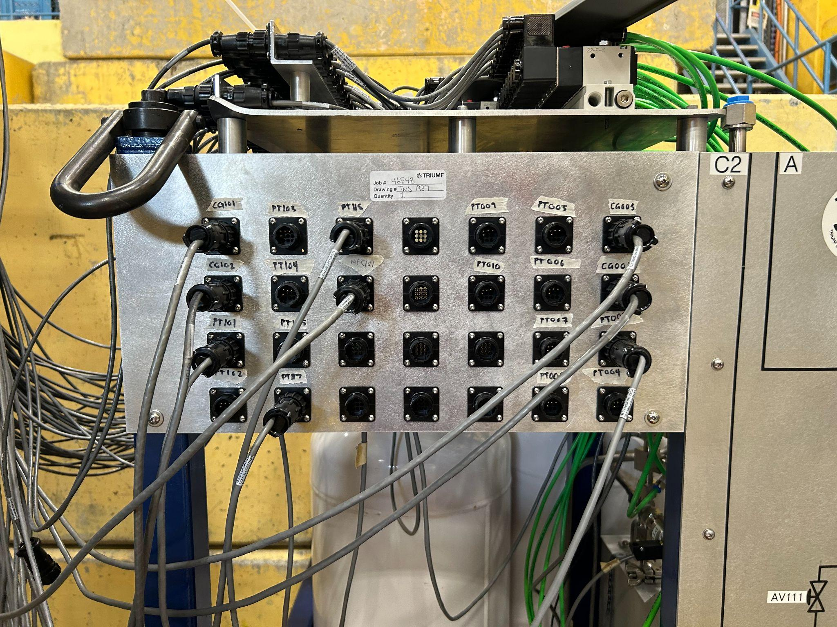
Helium-3 Gas Panel Extension
The gas panel is used to interface with the He3 system
To add more devices to the system, I was tasked with designing and installing an extension to this panel

Slide 12
Conclusion
Conclusion
Acknowledgements
The TUCAN collaboration is building the world’s highest-flux source of ultracold neutrons to measure the neutron electric dipole moment and its free lifetime to probe fundamental properties of the standard model related to CP violation and the weak decay of quarks
As a coop student, I helped to select parts for the liquid deuterium system, an essential component for cooling neutrons down to ultracold temperatures. I also designed and assembled electrical breakout boxes necessary to interface with various heaters and temperature sensors located along the UCN guide and source bulb
To assess our progress, we are going to be producing UCNs this September!
I will also be starting my undergraduate thesis with the TUCAN group, aimed at simulating the commissioning process
I’d like to thank the TUCAN collaboration for taking me on as a coop student; I am thankful in particular for my coop supervisor, Dr. Alexis Brossard
Thanks to the CASST organizing committee for organizing this event

