Slide 1
Diffuser ball Light simulations
Irina Nitu, McGill University
August 20, 2024

Slide 2
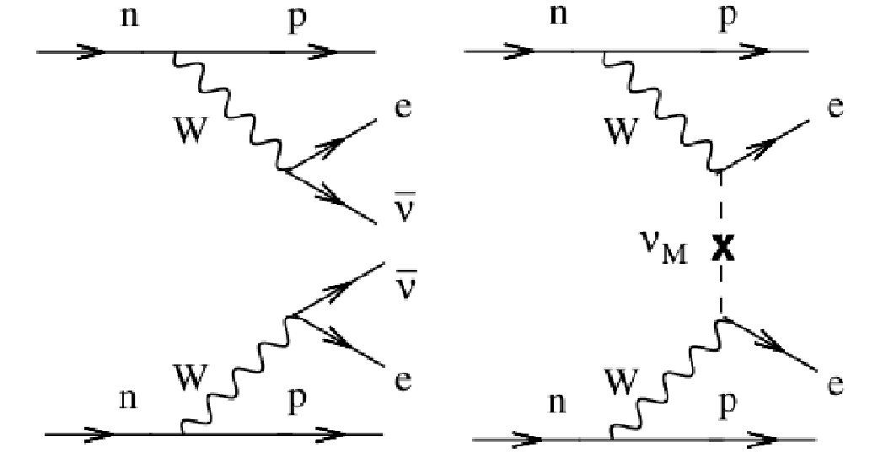
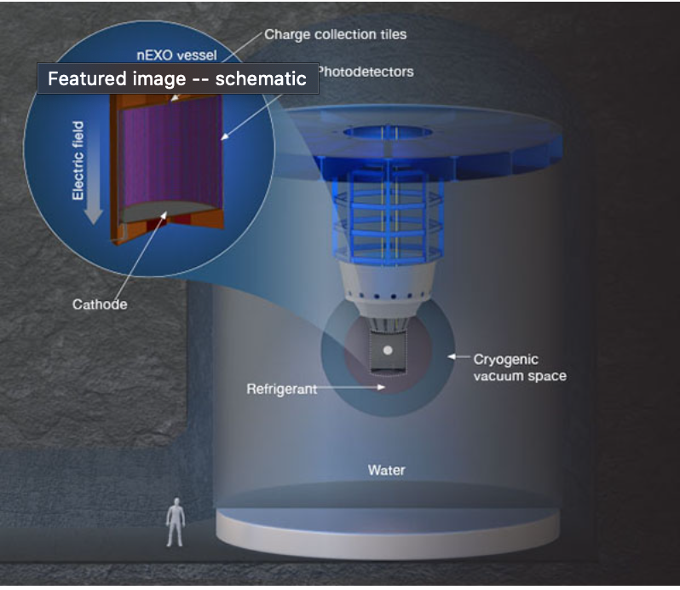
nEXO Experiment
2νββ
0νββ

Slide 3
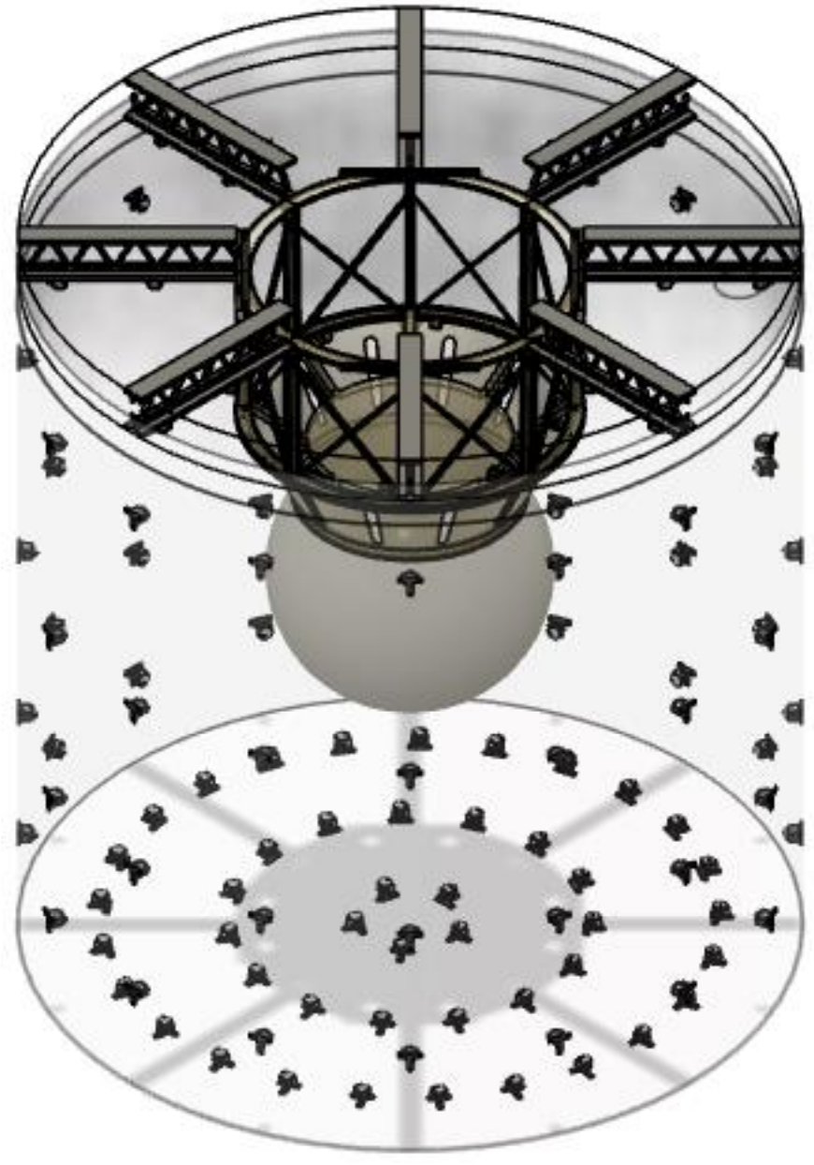
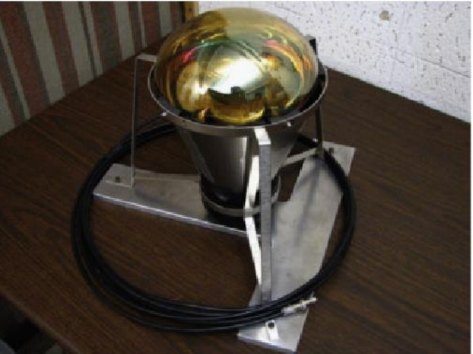
nEXO Outer Detector
12.8 m x 12.3 m tank of ultrapure water
Neutron moderation
Muon veto
Figures: Samin Majidi

Slide 4
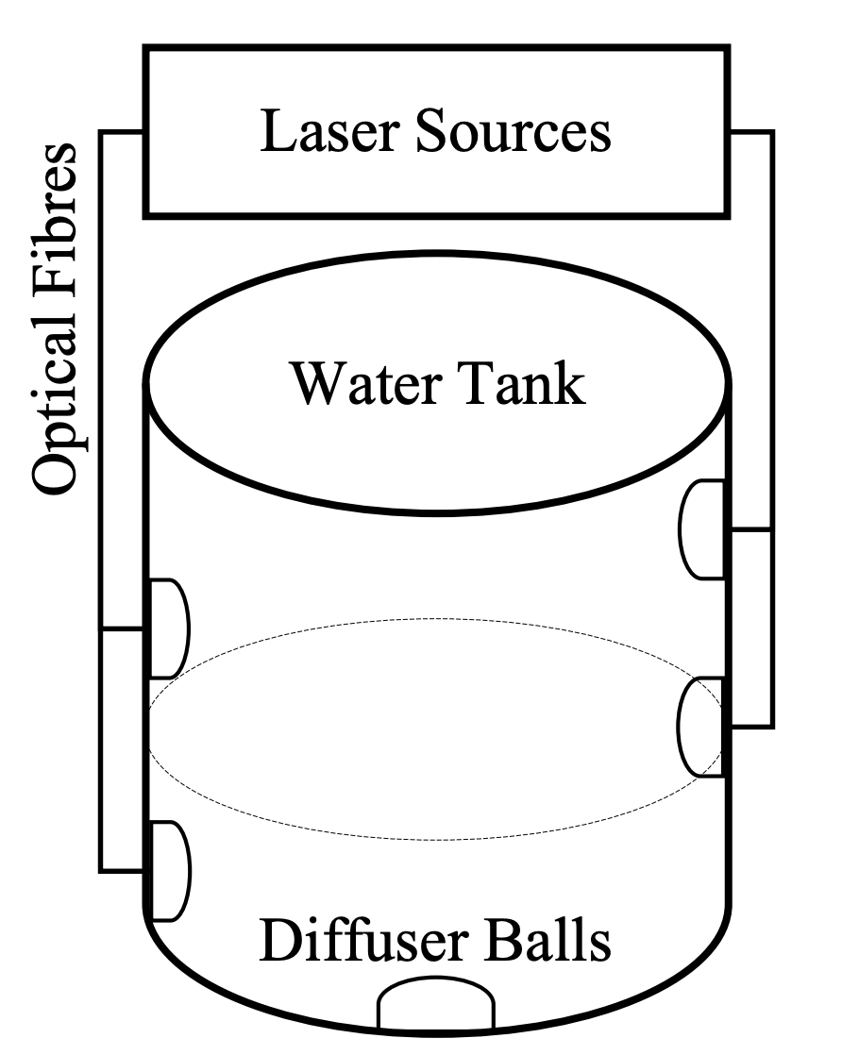
nEXO Outer Detector Calibration
Figures: Samin Majidi

Slide 5
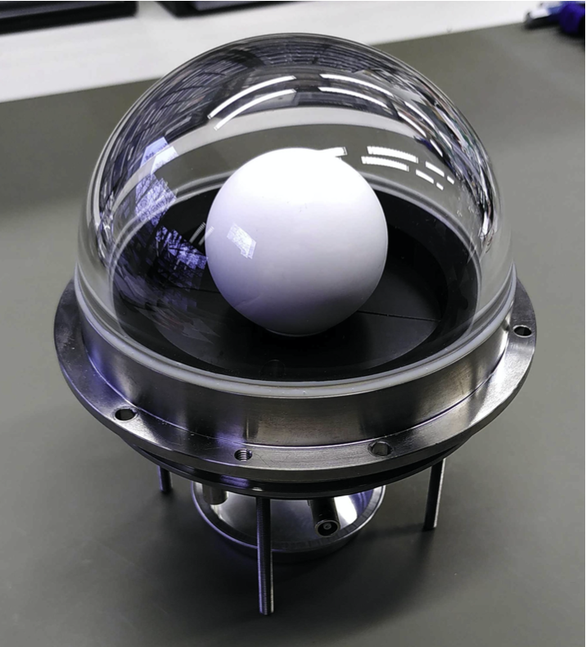
Diffuser Ball Isotropy
Goal: verify the isotropy of the device
Put together light simulations
Model device geometry
Determine optical parameters of component materials

Slide 6
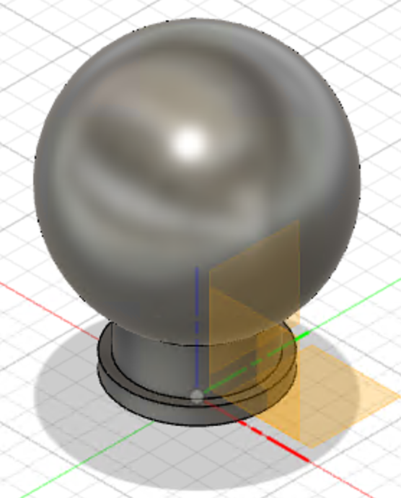
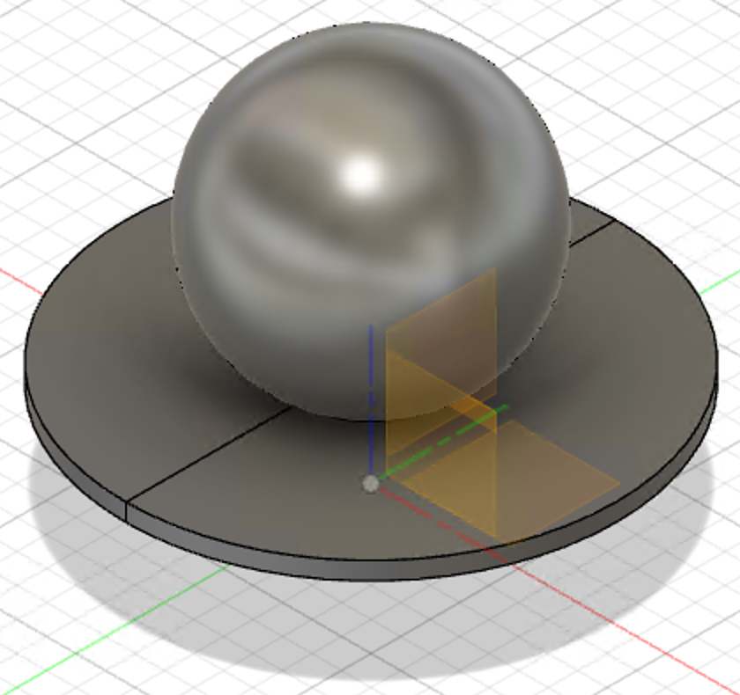
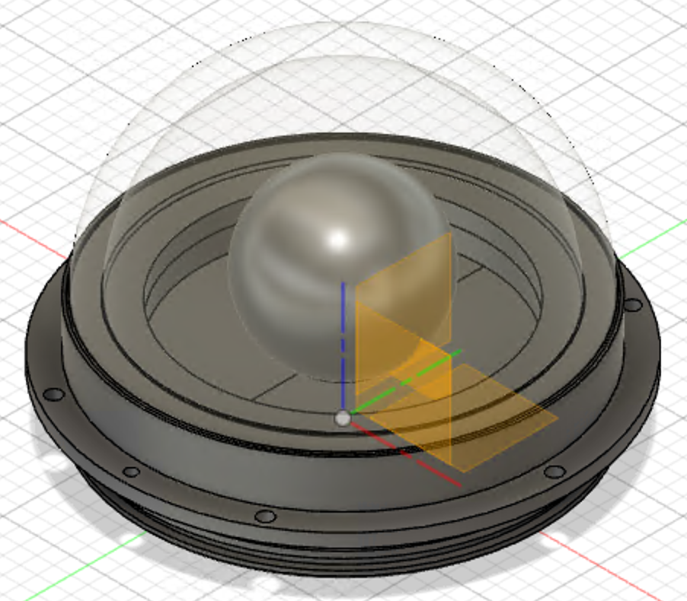
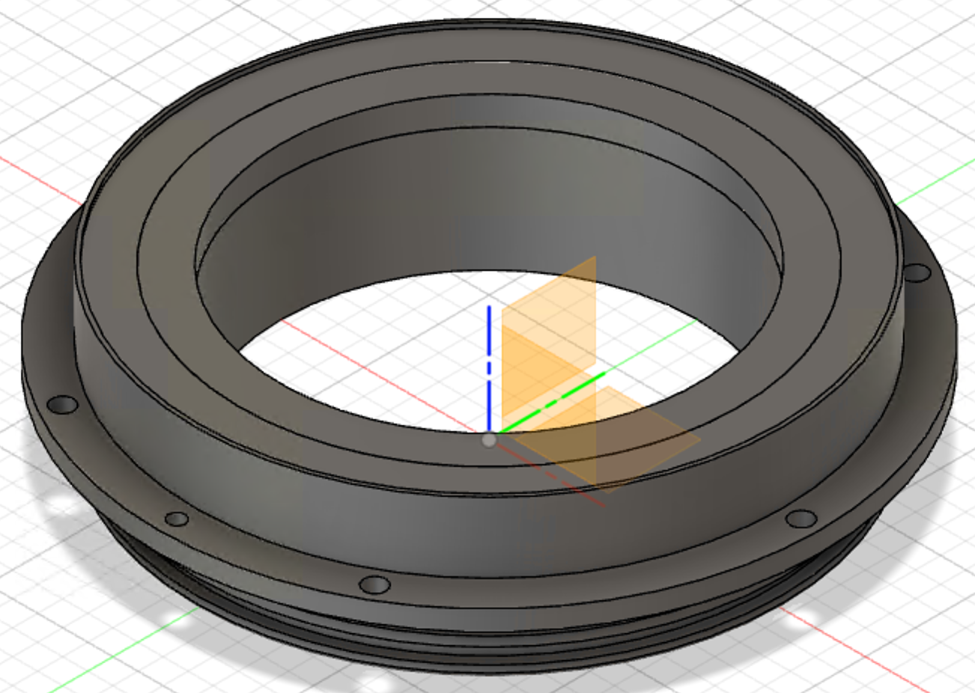
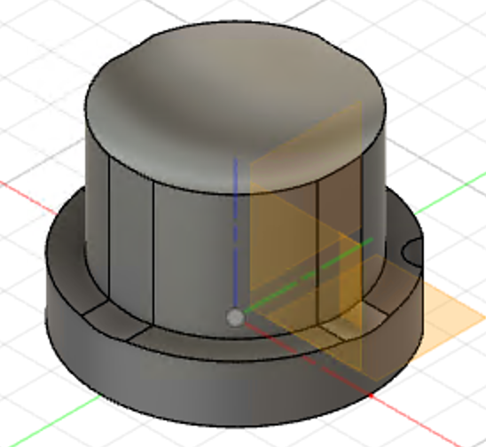
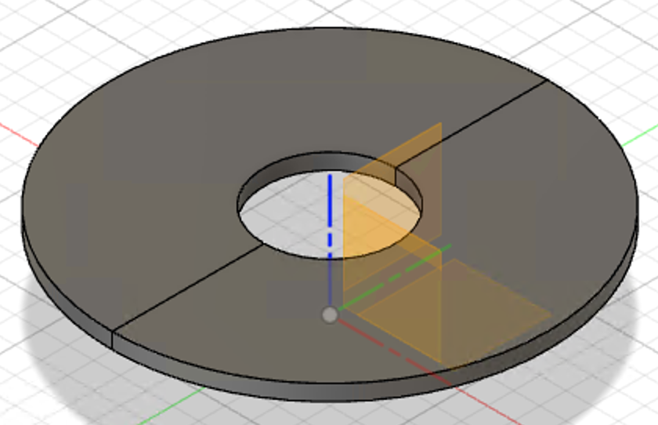
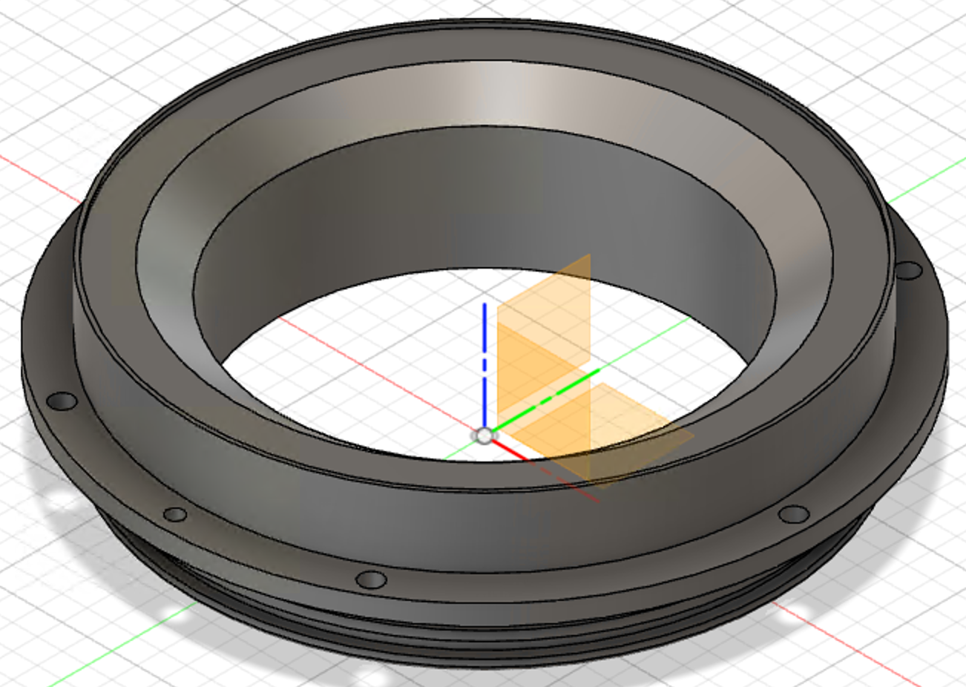
Diffuser Ball Design

Slide 7
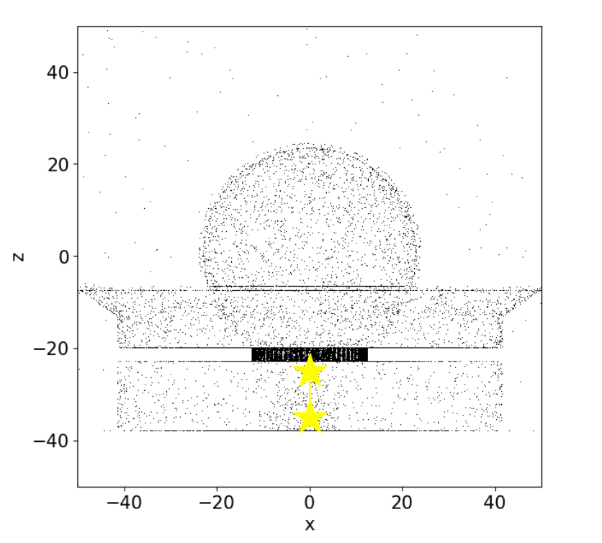
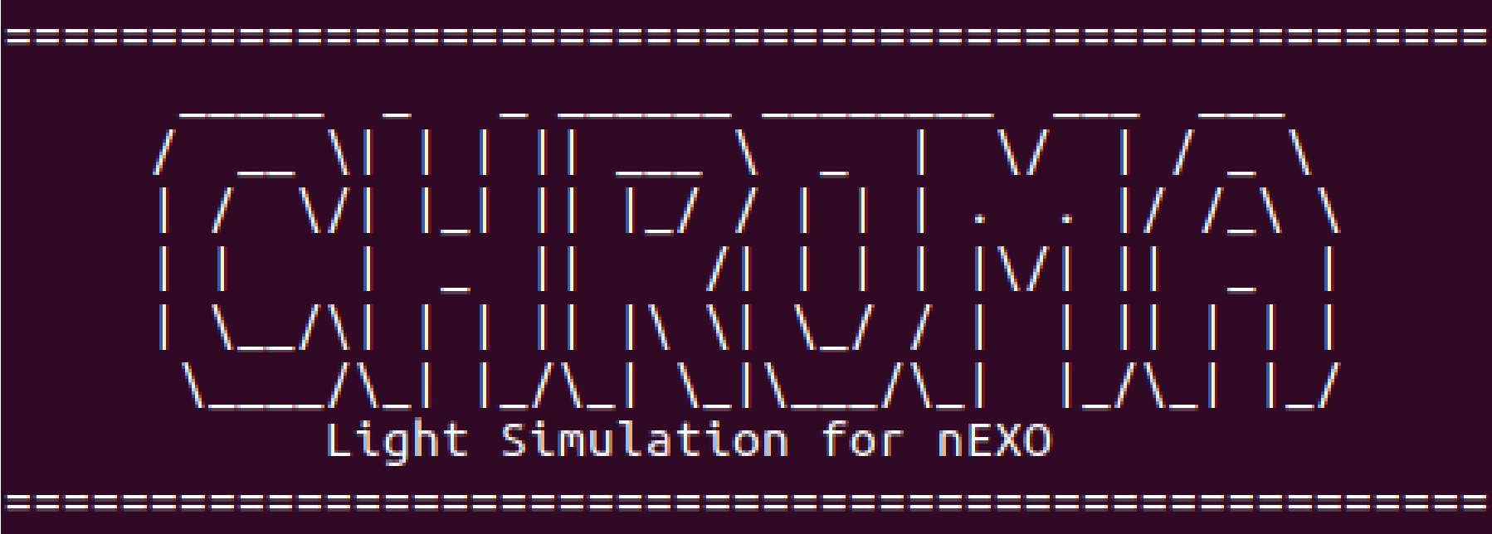
Chroma
Monte Carlo-based ray-tracing package
Specify component materials and material optical properties
Laser beam light generator

Slide 8
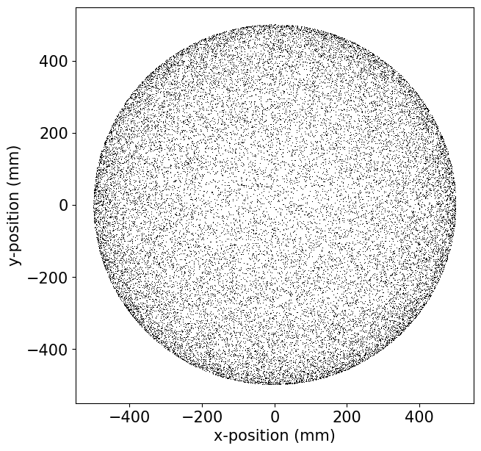
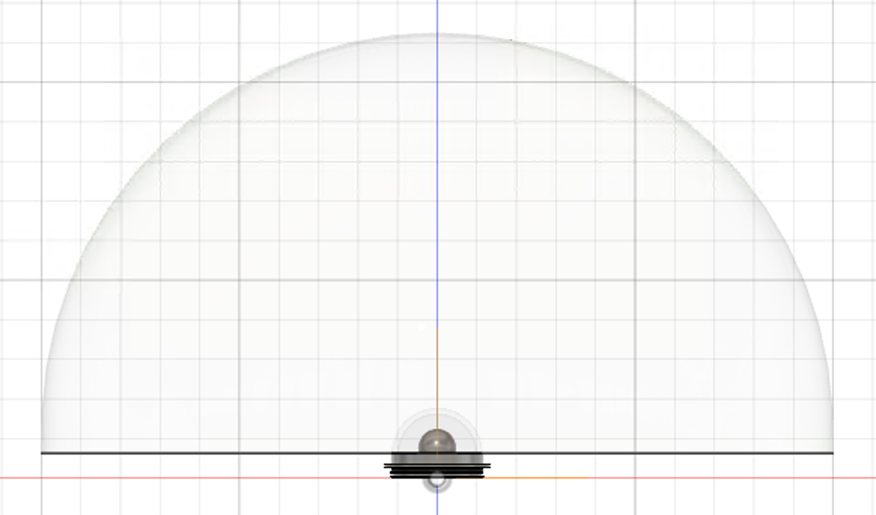
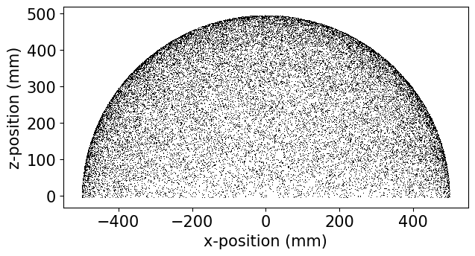
Simulation Geometry
Detecting surface: hemisphere shell

Slide 9
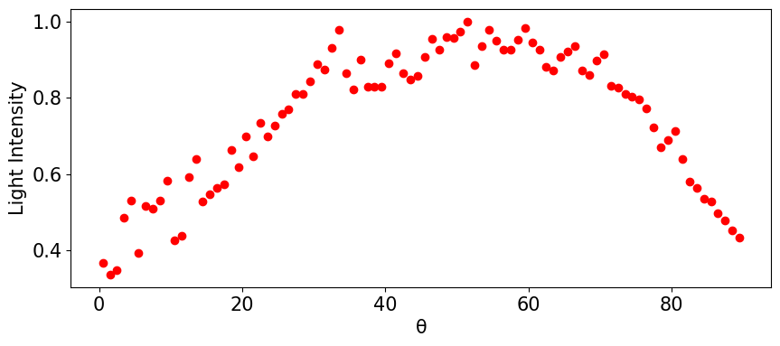
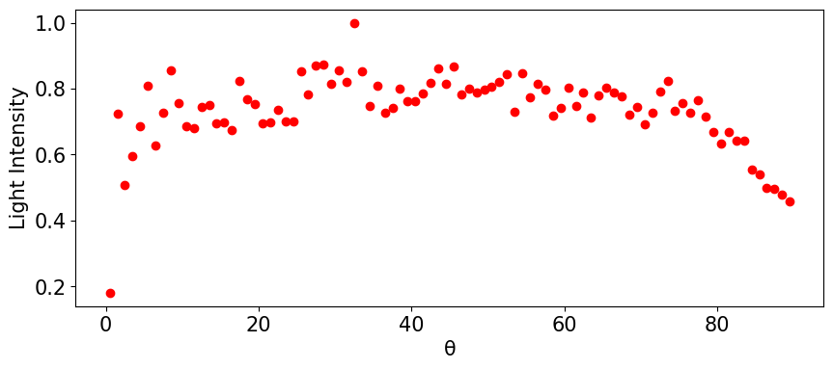
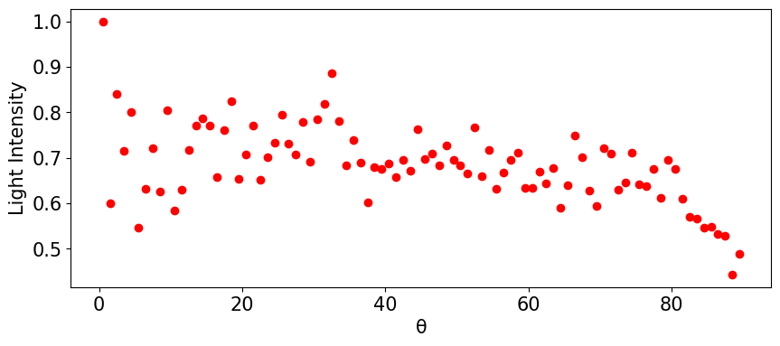
Isotropy Analysis
Reflectivity value
100%
50%
0%

Slide 10
Conclusion
Reflectivity of inner components has significant impact on the isotropy of the diffuser ball
Absorptive coating is required to ensure device isotropy
Simulations can be used to quantify attenuation through device for estimates of light intensity requirements

Slide 11
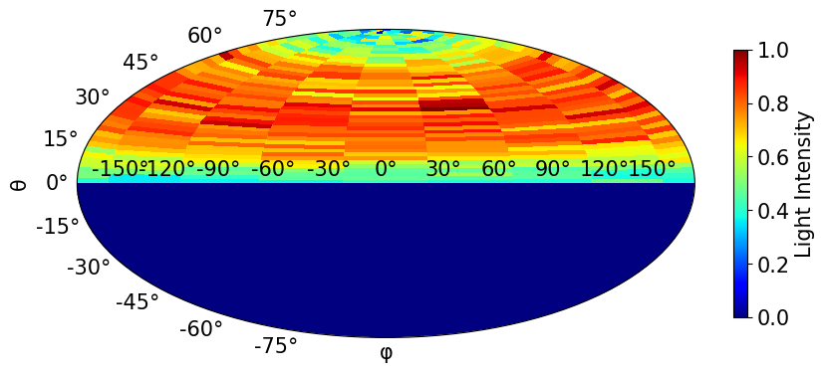
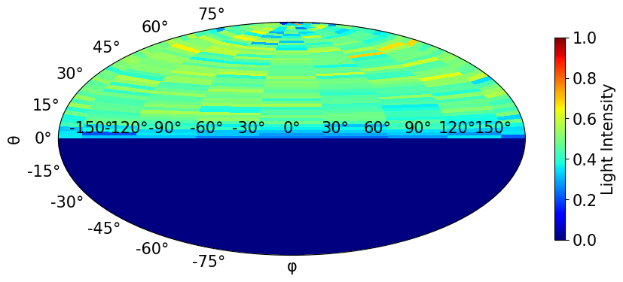
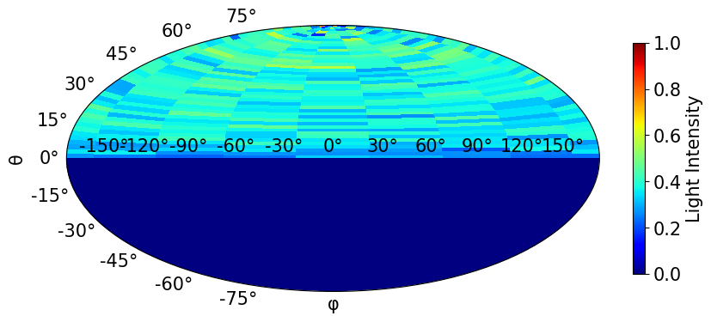
Remaining Work for Slides
Add references for figures (cite sources) and add a slide for references at the end
Talk about optical properties
Insert a slide about Cherenkov light?
Briefly describe diffuser ball configuration project (additional context, only if presentation is too short)?
Talk more about Chroma?
Mollweide Projections?
Appendix

Slide 12
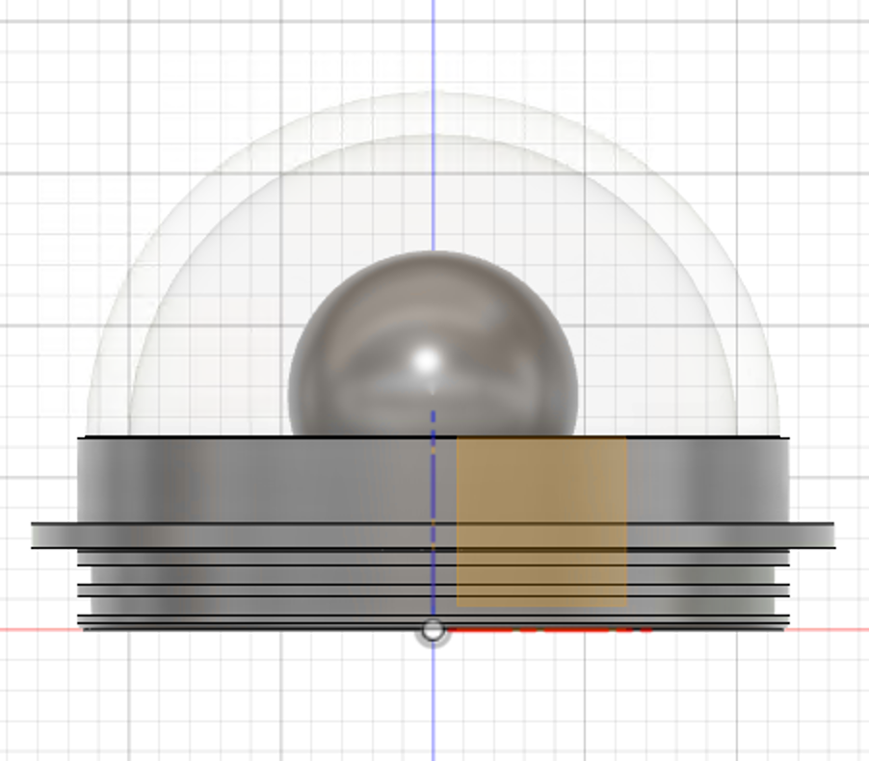
Diffuser Ball from the Side
Light emitted from diffusing sphere for θ > 60º w.r.t. the base of the pressure housing glass gets absorbed into the chamfer, half-disks

Slide 13
Optical Properties

