Slide 1
HVeV Run @ CUTE
Emilia Topp-Johnson

Slide 2
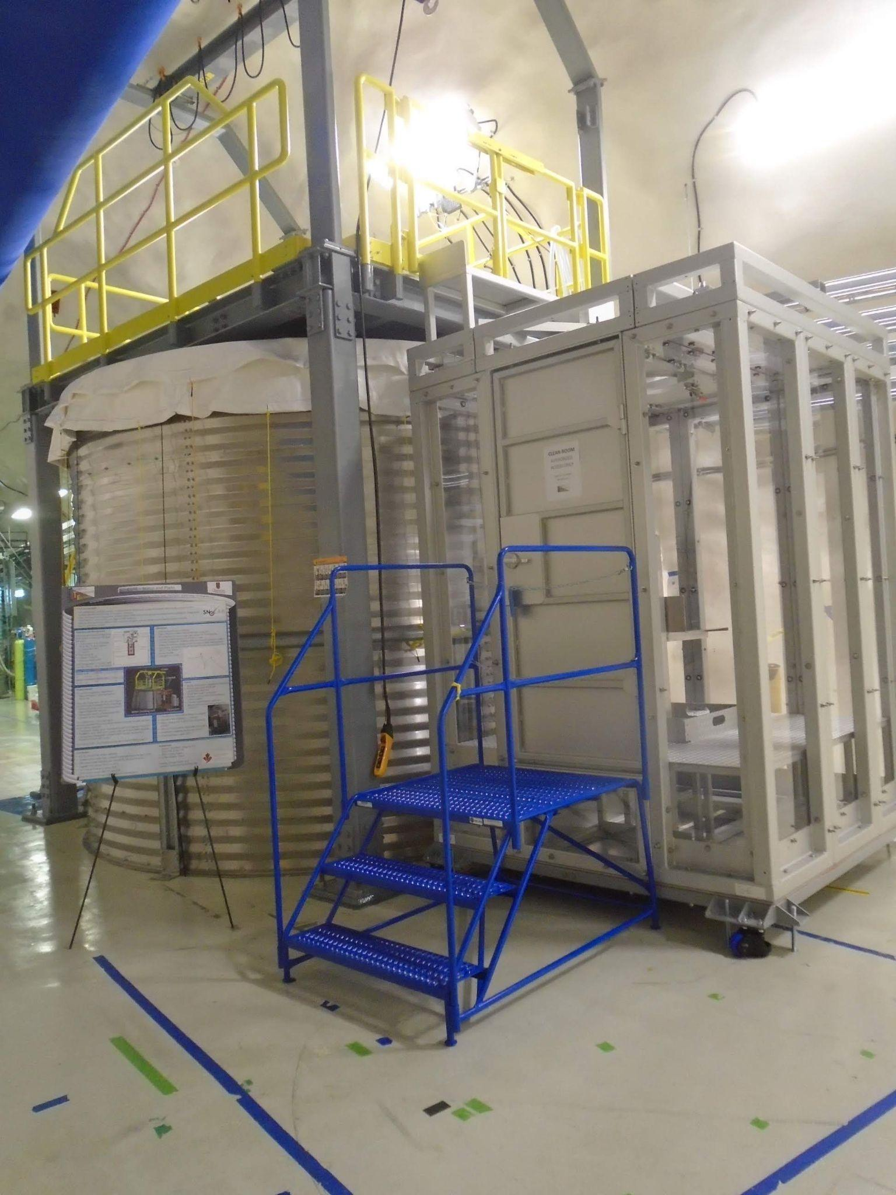
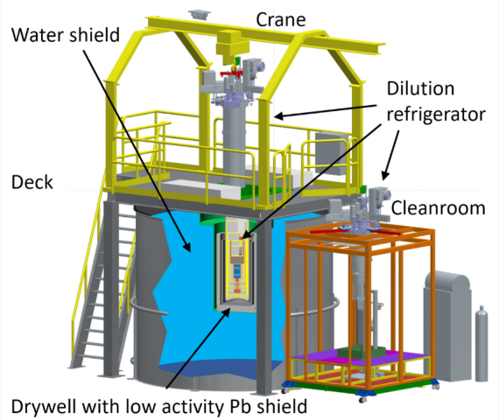
CUTE
Cryogenic Underground TEst

Slide 3
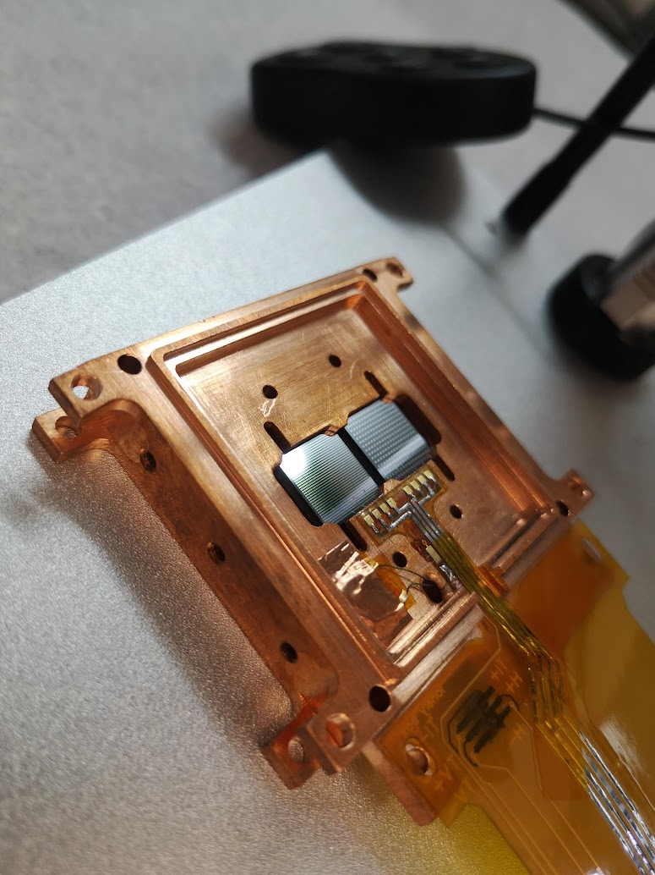
Cryogenic Particle Detector
Particle interacting with a target material
Resulting change in temperature
In the case of HVeV, Silicon crystals
Sensors
Aluminum/Tungsten superconducting films
Holder
Copper (good thermal conductor)
Cooled to very low temperatures
~12 mK
Lowers thermal noise

Slide 4
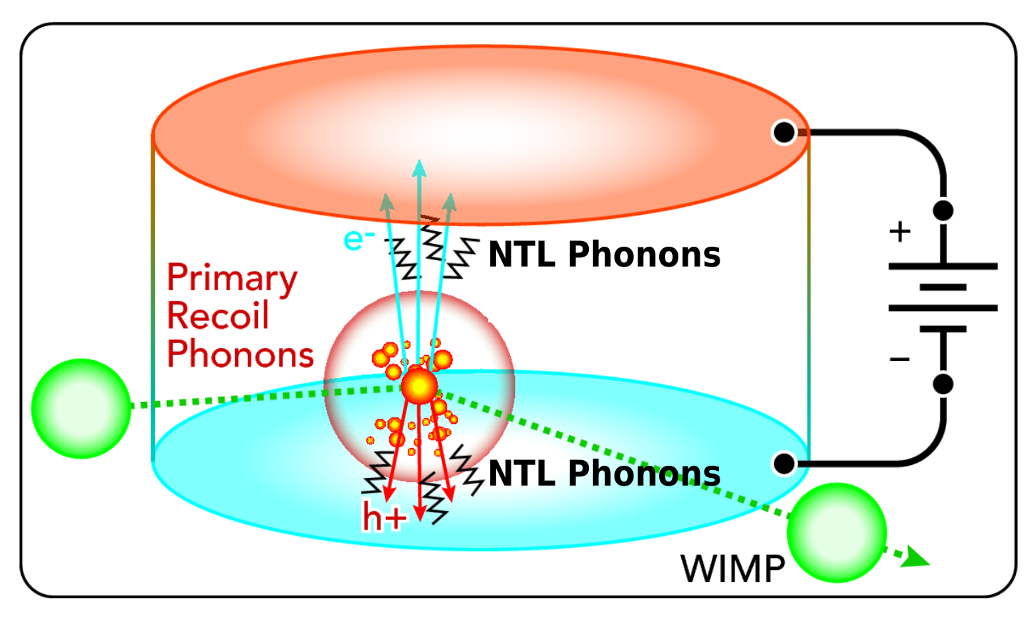
HVeV Detectors
Particle interacts with crystal
Deposits energy into crystal lattice
Phonons propagate through detectors
High voltage application = apply the field across the crystal
Accelerates the charge carriers, which helps with low energy
Neganov-Trofimov-Luke gain

Slide 5
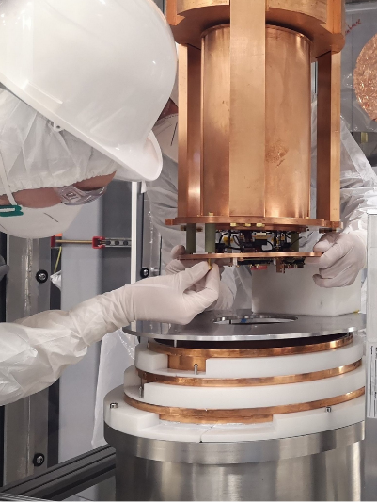
HVeV CUTE Run Objectives
Low resolution (low energy detection)
LED calibration
Low energy excess study
Eventually find dark matter

Slide 6
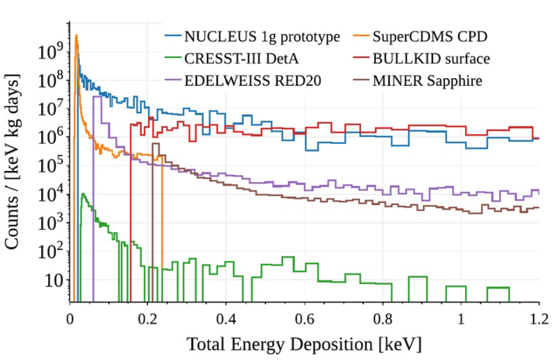
Low Energy Excess
Events measured in low energy spectrum
Number of events highly exceeds background predictions
Variation in signals across experiments = not likely to be dark matter

Slide 7
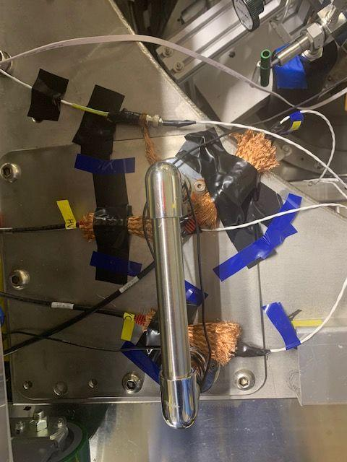
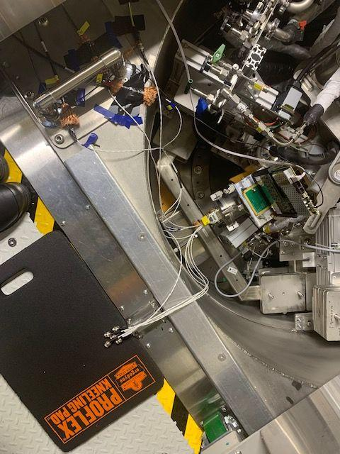
NOISE

Slide 8
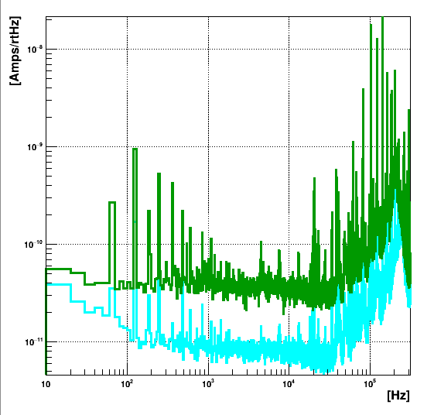
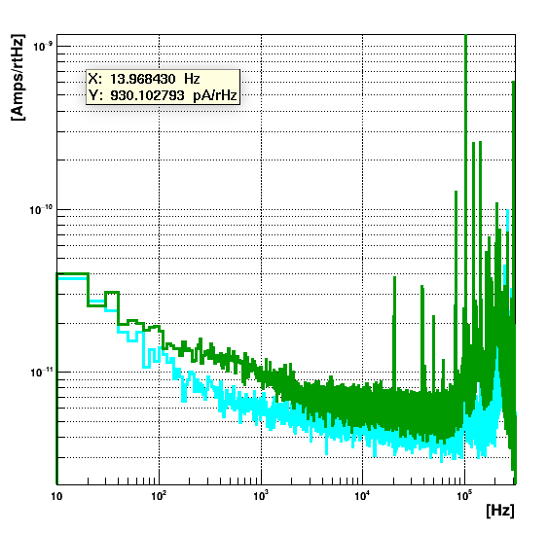
Noise Reduction

Slide 9
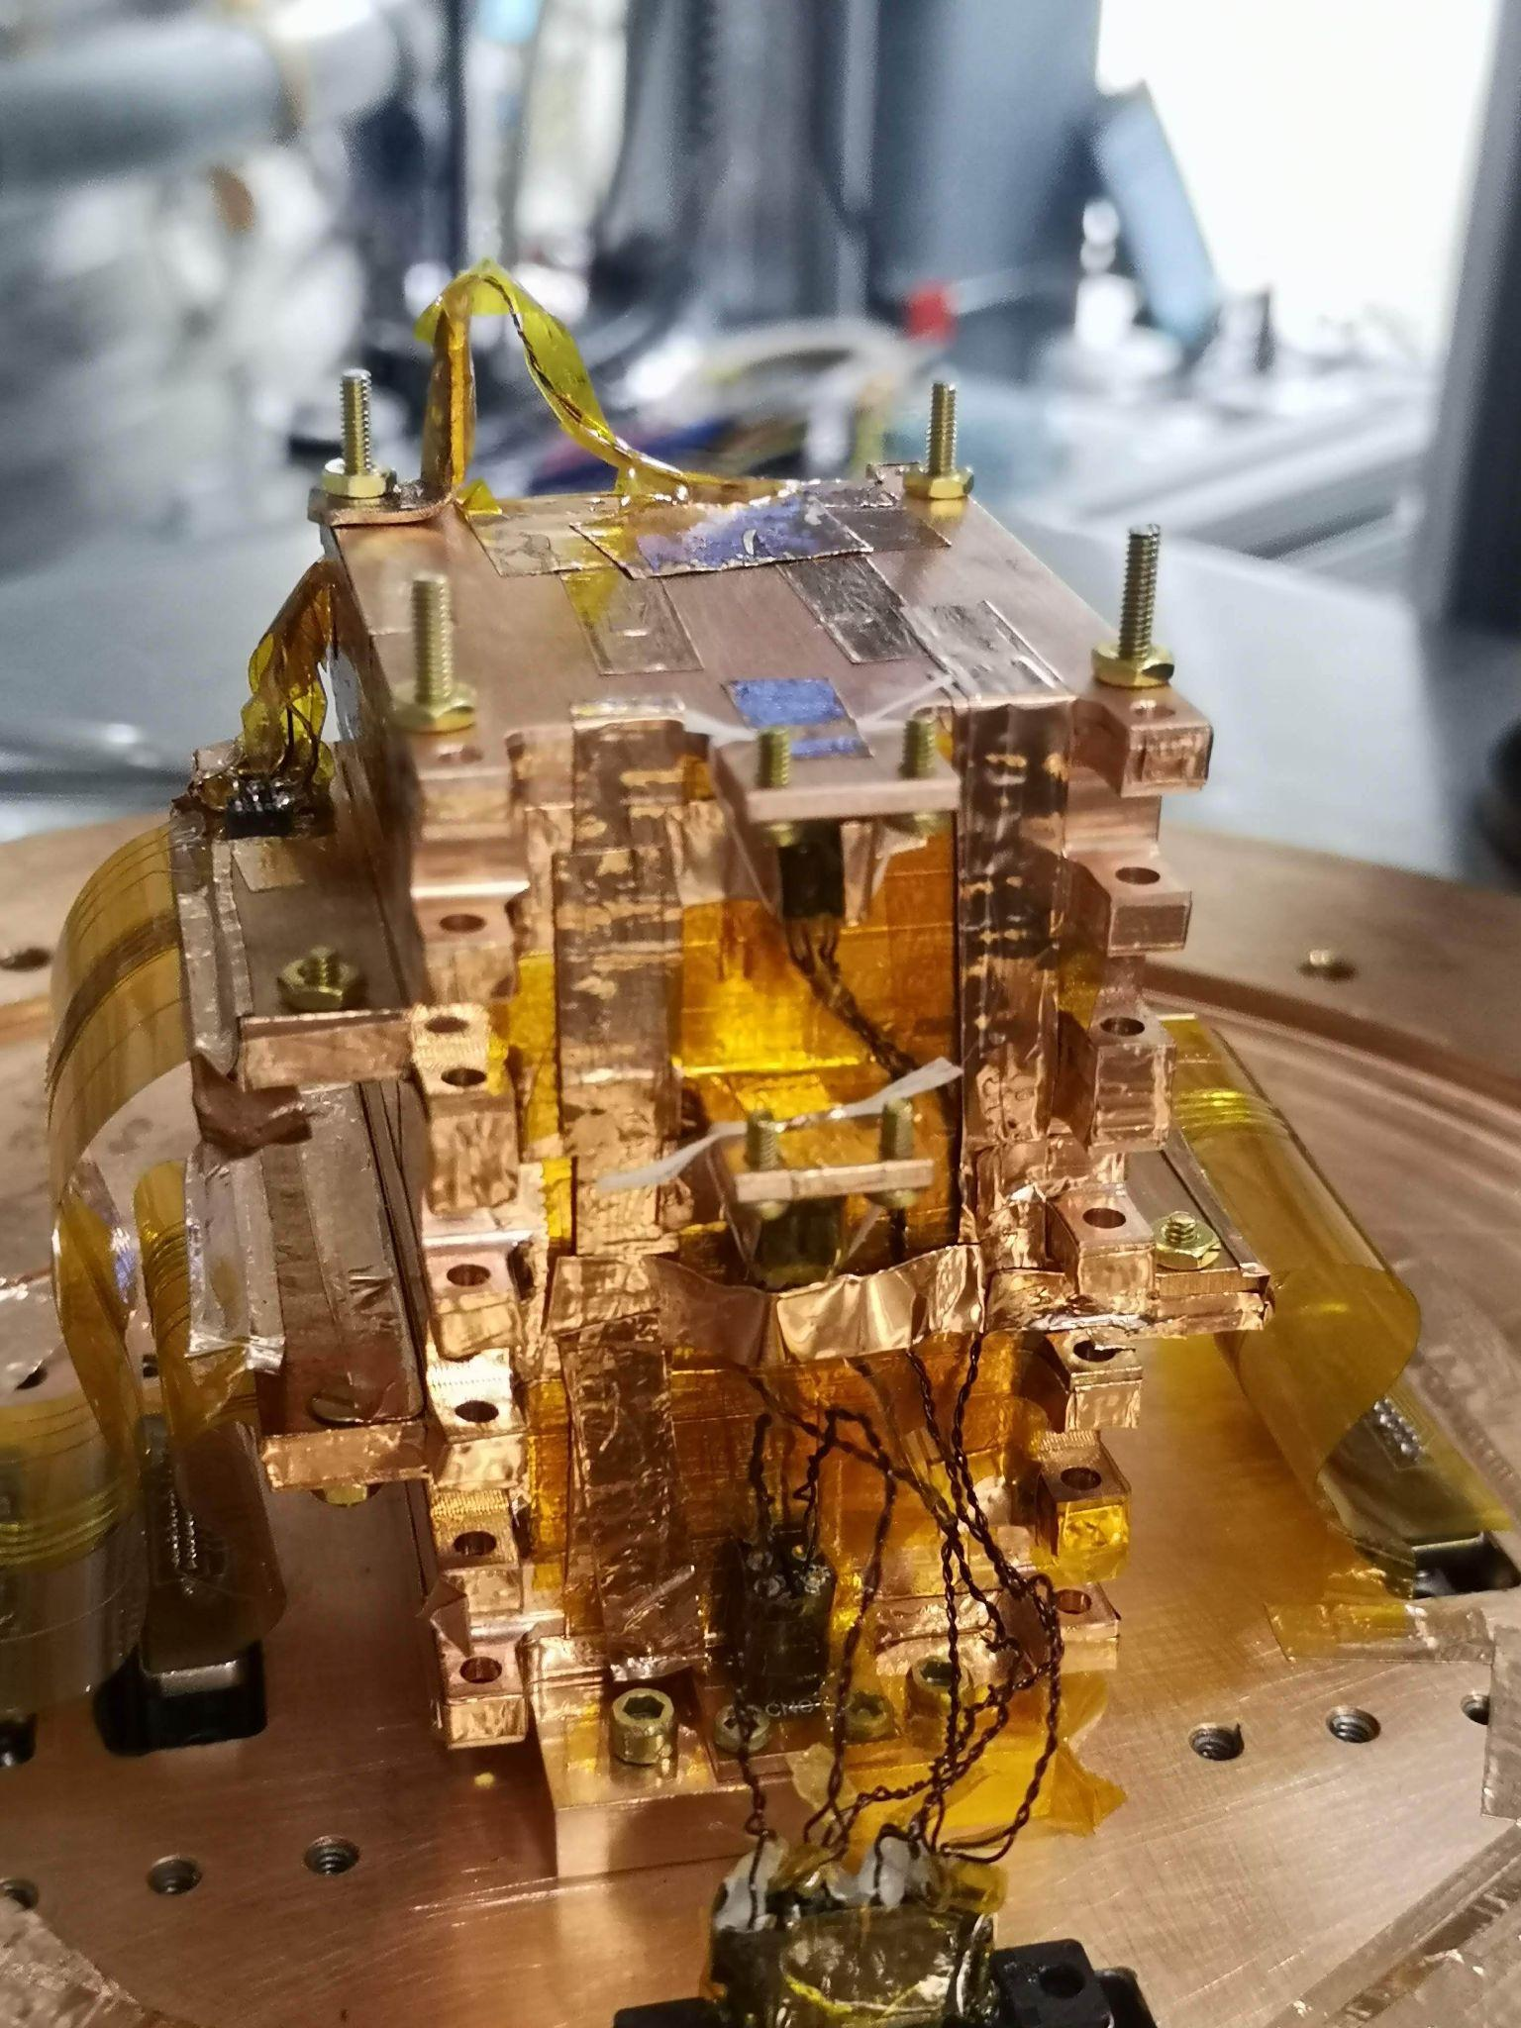
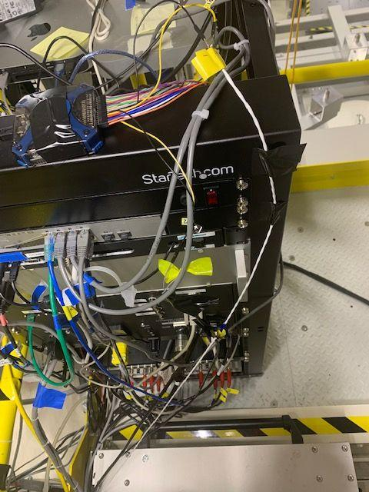
LED: Cable Synchronizing

Slide 10
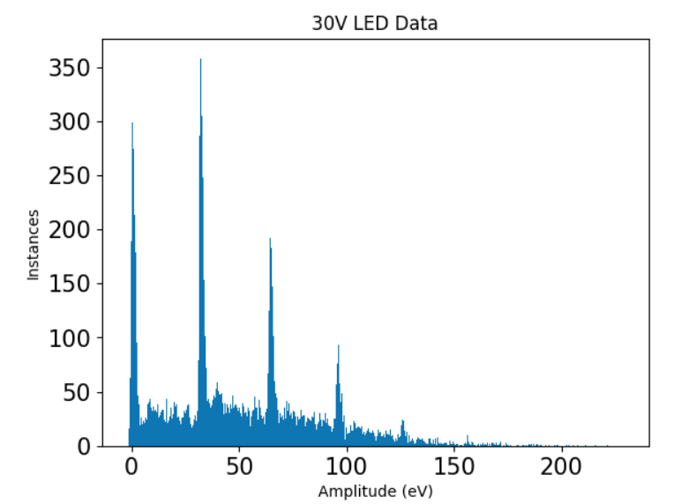
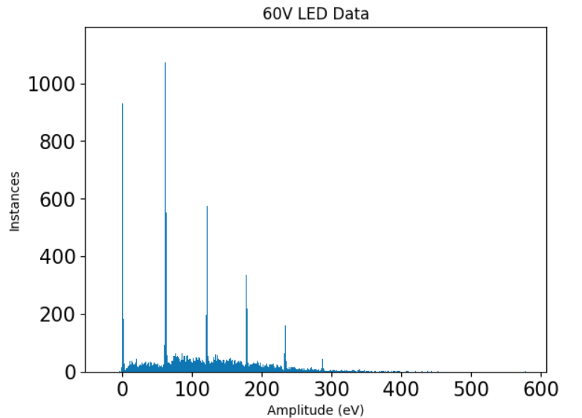
LED Calibration

Slide 11
Conclusions
HVeV detector is running and taking data
HV cable was a success - apply high voltage without introduction of extra noise
Calibrated detectors successfully with LEDs
Detector resolution of 0.65 eV!

Slide 12
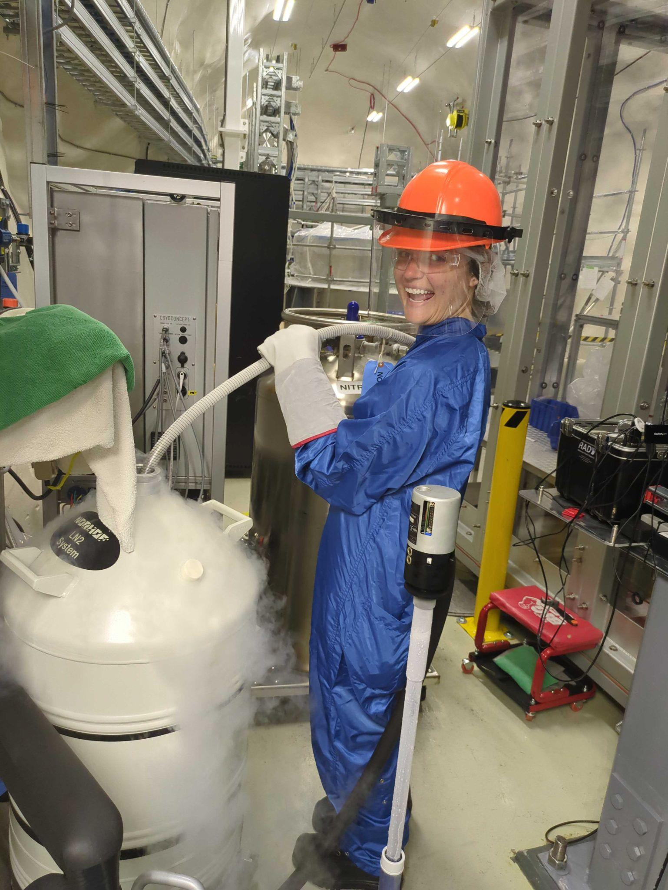
Thank You!

