Slide 1
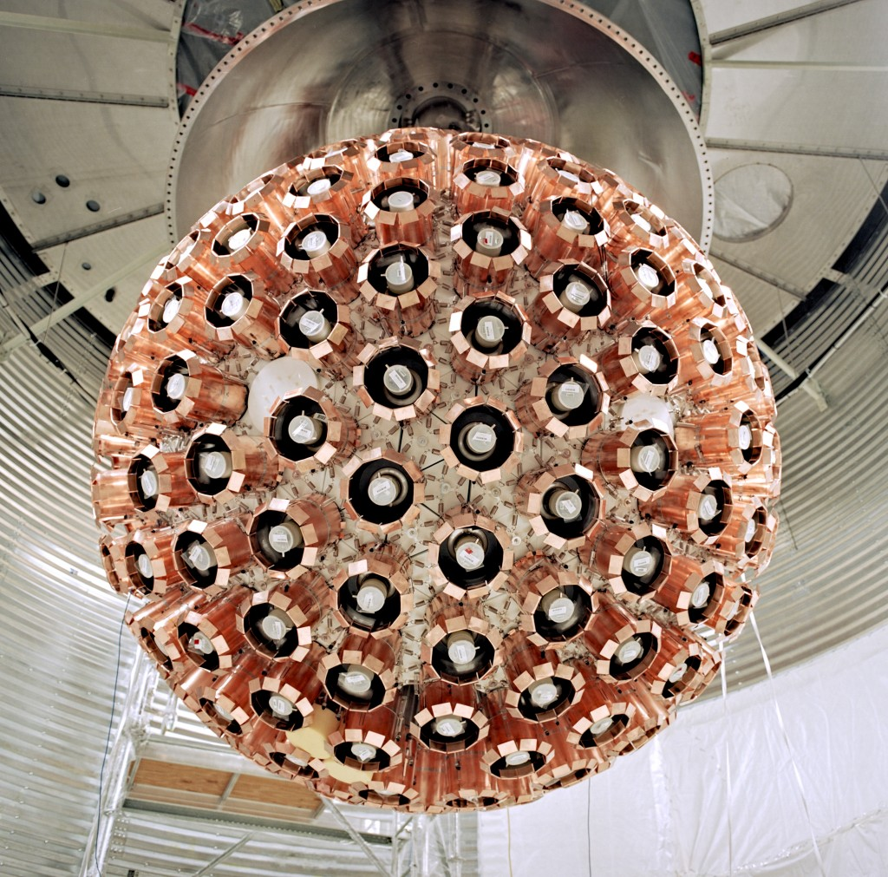
DEAP-3600 Upgrades, Liquid Level Estimation, and Automation
Rory Macdonald (he/him)
Queen's University

Slide 2
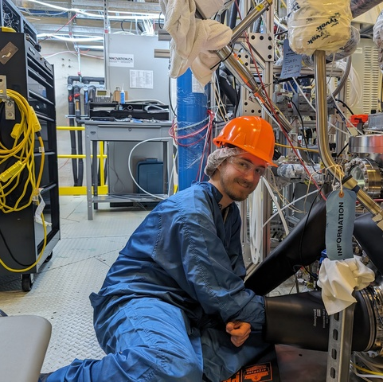
Hi, I'm Rory
Third year in computing and physics at Queen's
Worked at SNOLAB this summer
Was part of the DEAP-3600 dark matter experiment
Spent ~300 hours underground
1

Slide 3
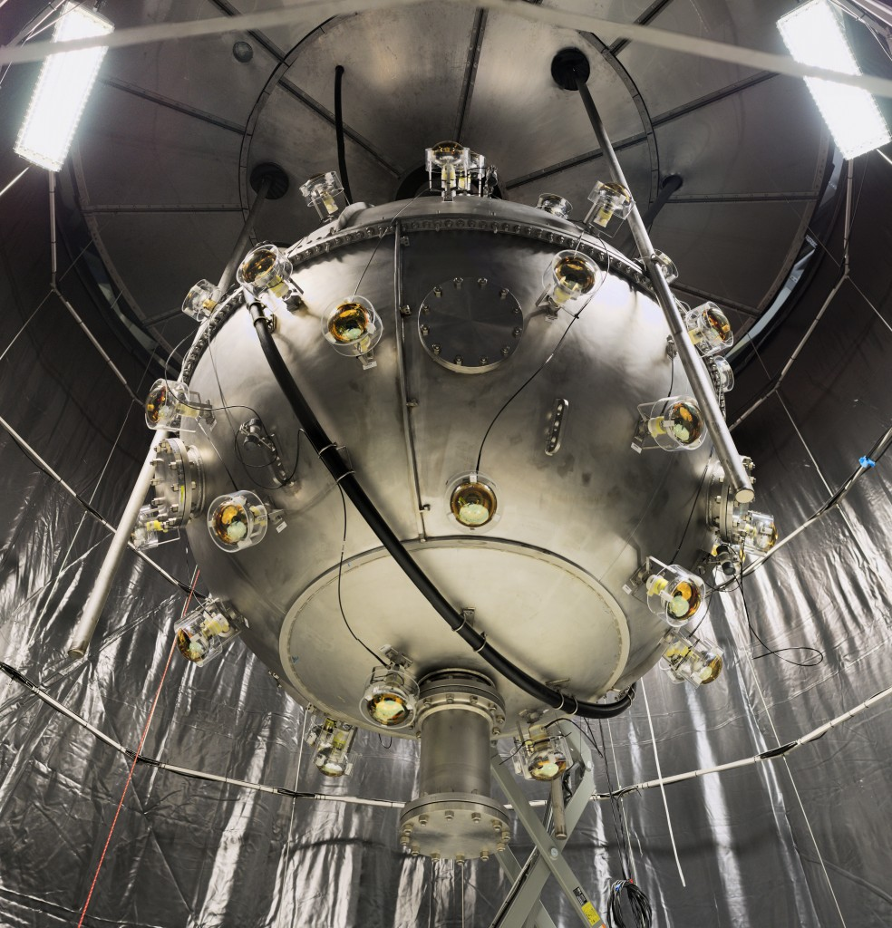
Experiments have a lot of parts.
Instrumentation
Analysis
Software
2

Slide 4
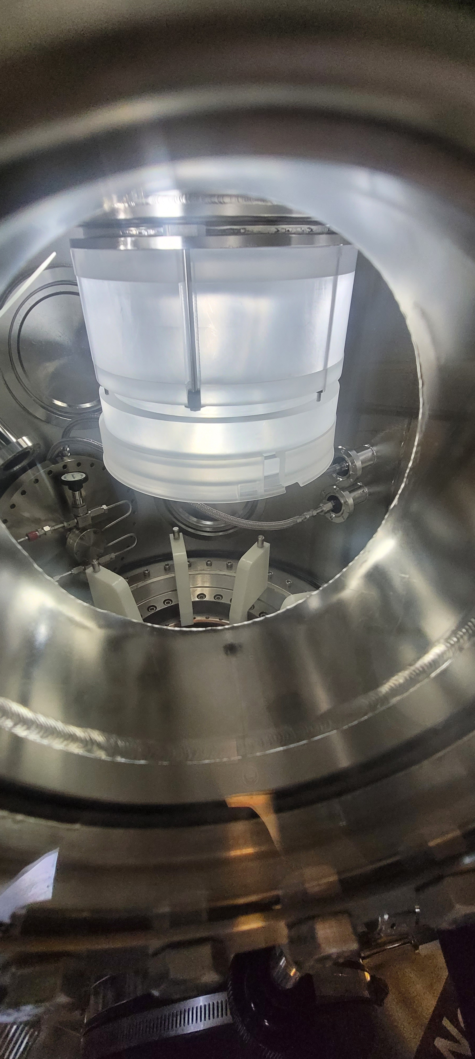
Underground Work
Installing new flow guides onto the neck
Installing the neck onto the detector
Commissioning the argon purification systems
Cleaning components for installation
Monitoring systems
General tasks and maintenance
Organization
Pump maintenance
3

Slide 5
Deployment Canister
4

Slide 6
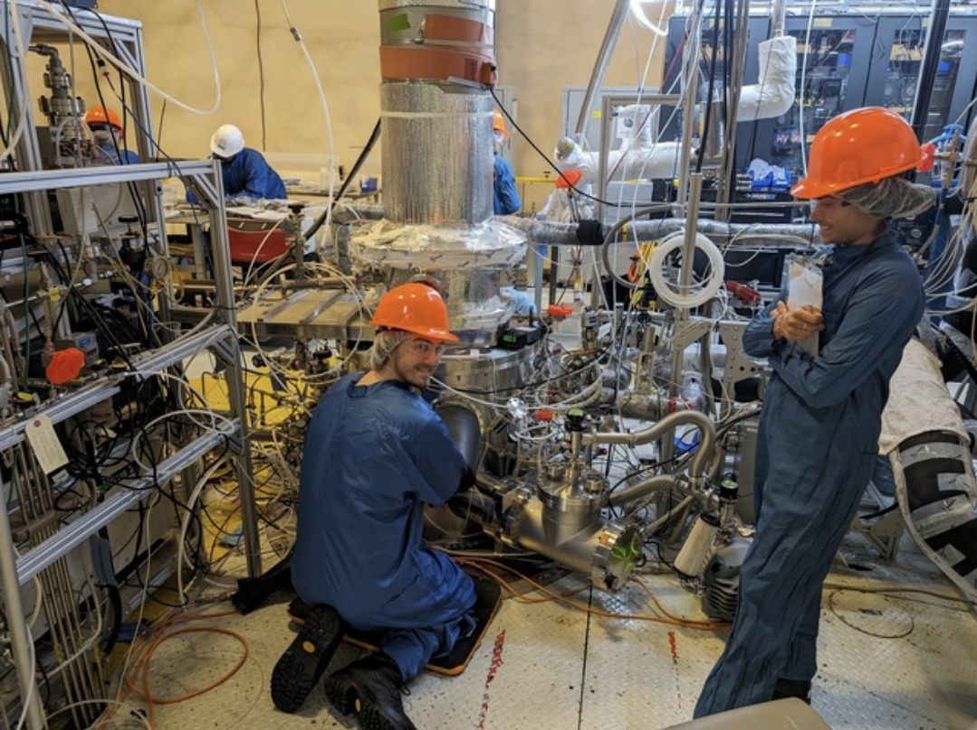
Glovebox
5

Slide 7
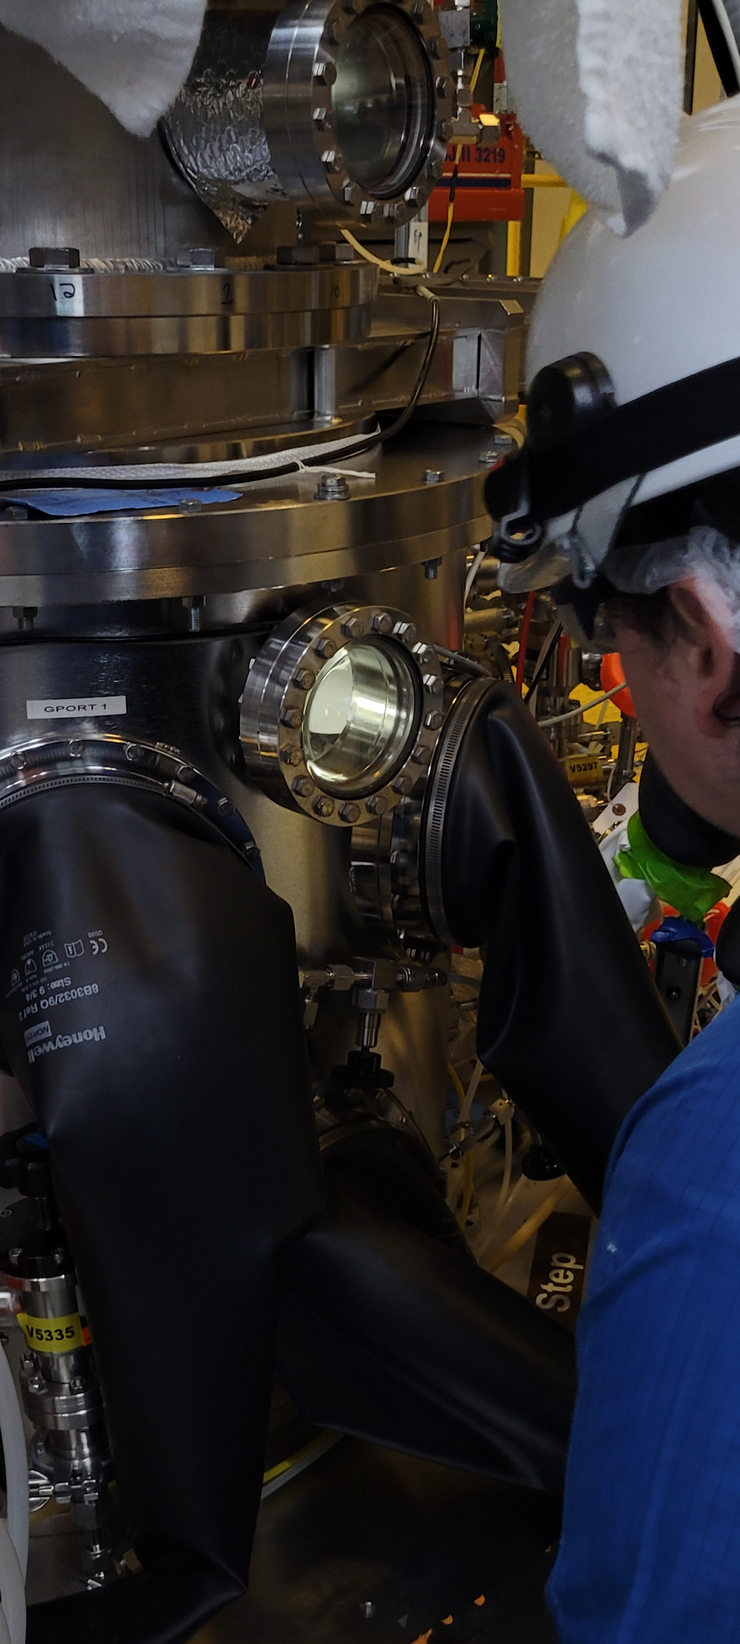
Flow guide Install
6

Slide 8
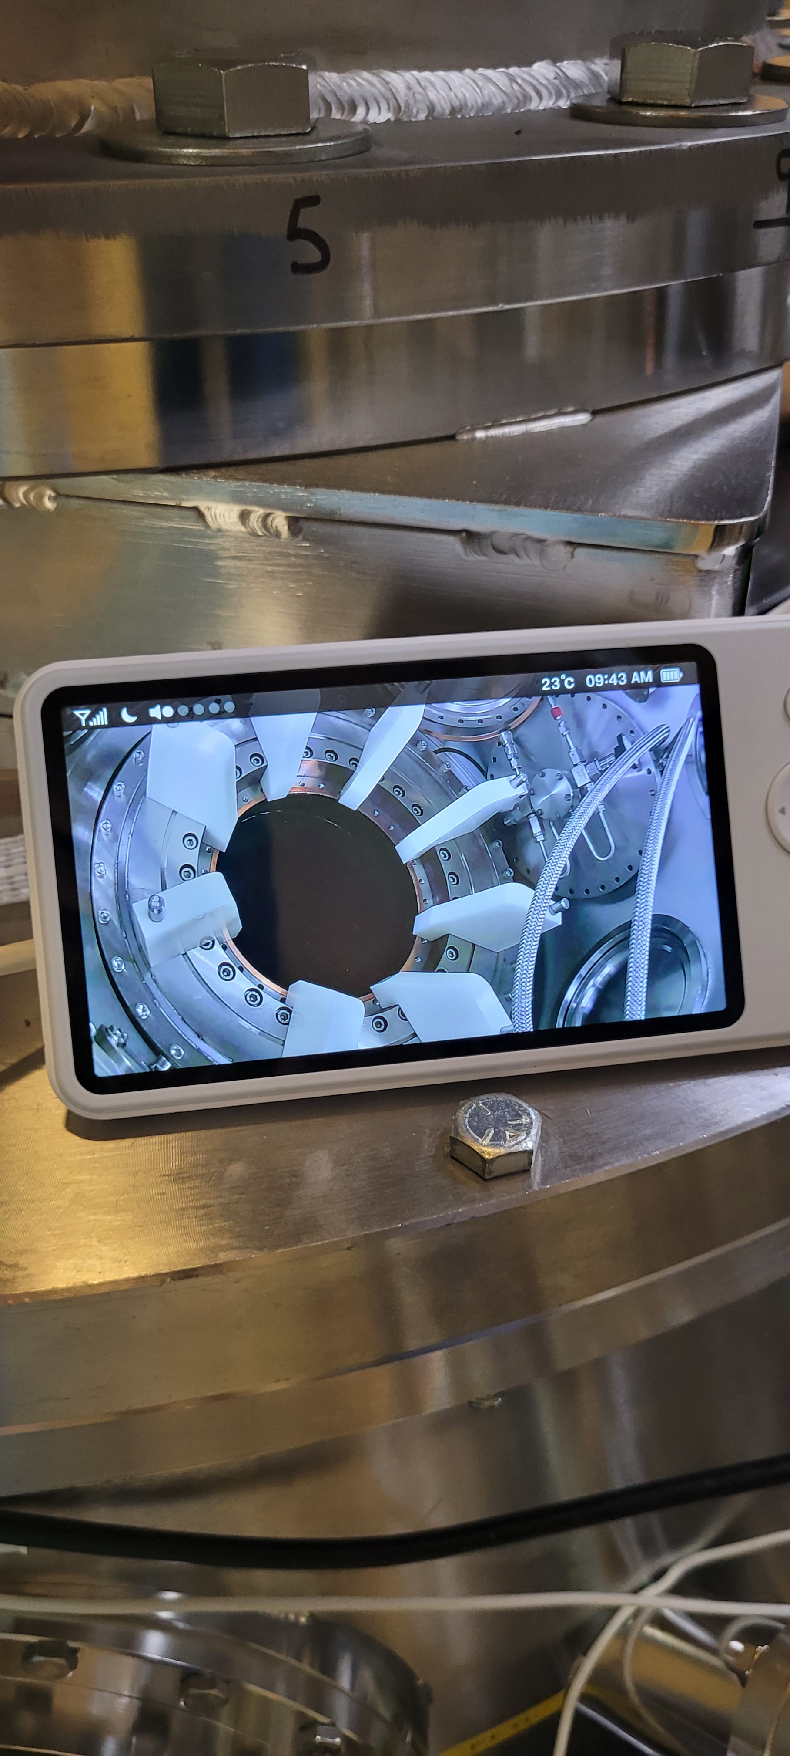
Acrylic Vessel (AV)
Brought to you by the baby monitor inside the glovebox (GB)
7

Slide 9
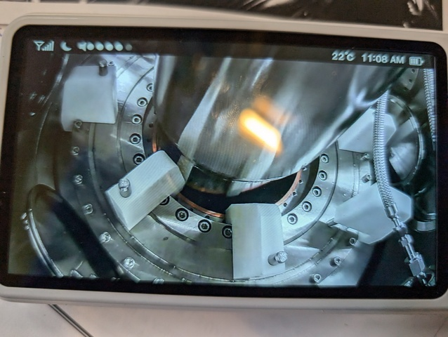
Lowering Neck / Flow Guides
8

Slide 10
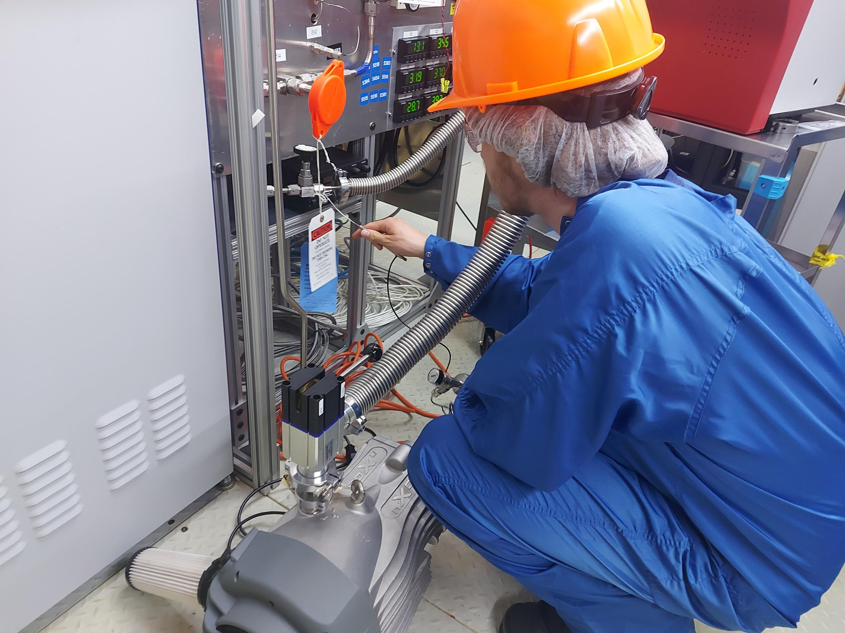
Other Work
Diaphragm Pumps
Leak Checking Pump/Purge Manifold
9

Slide 11
I want to see inside!
Apart from the glovebox, there is a distinct lack of windows
With all the shielding, I have never even seen the steel shell
Cannot see inside the AV
We use photomultiplier tubes (PMTs), so we don’t want extra light
10

Slide 12
So...We Can't Directly See our Liquid Argon
11

Slide 13
Liquid Level Estimation
Cannot directly observe the liquid level
Cannot use your hand, a ruler, or a camera
There is still a way though!
12

Slide 14
Load Cells for Mass Determination
Load cells (scales) on the top and bottom
Directly measures the weight of the detector
From this you can find out the mass of liquid added
Unfortunately, not accurate enough
13

Slide 15
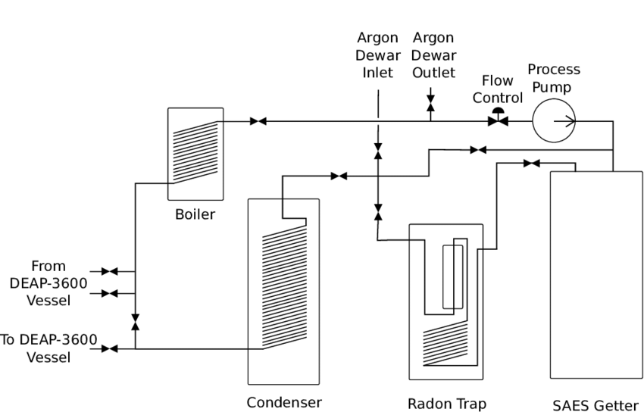
Mass Flow Controller for Mass Determination
As part of our process systems, we can track our argon flow into the detector
Unfortunately this is also not as accurate as we would like
14

Slide 16
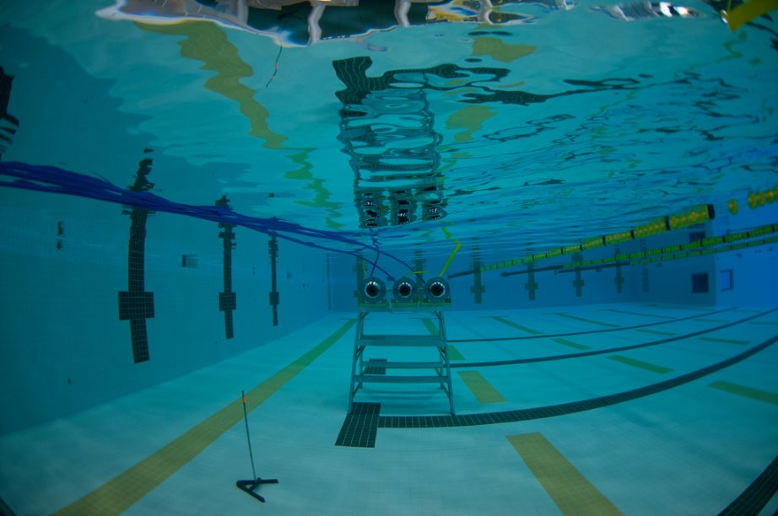
Using PMT Rates for Liquid Level Estimation
The basic idea is that PMTs below the liquid level (LL) will detect more photons
Scintillation rate
Light Yield
Total internal reflection
15

Slide 17
Divide PMTs into Rows
16

Slide 18
Plotting PMT Rates
Y-axis is the mean rate for a PMT in a given row
X-axis is row height
We can create a fit function to estimate the liquid level
Plotting using ~2000 events
17

Slide 19
Fitting:
18

Slide 20
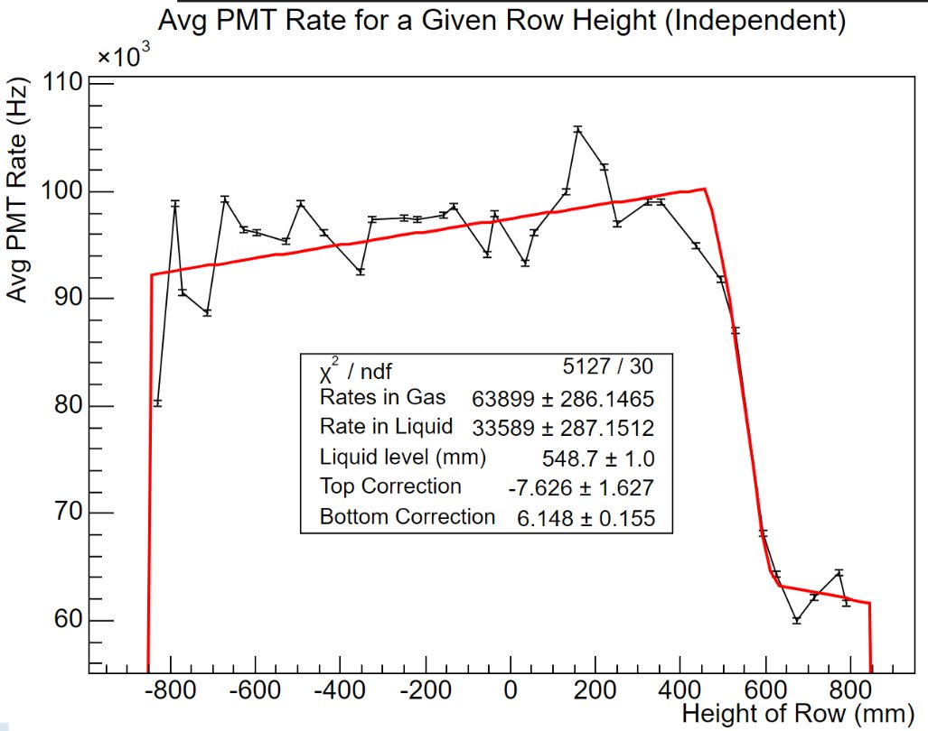
Started With too Much Noise
These fluctuations stayed over thousands/millions of events
Something inherent to the system
Not something my physics predicts
19

Slide 21
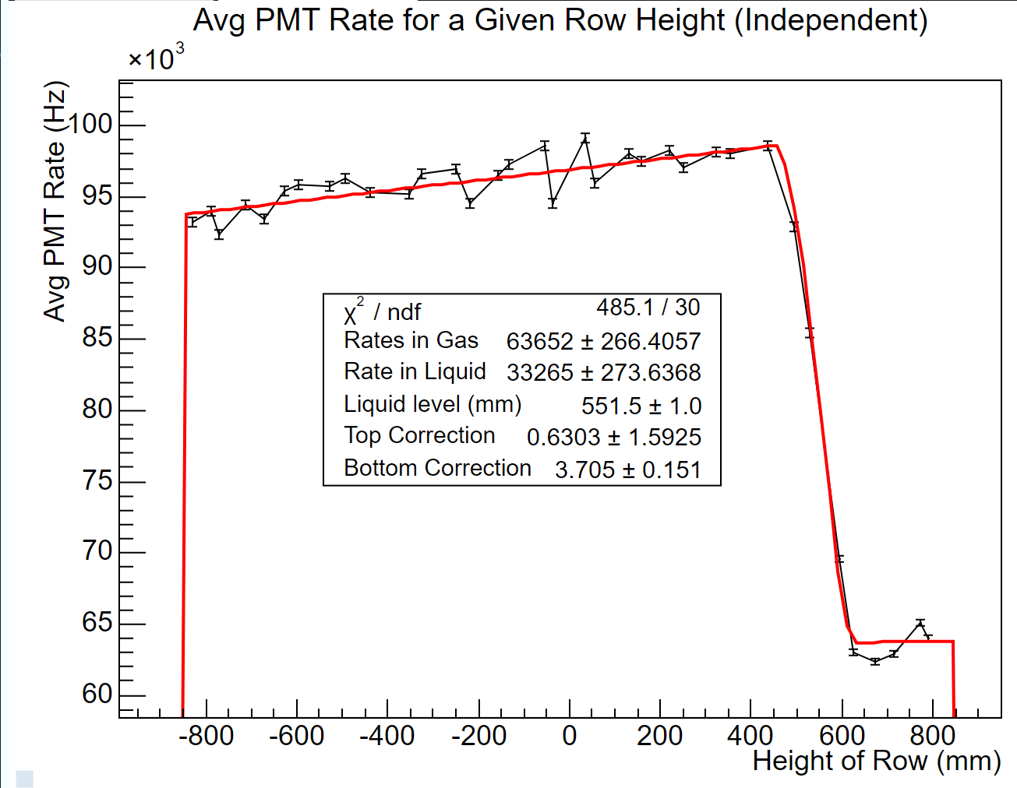
Accounting for PMT Efficiencies:
PMT efficiencies were not accounted for in the initial LL estimations, causing noticeable fluctuations
Before Efficiencies Applied
After Efficiencies Applied
20

Slide 22
Are We Close?
Yes. Probably.
Similar result with different methods
The uncertainties still need to be evaluated
21

Slide 23
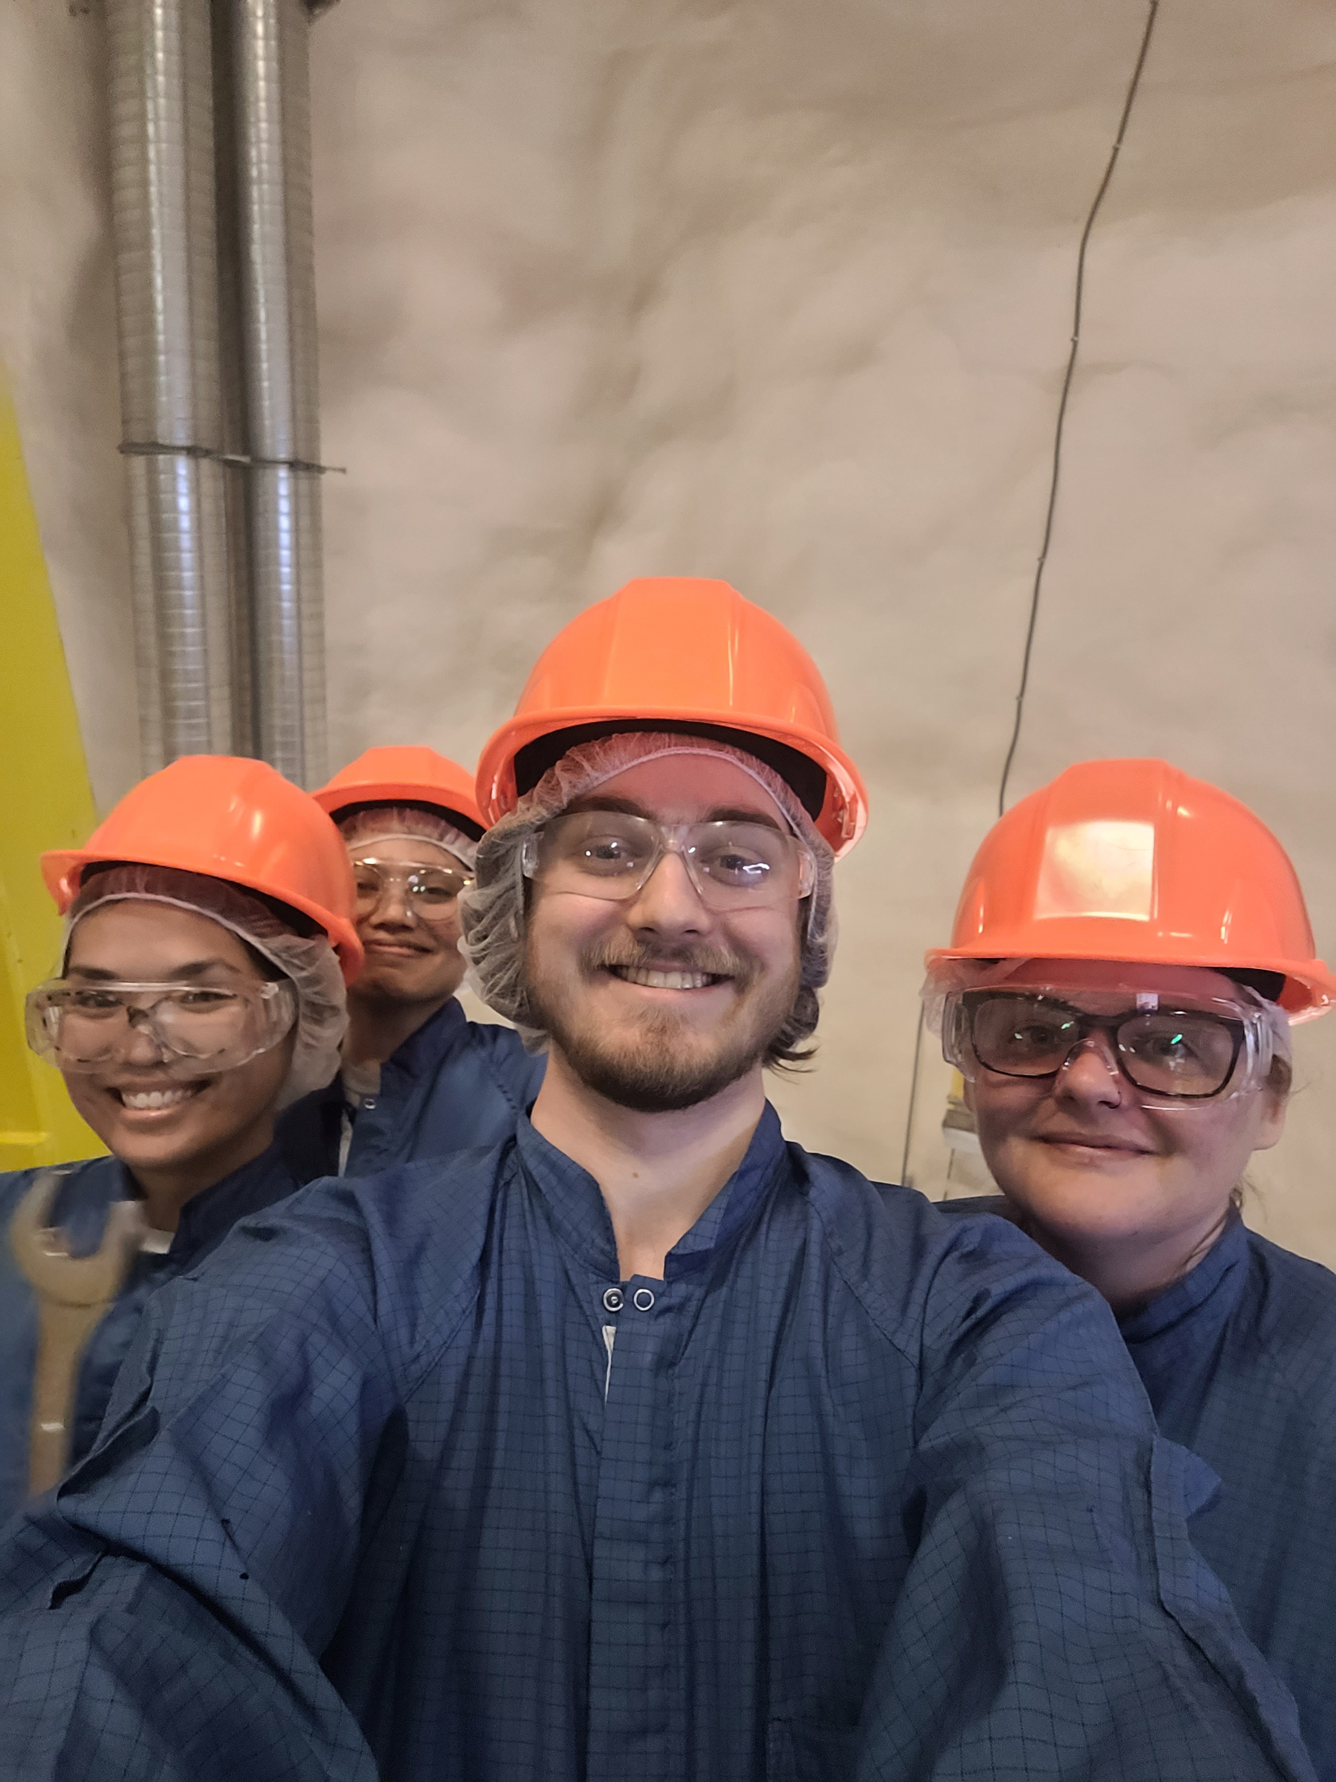
Thank you. Questions?
22

Slide 24
Backup Slides
23

Slide 25
Automatic Uploads
Our Printer
Python
Team Channel
deapdocs@snolab.ca
Sharepoint
Shift Report
Power Automate
24

Slide 26
Parameters:
Liquid level
Avg GAr Rate
Avg LAr Rate
Top Correction
Bottom Correction
Input:
Row Height (-846 to 846)
Current Fitting Function
Constants:
Geometries
Calculated:
RatioLGAreaImmerged
For PMTs Above LL:
Rate = GArRate+GArCorrection*(LGHeight-liquidLevel)
For PMTs Below LL:
Rate = (GArRate+LArRate)+(LArCorrection*LGHeight)
Partially Submerged:
Rate = GArRate+(LArRate*RatioLGAreaImmerged)
Calculated based on the height (differs per row)
25

