Slide 1
Zach Charlesworth
CASST Student Talk Competition

Slide 2
A brief history of the universe:
you want to be here (coffee break)
time
(not to scale)
Eminem records lose yourself
2008 market crash
Covid-19
you are here

Slide 3
Invention of sliced bread

Slide 4
Matter and antimatter created in equal parts
→ Then where is all the antimatter??
→ Are there asymmetries between matter ….and antimatter that could explain this ….discrepancy?
the Big Bang
ALPHA and HAICU: Make precision measurements of hydrogen and antihydrogen …………………..……..energy levels using the same apparatus
To have the same systematic errors
Notes:
same systematic errors by studying both hydrogen and antihydrogen in the same device

Slide 5
Current state of the Art:
ALPHA: Spectroscopic measurements of antihydrogen energy levels in a magnetic trap
{
Magnetic trap
Lasers
Antihydrogen
HAICU: Spectroscopic measurements of hydrogen energy levels in a magnetic trap
Hamamatsu VUV4
{
Lasers
Notes:
Add long term goal of HAICU
Mention Hamatsu VUV4 (~10% eff at 121nm)

Slide 6
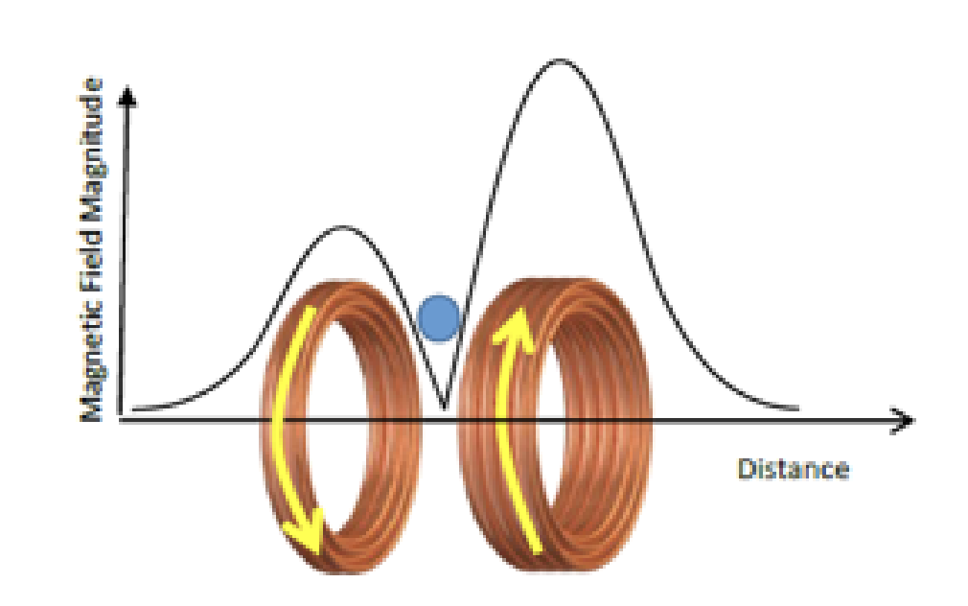
HAICU Layout
(Phase 1):
Magnetic Trap
Supersonic H beam
Colin Noort (UBC)
Bends beam 45°
Pulsed Valve
Decelerates beam
800 m/s → 200 m/s
Decelerates beam
200 m/s → 20 m/s
Bends beam 45°
Cryogenic source
Notes:
300 antihelholtz coils firing a different times. Moving trap
Antihydrogen caught in the trap
Phase 1 (restablish hydrogen magnetic trap spectroscopy), Future goals: extract hydrogen in free field

Slide 7
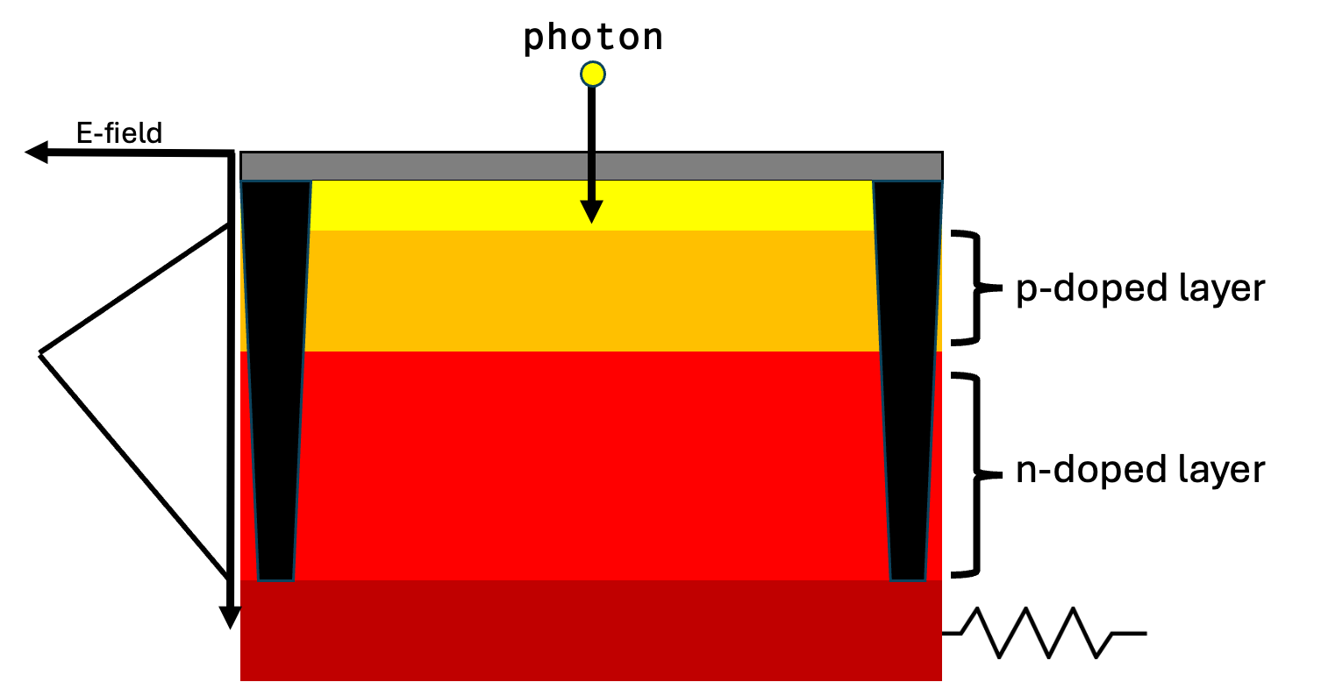
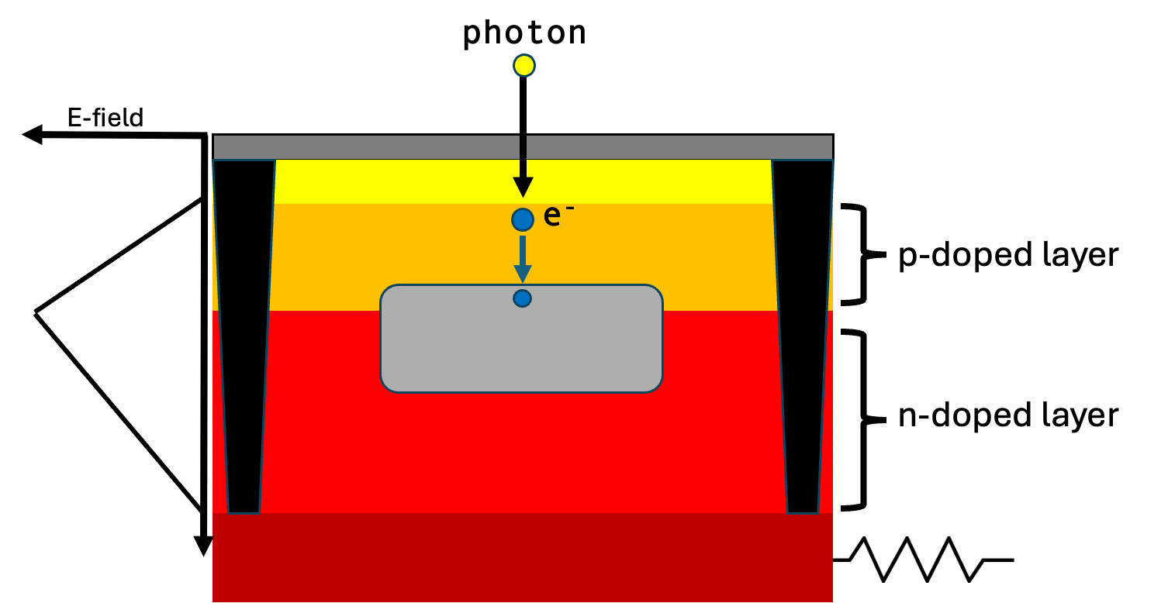
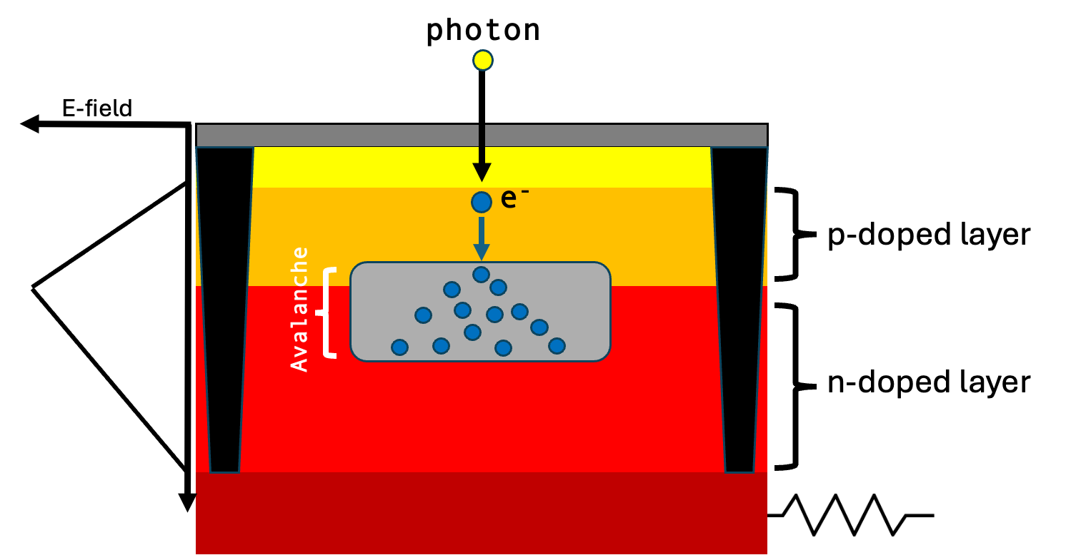
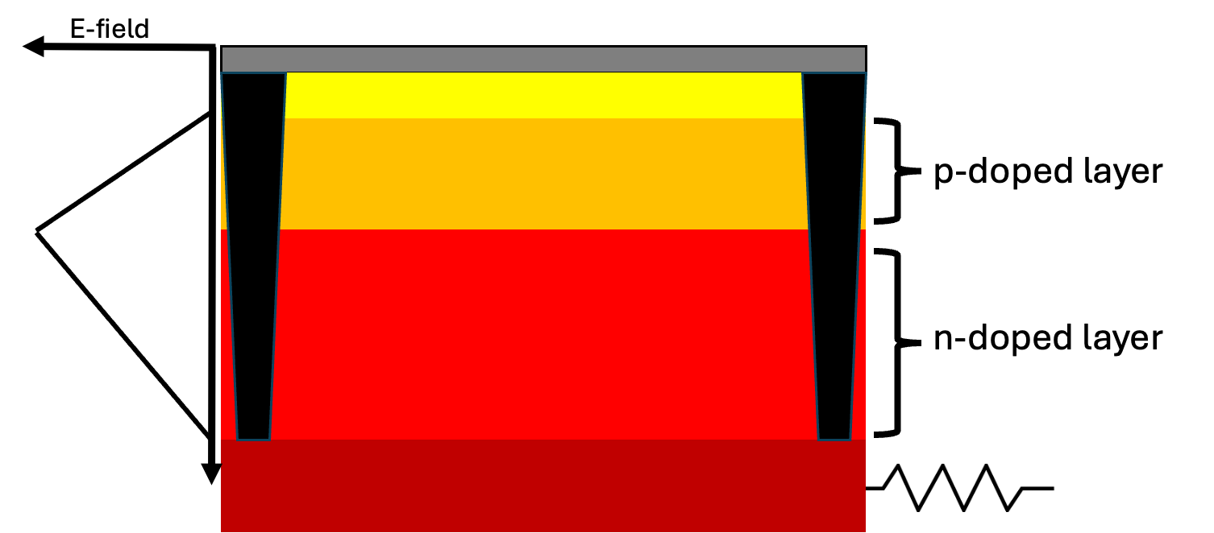
Silicon Photomultiplier (SiPM)
GMAD
GMAD
GMAD
GMAD
GMAD
GMAD
GMAD
GMAD
GMAD
GMAD
GMAD
GMAD
GMAD
GMAD
GMAD
GMAD
GMAD
GMAD
GMAD
GMAD
GMAD
GMAD
GMAD
GMAD
GMAD
GMAD
GMAD
GMAD
GMAD
GMAD
GMAD
GMAD
GMAD
GMAD
GMAD
GMAD
Notes:
Geiger mode avalanche diode

Slide 8
SiPM Output:
GMAD
1 GMAD Fires
2 GMADs Fire
4 GMADs Fire
Voltage
Time
Notes:
Make noise the same throughout whole waveform

Slide 9
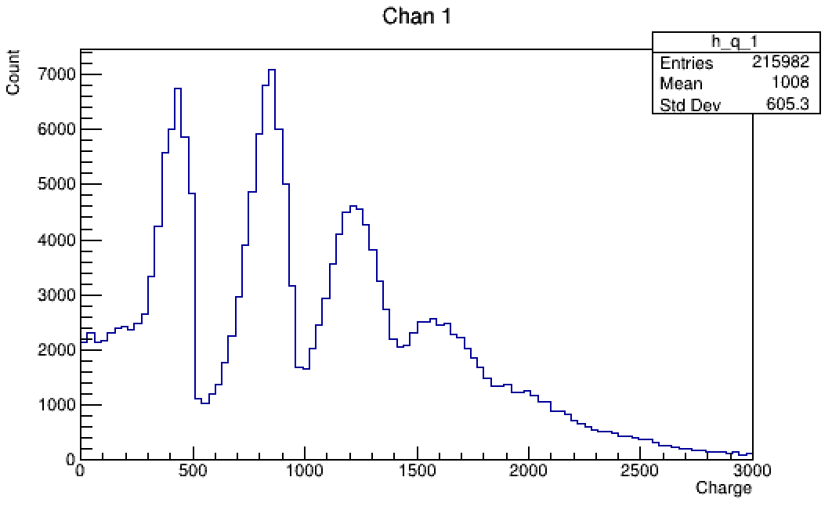
1 photon
Charge Finger Plot @4VoV, room temp
2 photons
3 photons
4 photons
Notes:
Add title (charge finger plot, temp, vov)
Testing new device, board, amplifyer

Slide 10
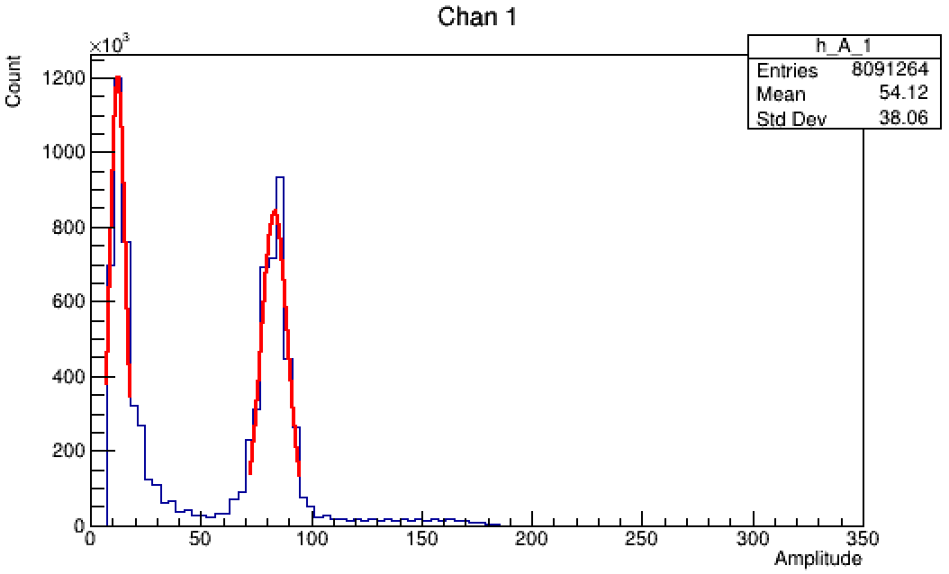
No light
0 photons (noise)
Charge Finger Plot @4VoV, room temp
1 photon
Signal to noise ratio: 8.45 +/- 0.01
*at 4VoV, room temp
Notes:
Summarize points made at the end

Slide 11
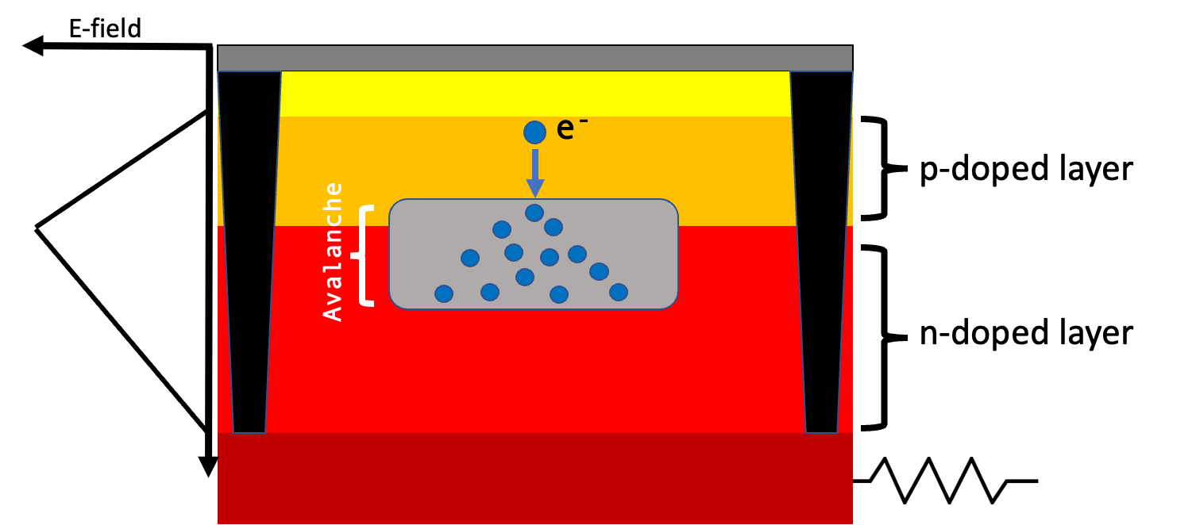
Dark noise:
Caused by thermal fluctuations

Slide 12
Dark Noise Waveform (4VoV, Room Temp)
Δt4
Δt1
Δt2
Δt3
Δt5
Δt6
Δt7
Filtered waveform
Raw waveform

Slide 13
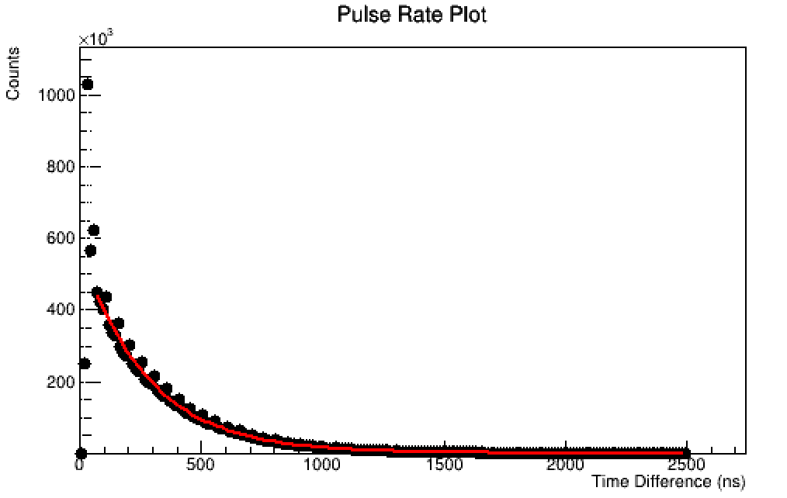
Time Between Pulses [SiPM set to 4V Overvoltage]
Fit: e^(-λ*t)
Pulse rate = 1/λ
Dark Count Rate = Pulse_rate/SiPM_area
Dark Count Rate: 171170 +/- 60 Hz/mm^2
(room temperature)
Notes:
Add label saying room temperature This is comparable with literature values

Slide 14
To recap:
Brief history lesson
Introduced the ALPHA and HAICU experiments
Brief overview of how a SiPM works
Identified 1 photon, 2 photon, .., pulses at room temperature
Quantified the SiPM signal to noise ratio
Characterized the dark noise rate
Thanks for Listening!
Special thanks to my supervisors Andrea Capra, Ina Carli, and Makoto Fujiwara, as well as the entire ALPHA and HAICU collaborations for making this all possible.

Slide 15
Backup Slides

Slide 16
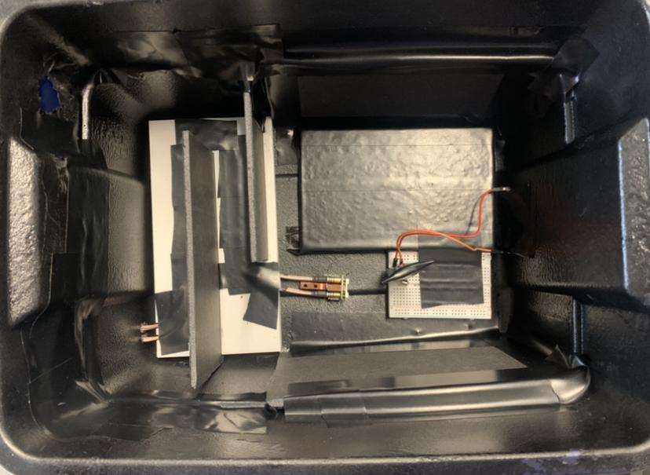
LED + Resistor
SiPM
Notes:
Everything else in the box is to keep light out. Zoom out to give more context

Slide 17
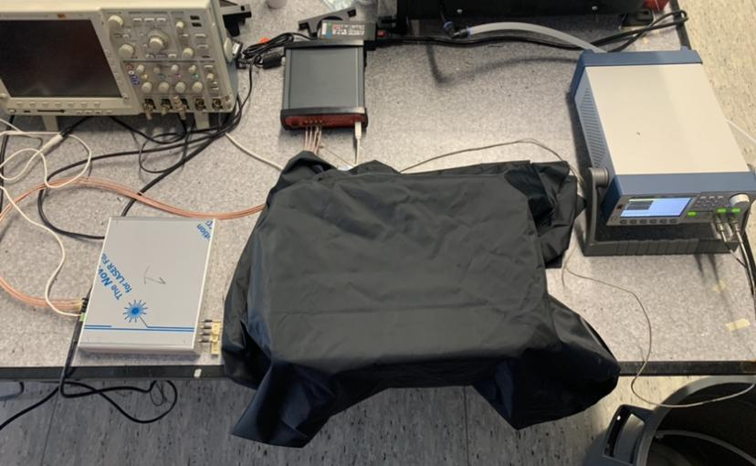
1. Voltage Board
→ Controls SiPM ….voltage
2. Digitizer
→ Digitizes the ….SiPM output ….waveforms
3. Box shown in previous slide
→ Holds SiPM ….and LED
4. Pulser
→ Generates ….pulses for LED ….and external ….trigger
2
4
3
1
Notes:
We are using an LED, we are looking at charge/amplitude not too concerned with timing

Slide 18
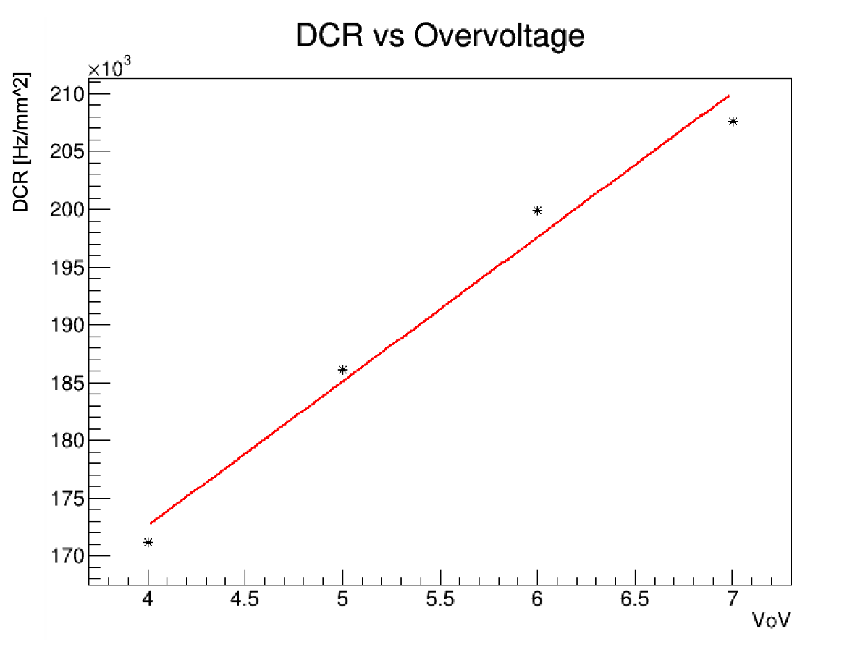

Slide 19
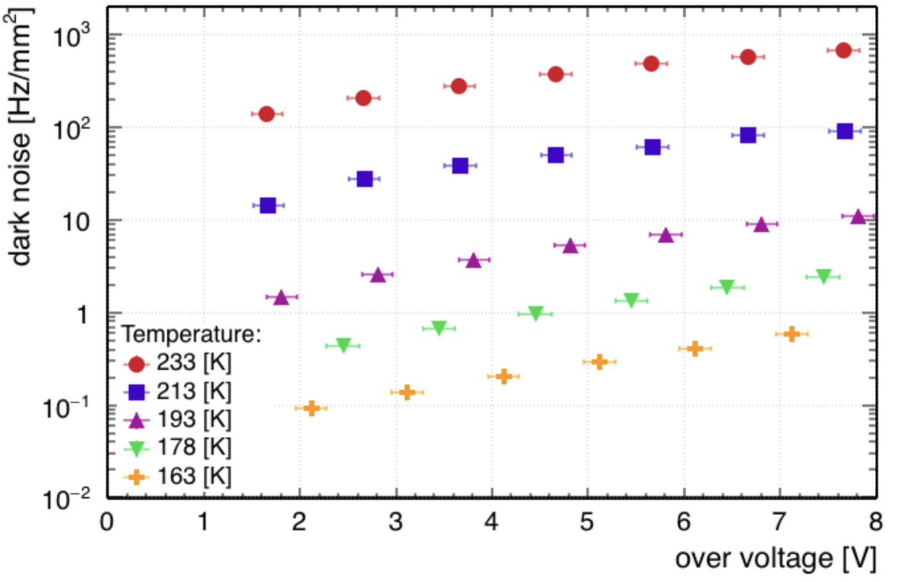
Order of magnitude estimation:
An increase of ~20K results in DCR increasing by a factor of ~10
Going from 233K to room temp (~293K) is an increase of 60K
ie, 3 orders of magnitude
At 233K and 4VoV DCR is ~2*10^2 Hz/mm^2, so we expect a DCR of ~2*10^5 at 293K and 4VoV
Characterization of the Hamamatsu VUV4 MPPCs for nEXO (https://arxiv.org/abs/1903.03663)
Notes:
Order of magnitude for increasing ~20K. Going from 233 to 293 is increasing by 3*20=60K, so 3 orders of magnitude. Start at ~2*10^2→2*10^5

