Slide 1
Canada’s Astroparticle Physics Network
Notes:
Optional – promotional slide – can be used as a title or intro slide as you talk about yourself and the McDonald Institute.
Feel free to use this background image for other uses.

Slide 2
Machine Learning Meets Ancient Geology in the search for dark matter
By Sharleen Chebet
Sharleenchebet04@gmail.com
Notes:
This PowerPoint template is intended to provide you with the resources and flexibility needed to create a presentation in your own way while preserving the brand recocnition of the McDonald Institute. Please direct any questions or comments to Zac at communications@mcdonaldinstitute.ca
Adjust size of title text as needed.

Slide 3
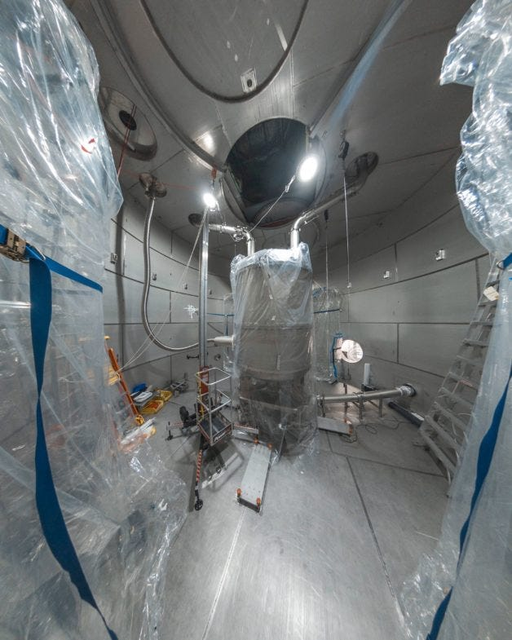
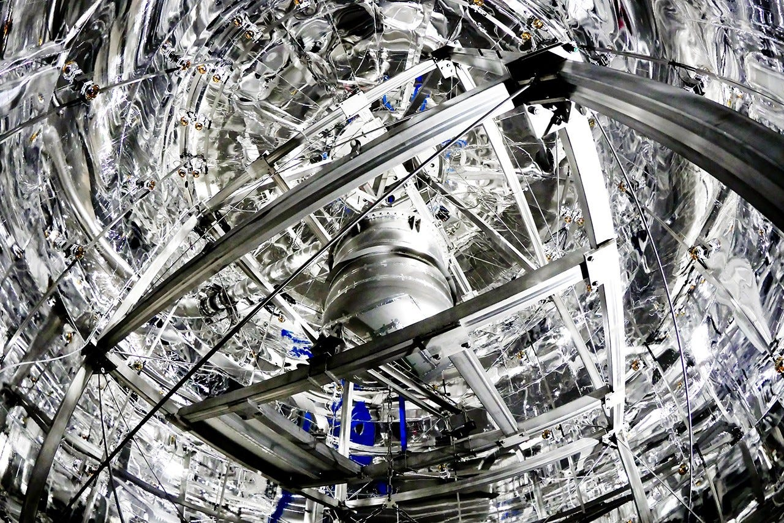
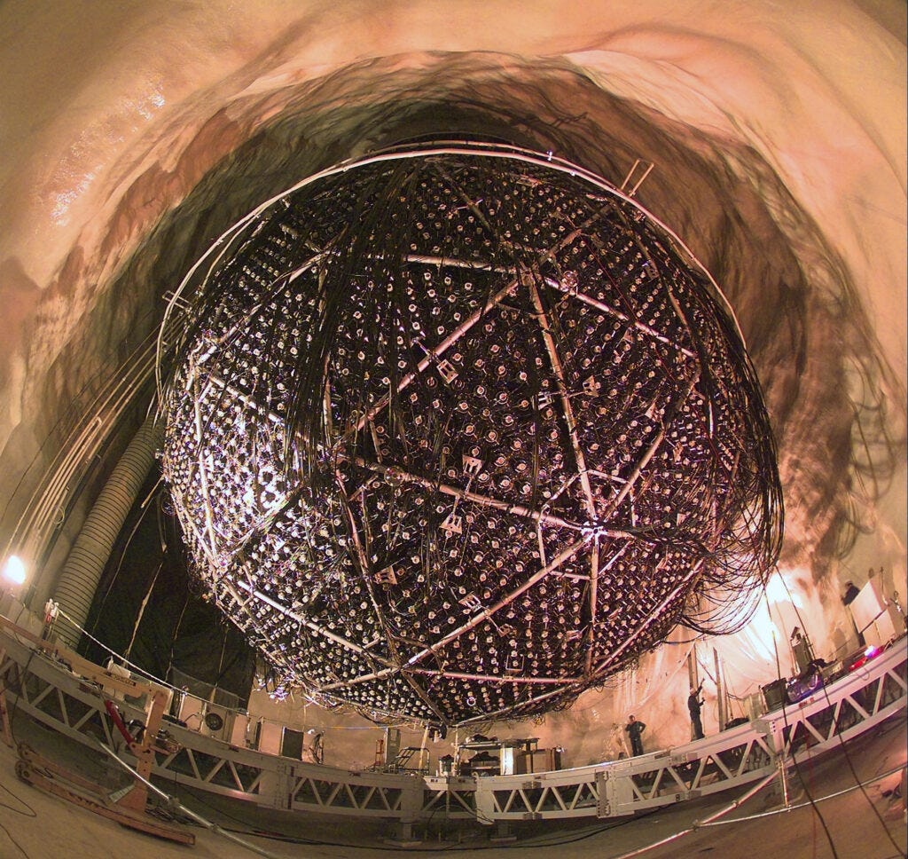
Current approach
Dark matter particles are predicted to be extremely small, and weakly interacting – partly because, until now, attempts to detect them have been unsuccessful.
Notes:
The importance of detecting, establishing, and proving the existence of dark matter cannot be overstated.
Most of these attempts have involved putting detectors deep underground It’s also important for dark matter detectors to be as big as possible. Since dark matter interacts very rarely, the bigger the detector, the more opportunities there are for dark matter particles to interact with atoms in the detector.

Slide 4
Ancient Rocks in the search for dark matter

Slide 5
Dark matter and “paleo detectors”
A group of researchers, from Sweden, the United States, and Poland have proposed using ancient rocks to look for dark matter.
The idea is that dark matter would hit atoms in the rock and cause the atoms to move, leaving a characteristic track in the rocks.
Notes:
.Ancient rocks are often found deep within the Earth’s crust, have been untouched for millennia.
Over time, they may have accumulated minuscule amounts of dark matter particles.
Thus, a relatively small sample of rock times a billion years might have experienced more dark matter interactions a detector .
Detectors are extremely expensive and involve cutting edge technology
By analyzing these ancient minerals, scientists hope to detect traces of dark matter interactions; these ancient rocks invaluable as “paleo detectors.”

Slide 6
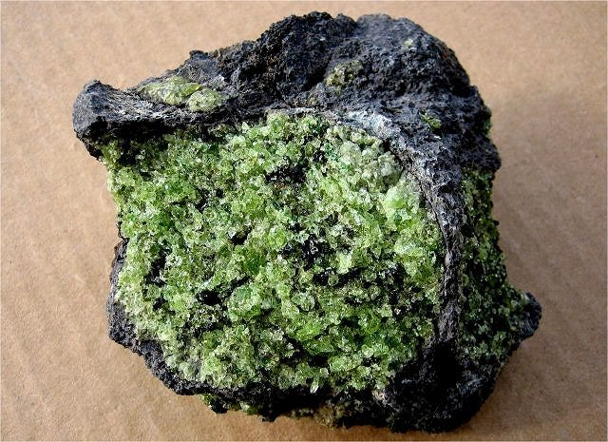
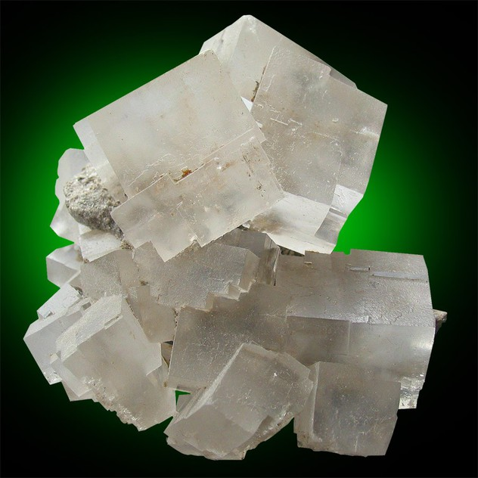
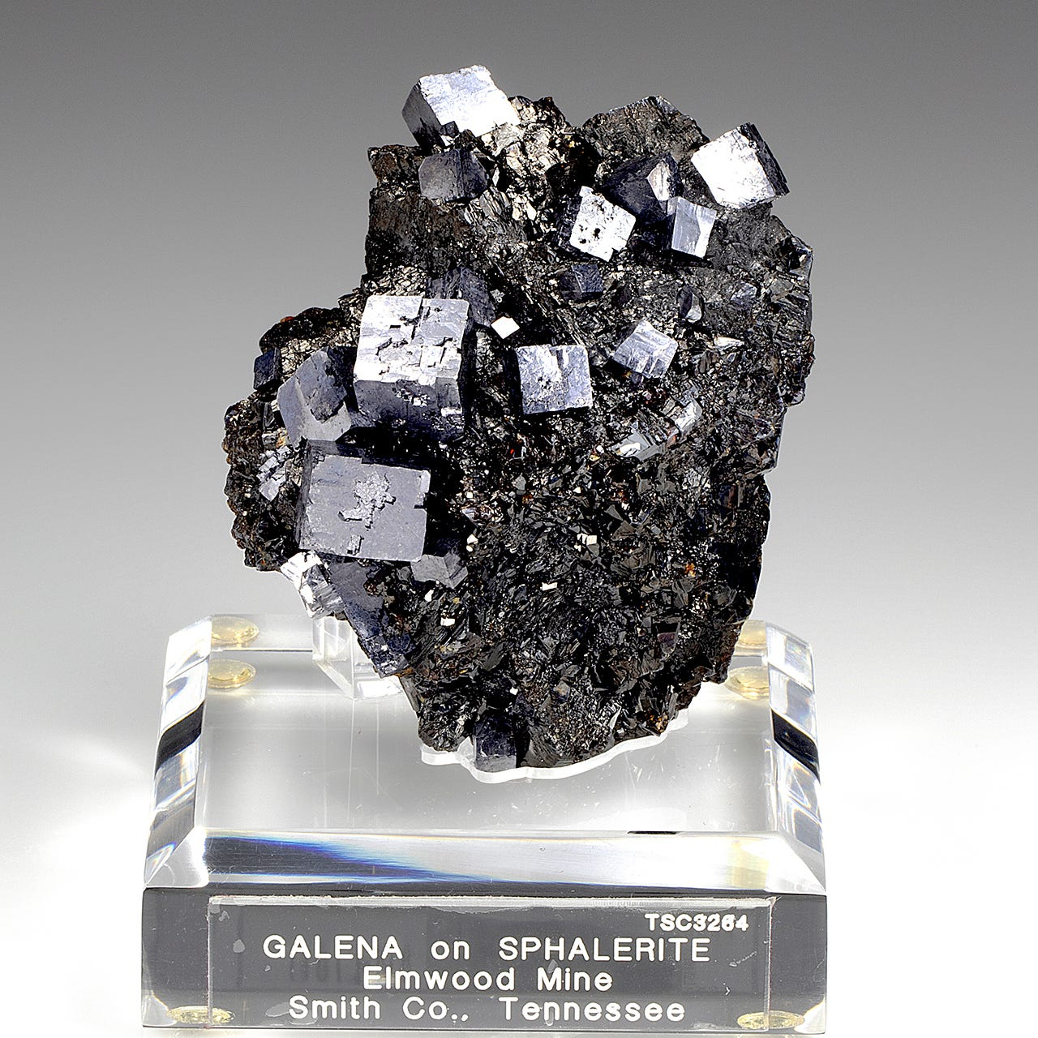
Rocks
The most valuable ancient rocks for scientific research are those that have remained relatively undisturbed and can provide insights into Earth's early history
Notes:
The most valuable ancient rocks for scientific research are those that have remained relatively undisturbed and can provide insights into Earth's early history
The researchers also needed to find ancient rocks that were not themselves radioactive, as radioactive decay would mimic the signature of dark matter interactions.
They settled on sedimentary rocks called marine halites. These halites form out of sea water and are unlikely to have much uranium in them. Uranium, of course, is radioactive with a very long half-life.

Slide 7
Potential Machine Learning

Slide 8
What is Machine learning
Machine learning refers to the use of algorithms and statistical models to identify patterns in data.
Notes:
Machine learning refers to the use of algorithms and statistical models to identify patterns in data, learn from these patterns, and make decisions or predictions based on new data.
It's revolutionizing many fields, including geology and astrophysics, by enabling the analysis of vast amounts of data far more efficiently than traditional methods.

Slide 9
Application
A problem researchers might encounter if the contains concentrations of Uranium and Thorium. Machine learning can quantify the interference of Uranium and Thorium in the search for dark matter
Notes:
As I previously mentioned researcher specifically sought rocks with low Ur and Th concentration .I think it might be interesting to quantify the intereference of Ur and Th in the search for

Slide 10
Uranium and Thorium
Uranium and thorium are naturally occurring radioactive elements that emit particles, including alpha and beta particles, as well as gamma rays. These emissions can mimic the signals produced by potential dark matter interactions in detectors. Therefore, accurately quantifying their presence in ancient rocks is crucial for several reasons:
Notes:
Uranium and thorium are naturally occurring radioactive elements that emit particles. These emissions can mimic the signals produced by potential dark matter interactions in detectors. accurately quantifying their presence in ancient rocks scientists can isolate potential dark matter events

Slide 11
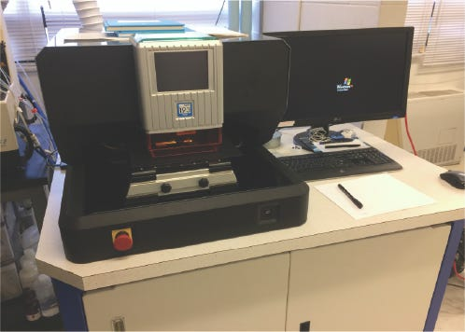
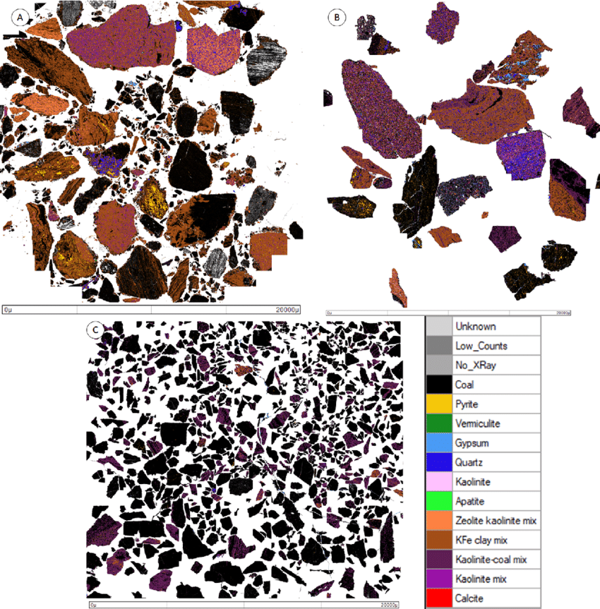
Data formats
LA-ICP-MS
Images
Notes:
LA-ICP-MS analysis which is an analytical technique used for the precise and sensitive measurement of elemental concentrations and isotopic compositions in solid samples.

Slide 12
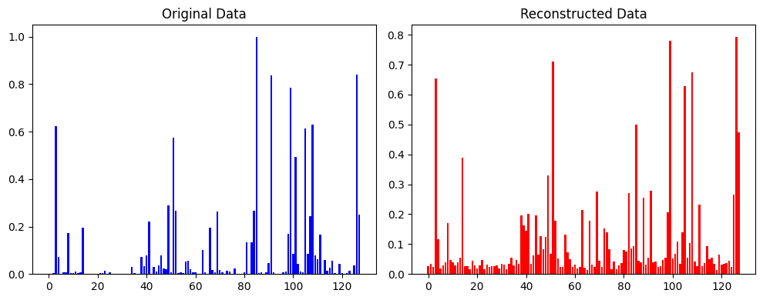
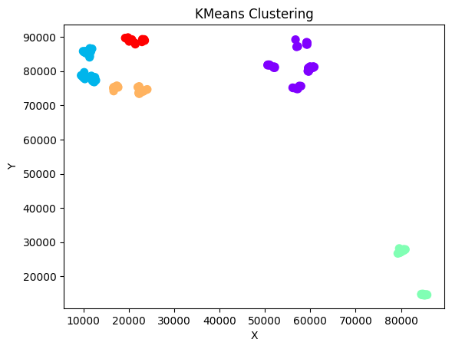
Data prep
Cleaning
EDA(Exploratory Data Analysis
Standardization and Normalization
Clustering
Notes:
This involves identifying and removing missing values ,identifying outliers, visualizing relationships in the data and getting sense of distribution. Use of unsupervised learning algorithms like K means clusering and Autoencoders to learn efficient representations of data can be applied.
Scaling and Normalization- Scaling and normalization ensure that all features have the same scale or distribution since many machine learning models are sensitive to the scale of the input features.. Common techniques include min-max scaling (scaling to a specific range) and z-score normalization (scaling to a mean of 0 and a standard deviation of
Proper data preparation can greatly impact the model’s performance and its ability to make accurate predictions.

Slide 13
Model selection
Notes:
Model selection is maybe the most interesting part

Slide 14
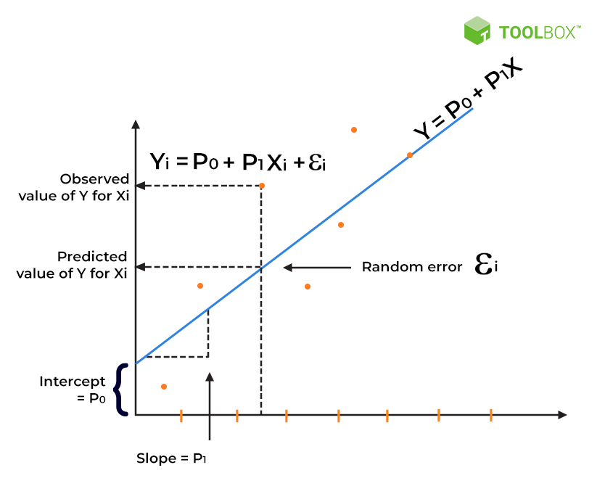
Regression Models
predicting interference levels.
Notes:
With machine learning models data format is relevant and varies from model to model , Regression models are suitable for predicting a continuous numerical value, which is the level of interference in this case.

Slide 15
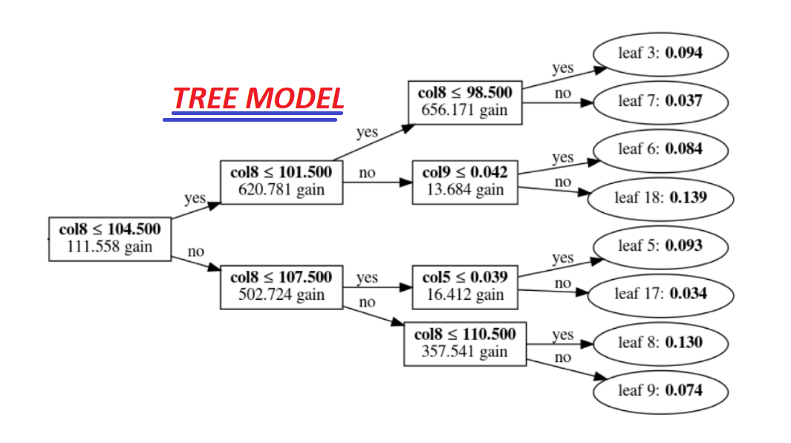
Tree based models
capture non-linear relationships between features.
Notes:
Tree-based models are known for their ability to handle complex interactions between features, which is likely in this scenario. They also provide feature importance information..

Slide 16
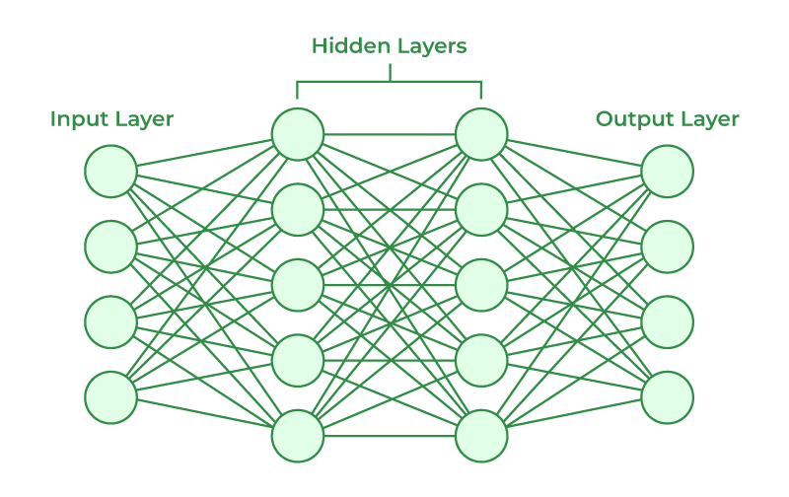
Neural Networks
capture complex patterns in the data
Notes:
Neural networks are powerful for capturing non-linear relationships and can potentially learn complex patterns in the data.

Slide 17
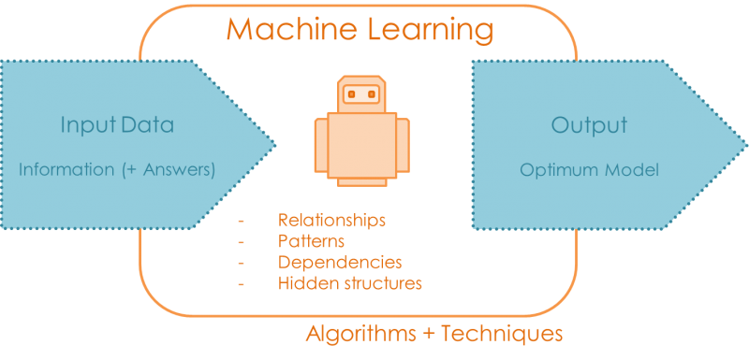
Model Input and Output
Input: Rock properties
Output: A numerical value
Notes:
The input can vary ; Uranium and thorium concentrationsGeological location (latitude, longitude, altitude)Rock typeAgeOther relevant geochemical or geophysical data
But its important for the output to be A numerical value representing the level of interference. This could be a continuous value (e.g., a scale from 0 to 1) or a categorical value (e.g., low, medium, high).

Slide 18
Model Evaluation
MSE
MAE
RMSE
R-Squared
Notes:
Here are some example of model valuation
MSE would give you the average squared difference between your predicted and actual uranium levels.RMSE would give you the average error in the same units as uranium concentration, making it easier to interpret.MAE would give you the average absolute difference between predicted and actual uranium levels, without penalizing larger errors as heavily as MSE.R-squared would tell you how much of the variation in uranium concentration is explained by your model.

Slide 19
Challenges
Data quality
Overfitting
Intepretability
Notes:
Machine learnings ability to be helpful is largely dependent on the data so having clean data is important
Another problem is overfitting , which is caused by insufficient data and noise in the data \
Interpretability has become more relevant recently due to the widespread use of AI , being able to understand the models decision making process is important of for building trust.

Slide 20
Thank you
Contact me at: Sharleenchebet04@gmail.com
This research was undertaken thanks in part to funding from the Canada First Research Excellence Fund through the Arthur B. McDonald Canadian Astroparticle Physics Research Institute.
Notes:
Acknowledging the McDonald Institute and CFREF
When people supported by the McDonald Institute publish research results, or accept honours for research undertaken with support from the Canada First Research Excellence Fund (CFREF), we instruct them to provide parenthetical, footnoted or endnote acknowledgement following this script:
“This research was undertaken thanks in part to funding from the Canada First Research Excellence Fund through the Arthur B. McDonald Canadian Astroparticle Physics Research Institute.”
As a rule of thumb, we would acknowledge CFREF anytime direct research cost supports (direct funding) has been used, and we would not when only indirect support has been used. The full guidelines document for acknowledging CFREF funding support can be found HERE.

