Slide 1
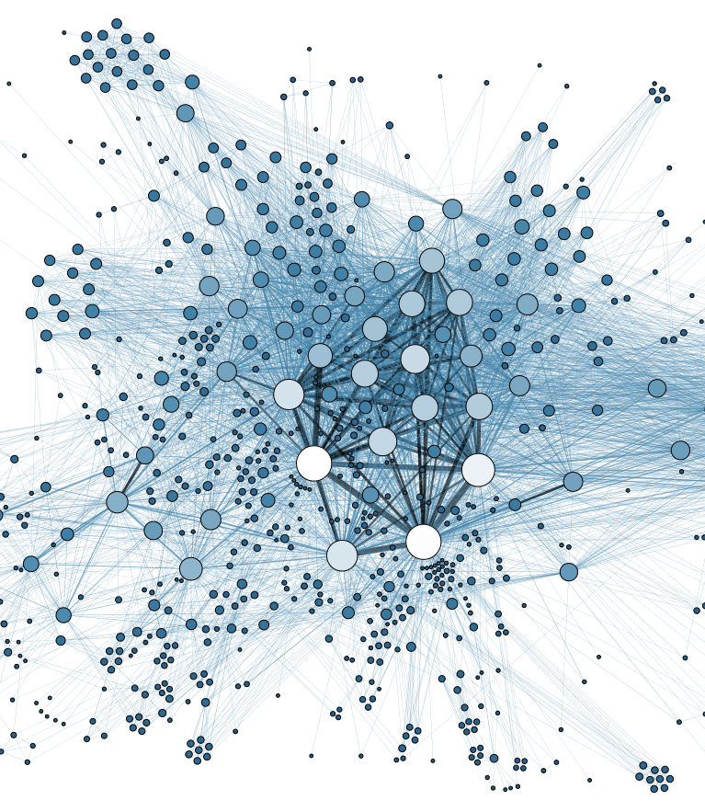
Building the Database Systems for HELIX
Kaan Sun
Queen's University
Notes:
Good [morning/afternoon] everyone! My name is Kaan Sun. I am an undergraduate student in Queen’s University, going into my third year of Computer Science and Physics. This summer, I had the very exciting opportunity to work on an experiment called HELIX, and I would like to share an overview of what it was all about.

Slide 2
HELIX Overview
Balloon-borne experiment
⁹Be and ¹⁰Be "clock isotopes"
Multiple stages – 1st stage 2024
Notes:
High Energy Light Isotope eXperimet (HELIX) is a balloon borne experiment designed to measure the composition of cosmic ray nuclei, particularly the “clock isotopes” Be_10 with approx 1.4 million year half-life and Be_9 (stable). These are important markers of secondary cosmic-ray nuclei production, which is needed to resolve important mysteries in cosmic-ray propagation.

Slide 3


University of Chicago
Chiba University
Indiana University
University of Michigan
Queen's University
McGill University
Northern Kentucky University
Ohio State University
Pennsylvania State University

Slide 4
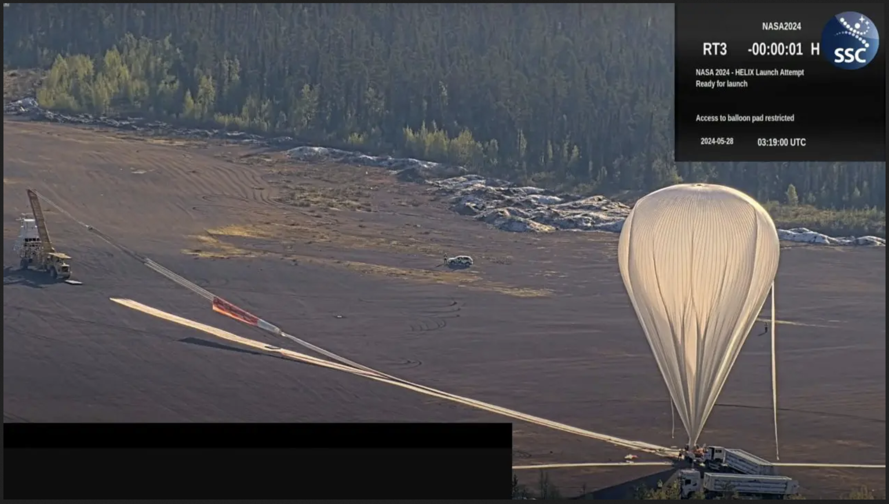
HELIX Flight 24 Kiruna
6 Days of succesful flight between May and June this summer
200M cosmic ray events are recorded
Image obtained from Swedish Space Corporation Official YouTube live stream
Notes:
HELIX, being a balloon borne detector, had a successful flight this summer (when I got to work on it) for 6 days between May and June, classifying it as a long duration balloon flight. During this period, around 200M cosmic ray events are recorded. This creates a massive amount of data that needs to be dealt with. I will mostly be talking about the handling of this data today.

Slide 5
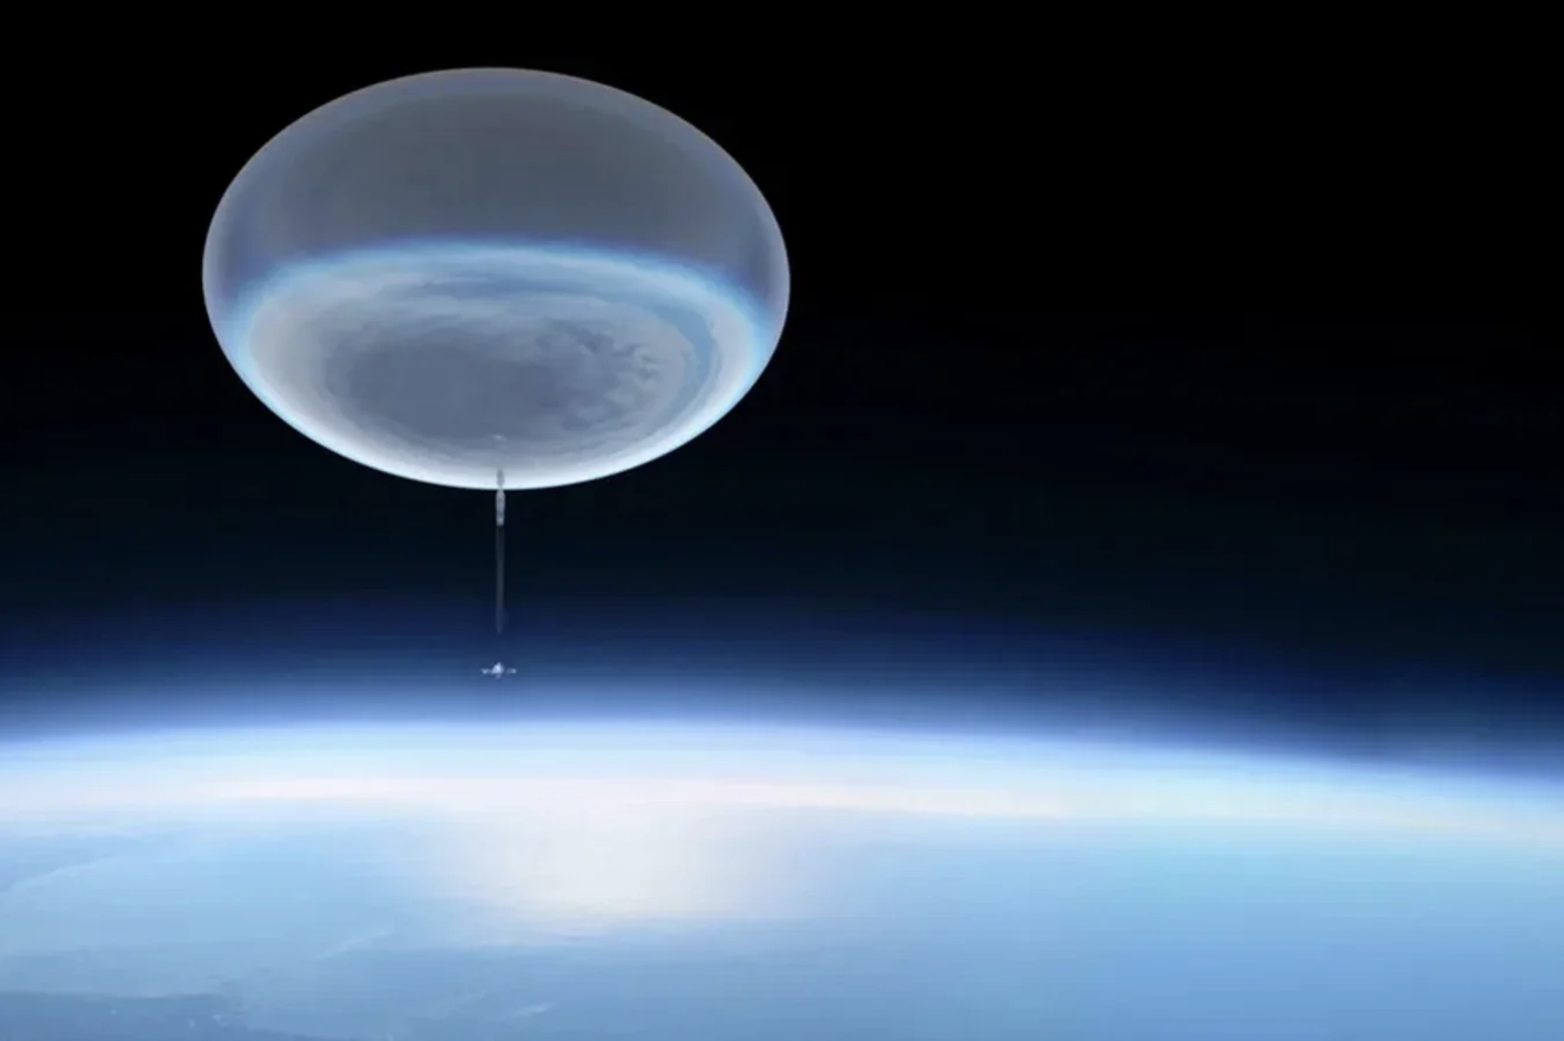
(Michael Lentz, NASA’s Goddard Space Flight Center Conceptual Image Lab)

Slide 6
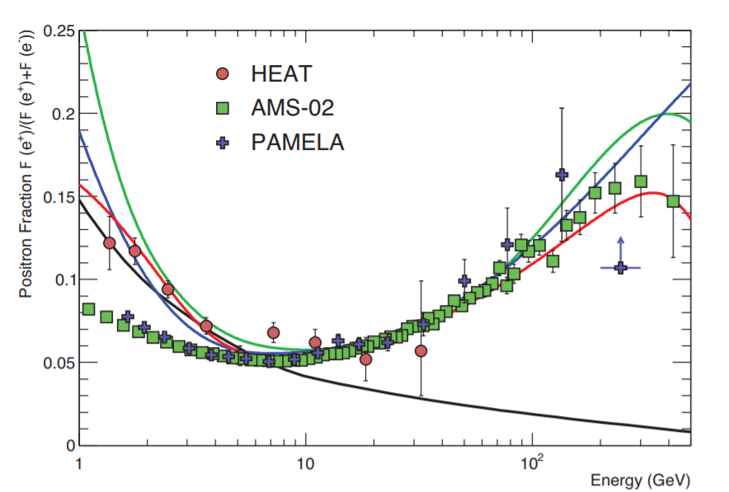
Motivation
Positron fraction as measured by AMS-02 and PAMELA (green blue)
Expected propagation by traditional models (black line)
Figure taken from the Particle Data Group.
Notes:
The measurements of Be_10 Be_9 propagation are of particular interest at the moment due to several cosmic-ray flux measurement anomalies. One of the primary ones being the recent studies, which have shown an increase in the positron flux. This cannot be explained with the classic cosmic ray propagation models.
It is very important to understand cosmic ray propagation to interpret these results. HELIX
[proceed to show the graph and explain]

Slide 7
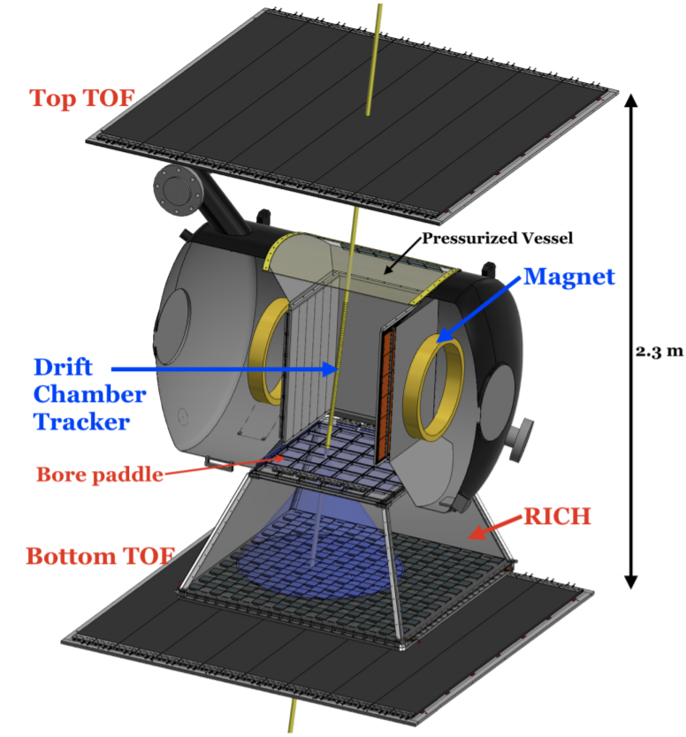
Technical Aspects
Time of Flight System
Spectrometer (Drift chamber and magnet)
Ring Imaging Cherenkov Detector
Notes:
HELIX, the primary instrument, is a magnet spectrometer. It consists of 3 main systems. These are called :
Time of Flight Sensors
Spectrometer (Drift chamber and magnet)
Ring Imaging Cherenkov Detector
Time of Flight system [proceeds to show it in the illustration] is a system designed to provide timing for cosmic rays, which can be used to obtain velocities of particles up to 1 Giga Electron Volts per Nucleus. For any higher energy particles Ring Imaging Cherenkov Detector is utilized where a transparent refractive medium (aerogels in our case) will cause passing particles to emit Cherenkov radiation, which can be measured to find accurate velocities of these particles.

Slide 8
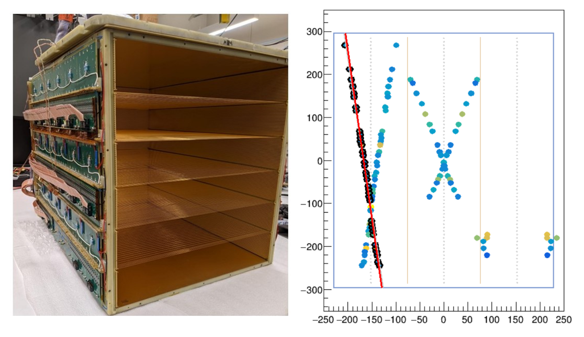
Drift Chamber and Magnet
1T electromagnet
Drift chamber to measure particle trajectories
(Helix Collaboration)
Notes:
Information about the charge and rigidity of a particle can be obtained using the combination of a magnet, and a drift chamber. This is possible since the trajectories of the charged particles change under a magnetic field. The drift chamber tracks this trajectory.

Slide 9
Why is the data so large?
13 Thousand detector sensor channels
2 Thousand housekeeping sensors
Notes:
All of these systems use arrays of sensors to record this information, about 13 thousand channels of data and an additional 2 thousand housekeeping sensors to monitor the health and status of the instrument. The massive amount of data recorded requires multiple stages of processing. This creates a massive bandwidth requirement for reliable transmission of data. Thus, it is not possible to transmit all of the experiment data to the base.

Slide 10
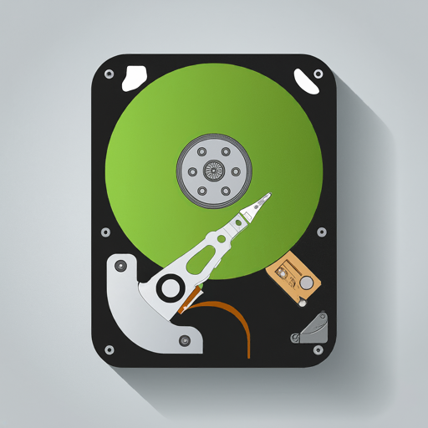
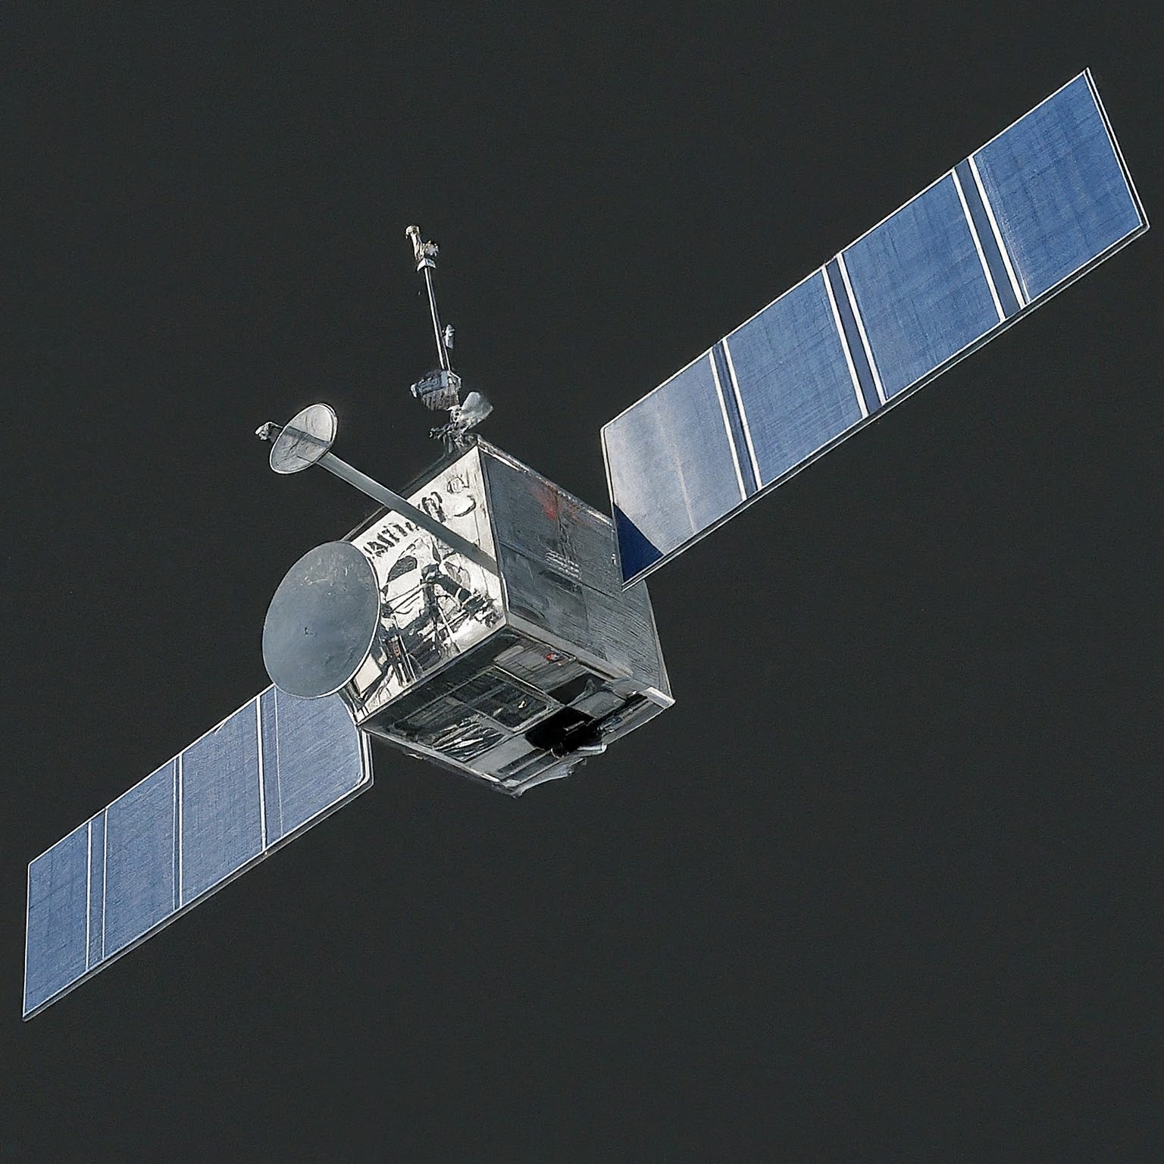

Detector Stream
On Board Storage
Status Stream
Starlink (Experimental)
Ground Base
Notes:
Because of the massive amount of sensors constantly recording cosmic event data, it is not possible to transmit everything (all data) back to the base during flight. There is a bandwidth limitation, thus only important status data (housekeeping data) is constantly being transmitted back to base. This information is critical for the health of the instrument.
This creates several challenges. Flight software that is running on the instrument separates all data into two channels: Event data, and status (hsk). The systems that record detector and status information work in different frequencies, meaning the data we are getting from the instrument is not uniform. There needs to be another layer of software that will successfully match these two data streams based on time and importance.

Slide 11
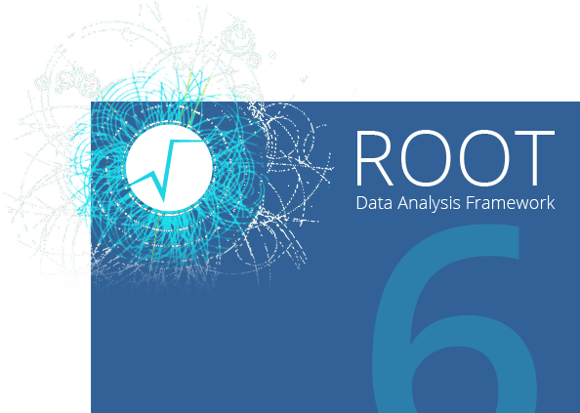
Software I Wrote
Written in C++, Works With the HELIX flight software
Match data from the Detector stream to the Status stream
Reduce the size of Data files
Translate this data into a JSON format for dynamic storage
Notes:
This is where my work comes in. I wrote a Database parser that accepts data that are formatted in Helix specification, which is a combination of the Scientific Framework “Root” software with custom defined C++ classes. My software achieves 3 different things:
Match data from the Detector stream to: the status stream and calibration files
Reduce the size of Data files
Translate this data into a JSON format for dynamic storage

Slide 12
Data Matching
Status Data 1
Status Data 2
Status Data 3
Status Data 4
Status Data 5
...
...
...
...
Status Data 124
Status Data 125
Status Data 126
Detector Data Array 1
Detector Data Array 2
Detector Data Array 3
Detector Data Array 4
Detector Data Array 5
Calibration file 1
Calibration file 2
Calibration file 3
Notes:
For every cluster of experiment data (we call this runs), there needs to be 3 status files (we call this housekeeping files) that need to be matched. This is done by implementing a custom stateful search algorithm. This algorithm tries to find files that were recorded at the closest possible time, and remembers where it found these matches to speed up the matching process.

Slide 13
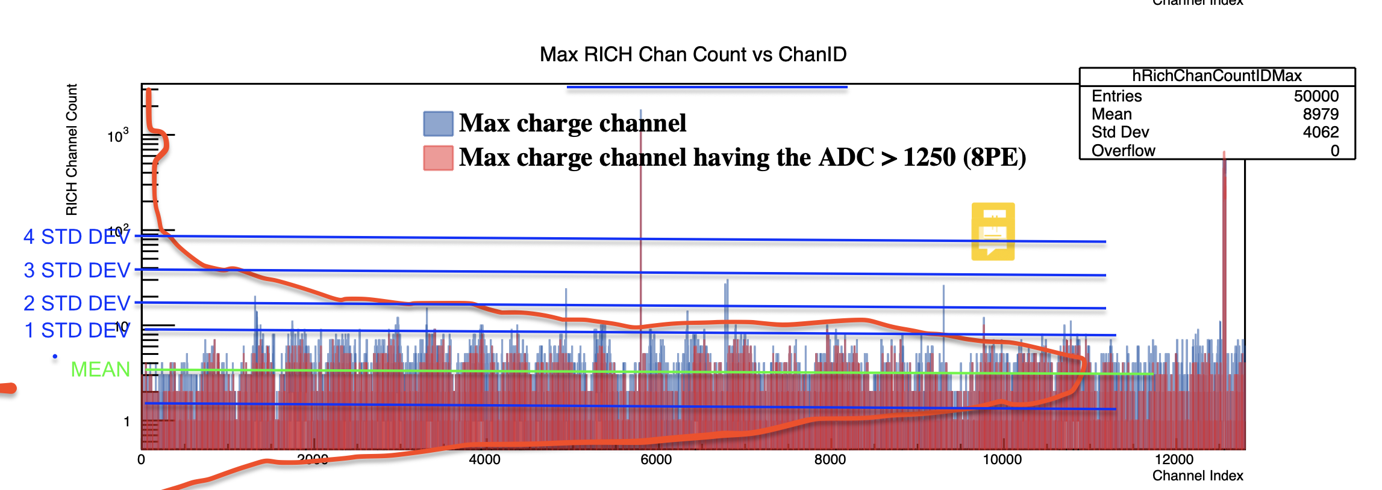
Reduced File Size
Automated Statistical analysis to find extremities in data
Notes:
My software only records the data that is significant to our research, stripping off any unwanted data. It also uses some statistical analysis to only record extremities in some channels of data, which are the only relevant information to our lab group.

Slide 14
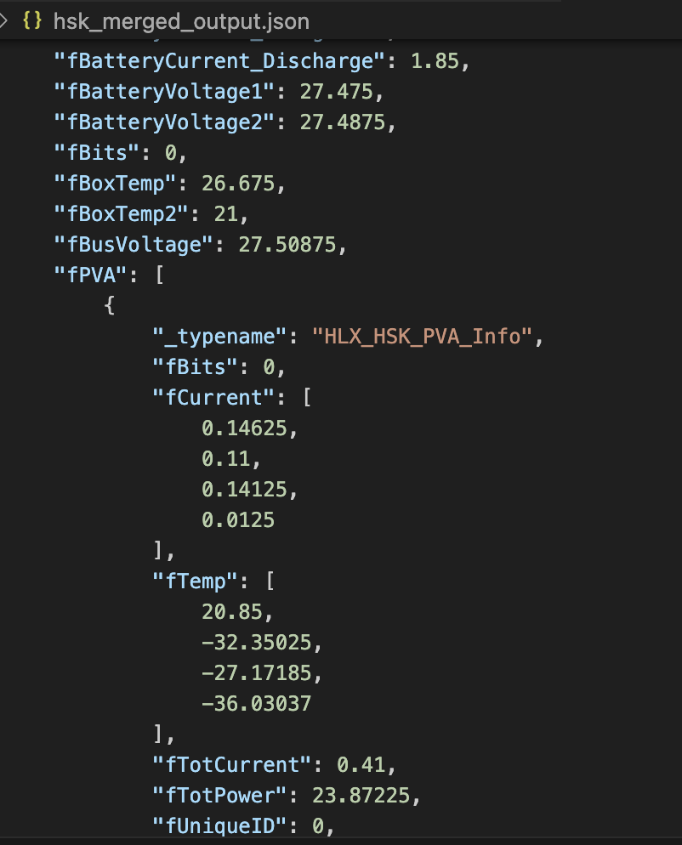
NoSQL
SQL
NoSQL
TABLE:MAIN DETECTOR INFO
EventID | BattDischarge | BusVoltage | Temp
123 | 1.52 | 27.12 | 21
124 | 1.53 | 27.12 | 21
New Kid on the block (databases)
Flexible Data structures which is good for Physics experiments
Good performance & scalability
TABLE: NORTH PANEL INFO
EventID | PanelTemp | PanelVoltage
123 | 1.52 | 27.12
124 | 1.53 | 27.12
Notes:
Over the years, a new system of storing big amounts of data has gained popularity amongst scientists and industry alike. It is called “NoSQL”. This method uses document-like objects to store data. Primary advantage of this way is the flexibility. I have decided to implement this system for the lab group. My software prepares this data such that it is ready to be pushed into a “NoSQL” server.
This data is later pushed into the MongoDB server I created in the lab.

Slide 15
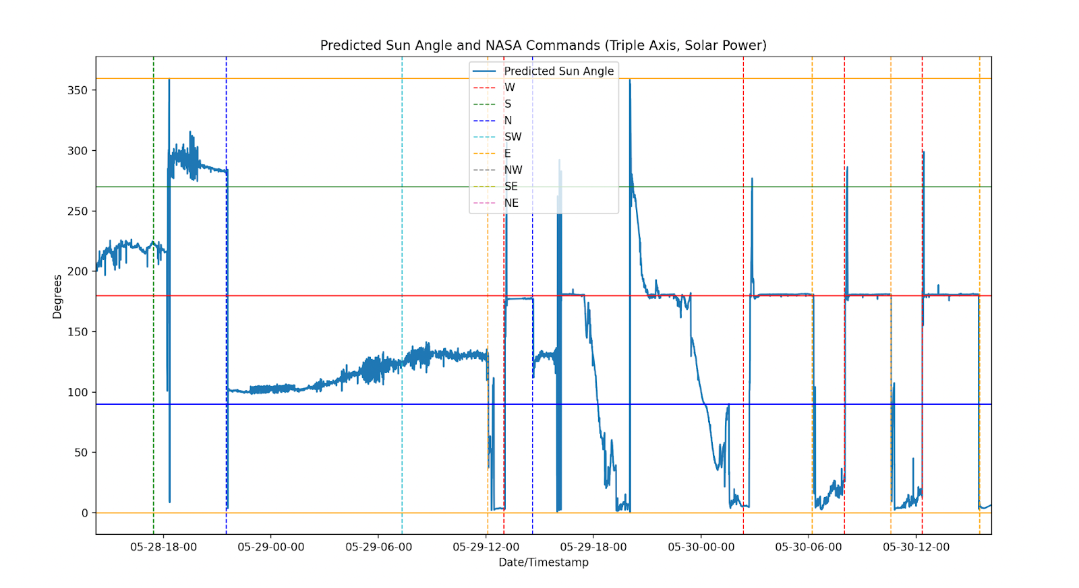
Why Do We Care?
Notes:
You might ask, “what is the advantage of having a noSQL database?” An earlier version of the database I built included most data our lab group needed. However, there was a new task assigned to me that required data I didn’t have in the database. Just using some light tweaking, I was able to add 15 new properties to my database, which I used to make this graph: [shows and explains the graph I made with the sun direction thing]

Slide 16
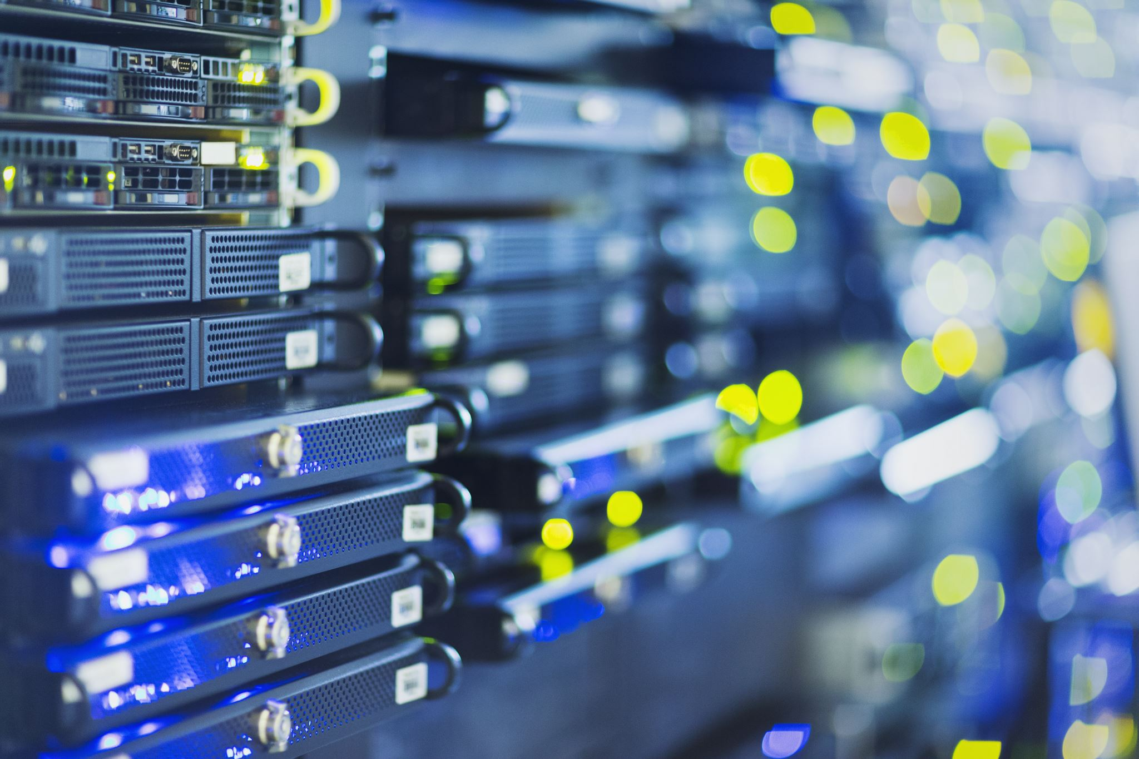
About Physics Experiments
Experimental physics is a very data-driven field
I believe keeping up with the newer technologies makes the process easier for everyone!
Notes:
I believe that keeping up with the newer technology as we are experimenting helps everyone in the lab group. Systems like this make managing the data we record much simpler, and more accessible.

Slide 17
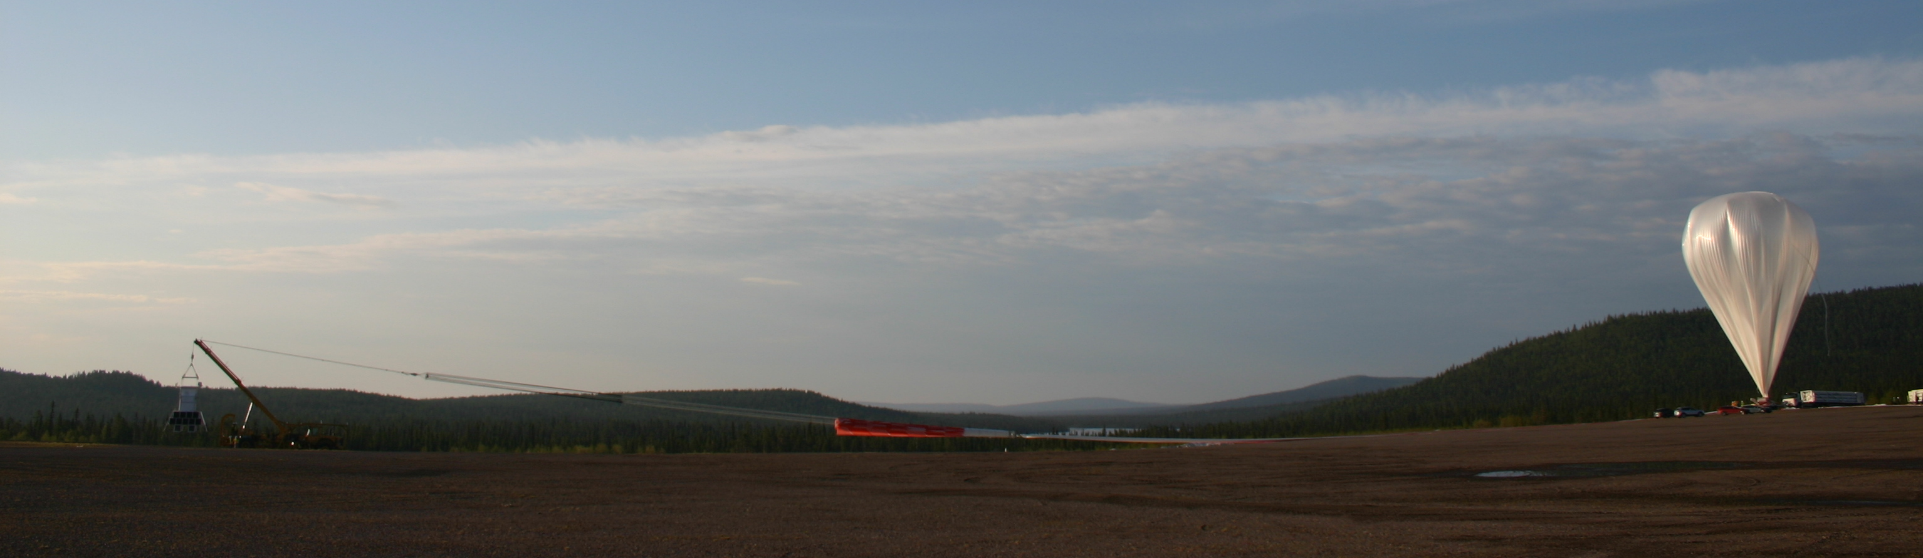
Thank you for listening!

