Slide 1
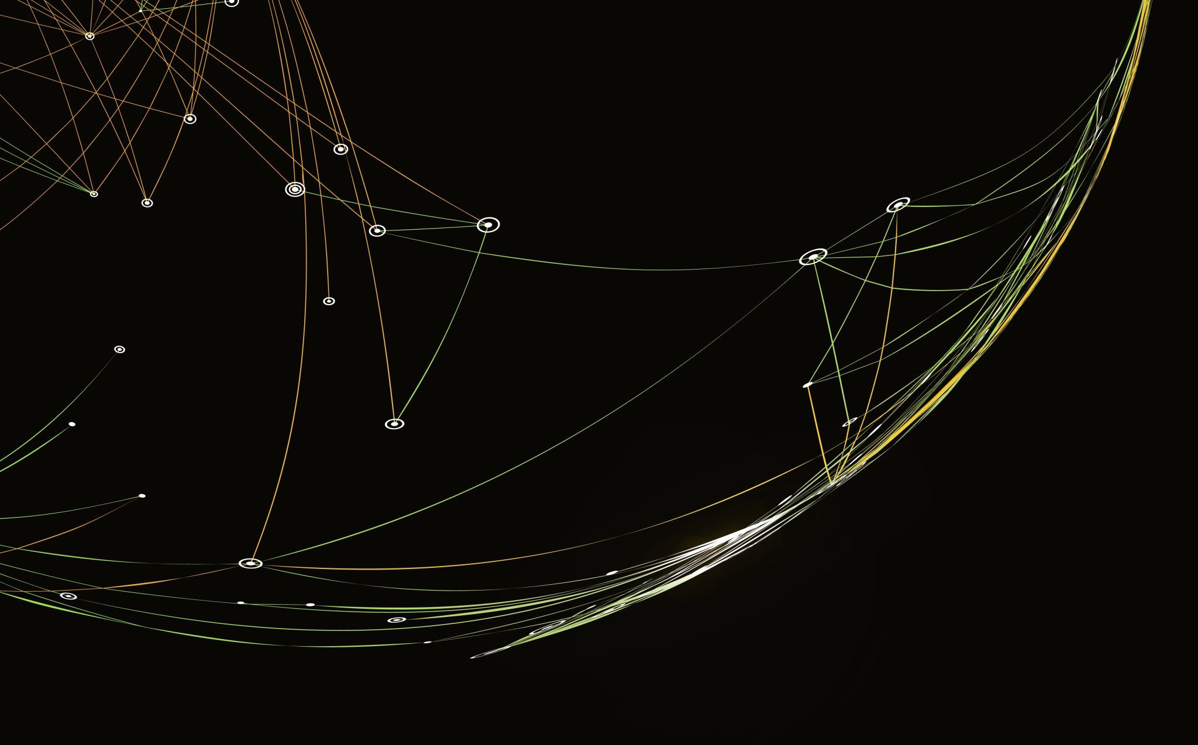
Machine Learning for Event Position Reconstruction in Germanium Detectors
Mary Calleja
Queen's University
Monday, August 19, 2024

Slide 2
Agenda
Germanium Detector Basics
Potential of Machine Learning
Current Progress
1
2
3

Slide 3
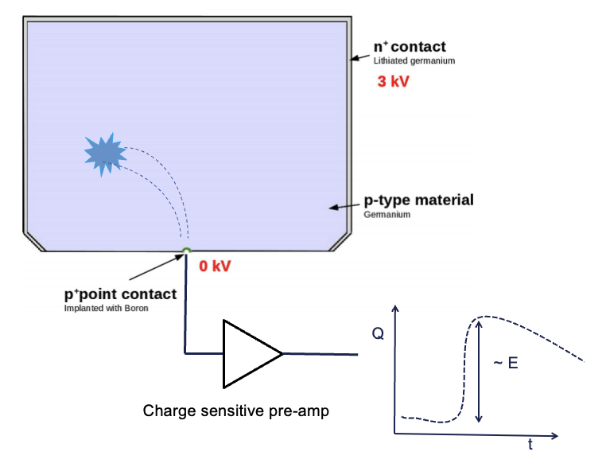
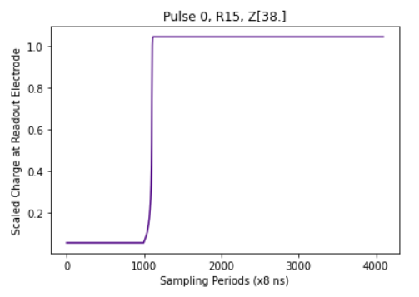
Germanium Detector 101
Particle interactions inside the cylindrical detector generate a signal on the readout called a pulse
These detectors are generally small (67mm in diameter, 51.6 mm in height)
Credit to Tianai Ye for diagram

Slide 4
Coordinate System for Position
R is the radial coordinate and ranges from 0-33mm
Z is the vertical coordinate and ranges from 1-51mm
The origin is the readout electrode
Z
R

Slide 5
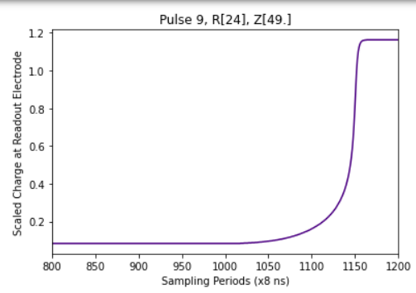
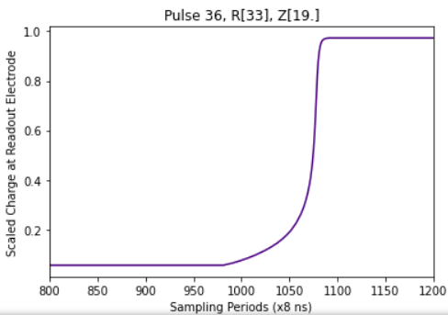
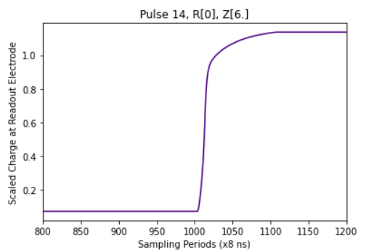
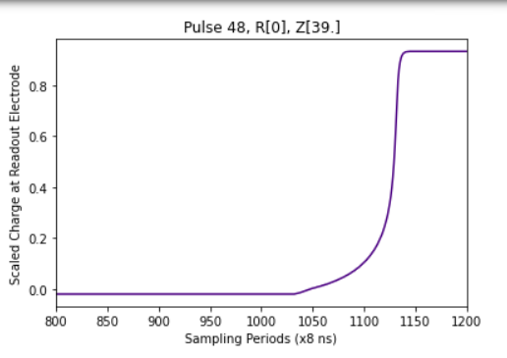
Pulse Shape Varies With Position
Type I
Type I
Type II
Type III
M Agostini et al 2011 JINST 6 P03005

Slide 6
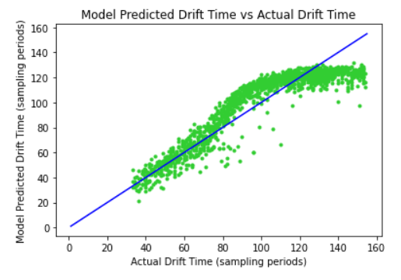
Current Algorithms
Current Algorithms perform well for low R and Z, but struggle to accurately predict at high Z
Accurately predicting position is important for event characterization and background rejection
Credit to Dr. Martin for explanation

Slide 7
Why Machine Learning
This technology is effective in a diverse array of applications
Machines can “learn” their own rules for position reconstruction without preestablished theory
Image in creative commons

Slide 8
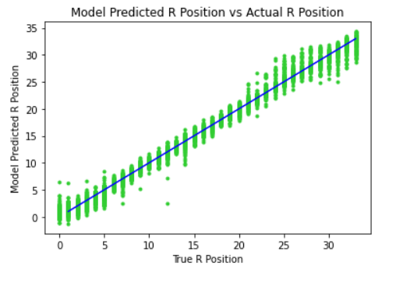
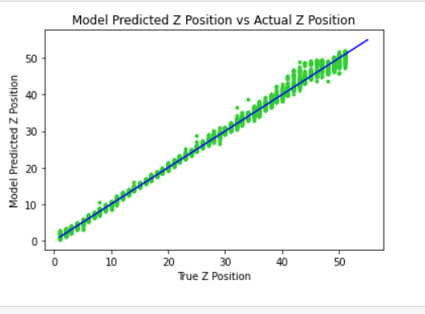
Potential Accuracy
This network performed extremely well on clean simulated pulses, and reached a Mean Squared Error of 0.39. It was trained for 232 epochs using about 400 000 sample pulses.

Slide 9
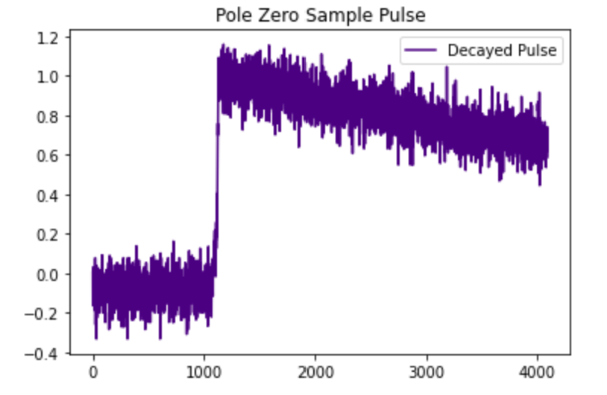
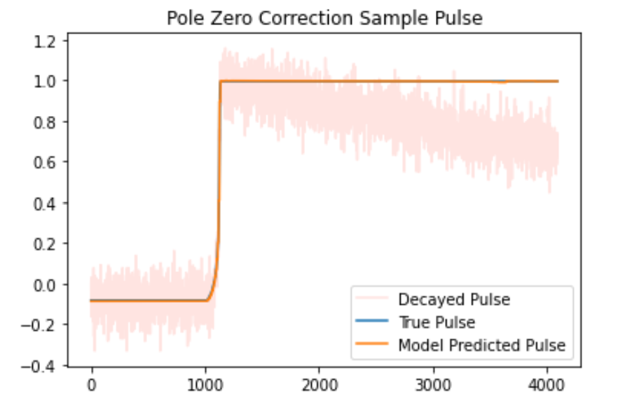
Pulses are Noisy
Unfortunately, realistic pulses look more like the image on the left. Even with denoising, as shown on the right, the true pulse can never be perfectly reconstructed.
Credit to Meghan Naar for denoising images

Slide 10
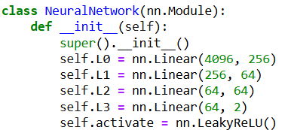
Model 1: Linear Network
A common, but basic, Neural Network architecture.
This Photo by Unknown Author is licensed under CC BY-SA

Slide 11
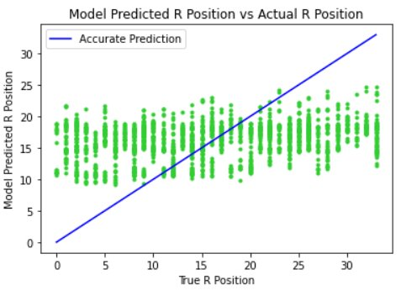
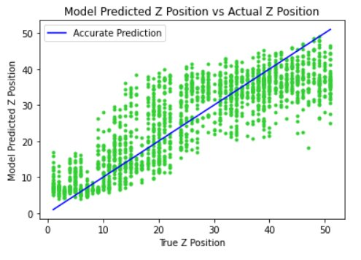
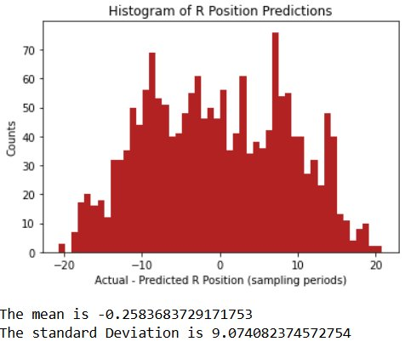
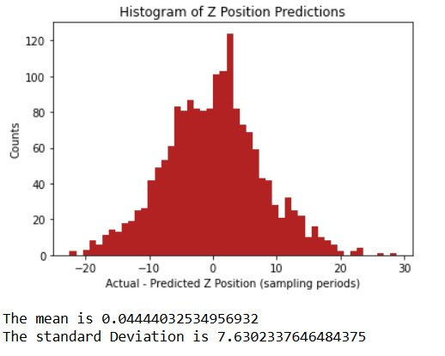
Performance of Best Linear Network
R Position
Z Position

Slide 12
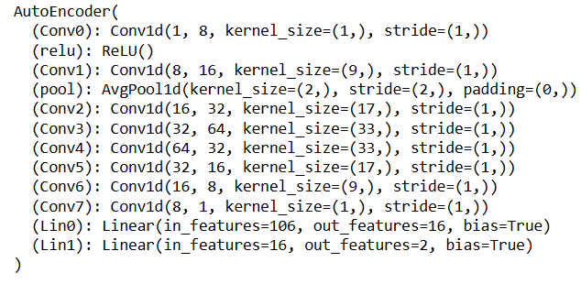
Model 2: Convolutional
A network of mostly convolutional layers
This Photo by Unknown Author is licensed under CC BY

Slide 13
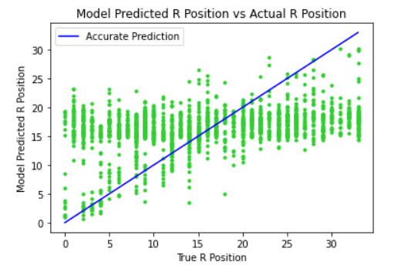
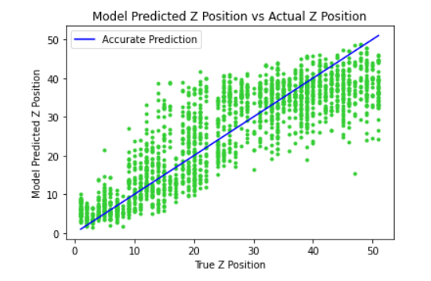
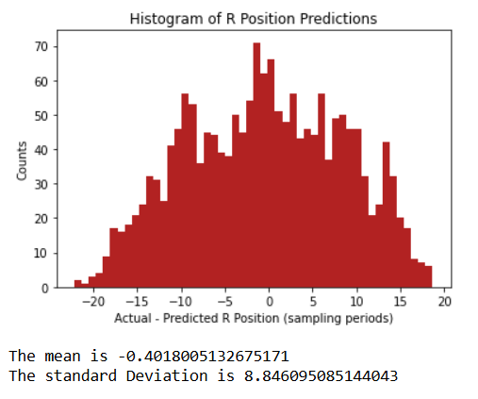
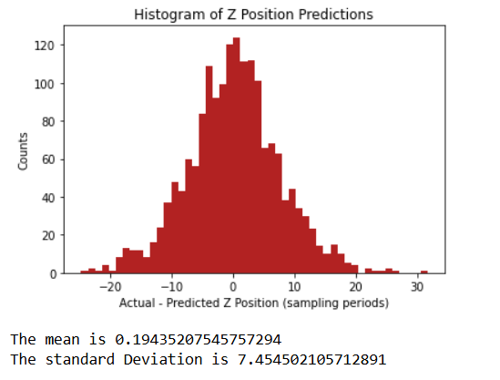
Performance of Best Convolutional Model
R Position
Z Position

Slide 14
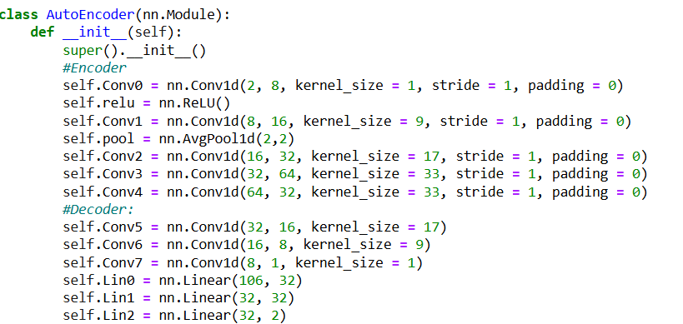
Model 3: Multi-Input
A network that accepts both pulses and their derivatives, with a combination of linear and convolutional layers

Slide 15
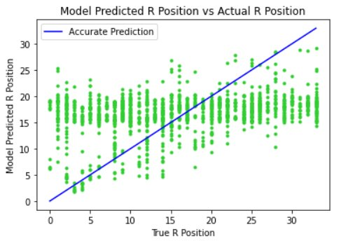
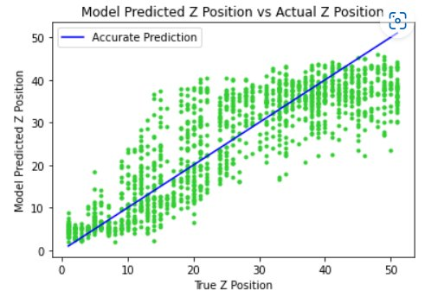
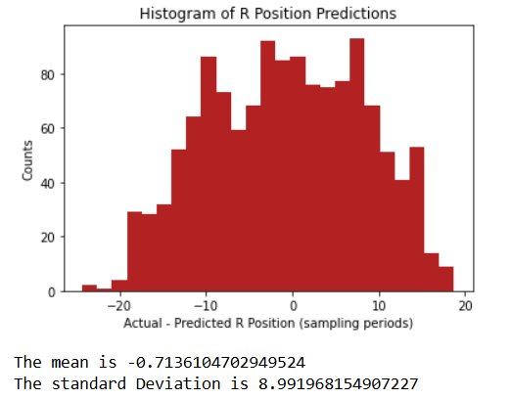
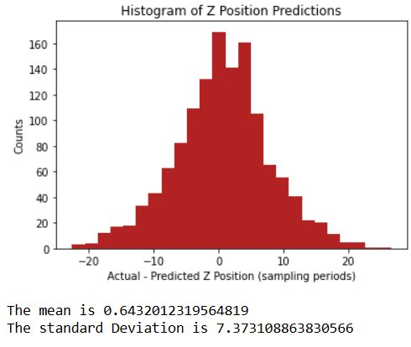
Performance of Best Multi-Input Model
R Position
Z Position

Slide 16
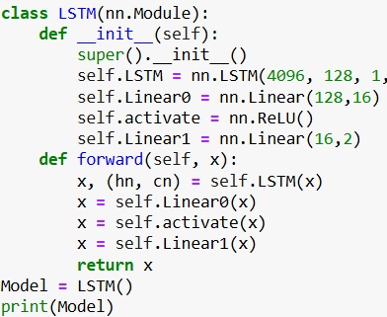
Model 4: LSTM
A network that remembers past values for good predictions on time series
Output
This Photo by Unknown Author is licensed under CC BY-SA

Slide 17
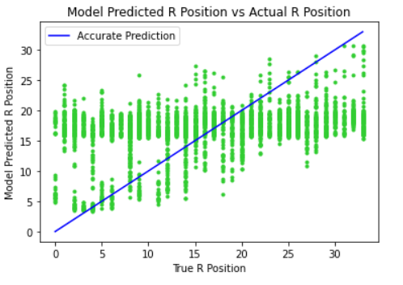
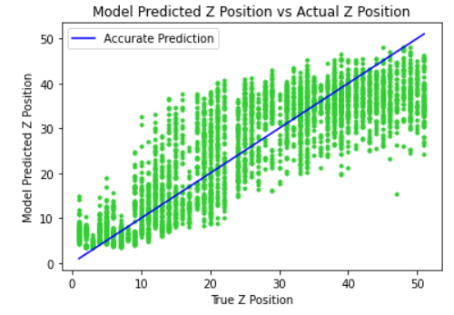
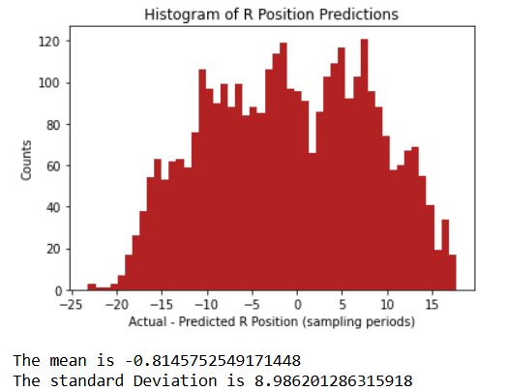
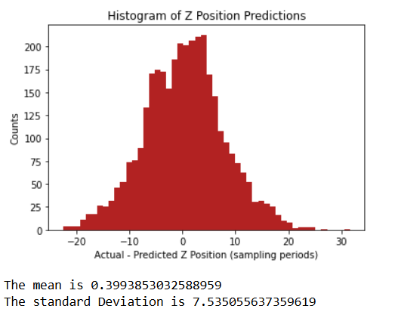
Performance of Best LSTM Model
R Position
Z Position

Slide 18
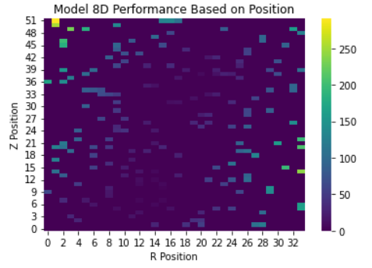
Where Models Struggle Most
Currently, machine learning performs best near the middle of detector, and at low R and Z (Type II trajectories)
As the models improve, the areas of high error and size of the error decrease
This heatmap shows the MSE Loss of 20 test pulses at 173 positions using the simple linear model (Model 1)

Slide 19
Summary
Machine learning has the potential to improve the accuracy of position reconstruction at high R and Z
Further, methodical investigation into different network styles and pre-processing techniques are needed to improve model performance

Slide 20
Questions?

Slide 21
References and Acknowledgements
M Agostini et al 2011 JINST 6 P03005
R Martin, Personal Communications, 2024
M Naar, Personal Communications, 2024
This Photo by Unknown Author is licensed under CC BY-SA-NC
This Photo by Unknown Author is licensed under CC BY
This Photo by Unknown Author is licensed under CC BY-SA
T Ye, Personal Communications, 2024

