Slide 1
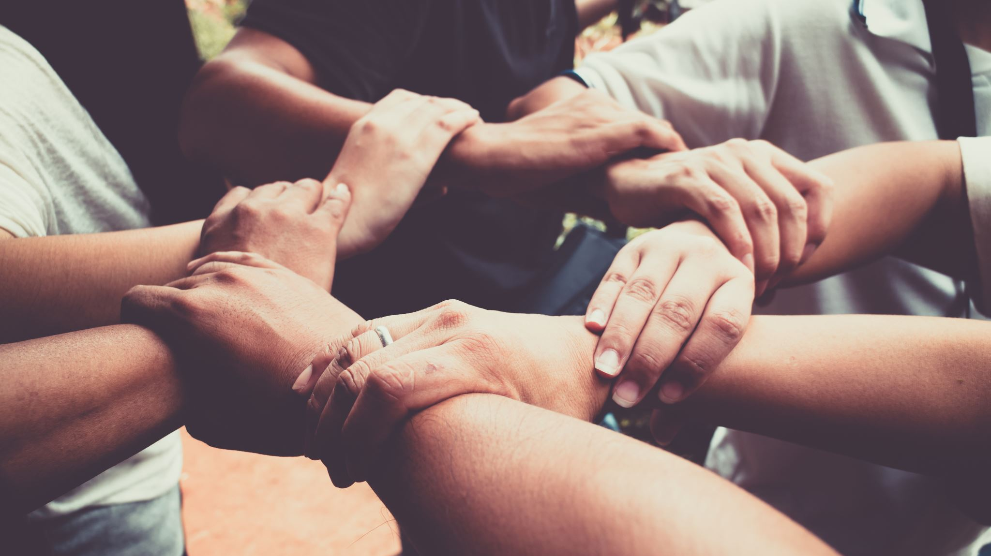
Inclusive Team Development
CASST Equity, Diversity, Inclusion (EDI) Workshop
Co-Presented by Danica Levesque & Dr. Alex Pedersen

Slide 2
Principles of Inclusive Teamwork
Awareness and Commitment – know your biases in an inclusive environment
Empowerment – encourage, amplify, and support
Equity and Fairness – promote opportunities for all
Openness to Differences – embrace and lean on new strengths
Accountability – be open to addressing any bias or discrimination
Collaboration and Support – fosters and nurtures an environment where everyone feels welcome to contribute and share their thoughts
Notes:
Awareness and Commitment: Leaders are aware of their own biases and actively commit to fostering an inclusive environment.
Empowerment: They empower diverse team members by encouraging their participation, amplifying their voices, and supporting their development.
Equity and Fairness: Inclusive leaders promote equity by ensuring fair opportunities for all, regardless of background or identity.
Openness to Differences: They embrace differences in perspectives, backgrounds, and ideas, seeing them as strengths that contribute to innovation and creativity.
Accountability: Leaders hold themselves and others accountable for fostering inclusivity and addressing issues of bias or discrimination.
Collaborative and Supportive: They foster a collaborative and supportive team culture where every member feels comfortable contributing and sharing their thoughts.

Slide 3
How to become an inclusive leader led by Meagan Pollock

Slide 4
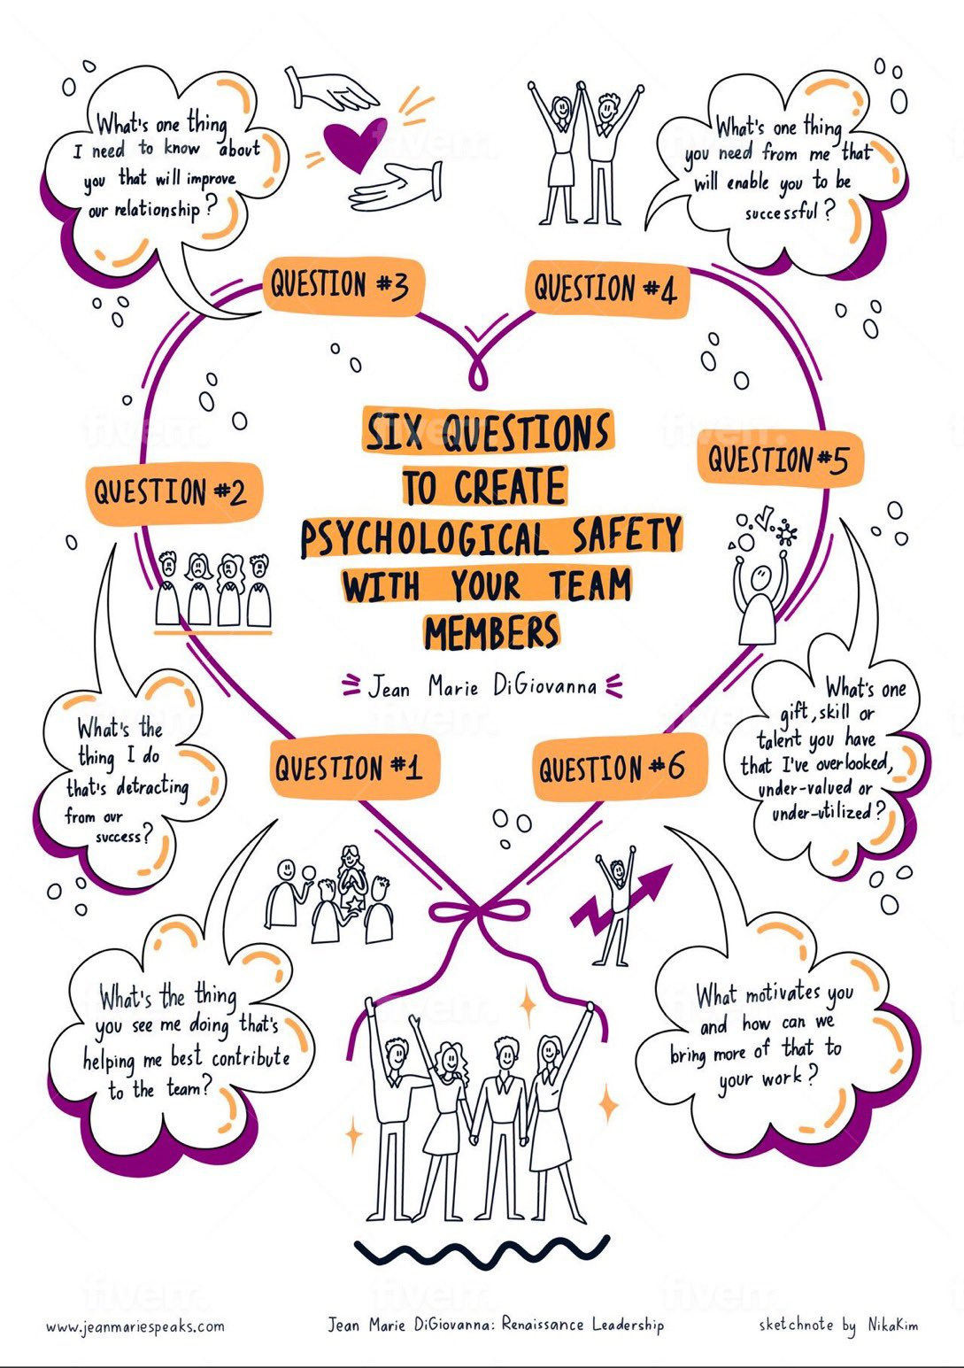
Inclusive leadership for Teamwork
A sense of belonging; the feeling of security and support when there is a sense of acceptance, inclusion, and identity for a member of a team or group.
A sense of psychological safety; feeling safe to take interpersonal risks, to speak up, to disagree openly, to raise concerns without fear of negative repercussions or pressure to sugarcoat bad news.

Slide 5
Who Owns the Zebra & Who Drinks the Water?
A logic puzzle intended to be solved in groups (7 people)
Think critically about:
Participation – who is participating, who is not?
Barriers – can everyone participate?
Inclusion v. Exclusion – can one's social identities impact one’s experience?

Slide 6
Who Owns the Zebra & Who Drinks the Water?
A logic puzzle intended to be solved in groups (7 people)
Your team has 30 minutes to solve the puzzle
You have 14 clues (2 clues from each team member)
You are done when you have consensus in your group, and you share the answer with the facilitator

Slide 7
Who Owns the Zebra & Who Drinks the Water?
There are five houses, each of a different color and inhabited by a person from a different country. Each person owns a different pet, drinks a different beverage, and performs a different exercise.
Your group’s task is to determine who owns the zebra and who drinks the water.

Slide 8
Debrief
What was your group’s experience like?
How did you make decisions about how to solve the puzzle?
What barriers did you feel to being heard?
How was influence/power expressed in your group?
How was conflict handled in your group?
Who “checked-out” in your group? Why?
How does this activity relate to our experiences in life?
What contributes to our feelings of inclusion/mattering or exclusion/marginality?

