Slide 1
15 Year Planning Exercise
2025/02/04
Jodi Cooley​
Executive Director | SNOLAB​
Professor of Physics | Queen’s University​
Adjunct Research Professor SMU​

Slide 2
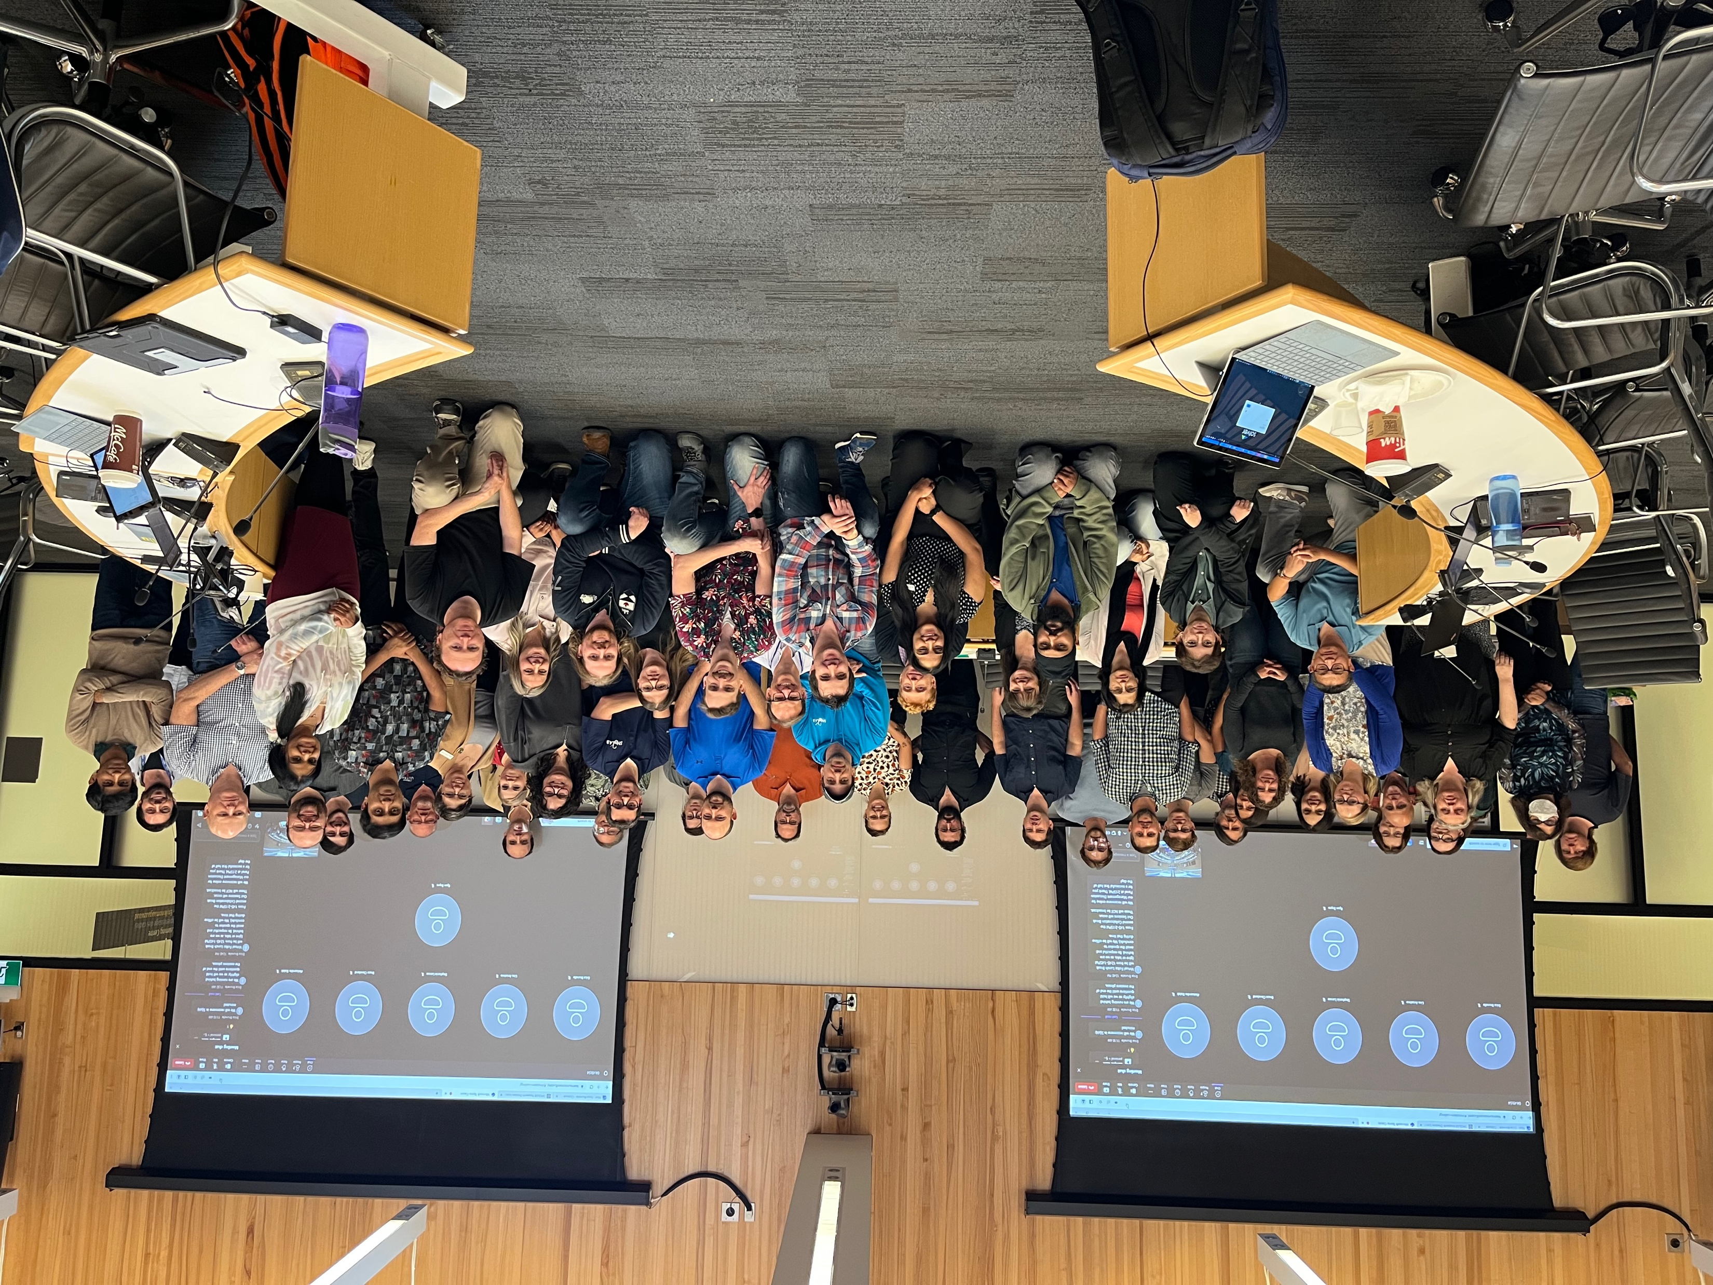
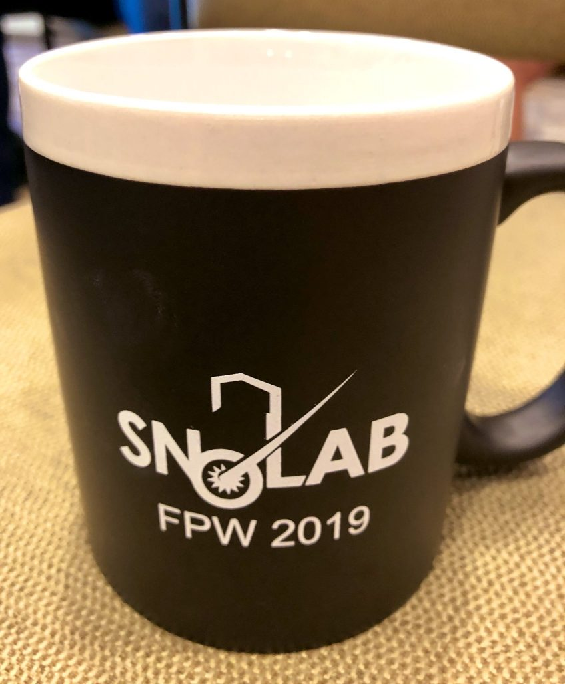
CFI requests SNOLAB to produce a 15-Year Operations and Maintenance Plan
CFI has requested SNOLAB to produce a 15-year under three budget scenarios by September 15, 2025.
Maintaining current levels of operation​
Fully supporting the needs of the Canadian research community​
Increasing global competitiveness​
Senior leadership has begun work on this plan. Hired additional temporary staff to help ensure delivery.
Engagement with SNOLAB staff occurred in December and January.
Various engagements with SNOLAB community are planned.
February 4th SEF meeting
Future Projects Workshop at SNOLAB, Apr 29 – May 1
Special session at CAP in June
Presentation of findings at the August MI meeting

Slide 3
2025 Future Projects Workshop
Registration now open!

Slide 4
Why Now?
New decision-making framework was introduced in the 2024 Canadian federal budget to support Canadian Major Research Infrastructures.
Six research facilities introduced including SNOLAB
Central Pillar Lifecycle funding for designated facilities
Requires CFI to assess long-term capital and operational needs of each MRF to make a request to the Government of Canada.
SNOLAB has been asked to provide detailed and reliable budget estimates for the next 15 years under three budget scenarios.
As part of this process, SNOLAB will also be required to provide a facility condition assessment and asset management plan under these three scenarios.

Slide 5
Three Scenarios: Current Working Definitions (subject to revision)
Maintaining current levels of operation​
Current laboratory at 100% occupancy
New modest surface building offsite: “Lively Campus”.
Fully supporting the needs of the Canadian research community​
Expand underground laboratory with new ladder labs to meet increased demands for space and capabilities.
New larger surface building offsite: “Lively Campus”.
Increasing global competitiveness
Expanded underground laboratory with new ladder labs and large cavern to potentially host a beyond tonne-scale 0νββ beta decay, a beyond 3rd generation dark matter experiment, or something else
New ”Lively Campus” with expanded facilities (hostel, cafeteria, …?)

Slide 6
What are we doing today?
Brainstorming: What new capabilities should we consider? What support do we need for those capabilities?
New Capabilities or Expansion of Existing Capabilities: What are they and what do they require?
Lab Expansion: What does that require? What capabilities or support infrastructure would be needed or housed in an expanded lab?
Additional Surface Building: What spaces/capabilities do we need to have in a new building?

