Slide 1
2025 Conference for Project Management Professionals
2025/05/13
Site Overview
Mehwish Obaid, PMO Manager (she/her)

Slide 2
Welcome to SNOLAB
The Canadian Laboratory Consortium Conference for Project Management Professionals was established in 2025.
The goal is to promote on-going networking and encourage collaboration between community of project management professionals from Canadian Light Source, Canadian Nuclear Laboratories, TRIUMF and SNOLAB
The purpose is to share project management lessons learned and best practices The theme of this year’s conference is Communication on R&D projects.

Slide 3
Welcome to SNOLAB
Washrooms are available on every floor.
All gender, accessible washroom on the first floor.
Drinking water is available in the spigot near the kitchenette faucets, water coolers. Do not drink the tap water.
Coffee/tea is available in the kitchenettes on the 1st, 2nd & 3rd floors.
Wifi is SNOLAB Guest.
We are at active mine site, please wait for escorts to walk you to the parking lot.

Slide 4
Emergency Evacuation
Do not use the elevator in an evacuation.
Use the nearest stairwell to exit the building.
Report to the SNOLAB Assembly Area.
The SNOLAB Assembly area is in the front parking lot, straight ahead from the front doors of the building.

Slide 5
Emergency Information
First aid kits: Warehouse, second floor kitchenette, third floor break area
Defibrillator: second floor kitchenette
EpiPens: second floor kitchenette
For a medical emergency, call the Vale Plant Protection Office at 705-692-2292.
If using a landline phone, dial 8 before dialling the number.

Slide 6
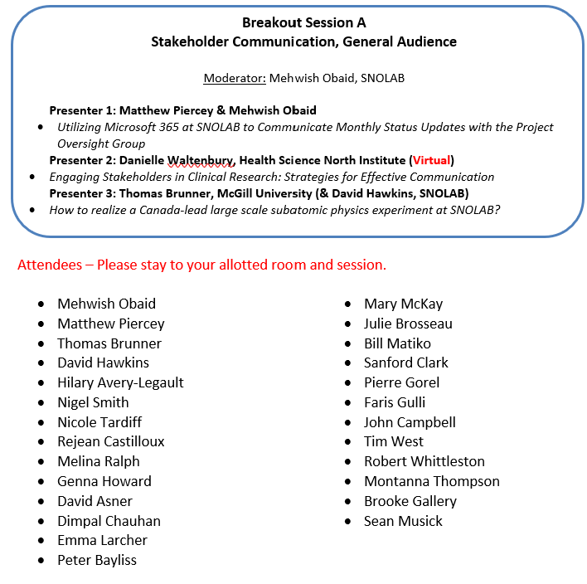
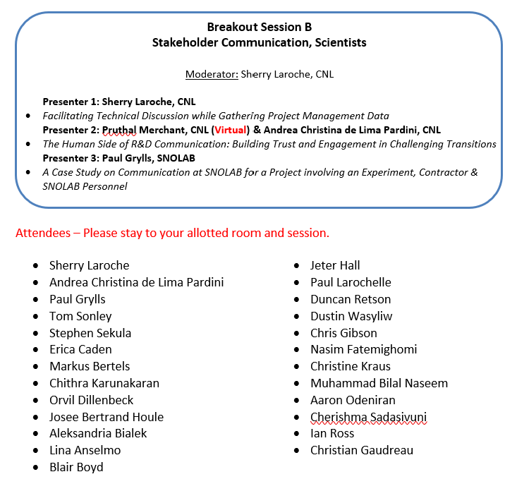
Breakout Sessions A and B (10:15 to 11:45)

Slide 7
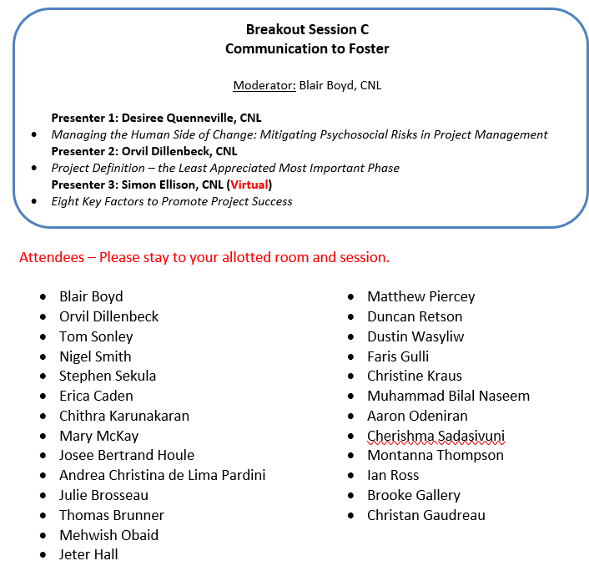
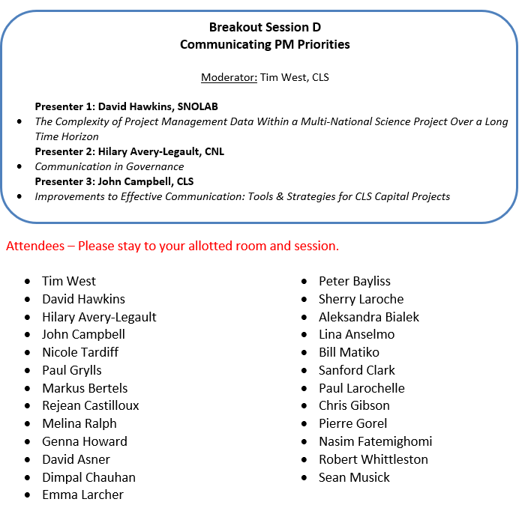
Breakout Sessions C and D (12:30 to 14:00)

