Slide 1

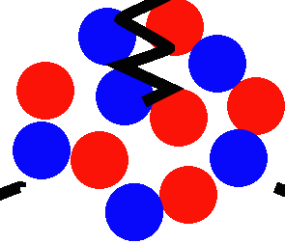
Inelastic Interactions on Nuclei
Kevin McFarland
University of Rochester
NNN 2025, Sudbury
2 October 2025

Slide 2
Plan for This Lecture
Why?
Experiments
A selection of Results and Trends
Lunch

Slide 3
Plan for This Lecture
Why would anyone willingly study this?
Experiments
A selection of Results and Trends
Lunch

Slide 4
Why?
(“because it’s there” is always the wrong answer)

Slide 5
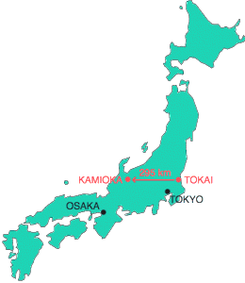
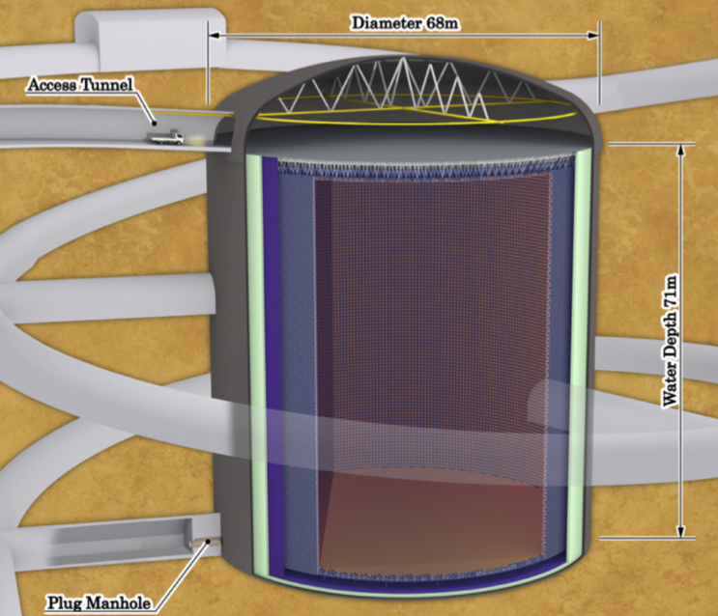
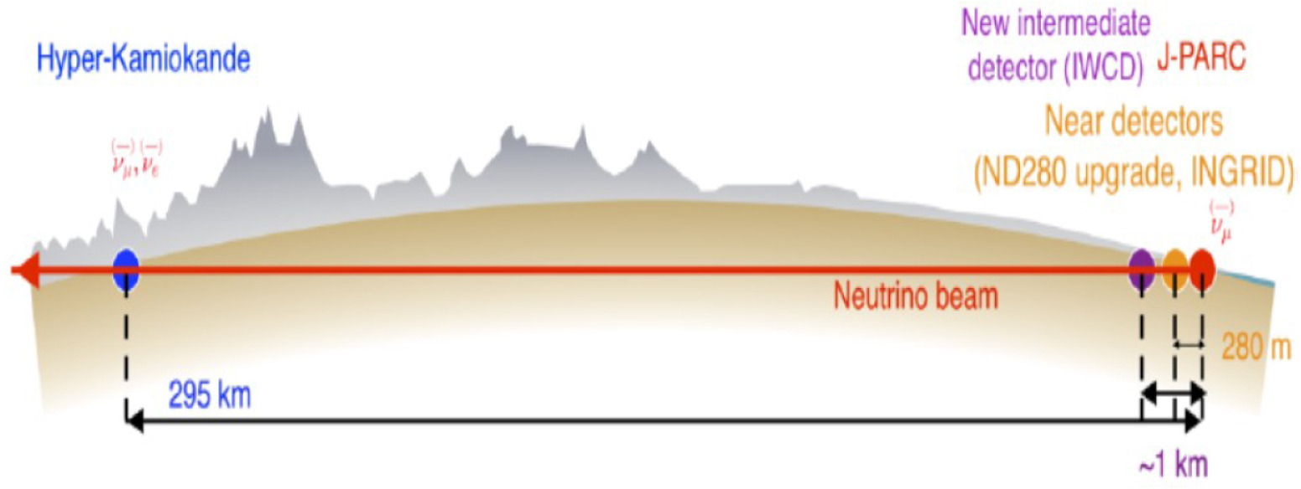
Future Neutrino Experiments: T2HyperK
Major upgrade of the T2K beam and a larger far detector, HyperKamiokande, in approximately the same location.
Designed to be a high statistics test of the observed (with low statistics) CP asymmetry in the T2K oscillation result.

Slide 6
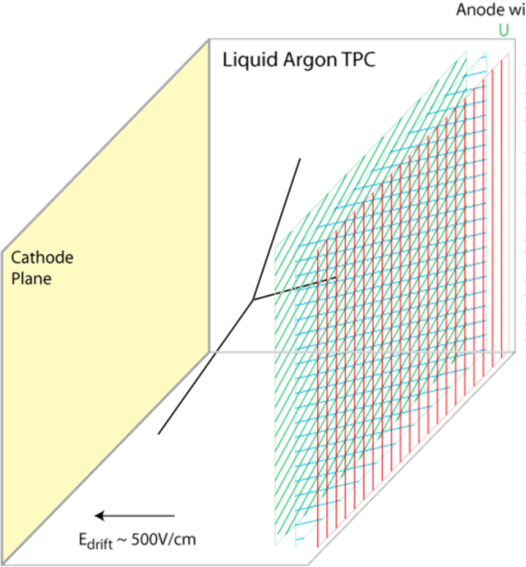
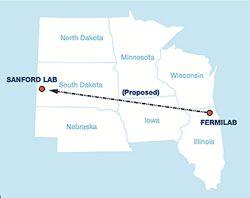
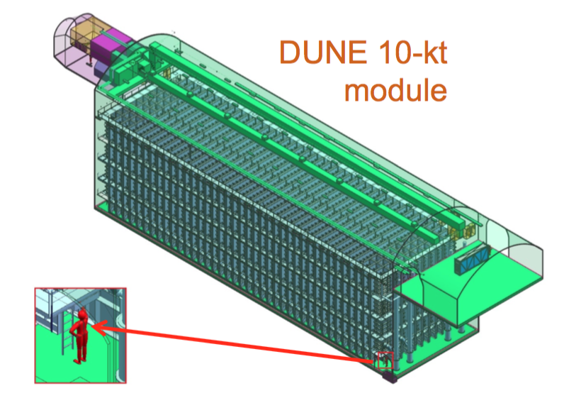
Future Neutrino Experiments: DUNE
Happy coincidence of location of Sanford lab (the former
Homestake mine where neutrino emission from the sun was discovered!) and locations of high-power multi-GeV proton sources at an
optimal distance.
Drift and collect ionization e⁻ in liquid argon
(~2 e⁻ per μm).
Try to identify all particles in the event by their ionization or interactions.
Detector mass of ~40kTon (or 40Gg if you prefer) of material capable of measuring ionization from neutrino interaction products anywhere in that mass.

Slide 7
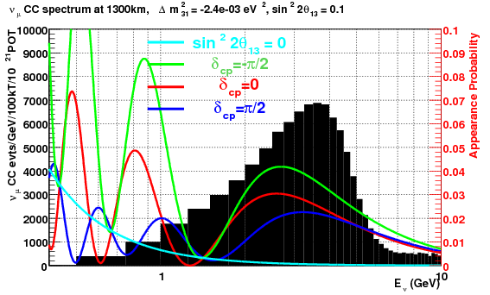
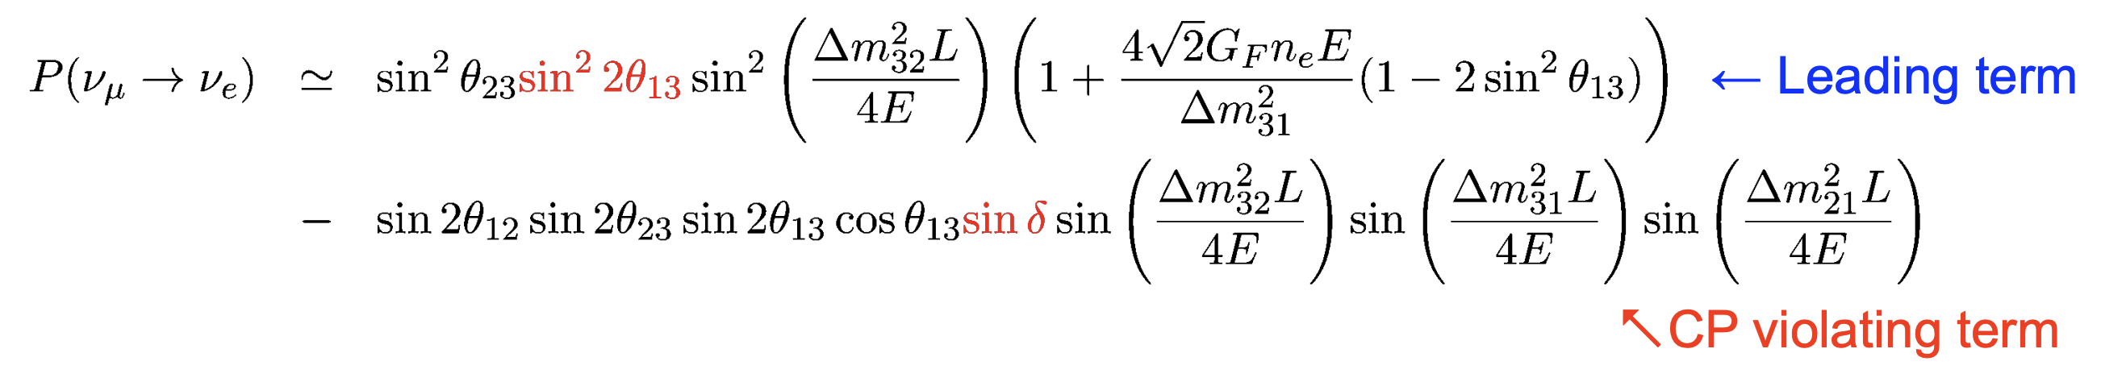
What must the detectors measure?
Rate and spectral differences as a function of CP phase
In flavor interferometry, neutrinos are characterized by flavor and energy.
But the beam has a broad spectrum. And events are rare, so need to observe flavor and energy from all the possible final states.
Requires a detailed understanding of a large number of neutrino interaction mechanisms, and how they may obscure energy and flavor.

Slide 8
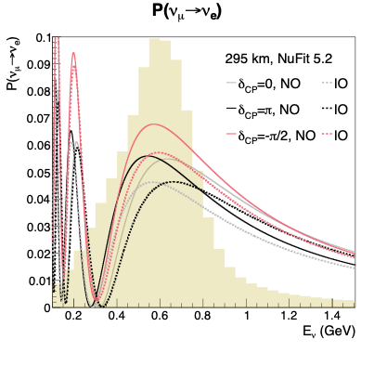
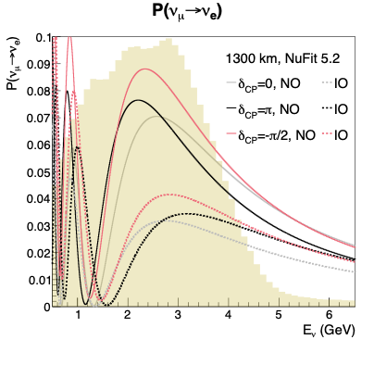
Oscillation at Hyper-K and DUNE
NO: Normal Mass Ordering
IO: Inverted Mass Ordering
Note the very different probabilities for HyperK and DUNE!

Slide 9
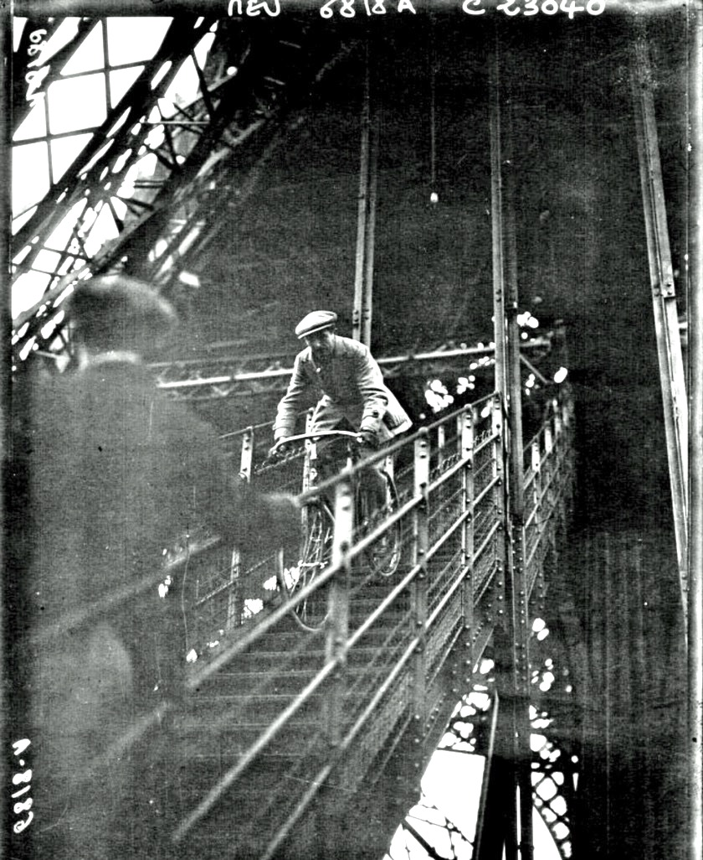
Failed Multi-Scale Problems
Consider a bicycle rider at right, descending the stairs of the Eiffel Tower
  A bicycle wheel is ~1m in diameter.
  If steps were ~1cm height or the steps were ramps of ~100m, we could predict the cyclist’s trajectory.
Descent of the Eiffel Tower stairs by bicycle, ca. 1910

Slide 10
Failed Multi-Scale Problems
Consider a bicycle rider at right, descending the stairs of the Eiffel Tower
  A bicycle wheel is ~1m in diameter.
  If steps were ~1cm height or the steps were ramps of ~100m, we could predict the cyclist’s trajectory.
But since the wheel size is too close to the step size, the only reliable prediction is that it is going to be painful.
Descent of the Eiffel Tower stairs by bicycle, ca. 1910

Slide 11
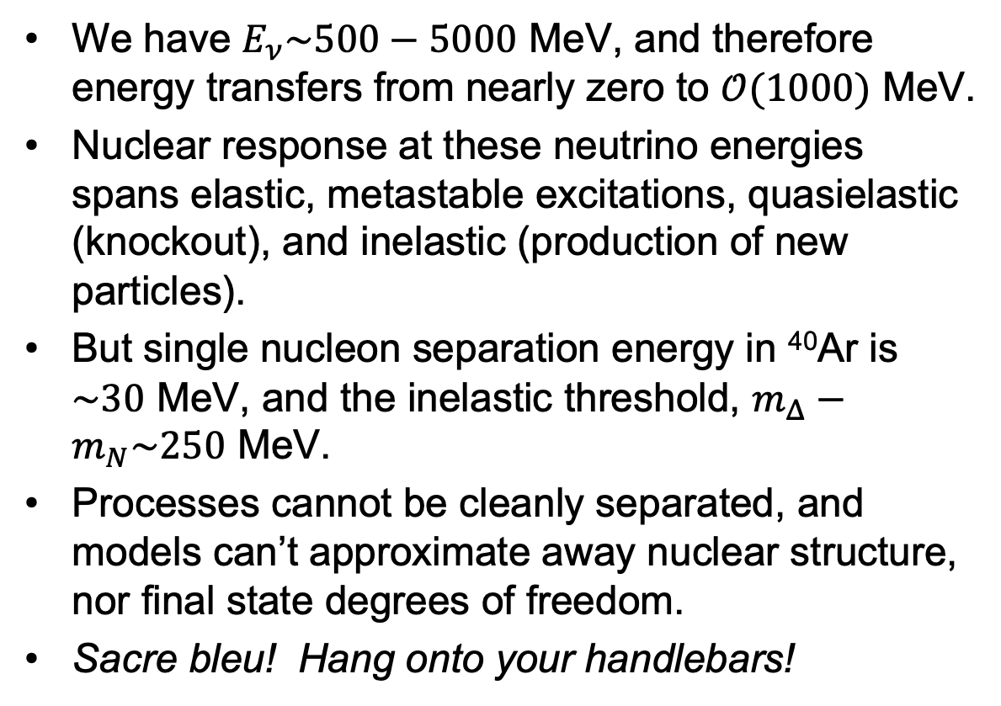
Our Failed Multi-Scale Problem
We have $E_{ν}\sim 500−5000$ MeV, and therefore energy transfers from nearly zero to $𝒪(1000)$ MeV.
Nuclear response at these neutrino energies spans elastic, metastable excitations, quasielastic (knockout), and inelastic (production of new particles).
But single nucleon separation energy in ⁴⁰Ar is $\sim 30$ MeV, and the inelastic threshold, $m_{Δ}−m_{N}\sim 250$ MeV.
Processes cannot be cleanly separated, and models can’t approximate away nuclear structure, nor final state degrees of freedom.
Sacre bleu! Hang onto your handlebars!
Descent of the Eiffel Tower stairs by bicycle, ca. 1910

Slide 12
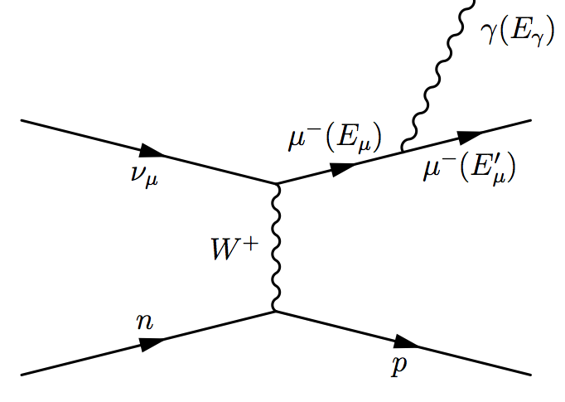
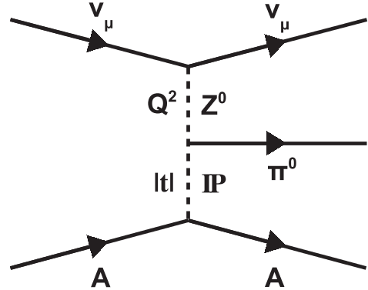
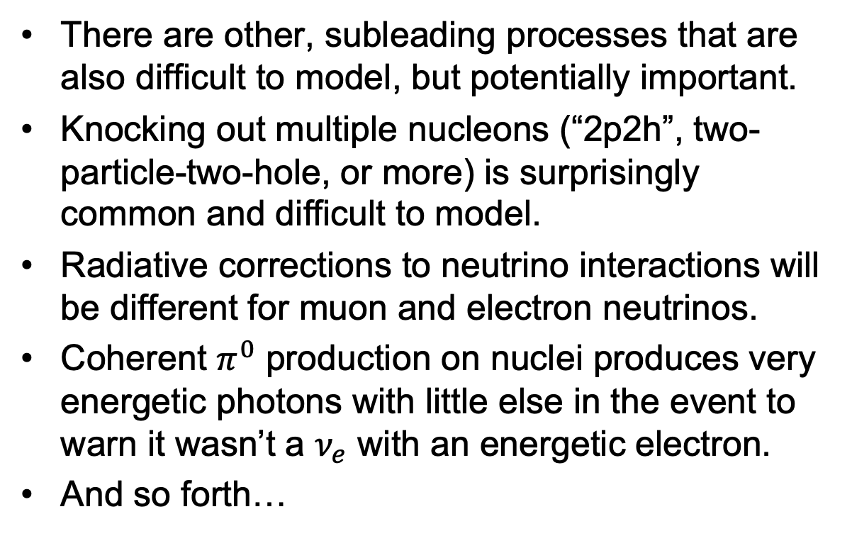

More Problems in $ν$ Interactions
There are other, subleading processes that are also difficult to model, but potentially important.
Knocking out multiple nucleons (“2p2h”, two-particle-two-hole, or more) is surprisingly common and difficult to model.
Radiative corrections to neutrino interactions will be different for muon and electron neutrinos.
Coherent $π^{0}$ production on nuclei produces very energetic photons with little else in the event to warn it wasn’t a $ν_{e}$ with an energetic electron.
And so forth…

Slide 13
Theory and Experiment
Both are critical, but both are limited in what they can offer.
Theory, as noted, uses necessary approximations, is limited in phase space, or calculates overly inclusive reactions ill-suited to describing the full final state.
Data are good at pointing out modeling deficiencies, but often poor at pinpointing the problem.
Effective Models
Reaction Data
(νA or eA)

Slide 14
Experiments: Detectors
(who studies this, and how?)
Notes:
I can’t run through every detector idea for the future, and it would be foolish to try. But here are some major players in the landscape.

Slide 15
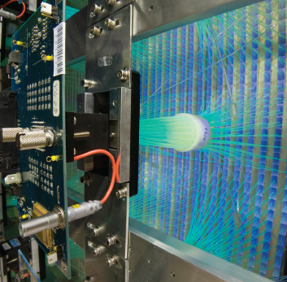
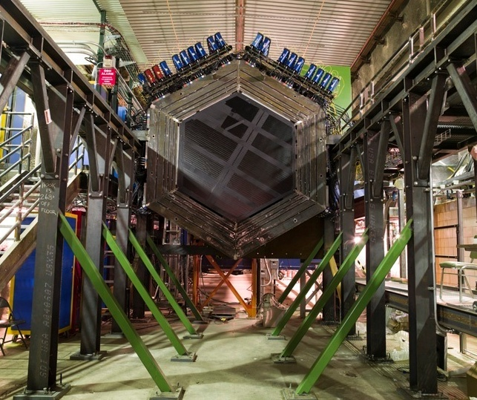
Lots of Experiments
Short baseline oscillation experiments have enough rate to also measure neutrino interactions: LSND, MiniBooNE, MicroBooNE.
Oscillation experiments have near detectors which measure interactions with varying degrees of effort: K2K, MINOS, T2K, NOvA, SBN.
A few dedicated experiments: SciBooNE, MINERvA, ANNIE.
DONE, PUBLISHING, ALMOST…

Slide 16
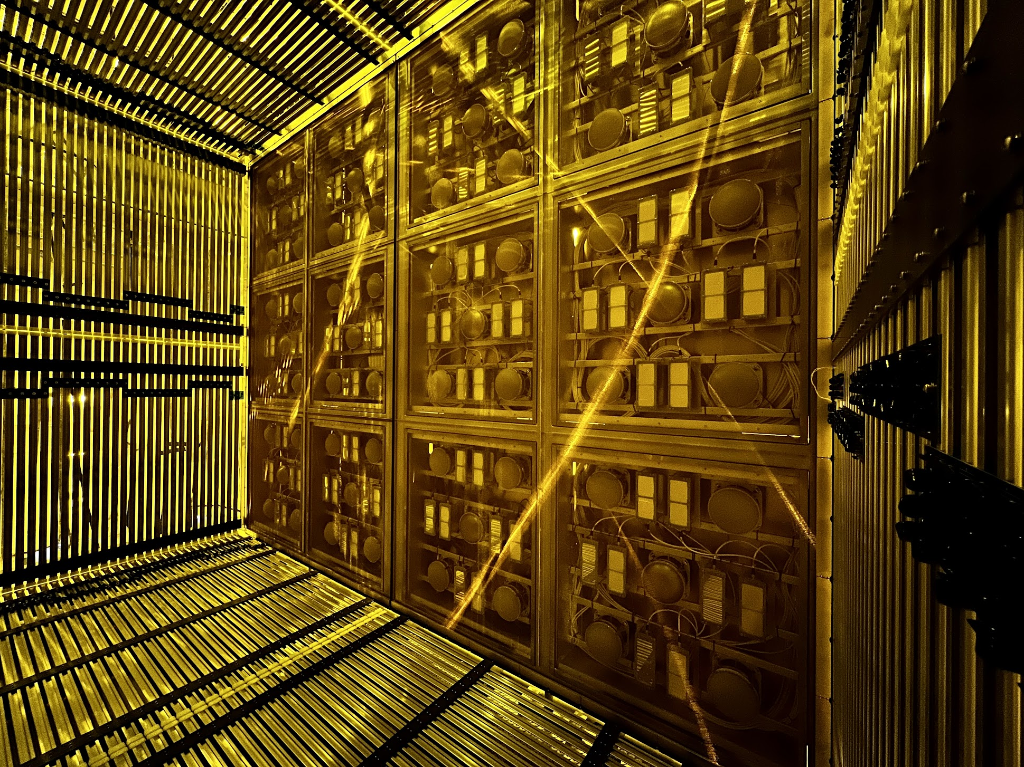
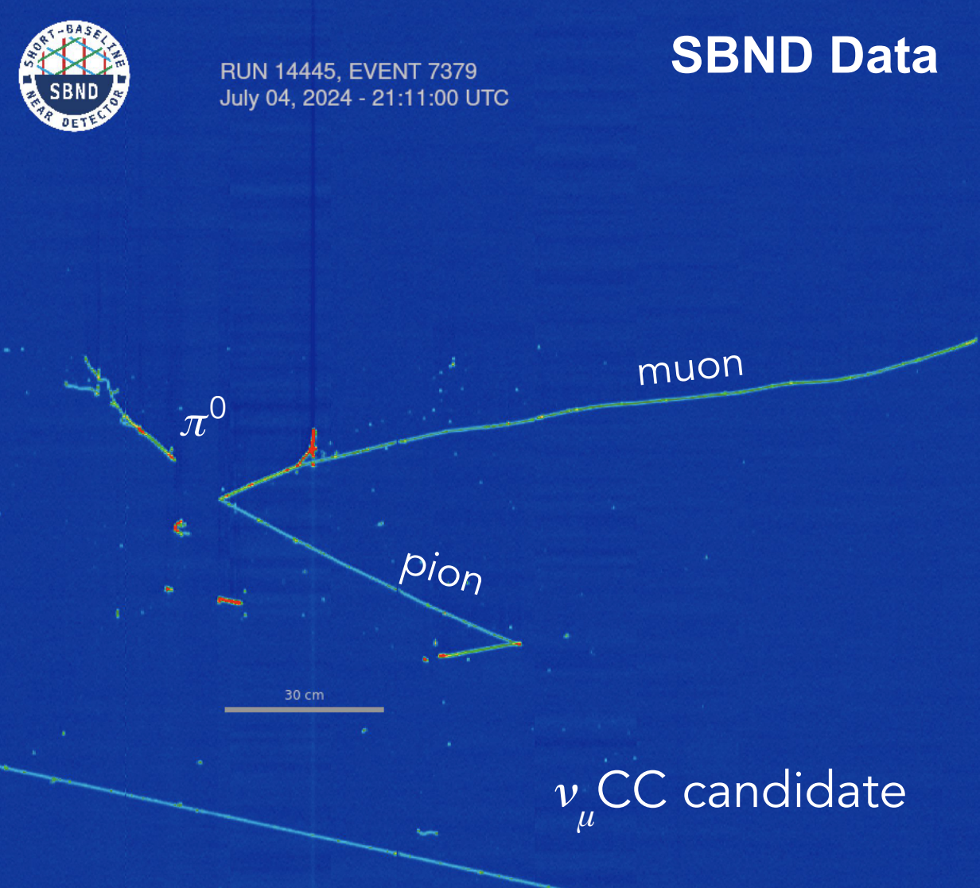
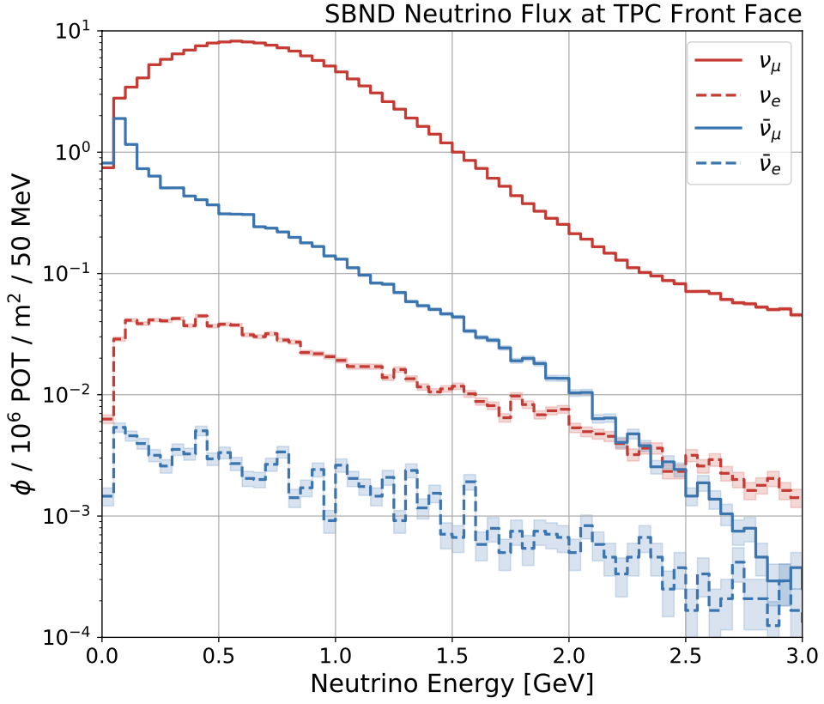
SBN Program Near Detector (SBND)
SBND utilizes liquid argon TPC (LArTPC) technology because of its low particle thresholds and good particle identification.
Close to the beam source and massive, it will accumulate nearly NOvA near detector or MINERvA sized statistics on argon.
Notes:
SBND is a large LArTPC very close to the source to optimize rate. It has all the advantages of LArTPC but for the first time will have samples rivaling the large scintillator detectors. Critically important for the SBN program and for DUNE.

Slide 17
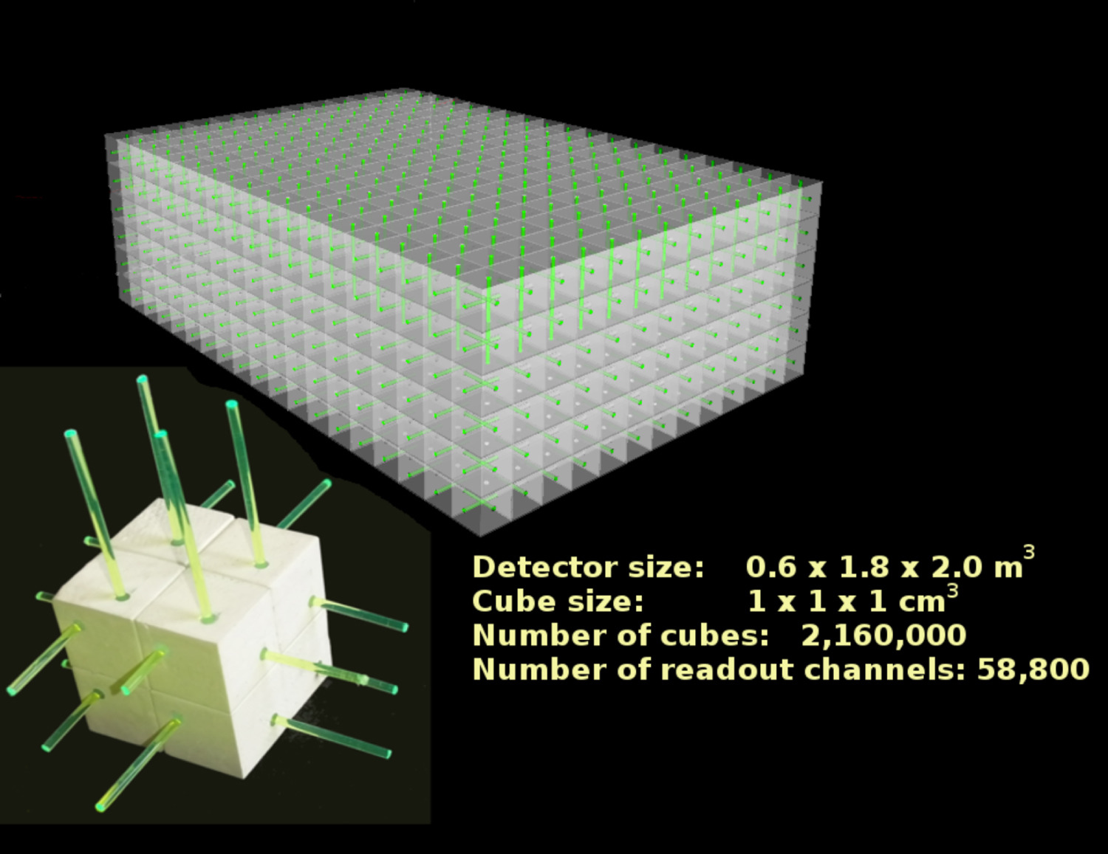
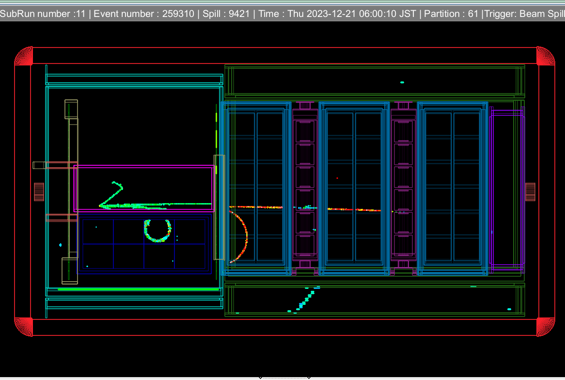
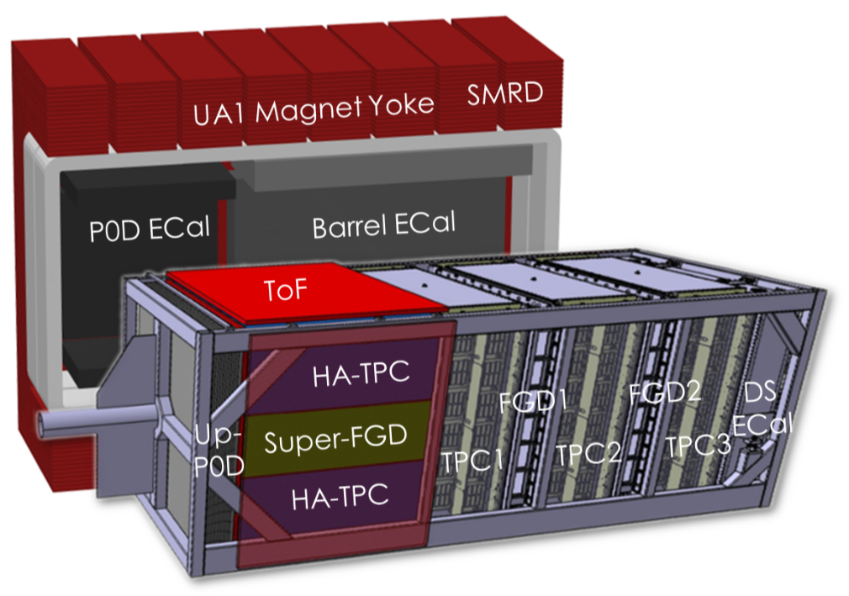
T2K/HyperKamiokande SuperFGD
The SuperFGD 3D pixelated scintillator also provides increased granularity for high multiplicity and low thresholds.
Also has excellent neutron capability, including time-of-flight momentum reconstruction.
Notes:
An revolutionary realization of an old technique is 3D segmented scintillator tat the T2K SuperFGD. It is cm^3 segments, read out by a 3D array of fibers. A highlight of this detector are its low thresholds with excellent segmentation, great timing, and therefore an ability to reconstruct neutrons down to ~10 MeV kinetic energies.

Slide 18
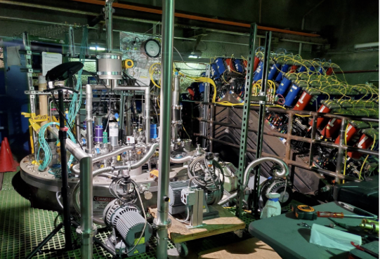
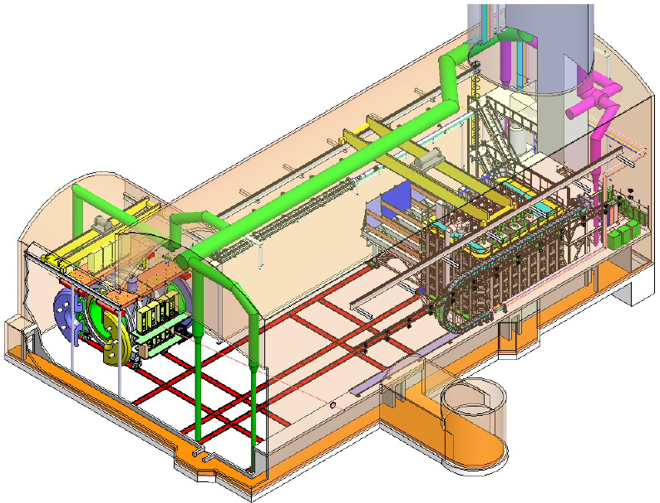
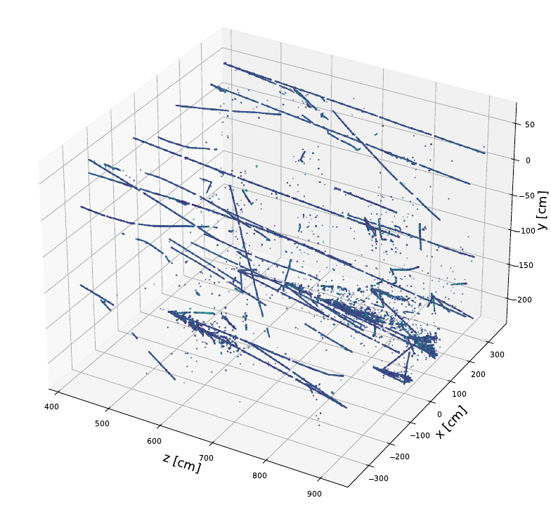

Future: DUNE Phase One Near Detector
Includes PRISM concept in novel
segmented LArTPC, which is currently
being prototyped.
Notes:
DUNE’s planned near detector has many novel concepts. A large LArTPC, that is segmented to handle the high rate, will be movable off-axis in the PRISM concept.

Slide 19
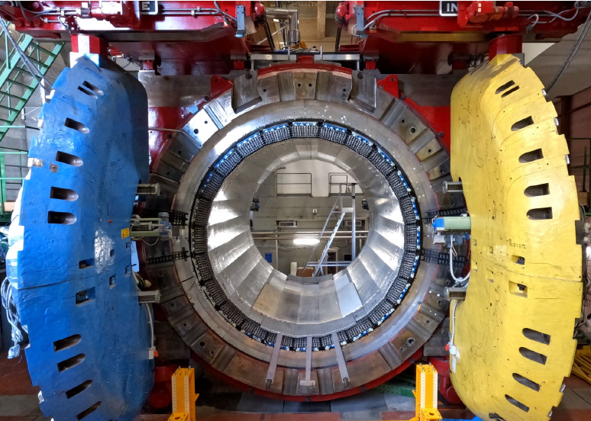
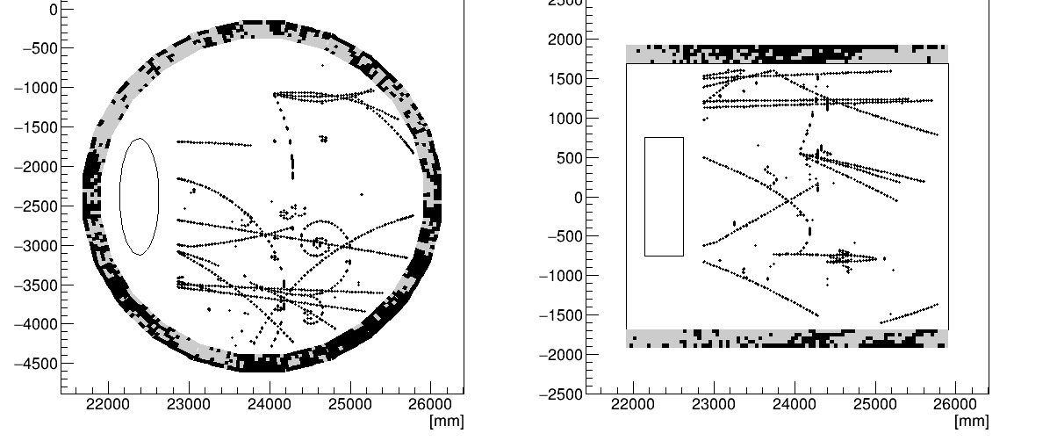
DUNE Phase One Near Detector
SAND includes CH₂ and C (for separation of H and C)
and Ar targets to compare interactions on different nuclei.
Notes:
DUNE’s ND also has an on-axis magnetized low density tracker detector with CH2 and C foil targets with a LAr target. Low thresholds, good charge and PID, and the ability to directly compare rates on different targets.

Slide 20
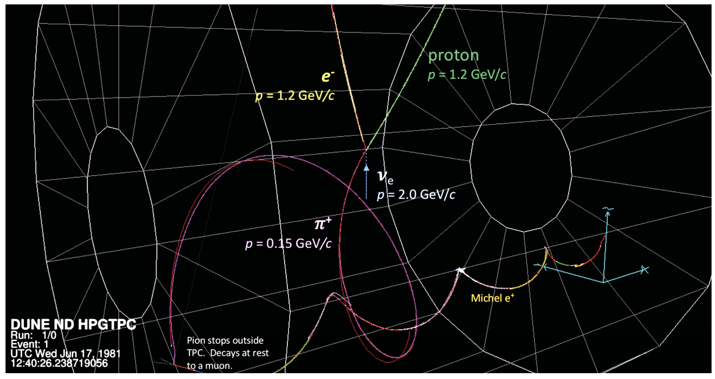
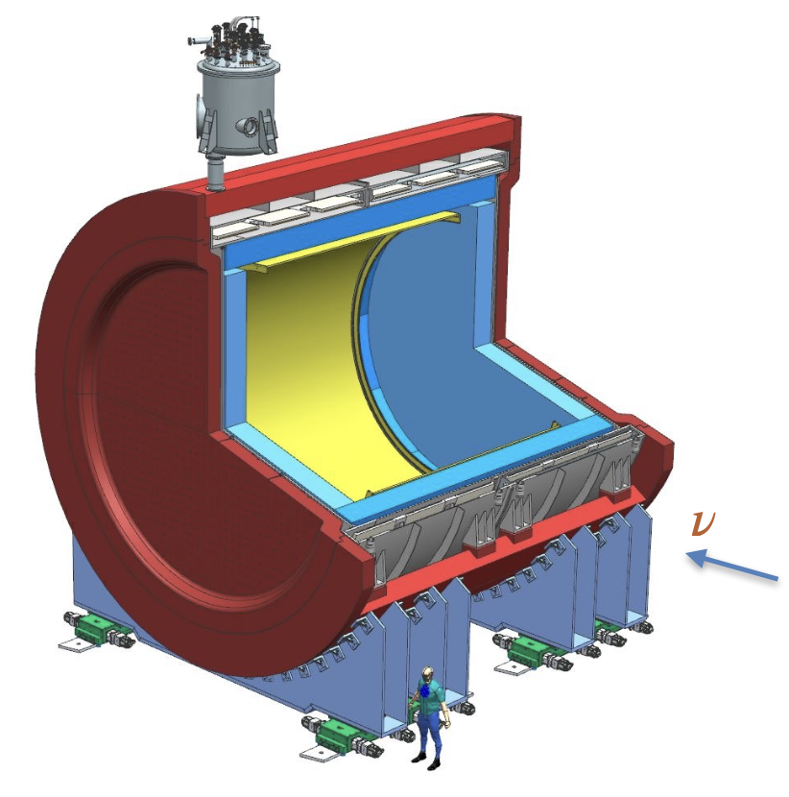
DUNE Phase Two Gaseous “more capable” ND
A future gaseous argon detector would provide bubble-chamber like low thresholds for reconstruction of charged particles.
Valuable information about energy lost to nuclear final states.
P5 Town Hall March 2023
Notes:
In DUNE Phase II, there are plans afoot for a high pressure gaseous Ar detector, which will exploit the high rates to make a low mass target with very, very low thresholds for charged particles.

Slide 21
Experiments: Neutrino Beams
what do we have to work with?

Slide 22
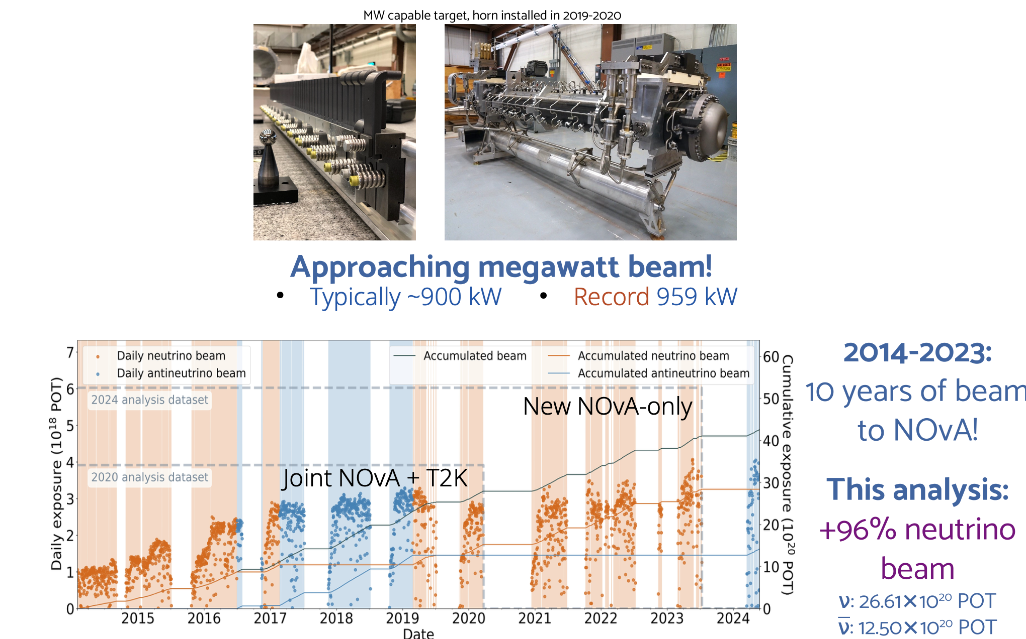
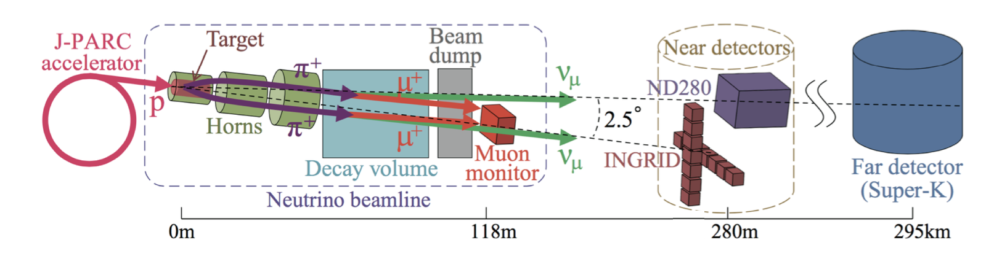
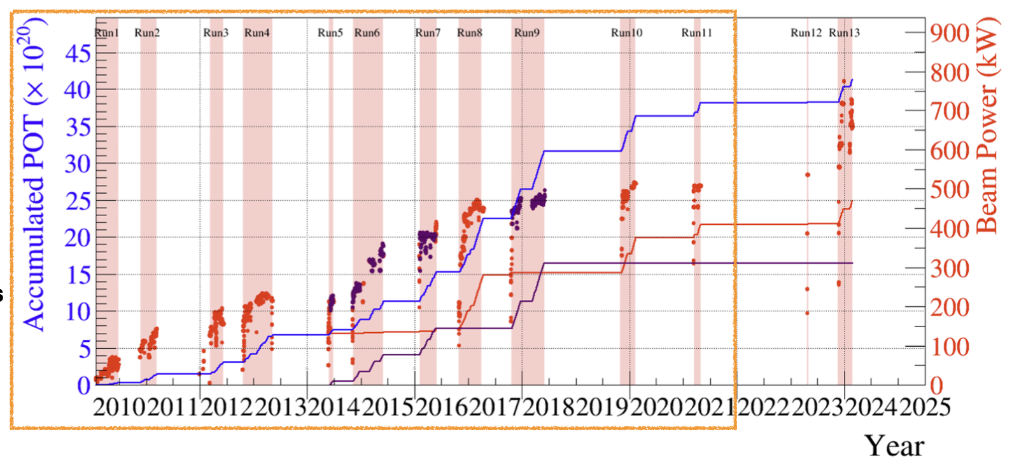
Neutrino Beams: Intensity
We have two ~GeV neutrino beams approaching 1MW beam power, both with incremental paths to slowly increasing power.
NOvA beam (NuMI)
T2K beam
Notes:
Even looking back over the last decade, it is astounding how much progress our power frontier accelerator beams have improved. Expect this to continue steadily in the short term.

Slide 23
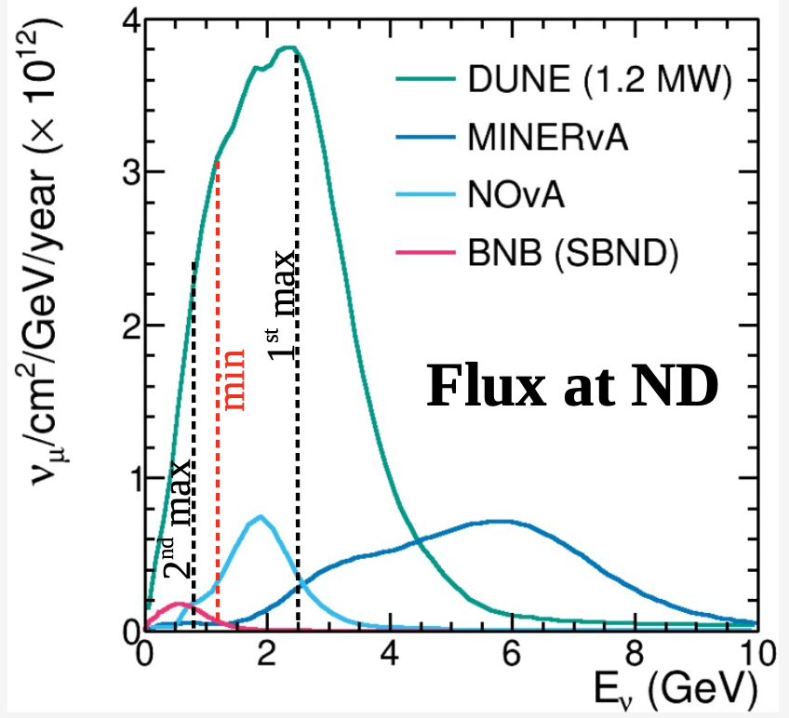
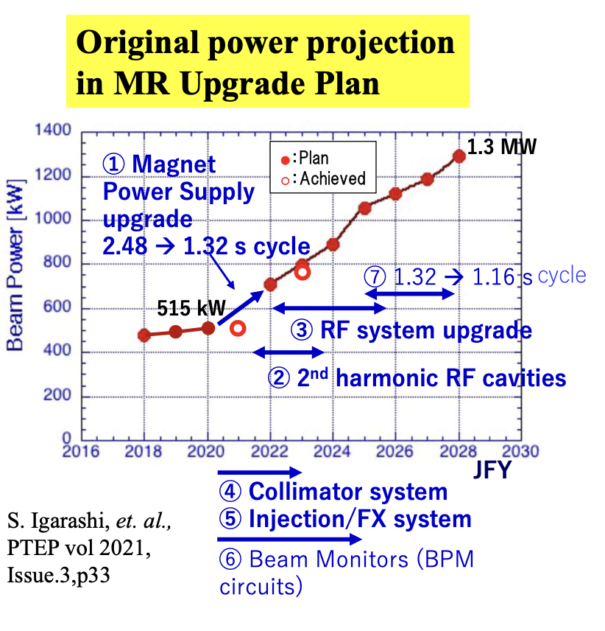
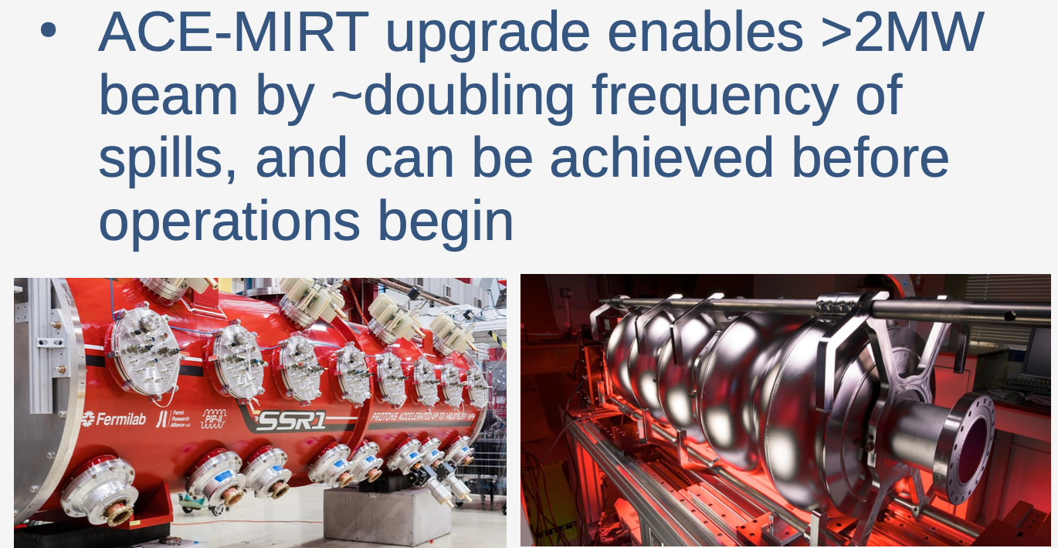
Neutrino Beams: Intensity
Both FNAL and J-PARC have paths to significant increases in what is now the visible future.
Notes:
In the long term, both facilities have impressive upgrade plans to continue these increases, to the point we’ll be an order of magnitude beyond the early 2010s. This has transformed the field of interactions in a meaningful way.

Slide 24
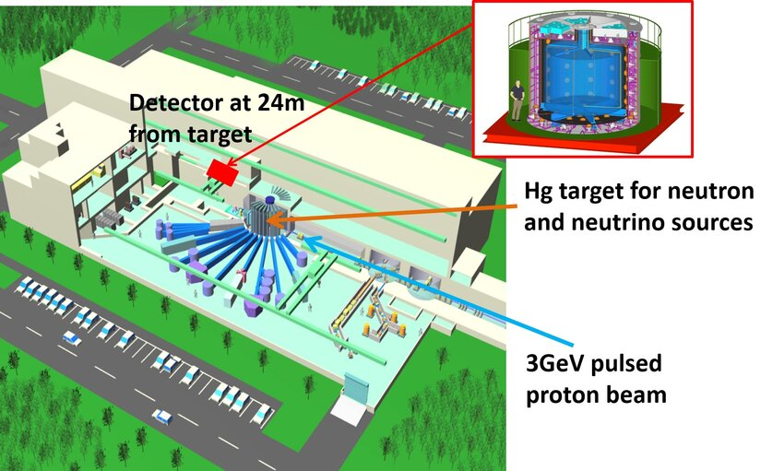
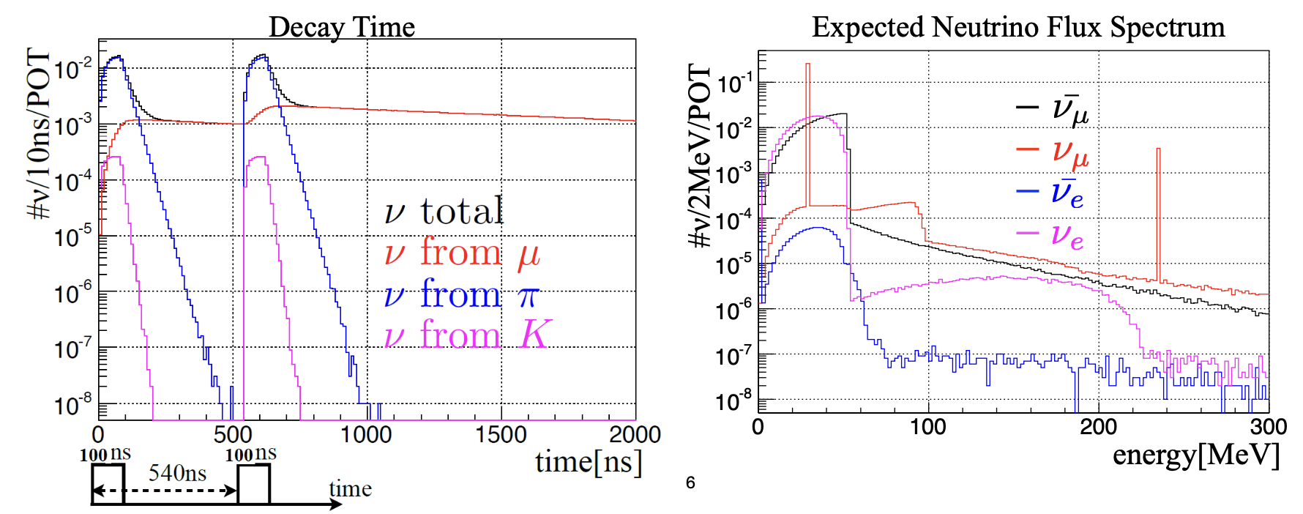
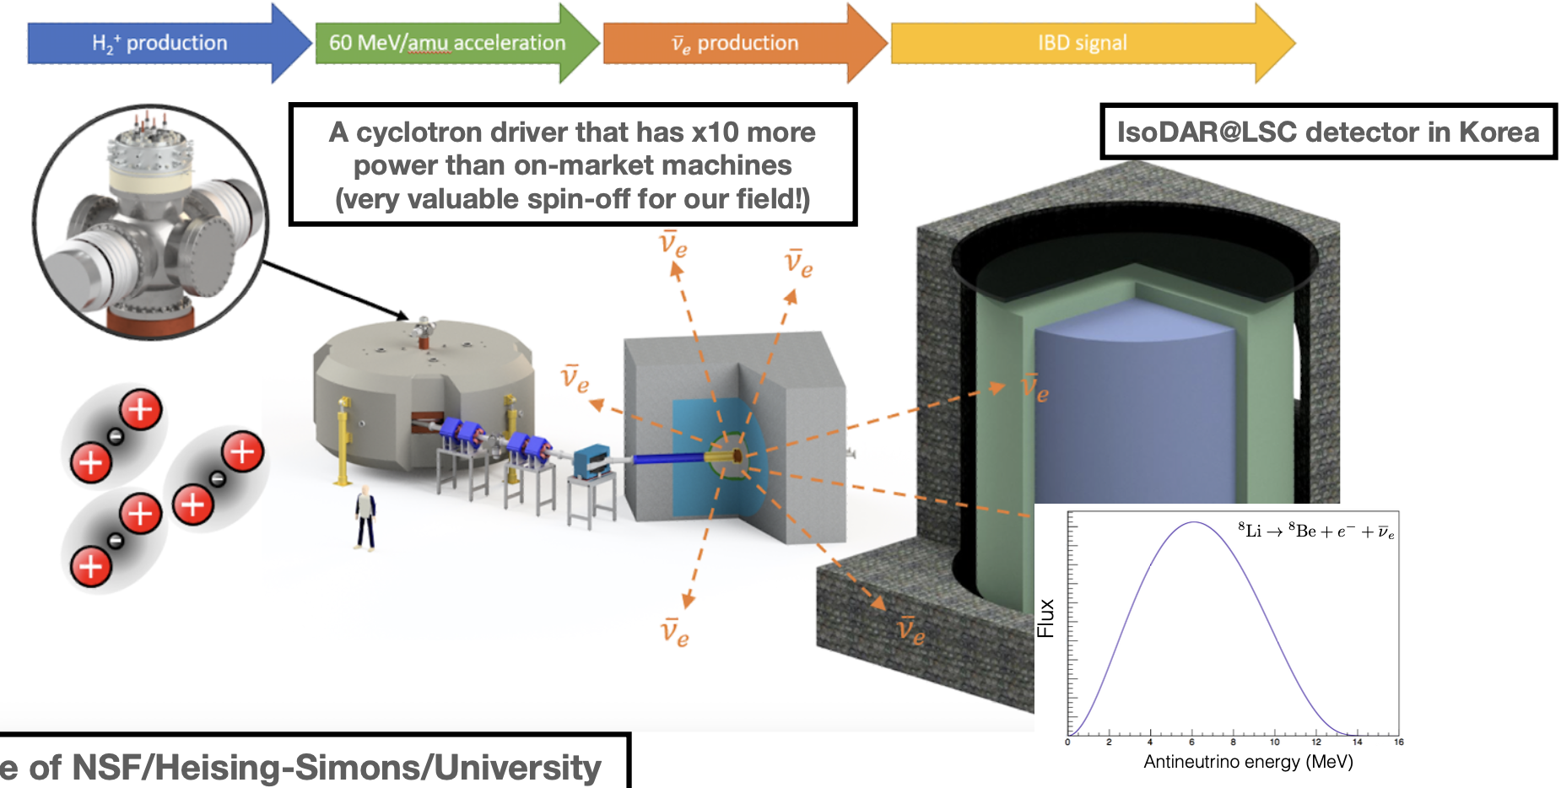
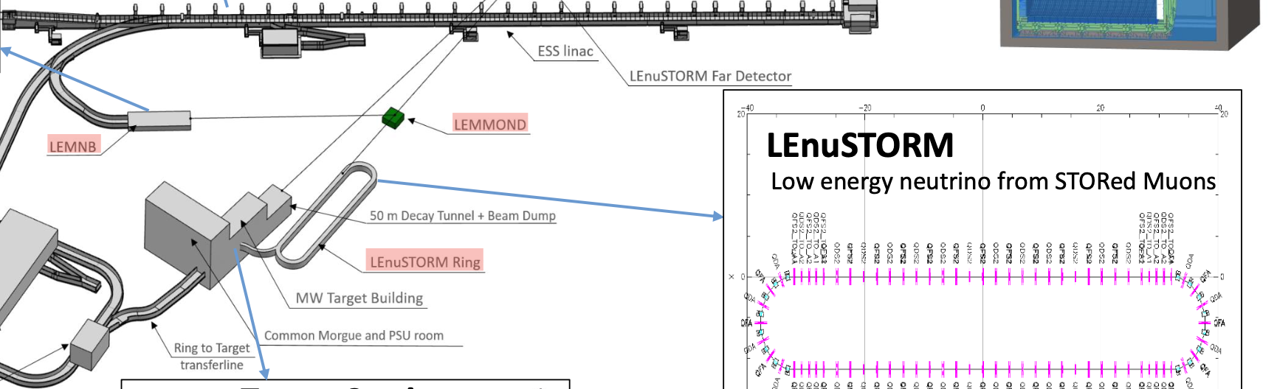
Neutrino Beams: Flavor
Our conventional beams are muon neutrinos. But…
…can produce electron neutrinos through decay-at-rest of leptons or ions, and even tackle the challenging task of capturing and accelerating them (nuSTORM).
JSNS
IsoDAR
ESSnuSB
Notes:
Recall that accelerator-based beams primarily produce muon neutrinos with a small contamination of electron neutrinos. But we want to know about electron neutrino interactions, so sources that can give us electron neutrinos are particularly important for the path forward. The idea is a capture and acceleration scheme, however challenging it will be.

Slide 25
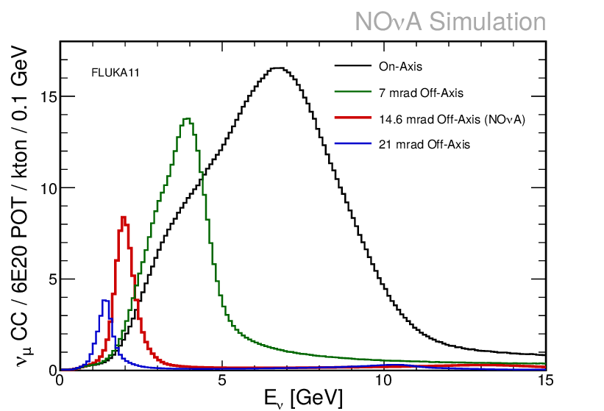
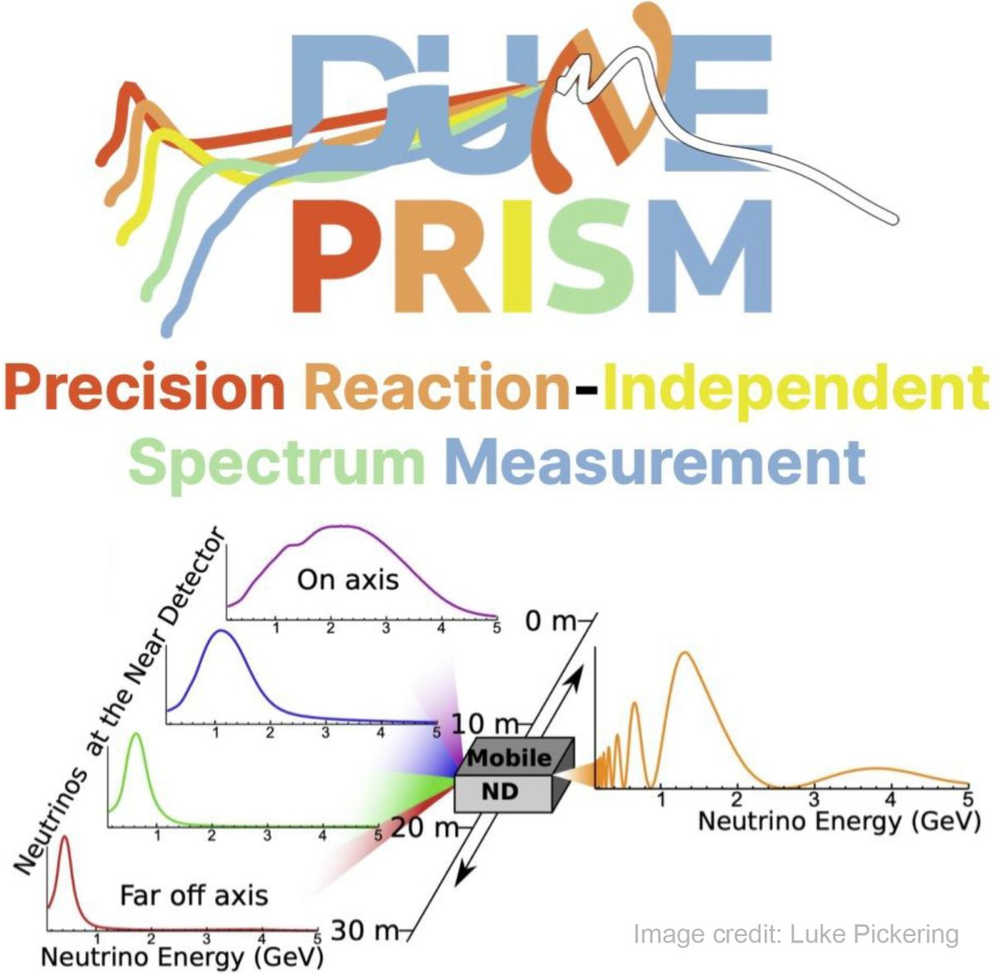
Energy by Location
Beams (like NuMI) can be tuned to produce different energies.
But also, NOvA and T2K use the “off-axis” technique, pointing the beam away from the detector to select neutrino energy.
PRISM: measure many off-axis angles in the same near detector to study beams of
different energies.
Journal of Physics: Conference Series. 1219. 012021
increasing angle, decreasing energy and rate
Notes:
A review of the techniques: (1) tune beam focusing, (2) go off axis, (3) look at both on axis and a range of off axis beams. The last PRISM technique provides the ability to explore a wide variety of spectra and to produce pseudomonochroatic beams by addition and subtraction of the events.

Slide 26
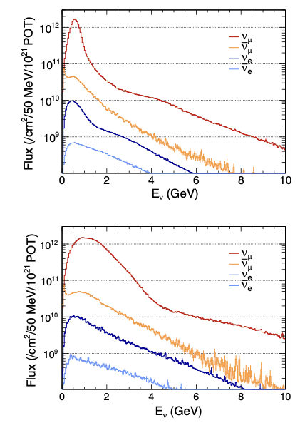

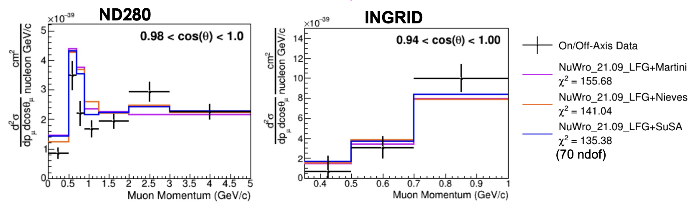
Energy by Location
T2K off-axis
T2K and MINERvA have both produced first results
exploiting this to measure energy dependence.
  T2K by using different detectors in different locations.
T2K on-axis
Phys Rev D108, 112009 (2023)
Notes:
We typically measure interactions integrated over a wide variety of energies and have little model independent information about how interactions change with neutrino energy.
Exploiting these technique is in its infancy for studying neutrino interactions.
Here’s an example Margherita gave this example of a T2K analysis of quasielastic like events comparing cross-sections as a function of muon kinematics at different energies taken in different detectors at different off axis beams.

Slide 27

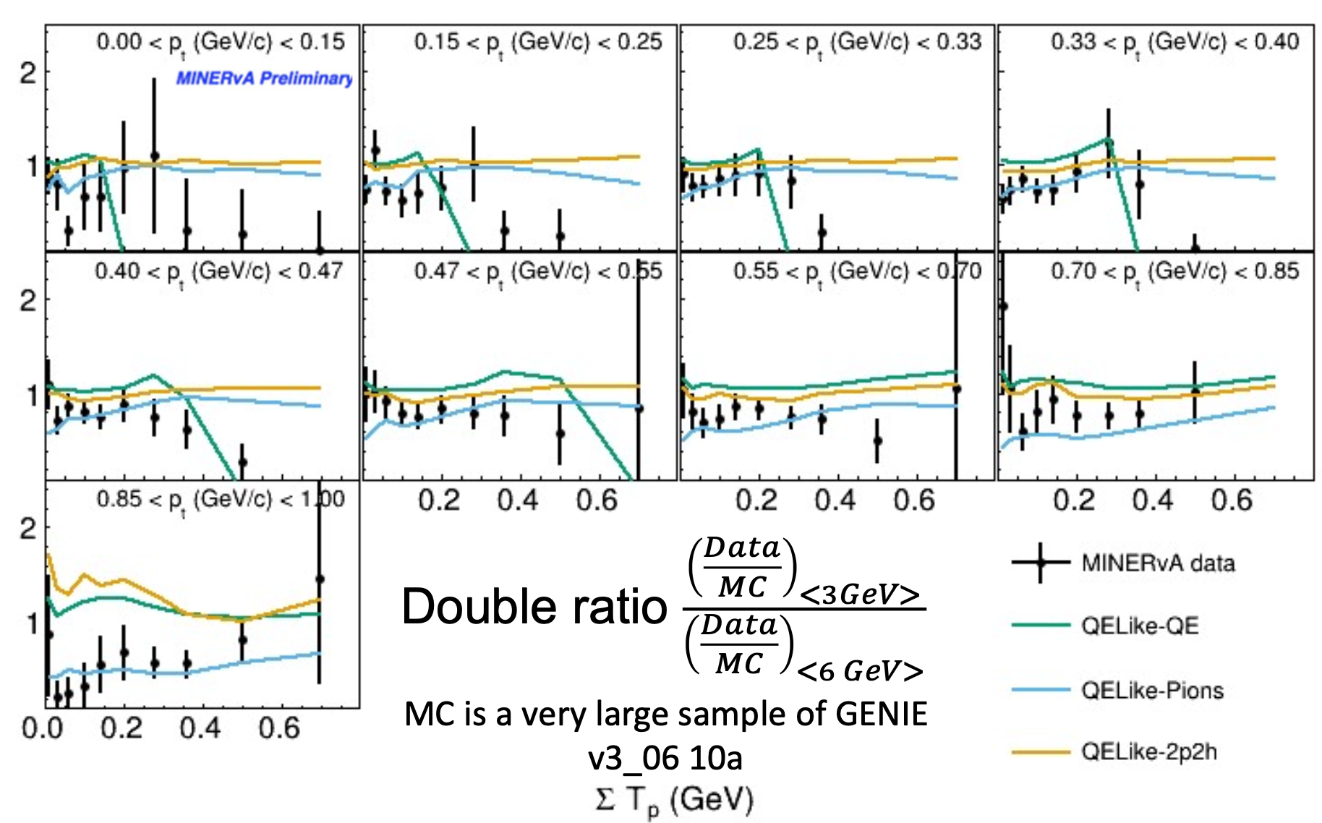
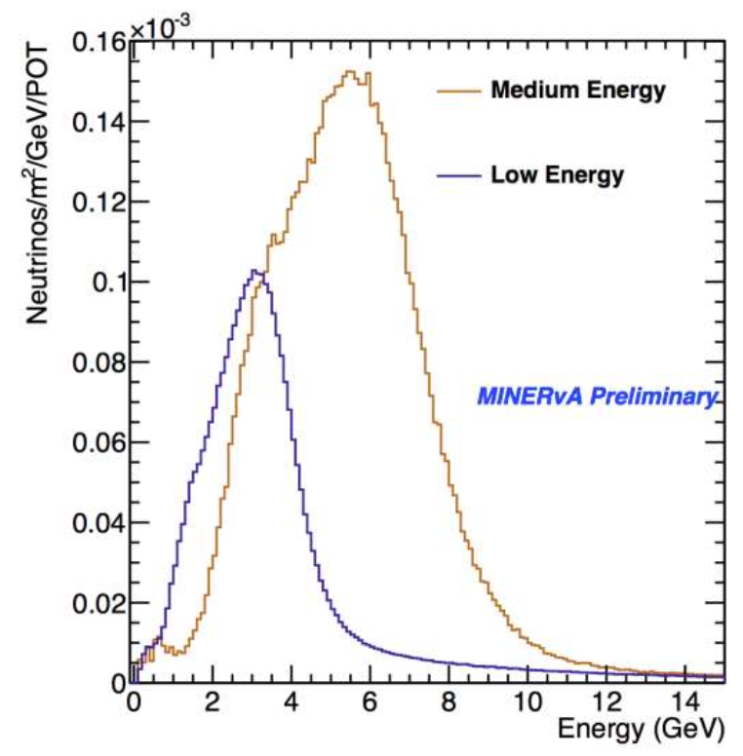
Location… for energy
T2K and MINERvA have both produced first results
exploiting this to measure energy dependence.
  MINERvA with differently tuned beams on the same detector!
Dan Ruterbories, NuINT 2024
Notes:
Here’s another example from MINERvA, comparing two different beam tunes in the same detector, again with a quasielastic like sample, this time in panels of lepton pT as a function of visible calorimetric energy.
This is just a starting point for the sort of studies that will be possible with PRISM

Slide 28
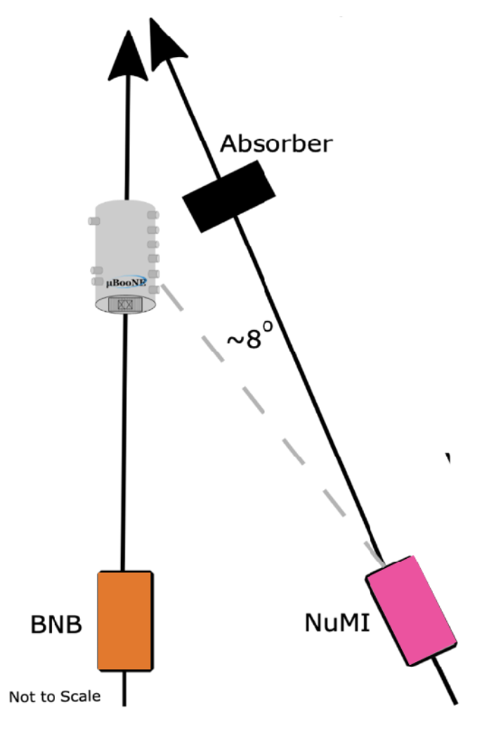
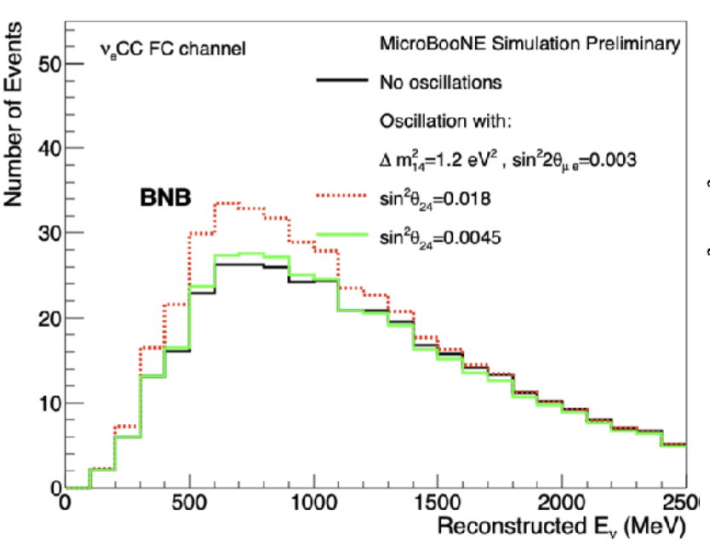
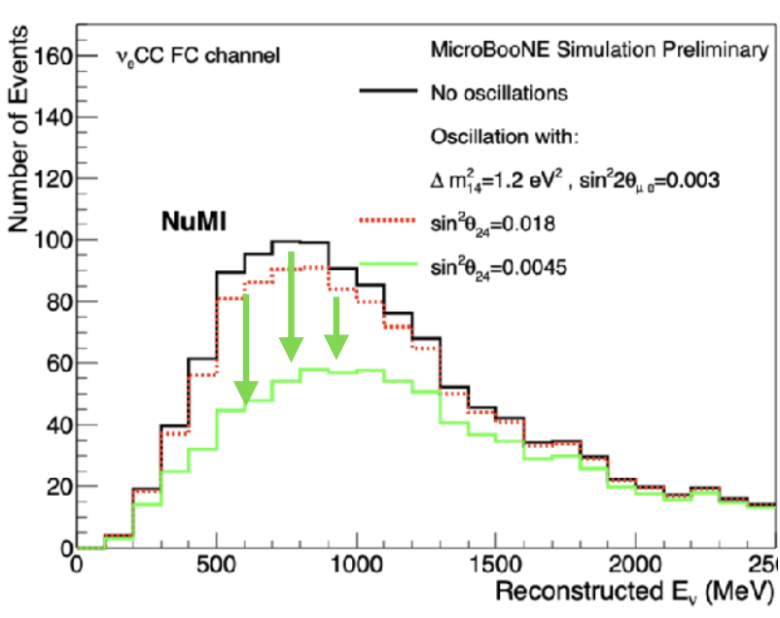



Flavor! By Location
MicroBooNE uses the NuMI beam far off-axis, where there are enhanced contributions from kaon decays, and therefore a larger $ν_{e}$ fraction.
MicroBooNE and SBN (ICARUS) plan to exploit this for oscillation and interaction studies.
MicroBoooNE
Notes:
But there is another emerging application of off-axis beams, illustrated here by MicroBooNE. We heard from David Caratelli about BSM searches at MicroBooNE and one thing they plan to exploit is that the electron neutrno fraction is much higher far off-axis (from the NuMI beam) than on axis (from the Booster beam). Other SBN FNAL experiments plan to use this as well.

Slide 29



SBND “Mini” (my word) PRISM
In the near future, SBND will be able to do this within their detector.
  Enabled by high statistics, and proximity to a low energy beam.
  Will be limited by access to low energies far off axis, but it should work well from 0.7 to 1.5 GeV in neutrino energy.
Notes:
And for the impatient, SBND has a short-term plan for another “mini” PRISM realization, just using the distribution of events within their detector. A bit more limited than the full PRISM, but will be a valuable learning tool.

Slide 30


DUNE and HyperKamiokande PRISM
DUNE and HyperKamiokande both intend to have movable detectors for the PRISM technique.
  While framed as a tool directly applied to oscillations,
  this probes neutrino energy dependence of interactions.
HyperKamiokande
DUNE
IWCD
movable, for PRISM
Notes:
We heard about the key technique in the context of DUNE’s PRISM. HK has a similar plan with the IWCD. Data on these detectors at different angles and therefore different fluxes can be directly translated into high statistics probes of cross-section evolution as a function of energy.

Slide 31
Results and Trends: Interactions by Neutrino Flavor
(in American English,
there is no “u” in “flavor”)
Notes:
I may spell flavor without a “u”, but “u” absolutely care about interactions for different neutrino flavors. There are two very distinct problems, mu->tau comparison and mu->e comparison. I’ll stick to the first in this talk.

Slide 32





The $ν_{e}$ Problem
By necessity, our $ν_{μ}$rich beams have few $ν_{e}$ in them to allow us to study any difference between $ν_{μ}$and $ν_{e}$ interactions.
Therefore, we infer $ν_{e}$ interactions from studies of $ν_{μ}$
But what we study can’t give us the whole picture.
Phase space (below), radiative corrections, nuclear effects.
Missing reaction space due to muon mass
this is Q²~0
Radiative corrections:
O. Tomalak et al.,
Nature Commun. 13 (2022) 1, 5286 and Phys.Rev.D 106 (2022) 9, 093006
Nuclear effects:
T. Dieminger et al.,
Phys.Rev.D 108 (2023) L031301
energy transfer
3-momentum transfer
Notes:
Why might nu_e and n_mu cross-sections be different? Well, two problems with predicting one from the other is that there is phrase space in energy-momentum transfer not available to muon neutrinos because of the heavy final state muon. But there are also nuclear effects (due to the phase space) and radiative correctinos which are different for the two. We have some theoretical understanding, improved recently by Sasha Tomalak and collaborators

Slide 33


MINERvA: Electron Neutrino Flux
NuMI Beams @ MINERvA
NuMI is a “conventional” neutrino beam, with most neutrinos produced from focused pions.
Pions decay mostly to muons, but weak decays involving electrons come from daughter muons or kaons.
~1% contribution of the beam.
FHC
RHC
Notes:
There is a current benchmark for this from MINERvA, noted by Margherita, just using the “1%” electron neutrinos in the beam

Slide 34



MINERvA 𝜈_{e} /𝜈_{𝜇} Ratios
𝜈_{e} /𝜈_{𝜇}
Preliminary.
Cross-sections in panels of $p_{T}^{ℓ}$ as a function of “available energy”, energy in calorimetrically visible particles, e.g., not neutrons.
Simulation predicts a ratio very close to one dominated by statistical uncertainties.
Testing the confidence of generators that ratio should be $≈$1.
MINERvA Preliminary, McFarland NuINT24
Notes:
Margherita referenced the result, but here is the preliminary version of the ratio to muon neutrinos. These are cross-section ratios, with the muon neutrinos corrected for flux, in panels of pT as a function of visible calorimetric energy

Slide 35






MicroBooNE 𝜈_{e} Pion Production
MicroBooNE has begun to probe exclusive electron neutrino interactions, exploiting capabitilies of liquid Ar TPCs.
Results are relatively low statistics today, but they point to the ability to do this in SBND at high statistics. Will be particularly interesting when this can be
done near threshold for the process and compared to muon neutrinos.
$$E_{e}$$
$$θ_{e}$$
$$θ_{π}$$
$$θ_{eπ}$$
MicroBooNE collaboration,
Phys. Rev. Lett. 135, 061802

Slide 36
Results and Trends:
Lepton-Hadron Correlations
(high dimensionality enabled by high statistics)
Notes:
Until recently neutrons had been largely absent. But a few experiments are moving forward with their reconstruction and it should be game changing.

Slide 37


Theory and Correlations
ν_{μ}
μ⁻
This is a many-layered problem:
  prediction is high-dimensional, growing rapidly multiplicity
  interaction with nucleus can modify kinematics of outgoing hadrons, or change an event with one collection of final state particles to another.
But effects can be large, and important. Example from a calculation of multinucleon knockout kinematics.
W
n
p
p’
nucleus
final state interactions
ν_{μ}
μ⁻
in this example, see a large difference in momentum sharing among leading and sub-leading nucleons
Exclusive Model
Inclusive Model
W
π⁺
n
p
n
J.E. Sobczyk et al,
Phys.Rev.C 102 (2020) 2, 024601

Slide 38



Correlations in Experiment
MicroBooNE measured multi-dimensional kinematic imbalance in $μ^{−}+p$ events due to nuclear effects.
Here, momentum imbalance in slices of imbalance angle, $δα_{T}$, where high $δα_{T}$ is the location of almost all reactions with inelastic interactions in the nucleus or with multi-nucleon production.
Note the dramatic range of model predictions.
Phys.Rev.Lett. 131 (2023) 10, 101802

Slide 39



Correlations in Experiment
Can directly look at neutrino energy determination from $μ^{−}+p+…$ events by calorimetry (NOvA or DUNE) and by lepton kinematics (T2K or HK).
Disagreements with simple nuclear models in generators are evident.
Must fix this to combine experiments at high statistics in the future.
MINERvA, D. Ruterbories et al.
Phys.Rev.Lett. 129 (2022) 2, 021803

Slide 40
Results and Trends: Neutrons
(we’re acquainted with light neutral long-lived particles, so maybe we should meet heavy ones?)
Notes:
Until recently neutrons had been largely absent. But a few experiments are moving forward with their reconstruction and it should be game changing.

Slide 41



Neutron reconstruction
MINERvA has, and SuperFGD will reconstruct neutrons through their quasielastic knockout of protons from nuclei, e.g., ¹²C(n,np)¹¹B
  SuperFGD has lower threshold
  three-dimensional reconstruction
  AND time-of-flight momentum.
Phys. Rev. D101 (2020) 9, 092003
Nature, 614, 48-53
Notes:
The technique in scintillator (or Ar for that matter) is detection of protons quasielastically knocked out. MINERvA showed this technique could work in scintillator strips with poor timing, but T2K SuperFGD has much lower thresholds with its native 3D reconstruction and adds TOF capabilities allowing for energy measurement as well, at least at the lower energies.

Slide 42



Neutron and Axial Form Factor
Nature, 614, 48-53
MINERvA used neutron reconstruction and ability to isolate events on hydrogen (only with direction!) to measure $F_{A}\left(Q^{2}\right)$ with useful precision ${0.06<Q}^{2}<2$ GeV².
SuperFGD will have two handles, direction and energy, to isolate hydrogen scattering.
MINERvA result
Phys. Rev. D 101, 092003 (2020)
Notes:
We have seen first phsycs with this. MINERvA used direction to kinematically isolate CC elastic scattering on hydrogen to measure the axial form factor. But the T2K SuperFGD with energy also and lower thresholds should do far better. Example of trasnverse kinematic balance separation where there can be S/N exceeding 1:1 (MINERvA is more like 1:3)

Slide 43
Trend: Nucleons and Nuclei
(can we use scattering on one to understand scattering on the other?)
Notes:
Nuclear dependence is a thing… or is it?

Slide 44



Is a nucleus a nucleus a nucleus?
In energies and momenta of individual nucleons within the nucleus, nuclei vary.
But we are beginning to see some consistencies in how models describe different nuclei equally well (or equally poorly).
MINERvA, A. Bercellie et al,
Phys.Rev.Lett. 131 (2023) 1, 1
This result, transverse momentum dependence of pion production on different nuclei, shows how different final state interaction models give different overall rates.
But a second conclusion is that all nuclei exhibit the same unexpected transverse momentum dependence.
correction to $σ_{C}$
$$Q^{2}≈p_{T}^{2}(1+𝒪\left(ν/E_{ν}\right))$$
Notes:
Actually, we have some evidence from data the Margherita interpreted as showing the ability to downselect pion final state interaction models – which is is – as showing that another nuclear effect (a large correction to the Q2 shape estimated in scattering on nuclei actually appears universal from carbon to iron to lead. This is an example of growing confidence that we are building in our nuclear models to predict scaling from one nucleus to another.

Slide 45



Nucleons vs Nuclei
By contrast, we are struggling to understand cross-sections on free nucleons as a base for calculating cross-sections on nucleons.
In $F_{A}\left(Q^{2}\right)$, there are significant
tensions between the deuterium
bubble chamber legacy data, and
either the MINERvA hydrogen or
lattice QCD calculations.
Why? It’s possible that nuclear
model assumptions in the analysis
of the deuterium data played a role.
Aaron Meyer, NuINT 2024
Notes:
But when it comes to free nucleon form factors, we are in more chaos. Aaron Meyer’s work at NuINT showed that there are serious problems with the deuterium bubble chamber data because of its internal inconsistency and incompatibility with the hydrogen measurement form MINERvA and with LQCD. Maybe the data was messed up by nuclear effects assumed in the analysis?

Slide 46


DUNE-ND “Solid Hydrogen”
Recall that the DUNE SAND near detector includes CH₂ and C foils interspersed with low density tracker.
This adds a third handle to direction and energy constraints, for separating hydrogen interactions by subtraction.
Significant potential to dramatically reduce backgrounds and systematics in a high statistics measurement.
  Caveat: the estimate at right isn’t a projection from DUNE (third-party authors), and IMHO it uses a deeply flawed metric. (But “it’s got a beat, and you can dance to it.”)
one realization of the SAND low-density tracker
Phys.Rev.D 109 (2024) 5, L051301
Notes:
This seems to motivate more measurements on free nucleons. And important player will be DUNE-ND. Recall that the SAND detector has a low density tracker with CH2 and C foils, so can infer H from subtraction. This adds another handle to reduce systematic uncertainties, and the high statistics in the DUNE beam should allow an enormous improvement.

Slide 47

Nucleons and Nuclei
We’ve made progress in our nuclear models, informed by electron scattering, theory, and data from neutrinos and hadron scattering.
While there is growing evidence that these models
may be helping us to understand nuclear effects,
there is also growing evidence that the input of
free nucleon predictions is not serving us well.
Experiments that can measure or theory that can
calculate free-nucleon interactions are important!
  Critical to carry out DUNE ND CH_{n}-C plan, and to
  supplement it with other ideas like modular hydrogen and deuterium bubble chambers now under development.
Understanding
Data on nuclei
Nuclear Model
Data on nucleons

Slide 48
Closing Thoughts

Slide 49
Conclusions
Motivated by high statistics oscillation experiments at accelerators, the two decades have seen a resurgence of interest in studying and modeling inelastic neutrino interactions on nuclei.
  Complementary to programs in GeV lepton scattering @ JLab.
Experiments have reached – or are well past – the point that we are challenging the fidelity of our current modeling, even for seemingly “simple” reactions.
  A similar renaissance of theoretical work has followed.
The program to unify these two, as they challenge each other, will be a critical ingredient to our long (and short) baseline futures.

Slide 50
Backup

Slide 51
Axial Form Factor

Slide 52


More on the Deuterium Data…
The deuterium bubble chamber data gives self-inconsistent fits for $F_{A}\left(Q^{2}\right)$, unless overregularized to force sensible results, like a reasonable value for the axial radius (slope at $Q^{2}=0$).
  Below is the effect of choices of how low in $Q^{2}$ to fit the data.
Aaron Meyer, NuINT 2024

Slide 53
MINERvA Electrons

Slide 54


Electron/Photon in $νe^{−}→νe^{−}$
Background from production neutral pions is manageable with dE/dx, even with an electron energy threshold of 800 MeV.

Slide 55

MINERvA: Uncertainties on 𝜈_{e} /𝜈_{𝜇}
𝜈_{e} /𝜈_{𝜇}
These are preliminary, and so far only for neutrinos.
Systematic uncertainties are ~subdominant, at least in any given bin.
Detector model (muon energy scale) becomes significant. But flux and interaction models are small uncertainties.

Slide 56
MINERvA Data Preservation

Slide 57

Revisionist History
In the past, our field has found value in reanalyzing old data sets. The deuterium bubble chamber data is an excellent example.
As I postulated, some of that data seems to be inconsistent with modern hydrogen data.
Wouldn’t it be great to go back and reanalyze it with different techniques to investigate why?
Notes:
Wouldn’t we all like another chance to go back and use what we’ve learned?

Slide 58

Data Preservation
MINERvA has embarked on a project to preserve
its data to give the ability to address “late breaking” questions from its own results or driven by outside work. For example…
  Would any of MINERvA’s precision quasielastic-like cross-sections be altered if measured with an alternate reference model?
  There are many $A(ν_{μ},μ^{−}p…)A^{′}$kinematic imbalance results. Is it the same in a $A(ν_{e},e^{−}p…)A^{′}$ sample?
  Are there more fruitful comparisons of MINERvA’s two (LE and ME, 3 and 6 GeV, respectively) beams to get at energy dependence?
  Are there hints of non-standard interactions that would be revealed if we looked at other variables, like time relative to beam RF structure or energy, in some of our rare event topologies?
Notes:
MINERvA has been working on a ”data preservation” project. Allows for late breaking analysis by MINERvA collaborators, but also reanalysis long after those who built MINERvA are no longer in the game.

Slide 59
Data Preservation (cont’d)
In brief, it is a set of tuples of the results of our standard reconstructions for every event, and a set of macros to allow an analyzer to efficiently interpret that data, focused on the measurement of a cross-section, but not limited to that goal.
Tuples with reconstructed objects
Event Loop Macros
Interpretation Macros:
background subtraction from sidebands
unfolding and efficiency correction
Data, ME and LE
Simulation, ~4x data in ME beam and ~10x or LE beam
flux and target counting
Notes:
The concept is to save a set of reconstructed objects in all events, and to provide macros to quickly spin over that data and interpret the events as cross-sections.

Slide 60
Data Preservation (cont’d)
What is in the reconstruction?
All macros and analysis tools are public, and data will be shortly.
Documentation with
analysis examples.
May serve as a
useful starting point
for more experiments
to do something
similar.
Primary Lepton: either muon or electron
Secondary track reconstruction
Particle ID
Global Track Vertex
Secondary Photon reconstruction
Neutral Pion Reconstruction
Neutron Candidates
Calorimetric Total Recoil Estimates
Variants exclusive of some secondary tracks
Recoil direction estimators
Notes:
The preserved data represents primary lepton reconstruction, charged hadron reconstruction, pi0 reconstruction, neutron candidates and calorimetric measurements from the calorimeter.
The important bit may not be the details, but that it can be an attempt to learn from for future experiments to the same.

Slide 61
Failed Figure

Slide 62
Oscillation at Hyper-K and DUNE
Version with Original Figures that Rotate in PDF
NO: Normal Mass Ordering
IO: Inverted Mass Ordering
Note the very different probabilities for HyperK and DUNE!

