Slide 1
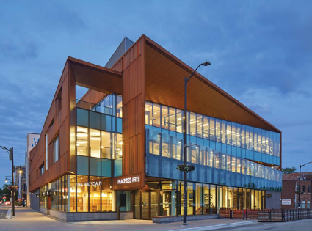


Results from the T2K experiment
Michael Reh, on behalf of the T2K Collaboration
24th International Workshop on Next Generation Nucleon Decay and Neutrino Detectors (NNN25)
Boulder

Slide 2
Overview
Neutrino oscillations with T2K
T2K experimental overview
T2K neutrino oscillation analysis
Joint analyses with Super-K and NOvA
Cross section results
Future plans

Slide 3
Overview
Neutrino oscillations with T2K
T2K experimental overview
T2K neutrino oscillation analysis
Joint analyses with Super-K and NOvA
Cross section results
Future plans

Slide 4






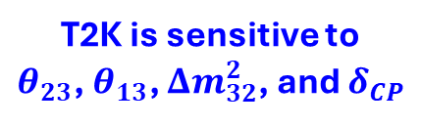

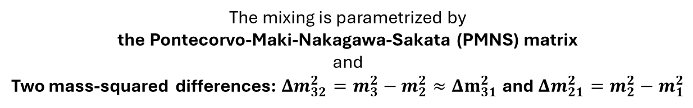
Neutrino Oscillations
$$ν_{μ}$$
$$ν_{1}$$
$$\left[\begin{matrix}ν_{e} \\ ν_{μ} \\ ν_{τ}\end{matrix}\right]=U_{PMNS}\left[\begin{matrix}ν_{1} \\ ν_{2} \\ ν_{3}\end{matrix}\right]$$
$$U_{PMNS}=\left(\begin{matrix}1 & 0 & 0 \\ 0 & c_{23} & s_{23} \\ 0 & −s_{23} & c_{23}\end{matrix}\right)×\left(\begin{matrix}c_{13} & 0 & s_{13}e^{−iδ_{CP}} \\ 0 & 1 & 0 \\ −s_{13}e^{iδ_{CP}} & 0 & c_{13}\end{matrix}\right)×\left(\begin{matrix}c_{12} & s_{12} & 0 \\ −s_{12} & c_{12} & 0 \\ 0 & 0 & 1\end{matrix}\right)$$
$$ν_{2}$$
$$ν_{e}$$
$$ν_{τ}$$
$$ν_{3}$$
Flavor eigenstates
Mass eigenstates
Neutrino flavor (interaction) eigenstates are mixed with their (free) mass eigenstates
The mixing is parametrized by
the Pontecorvo-Maki-Nakagawa-Sakata (PMNS) matrix
and
Two mass-squared differences: $Δm_{32}^{2}=m_{3}^{2}−m_{2}^{2}≈Δm_{31}^{2}$ and $Δm_{21}^{2}=m_{2}^{2}−m_{1}^{2}$
T2K is sensitive to
$θ_{23}$, $θ_{13}$, $Δm_{32}^{2}$, and $δ_{CP}$

Slide 5
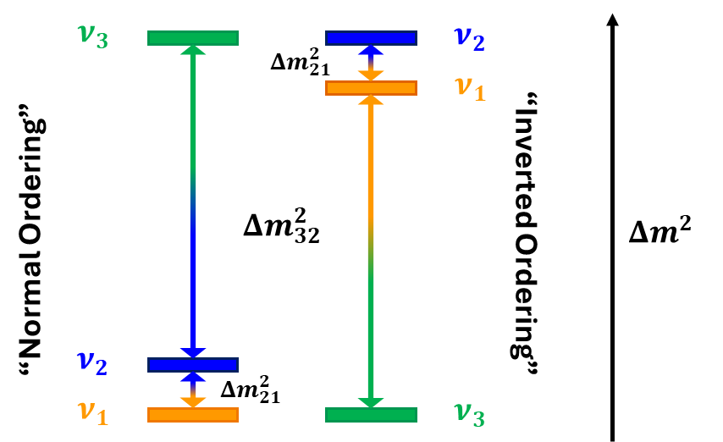
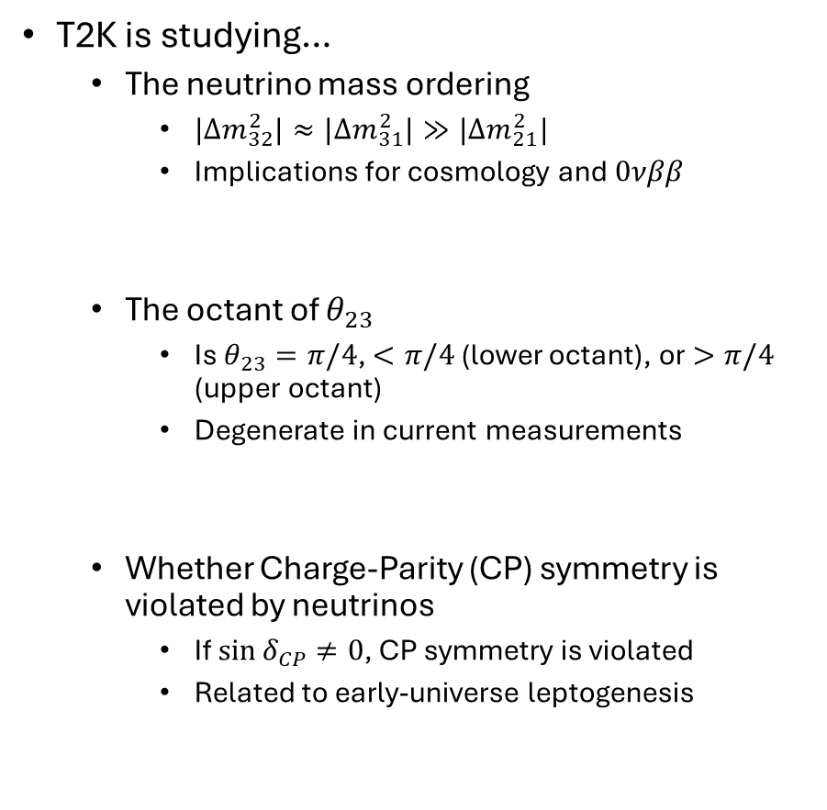


Neutrino Oscillation Questions
T2K is studying…
The neutrino mass ordering
$|Δm_{32}^{2}|≈|Δm_{31}^{2}|≫|Δm_{21}^{2}|$
Implications for cosmology and $0νββ$
The octant of $θ_{23}$
Is $θ_{23}=π/4$, $<π/4$ (lower octant), or $>π/4$ (upper octant)
Degenerate in current measurements
Whether Charge-Parity (CP) symmetry is violated by neutrinos
If $\sin{δ_{CP}}≠0$, CP symmetry is violated
Related to early-universe leptogenesis
$$ν$$
$$\overline{ν}$$

Slide 6
Overview
Neutrino oscillations with T2K
T2K experimental overview
T2K neutrino oscillation analysis
Joint analyses with Super-K and NOvA
Cross section results
Future plans

Slide 7
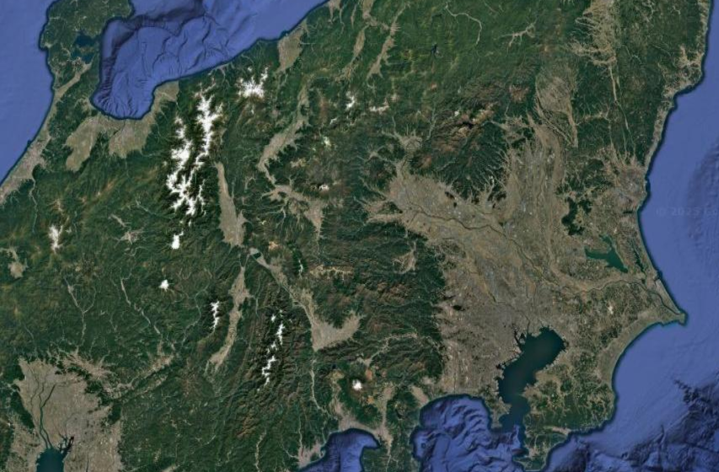
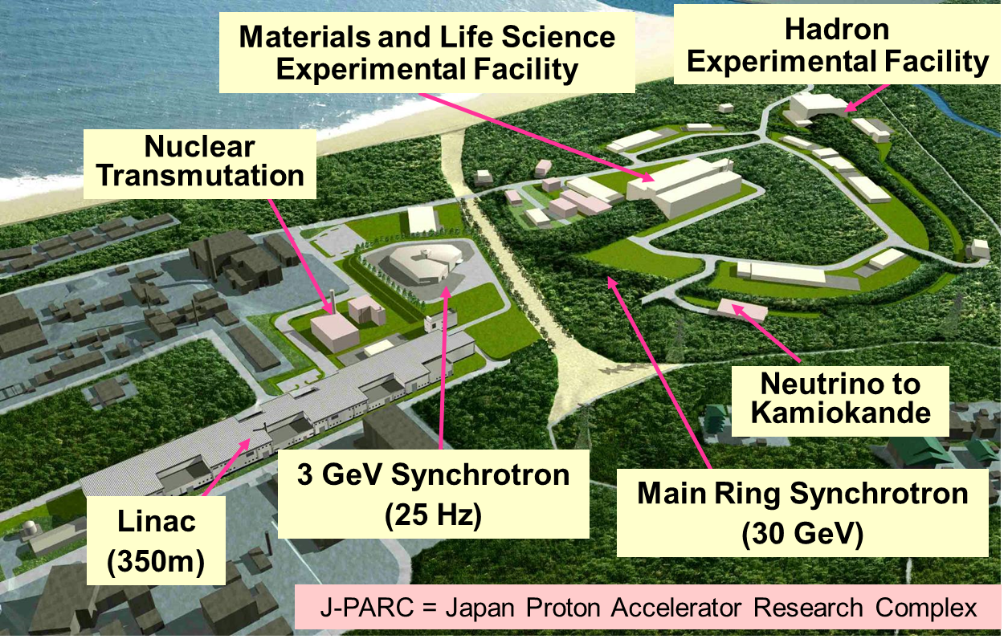
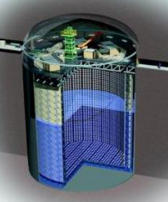
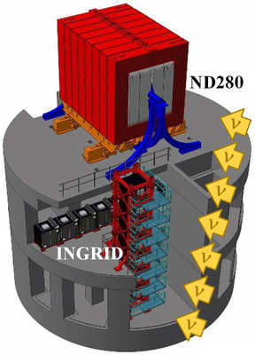

T2K Overview
Long Baseline neutrino oscillation experiment
Look for $ν_{μ}→ν_{μ}$ and $ν_{μ}→ν_{e}$ oscillations
“T2K” = “Tokai to Kamioka”
Measure the beam after oscillations
Near Detectors
Super-Kamiokande
J-PARC
Creates the neutrino beam
Measure the beam before oscillations

Slide 8
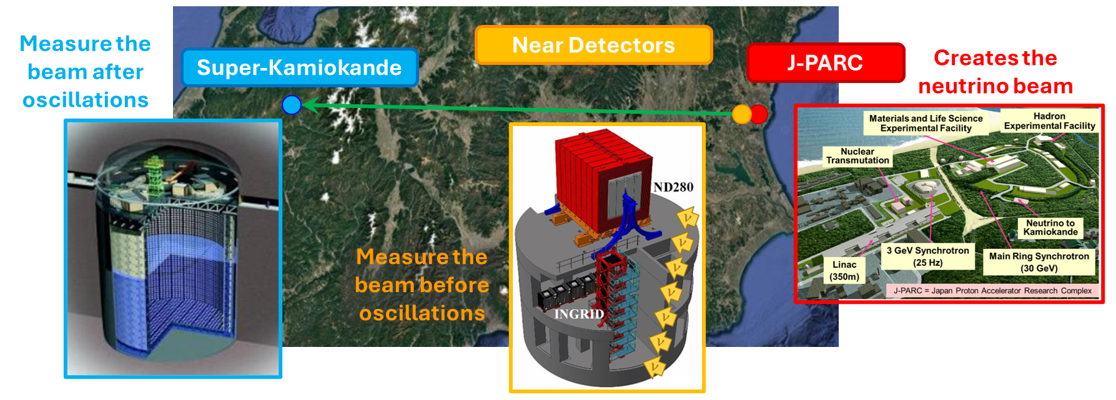
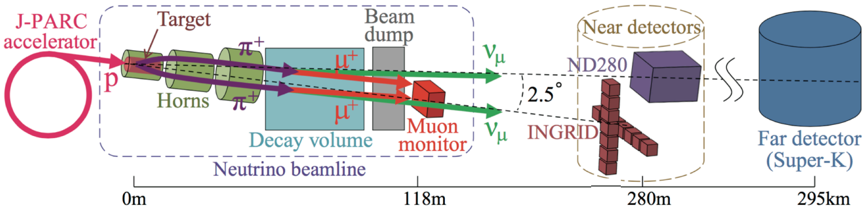
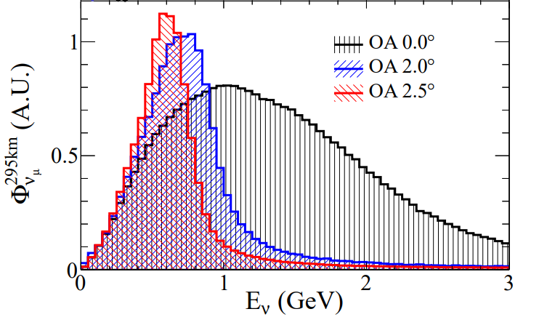
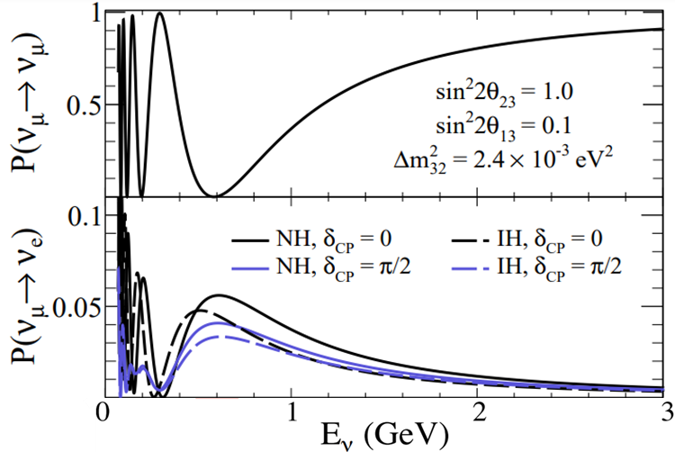
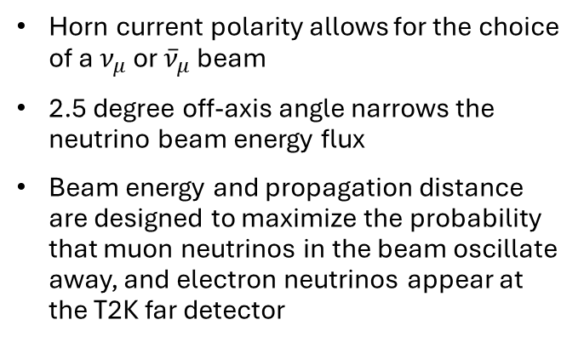
The T2K Neutrino Beam
30 GeV
Horn current polarity allows for the choice of a $ν_{μ}$ or ${\overline{ν}}_{μ}$ beam
2.5 degree off-axis angle narrows the neutrino beam energy flux
Beam energy and propagation distance are designed to maximize the probability that muon neutrinos in the beam oscillate away, and electron neutrinos appear at the T2K far detector

Slide 9
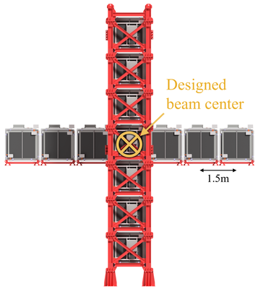
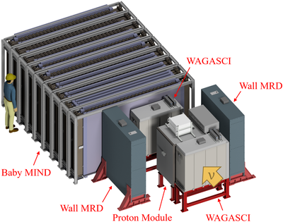
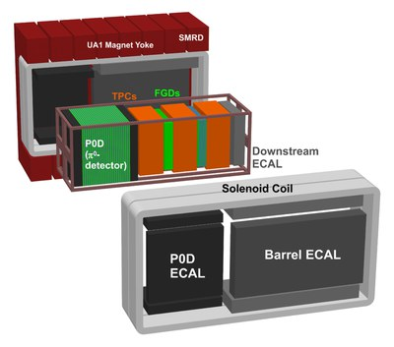
The T2K Near Detectors
INGRID (on-axis)
14 identical sub-modules made of alternating iron and scintillator plates
Monitors neutrino beam intensity and direction
WAGASCI/BabyMIND (1.5⁰ off-axis)
3D scintillator lattice for 4π angular acceptance
Magnetized iron muon range detector
Measures neutrino interaction cross sections – publishing first results!
Pre-print: https://arxiv.org/abs/2509.07814
ND280 (2.5⁰ off-axis)
Alternating fine-grained scintillator detectors and time projection chambers in tracker
0.2 T magnetic field
Provides the main constraints on neutrino beam flux and cross-section systematics in T2K oscillation analyses

Slide 10
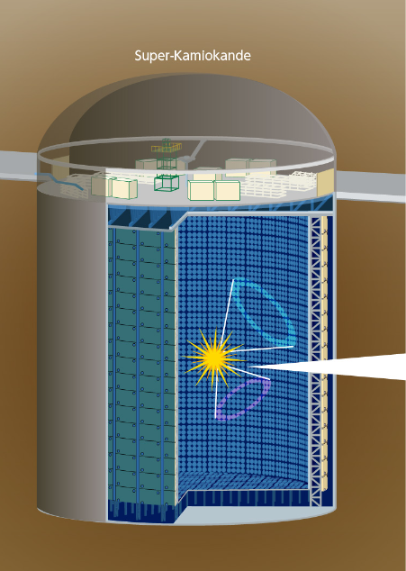
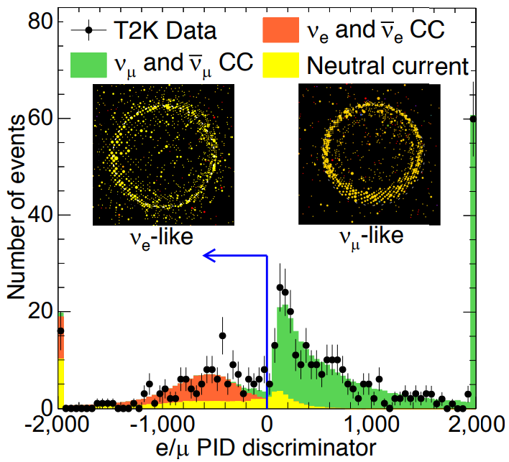
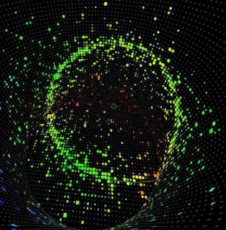
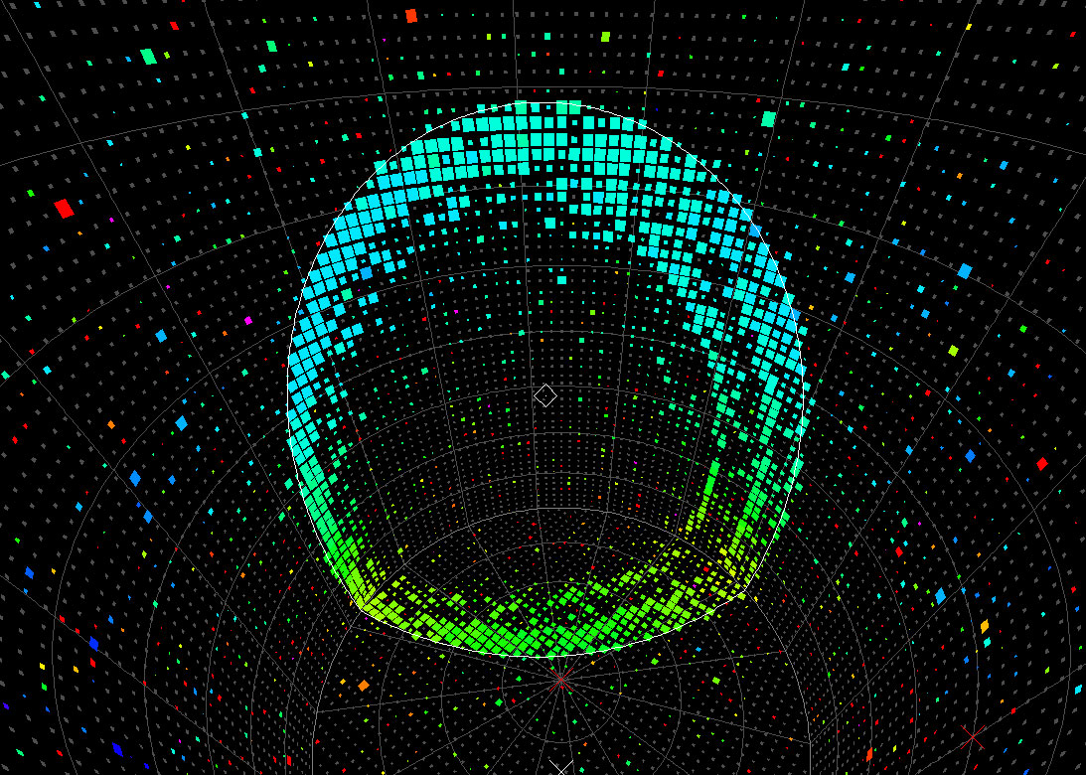

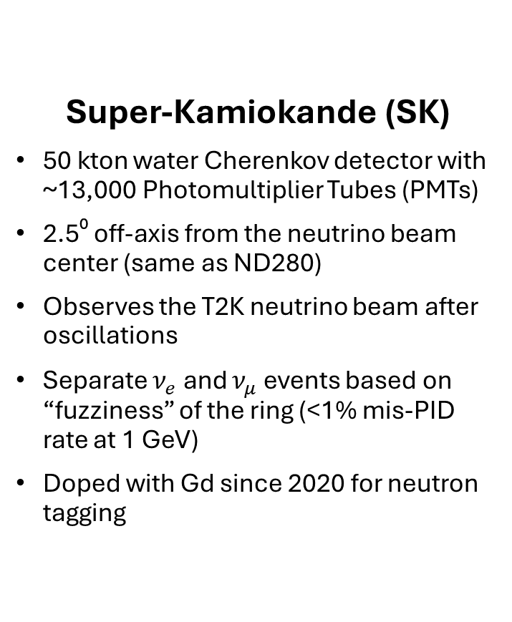

The T2K Far Detector
Super-Kamiokande (SK)
50 kton water Cherenkov detector with ~13,000 Photomultiplier Tubes (PMTs)
2.5⁰ off-axis from the neutrino beam center (same as ND280)
Observes the T2K neutrino beam after oscillations
Separate $ν_{e}$ and $ν_{μ}$ events based on “fuzziness” of the ring (<1% mis-PID rate at 1 GeV)
Doped with Gd since 2020 for neutron tagging
Data
True $μ$
True $e$
Other
41.4 m
“Fuzzy”
“Sharp”
39.3 m
Nature 580, 339 (2020)

Slide 11
Overview
Neutrino oscillations with T2K
T2K experimental overview
T2K neutrino oscillation analysis
Joint analyses with Super-K and NOvA
Cross section results
Future plans

Slide 12



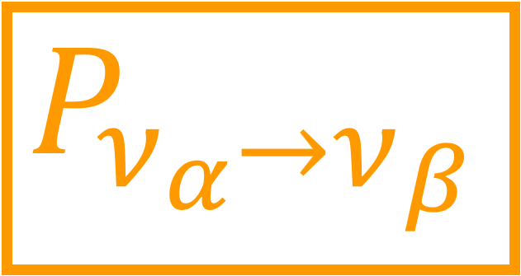
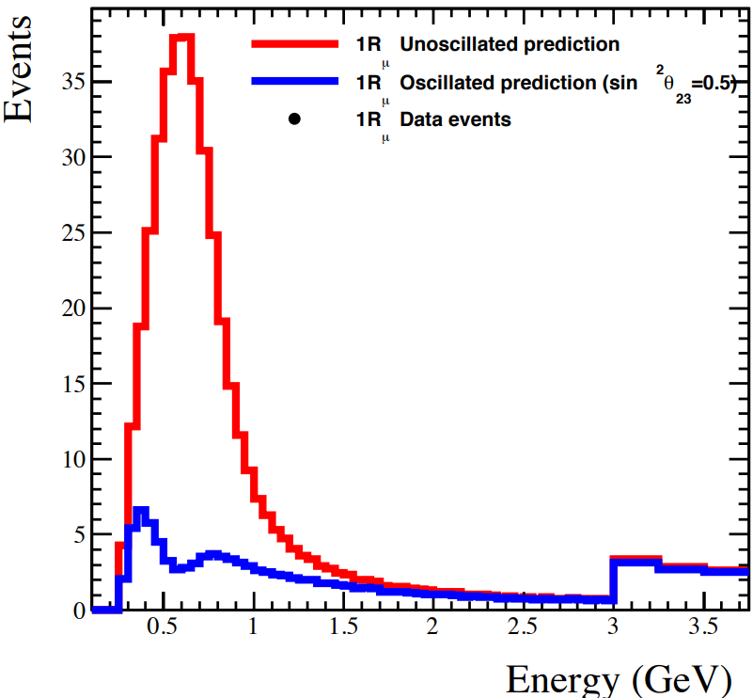
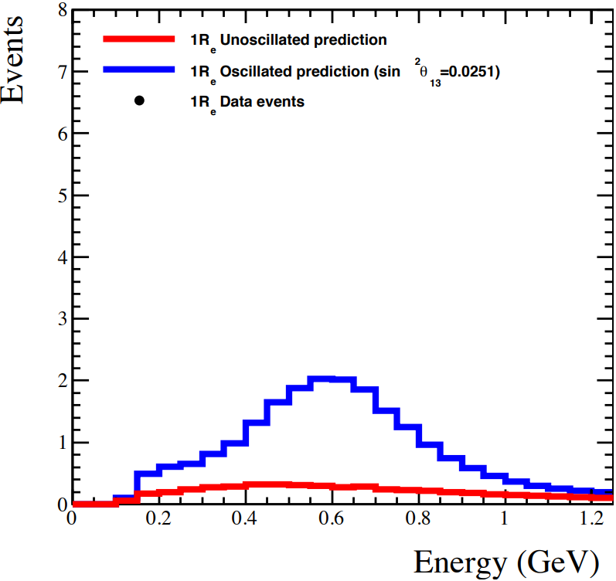



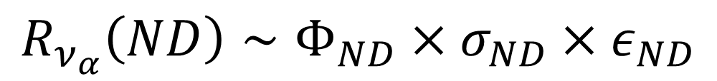
T2K Oscillation Analysis Overview
$$R_{ν_{α}}\left(ND\right)∼Φ_{ND}×σ_{ND}×ε_{ND}$$
Near detector event rate
Far detector event rate
$$R_{ν_{β}}\left(FD\right)∼Φ_{FD}×σ_{FD}×ε_{FD}×P_{ν_{α}→ν_{β}}$$
What we measure
Neutrino oscillation probability we hope to measure
Detector modeling
($α,β=e,μ,τ$)
Neutrino interaction cross sections
Neutrino flux
$ν_{μ}$ unosc
$ν_{μ}$ osc ($\sin^{2}θ_{23}=0.5$)
$ν_{e}$ unosc
$ν_{e}$ osc ($\sin^{2}θ_{13}=0.025$)

Slide 13
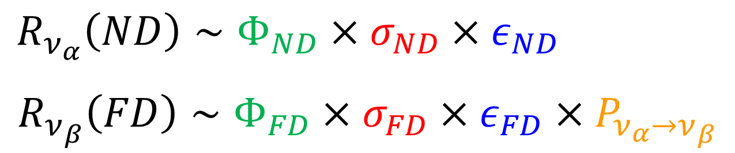
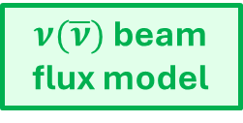
T2K Oscillation Analysis Overview
Frequentist analysis
Sequential near → far detector fit
Gradient descent-based algorithm
Feldman–Cousins to obtain confidence intervals
NA61/SHINE data, INGRID and beam monitor data
ND280 detector model
Super-K detector model
$ν(\overline{ν})$ beam flux model
Near Detector fit
Far Detector fit
Oscillation parameters
Cross-section model
Bayesian analysis
Simultaneous near + far detector fit
Markov Chain Monte Carlo-based
Credible intervals come from posterior distributions
ND280 data
Super-K data
Theoretical models, external & internal data

Slide 14
T2K Oscillation Analysis Overview
Frequentist analysis
Sequential near → far detector fit
Gradient descent-based algorithm
Feldman–Cousins to obtain confidence intervals
NA61/SHINE data, INGRID and beam monitor data
ND280 detector model
Super-K detector model
$ν(\overline{ν})$ beam flux model
Near Detector fit
Far Detector fit
Oscillation parameters
Cross-section model
Bayesian analysis
Simultaneous near + far detector fit
Markov Chain Monte Carlo-based
Credible intervals come from posterior distributions
ND280 data
Super-K data
Theoretical models, external & internal data

Slide 15
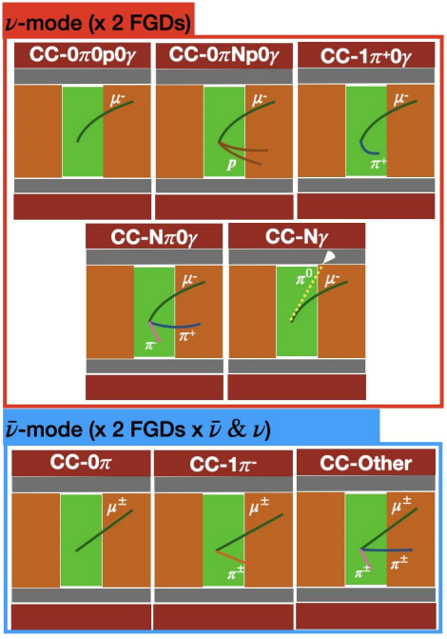
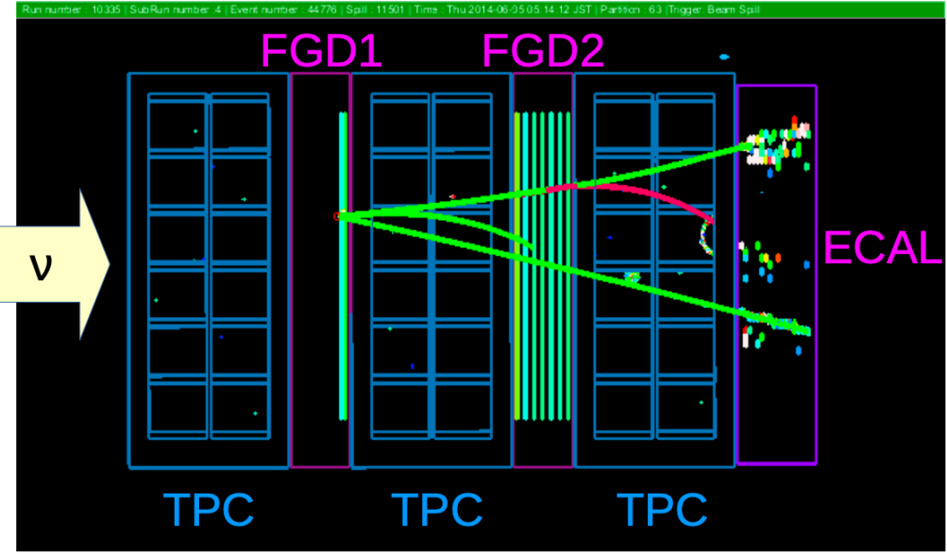
T2K Near Detector Fit
Primary goal is to constrain the beam flux and cross-section models for extrapolation to the far detector
Select 22 analysis samples by event topology, based on:
Neutrino vs anti-neutrino interactions
The number of final-state pions
The number of tagged protons and photons
These are intended to align with specific neutrino interaction modes and beam flux configurations to constrain the flux an interaction models

Slide 16
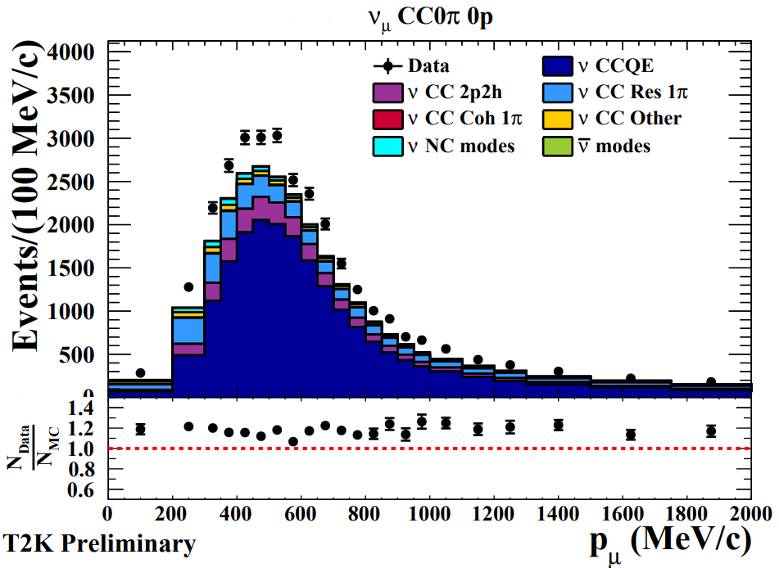
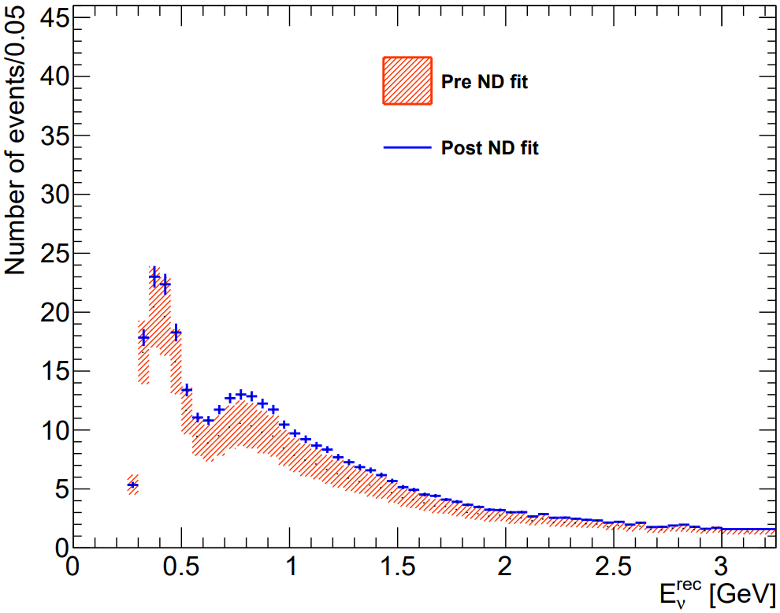
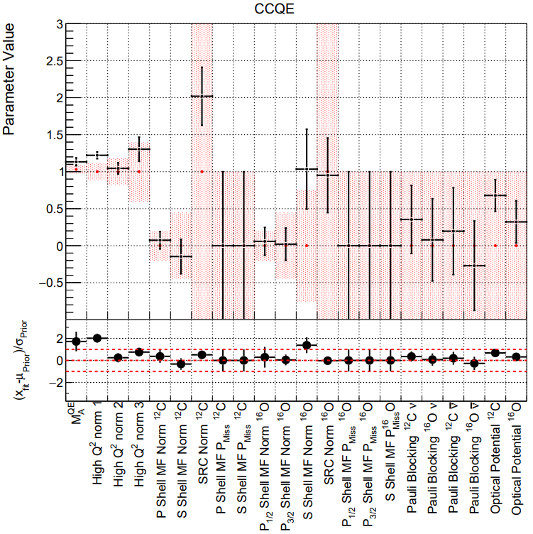
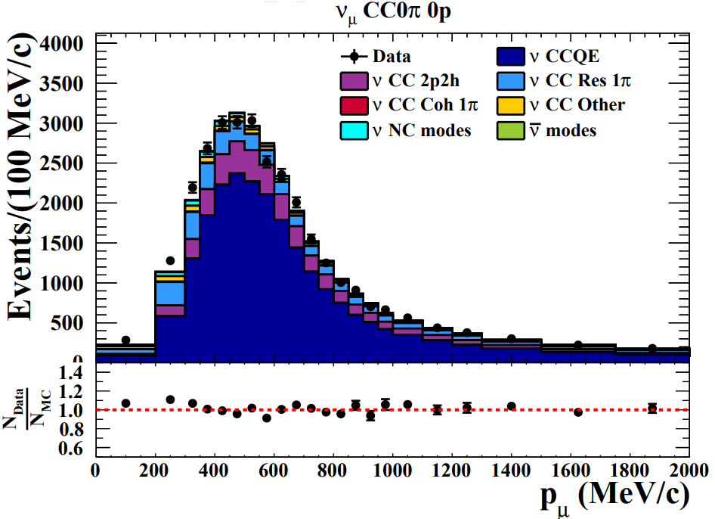
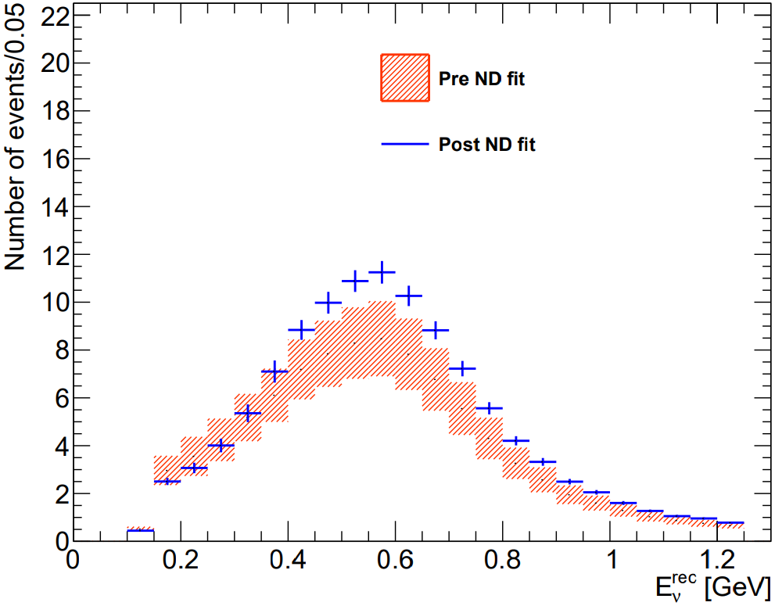


T2K Near Detector Fit
Binned likelihood fit to the selected data events across all 22 event samples as a function of muon kinematics
The fit greatly constrains the cross-section model parameters
The results constrain the uncertainty in the far detector spectrum
Pre-ND fit
SK $ν_{μ}$ sample
Pre ND fit prediction
Post ND fit prediction
T2K Preliminary
Pre-fit
Post-fit
T2K Preliminary
Post-ND fit
SK $ν_{e}$ sample
Pre ND fit prediction
Post ND fit prediction
T2K Preliminary
T2K Preliminary

Slide 17
T2K Oscillation Analysis Overview
Frequentist analysis
Sequential near → far detector fit
Gradient descent-based algorithm
Feldman–Cousins to obtain confidence intervals
NA61/SHINE data, INGRID and beam monitor data
ND280 detector model
Super-K detector model
$ν(\overline{ν})$ beam flux model
Near Detector fit
Far Detector fit
Oscillation parameters
Cross-section model
Bayesian analysis
Simultaneous near + far detector fit
Markov Chain Monte Carlo-based
Credible intervals come from posterior distributions
ND280 data
Super-K data
Theoretical models, external & internal data

Slide 18
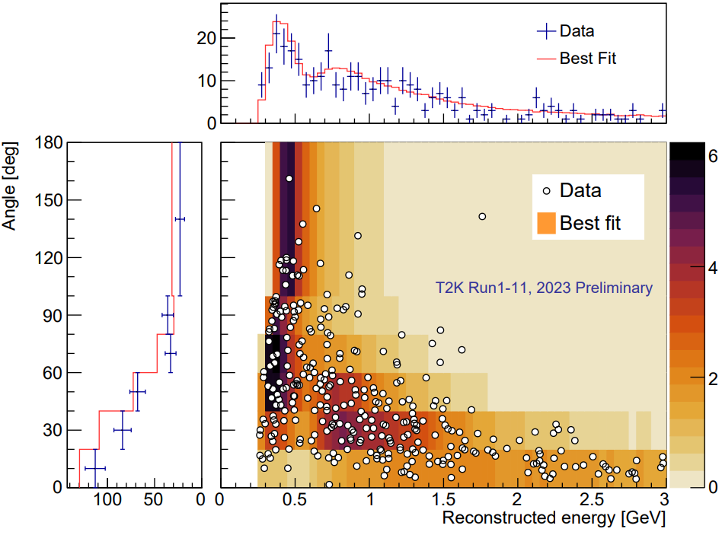
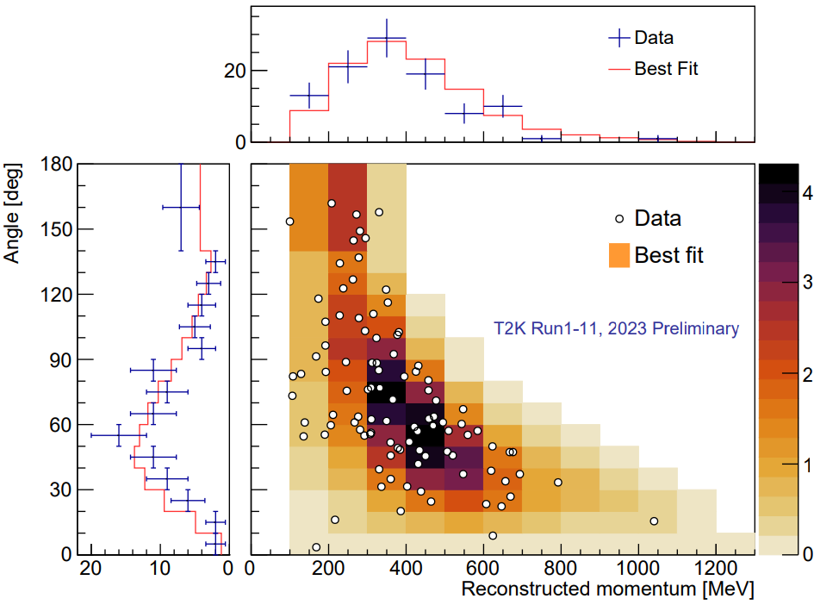

T2K Far Detector Fit
Separate data into $ν_{μ}$ and $ν_{e}$-like analysis samples so that we can view the effect of neutrino oscillations
μ
Muon-like
1 μ-like ring
CCQE
e
1 e-like ring
Electron-like
CCQE

Slide 19
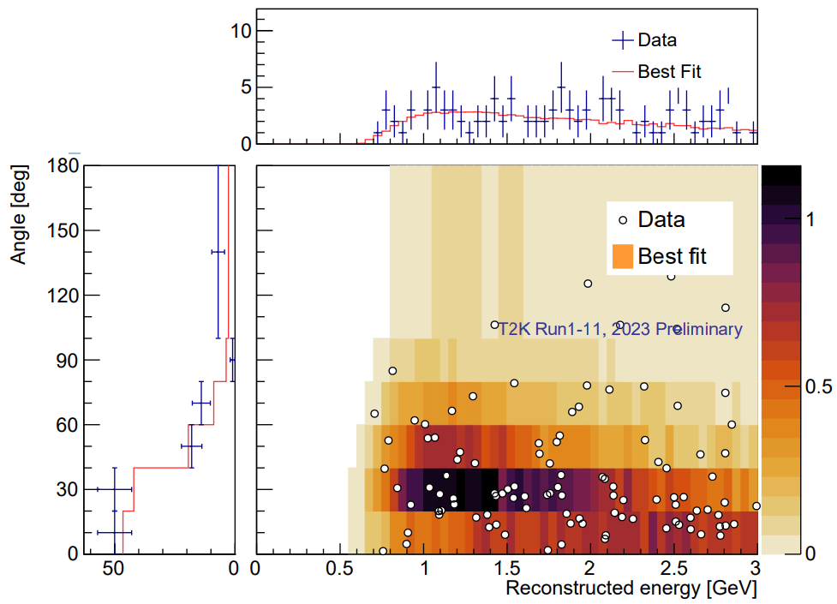
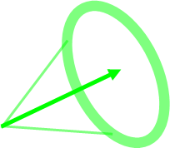
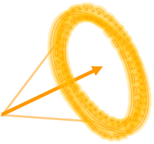
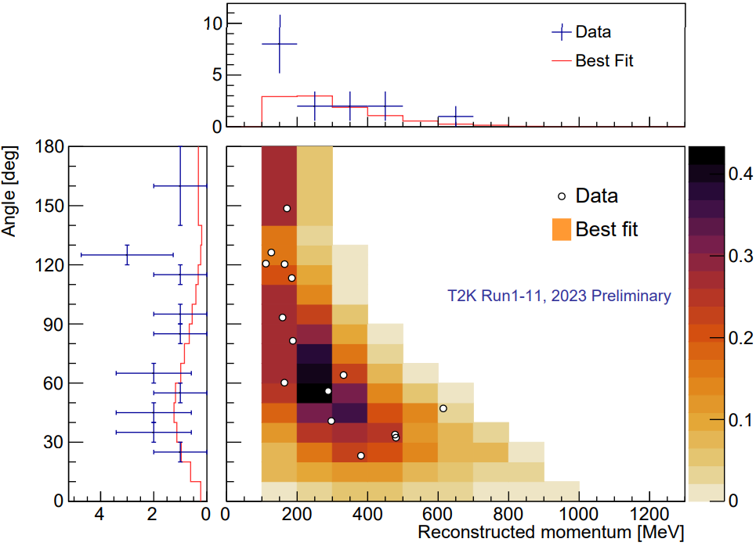
T2K Far Detector Fit
Separate data into $ν_{μ}$ and $ν_{e}$-like analysis samples so that we can view the effect of neutrino oscillations
1 μ-like ring
+
1 π-like ring OR
1 delayed Michel-e
CC1π
μ
Muon-like
CCQE
μ
e
π
e
1 e-like ring
+
1 delayed Michel-e
CC1π
Electron-like
CCQE
μ
e
π

Slide 20
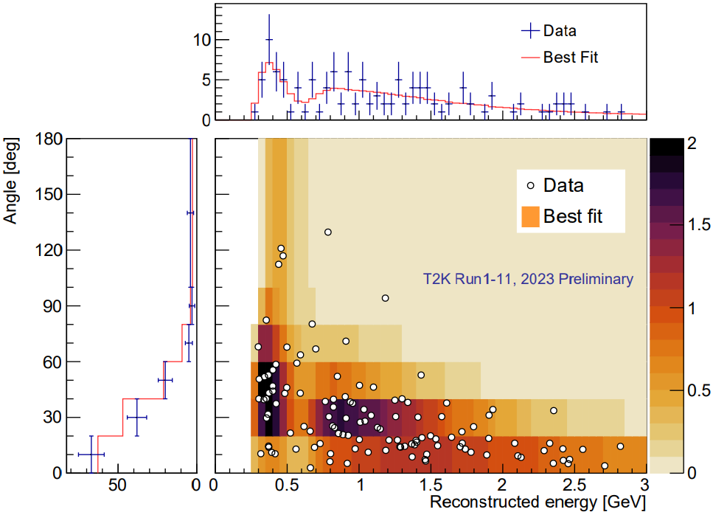
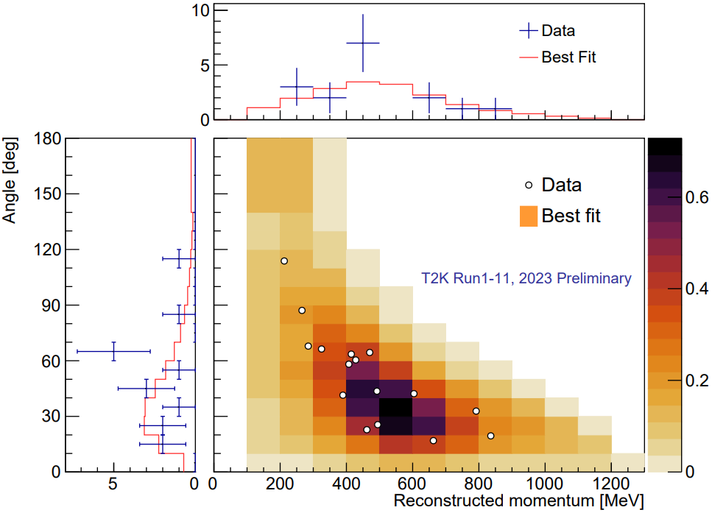
T2K Far Detector Fit
Separate data into $ν_{μ}$ and $ν_{e}$-like analysis samples so that we can view the effect of neutrino oscillations
Neutrino beam mode
Anti-neutrino beam mode
CC1π
Muon-like
CCQE
CCQE
CC1π
Electron-like
CCQE
CCQE
Notes:
Nubar samples let us look for CP symmetry violation

Slide 21
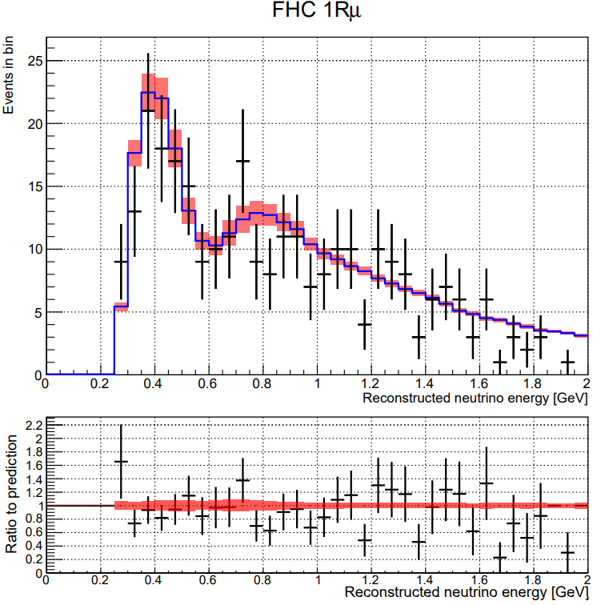
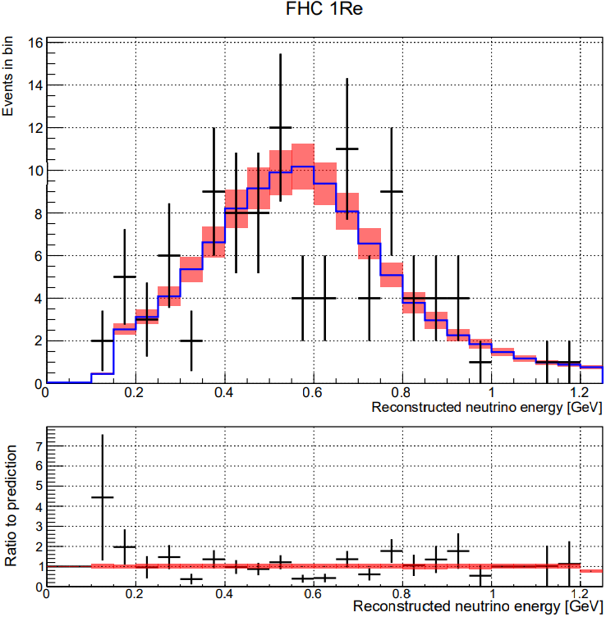


T2K Far Detector Fit
Fit FD predictions to data with the ND-constrained beam flux and cross-section models to extract the neutrino oscillation parameters
$ν$-mode, 1μ sample
$ν$-mode, 1e sample
T2K 2023 Preliminary
T2K 2023 Preliminary
Post-fit MC
Data
Post-fit MC
Data

Slide 22
T2K Oscillation Analysis Overview
Frequentist analysis
Sequential near → far detector fit
Gradient descent-based algorithm
Feldman–Cousins to obtain confidence intervals
NA61/SHINE data, INGRID and beam monitor data
ND280 detector model
Super-K detector model
$ν(\overline{ν})$ beam flux model
Near Detector fit
Far Detector fit
Oscillation parameters
Cross-section model
Bayesian analysis
Simultaneous near + far detector fit
Markov Chain Monte Carlo-based
Credible intervals come from posterior distributions
ND280 data
Super-K data
Theoretical models, external & internal data

Slide 23
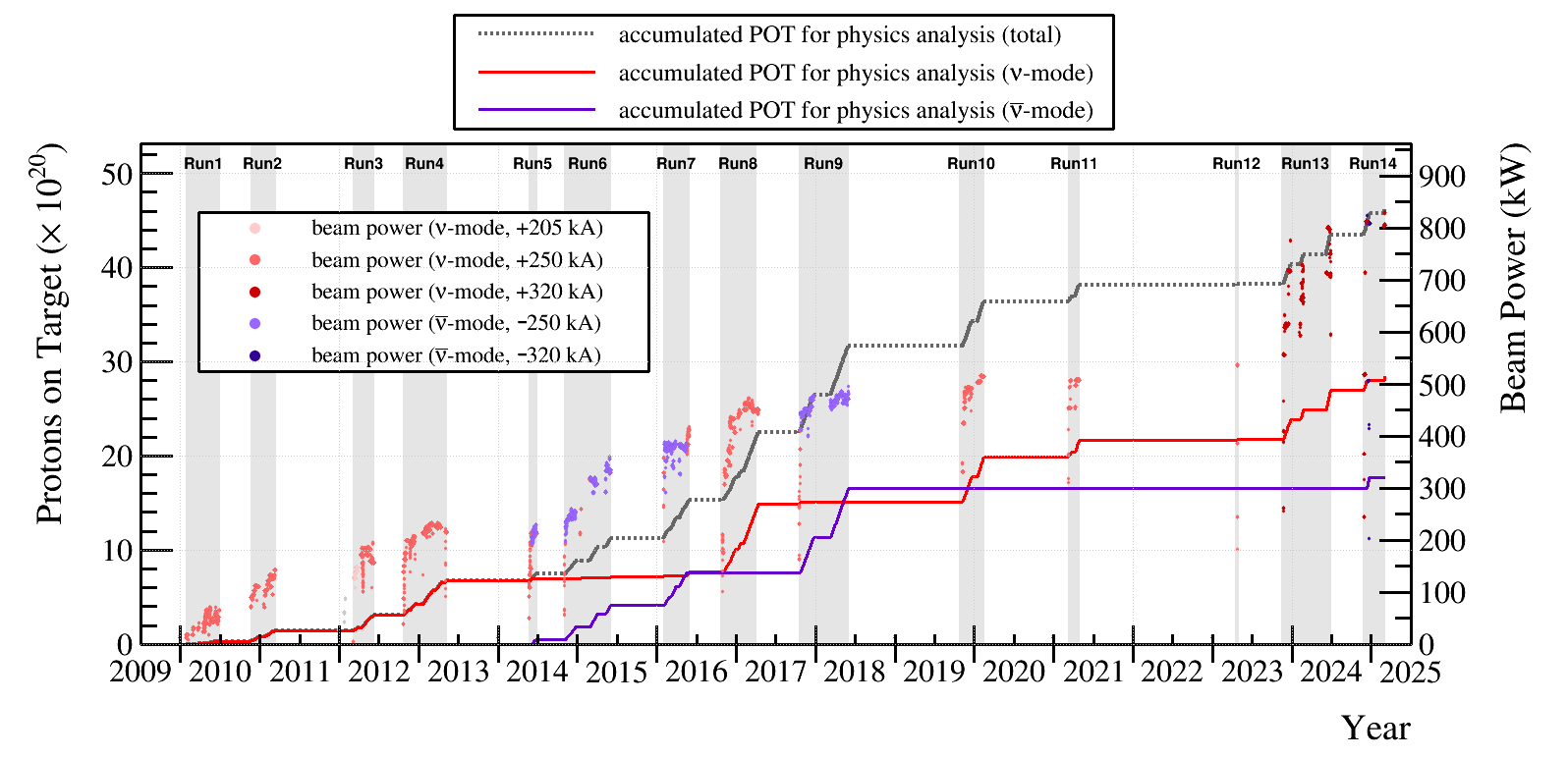
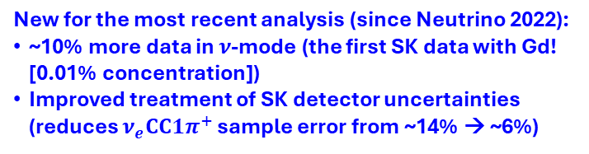
T2K Oscillation Analysis Results
New for the most recent analysis (since Neutrino 2022):
~10% more data in $ν$-mode (the first SK data with Gd! [0.01% concentration])
Improved treatment of SK detector uncertainties (reduces $ν_{e}CC1π^{+}$ sample error from ~14% → ~6%)
We’ll come back to this…
Latest T2K oscillation analysis uses data up to Run 11 $\left(3.8×{10}^{21} POT\right)$

Slide 24




T2K Oscillation Analysis Results
Best fit for $δ_{CP}$ is close to maximal CP violation!
CP-conservation excluded at the 90% CL! (Normal mass ordering)
Mild preference for normal mass ordering
Mild preference for upper octant for $θ_{23}$
Frequentist analysis
Inverted Mass Ordering
Normal Mass Ordering
Frequentist analysis
T2K 2023 Preliminary
T2K 2023 Preliminary
T2K 2023 Preliminary

Slide 25
Overview
Neutrino oscillations with T2K
T2K experimental overview
T2K neutrino oscillation analysis
Joint analyses with Super-K and NOvA
Cross section results
Future plans

Slide 26



T2K+SK Joint Analysis
SK atmospheric and T2K beam neutrinos have different oscillation baselines and energy ranges, but both experiments use the Super-K detector
Overlapping systematic uncertainties! (detector model + sub-GeV cross-section model)
T2K has good $δ_{CP}$ sensitivity, but mild mass ordering sensitivity
SK has good mass ordering sensitivity, but limited $δ_{CP}$ sensitivity
Break the degeneracy!
Increase $δ_{CP}$ sensitivity when combined!
Phys. Rev. Lett. 134, 011801

Slide 27




T2K+SK Joint Analysis Results
CP-conserving values of the Jarlskog invariant ($J_{CP}$) are excluded between 1.9σ and 2.0σ
No preference for octant of $θ_{23}$
Small preference for normal mass ordering (inverted ordering excluded at 1.2σ)
First result published! See Phys. Rev. Lett. 134, 011801 (figures here are from this paper)
Notes:
Jcp Significance depends on the analysis: Frequentist gives 1.96 sigma, Bayesian is 1.92 with prior uniform in sin(dcp) and 2.17 with prior uniform in dcp
Octant preferences lost since SK and T2K prefer different octants
Mass ordering plot shows the p-values for true IO vs NO hypothesis vs data. For NO, anything to the right is worse NO X^2 preference being excluded; for IO, left is worse IO X^2 being excluded

Slide 28




T2K+NOvA Joint Analysis
T2K and NOvA are complementary experiments
NOvA has better mass-ordering sensitivity; T2K has better CP sensitivity
Joint analysis aims to lift degeneracies
 | T2K | NOvA
Beam Peak Energy | 0.6 GeV | 2 GeV
Osc. Baseline | 295 km | 810 km
Detectors | Fine-Grained Scintillator (ND) and Water Cherenkov (FD) | Segmented Liquid Scintillator Bars (ND + FD)
Matter Effect | 9% | 29%
CP Effect | 32% | 22%

Slide 29






T2K+NOvA Joint Analysis Results
Mild preference for inverted mass ordering
CP conservation excluded at the 3σ level for inverted mass ordering!
Inconclusive for normal ordering
Improved precision on $\left|Δm_{32}^{2}\right|$
Look for a publication in Nature soon!
Notes:
Reactor Constraint applied

Slide 30
Overview
Neutrino oscillations with T2K
T2K experimental overview
T2K neutrino oscillation analysis
Joint analyses with Super-K and NOvA
Cross section results
Future plans

Slide 31




Neutron Capture Multiplicity
First measurement of neutron capture multiplicity for neutral-current quasi-elastic (NCQE) interactions on oxygen
Significant background for diffuse supernova neutrino background searches in SK
Measured using T2K data in the SK-Gd period!
Neutrons from NCQE interactions identified by delayed $γ$ signals (expected capture time: $115±1 μs$)
Published in Phys. Rev. D 112, 032003 (figures here are from this paper)
Flux-averaged mean neutron capture multiplicity is $1.37±{0.33 \left(stat\right) }_{−0.27}^{+0.17} (syst)$
Notes:
Data / MC disagreement seems to depend on secondary interaction treatment

Slide 32






$ν_{e}CC1π^{+}$ on Carbon
First measurement of $ν_{e}CC1π^{+}$ interactions on carbon
Important for T2K’s $ν_{e}$ appearance oscillation channel (~10% of statistics)
Awaiting publication. Pre-print: https://arxiv.org/abs/2505.00516 (figures here are from this paper)
Generators over-predict the total measured flux integrated cross-section (NEUT, NuWro, and GENIE tested)
Largest discrepancy is in the $0.45<p_{π}<1.5 GeV/c$ region
Uncertainties are dominated by statistics
Notes:
Important since T2K plans to add a nueCC1pi FD sample in the next analysis

Slide 33






$NC1π^{+}$ on Carbon
First measurement of $NC1π^{+}$ interactions on carbon
Important background for $ν_{μ}$ disappearance measurements in T2K due to μ and π similarities in SK
Mis-modeling limits T2K’s sensitivity to $θ_{23}$ and $Δm_{32}^{2}$
Mock T2K $ν_{μ}$ oscillated spectrum
$NC1π^{+}$ fills in the oscillation dip
Bin indices
Accepted to PRD & PRL. Pre-print: https://arxiv.org/pdf/2503.06849 (figures here are from this paper)
Measurement shows that NEUT, NuWro, and GENIE under-predict the total flux-integrated cross section by ~30%

Slide 34
Overview
Neutrino oscillations with T2K
T2K experimental overview
T2K neutrino oscillation analysis
Joint analyses with Super-K and NOvA
Cross section results
Future plans

Slide 35
T2K Data Taking History
Second Gd loading to SK (0.01% → 0.03%)
J-PARC upgrade
ND280 upgrade
First Gd loading to Super-K (0.01%)
Latest T2K oscillation analysis uses data up to Run 11 $\left(3.8×{10}^{21} POT\right)$

Slide 36

J-PARC Upgrade
Accelerator upgrades
Increase maximum neutrino beam power from 750 kW → 1.3 MW
Achieved 830 kW in June 2024
Improve the rate of neutrino events
Neutrino beamline upgrades
Increase focusing horn current from 250 kA → 320 kA
Increases the neutrino beam flux by ~10% and improves beam purity

Slide 37






ND280 Upgrade
Dedicated $π^{0}$ detector (P0D) was removed
Replaced by two time projection chambers (TPC) and a fine-grained scintillating detector (SuperFGD)
Downstream detectors remain as-is
High Angle TPC
SuperFGD
$1×1×1 cm^{3}$ scintillator cube
90 cm
~2 million scintillator cubes
180 cm
56 cm
192 cm
182 cm
80 cm
3D light readout

Slide 38




ND280 Upgrade
Muon and proton reconstruction efficiency is dramatically improved for particles moving $≳$ 60 degrees from the forward direction
Much better acceptance for low-momentum particles
Includes the possibility of tracking neutron kinematics in the SuperFGD
Together, these improvements should greatly improve T2K’s ability to constrain its neutrino interaction model
Phys. Rev. D 101, 092003

Slide 39

ND280 Upgrade
Started taking data in June 2024!
7 June 2024, Run 16847 Event 28852

Slide 40







SK-Gd
Super-Kamiokande’s ultra-pure water has been doped with gadolinium
0.01% from 2020, 0.03% from 2022
Goal: capture neutrons from $\overline{ν}$ events
~75% efficiency at 0.03% Gd
Mostly important for supernova neutrino studies, but neutron tagging can potentially help T2K mitigate background contamination in its $\overline{ν}$ beam as well
T2K Preliminary
T2K Preliminary
75%
Current
0.03%
$ν_{e}$ event spectrum
${\overline{ν}}_{e}$ event spectrum

Slide 41

Projected Sensitivity
T2K will continue to take data until Hyper-K takes over ~2028
We plan to extract as much physics as we can with our upgraded detectors and beamline
Sensitivity studies have been performed with the increased neutrino beam power and ND280 capabilities
With the right running configurations, and with some help with nature, it is possible that there is a world where T2K can exclude CP conservation at the 3σ level before the experiment finishes!
Stay tuned for future T2K updates!
T2K Preliminary

Slide 42

Summary
Most recent T2K oscillation analysis results:
Exclude CP symmetry at 90% CL
Have weak preference for normal mass ordering and upper octant in $θ_{23}$
Joint analyses:
T2K+SK: CP-conserving Jarlskog invariant excluded between 1.9σ and 2.0σ
T2K+NOvA: CP-conservation excluded at 3σ for inverted mass ordering, improved precision on $\left|{Δm}_{32}^{2}\right|$
Cross sections:
New measurements of neutron multiplicity, $ν_{e}CC1π^{+}$, and $NC1π^{+}$ will help constrain future neutrino oscillation measurements in T2K
Future:
New T2K analysis results will come soon!
More planned for the future with beamline, ND, and SK upgrades!
Thank you for listening!

Slide 43
Backup

Slide 44


Off-Axis Beam Technique
Beam is purposely aimed slightly away from the detectors (2.5 degrees)
Off-axis beam helps to select a more narrow band of neutrino energy than the full on-axis beam
A feature of charged pion two-body decay
$$E_{ν}=\frac{m_{π}^{2}−m_{μ}^{2}}{2(E_{π}−p_{π}\cos{(θ_{νπ})})}$$
T2K beam peak energy
~0.6 GeV
Neutrino Beam Source
Near Detector
Far Detector
Detector Axis
2.5 degrees
(Not to scale)
Neutrino Beam Center
From Ed Atkin’s Thesis

Slide 45



T2K Neutrino Beam Flux Model
Systematic uncertainties on the beam flux are dominated by hadron-production processes
Dedicated measurements of hadron production from a replica of the T2K target have been performed by NA61/SHINE
Reduces the uncertainty near the flux peak from >20% to only ~5%!
T2K Preliminary
T2K Preliminary
T2K Preliminary

Slide 46




T2K Cross Section Model
Dominant interaction type for T2K is CC quasi-elastic (QE)
Modeled based on the Benhar Spectral Function
Tuning based on external electron scattering data
Significant secondary effects from CC resonant pion production (RES) and 2p2h
RES model based on the Berger-Sehgal model tuned to bubble chamber data
For more information on the T2K cross-section model, see Stephen Dolan’s NuFact talk: https://indico.cern.ch/event/1528564/contributions/6614840/

Slide 47

T2K Near Detector Event Samples
22 event samples:
FHC $ν_{μ}$ samples
Two sub-samples: tracks originate in FGD1 XOR FGD2
CC 0π, 0p, 0γ
CC 0π, Np, 0γ
CC 1π, 0γ
CC Other, 0γ
CC Nγ
RHC ${\overline{ν}}_{μ}$samples
Two sub-samples: tracks originate in FGD1 XOR FGD2
CC 0π
CC 1π
CC Other
RHC $ν_{μ}$ samples (wrong sign!)
Two sub-samples: tracks originate in FGD1 XOR FGD2
CC 0π
CC 1π
CC Other

Slide 48



Coming Soon: ND Updates
Additional high-angle and backward track selections are being added for the ND280 event samples to provide “4π” angular acceptance in ND280 (pre-upgrade)
This will bring the ND280 angular acceptance in line with SK angular acceptance
The cross-section model is being updated to provide more model freedom
ND280 muon acceptance
SK electron acceptance

Slide 49



Coming Soon: SK Updates
New $ν_{e}CC1π^{+}$ multi-ring appearance sample (~6 new $ν_{e}$ events)
Previously did not allow the π to be above Cherenkov threshold
Updated SK detector systematic treatment that supports the new sample and better correlates the single-ring and multi-ring event samples in SK
New results coming soon!
Stay tuned…

