Slide 1


Slide 2
Poster Presentation Awards

Slide 3
OUR POSTER PRESENTERS
“Radioactive Loading for Sterile Neutrino Searches using Optomechanical Sensors” --- Jacqueline Baeza-Rubio (Yale University)
“Radon-222 Screening Capability at SNOLAB” --- Dr Nasim Fatemighomi (SNOLAB)
“The PIKACHU Experiment: Search for the Two-Neutrino Double Beta Decay of 160Gd in Kamioka” --- Takashi Iida (University of Tsukuba)
“Leveraging Water Cherenkov Detector Technologies for Water Quality Monitoring” --- Xiaoyue Li (TRIUMF)
“Water Cherenkov Test Experiment(WCTE): Detector and Physics Lessons Towards Hyper-Kamiokande” --- Akira Konaka (TRIUMF)
“The Quest for No Neutrinos: Advancing the Search with LEGEND-1000” --- Moritz Neuberger (Technical University of Munich)
“Region of Interest Filter in DUNE DAQ” --- Matthew Man (University of Toronto)
THANK YOU!
Poster presentations are not easy. You must be on-point for 90 minutes with an audience you cannot control and perpetual Q&A. This is one of the hardest kinds of presentations to give.

Slide 4
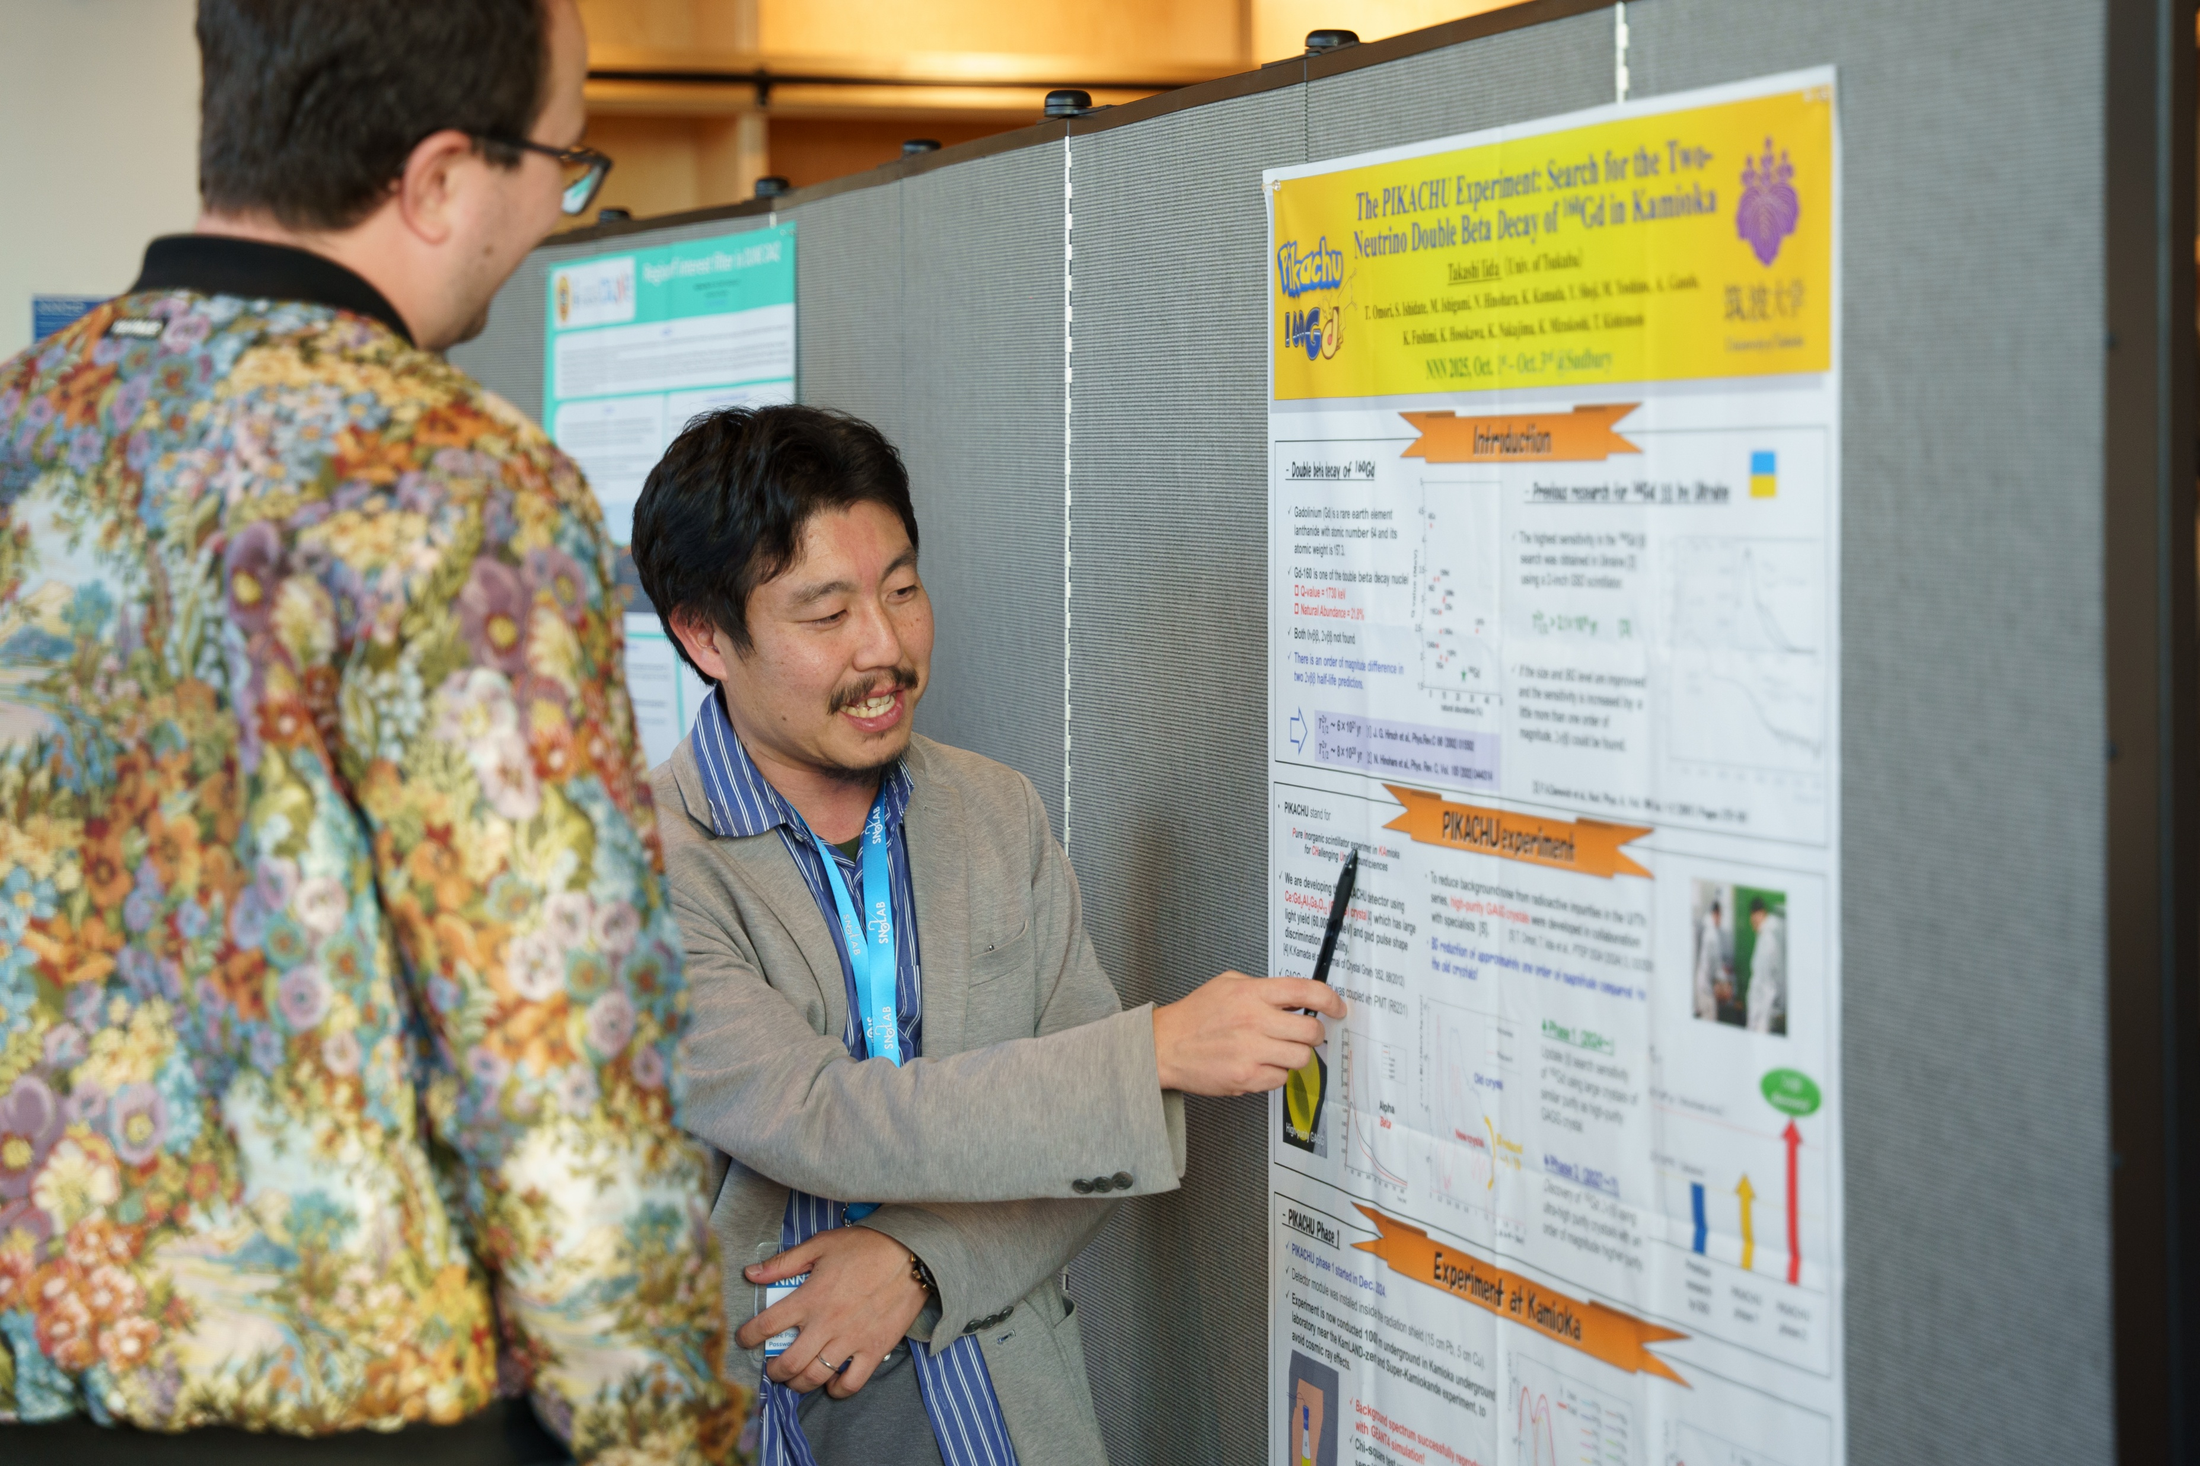
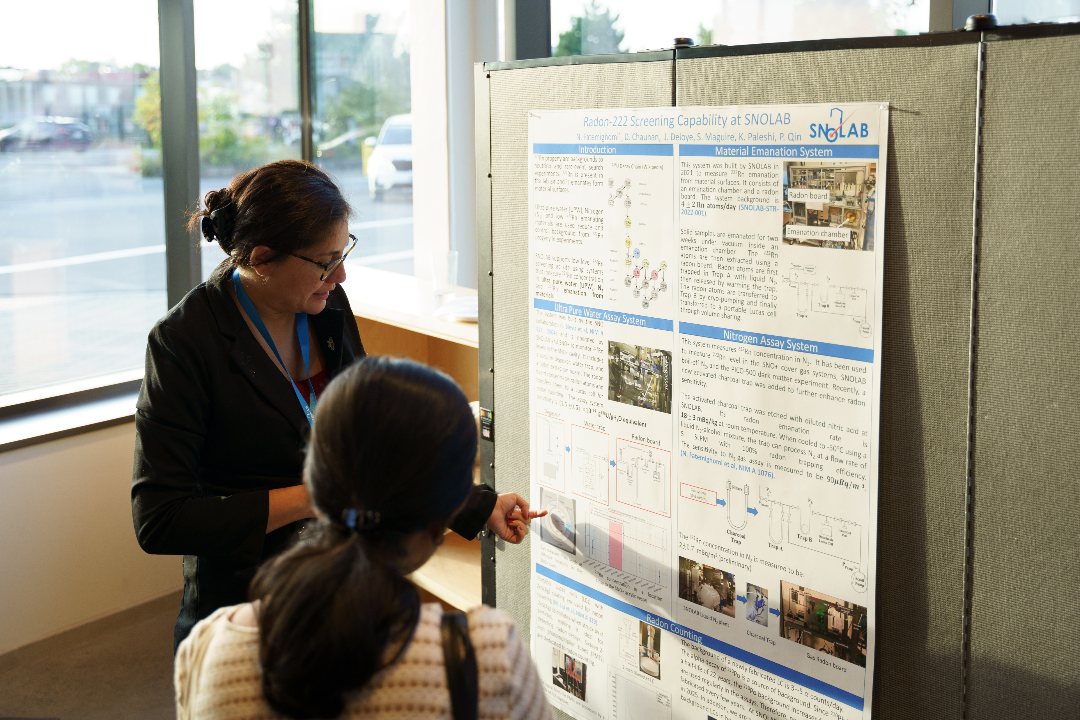
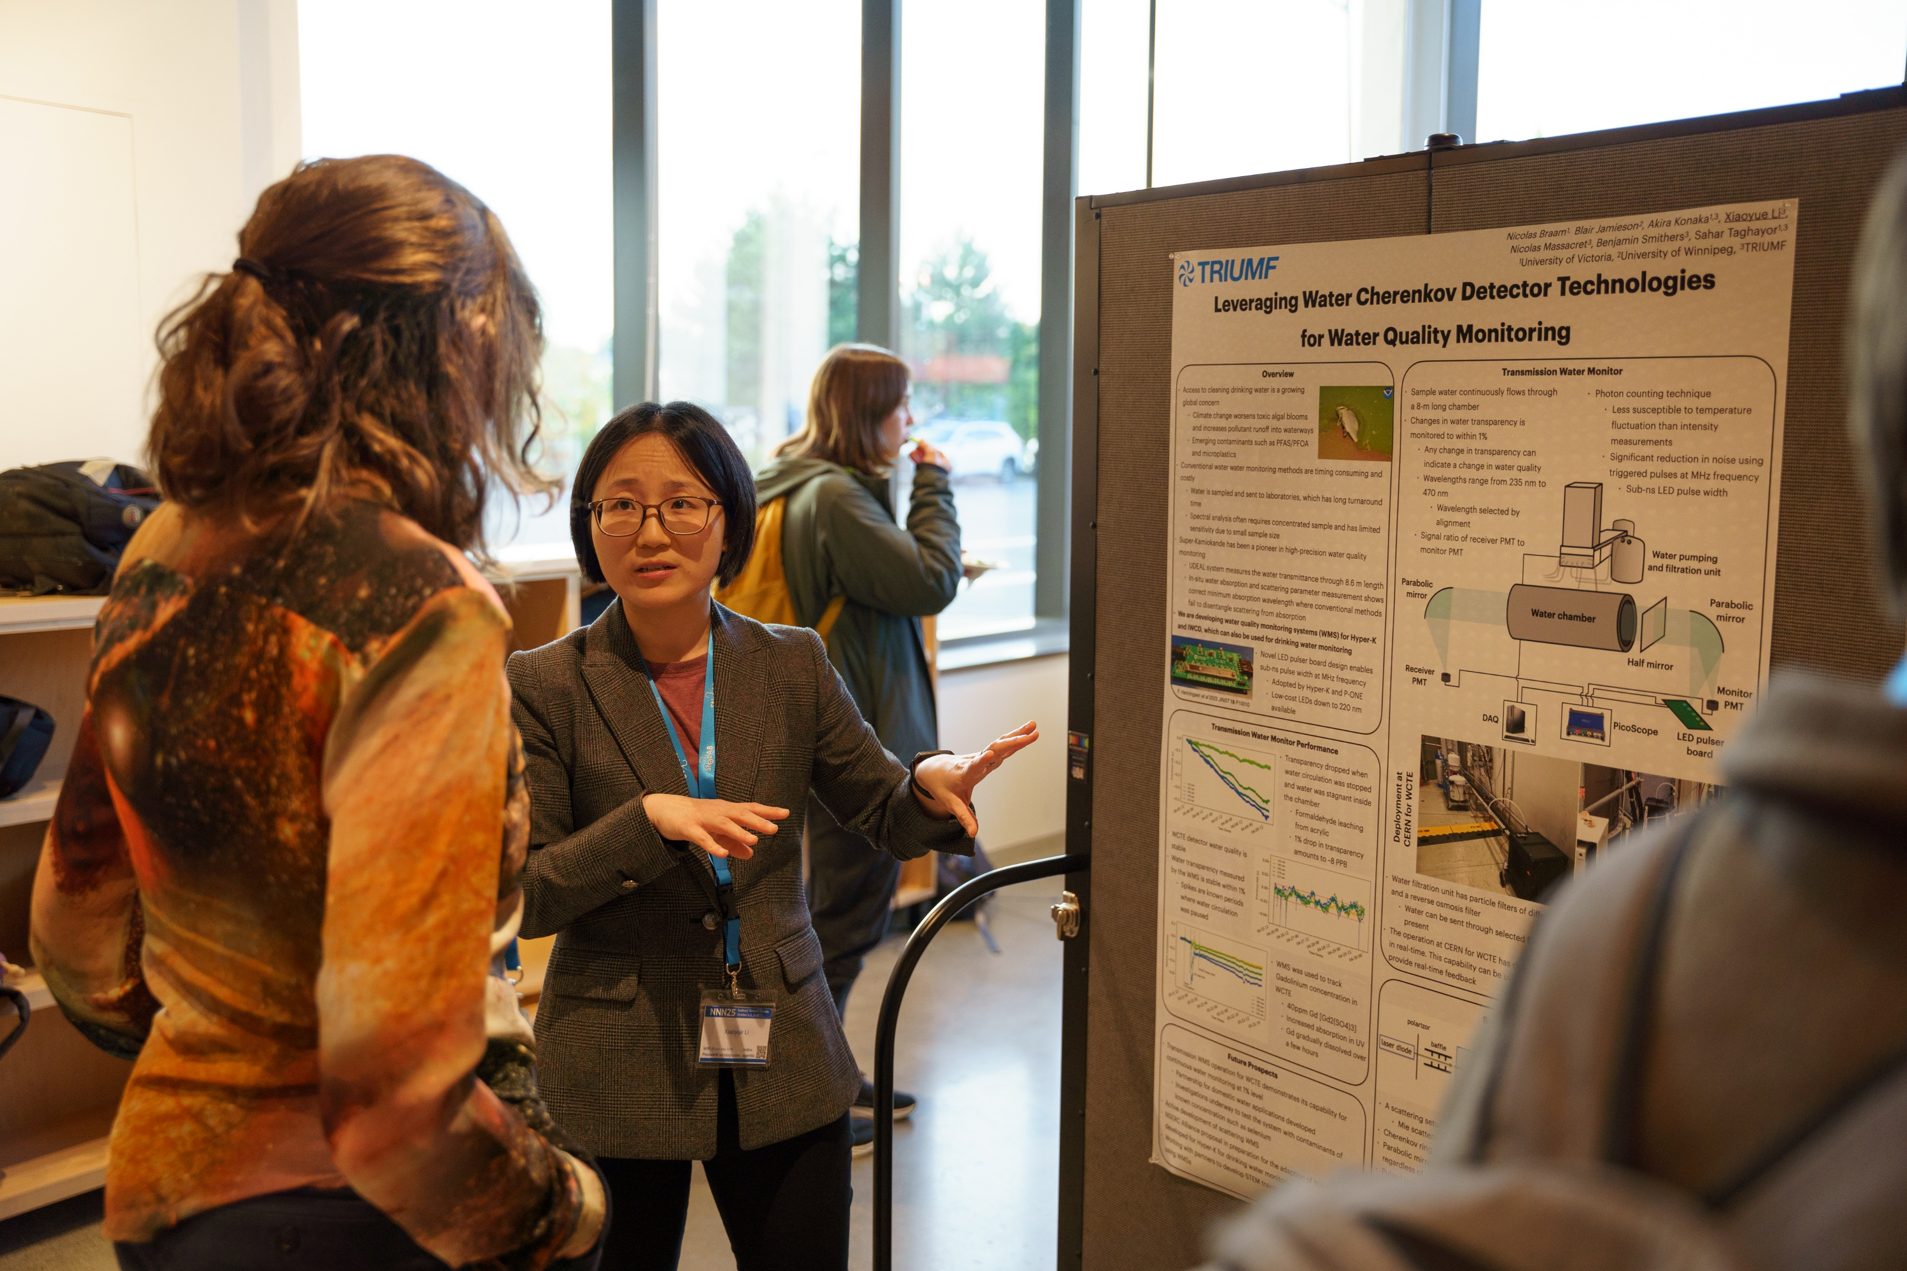
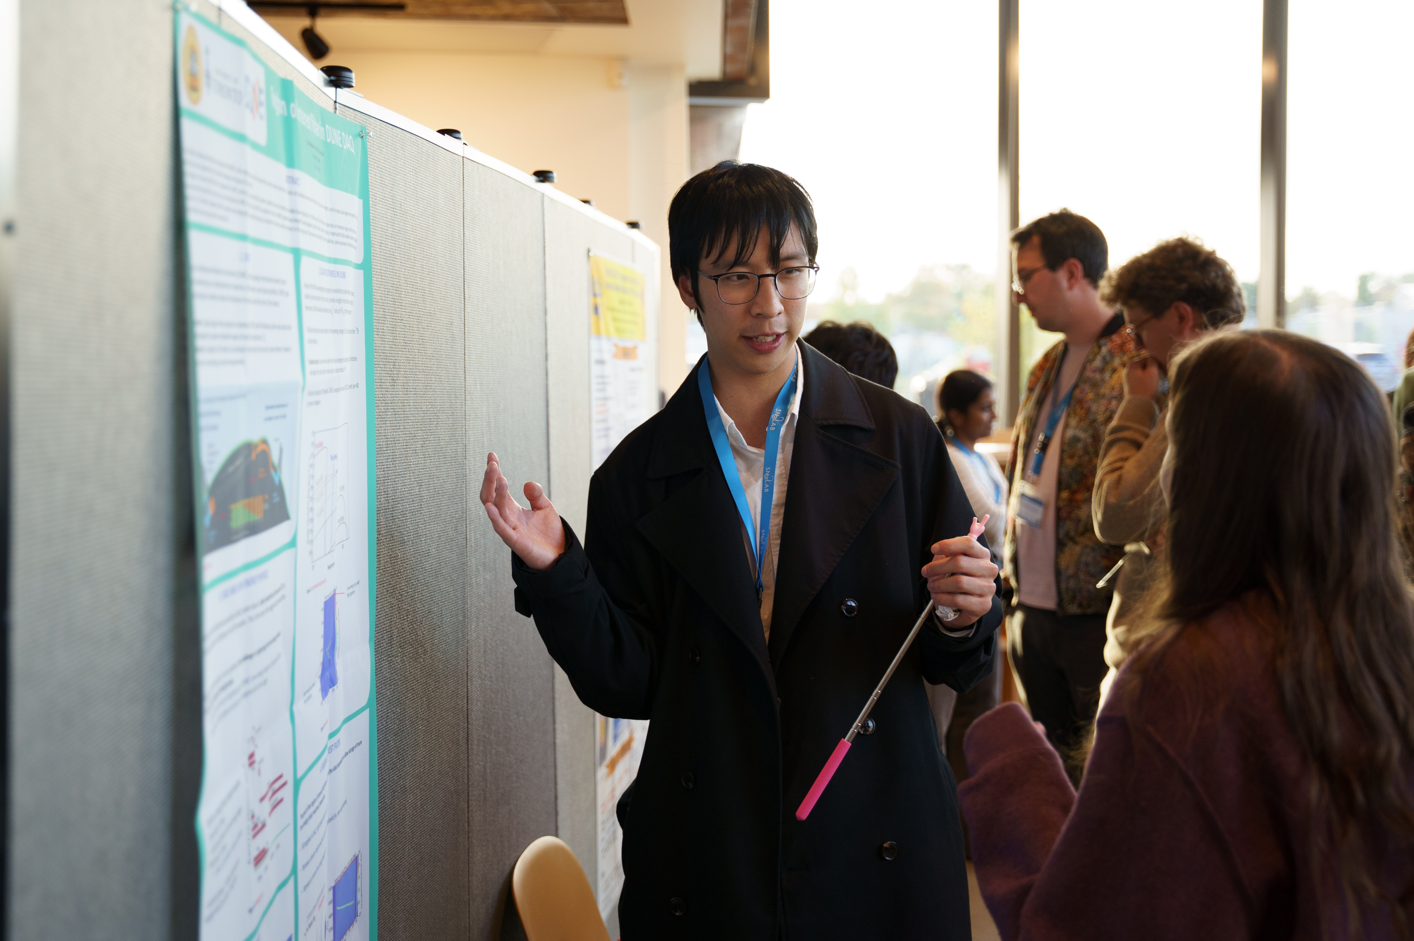
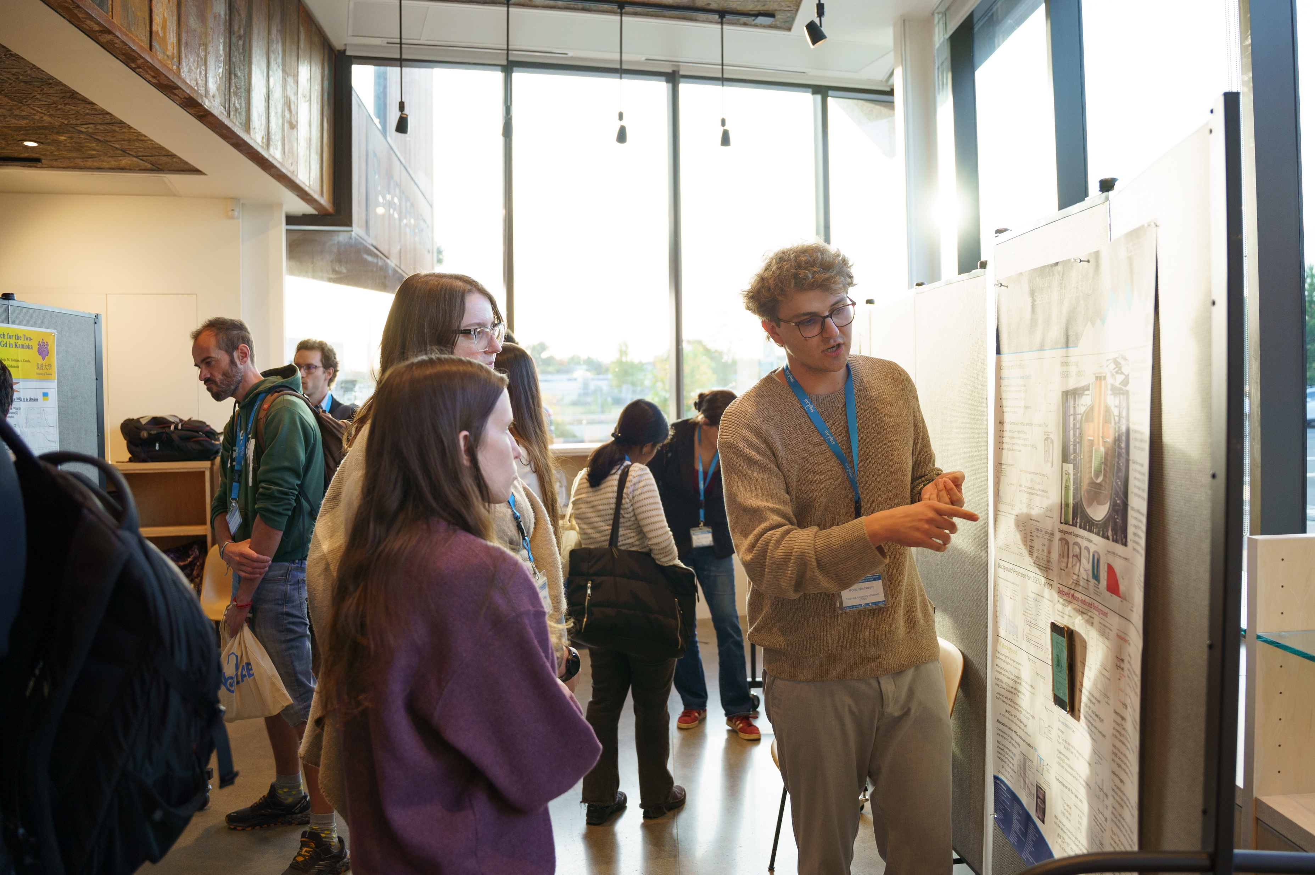
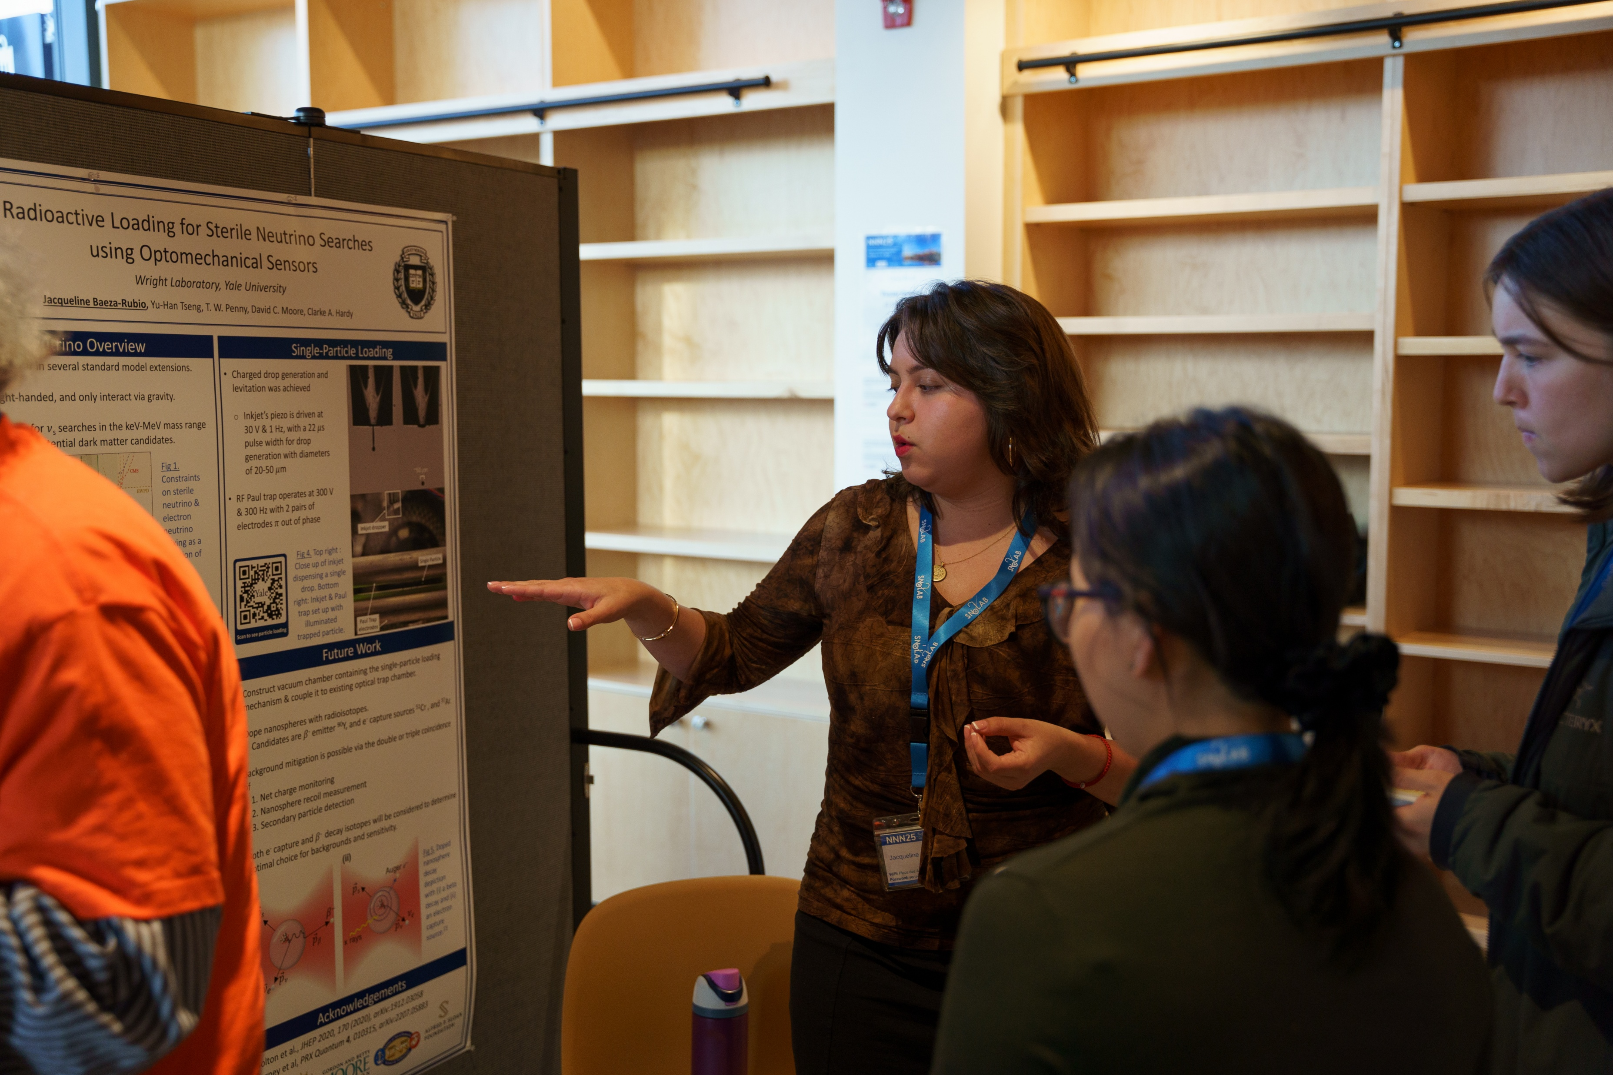
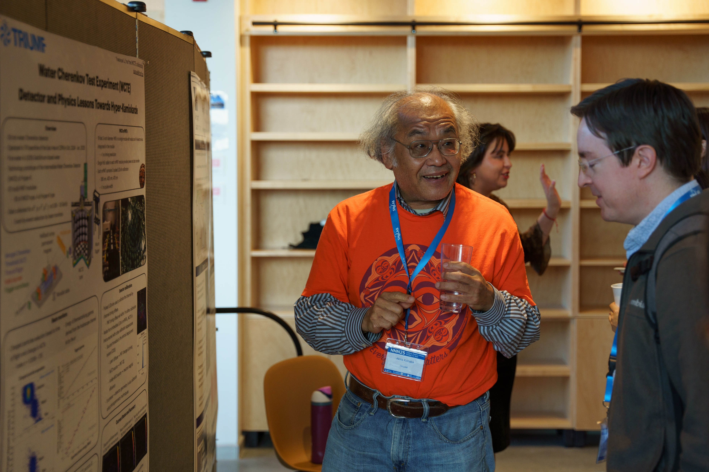
© Roam and Ramble Photography
© Roam and Ramble Photography
© Roam and Ramble Photography
© Roam and Ramble Photography
© Roam and Ramble Photography
© Roam and Ramble Photography
SCENES FROM POSTER PRESENTATIONS
© Roam and Ramble Photography

Slide 5
Judges and Rubric
Dr. Chris Jillings (SNOLAB, Laurentian University)
Dr. Ian Lawson (SNOLAB, Laurentian University)
Dr. Lorna Nolan (Laurentian University)
Rubric developed with Dr. Erica Caden. Each category scored 0-6, with examples of a 5-6 given for judges. Equally weighted categories. Judges’ averages scores used to reweight judges in final scoring.
Design/accessibility
A very good poster will have a design that uses space well. It is not too cluttered (too much text or too many graphics in dense layouts) and doesn't have wide unused spaces. It uses colours in a way that helps the viewer but doesn't distract, and is appropriate for eyes with different colour receptivity (e.g. avoid using only colour to label something, avoid mixing colours like red and green, etc.). It will have an introduction, details, and a conclusion, and will cite sources where needed. Graphs have axis labels and legends. The presenter indicates their name, institution, and collaborators, and acknowledges any other contributions.
Knowledge of work
The presenter will be able to discuss aspects of their work without following only the text or graphics on the poster. They will be able to demonstrate synthesis of knowledge, including points or conclusions with arise from combinations of material on the poster. The presenter will also admit when they don't know something, and does not appear to be trying to cover up a lack of knowledge.
Audience engagement
The presenter will invite the audience in to engage in their poster, leave space for the audience to ask questions of make comments, and will adapt to any response from the audience in a way that feels natural while respecting the story the presenter needs to tell. The presentation will balance speaking and listening and should not exceed about 5-10 minutes without interruption.
Flow of presentation
The presentation of the poster will draw the audience in with an opening, a middle, and an end (a conclusion). Transitions through the presentation will move naturally from segment to segment. The presenter will leave appropriate space for questions, which may result in adapting the flow of the presentation. This is an assessment of the speaker’s ability to present effectively
Response to questions
Presenter listens to question, and may even verify they have understood the question before answering (not required but a good practice). Presenter responds to the question in a way that demonstrates they understood what was asked, and does not give too much superfluous material in their response.

Slide 6
TOP 2 POSTERS

Slide 7
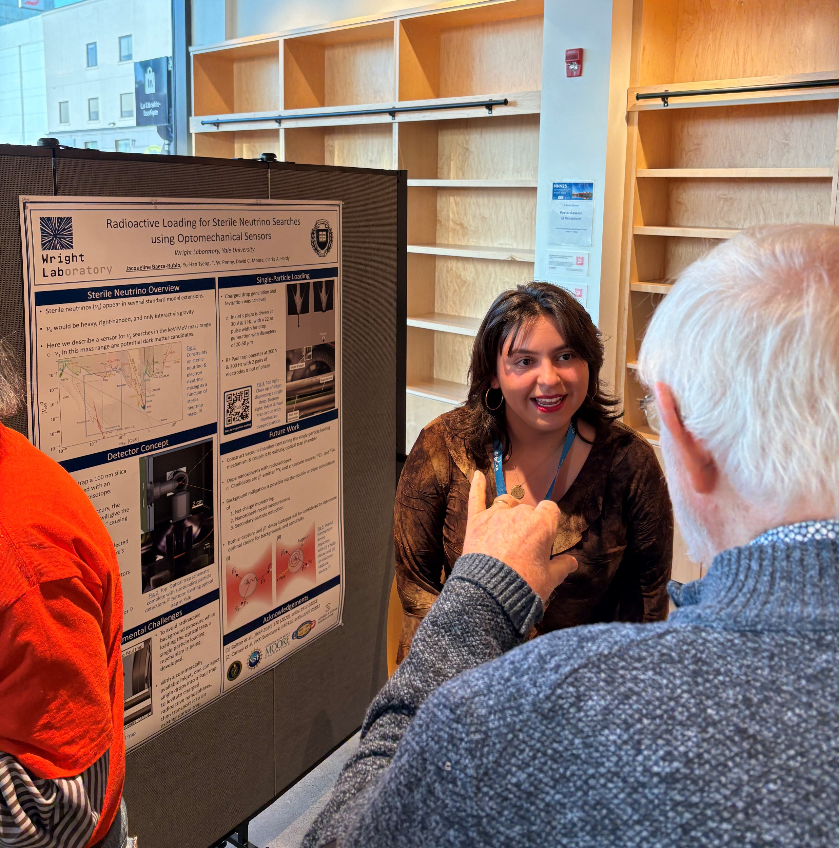
“Radioactive Loading for Sterile Neutrino Searches using Optomechanical Sensors” --- Jacqueline Baeza-Rubio (Yale University)
“Leveraging Water Cherenkov Detector Technologies for Water Quality Monitoring” --- Xiaoyue Li (TRIUMF)
© Roam and Ramble Photography

Slide 8
THANKS TO ALL POSTER PRESENTERS!

