Slide 1


Slide 2
Closing Perspectives from the Local Organizers

Slide 3
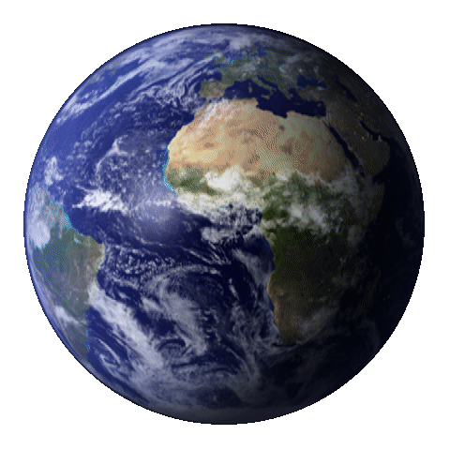
A WORLD OF THANKS

Slide 4
TO THE STEERING COMMITTEE
Chang Kee Jung (Chair), Stony Brook University
Sara Bolognesi, CEA Saclay, France
Takaaki Kajita, University of Tokyo, Institute for Cosmic Ray Research, Japan
THANK YOU for the opportunity to host this workshop!

Slide 6
TO THE INTERNATIONAL SCIENTIFIC ADVISORY COMMITTEE
M. Barbi, University of Regina
N. Barros, Laboratory of Instrumentation and Experimental Particle Physics
S. Bhadra, York University
F. Di Lodovico, King's College London
N. Di Marco, Gran Sasso Science Institute
D. Harris, York University
Z. Hong, University of Toronto
G. Illuminati, INFN-Bologna
S. Ipek, Carleton University
N. Jachowicz, Ghent University
T. Kobayashi, KEK
N. Kurahashi Neilson, Drexel University
M. Lindner, Max Planck Institute for Nuclear Physics
D. McKeen, TRIUMF
D. Moore, Yale University
M. Nakahata, Institute for Cosmic Ray Research University of Tokyo
K. Palladino, Oxford University
N. Park, Queen's University
L. Pattavina, Milan Bicocca University
O. Peres, UNICAMP
C. Riccio, Stony Brook University
B. Schmidt, CEA Saclay
A. Tapia, University of Medellin
Y. Wang, IHEP
THANK YOU for your hard work in recommending topics, encouraging submissions, reviewing abstracts, and tolerating a thousand emails.

Slide 7
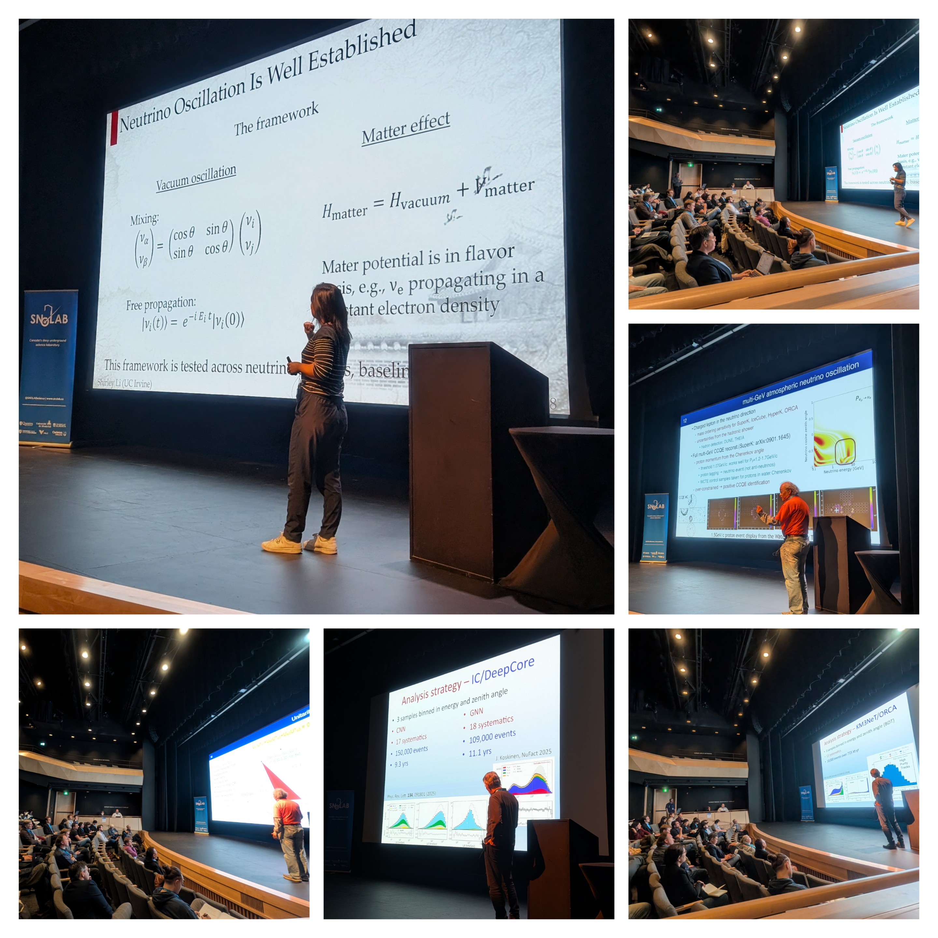
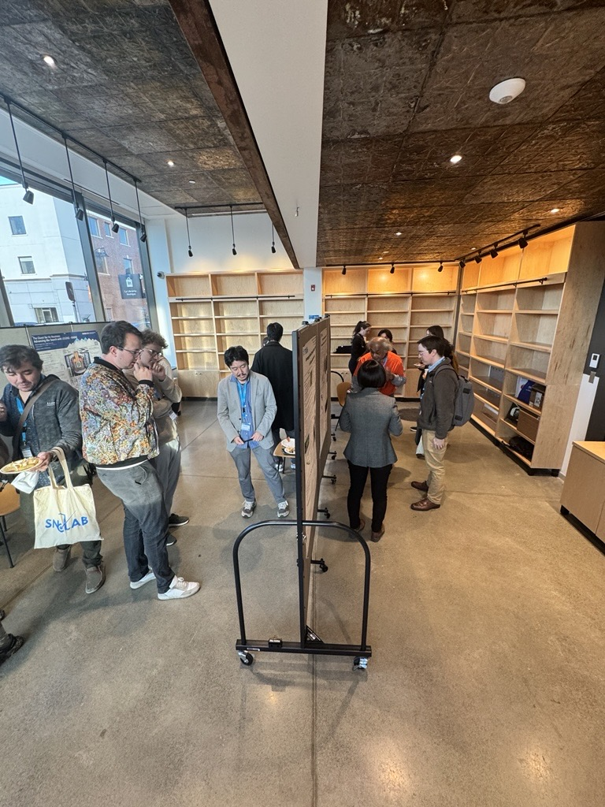
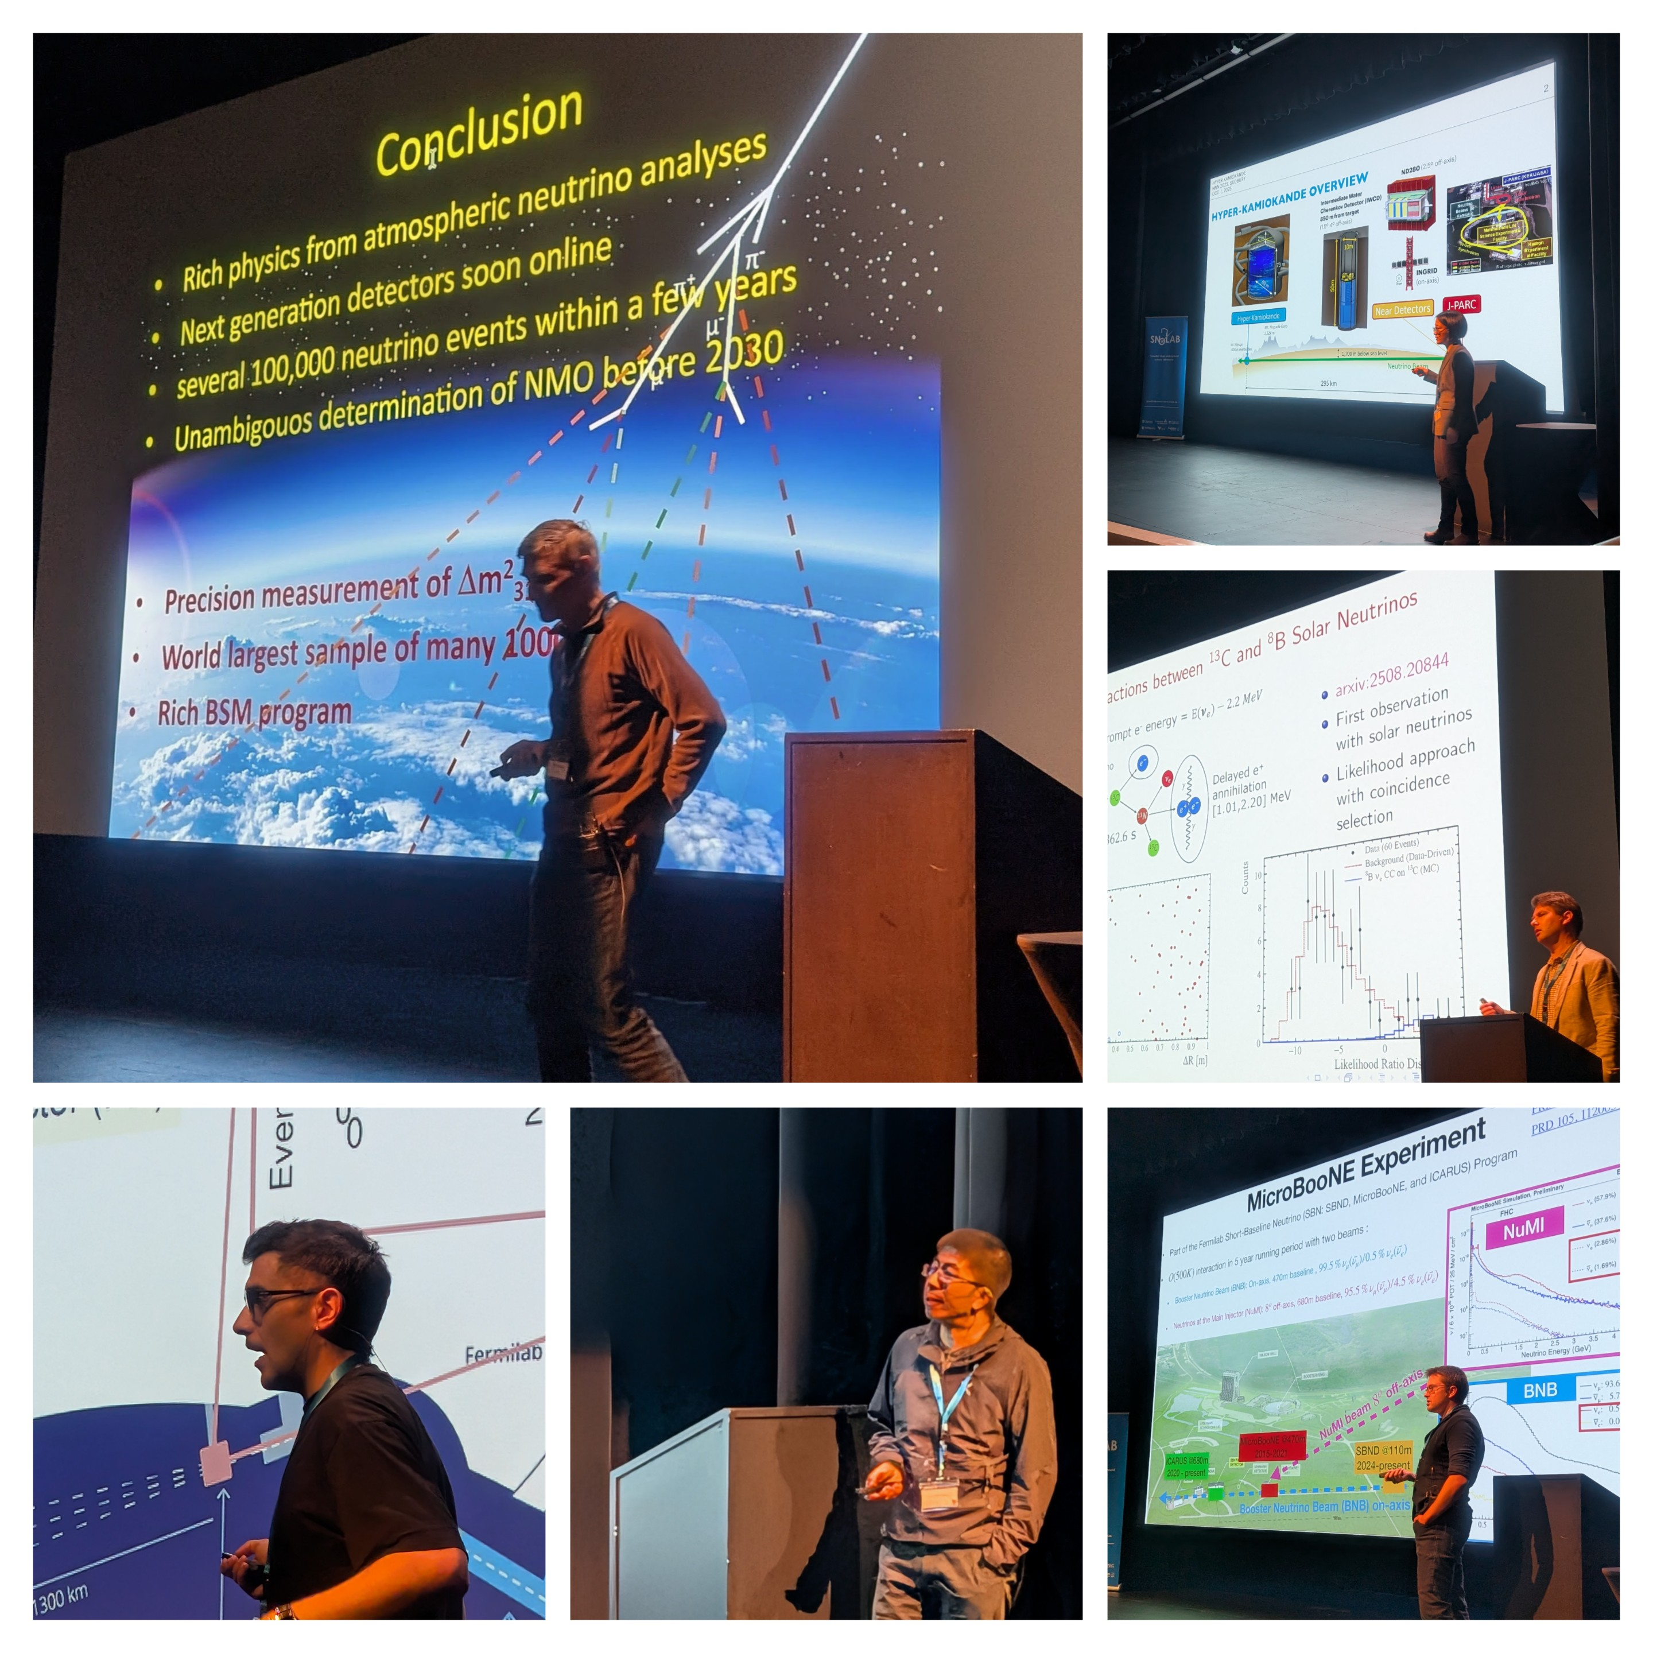
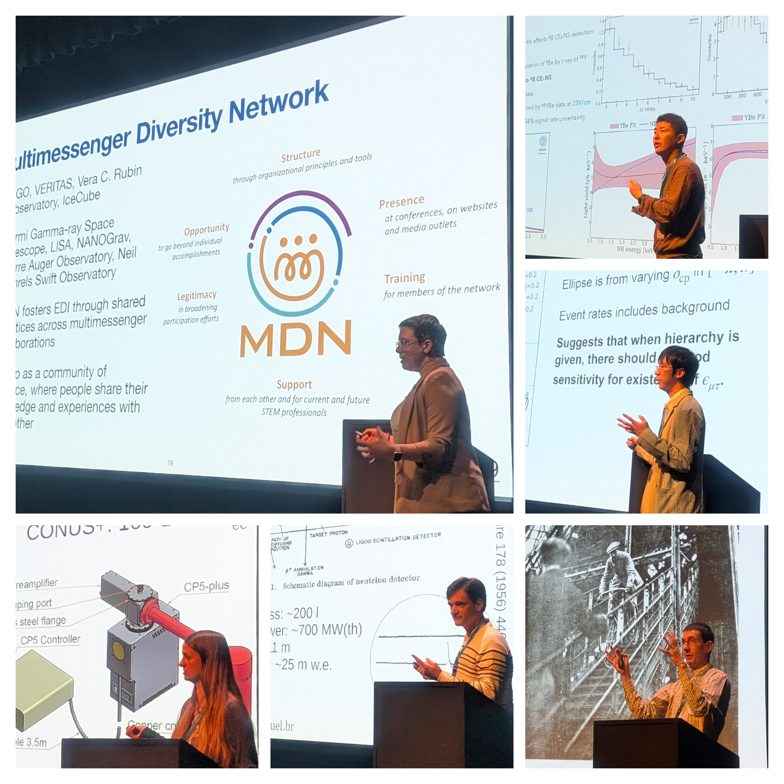
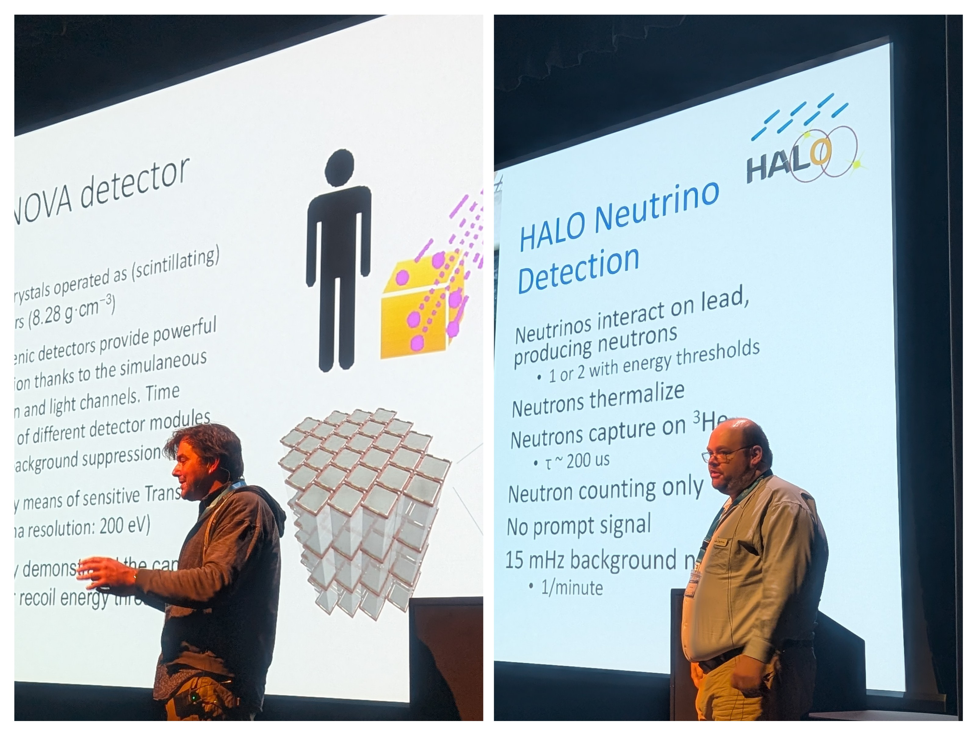
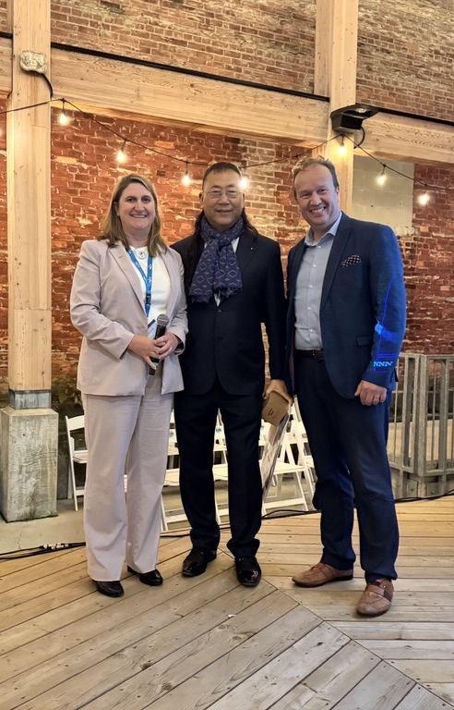
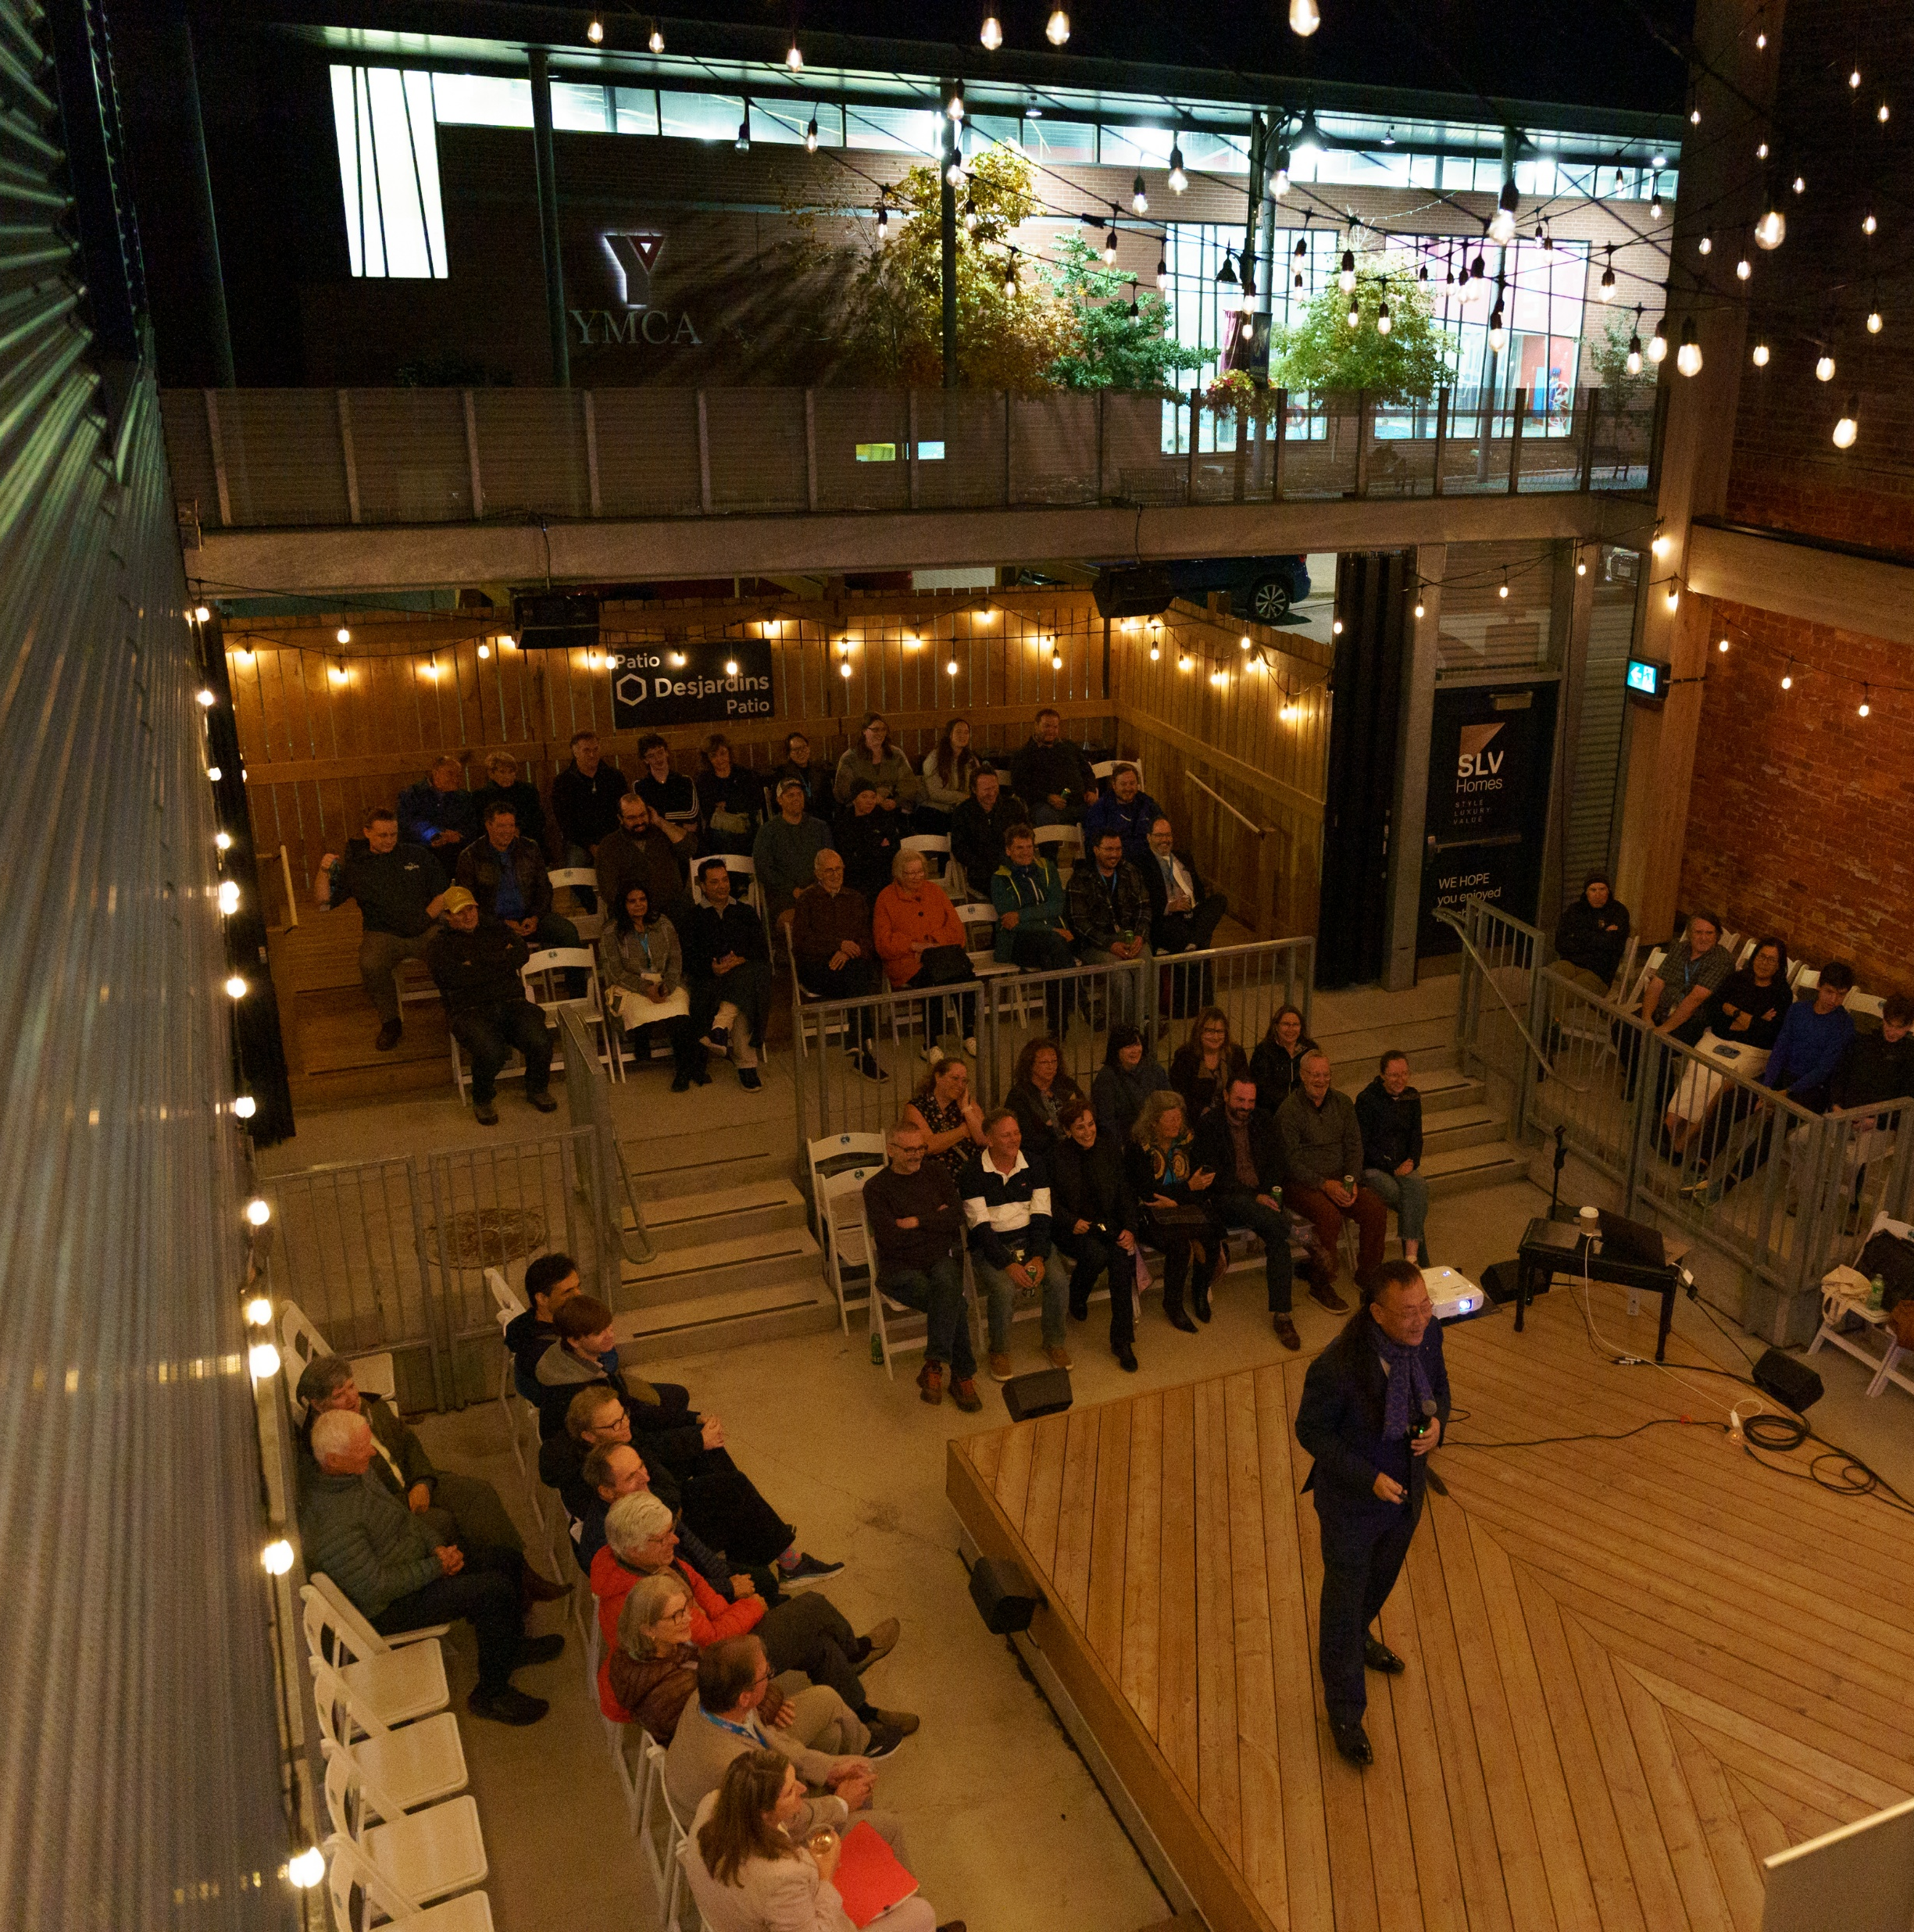
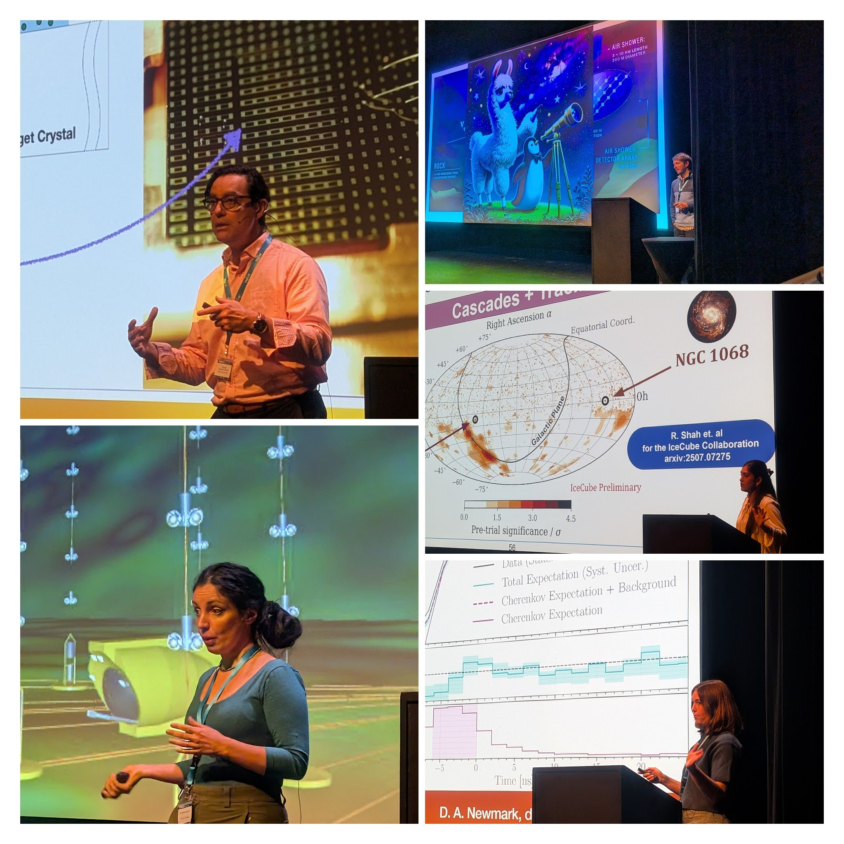
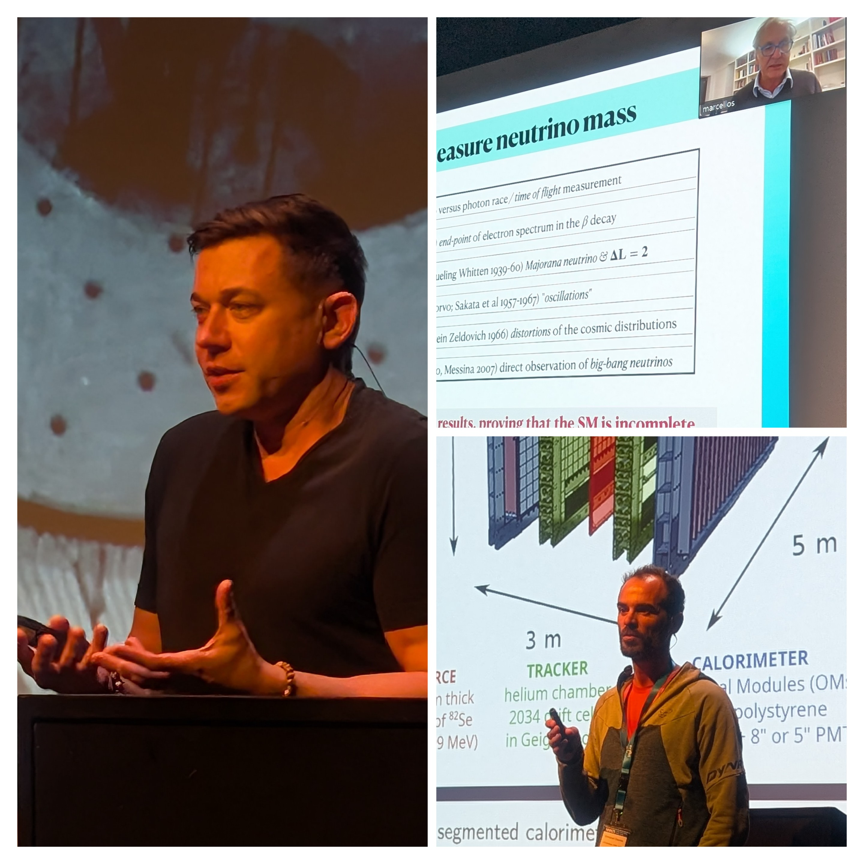
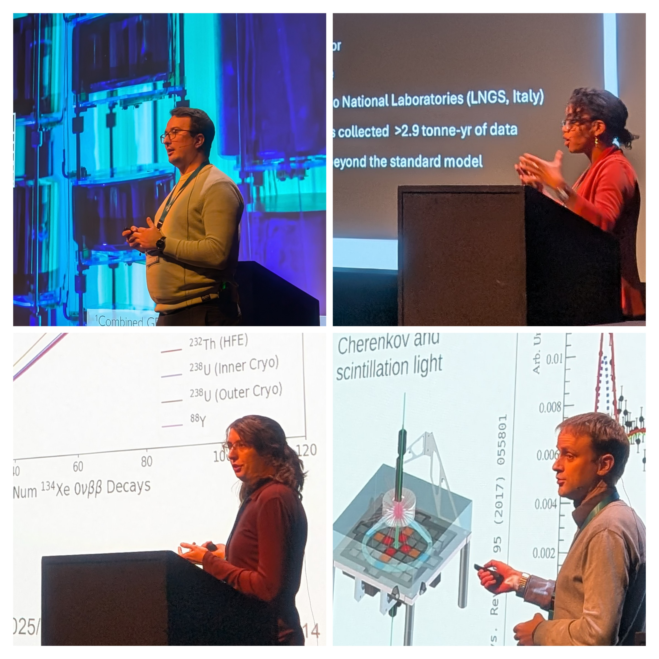
TO THE PRESENTERS
© Roam and Ramble Photography
THANK YOU for showing the frontiers of our fields, for sharing your ideas, for engaging in dialogue and debate, and bringing a little more light into the world.

Slide 8
TO MY FELLOW LOCAL ORGANIZERS
Josée Bertrand Houle, SNOLAB
Antonia Botas, SNOLAB
Erica Brunelle, SNOLAB
Thomas Brunner, McGill University
Erica Caden, SNOLAB, Laurentian University, and McGill University
Juliette Deloye, SNOLAB
Blaire Flynn, SNOLAB
Kipp Grose, SNOLAB
Samantha Kuula, SNOLAB
Emma Larcher, SNOLAB
Sylvie Milks, SNOLAB
Sandra Moskal, SNOLAB
Tony Noble, McDonald Institute
Mehwish Obaid, SNOLAB
Rachel Richardson, SNOLAB
Matthew Stukel, SNOLAB and University of Toronto
Edward Thomas, McDonald Institute
Michael Whitehouse, SNOLAB
AND TO
Art McDonald (Queen’s University) – for advancing the case for hosting NNN25!
Zeerak Azam (SNOLAB) and Cody O’Neill (Laurentian) – Kinetic Mic Experts!
Shelby Lebeau, Ivan Pitre, Drew Sauders, Luc Sellin (Place des Arts)
Matthew Zhao, Manpreet Kaur (The Radisson Hotel)
Nesci Catering
The Fromagerie
Marett McCulloch, Jake Deeth (The Refettorio)
We Live Up Here Urban Arts Organization
Roam and Ramble Photography
THANK YOU for intensity, brilliance, commitment, collaboration, and grit.

Slide 9
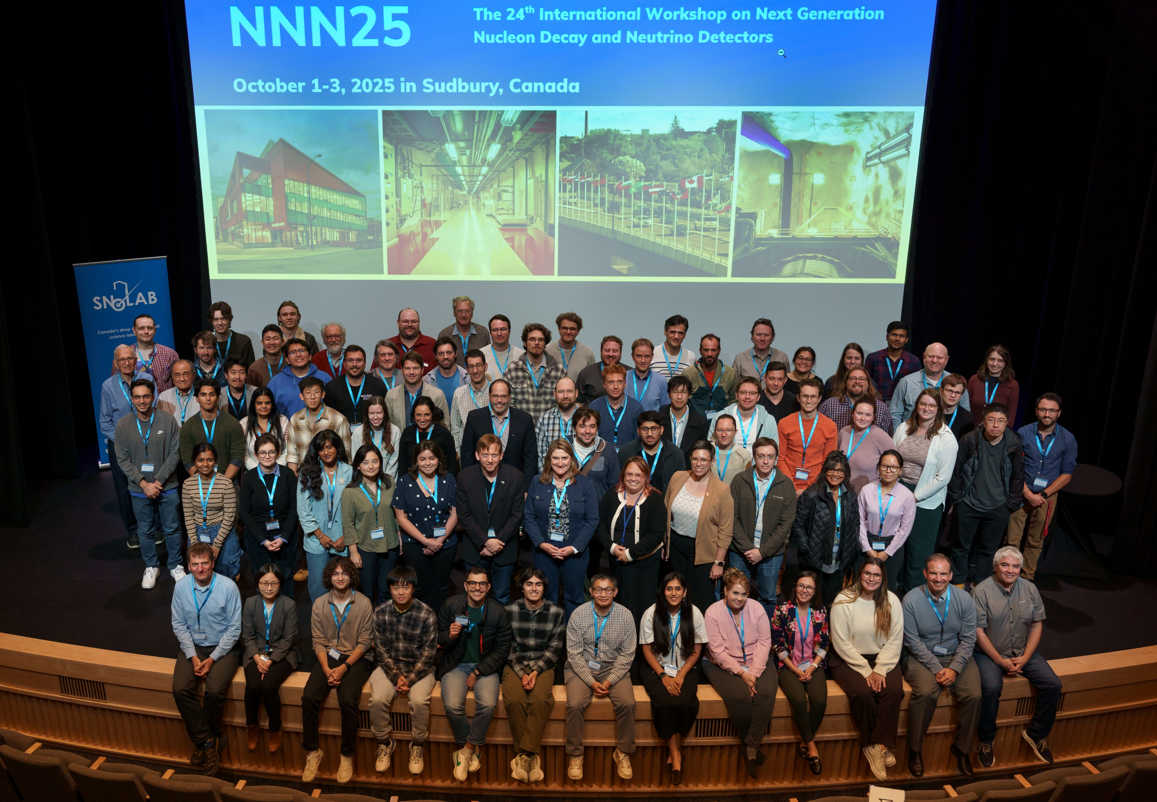
SAFE TRAVELS!
© Roam and Ramble Photography

