Slide 1
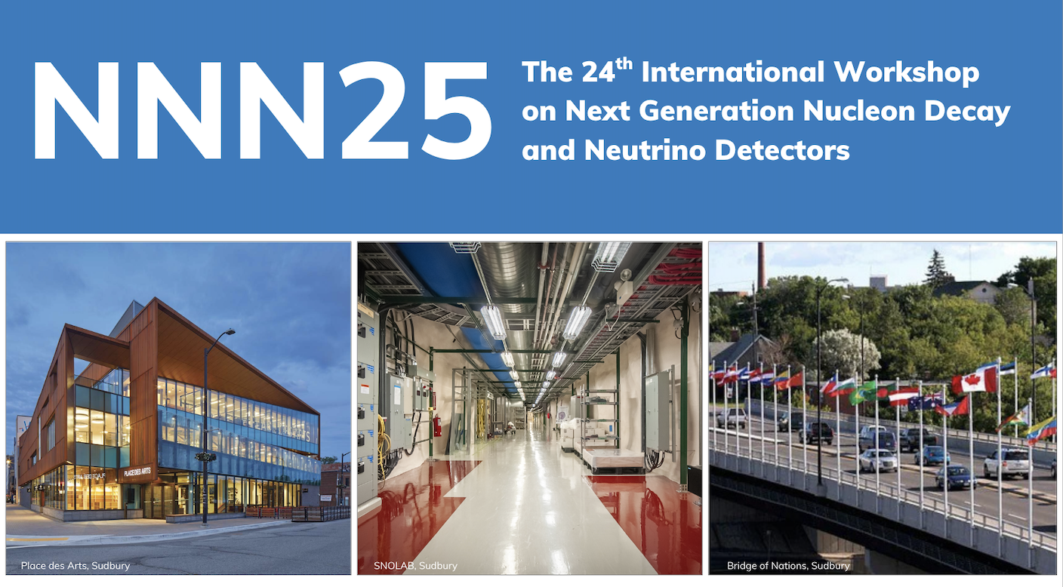
Closing Remarks (NNN Steering Committee Report)
Chang Kee Jung, Stony Brook University, Sudbury, Oct. 3, 2025

Slide 2
A great leader should have a clear and grand vision accompanied with an ability to carry out detailed execution of the vision

Slide 3
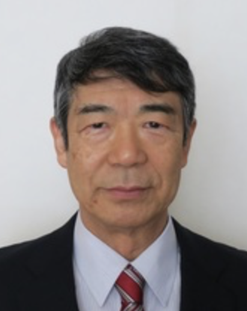
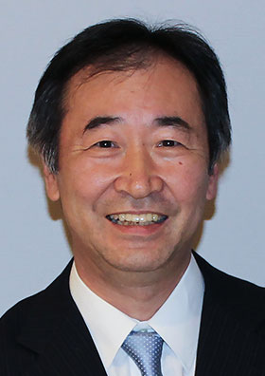
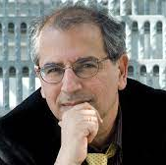
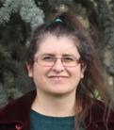
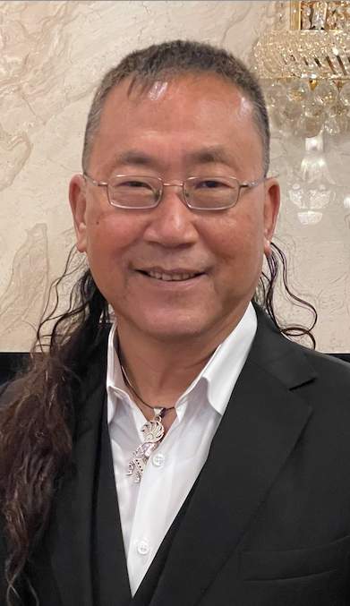
NNN Steering Committee
Asia:
  Kenzo Nakamura (1999 – 2008)
  Takaaki Kajita (2008 – present)
Europe:
  Stavros Katsanevas (2005 – 2022)
  Sara Bolognesi (2023 – present )
North America
  ckj (Chair)
K. Nakamura
T. Kajita
Late S. Katsanevas
S. Bolognesi
ckj

Slide 4
Recent Consideration and Decisions
Increasing the regional rotation:
  Past rotation
    Asia → Europe → North America
  New rotation
    Asia → Europe → North America → Latin/South America (→ Africa)
    NNN19 in Medellin, Colombia and NNN24 in Rio, Brazil
    Key considerations
      Regional Impact (Host institution, Country, Region)
      Inspiring young minds
Increasing the workshop duration from 3 days to 4-5 days
  Could include dedicated topical (not comprehensive) parallel sessions
  More time for poster sessions
  More opportunities for young people
  To be discussed (largely leave it to the LOC)
Keep the workshop attendance size modest (~100 - ~150 maximum)
  Do not duplicate Neutrino or NuFACT → limited available venues/locations

Slide 5
NNN Workshop Series
NNN99-Stony Brook
NNN00-Irvine (mini-workshop)
NNN00-Fermilab (mini-workshop)
NNN01-Baton Rouge (mini-workshop)
NNN02-CERN
NNN05-Aussois (France)
– Start Rotating Host Region (Europe, North America, Asia)
NNN06-Seatle (USA)
NNN07-Hamamatsu (Japan)
NNN08-Paris (France)
NNN09-Estes Park (USA)
NNN10-Toyama (Japan)
NNN11-Zurich (Switzerland)
NNN12-Fermilab (USA)
NNN13-Kashiwa (Japan)
NNN14-Paris (France)
NNN15-Stony Brook (USA)
NNN16-Beijing (China)
NNN17-Warwick (UK)
NNN18-Vancouver (Canada)
– Start including Latin America in the Host Region Rotation
NNN19-Medellin (Colombia)
NNN22-Hida (Japan)
NNN23-Procida (Italy)
NNN24-Rio (Brazil)
NNN25-Sudbury (Canada)
NNN26-Seoul (Korea)
Provides an international forum for cooperation, coordination and collaboration among the next generation large nucleon decay and neutrino detector community

Slide 6
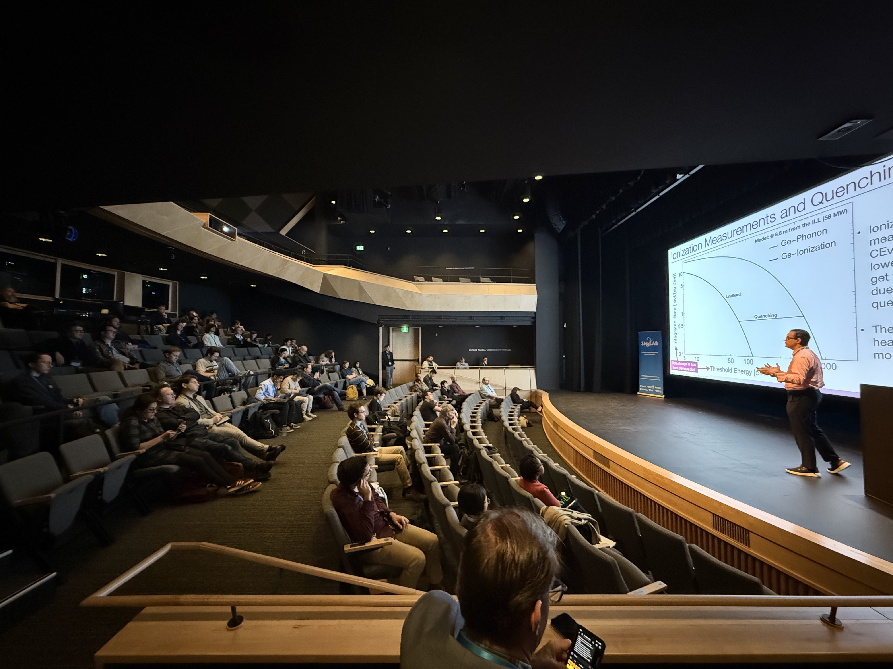
NNN25-Sudbury
Excellent and highly successful workshop
High quality presentations and major progresses reported
  Many presentations by the people from local and nearby regions
Wonderful and beautiful workshop venue
  Comfortable seats
  State of art facility
    Excellent audio/visual support
    Great projector 😍 🥰
Superb organization and staff support

Slide 7
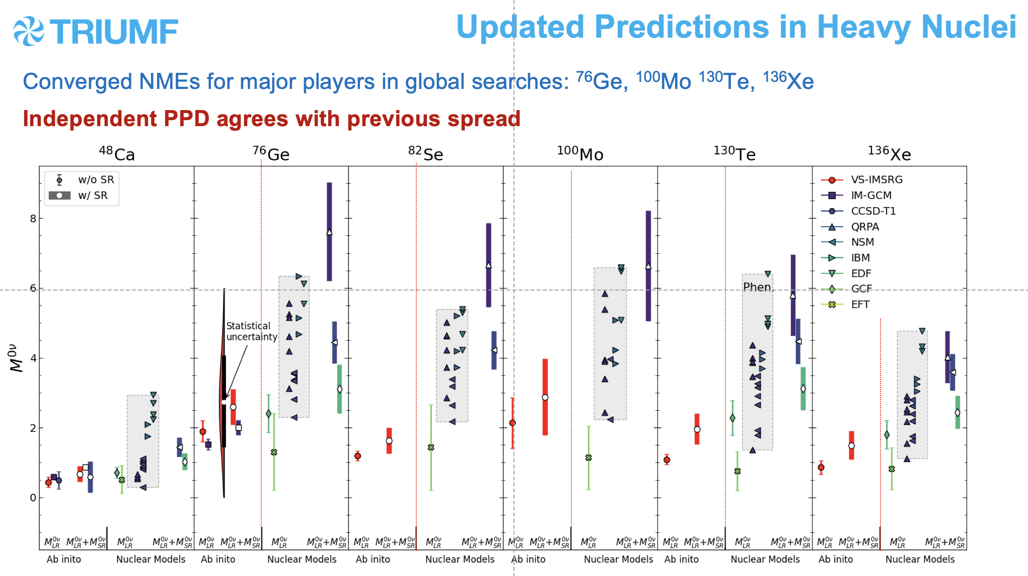
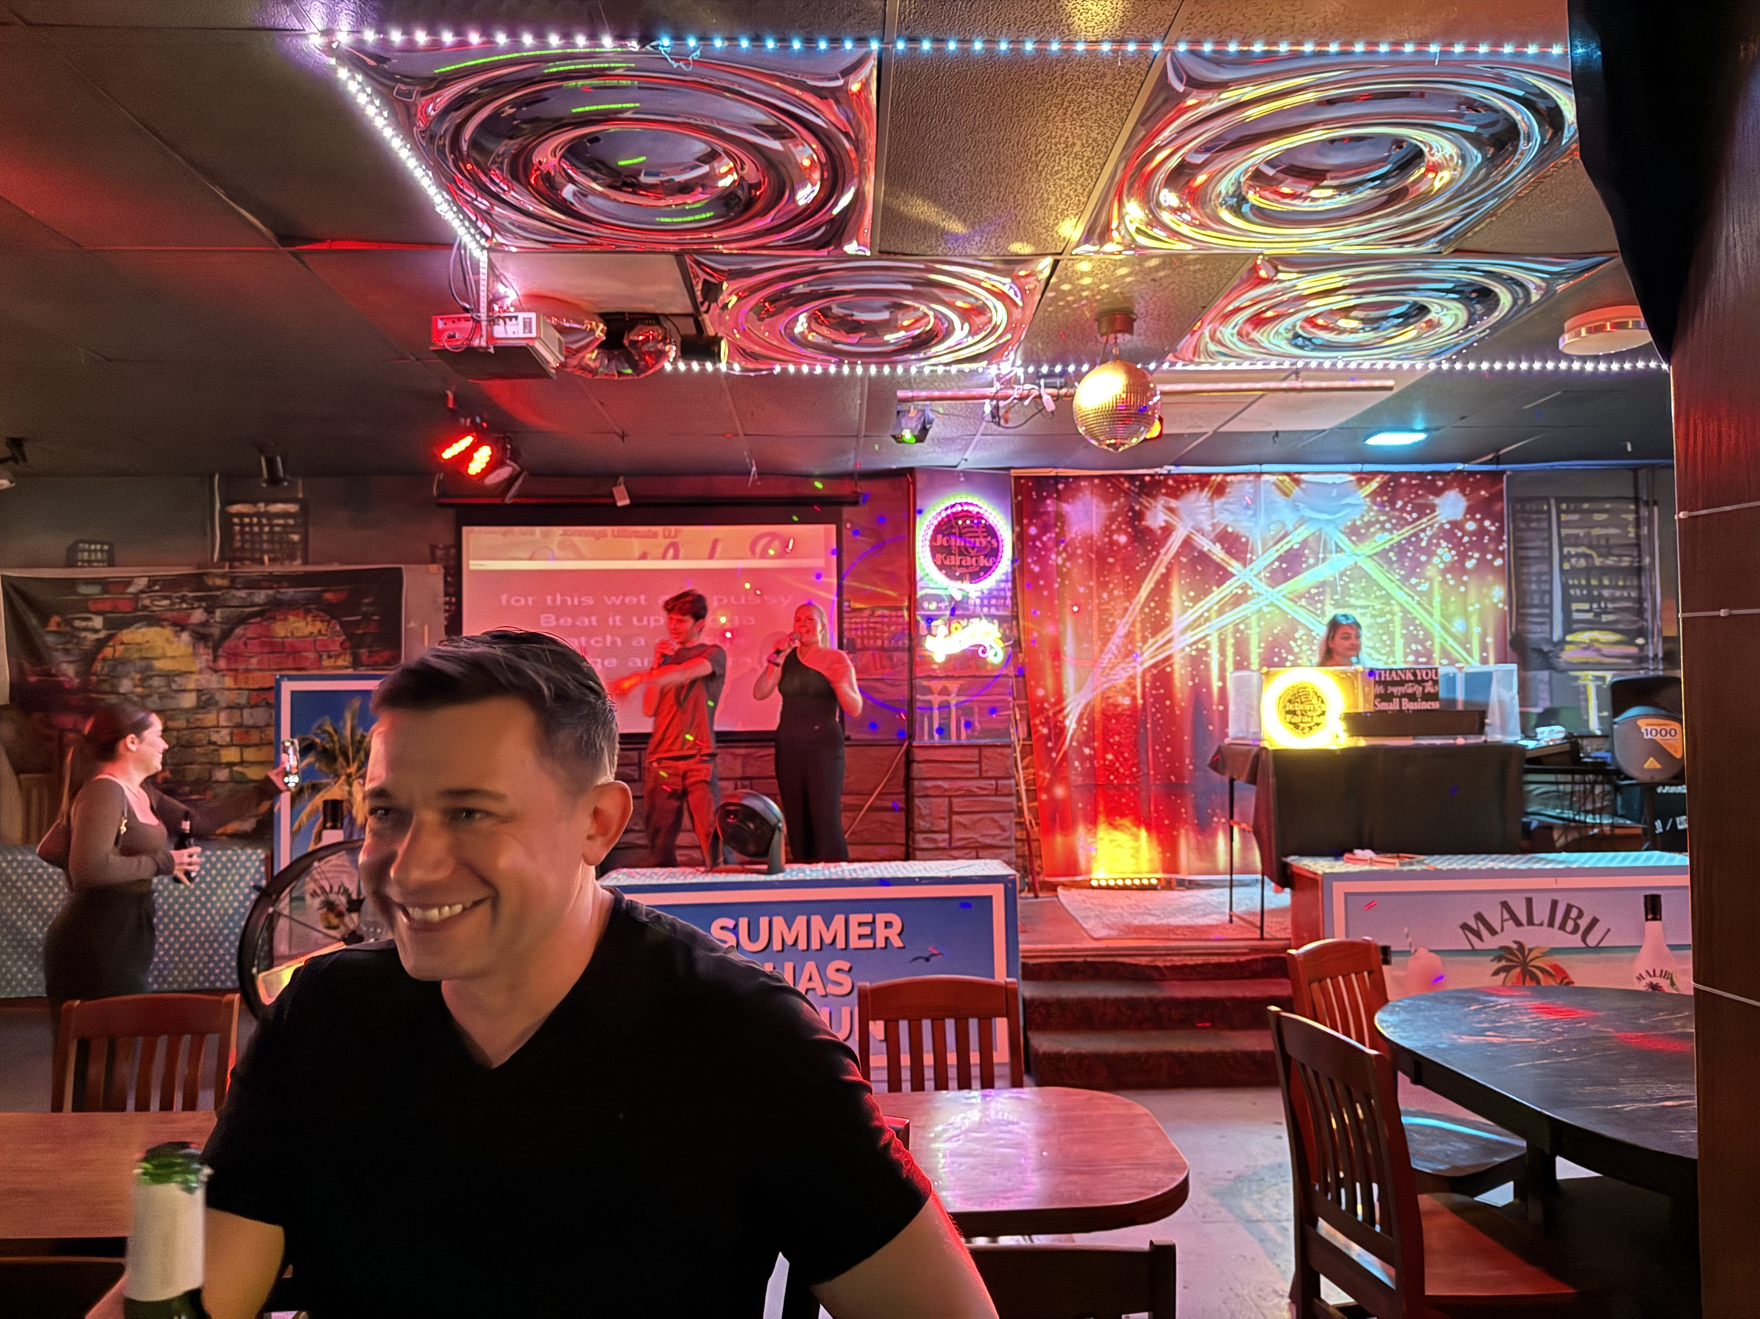
Ab Initio Theory for Neutrinoless Double Beta Decay
Jason Holt, TRIUMF, McGill University
A Stony Brook Ph.D.!

Slide 8
NNN25-Sudbury
Neutrino Social
Tonight (Oct. 3) at ~9 pm
Towne House Tavern, Sudbury
Live music!
Possibly to Little Montreal (karaoke/pool bar) afterwards
Everyone is welcome to join!

Slide 9
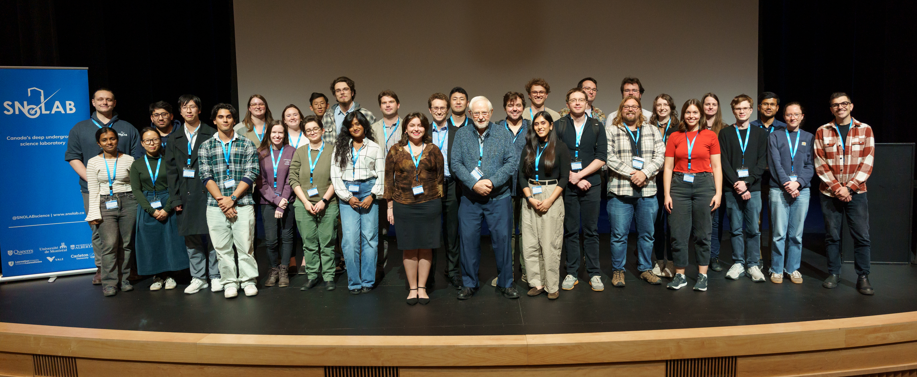
NNN25-Sudbury Workshop Photo
(The Future Leaders)

Slide 10
Many Thanks To:
Local Organizing Committee (Workshop Planning Committee)
Thomas Brunner, McGill University (Co-Chair)
Erica Caden, SNOLAB, Laurentian University, and McGill University (Co-Chair)
Stephen Sekula, SNOLAB and Queen’s U. (Co-Chair)
Erica Caden
Josée Bertrand Houle, SNOLAB
Antonia Botas, SNOLAB
Erica Brunelle, SNOLAB
Juliette Deloye, SNOLAB
Blaire Flynn, SNOLAB
Kipp Grose, SNOLAB
Samantha Kuula, SNOLAB
Emma Larcher, SNOLAB
Sylvie Milks, SNOLAB
Sandra Moskal, SNOLAB
Tony Noble, McDonald Institute
Mehwish Obaid, SNOLAB
Rachel Richardson, SNOLAB
Matthew Stukel, SNOLAB and University of Toronto
Edward Thomas, McDonald Institute
Michael Whitehouse, SNOLAB
Supporting Staff

Slide 11
In addition, many thanks go to the workshop speakers for their excellent presentations, and all participants for their active participation!
We hope to see many of you in future NNN workshops and present your discoveries, breakthroughs and advances!
The NNN Steering Committee is looking forward to NNN26 in Seoul, Korea!

