Slide 1


Slide 2
Opening Remarks from Dr. Jodi Cooley Executive Director of SNOLAB

Slide 3


Slide 4
Opening Remarks from Dr. Chang Kee Jung Chair of the NNN Steering Committee

Slide 5
Remarks from Dr. Stephen Sekula Representing the local organizers

Slide 6


Slide 7
Safety and Comfort

Slide 8
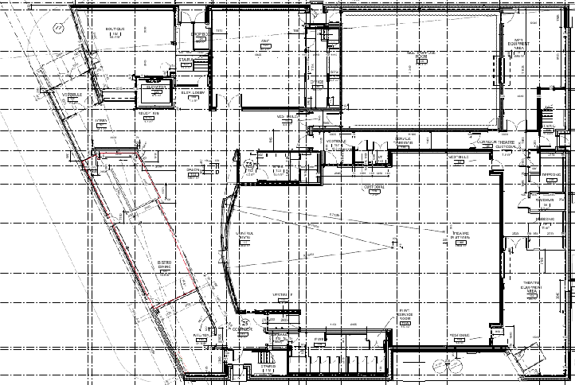


YOU ARE HERE
(GRAND SALLE)

Slide 9





ASSEMBLY AREA (PARKING LOT)
LARCH STREET
EXITS

Slide 10



RESTROOMS
The restrooms at the bottom of the map are universal.
Those near the middle of the map are urinals and a family washroom.

Slide 11


LUNCHES and BREAKS
(STUDIO DESJARDINS)
LUNCHES AND BREAKS
Studio only open for lunch and breaks – for use by caterers only otherwise.

Slide 12
NNN25 Highlights

Slide 13


Slide 14
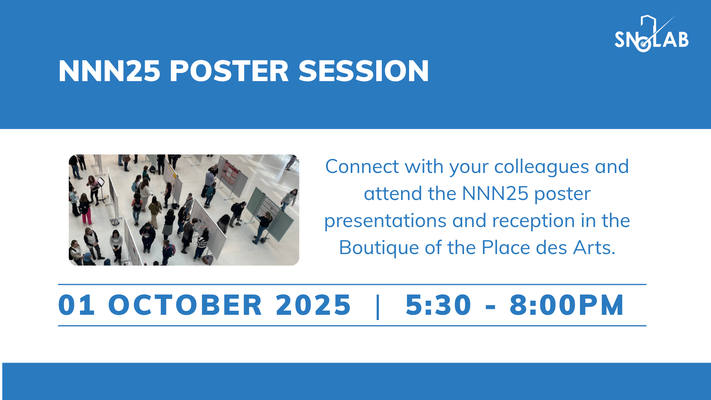

Slide 15


POSTERS
POSTER EVENT AND RECEPTION
Bistro space is available generally for conversations, work outside the Grand Salle, etc.
Reception Food
(Le Bistro)

Slide 16


Slide 17


Slide 18
Safety and Comfort
(one last item)

Slide 19
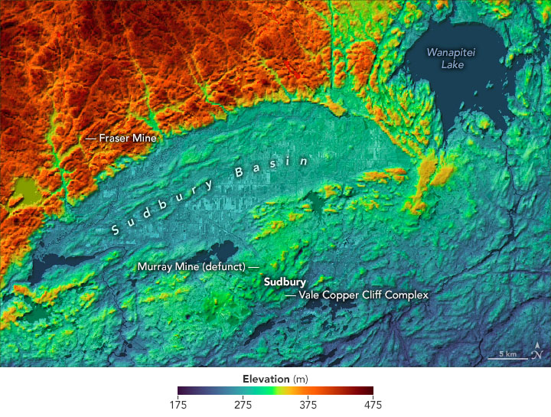
IN THE UNLIKELY EVENT OF A LARGE METEORITE IMPACT…
WELCOME TO SUDBURY!
SNOLAB
YOU MAY FIND YOURSELF IN A WONDERFUL PLACE THAT CAN HOST OUTSTANDING UNDERGROUND LABORATORY FACILITIES.

