Slide 1



The Quest for No Neutrinos: Advancing the Search with LEGEND -1000
Moritz Neuberger (TUM) - ENTENTE, SNOLAB - 30 Sep 2025
On behalf of the LEGEND collaboration
Notes:
ENTENTE, SNOLAB - 31 Sep 2025

Slide 2
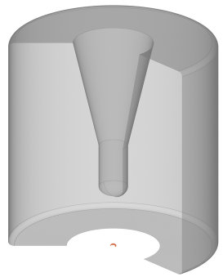
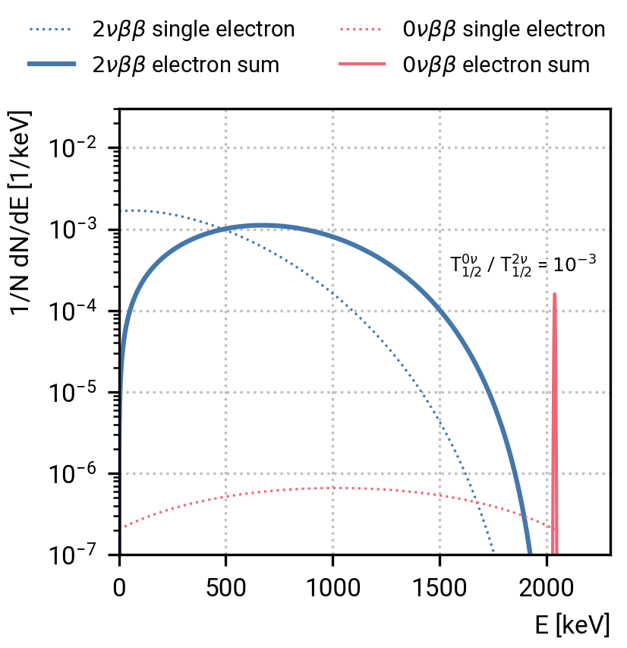
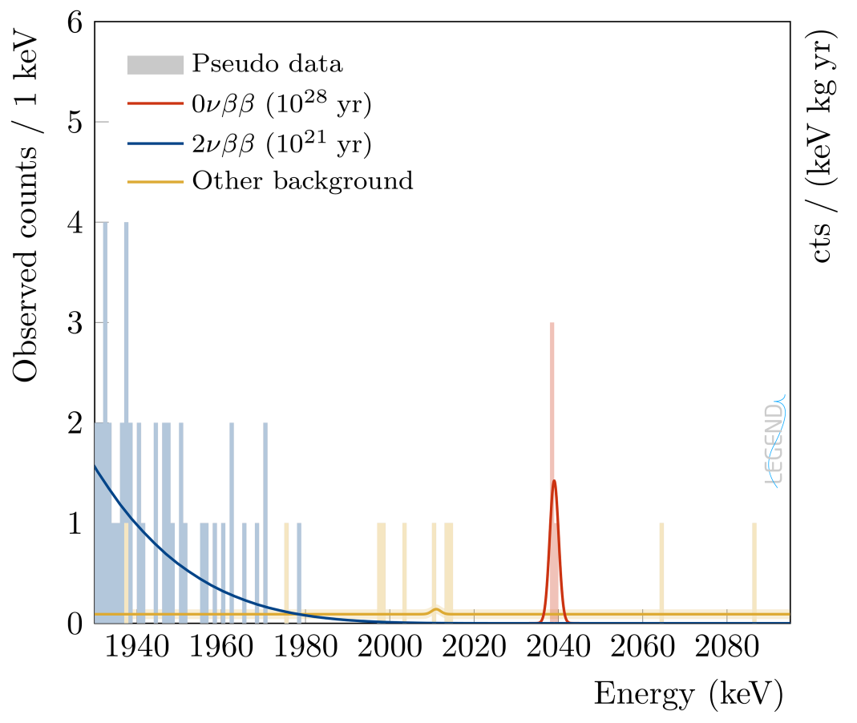





Search for 0𝜈ββ in ⁷⁶Ge enriched HPGe
High Purity Germanium (HPGe) detectors enriched in ⁷⁶Ge
source = detector → high efficiency
pure → negligible intrinsic background
Ge crystal → very good energy resolution (0.1% @ Q_{ββ})
pulse-shape discrimination
ββ
e⁻
h
Expected signal and background signature
Background is approximately flat near Q_{ββ}.
with E the exposure, DeltaE the resolution, and BI the background index in .
Q_{ββ} = 2039 keV
with background
when quasi background free
[10.48550/arXiv.2107.11462]
Notes:
the background index in cts/(keV kg yr),
the resolution at Q_{ββ} and the exposure.
- experimental signal (summation of electron energy)
- how background is quantified
- energy resolution optimal O(0.1%)
- low background contamination (high purity of material, GERDA limit on radiogenic contamination)
- high efficiency (source = detector)

Slide 3
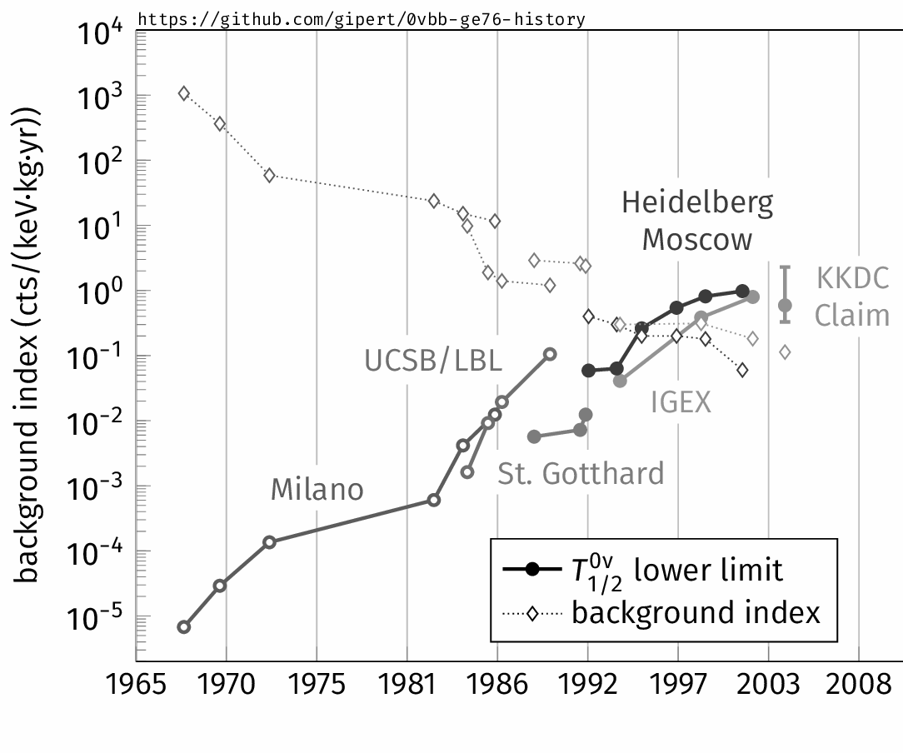
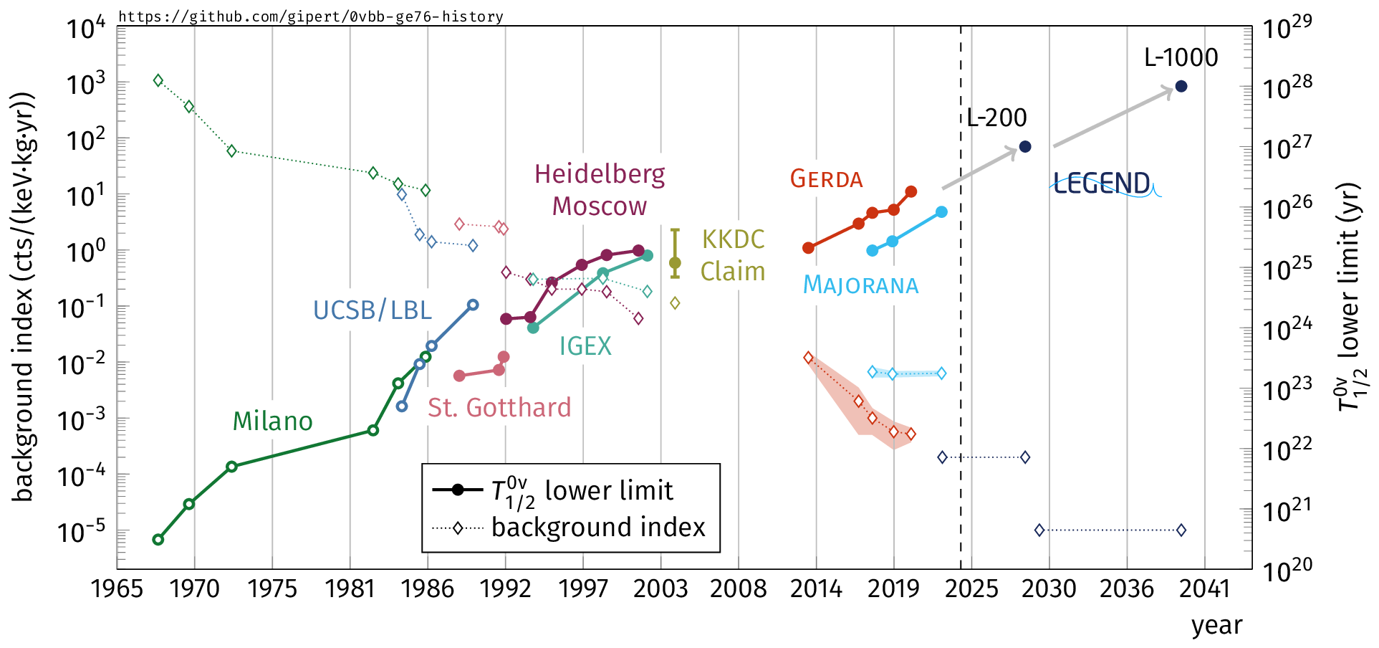

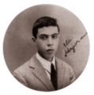
The History of ⁷⁶Ge based 0𝜈ββ Search
GERDA (127.3 kg yr)
Had the best BI:
5 × 10⁻⁴ cts/(keV kg yr)
Used both PSD and LAr anti-coincidence.
Majorana Demonstrator
(64.5 kg yr)
Had the best energy resolution:
2.5 keV @ Q_{ββ}
Used PSD to reduce BI.

Slide 4
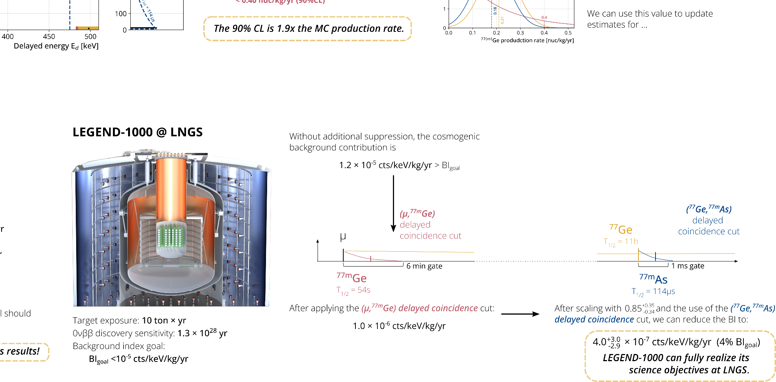
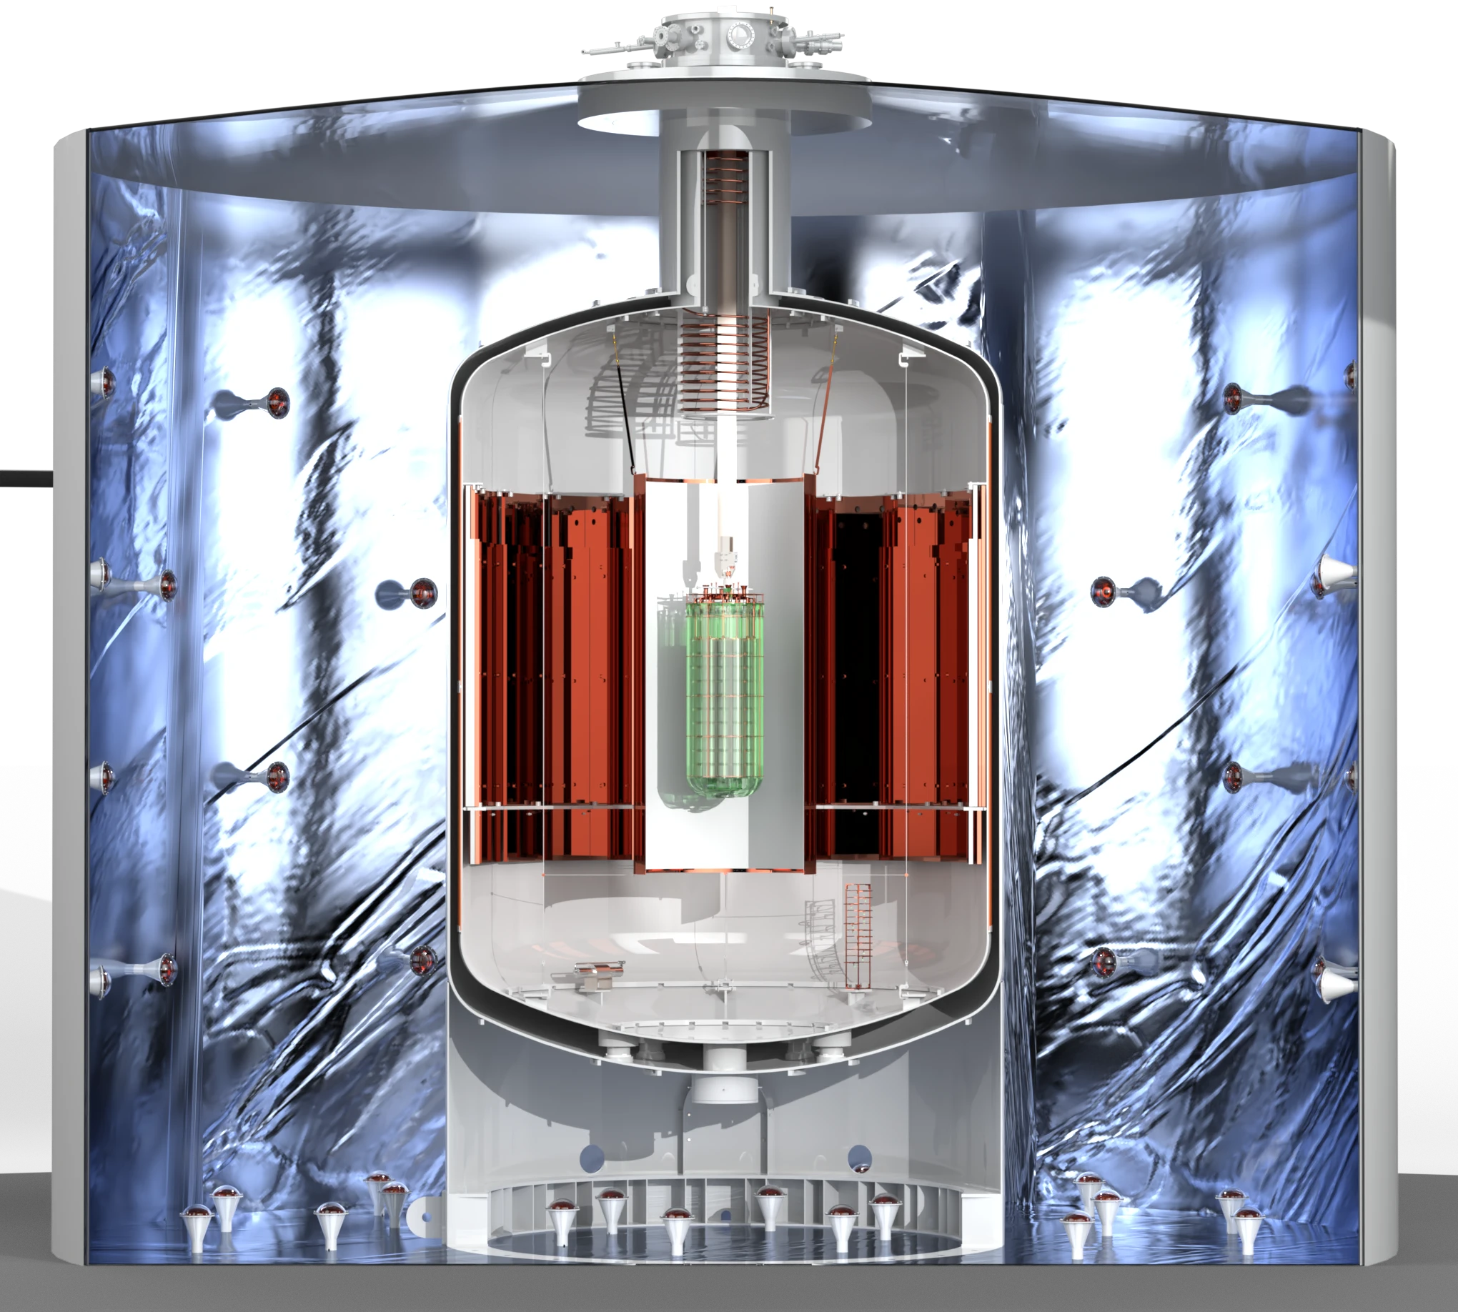
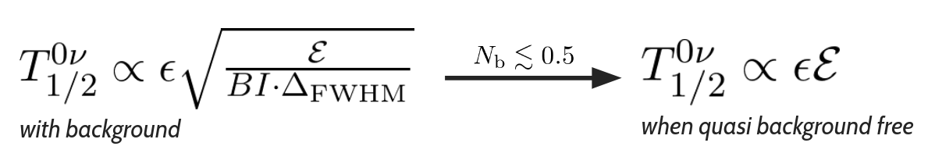
The Future of ⁷⁶Ge based 0𝜈ββ Search
LEGEND-200
LEGEND-1000
10x
target exposure | 1 ton yr | 10 ton yr
resolution in FWHM | ~2.5 keV
background [cts/(keV kg yr)] | 2 x 10⁻⁴ | 10⁻⁵
5 × 10⁻⁴ cts/(keV kg yr)
0.05x
2 × 10⁻⁴ cts/(keV kg yr)
10⁻⁵ cts/(keV kg yr)
Reminder:

Slide 5
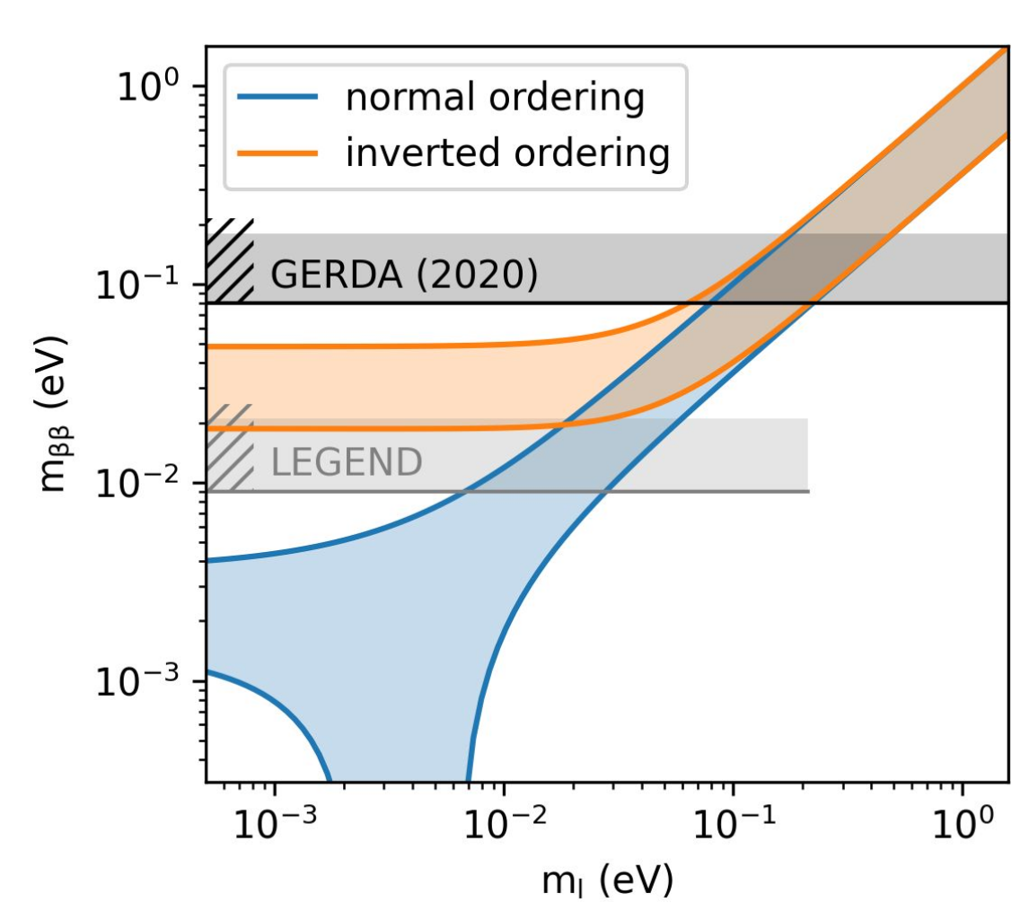
The Future of ⁷⁶Ge based 0𝜈ββ Search
LEGEND-200
LEGEND-1000
[9-24] meV
@T_{1/2} = 10²⁸yr
10x
target exposure | 1 ton yr | 10 ton yr
resolution in FWHM | ~2.5 keV
background [cts/(keV kg yr)] | 2 x 10⁻⁴ | 10⁻⁵
5 × 10⁻⁴ cts/(keV kg yr)
0.05x
2 × 10⁻⁴ cts/(keV kg yr)
10⁻⁵ cts/(keV kg yr)
Reminder:

Slide 6
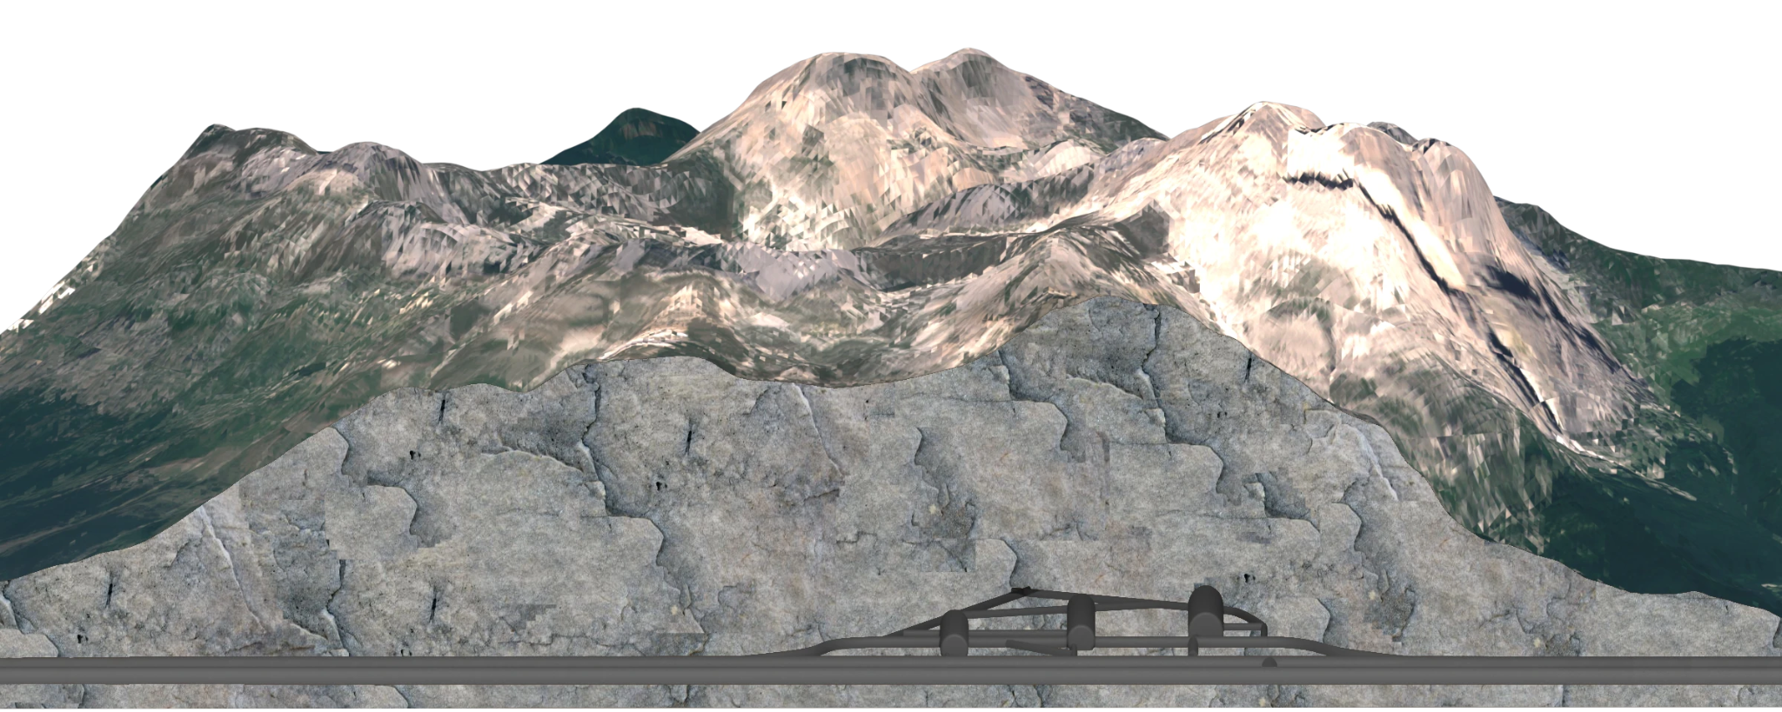
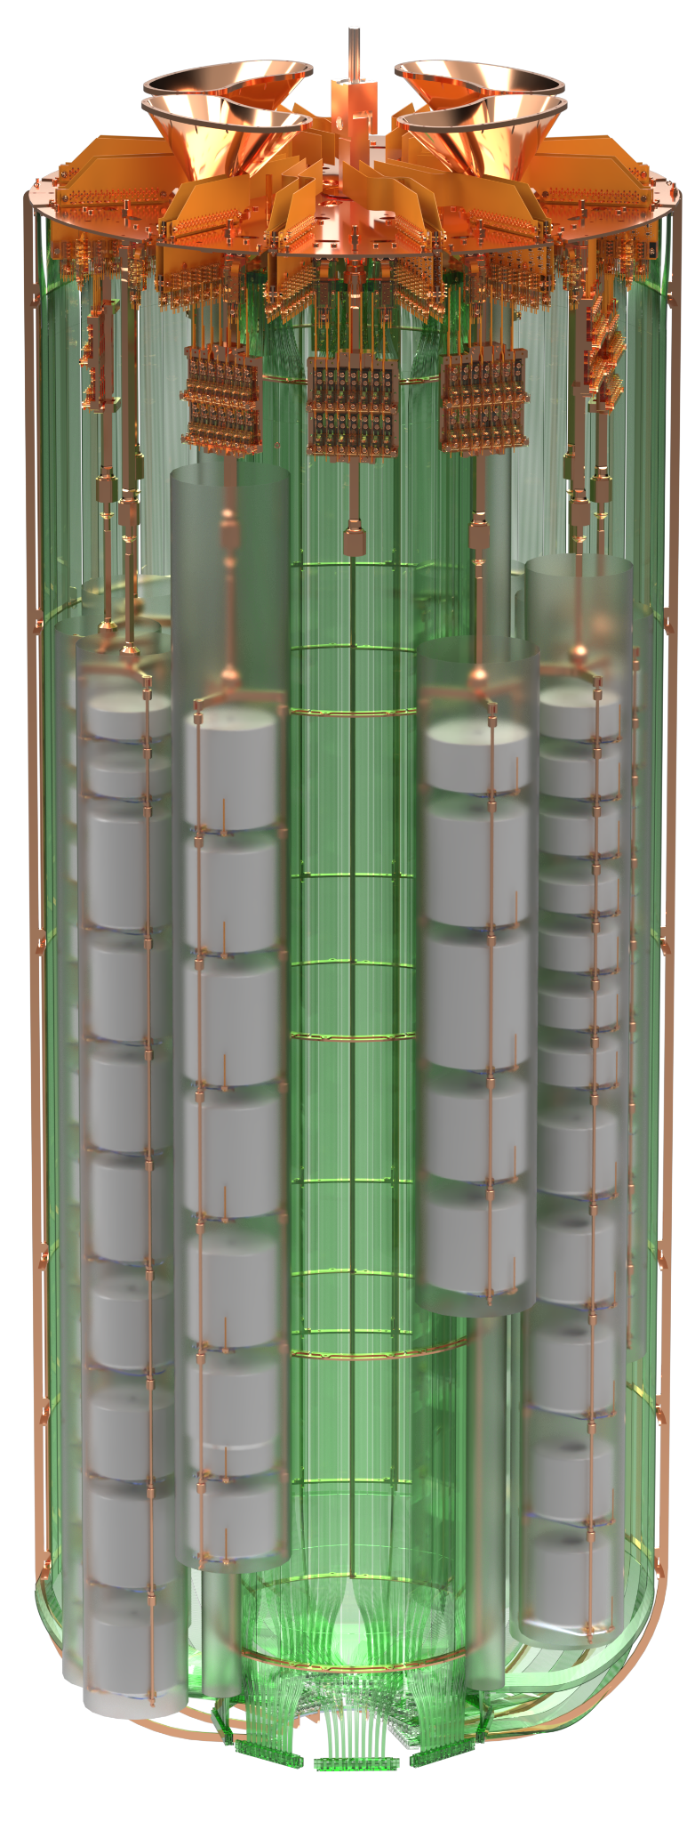
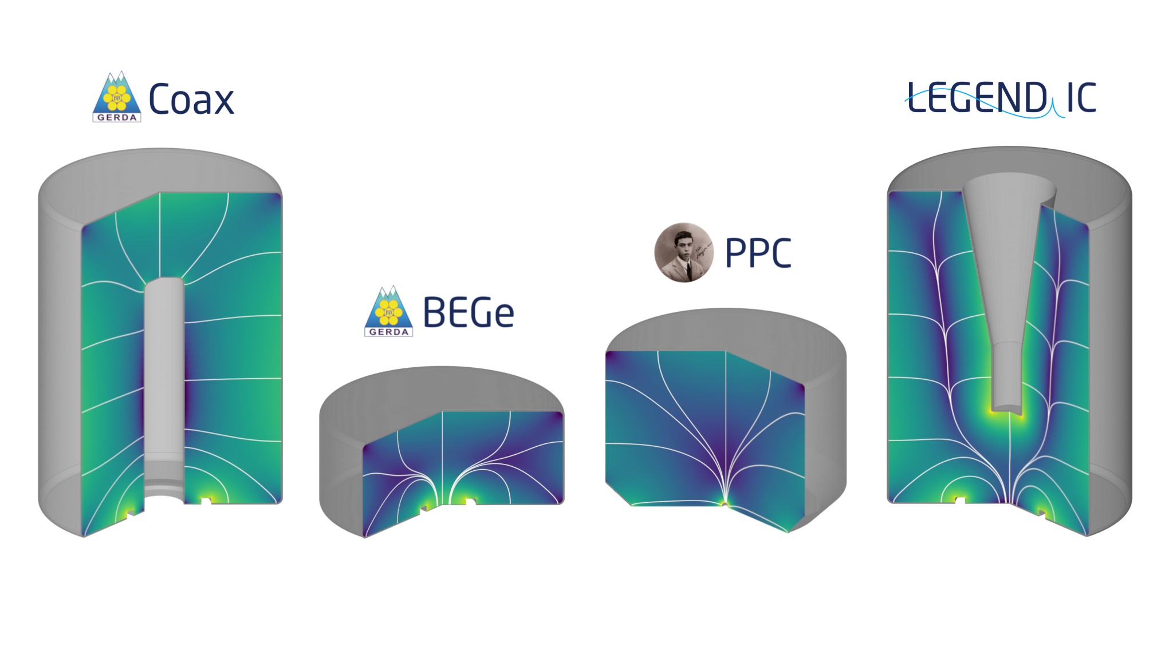
LEGEND -200: Setup and Status
@LNGS Hall A
SiPM
Last operation (2023-2024):
instrumented water tank for muon veto
fiber “curtain”
14.7 kg | 19.0 kg | 22.1 kg | 86.7 kg
liquid argon cryostat
142 kg of 86%-92% enriched HPGe installed
SiPM
LAr instrumented around HPGe
More information on this in Andreas Leonhardt’s talk on Friday!
Notes:
Quick mention of the most recent limit

Slide 7
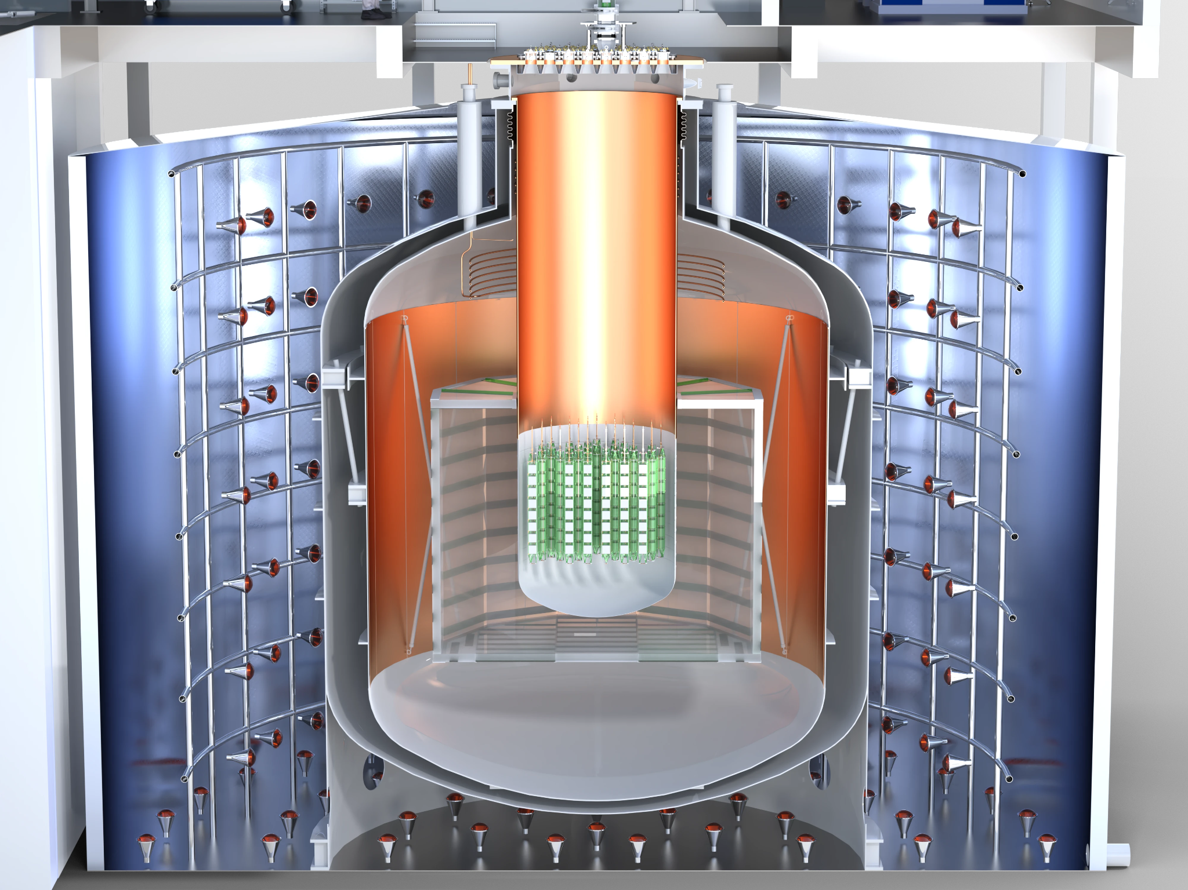
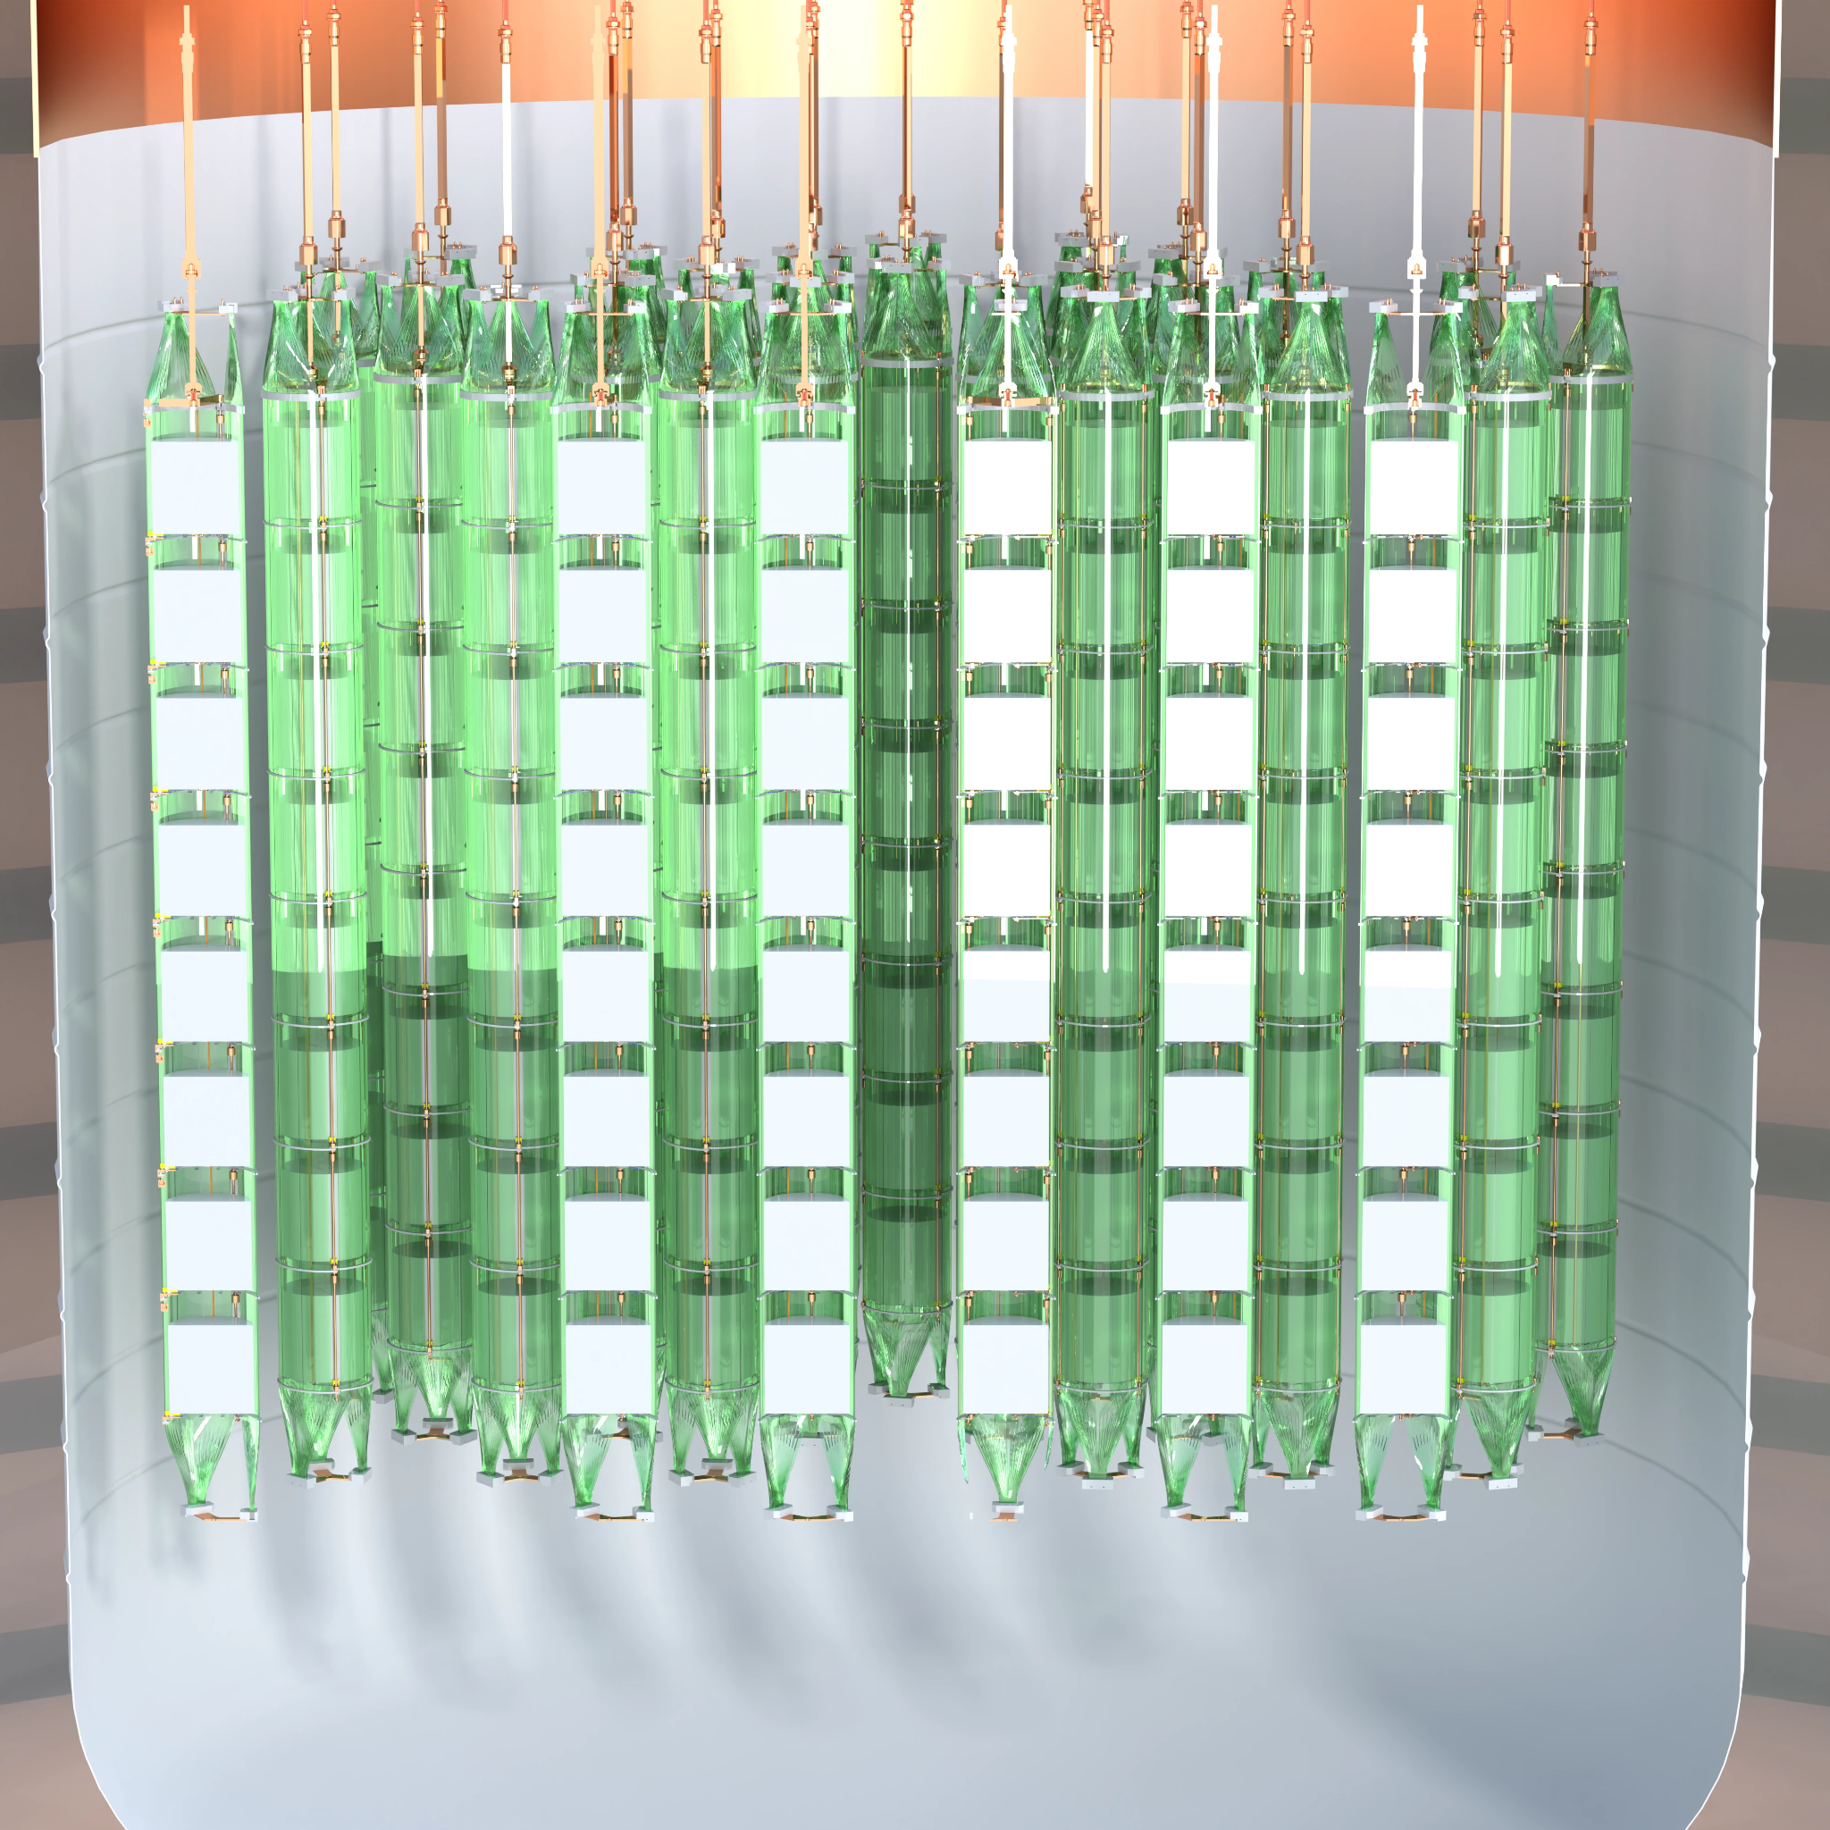
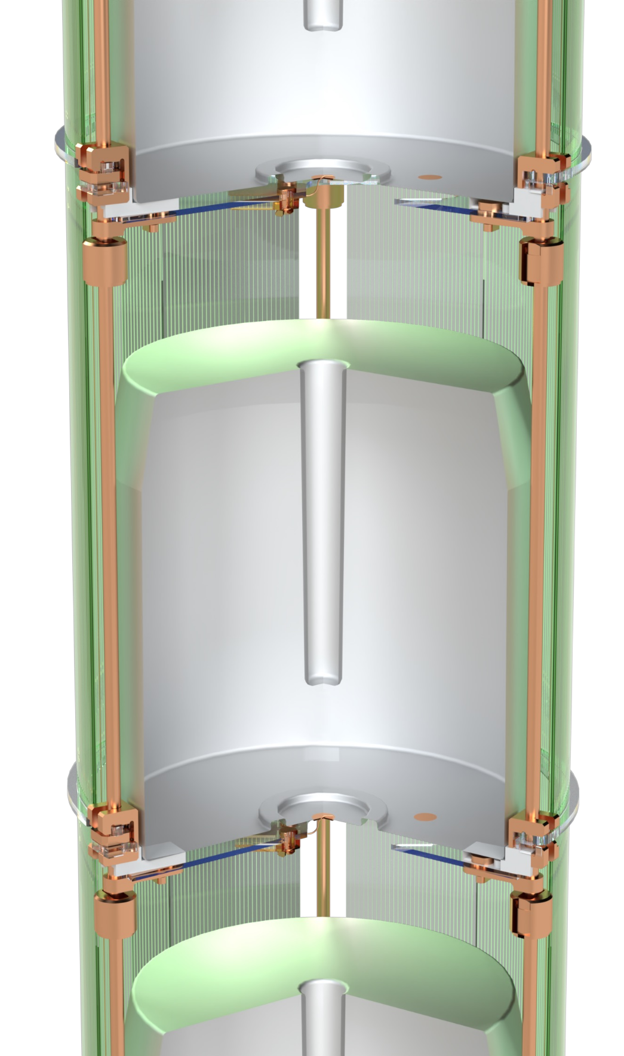
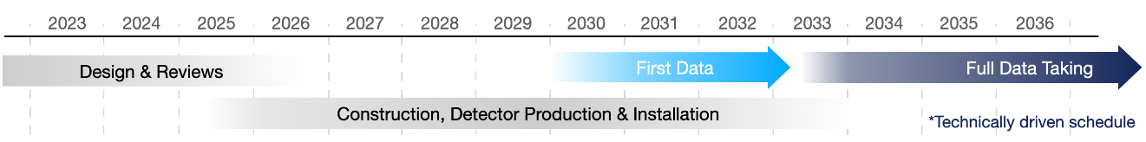
LEGEND -1000 @ LNGS Hall C
IC detectors
underground argon in re-entrant vessle
1000 kg of IC HPGe detectors
string modules
neutron moderator
atmospheric argon

Slide 8
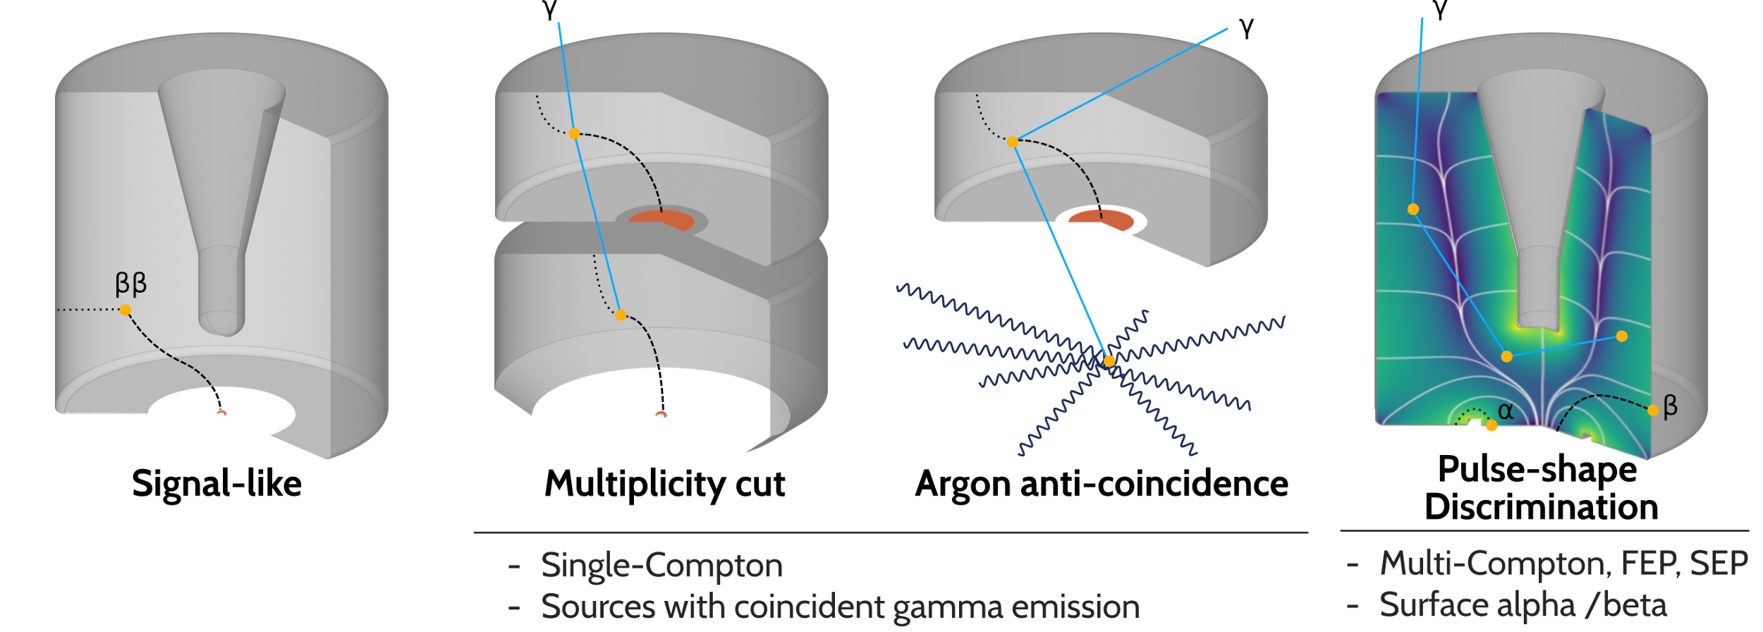
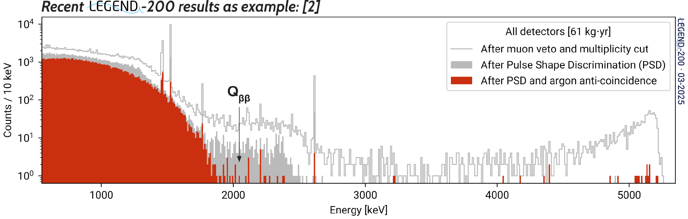
Background Suppression Techniques in LEGEND
a.k.a. standard cuts:
Recent LEGEND-200 results:
[10.1103/25tk-nctn]

Slide 9
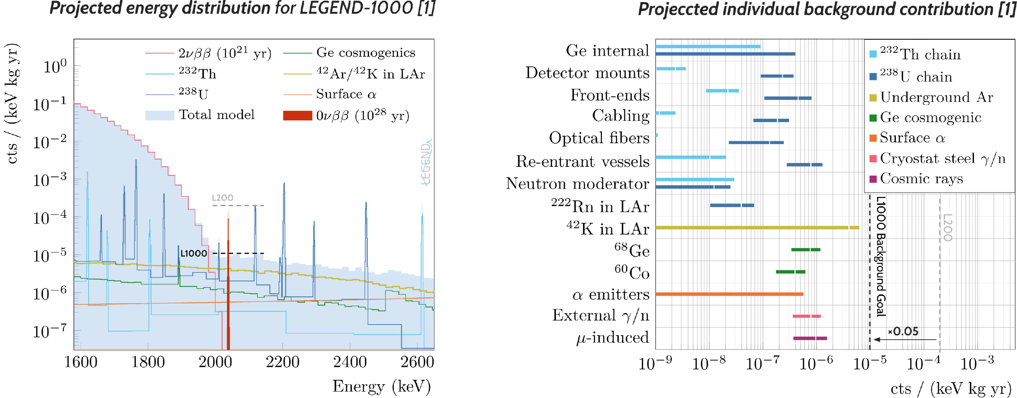
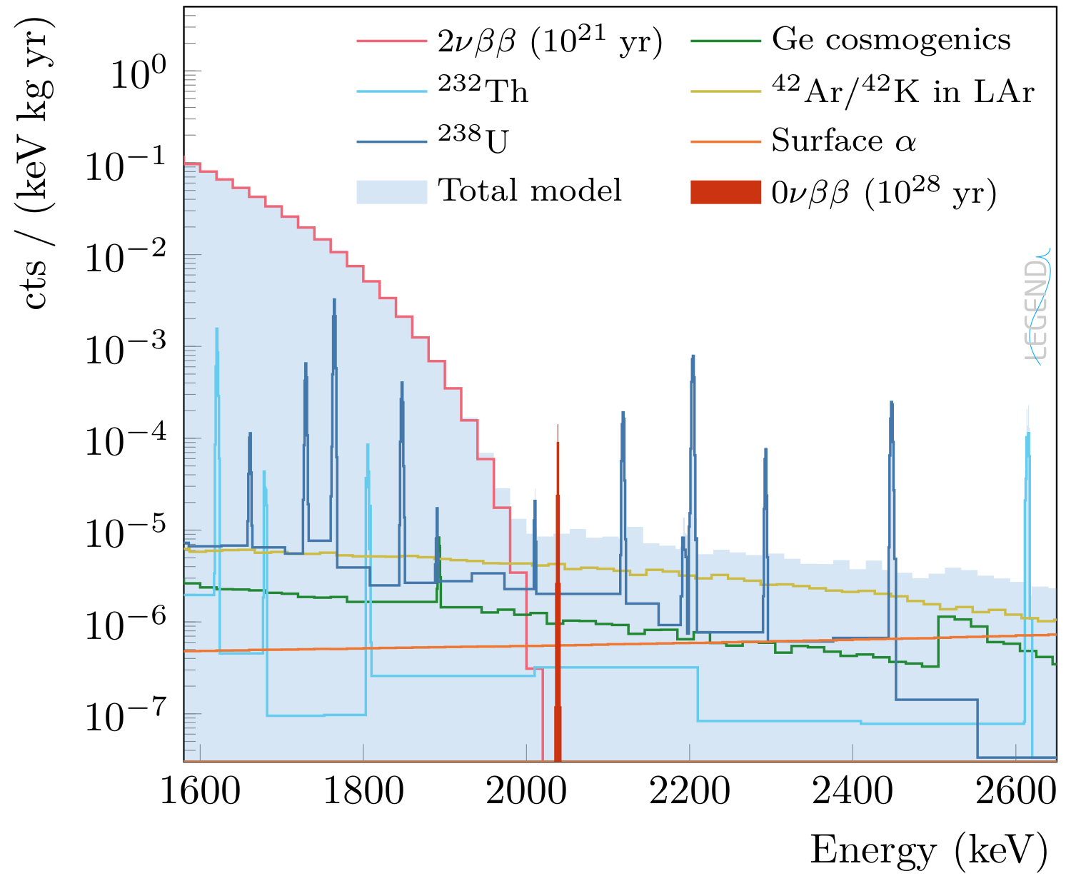
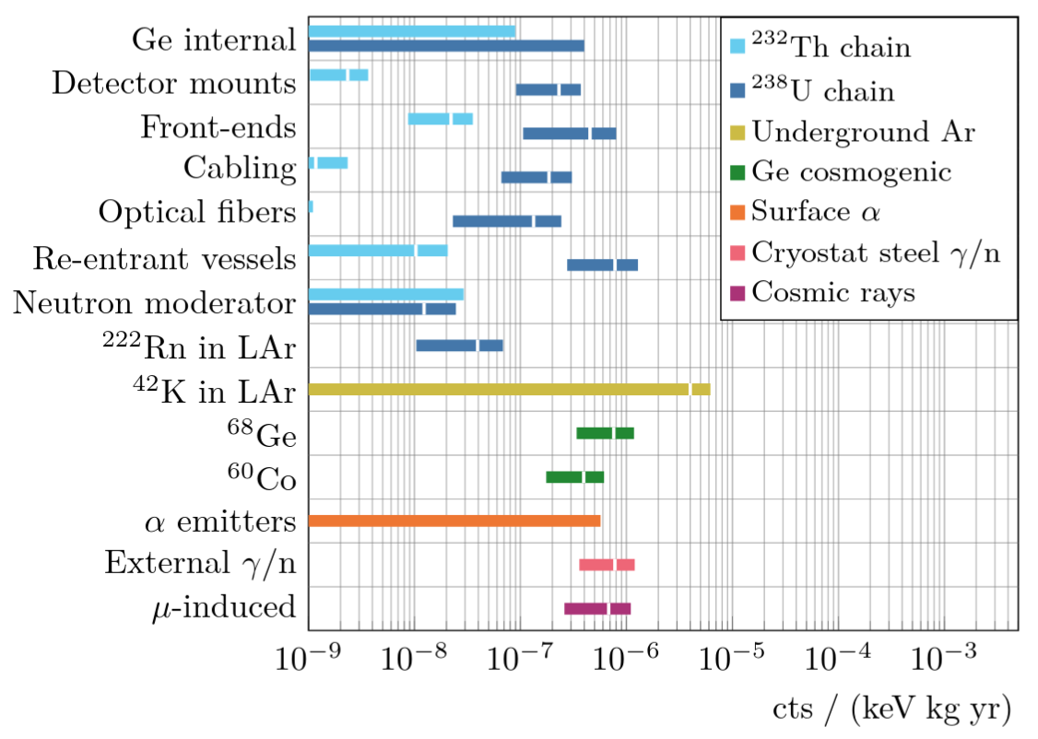
Background Budget for LEGEND-1000
Projected energy distribution for LEGEND-1000:
Projected individual background contributions:
L200
L1000
L1000 Background Goal
L200
×0.05
Notes:
plan have overfew of
radiogenic background
K42 background
Detailed on cosmogenic background

Slide 10
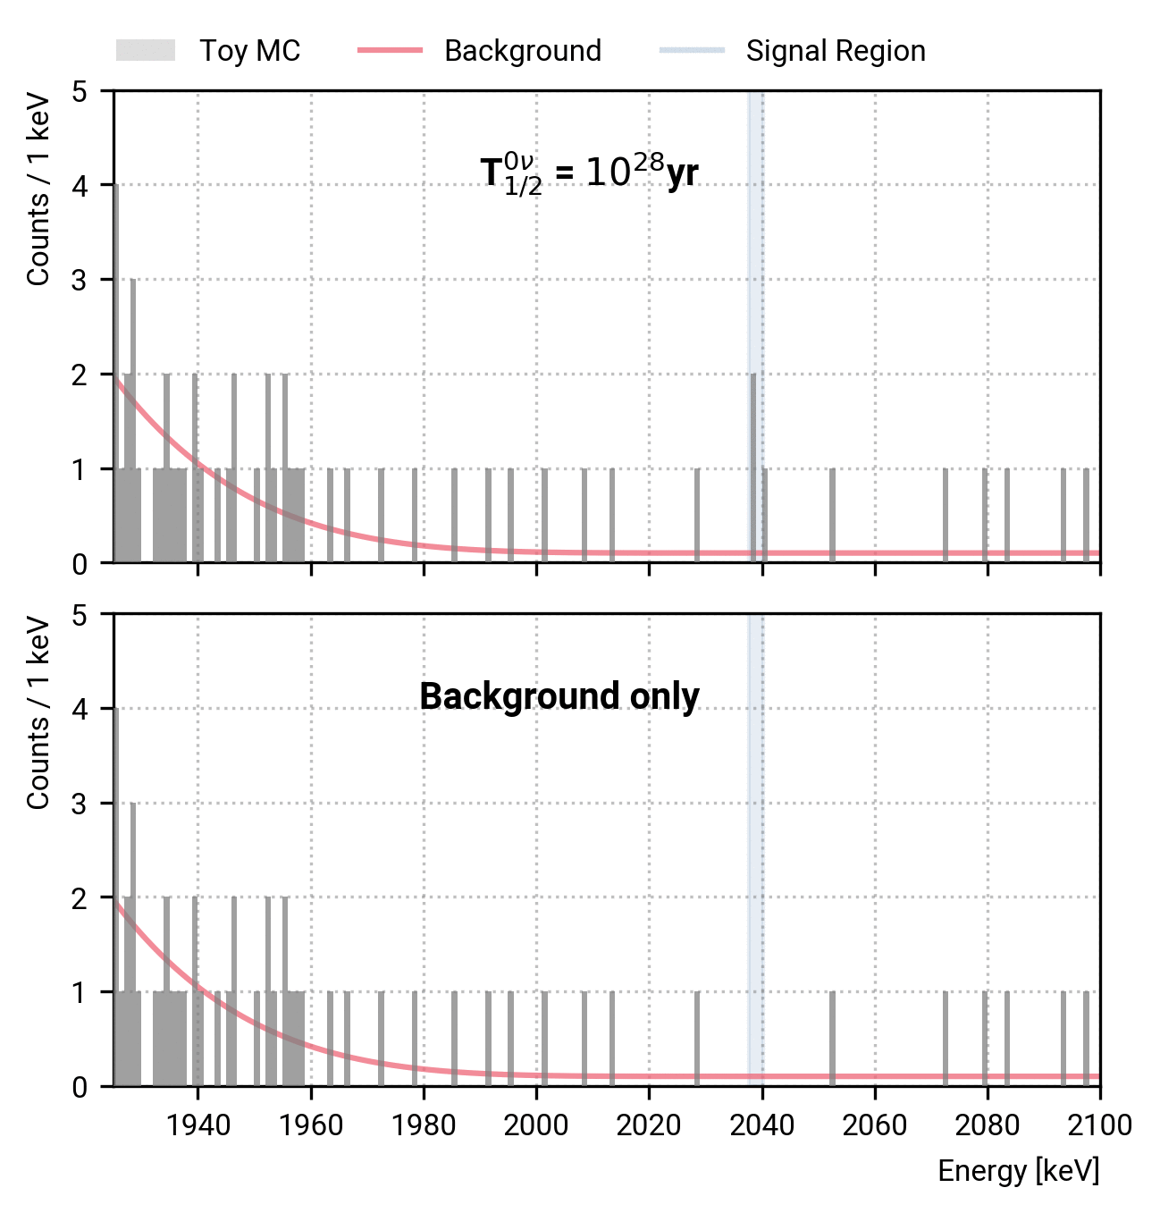
Background Budget for LEGEND-1000
Different Monte-Carlo realizations
radiogenic
We need a low background to achieve an unambiguous discovery of 0νββ decay with just a handful of counts.
Notes:
plan have overfew of
radiogenic background
K42 background
Detailed on cosmogenic background

Slide 11
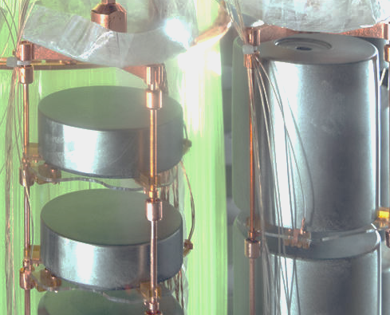
Radiogenic Background - Clean and active material
Clean materials:
Thorough screening to identify final materials (gamma counting, radon emanation and surface screening)
In-house production for high-risks parts: (i.e. close to detectors)
scintillating PEN base-plates
electroformed (EF) copper
More active material: (i.e. sensitive, either HPGe bulk or optically)
larger inverted coaxial (IC) detectors result in larger ratio of bulk (active) to surface (inactive)
less inactive structural material improves LAr rejection
The total expected radiogenic background is:
(2.2±0.8) × 10⁻⁶ cts/(keV kg yr) or ~22% of the total budget
Picture from LEGEND-200
BEGe detectors usually ~0.5 kg
IC detector
usually ~3 kg
EF copper mounting structure
PEN base-plate

Slide 12
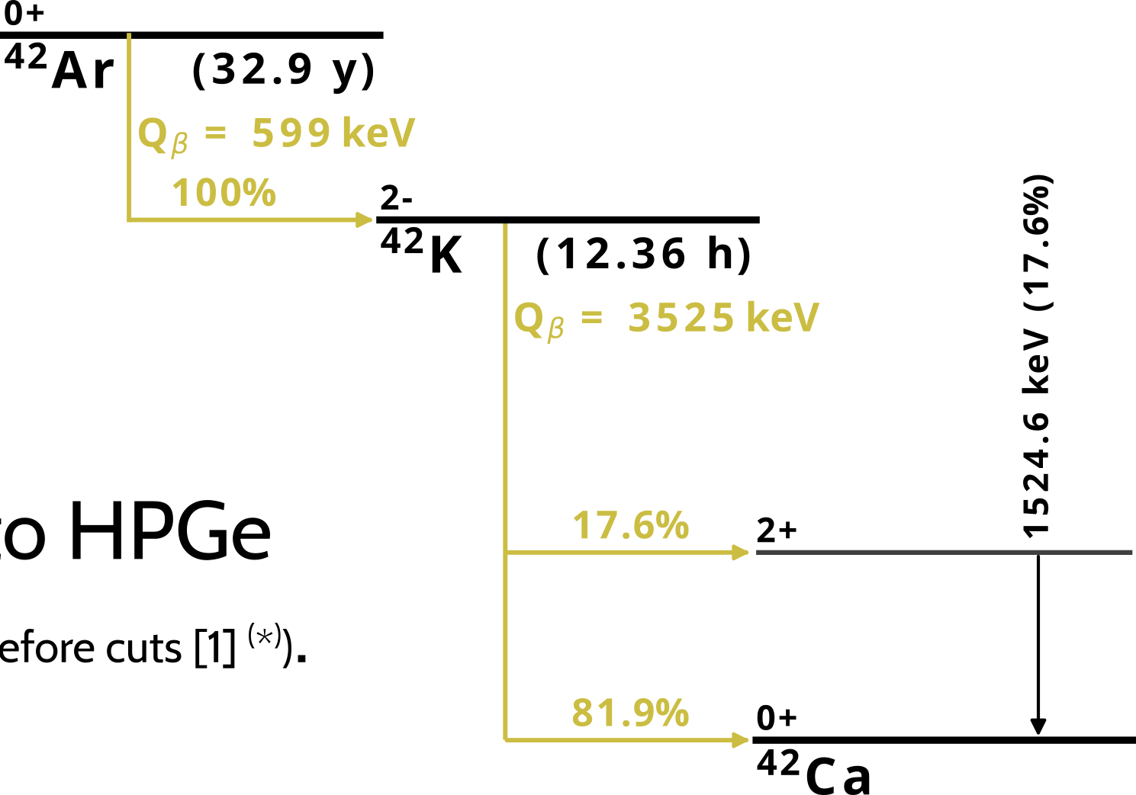
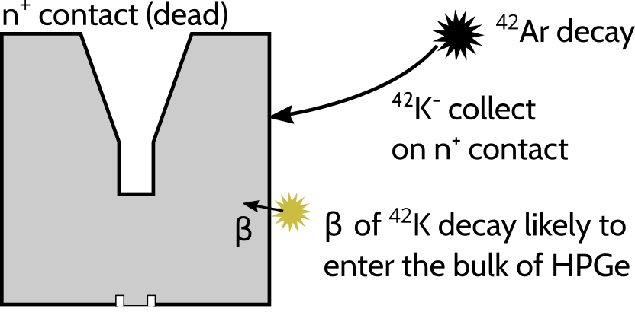
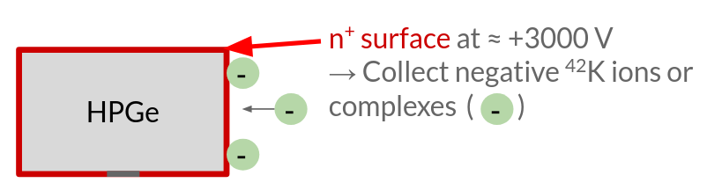
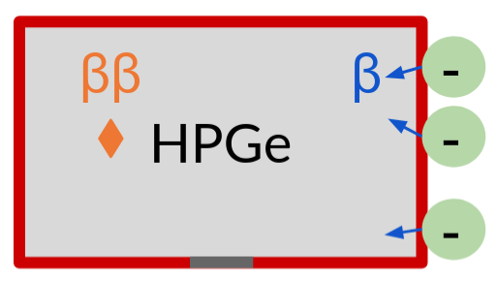
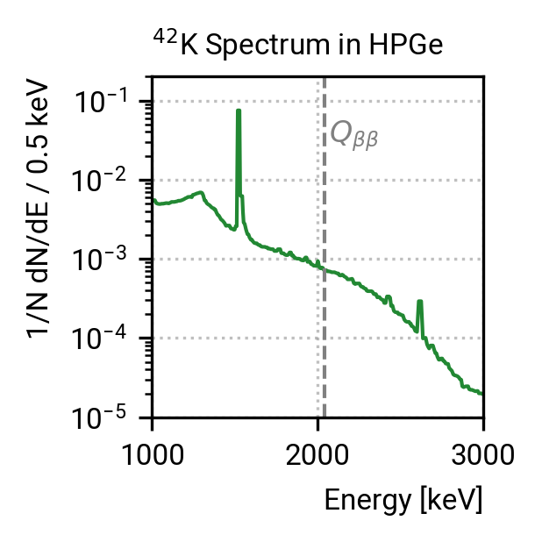
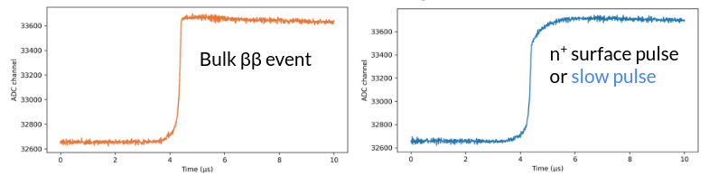
⁴²K background - UnderGround Liquid Argon (UGLAr)
The cosmogenic ⁴²Ar is present in commercial argon. (Atmospheric LAr ~ 40 - 110 mBq/t) [1,2].
After production, ⁴²K is charged, drifts towards HPGe and decays close to HPGe (0.73 cts/(keV kg yr) before cuts) [3].
GERDA/LEGEND-200 solution:
physical barrier to reduce collection volume (however, suppression not sufficient to reach LEGEND-1000 background goal).
LEGEND-1000 solution:
UGLAr from wells depleted in ⁴²Ar (<7×10⁻⁴) [3] , 22 ton
Combined with PSD suppression due to late charges,
the ⁴²K decay survival fraction (SF) is 5.5 x 10⁻⁶
+3000V
_{-4.0}
(4.0^{+2.2} ) × 10⁻⁶ cts/(keV kg yr) or ~40% of the total budget (largest single contributor)
[1] GERDA internal report (2016)
[2] DEAP Collaboration, arXiv:1905.05811 (2019)
[3] N. Abgrall et al. (LEGEND Collaboration), arXiv:2107.11462 (2021)
⁴²Ar (uniform)
⁴²K is a daughter of the cosmogenic ⁴²Ar (T_{1/2} = 33 yr). After its production it can drift to the n⁺ surface of HPGes. βs can pass into the bulk and mimic 0𝜈ββ decay.
AtmLAr: 0.72 cts/(keV kg yr) (before cuts)
UGLAr: reduction of ⁴²Ar by factor <7 × 10⁻⁴ + strong PSD suppression of ⁴²K decays → total survival fraction: SF = 5.5 × 10⁻⁶
The estimated ⁴²K background is:
(4.0^{+2.2} ) × 10⁻⁶ cts/(keV kg yr) or ~40% of the total budget (largest single contributor)
β of ⁴²K decay likely enters HPGe
[10.48550/arXiv.2107.11462]
Re-entrant vessel filled with UGLAr:

Slide 13
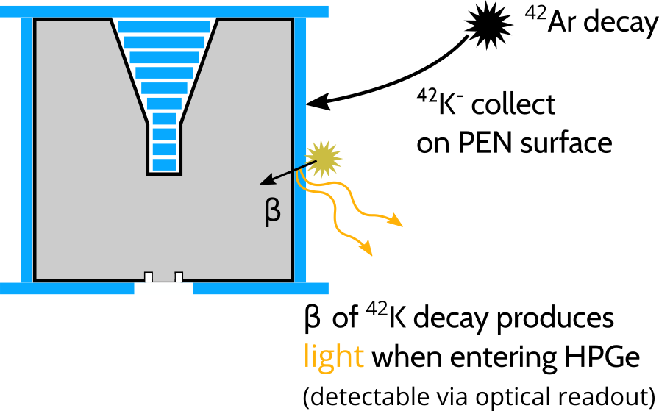
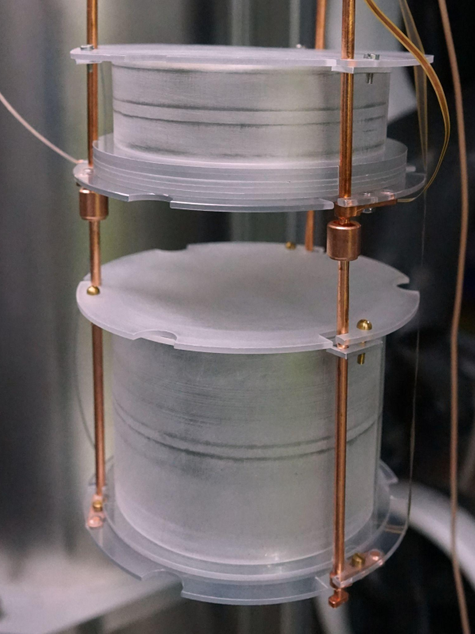
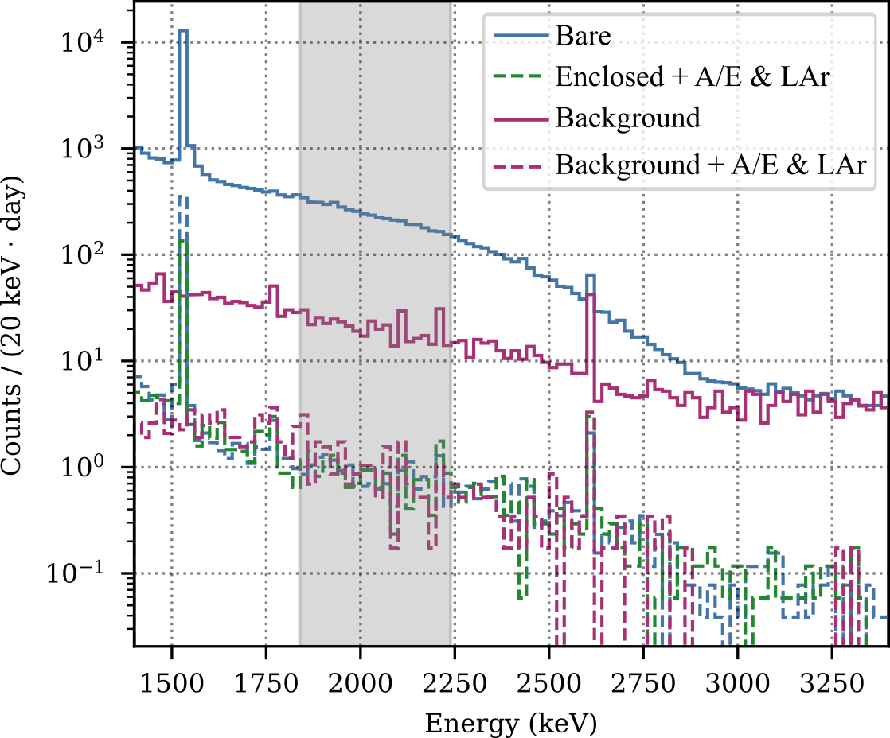
⁴²K background - alternative
PEN Enclosures
Optically Active HPGe detector enclosures e.g. PEN.
LAr test stand doped with ⁴²Ar at found, that with PEN enclosures and background cuts a SF < 1.6× 10⁻⁴ (90% CL) is possible [1].
Future prospects:
more ⁴²Ar to improve sensitivity
optimized geometry for enclosures
specialized PSD based on machine learning
In the test stand:
Resulting energy spectra:
[1] Christoph Vogl et. al., ⁴²K mitigation for LEGEND, TAUP 2025

Slide 14
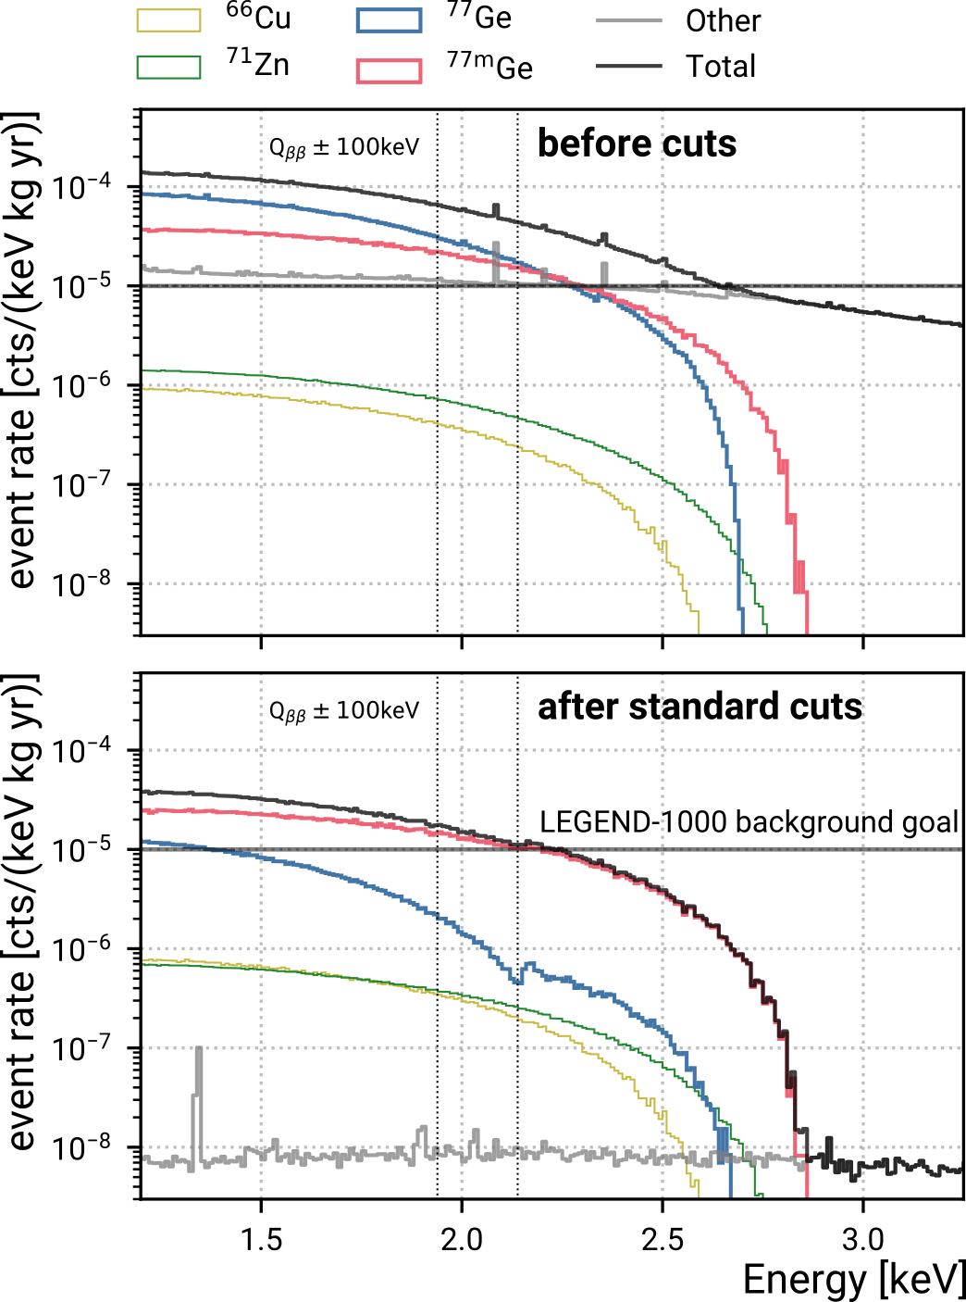
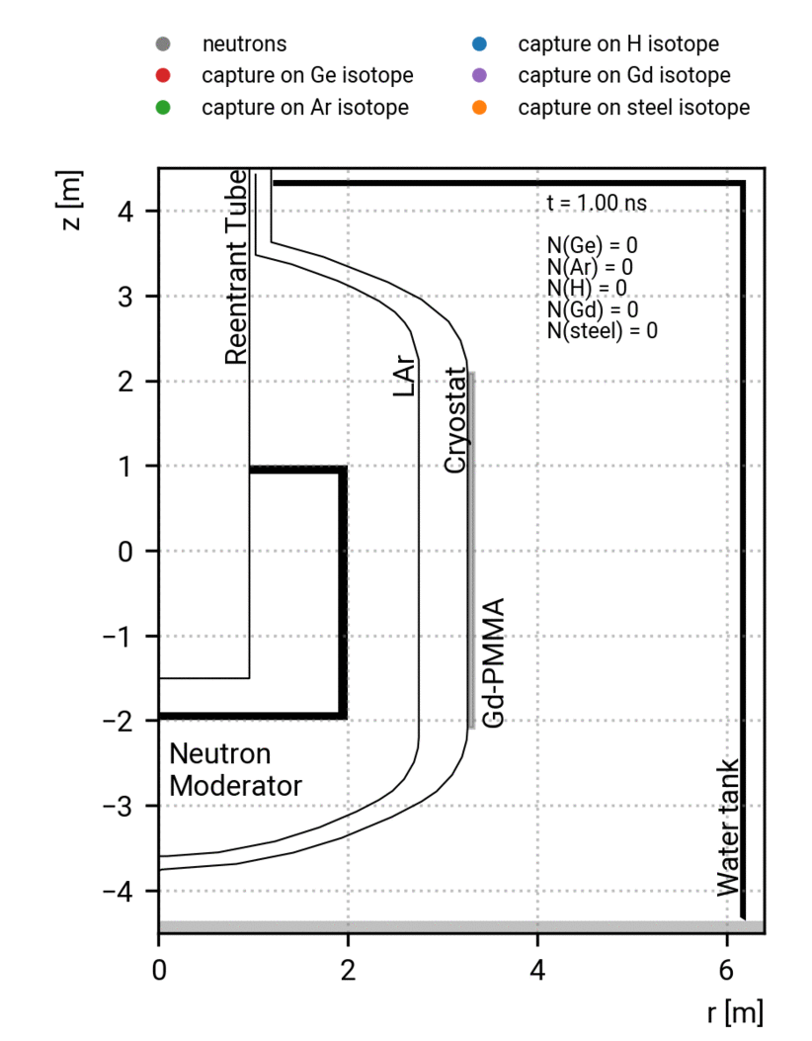
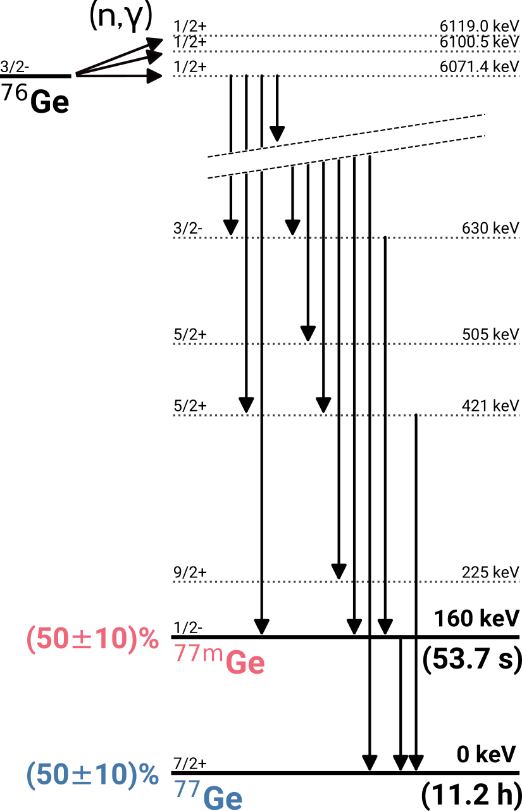
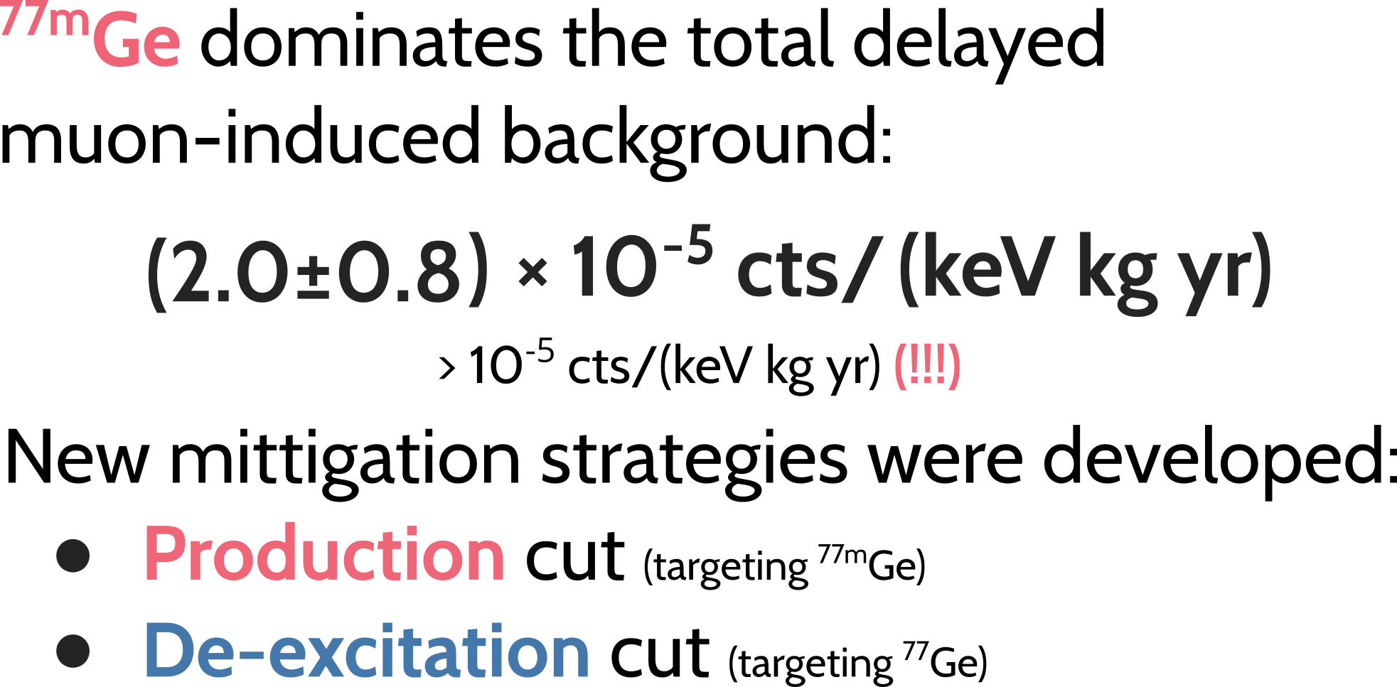
Delayed µ-induced background - ^{77m}Ge dominates
In-situ muon-induced production of isotopes
De-excitation from compound after ⁷⁶Ge(n,γ):
Decay background contribution (after standard cuts)

Slide 15
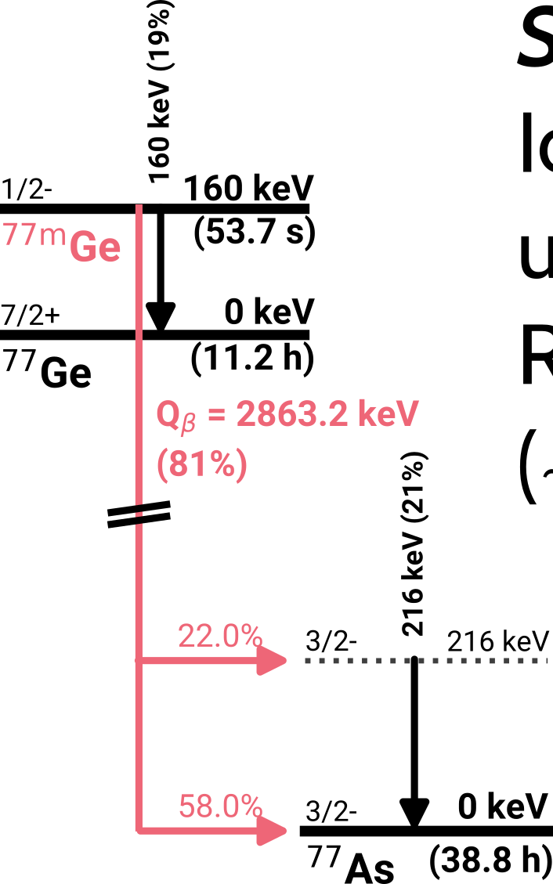
Delayed µ-induced background - Production Cut (for ^{77m}Ge)
Strategy:
Identify the production of ^{77m}Ge using its production topology, then reject 0nββ candidates up to 5τ (~6.5 min) after.
Two tagging strategies:
Direct approach identifying the ⁷⁶Ge(n,γ) cascades
Indirect approach identifying captures of sibling neutrons

Slide 16
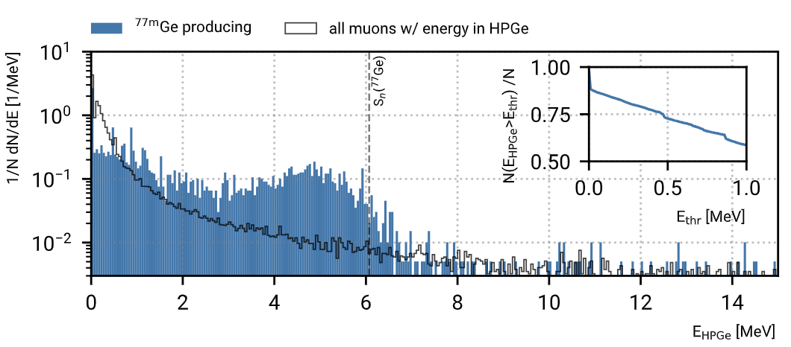
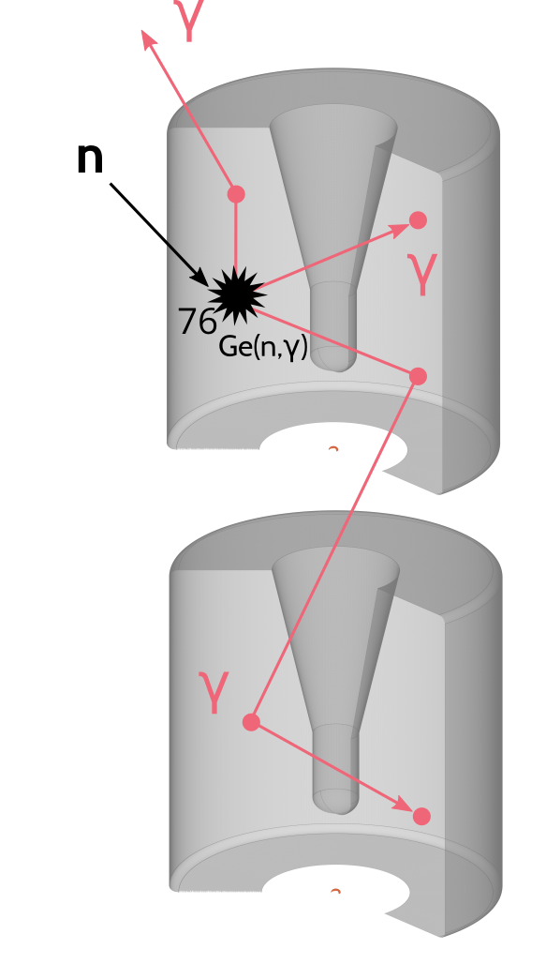
Delayed µ-induced background - Production Cut (for ^{77m}Ge)
1. Direct tagging:
Energy deposited in HPGe in ^{77m}Ge production / all muons
In most ⁷⁶Ge(n,γ) cascades (~80%), an energy of >250 keV is deposited in the containing detector.
If >250 keV is deposited up to 3ms after a muon, tag this HPGe as ^{77m}Ge-producing.

Slide 17
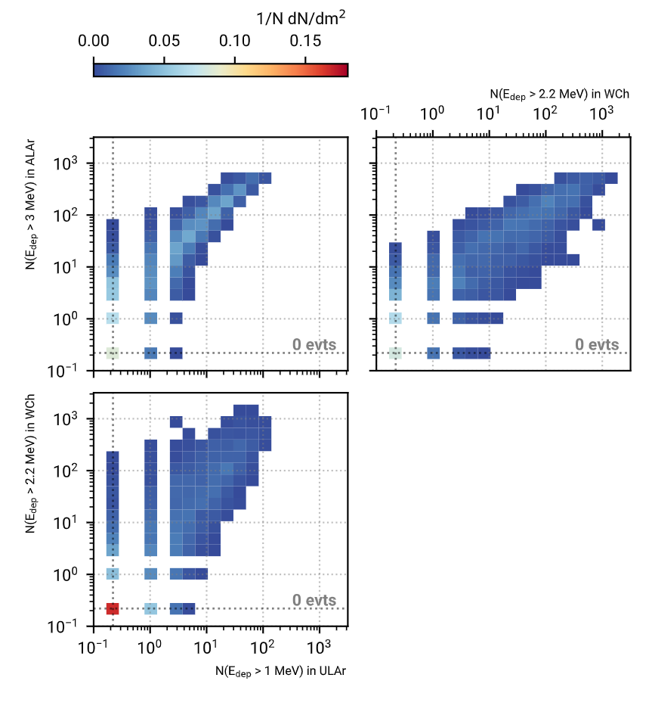
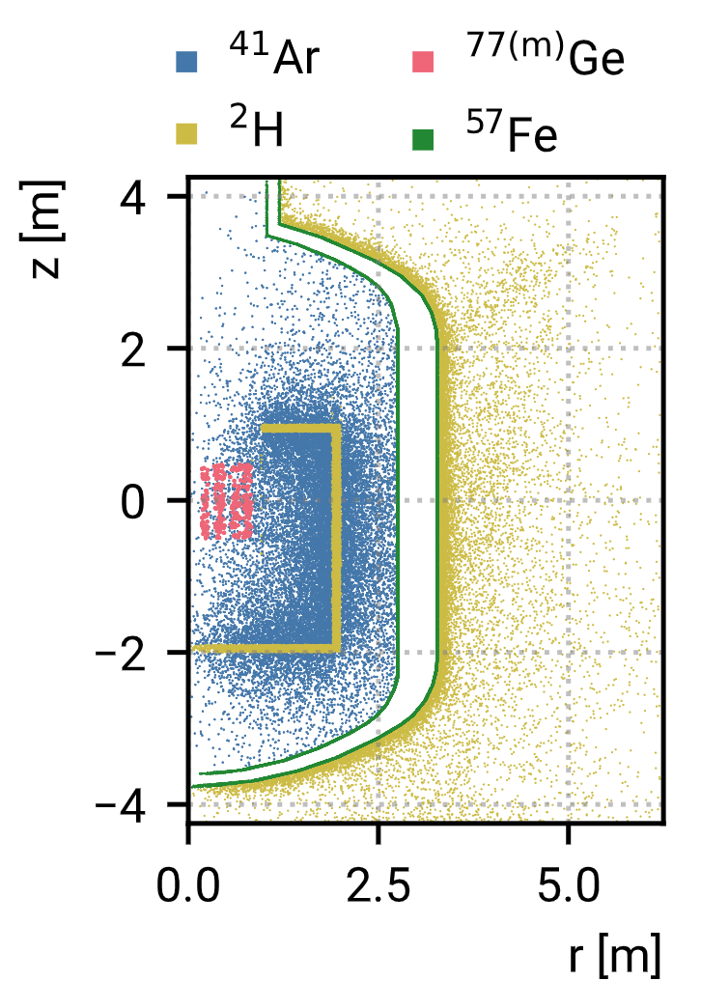
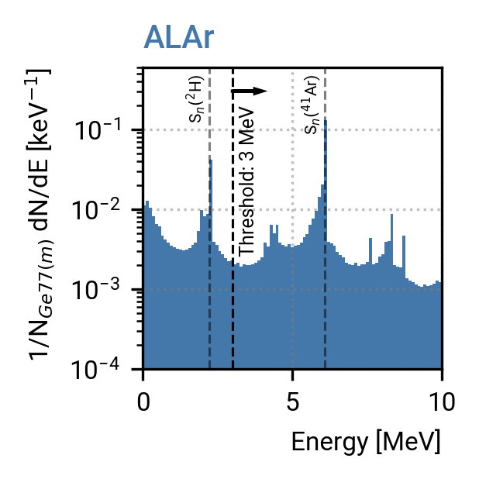
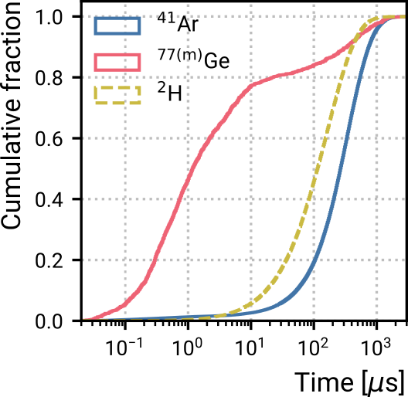
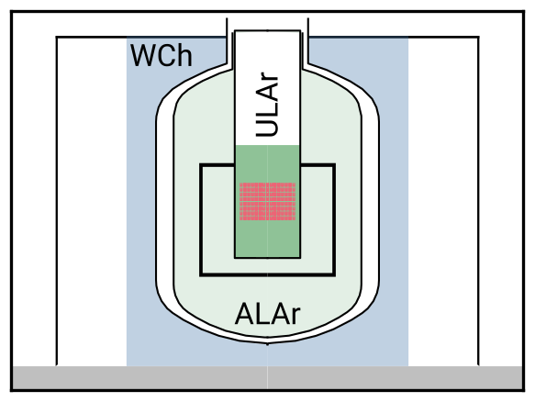
Delayed µ-induced background - Production Cut (for ^{77m}Ge)
2. Indirect tagging:
Production correlates with hadronic muon showers with many neutrons.
Correlation of # detected γ-cascades per muon in sensitive volumes in ^{77m}Ge production:
Count γ-cascades via p.e. thresholds and consider time profile.
Tag µ as ^{77m}Ge-producing when the number of γ-cascades in the event exceeds a threshold.
Tagged
Deposited Energy per response window (5µs):
Tagged
Location:
Timing after µ:
Sensitive volumes
Tagged

Slide 18
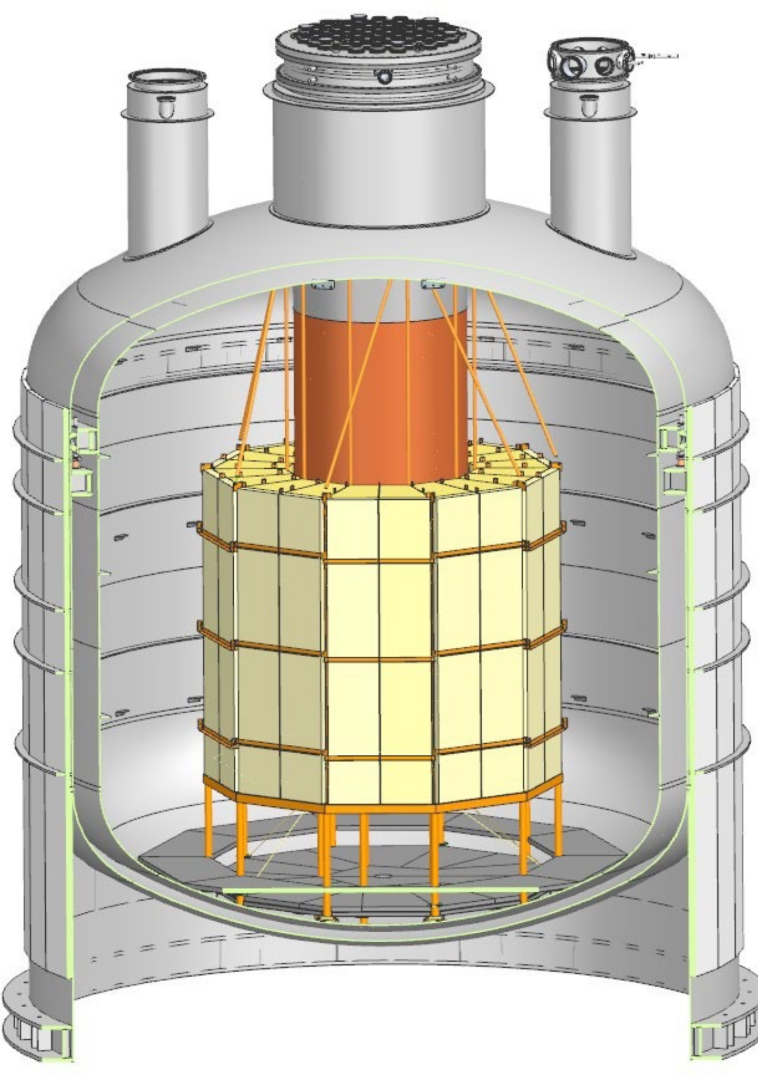
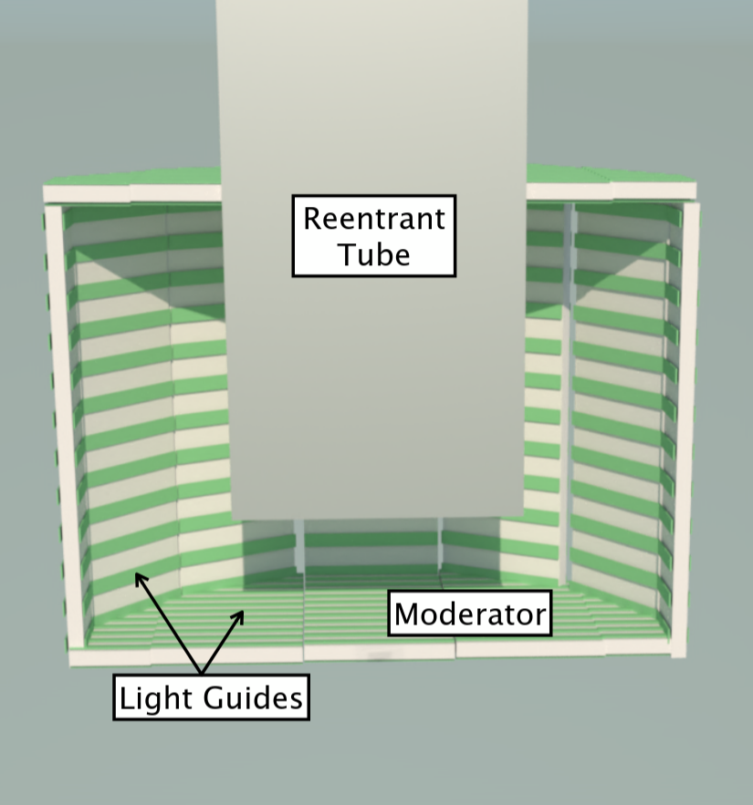
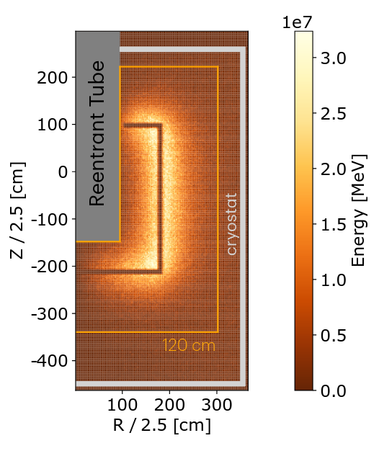
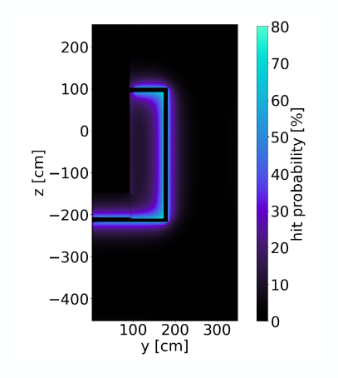
Side note: neutron moderator and ALAr instrumentation
Neutron moderator:
12 panels made of PMMA (3m x 1m x 10cm)
reduces ^{77m}Ge-production by factor 56%
Light readout of ALAr via light guids into SiPM:
most sibling neutrons are captured in the LAr around the moderator
optical readout close to where most light emitted after ⁴⁰Ar(n,γ)
[1]
Energy deposition of ⁴⁰Ar(n,γ) [1]:
Light detection probability [1]:
[1] Michele Morella, PhD thesis, GSSI (2025)

Slide 19
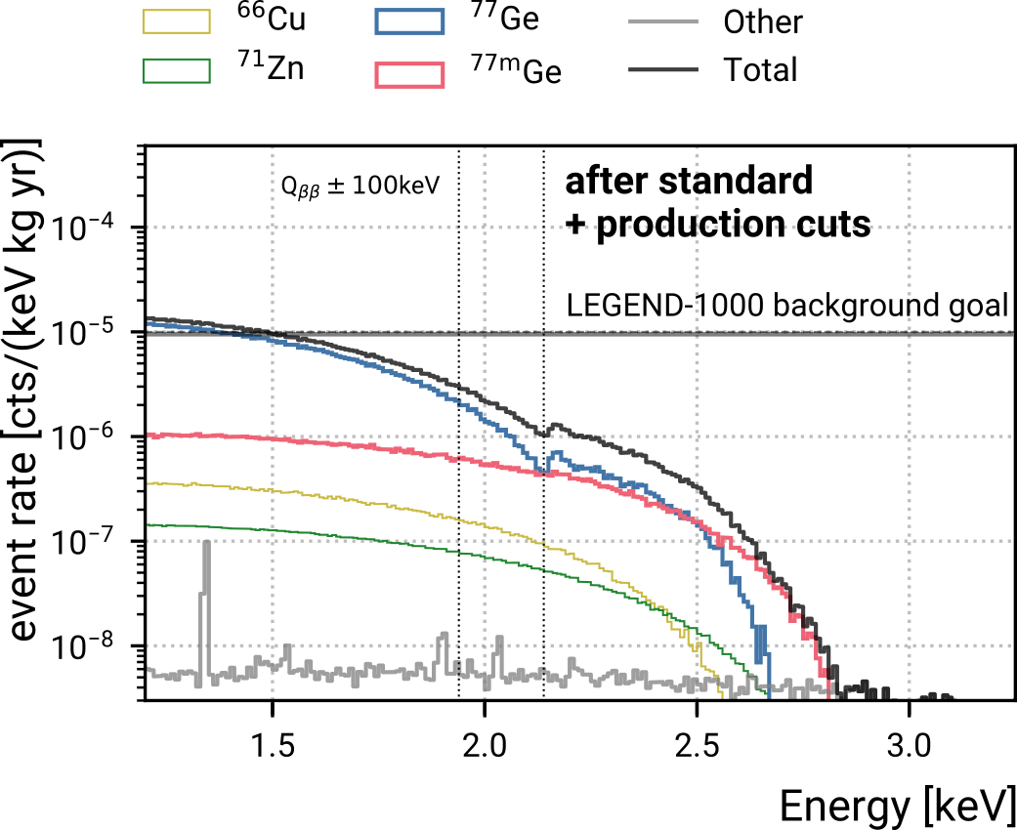
Delayed µ-induced background - Production Cut (for ^{77m}Ge)
If a HPGe detector / µ is tagged as ^{77m}Ge-producing, reject 0nββ candidates up to 5τ (~6.5 min) after.
Tagging conditions based on calorimetric simulations found by optimising the discovery sensitivity:
 | Survival fraction @ Q_{ββ}
^{77m}Ge decay | 4.2%
0nββ decay | 97%

Slide 20

Delayed µ-induced background - De-excitation Cut (for ⁷⁷Ge)
Strategy:
Tag ⁷⁷Ge decays via the delayed de-excitation from ^{77m}As (475 keV, 114 µs).
Implementation:
Cut 0νββ candidates if the same detector has >200 keV deposited within 1 ms after.
 | Survival fraction @ Q_{ββ}
⁷⁷Ge decay | 35%
0nββ decay | 99.999%

Slide 21


Delayed µ-induced background - Performance
With the production and de-excitation cut, the total delayed µ-induced background is
Decay background contribution:
with only a marginal reduction in 0𝜈ββ decay survival fraction.
The total background is estimated at
_{-6.5}
(9.2^{+5.0} ) × 10⁻⁶ cts/(keV kg yr)
with which the physics goal is reachable i.e. discovery sens. of >10²⁸ yr (99.73% CL).

Slide 22

Summary
Design and Physics Goals
Preparation for LEGEND -1000 at LNGS ongoing and construction starts 2026.
To reach the background goal:
radiogenic: clean and active material
⁴²K: UGLAr, active enclosures as alternative
µ-induced: topology based tagging to reject decays of in-situ produced isotopes
With this, we can make an unambiguous discovery of 0νββ decay with just a handful of counts at Q_{ββ}.

Slide 23
Backup

Slide 24


Reminder: Neutrinoless Double Beta Decay
Double beta decay (2𝜈ββ)
an observed standard model (SM) process
Neutrinoless double beta decay (0𝜈ββ)
a beyond SM process that violates lepton-number conservation (ΔL=2)
has not been observed so far, but
its detection would confirm the Majorana character of neutrinos.

Slide 25



Reminder: Link between 0𝜈ββ and 𝜈-mass
Assuming light Majorana neutrino exchange
with
Next generation 0𝜈ββ experiments aim to probe the entire inverted mass ordering region
half life - ββ-mass relation
ββ-mass (coherent sum)
graph by Christoph Wiesinger

Slide 26

Comparison to other experiments

Slide 27


Nuclear matrix element and phase space

