Slide 1
Welcome to ENT_{1/2}ENTE
2025/09/30
Network: Radisson Hotel Sudbury
Password: 85rad

Slide 2
Land Acknowledgement
SNOLAB is located on the traditional territory of the Robinson-Huron Treaty of 1850, shared by the Indigenous people of the surrounding Atikameksheng Anishnawbek First Nation as part of the larger Anishinabek Nation.​​
​​
We acknowledge those who came before us and honour those who are the caretakers of the land and the waters.

Slide 3

Truth and Reconciliation
94 Calls to Action
https://nctr.ca/exhibits/survivors-flag/
Notes:
Indian Residential Schools were created to separate Indigenous children from their families and communities, and to systematically strip away their traditions, cultural practices and languages.
More than 150,000 First Nations, Inuit and Métis children from across the country were forced to attend Indian Residential Schools, which were often located far from their homes. Thousands never made it home.
Each year on the federally recognized National Day for Truth and Reconciliation, we reflect and honour Survivors, their families and communities affected by the legacy of Indian Residential Schools.
The Survivors’ Flag is an expression of remembrance, meant to honour residential school Survivors and all the lives and communities impacted by the residential school system in Canada. Each element depicted on the flag was carefully selected by Survivors from across Canada, who were consulted in the flag’s creation.

Slide 4
WiFi
Network: Radisson Hotel Sudbury
Password: 85rad

Slide 5
ENT_{1/2}ENTE...?

Slide 6
ENTENTE
en·​tente (noun): an international understanding providing for a common course of action
Origin: 1830–45; < French: understanding

Slide 7
ENTENTE
Extreme Nuclear Half-Life Efforts:
New Theories and Experiments
A focused workshop on the nuclear physics of extremely long half-lives, opportunities for theory and experiment, and paths to science targets like grand unified theories, the ability to directly probe the normal ordering band of the Majorana neutrino mass scale, and new ultra-low background techniques.

Slide 8
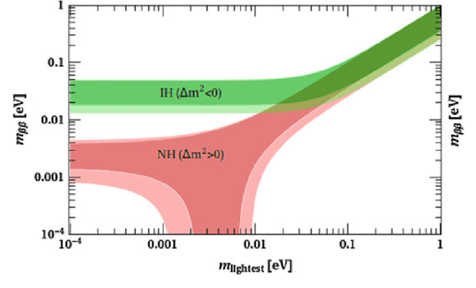
“Lobstrocity Plot”

