Slide 1
2025 / 04 / 17
PMO-azing Adventures
Muhammad Bilal Naseem
Supervisor: Mehwish Obaid

Slide 2
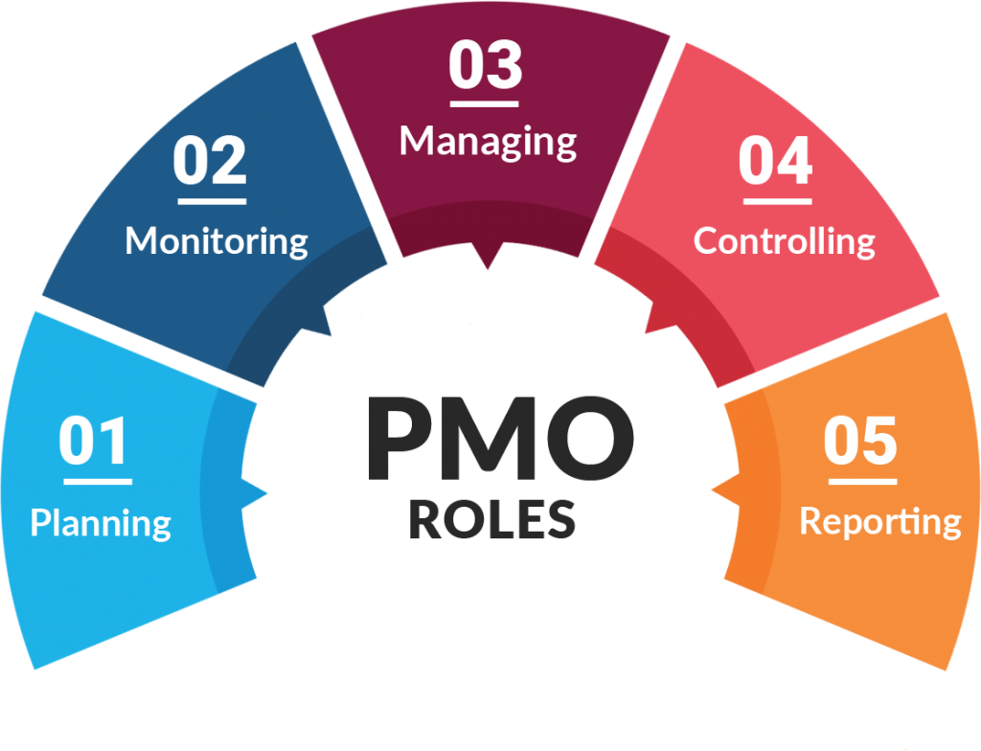
PMO

Slide 3
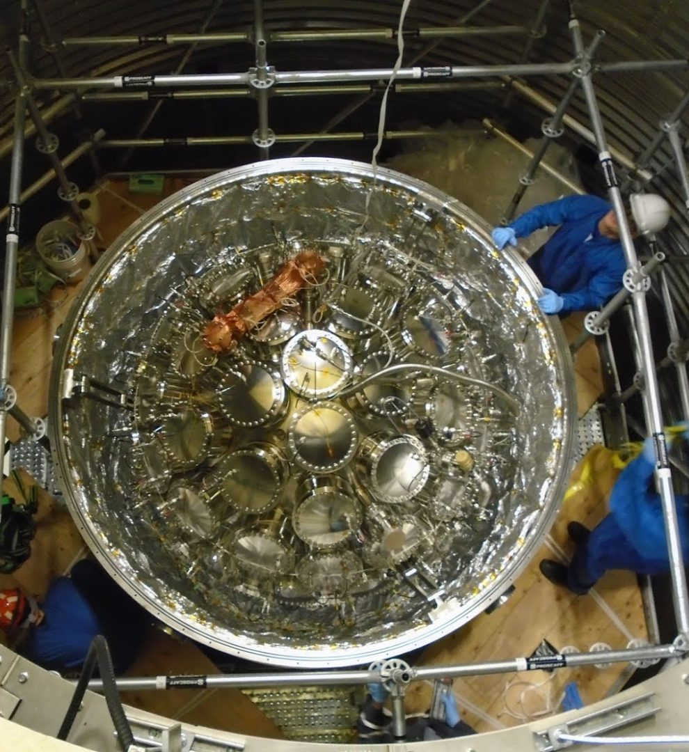
Experimental Projects
SNOLAB Research Experiments:
PICO
DEAP-3600
DAMIC
SuperCDMS
FLAME
SNO+

Slide 4
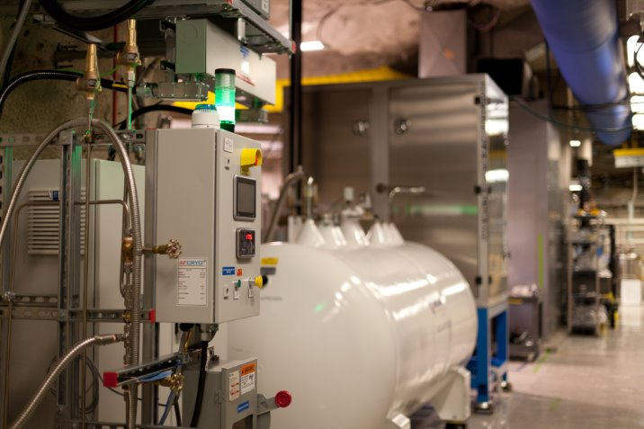
Internal Projects
Manages projects related to internal operations such as:
Communications
Power Systems
HVAC
IT Infrastructure
Support for Experimental Projects
Civil Engineering Work

Slide 5
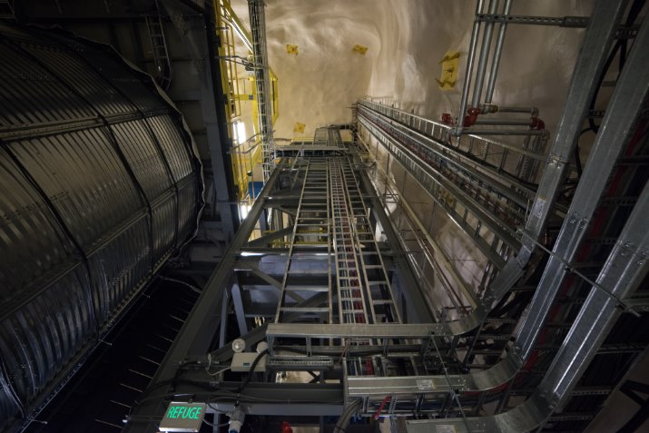
Information Security Project – Fiber Optics Installation – UG – P2102

Slide 6
Information Security Project – Fiber Optics Installation – UG – P2102
Why We Needed the IT Project
CIS audit
Cisco Collaboration
Evolving cyber threats.
Reliable internet for seamless operations.
What this Project will bring to SNOLAB
Faster & secure IT environment. (via 1 G firewalls and 10 G upgrades).
Aligned with SNOLAB’s 2023–2029 plan.
Laid groundwork for a smooth Phase 2 transition post CIS - Audit.

Slide 7
IT Project Lifecycle
Current Status

Slide 8
My Role & Responsibilities
Engaged networking with contractors.
Surveyed the UG lab and developed plans to ensure clean, safe drilling and cable pulls.
Procured multiple fixed- bids, now pending evaluation.
Supported IT Spare network Inventory Count.
Networked with our Electrical team on confined‑space and sensitive‑material.

Slide 9
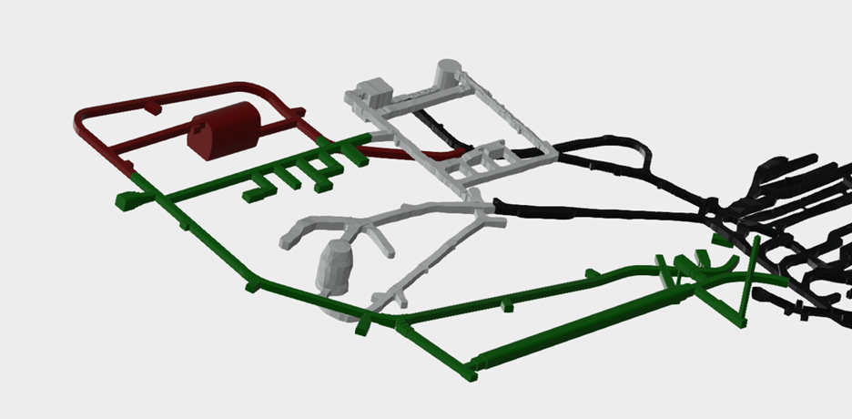
Facility Expansion – Phase 1 – P1819

Slide 10
Facility Expansion – Phase 1 – P1819 (upcoming)
Why We Needed the Expansion Project
Limited clean lab space.
Rising global demand for UG research.
Risk of delays due to space shortages.
Need for advanced facilities for next-gen physics.
Supports SNOLAB’s vision as a global leader.
What this Project will bring to SNOLAB
New clean labs, argon storage, and detector hall.
Infrastructure ready for large-scale experiments.
Upgraded HVAC, power, and cooling systems.
Built for long-term readiness and global competitiveness.

Slide 11
My Role
Maintained documentation to meet SNOLAB standards.
Revised Gantt charts and organized tasks by project phase.

Slide 12
Document Support: The Backbone of Project Success
Why is document automation needed?
PMO documents are dynamic and needs real-time Integration.
Proposal Form – Cost , Resources, WBS
Review Calendar – Review Status Tracking & Sorting
Automation achieved via VBA Code.
Few other Document Support.
Organogram for CFI.
Project Gateway Reviews Terms Of Reference .
Space Allocation Form.

Slide 13
Thankyou

