Slide 1
Characterizing Acoustic Coupling in the Detector: FFT Analysis and Sensor Development
Supervisor: Pierre Gorel and Guillaume Giroux
April 17, 2025

Slide 2
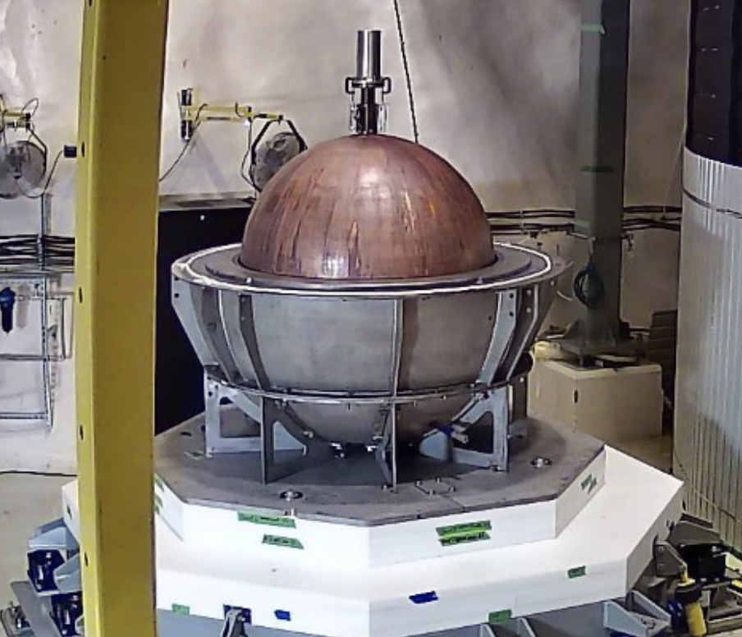
NEWS-G searches for low-mass dark matter using a spherical gas detector
WIMPS
Sphere filled with low mass noble gas (H, He, Ne,…)
Source: NASA, NEWS-G Collaboration
2

Slide 3
NEWS-G uses central anode to create radial electric field
Copper Sphere ~ 1.4 m
Multi-Anode Sensor in middle
High Voltage
Radial Electric Field
Anode
3

Slide 4
Avalanche near the anode creates ion drift induces the detectable signal
4
Source: NEWS-G Collaboration
Notes:
Incoming particle ionizes the gas – Primary Ionization
e- drift towards the anode at the center along the 𝐸 field lines
Avalanche occurs – Secondary Ionization
Signal is produced and measured

Slide 5
Multiball sensor "Achinos"
North 5
Multi Anode sensor
Small anode – High gain
Large structure – High drift field
2 Channels
North (5 balls), South (6 balls)
North/South Comparison
South 6
5
Notes:
High gain, capable to go up to single electron detection
Strong 𝐸 field to collect primary e- far from the center

Slide 6
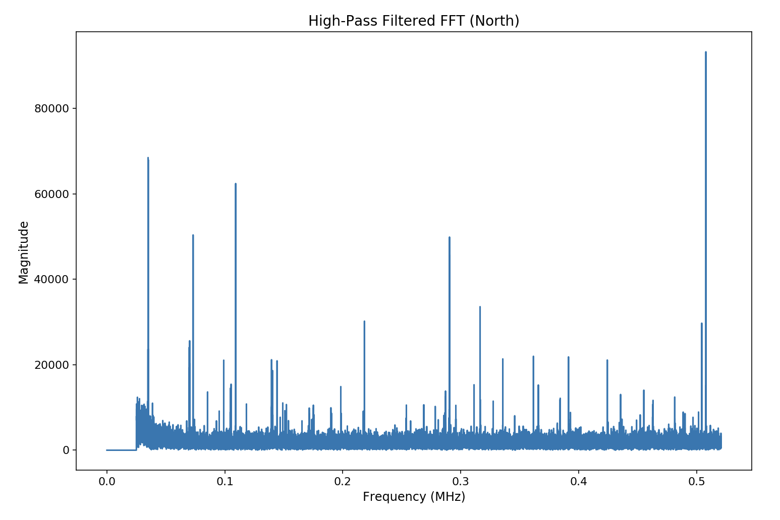
Fast Fourier Transform (FFT) Analysis
High-Pass Filtered FFT (North)
Identify dominant frequencies present in the signal
Study the effect overtime with the lab activity and different conditions
Change in voltage
Magnitude
Frequency (MHz)
6

Slide 7
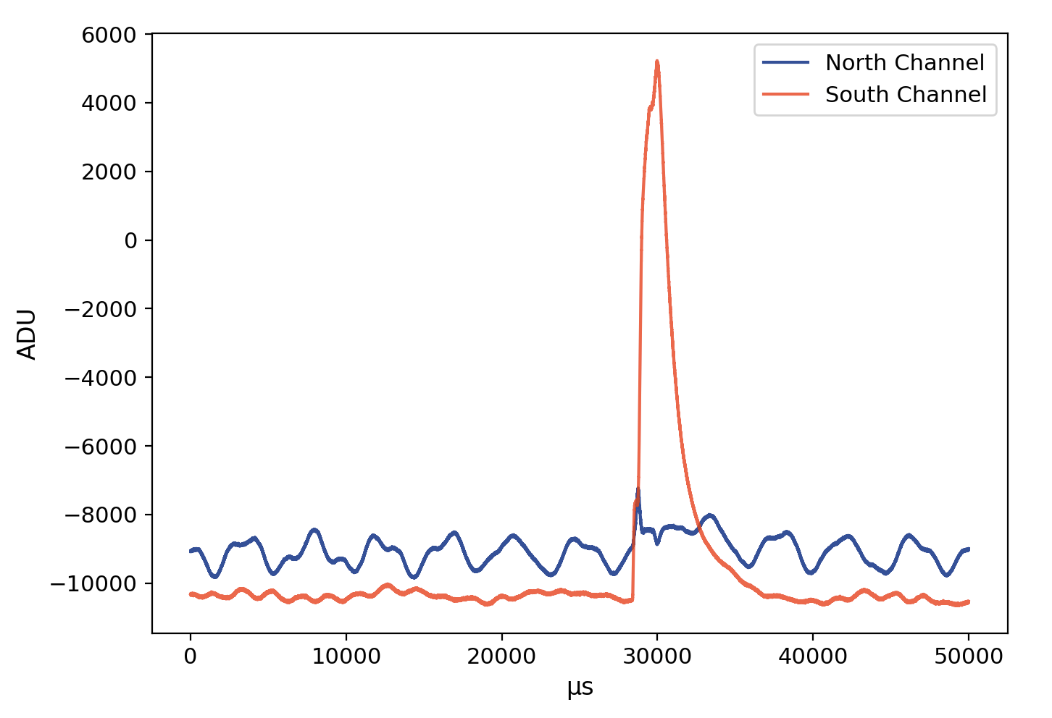
FFT Analysis : How is signal Characterized?
Signal characterized each channel based on:
Positive Peak (Event)
No Peak (raw signal without event)
Positive Peak South channel​​
7

Slide 8
FFT Analysis : How is signal Characterized?
Signal characterized each channel based on:
Positive Peak (Event)
No Peak (raw signal without event)
8

Slide 9
FFT Analysis : Average FFT without Peak (event)
Region of interests
High frequency noise: ~ > 10KHz
Effects Trigger rate
Forces to Increase Threshold
9

Slide 10
FFT Analysis : Average FFT without Peak (event)
Region of interests
Low frequency noise: ~10 Hz – 1 kHz
Sensitive to:
Mechanical vibrations
Acoustic coupling
Effects baseline
10

Slide 11
Acoustic Noise and Microphonic Effect
11

Slide 12
FFT shows voltage dependence in the South channel
12

Slide 13
FFT shows no voltage dependence in the North channel
13

Slide 14
MEMS sensor allows us to record noise in the Cube Hall
14

Slide 15
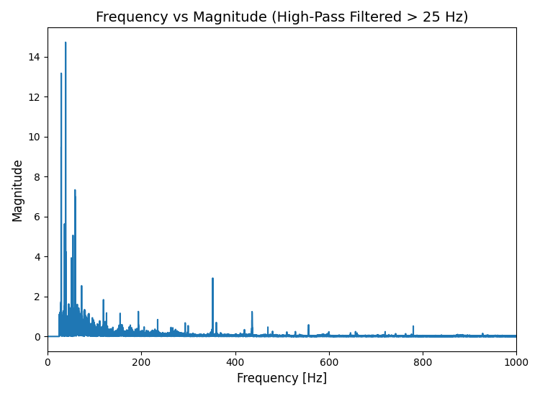
FFT and spectrogram reveals dominant low frequency noise
14

Slide 16
MIDAS: A way to collect the data
sensor data through pi
collected by MIDAS DAQ software
MIDAS monitor and control sensor data
15

Slide 17
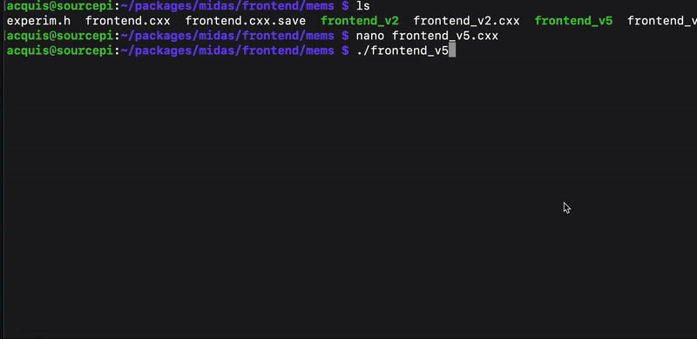
Sensor data is captured, buffered, and saved by the MIDAS frontend
16

Slide 18
The current setup captures only one second of data and fails to record a full waveform
Time (sec)
Magnitude
17

Slide 19
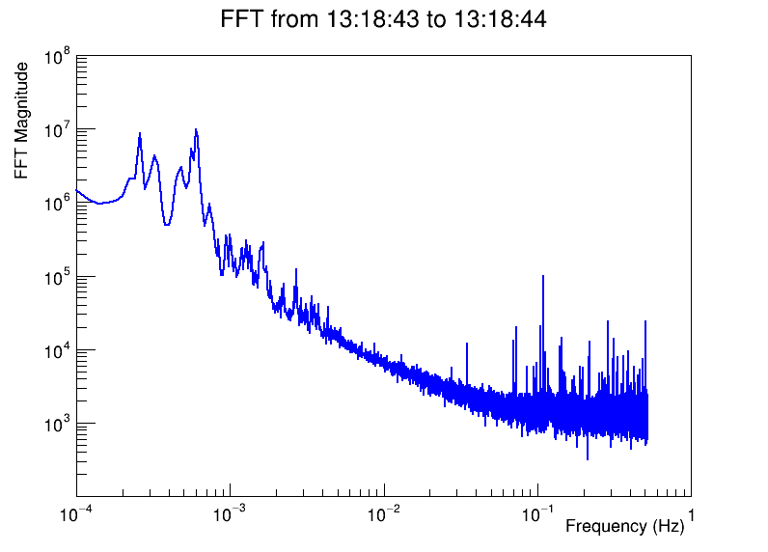
Future Work
Compare FFT to lab activity
Finish developing MIDAS frontend
Attach sensor to detector
Develop shielding
18

Slide 20
Thank you!

