Slide 1

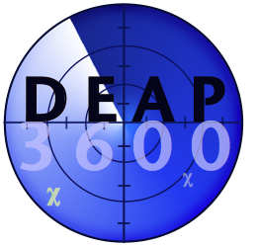
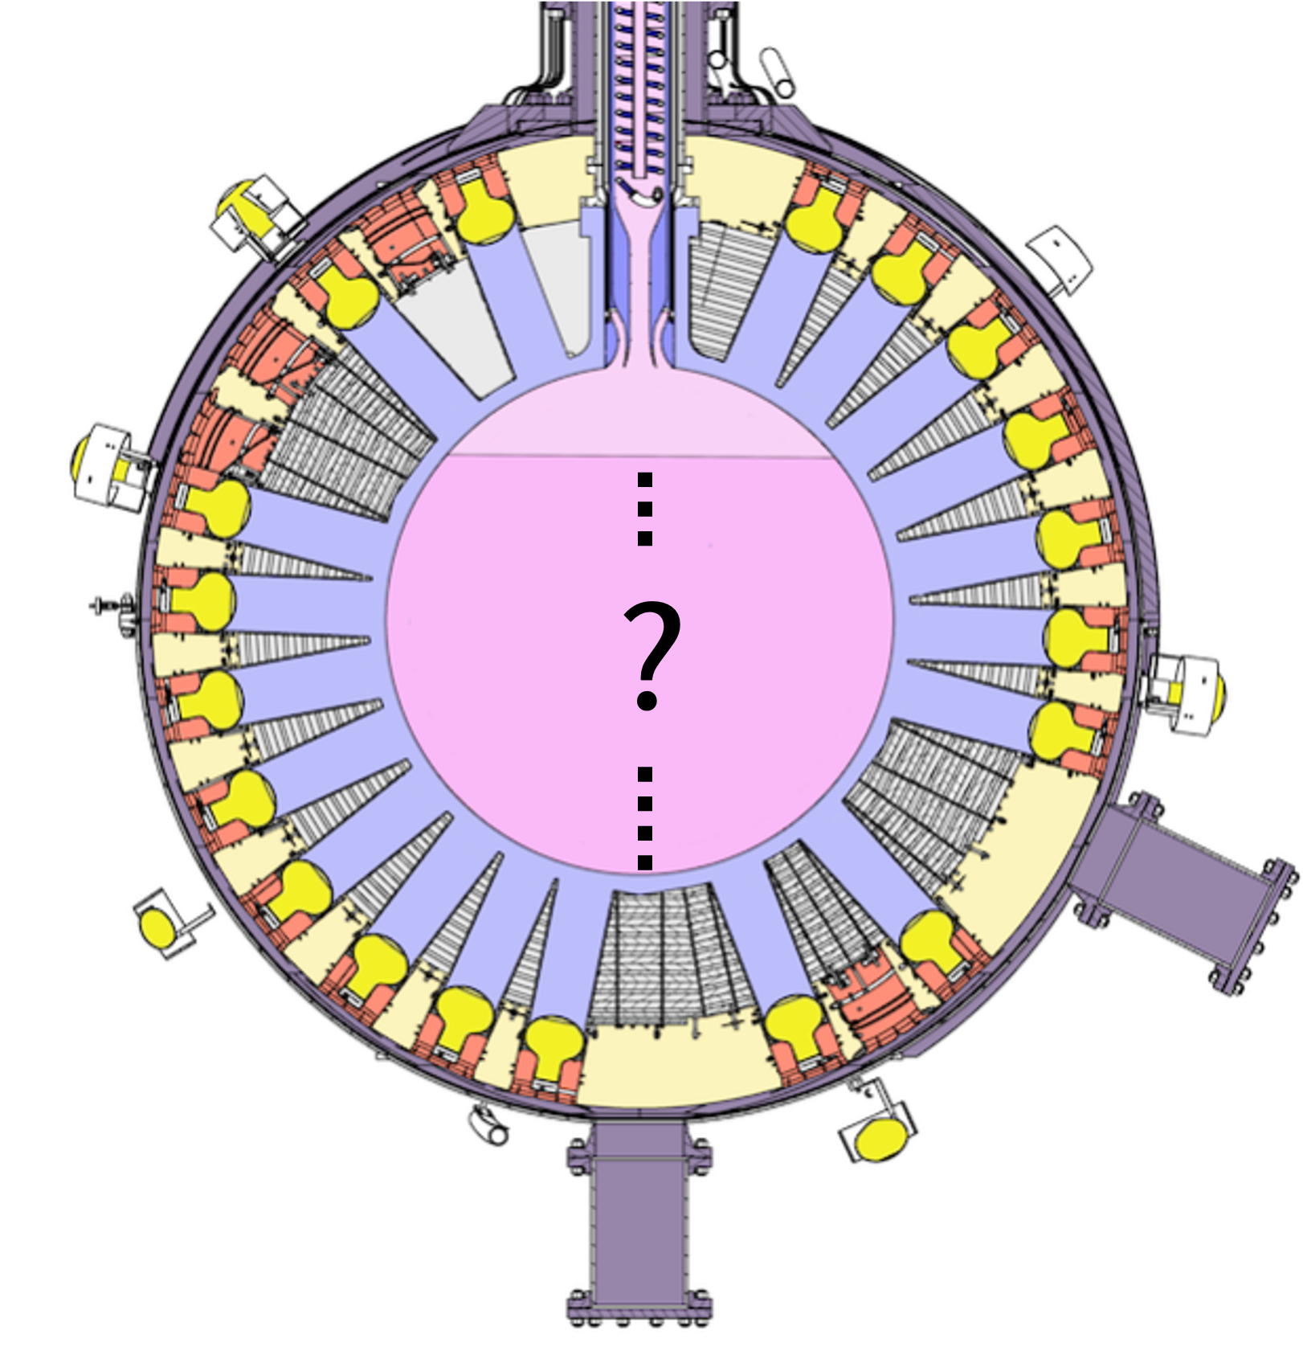
How full is DEAP?
Samuel Quinteiro Perez
Supervisors: Chris Jillings, Pierre Gorel
Notes:
Hello everybody, in this presentation I will talk about what I’ve been working over the past few months as well as the context behind it
Today I’m going to be talking about the work I did over the last 4 months, and a brief introduction with some context, and as to why this work is important

Slide 2
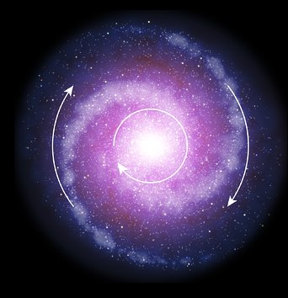
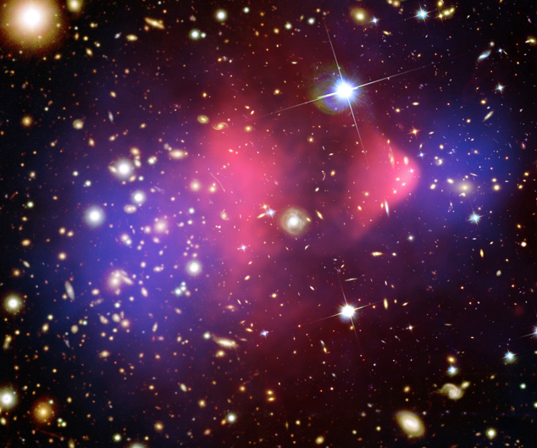
There is compelling evidence for Dark Matter
?
Galaxy Rotation Curves
[ESO/L. Calçada]
Gravitational Lensing
[NASA]
Weakly Interacting Massive Particle
(WIMP)
Notes:
ROOT: One of the most compelling evidence we have for dark matter is the galaxy rotation curves. LEAF: So far, all of the evidence for dark matter has been indirect observations and it has not yet been detected directly
The most compelling evidence we have is that the outer part of galaxies are seen to be rotating much faster than predicted.
This is possible if there was some invisible mass in the outer parts of galaxies that we can not observe
Another indication of the presence of this invisible mass is the gravitational lensing seen around massive galaxy clusters (specifically the bullet cluster
Gravitational lensing occurs when large masses curve the space around it, causing light to follow this curved path and make the sources of the light look stretch out or distorted
In this image the blue area is where we see the most mass causing gravitational lensing, but the pink area is where we can directly see the most ordinary matter, indicating that the majority of gravitational lensing that’s observed is coming from matter that’s not directly observed
The name given to this invisible mass is dark matter and
The leading explanation for dark matter is the existence of Weakly Interacting Massive Particles – or WIMPS that exert gravitational influence but interact so minimally with normal matter that they are extremely difficult to detect

Slide 3
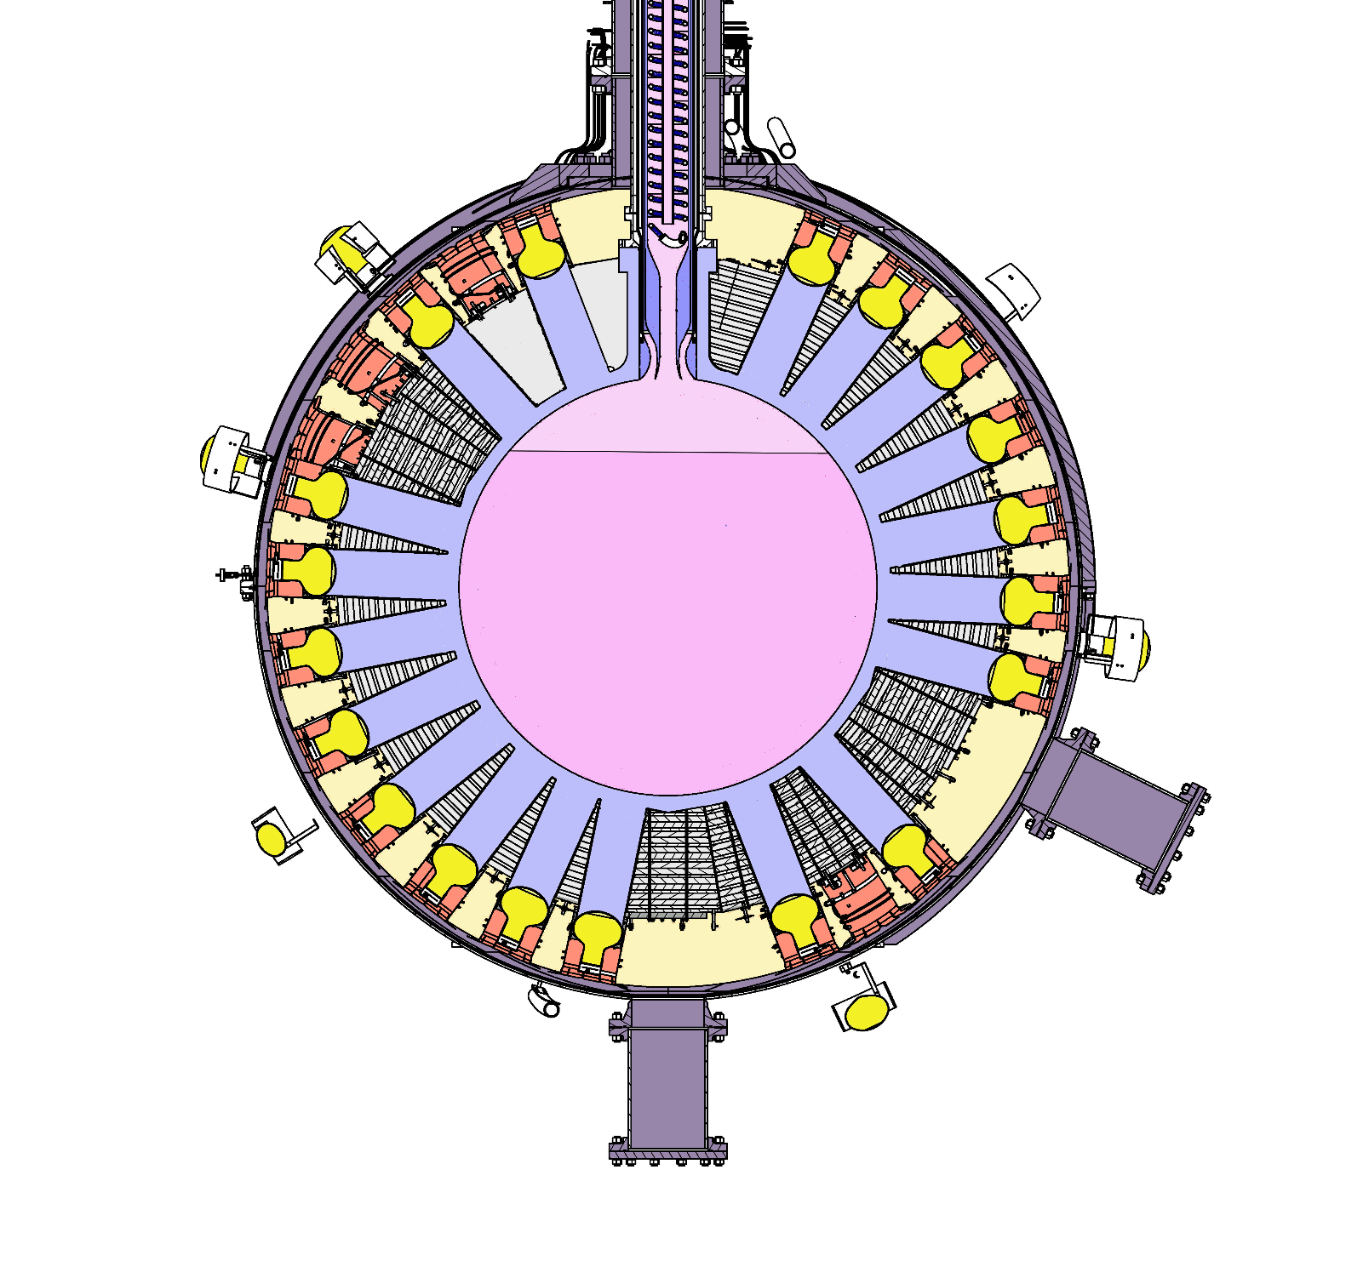
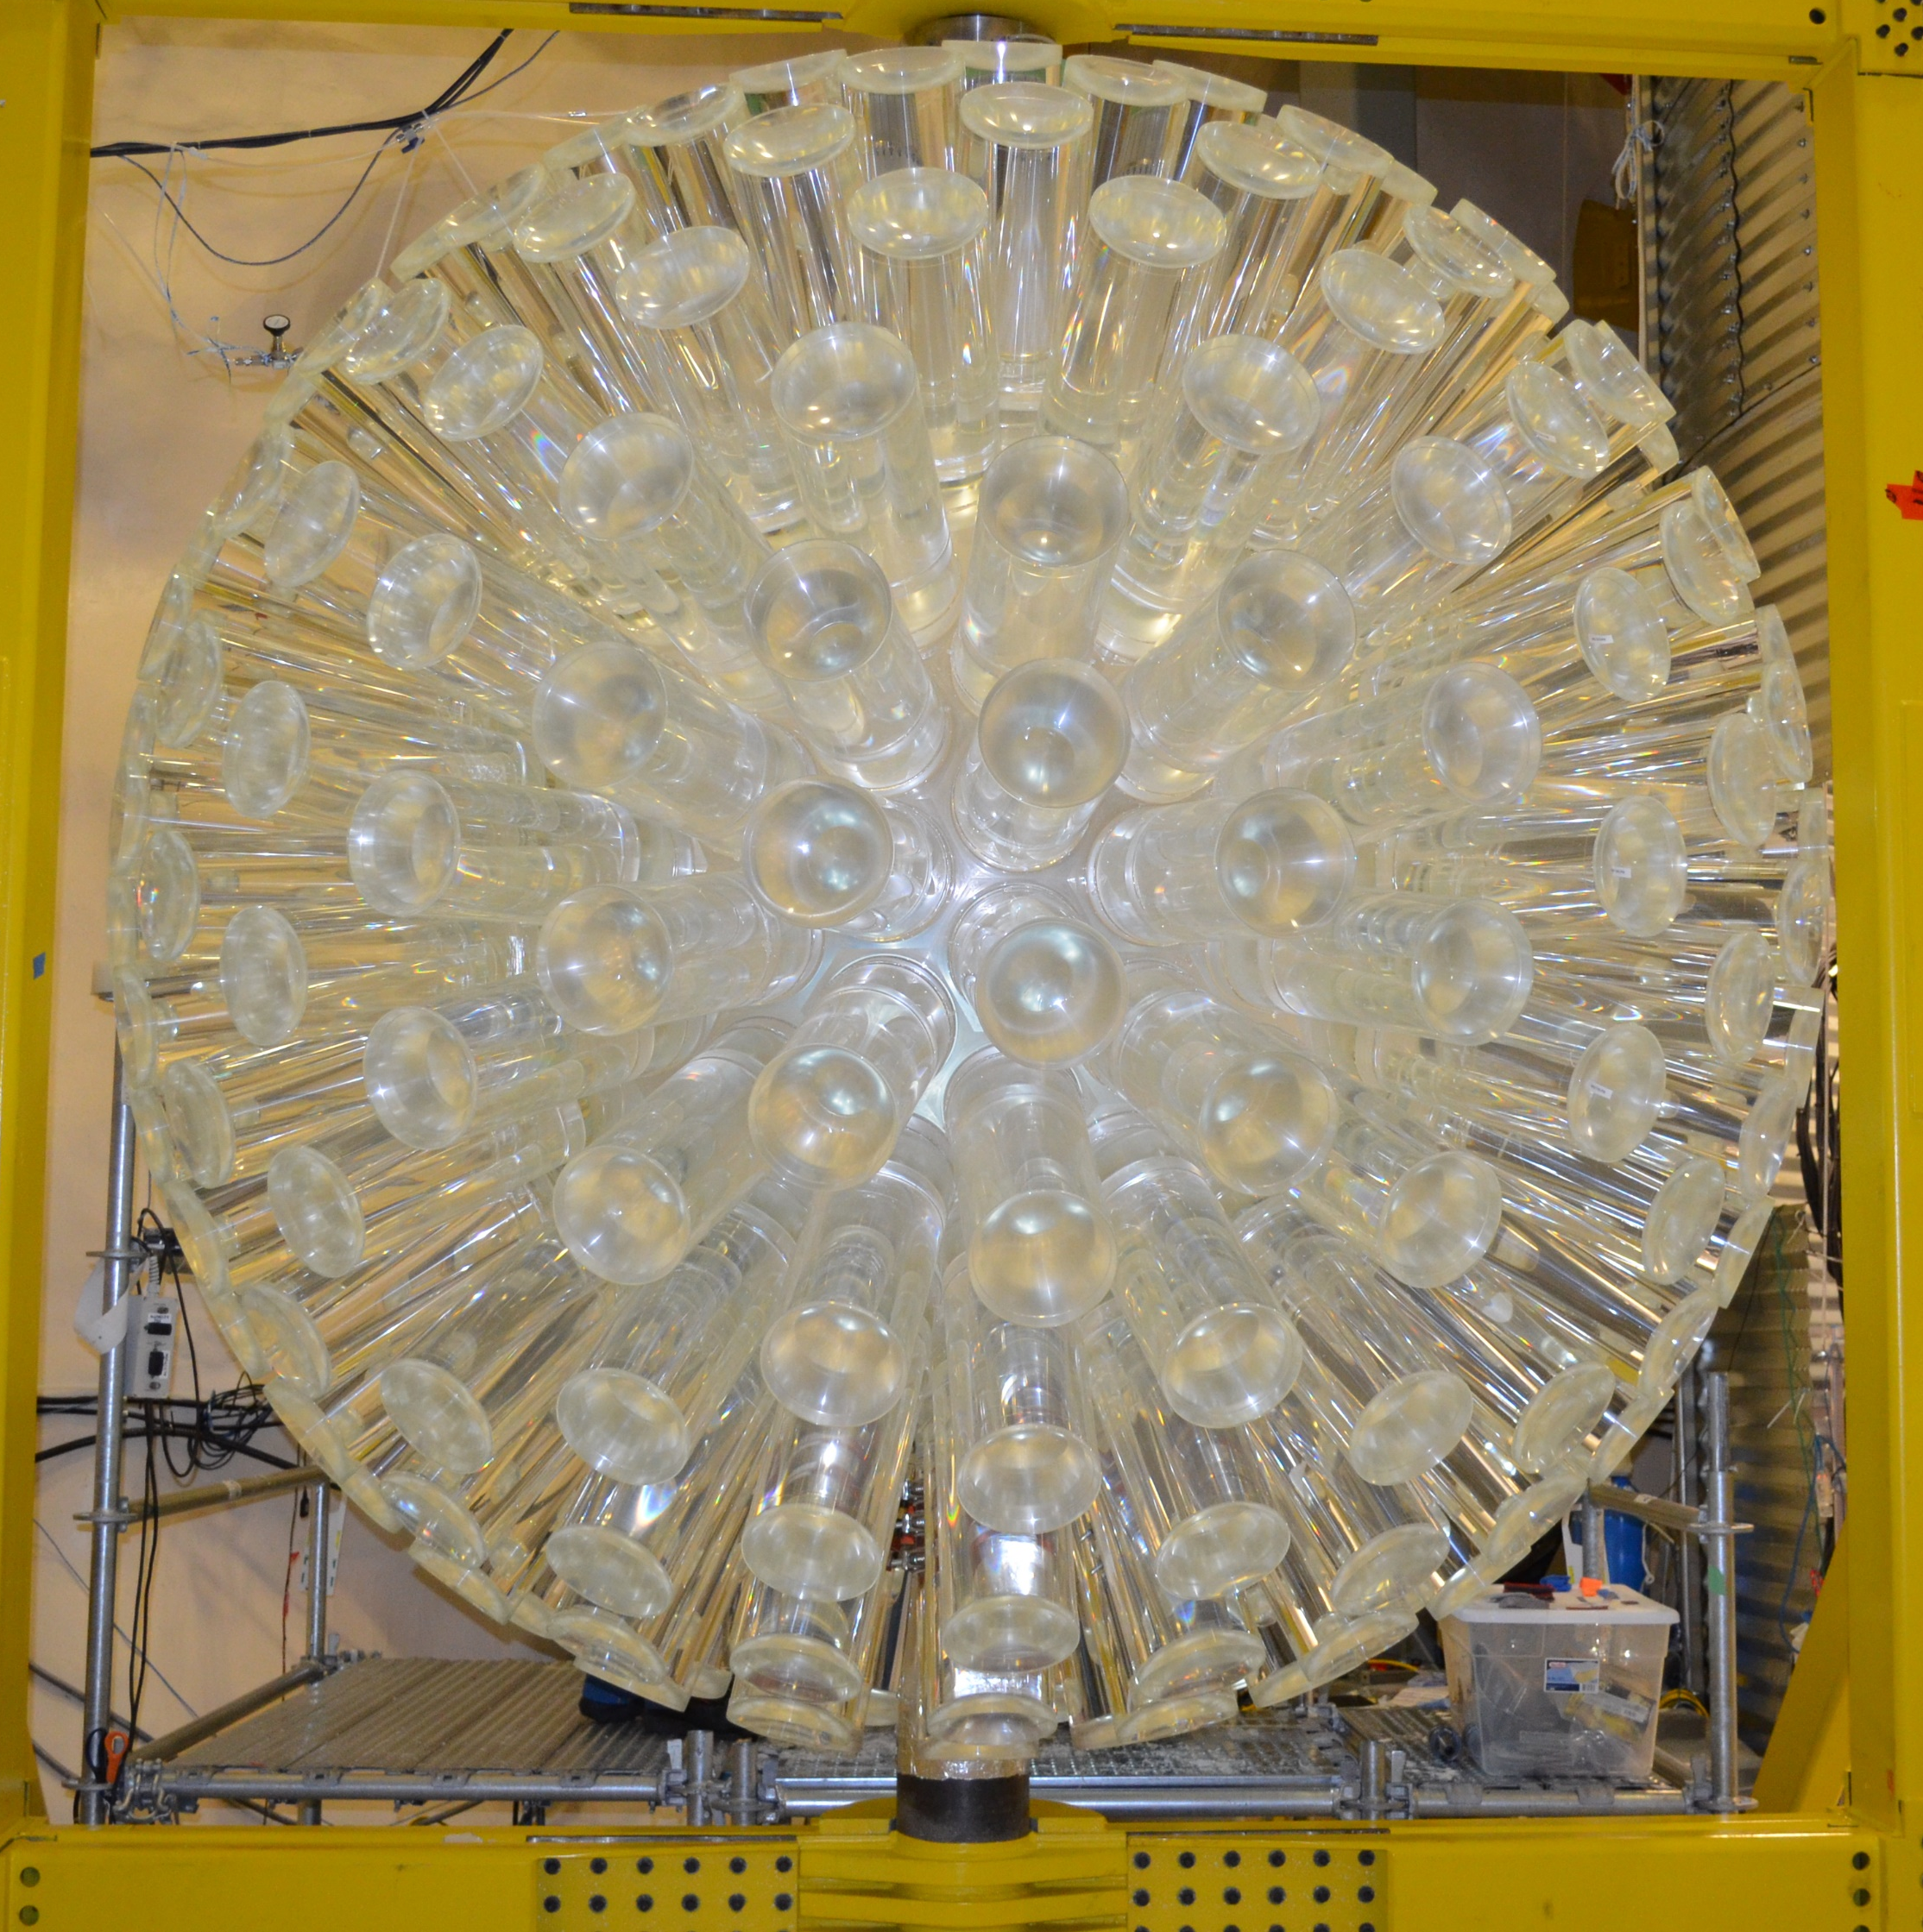
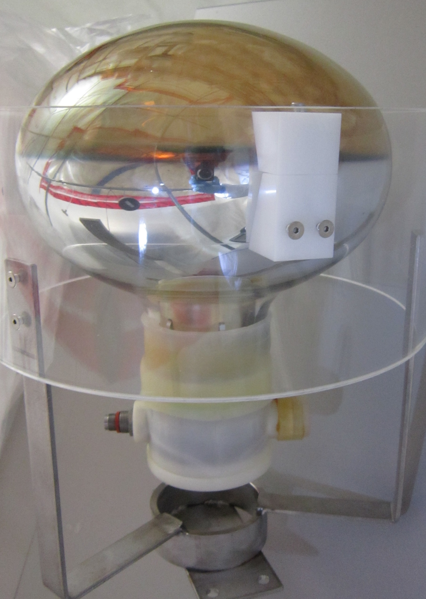
Dark matter Experiment using Argon Pulse-shape discrimination (DEAP-3600) is a sensitive dark matter detector
Acrylic Vessel coated with wavelength shifter TPB (tetraphenyl butadiene)
255 Photomultiplier Tubes (PMTs)
3269kg liquid argon
Notes:
ROOT: DEAP 3600 is a sensitive dark matter detector
LEAF: What do these PMTs detect?
This drawing is a cross section of the DEAP-3600 detector located in SNOLAB's Cube hall with the neck cut off
The area in red is the acrylic vessel and it contains about 3.3 tonnes of ultra-pure liquid argon when operating
The inner surface of the acrylic vessel is coated with a wavelength shifter called tetraphenyl butadiene (TPB)
Adhered to the acrylic vessel are acrylic cylinders called light guides which guide light into the 255 surrounding photomultiplier detectors.
Show pictures of the AV when the red circle
Show photo of PMT when talking about it
Not quite full
Mention light guides

Slide 4
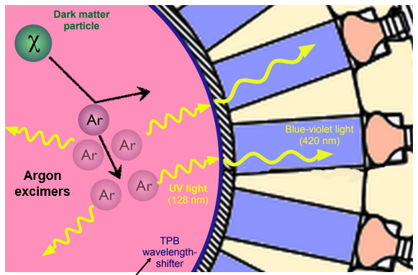
Dark matter Experiment using Argon Pulse-shape discrimination (DEAP-3600) is a sensitive dark matter detector
Notes:
ROOT: The idea is that a WIMP will scatter off an Argon nuclei, transferring energy and creating argon excimers
LEAF: WIMPS aren't the only thing we expect to scintillate the argon
This creates argon excimers which are just excited argon 2 molecules
Since these molecules are unstable, they eventually decay and release energy in the form of UV light to do so
The wavelength of the light gets shifted into the visible range once it hits the TPB coating, and then travels through the light guides
And hits the PMT's
These PMT convert the photons into an electrical signal
What makes DEAP so sensitive is that all of these parts have been selected for extremely low levels of radioactivity
The target mass is large,
Located 2km below the surface
Interfere with the wimp search

Slide 5
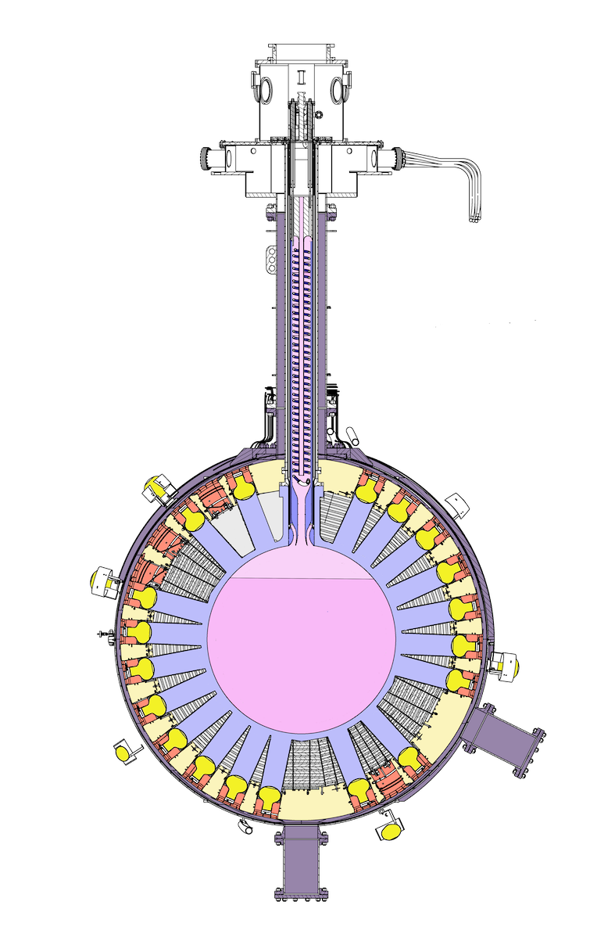
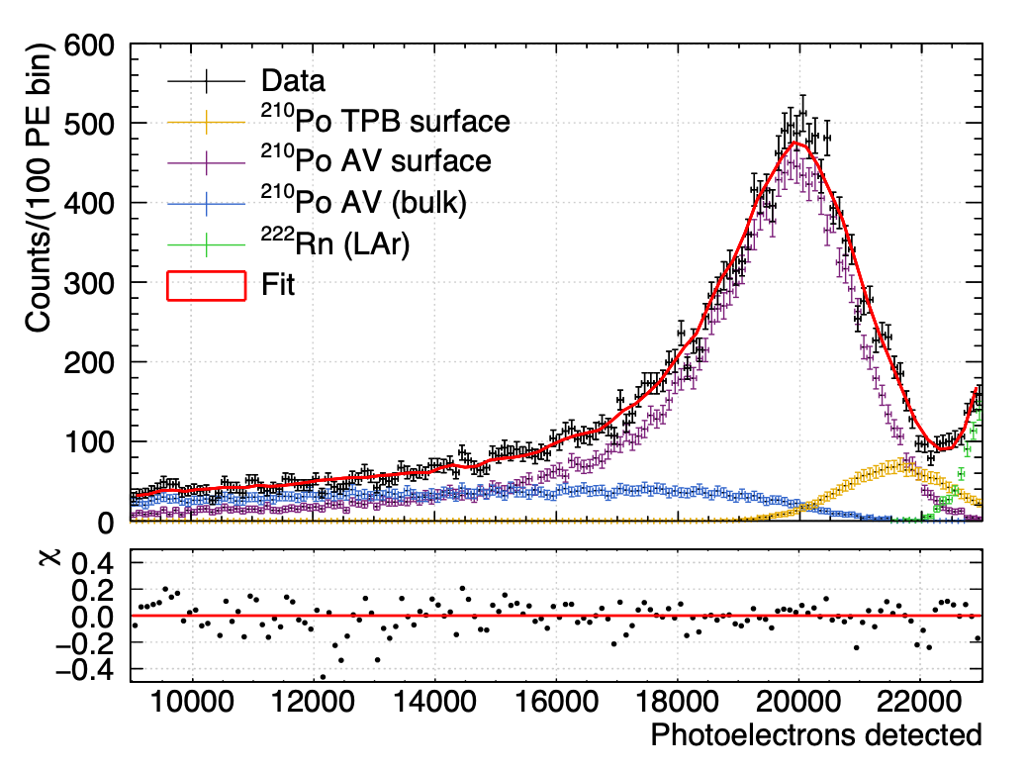
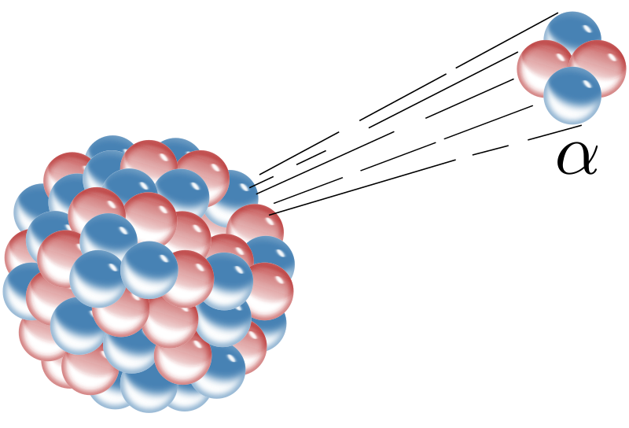
Low particulate contamination can explain excess alpha events
“dust”
[Search for dark matter with a 231-day exposure of liquid argon using DEAP-3600 at SNOLAB]
Notes:
ROOT: Events caused by alphas can mimic WIMP events, but because we expect them to originate from the TPB surface and the AV vessel surface, these events can be cut out using position reconstruction.
LEAF: Thankfully
In the 231-day exposure of liquid argon paper, it was noticed that there was an excess of alpha events that was not predicted by our model. One explanation for this is that there is low particulate contamination within the liquid argon, emitting alphas.
These events originating from the alpha emitting particulates cannot be cut out using position reconstruction
The degraded energy enters the region of interest which Is problematic when we expect low counts of WIMP events
100-200 PE is where we look for WIMPS
Even very few alphas can make a difference when we are looking for few events
Over time the components are degraded

Slide 6
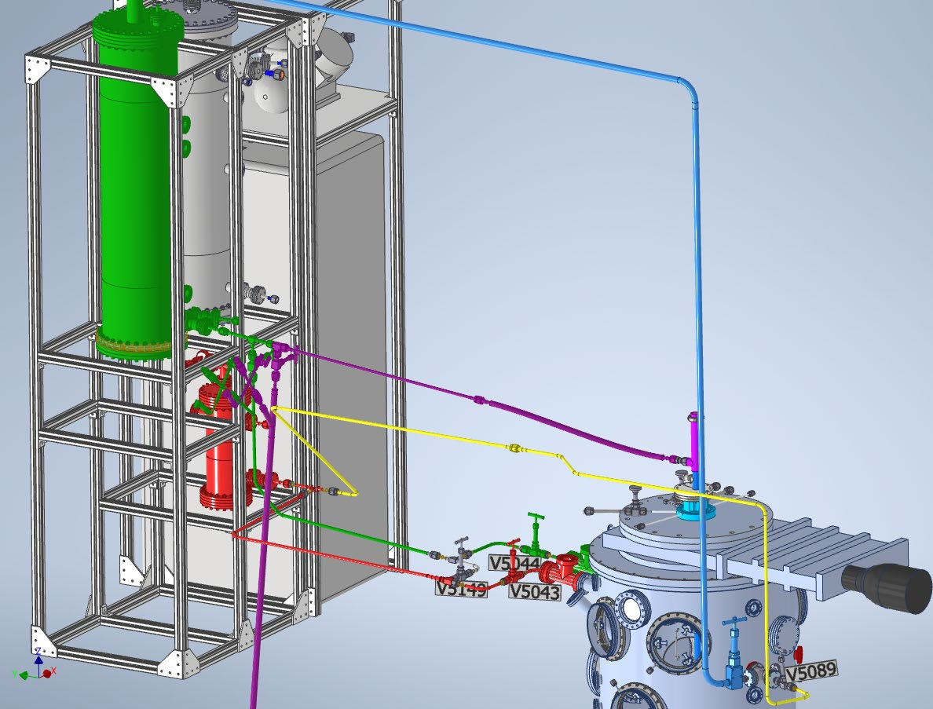

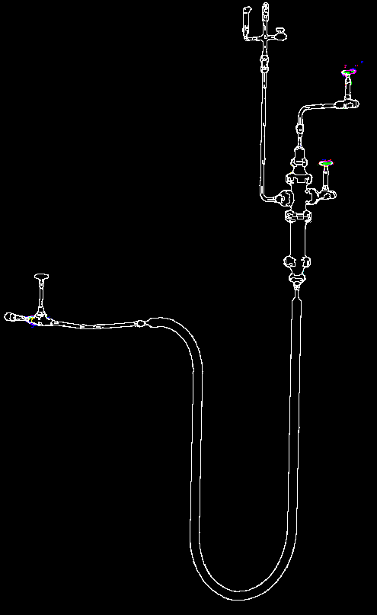
We have a deployable particulate removal system
Filter
and
P-trap
To argon storage tank
Notes:
ROOT: We have a deployable particulate removal system.
LEAF: Assisting with the installation of this system was the bulk of my work underground
This works by lowering a metal tube we call the dust pipe into the acyrlic vessel, and by increasing the pressure in the AV, it will force the contaminated liquid up the tube, through the filter and P-Trap, and back to the argon storage tank.

Slide 7
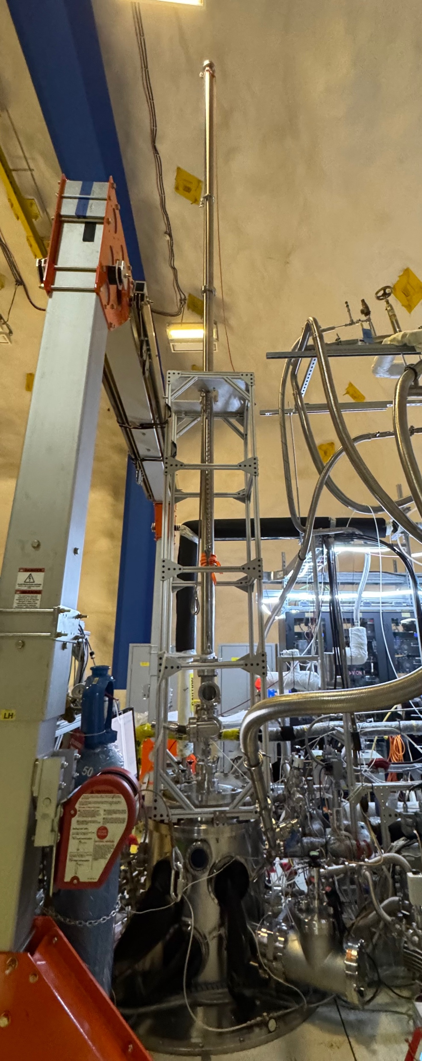
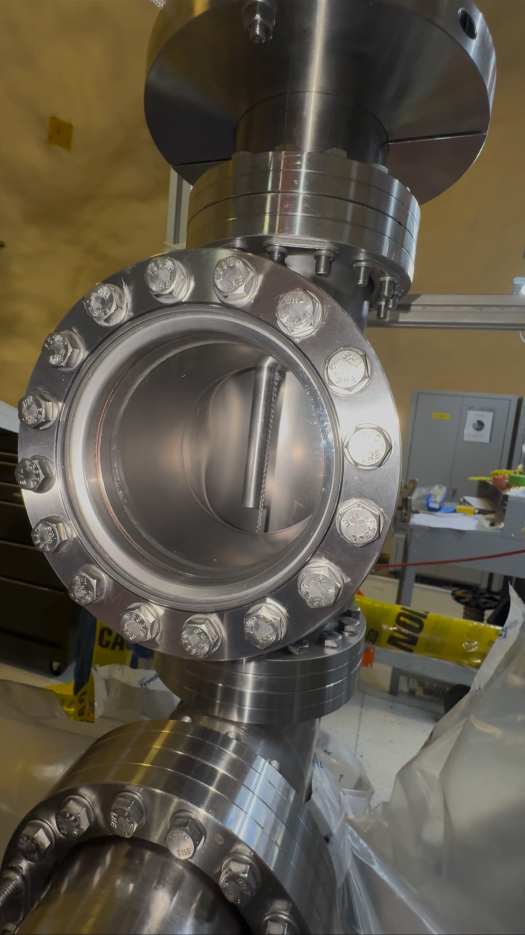
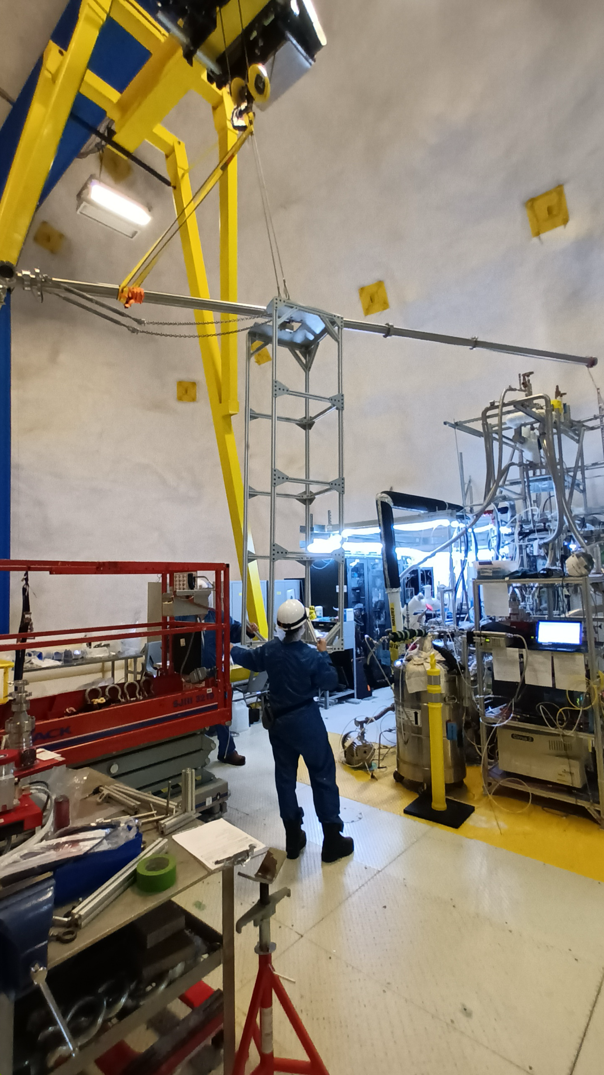
The hardware was recently installed
Notes:
ROOT: Here are some photos of the installation.
LEAF: lowered into the AV
1. Here you can see the dust pipe being lifted onto the detector,
2. The second image shows the frame of the dust pipe being secured to the glovebox and the dustpipe now in vertical position.
3. The cylinder that contains the dust pipe has a small window on it, and this arrow is pointing to the end of the pipe that will soon be lowered into the AV

Slide 8
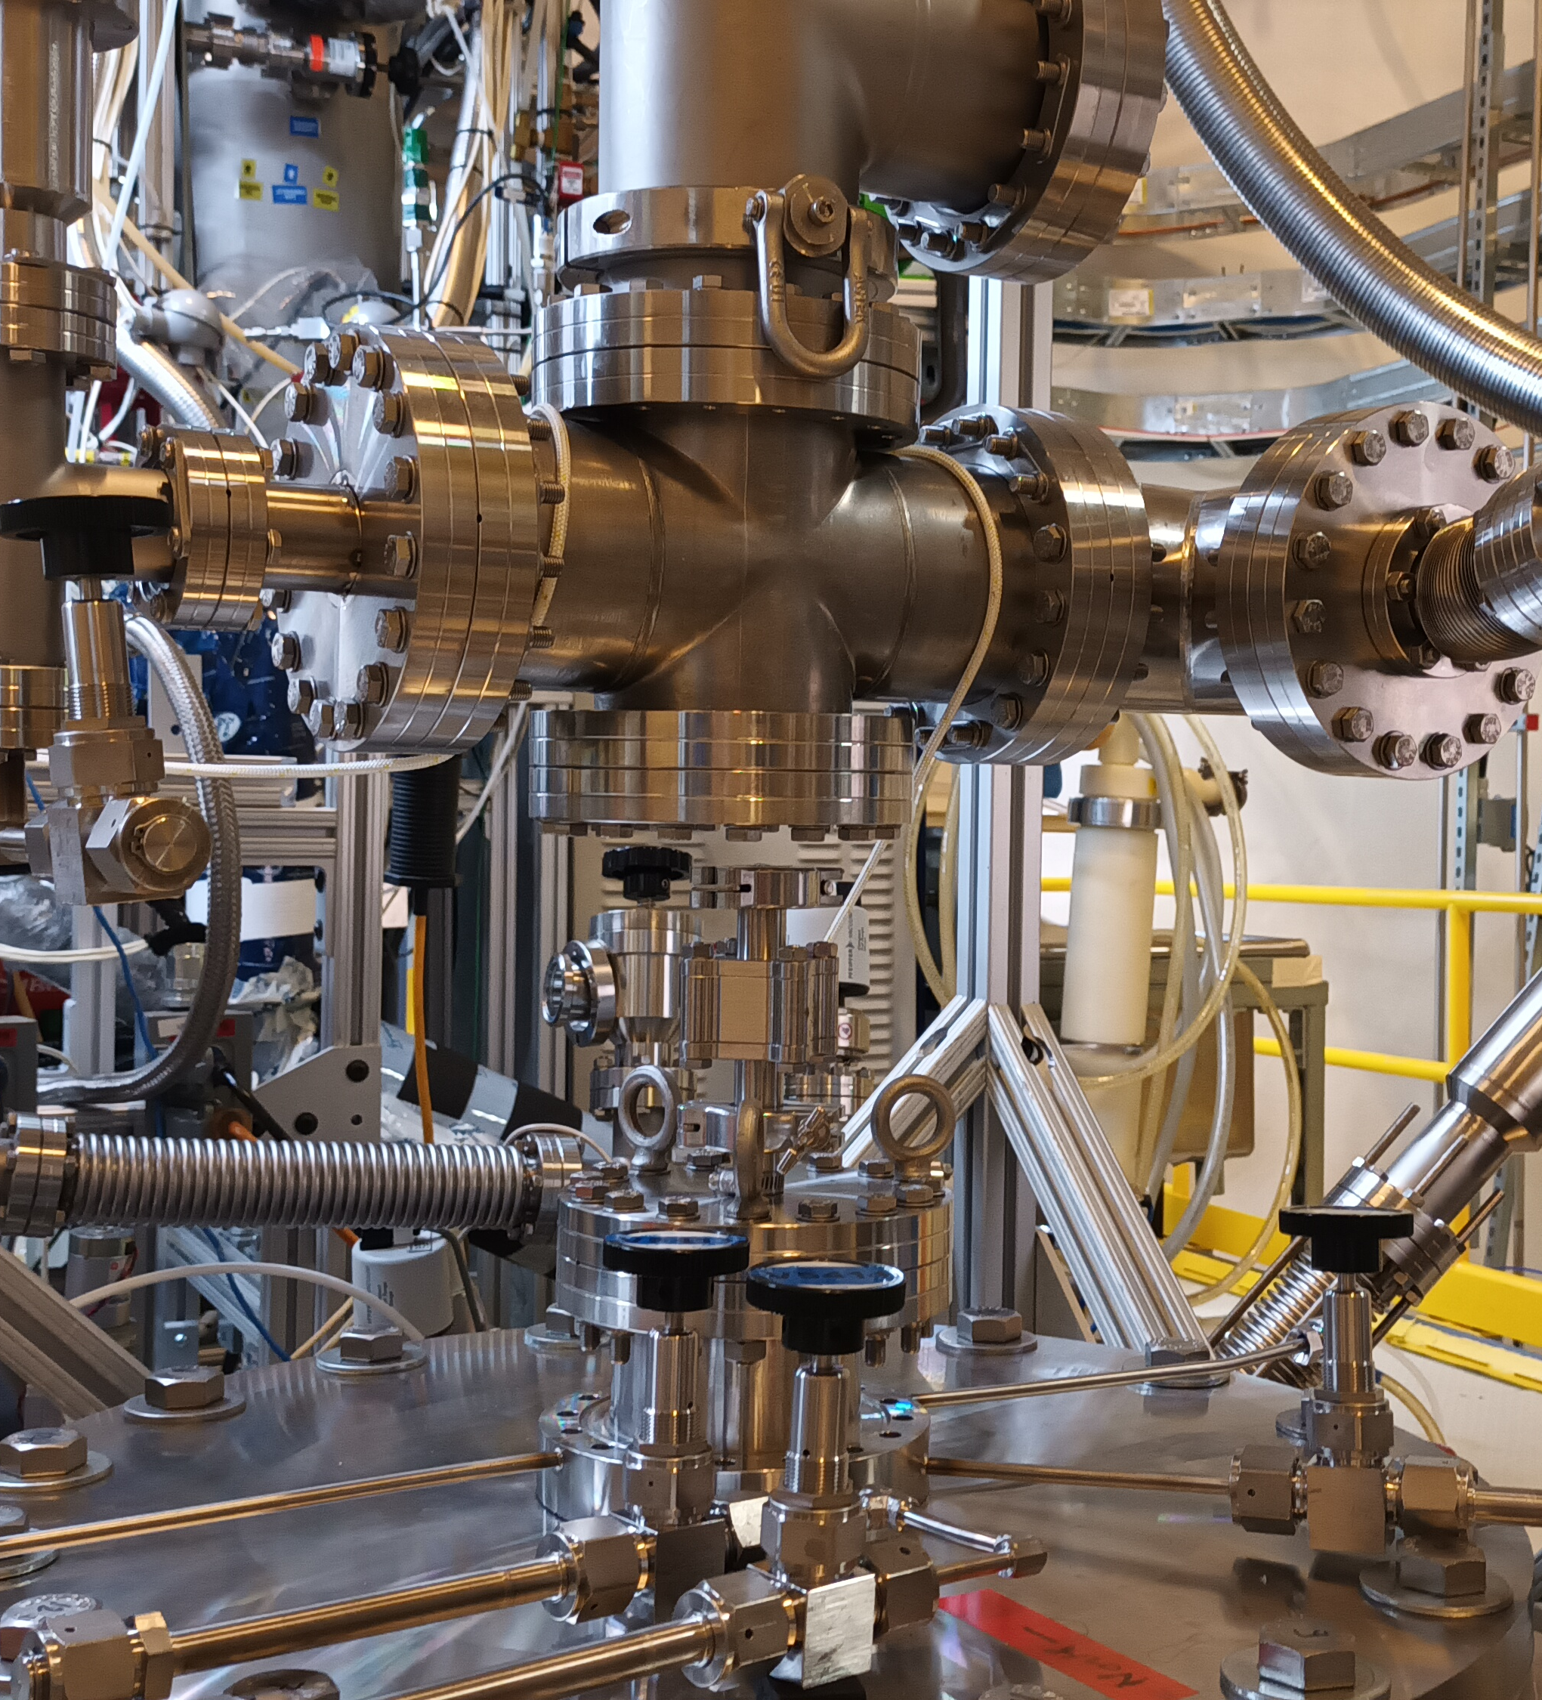
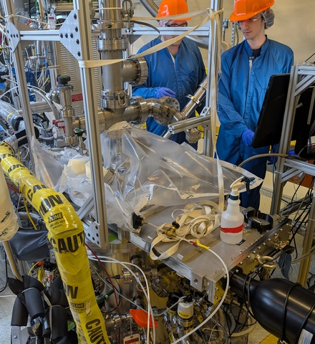
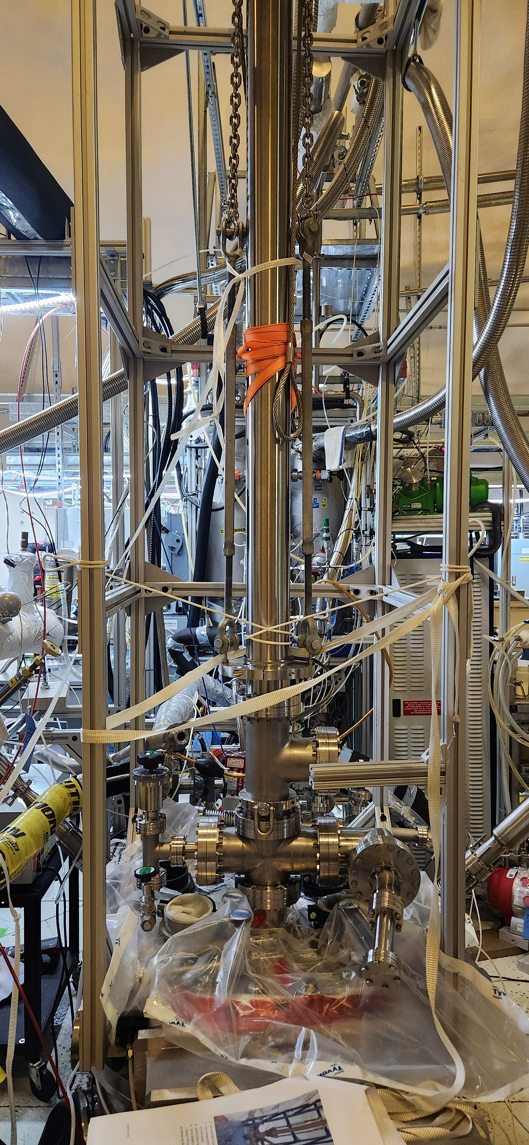
The hardware was recently installed
Notes:
ROOT: In order to lower the dust pipe into the AV, we first had to make the connection between these two flanges to allow a path for the pipe.
LEAF: Now that the dust pipe has been installed, the next step is to fill the vessel with liquid argon.
By removing these blanks we would open up a space that will eventually be open to the Acrylic Vessel to lab air, so we created and installed a glove bag that had a constant purge of nitrogen to keep the space clean when making this connection. Finally in this third image you can see that the connection was made.

Slide 9
We will mimic the 2016 fill
2016-2020
2025
=
1398mm
1398mm
?
Notes:
ROOT: The question is, to where do we want to fill the detector?
LEAF: There are many methods to measure the liquid level.
During the 2016-2020 run, we had a good understanding of the detector, so we want to replicate those conditions as close as possible. This will allow us to preserve the same optical effects, and reuse the previous analysis to compare what's changed after removing the dust.
Filling to the same level allows us to keep the same analysis with the same optical effects
Analysis depends on the amount of liquid contained
Depends on the optical effects
During the 2016-2020 run, we understand well our detector so we want to get as close as possible to that state.

Slide 10
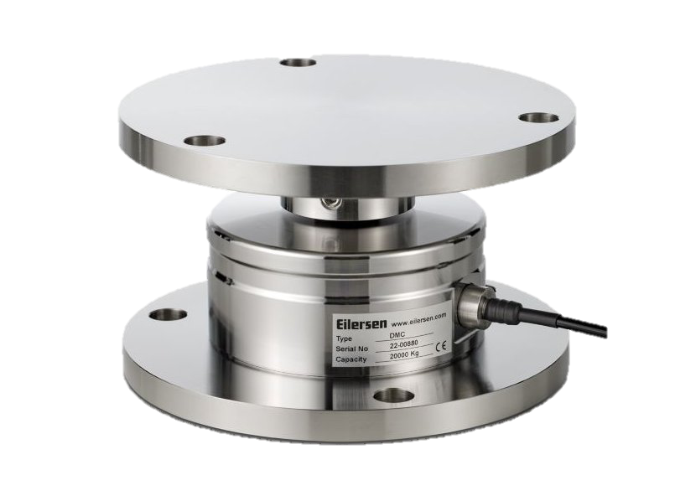
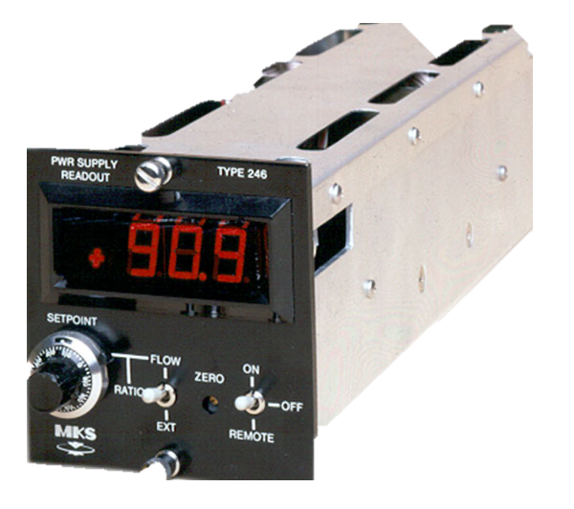
There are many methods to measure liquid level
Load Cells
Flow Controller
PMT Rates
±89kg
±50kg
±27kg
Notes:
ROOT: There are many methods to measure the liquid level.
LEAF: This means that we expect to see higher rates on the pmts that are submerged in the liquid.
One is the load cells, these are devices that measure weight and they have an uncertainty of pm 89kg because they seem to get stuck
The flow controller can be used to calculate the liquid in the detector but due to a systematic uncertainty it's accurate to pm 50kg
Lastly we have an analysis method that uses the pmt rates. THIS TAKES ADVANTAGE OF THE FACT that the liquid argon has a greater index of refraction than then gaseous argon, effectively trapping scintillation light in the liquid.

Slide 11
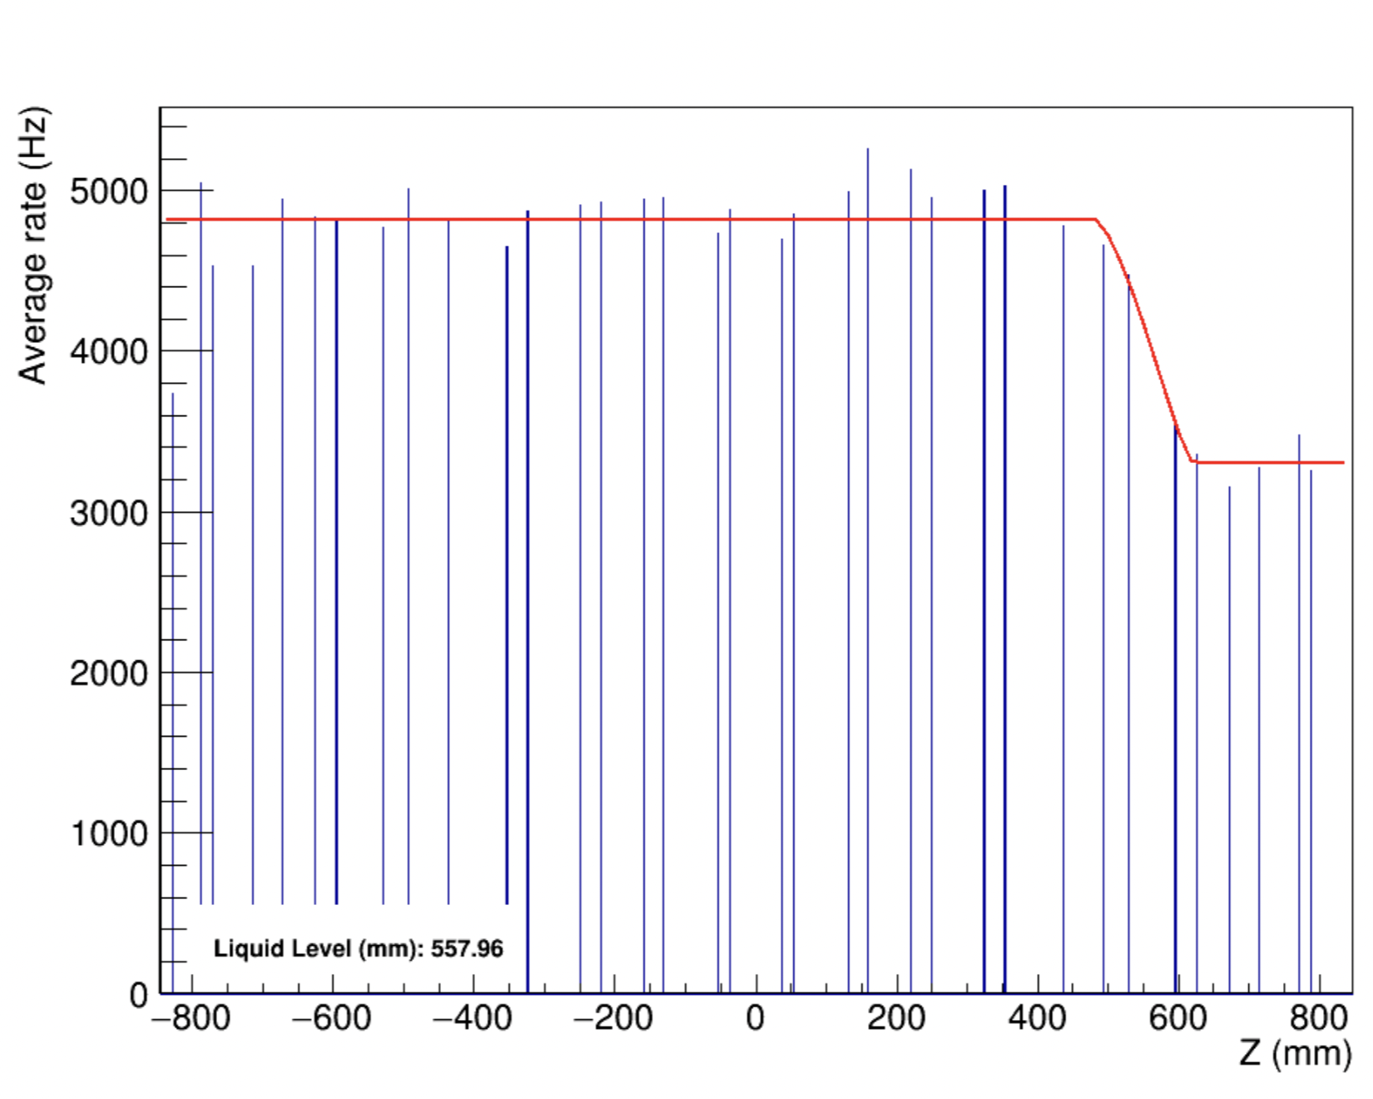
Our DAQ allows real-time monitoring of liquid level
Rate per PMT as a Function of Height
1
2
3
2
3
1
Bottom of detector
Top of detector
Notes:
ROOT: Here is what those rates look like for a run taken in 2020 LEAF: So I normalized the pulses that each PMT sees by divided by its own relative efficiency
The horizontal axis goes from the bottom of the detector to the top of the detector in mm, and the vertical axis shows the average rate for each row of PMTs.
The function that fits this data consists of the 3 parts,
The first corresponds to the PMTs that are completely submerged in the liquid - these are the ones that have the highest rate due to the reflection on the liquid's surface
The seconds corresponds to the PMTs whose light guides are partially submerged in the liquid,
And the third corresponds to the PMTs that are completely in the gaseous Argon
MY MAIN FOCUS OF WORK WAS CONSIDERING THE EFFECTS that the efficiencies of each PMT had on this fit.
Over time the components of the PMTs degrade, and this leads to some PMTs seeing less light than other. Specifically the relative PMTs is how an individual PMT compares to the rest. For example, if the relative effienciency of a PMT is 0.5, then that PMT on average sees about half as much photons as the rest.

Slide 12
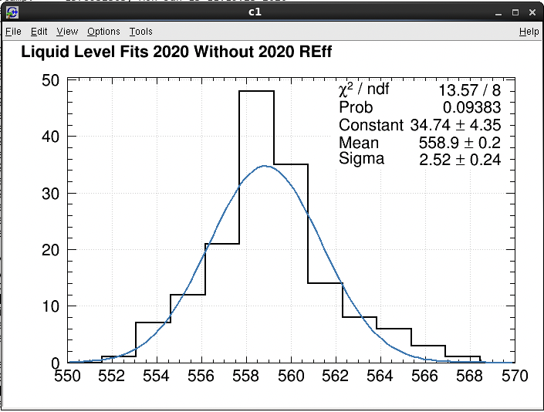
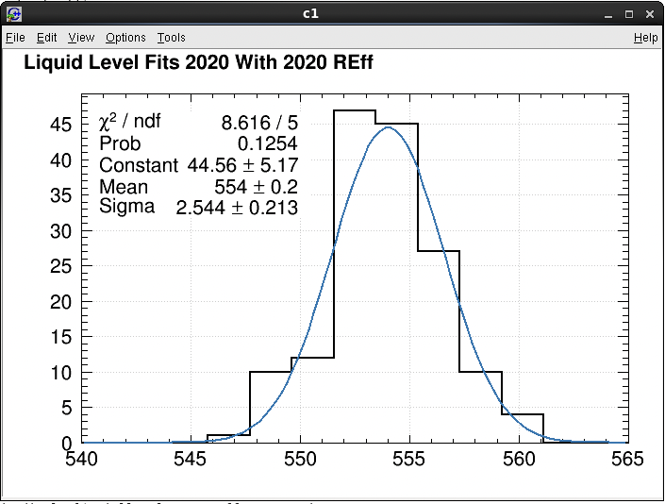
The relative PMT efficiencies have a measurable effect
WITHOUT Relative Efficiencies
WITH Relative Efficiencies
mm
mm
~2𝜎 difference
Notes:
ROOT: Here are those results
LEAF: Adding the relative efficiency correction also smoothens out the data.
These histograms are the result of taking multiple fits with and without the relative efficiency correction, and we can see that there is about a 2 sigma difference between them.

Slide 13
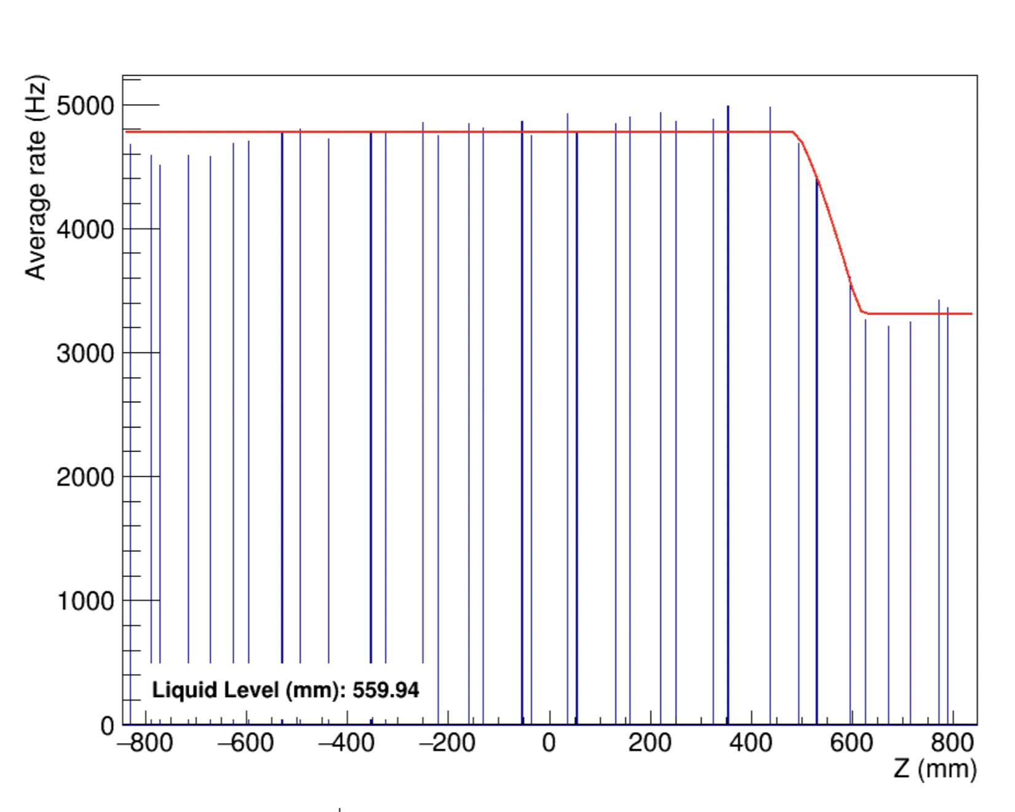
The relative PMT efficiencies have a measurable effect
Old
New
Rate per PMT as a Function of Height
Rate per PMT as a Function of Height
Notes:
ROOT: Old is without the relative efficiency correction and new is with
LEAF: Since we would like to know the fill level in real time as we are filling,
We can focus on the lowest row where the arrow is pointing as a good example here. We can see that it used to receive about 3/4 as much light compared to the rest, but after adding the efficiency correction it jumps closer to the fit line which is expected.

Slide 14
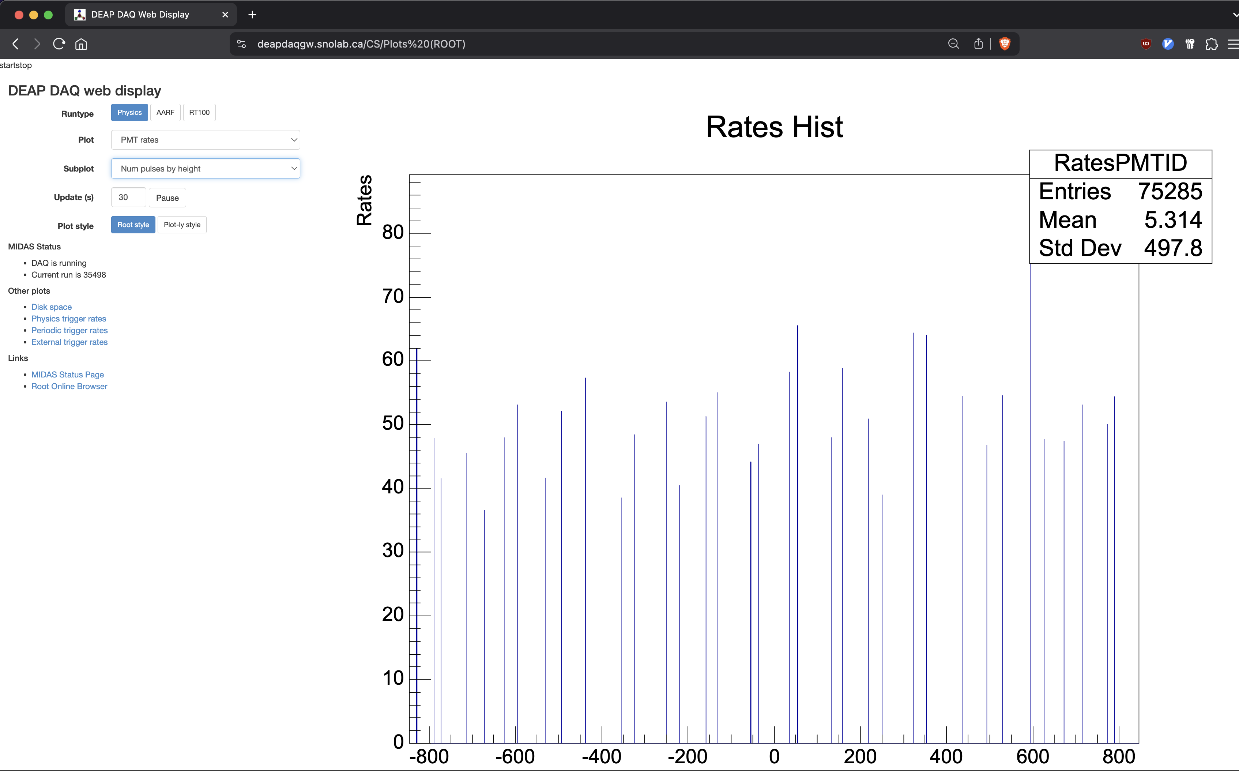
Real-time fill monitoring
Notes:
ROOT: I also added this fit and plot to the website so that the DEAP team can monitor the fill in real time
LEAF:
The reason there is no fit line and the data looks random is because there is no liquid argon currently in the detector and this screencap was taken this week.

Slide 15
Next Steps
AV Cooldown
Use the PMT rates with the efficiency corrections to fill the AV to the same level as the previous fill
Notes:
ROOT: The next steps are to..
LEAF:
Cool down the AV, and I'm happy to say this has officially started as of this week
and to use the pmt rates with the efficiency corrections to fill the AV to the same level as it was in 2016-2020

Slide 16
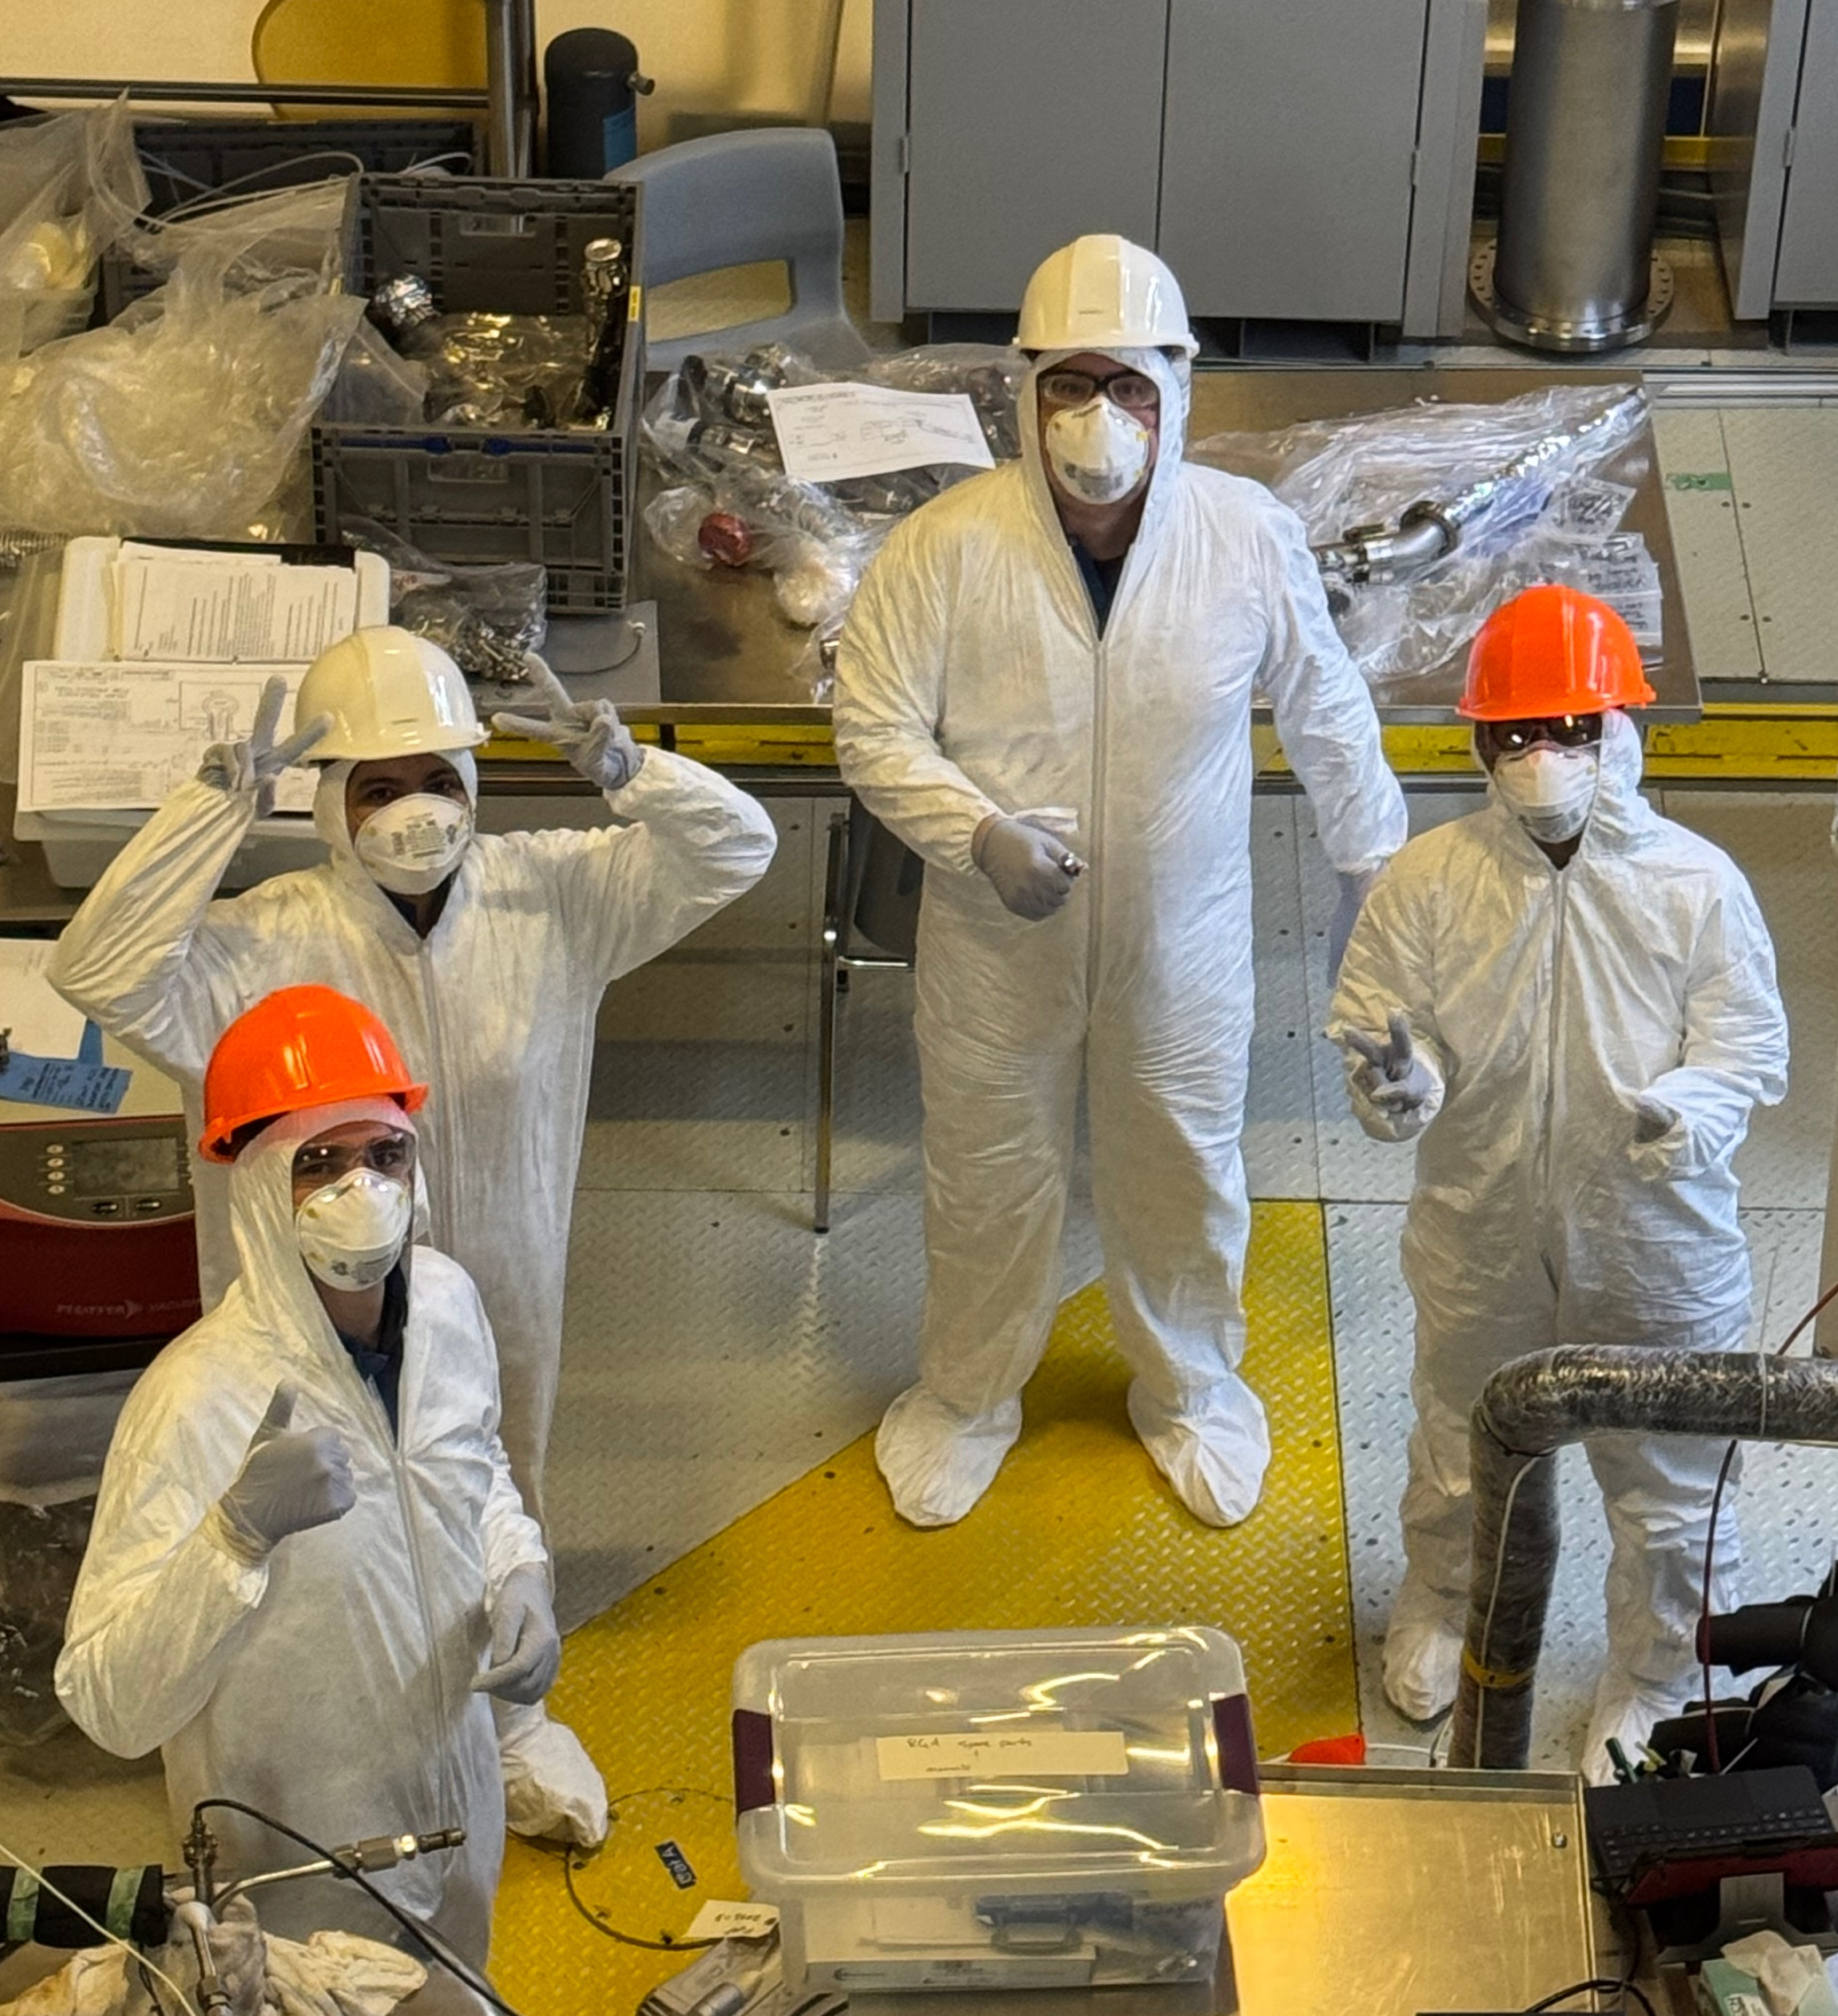
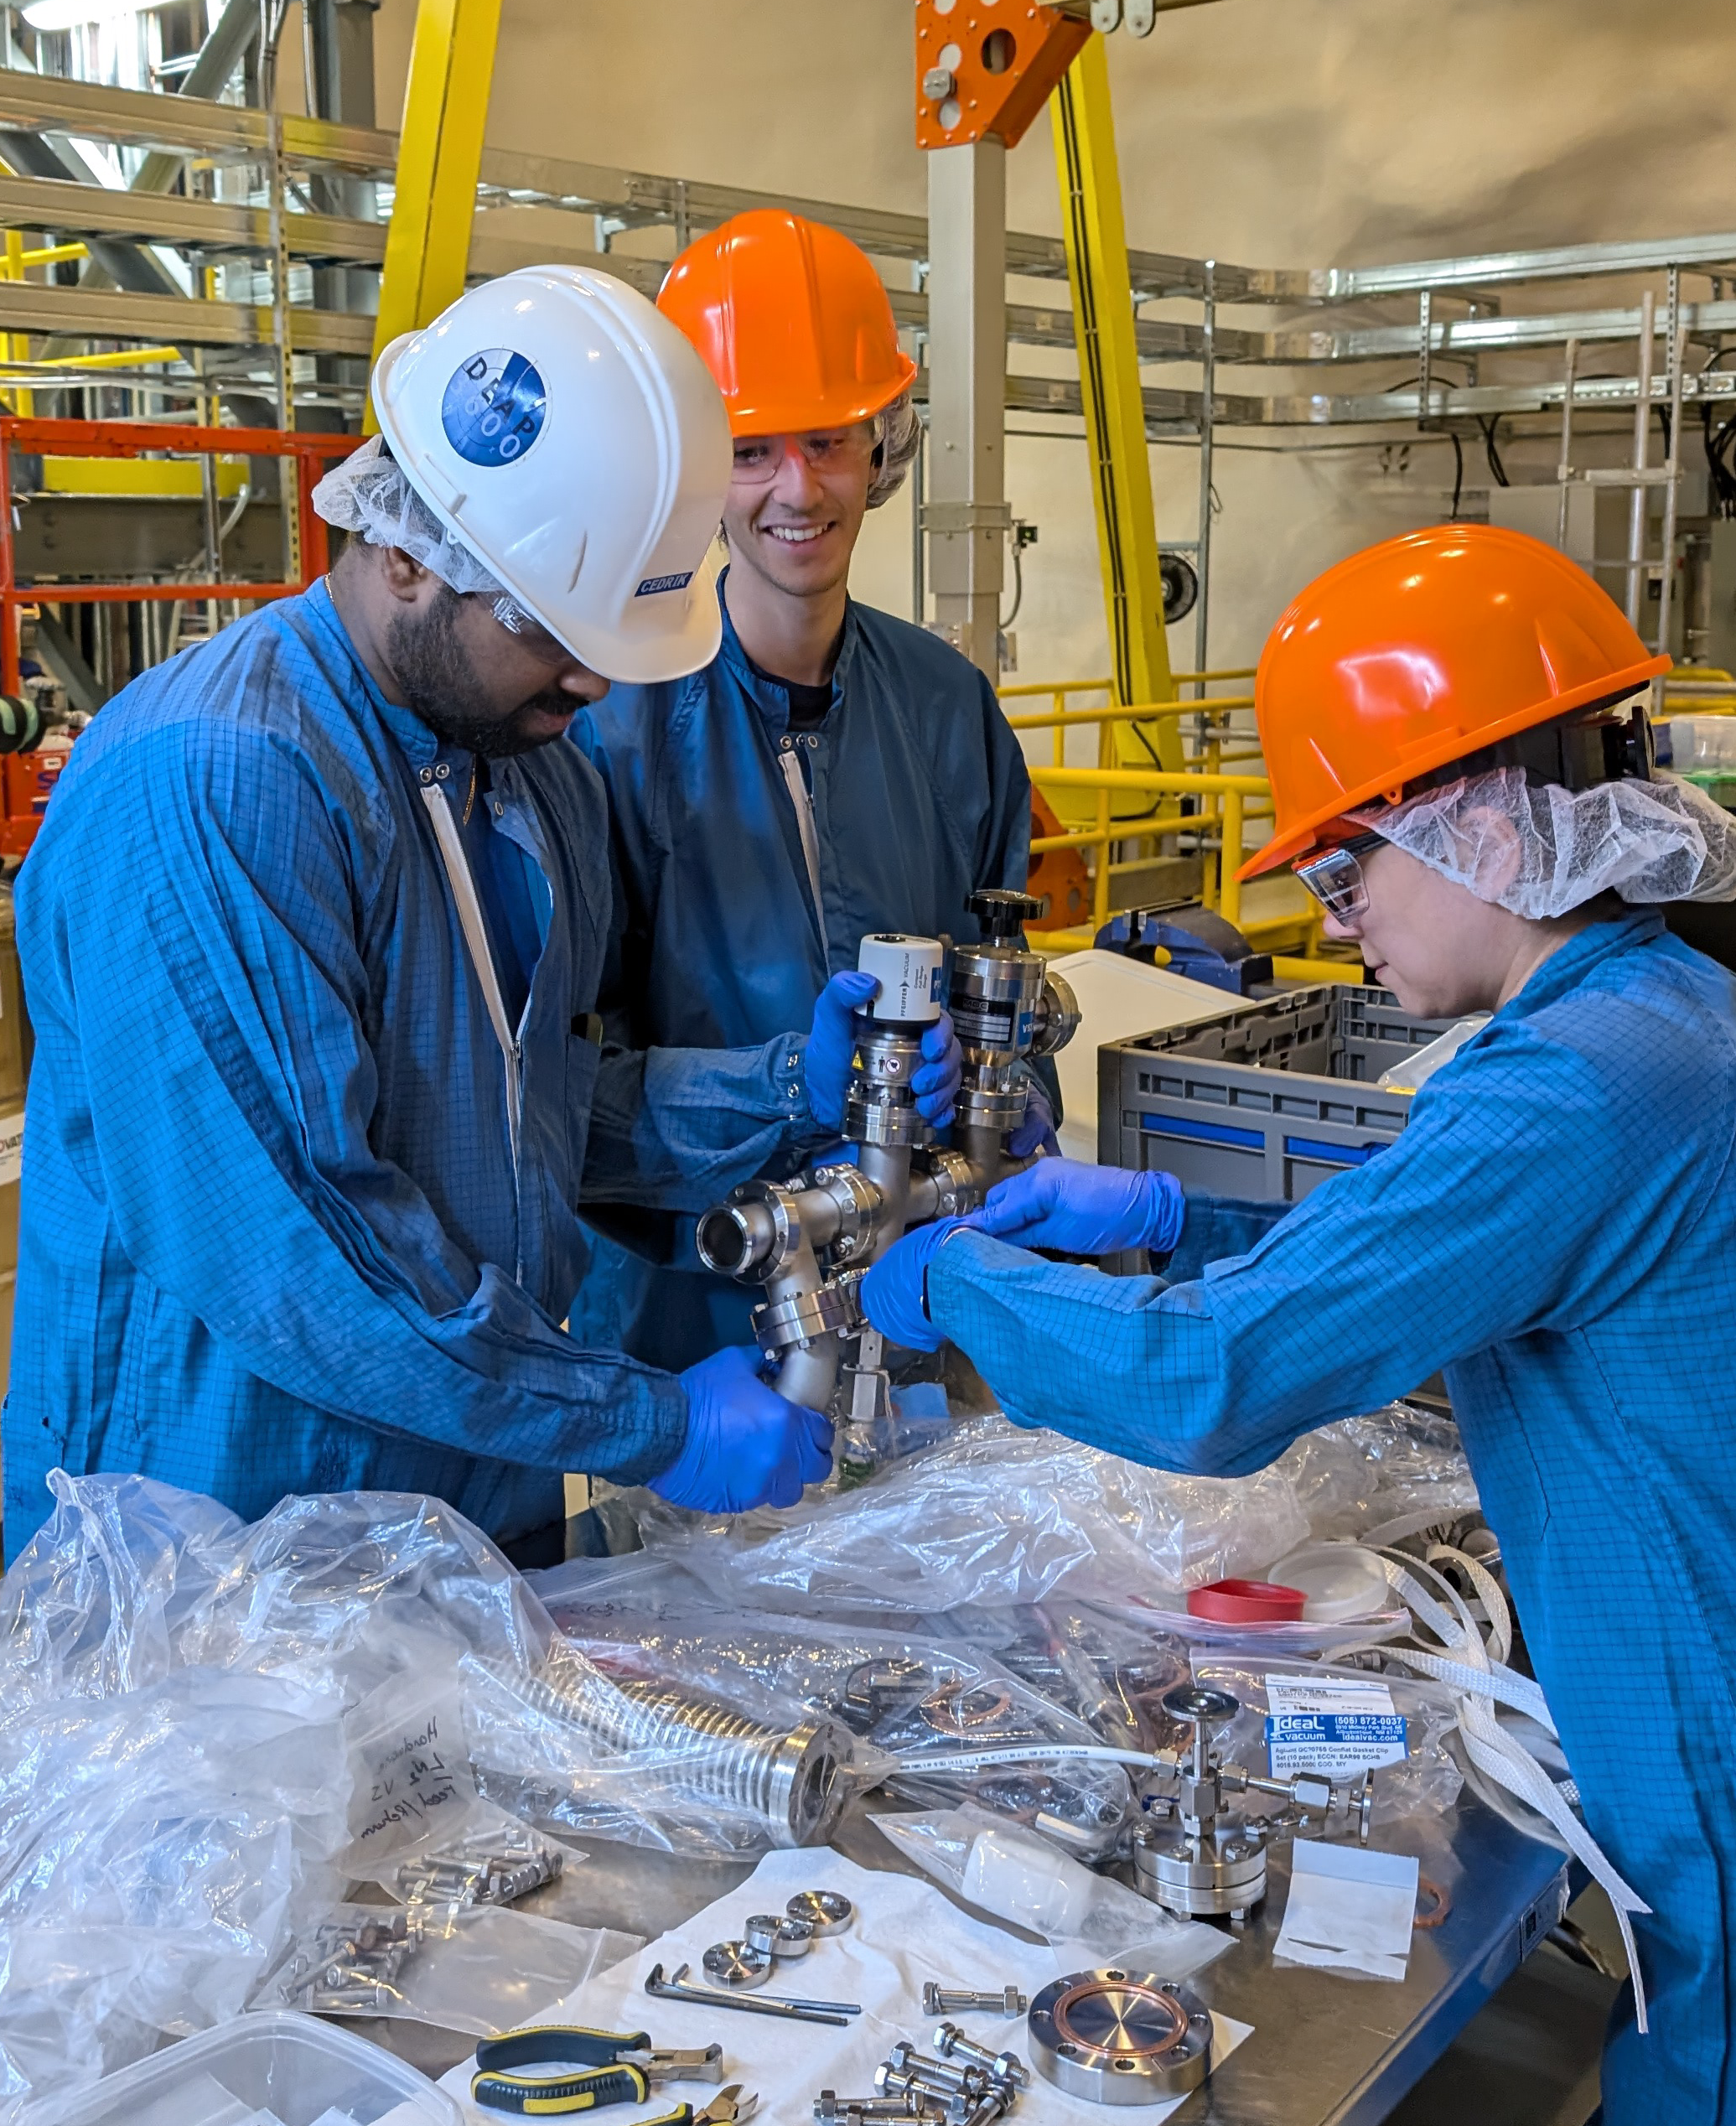
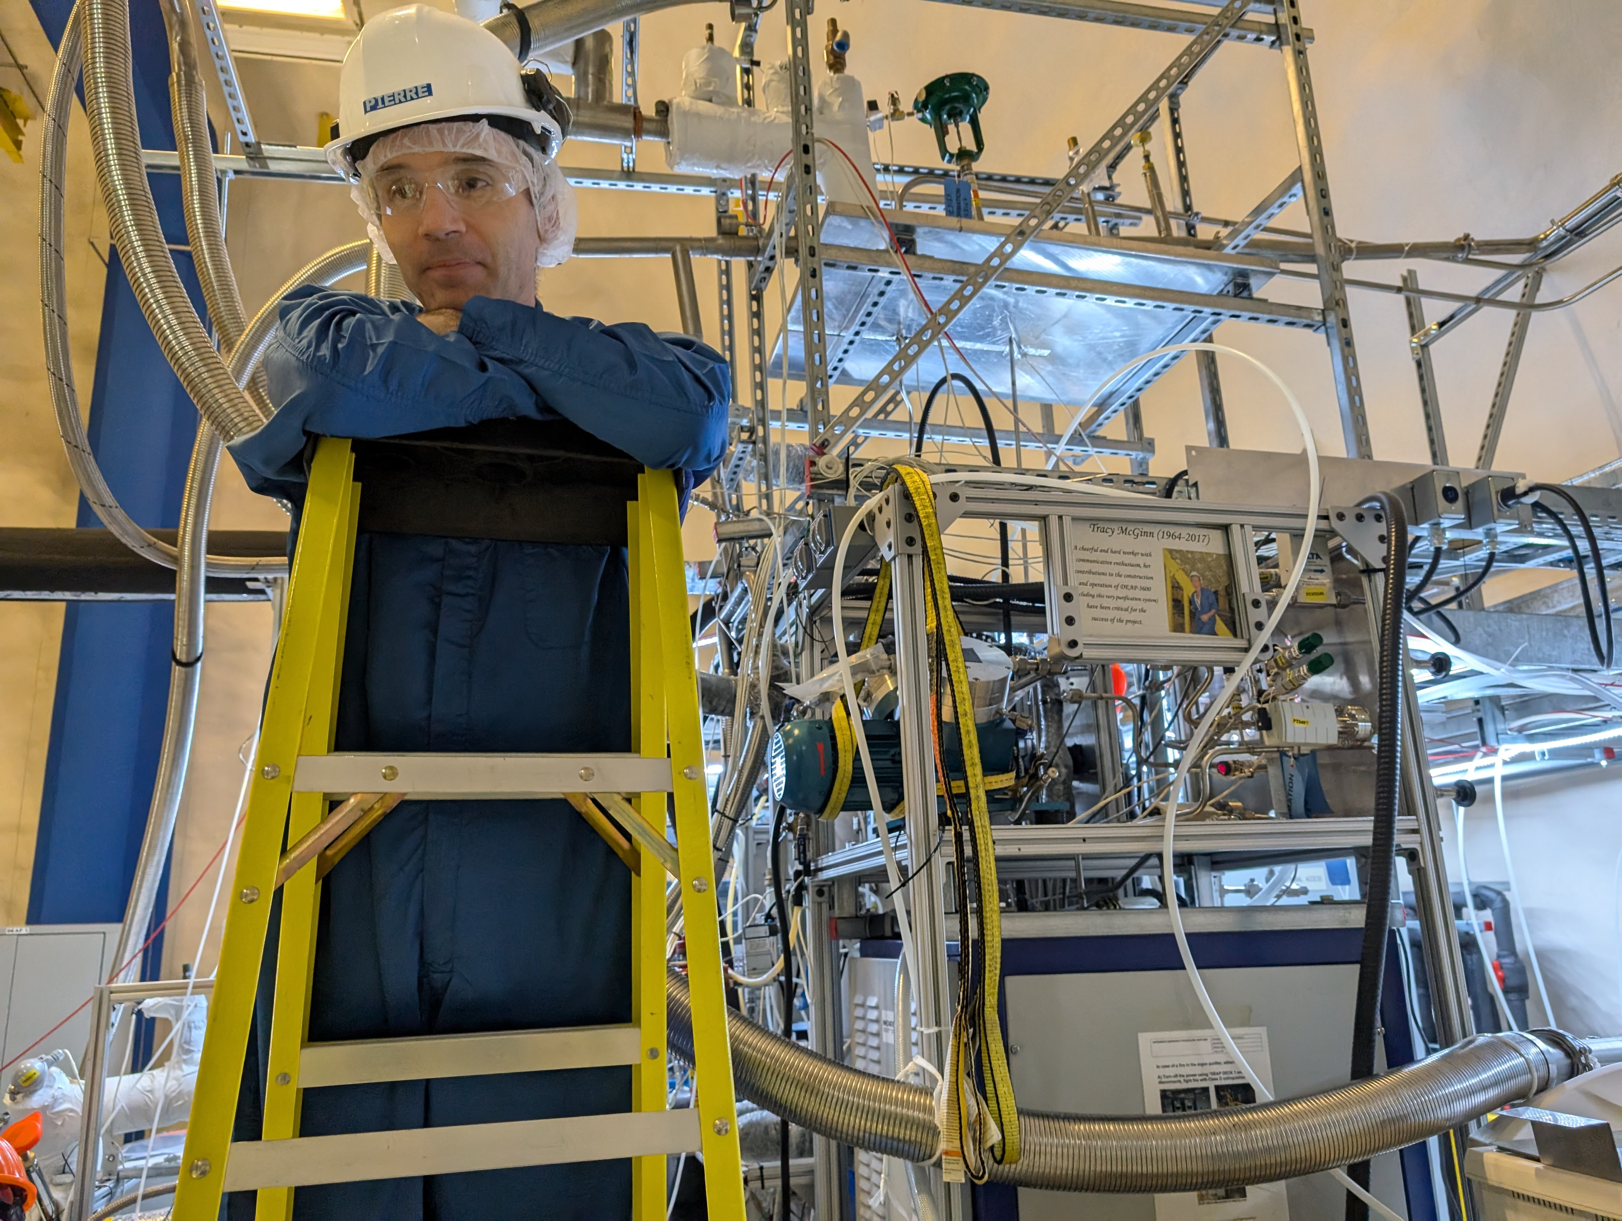
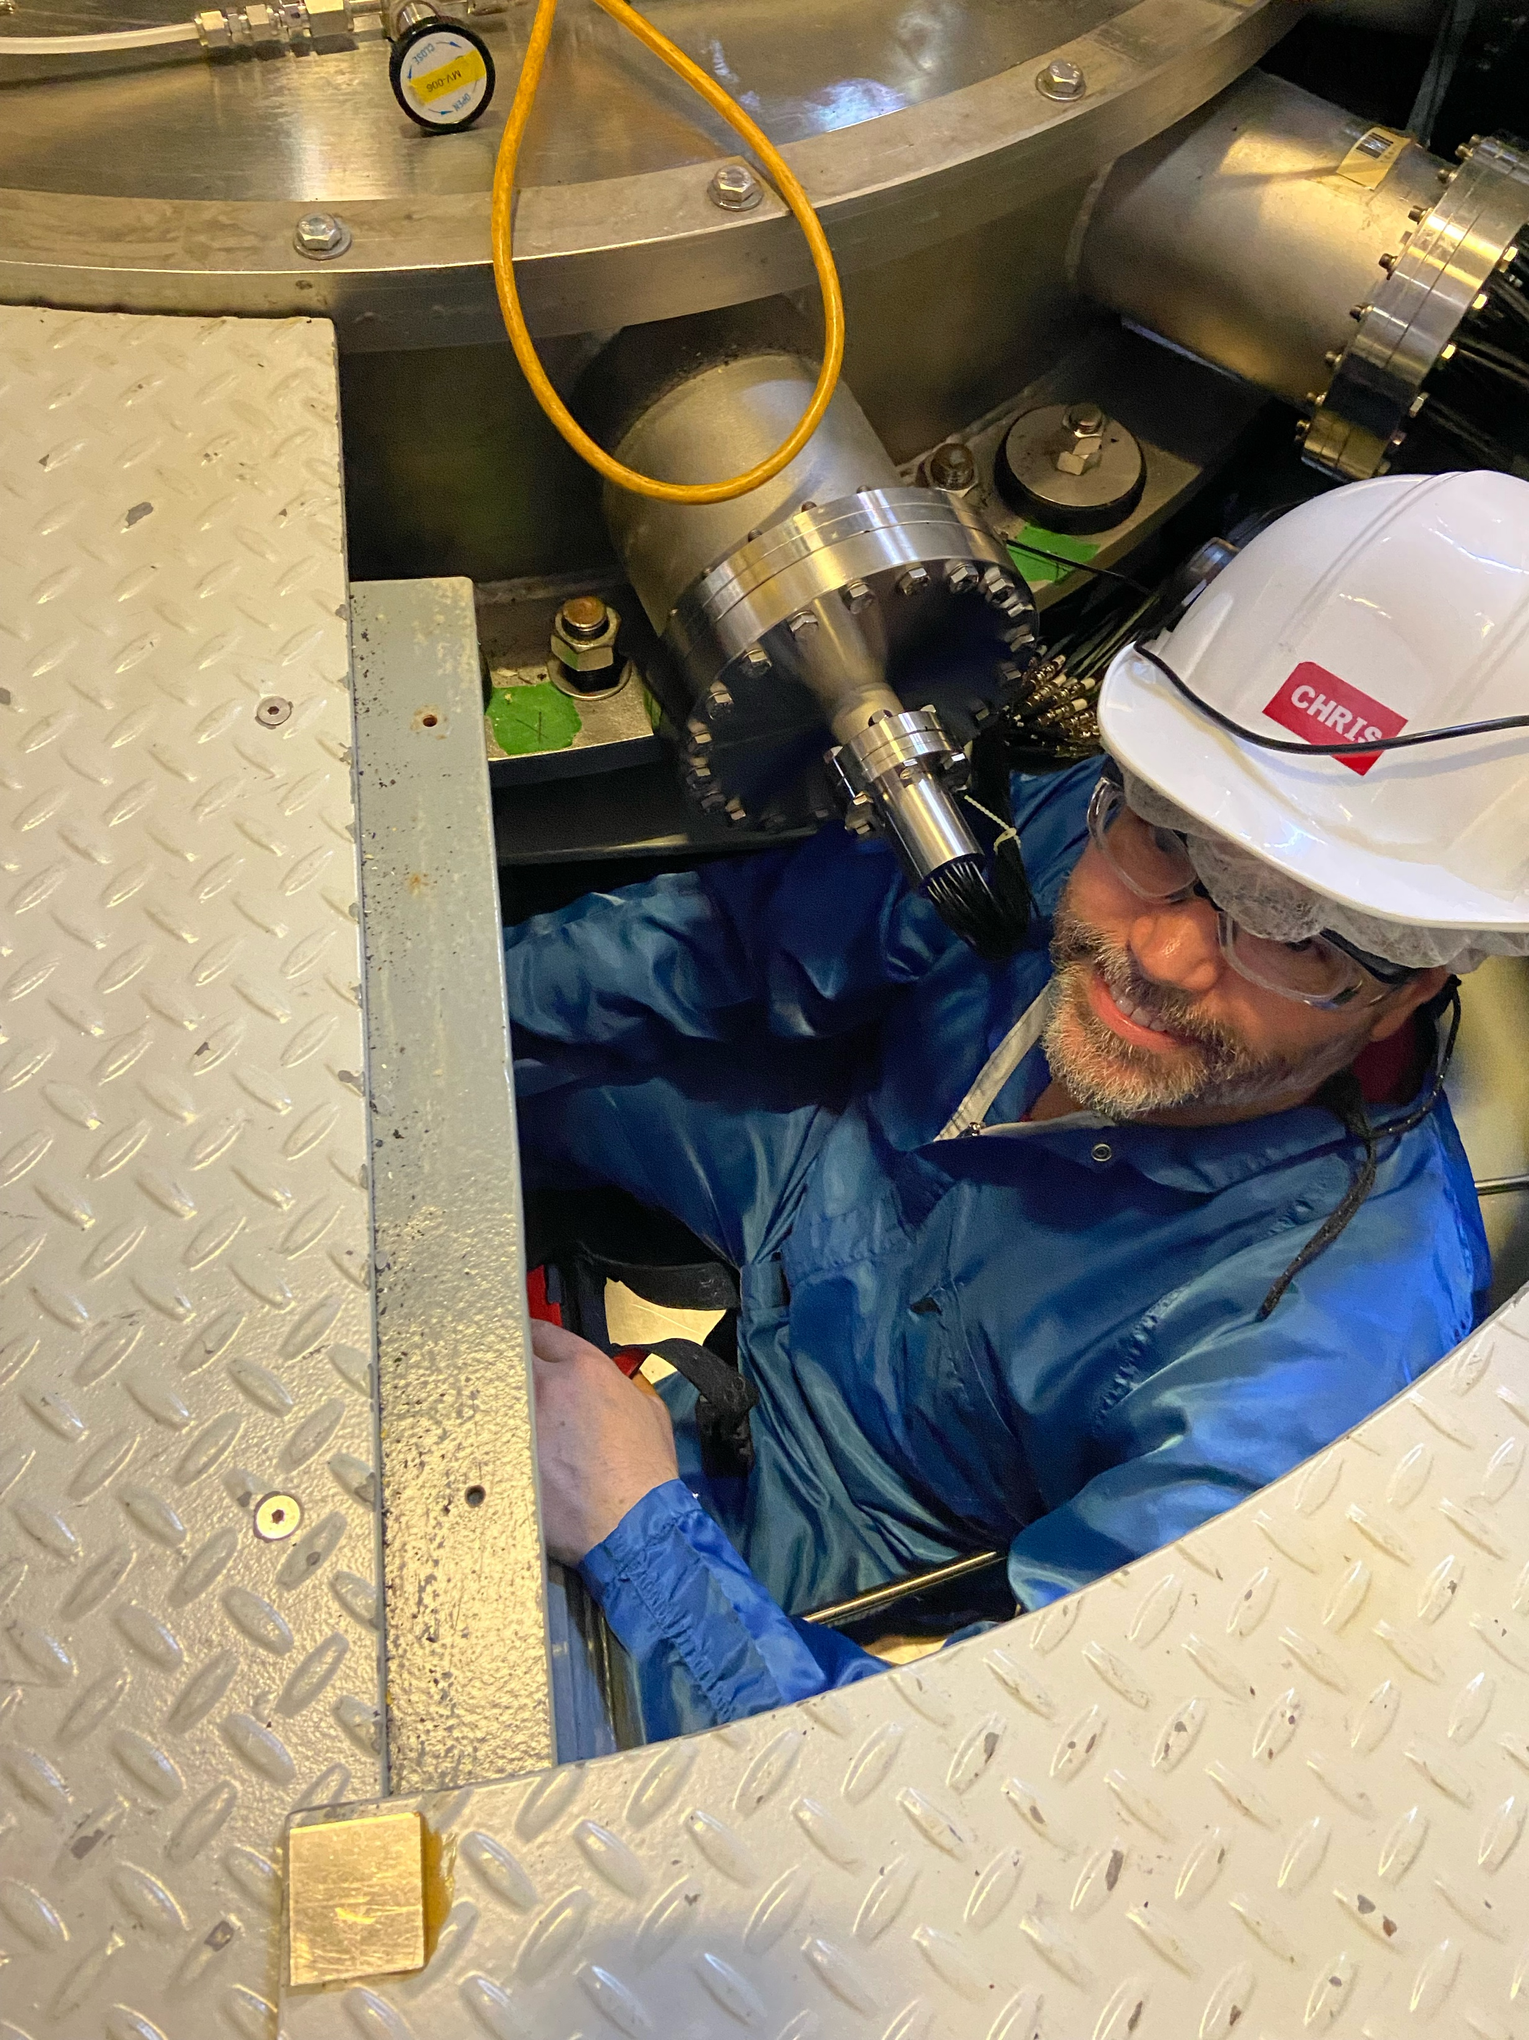
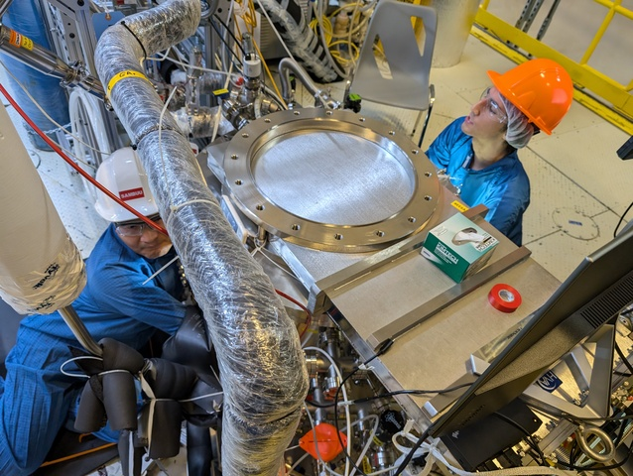
THANK YOU!
Notes:
I would like to give a very special thanks to my supervisor Chris Jillings and Pierre Gorel, as well as the underground team I had the pleasure of working with Sean, Cedrik, Sambuu, Theo, and Mona.
And also thank you to the other students and to you guys for not falling asleep during my talk.

