Slide 1
The Liquid Nitrogen Excluding Argon (LiNEAr) Project – A Cold Divorce
Charles Liu

Slide 2
A Radioactive Background
The LN2 from the UG LN2 plant is used for SNO+ scintillators, cover gas, cooling power
The plant produces nitrogen containing a 3% argon impurity, which can contain radioactive Ar-39
Goal: create ultra-pure nitrogen and argon via a set of distillation columns
 | LN2 Plant (Past 6 Months) | LN2 Plant (Upgraded)
Avg LN2 Production Rate (kg/hr) | 5.1 | 6.17
Peak LN2 Production (kg/hr) | 13.12 | 13.12
Notes:
The nitrogen plant underground is a great source for cooling power, cover gas, and can be used in experiments like for the SNO+ scintillators. This plant currently produces nitrogen containing a 3% argon impurity, which can partially be made of radioactive argon-39, which can have negative impacts on the sensitive experiments underground. So, our goal is to design a set of distillation columns capable of creating ultra pure nitrogen and argon. The nitrogen plant has produced about 5 kg/hr in the past 6 months and 6 kg/hr post upgrades, which will lead up to the specific design requirements.

Slide 3
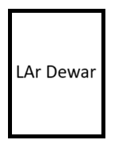
Initial Distillation Design Requirements
Feed of 5 kg/hr, better to slightly undersize than oversize for continuous
>99.9999% liquid purity (<1ppm impurities)
600 W max. cooling power from one cryocooler
All cooling sources should match in temperature
Cannot allow for argon to freeze,
Cannot pre-expand feed or go near 84K
97% N2, 3% Ar
3.7 bar
5 kg/hr
~100% LN2
1.4 bar
Distillation Columns
3
Notes:
Its always better to slightly undersize than oversize a column, since the stopping and starting procedures for continuous columns are wastes of both time and material. The plan is to route the nitrogen plant products through the distillation columns, which will then purify the material into liquid nitrogen, which will collect in the international dewar, and liquid argon, which can be siphoned out into its own dewar. Both should have impurities less than 1ppm, and this entire setup should be able to utilize a single 600 W cryocooler, which as a result, forces all points of cooling to share a temperature. We also can’t allow for the argon to freeze, so we can’t pre-expand the feed or go near 84K.

Slide 4
Initial Design Requirements
0.97 N2, 0.03 Ar
3.7 bar
5 kg/hr
~100% LN2
1.4 bar
Simulation streams
Recycle stream
Recycle lines
Aiming for >99.9999% liquid purity (<1ppm impurities)
600 W max. cooling power from one cryocooler
All cooling sources should match in temperature
Cannot allow for argon to freeze, so cannot pre-expand feed or go near 84K
Notes:
It’s better to slightly undersize the column than oversize it, as restart procedures for continuous columns waste tons of material and time while it’s moving to equilibrium, so we chose a 5 kg/hr flowrate. The LN2 plant will feed into the first distillation column, where purified nitrogen will come out of the top and routed to the international dewar. The bottoms product will then be fed into the 2nd column to output purified argon from the bottom. The waste stream would then be recycled back to the feed stream for reuse. We are aiming for products with less than 1ppm of impurities, using the condensing power of a single 600W cryocooler. As a result, all cooling points should be the same temperature as well. We can’t let the argon freeze and clog our lines, so we cannot expand the feed or go near 84K.

Slide 5
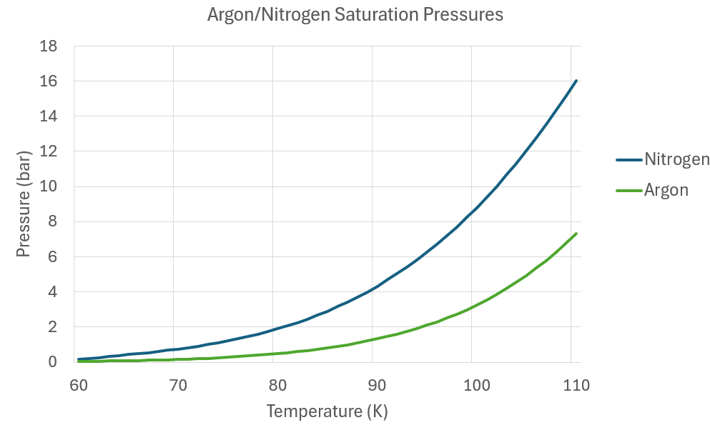
Condensing thermodynamics into two slides
Temperature
Notes:
So now let’s talk about the principles behind distillation. Different molecules have differing intermolecular forces with each other due to their structure, and as a result, have different temperatures at which they boil at a single pressure. Let’s imagine a tray filled with liquid nitrogen and argon in equal ratios. If we were to heat the trap, a lot more nitrogen would start evaporating relative to argon, since nitrogen is the more volatile substance.

Slide 6
Temperature
Notes:
Now let's add a tray above this one, and poke holes in it so some mass can travel between trays. Once the vapour hits the new tray, which sits at a slightly colder temperature, some nitrogen and some argon will condense to liquid, which could flow back down, but in this new tray, theres much more nitrogen relative to argon, a purer composition. Keep repeating this with more and more trays, and you will have more of the more volatile component as you go up.

Slide 7
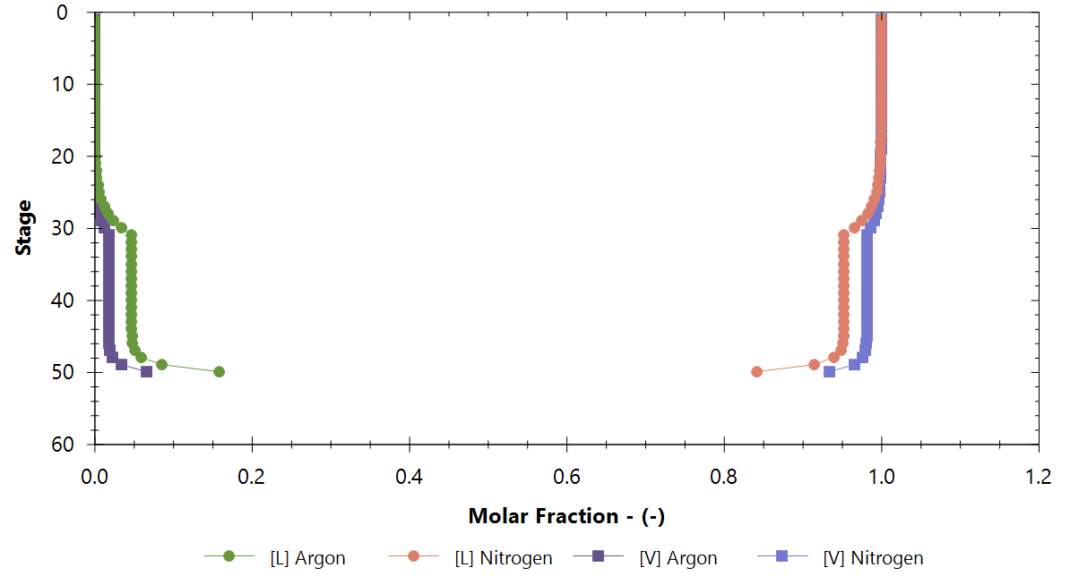
Temperature
Notes:
Now let's add a tray above this one, and poke holes in it so some mass can travel between trays. Once the vapour hits the new tray, which sits at a slightly colder temperature, some nitrogen and some argon will condense to liquid, which could flow back down, but in this new tray, theres much more nitrogen relative to argon, a purer composition. Keep repeating this with more and more trays, and you will have more of the more volatile component as you go up.

Slide 8
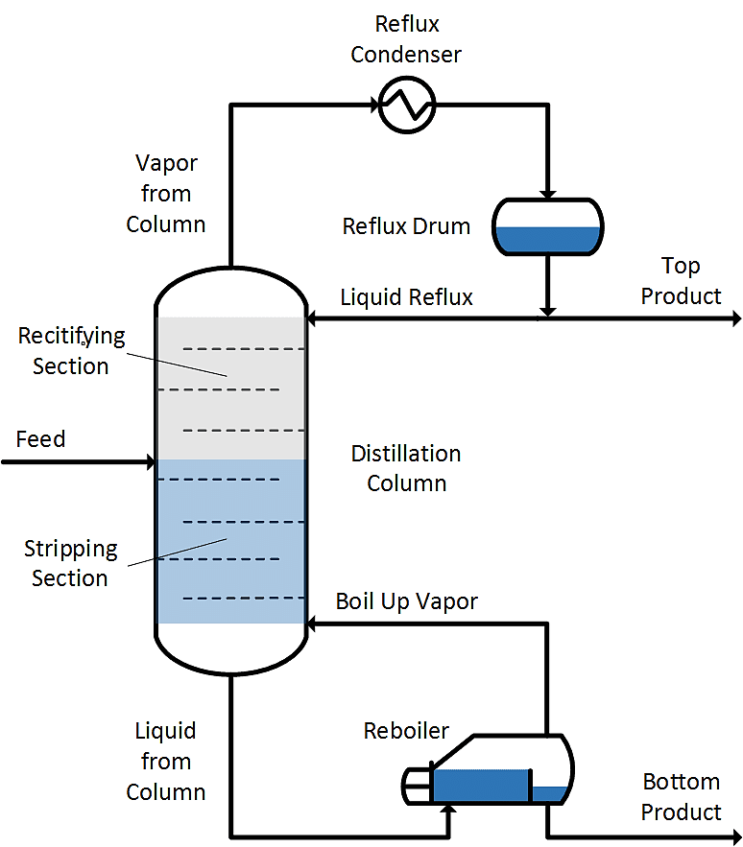
A distillation is a tower of high surface area trays intended for separating two or more components
Up-Flowing Vapour
DWSIM: an open-source chemical processing simulation for column calculations
The contact between the counterflowing L-V phases facilitates mass transfer (purification)
Packed beds will be used instead of traditional trays
Lower pressure drop across bed
Reflux ratio = $\frac{\text{Liquid} \text{Reflux} \text{Flowrate}}{\text{Top} \text{Product} \text{Flowrate}}$
Higher reflux means higher energy duties and higher purity
Down-Flowing Liquid
Heater
5
Notes:
And that is a distillation column, a tower of trays that separates two or more components based on differing boiling points. This contact between the vapour and liquid phase is also what facilitates the interphasial mass transfer, the purity. We have a heater that partially boils up incoming liquid at the bottom, with some of it being outputted as bottoms product, and we have a condenser at the very top that partially condenses the incoming vapour, returning some of it back into the column, and outputting some as the tops product. Our columns will be using a packed bed as opposed to traditional trays, since it has a much lower pressure drop. One important term I’ll be referring to is the reflux ratio, which is the fraction of liquid being returned into the colum divided by the tops output flowrate. This return of liquid increases the subsequent purity of the output, basically re-cycling the liquid through the column again, allowing us to minimize the trays we need.

Slide 9
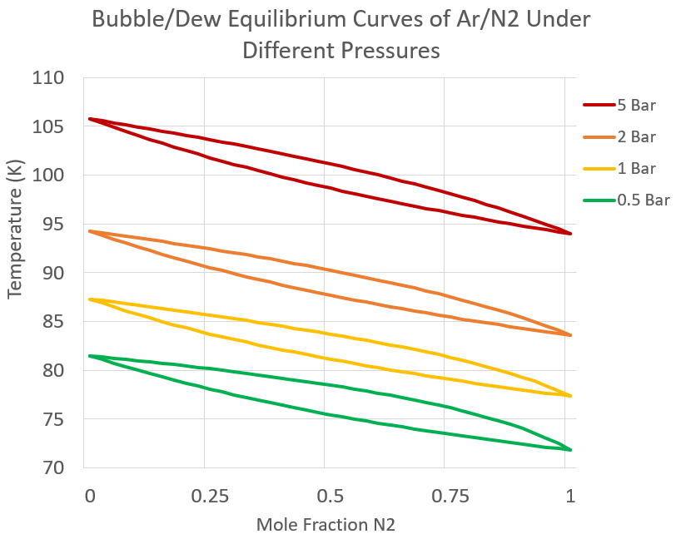
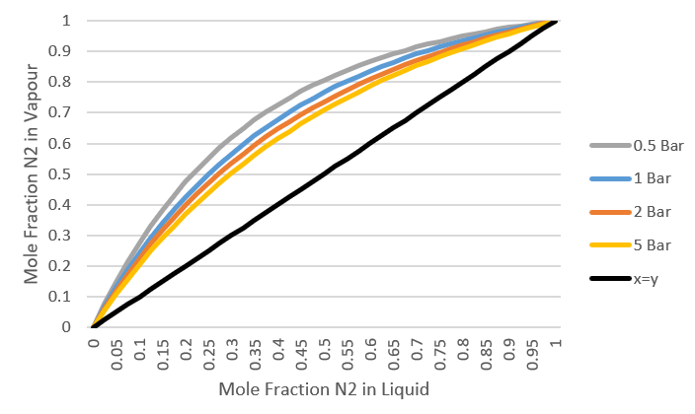
The L-V pocket is the range where distillation occurs.
Column pressure and pressure drop changes the boiling points of components
The lower the pressure, the more dissimilar the liquid and vapour phase compositions are from each other, providing a basis for separation
Stream Comp.
Vapour Comp.
Liquid Comp.
6
Notes:
Column pressure and pressure drop affects how efficient a distillation process is. Any column will only operate within the liquid vapour pocket sitting between the dew and bubble equilibrium lines, and the temperatures at which you distill at, as well as the pressures, will affect the size of this pocket. The lower the pressure, the larger this pocket is, allowing for easier distillation to occur since you can have higher dissimilarities between your phases.

Slide 10
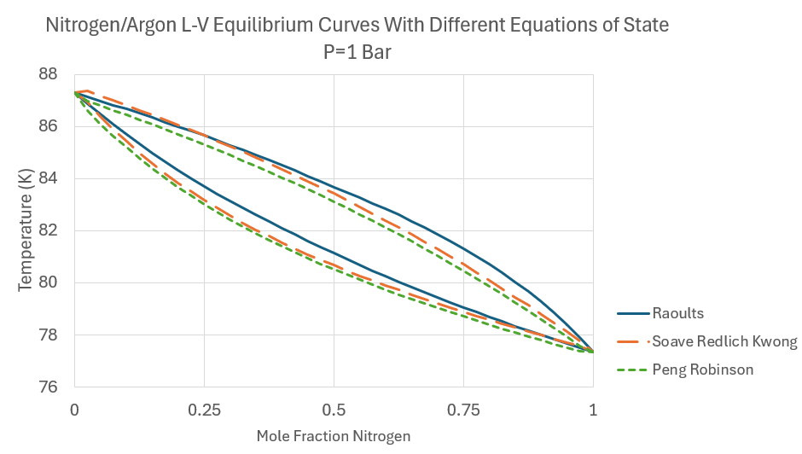
Raoults: Assumes ideality
Forces between two unlike components are the same.
Alternative correlations are usually based on hydrocarbons so aren’t as accurate
7
Notes:
The equation of state used assumed ideality with Raoults law, assuming that the forces between two unlike components are the same, which is a good enough assumption since nitrogen and argon are both relatively small and nonpolar. Other alternative correllations are fitted for hydrocarbons, so wouldn’t be as good of a fit.

Slide 11
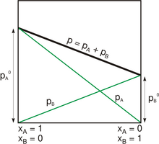
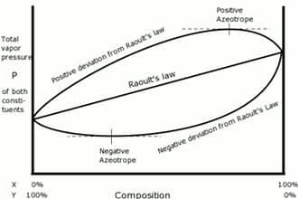

Slide 12
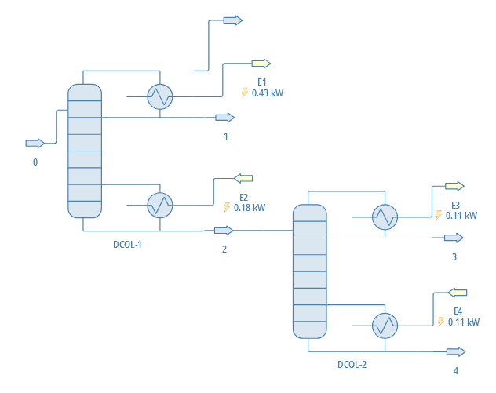
Down to the basics
0.43 kW
90.3 K
3.7 bar
3.7 bar
90.3 K
4 kg/hr LN2
0.28 ppm impurity
3.7 bar
91 K
5 kg/hr
97% N2, 3% Ar
0.11 kW
90.3 K
0.18 kW
3.7 bar
3.7 bar
90.3 K
0.79 kg/hr LN2
15 ppm impurity
50 stages
We condense the tops products directly
Unable to obtain LN2 purities >99.99% for all streams for given cooling power
0.11 kW
3.7 bar
101.6 K
0.21 kg/hr LAr
2 ppm impurity
50 stages
8
Notes:
The most basic design is just two distillation columns, with an intake of 5 kg/hr from the nitrogen plant, we can directly condense the tops product into nitrogen, route the bottoms liquid to the second column, and distill to create a bottoms of liquid argon and tops of nitrogen. Due to our constraints however, we don’t have enough power to get the desired purities for the nitrogen in the second column.

Slide 13
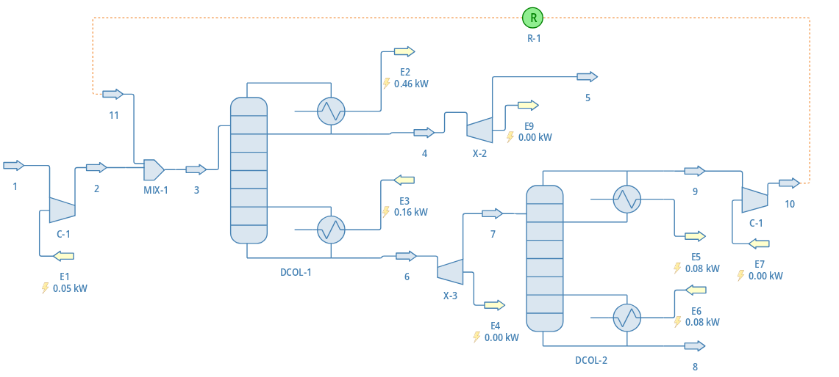
Recycling old material, Slinging a Pressure Swing
1.4 bar
80 K
4.79 kg/hr LN2
0.5 ppm impurity
0.46 kW
91.8 K
3.7 bar
3.7 bar
105.1 K
0.19 kg/hr
76% N2, 24% Ar
3.7 bar
91 K
5 kg/hr
97% N2, 3% Ar
3 bar
0.16 kW
0.08 kW
91.8 K
Compressor
50 stages
0.08 kW
Expander
3 bar
99 K
0.21 kg/hr
0.5 ppm impurity
We can recycle the waste tops stream to purify further
Pressure swing distillation is required to maintain condenser temperatures
30 stages
9
Notes:
So, we can add a recycle stream on the 2nd nitrogen stream, to recycle and repurify any nitrogen out of the system. Constantly flowing less than pure nitrogen through the system means that our waste stream will be a differing composition than our liquid nitrogen output, meaning that our condensing temperatures will be different between the tops of the two columns. As a result, to ensure that these values match, we must create a pressure swing in our system, resulting in a network of compressors and expanders. This does help, with both our nitrogen and argon products sufficiently pure, but we can make this more efficient.

Slide 14
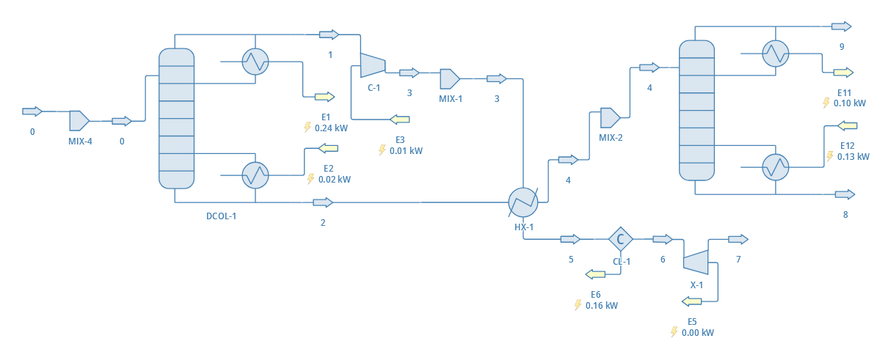
Compromising on an exchange

Slide 15
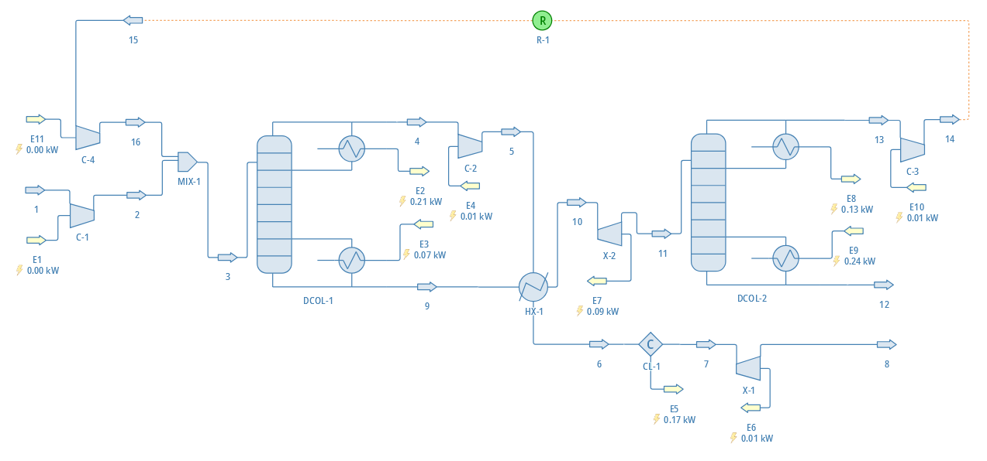
A Heated exchange
2.79 kg/hr
0.21 kW
90.3 K
5 bar
101.1 K
0.13 kW
90.3 K
3.7 bar
3 bar
3.7 bar
91 K
5 kg/hr
97% N2, 3% Ar
93 K
3 bar
99 K
0.21 kg/hr Ar
0.8 ppm impurity
0.07 kW
0.24 kW
50 stages
91.9 K
0.17 kW
40 stages
1.4 bar
80.2 K
4.79 kg/hr LN2
0.5 ppm impurity
Instead of directly condensing VN2, we compress it
Heat exchanger saves on cooling power by partially condensing part of the purified N2, vapourizing the bottoms (exchanges 100 W, 70% efficient)
Cooling power saved scales with the mass flow
94 K
90.3 K
10
Notes:
By adding a heat exchanger to the system, we utilize more cooling power than if we directly condensed. We can compress the purified nitrogen vapour to 5 bars instead of condensing it to make the tops product warmer than the bottoms, so that when we heat exchange, we can condense some of the nitrogen vapour, while vapourizing a portion of the argon rich bottoms, reducing cooler load. The purified argon is outputted from the bottom of the 2nd column, and we still can recycle the waste tops stream in the 2nd column with our pressure swing implemented. This setup also allows us to scale with the input flow, with more cooling power being saved with higher feed flowrates.

Slide 16
The Recycled Heat Exchange Columns
Defined Constraints
Simulation Results
Purity Targets
2.79 kg/hr (V)
3.7 bar
98.3 K
0.85 N2
4.79 kg/hr (V)
3.7 bar
90.3 K
0.5ppm Impurities
2.79 kg/hr (V)
3 bar
90.4 K
0.85 N2
5 bar
101.1 K
93.5 K
0.93 N2
5 kg/hr (V)
3.7 bar
91 K
0.97 N2
93 K
90.3 K
0.2112 kg/hr (L)
3 bar
99 K
0.8ppm Impurities
3 kg/hr (L)
3.7 bar
91.9 K
0.8 N2
94 K
90.3 K
DCOL-1
 | Condenser Duty (kW) | 0.21
 | Reboiler Duty (kW) | 0.07
DCOL-2 | Condenser Duty (kW) | 0.13
 | Reboiler Duty (kW) | 0.24
Cooler Duty (kW) |  | 0.17
Compressor/Expander Duty (kW) |  | 0.13
4.79 kg/hr
(0.91L+V)
1.4 bar
80.2 K
0.5ppm Impurities

Slide 17
The Heat Exchange Columns
Defined Constraints
Simulation Results
Purity Targets
2.79 kg/hr (V)
3.7 bar
98.3 K
0.85 N2
4.79 kg/hr (V)
3.7 bar
90.3 K
0.5ppm Impurities
2.79 kg/hr (V)
3 bar
90.4 K
0.85 N2
5 bar
101.1 K
93.5 K
0.93 N2
5 kg/hr (V)
3.7 bar
91 K
0.97 N2
93 K
90.3 K
0.2112 kg/hr (L)
3 bar
99 K
0.8ppm Impurities
3 kg/hr (L)
3.7 bar
91.9 K
0.8 N2
94 K
90.3 K
4.79 kg/hr
(0.91L+V)
1.4 bar
80.2 K
0.5ppm Impurities
Heat exchanger saves on condensing power, vapourizing the bottoms
Cooling power saved scales with the mass flow, higher ceiling with condenser restrictions

Slide 18
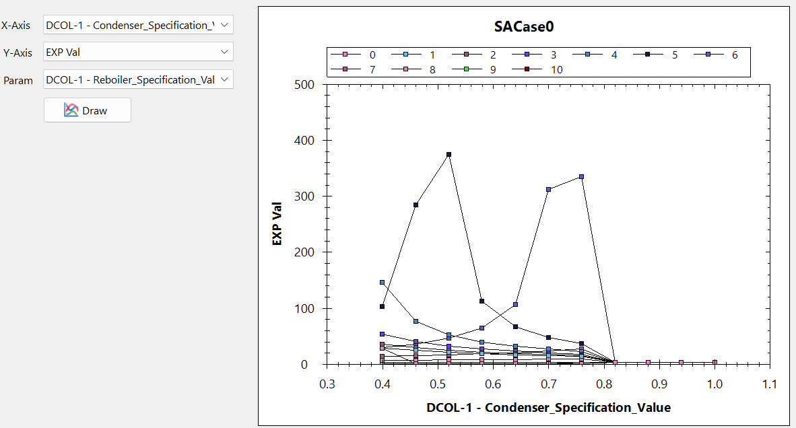
Reflux Ratio vs Output LN2 kg/hr-kW for 10 bottoms flows (kg/hr)
We can use sensitivity tests and optimization methods to find ideal operating parameters
Reflux ratio and bottoms flowrate can be controlled to maximize heat exchanger and column efficiency
5 kg/hr
4 kg/hr
Output LN2/kW
Reflux Ratio
11
Notes:
We can optimize our parameters by conducting optimization runs and sensitivity tests to maximize the LN2 produced per kW used, for example with the previous system without the recycle stream, we can see two peaks in efficiency. This gets much more difficult with systems with recycle streams though, and manual tests were done instead.

Slide 19
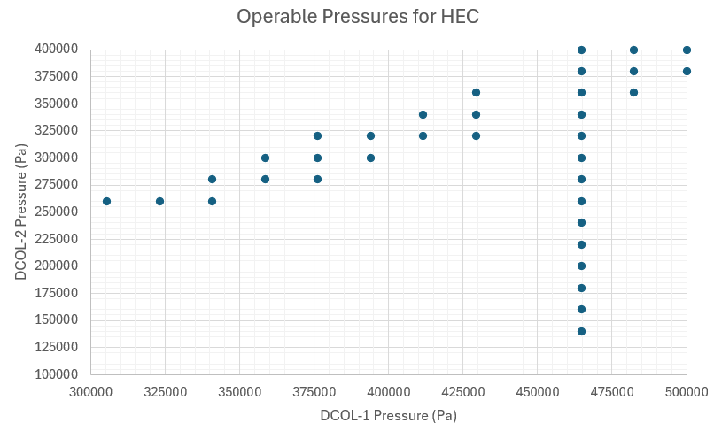
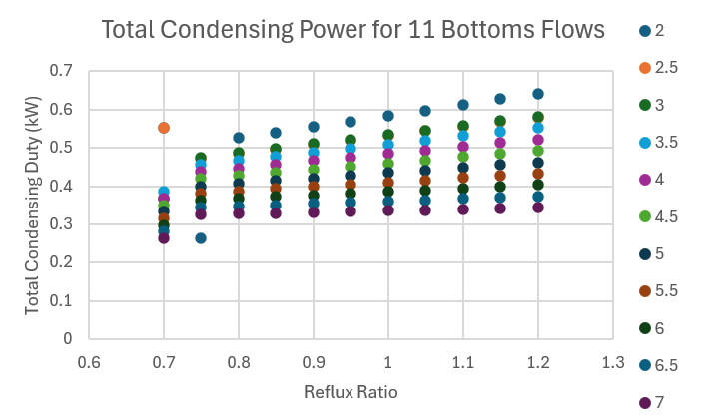
Operating Variations

Slide 20
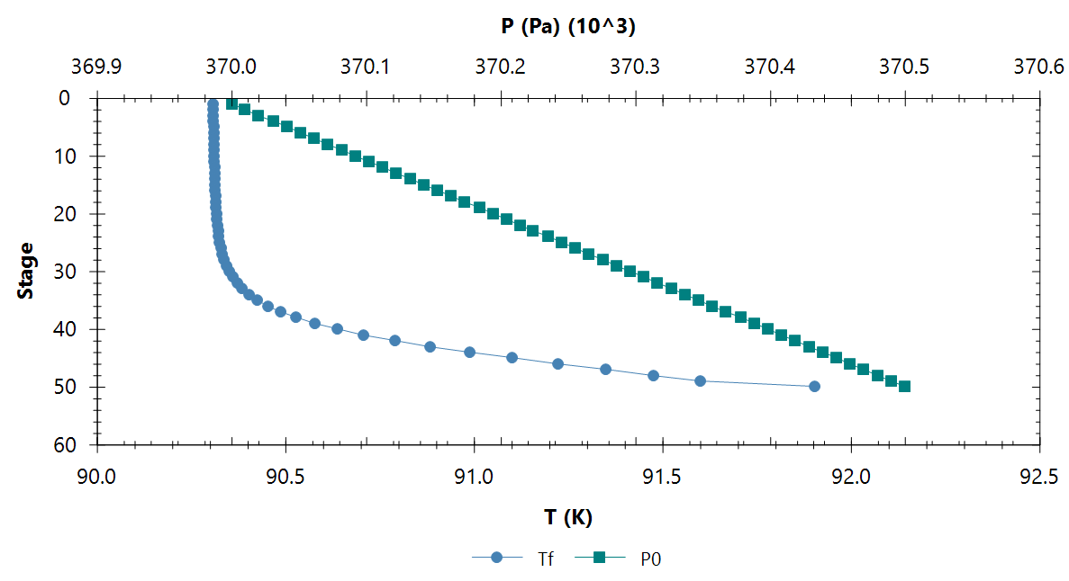
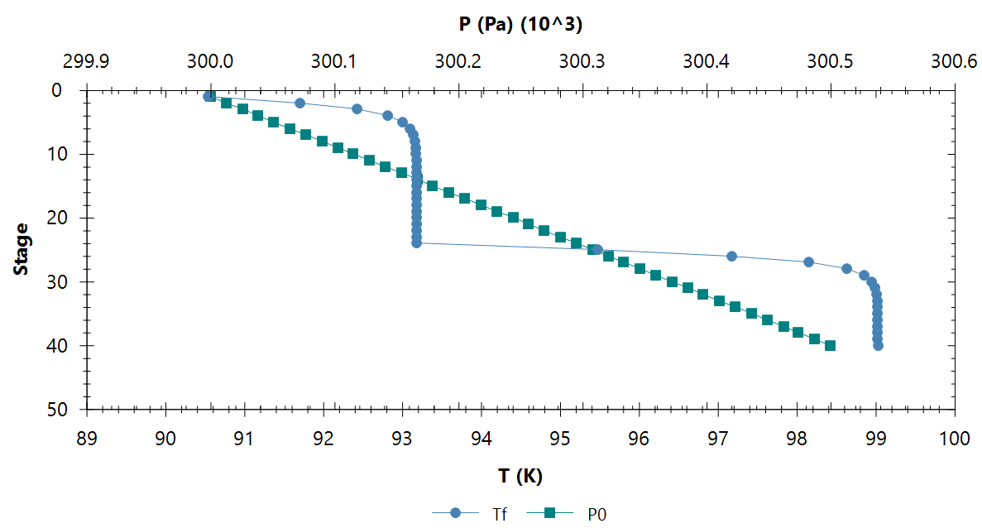
P-T Profiles
DCOL1
DCOL-1
 | Stages | 50
 | Stage 1 Pressure (bar) | 3.7
 | Condenser Duty (kW) | 0.21
 | Reboiler Duty (kW) | 0.07
DCOL-2 | Stages | 40
 | Stage 1 Pressure (bar) | 3
 | Condenser Duty (kW) | 0.13
 | Reboiler Duty (kW) | 0.24
Cooler Duty (kW) |  | 0.17
Compressor/Expander Duty (kW) |  | 0.13
DCOL2

Slide 21
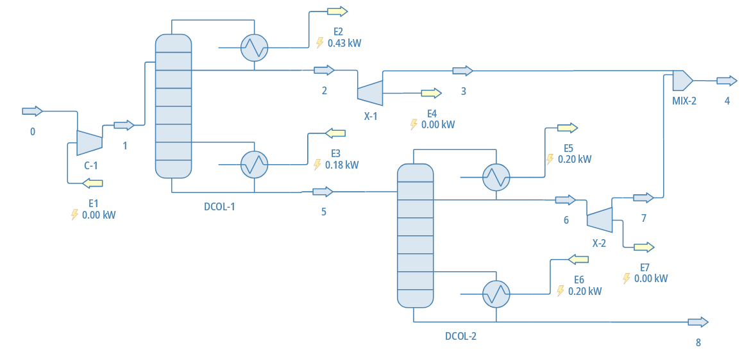
Salvation: the Suggestion of the Second Condenser
3.7 bar
0.43 kW
90.3 K
1.4 bar
80 K
4.79 kg/hr LN2
0.3 ppm impurity
3.7 bar
91 K
5 kg/hr
97% N2, 3% Ar
0.07 kW
0.2 kW
90.3 K
3 bar
50 stages
A 2nd condenser allows for a much larger cooling ceiling, simplifying the setup significantly
Allows the 2nd column to purify Ar/N2 enough to not need a recycle or waste stream
While condensers (100k) are more expensive than a heat exchanger (22k), they usually are much more reliable
0.2 kW
3.7 bar
101 K
0.21 kg/hr Ar
1 ppm impurity
40 stages
12
Notes:
We also could potentially justify budget for a second condenser, which would simplify the system significantly, as it gives us much more freedom in setting parameters. We would have enough power to directly condense and purify all streams, like the simplest setup we had. However now, we aren’t limited by only 600 W and we can even run the columns at differing condensing temperatures without differing pressures. While a 2nd condenser would cost 100k compared to a heat exchangers 20k, the simplified and easier to control setup, as well as the extra cooling power we could use may be worth the extra money. Future steps in this project include zeroing in on what exactly we can justify for budget to select the right build, and sending it off to an engineering team for their approval of the setup.

Slide 22
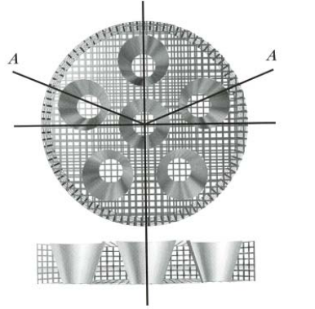
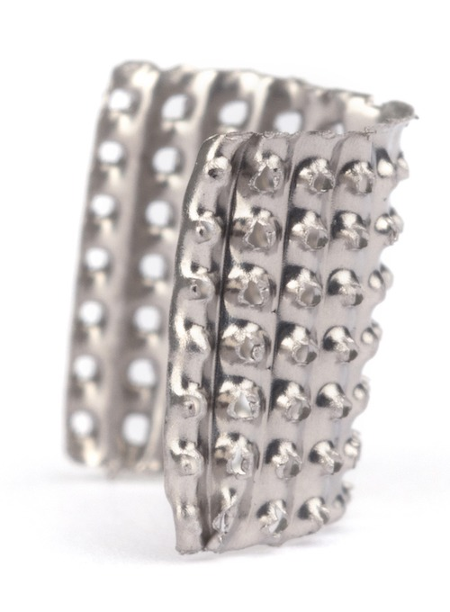
The Live Adaption
ProPak Packing Material
13
0.16” Propak
Column Diameter (in) | Type | Extrapolation (Pa/m) | Stichlmair Correlation (Pa/m) | PDS Derived (Pa/m)
2 | Vel vs ΔP | 113.98 | 805.42 | 540.74
 | Reflux vs ΔP | 9
4 | Vel vs ΔP | 23.75 | 51.7 | 63.13
 | Reflux vs ΔP | 35.51
Packing Support Trays
Public data and general correlations show low accuracy for pressure drop for packing
Must rely on manufacturer empirically derived data
Column height depends on Height Equivalent Theoretical Plate (HETP)
Determined from empirically derived data
Column diameter is dependent on Maximum Allowable Vapour (MAV%)
Too much and flooding occurs, too little and there isn’t sufficient L-V exchange
Feed Flowrate (kg/hr) | Column ID | HETP (m) | Pressure Drop (Pa/50 stages) | Flooding Max Allowable Vapour (MAV%)
10.2 | 2” | 0.035 | 946.29 | 77.58
 | 4” | 0.042 | 132.575 | 19.4
27.132 | 2” | - | - | -
 | 4” | 0.045 | 226.785 | 32.26
Notes:
Pressure drop in a packed bed is highly dependent on the packing material and shape, in the top righ. Comparing extrapolated the public manufacturer data to a generic packed bed correlations to their empirically derived internal data, shows wildly different results in pressure drop. The internal empirical data is most accurate and is column specific. The Height Equivalent Theoretical Plate equates the separation efficiency of a certain height of packing to a tray, which itself varies depending on flowrates and densities, which determines the height of our column. To get the width requirements of our column, we need the Maximum Allowable Vapour values, to prevent liquid accumulation in the columns, which ideally should sit between 20-80%. Too much and you flood, too little and there isn’t enough liquid vapour contact. Currently we are looking at a 2” diameter column to accommodate our input.

Slide 23
0.24 Propak
Column Diameter (in) | Type | Extrapolation (Pa/m) | Stichlmair Correlation (Pa/m) | PDS Derived (Pa/m)
4 | Vel vs P | 164.05 | 27.80 | -
 | Reflux vs P | 18.78

Slide 24
Side quests: The Cleanroom Chamber
14
Zeolites are porous crystalline aluminosilicates capable of filtering out argon from nitrogen
Ar/N2 mixtures pumped through the chamber or the bypass to observe adsorption capabilities of the zeolite using the RGA
Argon is much more polarizable and so has a higher affinity to doped zeolites.
Ar
2
Pressure Release Valve
FC
1
N2
FC
FC
4
6
To atm
3
To atm
5
RGA
Quick Connect
Notes:
Zeolites are porous crystalline structures that, when doped with an ion such as silver or sodium, are especially good at filtering out specific gases. While the electrons in N2 are bound in a sturdy triple bond, the electrons on argon are highly polarizable, which gives them a higher affinity to ions housed within the zeolite structure, filtering them out of a flowing gas. The setup we have includes flow controllers to regulate the composition of the nitrogen and argon, and a third controller to control the overall flow. The gas can either go around the chamber through the bypass, or flow through it, where the gas is then read with the RGA. As we increase this ion loading, we can expect to see a more smoothed out curve, corresponding to the argon taking longer to fully saturate the RGA as its getting adsorbed by the zeolite.

Slide 25
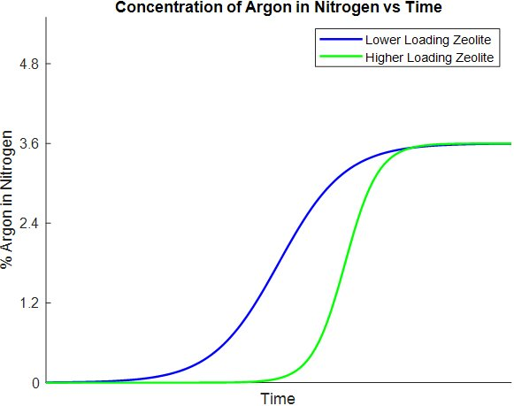
Side quests: The Cleanroom Chamber
Zeolites are porous crystalline aluminosilicates capable of filtering out argon from nitrogen
Ar/N2 mixtures pumped through the chamber or the bypass to observe adsorption capabilities of the zeolite using the RGA
Argon is much more polarizable and so has a higher affinity to doped zeolites.
Ar
2
Pressure Release Valve
FC
1
N2
FC
FC
4
6
To atm
3
To atm
5
RGA
Quick Connect
Sample Graph
Notes:
Zeolites are porous crystalline structures that, when doped with an ion such as silver or sodium, are especially good at filtering out specific gases. While the electrons in N2 are bound in a sturdy triple bond, the electrons on argon are highly polarizable, which gives them a higher affinity to ions housed within the zeolite structure, filtering them out of a flowing gas. The setup we have includes flow controllers to regulate the composition of the nitrogen and argon, and a third controller to control the overall flow. The gas can either go around the chamber through the bypass, or flow through it, where the gas is then read with the RGA. As we increase this ion loading, we can expect to see a more smoothed out curve, corresponding to the argon taking longer to fully saturate the RGA as its getting adsorbed by the zeolite.

Slide 26
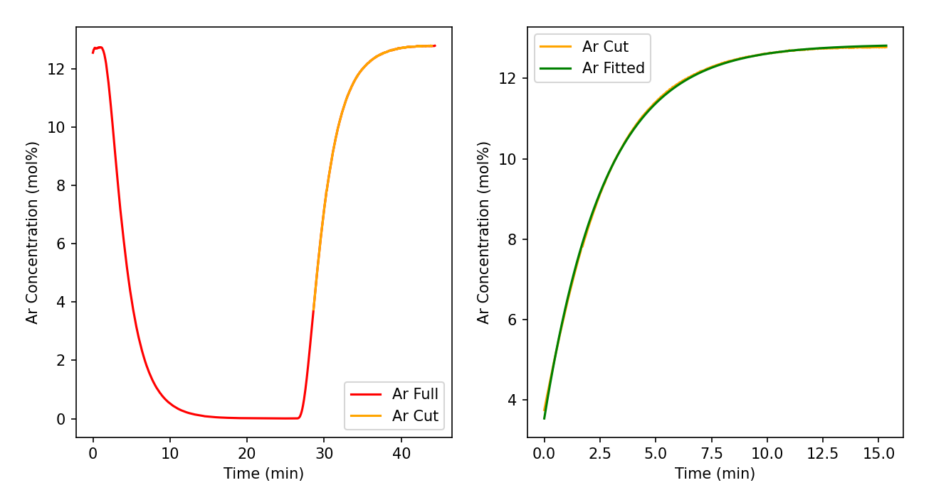
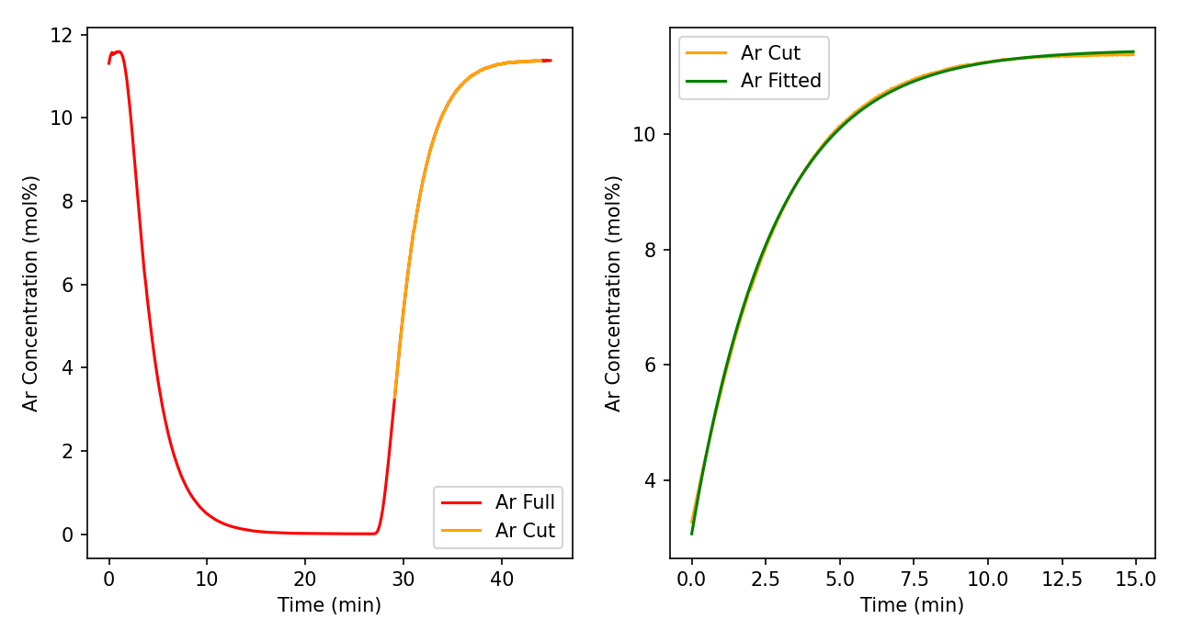
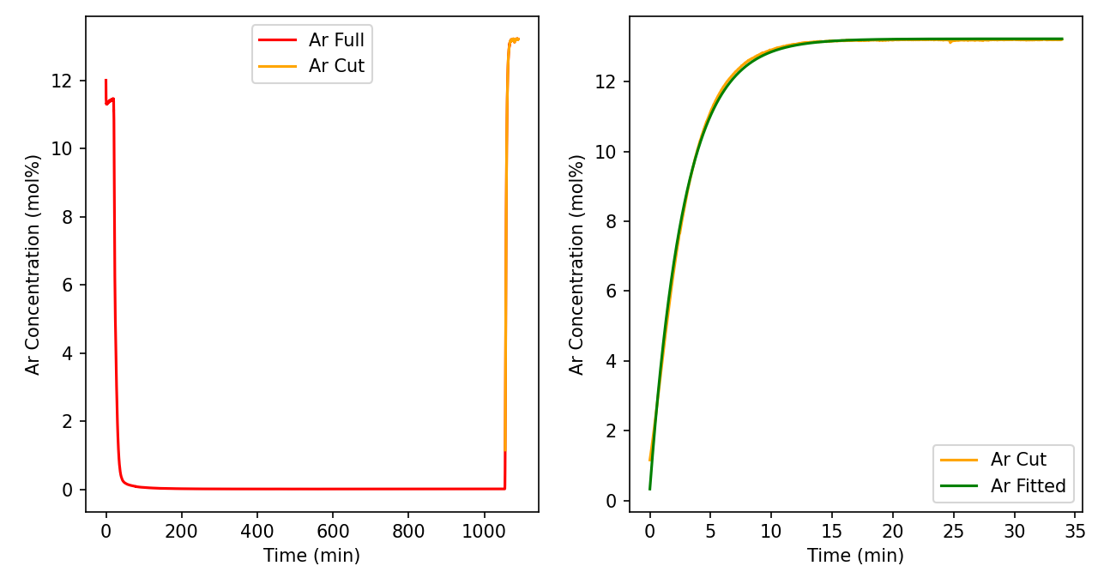
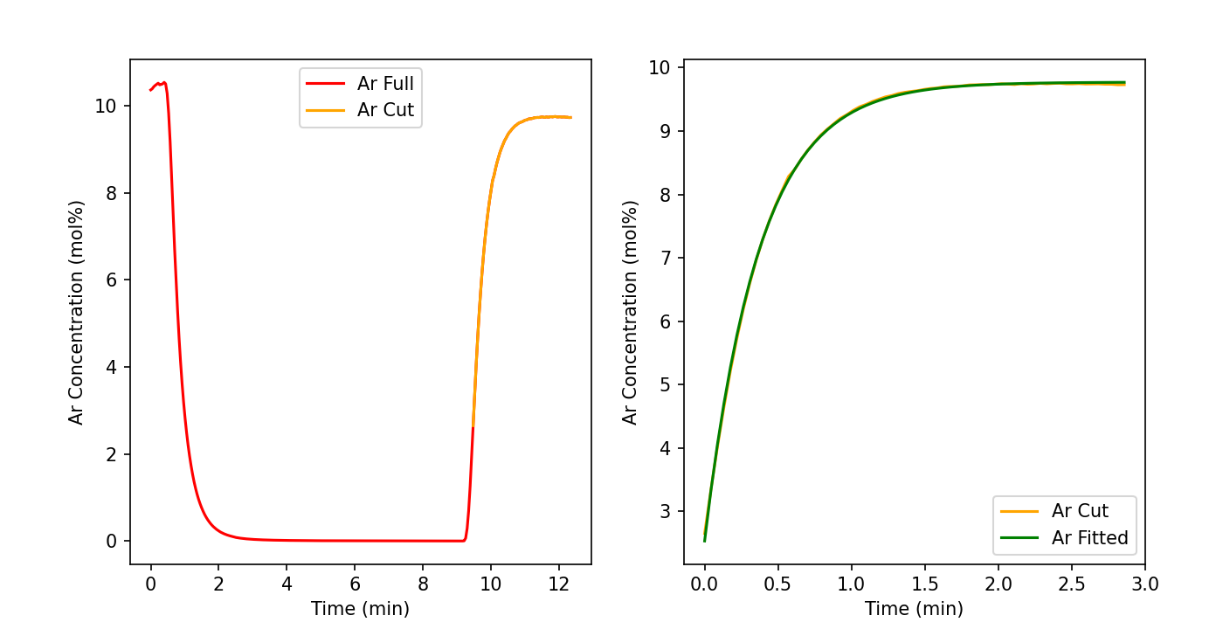
Side quests: The Cleanroom Chamber
15
Flow Through, undoped
A=12.85
B=-9.31
V=0.27 (L)
Empty Chamber
A=11.45
B=-8.38
V=0.28
Flow Around
A=13.23
B=-12.90
V=0.28
Flow Through, QuickConnOff
A=9.77
B=-7.24
V=0.037
Notes:
Seeing as how the effective volume calculated from the argon adsorption curves didn’t change between running gas through a 0.11L empty chamber, one filled with zeolites, and running gas through the bypass, there was an issue with the system itself that needed to be addressed. We eventually found that the quick connect was the cause of this extra volume being detected, with tests run while the RGA was directly connected to the system show a much lower effective volume. Zeolites were also doped with silver, and following the ongoing drying process, we hope to see argon adsorption occur.

Slide 27
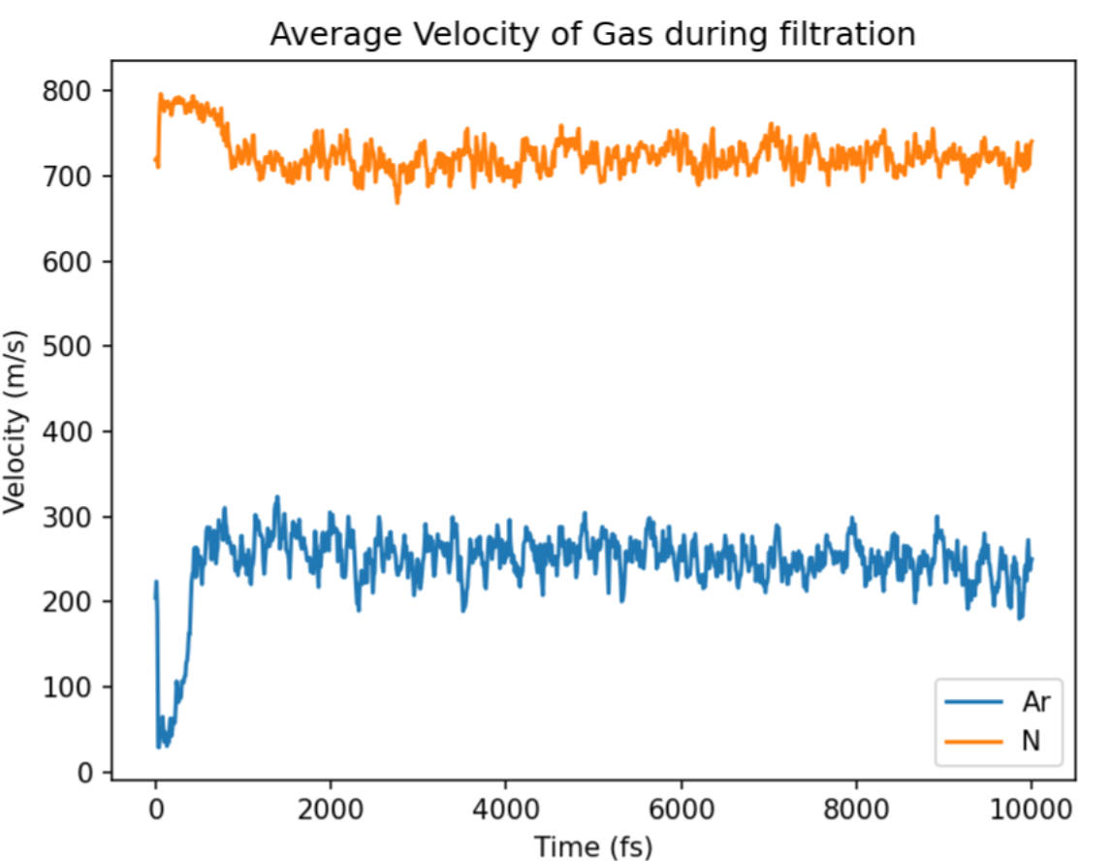
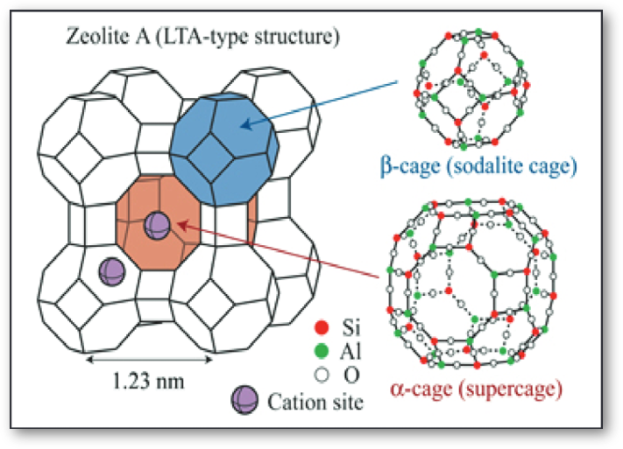
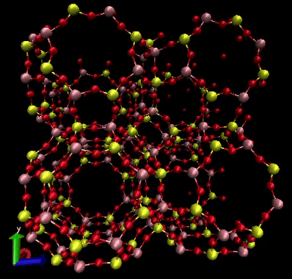
Side quests: The Zeolite Zenith
16
CP2K was used to perform geometry and cell optimization, followed by gas molecular dynamics runs
LTA type zeolite structure
Undoped zeolite optimization
Undoped zeolite slab molecular dynamics simulation
We expect to see the argon velocity drop when flowing through doped zeolites
Notes:
LTA zeolite structures were also geometrically optimized before molecular dynamics runs were executed with flowing nitrogen and argon gas. The gases show relatively stable velocities as it flows through the zeolite, and after the optimizations are completed with the doped zeolites, similar runs will be done. It is expected that the velocity of argon will decrease as it flows through the doped zeolite, while nitrogen remains unaffected.

Slide 28
Thanks for listening
Thanks to Tom Sonley, Shaun Hall, Chris Jillings, and Aleksandra Bialek for their support throughout the project
Questions?

