Slide 1
SNO+ Am-Be Calibration Data Analysis
Detector response to neutrons and gamma rays in scintillator
Cody O’Neill

Slide 2
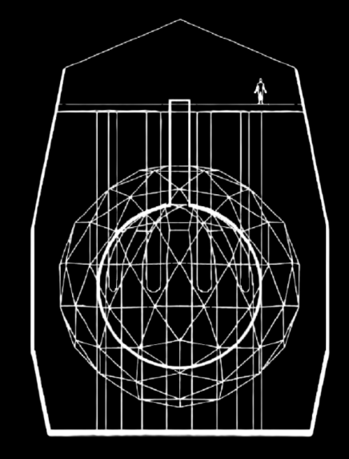
What is SNO+?
2 Km Underground
Sudbury, Ontario
~9300 PMTS
12 m Diameter Acrylic Vessel
Geodesic PMT Support Structure

Slide 3
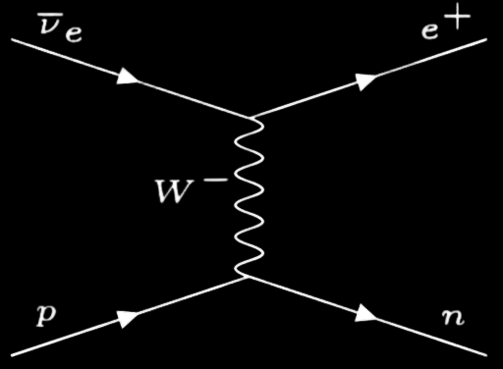
Inverse Beta Decay
Understanding this process is essential for Solar and Reactor Antineutrino Analyses
Incident Antineutrinos Interact with protons in the detector volume producing a positron and free neutron
A Free Neutron scatters inelastically with its surrounding media before reaching thermal equilibrium.

Slide 4
Neutron Capture in SNO+
Once Thermal Equilibrium is reached the neutron will be captured by a nearby nucleus
Capture on Hydrogen Is the most likely process
Excited Deuterium Produced in this reaction de-excites, producing a 2.2 MeV Gamma ray
Detection of this gamma ray indicates an Antineutrino Event in the Detector
n
p
2.2 MeV

Slide 5
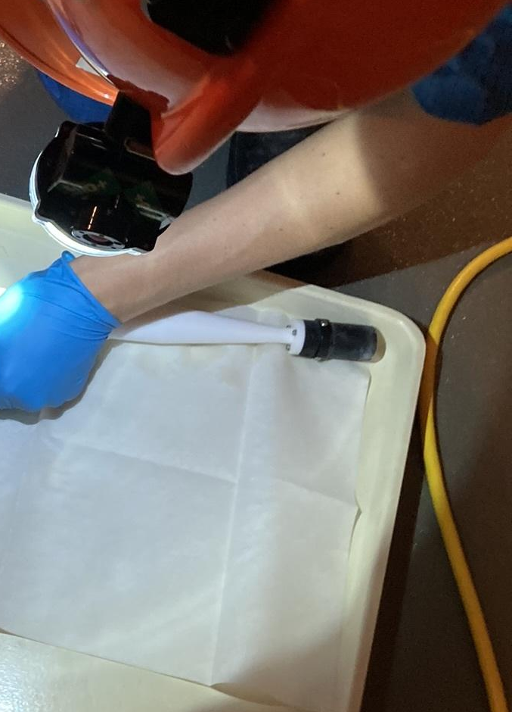
Americium Beryllium Neutron Source
1 MBq Neutron and Gamma Source located at SNOLAB
Commonly Used in Industry
Alpha-Neutron Reaction occurs between ⁹Be, producing ¹²C and a free Neutron
4.4 MeV Gamma Ray Is produced upon de-excitation of ^{12m}C (60% BR)
Produces:
Neutrons ~ 65 Hz
Gammas ~ 40 Hz

Slide 6
Purpose of the Source
Calibration with an In-Situ source is essential in understanding
Gamma Response
Neutron Response
Particle ID
Used to understand the properties of the new target volume
Neutrons produced by the source produce the same signals as antineutrinos
Understanding these interactions allows us to tag antineutrino events

Slide 7
Problem Definition
Comparison To Simulations
Comparing data to GEANT 4 simulations of the AmBe Deployments can validate the results of our simulations
Radial Dependences
Quantifying how event rate and energy reconstruction changes with radial distance from the Acrylic vessel will allow us to understand how events outside the target volume may appear
Preparing for Internal Deployments
Conducting simulations of the internal deployment plan will help prepare for deploying the source inside the AV in the future

Slide 8
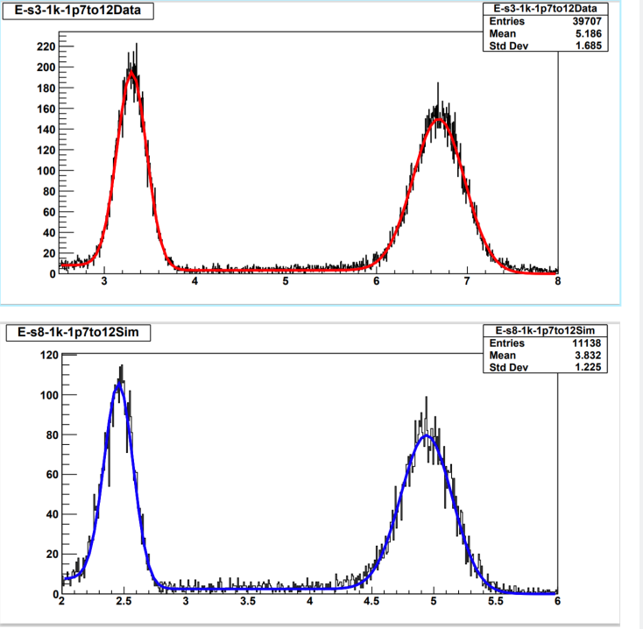
Results
Source Deployment
Date | Run # | X pos. | Y pos. | Z pos. | Coverage
Dec 8-9 | 354356- 354378 | 118.11 cm | - 119.38 cm | 594.03 cm | Crates 2 / 3 off
Dec 9-10 | 354380-354403 | 118.11 cm | - 119.38 cm | 600.01 cm | Crates 2 / 3 off
Dec 10 | 354404-354417 | 118.11 cm | - 119.38 cm | 650.03 cm | Crates 2 / 3 off
Notable Differences
Light yield of the detector increased by 1.5x, reconstruction did not account for new scintillation cocktail
Lower Counts
Were seen as the distance of the source increases.

Slide 9
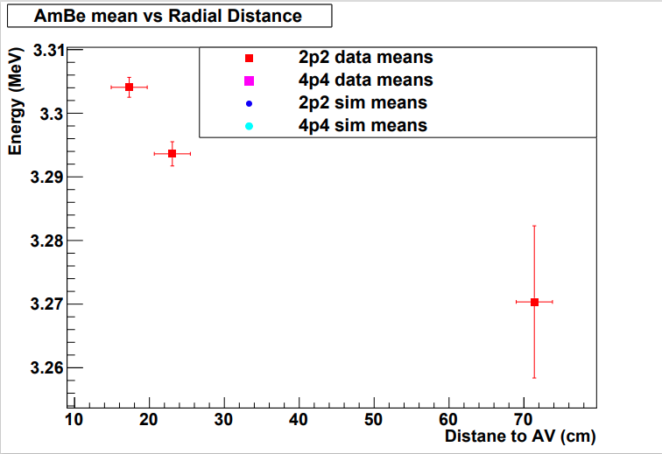
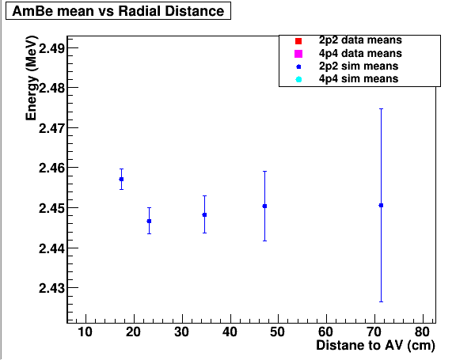
Radial Dependence On Energy
Mean Reconstructed Energy
Was shown to be appropriately stable for as distance from the Acrylic Vessel increased.
Errors Increased
Because of a reduction in events that passed selection
Simulations and Data
Showed similar behaviour with radial distance

Slide 10
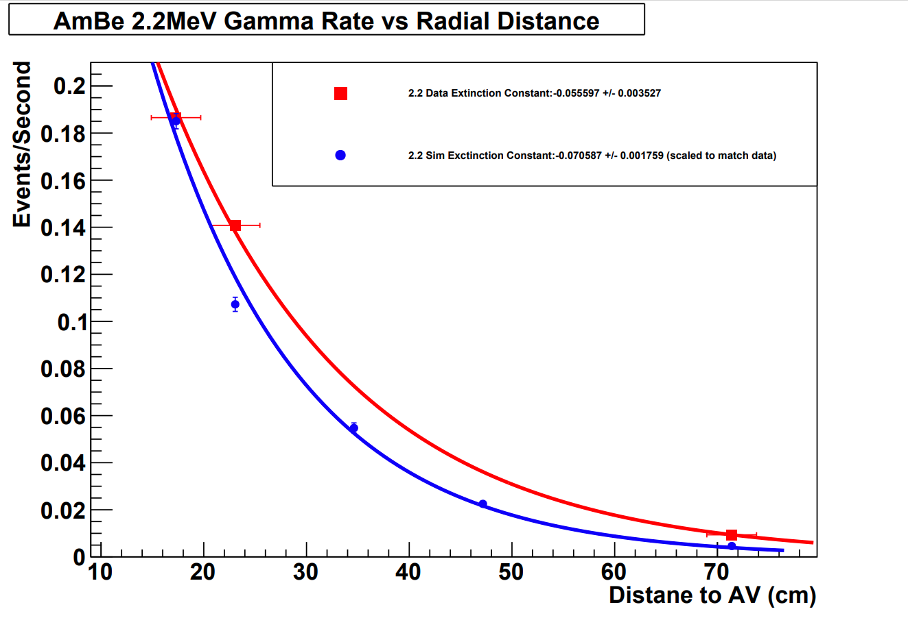
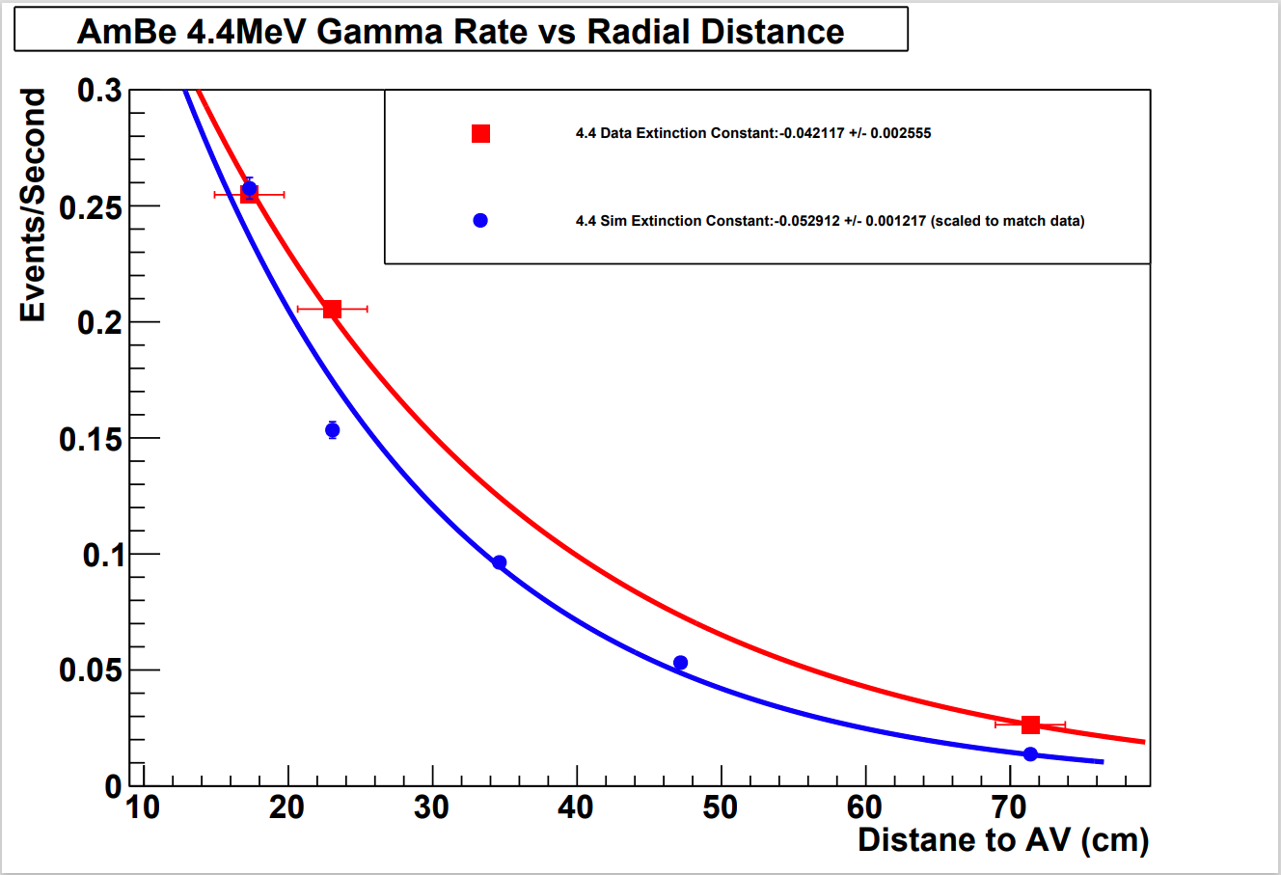
Effect of Radial Distance on Event Rate
2.2 MeV Gammas
Showed Different Extinction constants between data and simulation
Data: -0.055597 +/- 0.003527
Simulations: -0.070587 +/- 0.001759
4.4 MeV Gammas
Showed Similar Extinction constants between data and simulation
Data: - 0.042117 +/- 0.002555
Simulations: - 0.052912 +/- 0.001217
Unusual Drop in Rate
Seen for neutron simulations ~20 cm from the acrylic vessel.

Slide 11
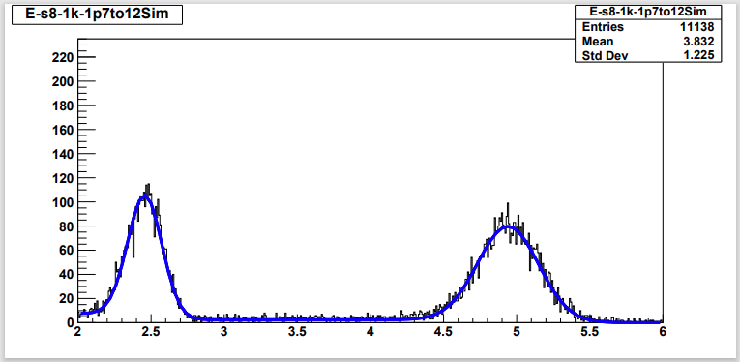
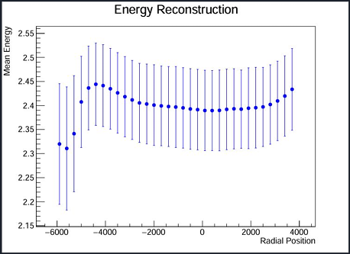
Internal Simulation Data
Diminished Counts and Energy Reconstruction
Seen near the edge of the Acrylic Vessel
Better Reconstruction
Seen for events closer to the center of the AV

Slide 12
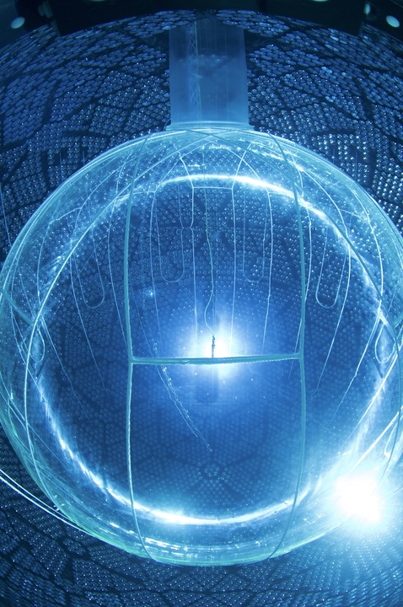
Next Steps
Perform Internal Calibration Plan with AmBe Source
To validate internal calibration simulations
Analyze Simulations Conducted in Neck Region
To understand the effects of the neck geometry on reconstruction
Compare Simulations and Data From Internal Calibration
Once the source has been deployed

Slide 13


Thanks To:
Christine Kraus - Supervisor and Editor
Ryan Bayes - Mentor and Editor
Bonus thanks to:
Matt Depatie and Mark Ward
Questions?

