Slide 1


The CUTE side of Neutrons
By – Dev Chauhan
Supervisor – Matthew Stukel
1

Slide 2
Presentation Path
CUTE
Neutrons
CUTE Neutron study
2

Slide 3

01
What is CUTE?
Cryogenic Underground TEsting facility
3

Slide 4
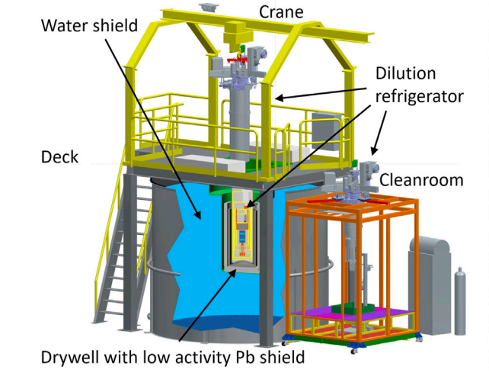
An extraordinary underground facility
Neutron source
37.5 kBq Ca-252 Neutron source
37 kBq Ba-133 Gamma source
4

Slide 5
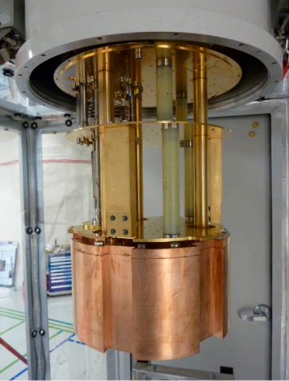
CUTE fridge
Dry Dilution Fridge
Reaches temperatures of 12 mK
Past projects include:
  Supercdms Tower run
  HVeV Detector run
Next Project is a Qubit run
5

Slide 6
02
Neutrons
A Neutral Player in the Atomic Game
6

Slide 7
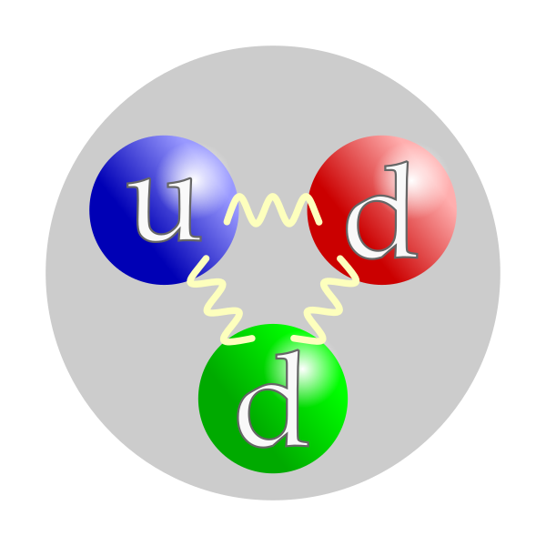
Neutron
El
Interacts via Strong nuclear force, weak nuclear force and Gravity
Overall neutral charge
Can be characterized based on energy:
Thermal neutrons – meV range
Fast neutrons – MeV range
Has a small magnetic moment
7

Slide 8
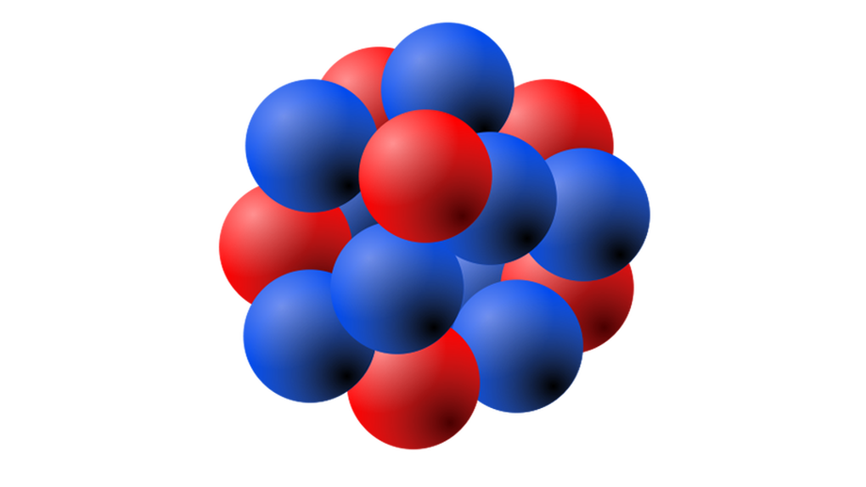
Elastic interaction
El
Nucleus
Neutron
8

Slide 9
Elastic interaction
El
Collision
8

Slide 10
Elastic interaction
El
Maximum energy transfer for comparable mass
Recoiled Nucleus
Neutron
8

Slide 11
Inelastic interaction
El
Nucleus
Neutron
9

Slide 12
Inelastic interaction
El
Collision
9

Slide 13
Inelastic interaction
El
Excited Nucleus
Lower energy
Neutron
9

Slide 14
Inelastic interaction
El
γ-ray
De-excited Nucleus
Lower energy
Neutron
9

Slide 15
Neutron Capture
El
Neutron
Nucleus
10

Slide 16
Neutron Capture
El
Collision
10

Slide 17
Neutron Capture
El
Excited stable nucleus with higher atomic mass
10

Slide 18
Neutron Capture
El
γ-ray
De-excited and stable Nucleus with higher atomic mass
10

Slide 19
Neutron Capture
El
Stable lower mass isotope
Alpha particle, neutrons or energy
Unstable Isotope
10
Stable lower mass isotope

Slide 20
03
Sources
How do they reach CUTE?
11

Slide 21
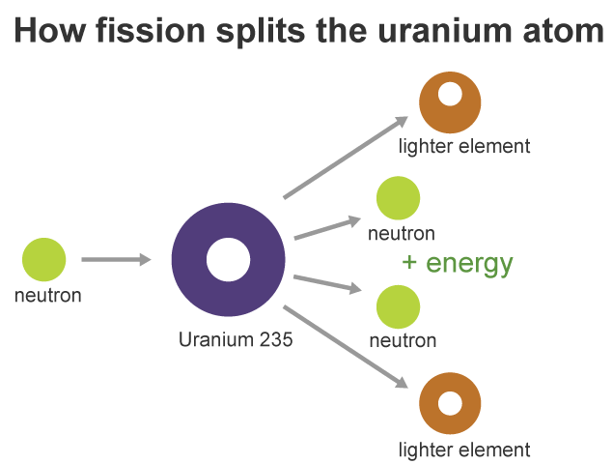
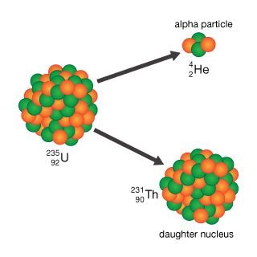
Uranium decay chain
The surrounding rock and shotcrete contains Uranium-238, Uranium-235, and Thorium-232
These isotopes undergo spontaneous fission to produce neutrons and importantly, alpha particles
12

Slide 22
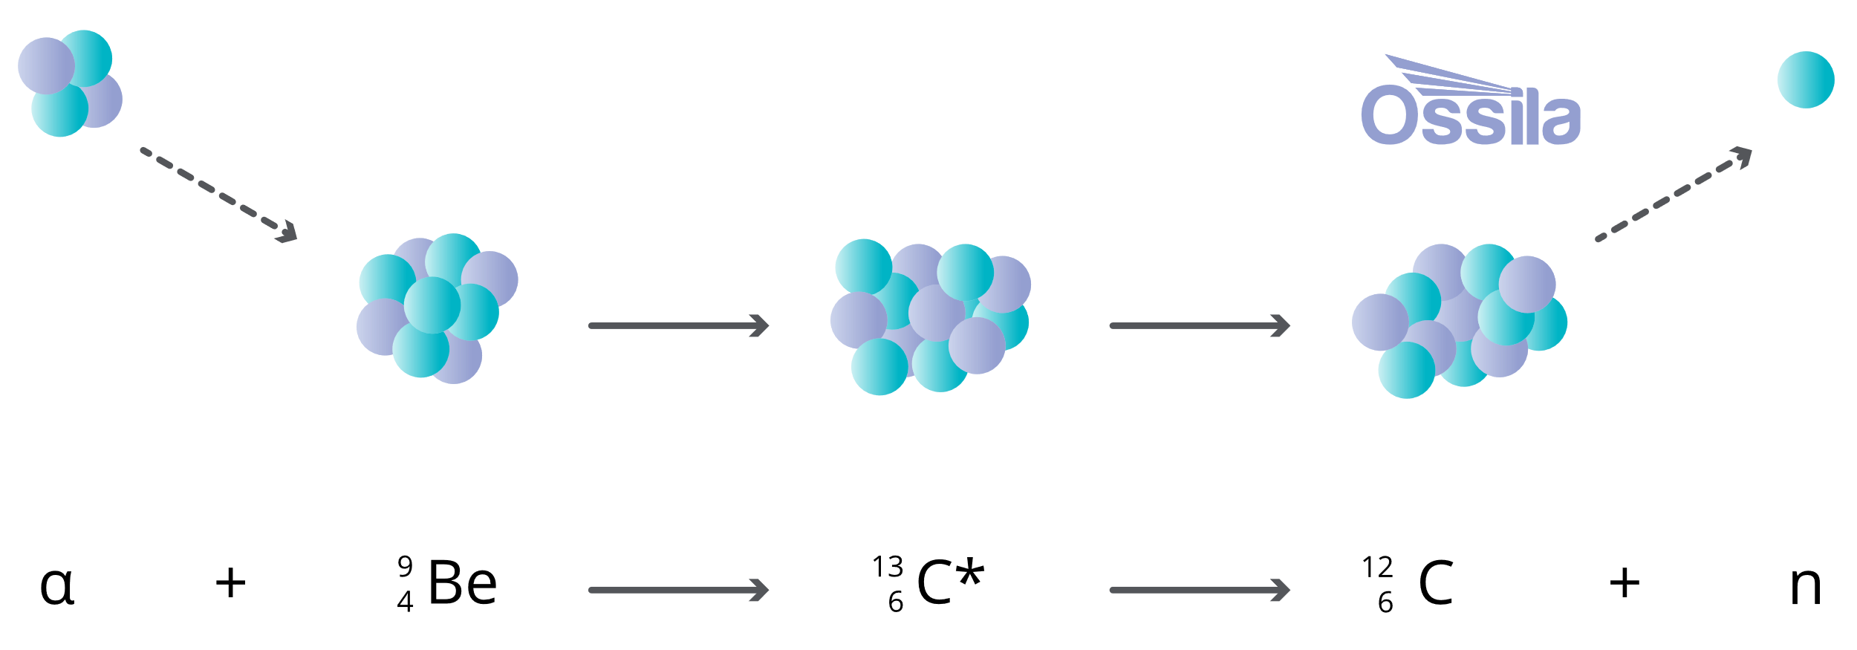
2. (Alpha,n) interactions
Occurs when an alpha particle (He²⁺) collides with a nucleus and ejects a neutron.
α + Target Nucleus → New Nucleus + Neutron (n)
These reactions typically occur with light elements like beryllium, boron, fluorine, carbon, and oxygen
This reaction produces 99% of the neutrons observed
13

Slide 23
Sources4C
A code designed to:
Calculate neutron production rates and energy spectra from
(α,n) reactions
Spontaneous fission
Delayed neutron emission due to radionuclide decay
For more information, visit the RSICC SOURCES-4C page.
14

Slide 24

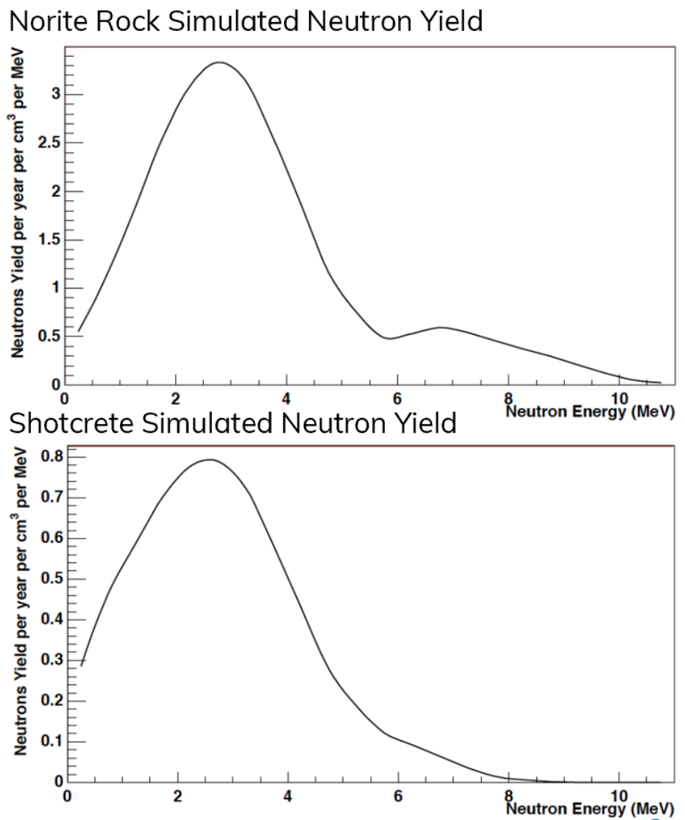
Expected energy spectrum
Created using Sources4C
15

Slide 25
04
Detection
How do we find them?
16

Slide 26
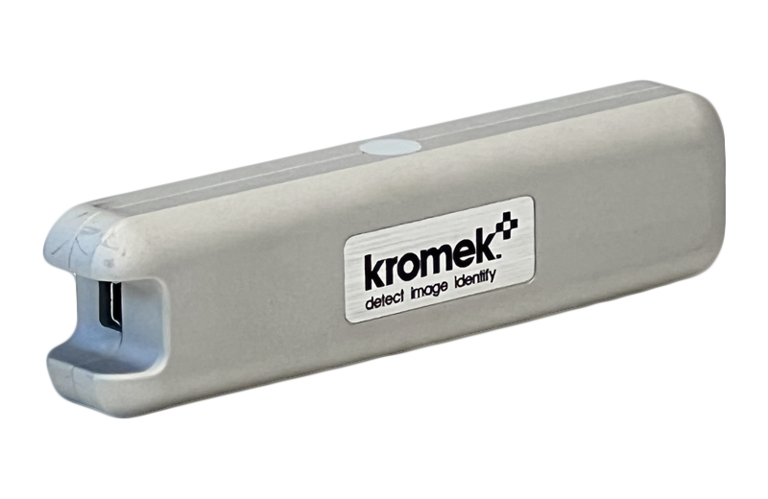
Kromek TN15
131mm x 33mm x 24mm
Thermal neutron detector
Suitable for measurement inside drywell
Lithium-6 scintillator based detector
17

Slide 27
Lithium scintillation
Thermal Neutron
Li⁶ Nucleus
18

Slide 28
Lithium scintillation
Collision
18

Slide 29
Lithium scintillation
Alpha particle
4.78 MeV gamma ray
Triton
18
Scintillator

Slide 30
Lithium scintillation
Light
Scintillator
18
SiPM

Slide 31
Why do we put it in the drywell?
Neutron source
Takes an order of ~10 cm of water to thermalize a 1 MeV neutron
19

Slide 32
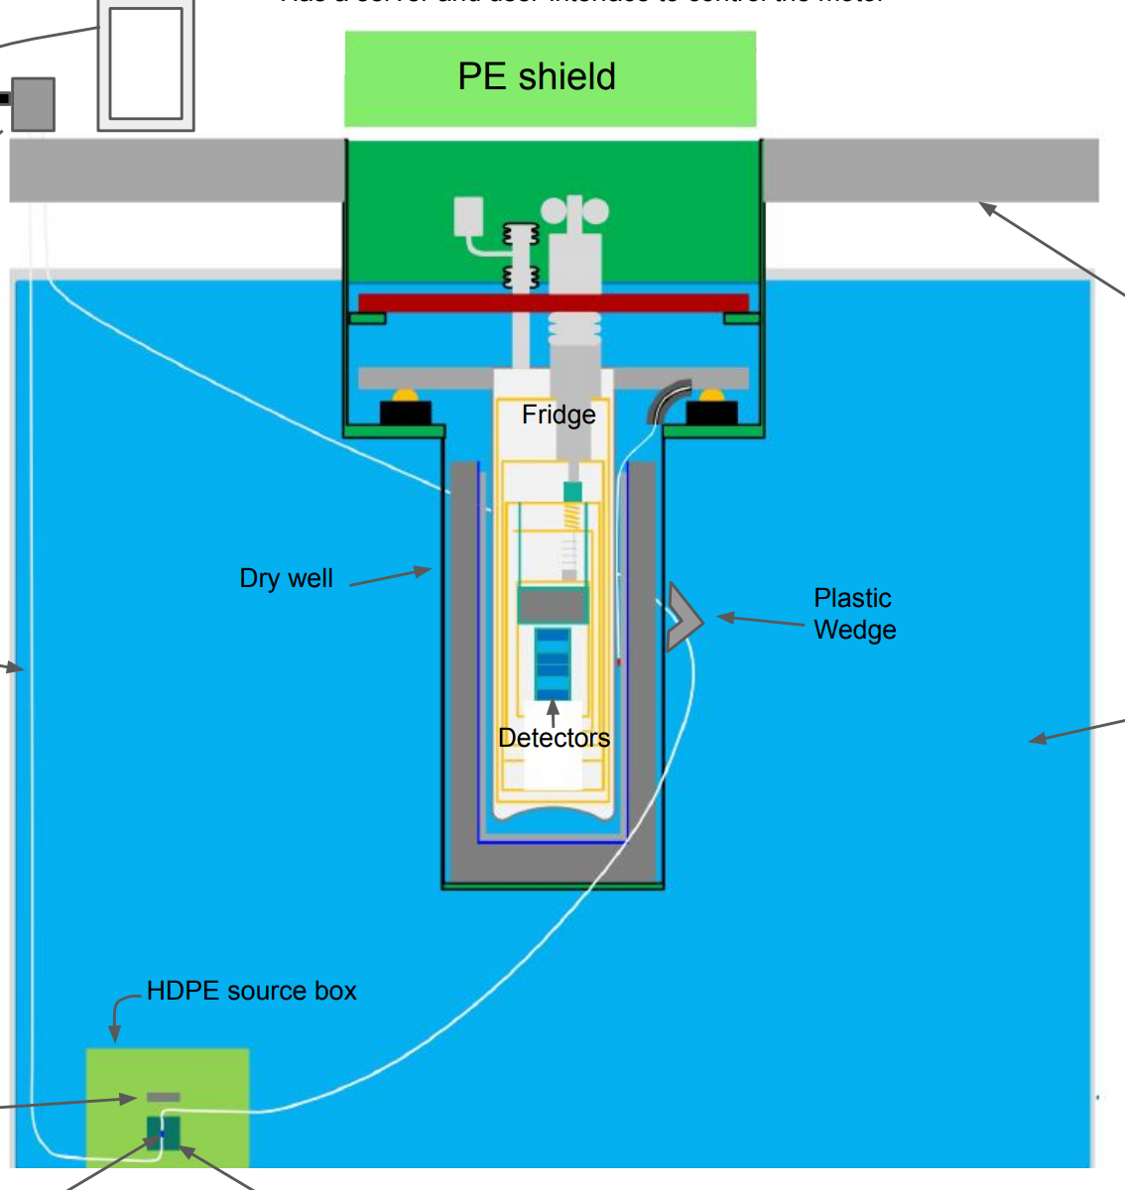
-Detector
-Neutron source
Allows us to measure the background thermal neutron flux rate at the MC stage
Detector position - MC Plate
Home box position
20

Slide 33
-Detector
-Neutron source
Allows us to measure the change in thermal neutron flux as a function of distance from source box
Detector position - MC Plate
Edge of home box(37 cm)
20

Slide 34
-Detector
-Neutron source
Allows us to measure the change in thermal neutron flux as a function of distance from source box
Detector position - MC Plate
1m from home box
20

Slide 35
-Detector
-Neutron source
Allows us to measure the change in thermal neutron flux as a function of distance from source box
Detector position - MC Plate
2m from home box
20

Slide 36
-Detector
-Neutron source
Allows us to measure the change in thermal neutron flux when the source is close st to the MC stage
Detector position - MC Plate
Calibration position (3.04 m)
20

Slide 37
-Detector
-Neutron source
Allows us to measure the change in thermal neutron flux as a function of distance from source box
Detector position - MC Plate
Extreme position (3.35 m)
20

Slide 38
-Detector
-Neutron source
Allows us to measure the thermal neutron flux at the drywell base
Detector position – Drywell base
20

Slide 39
-Detector
-Neutron source
Allows us to measure the thermal neutron flux at the CP plate
Detector position - CP Plate
20

Slide 40
-Detector
-Neutron source
Allows us to measure the thermal neutron flux at the Still plate
Detector position - Still Plate
20

Slide 41
05
Analysis and Simulation
21

Slide 42
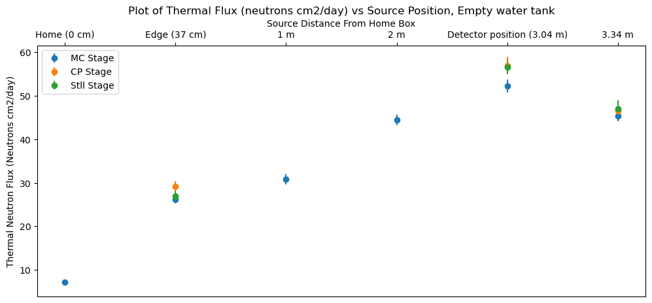
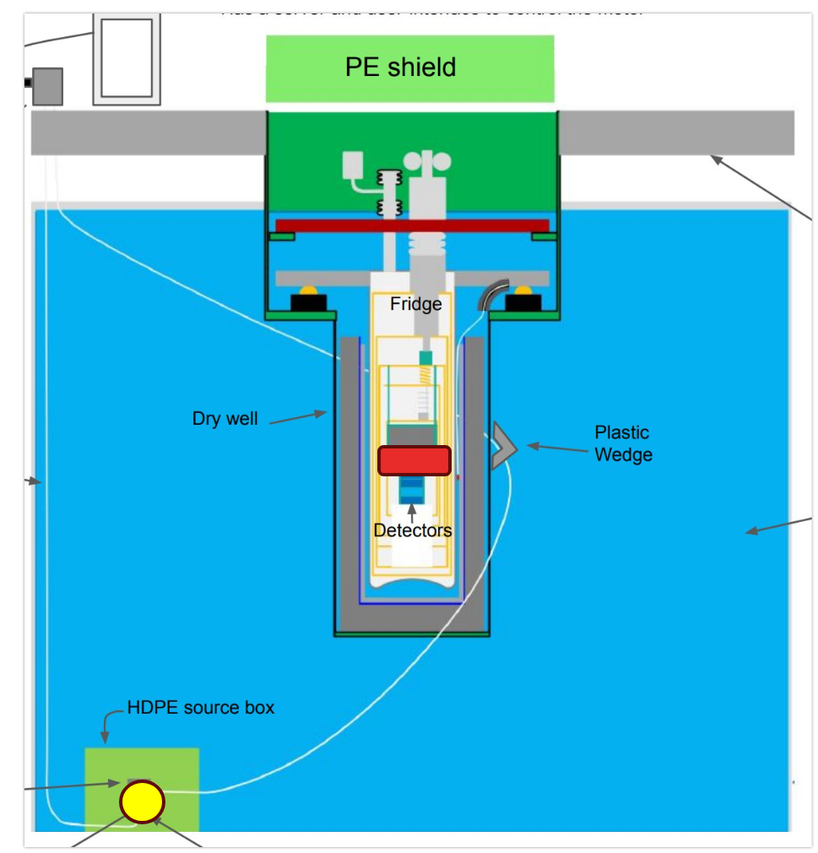
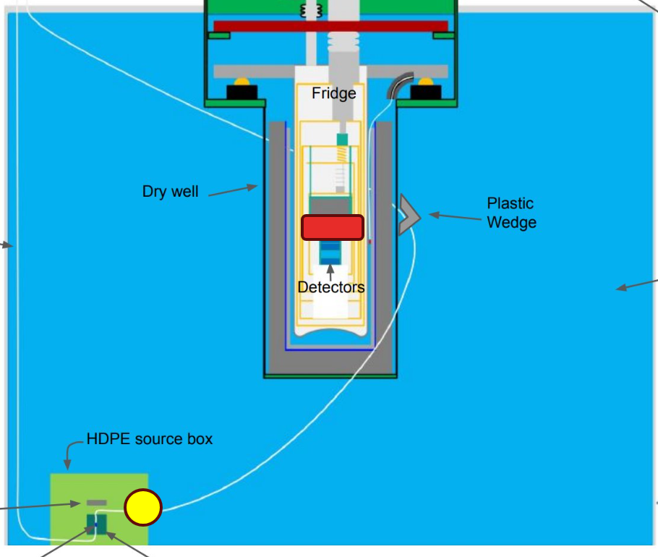
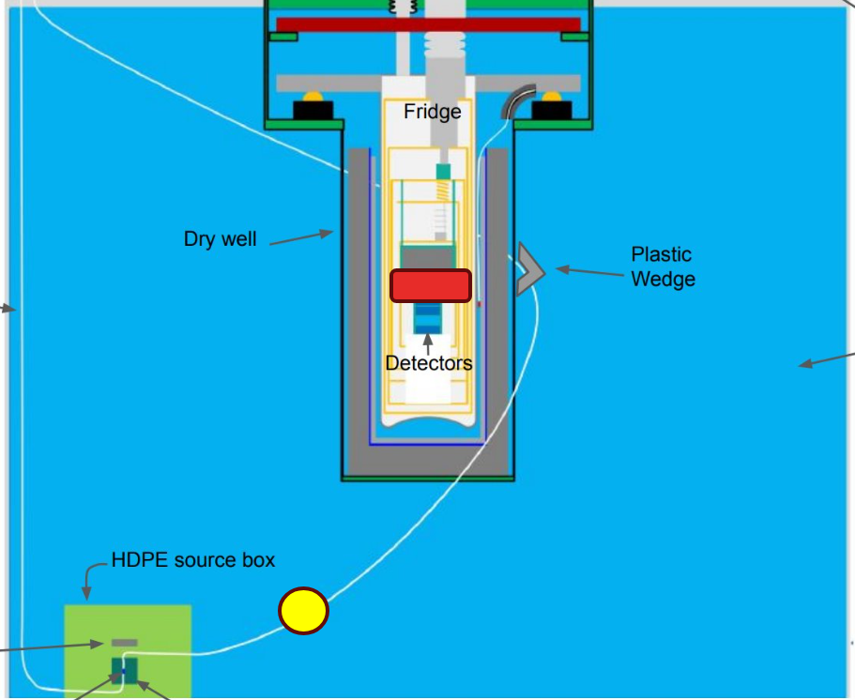
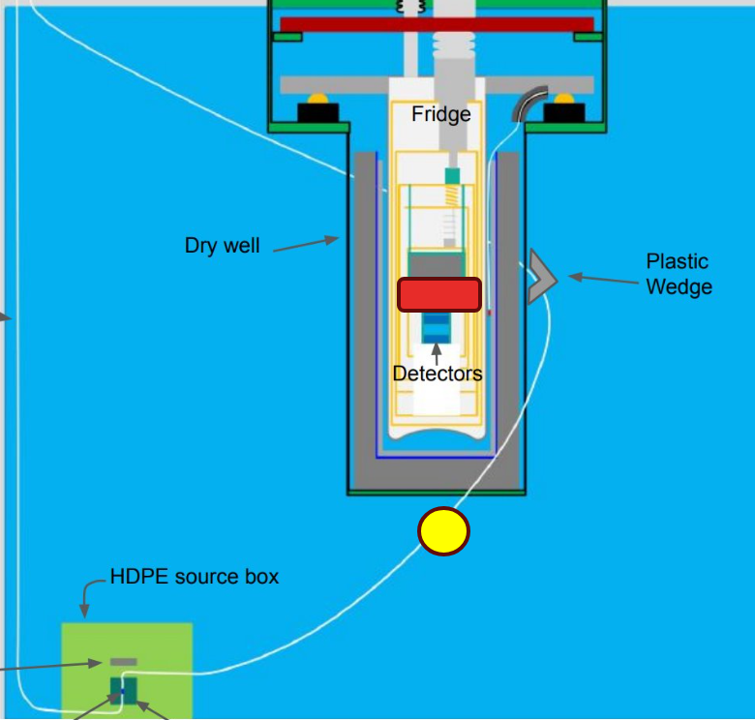
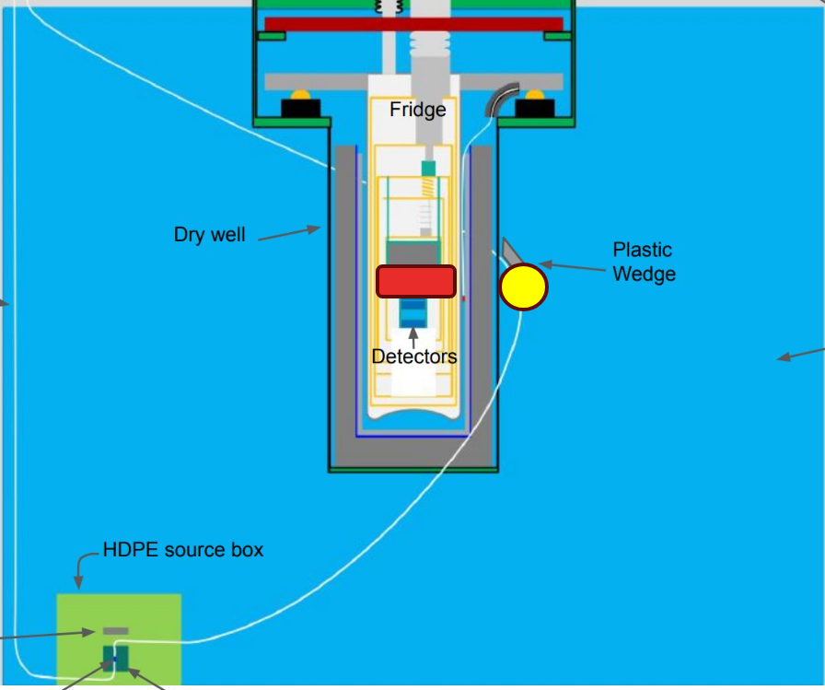
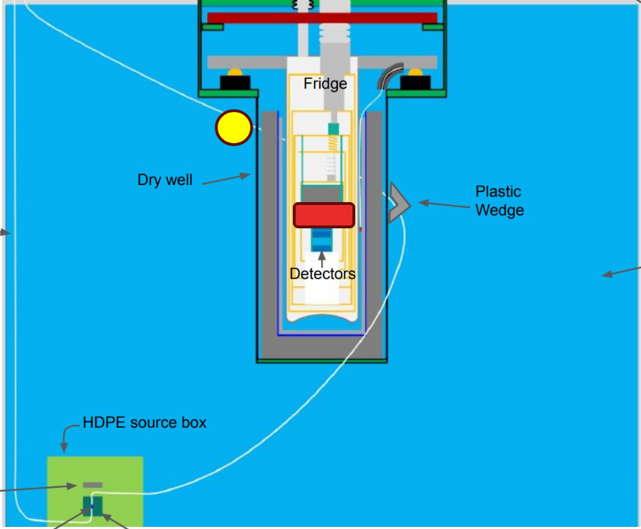
22

Slide 43
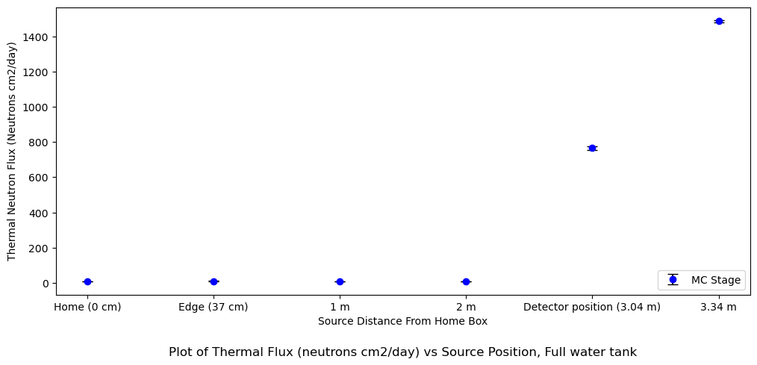
23

Slide 44
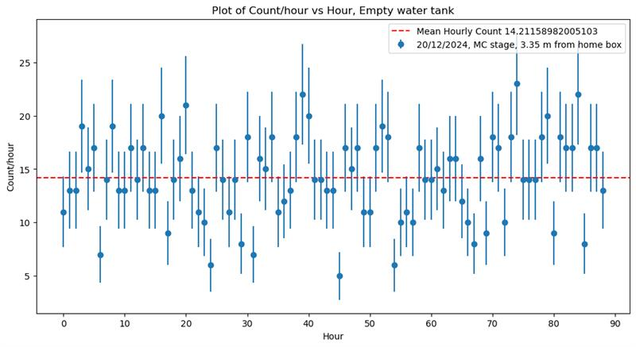
Hourly count analysis
24

Slide 45
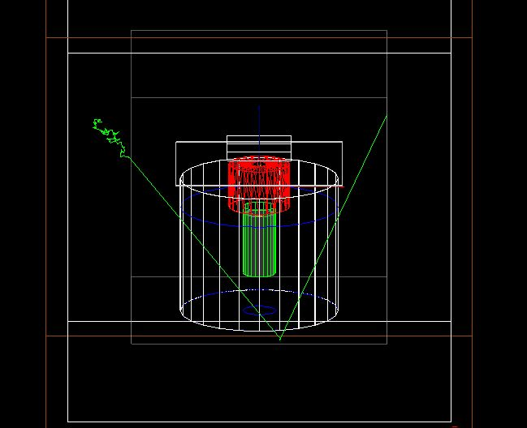
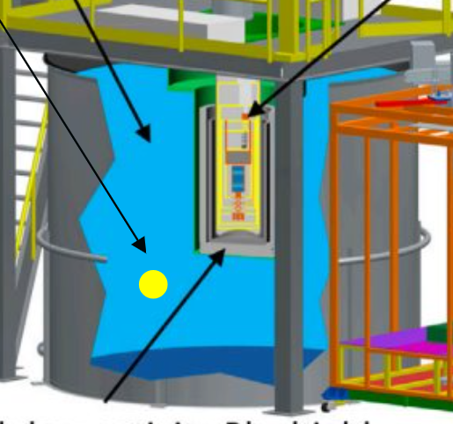
Simulations (Geant4)
Cavern rock
Shotcrete
CUTE facility
Preliminary simulations show - thermal neutron flux of 147.63 neutrons/cm^2/day
Observed flux - 8.6 neutrons/cm^2/day
Reasons may include cavern shape and size or rock energy spectrum
25

Slide 46
Conclusion
Thermal neutron flux inside the drywell is proportional to the distance of the source from the detector when the water tank is empty
Thermal neutron flux not trivially related to the distance of the source from detector with a full water tank
Further study is required to fully understand the thermal neutron background
26

Slide 47
Future work
Next term I will be continuing this study
My tasks include:
  Finishing the full water tank measurements
  Improving simulations to better understand results
  Using a new fast neutron detector to measure fast neutron flux
  Complete the study to gain a proper understanding of the neutron background at CUTE
27

Slide 48
Thank you!!
To my supervisor Matthew Stukel
To everyone at the CUTE team, including Vijay, Marco, Andy and Wolfgang
To Steffon Luoma for his help in the project
To all of my fellow students for an amazing term!
28

Slide 49
References
Oak Ridge National Laboratory. SOURCES-4C: A Code for Calculating (α,n), Spontaneous Fission, and Delayed Neutron Sources and Spectra. ORNL/TM-2000/161, 2002.
SNOLAB. SNOLAB Analysis of Rock Samples from the New Laboratory. SNOLAB-STR-2007-003, 2007.
29

