Slide 1
Transfer Station & Scintillator Plant Upgrade for SNO+
2025/04/17
William Zhang
Co-op Winter 2025

Slide 2
SNO+ Overview
Main physics goal: observe 0vbb through scintillation
Scintillator = LAB organic(oil)
THEY DON’T MIX
TeA + BD → TeBD
TeBD/DDA mixture cycle into detector
Source = TeA aqueous(water)

Slide 3
BD/DDA Transfer Station
Want Te-source in detector → DDA & BD into plants UG to mix with TeA
DDA:
distilled on surface
shipped UG in drums
Goal of Transfer Station:
drum to TeDiol Plant for mixing
Then load into detector via Scint
BD:
shipped UG in drums
Goal of Transfer Station:
drum to Scint Plant for distillation
Then to TeDiol for rxn/mixing
Then load into detector via Scint

Slide 4
BD/DDA Transfer Station – What do we need?
Drum → Pump → Pipe
Hand valves to direct flow
Flowmeter to monitor flow
N2 cover gas
Manometer to monitor pressure
Safety valve & break valve for extreme pressure
Compressed air to power pump
Pressure regulators & solenoid valves to control flow
Support Structures (Unistruts & Aluminum Panels)

Slide 5
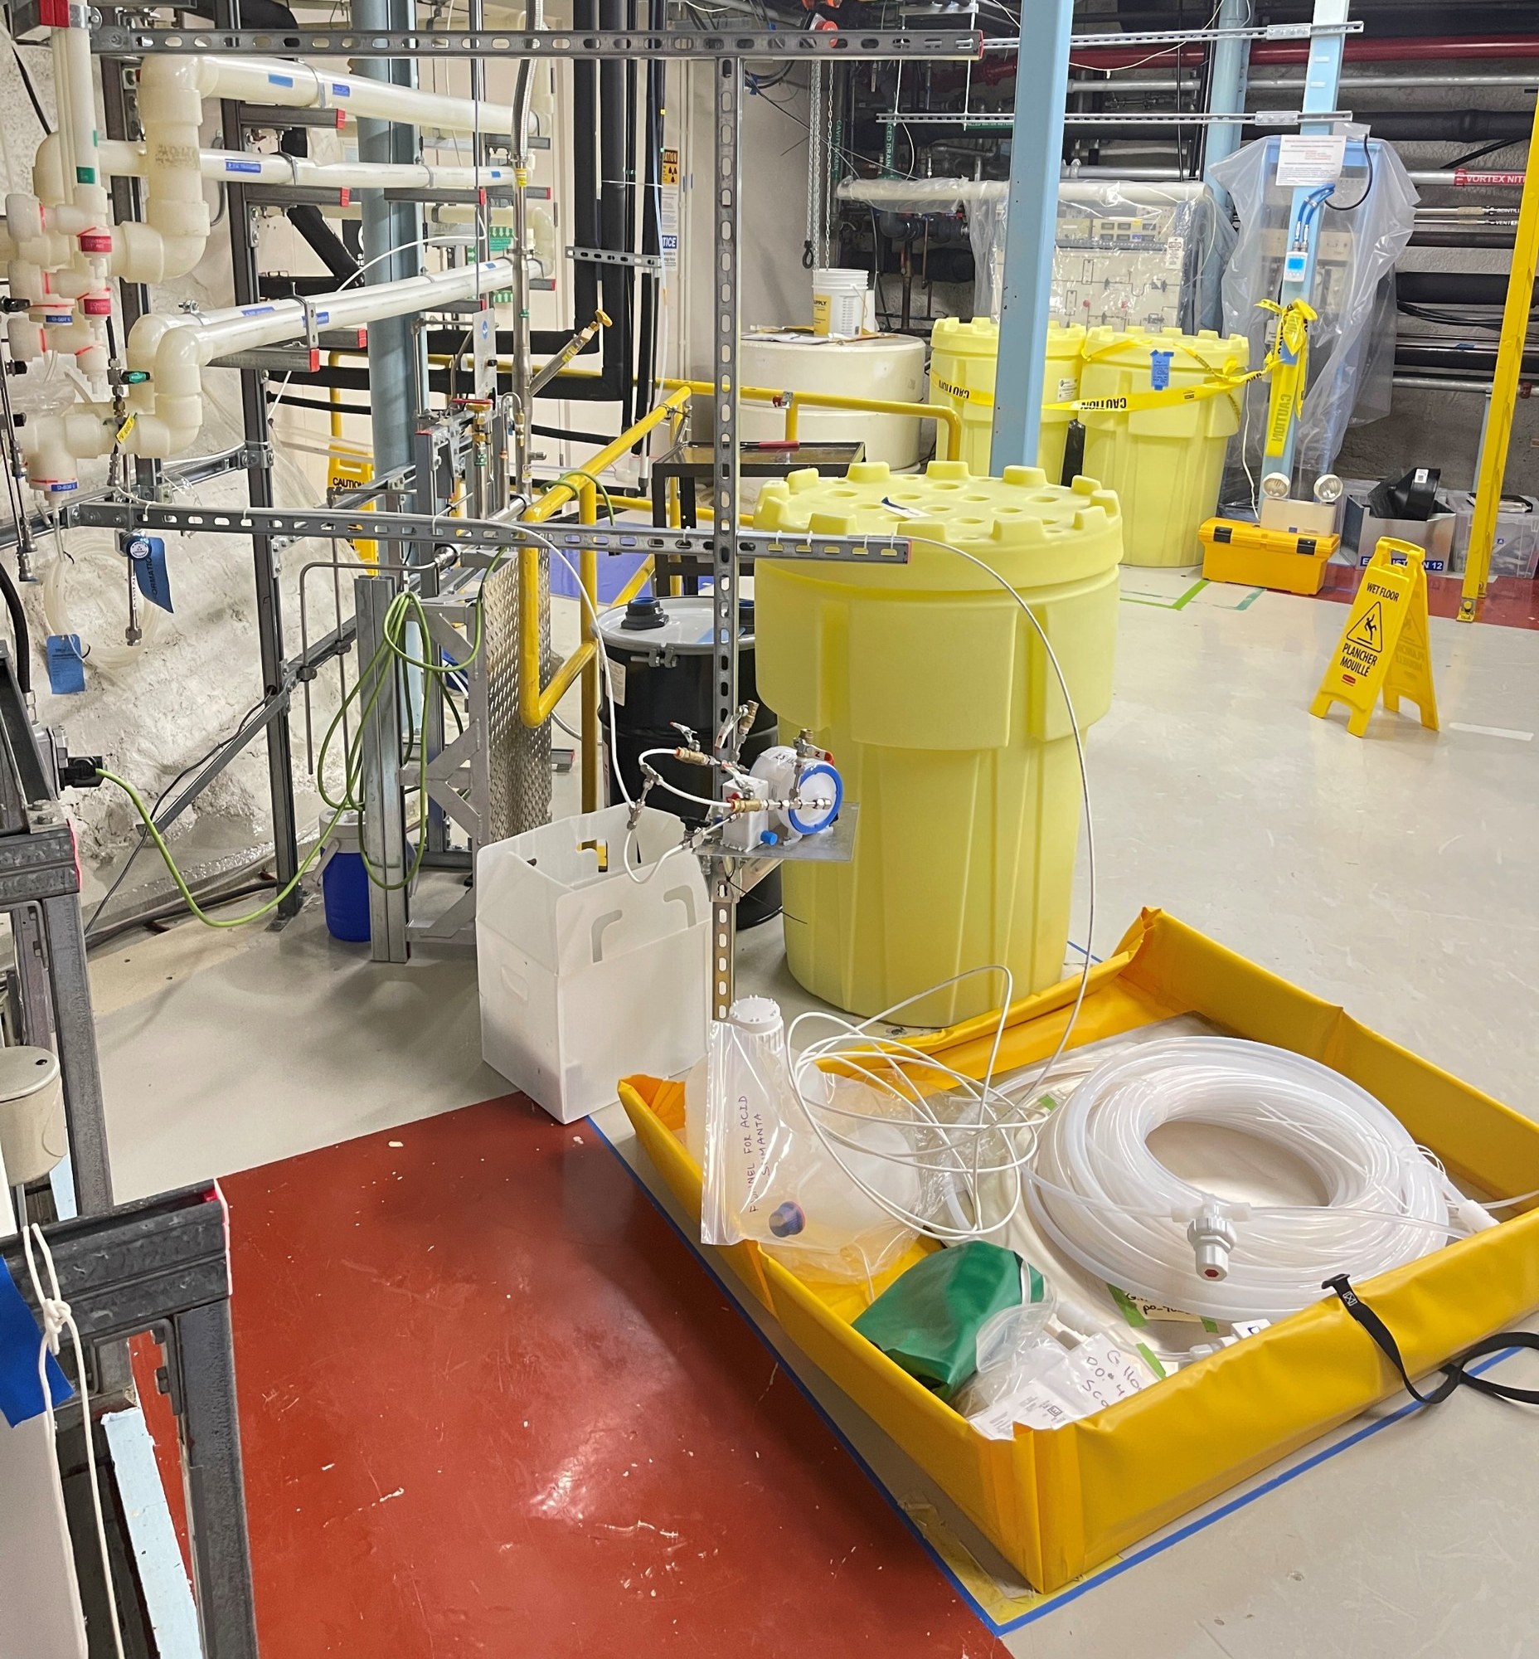
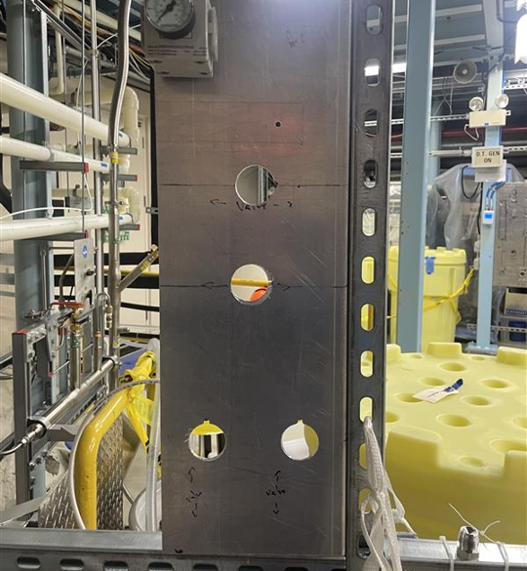
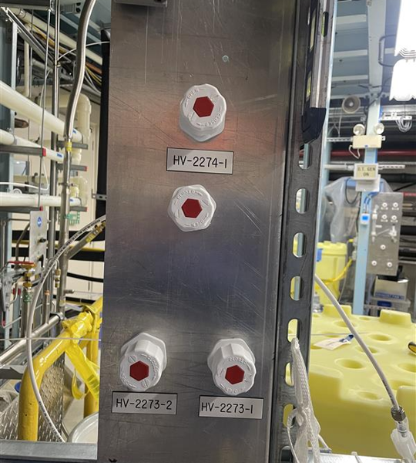
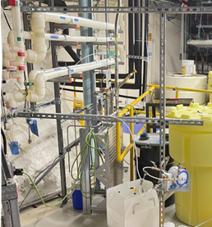
The unistrut The panel The hand valves
DDA Transfer Station

Slide 6
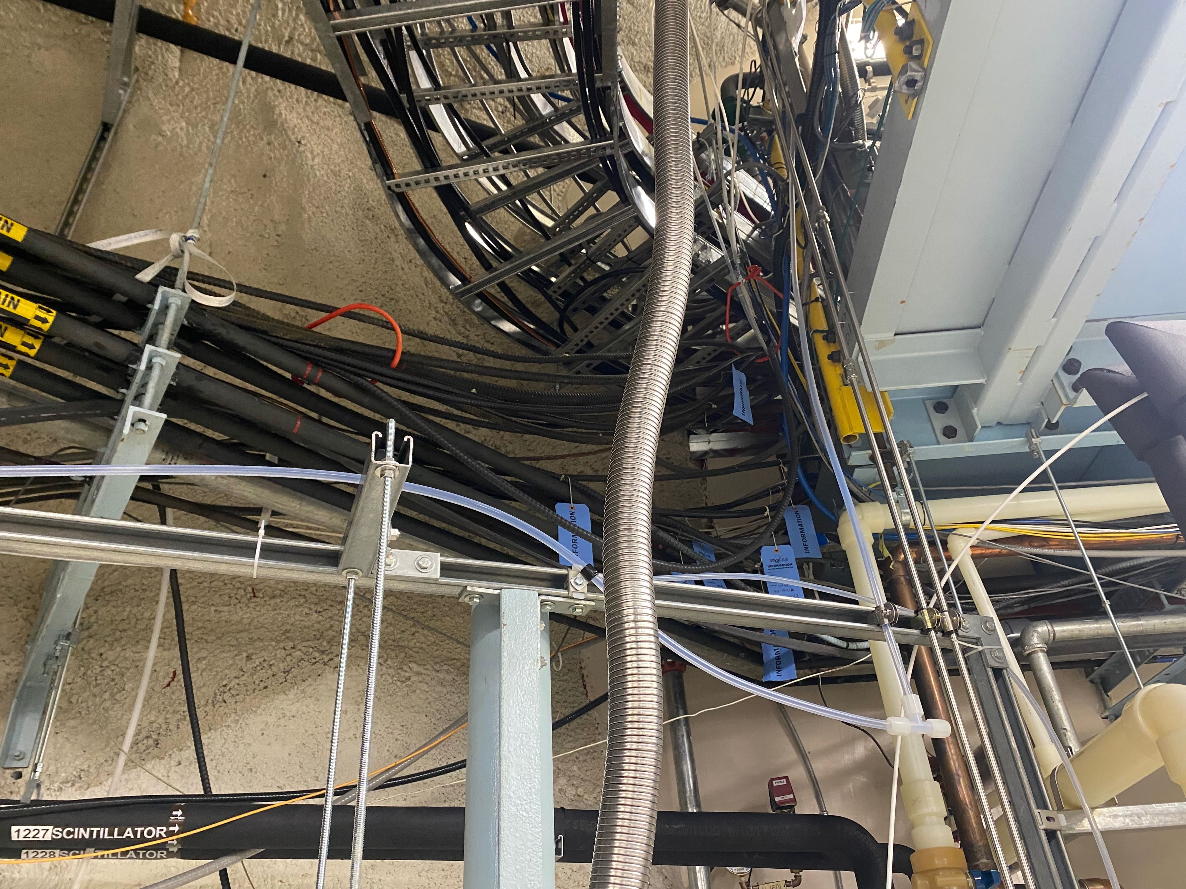
THE DEWAR
The Dewar
NITROGEN

Slide 7
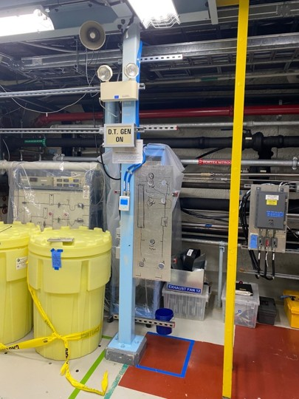
←
The
Unistrut
→
The Panel
BD Transfer Station

Slide 8
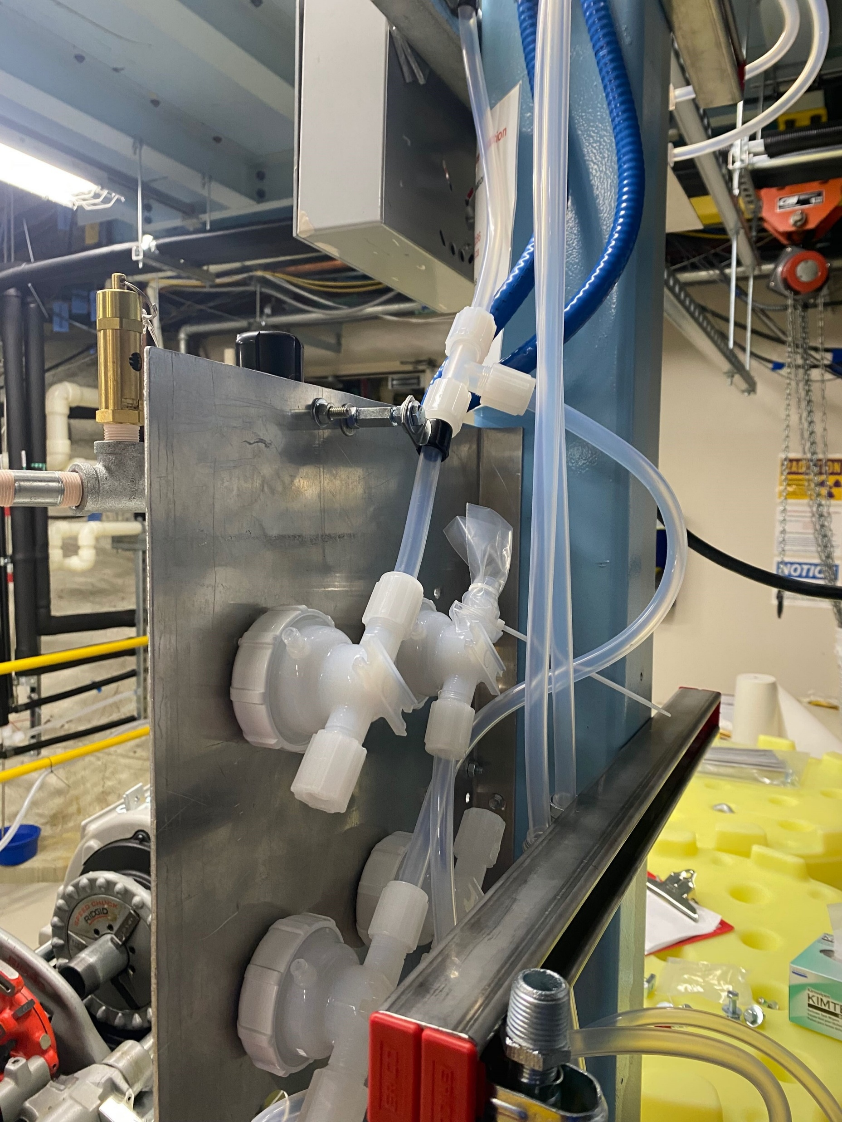
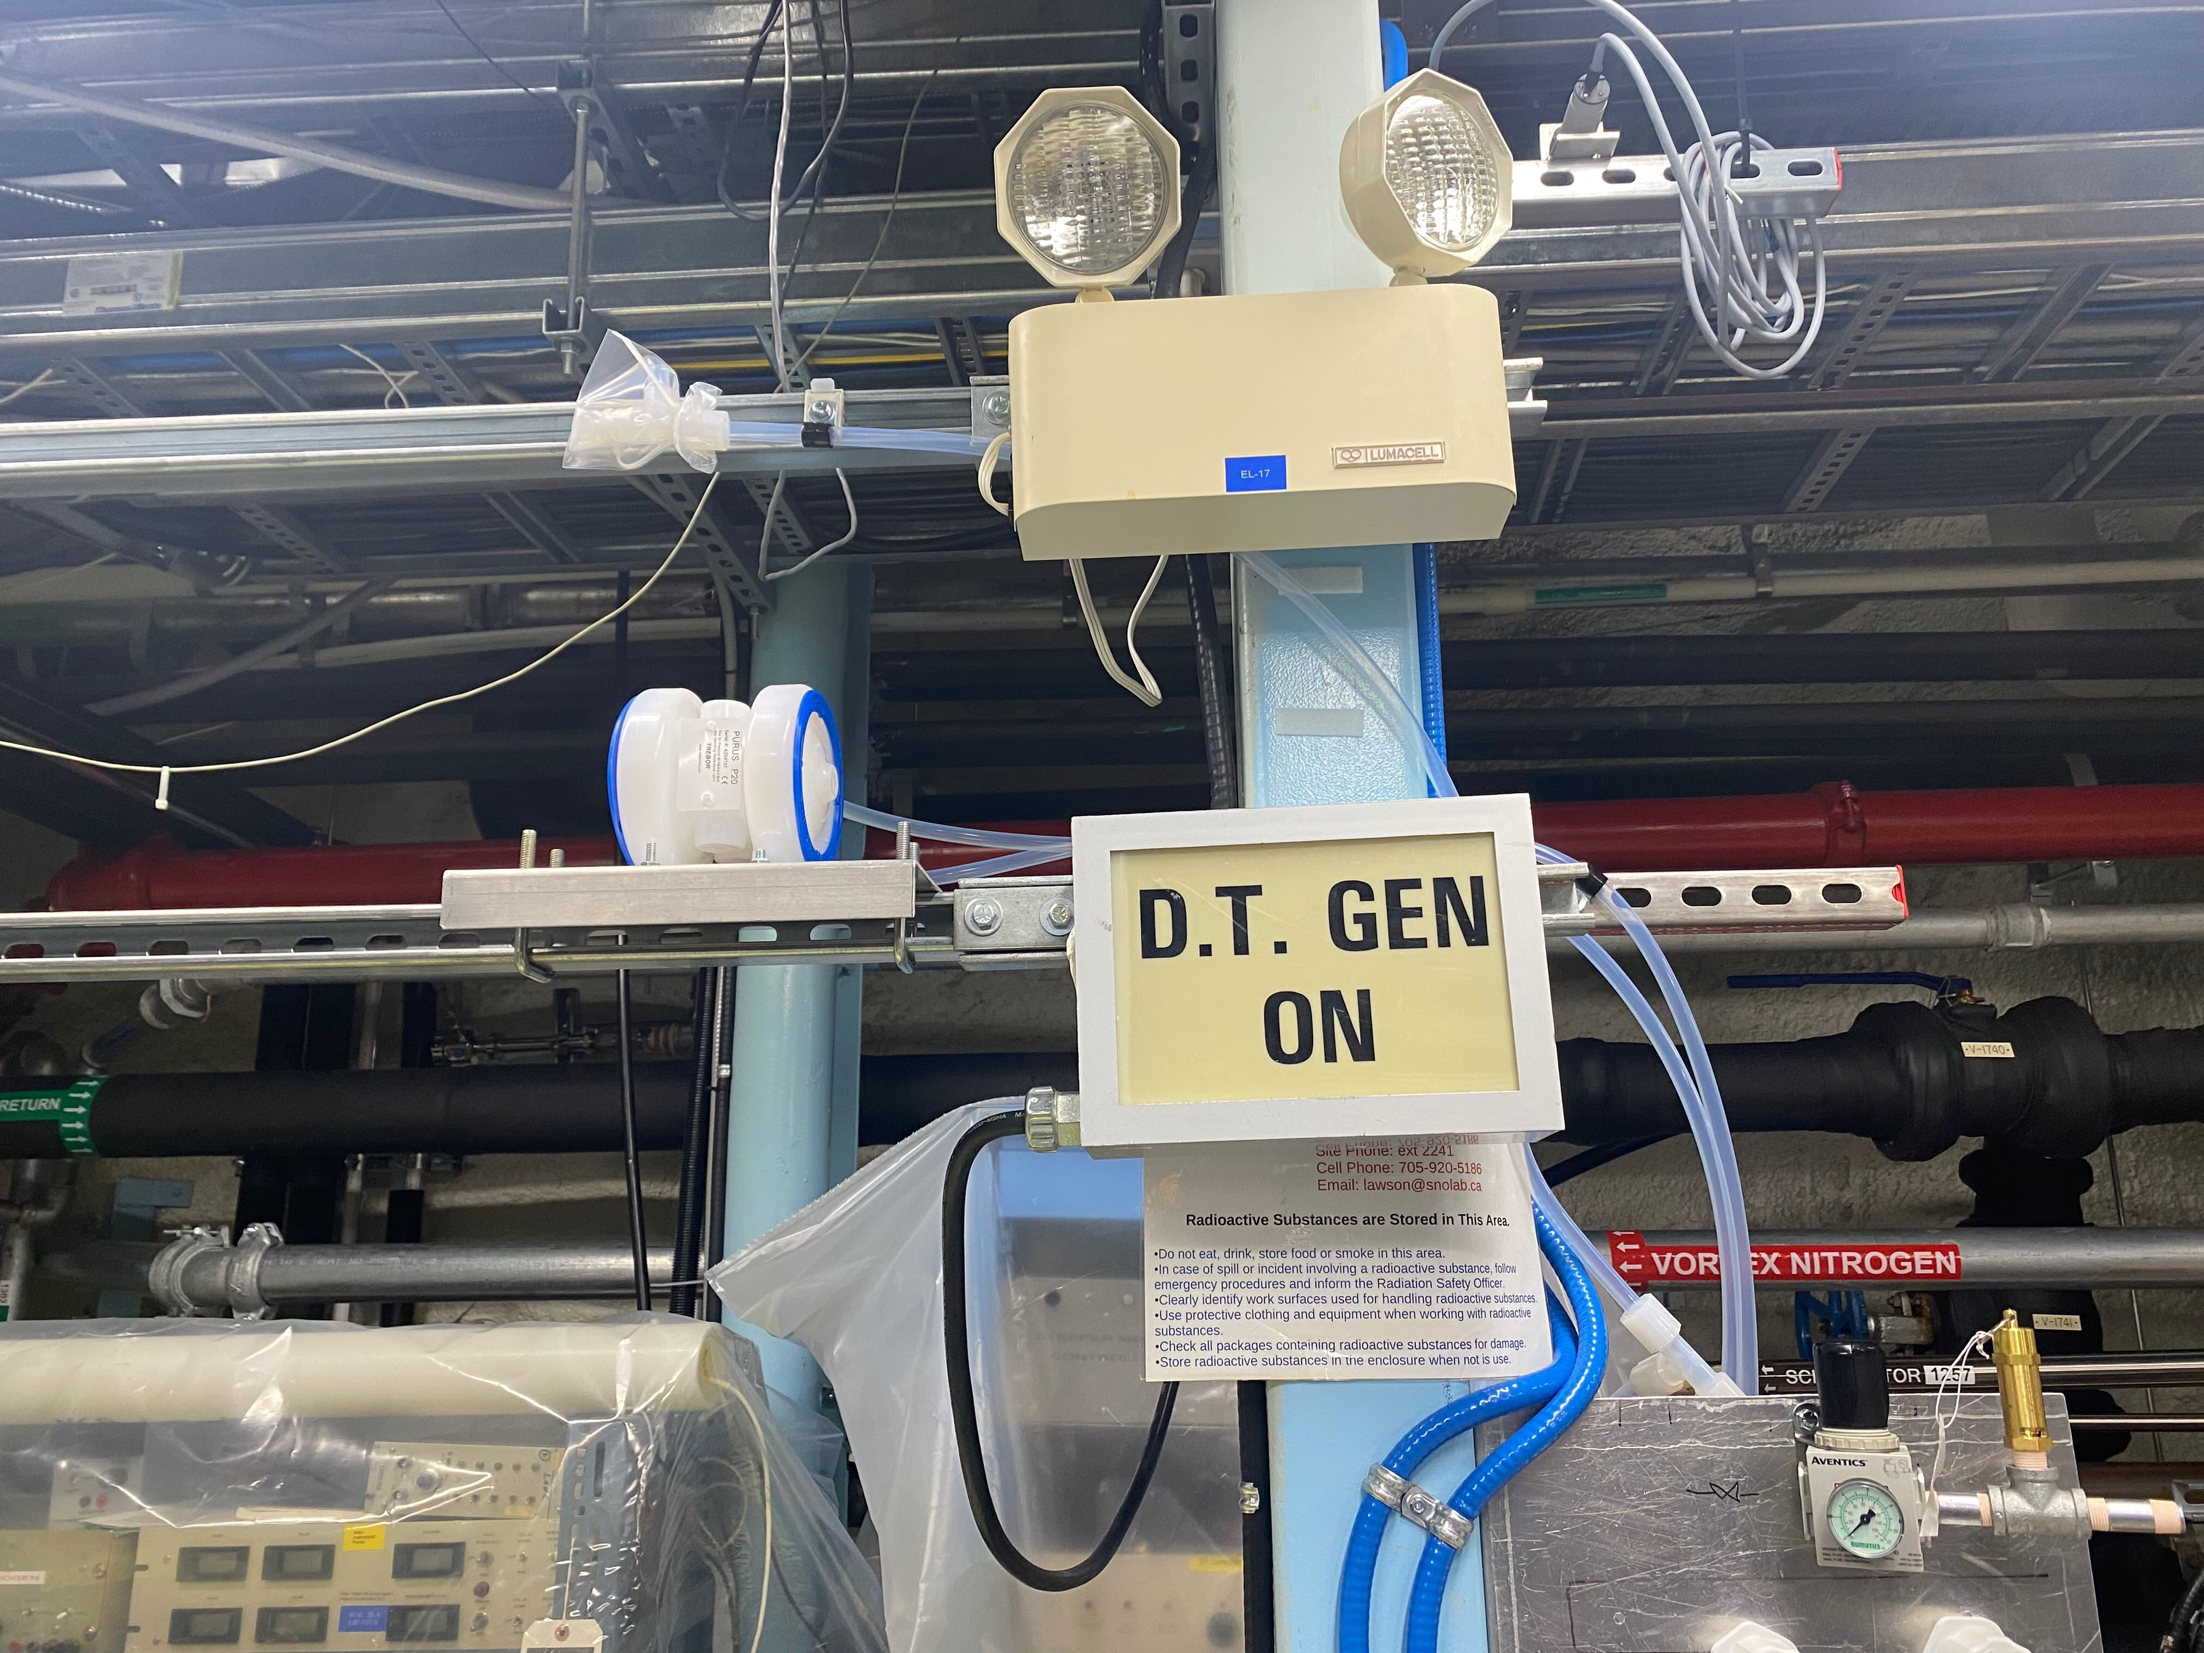
The hand valves The backside
→
BD Transfer Station The pump

Slide 9
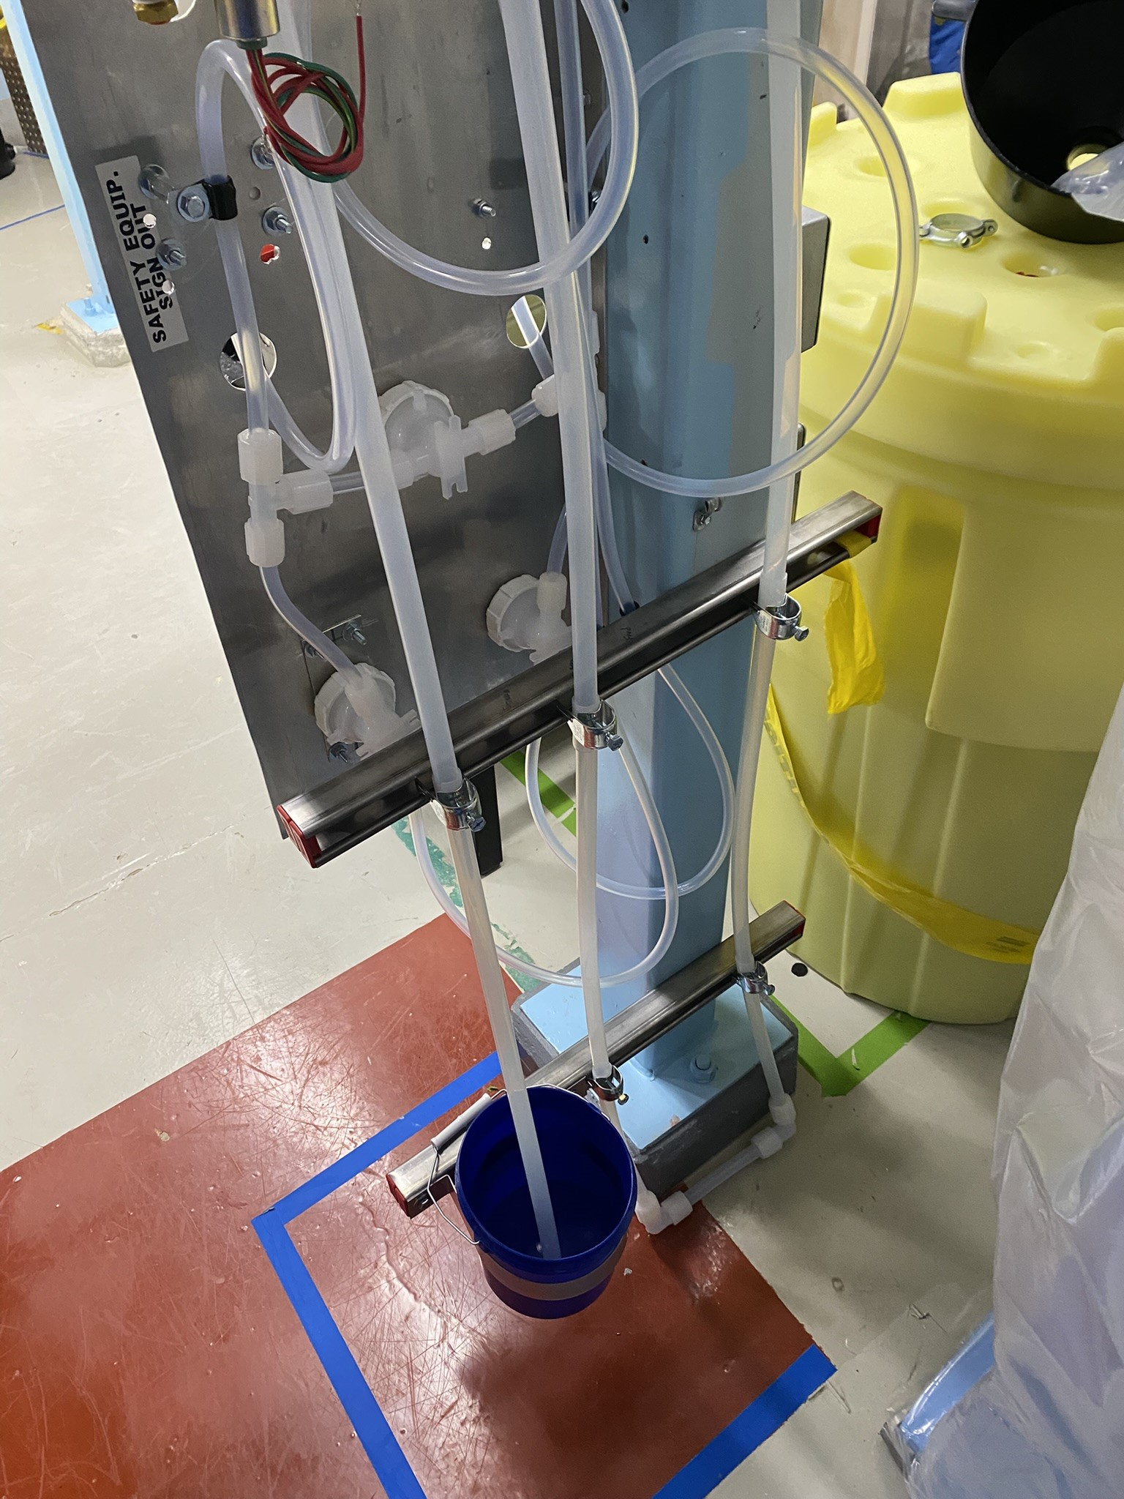
Manometer

Slide 10
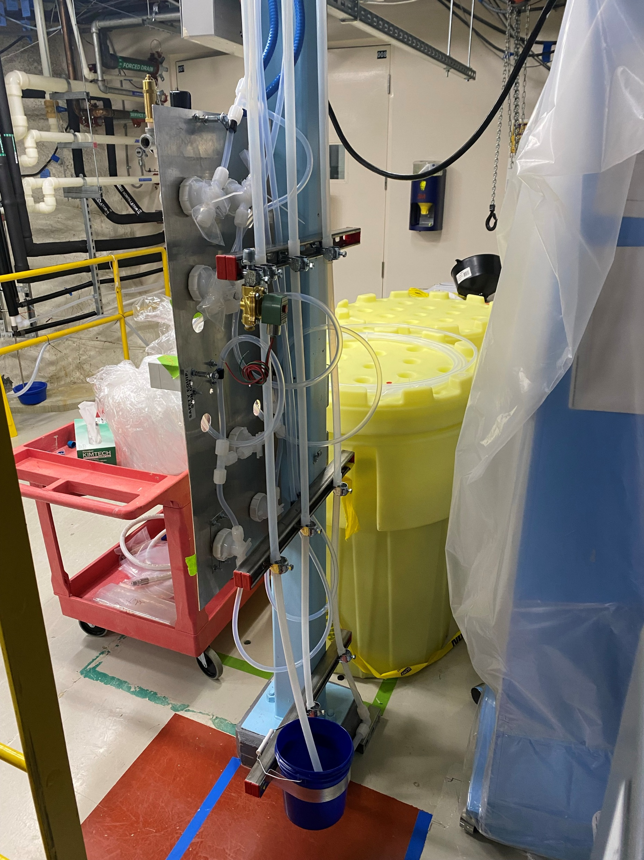
BD
Transfer
Station

Slide 11
BD/DDA Transfer Station – Current Status
Near complete
When complete, have capability to transfer BD/DDA into plant

Slide 12
Compatibility: Carbon black-filled PFA hose with LAB/BD
Why:
confirm material doesn’t change optical properties of experiment
What:
Carbon black-filled PFA hose
connect BD drum to Scint Plant
Procedure:
Fill hose with LAB/BD
Take 4 samples: day 0 (control), day 1, day 7, day 14
Compare UV-Vis

Slide 13
Setup

Slide 14
Result
They are compatible
Brought UG & connected week of Apr 14
BD
LAB

Slide 15
Scint Plant Upgrade
The column is leaking
install N2 supply + gauges at flanges to monitor leak
GAUGE
PIPE
MANIFOLD

Slide 16
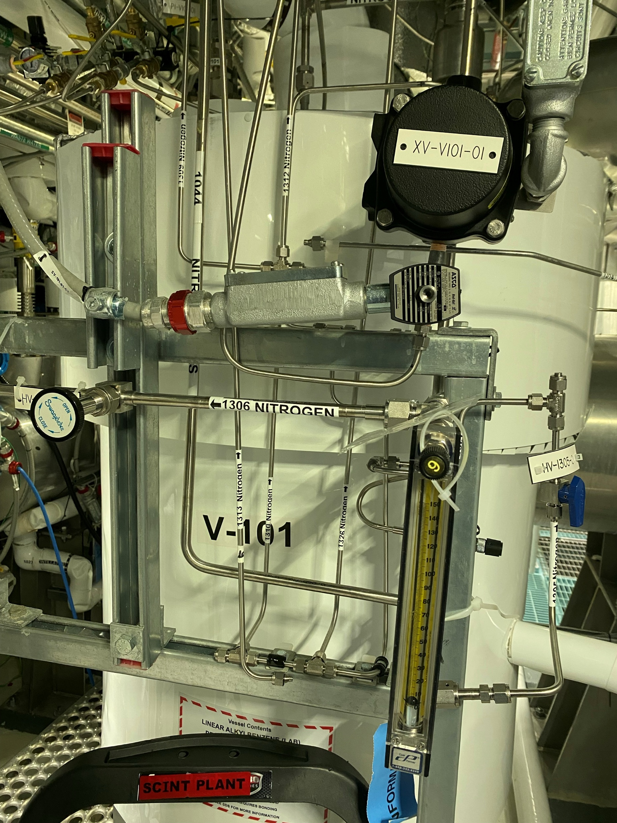
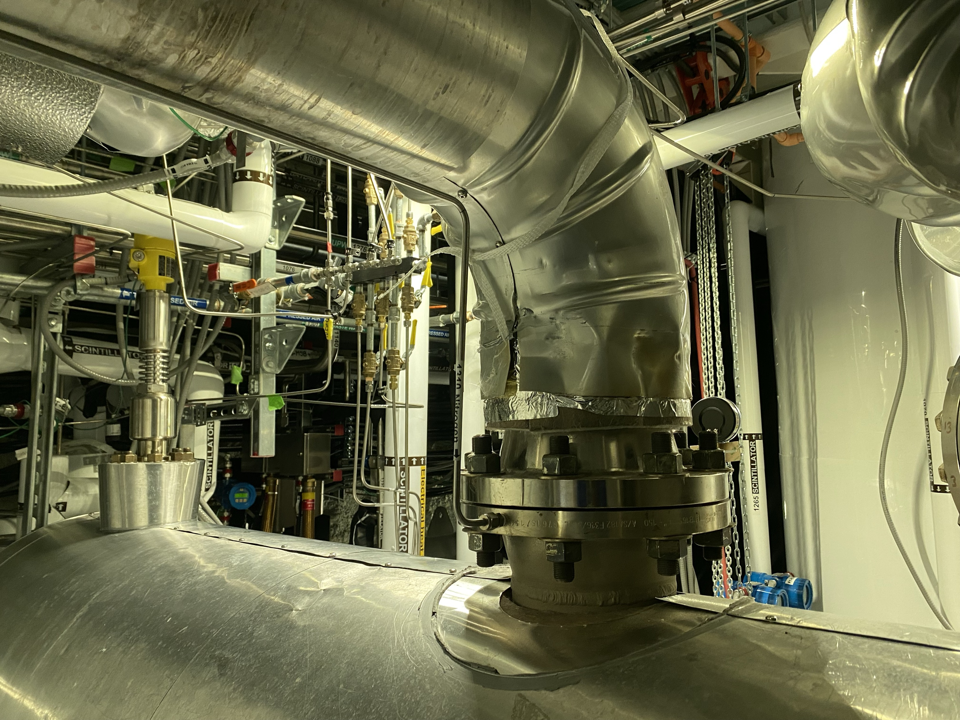
←
The gauge
→
The manifold
←
The pipe

Slide 17
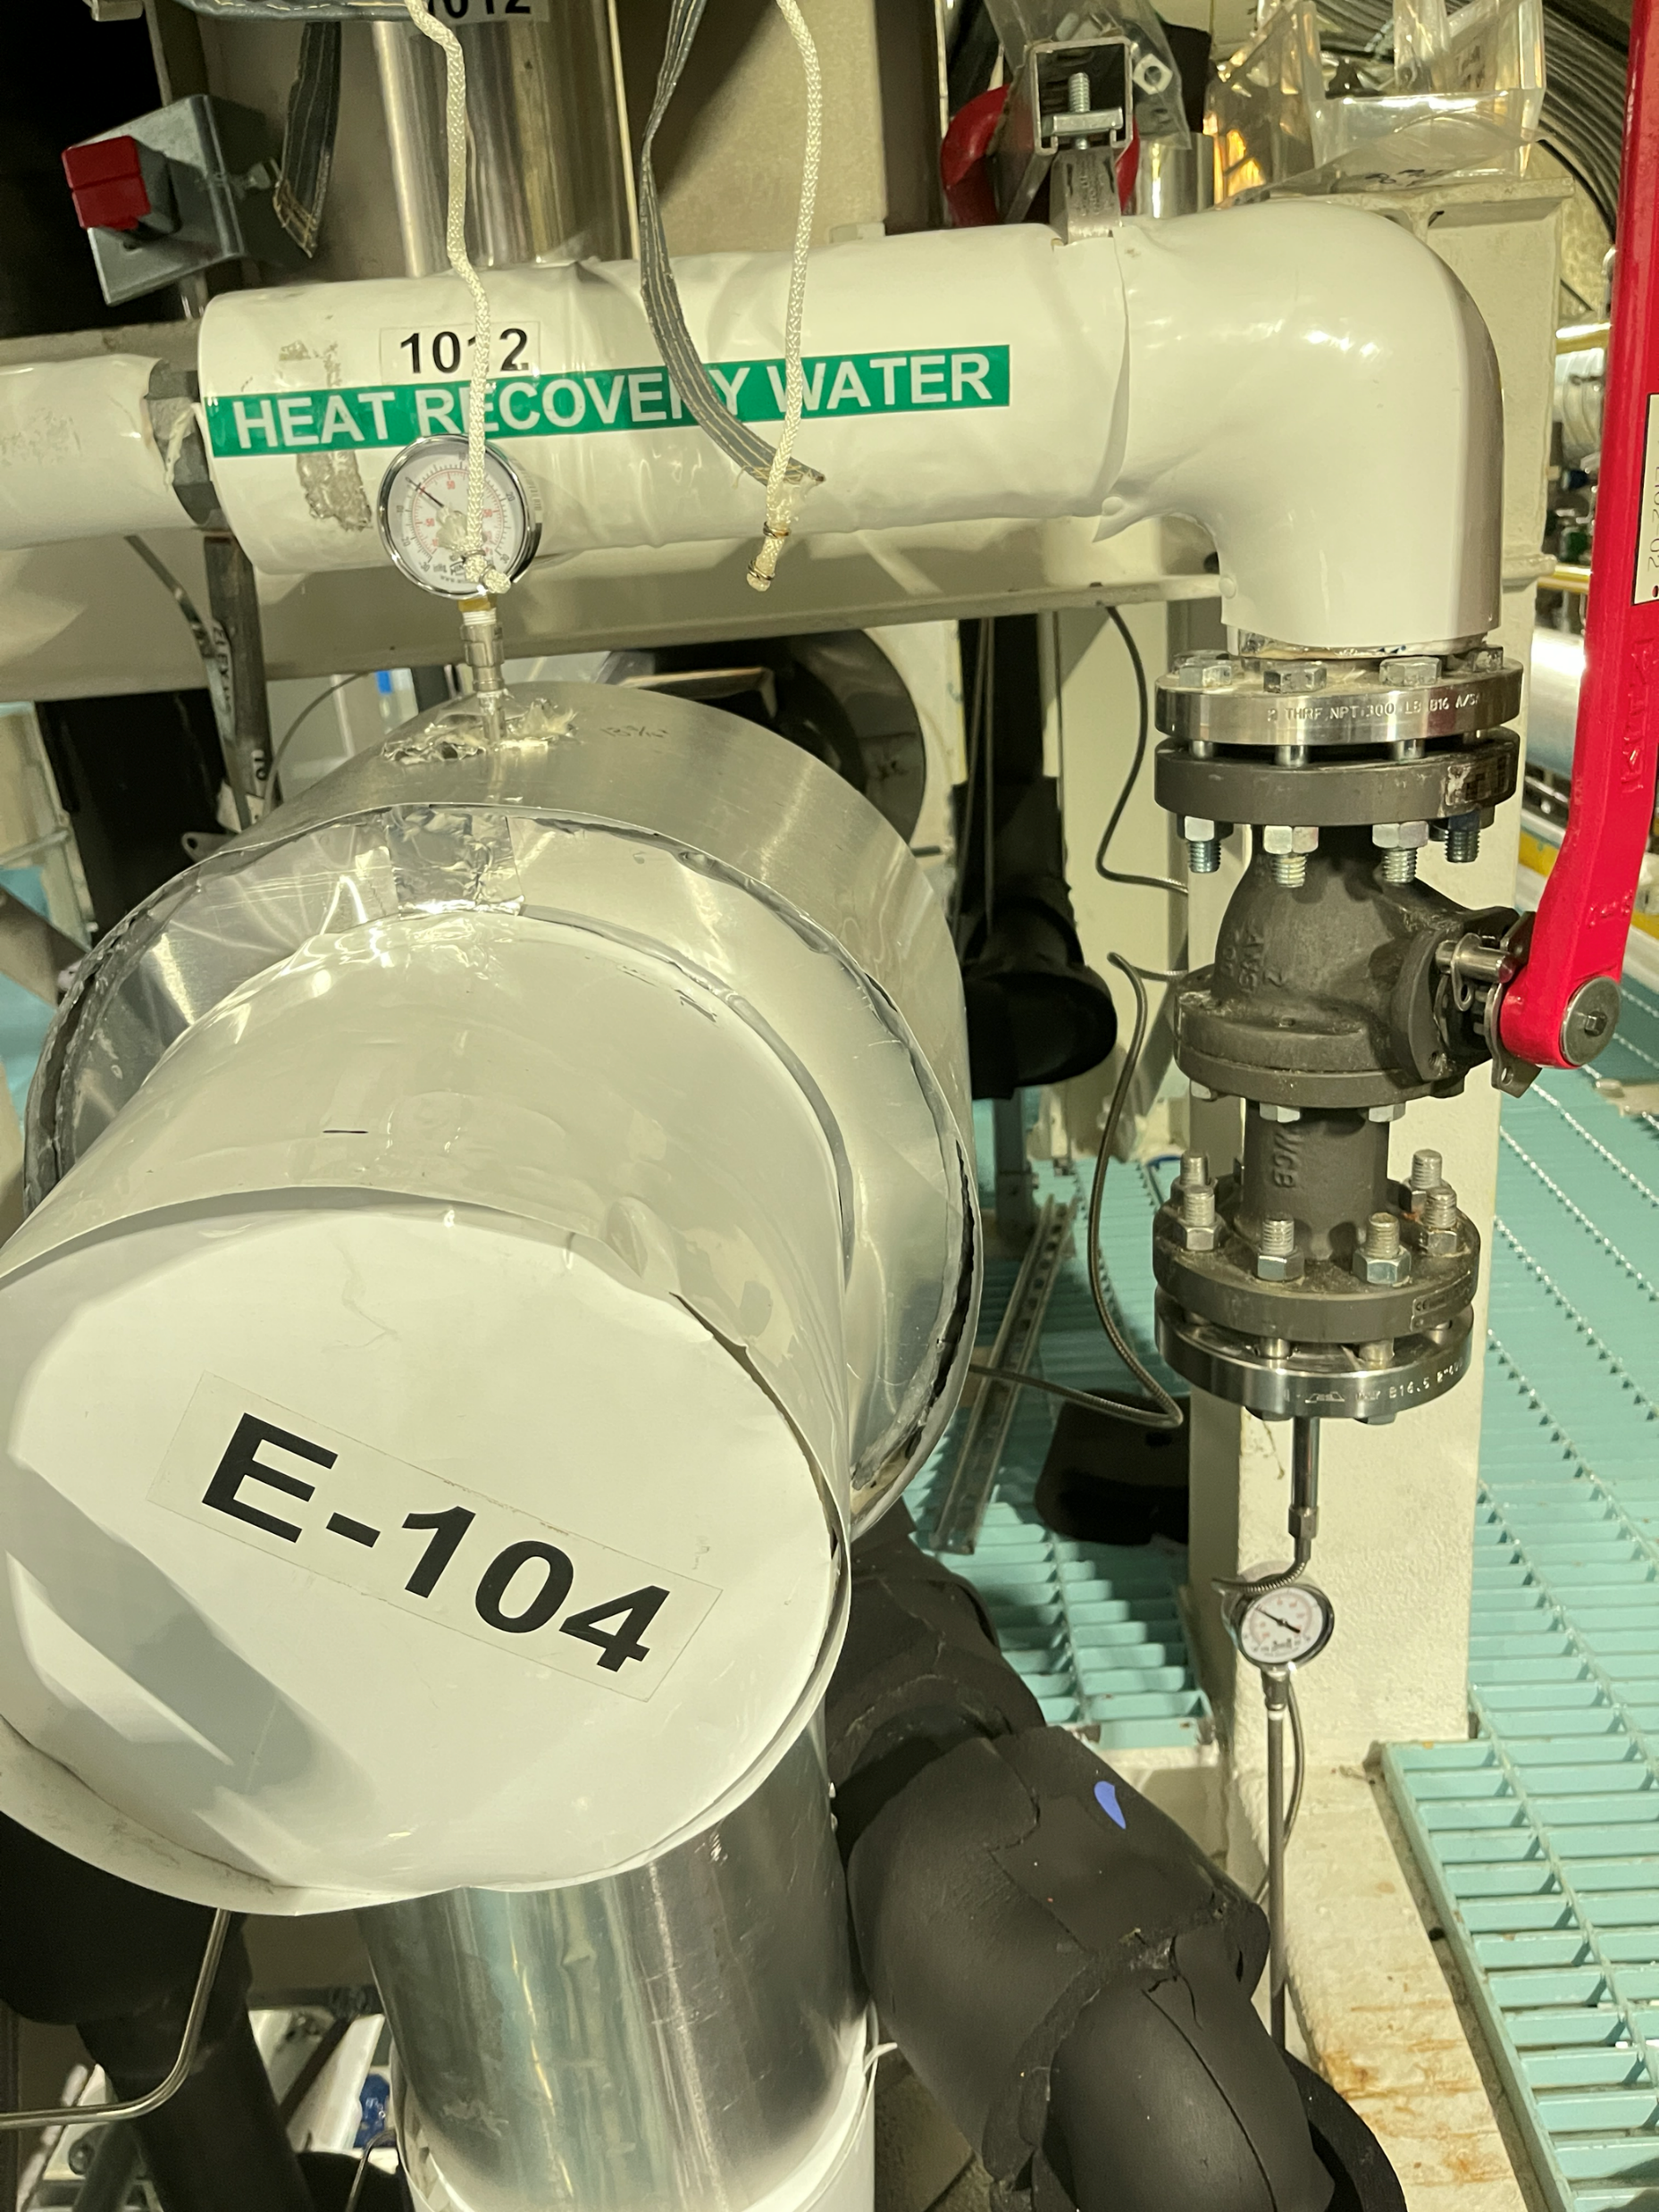
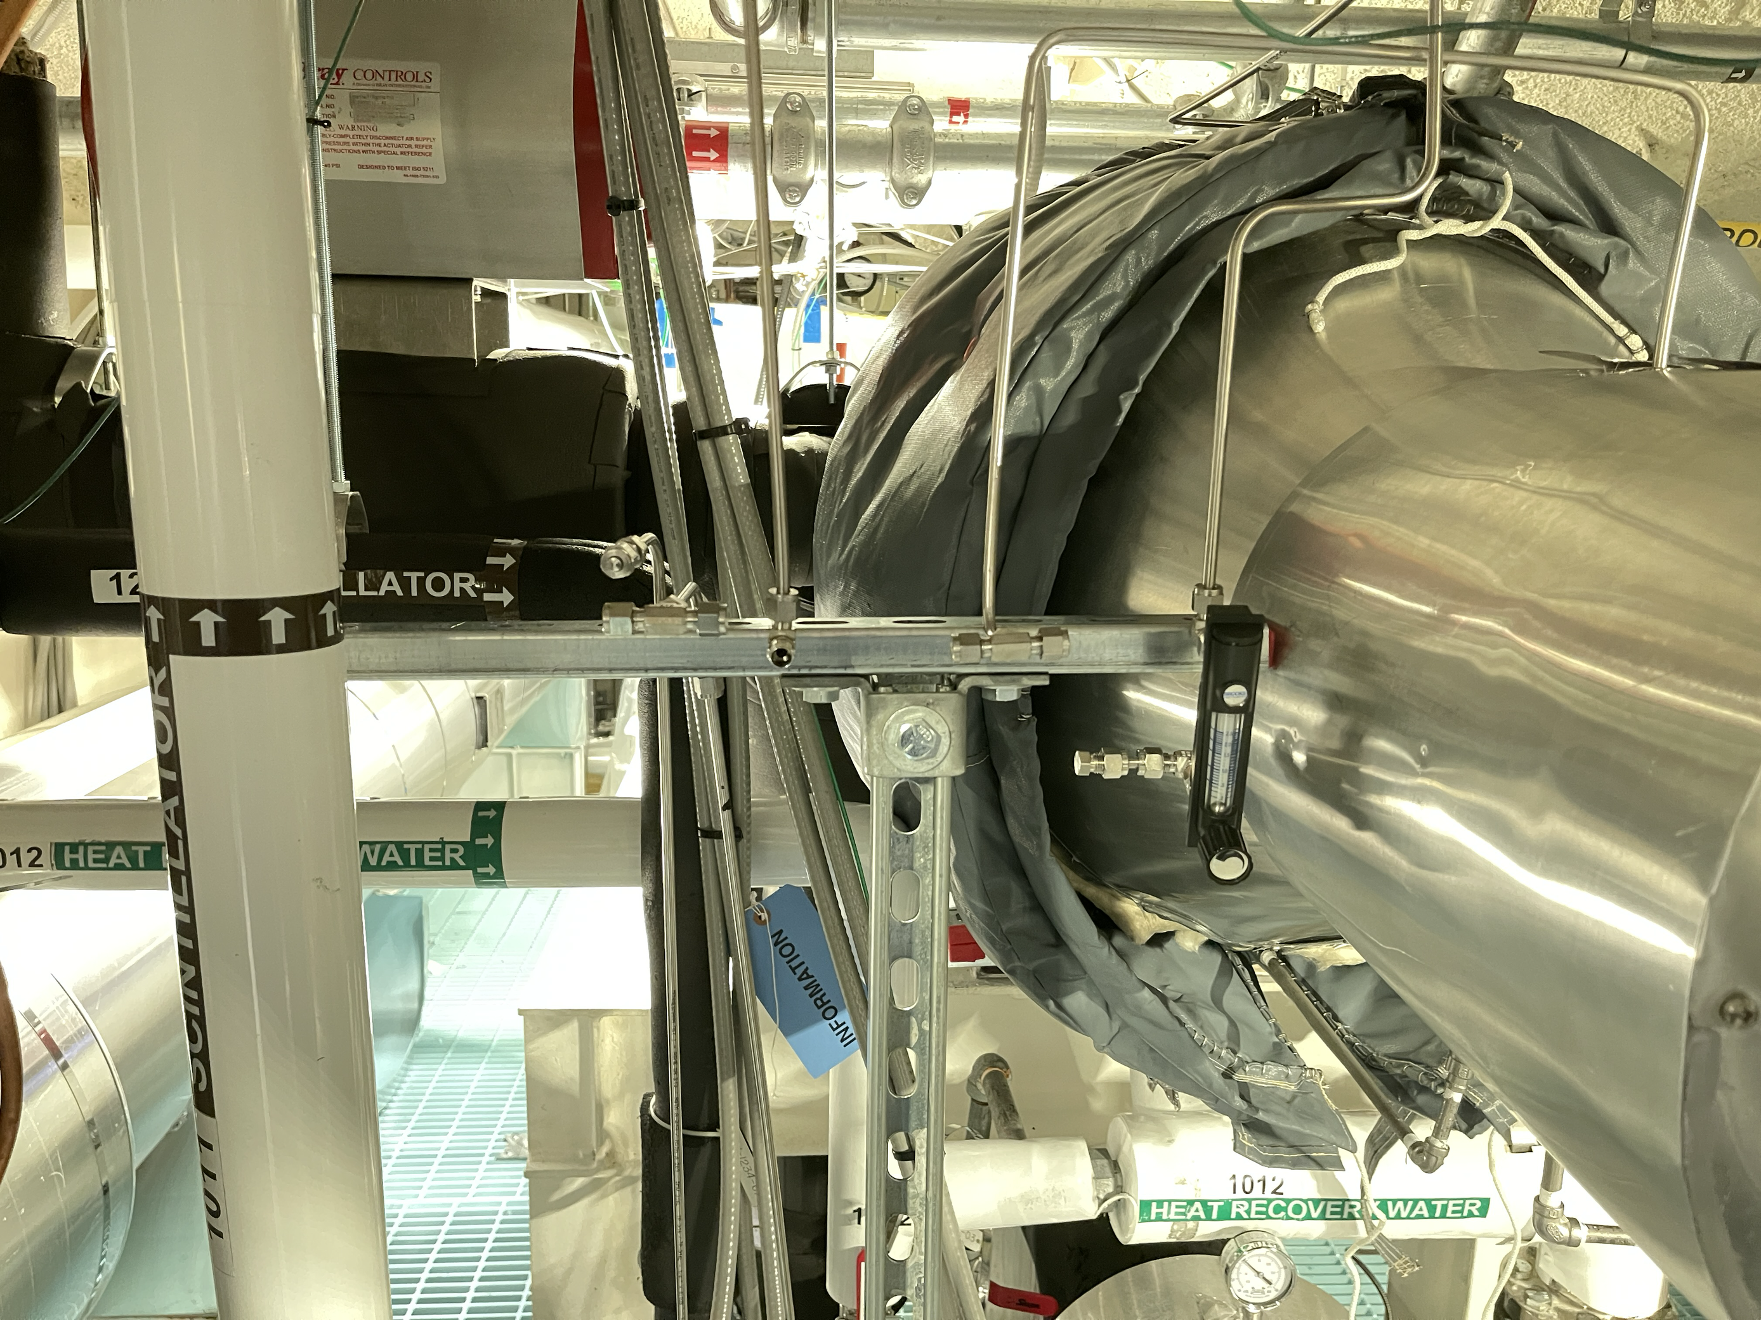
←
The gauge
→
More gauge
←
The manifold

Slide 18
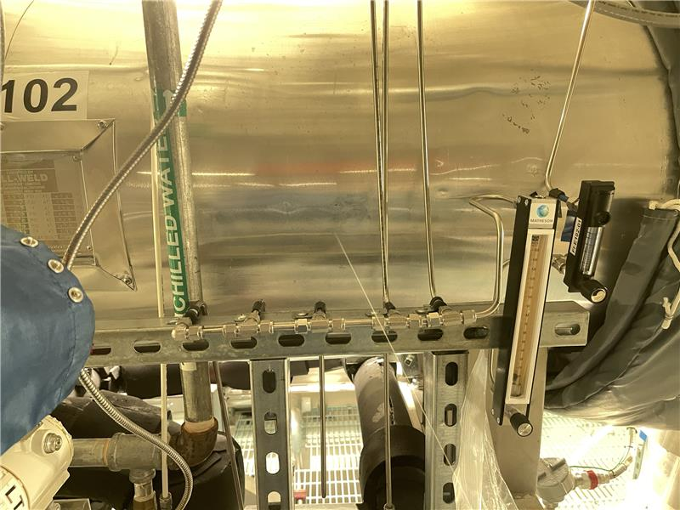
The manifold
←
The gauge
←

